Slide 1
数字化项目助力欠发达地区创业就业
The Value of Digital Employment in Underdeveloped Counties of China
阿里研究院
AliResearch
2022.12

Slide 2
数字化就业项目助力县域就业的三个特点
3 Processes in Our Digitally-enabled Employment Program in Counties
（一）创造就业机会：引回来
Create Job Opportunities: Attract Talents
（二）提升就业质量：留得住
Improve Job Quality: Retain Talents
（三）赋能本地人才：促发展
Empower Local Talents: Grow Talents
注：选取两个欠发达县域开展了深入调研，通过政府座谈、访谈、问卷调查等手段收集了一手资料，300多份调查问卷和30多个非结构式访谈

Slide 3
引回来：创造就业机会 Attract Talents: Create Job Opportunities
1.推动产业数字化升级，带来就业机遇
Promote industrial digitalization for job opportunities
一、二产业在欠发达县域有重要地位，但缺乏特色产业，销售模式原始，从业者以本地农民为主，无法吸引年轻人
The primary and secondary industries are dominant in underdeveloped counties. However, there are few leading or distinctive industries, sales models are too simple, and most of the practitioners are local farmers.
阿里巴巴数字化就业项目推动县域农业生产经营数字化、产业现代化，创造了一批新型数字化就业岗位，有了产业，就有了就业的机会
Our Digitally-enabled Employment Program boosted the digitalization of agricultural production and operation and the modernization of industries and also created many jobs in the counties.
通过数字化赋能，当地企业接触到新零售、电商销售、直播带货等新兴推广方式，吸引本地年轻人返乡就业
Through our projects, local businesses learned how to use new promotional channels, such as new retail, e-commerce platforms, and live-streaming, and thus young people are more willing to go back home for jobs.

Slide 4
案例：产业兴，则县域兴 Case Study: When a company wins, a county wins.
河北省巨鹿县的旺泉食品有限公司成立于2017年，是一家制作饮料类产品的企业，最初以线下传统的销售渠道为主，需要实际地推广到一定数量的人才能获得部分消费者的购买量，企业的运营艰难。2020年阿里数字化就业项目为企业培训了3名电商人员，并且接触到线上销售和新零售的方式，节省了中间商的环节，有效地增加了产量，企业转亏为盈。
Wangquan Food Corporation Ltd. in Julu County, Hebei Province is a beverage company established in 2017. Its operation was in trouble because it adopted the traditional offline sales model, which could only attract a few customers through cold promotion. In 2020, our program trained for the company 3 e-commerce workers, who helped sell products through online sales platforms and new retail, instead of intermediary businesses. The production then quickly picked up, turning the company into profit.

Slide 5
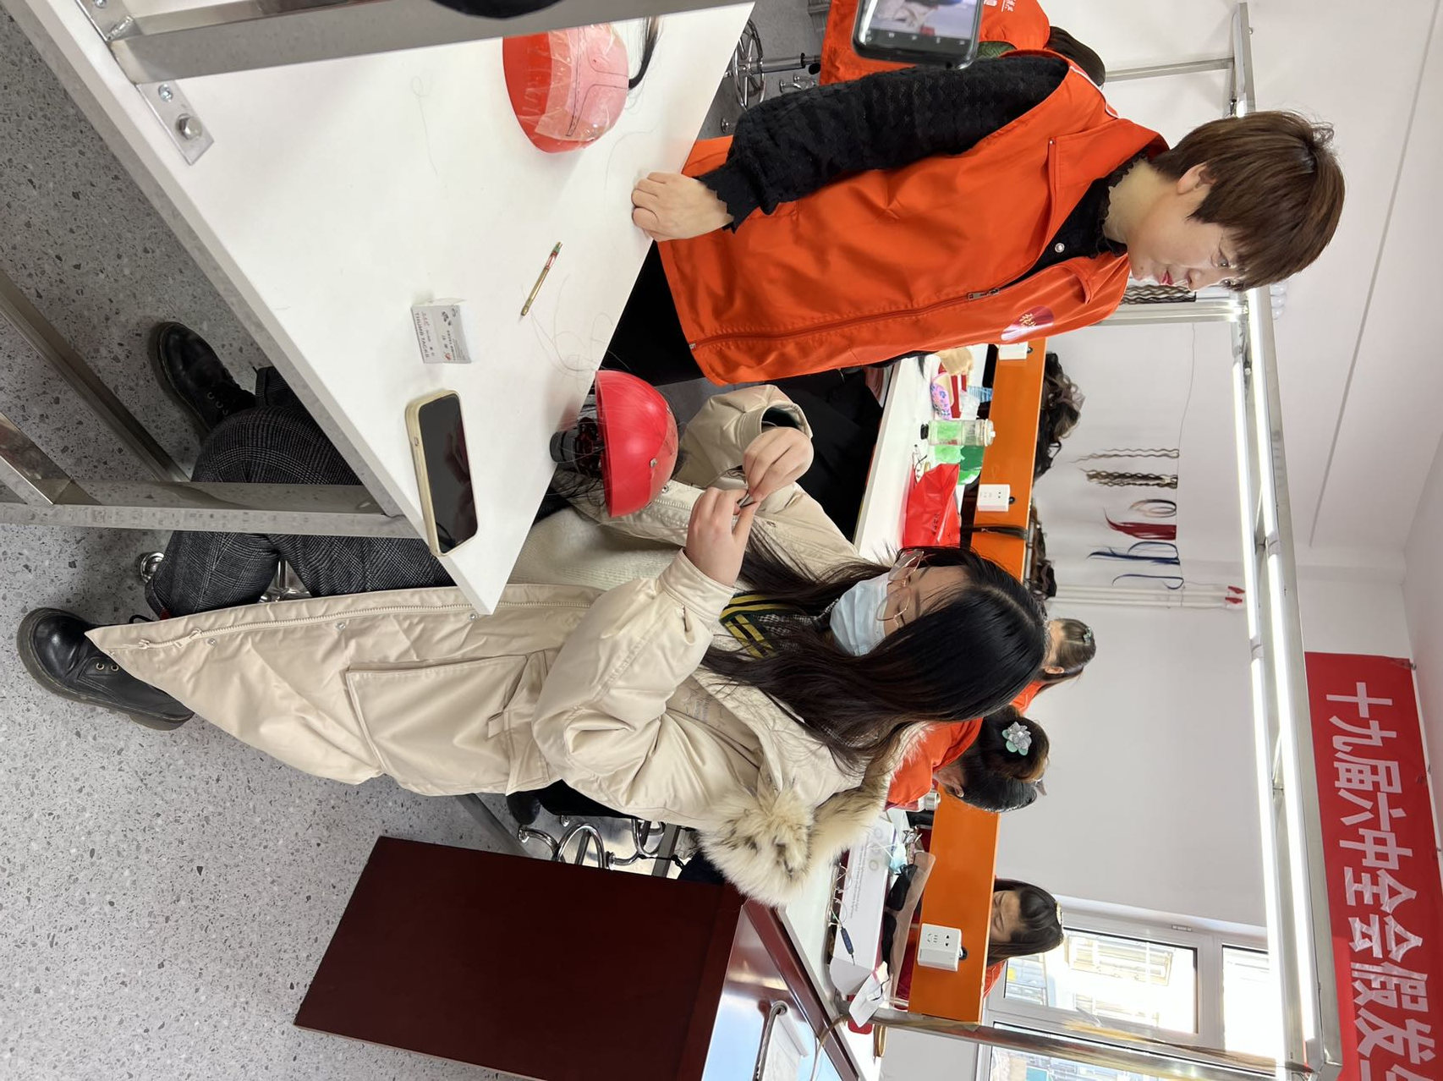
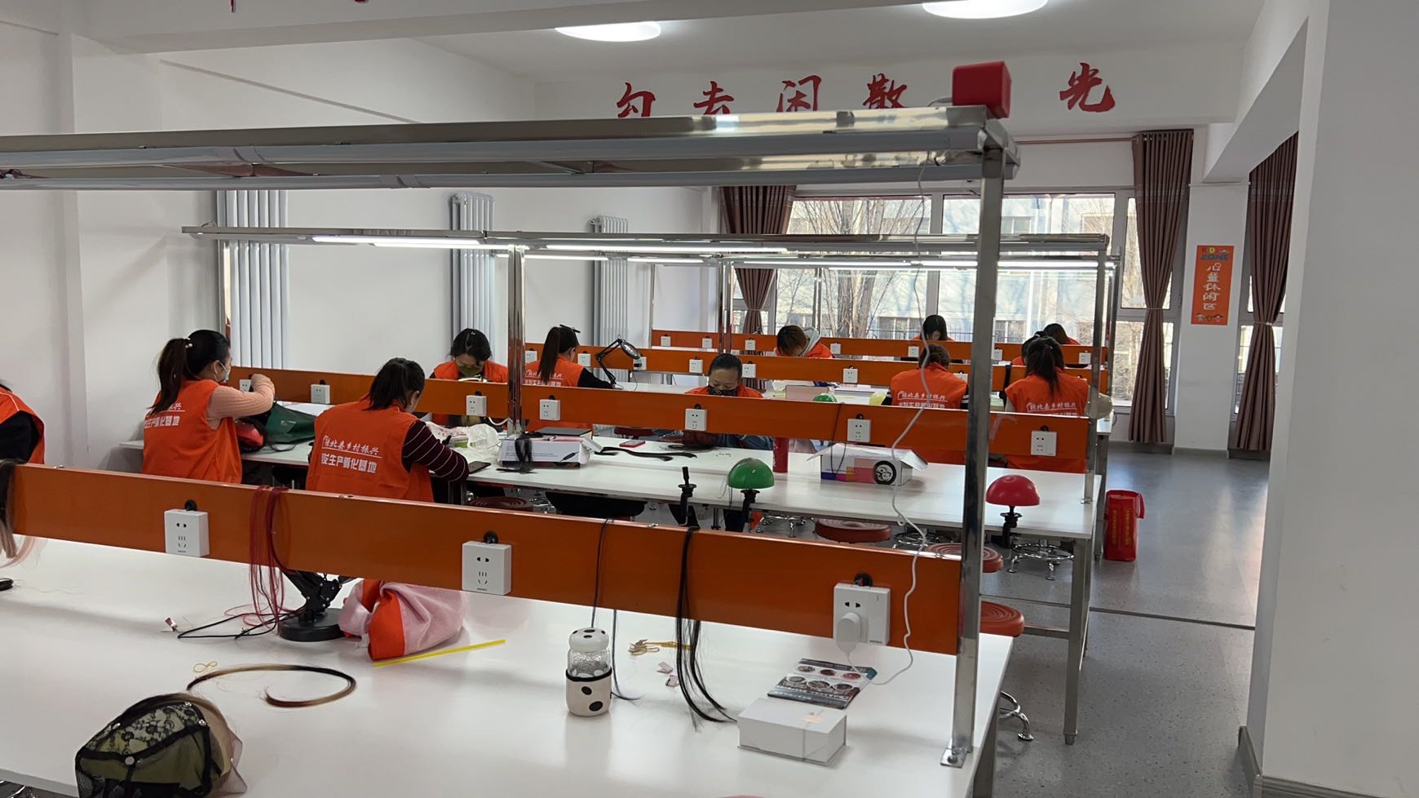
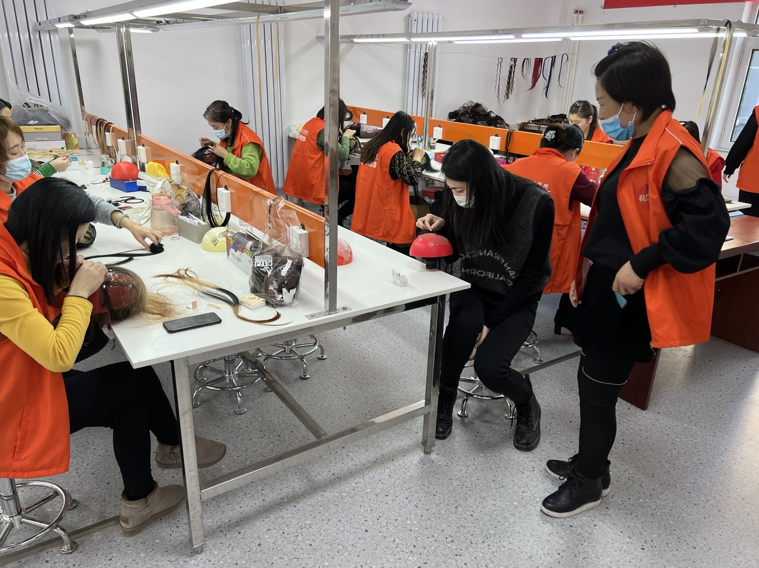
引回来：创造就业机会 Attract Talents: Create Job Opportunities
2. 引入数字化就业项目，创造就业岗位
Introduce digitally-enabled employment projects for job opportunities
阿里巴巴在全国多地建设4所“假发工厂”、10个“AI标注基地”、37家客服中心，创造1.1万个就业机会。提升县域的就业吸纳能力，吸引了本地青年返乡，甚至周边地区年轻人前来就业
Alibaba has built 37 customer service centers, 4 "wig factories“, and 10 "AI labeling bases" across the country, creating 11,000 jobs. These projects created many job opportunities in counties, attracting local youth to return to their hometowns and even those from surrounding areas to come to work.
数字化就业项目：针对“留守女性”的就业项目（“假发勾丝”和“穿戴甲”）
Digitally-enabled employment projects for left-over women (making wig and press-on nails)

Slide 6
调研访谈：假发生产基地负责人 Interview with the manager of a wig factory
“假发基地创立于2020年9月，工人都是女性，基本在20-45周岁，最大52岁，也有残疾人，初中文化水平为主。
“The wig factory was set up in September 2020. All workers are women, mostly aged from 20 to 45, with the oldest at 52. There are also workers with disabilities; most have only finished studying in junior high school.
工人每单15-30元，熟练后每小时平均可以赚到8-10元，一个月之后基本可以达到熟练的程度，并且可以带回家进行假发制作。
They can earn 15 to 30 RMB for each wig. They can quickly master the skill in just one month, and by then, they can learn 8 to 10 RMB per hour on average. They are also allowed to make wigs at home.
政府提供场地，政府和阿里提供相关补贴，在基本工资基础上，前三个月另有工资的40%进行补助（上限不超过500），后九个月按照10%补助。
The local government provided a place for production. the local government and Alibaba provided the subsidy for workers.For the first three months, each worker can get a subsidy worth 40% of their salary (no more than 500 RMB), and then 10% for the following nine months.

Slide 7
留得住：提升就业质量 Retain Talents: Improve Job Quality
1. 增加劳动者收入，改善就业环境
Increase incomes and improve working environment
“阿里客服县”项目为当地提供了具有竞争力收入的就业岗位，入职后的平均工资为5000 元，远高于县域其他工作的收入水平。
Our customer service project has created jobs in counties, with the average salary reaching 5,000 RMB, much higher than that of other jobs there.
就业岗位具有良好的发展前景，最高收入可达到15000 元，还有去客服中心总部锻炼的机会
The positions have sound promotion potential, with the highest income reaching 15,000 RMB. Workers also have the opportunity to work in the customer service headquarter.
数字化就业项目为员工提供了轻松愉快的工作氛围，符合年轻人的需求
Our project has offered employees a pleasant and comfortable working environment that young people like.
阿里客服县员工王某：“客服县工作环境和大城市比较相似，工作环境轻松，可以放音乐，吃零食。”
Mr. Wang, who works in the county-level customer service center said, “The working environment here is just like that in big cities. Very pleasant. We can play music and have snacks.”

Slide 8
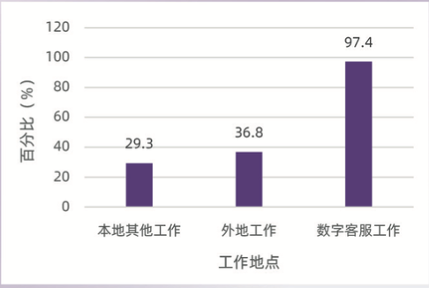
留得住：提升就业质量 Retain Talents: Improve Job Quality
2.完善社会保障，增强职业稳定性
Improve social security and make jobs more stable
客服县的员工的五险一金缴纳比例高达97.4%
97.4% of workers in our customer service project have been covered by the “five insurances and one fund”.
Other local jobs
Jobs elsewhere
Jobs in our project
数字客服与其他工作五险一金覆盖率比较
The Coverage of the “Five Insurances and One Fund”
Notes:
(old-age pension, medical insurance, unemployment insurance, and maternity insurance, workers' compensation, and housing provident fund)

Slide 9
促发展：赋能本地人才 Grow Talents: Empower Local Talents
以电商培训提升本地人才的数字化素养
Enhance local talents’ digital literacy through e-commerce training
1. 培养电商直播、客服和物流等实践人才，提升本地居民的数字化素养
Cultivate talents of live-streaming, customer service, and logistics and improve the digital literacy of local residents.
2.通过课堂教学，现场教学， 培养当地的新型职业农民，提高劳动者素质
Cultivate new local professional farmers and enhance the quality of labor.
提升职业教育质量，培养青年数字化技能
Raise the quality of vocational education to help youths acquire digital skills
1. 开设适应时代发展需求和年轻劳动力青睐的新兴专业
Launch new programs that respond to the calls of the times and young people.
2. 校企合作的方式，为企业定向输送高素质人才
Prepare high-quality talents for enterprises through school-business partnership.
提升办学水平，优化中小学生的成长环境
Optimize school operation to build a better environment for children
1. 与县域政府协同合作，对小学校园进行整体性改造、优化当地学子的教育环境
Work with county governments to optimize elementary schools for a better educational environment.

Slide 10
数字化就业项目的四大价值
4 Values in Digitally-enabled Employment Projects
（1）促进产业发展 Boost Industry Growth
（2）完善公共服务 Improve Family Services
（3）增强家庭凝聚力 Facilitate Family Cohesion
（4）提升个体价值感 Make People Feel More Valued

Slide 11
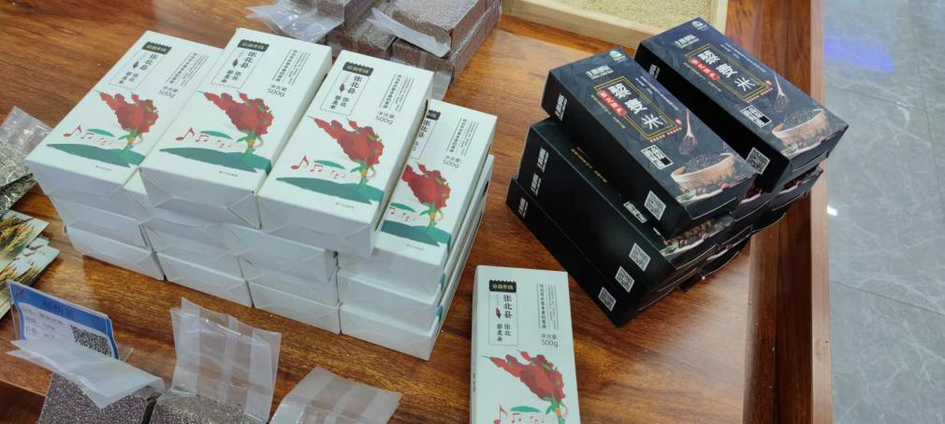
（1）促进产业发展 Boost Industry Growth
1. 对接电商平台，增加企业产品销量
Work with e-commerce platforms to increase sales
线上、线下模式相结合，增加县域企业和商户产品的销售量
We helped increase the sales of local enterprises and individual businesses through online and offline sales channels.
2. 打造区域品牌，助力县域产业升级
Create local brands to upgrade local industries
张北县的特色农产品藜麦由阿里巴巴提供设计支持
We designed the package of quinoa, a special agricultural product of Zhangbei county, Hebei province.

Slide 12
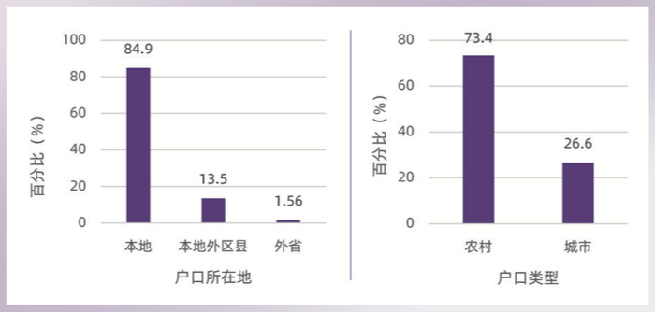
（2）完善公共服务 Improve Family Services
1. 提供就业岗位，吸引人才回流
Create jobs to attract talents back
数字客服项目员工的平均年龄为28岁，是最具有活力和创造力的一批年轻劳动力
Employees in our customer service project, aged 28 on average, are the most energetic and creative group.
数字客服中心员工中，超八成为本地人；数字化就业项目对于生长于本县的年轻人产生了有力的吸引
Over 80% of them are local people. Hence, our project is very attractive to local young people.
Hukou Location
Hukou Type
数字客服县员工户口情况
Hukou (house registration) of employees in our customer service project

Slide 13
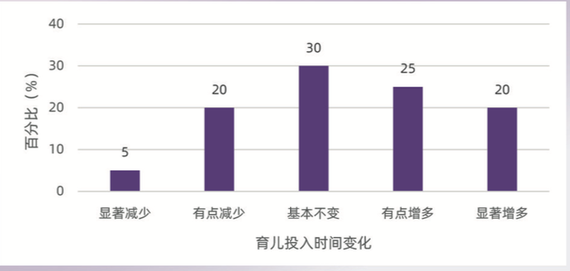
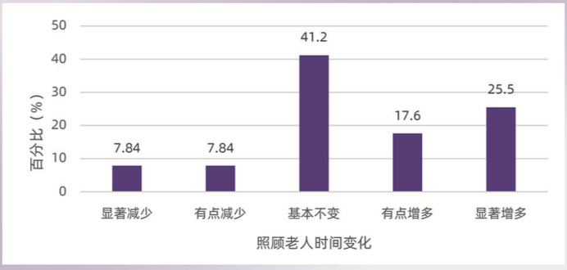
（3）增强家庭凝聚力 Facilitate Family Cohesion
1.减小生活压力，增进家庭联结
Relieve stress in life and facilitate family cohesion
对于从外地返回县域就业且有子女的群体而言，他们在养育子女上投入的时间呈现出增加的趋势
Parents who once worked in other places now have more time to raise their children.
返乡员工陪伴和照顾父母以及配偶父母的时间也有所增多
Returnees have more time to take care of their parents and parents-in-law.
图：返乡就业数字客服县员工育儿投入时间变化
Figure: Change in time for raising children of Returnees in the customer service project
图：返乡就业数字客服县员工照顾老人时间变化
Figure: Change in time for taking care of the elderly of Returnees in the customer service project

Slide 14
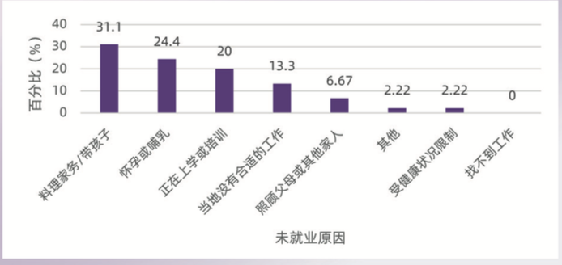
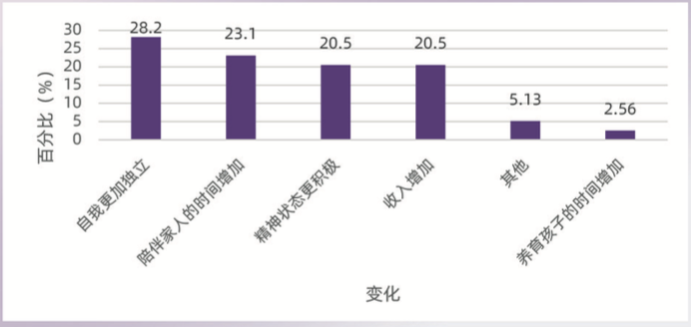
（4）提升个体价值感 Make People Feel More Valued
1. 促进女性经济独立，提升自我价值感
Help women become economically independent and feel more valued
女性未就业的原因中，怀孕或哺乳、料理家务或带孩子、照顾家人等家庭因素的占比超过50%
50% of women are employed because of pregnancy or breastfeeding, housekeeping or childcare, taking care of family members, and other family-related factors.
近三成女性认为自我的独立性增强，20%左右的群体认为精神状态更加积极
Nearly 30% of reemployed women feel more independent, and about 20% of them are more optimistic.
数字客服员工近半年未就业原因（女性）
The reasons why female customer service workers were not employed for the past 6 months
数字客服员工工作后生活变化（本地再就业女性）
The changes in life for reemployed female customer service workers

Slide 15
THANKS

