Slide 1
Technological Innovation for Rice Grain Storage
Dr. SUN Xinyang
College of Food Science & Engineering
Nanjing University of Finance & Economics
Email: xinyang.sun@nufe.edu.cn
December 21st, 2022

Slide 2
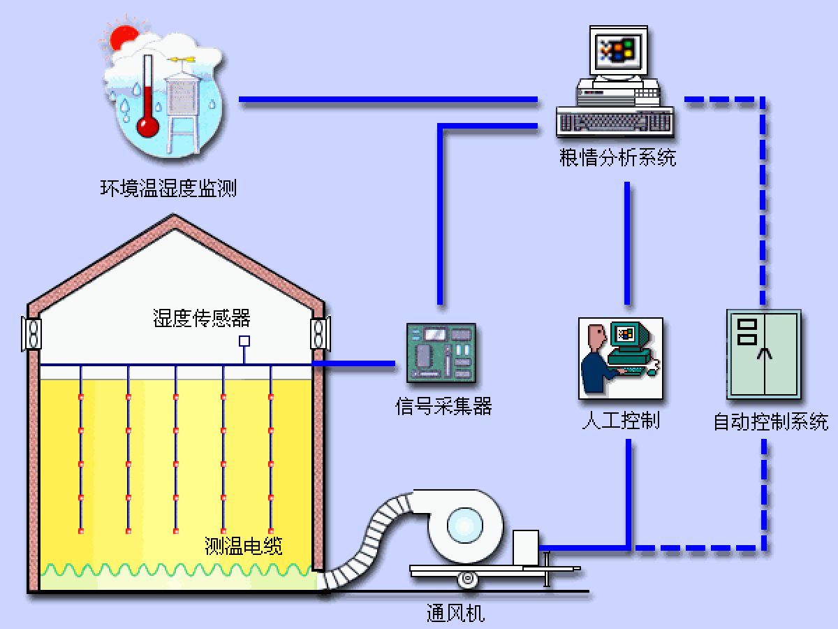
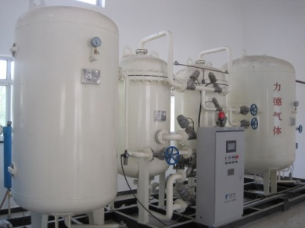
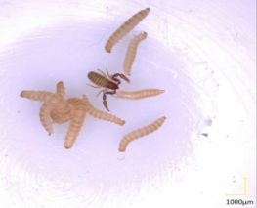
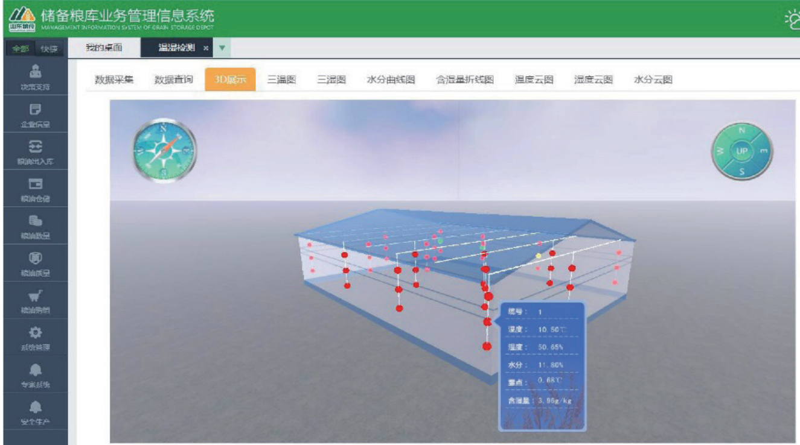
1
Storage Technologies
Low temperature
Atmosphere control
Non-chemical prevention
Intelligent information

Slide 3
Low-temperature storage technologies
Thermal insulation retrofit of silo roof
Airtightness modification of silo gate
Thermal insulation retrofit of silo body
Silo roof AC & grain cooling technology
Internal circulation temperature control technology
Ground/water-source heat pump & low-temperature grain storage technology

Slide 4
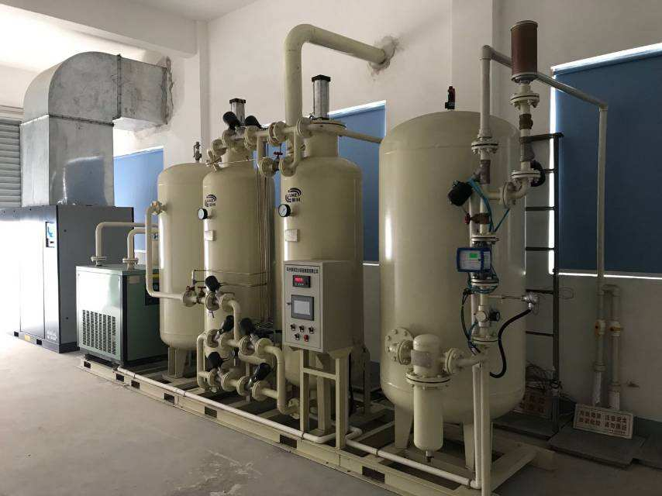
Atmosphere control storage technologies
Reduce oxygen concentration
Inhibit grain respiration
Control pest & mold
Slow down grain quality deterioration

Slide 5
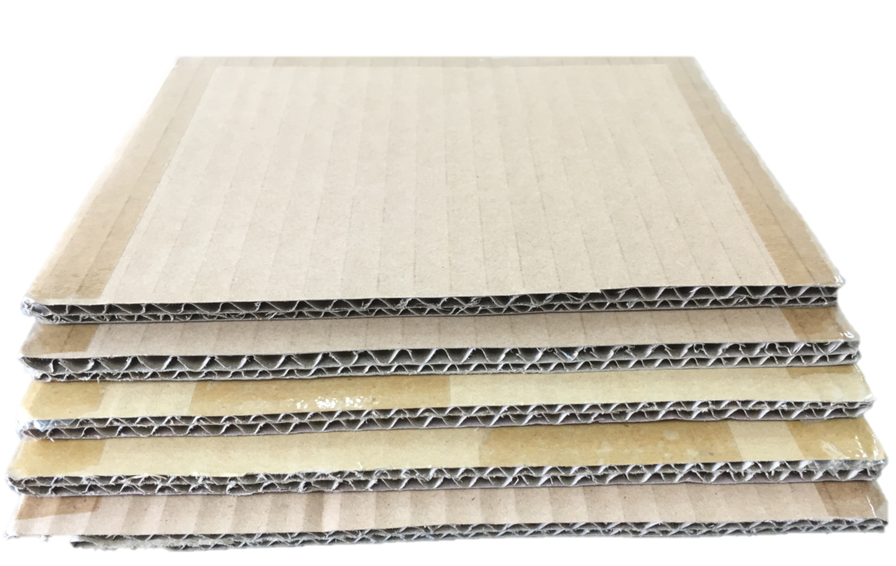
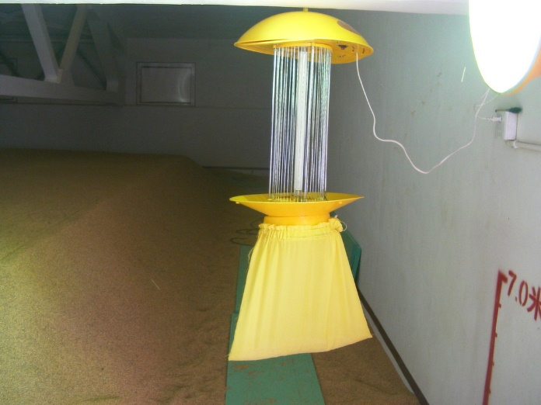
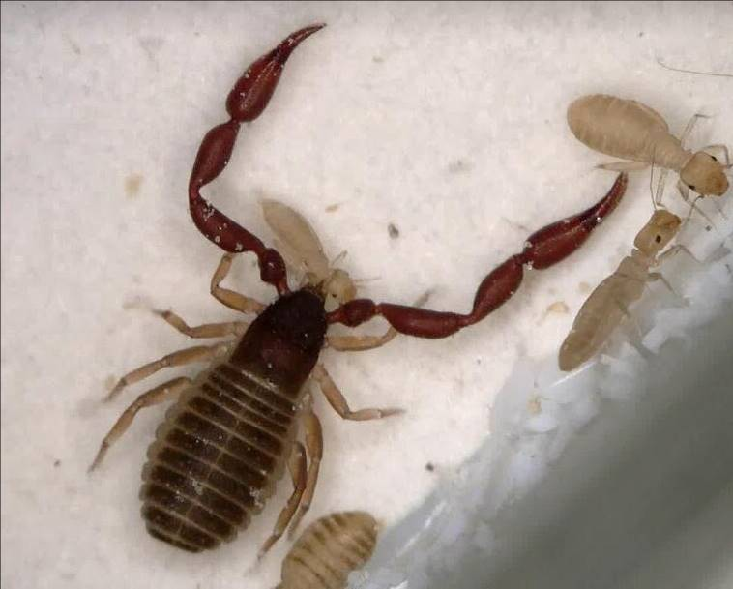
Non-chemical prevention technologies
Physical prevention & control
Biological prevention & control
Habitual prevention & control

Slide 6
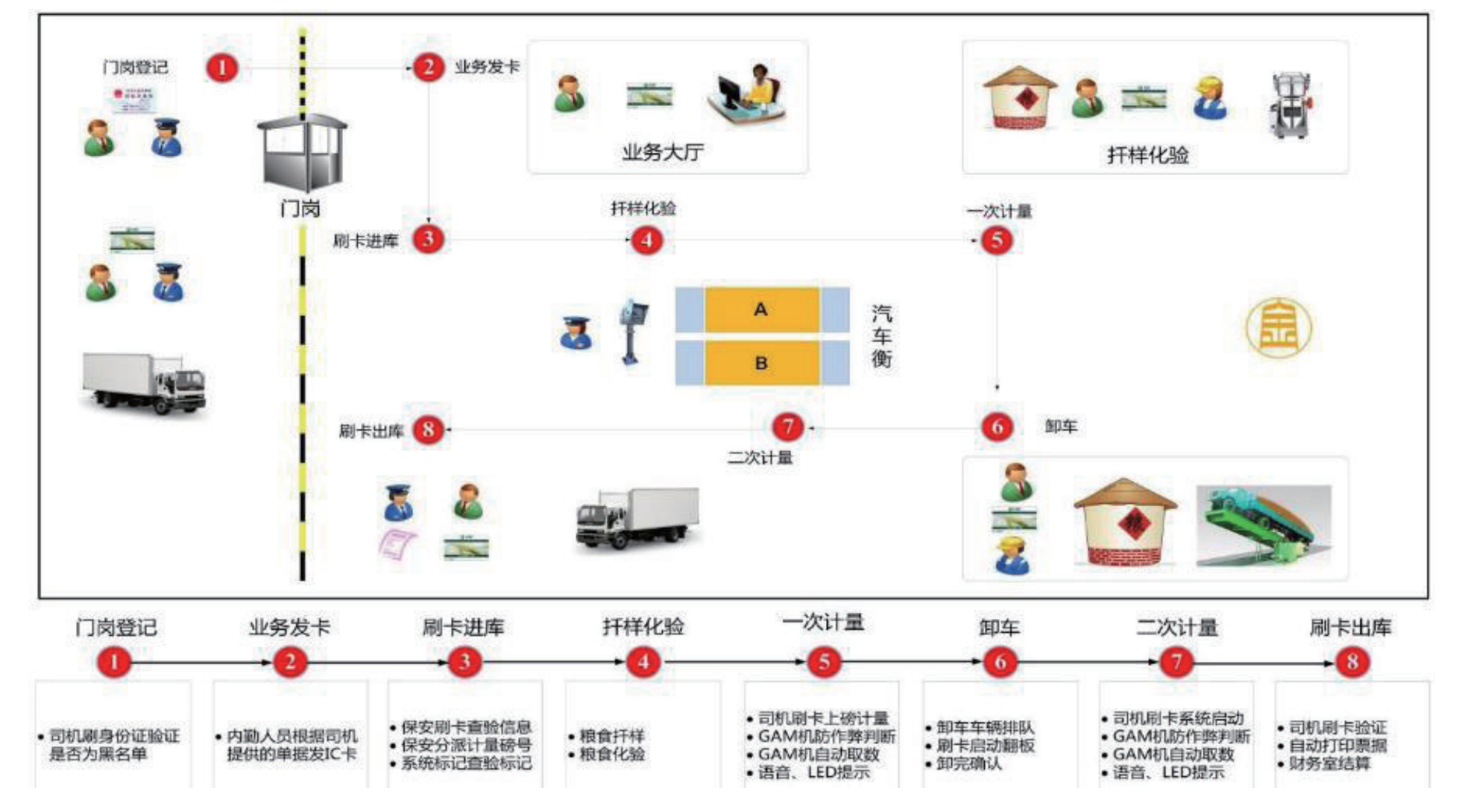
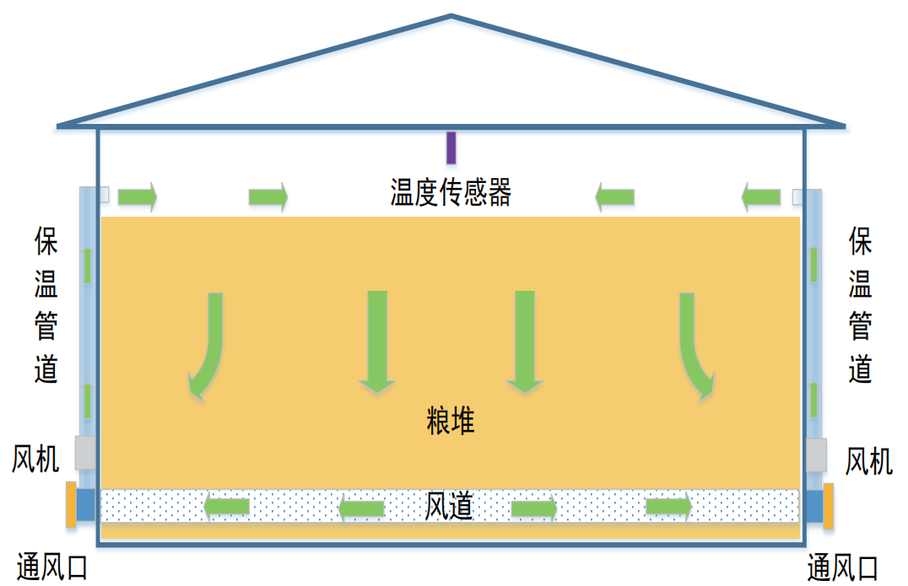
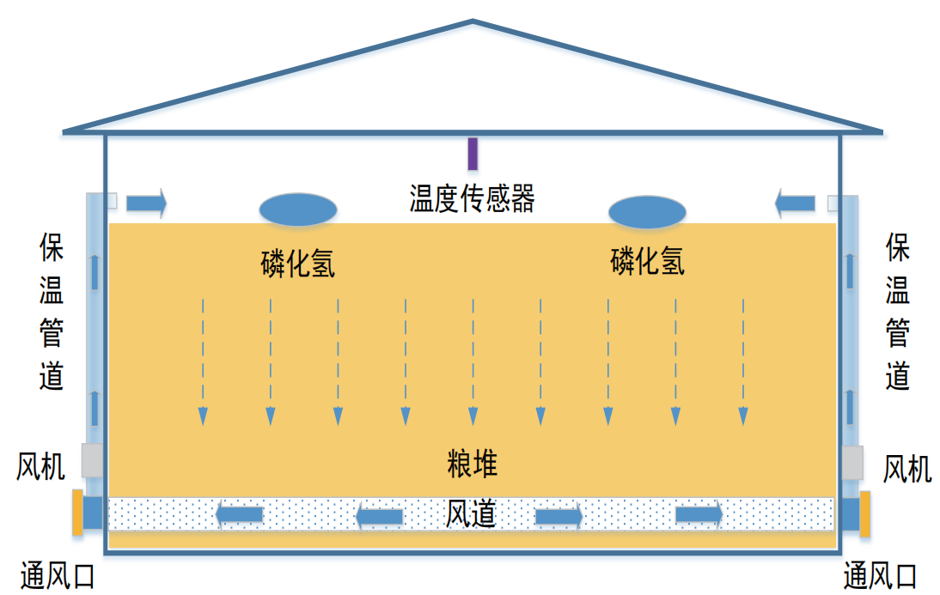
Intelligent information technologies
Intelligent system for silo output & input
Online automatic quantity monitoring system
Multi-parameter automatic measuring system
Intelligent ventilation & cooling system

Slide 7
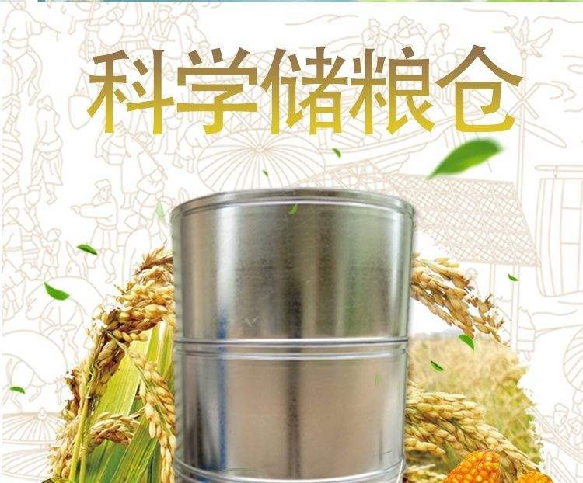
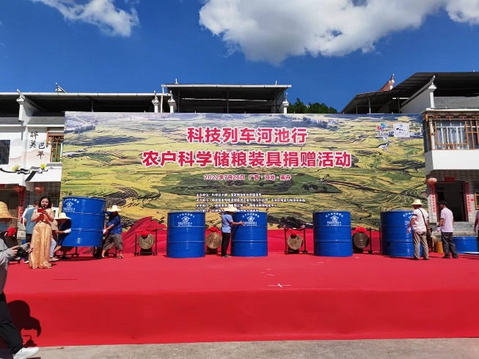
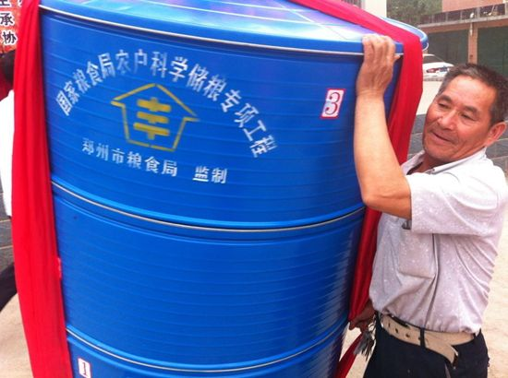
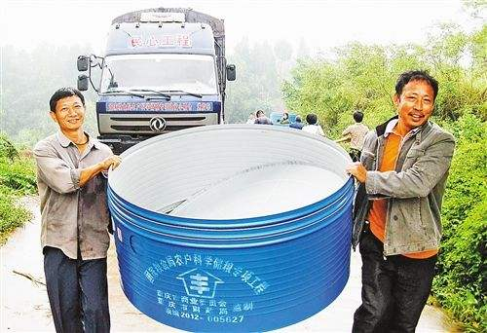
2
Technological Innovation

Slide 8
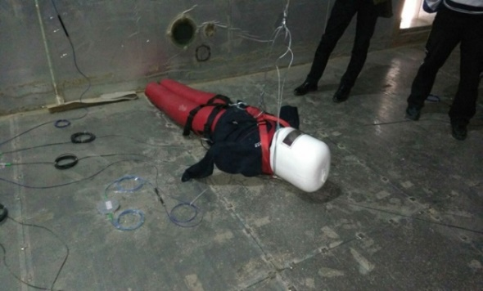
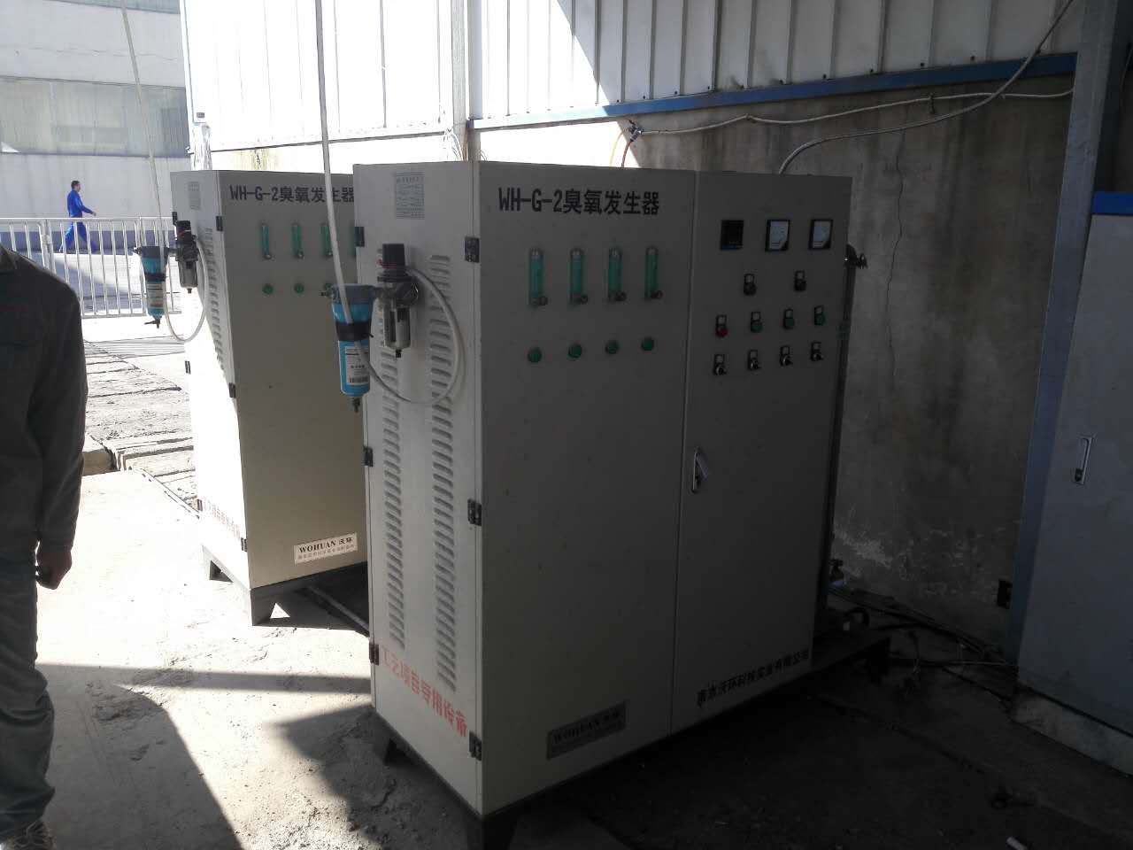
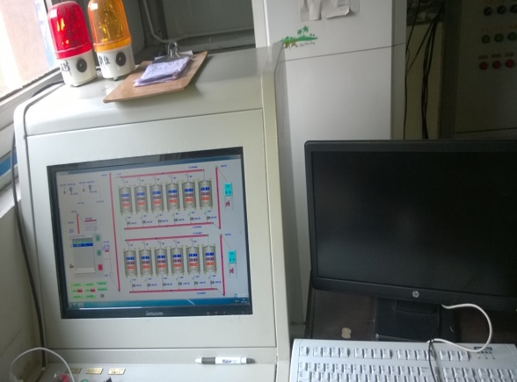
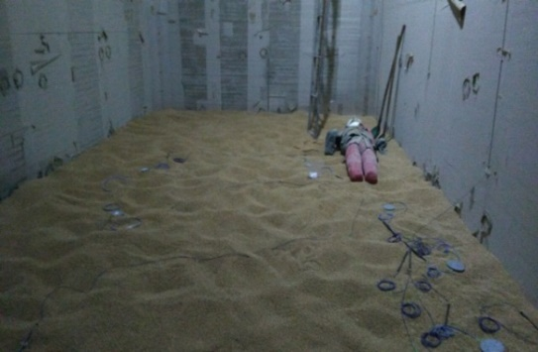
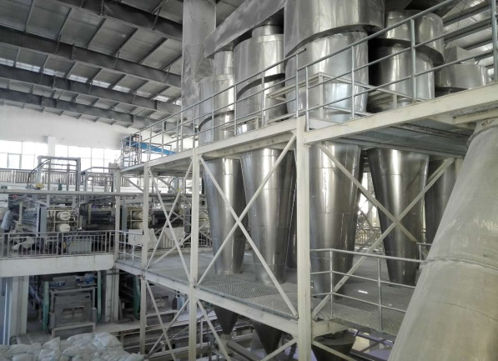
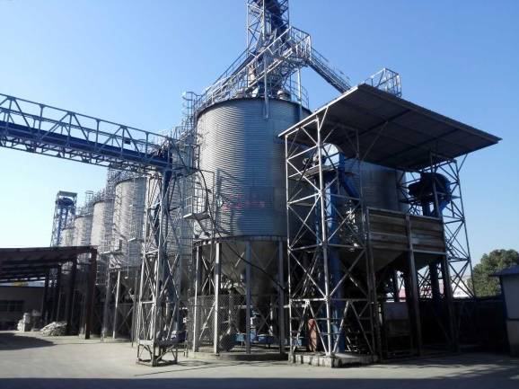
Simulation of filling & emptying operation in grain depots
Key production technology of
special glutinous rice flour

Slide 9
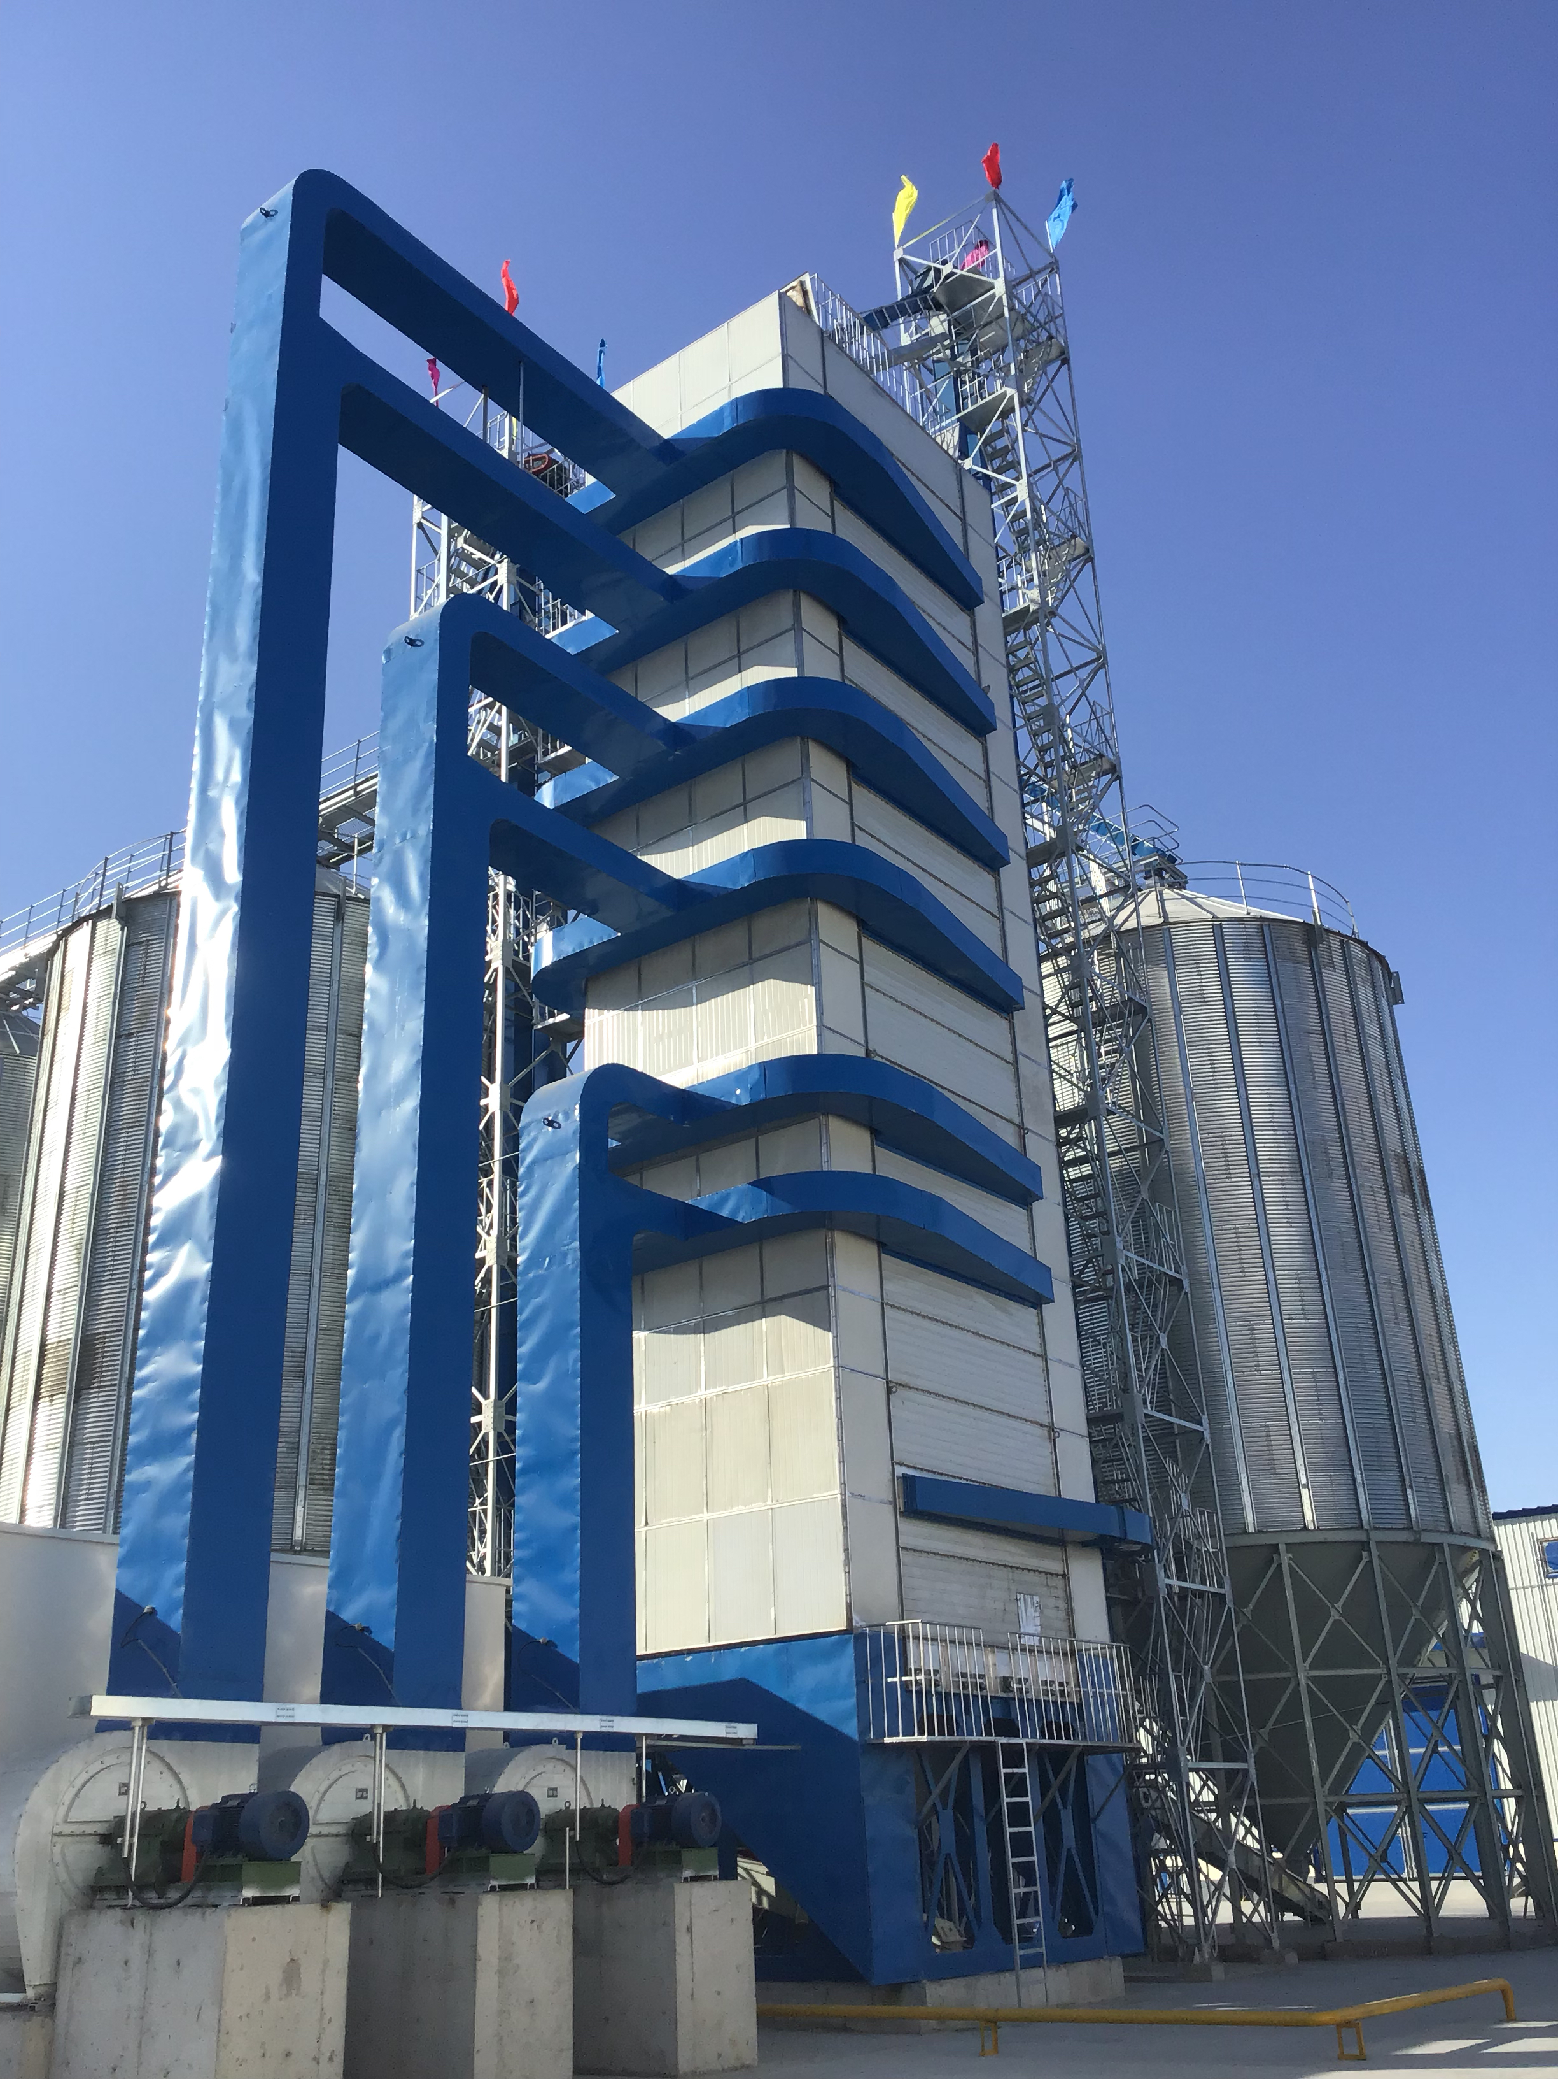
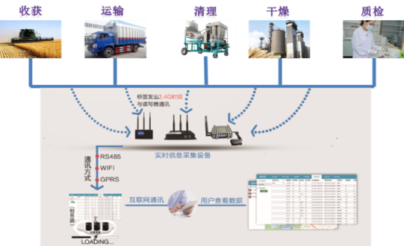
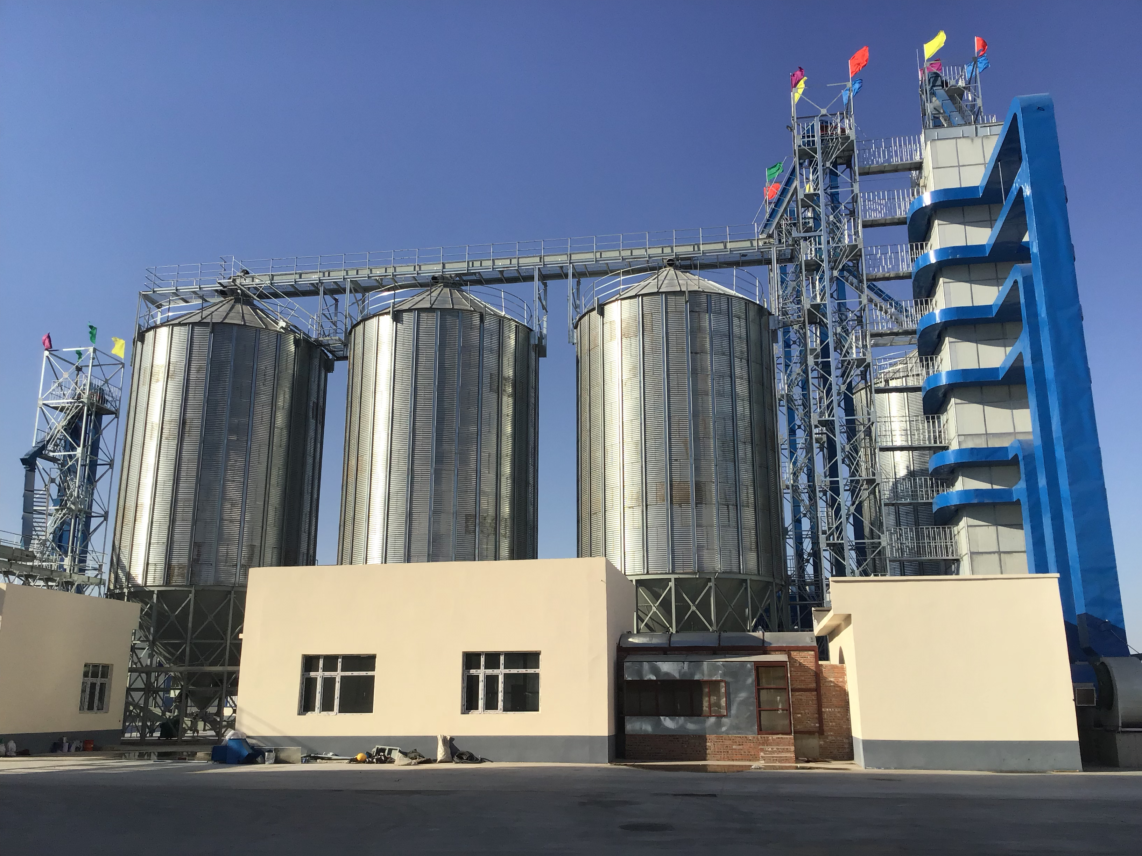
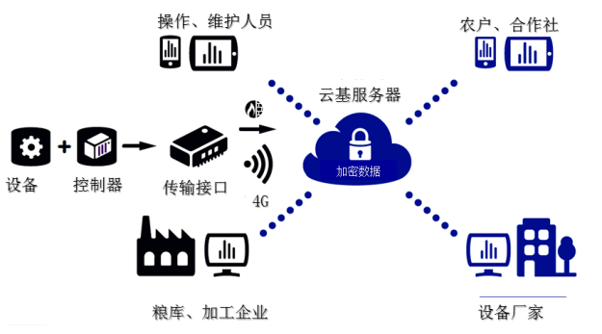
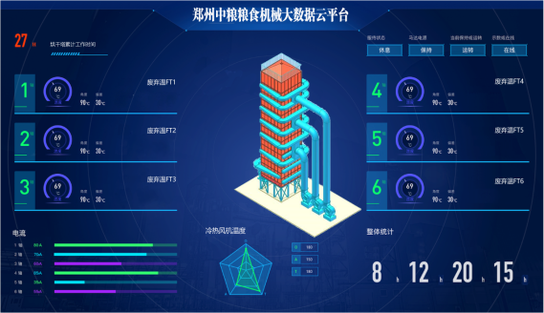
Grain quality & quantity information data system
New energy-efficient & environment-friendly variable temperature smart dryer
Cloud platform framework for grain facilities

Slide 10
Thank You
Dr. SUN Xinyang
College of Food Science & Engineering
Nanjing University of Finance & Economics
Email: xinyang.sun@nufe.edu.cn

