Slide 1
奔跑在共同富裕路上的陇南电商 Local E-commerce Development in Gansu
陇南市电子商务发展局 王小元 Ms. Wang Xiaoyuan, Director Longnan E-commerce Development Bureau
甘肃·陇南 Longnan，Gansu

Slide 2
陇南电商 Longnan E-commerce
01
02
03
乡村振兴新作为 Practices for Rural Vitalization
基本情况 Basic Facts
经验启示 Lessons Learned

Slide 3
01
基本情况 Basic Facts

Slide 4
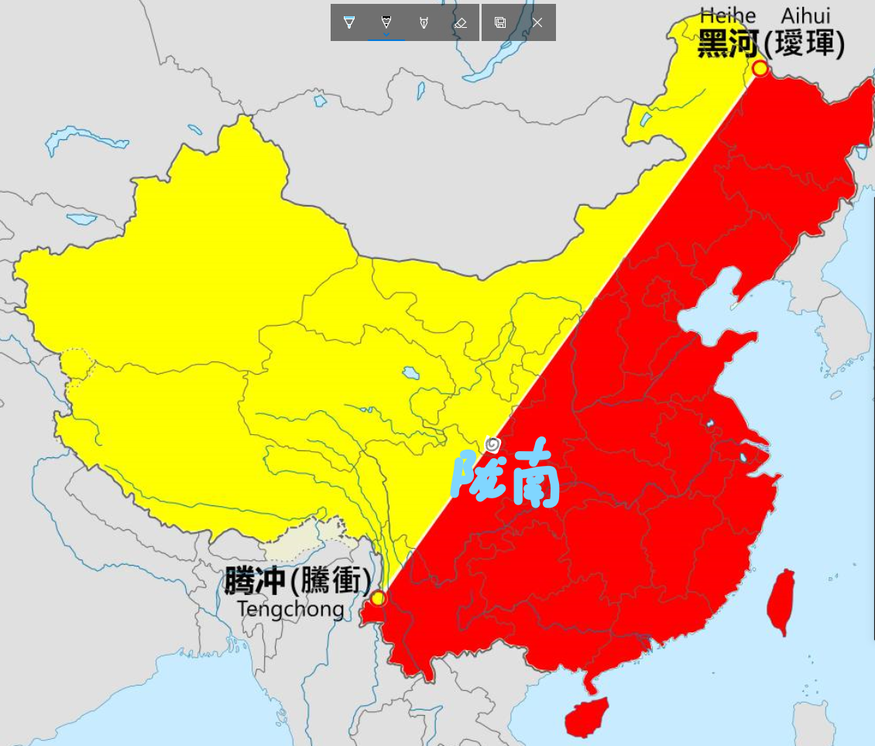
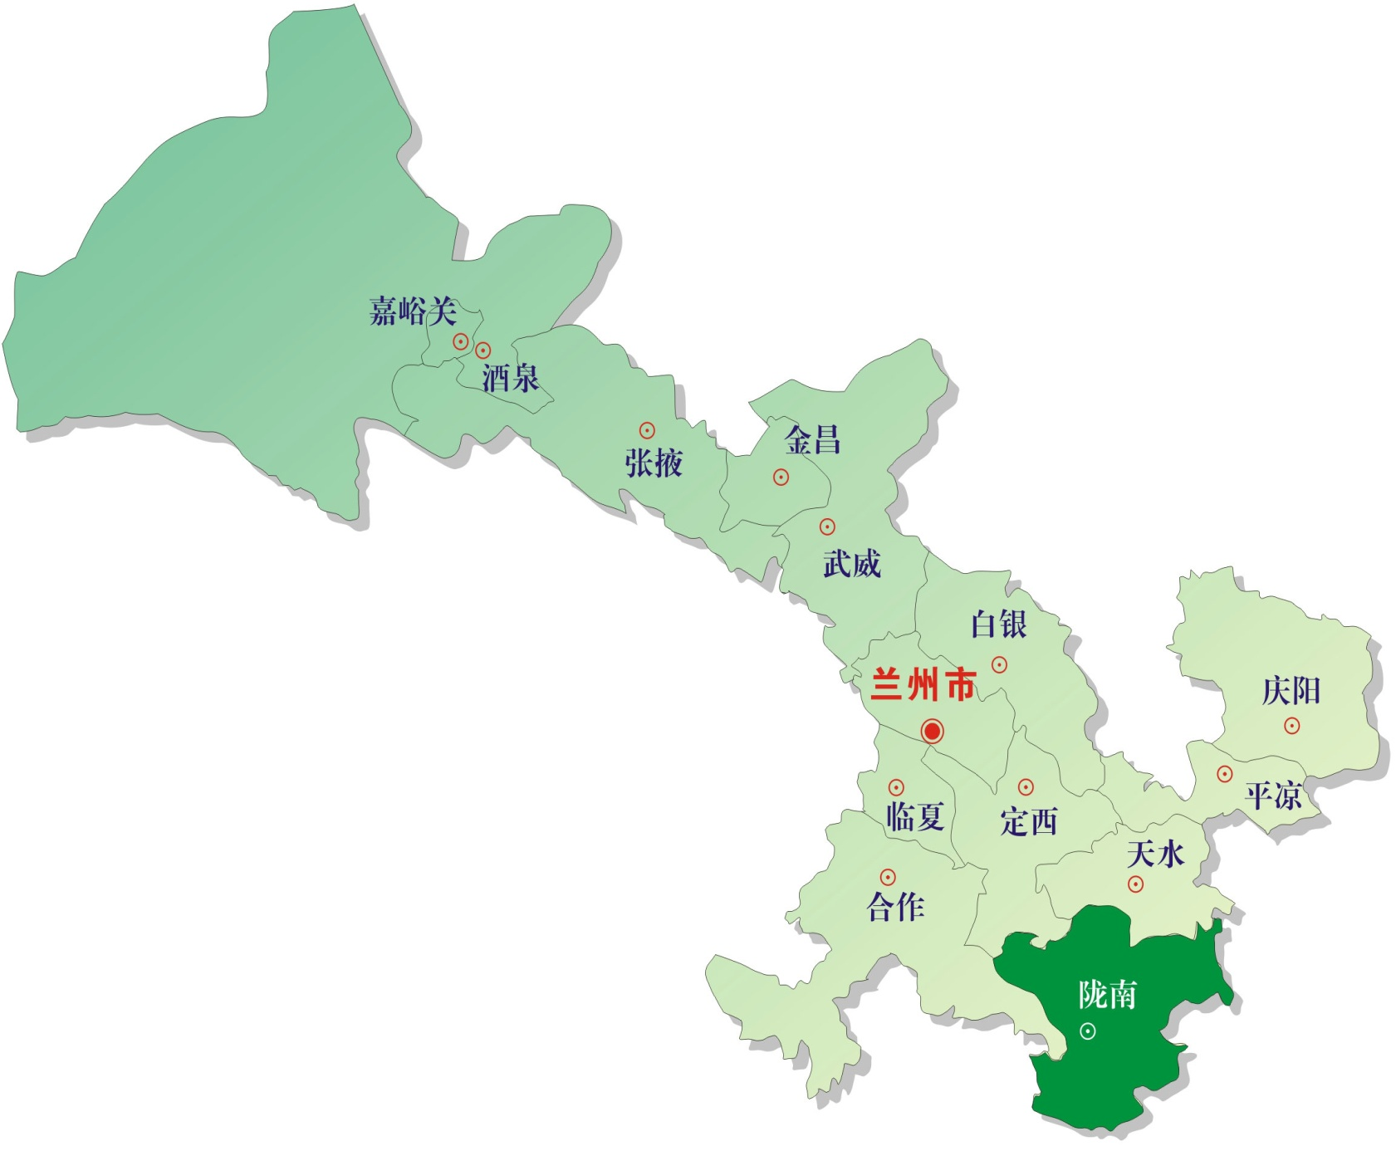
陇南简介 About Longnan
2013年全市开始发展电子商务 Began to develop e-commerce across the city in 2013
Longnan
解决农产品卖难问题 Solving the problem of difficulty in selling agricultural products
初心 Original aspiration
秦巴山连片特困地区
Contiguous destitute areas in Tsinling Mountains
一区八县 One district & eight counties
2014年电商扶贫在陇南试点 Piloted poverty alleviation through e-commerce in Longnan in 2014
238.7万人 Population: 2.387 million
2.79万平方公里 Area: 27,900 km²

Slide 5
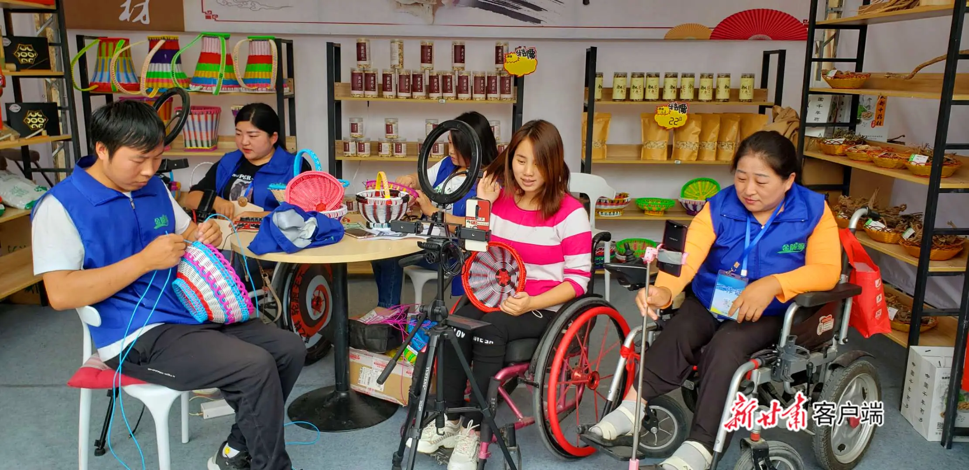
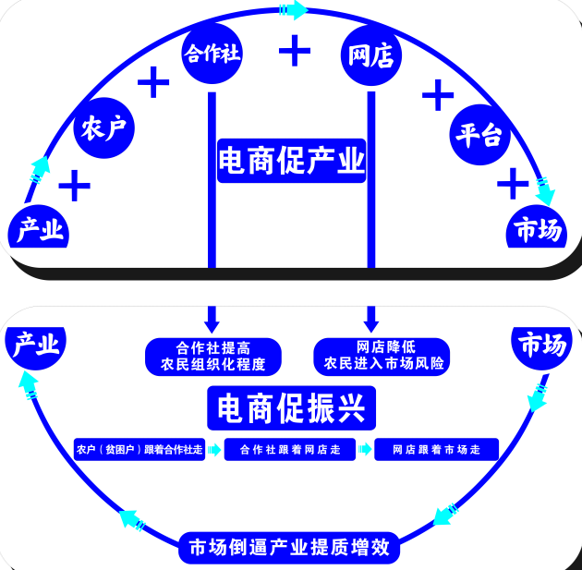
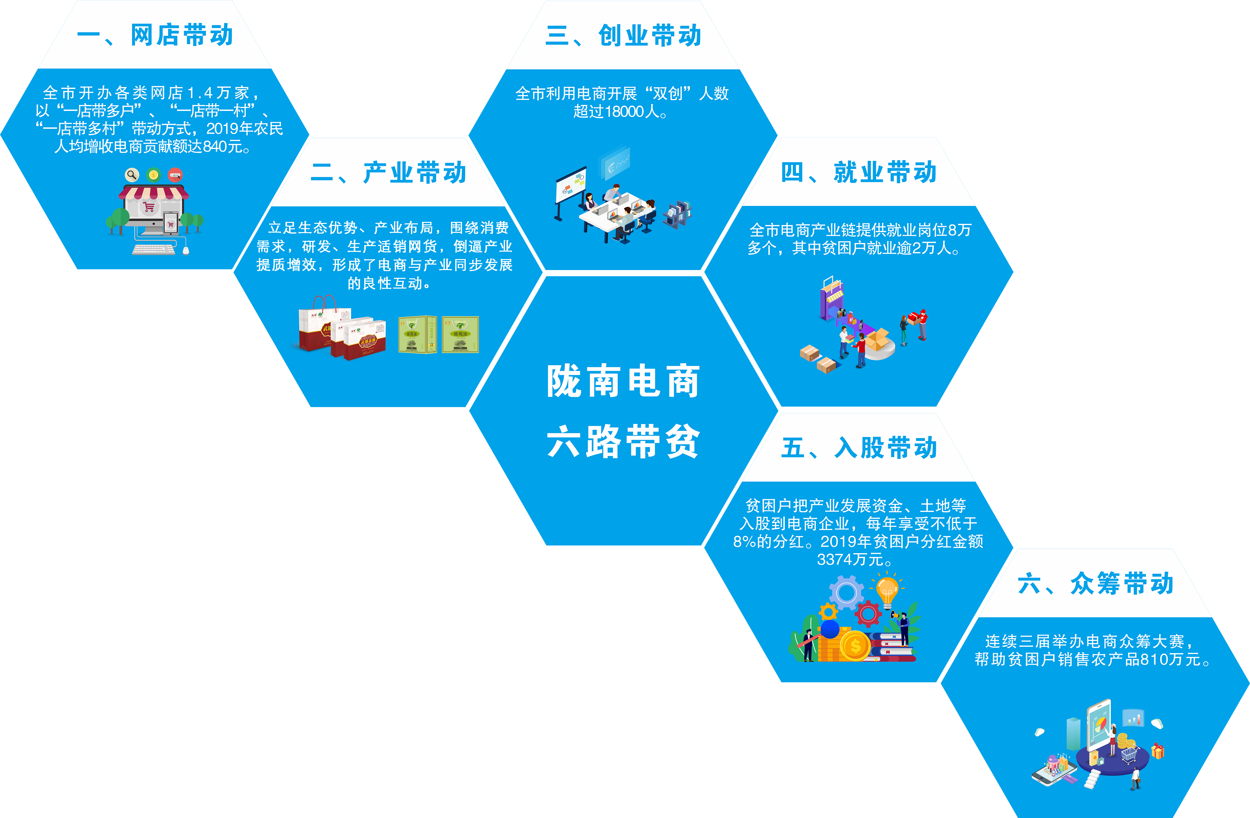
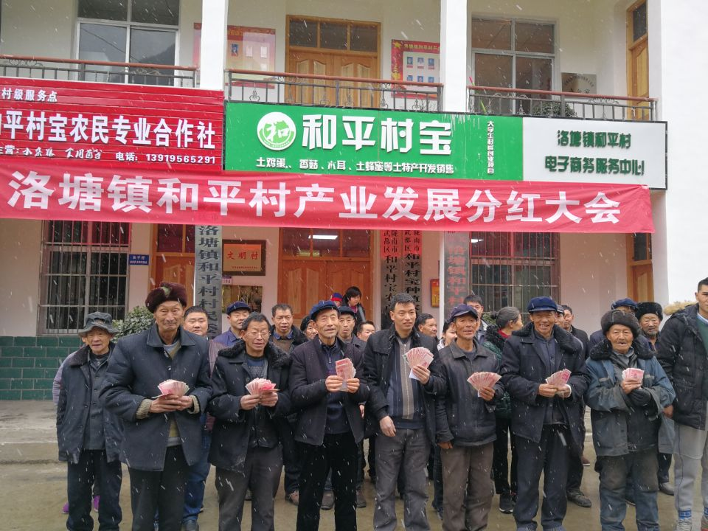
增收路径 Income Growth Path
III. Innovation & Entrepreneurship
Co-ops
Online stores
I. Opening online stores
II. Developing the industry
Farmers
Platform
IV. Improving employment
E-commerce for industry
Market
六路带贫机制
Industry
五、入股带动
V. Becoming a shareholder
Co-ops improve the engagement of farmers
Online stores reduce the risk of farmers entering the market
Market
贫困户把产业发展资金、土地入股到电商企业，每年获得不低于8%的分红
Industry
VI. Crowd funding
E-commerce
for vitalization
Farmers follow Co-ops
Co-ops follow online stores
Online stores follow the market
Six mechanisms to bring development to poverty-stricken areas
The market forced the industry to improve quality and increase efficiency

Slide 6
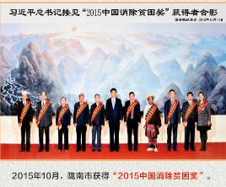
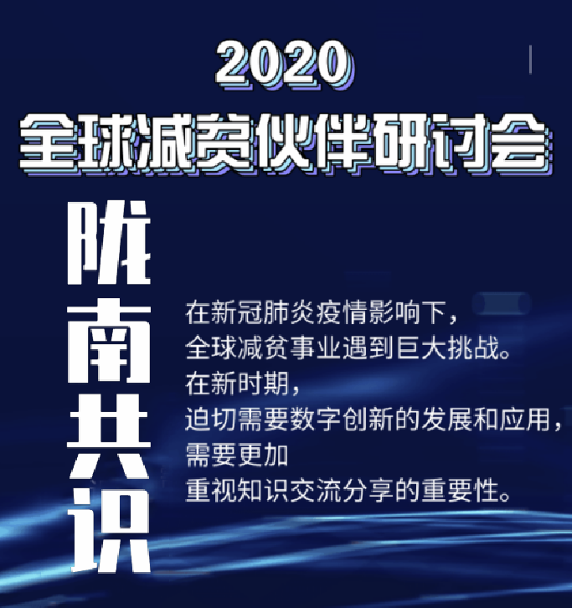
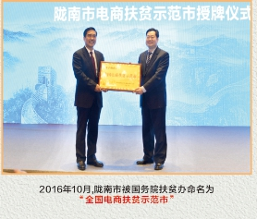
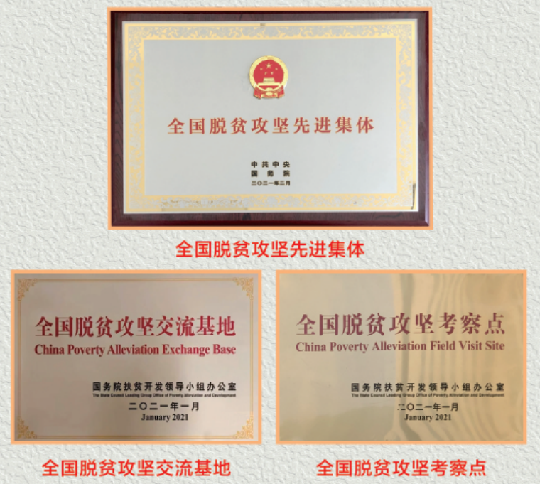
获得荣誉 Honors & Awards
2015年——陇南市荣颁“中国消除贫困创新奖”
2016年——陇南市荣颁“全国电商扶贫示范市”
2020年——“陇南共识”世界发布
2021年——陇南市电子商务发展局荣获“全国脱贫攻坚先进集体”
2021年——陇南电商产业服务中心被
认定为“全国脱贫攻坚交流基地”、
“全国脱贫攻坚考察点” 2015 - Longnan City was awarded the “China Poverty Eradication Innovation Award” 2016 - Longnan City was awarded the “National Demonstration City of Poverty Alleviation through E-commerce” 2020 - “Longnan consensus” was released worldwide 2021 - Longnan E-commerce Development Bureau won the title of “National Outstanding Unit of Poverty Alleviation” 2021 - Longnan E-commerce Service Center was recognized as the “National Poverty Alleviation Exchange Base” and “National Poverty Alleviation Model"

Slide 7
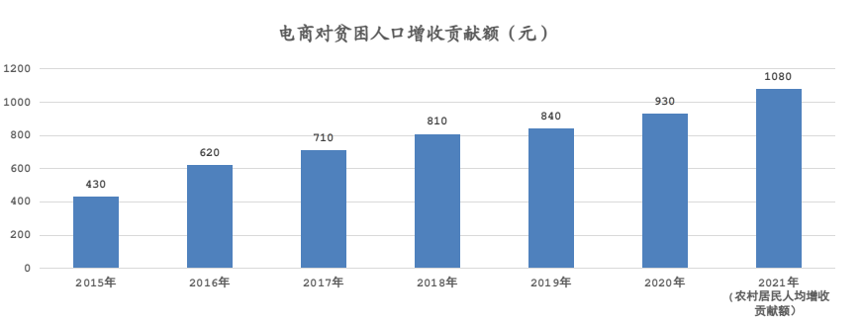
电商对人均增收贡献额
The contribution of e-commerce to per capita income growth
2015年430元增长到2021年1080元 increased from 430 yuan in 2015 to 1080 yuan in 2021
电商扶贫 Poverty Alleviation through E-commerce
电子商务交易额 E-commerce turnover
2014年7.71亿元增长到2021年52.1亿元 increased from RMB 771 million in 2014 to RMB 521 million in 2021
The contribution of e-commerce to income growth of poor people (Unit: yuan)
1.4万家
网店
累计销售逾300亿元
培训人才30万人次
9个电商公共服务中心
192个乡镇电商服务站
2404个村级电商服务点
14,000 online stores
Cumulative sales revenue exceeds RMB 30 billion
300,000
training opportunities
9 e-commerce public service center
192 township- and town-level service stations for e-commerce
2,404 e-commerce service focal points at village level

Slide 8
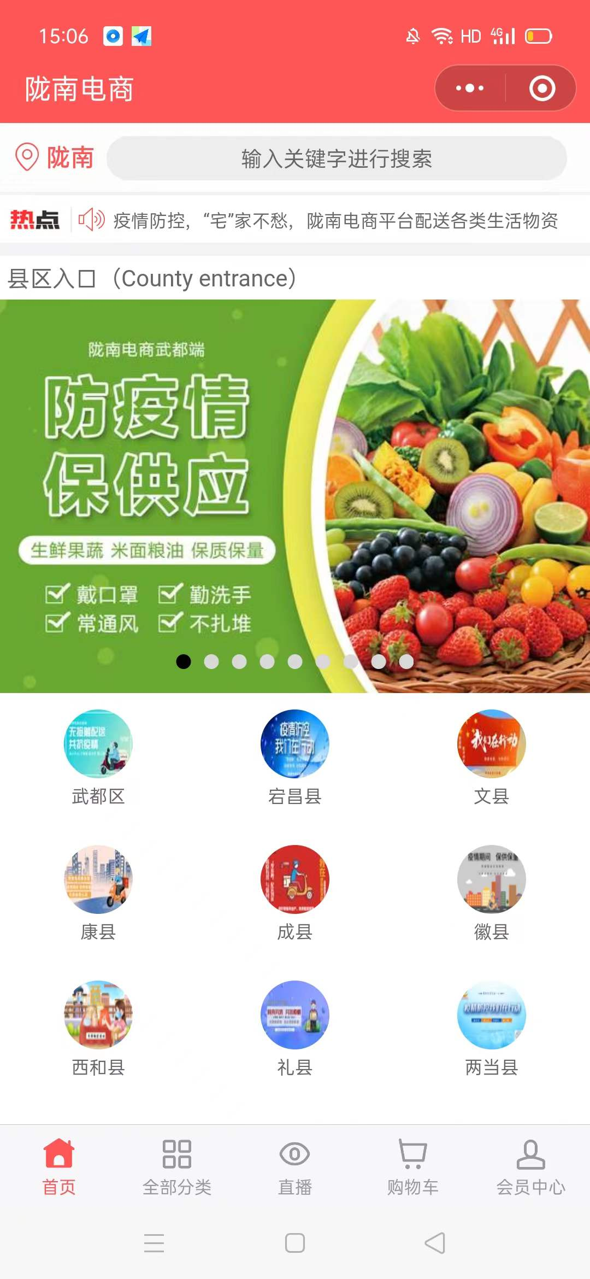
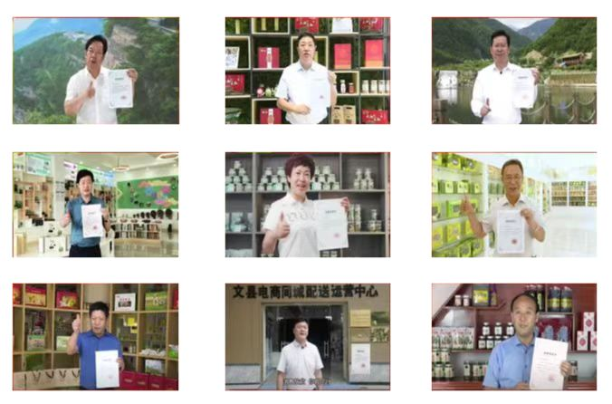
自建电商平台 Build e-commerce platform
会员：50.8万人
Members: 508,000
商家：1061户
Merchants: 1,061
交易：14.85亿元
Trading volume: RMB 1.485 billion
九个县（区）长为平台产品质量视频背书
Video endorsements from heads of nine counties (districts) for product quality on the platform

Slide 9
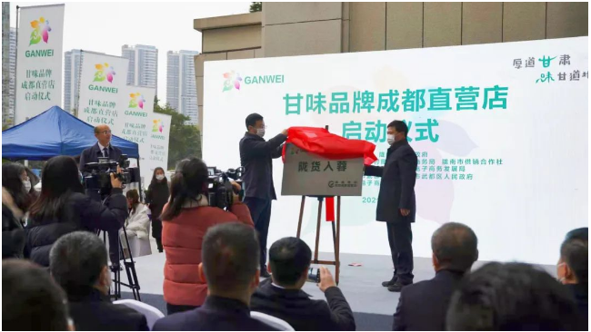
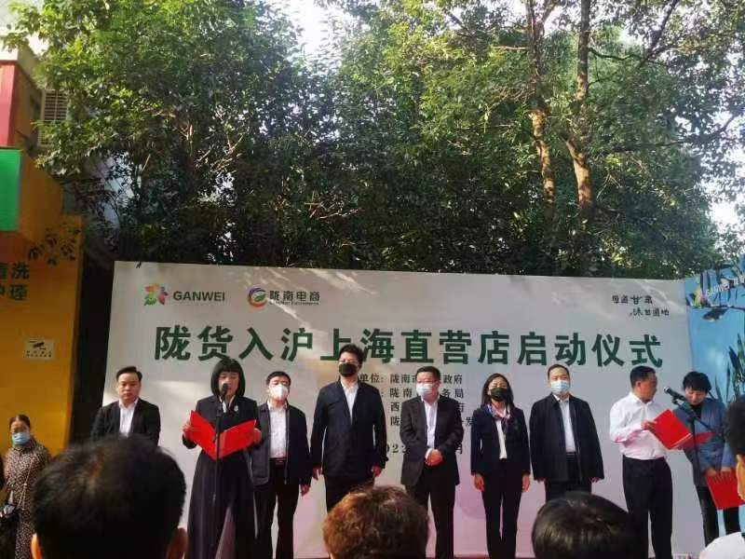
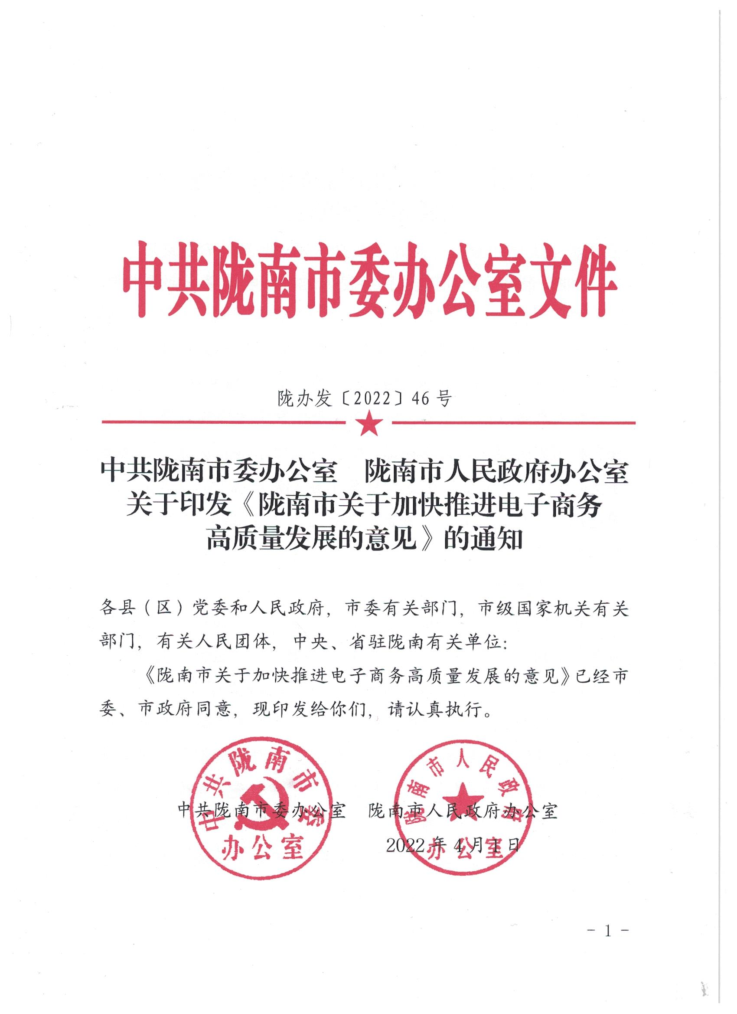
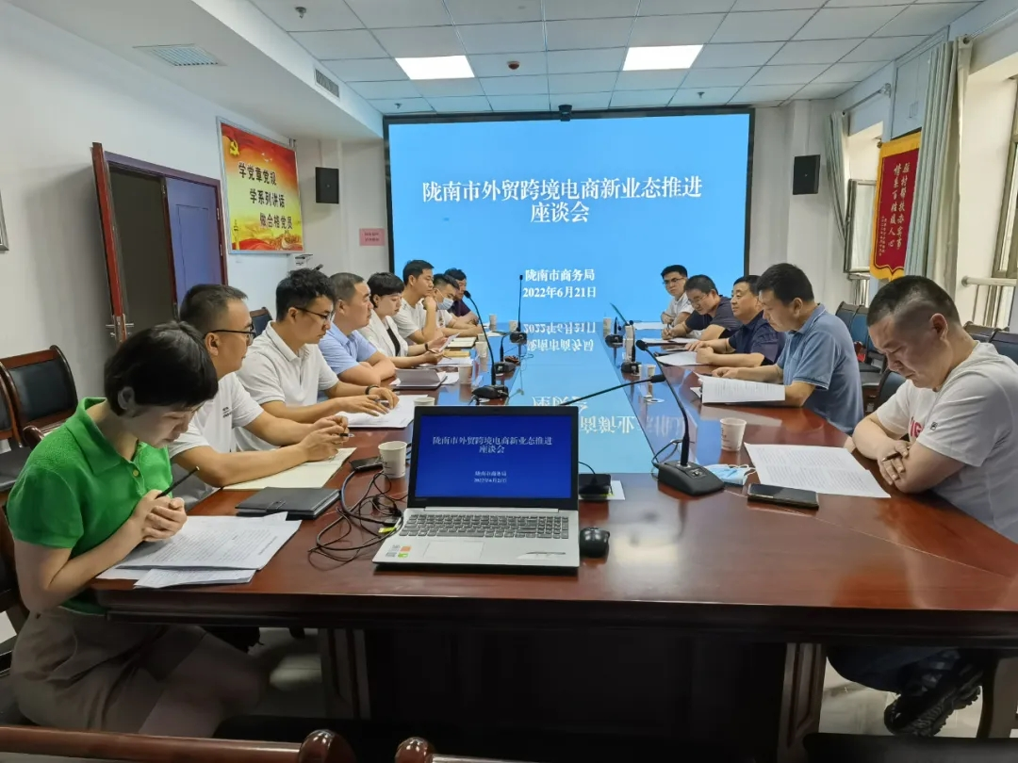
拓宽域外市场 Expand markets outside the region
国内直营店31家
31 direct-sale stores in China
跨境电商企业15家
15 cross-border e-commerce enterprises
出口20个国家和地区
Export to 20 countries and regions

Slide 10
02
经验启示
Lessons Learned

Slide 11
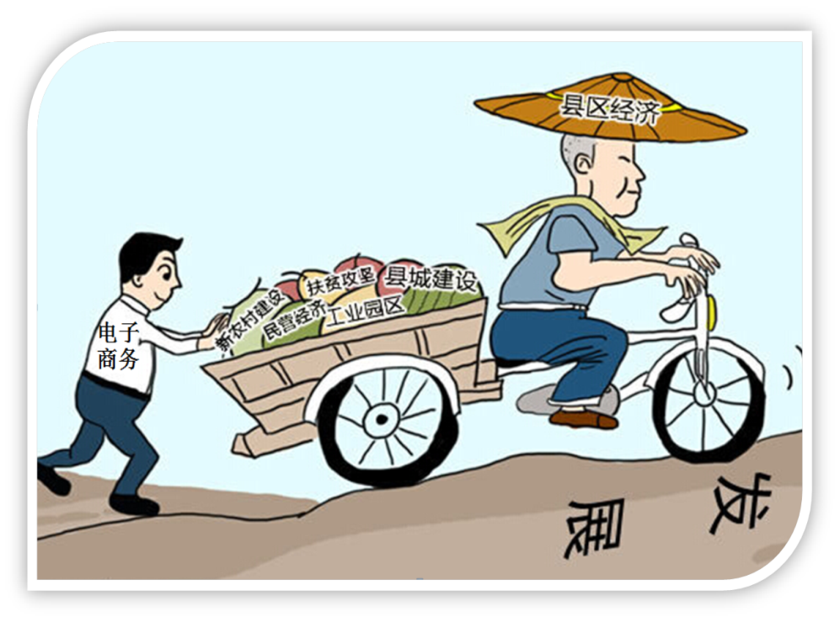
探索发展经验Explore development experience
“1333”电商发展思路
“1333” e-commerce development strategy
打好电商“四战”
Four “development goals”
打开一个思想总开开关Strategy
三大提升
Three improvements
网商规模
Online business scale
发展质量
Development quality
扶贫效益
Benefits of poverty alleviation
三项体系
Three systems
行政推动Administration promotion
网货供应
Online supply
扶贫效益
Benefits of poverty alleviation
三轮驱动
Three incentives
电商团队
E-commerce team
微媒助力
Wemedia
典型引领
Exemplary demonstration
融合战
Integrated deveopment
整体战
Overall development
全域战
Region-wide development
质量战
High-quality development

Slide 12
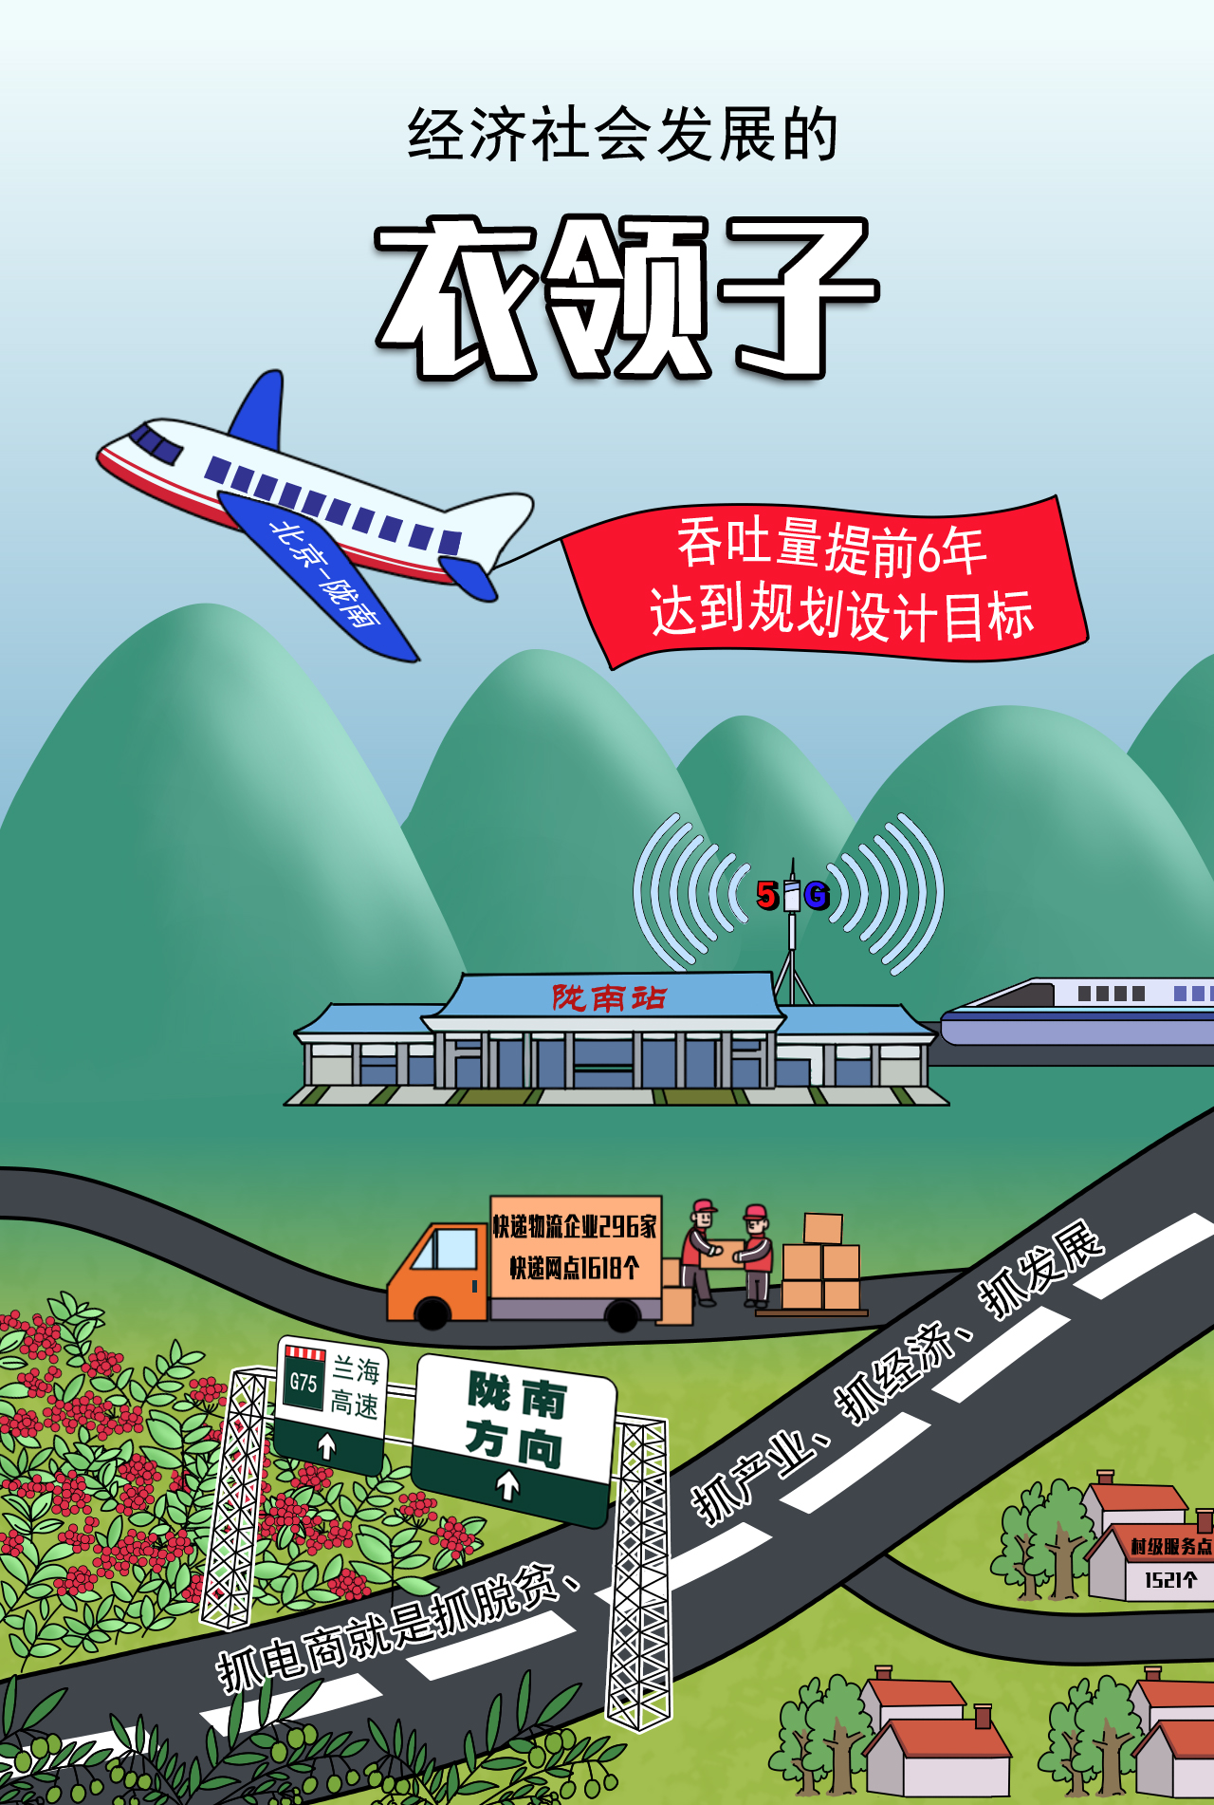
探索发展经验 Explore development experience
The “key” of economic development
政策
Policy
解决农产品卖难问题初心不变
Make every effort to solve the problem --“difficult to sell out farm produts”
机制Mechanism
电商“衣领子”作用不变
Pay more attention to the “key” role of e-commerce
创新Innovation
一把手抓责任不变
Assign top officials to take overall responsibility
人才
Talent
行政推动机制不变
Put into action the mechanism of administration promotion

Slide 13
陇南电商特质 Features of Longnan E-commerce
生于大山
立于扶贫
成于创新
贵于化人
Rooted in the mountains, aming to alleviate poverty, make innovations and change people’s mindset.

Slide 14
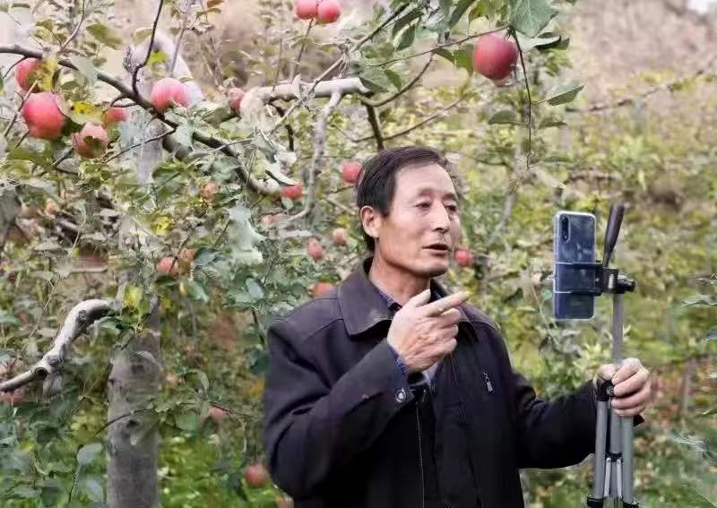
发展中的启示 Insights obtained from development
◆解放干群思想是发展农村电商的前提；
Embracing new ideas is the premise of local e-commerce development;
◆强力行政推动是发展农村电商的保障；
Powerful administration is the guarantee of local e-commerce development;
◆培育市场主体是发展农村电商的根本；
Cultivating market entities is an fundamental issue of local e-commerce development;
◆创新服务模式是发展农村电商的关键；
Innovative service model is the key of local e-commerce development;
◆坚持联农助农是发展农村电商的责任；
Adhering to connecting farmers and helping them is the responsibility of local e-commerce development;
◆夯实供应链是发展农村电商的基础；
Consolidating the supply chain is the foundation of local e-commerce development;
◆抢抓电商项目是发展农村电商的抓手。
Seizing e-commerce projects is an important channel of local e-commerce development;
60多岁的果农张加成“晋升”为电商新农人
Zhang Jiacheng, a fruit farmer in his 60s, becomes a new e-commerce farmer

Slide 15
03
乡村振兴新作为
Practices for Rural Vitalization

Slide 16
乡村振兴
Rural Vitalization
生产销售两促进
Promote production and sales
下沉外拓两手硬
Attach equal emphasis to lower-tier markets and business outreach
上行下行两手抓
Attach equal importance to higher-tier and lower-tier markets
守正创新两并行
Keep on the right track and make innovations

Slide 17
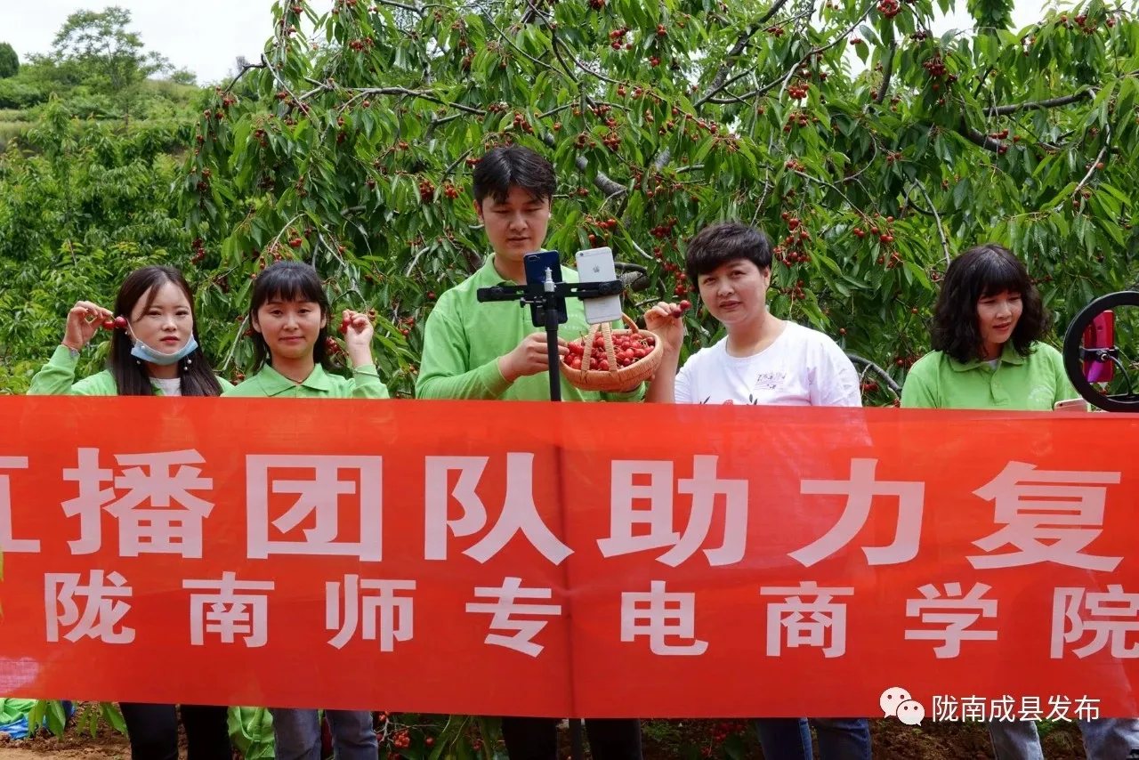
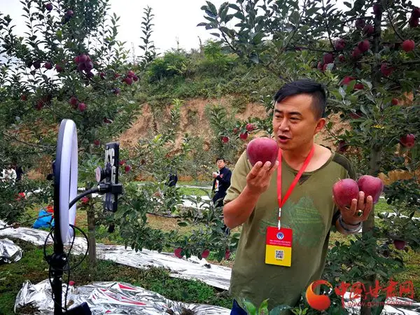
生产销售两促进
Promote production and sales
提升网货生产质量
Enhance the production quality of online products
品牌、标准、溯源
Brand, standard, traceability
提高电商销售水平
Improve e-commerce sales
防疫保供 让利营销
Ensure the supply during the pandemic
Lower prices to increase sales
提高农产品供应链韧性
Strengthen the resilience of agricultural products supply chain
免税店国际供应链
International supply chain – duty-free stores
工厂店国内供应链
National supply chain – factory outlets
甘味省内供应链
Gansu products supply chain in Gansu Province
陇货市内供应链
Longnan products supply chain in Longnan City
刚需县域供应链
Supply chain in counties

Slide 18
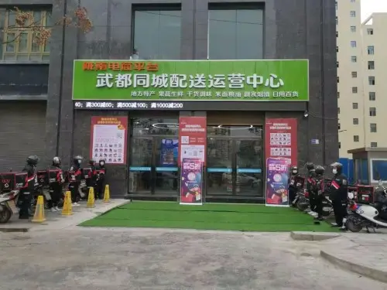
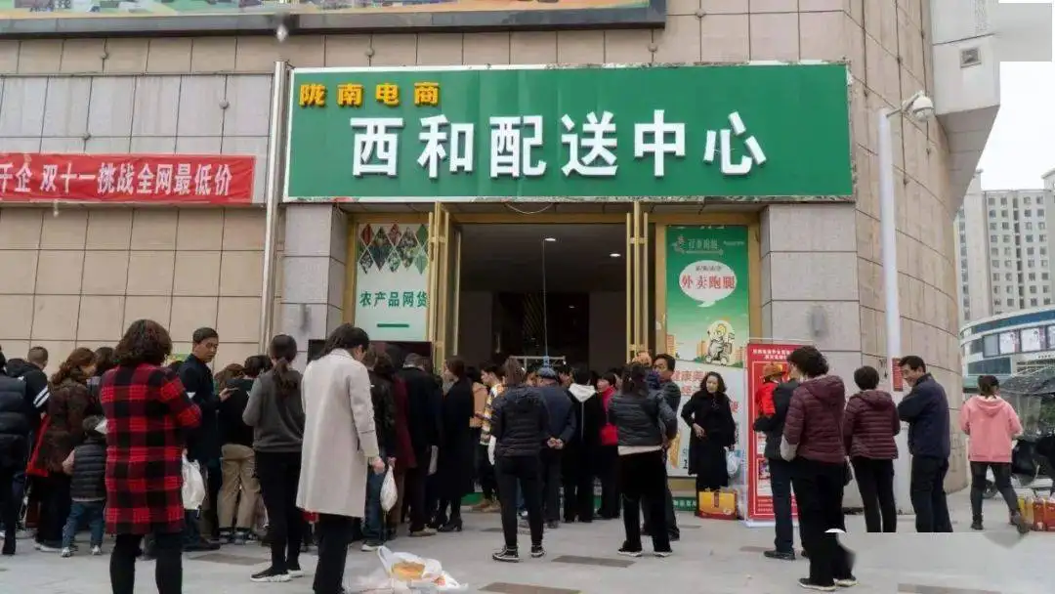
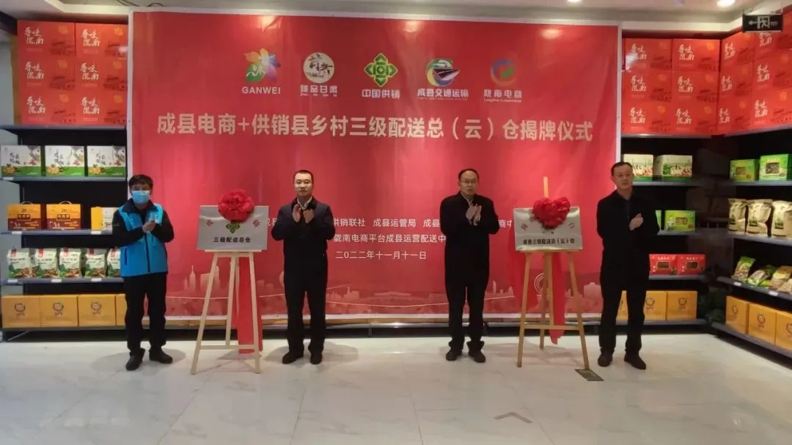
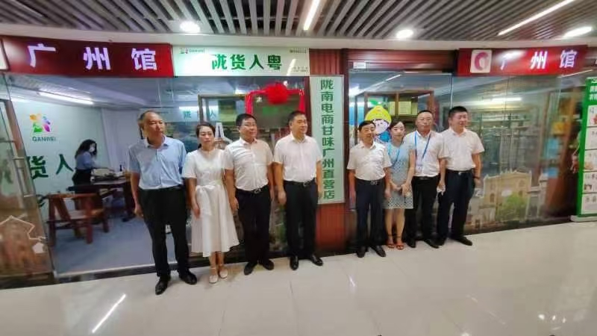
下沉外拓两手硬
Attach equal emphasis to lower-tier markets and business outreach
强化平台下沉
门店建设
Develop outlets in lower-tier cities
强化平台外拓
门店建设
Promote the outreach of the platform
• 县域统仓共配
Shared warehousing and distribution in counties
• 社区门店
Outlets in communities
• 前置仓和村级服务点
Front warehouses and service stations at the village level
• 甘味直营店
Gansu product retail outlets
• 异地配送中心
Cross-regional distribution center
• 专柜、免税仓
Special counter and duty-free warehouse

Slide 19
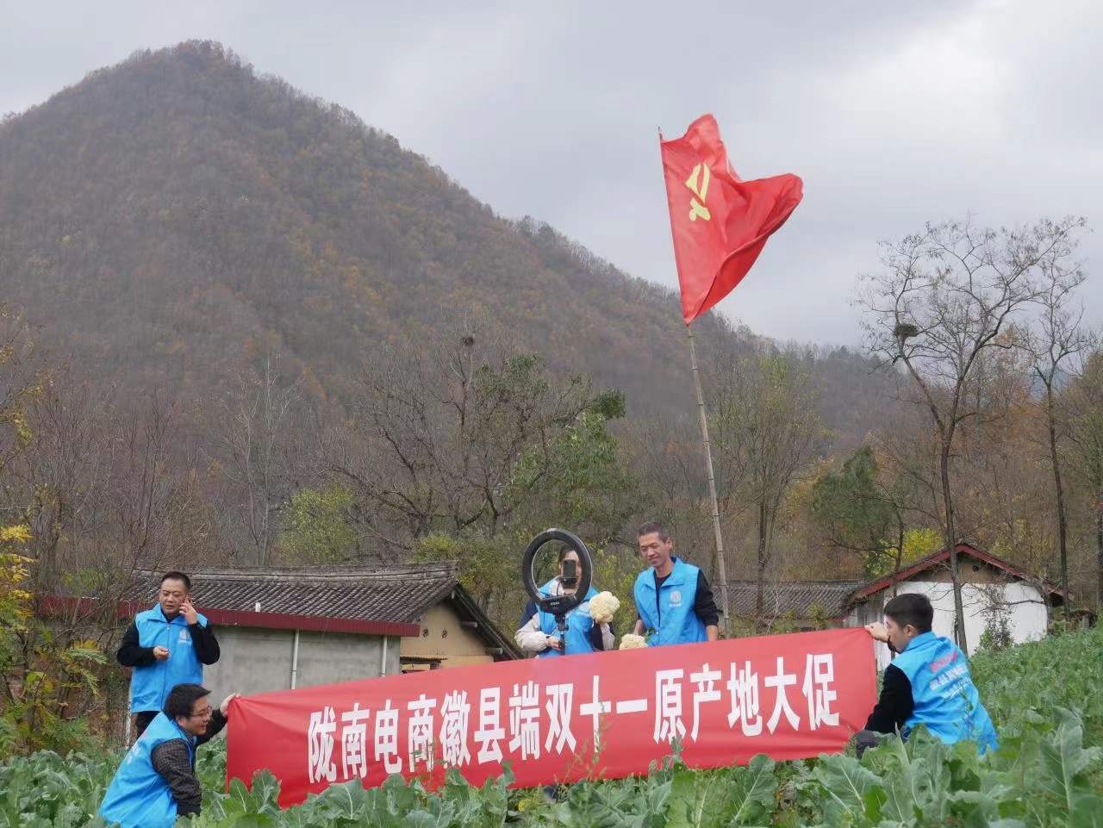
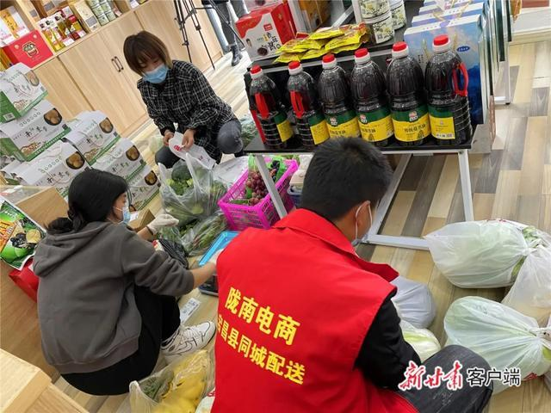
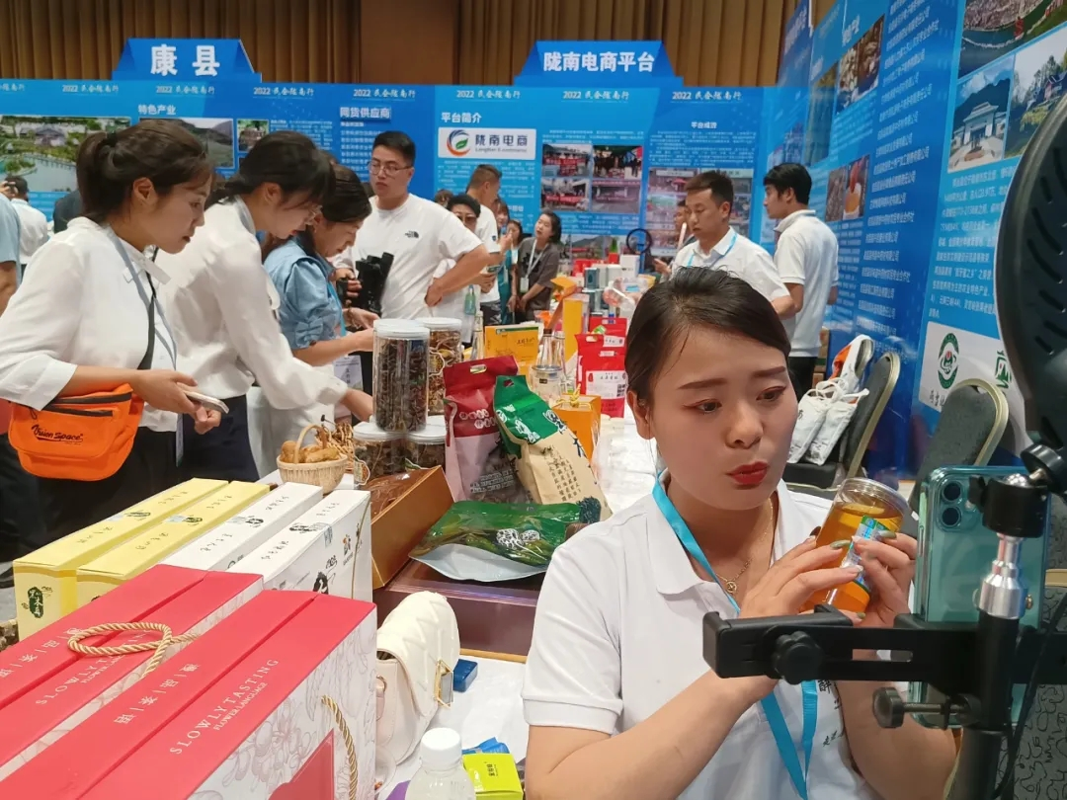
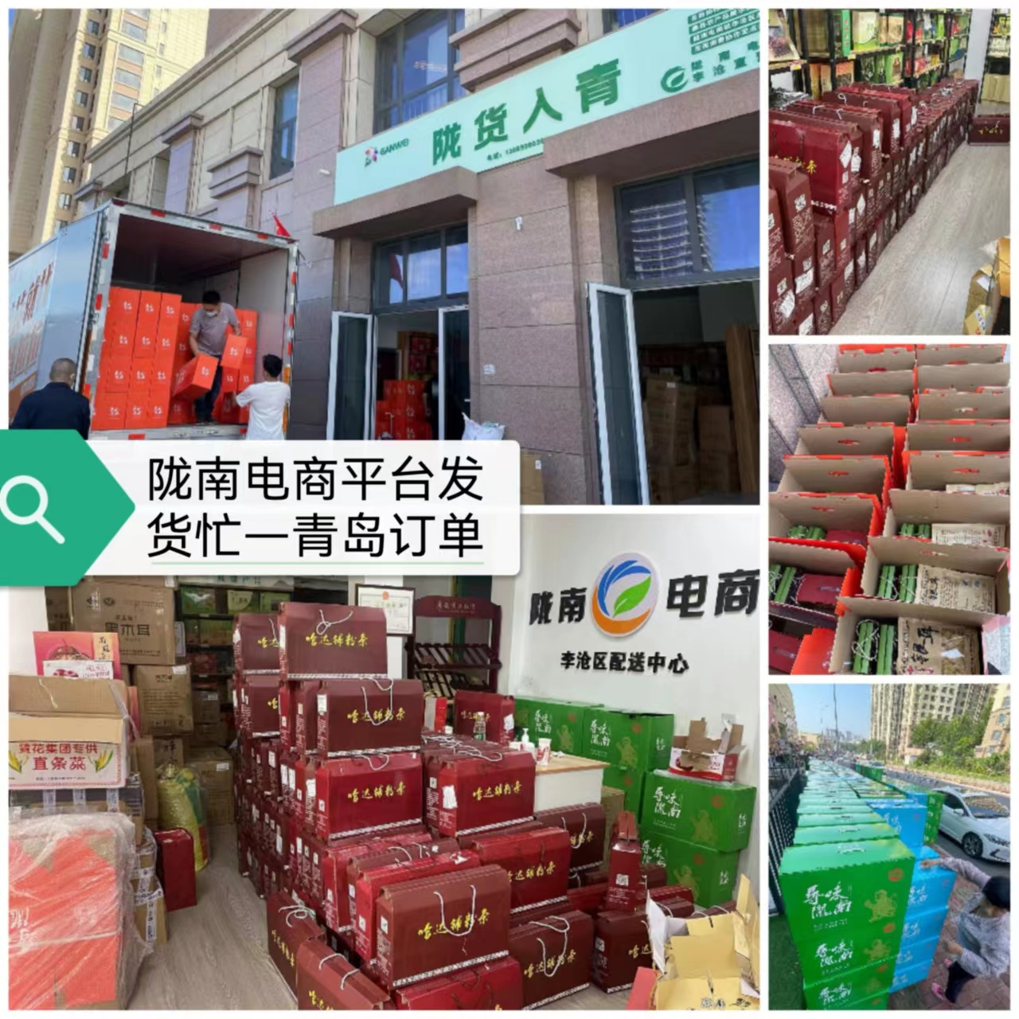
上行下行两手抓
Attach equal importance to higher-tier and lower-tier markets
上行
Higher-tier
农产品销售
Agricultural products sales
产销对接
Ensure linkage between production and sales
下行
Lower-tier
稳价保供
Stabilize the price and ensure supplies
同城配送
City-wide delivery

Slide 20
守正创新两并行
Keep on the right track and make innovations
构建电商生态体系
Build e-commerce ecosystem
提高创新融合能力
Enhance capabilities in innovation and integration
推进数字电商建设
Promote digitalized e-commerce
推动电商：从业态、内涵、服务、网货、渠道、团队、
动力、市场、效益、监管等方面提档升级
Promote the upgrading of e-commerce in aspects of business form, content, service, products, channel, team, driving force, market, effectiveness and supervision

Slide 21
推开了一扇更新观念的窗
Provides an opportunity to embrace new ideas
创出了一条群众增收的路
Creates a new way to increase income
架起了一座连通市场的桥
Builds a bridge to the market
铸就了一本经验汇集的书
Provides experience and lessons learned
电
子
商
务
E-commerce

Slide 22
谢 谢！
Thank you!
Sharing for Learning

