Slide 1
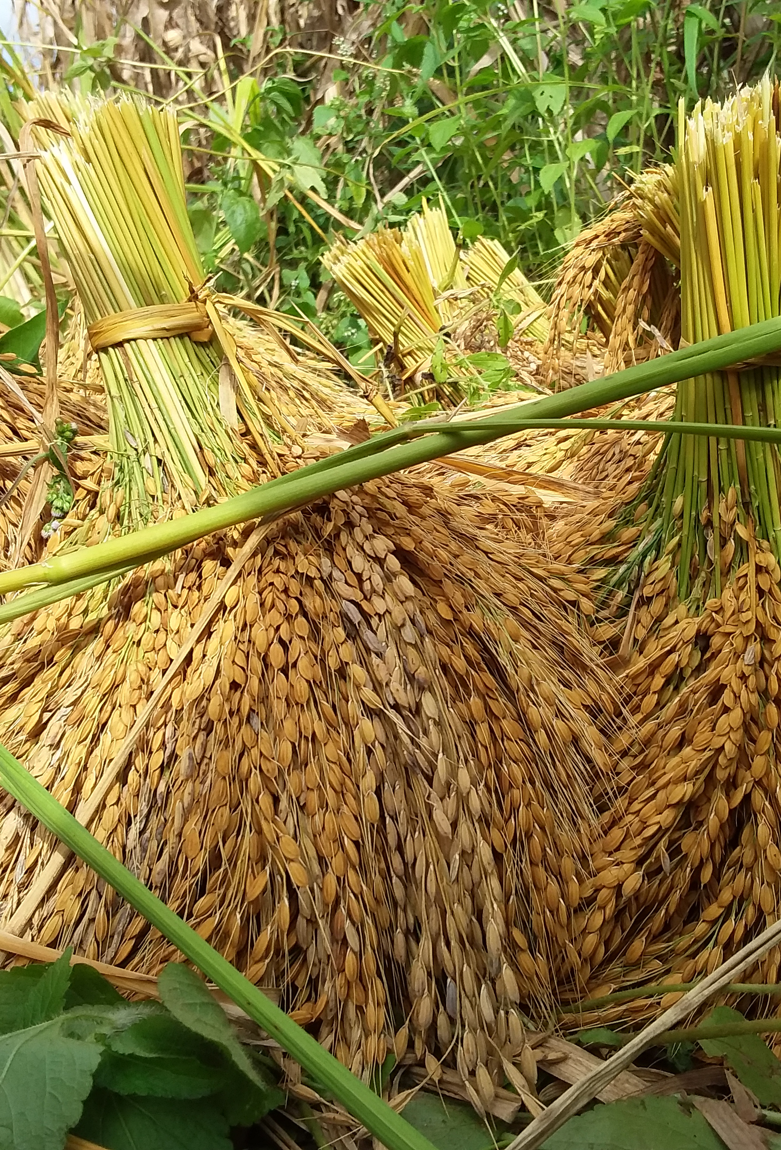
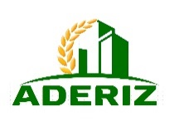
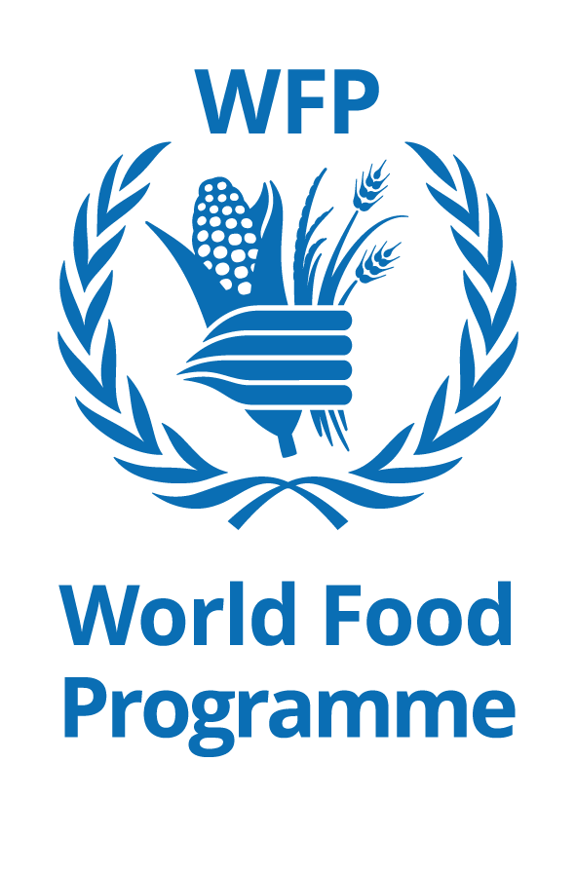
Supporting the rice value chain to increase resilience in Côte d’Ivoire
How the China-Africa rice value chain initiative supports local communities in overcoming challenges and contributes to resilient food systems.
WFP Côte d’Ivoire
Notes:
Eradicate hunger and malnutrition are important goals of the SDG. To do this, it is essential to work on all aspects of food systems, including increase production, promote sustainable business models, invest in production, transformation and distribution technologies and infrastructures, and improve productivity.

Slide 2
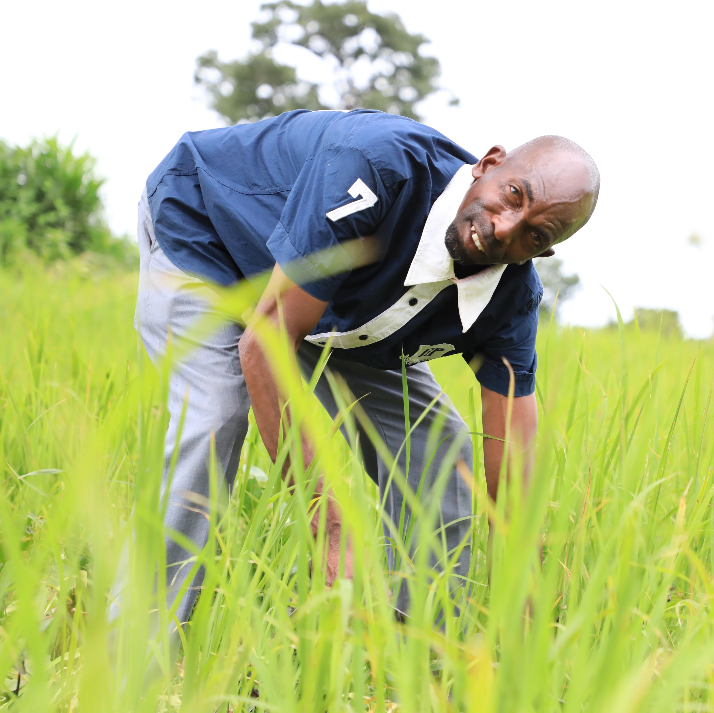
Context
80% of agriculture is composed by small holder farmers
Weak structuring – informal sector
Women represent 90% of agricultural labor forces
155th on the Gender Inequality Index
Notes:
In Côte d'Ivoire, smallholders represent 80% of farmers. Food production is carried out by a very large number of family-type farms that work on limited agricultural areas. For those farmers, it is primarily a self-subsistence activity.
The food sector here has limited yields and is disadvantaged by its informal nature and the weak structuring of farmers organizations. This is mainly due to the lack of cooperative spirit and entrepreneurship, as well as the illiteracy of a large number of actors.
Women represent 90% of the agricultural labor force. Only 8% have property titles, compared to 22% for men. As in many other countries, socio-cultural barriers limit their access to land and participation in decision-making.
Côte d'Ivoire ranks 155th on the gender inequality index. According to the Ministry of Agriculture and Rural Development, if women had the same access as men to agricultural production resources, they could increase the yield of their farms by 20 to 30%.

Slide 3
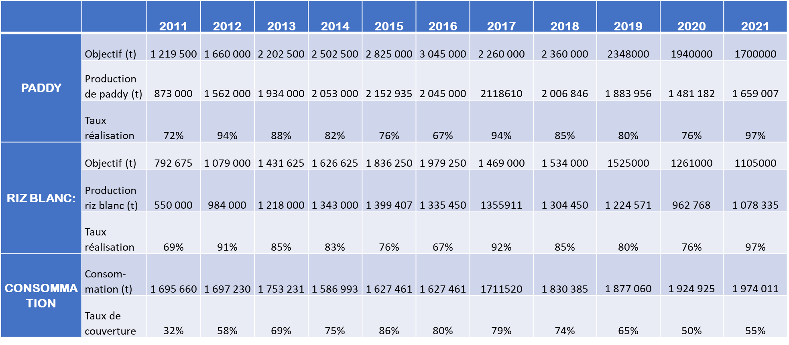
Snapshot of Côte d’Ivoire rice value chain
Source ADERIZ
Notes:
Among the main cereals, rice is the food most consumed by the Ivorian population with a growing demand (6% annual progression of the consumption and about 86kg/year/person). Despite its strengths in rice production, Côte d'Ivoire is in a situation of massive imports to meet the growing needs of domestic rice consumption. National rice production meets about half of demand (55%) for more than three decades despite the various rice sector development policies.
Analysis: the production has decreased past years, due to COVID 19 and climate changes, while the consumption has increased due to population growth and increase in the quantities consumed (from 70kg to 86 kg per person per year).

Slide 4
Côte d’Ivoire Government vision
VISION to meet all national consumption needs in good quality and competitive rice compared to imported rice, with the opportunity to build a security stock and export surplus production.
OBJECTIVE to ensure that Côte d'Ivoire is self-sufficient in rice production & consumption by 2025 and to make the country one of Africa's largest rice exporters by 2030.
GOAL/BUT: In order to achieve self-sufficiency in rice by 2030, the Government has set itself the goal of increasing local production and processing capacities.
Notes:
Despite the situation just described, Côte d'Ivoire has major assets that make it one of the best areas in Africa conducive to the development of rice growing:
More than 2 million hectares of lowland and full rice crops;
Abundant water resources with a national rainfall average of 1,500 mm of rainfall per year corresponding to more than 70 billion m3 per year;
Effective scientific research that provides high-yielding, disease-resistant and highly valued Ivorian varieties;
A very good macroeconomic and institutional environment to interest the private sector.
It is in front of such stakes that the Ivorian Government, taking into account the potentialities of the Country, adopted during the session of February 15, 2012 of the Council of Ministers, the National Strategy of Rice Development (NSRD) 2012-2020.

Slide 5
National Strategy of Rice Development
Stratégic Axis 1 :
Strengthen technical
support to production
Strategic Axis 2 :
Strengthen support to
valorization of local rice
(1) Comptetive whitened rice
(2) Whitened rice of good quality and quantity
Promotion a label of
RICE of CÔTE D’IVOIRE
Development of private sector particpation
Development of Public-private partnership
Support to processing
Support for the marketing of the local rice
(1) Improvement of yields
(2) Control of productions costs
Selected seed production
Water control
Support for the mechanization from production to posft-harvest operations
Adoption of efficient farming techniques
Research and development

Slide 6
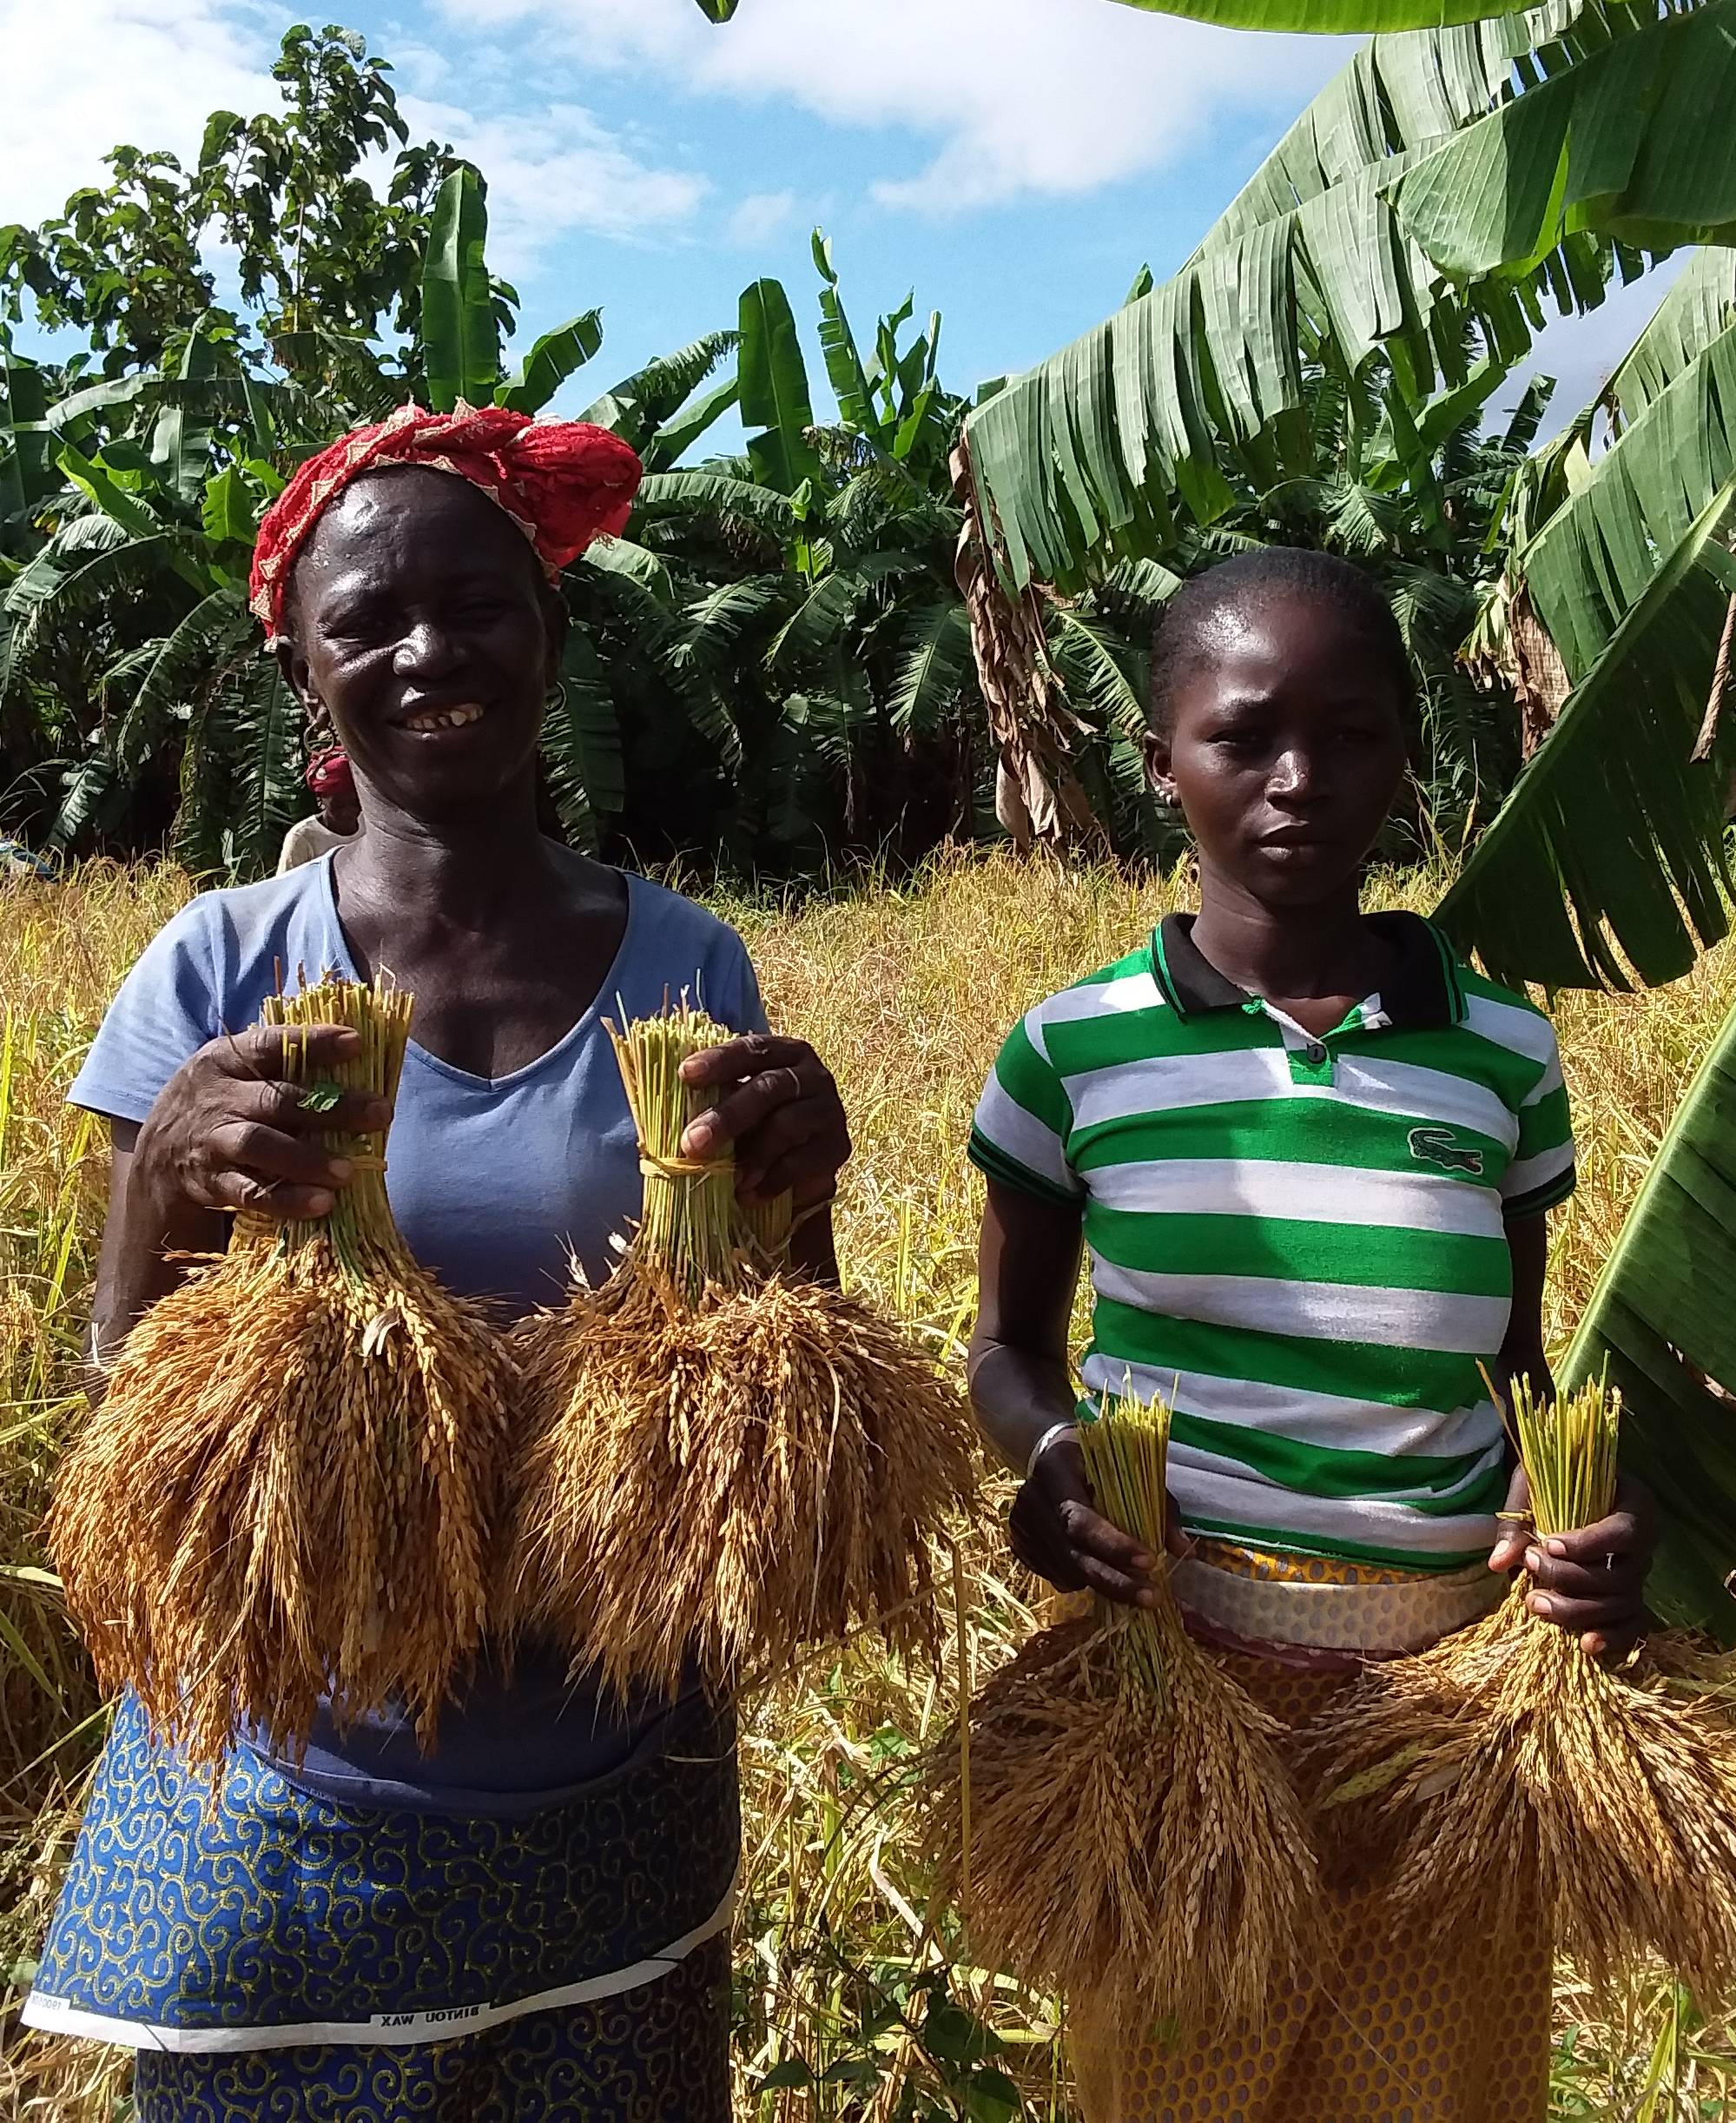
China-Africa Rice Value Chain Initiative
Launched in 2021 and funded by UNOSSC
Partners: ADERIZ, AfricaRice, China CoE, CERFAM, CICETE, WFP Côte d’Ivoire
Project objectives: 1) Capacity strengthening for rice local producers, 2) Knowledge and technology exchange between Chinese experts and Ivorian stakeholders, 3)Mechanization of rice production and post-harvest management with machines adapted to local context, 4)Setting up a demonstration sites for other producers in the region
Notes:
In this perspective, the Government of Côte d'Ivoire and its technical and financial partners, including WFP, have identified the rice sector as a priority actions to strengthen food system. It is also in this perspective that WFP, through its two centres of Excellences, the CERFAM and the Centre of Excellence of China, have initiated the China-Africa rice Value Chain Initiative.
The Rice Value Chain project was launched in 2021 and funded by UNOSSC (the United Nation Office for South South Cooperation) . Its objective is to strengthen the capacity of smallholder farmers involved in the rice value chain in Côte d’Ivoire through multi-diversified partnership and to facilitate South-South knowledge-sharing, mutual-learning, as well as technology and expertise transfer in advancing sustainable agriculture and rice value chain development.
Partners:
Aderiz: Agency for rice value chain development
Africa Rice: Research centre
CICETE: China international centre for economic and technical exchanges.
CoE: China Centre of Excellence
CERFAM: Regional Centre of Excellence against Hunger and Malnutrition

Slide 7
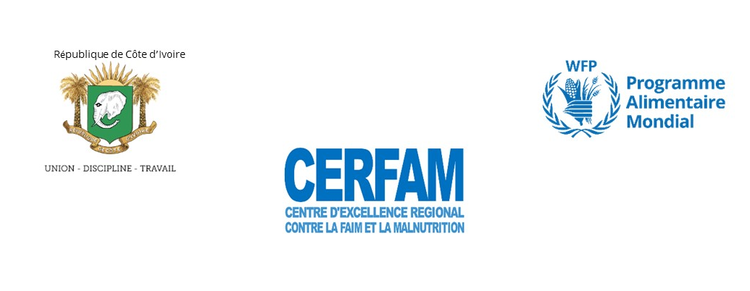
Project Timeline
Early June 2021
Policy Dialogue on rice value chain with African stakeholders
Mid October 2021
Webinar for exchange between stakeholders/experts in rice value chain
Late November 2021
On-site PHLM training for local stakeholders (Local communities, gov authorities, NGOs)
February 2022
Online training of local stakeholders by Chinese experts
Late April 2021
Visit to a demonstration site established by Chinese experts in CIV
Mid June 2021
Mission to Korhogo for field visit
Mid November 2021
Joint need assessment with AfricaRice and ADERIEZ
Early December 2021
Purchase and installation of harvest and post-harvest equipment
Mid March 2022
Distribution of quality seeds and inputs to target farmer groups
Notes:
On this slide you can see the main steps of the project:
1. Policy Dialogue on the rice value chain with African stakeholders: Aderiz and Africa Rice provided an overview of rice value chain in Côte d’Ivoire while China Centre of Excellence presented the opportunities which may be offered by China in terms of technology and technique.
2. Joint need assessment with AfricaRice and ADERIZ in mid-November: To identify target groups and their strengths, weakness and opportunities in rice production, processing and post-harvest management
3) In November Aderiz, acompagnied by WFP, organized an on-site training on post-harvest losses – such equipment is expected to reduce losses by 40%. Purchase and installation of equipment: two tractor, two threshers and two paddy huskers
4) In Feb online training by chinese experts experts focus on processing, storage and post-harvest management
5) distribution of inputs in march

Slide 8
Challenges in rice value chain in the North of Côte d’Ivoire
Rice production
Rice processing
Distribution
Other challenges
Undevelopped land
Lack of technical itinerary
Deficient upland technique
Mix of different rice variety
Long lean season (from Oct to May)
Insufficiency of raw materials
Difficulty to access to quality inputs
High level of impurity
Existing equipment not
adapted to the context
High soil erosion in some zones
High production cost
Insufficiency of raw materials
Little knowledge of agricultural calendar
Low quality of shelled rice
Poor water management
High level of crack
Non-adaptability of farming land
No weather forecasting
Lack of quality seeding system
Rice varieties with low yield
Notes:
At the very start of the project the team conducted a diagnosis of the rice sector. The aim of the diagnosis was to determine the practical modalities for the implementation of activities for the improvement of the rice value chain within groups of women farmers in northern Côte d'Ivoire.
The four 4 villages targeted by the project were visited (Maramana, Kantara, Pitiangomon and Nankaha). Challenges identified are presented here under various stage of the rice value chain. (explain)
Despite these challenges, strengths were also identified, in particular the potential of available surfaces, the existence of a variety that has adapted to the conditions on the production side and the existence of a demand or market for the distribution.

Slide 9
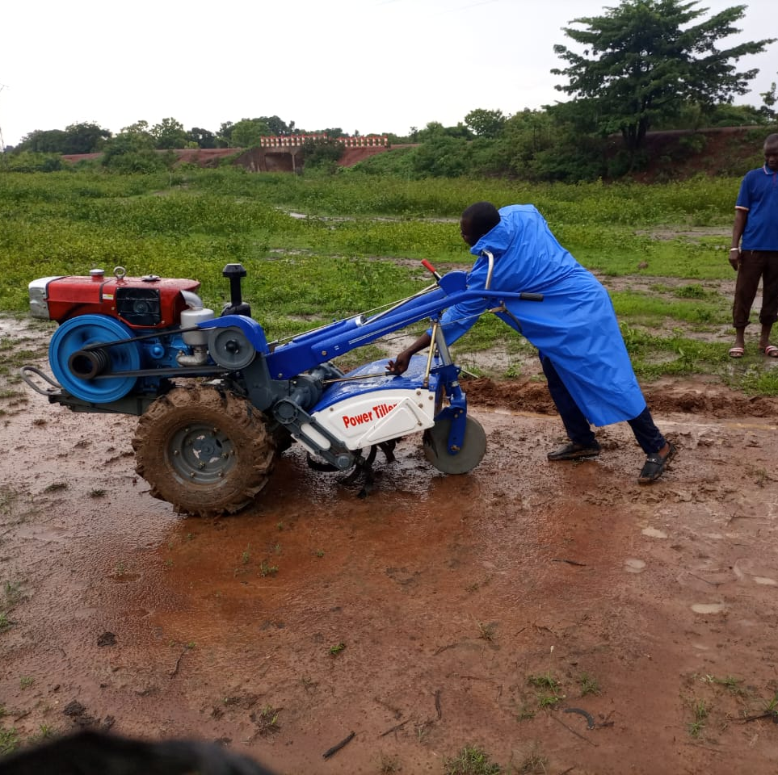
Achievements
Training on rice post-harvest management
Supply of equipment
Supply of agricultural inputs
Construction of a drying area
Notes:
Training on rice post-harvest management (harvest and post-harvest operation, use of equipment)
Supply of production and post-harvest management equipment (2 threshers, 2 tillers, 2 shellers)
Supply of agricultural inputs
Construction of a drying area

Slide 10
Positive effects
reduction of the drudgery of work
improved grain quality
improved knowledge in production and post-harvest management
supply of local products (rice) to school canteens
Notes:
reduction of the drudgery of work thanks to mechanisation
improved grain quality (less BROKEN rice after processing)
improved knowledge of production and post-harvest management
supply of local products (rice) to school canteens

Slide 11
Opportunities
Continue similar initiatives aimed at increasing production and modernizing the rice value chain
Create demonstration site to transfer good practices
Improve labour productivity through mechanization
Improve the employability of young people
Advanced irrigation system enabling production during lean season
The development of inclusive value chains
Improve access to markets
Link with other initiatives such as rice fortification
Notes:
Considering what has been said before: the consumer preferences for rice, the potential of the land, and the government vision of self sufficiency in rice production, Continue similar initiatives aimed at increasing production and modernizing the rice value chain to reduce dependence on imports and enhance food security.
There is land available and farmers groups are willing to cultivate rice.
Create demonstration site to transfer good practices and showcase advanced equipment for rice production, processing and post-harvest management
Improve labour productivity through mechanization
Improve the employability of young people by providing better employment opportunities and thus reduce rural-urban migration
Advanced irrigation system enabling production during lean season (potential for two production cycles per year).
The development of inclusive value chains contributes to a substantial decrease in the poverty rate, hence the concept of changing lives.
Improve access to markets
The link with other initiatives such as rice fortification

Slide 12
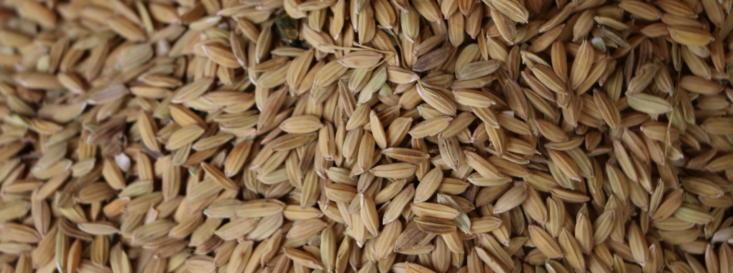
Thank you for your attention

