Slide 1
Technology and equipment of smallholder farm storage for paddy
Yue Li
Senior Engineer
2022.12.21
Sinograin Chengdu Storage Research Institute Co. Ltd

Slide 2
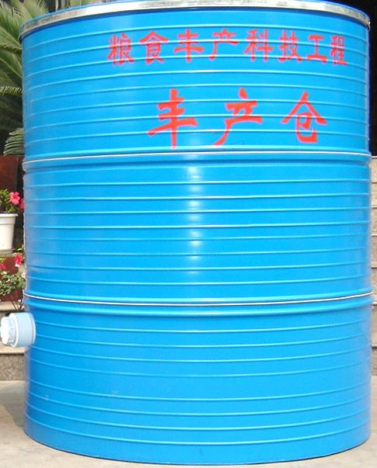
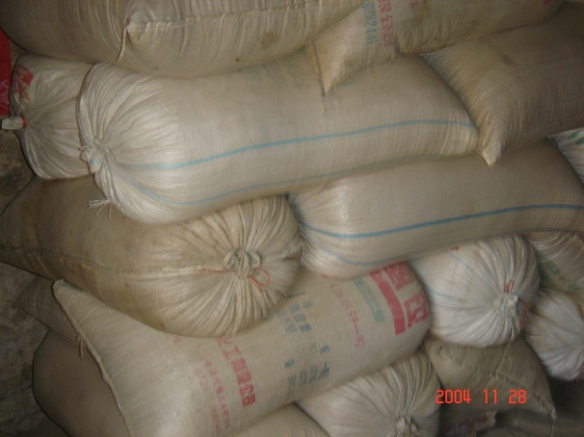
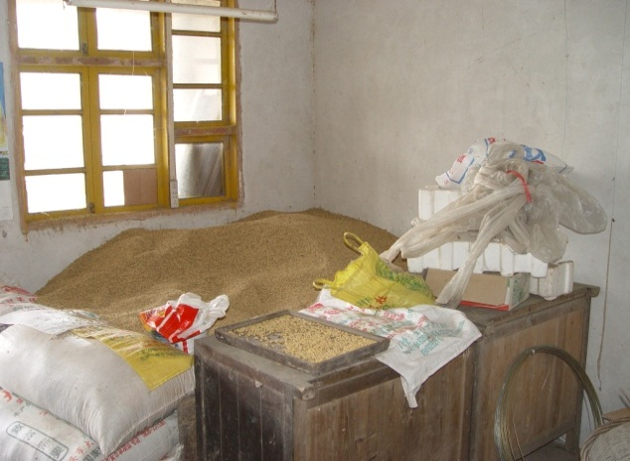
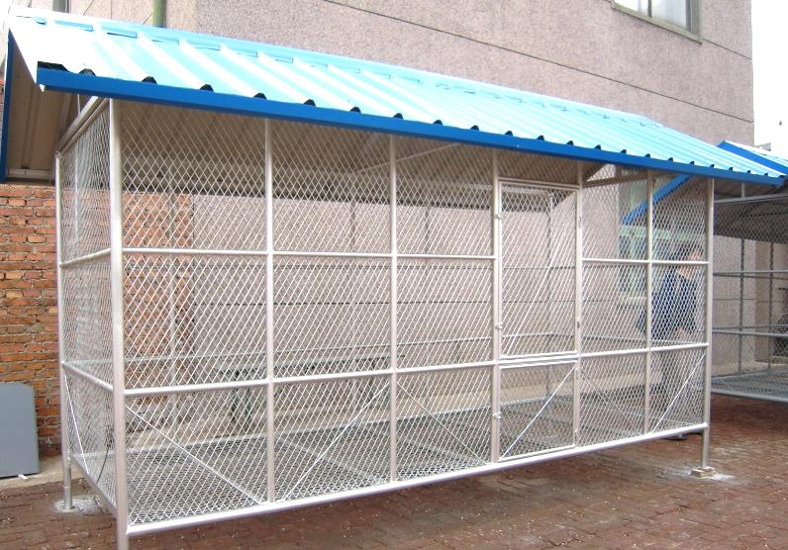
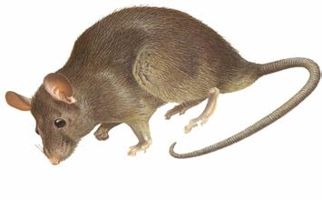
The rate of farmers’ grain storage loss
in China is around 8%.
New types of granaries
Loss caused by mice takes up about 50%

Slide 3
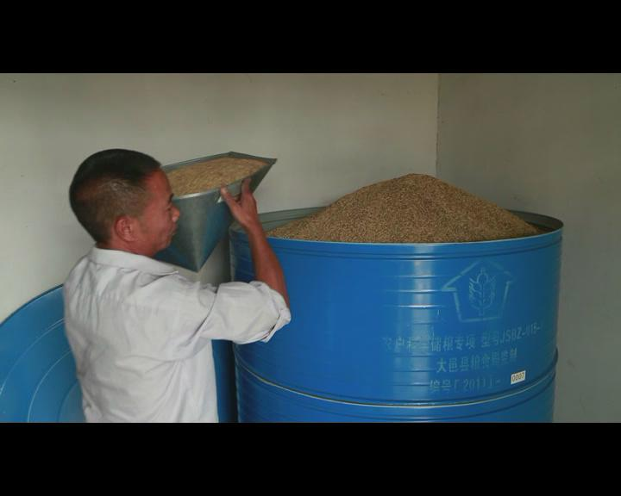
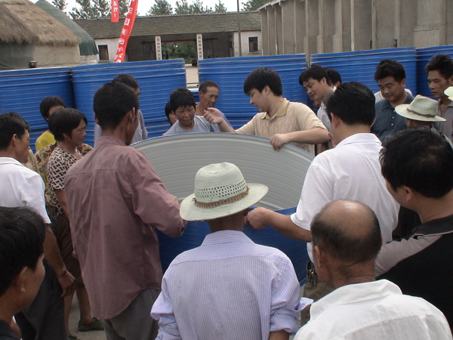
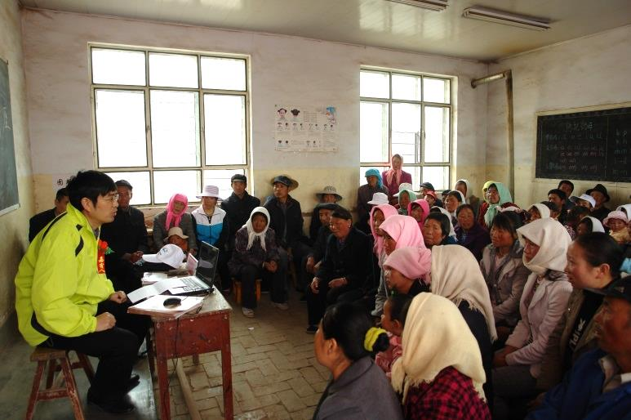
Effective technical training and extensive popular science publicity have promoted the overall level of farmers ’ scientific grain storage.

Slide 4
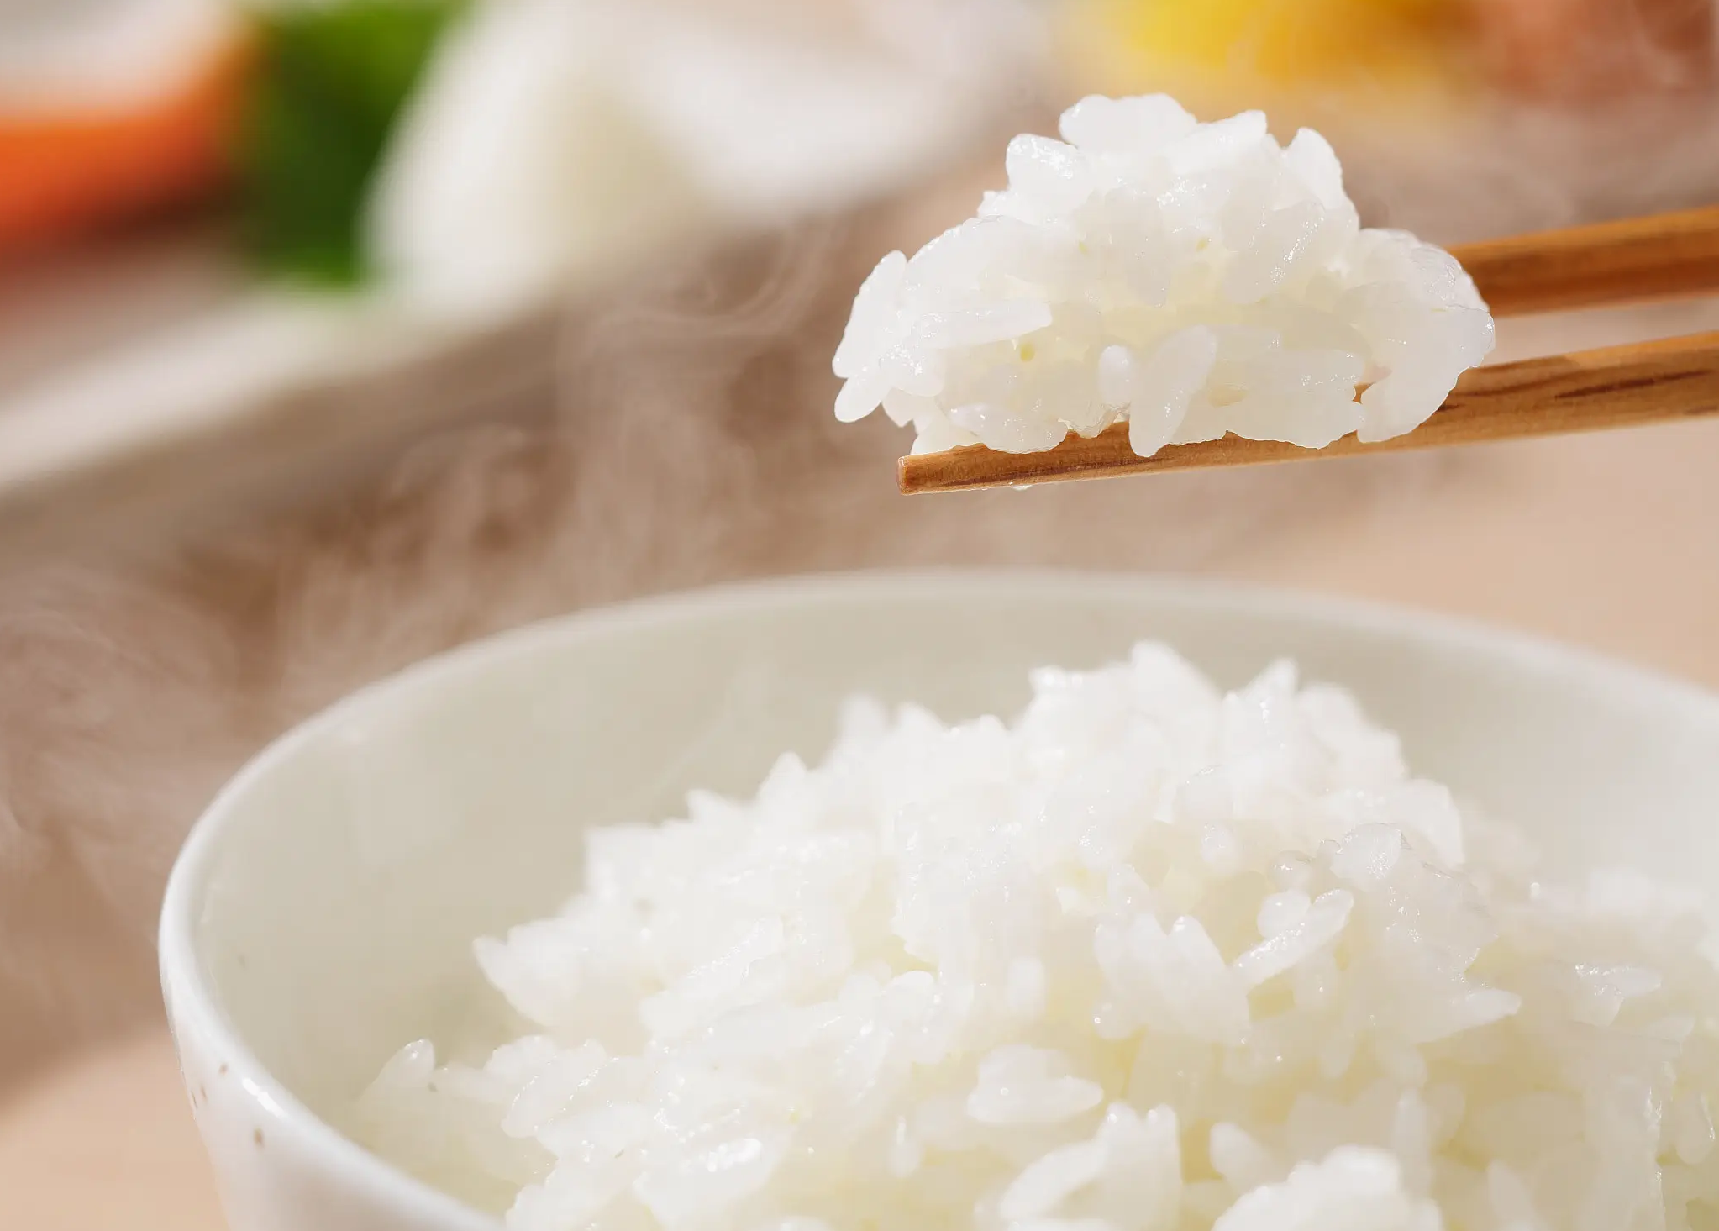
Special achievements of farmers' scientific grain storage
7.46 million
Demonstration farming households
Farmers' contribution
8%→<2%
The loss reduction rate of demonstration farmers decreased significantly
central and local goverment contribution
Pre-painted Steel Farm Bin

Slide 5
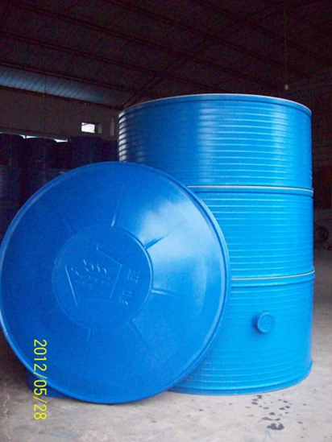
Pre-painted Steel Farm Bin
0.4mm thick pre-painted steel sheet
Volume 1.5m³ to store about 1 ton grains
Suitable for storage of paddy with safe water content

Slide 6
General requirment of smallholder farm storage for paddy
Characteristics
Caution
Suitable for storage of paddy with safe water content
Facilitate large-scale and assembly line processing
Collapsible
Easy to clean
Don't overlay more than 3 rings.
The moisture proof pad in bottom.
Don't put heavy bag on silo.
Use indoor only.

Slide 7
Requirment For Paddy
Requirement For Barn & Equipment
Keep space tidy
within safe water content
Separation
Dry
silo put in ventilating and dry environment.
keep surroundings tidy.
Grains with pests separated from none-pests grains.
Newly harvested grains separated from ageing grains.
Well-filled
Harvested after Well-filled
Well-filled
Clean
Clean off impurity

Slide 8
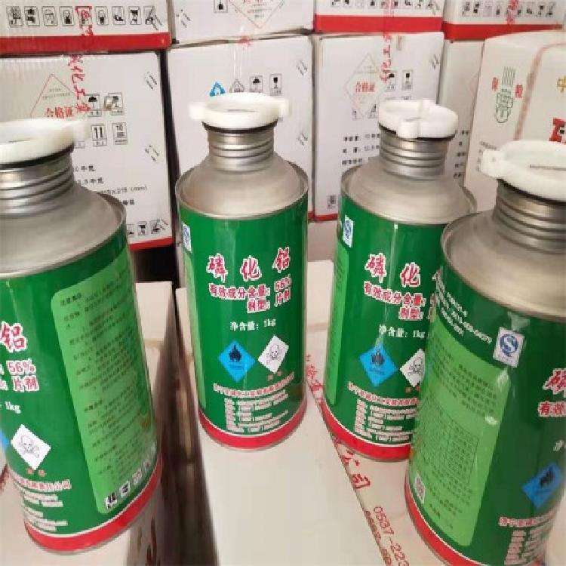
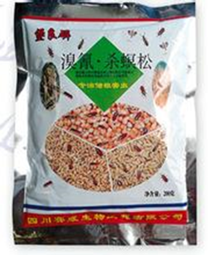
Caution
Don't use PH₃ for farm storage
Sustained release of microcapsules
Broad spectrum
long term of validity
High efficiency and low toxicity
Without security threat
Plant sources are used to prevent insects, such as prickly ash, tree leaves, calamus and wormwood, etc.

Slide 9
Thank You
SINOGRAIN Chengdu Storage Research Institute Co. Ltd
Building 32, No. 239, Guangfu Road, Qingyang District, Chengdu, Sichuan
Sharing for Learning

