Slide 1


西部小农电商发展
E-COMMERCE DEVELOPMENT OF SMALL FARMERS IN WESTERN CHINA
数字化经济与农业科技结合的思考
THOUGHTS ON THE COMBINATION OF DIGITAL ECONOMY AND AGRICULTURAL SCIENCE AND TECHNOLOGY
陈其辉 Chen Qihui
陕西杨凌农业高新科技示范区电子商务办公室副主任
DEPUTY DIRECTOR OF E-COMMERCE OFFICE OF
YANGLING AGRICULTURAL HIGH TECH DEMONSTRATION ZONE, SHAANXI

Slide 2

CONTENTS
数字化营销为小农经济带来的实惠
benefits brought by digital marketing.
01
数字化供应链降低营销成本
digital supply chain reduces marketing cost.
02
数字化经济与农业科技结合助推优品优价
combination of digital economy and agricultural science and technologyboost premium products and prices.
03

Slide 3
01
数字化营销为小农经济带来的实惠
BENEFITS BROUGHT BY DIGITAL MARKETING

Slide 4

让我们从一颗苹果开始！
Let's start with an apple!

Slide 5


1.0RMB/1kg
10.6RMB/1kg
线下销售
Offline sales
互联网销售
Internet sales
解决卖难
SOLVE THE DIFFICULTY OF SELLING
“2022 科技赋能乡村发展国际论坛“
Sci-Tech Empowering Rural Transformation Thematic Study and Knowledge Sharing

Slide 6
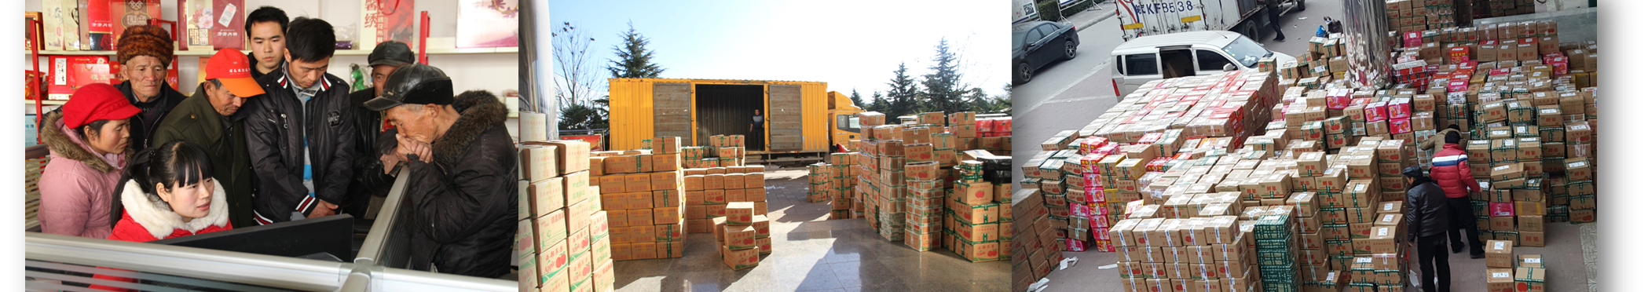
打破市场信息不对称原则
AGRICULTURAL E-COMMERCE BREAKS THE PRINCIPLE OF MARKET INFORMATION ASYMMETRY
纯生产者转变为生产+销售
CHANGE FROM PURE PRODUCER TO PRODUCTION+SALES
“2022 科技赋能乡村发展国际论坛“
Sci-Tech Empowering Rural Transformation Thematic Study and Knowledge Sharing

Slide 7
02
数字化供应链降低成本
DIGITAL SUPPLY CHAIN REDUCES COSTS

Slide 8
专业团队入场
ENTRANCE OF PROFESSIONAL TEAM
小农瓶颈出现
SMALL FARMER BOTTLENECK APPEARS
资金充沛
Abundant funds
供应链成熟
Mature supply chain
稳定渠道
Stable channel
综合成本低
Low comprehensive cost
规模小
No scale
无供应链
No supply chain
渠道不稳定
Unstable channel
成本高
High cost

Slide 9



数字化供应链
DIGITAL SUPPLY CHAIN
仓储
STORAGE
物流
LOGISTICS
包装
PACKING

Slide 10
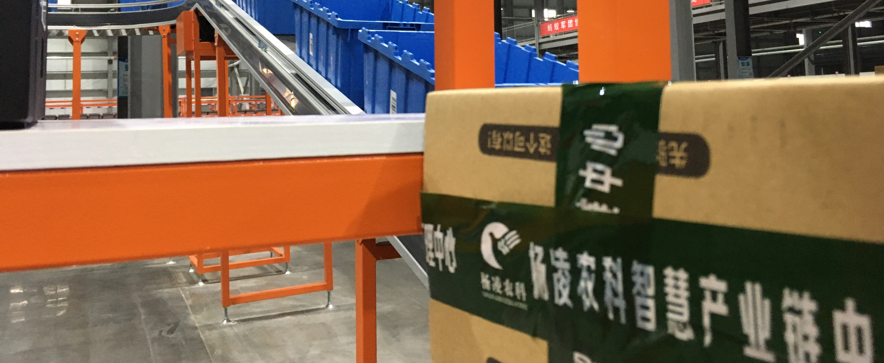
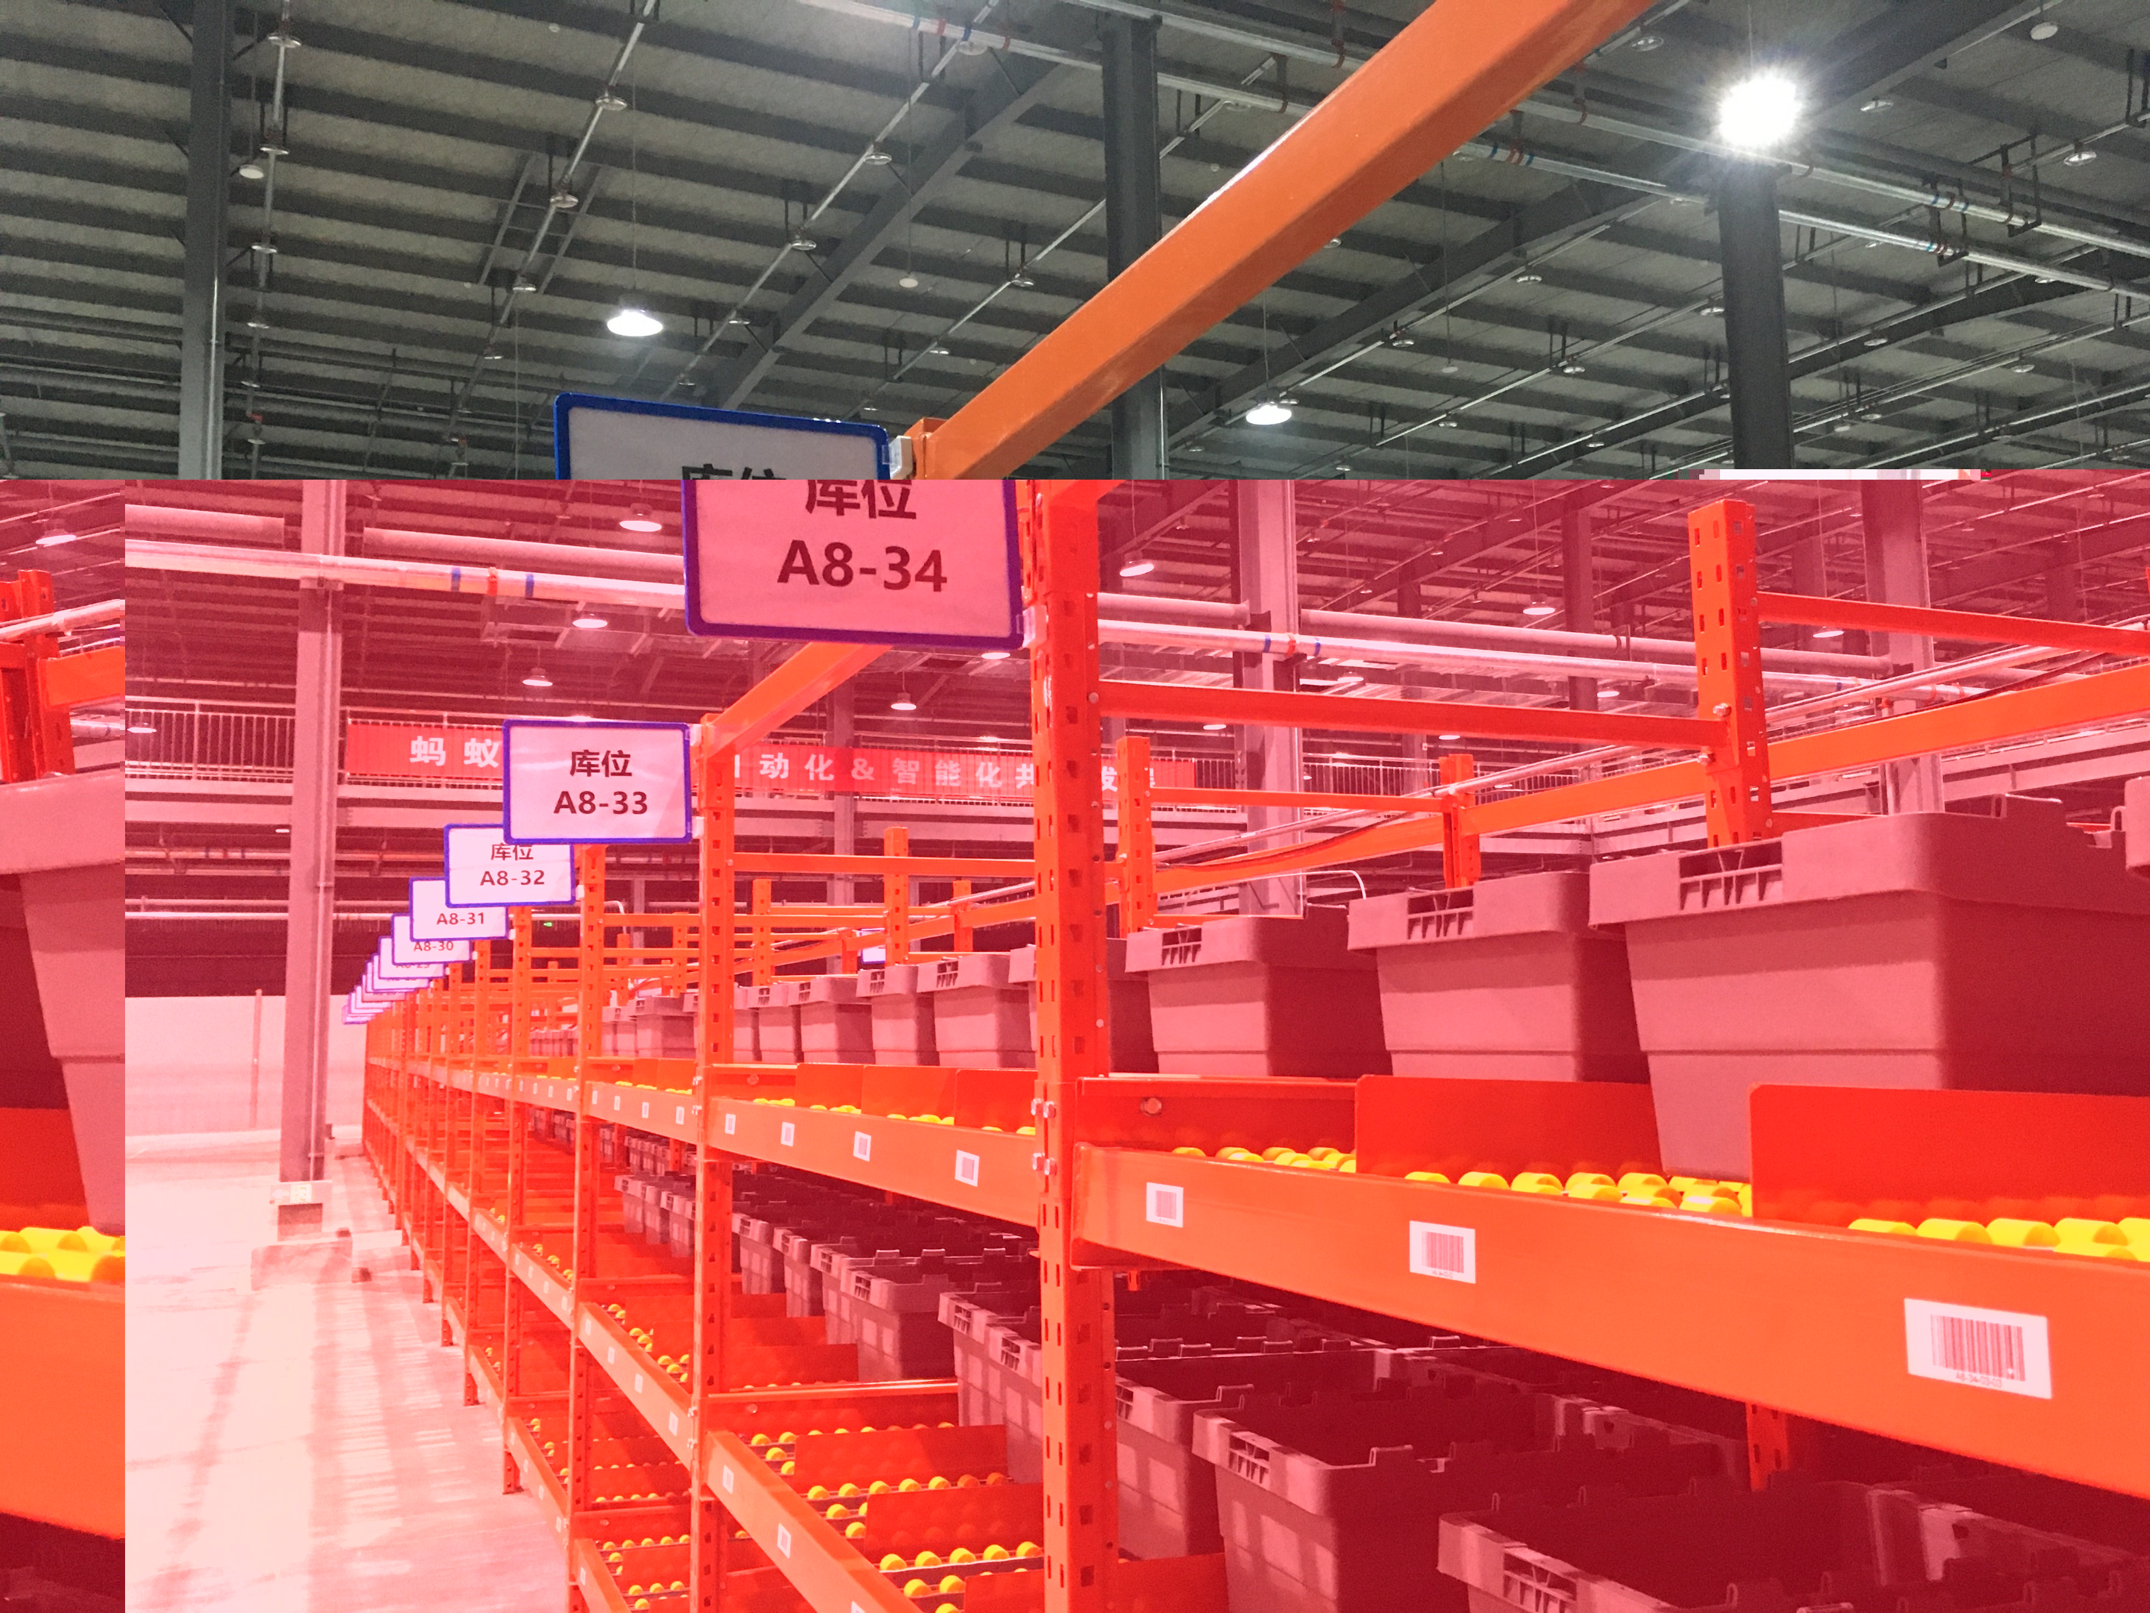
培育龙头专业企业支撑供应链
小农经济规模化
Cultivate leading professional enterprises to support supply chainScaling of small-scale peasant economy

Slide 11
03
数字化经济与农业科技结合助推优品优价
COMBINATION OF DIGITAL ECONOMY AND
AGRICULTURAL SCIENCE AND
TECHNOLOGYBOOST PREMIUM PRODUCTS AND PRICES

Slide 12
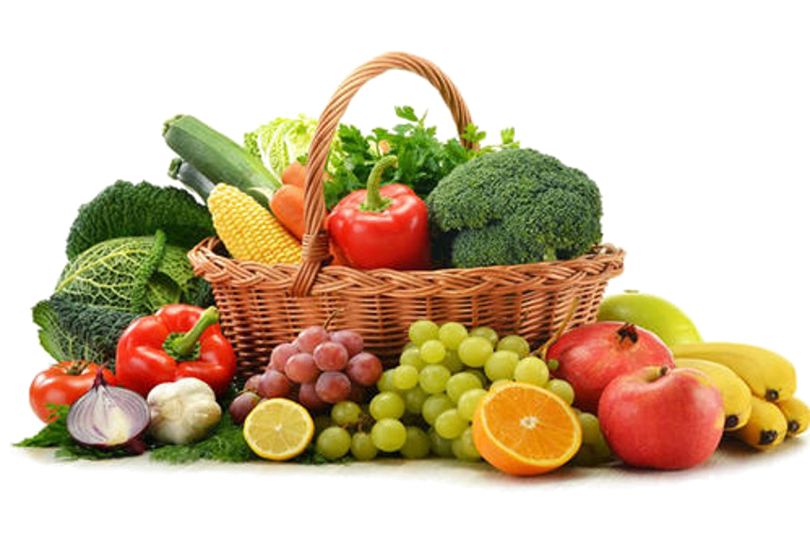
流量
FLOW
好产品
GOOD PRODUCT
转
化
率
Conversion rate
微信、垂直、跨境、直播、团购、微博、分销、私域、团购、社群
WECHAT, LIVE BROADCAST, GROUP PURCHASE, MICROBLOG, DISTRIBUTION, PRIVATE DOMAIN, GROUP PURCHASE, COMMUNITY

Slide 13
为什么这些地方的苹果市场大受欢迎？
Why are the apple markets in these places so popular?
静宁苹果 Jingning Apple
烟台苹果 Yantai apple
阿克苏苹果 Aksu apple
洛川苹果 Luochuan Apple
农业优生区 LAND GENE
土壤、气候、温度、日照
Soil, climate, temperature, sunshine

Slide 14
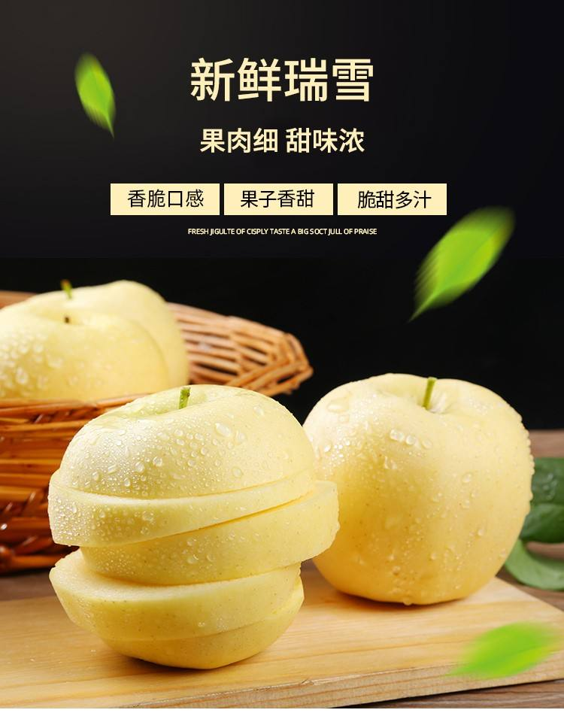
15RMB/1kg
7RMB/1kg
瑞雪苹果
Offline sales
红富士
Internet sales
优质品种 LAND GENE
土壤、气候、温度、日照
Soil, climate, temperature, sunshine

Slide 15

农业技术 AGRONOMIC GENE
滴灌技术 drip irrigation
矮化种植技术 Dwarfing planting technology
选果生产线 Fruit selection production line
精细化管理 Refined management

Slide 16
良好农业规范
GOOD AGRICULTURAL PRACTICE
标准化
STANDARDIZATION
规模化
SCALE
品牌化
BRANDING
土地基因
Land gene
种子基因
Seed gene
农艺基因
Agronomic gene
严选标准
Strict selection criteria

Slide 17
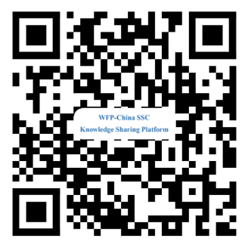
西部小农电商发展
E-COMMERCE DEVELOPMENT OF SMALL FARMERS IN WESTERN CHINA
数字化经济与农业科技结合的思考
THOUGHTS ON THE COMBINATION OF DIGITAL ECONOMY AND AGRICULTURAL SCIENCE AND TECHNOLOGY
Thank You
陈其辉 Chen Qihui
陕西杨凌农业高新科技示范区电子商务办公室副主任
DEPUTY DIRECTOR OF E-COMMERCE OFFICE OF
YANGLING AGRICULTURAL HIGH TECH DEMONSTRATION ZONE, SHAANXI
Sharing for Learning

