Slide 1
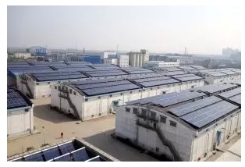
“Warehouse Roof Sunshine Project”
Photovoltaic Generation System
HEBEI PINGLE FLOUR MACHINERY GROUP CO., LTD.
Liu Xiao

Slide 2
CONTENTS
Back Ground
Functional features
01
02
Construction Plan
Application
03
04

Slide 3
01
Back Ground

Slide 4
Outline of the 13th Five Year Development Plan for the Grain Industry
During the 13th Five Year Plan period, we will develop a new green and environment-friendly grain industry, make full use of the resources and conditions of grain depot facilities, guide social investment, and support grain enterprises to accelerate the implementation of the demonstration of the "warehouse roof sunshine project", so as to achieve an installed capacity of 1GW by 2020.
"Warehouse roof sunshine project", refers to laying photovoltaic power generation panels on the top of grain warehouse to promote green low temperature grain storage, maintain grain quality and improve economic benefits.

Slide 5
02
Functional Features

Slide 6
01
Make use of photovoltaic energy to build a "zero energy consumption" grain warehouse
Photovoltaic power generation on the roof of the grain warehouse can be used for daily purchase, storage, and out of the warehouse, and it needs to provide necessary power supply for drying, transportation, ventilation, cooling, and office work; it can also provide power supply for grain processing equipment.

Slide 7
02
Photoelectric building integration
fashionable and beautiful appearance
The construction of the "warehouse roof sunshine project" not only keeps the architectural style of traditional tiles, but also increases the visual beauty of the building, better realizes the integration of photoelectric buildings, changes the traditional architectural style of grain warehouses, integrates modern elements of new industrialization and urbanization, beautifies the overall architectural image, improves the ecological civilization environment, and makes the overall appearance fashionable and beautiful.

Slide 8
03
Create "Constancy Low Temperature" Standard Warehouse
After the photovoltaic roof is completed, it can effectively reduce the direct sunlight on the original roof and reduce the heat accumulation and transmission.
In particular, after the transformation of the photovoltaic warehouse roof, a new thermal insulation layer is added between the photovoltaic roof and the original roof, and the thermal insulation effect of the roof is significantly improved.

Slide 9
03
Create "Constancy Low Temperature" Standard Warehouse
The actual warehouse reconstruction test in the direct warehouse shows that the temperature of the original roof insulation layer is reduced by about 12~14 ℃.
The warehouse temperature is reduced by about 6~7 ℃ on a year-on-year basis.
The average grain temperature in the upper layer is reduced by 2~3 ℃ on a year-on-year basis.

Slide 10
03
Construction Plan

Slide 11
01
Overall design idea
The "Warehouse Roof Sunshine Project" is designed in accordance with the operation mode of "self use, residual power grid connection, nearby consumption and power grid regulation", highlighting the function of driving low-temperature grain storage, achieving the "multi integration" effect and maximizing economic and social benefits.

Slide 12
02
System construction mode
Photovoltaic power station includes warehouse roof, photovoltaic modules, inverter equipment, lightning protection facilities, meteorological station, monitoring system, etc. At present, photovoltaic modules have various forms, and we mainly use photovoltaic ceramic tiles and photovoltaic panels; In terms of installation form, the roof is paved in the south and the roof is paved in the north and south; At the same time, cooperate with information construction.

Slide 13
04
Application in Grain Processing

Slide 14
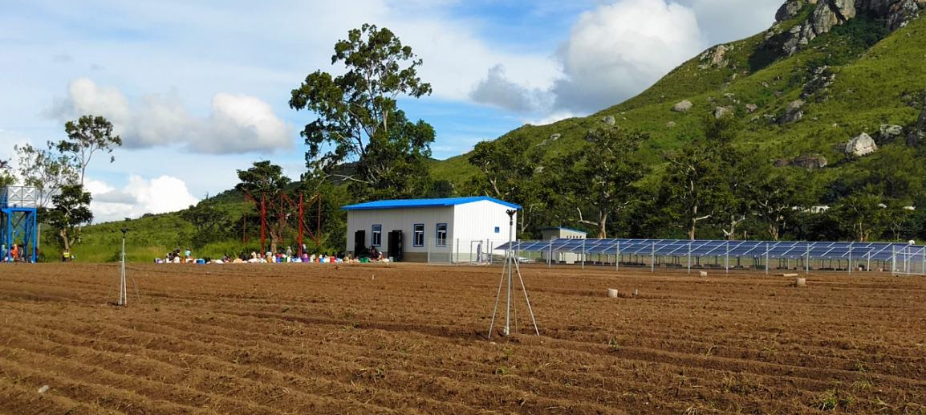
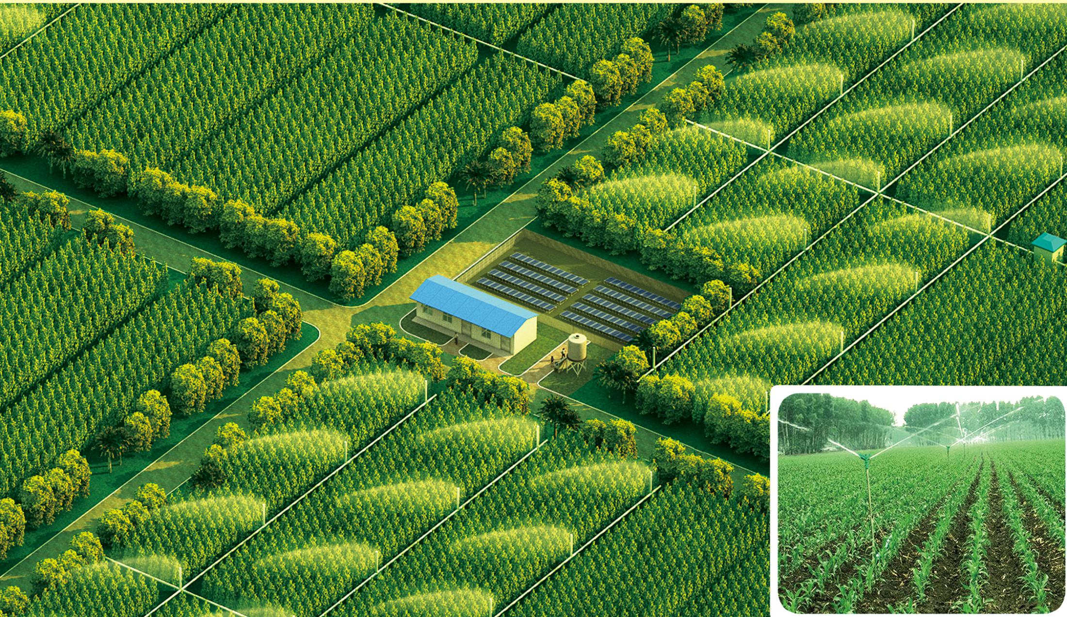
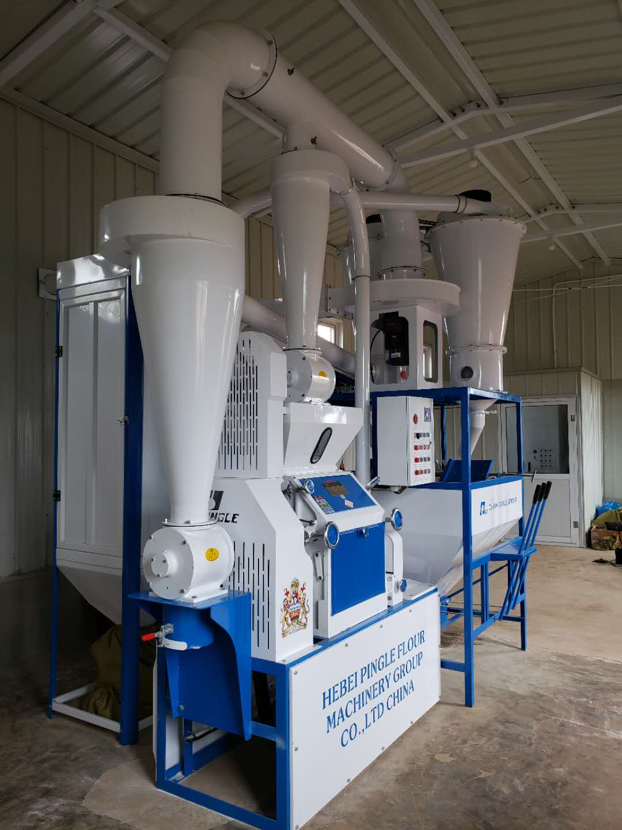
1
Malawi Solar Powered Irrigation and Maize Mill Project
0
1. A Solar Photovoltaic Power Generation system which will supply power required.
2. An irrigation system with a fixed sprinkler adequate for an area of 10 hectares.
3. A Water Supply System comprising of a 5000 litre water tank that can supply the local community
4. A Maize Flour Milling Plant with a processing capacity of 250 kilogrammes per hour.

Slide 15
Thank You
Sharing for Learning

