Slide 1
Rice Policy in China
Binjian Yan
Nanjing Agricultural University

Slide 2
CONTENTS
Background
Agricultural Policies
01
02
Cost and profit of rice production
Conclusion
03
04

Slide 3
Background
Three stages of grain(rice) policies
1953-1984: State monopoly of the purchase and marketing of grain
1985-2003: market-oriented reform
1985-1997: double-track pricing system
1997-2003: deepening the market reform
2004- now: market-based allocation with price support

Slide 4
Food security problem after market reform
Sharp decrease of rice production from 1997 to 2003
Low profit and cost-profit ratio during this period
Profit: 74.8 yuan per mu in 2003
Cost-profit ratio: 17.3% in 2003

Slide 5
Agricultural Policies in China
Producer Support
Market price support (rice,wheat)
Payment based on fixed area/yield/production, producer subsidies (corn, soybean, cotton, rice)
Payment based on input use
Other payments
General Services Support
Agricultural knowledge and innovation system
Inspection and control
Development and maintenance of infrastructure
Marketing and Promotion
Cost of public stockholding

Slide 6
Market price support of rice

Slide 7
Subsidies of rice in husk
Payments are paid based on 85% of the base level of production (“Blue box”measure).
The subsidy amount is subject to the limit which is calculated according to 85% of the average annul production during the base period (2016-2018).
The policy also covers the reduction of the rice planting in heavy metal contaminated areas and the planting with well irrigation in cold region.
CNY 18.685 billion in 2020

Slide 8
Payment based on input use
Insurance fees subsidy for crops and livestock commodities;
Mechanization of farming;
Farmland irrigation construction;
Soil conservation;
Subsidy for production base construction of agricultural industrialization;
Other Payment
Stabilize farmers income payments
Payments for agricultural structural adjustment

Slide 9
General Services Support
Agricultural knowledge and innovation system
Research and development
Agricultural extension and advisory services
Inspection and control
Pest and disease inspection and control
Development and maintenance of infrastructure
Marketing and Promotion
Cost of public stockholding
Public stockholding for food security purposes

Slide 10
Cost and Profit of Rice Production

Slide 11
Conclusion
Rice production should be well supported in market environment.
Market price support had a significant impact in short run, but it should not be deviated from market price in the long run.
Subsidy will play increasing important role as government budget allowed, and needs to well design.
The general service supports, such as research and development, agricultural extension, are fundamental for rice production.

Slide 12
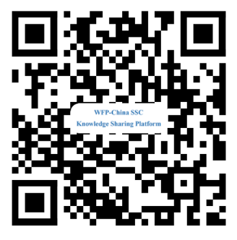
Thank You
Sharing for Learning

