Slide 1
2022 International Forum on Technology Empowering Rural Development
从乡村振兴到共同富裕：以技术为路径
From Rural Revitalisation to Common Prosperity:
Technology as the means of achieving goals
Robert Walker
2022/11/25

Slide 2
中国：发展与消除绝对贫困
Development, and the eradication of absolute poverty
动员Mobilisation
政策
目标
Policy
targets
强大的政治领导力Strong political leadership
精确
定位
Precision
targeting
企业对企业
Firm to firm
东部的城市到西部的村庄 Cities to W. villages
1986CE
经济增长
Economic growth
基础设施发展
Infrastructure development
国家级
National
空间定位
Spatial targeting
人力资本投资
Human capital investment
省级
Provincial
乡镇
Township
电子商务
E-commerce
社会救助
Social assistance
2021CE
村
Village
企业界
Entrepreneurialism
社会救助
Social assistance

Slide 3

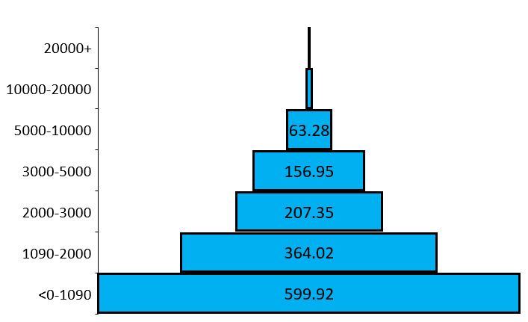
中国：走向共同富裕
Towards common prosperity
Monthly per capita household income (yuan)
家庭月人均收入（元）
2019
0.7
7.84
2035
2050
百万人
Millions of people

Slide 4
中国：走向共同富裕
Towards common prosperity
收入中位数
Median income
¥72.7/天day US$17.71/天day
高收入国家
High Income
¥100.7/天day
US$24.55/天day
> 8 亿人
> 800 million people
2019
3.48亿人
348 million people
中高收入国家
Upper Middle-Income
¥28.1/天day
US$6.85/天day
2035
4200万人
42 million people
2050
中低收入国家
Lower Middle-Income Countries
¥15/天day (2019) US$3.65/天day (2017 PPP)
收入 Income

Slide 5
农村经济的科技生态
Technological ecology of the rural economy
Technological ecology of the rural economy
农村生活水平
Rural living standards
技术
Technology
基础设施
Infrastructure
绿色能源
Green energy
农业生产Farm production
农产品加工Farm processing
物理型基础设施Physical infrastructure
传统的 Traditional
技术创新Technological innovation
智慧旅游‘Smart Tourism’
本地商业Local commerce
社会型基础设施Social infrastructure
现代的 Modern
数字金融Digital finance
工业搬迁和初创企业Industrial relocation & start-ups
汇款
Urban remittances
政策型基础设施Policy infrastructure
电子商务
E-commerce
城市生活水平
Urban living standards

Slide 6
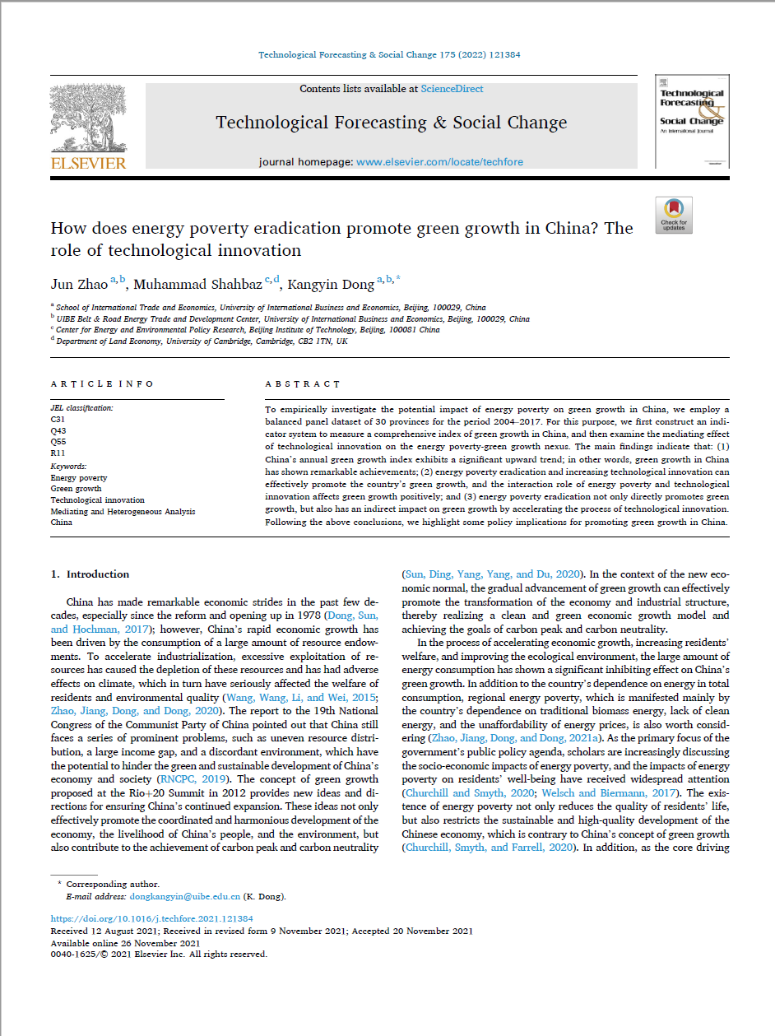
绿色能源
2021
Green energy
消除能源贫困:
  Eradicating energy poverty:
  直接推动绿色增长
    Directly promotes green growth
  通过激励技术创新间 接促进绿色增长
    Indirectly promotes green growth by stimulating technological innovation.

Slide 7
绿色能源
Green energy
直接作用Direct effect
减少能源贫困
Reduce energy poverty
间接影响Indirect effect
使用清洁能源
Consume
clean energy
完备的能源管理
Complete
energy management
负担能力和效率
Affordability & efficiency
技术创新Technological innovation
能源供应 Availability of energy
降低生产成本
Reduced production costs
升级用能设备
Upgraded energy-using equipment
提高生产力
Increased productivity
绿色增长
Green growth
经济增长Economic growth
民生
People’s livelihood
资源环境Resource and environment

Slide 8
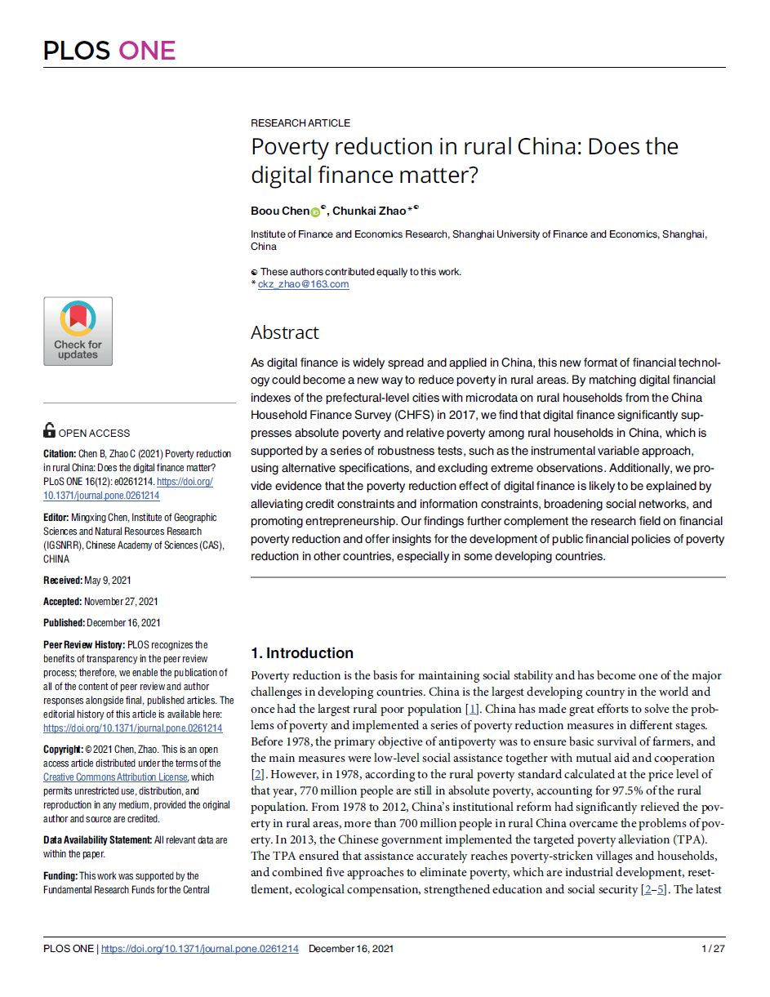
数字金融
2022
Digital finance
数字金融每增加一个单位：
  Each unit increase in digital finance
  农村家庭绝对贫困率降低10%
    Decreases the absolute poverty rate of rural households by 10%
  农村家庭相对贫困率降低18%
    Decreases the relative poverty rate of rural households by 18%
  将高收入省份的绝对贫困人口减少 10%
    Decreases absolute poverty in high income provinces by 10%
  将低收入省份的绝对贫困人口减少 20%
    Decreases the absolute poverty in low-income provinces by 20%
2021

Slide 9
数字金融
Digital finance
信用约束Credit constraints
老人
The Elderly
绝对贫困Absolute
Poverty
受教育程度低
Less educated
信息约束Information constraints
社会弱势群体
Socially disadvantaged
数字金融
Digital finance
社交网络Social networks
社会资本Social capital
创业活动Entrepreneurial activities

Slide 10
数字金融
Digital finance
信用约束Credit constraints
老人
The Elderly
绝对贫困Absolute
Poverty
受教育程度低
Less educated
信息约束Information constraints
社会弱势群体
Socially disadvantaged
数字金融
Digital finance
老人
The Elderly
社交网络Social networks
社会资本Social capital
相对贫困
Relative
Poverty
受教育程度低
Less educated
创业活动Entrepreneurial activities
社会弱势群体
Socially disadvantaged

Slide 11
数字金融
2022
Digital finance
数字金融每增加一个单位：
  Each unit increase in digital finance
  农村家庭绝对贫困率降低10%
    Decreases the absolute poverty rate of rural households by 10%
  农村家庭相对贫困率降低18%
    Decreases the relative poverty rate of rural households by 18%
  将低收入省份的绝对贫困人口减少 20%
    Decreases the absolute poverty in low-income provinces by 20%
  将高收入省份的绝对贫困人口减少 10%
    Decreases absolute poverty in high income provinces by 10%
2021

Slide 12
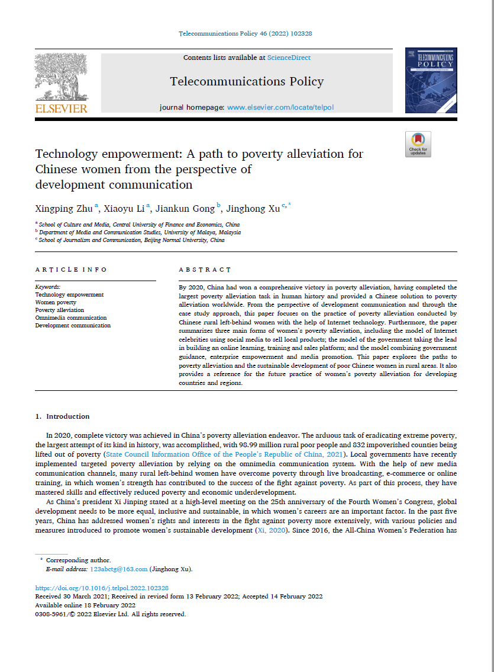
电子商务
2022
E-commerce
农村地区的互联网普及率仍远低于城市地区
  Internet penetration is still much less in rural areas than in urban ones
农村电子商务显着提高了村民的平均收入
  Rural e-commerce significantly increases average village incomes.
增幅保留
  The increase is retained
但3年后贫困村村民收入并没有明显增加
  But there is no significant increase in villagers’ incomes living in poverty villages after 3 years
2021

Slide 13
电子商务
E-commerce
农村地区的互联网普及率仍远低于城市地区
  Internet penetration is still much less in rural areas than in urban ones
农村电子商务显着提高了村民的平均收入
  Rural e-commerce significantly increases average village incomes.
增幅保留
  The increase is retained
但3年后贫困村村民收入并没有明显增加
  But there is no significant increase in villagers’ incomes living in poverty villages after 3 years
互联网普及率
城市
农村

Slide 14
电子商务
E-commerce
农村地区的互联网普及率仍远低于城市地区
  Internet penetration is still much less in rural areas than in urban ones
全国农村电子商务综合示范项目
National Rural E-commerce Comprehensive Demonstration Project.
农村电子商务显着提高了村民的平均收入
  Rural e-commerce significantly increases average village incomes.
增幅保留
  The increase is retained
但3年后贫困村村民收入并没有明显增加
  But there is no significant increase in villagers’ incomes living in poverty villages after 3 years
全国农村电子商务综合示范工程影响
Impact of the National Rural E-commerce Comprehensive Demonstration Project.
对人均可支配收入的影响
所有村庄
All villages
相对贫困村
Relative poverty villages
不重要
Not significant
第一年
第二年
第三年
第四年
第五年

Slide 15
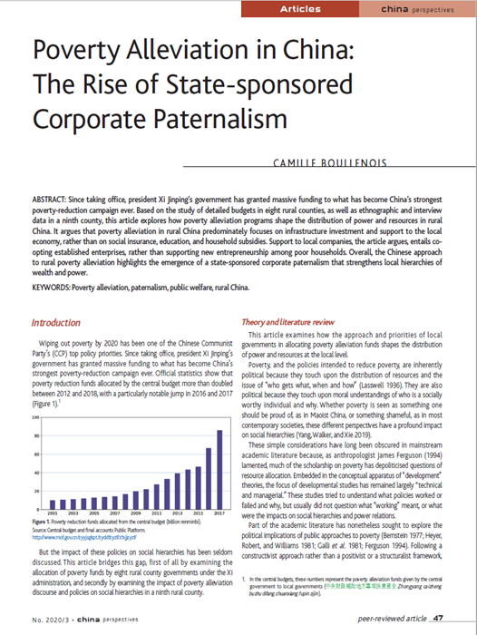
社会型基础设施
Social infrastructure
2020
产业扶贫
Industry poverty alleviation schemes
公司和企业家……在扶贫中发挥积极作用
  Companies and company owners…play an active role in poverty alleviation.
可能解决绝对贫困问题，但会加剧相对贫困，因为：
  May address absolute poverty, but reinforces relative poverty because:
  “福利金被当地企业家攫取”
    ‘Welfare funds captured by local entrepreneurs’
  “巩固地方官员作为最重要的地方权力持有者的地位”
    ‘Entrench local officials as the most prominent holders of local power’

Slide 16
社会型基础设施
Social infrastructure
2020
产业扶贫
Industry poverty alleviation schemes
  “不进行再分配，不……挑战或缓解当前的社会不平等现象”
    ‘Not redistributive, do not… challenge or alleviate current social inequalities’
  “扭曲市场并维持本来会倒闭的公司”。
    ‘Distorts the market and maintains companies that would have otherwise collapsed’.
  “地方官方话语……认为穷人要么懒惰，要么不愿工作； 或生病而无法工作”。
    ‘Local official discourse … considers poor people either lazy and unwilling to work; or sick and unable to work’.

Slide 17
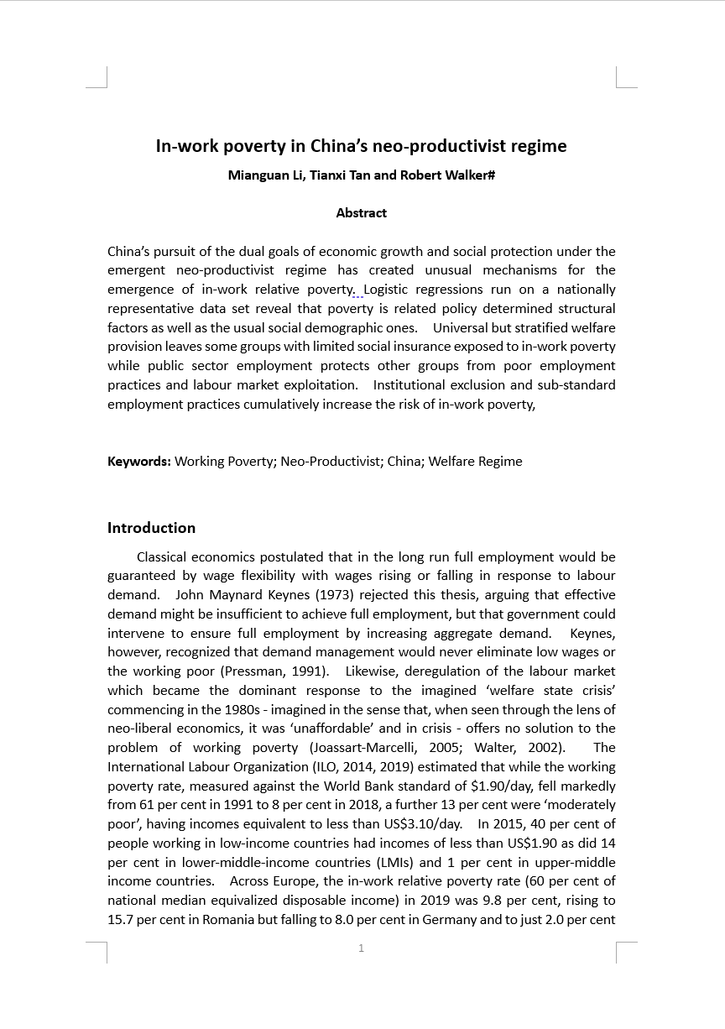
政策基础设施
2023
Policy infrastructure
农村户籍加重了相对贫困
  Relative poverty is increased by a rural hukou
相对贫困与残病相关
  Relative poverty is associated with ill-health
医疗保险降低了贫困风险
  The risk of poverty is reduced by health insurance
教育可以防止贫困
  Education is protective against poverty

Slide 18
政策基础设施
Policy infrastructure
农村户籍加重了相对贫困
  Relative poverty is increased by a rural hukou
相对贫困与残病相关
  Relative poverty is associated with ill-health
医疗保险降低了贫困风险
  The risk of poverty is reduced by health insurance
教育可以防止贫困
  Education is protective against poverty
户籍*就业状况 Household registration* Employment status (1.356)
造成贫困
Causing poverty
预防贫困
Preventing poverty
农村户籍
Rural Hukou (1.448 NS )
偶数的距离
Distance from even odds

Slide 19
政策基础设施
Policy infrastructure
农村户籍加重了相对贫困
  Relative poverty is increased by a rural hukou
相对贫困与残病相关
  Relative poverty is associated with ill-health
医疗保险降低了贫困风险
  The risk of poverty is reduced by health insurance
教育可以防止贫困
  Education is protective against poverty
残病
Unhealthy (2.003)
户籍*就业状况 Household registration* Employment status (1.356)
造成贫困
Causing poverty
平均健康水平 Average health (1.345)
预防贫困
Preventing poverty
农村户籍
Rural Hukou (1.448 NS )
有医疗保险 Has health insurance (0.657)
偶数的距离
Distance from even odds
大专以上学历 College degree or above (0.303)

Slide 20
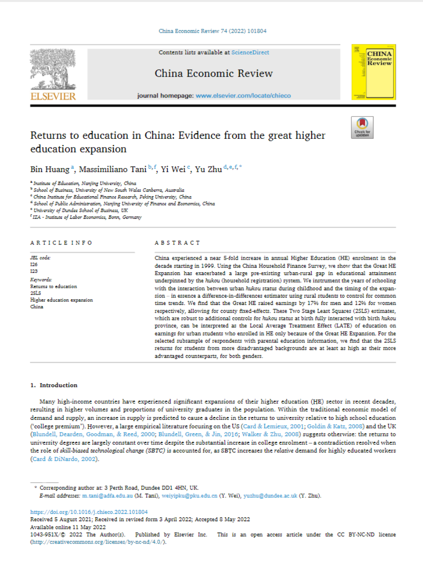
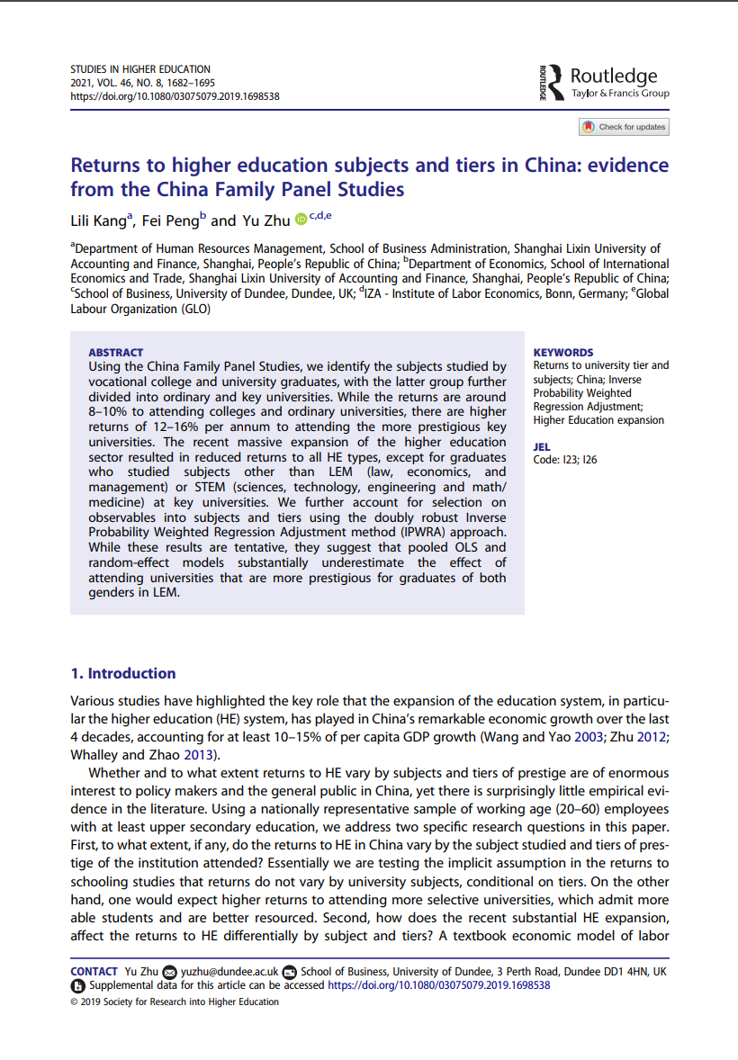
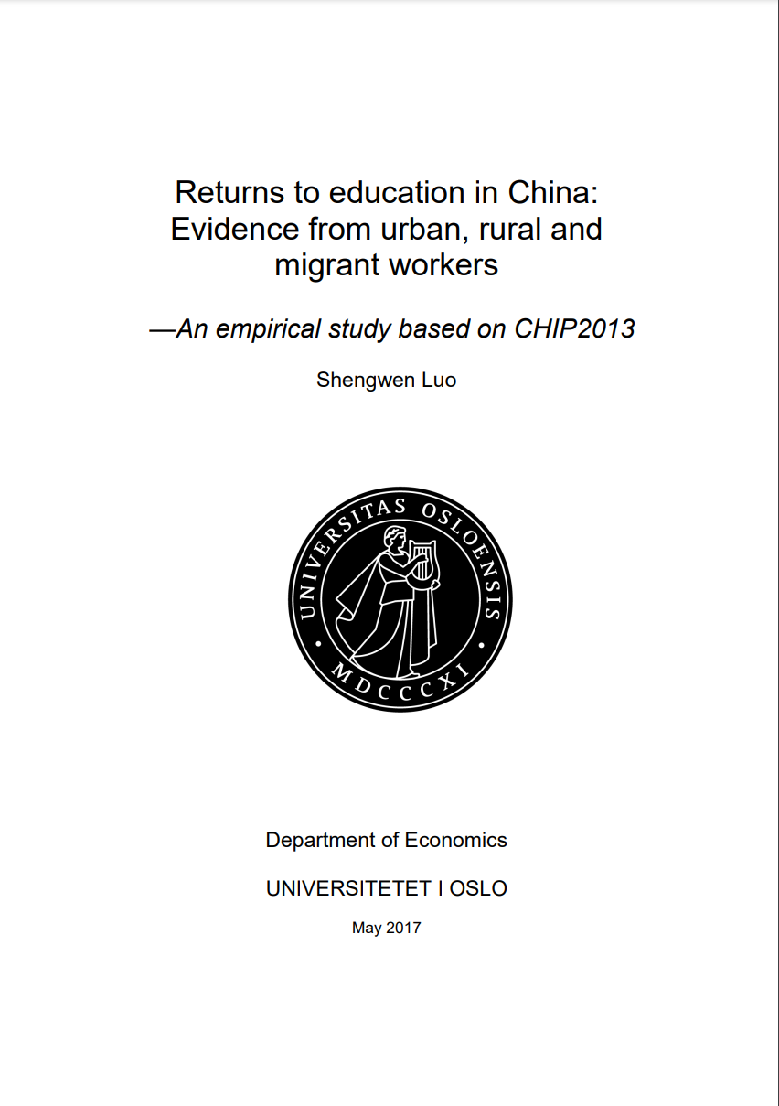
政策基础设施
2022
Policy infrastructure
农村户籍人口普遍无法从高等教育扩张中受益
  Rural hukou holders generally fail to benefit from the expansion in Higher Education
农村地区教育收入回报太低
  Income returns to education are too low in rural areas
外出务工仍然是摆脱绝对贫困而非相对贫困的最佳方式
  Migration remains the best means of escaping absolute poverty, but not relative poverty
农村经济仍然严重依赖外出务工和城乡间的汇款
  Rural economies remain heavily dependent on migration and remittances
2021
2017

Slide 21
政策基础设施
Policy infrastructure
农村户籍人口普遍无法从高等教育扩张中受益
  Rural hukou holders generally fail to benefit from the expansion in Higher Education
农村地区教育收入回报太低
  Income returns to education are too low in rural areas
外出务工仍然是摆脱绝对贫困而非相对贫困的最佳方式
  Migration remains the best means of escaping absolute poverty, but not relative poverty
农村经济仍然严重依赖外出务工和城乡间的汇款
  Rural economies remain heavily dependent on migration and remittances
月收入/受教育年限的增长百分比
城市男性
所有男性
所有女性
城市女性
非农户籍男性
非农户籍女性
2012--4: China Family Panel Study

Slide 22
政策基础设施
Policy infrastructure
重返教育
农村户籍人口普遍无法从高等教育扩张中受益
  Rural hukou holders generally fail to benefit from the expansion in Higher Education
农村地区教育收入回报太低
  Income returns to education are too low in rural areas
外出务工仍然是摆脱绝对贫困而非相对贫困的最佳方式
  Migration remains the best means of escaping absolute poverty, but not relative poverty
农村经济仍然严重依赖外出务工和城乡间的汇款
  Rural economies remain heavily dependent on migration and remittances
每小时工资/受教育年限的增长百分比
城市的
乡村的
外出务工人员
不重要
Not significant
2013: Chinese Household Income Project
Controls: Gender, age, ability (using IV regression)

Slide 23
政策基础设施
Policy infrastructure
农村户籍人口普遍无法从高等教育扩张中受益
  Rural hukou holders generally fail to benefit from the expansion in Higher Education
农村地区教育收入回报太低
  Income returns to education are too low in rural areas
外出务工仍然是摆脱绝对贫困而非相对贫困的最佳方式
  Migration remains the best means of escaping absolute poverty, but not relative poverty
农村经济仍然严重依赖外出务工和城乡间的汇款
  Rural economies remain heavily dependent on migration and remittances
接收汇款的家庭
Households receiving remittances
国家的
城市的
乡村的
有打工者的家庭/接收汇款的家庭百分比
汇款占总收入的比例
有打工者或汇款的家庭
汇款占总收入的比例
最低收入家庭（收入分层最低的四分之一）的汇款占总收入的比例

Slide 24
政策基础设施
Policy infrastructure
农村户籍人口普遍无法从高等教育扩张中受益
  Rural hukou holders generally fail to benefit from the expansion in Higher Education
农村地区教育收入回报太低
  Income returns to education are too low in rural areas
外出务工仍然是摆脱绝对贫困而非相对贫困的最佳方式
  Migration remains the best means of escaping absolute poverty, but not relative poverty
农村经济仍然严重依赖外出务工和城乡间的汇款
  Rural economies remain heavily dependent on migration and remittances
接收汇款的家庭
Households receiving remittances
国家的
城市的
乡村的
有打工者的家庭/接收汇款的家庭百分比
汇款占总收入的比例
有打工者或汇款的家庭
汇款占总收入的比例
最低收入家庭（收入分层最低的四分之一）的汇款占总收入的比例

Slide 25
农村经济的科技生态
Technological ecology of the rural economy
Technological ecology of the rural economy
农村生活水平
Rural living standards
技术
Technology
基础设施
Infrastructure
绿色能源
Green energy
农业生产Farm production
农产品加工Farm processing
物理型基础设施Physical infrastructure
共同富裕
传统的 Traditional
技术创新Technological innovation
智慧旅游‘Smart Tourism’
本地商业Local commerce
社会型基础设施Social infrastructure
现代的 Modern
数字金融Digital finance
工业搬迁和初创企业Industrial relocation & start-ups
汇款
Urban remittances
政策型基础设施Policy infrastructure
电子商务
E-commerce
城市生活水平
Urban living standards

Slide 26

谢谢！

