Slide 1
China's Food Processing Losses and Implementation of the Loss-reduction Program
Qi Huaqing
Food Economics Research center, Wuhan Polytechnic University
SEMINAR ON POST-HARVEST LOSS MANAGEMENT 粮食减损国际研讨会

Slide 2
content
1. What is food processing loss and how to measure it?
2. How Can China reduce losses in food processing?
河南·开封
2023年9月25日
SEMINAR ON POST-HARVEST LOSS MANAGEMENT 粮食减损国际研讨会

Slide 3
What is food processing loss and how to measure it?
(一) International definition and measurement of food processing loss
FAO (2019): Conceptual Framework for food loss and waste (“Intended use-end-result inconsistency” theory)
Expected edible food is processed with the aim of producing food for human consumption, but there are three endpoints: food for human consumption, food for economic production and food thrown away.
Among them, food that is diverted to economic production is not a food processing loss.

Slide 4
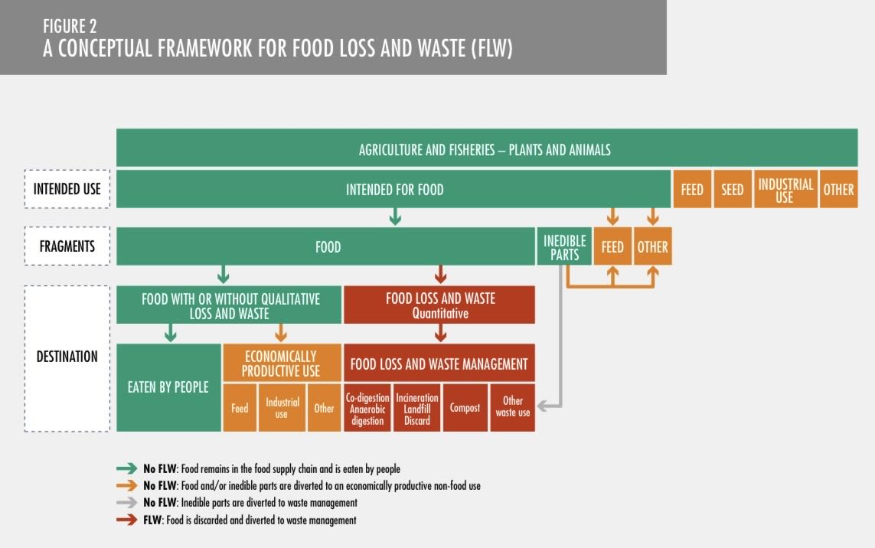
What is food processing loss and how to measure it?
(一) International definition and measurement of food processing loss
Figure 1 FAO Conceptual Framework for food loss and waste

Slide 5
What is food processing loss and how to measure it?
(一) International definition and measurement of food processing loss
The FAO framework is still open to question.
The key point : whether the by-product “economic production use” does not count towards food processing losses?
Ignoring the true nature of food: To meet the increasing use of human value (that is, edible value) needs. The purpose of food processing is primarily to produce food for human consumption, and by-products are only substances that have to be removed to ensure the safety and nutritional supply of edible food.
The economic value of by-products is highlighted: To some extent, the scale of food production for“Human consumption” is reduced by not counting some of the by-products as food losses

Slide 6
What is food processing loss and how to measure it?
( 二 ) Definition and measurement of food processing loss in China
1.The definition of food processing loss and its Chinese context
(1) definition
The loss of grain processing is the loss of quantity and quality of food that could be produced in the process of food processing, but is not directly consumed by human beings. Further, losses from food processing are mainly by-products that are available for human consumption but are discarded.

Slide 7
What is food processing loss and how to measure it?
( 二 ) Definition and measurement of food processing loss in China
(2）The Chinese context of food processing loss: over-processing loss (attribution theory)
For example, in 2014, the former Ministry of Agriculture reported that it lost more than 15 billion catties of grain annually due to overprocessing.
Source:
Global consensus on food security, nutrition and health
FAO (1995) : Food security is“adequate, nutritious and safe food available to all at all times to meet healthy dietary needs and reasonable preferences”(《national action plans》)

Slide 8
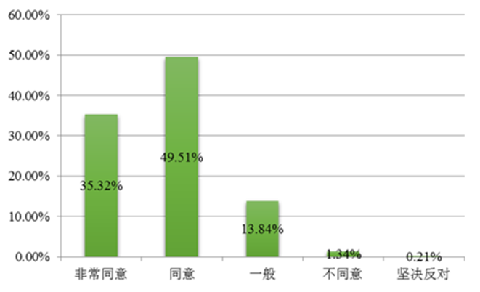
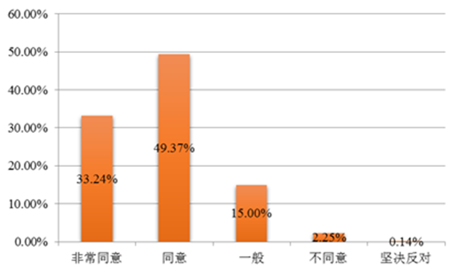
What is food processing loss and how to measure it?
( 二 ) Definition and measurement of food processing loss in China
China's consumer safety, nutrition and health consumption concept and awareness of food products to improve the level
Figure 2 In 2019, consumers made nutrition and health standards their top purchase choice
Figure 3 2019 is expected to understand the nutritional composition of grain and oil products

Slide 9
What is food processing loss and how to measure it?
( 二 ) Definition and measurement of food processing loss in China
The over-processing of food in our country is very serious
The early days of New China: 92 rice, that is 100kg of brown rice to produce 92kg of milled rice.
Currently: the average milled rice yield of brown rice in our country is about 80% .
The higher the processing accuracy, the more by-products, the greater the loss of food and energy.

Slide 10
What is food processing loss and how to measure it?
( 二 ) Definition and measurement of food processing loss in China
Meaning:
It returns to the nature of food processing and conforms to FAO food security definition
It is helpful to identify the target of loss reduction and find the key point of loss in food processing, which provides a basis for formulating measures or programs of loss reduction

Slide 11
What is food processing loss and how to measure it?
( 二 ) Definition and measurement of grain processing loss in China
2.Measurement
Taking rice processing as an example, the formula for calculating the loss (rate) of grain processing is as follows:
The loss (rate) of narrow sense rice processing link = the loss (rate) of rice before milling + the loss (rate) of rice after milling = the missing grain (rate) of brown rice production + the loss (rate) of broken rice and rice chips after processing of brown rice

Slide 12
What is food processing loss and how to measure it?
( 二 ) Definition and measurement of grain processing loss in China
If the loss of rice prior to milling is ignored, then:
Loss rate of rice processing = loss rate of rice after milling = loss rate of broken rice and rice chips after processing of brown rice
Thus, the amount (rate) of overmachining loss can be estimated, and the formula is as follows:
The loss (rate) of paddy over-processing = the loss (rate) of paddy processing links-the loss (rate) of moderate processing

Slide 13
How can China reduce losses in food processing?
（一） China's Loss-reduction Goals and Specific Initiatives
In a general sense, food loss reduction realizes the goals of reducing production costs, improving food security and nutrition, and enhancing environmental sustainability.
However, when it comes to loss reduction in the food processing chain, the overall objective is to increase the conversion rate of food processing, improve the quantity and quality of edible food, and correspondingly reduce the amount of by-products, while improving the comprehensive utilization rate of by-products.

Slide 14
How can China reduce losses in food processing?
（一） China's loss-reduction goals and specific Initiatives
Table 1 China's loss-reduction targets and specific initiatives
Loss of key points | derogation target | Specific initiatives
excessive processing | Improvement of processing conversion rates | Establishment of standards for moderate processing
 |  | Developing the whole grain industry
 |  | Application of intelligent and flexible equipment technology
 |  | Enhancement of digital management
 |  | Innovative Food Processing and Distribution Models
 | Improvement of integrated by-product utilization | Effectively utilize the by-products of grain and oil processing, such as rice bran, bran, germ, oilseed meal, potato residue and potato liquid, to produce edible products, functional substances and industrial products.
 |  | Promote the technology of reducing and replacing corn and soybean meal in pig and chicken feed, and fully explore the use of alternative resources such as miscellaneous grains, miscellaneous meals and by-products of food processing.

Slide 15
How can China reduce losses in food processing?
（二）Implementation of Food Processing Loss Reducation Program
1. Main body of oss reduction implementation
China's food processing loss-reduction action adopts a government-led, enterprise-led and social participation model. Under the conditions that China's food processing loss reduction program has been clearly defined, the key to whether the loss reduction goal can be realized lies in the initiative of food processing enterprises.
Enterprise goal: profit maximization. When the income exceeds the cost, the enterprise will take the initiative to implement the loss-reduction program.

Slide 16
How can China reduce losses in food processing?
（二）Implementation of food processing loss reduction program
2. Dilemmas in the implementation of enterprise loss reduction
(1) “Impossible Trinity” contradictions
Technical Constraints: the compatibility of food nutrition and taste and other market constraints: nutritional food shelf-life and consumption habits, consumer perception has not completely changed, and so on
Meet market demand
Reduction of volume losses
Ensure safety and nutrition

Slide 17
How can China reduce losses in food processing?
（二）Implementation of food processing loss reduction program
(2) Small and medium-sized enterprises (SMEs) have significantly less incentive to reduce losses
The vast majority of China's food processing enterprises are small and medium-sized enterprises, for example, of the nearly 10,000 rice processing enterprises, the daily processing capacity of less than 200 tons accounted for more than 90%.
Overcapacity, coupled with low profit margins (about 2%), financing difficulties--------------less incentive to reduce losses

Slide 18
How can China reduce losses in food processing?
（二）Implementation of food processing loss reduction program
(3) Apparently insufficient government funding for enterprise loss-reduction support
At present, the government's support for grain processing enterprises is mainly manifested in the following: subsidy funds, the central and provincial financial processing enterprises to give certain subsidies to support the local accelerated extension of the industrial chain, enhance the value chain; incentive funds, since 2017, the central financial further use of grain-producing counties incentive funds to support the local implementation of the "high-quality grain project".

Slide 19
How can China reduce losses in food processing?
（ 三 ）Recommendations for resolving the dilemma
Publicity and popularization of science
By the government, enterprises, universities and other forces, the use of new media and other means to carry out food publicity and popularization of science, so that publicity and popularization of science into the community, schools and families.

Slide 20
How can China reduce losses in food processing?
（ 三 ）Recommendations for resolving the dilemma
Processing System
Improvement of a strict standards system and elimination of backward production capacity. Within the next five years, a food processing industry system will be gradually established, led by large-scale enterprises and supported by small and medium-sized enterprises specializing in specialties.

Slide 21
How can China reduce losses in food processing?
（ 三 ）Recommendations for resolving the dilemma
Science and Technology Innovation
First, we should make comprehensive use of fiscal, taxation, financial and other policy measures to establish a mechanism for the growth of research and development investment in food conservation and loss reduction; secondly, we should carry out technological research and the creation of major products; and thirdly, we should improve the technological chain from the principle design to the manufacturing and performance testing of food processing equipment.

Slide 22
How can China reduce losses in food processing?
（ 三 ）Recommendations for resolving the dilemma
Financial Support
The establishment of special support funds for grain processing loss reduction, in the existing subsidies, incentives funds, clearly detailed to the grain processing loss reduction projects; at the same time, increase the loss reduction funds special support efforts to stimulate the enterprise loss reduction motivation.

Slide 23
THANKS！
河南·开封
2023年9月25日
SEMINAR ON POST-HARVEST LOSS MANAGEMENT 粮食减损国际研讨会

