Slide 1
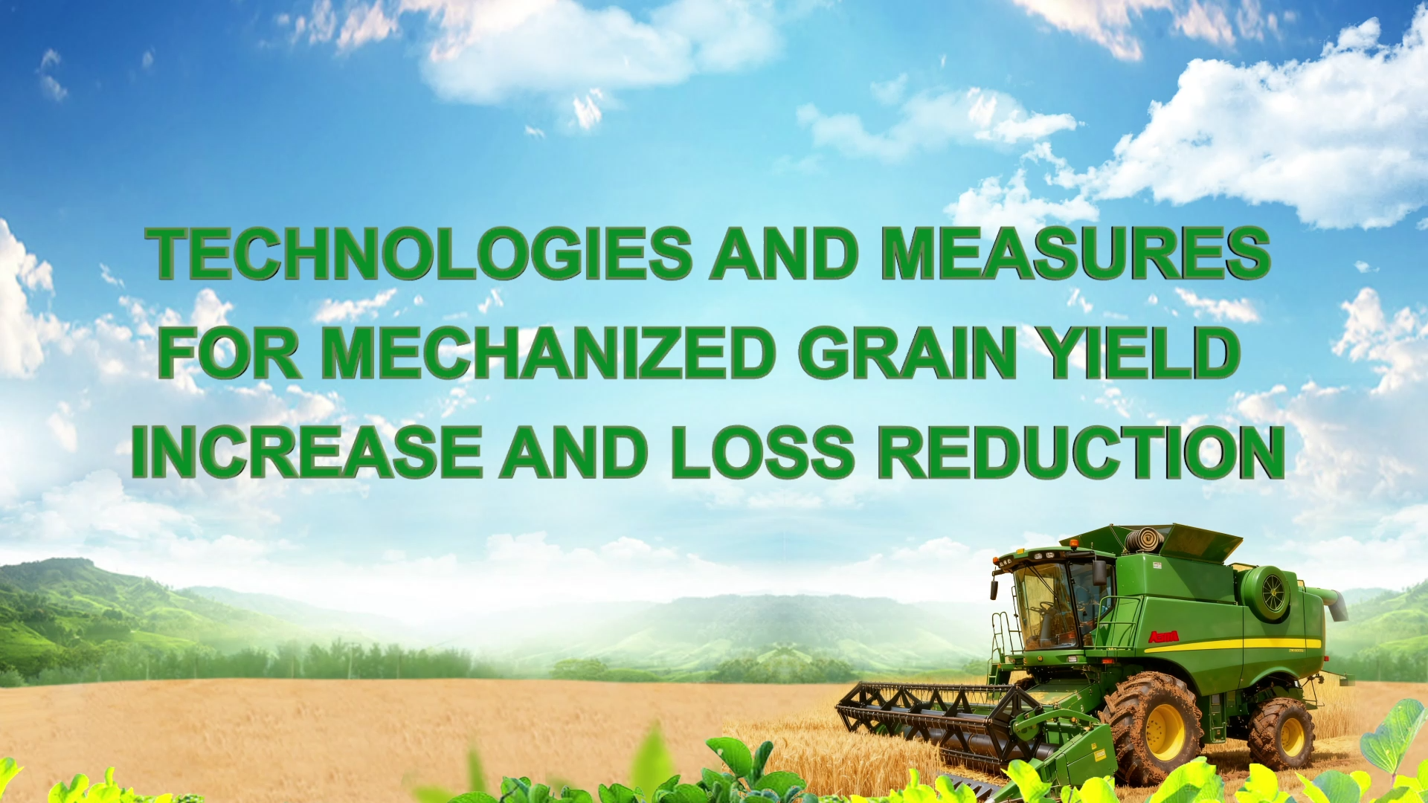


Notes:
Technologies and Measures for
Mechanized Grain Yield Increase and Loss Reduction
谷物机械化增产减损技术与措施

Slide 2
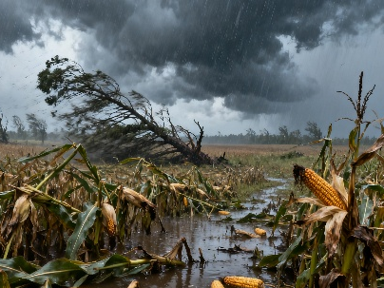
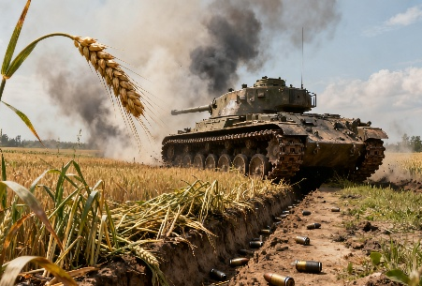
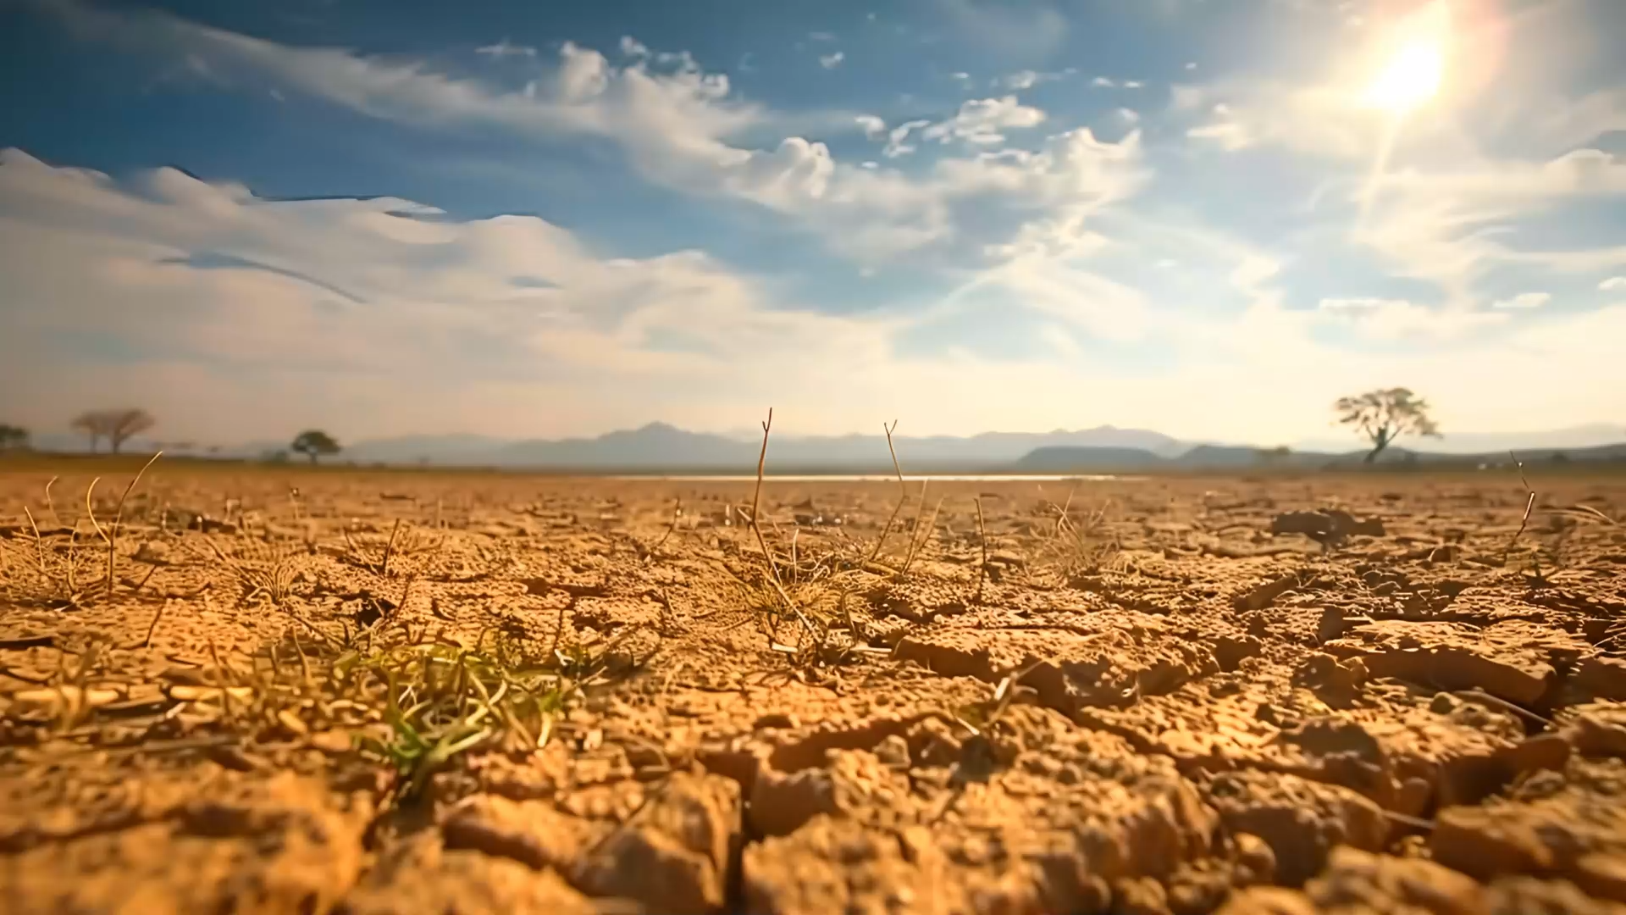
Background
  In today's world, extreme weather events are frequent, regional instability is rising, and global food supplies are under increasing pressure.
Reason
  Food security is drawing growing global concern.
Action
  Prioritize reducing losses in grain production, increase yields while saving resources and minimizing losses.
Notes:
In today’s world, extreme weather events are becoming more frequent, regional instability is on the rise, and global food supplies are under growing pressure.
As a result, food security has become a matter of increasing global concern.
This makes it more important than ever to give greater priority to reducing losses in grain production. On one hand, we must make every effort to increase yields. On the other, we need to use resources more efficiently and reduce losses throughout the production process.
当今世界，极端天气频发，地区局势动荡，全球粮食供应日趋紧张，粮食安全问题正受到越来越多的关注。这要求我们比以往任何时候都更加重视粮食生产减损，一方面要千方百计地增产，另一方面要想方设法节约资源、减少损失。

Slide 3
Part 01
Mechanization as the Primary Approach for Grain Yield Increase and Loss Reduction
Part 02
Technologies and Measures for Increasing Grain Yield and Reducing Losses Through Mechanization
Part 03
Continuing to Promote the Application of Mechanized Technologies for Yield Increase and Loss Reduction
Notes:
This course will cover three main aspects:
Mechanization as the primary approach for grain yield increase and loss reduction.
Technologies and measures for increasing grain yield and reducing losses through mechanization.
Continuing to promote the application of mechanized technologies for yield increase and loss reduction.
本课程从以下三个方面给大家介绍，一是机械化是粮食增产减损的主要途径，二是粮食机械化的增产减损技术与措施，三是持续推进机械化增产减损技术应用。

Slide 4
PART.01
Mechanization as the Primary Approach for Grain Yield Increase and Loss Reduction
Notes:
Mechanization as the primary approach for grain yield increase and loss reduction
一、机械化是粮食增产减损的主要途径

Slide 5
Mechanization as the Primary Approach for Grain Yield Increase and Loss Reduction
Importance of Agricultural Mechanization
  Agricultural mechanization is a crucial way to enhance agricultural productivity.
Benefits of Full-Process Mechanization
  Increase labor productivity.
  Improves resource use efficiency.
  Raises land output.
  Ensures timely sowing and harvesting of crops.
  Enhances agricultural capabilities in:
Significance
  It plays a key role in increasing grain production and reducing losses.
  Disaster prevention.
  Disaster mitigation.
  Emergency response.
Notes:
Agricultural mechanization is an important way to improve agricultural productivity.
The use of full-process mechanization for crops can effectively increase labor productivity, resource use efficiency, and land output. It also ensures timely sowing and harvesting of crops, enhancing agricultural capabilities in disaster prevention, mitigation, and emergency response.
It plays a key role in increasing grain production and reducing losses.
农业机械化是提高农业生产力的重要途径。农作物全程机械化的应用可以有效地提高劳动生产率、资源利用率和土地产出率，确保农作物的适时播种与收获，增强农业防灾减灾及应急救灾能力，在促进粮食增产和减损方面发挥着重要作用。

Slide 6
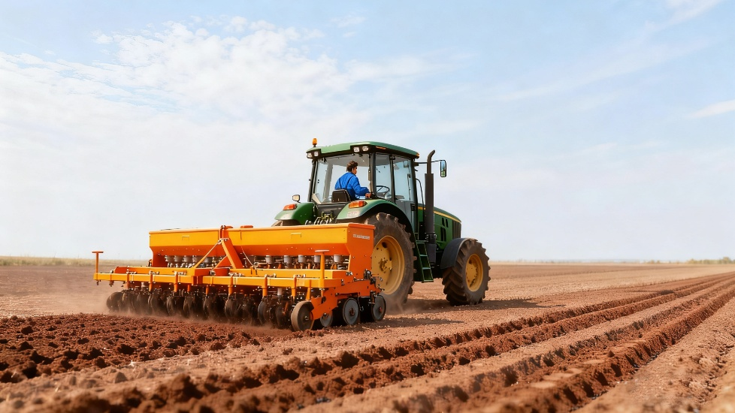
1. Mechanization Helps Ensure Timely Planting
Key factor
  Choosing the right time to plant is very important in areas with more than one cropping cycles per year.
Mechanization advantage
  Mechanized operations greatly shorten the time gap between two crop cycles.
Positive impact
  It secures a longer growing period for the next crop to increase yields.
Notes:
1. Mechanization Helps Ensure Timely Planting
In areas with more than one cropping cycle per year, choosing the right time to plant is very important.
Mechanized operations greatly shorten the time gap between two crop cycles.
This secures a longer growing period for the next crop and helps increase yields.
（一）机械化促进适时播种。在一年多熟的地区，合理安排播种时机至关重要。农机作业大幅缩短了两茬庄稼种植的时间间隔，为下茬作物争取了生长期，确保了作物的增产。

Slide 7
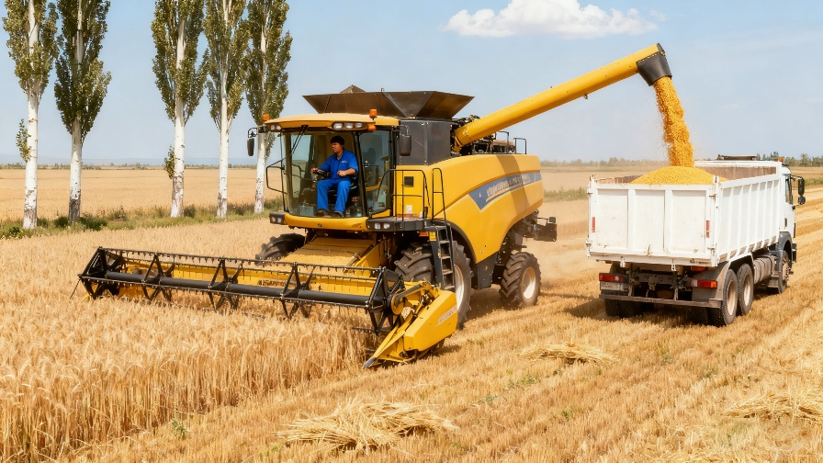
2. Mechanization Ensures Timely Harvesting
The maturity level of crops affects the loss rate during mechanized harvesting
Manual drawback
Manual harvesting is slow and prone to missing the optimal harvest time.
Mechanical advantage
Mechanized harvesting is highly efficient, speeding up the process and enabling timely harvesting.
Notes:
2.Mechanization ensures timely harvesting
The maturity level of crops has a significant impact on the loss rate during mechanized harvesting.
Manual harvesting is slow and can miss the best harvest time.
Mechanized harvesting is much more efficient. One machine can usually harvest about 6.67 hectares in one day. This speeds up the process and ensures crops are harvested on time.
（二）机械化保障适时收获。作物成熟度对机收损失率的影响很大。人工收获速度慢，容易错失最佳的收获期。机械收获效率高，通常一天一台机子可以收获近6.67公顷，大大地加快了收获的进度，实现适时收获。

Slide 8
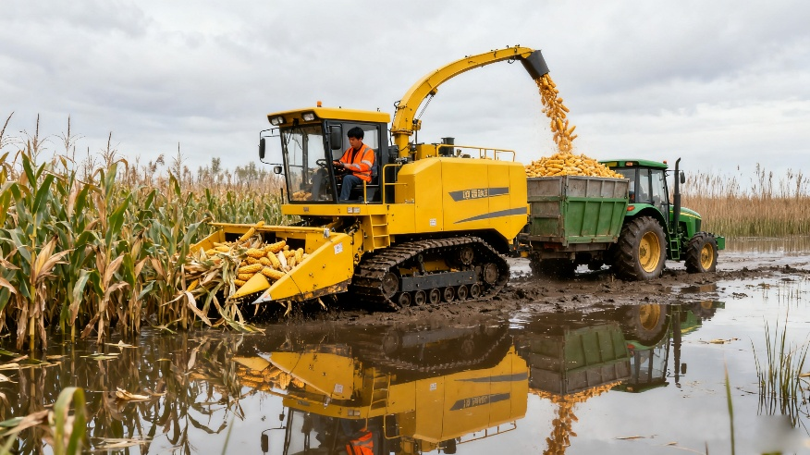
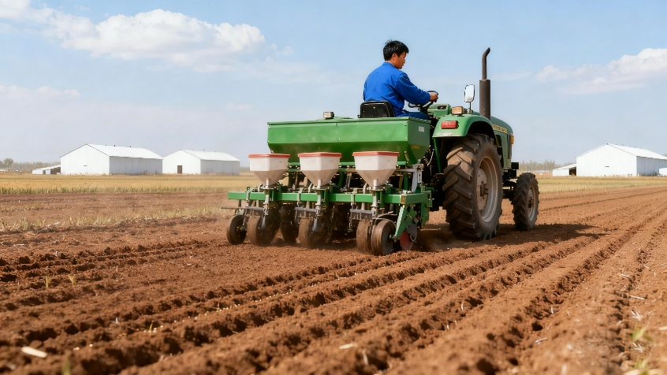
3. Mechanization Is an Effective Tool for Disaster Prevention and Reduction in Agriculture
a. Flood resistance
Two-crop rotation model
  In temperate monsoon climate zones, the two-crop rotation model of "planting winter wheat after harvesting maize" is widely adopted.
Managing Waterlogging in Maize Fields
  Maize grown in low-lying areas is prone to waterlogging.
  Flood control becomes a key measure for increasing yield and reducing losses.
  Tracked harvesters can be used to harvest maize from waterlogged-prone fields, reducing losses from lodging and mold.
Notes:
3. Mechanization Is an Effective Tool for Disaster Prevention and Reduction in Agriculture
a. Flood resistance
In temperate monsoon climate zones, the two-crop rotation model of "planting winter wheat after harvesting maize" is widely adopted.
maize grown in low-lying areas is prone to waterlogging. During the rainy season, these fields can easily get flooded. Therefore,
flood control becomes a key measure for increasing yield and reducing losses. Once the water recedes,
tracked harvesters can be used to harvest maize from waterlogged-prone fields. This avoids losses caused by muddy field conditions that prevent machinery access, such as maize lodging and mold.
1. 抗水灾。温带季风气候区广泛采用 “收获玉米后种植冬小麦” 的一年两熟轮作模式。其中，湿地玉米通常种植在地势较低、易受涝渍的区域。这些地块在雨季极易发生积水内涝。抗水灾措施成为增产减损的关键保障。积水退去后，借助履带收获机可及时收获湿地玉米，有效避免因田间泥泞导致机械无法进入，进而引发玉米倒伏、霉变等损失。

Slide 9
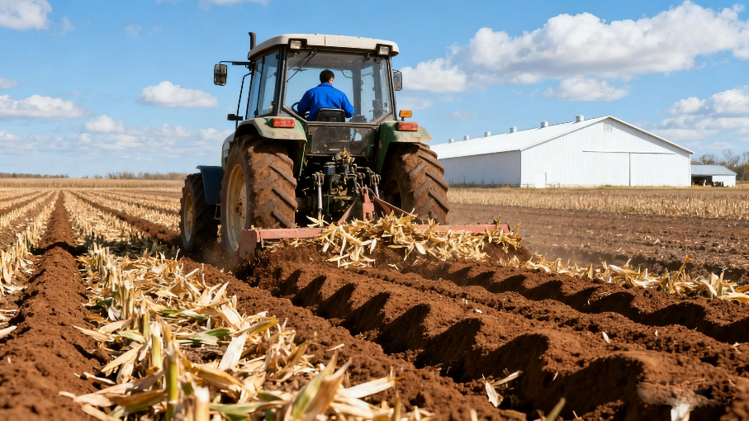
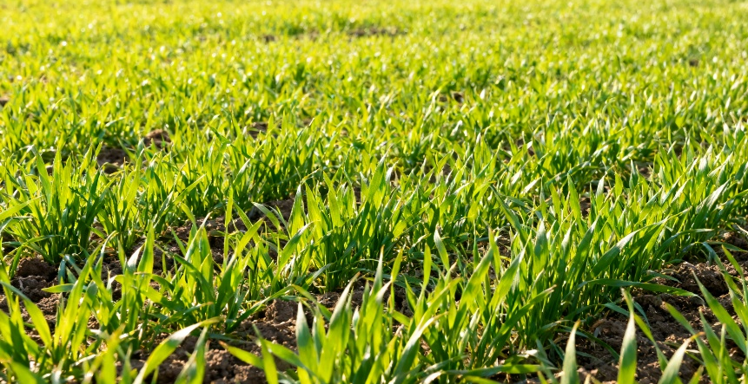
3. Mechanization Is an Effective Tool for Disaster Prevention and Reduction in Agriculture
a. Flood resistance
Preparations for Sowing Winter Wheat
Deep plowing & turning → incorporate shredded maize stalks deep into the soil → increase organic matter.
Plowing → break hardpan layer → improve aeration & water infiltration.
Result → creates loose, fertile soil → deeper roots + better nutrient absorption.
Enhancing Winter Wheat Establishment
No-tillage & reduced-tillage sowing methods → minimize soil disturbance + reduce moisture evaporation + improve soil moisture retention.
Provides better water conditions for winter wheat growth.
Notes:
After maize is harvested, a series of mechanized techniques is used to prepare for sowing winter wheat. Deep plowing and turning can incorporate shredded maize stalks deep into the soil, increasing organic matter content. This also breaks the hardpan layer formed by long-term tillage, improving soil aeration and water infiltration. This creates loose and fertile soil conditions for winter wheat, helping its roots grow deeper and absorb nutrients better.
No-tillage and reduced-tillage sowing methods minimize soil disturbance, reduce moisture evaporation, and improve soil moisture retention. It provides better water conditions for winter wheat growth.玉米收获后，为确保下茬冬小麦顺利播种，需采用一系列机械化技术。深耕深翻能将田间残留的秸秆粉碎后翻入土壤深层，增加土壤有机质含量；同时打破长期耕作形成的犁底层，改善土壤通气性和透水性，为冬小麦播种营造疏松肥沃的土壤条件，有利于冬小麦根系下扎和养分吸收。
免耕与少耕播种技术则减少了土壤扰动，有效降低了土壤水分蒸发，提高了土壤保墒能力，为冬小麦生长提供了良好的水分条件。

Slide 10
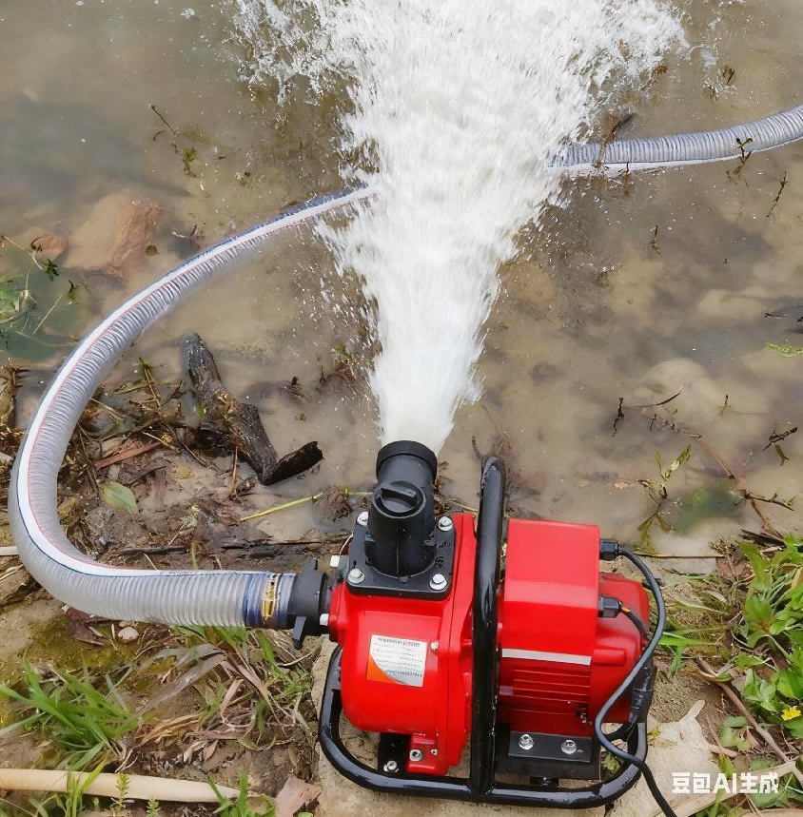
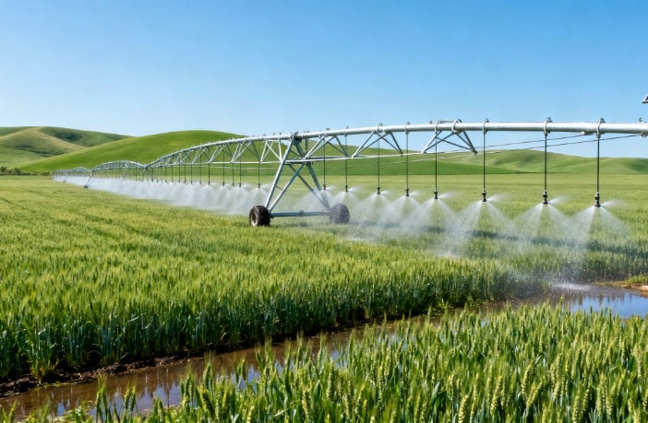
3. Mechanization Is an Effective Tool for Disaster Prevention and Reduction in Agriculture
b. Drought resistance
Disaster scenario
Drought or extremely dry conditions.
Irrigation methods
Use large-scale irrigation machines and water-saving equipment (e.g., pumps).
Goal
Ensure timely watering and support normal crop growth.
Notes:
b. Drought resistance
During droughts or extremely dry conditions,
large-scale irrigation machines and water-saving equipment like pumps can be used to water crops in time.
This can ensure the normal growth of crops.
2. 抗旱灾。当遇到干旱或极端少雨的天气时，可使用大型喷灌机、水泵等节水灌溉设备及时灌溉，可确保作物正常生长。

Slide 11
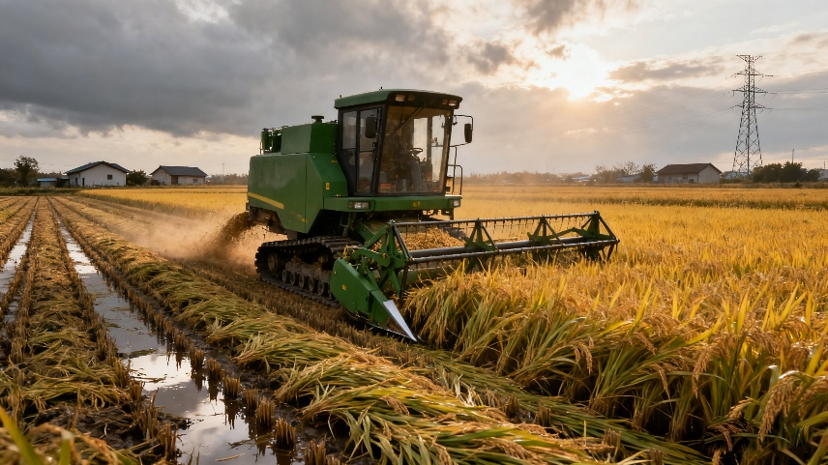
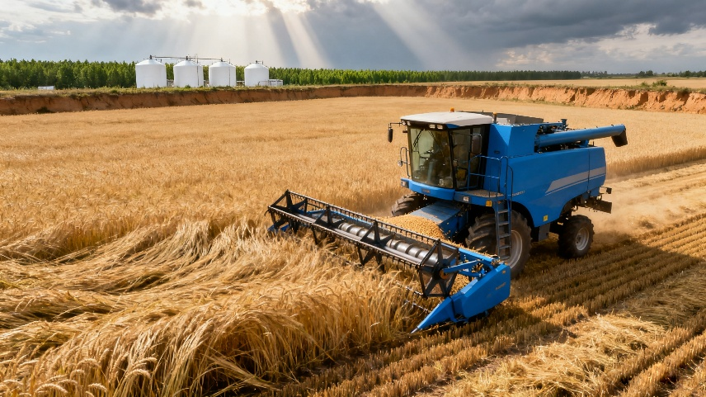
3. Mechanization Is an Effective Tool for Disaster Prevention and Reduction in Agriculture
c. Wind resistance
Disaster situation
Strong winds cause crops to lodge.
Response equipment
Harvesters suitable for lodged crops (rice, wheat, maize) and those equipped with forced feeding systems.
Implementation effect
Timely harvest of lodged crops to reduce yield losses.
Notes:
c. Wind resistance
When strong winds cause crops to fall over,
special harvesters adapted for lodged rice, wheat, or maize can be used. Harvesters with forced feeding systems can also be used.
These machines help harvest the fallen crops in time and reduce yield losses caused by lodging.
3. 抗风灾。面对强风导致作物倒伏的情况，可使用适用倒伏作业的水稻、小麦、玉米收获机，以及加装强制喂入装置的收获机，确保倒伏粮食作物及时收获，减少因倒伏造成的产量损失。

Slide 12
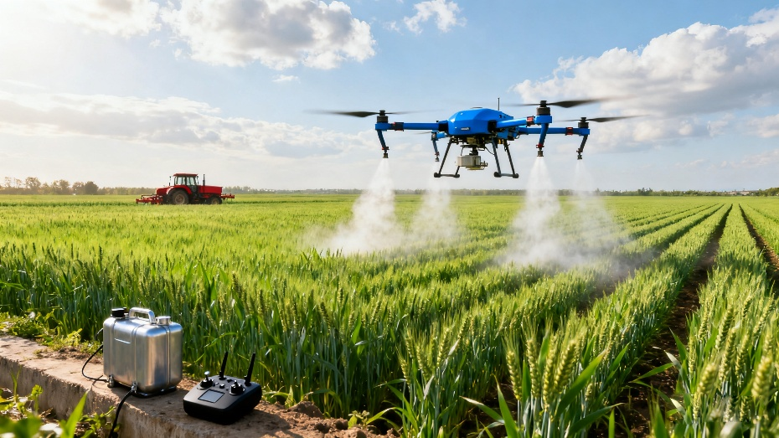
3. Mechanization Is an Effective Tool for Disaster Prevention and Reduction in Agriculture
d. Pest resistance
Disaster situation
Serious pests such as fall armyworms threaten crops.
Response measures
Use high-clearance boom sprayers and agricultural drones for rapid pest control.
Achieved results
Ensure timely control of pests and diseases, ensuring stable and increased grain production.
Notes:
d. Pest resistance
When facing serious pests like fall armyworms,
high-clearance boom sprayers and agricultural drones can be used.
These plant protection machines help control pests and diseases quickly, ensuring stable and increased grain production.
4. 抗虫灾。遇到如草地贪夜蛾等重大病虫害时，可使用高地隙喷杆喷雾机、植保无人机等植保设备，及时地对虫害或病害进行防治，确保粮食的稳产和增产。

