Slide 1
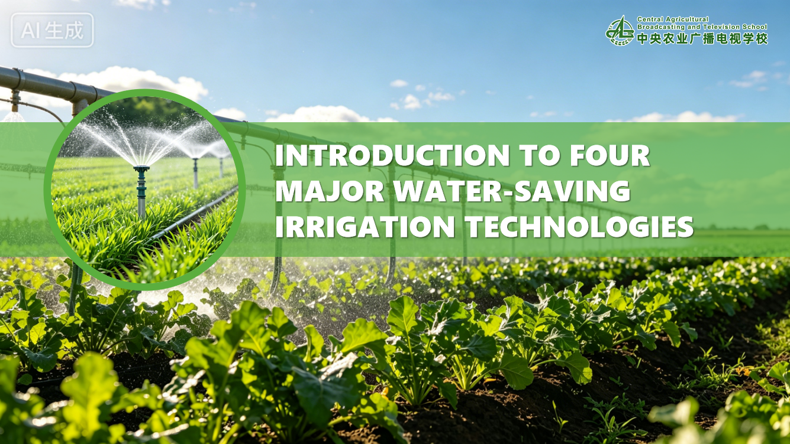

Notes:
四大节水灌溉技术介绍
Introduction to Four Major Water-Saving Irrigation Technologies

Slide 2
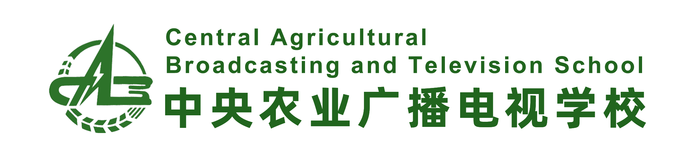
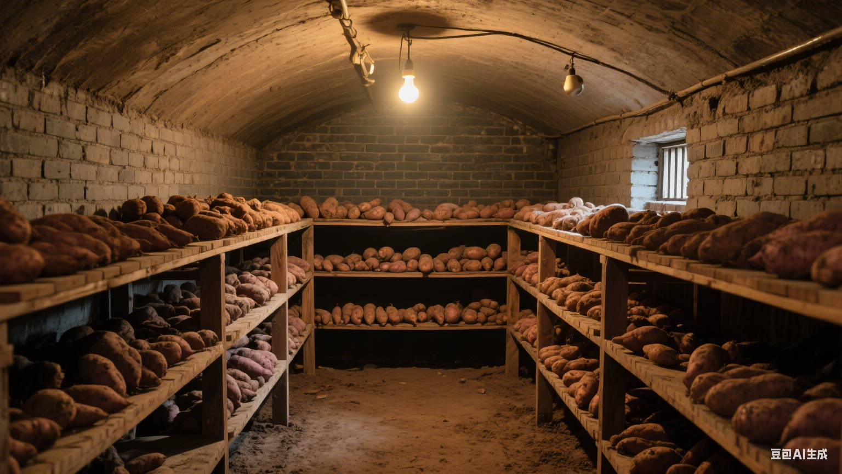

PART.03
Fertigation
Notes:
三、水肥一体化技术
PART.03 .Fertigation

Slide 3
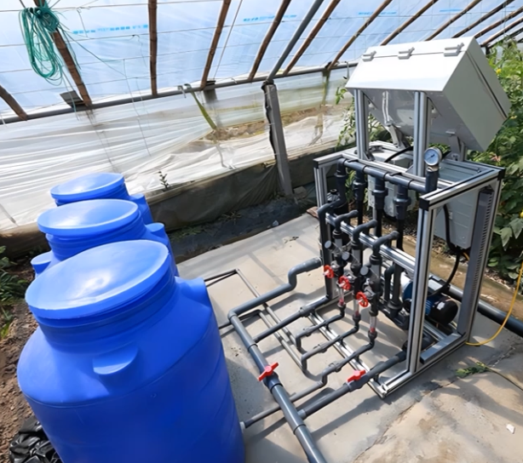
1. What Is Fertigation?
Definition
Fertigation is a water-saving agricultural technology that integrates irrigation and fertilization.
Pipeline-Based Application
Uses pipeline irrigation systems to dissolve fertilizers into water → applies irrigation and fertilization simultaneously.
Purpose
Supplies crops with water and nutrients at proper time and in appropriate amounts.
⇒ Achieves integrated management and efficient
utilization of water and fertilizer.
Notes:
（一）什么是水肥一体化
水肥一体化，是利用管道灌溉系统，将肥料溶解在水中，同时进行灌溉与施肥，适时、适量地满足农作物对水分和养分的需求，实现水肥同步管理和高效利用的节水农业技术。
3.1.What Is Fertigation?
Fertigation is a water-saving agricultural technology that integrates irrigation and fertilization.
It uses pipeline irrigation systems to dissolve fertilizers into water and apply irrigation and fertilization simultaneously.
This approach supplies crops with water and nutrients at the proper time and in appropriate amounts,
achieving integrated management and efficient utilization of water and fertilizer.

Slide 4
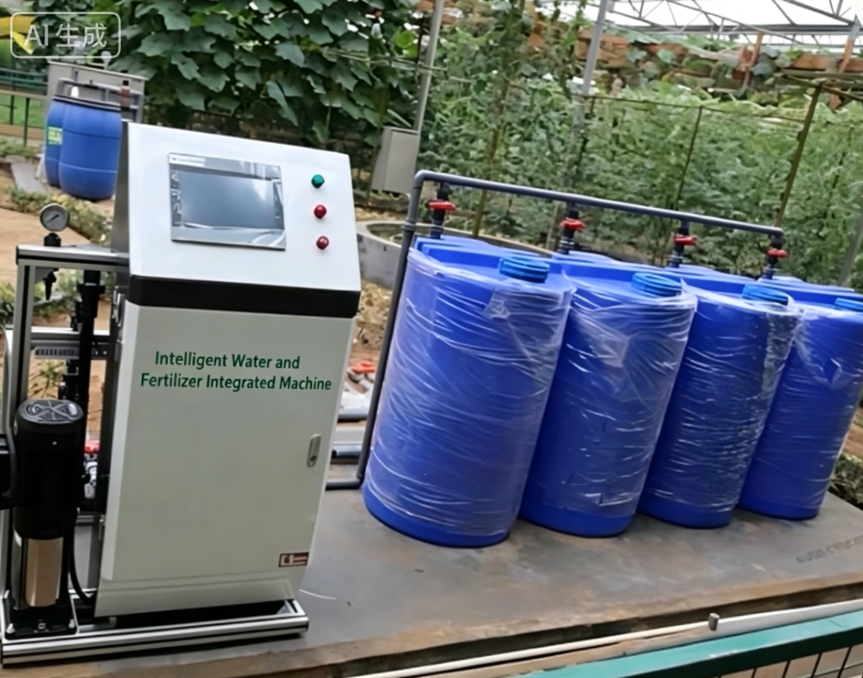
2. Differences Between Fertigation and Water-Saving Irrigation
Water-saving irrigation
  Improves irrigation utilization efficiency of irrigation water.
Fertigation
  Leverages the synergistic effect of water–nutrient coupling.
  Enhancing water and fertilizer use efficiency.
  Broader Performance Considerations:
  ⇒ Better meets requirements of sustainable modern agriculture.
Crop yield.
Crop quality.
Economic benefits.
Ecological performance.
Notes:
（二）水肥一体化与节水灌溉的区别
水肥一体化与节水灌溉二者的本质区别在于：节水灌溉技术主要提升灌溉水的利用效率；而水肥一体化技术则充分发挥了“水分与养分耦合”的协同效应，在提高水肥利用率的同时，综合考虑了作物产量、品质、经济效益以及生态环境效益。因此，水肥一体化技术更能体现现代农业可持续发展的要求。
3.2.Differences Between Fertigation and Water-Saving Irrigation
Fertigation and water-saving irrigation differ fundamentally in their core objectives.
Water-saving irrigation mainly aims to improve the utilization efficiency of irrigation water.
In contrast,
fertigation leverages the synergistic effect of water-nutrient coupling.
While enhancing water and fertilizer use efficiency,
it also takes full account of crop yield,
crop quality,
economic benefits,
and ecological performance. Therefore,
fertigation better meets the requirements of sustainable modern agriculture.

Slide 5
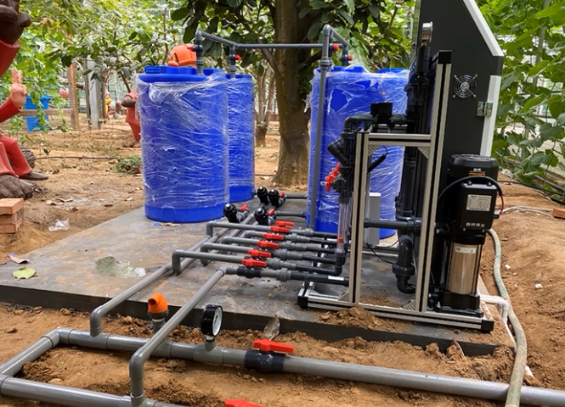
2. Differences Between Fertigation and Water-Saving Irrigation
(1) Separate water and fertilizer application is replaced by integrated management.
Traditional farming:
Irrigation and fertilization are two independent operations.
Fertigation Practice:
Combines the two processes.
Fertilizer is delivered to the same soil layer via emitters along with water during a single irrigation event.
⇒ Realizing the integration of water and fertilizer supply.
Notes:
首先，水肥分开转变为水肥一体：传统农业灌溉和施肥是两个独立的过程，水肥一体化将灌溉和施肥合二为一，在同一次灌溉中同步完成施肥，肥料通过同一个灌水器随水输送至相同的土壤位置，实现了水肥一体。
Firstly, separate water and fertilizer application is replaced by integrated water and fertilizer management.
In traditional farming,
irrigation and fertilization are two independent operations.
Fertigation combines the two processes:
fertilizer is delivered to the same soil layer via emitters along with water during a single irrigation event,
realizing the integration of water and fertilizer supply.

Slide 6
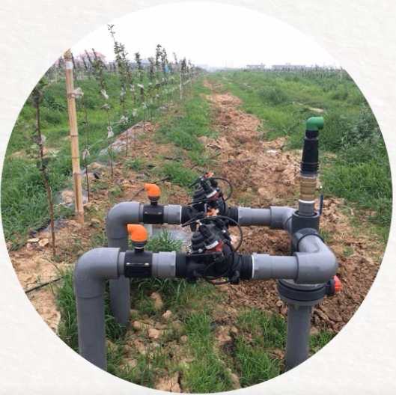
2. Differences Between Fertigation and Water-Saving Irrigation
(2) Open-channel water conveyance is replaced by piped water delivery.
Pressurized Irrigation in Fertigation
Irrigation water is pressurized by external power equipment (e.g., water pumps).
Both drip irrigation and sprinkler irrigation require a certain level of pressure → to deliver water and fertilizer evenly to target areas.
Advantages of Piped Conveyance
Maintains stable water pressure for fertigation.
Provides cleaner water to emitters.
Notes:
其次，渠道输水转变为管道输水：水肥一体化多数采用承压灌溉方式，即通过外加动力（如水泵）对灌溉水加压，使其获得一定压力的灌溉方式。不论是滴灌还是喷灌，都需要一定压力才能将水肥均匀地输送到相应的位置。采用管道输水不仅能为水肥一体化提供稳定的供水压力，还能为灌水器提供较为干净的水源。
Secondly, open-channel water conveyance is replaced by piped water delivery.
Fertigation generally adopts pressurized irrigation,
where irrigation water is pressurized by external power equipment such as water pumps.
Both drip irrigation and sprinkler irrigation require a certain level of pressure to deliver water and fertilizer evenly to target areas.
Piped conveyance not only
maintains stable water pressure for fertigation
but also provides cleaner water to emitters.

Slide 7
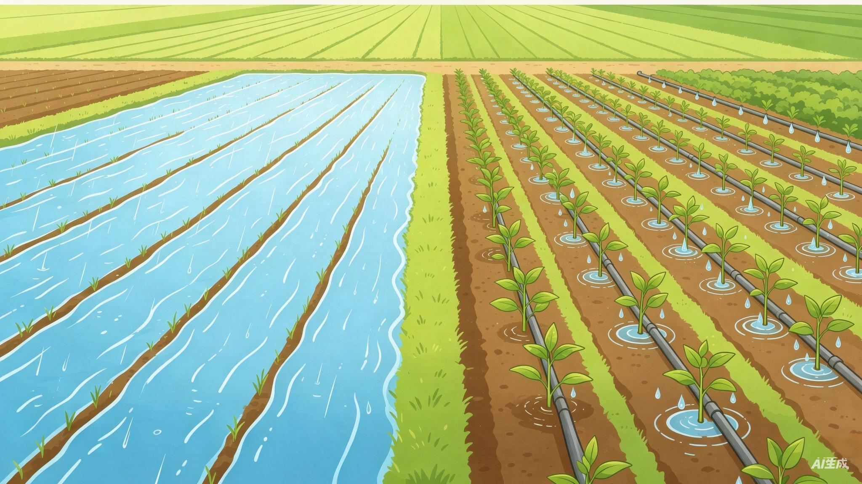
2. Differences Between Fertigation and Water-Saving Irrigation
(3) Irrigation shifts from watering the field to feeding the crops.
Core Concept
Applies water specifically to the root zones of crops.
Focuses on crop demand, rather than simply wetting the entire field.
Watering the field
Feeding the crops
Shift from watering the field to feeding the crops
Notes:
另外，浇地转变为浇作物：水肥一体化首要的理念转变，就是围绕作物根系分布区域特征对作物进行灌溉，是浇作物，而不再是浇地。
Thirdly, the irrigation philosophy shifts from watering the field to feeding the crops.
A core concept of fertigation is to apply water specifically to the root zones of crops,
focusing on crop demand rather than simply wetting the entire field.

Slide 8
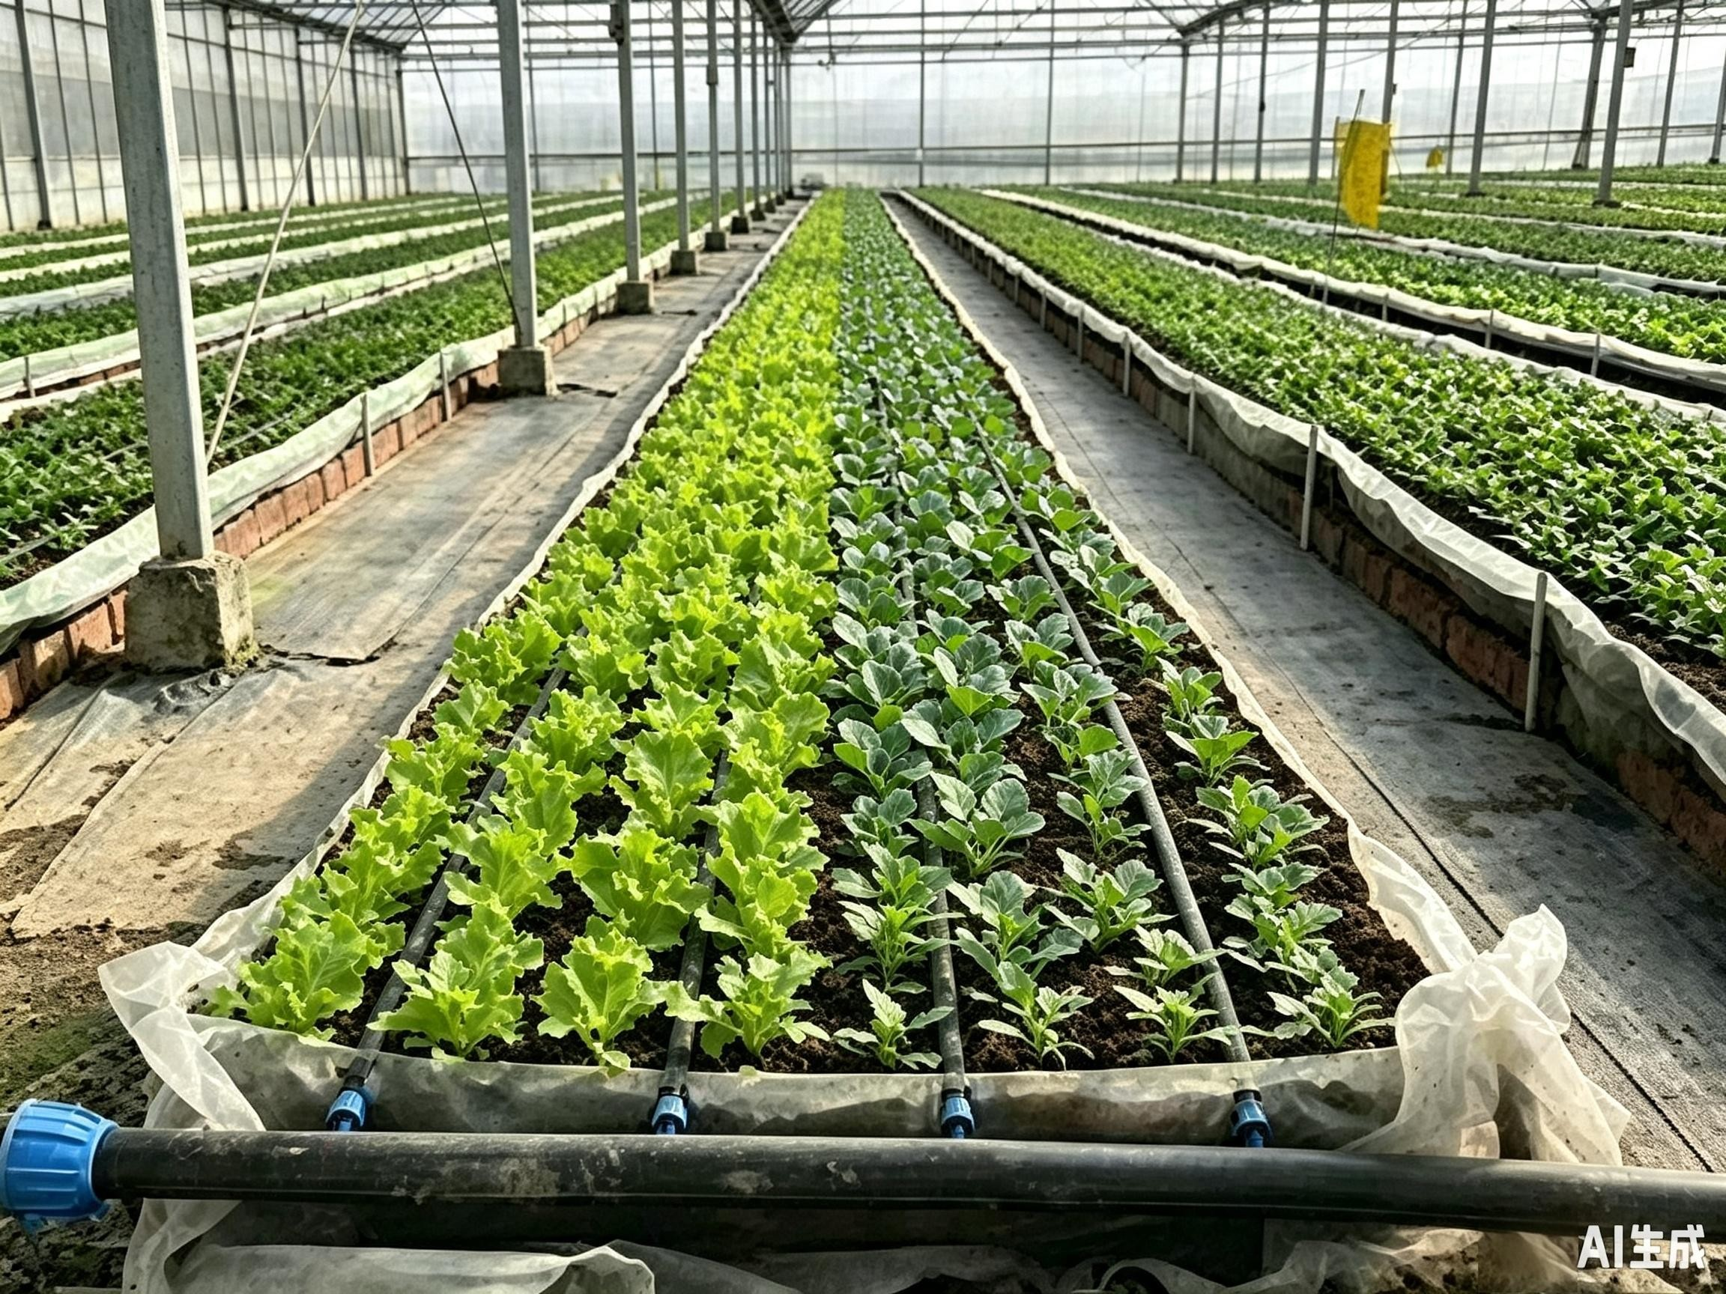
2. Differences Between Fertigation and Water-Saving Irrigation
(4) Broadcast soil fertilization is replaced by targeted crop fertilization.
Precise Root-Zone Delivery
Fertigation delivers water and nutrients directly to crop roots.
→ Promotes concentrated root growth.
→ Facilitates topdressing.
Shift from Traditional Fertilization Practices
Moves away from one-time heavy basal fertilization.
Replaces surface broadcasting + tillage incorporation.
Enables flexible water and fertilizer management aligned with different crop growth stages.
Notes:
最后，土壤施肥转变为作物施肥：水肥一体化技术让水分和养分可以精准地送到作物根部，使得根系长得更集中，追肥也变得非常方便。
改变了传统的一次性集中施肥、把肥料撒在土壤表面再翻入耕作层、大量施用基肥的理念，使施肥逐步转变为按照作物生育期进行的随时随地水肥管理。
Finally, broadcast soil fertilization is replaced by targeted crop fertilization.
Fertigation delivers water and nutrients precisely to crop roots,
promoting concentrated root growth
and facilitating topdressing.
It moves away from traditional practices of one-time heavy basal fertilization
and surface broadcasting with tillage incorporation,
enabling flexible water and fertilizer management aligned with different crop growth stages.

Slide 9
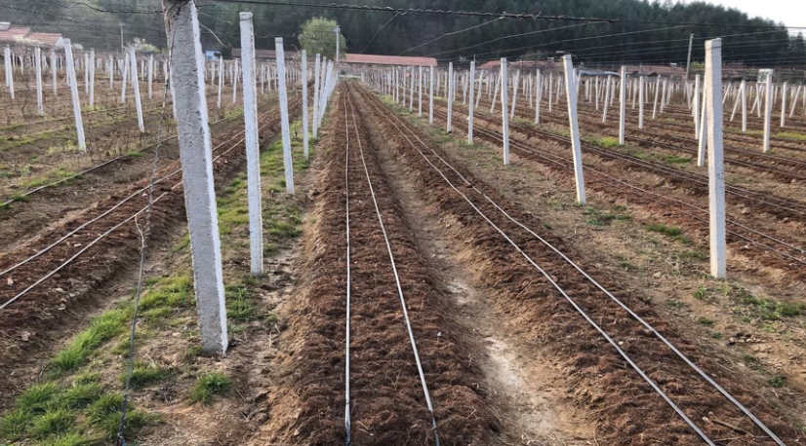
3. Classification of Fertigation—Five Categories
(1) Drip fertigation technology
Demand-Based Root-Zone Drip Application
Based on actual water and fertilizer requirements of crops.
Uses emitters on drip laterals + low-pressure pipelines.
Delivers dissolved fertilizer solutions uniformly and gradually
→ reaches crop root zones.
→ in the form of discrete droplets.
Precise Drip Control
Enables precise control of water volume.
Effectively extends irrigation duration.
Notes:
（三）水肥一体化分类
根据不同的灌溉方式，水肥一体化可以划分为五个类型：
1.滴灌水肥一体化技术：以农作物对水肥的实际需求为基础，使用毛管上的灌水器和低压管道系统，把作物需要的可溶性肥料溶液逐渐均匀地滴入农作物的根区。这种方法可以保证灌溉水以水滴的形式滴入土壤，在有效控制水量的同时，显著延长了灌溉时间。
3.3.Classification of Fertigation
Based on different irrigation methods, fertigation can be divided into five categories:
3.3.1.Drip fertigation technology
Based on the actual water and fertilizer requirements of crops,
this technology uses emitters installed on drip laterals and low-pressure pipeline systems
to
deliver dissolved fertilizer solutions uniformly and gradually
into crop root zones.
Water is applied to the soil in the form of discrete droplets,
enabling precise control of water volume
and effectively extending irrigation duration.

Slide 10
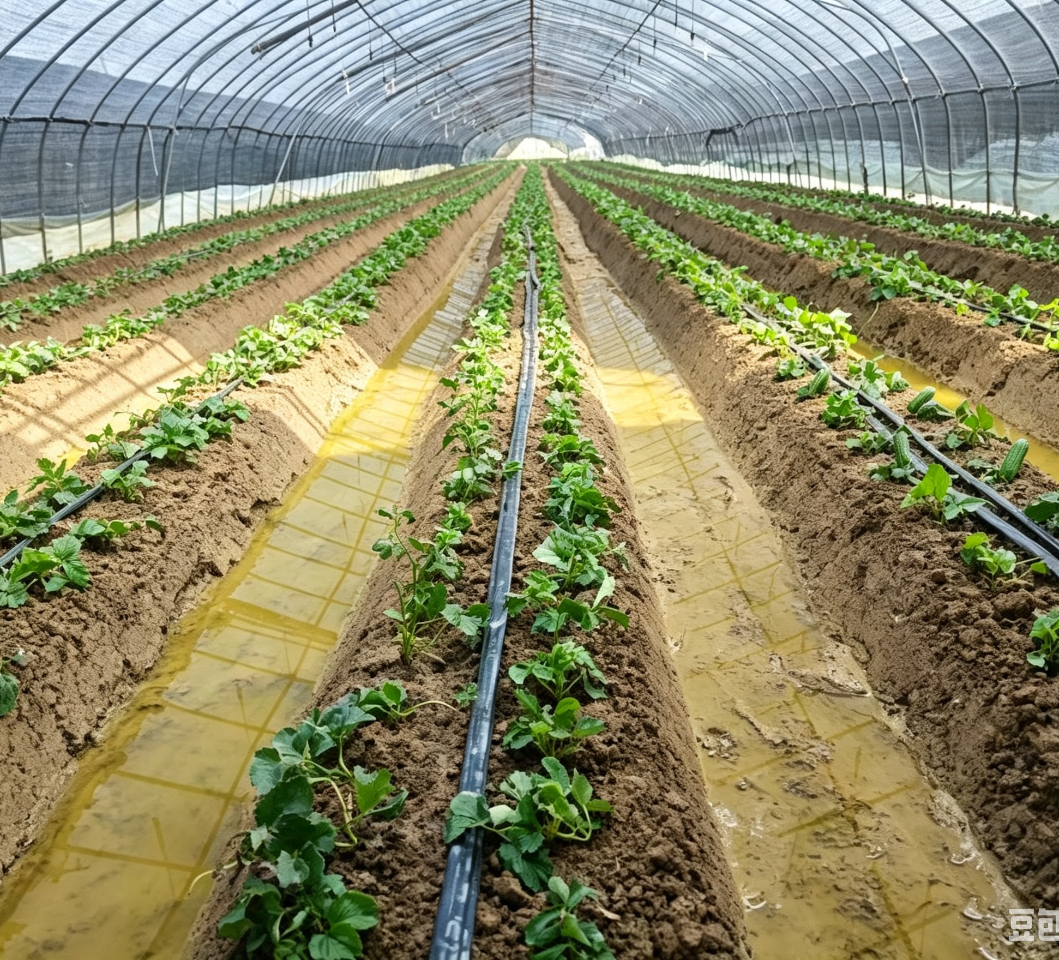
3. Classification of Fertigation—Five Categories
(1) Drip fertigation technology
Continuous Low-Concentration Supply
  Supplies water + low-concentration nutrients continuously and slowly.
  → Keeps soil moderately moist, well-aerated, and loose.
  → Prevents root burn caused by excessive fertilizer concentration.
Soil & Root-Zone Effects
  Soil moisture + air + temperature + nutrient conditions remain optimal for crop growth.
  Further reduces deep percolation.
  Avoids damage to soil structure.
Notes:
另外，这种技术通过持续、缓慢地供给水分和低浓度养分，既能保持土壤不干不涝、透气松软，又能避免肥料浓度过高灼伤根系，从而让土壤的水、气、热和养分环境，始终处于作物生长的适宜状态，减少土壤的渗漏程度，并且避免对土壤结构造成破坏。
In addition, by supplying water and low-concentration nutrients continuously and slowly,
the technology keeps the soil moderately moist, well-aerated and loose.
It also prevents root burn caused by excessive fertilizer concentration.
As a result, soil moisture, air, temperature and nutrient conditions remain optimal for crop growth.
This approach further reduces deep percolation
and avoids damage to soil structure.

Slide 11
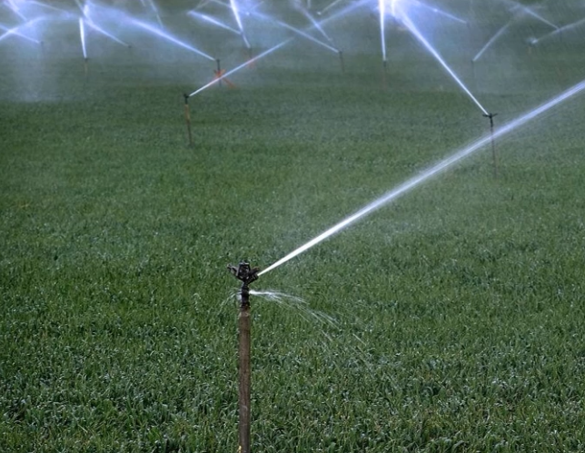
3. Classification of Fertigation—Five Categories
(2) Sprinkler fertigation technology
Demand-Based Fertilizer Injection
Based on water + nutrient requirements of crops at various growth stages.
Fertilizer solution
→ Injected into pipelines of sprinkler system via fertilization devices.
→ Fertilizer fully dissolved in irrigation water.
Uniform Spray Application
Mixture is sprayed through sprinkler nozzles.
→ Form fine droplets.
→ Fall evenly onto crop foliage + soil surface.
⇒ Achieves simultaneous irrigation and fertilization.
Terrain Adaptability
Low requirements for land-levelling.
Suitable for complex terrains such as orchards in mountainous and hilly areas.
Notes:
2.喷灌水肥一体化技术：根据不同作物在不同生长阶段的需水需肥规律，借助施肥装置将肥料溶液注入喷灌系统的管道中，使肥料溶解于灌溉水，再通过喷头将水肥混合液喷射到空中，形成细小的水滴，均匀地洒落在作物叶面或地表，从而实现同步灌溉与施肥的一种现代农业技术。该技术对土地平整度的要求不高，尤其适用于山地、丘陵果园等复杂地形。
3.3.2.Sprinkler fertigation technology
In accordance with the water and nutrient requirements of crops at various growth stages,
this technology injects fertilizer solution
into the pipelines of the sprinkler system via fertilization devices.
The fertilizer dissolves fully in the irrigation water,
and the mixture is sprayed through sprinkler nozzles
to form fine water droplets.
These droplets fall evenly onto crop foliage and the soil surface,
thereby achieving simultaneous irrigation and fertilization.
This technology has low requirements for land leveling
and is particularly suitable for complex terrains such as orchards in mountainous and hilly areas.

Slide 12
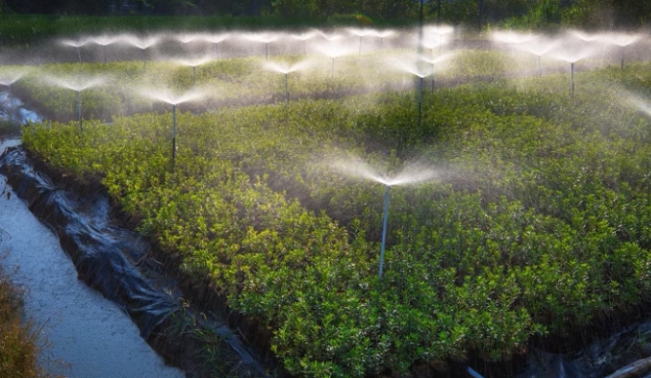
3. Classification of Fertigation—Five Categories
(3) Micro-sprinkler fertigation technology
Water-Fertilizer Delivery Mechanism
Fertilizer solution
→ injected into micro-sprinkler pipelines via dedicated fertilization devices.
→ uniformly distributed across soil surface along with irrigation water.
System Requirements
Compared with drip fertigation, less stringent requirements on filtration facilities.
Limitations & Application Suitability
Irrigation uniformity easily affected by obstructions from crop stalks and field weeds.
Crop types + topographic conditions → should be carefully evaluated prior to application.
Notes:
3.微喷灌水肥一体化技术：通过施肥设备把肥料溶液加入微喷灌的管道中，随着灌溉水分均匀地喷洒到土壤表面的一种灌溉施肥方式。与滴灌施肥技术相比，微喷灌技术对过滤器的要求不高，但是该技术的灌溉效果容易受到作物茎杆与杂草的影响。因此，应用该技术时，一定要事先考虑作物种类和地形条件。
3.3.3.Micro-sprinkler fertigation technology
Fertilizer solutions are
injected into micro-sprinkler pipelines through dedicated fertilization devices
and are uniformly distributed across the soil surface along with irrigation water.
Compared with drip fertigation, this technique imposes less stringent requirements on filtration facilities.
However, its irrigation uniformity is easily affected by obstructions from crop stalks and field weeds.
Accordingly, crop types and topographic conditions should be carefully evaluated prior to application.

Slide 13
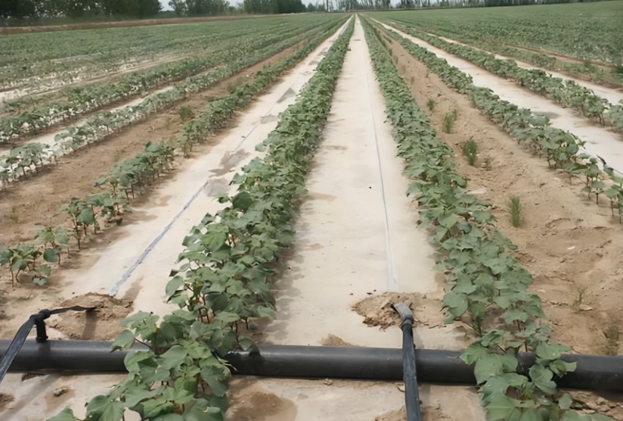
3. Classification of Fertigation—Five Categories
(4) Fertigation under plastic mulch
System Composition
Integrates plastic film mulching + drip irrigation technologies.
Drip tapes placed beneath plastic mulch layer.
Operating Principle
Follows the same irrigation and fertigation principles as drip fertigation systems.
Notes:
4.膜下滴灌水肥一体化技术：膜下滴灌是覆膜和滴灌技术的结合，滴灌带铺设于地膜之下，灌溉施肥原理与滴灌水肥一体化技术相同。
3.3.4.Fertigation under plastic mulch
Mulch drip fertigation integrates plastic film mulching and drip irrigation technologies.
Drip tapes are laid beneath the plastic mulch layer,
and this approach follows the same irrigation and fertilization principles as drip fertigation systems.

Slide 14
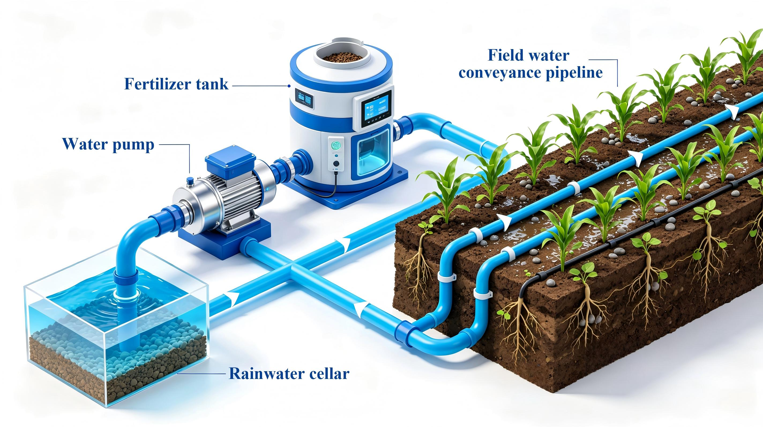
3. Classification of Fertigation—Five Categories
(5) Rainwater harvesting and supplemental irrigation fertigation technology
System Components
Constructed rainwater ditches.
Catchment surfaces.
Storage cellars.
Small water-lifting equipment.
Field water conveyance pipelines.
Operating Mechanism
Drip or micro-sprinkler irrigation + water-soluble fertilizers.
→ Achieves efficient supplemental irrigation + fertigation.
Functional Benefits
Maximizes the use of natural precipitation.
Resolves mismatches between rainfall timing and crop water demand.
Helps mitigate severe seasonal drought.
Suitable Conditions
Regions with abundant but unevenly distributed precipitation.
Areas with severe seasonal drought.
Notes:
5.集雨补灌水肥一体化技术：通过开挖集雨沟，建设集雨面和集雨窖池，并配套安装小型提水设备和田间输水管道，采用滴灌或微喷灌技术，结合水溶性肥料应用，可实现高效补灌和水肥一体化。该技术可以充分利用自然降雨，解决降雨时间与作物需水时间不同步及季节性干旱严重的问题，适用于降水量较多，但时空分布不均、季节性干旱严重的地区。
3.3.5. Rainwater harvesting and supplemental irrigation fertigation technology
This technology relies on constructed rainwater ditches,
catchment surfaces,
and storage cellars,
paired with small water-lifting equipment
and field water conveyance pipelines.
By adopting drip or micro-sprinkler irrigation combined with water-soluble fertilizers,
the system achieves efficient supplemental irrigation and fertigation.
This method maximizes the use of natural precipitation,
resolves mismatches between rainfall timing and crop water demand,
and helps mitigate severe seasonal drought.
It is primarily applicable to regions with abundant but unevenly distributed precipitation
and severe seasonal droughts.

Slide 15
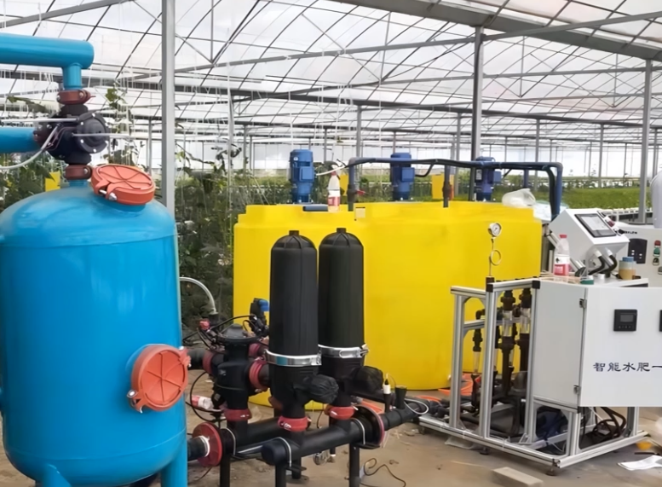
4. Misconceptions Regarding Fertigation
(1) Inadequate understanding of fertigation
Grower Misunderstanding
Fertilizers must be completely dissolved in water.
Undissolved fertilizers viewed as:
Unusable.
Wasteful.
Likely to clog pipelines.
Cumbersome for routine maintenance.
Resulting Behavior
  Regard traditional flood irrigation after broadcast fertilization as more convenient.
    → Growers abandon fertigation equipment.
Notes:
（四）水肥一体化认识误区
在水肥一体化的实际应用中，存在一些误区，影响了使用效果，主要表现在：
1.对水肥一体化认识不到位：有些种植户认为，采用水肥一体化系统需要把肥料彻底溶解，不溶解的肥料就无法使用，会产生浪费甚至堵塞管道，维护维修麻烦，不如撒施肥料后再漫灌方便实用，从而导致弃用水肥一体化设备。
3.4.Misconceptions Regarding Fertigation
Several prevalent misconceptions in the practical application of fertigation systems adversely affect their performance, which are summarized as follows:
3.4.1. Inadequate understanding of fertigation
Some growers mistakenly believe that fertigation requires fertilizers to be completely dissolved in water;
undissolved fertilizers are viewed as unusable,
wasteful,
and likely to clog pipelines,
and handling them is considered cumbersome for routine maintenance.
As a result, they regard traditional flood irrigation after broadcast fertilization as more convenient
and ultimately abandon fertigation equipment.

Slide 16
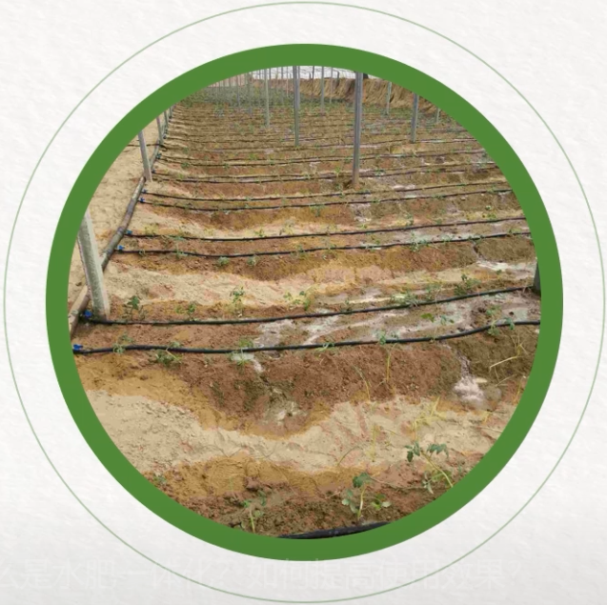
4. Misconceptions Regarding Fertigation
(2) Unreasonable irrigation scheduling
Flood-Irrigation Mindset: Overwater crops
Excessively long irrigation durations.
Excessive water application.
→ Leads to deep percolation with water penetrating beyond the active
root zone of crops.
Lack of Stage-Specific Adjustment
Fixed irrigation schedules across all growth stages.
No adjustment of irrigation volume & frequency in response to crop water requirements.
Notes:
2.灌溉制度不合理：一些种植户受传统思维影响，认为采用水肥一体化技术后，每次灌溉仍需像大水漫灌那样浇透才行，导致灌溉时间过长、水量过大，水渗到了作物根系够不着的深层土壤中。此外，在作物不同生长阶段，部分种植户仍沿用同一套灌溉制度，未能根据植株生长需求及时调整灌水量和灌溉次数。
3.4.2. Unreasonable irrigation scheduling
Influenced by traditional farming perceptions,
some growers still adhere to the flood irrigation mindset and overwater crops during each fertigation event.
Excessively long irrigation durations
and excessive water application
lead to deep percolation, with water penetrating beyond the active root zone of crops.
Additionally,
many growers continue using a fixed irrigation schedule across all growth stages,
failing to adjust irrigation volume and frequency in response to crop water requirements.

Slide 17
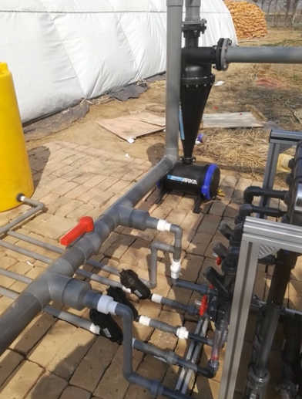
4. Misconceptions Regarding Fertigation
(3) Neglect of filter installation and routine maintenance
Grower Misunderstanding
Assume well water / other water sources are clean enough and do not require filters.
Fail to clean filters on a regular basis.
Actual Situation
Well water contains sediment.
Sediment accumulates over time.
  → Clogs filters.
  → Hinders normal water flow in irrigation systems.
Notes:
3.不安装或没有定期清理过滤设备：有些种植户认为井水或其他水源很干净，不需要安装过滤器，或者长时间不清理过滤器。实际上，井水中常含有较多泥沙，积累多了容易堵塞过滤器，影响过水。
3.4.3.Neglect of filter installation and routine maintenance
Some growers assume that well water and other water sources are clean enough and do not require filters,
or they fail to clean the filters on a regular basis.
In fact, well water usually contains sediment.
Such particles accumulate over time,
clog filters
and hinder normal water flow within irrigation systems.

Slide 18
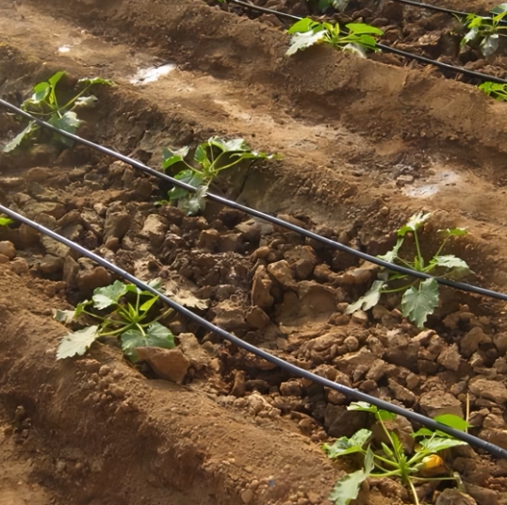
5. Precautions for Applying Fertigatione
Drip Irrigation Control
Avoid excessive irrigation.
Apply water only to crop root zones and surrounding soil.
Filter Maintenance
Require regular upkeep + cleaning after a period of operation to prevent blockage.
Concentration of Fertilizer Solution
Properly regulated to prevent crop damage caused by over-fertilization.
System Maintenance
Routine maintenance of the entire irrigation system.
Comprehensive inspection & overhaul of all pipelines.
  recommended after the end of each irrigation season.
Notes:
（五）水肥一体化技术应用注意事项
滴灌施肥时，要防止过量灌溉，只灌溉根系及根系周围；要注意过滤设备的保护，过滤器使用一段时间后，要进行清洗，以防止堵塞。施肥时要合理控制施肥浓度，避免因过量施肥引起肥害。灌溉系统需要做好日常维护保养，每年灌溉季节结束后，应对管道进行一次全面检查维修。
3.5.Precautions for Applying Fertigation
During drip fertigation,
excessive irrigation should be avoided,
and water should only be applied to crop root zones and the surrounding soil.
Filter facilities
require regular upkeep and cleaning after a period of operation to prevent blockage.
In terms of fertilization,
the concentration of fertilizer solution should be properly regulated to prevent crop damage caused by over-fertilization.
Furthermore, the entire irrigation system needs routine maintenance.
A comprehensive inspection and overhaul of all pipelines is
recommended after the end of each irrigation season.

