Slide 1

粮库粮食储藏减损的工程技术措施
Engineering and Technical Measures for Reducing Grain Storage Losses in Grain Depots
国家粮食和物资储备局科学研究院
Academic of National Food and Strategic Reserves Administration
北京国贸东孚工程科技有限公司
Beijng Guomao Dongfu Engineering Technology CO. Ltd.
胡 小 中 博士
Dr. Hu Xiaozhong
September, 2024

Slide 2
CONTENTS
粮食储藏损失原因
Reasons for grain storage losses
提升仓房储藏效能
Improvement on the storage efficiency of granaries
01
02
集成绿色储粮技术
Integration of green techniques
for grain storage
升级接发工艺装备
Upgradation on grain loading and unloading equipment
03
04
强化库区智慧管理
Strengthening intelligent management of grain in depots
粮食储藏减损成就
Achievements in reducing grain storage losses
05
06

Slide 3
01
粮食储藏损失原因
Reasons for the grain storage losses

Slide 4
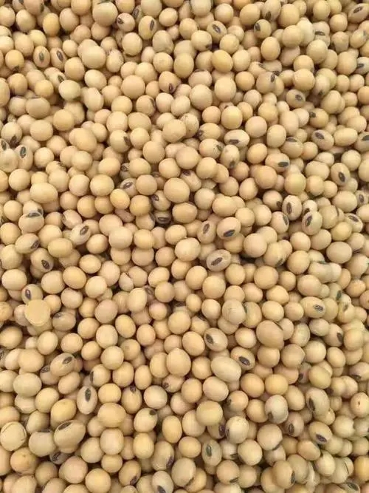
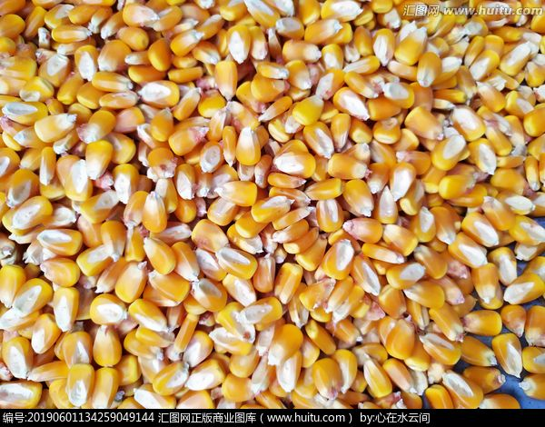
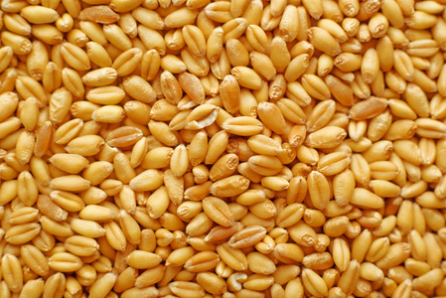
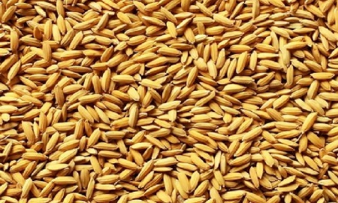
粮食储藏损耗主要发生在出入库环节和静态保管期间，主要因素包括自然因素和人为因素，自然因素包括粮食的水分、杂质、破碎度，仓库的温度、湿度与通风情况等；人为因素包括操作不当、管理不善等。因此，需深入了解粮食出入库作业过程及粮食储藏特点，分析损耗原因，采取有效应对措施，降低粮食储藏损耗。
Grain storage losses mainly occur during the entry and exit to depot as well as static storage periods. Natural factors for grain losses include the moisture content, impurities, breakage degree of grain, and the temperature, humidity, and ventilation conditions within warehouses. Human-related factors for drain losses include improper operation and poor management practices etc. Therefore, it is essential to gain a deep understanding of the flow of entrance/exit to grain depot and the characteristics of grain storage, analyze the losses reasons, and take effective measures to reduce the grain losses during storage.

Slide 5
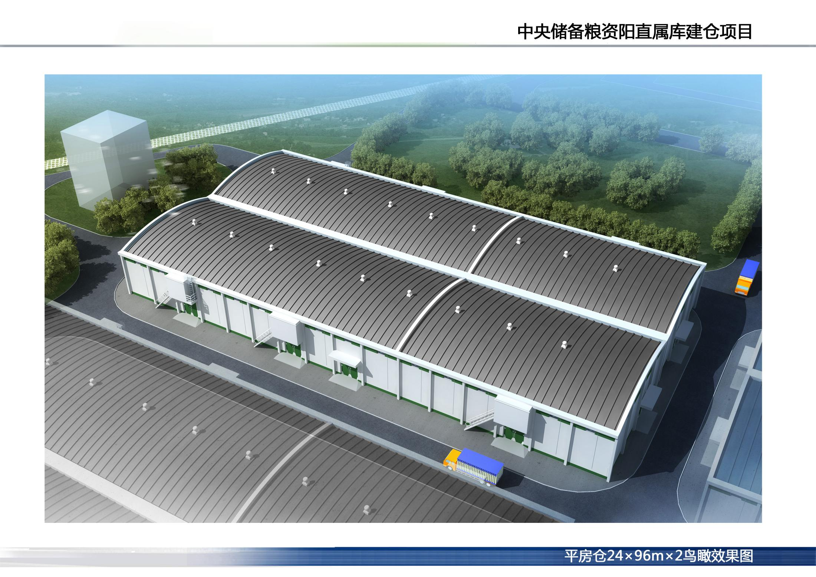
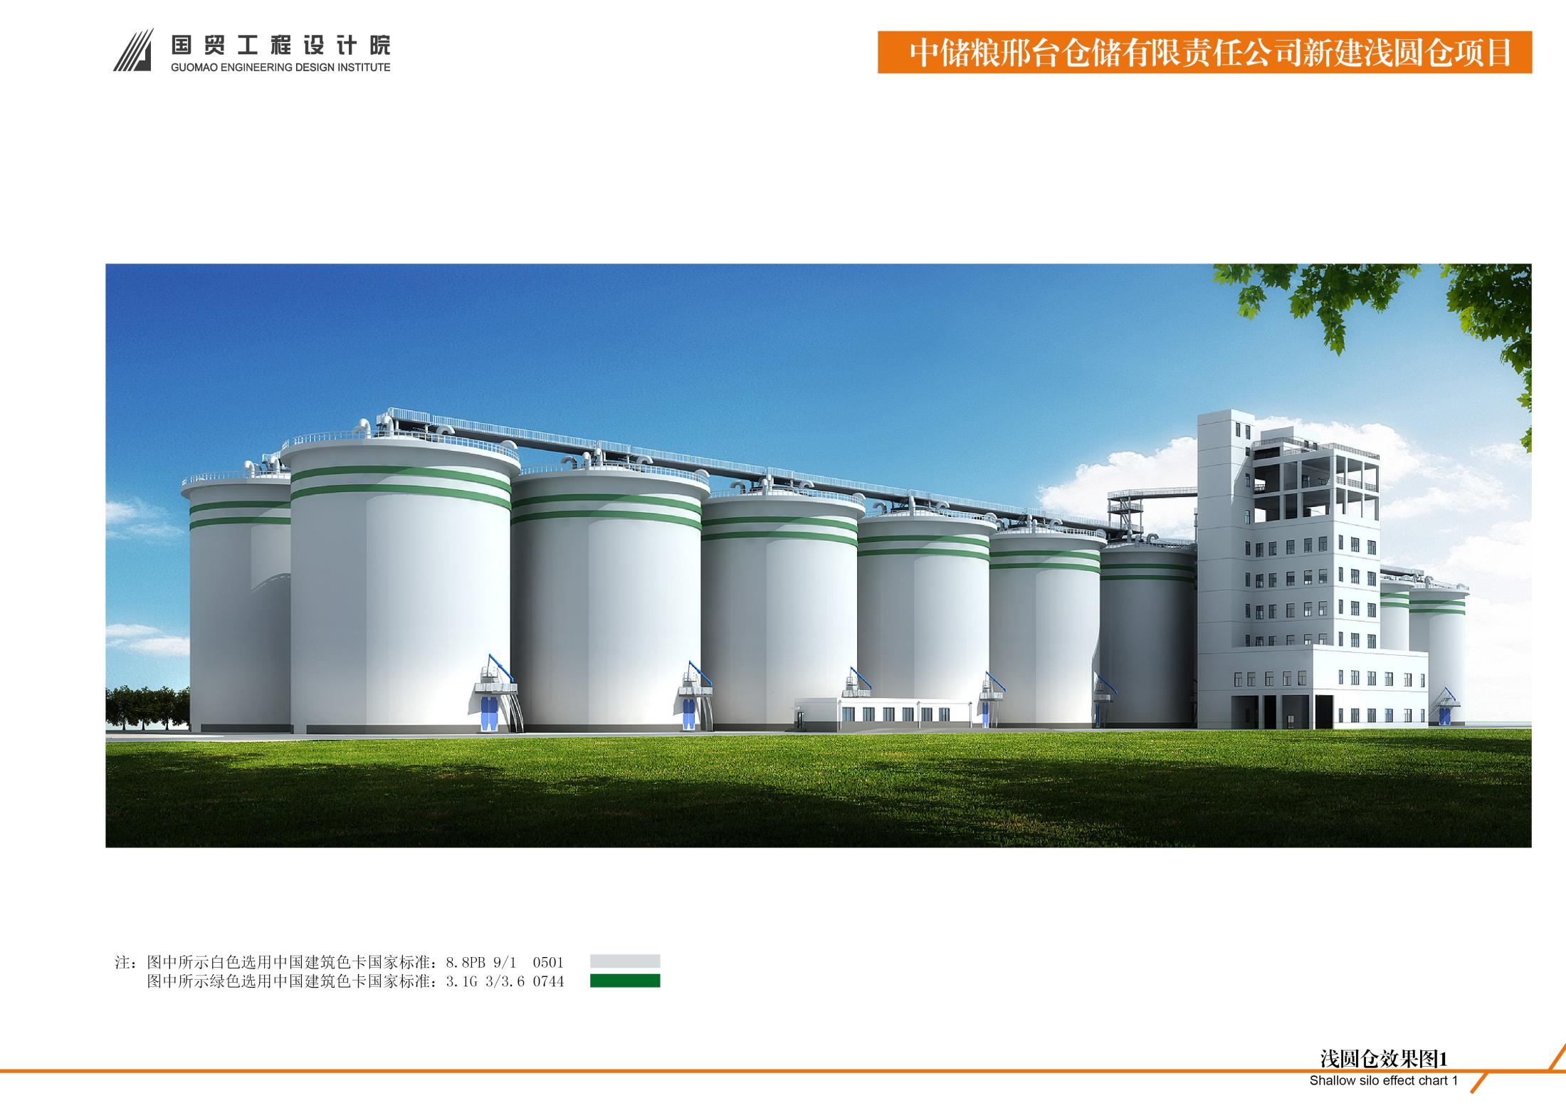
粮食出入库流程
Flow of entrance/exit to grain depot
粮食
Grain
入 库
Entrance to depot
扦检
Sampling、Inspection
计量
Weighing
接收
Unloading
清理
Cleaning
Grain storage
发放
Loading
出仓
Out-warehousing
入仓
Warehousing
输送
Conveying
计量
Weighing
出 库
Exit to depot
粮食
Grain

Slide 6
粮库粮食储藏特点
Characteristics of grain storage in depots
储粮仓房型式多样，包括平房仓、浅圆仓、立筒仓、钢板仓、楼房仓等。
There are various types of grain storage granaries, including warehouses, squat silos, steel silos, and multi-storied warehouses etc.
01
储粮技术复杂，七大储粮生态区的储粮工艺存在差异。
The grain storage technology is complex, and there are differences in grain storage technology among the seven ecological zones for grain storage.
储粮品种多样，包括小麦、玉米、稻谷、大豆。
There are various types of stored grain, including wheat, corn, rice, and soybeans.
05
02
粮库粮食储藏特点
单库仓容规模大。
The storage capacity of Individual grain depot is generally large.
政策性粮食储藏周期长，一般为一年至五年。
Storage period of policy oriented grain is long, generally from one to five years.
04
03

Slide 7
粮食储藏损失主要原因
Main reasons for grain storage losses in depots
仓房储藏效能低
Lower storage efficiency of granaries
储粮工艺问题
Problems on storage technologies
虫害粮
Pest damaged grain
储藏粮食
Stored grain
粮堆结露
Dewfall of grain piles
损失粮食
Lost grain
粮堆温度高
High temperature of grain piles
霉变粮
Mold contaminated grain
粮堆杂质聚集
Impurity aggregation of grain piles
自然损失粮
Lost grain naturally
粮堆破碎度大
High grain breakage rate
管理原因
Management reasons

Slide 8
02
提升仓房储藏效能
Improvement on the storage efficiency of granaries

Slide 9

仓房储藏效能优良是保障储粮安全、降低粮食损失的基础，粮食仓房的保温隔热性、气密性、防水防潮性能是影响储藏效能的关键因素。储粮期间，气温对粮温的影响程度不仅取决于仓房的保温隔热性能，而且还与仓房的气密性密切相关，良好的保温隔热性能和气密性可以阻止外界热量经仓房围护结构和仓房缝隙传递入仓，从而维持粮温的相对稳定。提升仓房储藏效能措施包括选择合理仓型，采用新型保温隔热材料等。
The excellent storage efficiency of granaries is the basis for ensuring food safety and reducing grain losses. The thermal insulation, airtightness, and waterproof and moisture-proof properties of granaries are key factors affecting storage efficiency. During grain storage, the influence of air temperature on grain temperature in the granaries not only depends on the thermal insulation, but is also closely related to the airtightness. Good thermal insulation and airtightness performance can prevent external heat from transmitting into the granary through its enclosure structure and gaps, thereby maintaining a relatively stable grain temperature. Measures to improve the storage efficiency of warehouses include choosing a reasonable type of granary and using new types of thermal insulation materials.

Slide 10
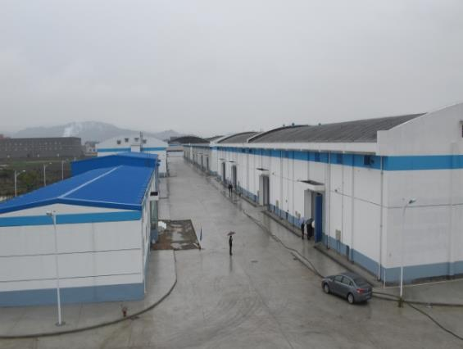
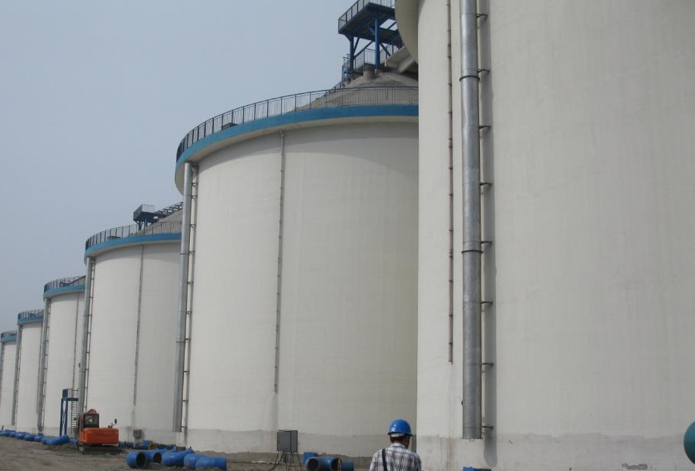
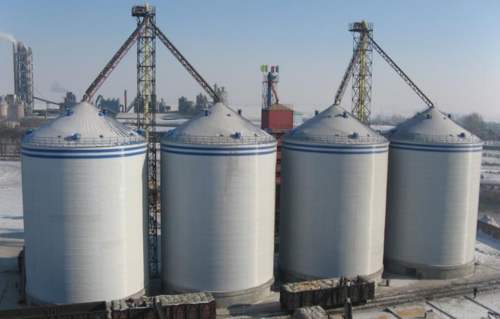
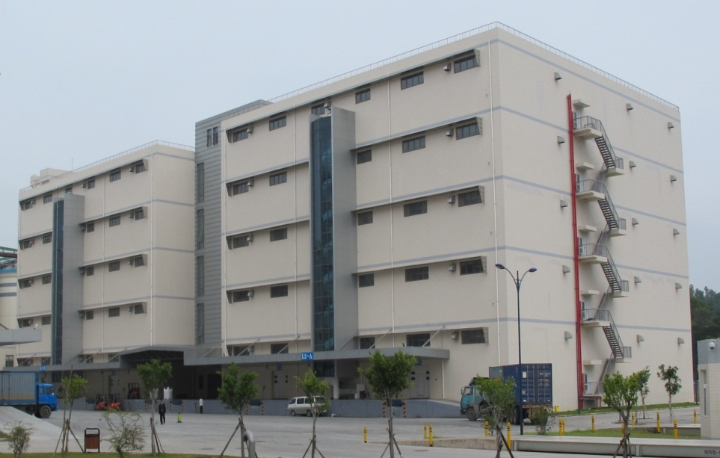
仓型选择
Choice for granary types
中国现有储藏粮食仓型包括：平房仓、浅圆仓、钢板仓（保温）、楼房仓等。应选用具有良好保温隔热和气密性能的平房仓、浅圆仓。
平房仓
Warehouses
浅圆仓
Squat silos
There are various types of storage granaries, including warehouses, squat silos, insulated steel silos and multi-storied warehouses etc. The warehouses and squat silos are preferred to be designed and constructed, due to their thermal insulation and airtightness properties.
钢板仓（保温）
Insulated steel silos
楼房仓
multi-storied warehouses

Slide 11
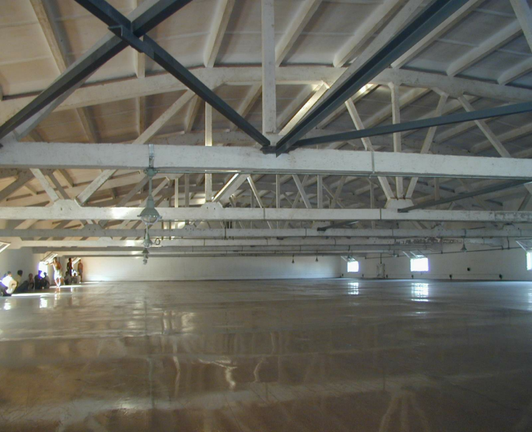
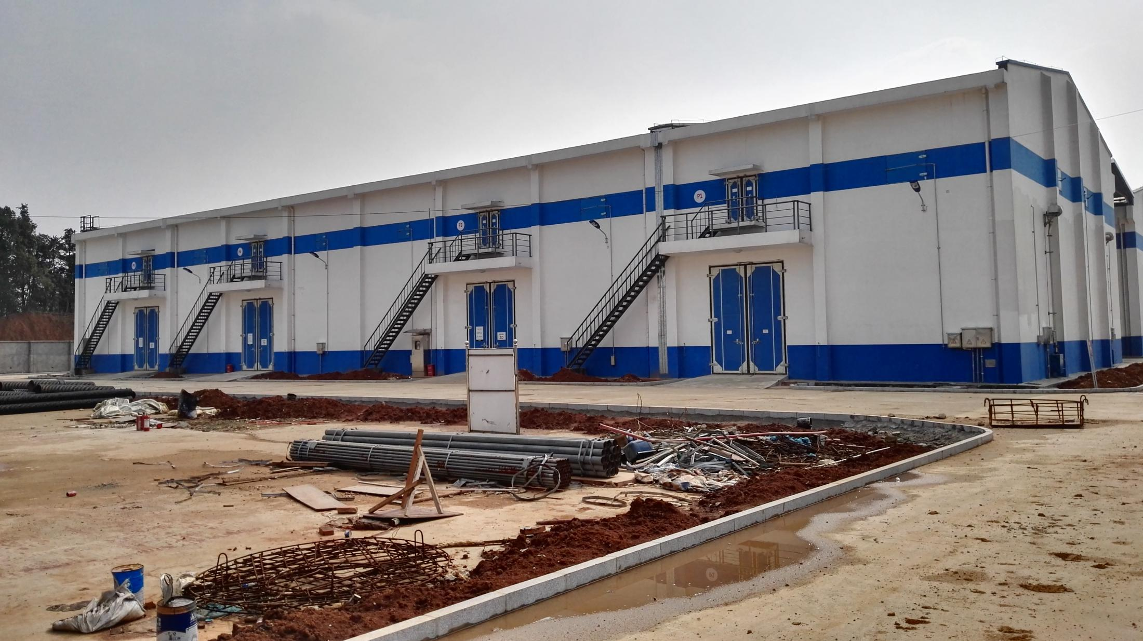

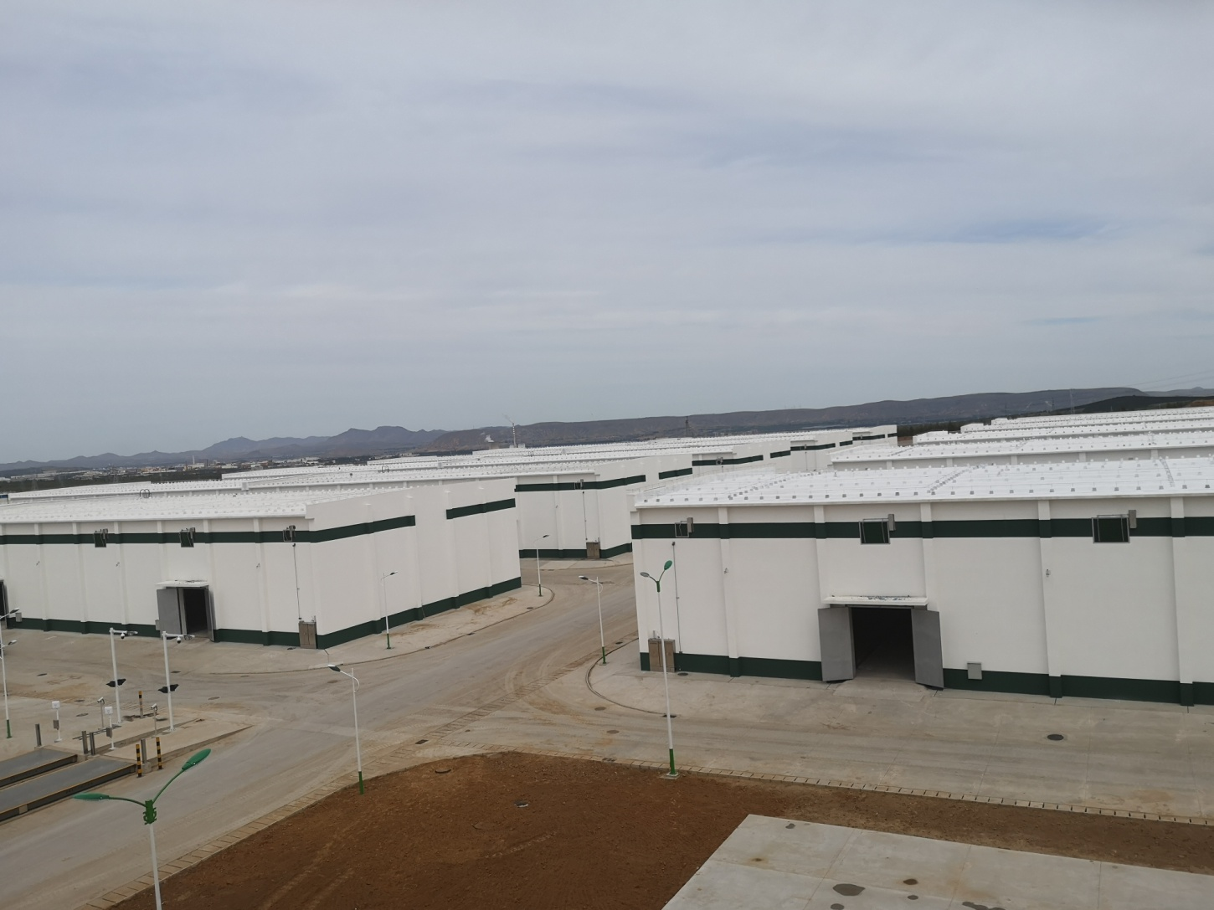
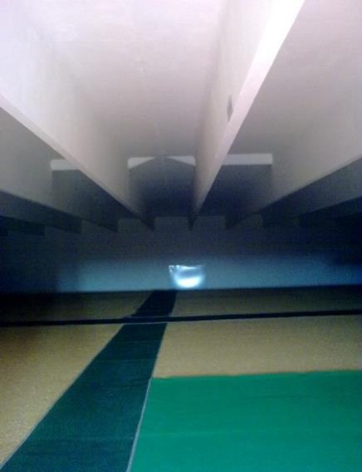
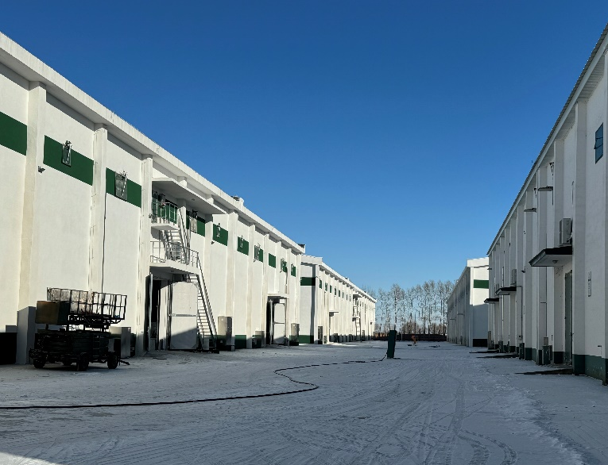
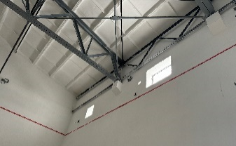
仓型选择
Choice for granary types
储藏粮食平房仓仓型包括：折线形屋架平房仓、拱板屋盖平房仓、双T板屋盖平房仓、钢屋盖平房仓等。当前，在平房仓设计和建造中，宜采用具有良好气密性的折线形屋架平房仓、拱板屋面平房仓。
折线形屋架平房仓
Line shaped roof truss warehouse
拱板屋面平房仓
Arch slab roof warehouse
There are various types of warehouses, including line shaped roof truss warehouse, arch slab roof warehouse, double T-shaped board warehouse and steel roof warehouse etc. At present，Line shaped roof truss warehouse and arch slab roof warehouse are suitable to be designed and constructed，owing to their good airtightness properties.
双T板屋盖平房仓
Double T-shaped board warehouse
钢屋盖平房仓
Steel roof warehouse

Slide 12
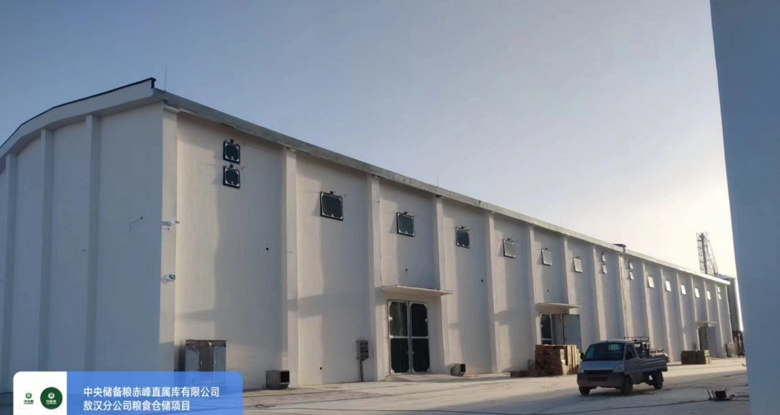
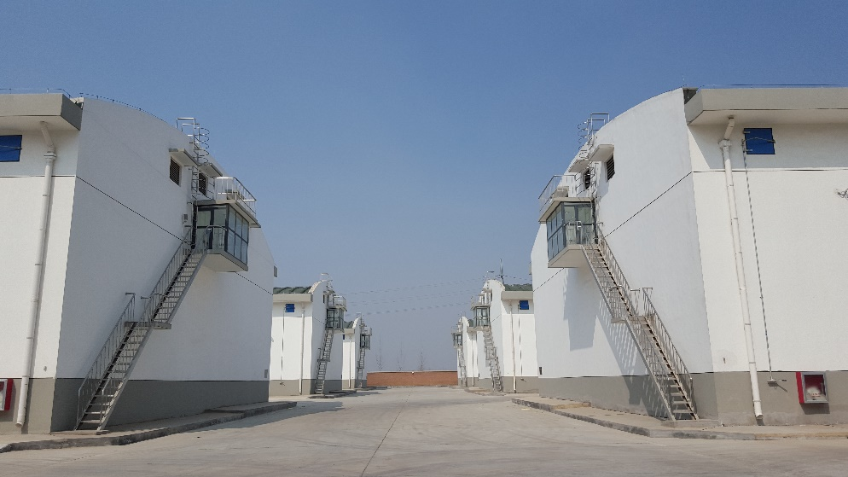
仓型选择
Choice for granary types
仓型 granary types | 储粮生态区 Ecological zones for grain storage | 特点 Characteristics
折线形屋架平房仓 Line shaped roof truss warehouse | 高寒干燥储粮区、低温干燥储粮区、低温高湿储粮区、中温干燥储粮区 Grain storage zones of ice-cold and dry, low temperature and dry, low temperature and high humidity, moderate temperature and dry | 跨度18m～30m；技术成熟，易积热积尘 Span of 18m～30m；Mature construction technology, Higher roof solar absorptivity and dust accumulation
拱板屋面平房仓 Arch slab roof warehouse | 中温干燥储粮区、中温高湿储粮区、中温低湿储粮区、高温高湿储粮区 Grain storage zones of moderate temperature and dry, moderate temperature and high humidity, moderate temperature and low humidity, high temperature and high humidity | 跨度18m～24m；保温隔热效果好，不易积尘 Span of 18m to 24m，Higher thermal insulation and air tightness, and lower dust accumulation.
折线形屋架平房仓
Line shaped roof truss warehouse
注：摘自《高标准粮仓建设标准》
Note: form” Construction standard for well-facilitated granary”
拱板屋面平房仓
Arch slab roof warehouse

Slide 13
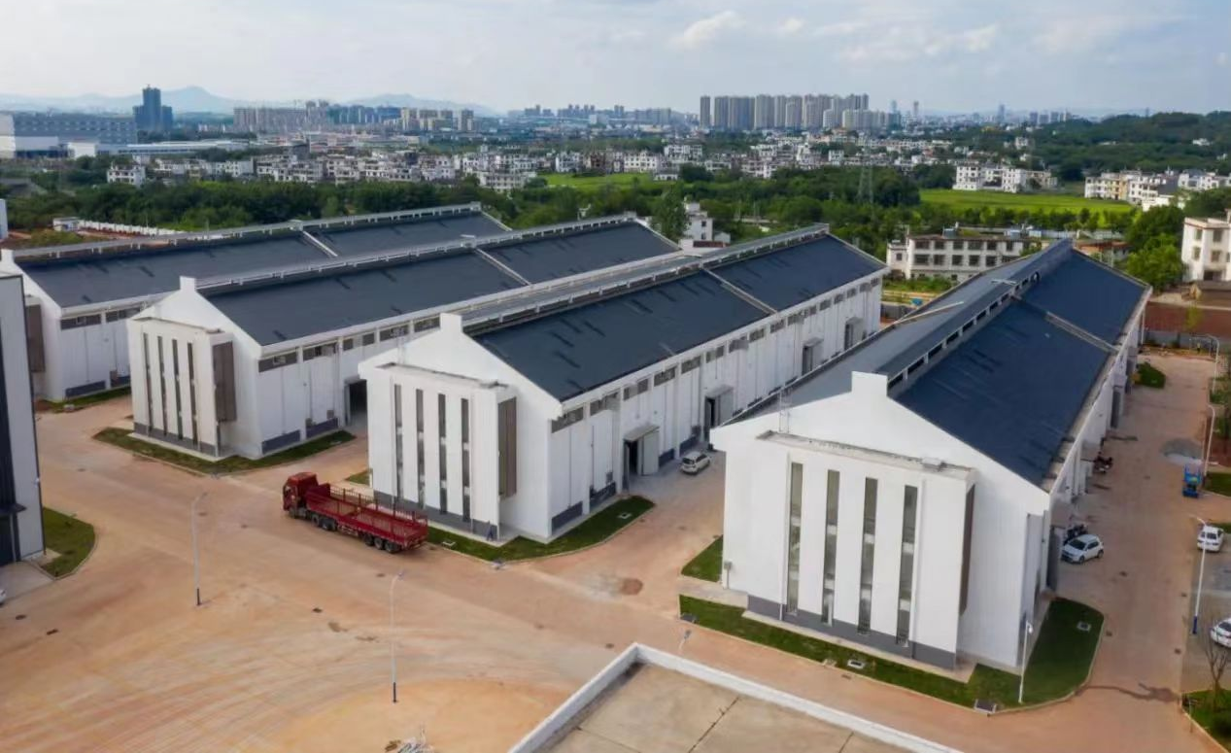
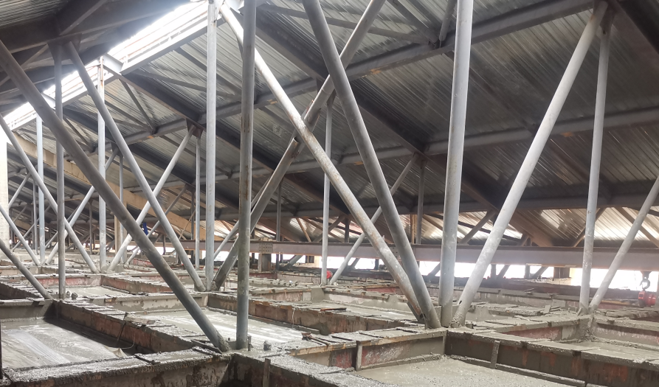
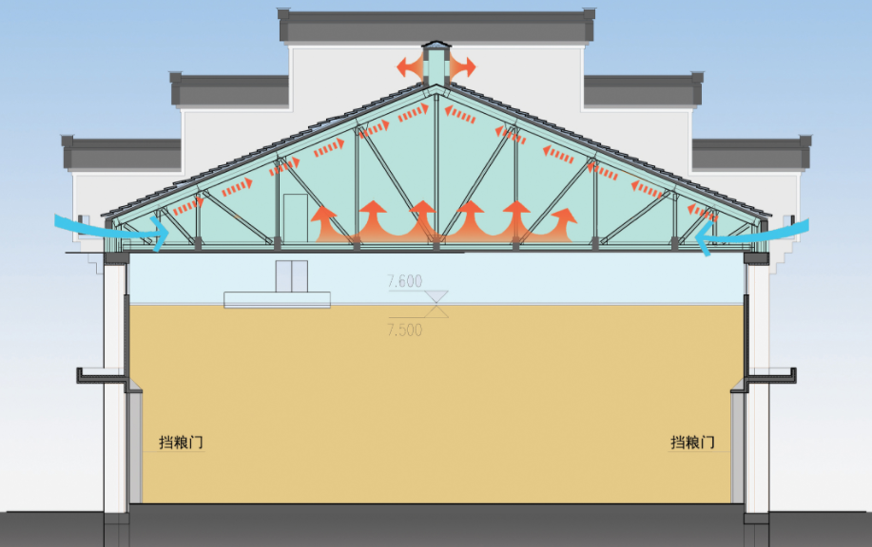
仓型选择
Choice for granary types
钢制-混凝土组合双层屋盖平房仓，其具有装配式和整体式有机结合、气密保温隔热效果好、跨度适用性强、施工进度快、总图布局适宜性优等特点，有利于集约利用土地。屋顶（下层屋面板）和墙体采用现浇混凝土，形成封闭的钢筋混凝土储粮空间，仓体气密性好；檐口设置通长通风百页窗，屋脊设置通长通风天窗，形成贯穿平房仓全长的屋顶自通风系统，仓房隔热性优。
upper cast-in-situ roof
Air outlets
Double roof warehouse with combination of steel roof truss and cast-in-situ concrete, the pre-fabricated steel roof truss helps to speed up the construction progress. Cast-in-place concrete is used on the lower roof panel and wall to form a grain storage space with good air tightness and strong applicability of span. The eaves with long ventilating louvers and the roof with long ventilating skylights form a full-length roof self-ventilating system with excellent thermal insulation.
Air inlets
Air inlets
Lower cast-in-situ roof
Steel roof truss
Door of warehouse
Cast-in-situ concrete warehouse body

Slide 14
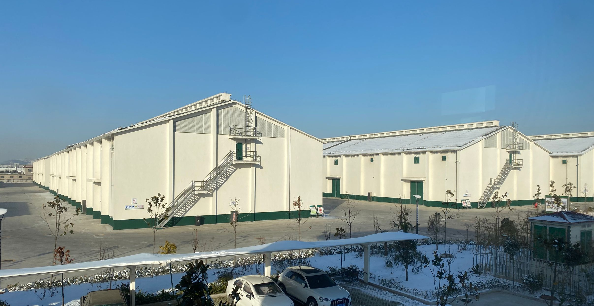
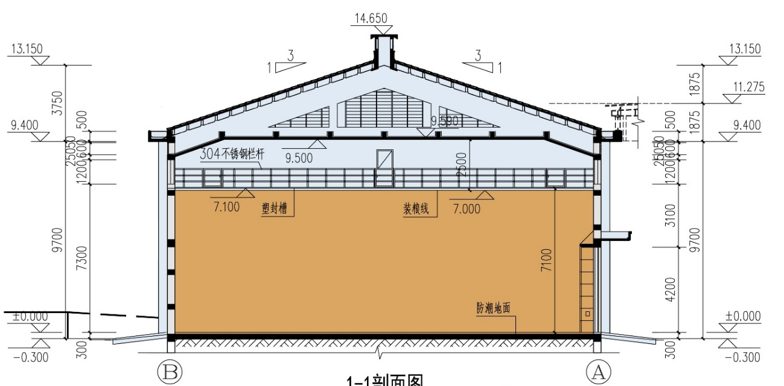
仓型选择
Choice for granary types
瓦顶-混凝土组合双层屋盖平房仓，其屋面底层为现浇钢筋混凝土板，顶层为挂瓦屋面，四周围护结构为砖砌墙体，利用空气自然流动原理，排出屋盖夹层的热空气，保温隔热及气密效果好，有效降低仓内粮堆温度约5℃。
Double roof warehouse with combination of tile and cast-in-situ concrete, the roof structure has a cast-in-place reinforced concrete slab at the base layer, with a tiled roof at the top. The surrounding protective structure is a brick masonry wall. Utilizing the principle of natural air flow, it expels the hot air from the roof interlayer, providing good thermal insulation and air tightness. This effectively reduces the temperature of the grain pile inside the warehouse by approximately 5℃.
upper-level tiled roof
Lower cast-in-situ roof
brick wall warehouse body
Notes:
双层屋盖平房仓通常应用在第五/六/七储粮生态区。

Slide 15
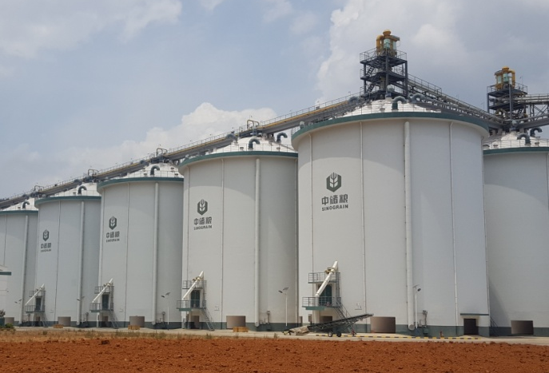
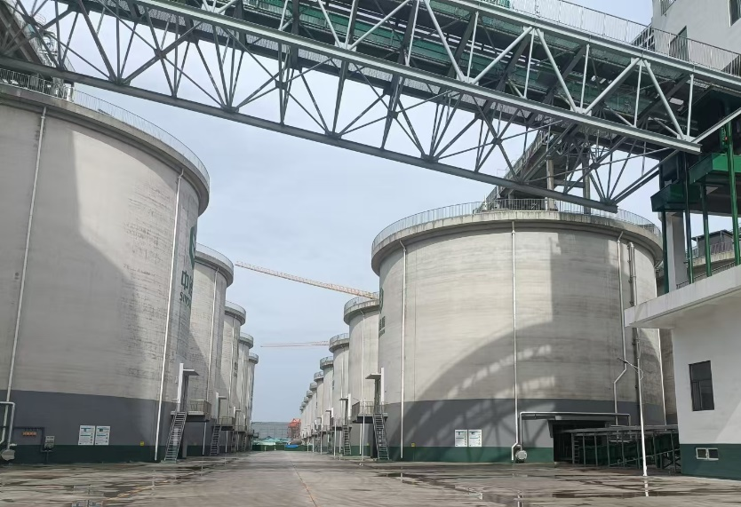
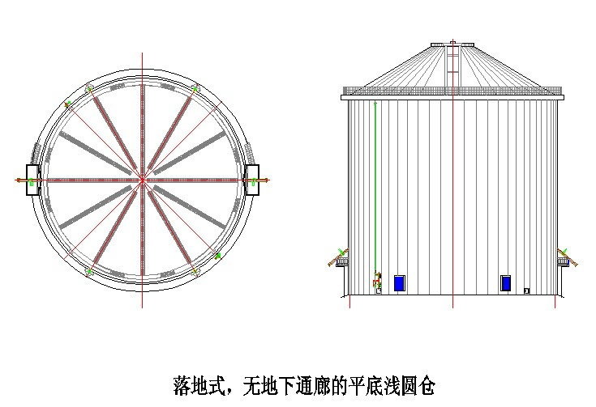
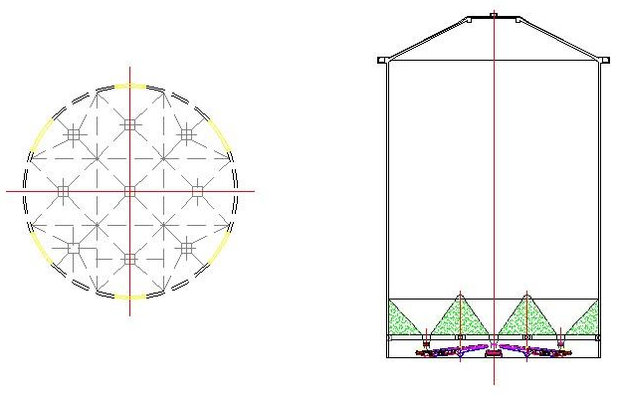
仓型选择
Choice for granary types
储藏粮食浅圆仓仓型包括：落地式浅圆仓、架空式浅圆仓。在满足储粮工艺要求的前提下，优先选用机械化程度高、占地少、气密性能好的浅圆仓。并且，架空式浅圆仓兼顾储备和中转功能，广泛应用港口等重要粮食物流节点。
落地式浅圆仓
Ground-supported squat silos
架空式浅圆仓
stilted floor squat silos
There are two types of squat silos, i.e. ground-supported squat silos and stilted floor squat silos. Compared with warehouses, the design and construction of squat silos are more popular because of their higher degree of mechanization, less land occupation, and better air tightness performance. Furthermore, stilted floor squat silos combine reserve and transit functions, and are widely used in important grain logistics nodes such as ports.

Slide 16
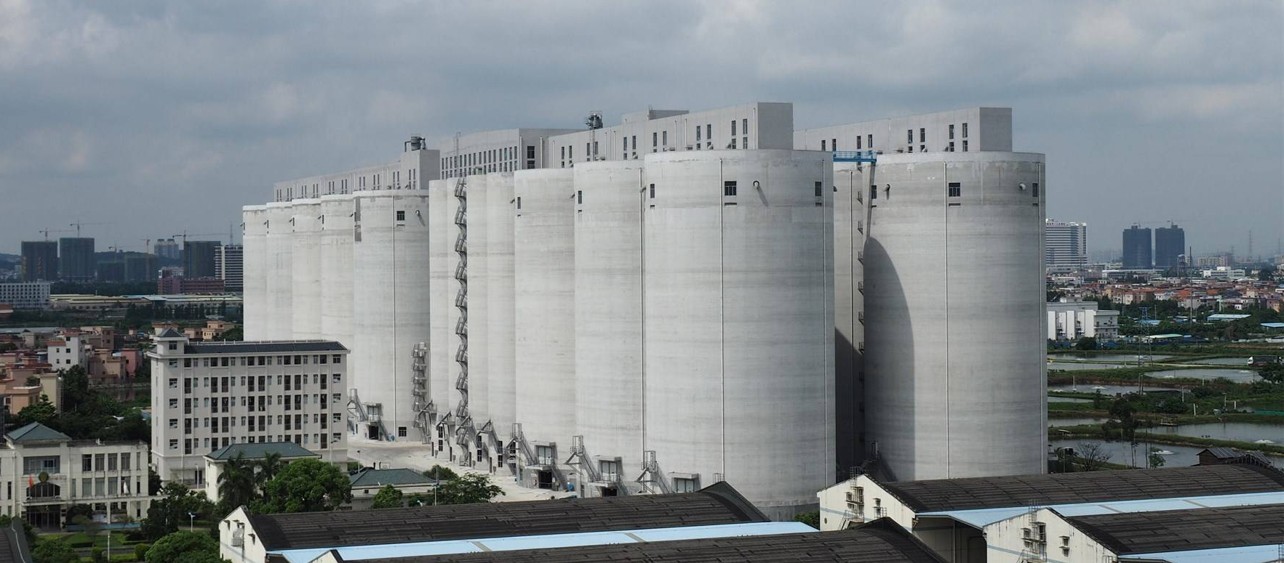
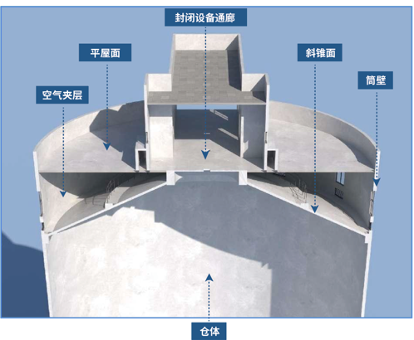
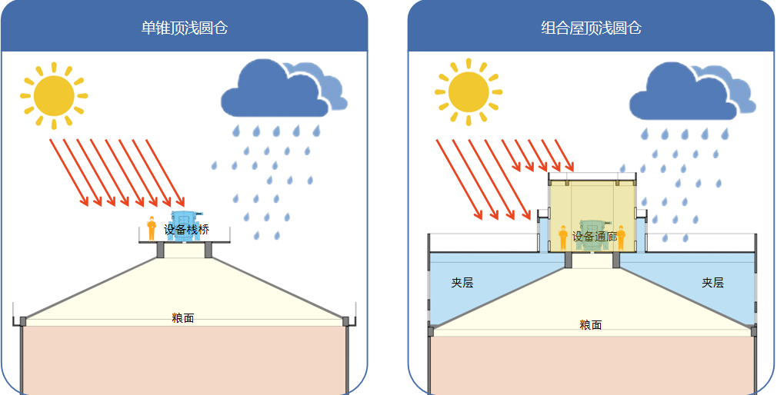
仓型选择
Choice for granary types
组合屋盖浅圆仓：采用空间组合薄壳结构形式，包括筒壁、斜锥面、空气夹层、平屋面、封闭设备通廊。具有隔热节能、防水优良、运维方便等优点。
Double roof squat silos: It has a spatial composite thin-shell structure, including cylindrical walls, lower conical roofs, air interlayers, upper flat roofs, and enclosed equipment corridors. It features excellent thermal insulation for energy saving, superior waterproofing, and convenient operation and maintenance.
enclosed equipment corridor
Upper flat roof
lower conical roof
cylindrical wall
air interlayer
Conventional squat silos
Double roof squat silos
squat silo body

Slide 17
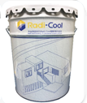
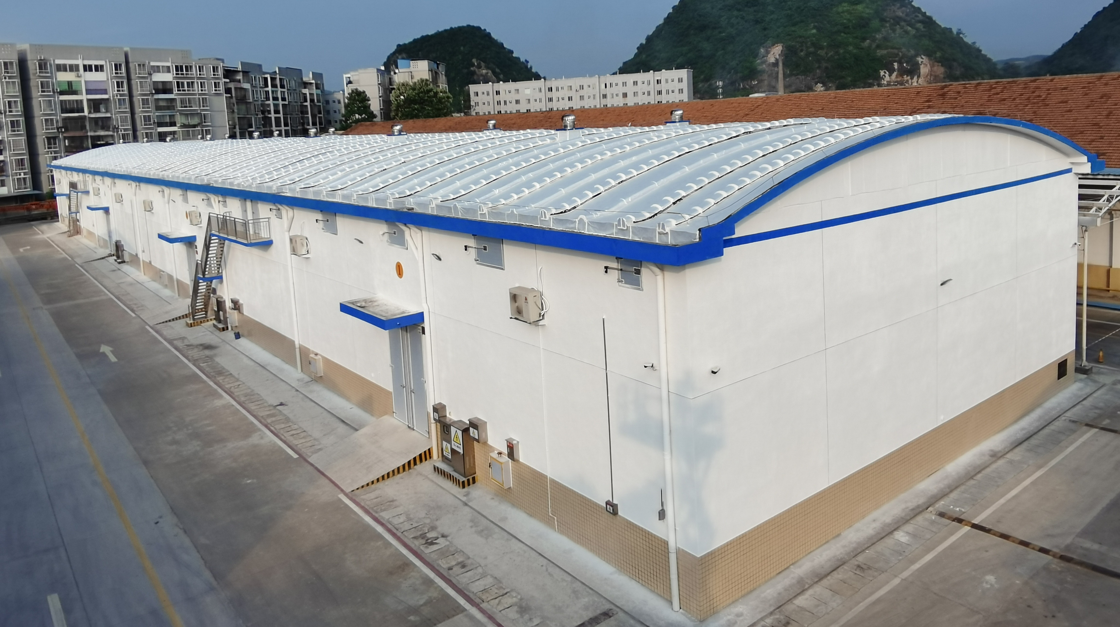
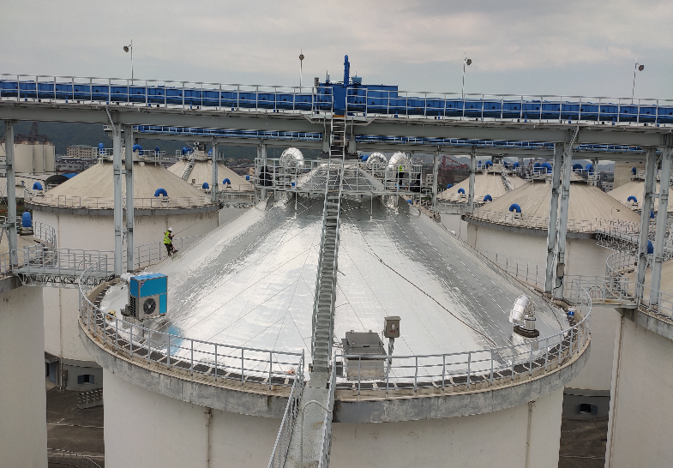
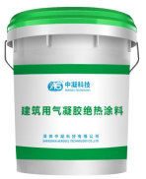
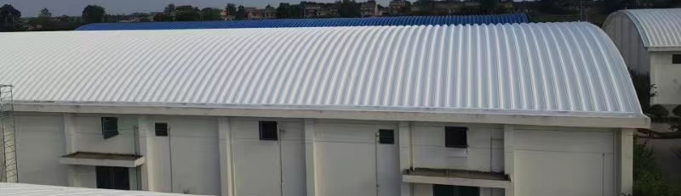
新型保温隔热材料
New materials for the thermal insulation
近年来，随着绿色储粮和节能降碳技术的发展，气凝胶、辐射制冷等新型保温隔热材料具有密度小、比表面积大、热导率低、环保性能高等优点，其在粮食仓房中的应用越来越受到人们的广泛关注。
In recent years, with the development of green grain storage technology and energy-saving carbon reduction technology, new thermal insulation materials， such as aerogel and radiative cooling structural materials have attracted wide attention due to their advantages of low density, large specific surface area, low thermal conductivity, and high environmental performance. Their application in grain warehouses is becoming more and more popular.

Slide 18
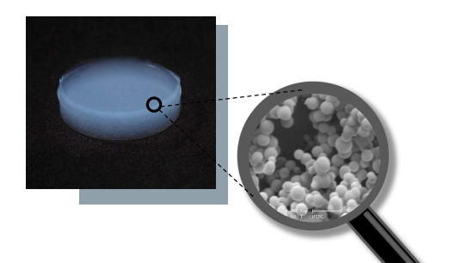

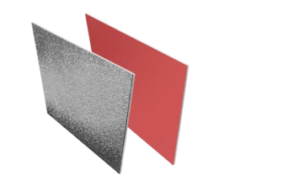
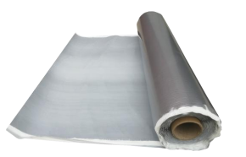
新型保温隔热材料—气凝胶
New materials for the thermal insulation— Aerogel
特性：
隔热保温 导热系数低, 0.013～0.016W/m.K
高效吸附 纳米结构，比表面积大，气孔率高
疏水防潮 粉体内部骨架呈疏水性，憎水率≥99%
产品种类：
气凝胶涂料、气凝胶板材、气凝胶卷材
Features
Thermal insulation: thermal conductivity of 0.013～0.016 W/m.K
High adsorption: Nanoscale structure, large specific surface area
High hydrophobicity: the water-repellent rate of ≥99%
Product Types
Aerogel coating, aerogel panels and aerogel roll
气凝胶结构
Structure of aerogel
气凝胶涂料
Aerogel coating
气凝胶板材
Aerogel panel
气凝胶卷材
Aerogel roll

Slide 19
新型保温隔热材料—气凝胶涂料
New materials for the thermal insulation— Aerogel coating
技术参数 technical specification
特性：
保温隔热性能好：较高太阳辐射反射系数，较低导热系数
防潮性能好：疏水性好，屋顶施工可以再刷一层防水
阻燃性能优：不会造成自燃或助燃
耐候性好：漆面可洗刷，不易开裂
绿色环保：无毒无害，不造成环境污染
项 目 Items | 指 标 Index
导热系数（W/m.K） Thermal conductivity（W/m.K） | 0.035～0.065
耐温范围（℃） Range of temperature（℃） | -40～120
干燥时间（表干）/h Time of drying/h | ≤4
施工温度（℃） Temperature of construction（℃） | 5～40
用量（厚2mm）kg/m2 aerogel dosage（kg/m2） | 1.5
状态 State | 均匀浆状 Uniform slurry
Features
Good thermal insulation: higher solar radiation reflectivity, lower thermal conductivity
Good water-proof performance: good hydrophobicity, a layer of waterproofing applied to the roof construction
Excellent flame retardant properties: no self-combustion or combustion aid
Good weather resistance: paint surface is washable and not prone to cracking
Green environmental protection: non-toxic and harmless, no pollution

Slide 20
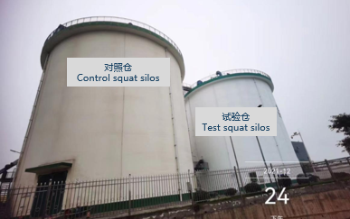
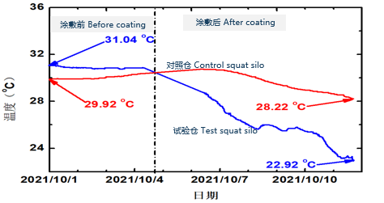
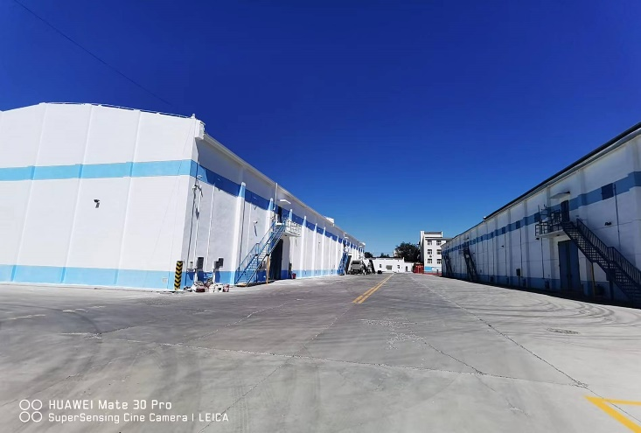
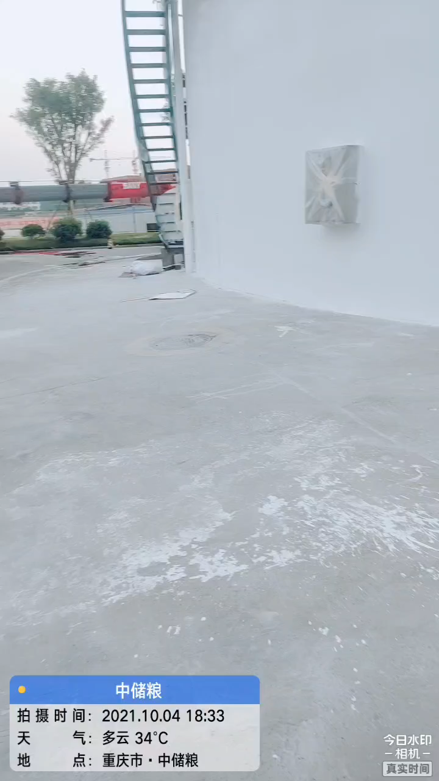
涂敷气凝胶制冷材料（仓顶、仓壁）后，仓内粮食温度31.04 ºC降低到22.92 ºC ；对照浅圆仓粮食温度从29.92 ºC降低到28.22 ºC。与对比仓相比，降低5.3ºC（地点：重庆江津市）。
The temperature of grain decreased from 31.04 ºC to 22.92 ºC inside the test silo , which dropped from 29.92 ºC to 28.22 ºC inside the control silo. Compared with the control silo, it was reduced by 5.3ºC. (location: Jiangjin City, Chongqing)

Slide 21
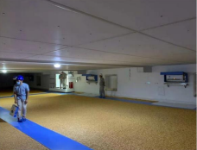
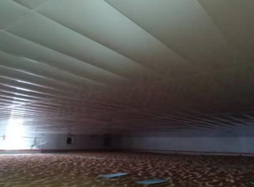
新型保温隔热材料—气凝胶板材
New materials for the thermal insulation— Aerogel panel
技术参数 technical specification
特性：
燃烧性能等级：A级防火
重量轻：10～13kg/m2，施工简捷
防潮性能好：防水性能好，使用寿命长（10年）
规格 Size | 吊顶板 Ceiling Panel | 内墙板 Interior Wall Panel
厚度（mm) Thickness（mm) | 6～16 | 15～20
平米重量（kg/m2） mass per square meter （kg/m2） | 10～13 | /
Features
Combustion performance grade: A level fire prevention
Light weight: 10~13 kg/m², easy construction
Moisture-proof performance: Good waterproof performance and long service life (10 years)

Slide 22
新型保温隔热材料—气凝胶卷材
New materials for the thermal insulation— Aerogel roll
特性：
抗紫外线、太阳辐射反射比高
施工便捷，可直接与水泥基面、金属面粘结，成型好
粘结强度高，柔性好，能适应金属屋面热胀冷缩变形和风载荷变形
抗拉强度高，延伸性好，对基层收缩变形和开裂的适应能力强
技术参数 technical specification
项 目 Items | 指 标 Index
持粘性（min） Permanent adhesion（min） | 26
耐热性 Heat resistance | 无流淌、龟裂、变形 No flowing, cracking, or deformation
低温柔软性 Low temperature softness | 无裂纹 No cracks
剥离强度（N/mm） Peel strength（N/mm） | 0.8
太阳光反射比 Solar reflectance | 0.82
Features
UV resistant, high solar radiation reflectance
Easily constructed, directly bonded with cement-based or metal surfaces
High bonding strength, good flexibility, adaptable to the deformation of thermal expansion and contraction of metal roofs and wind load
High tensile strength, good elongation properties, strong adaptability to shrinkage deformation and cracking of the substrate

Slide 23
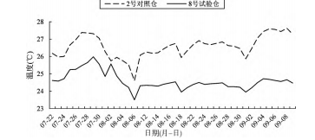
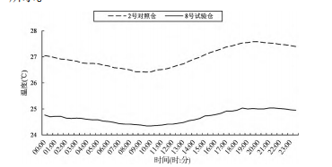
新型保温隔热材料—气凝胶卷材
New materials for the thermal insulation— Aerogel roll
对照仓 Control warehouse
试验仓 Test warehouse
平房仓仓顶敷设气凝胶卷材，试验仓仓内空间最高温度 25,9℃, 最低温度 23,7℃, 波动幅度 2,2℃; 对照仓仓内空间最高温度 27,8℃, 最低温度24,8℃, 波动幅度 3℃（福建省长乐市）。
The maximum environmental temperature is respectively 25.9°C and 27.8°C inside the test and control warehouse, and the minimum temperature is respectively 23.7°C and 24.8°C, with a fluctuation range of 2.2°C and 3.0°C respectively . Compared with control warehouse, it was reduced by 1-2ºC. (location: Changle City, Fujian province)
对照仓 Control warehouse
试验仓 Test warehouse
参考文献：李彦海等，气凝胶防水隔热卷材在南方粮仓应用效果研究. 【J】粮食储藏，2022（51）：13-18
Reference: Li Yanhai et al, Aanlysis and research on the application effect of aerogel waterproof and heat insulation coiled material in granary in southern China. [J] Grain Storage, 2022（51）：13-18

Slide 24
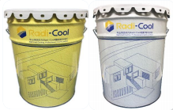
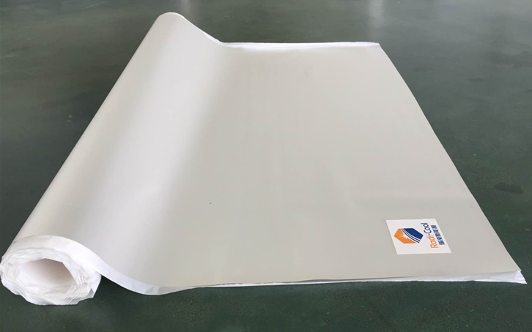
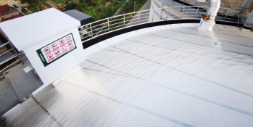
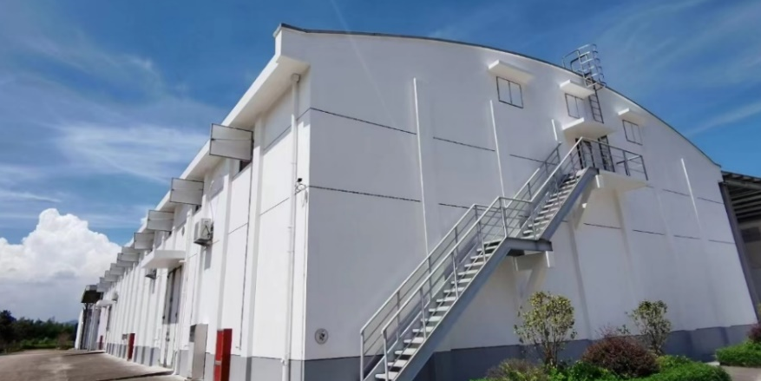
新型保温隔热材料—辐射制冷材料
New materials for the thermal insulation— Radiative cooling materials
功 能：保温隔热
用 途：涂料应用于仓房外墙表面涂层；膜材应用于仓房屋顶
表面敷设
Function：Thermal insulation
Usage: Radiation cooling coating applied to the exterior walls of the granary, and Radiation cooling film laid on the roof surface of the granary.
辐射制冷涂料
Radiative cooling coating
辐射制冷膜
Radiative cooling film

Slide 25



新型保温隔热材料—辐射制冷材料
New materials for the thermal insulation— Radiative cooling materials
仓温 Temperature curve of silo
对照仓 Control squat silo
浅圆仓仓顶敷设辐射制冷卷材，仓壁涂刷辐射制冷涂料，与对比仓相比，涂敷制冷涂料的浅园仓仓温最大降5.6ºC；粮面温度最大降4.9 ºC（浙江省衢州市）。
试验仓 Test squat silo
温差 Temperature difference
The experiment was conducted where a cooling radiant film was laid on the roof, and cooling radiant coating was painted. Compared to the control squat silo, the maximum temperature reduction of silo was 5.6°C，and the maximum temperature reduction of grain was 4.9°C (location: Quzhou City, Zhejiang province).
粮温 Temperature curve of grain
对照仓 Control squat silo
试验仓 Test squat silo
温差 Temperature difference

Slide 26




新型保温隔热材料—辐射制冷材料
New materials for the thermal insulation— Radiative cooling materials
仓温 Temperature curve of warehouse
对照仓 Control warehouse
拱板屋盖平房仓仓顶敷设辐射制冷卷材，与对比仓相比，辐射制冷膜的仓温最大降10.4ºC；粮面温度最大降4.5 ºC（浙江省杭州市）。
试验仓 Test warehouse
The experiment was conducted where a cooling radiant film was laid on the roof. Compared to the control warehouse, the maximum temperature reduction of warehouse was 10.4°C，and the maximum temperature reduction of grain was 4.5°C (location: Hangzhou City, Zhejiang province).
温差 Temperature difference
粮温 Temperature curve of grain
对照仓 Control warehouse
试验仓 Test warehouse
温差 Temperature difference

Slide 27



新型防水材料—丙烯酸聚合物水泥防水涂料
New materials for the thermal insulation— Acrylic polymer cement waterproof coating
功能：防水
特点：较好的稳定性、耐候性、耐紫外线老化性；抗裂性及粘接力强，抗剪切强度大；极好的耐水性、环保性。
用途：涂敷于平房仓、浅圆仓屋面
Function: waterproof
Features: Good stability, weather resistance and UV aging resistance; strong crack resistance and adhesion, high shear strength; excellent water resistance and environmental friendliness.
Usage: Acrylic polymer cement waterproof coating are laid on the roof of granary.

Slide 28

气密措施
Measures for granary air tightness
仓顶、门窗、设备孔洞等采用环保、耐候性能好的材料进行密封、气密技术处理。门窗、设备孔洞应设置双密封槽。仓房气密性500 Pa压力半衰期满足下列要求：
平房仓：气调仓空仓压力半衰期不低于300 s；非气调仓空仓不低于180 s。
浅圆仓：气调仓空仓应不低于480 s；非气调仓空仓不低于300 s。
The warehouse roof, doors and windows, equipment holes, etc. are sealed with environmentally friendly and weather resistant materials. Double sealing grooves should be installed for doors, windows, and equipment holes. The airtightness of the granary meets the following requirements for half-life at 500 Pa pressure :
Controlled atmosphere warehouse ≥ 300s，non controlled atmosphere warehouse ≥ 180s.
Controlled atmosphere squat silo ≥ 480s，non controlled atmosphere squat silo ≥ 300s.

Slide 29
03
集成绿色储粮技术
Integration of green techniques for grain storage

Slide 30
目前，中国正在深入实施粮食绿色仓储提升行动，坚持“藏粮于技”，在仓房性能良好前提下，综合考虑自然条件、储粮品种、储粮生态区等因素，合理选择应用氮气气调、制冷控温、内环流控温、横向通风集成，以及非化学药剂防治等技术，推广绿色、低温储粮技术集成应用。
At present, China is deeply implementing the action to enhance green grain storage, adhering to the principle of “storing grain through technology”. Under the premise of good granary performance, taking into account natural conditions, stored grain varieties, ecological zones for grain storage and other factors, reasonable technologies, such as nitrogen controlled atmosphere, refrigeration temperature control, inner circulation temperature control, transverse ventilation, as well as non chemical pest prevention technologies are selected and applied, which promote the integrated application of green and low-temperature technologies for grain storage.

Slide 31



多参数粮情测控和预警技术
Multi-parameter grain condition monitoring ，
controlling and warning technology
对粮温、湿度、仓温、仓湿度等参数实行实时监测，并推理拟合粮情云图分析技术，动态分析和预测粮情变化，区分粮堆正常变化和异常变化，为通风、控温、气调等决策与作业操作提供数据支持，保障储粮安全。
The real-time monitoring of parameters such as grain temperature, humidity, warehouse temperature, and warehouse humidity is implemented, and the Fitting grain situation cloud image analysis technology is applied to dynamically analyze and predict changes in grain conditions, and distinguish between normal and abnormal changes in the grain pile, which provides data support for ventilation, temperature control, controlled atmosphere, and other operations to ensure food safety.

Slide 32



机械通风技术
Ventilation system for grain storage
将符合温湿度条件的外界空气由通风机产生的压力差作用下沿着粮堆籽粒空隙穿过粮层，以改变粮堆空隙中气体介质的参数，实现粮堆温度、湿度精准调控等，防止粮食结露霉变 , 保障粮食储藏安全。
“External air meeting temperature and humidity conditions is forced through the grain layers along the gaps in the grain pile by the pressure difference created by a ventilator. This process alters the parameters of the gas medium within the grain storage space, precisely controls the temperature and humidity of the grain pile, which prevents moisture condensation and mold growth, and ensures the safe storage of grain.

Slide 33


气调储粮技术
Atmosphere control technologies
for grain storage
气调储粮技术包括氮气储粮技术、二氧化碳储粮技术，即分别向密闭性能良好的粮仓内充入氮气、二氧化碳，改变仓房及粮堆内气体组成成分，防治储粮害虫和霉菌，延缓粮食品质劣变。
氮气气调
Nitrogen controlled atmosphere
Nitrogen controlled atmosphere technology and carbon dioxide controlled atmosphere technology in grain storage are usually applied, which respectively fill nitrogen and carbon dioxide into warehouses to change the gas composition in the warehouse and grain pile, prevent stored grain pests and mold, and delay the deterioration of grain quality.
二氧化碳气调
Carbon dioxide controlled atmosphere

Slide 34




控温技术
Temperature control technologies
for grain storage
控温储粮技术是指结合自然条件和储粮生态区等因素, 通过一系列的方法和设备来调节和控制粮食储存环境的温度,使储粮长期保持较低的温度水平,有效抑制粮堆内有害生物的生命活动, 减少储粮损失。常用的储粮控温技术包括谷冷控温、通风降温、空调控温、内环流控温等。
谷冷控温
Cooler temperature control
通风降温
Ventilator temperature control
According to natural condition and ecological zones for grain storage, the temperature control technologies of cooler, ventilator, air conditioner and inner circulation system are often used, which regulates and controls the temperature of the environment in stored grains, maintain a low grain temperature for a long time, effectively inhibit the life activities of pest in the grain pile, and reduce grain losses.
空调控温
Air conditioner temperature control
内环流控温
Inner circulation temperature control

Slide 35
控温技术
Temperature control technologies for grain storage
储粮生态区 Ecological zones for grain storage | 控温技术 Temperature control technologies
高寒干燥储粮区、低温干燥储粮区、低温高湿储粮区、中温干燥储粮区 Grain storage zones of ice-cold and dry, low temperature and dry, low temperature and high humidity, moderate temperature and dry | 通风降温+内环流控温，空调控温选配 Ventilator temperature control + Inner circulation temperature control，Air conditioner temperature control optionally
中温干燥储粮区、中温高湿储粮区、中温低湿储粮区、高温高湿储粮区 Grain storage zones of moderate temperature and dry, moderate temperature and high humidity, moderate temperature and low humidity, high temperature and high humidity | 通风降温+空调控温+谷冷控温 Ventilator temperature control + Air conditioner temperature control + Cooler temperature control
注：摘自《高标准粮仓建设标准》
Note: form” Construction standard for well-facilitated granary”

Slide 36



储粮技术集成
Integration of technologies for grain storage
01
02
机械通风
Ventilation
“四合一”
FOUR IN ONE
粮情检测分析
TEMP Monitoring
04
03
低剂量环流熏蒸
Fumigation
高效谷物冷却机
Cooling
通过长期实践，将机械通风技术、低剂量磷化氢环流熏蒸技术、粮情检测技术和谷物冷却技术相结合，形成了“四合一”储粮新技术，并形成标准化设计，有效解决了储粮中温度、水分、微生物和害虫等多因素影响储备粮安全的问题。
Combining the four kinds of technologies, i.e. ventilation, low-dose phosphine fumigation, grain condition monitoring, and grain cooling has formed the “four-in-one” new grain storage technology. This approach has been standardized to design and effectively address issues related to temperature, moisture, microorganisms, and pests that affect grain storage safety.

Slide 37
04
升级接发工艺装备
Upgradation on grain loading and unloading equipment

Slide 38
粮食接发过程中，选择合理的工艺流程，配备先进的输送、清理、防分级破碎、装卸等装备，有利于降低粮食入仓的杂质含量及分级，减少粮食的破碎度，改善粮食通风及控温效果，降低粮食储藏损耗。
In the process of grain receiving and dispatching, choosing a reasonable technological process and equipping advanced conveying, cleaning, anti-classification and anti-crushing, loading and unloading equipment is conducive to reducing impurity content and classification during grain storage, minimizing grain breakage, improving ventilation and temperature control effects, and reducing grain storage losses.

Slide 39

低破碎斗式提升机
Bucket elevator with low broken ratio
粮食垂直运输常用设备为斗式提升机，如果输送速率过快，会导致粮食与机头罩壳、畚斗等部件的碰撞频率和力度增加，从而加剧粮食破碎，造成粮食损失，影响储粮安全。一般地，斗式提升机的输送速率为3.15m/s，为了降低粮食的破碎率，常控制斗式提升机带速不超过2.5m/s。
The commonly used equipment for vertical transportation of grain is a bucket elevator. If the conveying speed is too fast, it will increase the collision frequency and intensity between the grain and components such as the hopper head cover and the scoop, thereby exacerbating grain breakage and causing grain loss, and affecting grain storage safety. Generally, the conveying speed of the bucket elevator is 3.15 m/s. the belt speed of the bucket elevator is often controlled not to exceed 2.5 m/s in order to reduce the rate of grain breakage.

Slide 40


多点卸料带式输送机
Multi-point unloading belt conveyor
浅圆仓仓上输送设备多采用多点卸料带式输送机，与传统的搭接工艺相比，其具有一次重力落料、粮食破碎度低、仓上结构简单、便于检修等特点。
卸料形式：犁式和回抛式。
The multi-point discharge belt conveyor is mostly adopted to convey grain above the squat silos. Compared with the traditional overlapping technology, it has the characteristics of one gravity loading, low grain breakage rate，simple structure and easy maintenance.
Unloading type: plow type , back throw type.
单点卸料工艺
Single-point unloading belt conveyor
多点卸料工艺（犁式）
Multi-point unloading belt conveyor（plow type）
多点卸料工艺（回抛式）
Multi-point unloading belt conveyor（Back throw type）

Slide 41

大产量清理筛
Cleaning screen for large capacity
常规杂质清理设备最大清理能力一般不超过300t/h，难以满足沿江沿海等大产量接收项目需求。随着国内设备研发的进展，目前国内单台清理筛清理效率达到500t/h，接收清理效率大幅度提高，同时可节省安装空间和投资。
Conventional cleaning screen has a maximum Individual capacity of no more than 300t/h, requiring larger equipment quantity to be line with the conveying capacity of the project located at important grain logistics nodes along rivers and coasts. With the advancement of equipment research and development in China, the improved cleaning screen has a Individual capacity of 500 t/h, which not only significantly improves the cleaning efficiency, but also reduces the number of equipment needed, saves installation space and investment.

Slide 42


移动式清理中心
Mobile cleaning center
移动式清理设备常用于间歇式粮食接收工艺中，其正在向多功能、集成化的方向发展。
特点：
多功能：集成均料+风选+双圆筒筛理+振动筛理+循环风选等功能；
大产量：最大清理能力达到120t/h；
清理效果好：高含杂率（3.0%）的原粮一次性清理至1.0%标准指标的要求；
绿色环保：设备四周最高粉尘浓度不高于8mg/m³，满足国家环保标准要求。
The mobile cleaning equipment is often used in the intermittent grain receiving process, and it is developing towards multi-functionality and integration.
Features:
Multi-functional: Integrated functions of grain distributed evenly, cylinder screening, vibration screening and circulating air separation;
Large output: Maximum cleaning capacity up to 120 t / h;
Good cleaning effect: Raw grain with high impurity rate (3.0%) can be cleaned once to meet the standard requirement of 1.0%;
Green environmental protection: The maximum dust concentration around the equipment does not exceed 8 mg / m³.

Slide 43



防分级、防破碎装置
Classification and crushing prevention devices
浅圆仓入粮时，设计安装防分级、防破碎装置，包括扶壁折板降碎装置、多功能减压管降碎装置、阀控式防分级装置等，可以有效减少粮食入仓的破碎、分级现象，保证粮堆的良好通风条件，提高粮食的适储性，减少粮食损耗。
When grain is conveyed into the squat silo, the design and installation of classification and crushing prevention devices, such as supporting wall baffle for crushing prevention, multi-functional decompression and crushing prevention device, valve-controlled classification prevention device, etc., can effectively reduce the breakage and classification of grain during storage. It ensures good ventilation conditions for the grain pile, improves the storability of grain, and reduces grain losses.
扶壁折板降碎装置
Supporting wall baffle for crushing prevention device
多功能减压管降碎装置
Multi-functional decompression and crushing prevention device
阀控式防分级装置
Valve-controlled classification prevention device

Slide 44




集装箱粮装卸设施
Container loading and unloading facilities for bulk grain
随着中国粮食物流多式联运水平的不断提高，粮食集装化运输以粮食损耗少、物流效率高、门对门装卸快捷为广大用户所青睐。粮食集装化运输稳步上升，粮食物流箱化率快速增长，在粮库配套集装箱散粮接发设施正在流行。
With the continuous improvement of multimodal transport level in China’s grain logistics, containerized transportation of grain is favored by users for its low grain losses and high logistics efficiency as well as door-to-door loading and unloading convenience. The containerization in grain logistics transportation is growing rapidly in China. Container loading and unloading facilities for bulk grain in depots are becoming popular.
集装箱散粮自卸车
Self-unloading container truck for bulk grain
集装箱翻箱机
Loading container device for bulk grain
液压翻板卸粮
Hydraulic tilting platform

Slide 45




卸粮液压翻板
Hydraulic tilting platform
for unloading bulk grain
液压翻板作为汽车散粮专用快速卸粮设备，正在粮库得到广泛应用，种类包括后卸式、侧卸式、固定式、移动式等。
后卸式液压翻板（有基础）
Rear unloading hydraulic tilting platform
移动式液压翻板（无基础）
Mobile hydraulic tilting platform
Hydraulic tilting platforms, as a special quick unloading grain device for trucks, are widely used in grain depots. The types of hydraulic tilting platform include rear unloading, side unloading, fixed and mobile hydraulic tilting platform.
侧卸式液压翻板（有基础）
Side unloading hydraulic tilting platform
固定式液压翻板（无基础）
Fixed hydraulic tilting platform

Slide 46
05
强化库区智慧管理
Strengthening intelligent management of grain in depots

Slide 47
中国正在大力推进粮食仓储管理信息化建设，实施粮食仓储作业动态实时智能监测，以及粮食仓储管理系统（平台）的智慧集成。持续推动仓储智能化，促进信息技术与储藏业务深度融合，可以提高粮食仓储运营管理全要素生产率，降低人为因素导致的粮食储藏损耗。
China is actively promoting the informatization of grain storage management, implementing dynamic real-time intelligent monitoring of grain storage operations, and the smart integration of grain storage management systems (platforms). The continuous drive towards warehouse intelligence and the deep integration of information technology with storage business can enhance the total factor productivity in warehouse management and reduce losses caused by human factors during grain storage.

Slide 48


智能出入库管理
Intelligent management for in-and-out grain depots
智能出入库系统主要由出入库登记、扦样管理、检验管理、计量管理、值仓管理、结算管理和统计分析等模块构成，提高出入库效率。基于RFID卡、二维码或车牌识别，实现出入库过程数据自动采集，确保粮食数量准确。
The intelligent management system mainly consists of modules such as access registration, sampling management, inspection management, weighing management, unloading management, settlement management, and statistical analysis, which improve the efficiency of warehousing operations. Based on RFID cards, QR codes or truck license plate recognition, it realizes automatic data collection during entrance to grain depot to ensure accurate grain quantities.
智能出入库3D示意图
Intelligent management 3D schematic diagram for in-and-out grain depots
自动计量3D示意图
Automatic weighing 3D schematic diagram

Slide 49








智能出入库管理
Intelligent management of grain in depots
预约系统
Online appointment booking
门禁排队
Access control queuing
车辆调度
Vehicle scheduling
质检扦样
Sampling and Inspection
自动计量
Automatic weighing
理货管理
Unloading management
路径规划
Path planning

Slide 50

智能仓储作业管理
Intelligent operation management
包括多参数粮情监测、智能通风、智能气调、智通内环流、智能控温、仓内数量监控、能耗分析等。系统基于大数据分析模型，对采集到的储粮温湿度、气体浓度、化验数据、环境参数等数据进行智能分析，并对粮食可能出现的有害质量问题进行预测预警，综合利用多参数粮情、智能通风、智能气调等系统，自动调节仓内的温、湿度、气体浓度在适宜范围内，达到最佳保粮效果，降低粮食损耗。
It consists of multi-parameter grain condition monitoring, intelligent ventilation, intelligent atmosphere control, intelligent internal circulation, intelligent temperature control, warehouse quantity monitoring, energy consumption analysis, etc. The system is based on big data analysis models to intelligently analyze the collected storage temperature and humidity, gas concentration, environmental parameters, etc., and predicts and warns of potential harmful quality problems in grains. It automatically adjusts the temperature, humidity, and gas concentration within the suitable range inside the warehouse to achieve optimal grain preservation effects and reduce grain losses.
智能仓储作业管理示意图
Intelligent operation management
schematic diagram

Slide 51










智能控温控制
Intelligent temperature control
仓顶综合控制柜
Integrated control cabinet
多参数粮情测控multi-parameter grain condition monitoring
智能通风控制Intelligent ventilation
智能安防
Intelligent security
仓内库存监测
与视频监控
Grain quantity monitoring
智能气调控制Intelligent atmosphere control
仓底综合控制柜Integrated control cabinet

Slide 52
06
粮食储藏减损成就
Achievements in reducing grain storage losses

Slide 53




工程项目: 包括粮食仓储、物流、加工等产业，建有汽车接卸站、专用码头及铁路专用线等设施，集公、铁、水多式联运于一体，可实现多种不同粮食物流的无缝衔接。
Project : It includes industries such as grain storage, logistics, and processing. It has truck stations, dedicated docks and railway dedicated lines for loading and unloading bulk grain, with integrating road, rail, and water transportation modes, and it facilitates seamless connections for various types of grain logistics operations.
Bulk Grain Carrier
Operation Area
Bulk Grain Railway Operation Area
Bulk Grain Truck
Operation Area

Slide 54


主要成就
Main achievements
粮食仓容规模稳步增长
中国持续加强粮食仓储设施建设，粮食露天堆放储存已基本被淘汰，粮食储存设施总体容量能满足国家粮食购买和储存需求。
1. Steady growth in grain storage capacity
China has been continuously strengthening the construction of grain storage facilities, and the open-air stacking and storage of grain has basically been eliminated. The overall capacity of grain storage facilities can meet the national demand for grain purchase and storage.

Slide 55


主要成就
Main achievements
2.绿色储粮技术广泛应用
集成智能粮情检测、低剂量环流熏蒸、智能通风和高效谷物冷却的“四合一”储粮技术在全国粮库大规模推广。以氮气气调储粮、低温准低温储粮为典型的绿色生态储粮技术应用较快。
2. Green technology application for grain storage widely
Integrated "four-in-one" grain storage technologies -- covering mechanical ventilation, fumigation, monitoring and cooling have been applied as a standard in state-owned grain warehouses. The application of green technologies during grain storage, such as nitrogen controlled atmosphere and low temperature/semi-low temperature storage, is developing rapidly.

Slide 56

主要成就
Main achievements
3. 虫霉综合防治技术创新研发
在绿色储粮技术的基础上，创新研发虫霉智能监测预警技术，适时采用惰性粉防虫技术、多杀菌素防虫技术、捕食螨生物杀虫、混合熏蒸技术等综合防治技术，避免或减少虫霉发生的概率。
3. Innovative research of comprehensive pest and mold control technology
Based on the green grain storage technology, innovative research of intelligent monitoring and early warning technology for grain insects and mold is carried out. Timely, comprehensive control technologies such as inert powder pest prevention technology, spinosad pest prevention technology, predatory mite biological pest control, mixed fumigation technology are adopted to avoid or reduce the probability of pests and mold occurrence.

Slide 57


主要成就
Main achievements
4. 智慧仓储管理技术快速迭代
以浪潮、华为为代表的云计算和大数据服务商，依托自身强大的云计算、大数据、物联网、人工智能等技术积累，在推动粮食仓储运营和管理的智慧化、数字化转型方面，不断总结、优化、提升，纷纷推出与运营深度融合、管理高效协同的智慧粮食仓储管理系统或平台。
4. Rapid iteration of smart warehouse management system
Smart warehouse management system service providers, represented by Inspur and Huawei, rely on their own technical accumulation in cloud computing, big data, Internet of Things, artificial intelligence etc. to continuously summarize, optimize and improve in promoting the intelligent and digital transformation of grain storage operation and management, and have launched a series of smart grain storage management systems or platforms that are deeply integrated with operations and efficiently coordinated with management.

Slide 58






主要成就
Main achievements
5. 相关行业标准配套支撑
2020年以来，一批粮食行业标准，如《高标准粮仓建设标准》（LS/T8014-2023）、《二氧化碳气调储粮技术规程》（LS/T1213-2022）、《氮气气调储粮技术规程》（LS/T1225-2022）、《惰性粉储粮防虫技术规程》（LS/T1227-2022）等实施，为粮食绿色储粮设施工程设计与建设、粮食储藏减损提供支撑。
5. Support of relevant standards
Since 2020, a series of grain industry standards have been implemented, such as “Construction standard for well-facilitated granary”, “Code of practice for carbon dioxide controlled atmospheric in grain storage”, “Code of practice for nitrogen controlled atmospheric in grain storage”, and “Code of practice for inert powder against pests in grain storage”. These standards provide new guidance for the design and construction of green grain storage facilities and loss reduction in grain storage.

Slide 59

Thank You
Sharing for Learning

