Slide 1
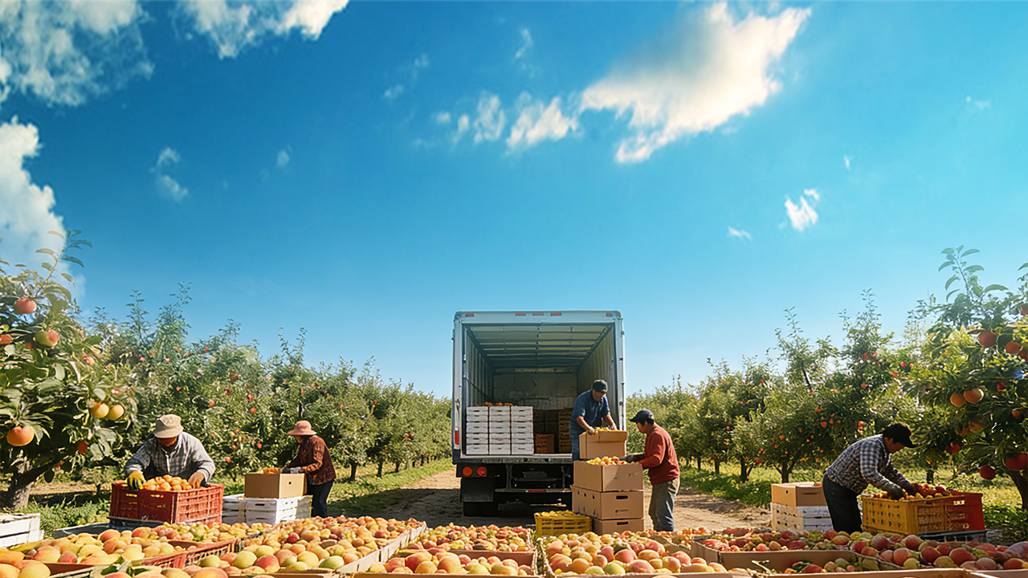

Postharvest Quality Deterioration and Preservation/Loss Reduction Technologies in Fruits and Vegetables
Notes:
果蔬采后品质劣变及保鲜减损控制技术
Postharvest Quality Deterioration and Preservation/Loss Reduction Technologies in Fruits and Vegetables

Slide 2
PART.02
Postharvest Preservation and Loss-Reduction Technologies for Fruits and Vegetables
Notes:
接下来我们进入本课程的第二模块——果蔬采后保鲜减损技术。
Next, we move on to the second module of this course — Postharvest Preservation and Loss-Reduction Technologies for Fruits and Vegetables.

Slide 3
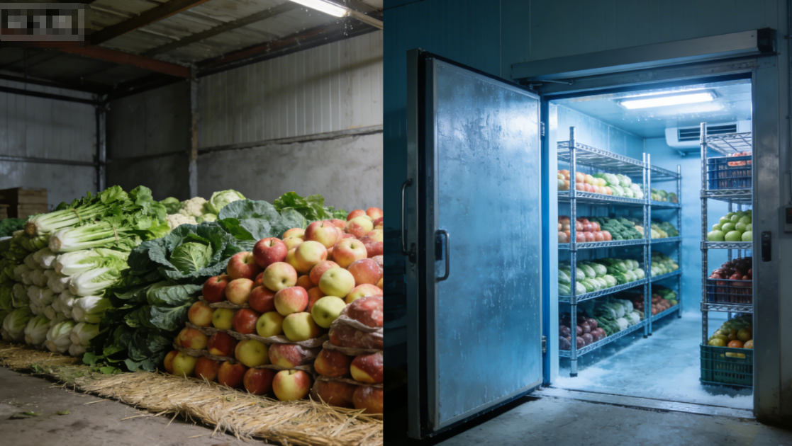

3. Precooling of Fruits and Vegetables
Core Requirements
  Postharvest fruits and vegetables must be precooled promptly after grading.
  Produce should be placed in a cool environment quickly to reduce field heat accumulation.
  Precooling effectively delays quality deterioration.
Classification of Precooling Methods
  Natural precooling.
  Cold storage precooling.
Notes:
三、果蔬预冷
果蔬完成分级后，需及时开展预冷处理；果蔬采收后应尽快置于阴凉处初步预冷，减少田间热积累，延缓品质衰减。常见预冷方式主要分为自然预冷和冷库预冷两类，具体特点如下：
III.Precooling of Fruits and Vegetables
After grading, fruits and vegetables should be precooled promptly. Postharvest produce should be initially placed in a cool environment as soon as possible to reduce field heat accumulation and delay quality deterioration. Common precooling methods are generally divided into natural precooling and cold storage precooling, each with distinct characteristics.

Slide 4
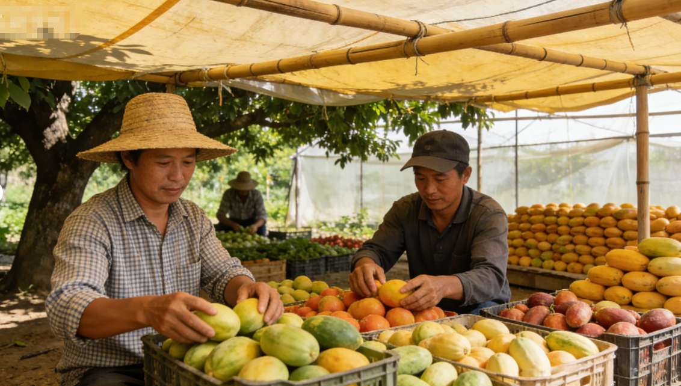
3. Precooling of Fruits and Vegetables
(1) Precooling Methods
Natural Precooling
Principle
  Place fruits and vegetables in a shaded, ventilated environment and utilize natural air circulation → to remove field heat.
AI生成
Application Scale
  Widely used by small-to medium-scale growers.
Typical Practice
  Harvested produce placed under trees, in shaded, well-ventilated areas, or under temporary shade structures.
  Airflow facilitates gradual cooling.
Notes:
1、预冷方法
(1)自然预冷
自然预冷是通过将果蔬放置在阴凉通风处，借助自然环境实现降温，逐步散发田间热的简易预冷方式，在中小种植户中应用广泛。操作时只需将采收后的果蔬置于树荫下、阴凉通风处或临时搭建的遮阳棚内，依靠空气自然对流完成降温。
1.Precooling Methods
(1)Natural Precooling
Natural precooling relies on placing fruits and vegetables in a shaded, ventilated environment and utilizing natural air circulation to gradually remove field heat. This method is widely used by small- to medium-scale growers. Typically, harvested produce is placed under trees, in shaded, well-ventilated areas, or under temporary shade structures, where airflow facilitates gradual cooling.

Slide 5
3. Precooling of Fruits and Vegetables
(1) Precooling Methods
Natural Precooling
Advantages
  Simple, low cost, and requires no additional equipment investment.
  Ideal for small-scale, low-cost production systems.
Limitations
  Slow cooling rate and high dependence on weather conditions → During high-temperature, rainy, or overcast conditions: fail to achieve the desired cooling effect + accelerate produce deterioration.
  Limited temperature control precision → cannot reliably reduce produce temperature to the optimal storage range → only suitable as an initial cooling step.
Notes:
该方法的核心优势是简便易行、成本极低，无需额外设备投入，仅通过利用自然环境即可实现，适配小规模、低成本种植场景。
但局限性也较为明显：
一是降温速度缓慢，受天气条件制约显著，遇到高温、阴雨等恶劣天气时，不仅无法达到理想降温效果，还可能加剧果蔬变质；
二是降温精度差，无法控制环境温度，难以将果蔬温度降至适宜贮藏区间，仅能作为初步预冷手段。
Advantages:
Simple, low-cost, and requires no additional equipment investment.
Ideal for small-scale, low-cost production systems.
Limitations:
Slow cooling rate and high dependence on weather conditions. During high-temperature, rainy, or overcast conditions, natural precooling may fail to achieve the desired cooling effect and can even accelerate produce eterioration.
Limited temperature control precision. Natural precooling cannot reliably reduce produce temperature to the optimal storage range and is therefore only suitable as an initial cooling step.

Slide 6
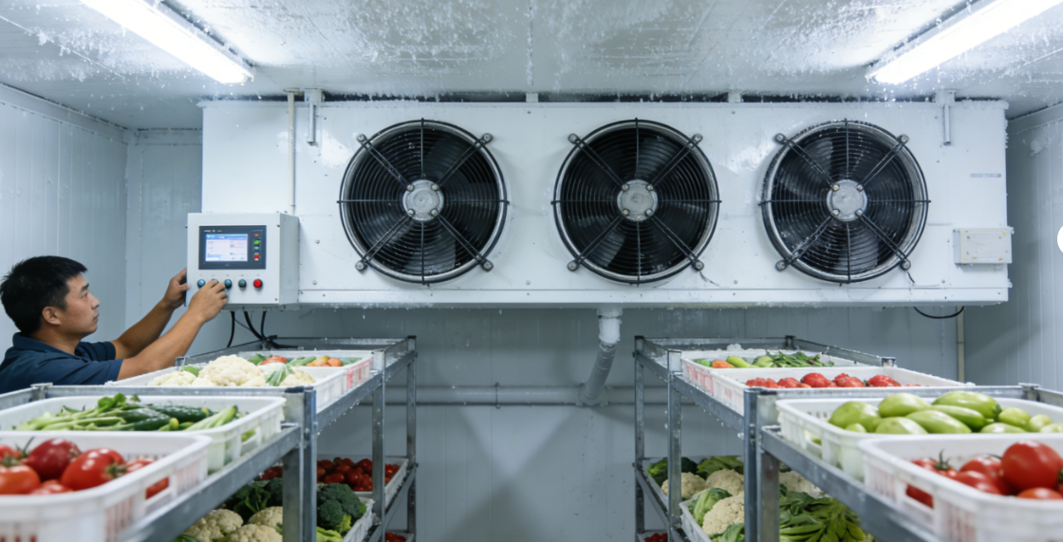
3. Precooling of Fruits and Vegetables
(1) Precooling Methods
Cold Storage Precooling
Application
  Mainstream method for high-value fruits and vegetables.
  Relies on controlled refrigeration systems to rapidly lower temperature.
  Common techniques:
Forced-air cooling.
Pressure-differential precooling.
Parameters adjustable according to produce type.
Advantages
  Rapid and precise temperature reduction, achieving the target range in a short time.
  Independent of external weather conditions.
  Effectively suppresses respiration and microbial growth.
Notes:
(2)冷库预冷
冷库预冷是商品价值较高果蔬的主流预冷方式，依托冷库设备实现人工控温降温，常见配套技术包括强制通风预冷、压差预冷等，可根据果蔬品类调整预冷参数。其核心优势在于降温效果好、速度快，能在短时间内将果蔬温度降至目标区间，且不受外界天气环境影响，温度可精准调控并保持恒定，有效抑制果蔬呼吸作用与微生物繁殖。
(2)Cold Storage Precooling
Cold storage precooling is the mainstream method for high-value fruits and vegetables. It relies on controlled refrigeration systems to rapidly lower temperature. Common techniques include forced-air cooling and pressure-differential precooling, with parameters adjustable according to produce type.
•Advantages:
Rapid and precise temperature reduction, achieving the target range in a short time.
Independent of external weather conditions.
Effectively suppresses respiration and microbial growth.

Slide 7
3. Precooling of Fruits and Vegetables
(1) Precooling Methods
Cold Storage Precooling
Limitations:
High upfront cost and energy consumption
  Construction or rental of cold storage facilities requires significant investment.
  Operating costs increase overall production costs.
Environmental considerations
  Energy-efficient equipment and energy-saving technologies should be prioritized to minimize carbon emissions.
Risk of surface dehydration
  Cold storage air is typically dry → surface shriveling if humidity control measures are not implemented → negatively affecting visual quality.
Notes:
该方法的缺点主要体现在成本与损耗两方面：一是前期投入大，冷库建设或租用需承担较高费用，且运行过程中能耗较高，增加种植成本；二是需兼顾环保要求，当前农业生产强调环境友好，即便选用冷库预冷，也应优先采用低能耗设备与节能技术，降低碳排放；三是易导致果蔬表面失水，冷库内空气干燥，若未采取保湿措施，会造成果蔬表皮皱缩，影响外观品质。
Limitations:
High upfront cost and energy consumption. Construction or rental of cold storage facilities requires significant investment, and operating costs increase overall production costs.
Environmental considerations. Agricultural production emphasizes sustainability, so energy-efficient equipment and energy-saving technologies should be prioritized to minimize carbon emissions.
Risk of surface dehydration. Cold storage air is typically dry, which can lead to surface shriveling of produce if humidity control measures are not implemented, negatively affecting visual quality.

Slide 8
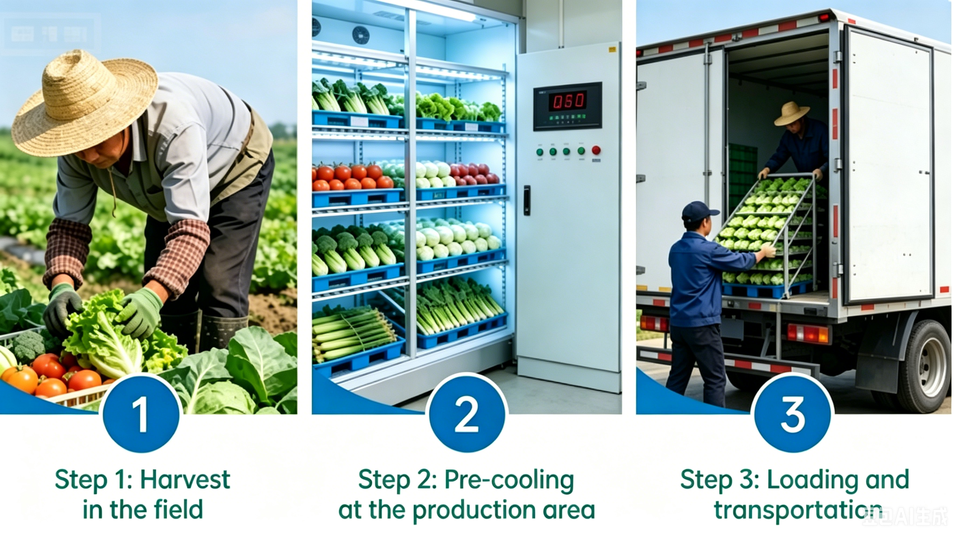
3. Precooling of Fruits and Vegetables
(2) Precooling Considerations
Timely precooling
Timing
  Conducted as soon as possible after harvest → minimize temperature rise and quality loss during transport.
Facility Location
  Cold storage or precooling facilities near or within the production site → seamless “harvest–precool” integration.
Impact of Delay
  Increase postharvest losses by 10–30% → severely affecting commercial value.
Notes:
2、预冷注意事项
(1)预冷需及时：果蔬采收后应就近开展预冷，减少运输过程中的温度升高与品质损耗，建议在产地或产地周边配套建设冷藏预冷设施，实现“采收－预冷”无缝衔接，最大限度缩短田间热积累时间。研究表明，预冷不及时会使果蔬损耗率增加10%—30%，严重影响商品价值。
2.Precooling Considerations
(1) Timely precooling
Precooling should be conducted as soon as possible after harvest to minimize temperature rise and quality loss during transport. Ideally, cold storage or precooling facilities should be available near or within the production site to enable seamless integration of “harvest–precool”. Research indicates that delayed precooling can increase postharvest losses by 10–30%, severely affecting commercial value.

Slide 9
3. Precooling of Fruits and Vegetables
(2) Precooling Considerations
Accurate temperature control
Core Principle
  Precooling temperature should NOT be excessively low.
  Lower temperature to an appropriate range without causing chilling or freezing injury.
  Temperature settings must consider biological characteristics and tissue sensitivity of different fruits and vegetables.
Freezing Injury
  Frost damage occurs when temperatures fall below the freezing point (<0°C) → ice crystal formation and cellular rupture.
Chilling Injury
  Affects tropical and subtropical produce at temperatures above freezing but still low enough to cause physiological damage.
Notes:
(2)精准控制预冷温度：预冷温度并非越低越好，核心原则是在不引发冷害、冻害的前提下，尽可能将温度降至适宜区间，需结合果蔬的生物学特性与组织结构差异化设定。其中，冻害是指温度低于冰点（通常低于0℃）时，果蔬细胞内形成冰晶导致的损伤；冷害则是热带、亚热带果蔬在高于冰点但较低温度下出现的生理损伤，二者本质上并不相同。
(2)Accurate temperature control
Precooling temperature should not be excessively low. The core principle is to lower the temperature to an appropriate range without causing chilling or freezing injury. Temperature settings must consider the biological characteristics and tissue sensitivity of different fruits and vegetables.
•Frost damage occurs when temperatures drop below the freezing point (typically <0°C), causing ice crystal formation and cellular rupture.
•Chilling injury affects tropical and subtropical produce at temperatures above freezing but still low enough to cause physiological damage.

Slide 10
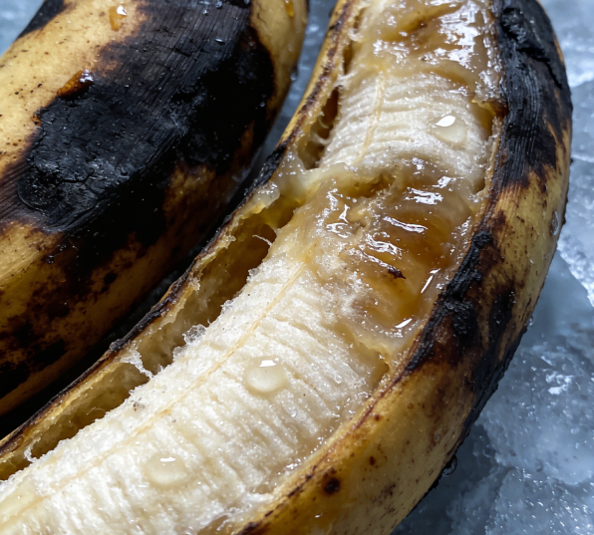
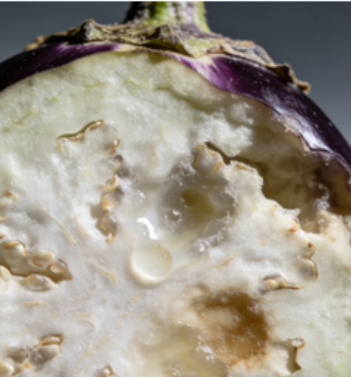
3. Precooling of Fruits and Vegetables
(2) Precooling Considerations
Accurate temperature control
For example:
  Bananas, cucumbers, eggplants, and yardlong beans: sensitive to temperatures below 5°C.
  Bananas stored at 4–5°C may develop blackened peel and deteriorated flesh.
  Eggplants may develop water-soaked tissues internally at low temperatures. These symptoms are chilling injury, not frost damage.
Notes:
例如香蕉、黄瓜、茄子、豇豆等热带、亚热带果蔬，对低温敏感，温度低于5℃时易发生冷害——香蕉在4-5℃环境下易表皮变黑、果肉变质，茄子低温下内部会形成水渍状组织，这些均为冷害表现，而非冻害。
For example:
Bananas, cucumbers, eggplants, and yardlong beans are sensitive to temperatures below 5°C.
Bananas stored at 4–5°C may develop blackened peel and deteriorated flesh.
Eggplants may develop water-soaked tissues internally at low temperatures. These symptoms are chilling injury, not frost damage.

Slide 11
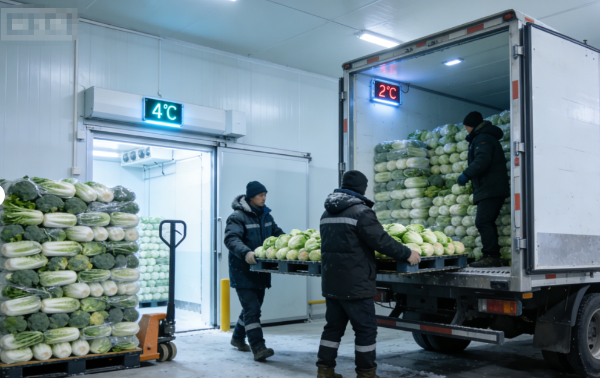
3. Precooling of Fruits and Vegetables
(2) Precooling Considerations
Maintain continuity after precooling
Temperature Stability Requirements
  Precooled produce should remain under low-temperature conditions → avoid sudden temperature fluctuations.
Consequences of Poor Handling
  Transferring produce directly from precooling to ambient-temperature transport or storage → accelerate respiration, senescence, and microbial spoilage → shorten shelf life.
Control Measures
  Produce promptly transferred to appropriately chilled storage conditions.
  Cold chain must be maintained during transport → ensuring stable temperatures throughout the “precool-storage-transport” continuum.
Notes:
(3)做好预冷后衔接处理：预冷后的果蔬需保持低温连贯性，避免温度剧烈波动。若预冷后直接转入常温运输或贮藏，温度骤升会加速果蔬呼吸作用与腐烂变质，缩短货架期。因此，预冷后应及时将果蔬转入适宜温度的冷藏环境，运输过程中需保障冷链不间断，维持温度稳定，实现“预冷－贮藏－运输”全链条低温管控。
(3)Maintain continuity after precooling
Precooled produce should remain under low-temperature conditions to avoid sudden temperature fluctuations. Transferring produce directly from precooling to ambient-temperature transport or storage conditions can accelerate respiration, senescence, and microbial spoilage, shortening shelf life.
Therefore, produce should be promptly transferred to appropriately chilled storage conditions, and the cold chain must be maintained during transport, ensuring stable temperatures throughout the “precool–storage–transport” continuum.

Slide 12
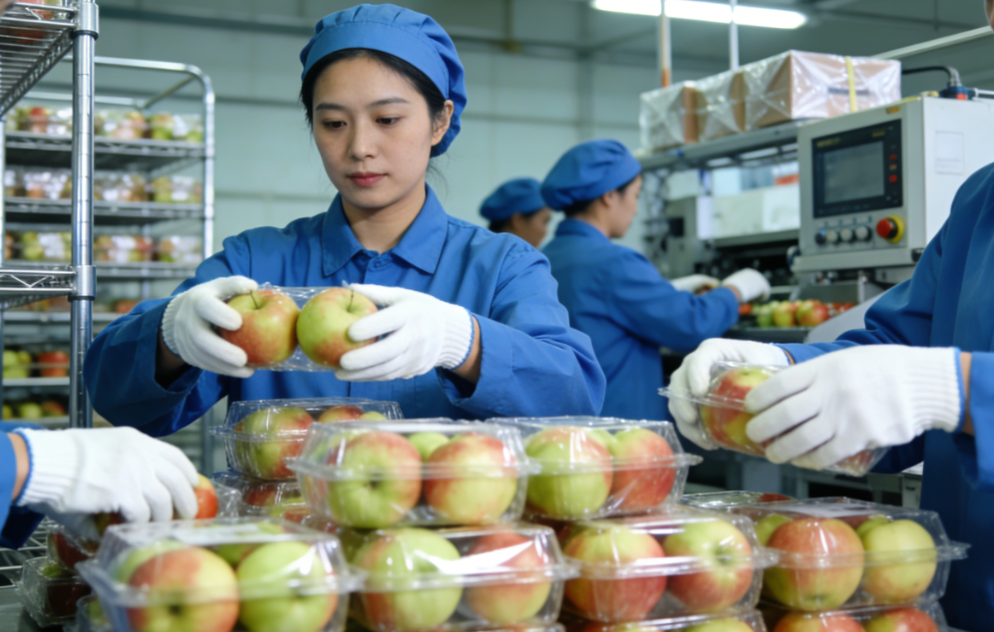
4. Packaging
AI生成
Function of Packaging After Pre-Cooling
  After pre-cooling, fruits and vegetables must be promptly packaged.
  A critical commercialization step between pre-cooling and subsequent storage, transportation, and marketing.
Benefits of Packaging
  Extends the preservation effect of pre-cooling.
  Enhances product value.
  Ensures quality stability from the farm to the consumer.
Notes:
四、包装
果蔬完成预冷后，需及时进行包装处理，这是衔接预冷与储运、销售的关键商品化环节，既能延续预冷保鲜效果，又能提升商品价值，保障果蔬从产地到终端的品质稳定。
IV.Packaging
After pre-cooling, fruits and vegetables must be promptly packaged, which serves as a critical commercialization step between pre-cooling and subsequent storage, transportation, and marketing. Packaging not only extends the preservation effect of pre-cooling but also enhances product value and ensures quality stability from the farm to the consumer.

Slide 13
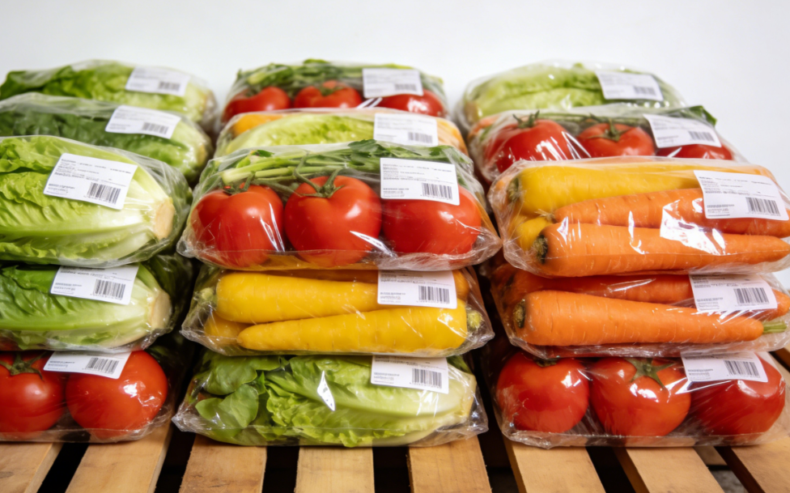
4. Packaging
(1) Functions of Packaging
演亦文化
Commercialization
Protection
Promotes product standardization and marketability by:
Unifying packaging specifications and visual design.
Improving aesthetic appeal and strengthening brand recognition.
Meeting standardized requirements for market circulation.
Prevents mechanical damage (bumping, compression, abrasion) during transportation and storage.
Isolates external contaminants.
Maintains an appropriate microenvironment.
Delays quality deterioration and improves storage safety and handling convenience.
Consumer Adaptability
Facilitates ease of handling, transport, and storage for consumers.
Attractive and functional packaging stimulates purchase intent.
Supports realization of “premium quality at premium price”.
Notes:
1.包装的作用
包装的核心作用体现在商品化、防护性与消费适配性三大维度：一是推动产品标准化、商品化，通过统一包装规格与外观设计，提升产品美观度，强化品牌辨识度，契合市场流通的标准化需求 ；二是起到防护作用，能有效减少果蔬在运输、贮藏过程中的磕碰、挤压损伤，隔绝外界污染，同时辅助维持适宜环境，延缓品质衰减，提升储运安全性与便捷性；三是适配消费需求，包装后的果蔬便于消费者携带、存放，良好的包装设计能激发消费者购买欲望，助力实现“优质优价”。
1.Functions of Packaging
The core functions of packaging can be categorized into three dimensions: commercialization, protection, and consumer adaptability:
•Commercialization: Packaging promotes product standardization and marketability by unifying packaging specifications and visual design, improving aesthetic appeal, strengthening brand recognition, and meeting the standardized requirements of market circulation.
•Protection: Packaging protects fruits and vegetables from mechanical damage such as bumping, compression, and abrasion during transportation and storage. It also isolates external contaminants and helps maintain an appropriate microenvironment, thereby delaying quality deterioration and enhancing storage safety and handling convenience.
•Consumer adaptability: Well-designed packaging facilitates ease of handling, transport, and storage for consumers. Attractive and functional packaging can stimulate purchase intent and support the realization of “premium quality at premium price”.

Slide 14
4. Packaging
(2) Packaging Requirements
Core principles: Safety, standardization, practicality, and economy.
Standardized specifications & aesthetic appeal
  Balance cost efficiency with ease of use → allowing convenient stacking, storage, and display.
Packaging Material Requirements
  Basic material criteria: non-toxic, moisture-resistant, breathable, and compression-resistant.
  Physiological basis: Fruits and vegetables continue to respire after harvest→ releasing moisture and CO₂.
  Moisture-resistance materials: → prevent condensation-induced damage to packaging.
  Breathability materials → maintain internal gas balance, inhibit microbial growth and anaerobic respiration, and reduce postharvest decay losses.
Suitability to produce characteristics
  Adapted to compressive strength, respiration rate, and other physiological traits of specific produce type → to avoid under- or over-packaging.
Notes:
2.包装的要求
果蔬包装需遵循“安全、标准、实用、经济”的核心原则，具体要求如下：第一，规格标准化、外观美观化，兼顾经济性与使用便捷性，便于堆叠储运与陈列销售；第二，包装材料需满足无毒、耐湿、透气、抗压的核心要求。果蔬作为具有呼吸作用的鲜活农产品，采收后会释放水分与二氧化碳，耐湿材料可避免包装受潮破损，透气性能则能平衡内外气体环境，抑制微生物滋生与无氧呼吸，减少腐烂损耗。此外，包装还需根据果蔬品类特性，适配其耐压性、呼吸强度等指标，避免过度包装或包装不足。
2. Packaging Requirements
Fruit and vegetable packaging should follow the core principles of safety, standardization, practicality, and economy. Specific requirements include:
•Standardized specifications and aesthetic appeal: Packaging should balance cost efficiency with ease of use, allowing convenient stacking, storage, and display.
•Material performance: Packaging materials must meet the essential requirements of being non-toxic, moisture-resistant, breathable, and compression-resistant. As living produce with ongoing respiration, fruits and vegetables release moisture and carbon dioxide postharvest. Moisture-resistant materials prevent packaging damage from condensation, while breathable materials help maintain internal gas balance, inhibit microbial growth and anaerobic respiration, and reduce postharvest decay losses.
•Suitability to produce characteristics: Packaging must be adapted to the compressive strength, respiration rate, and other physiological traits of the specific produce type to avoid under- or over-packaging.

Slide 15
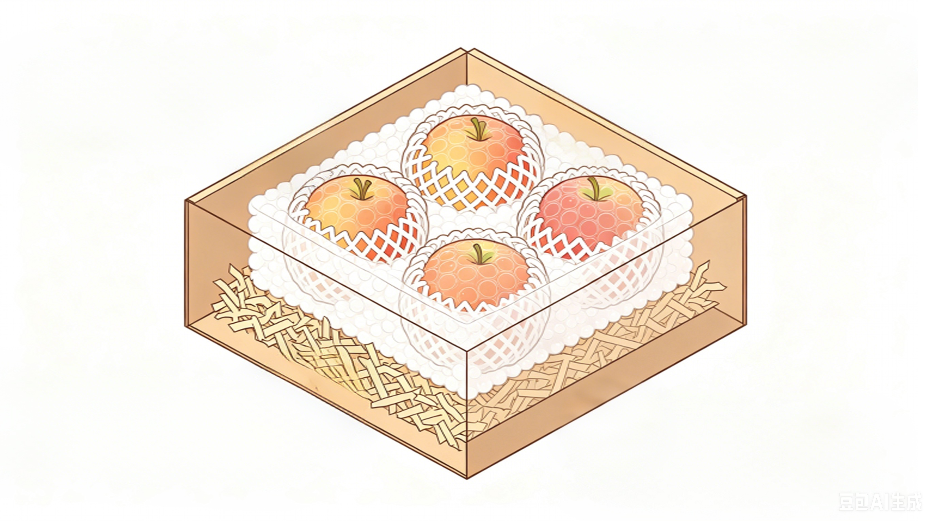
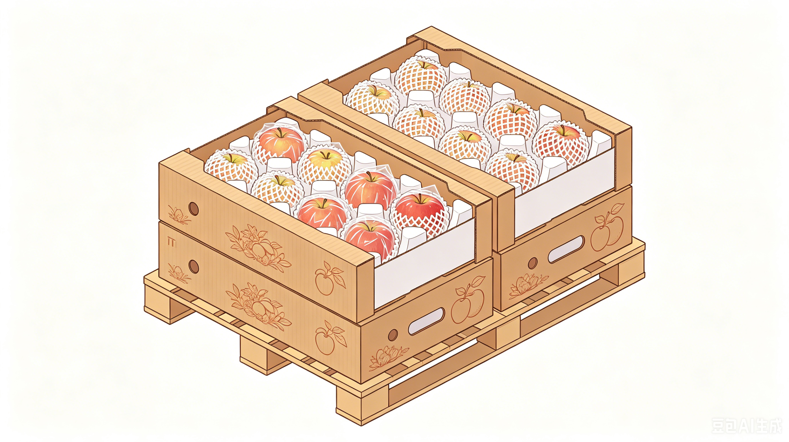
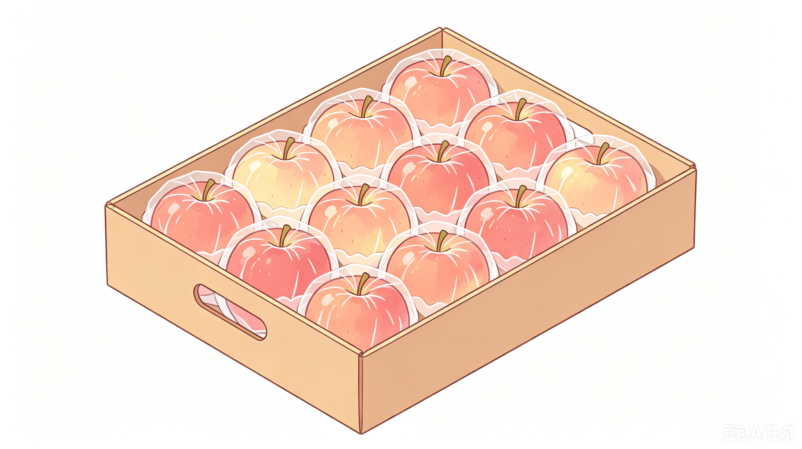
4. Packaging
(3) Common Packaging Materials and Selection
Material selection considerations
  Produce characteristics.
  Storage/transport needs.
  Cost constraints.
Commonly used materials
Paper-based materials, foam plastics & Polyethylene films
Used as internal cushioning or support materials → shock-absorbing properties reduce mechanical damage during handling and transport.
Corrugated cardboard & rigid cartons
Used as outer packaging → structural support; moisture resistance; compression resistance; aesthetic display.
Suitable for bulk storage and transport.
Plastic films
Used for single-fruit wrapping or overall sealing → reducing water loss.
Breathable films → allow respiration and prevent anaerobic conditions.
Notes:
3.常用包装材料及选择
果蔬包装材料种类丰富，需结合产品特性、储运需求与成本预算合理选择，常见材料包括纸类、泡沫塑料、塑料薄膜、瓦楞纸板等。其中，软纸、泡沫塑料、珍珠棉等常作为内部衬垫物与支撑物，利用其缓冲性能减少果蔬在搬运、运输中的磕碰损伤；瓦楞纸板、硬纸盒等作为外层包装，兼具支撑定型、防潮抗压与美观展示的作用，适配大多数果蔬的批量储运。塑料薄膜则可用于单果包装或整体密封，能减少水分流失，但需选择透气型薄膜，避免影响果蔬呼吸。
3.Common Packaging Materials and Selection
A wide variety of materials are available for fruit and vegetable packaging. Selection should consider produce characteristics, storage and transportation requirements, and cost constraints. Commonly used materials include:
•Paper-based materials, foam plastics, and polyethylene films: Often used as internal cushioning or support materials. Their shock-absorbing properties reduce mechanical damage during handling and transport.
•Corrugated cardboard and rigid cartons: Used as outer packaging to provide structural support, moisture resistance, compression resistance, and aesthetic display, suitable for bulk storage and transport.
•Plastic films: Can be used for single-fruit wrapping or overall sealing, reducing water loss. Breathable films are preferred to allow respiration and prevent anaerobic conditions.

Slide 16
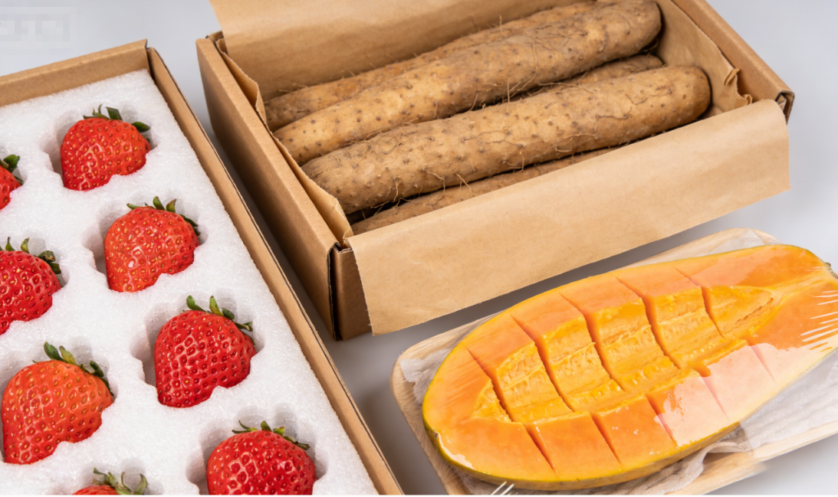
4. Packaging
(3) Common Packaging Materials and Selection
Tailored to Produce Characteristics
  Soft & delicate fruits (e.g., berries)
Cushioning materials (foam pads) + rigid cartons→ prevent mechanical damage.
  Root & tuber crops
More resistant to moisture and compression.
Corrugated cartons with moisture-resistant liners are suitable.
  Fresh-cut fruits & vegetables
Require high hygiene and proper gas exchange.
Food-grade, non-toxic, breathable packaging materials must be used.
Notes:
包装材料的选择需针对性适配果蔬特性：如柔软易损的浆果类，需优先选用缓冲性强的泡沫衬垫+硬纸盒组合；根茎类果蔬耐湿性、耐压性较强，可选用瓦楞纸箱搭配防潮纸；鲜切果蔬对卫生与透气要求极高，需选用食品级无毒透气包装材料。
Material selection should be tailored to the characteristics of each produce type:
•Soft and delicate fruits (e.g., berries): Prefer cushioning materials such as foam pads combined with rigid cartons to prevent damage.
•Root and tuber crops: More resistant to moisture and compression; corrugated cartons with moisture-resistant liners are suitable.
•Fresh-cut fruits and vegetables: Require high standards for hygiene and gas exchange; food-grade, non-toxic, and breathable packaging materials must be used.

Slide 17



5. Storage
Three Key Parameters
  Temperature
  Humidity
  Gas composition
Combined Effects
  Interplay of these factors determines storage duration and quality stability.
Produce-specific control
  Precise control must be tailored to the characteristics of each produce type.
Notes:
五、贮藏
影响果蔬贮藏的因素繁多，其中温度、湿度和气体成分是最核心的三大要素，三者协同作用决定果蔬贮藏期长短与品质稳定性，需结合果蔬品类特性精准调控。
V.Storage
The factors affecting fruit and vegetable storage are numerous, with temperature, humidity, and gas composition being the three most critical parameters. The interplay of these factors determines storage duration and quality stability during storage, and precise control must be tailored to the specific characteristics of each produce type.

Slide 18
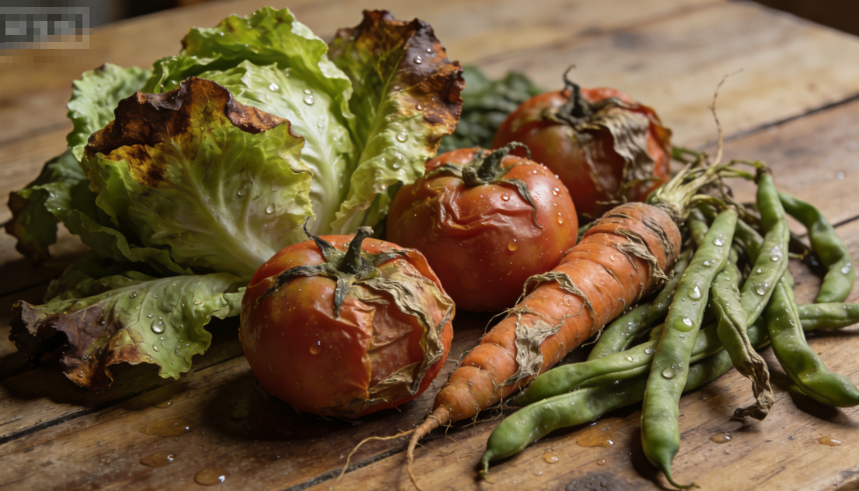
5. Storage
(1) Temperature Regulation
Temperature continuously and profoundly affects postharvest quality in four aspects.
Respiration rate
  Every 10°C increase → respiration rate increases by 1–1.5 times → accelerates consumption of internal nutrients.
Water loss
  Elevated temperatures → rapid moisture loss → wilting and significant decline in appearance and edibility.
Accelerated maturation and senescence
  Enhanced respiration + moisture loss → speed up ripening and aging processes.
Microbial proliferation
  High temperatures create favourable conditions for microbial growth → increasing risk of decay and disease → significantly shortens storage life.
Temperature Control Principle
  Avoid excessive heat + low-temperature damage.
  Optimal range determined based on cold tolerance of specific produce.
Notes:
1.温度调控
温度对果蔬贮藏品质的影响贯穿全程，具体体现在四方面：一是温度每升高10℃，果蔬呼吸作用强度会增加1-1.5倍，加速营养物质消耗；二是高温会加快果蔬体内水分向外散失，导致快速失水发蔫，外观和食用品质大幅下降；三是呼吸作用、水分散失的加剧，会同步加快果蔬成熟、衰老的速度；四是高温为微生物繁殖提供适宜环境，加重病害发生风险，最终显著缩短贮藏期。因此，贮藏温度既不能过高，也不能过低引发低温伤害，需根据果蔬耐冷性差异化设定适宜区间。
1.Temperature Regulation
Temperature exerts a continuous and profound influence on the postharvest quality of fruits and vegetables, specifically in four aspects:
•Respiration rate: For every 10°C increase in temperature, the respiration rate of fruits and vegetables increases by 1–1.5 times, accelerating the consumption of internal nutrients.
•Water loss: Elevated temperatures promote rapid moisture loss from tissues, leading to wilting and a significant decline in both appearance and edibility.
•Accelerated maturation and senescence: Enhanced respiration and moisture loss synergistically speed up ripening and aging processes.
•Microbial proliferation: High temperatures create favorable conditions for microbial growth, increasing the risk of decay and disease, thereby significantly shortening storage life.
Therefore, storage temperatures must avoid both excessive heat and low-temperature damage. The optimal range should be determined based on the cold tolerance of the specific produce.

Slide 19
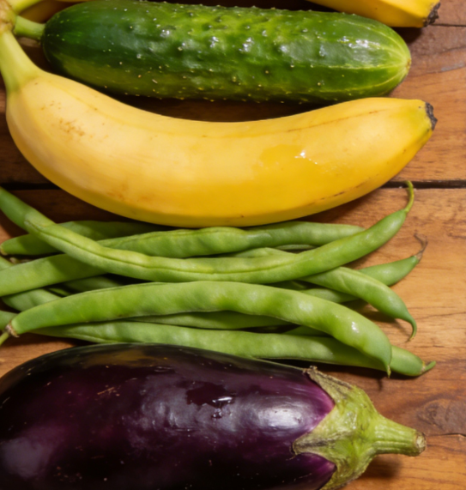
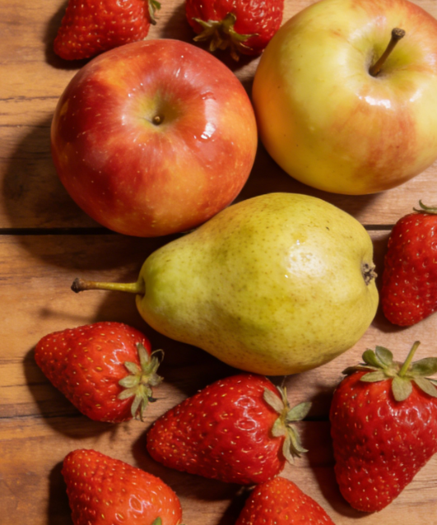
5. Storage
(1) Temperature Regulation
Cold-sensitivity classification
Cold-Sensitive Produce
  Example: bananas, cucumbers, eggplants, yardlong beans.
  Ideally stored at 10–15°C.
  Exposure below 10°C (0–10°C) → induce chilling injury.
  Typical symptoms: blackened banana skin or water-soaked tissue in eggplants.
Cold-Tolerant Produce
  Example: apples, pears, strawberries.
  Best stored at 0–5°C.
  Temperatures >5°C → accelerate quality deterioration.
  Temperatures below their freezing point must be avoided to prevent freezing injury.
  Most can tolerate –1 to –2°C.
  Temperatures < –5°C → irreversible cell damage due to ice crystal formation.
Notes:
按对低温的敏感程度，果蔬可分为两类：冷敏性果蔬（如香蕉、黄瓜、茄子、豇豆等），理想贮藏温度为10-15℃，低于10℃（0-10℃区间）易发生冷害，表现为香蕉表皮变黑、茄子内部形成水渍状组织等；非冷敏性果蔬（如苹果、梨、草莓等）耐低温性较强，适宜贮藏温度为0-5℃，温度高于5℃会加速品质衰减，但需避免温度过低导致冻害——多数非冷敏性果蔬可耐受-1至-2℃低温，极限温度不低于-5℃，否则细胞内形成冰晶造成不可逆损伤。
Classification based on cold sensitivity:
•Cold-sensitive produce (e.g., bananas, cucumbers, eggplants, yardlong beans) should ideally be stored at 10–15°C. Exposure below 10°C (0–10°C range) may induce chilling injury, such as blackened banana skin or water-soaked tissue in eggplants.
•Cold-tolerant produce (e.g., apples, pears, strawberries) can withstand lower temperatures and are best stored at 0–5°C. Temperatures above 5°C accelerate quality deterioration, while temperatures below their freezing point must be avoided to prevent freezing injury. Most cold-tolerant fruits can tolerate -1 to -2°C, but temperatures below -5°C may cause irreversible cell damage due to ice crystal formation.

Slide 20
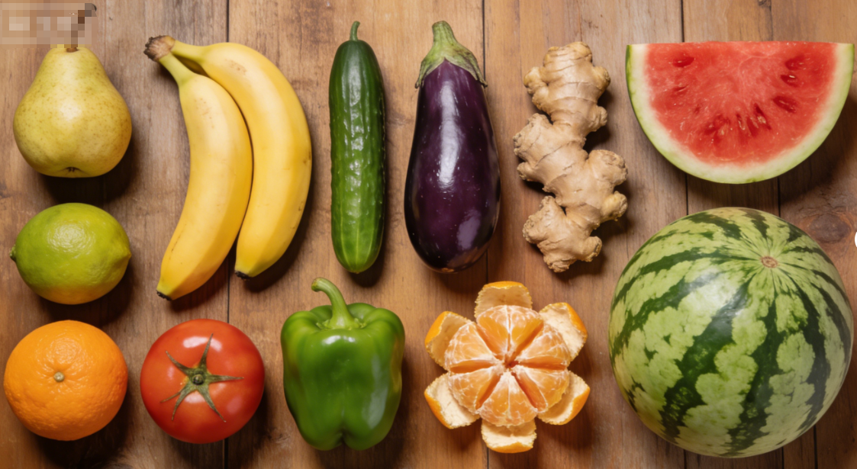
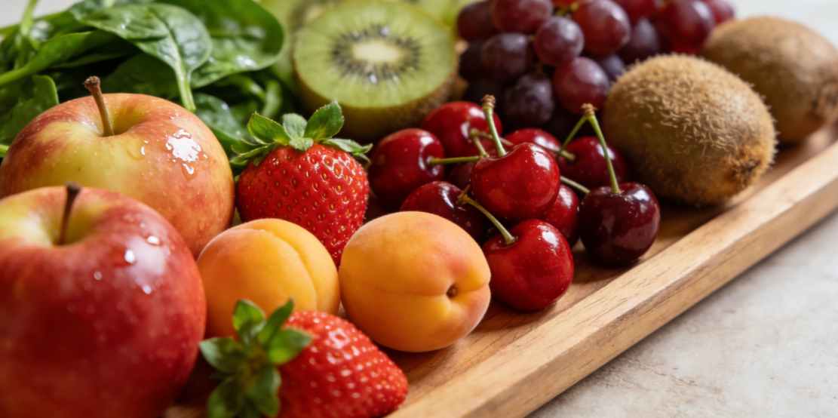
5. Storage
(1) Temperature Regulation
Recommended Storage Temperature Ranges
Cold-Sensitive Produce
  Bananas, cucumbers, eggplants, ginger, watermelons, bell peppers, tomatoes, citrus fruits.
  Recommended temperature: 7–15°C.
  Strictly avoid 0–4°C environments.
Cold-Tolerant Produce
  Apples, apricots, strawberries, cherries, grapes, kiwifruit, spinach.
  Suitable temperature: 0–5°C.
  Low-temperature tolerance: apples down to -1°C, apricots down to -0.5°C.
Notes:
不同品类果蔬的具体温度要求需精准适配：梨、香蕉、黄瓜、茄子、生姜、西瓜、青椒、番茄、柑橘类等冷敏性果蔬，推荐贮藏温度为7-15℃，严禁置于0-4℃环境；苹果、杏、草莓、樱桃、葡萄、猕猴桃、菠菜等非冷敏性果蔬，适宜0-5℃贮藏，苹果可耐受-1℃，杏可在-0.5℃环境中贮藏。
Recommended storage temperature ranges by produce type:
•Cold-sensitive fruits and vegetables: bananas, cucumbers, eggplants, ginger, watermelons, bell peppers, tomatoes, citrus fruits – 7–15°C; strictly avoid 0–4°C environments.
•Cold-tolerant fruits and vegetables: apples, apricots, strawberries, cherries, grapes, kiwifruit, spinach – 0–5°C; apples can tolerate down to -1°C, apricots -0.5°C.

Slide 21
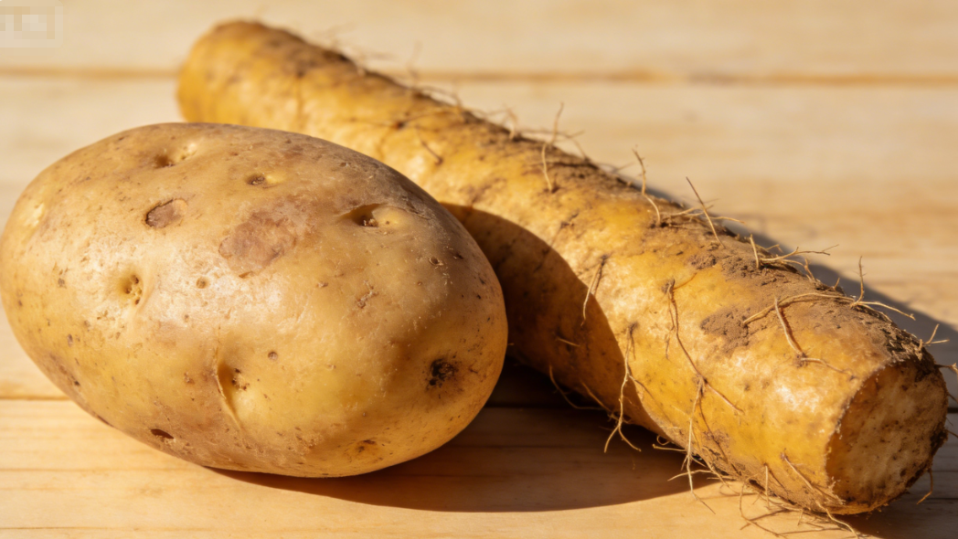
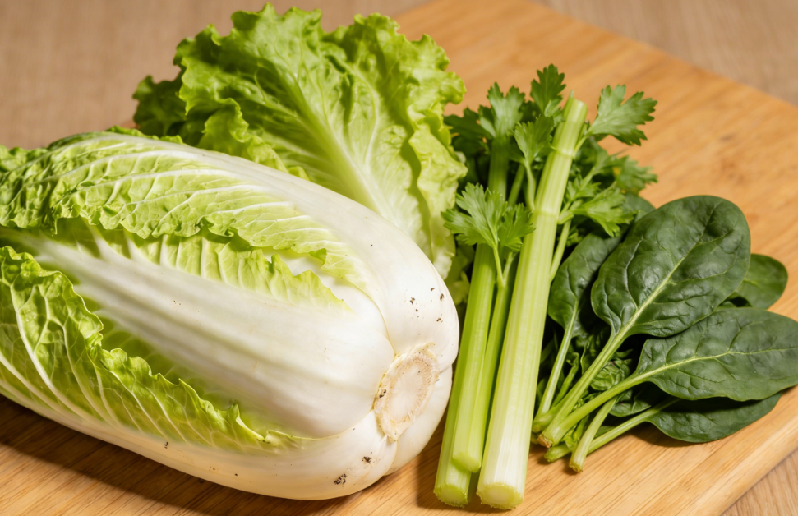
5. Storage
(1) Temperature Regulation
Storage Temperature Recommendations for Seven Produce Categories
A. Root and Tuber Vegetables (e.g., potatoes, Chinese yam)
  Optimal storage temperature: 3–5°C.
  Relative humidity: 80–90%.
  Potatoes: stored near 0°C → starch-to-sugar conversion (cold-induced sweetening) → quality deterioration.
  Chinese yam: cold tolerant with natural dormancy period → suitable for low temperature 0–2°C, low humidity storage conditions.
B. Leafy Vegetables (e.g., lettuce, Chinese cabbage, celery, spinach):
  Cold tolerance: strong, but high respiration and prone to water loss.
  Optimal storage temperature: around 0°C.
  Wrapped with moisture-retentive, breathable film → maintain hydration while avoiding condensation dripping that could trigger decay.
  Packaging must ensure good air permeability.
Notes:
七大类果蔬贮藏温度细分：
① 根茎类蔬菜（土豆、山药等）：适宜温度3-5℃，湿度80%—90%。0℃左右易导致土豆淀粉转化为糖（糖化反应），造成品质劣变；山药属耐贮蔬菜，具有休眠期，耐低温（0°C-2°C）、低湿保存。
② 叶菜类蔬菜（生菜、白菜、芹菜、菠菜等）：耐冷性强但呼吸旺盛、易失水，适宜0℃左右贮藏，需用透气保鲜膜包裹保湿，同时避免包装结露滴水引发腐烂，包装材料须具备良好通透性。
Storage Temperature Recommendations for Seven Major Fruit and Vegetable Categories
A.Root and tuber vegetables (e.g., potatoes, Chinese yam):
Optimal storage temperature: 3–5°C
Relative humidity: 80–90%
Potatoes stored near 0°C are prone to starch-to-sugar conversion (cold-induced sweetening), leading to quality deterioration.
Chinese yam is cold-tolerant with a natural dormancy period, suitable for low-temperature (0–2°C), low-humidity storage conditions.
B.Leafy vegetables (e.g., lettuce, Chinese cabbage, celery, spinach):
Cold tolerance: strong, but high respiration and prone to water loss
Optimal storage temperature: around 0°C
Should be wrapped with moisture-retentive, breathable film to maintain hydration while avoiding condensation dripping that could trigger decay. Packaging must provide good air permeability.

Slide 22
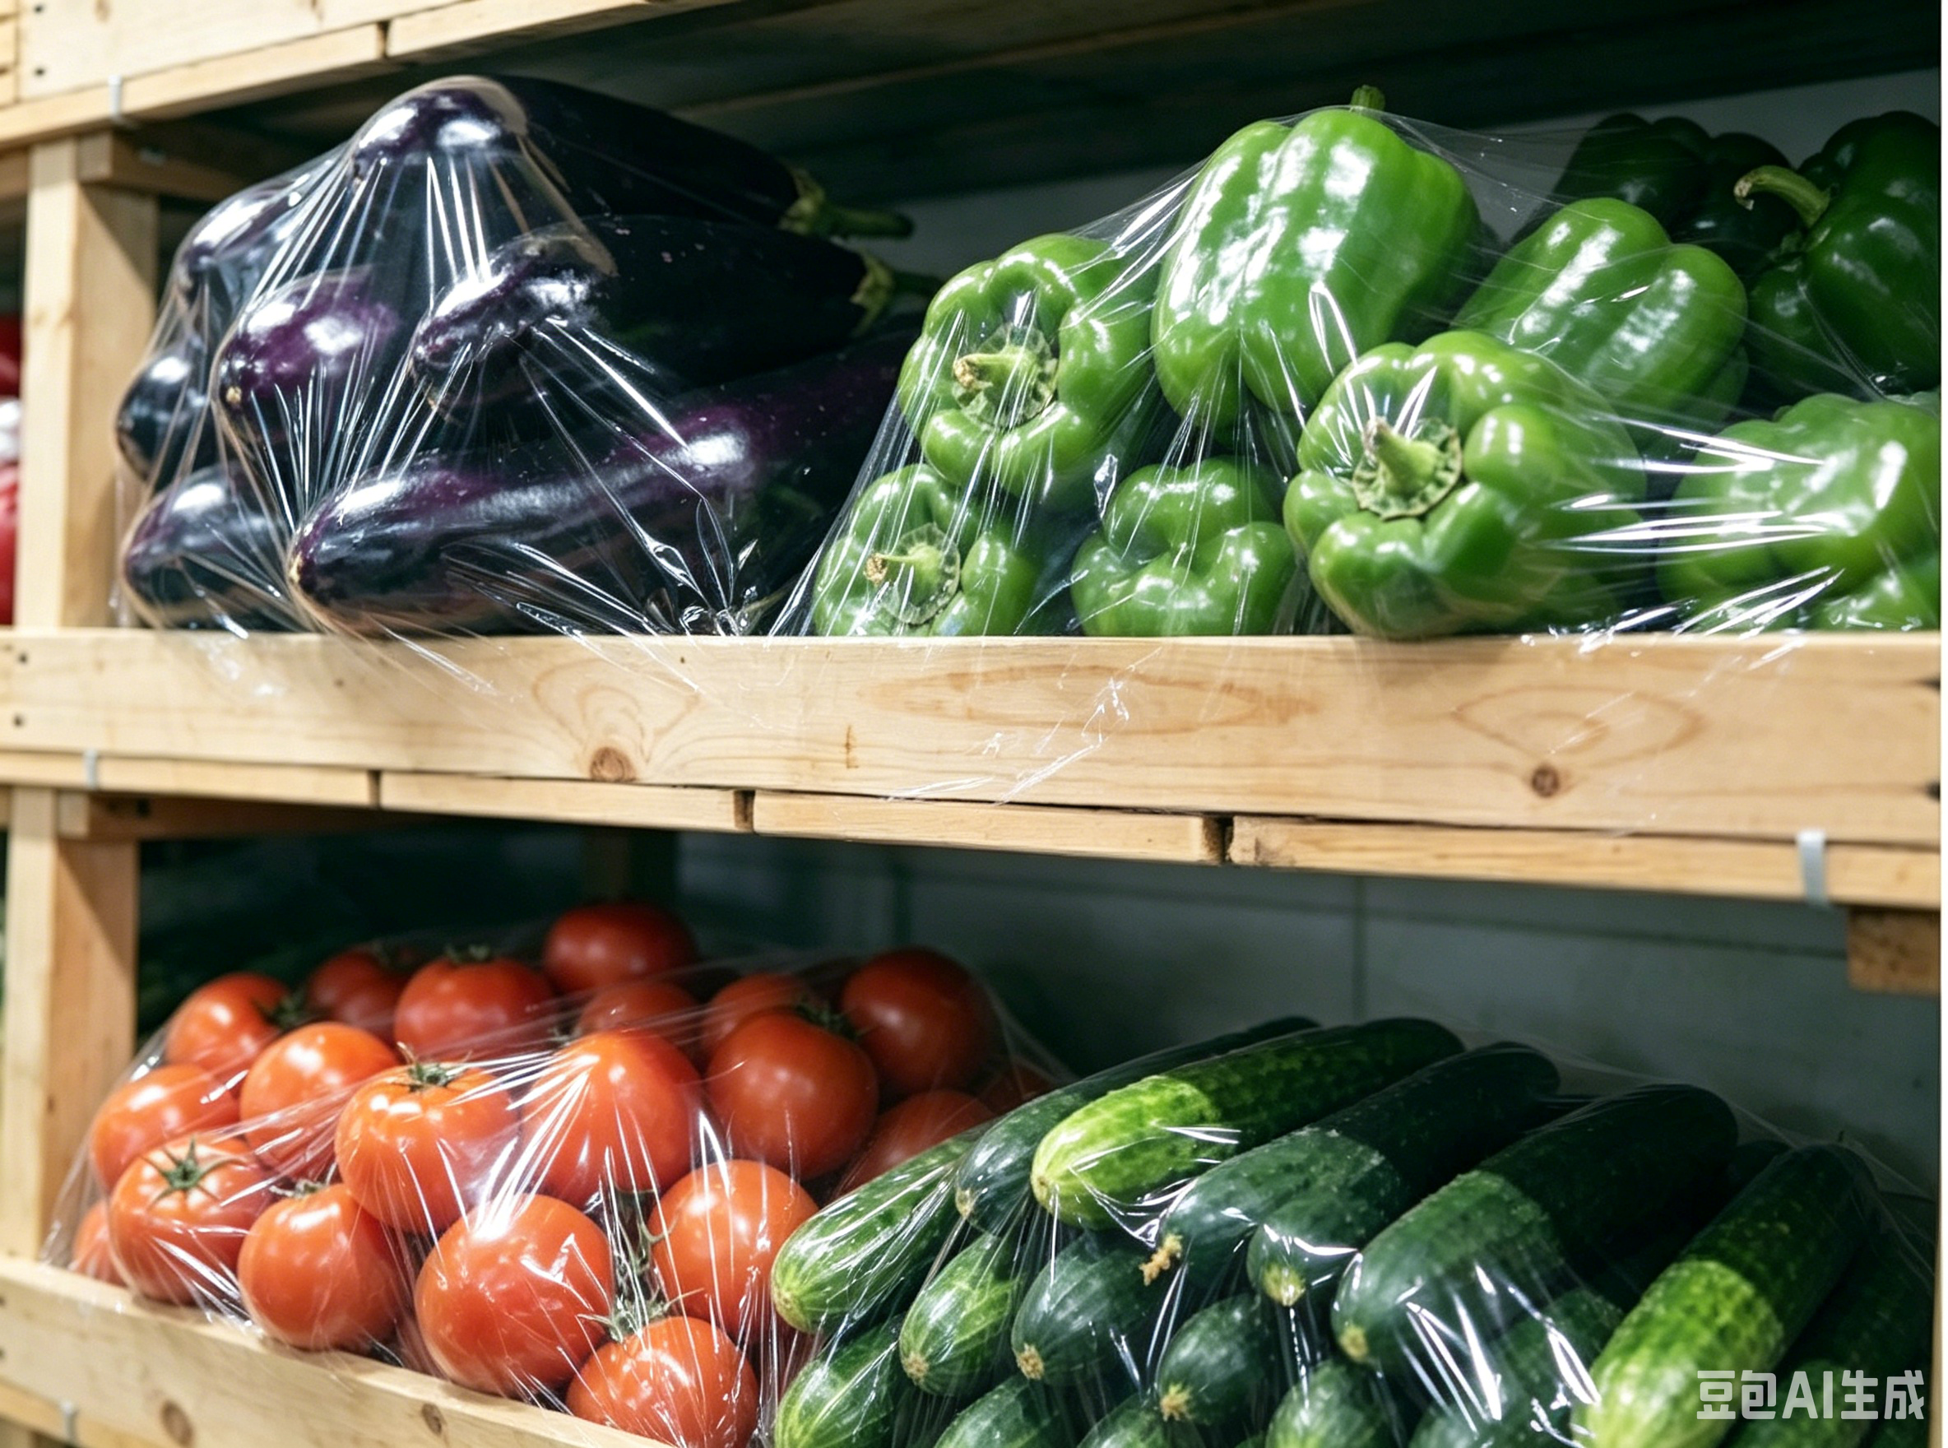
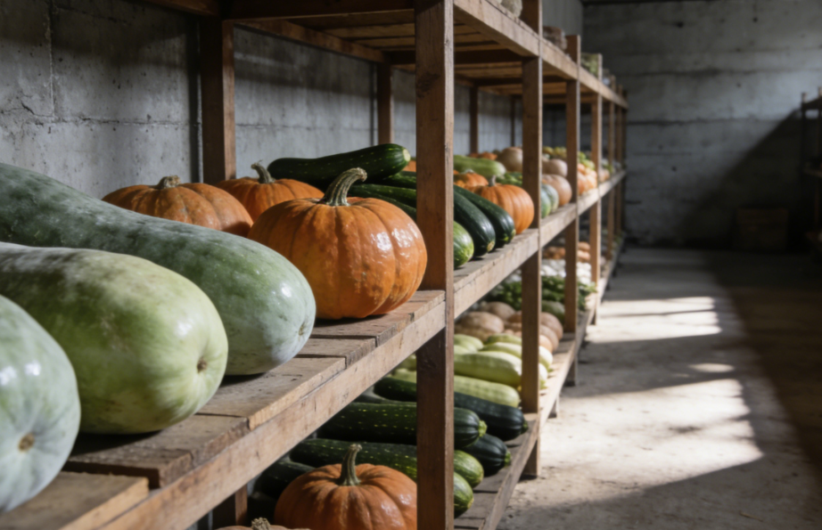
5. Storage
(1) Temperature Regulation
Storage Temperature Recommendations for Seven Produce Categories
C. Fruit Vegetables (e.g., eggplants, peppers, tomatoes, cucumbers):
  Cold-sensitive category.
  Optimal storage temperature: 7–15°C.
  Wrapping with fresh-keeping film → reduce water loss and slow respiration.
D．Gourd Vegetables (e.g., winter melon, pumpkin, zucchini):
  Winter melon & pumpkin: thick skins; store in cool, dry, ventilated conditions at ~10°C + retain surface natural waxy bloom to enhance shelf life.
  Zucchini: cold-sensitive; optimal storage ~7°C.
Notes:
③ 果菜类蔬菜（茄子、辣椒、西红柿、黄瓜等）：均为冷敏性品类，适宜温度7-15℃，用保鲜膜包裹可减少水分流失、抑制呼吸作用。
④ 瓜菜类蔬菜（冬瓜、南瓜、西葫芦等）：冬瓜、南瓜表皮厚实，适宜在阴凉通风干燥处贮藏，温度维持10℃左右，需保留表面白霜以增强保鲜性；西葫芦为冷敏性蔬菜，适宜温度7℃左右。
Fruit vegetables (e.g., eggplants, peppers, tomatoes, cucumbers):
Cold-sensitive category
Optimal storage temperature: 7–15°C
Wrapping with fresh-keeping film helps reduce water loss and slow respiration.
D.Gourd vegetables (e.g., winter melon, pumpkin, zucchini):
Winter melon and pumpkin have thick skins; store in cool, dry, ventilated conditions at approximately 10°C. Retain the surface natural waxy bloom to enhance shelf life.
Zucchini is cold-sensitive, optimal storage at around 7°C.

Slide 23
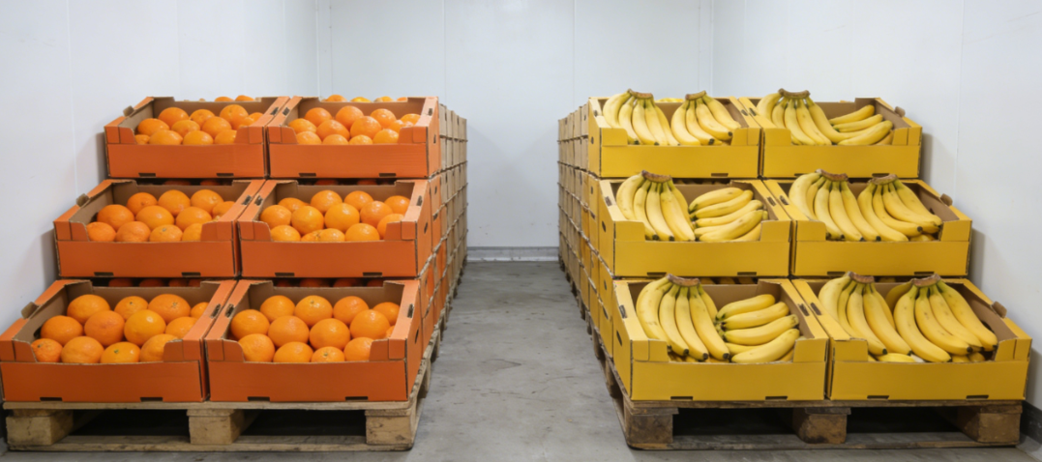
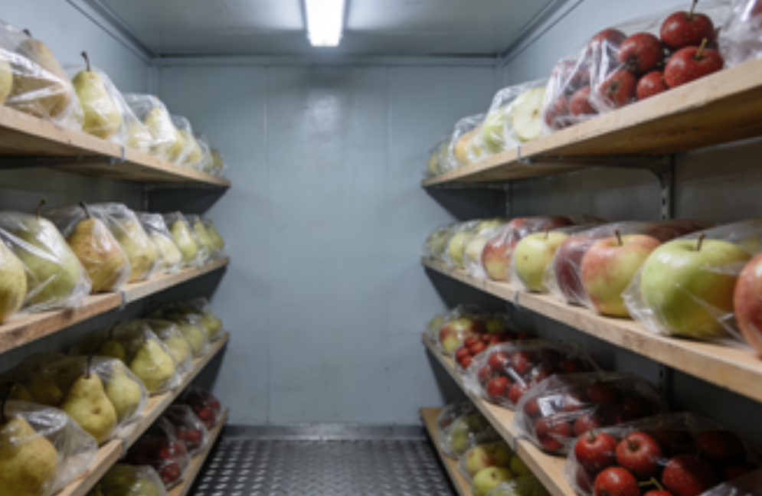
5. Storage
(1) Temperature Regulation
Storage Temperature Recommendations for Seven Produce Categories
E. Subtropical fruits (e.g., citrus, bananas):
  Cold-sensitive.
  Optimal storage 10–15°C.
  Avoid chilling injury that impairs flavour and quality.
F．Pome Fruits (e.g., pears, apples, hawthorn):
  Cold-tolerant, not sensitive to chilling.
  Optimal storage temperature: 0–4°C.
  Apples can tolerate –1°C.
  Use fresh-keeping film or carton boxes to prevent water loss.
Notes:
⑤ 亚热带水果（柑橘类、香蕉等）：对低温敏感，适宜10-15℃贮藏，避免冷害导致风味劣变。
⑥ 仁果类水果（梨、苹果、山楂等）：非冷敏性，适宜0-4℃贮藏，苹果可耐受-1℃，用保鲜膜或纸箱包装防止失水。
E.Subtropical fruits (e.g., citrus, bananas):
Cold-sensitive; optimal storage at 10–15°C
Avoid chilling injury that may impair flavor and quality.
F.Pome fruits (e.g., pears, apples, hawthorn):
Cold-tolerant, not sensitive to chilling
Optimal storage temperature: 0–4°C (apples can tolerate -1°C)
Use fresh-keeping film or carton boxes to prevent water loss.

Slide 24
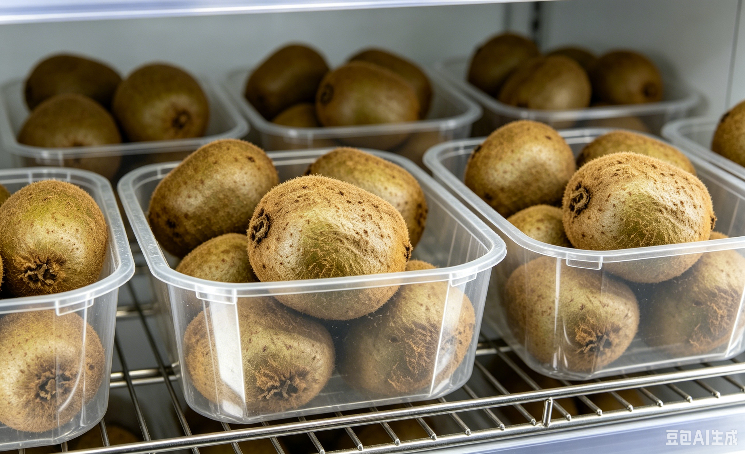
5. Storage
(1) Temperature Regulation
Storage Temperature Recommendations for Seven Produce Categories
G．Berries (e.g., strawberries, grapes, kiwifruit):
  Optimal storage temperature: around 0°C.
  Kiwifruit: highly sensitive to ethylene → must be stored separately from ethylene-producing fruits to prevent accelerated ripening and senescence.
Notes:
⑦ 浆果类水果（草莓、葡萄、猕猴桃等）：适宜0℃左右贮藏。猕猴桃对乙烯极敏感，需单独贮藏，避免与其他释放乙烯的水果混存，以防止加速衰老。
G.Berries (e.g., strawberries, grapes, kiwifruit):
oOptimal storage temperature: around 0°C
oKiwifruit is highly sensitive to ethylene and must be stored separately from ethylene-producing fruits to prevent accelerated ripening and senescence.

Slide 25
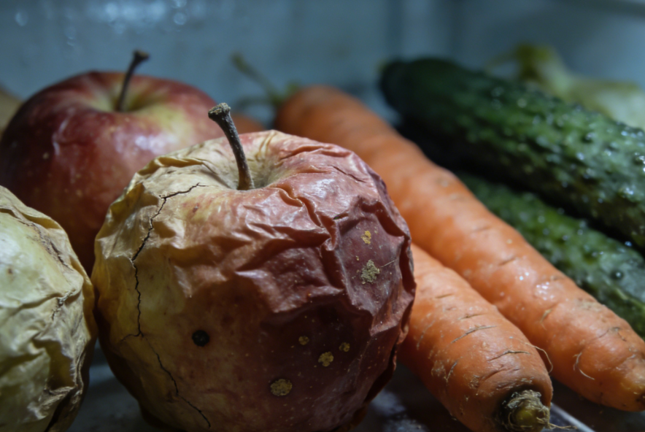
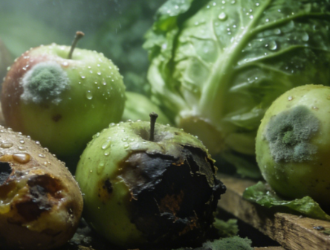
5. Storage
(2) Humidity Control
Directly affects water loss and the risk of disease development in fruits and vegetables.
Too Low Humidity
  Leads to dehydration and shrivelling → loss of crispness and firmness + can trigger physiological disorders.
Too High Humidity
  Promotes mold growth.
  Causes surface condensation.
  Accelerates decay.
Notes:
2.湿度调控
湿度直接影响果蔬失水率与病害发生风险：湿度过低会导致果蔬失水皱缩，丧失爽脆口感，引发生理性病害；湿度过高则易滋生霉菌，且易在果蔬表面形成凝结水，加重腐烂。
2.Humidity Control
Humidity directly affects water loss and the risk of disease development in fruits and vegetables:
•Too low humidity leads to dehydration and shriveling, resulting in loss of crispness and firmness, and can trigger physiological disorders.
•Too high humidity promotes mold growth and can cause surface condensation, which accelerates decay.

Slide 26
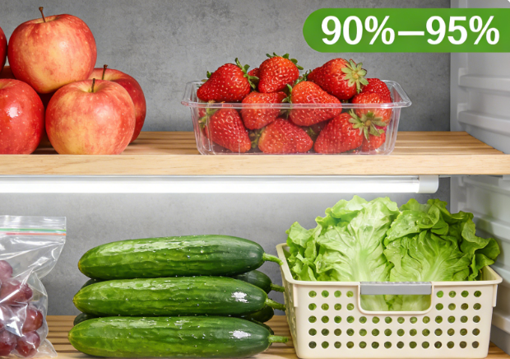
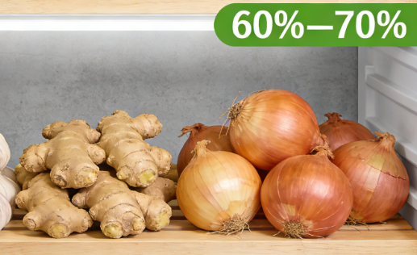
5. Storage
(2) Humidity Control
Most fruits and vegetables are optimally stored at 80–95% relative humidity.
  Commodities Stored at 80–95% Relative Humidity
Apples, apricots, pears, bananas, strawberries, cherries, figs, grapefruit, grapes, kiwifruit, lemons, cucumbers, eggplants, lettuce, watermelon, mushrooms, bell peppers, spinach, potatoes.
  Commodities Requiring Low-humidity Storage
Garlic, ginger, onions.
Postharvest storage humidity maintained at 60–70% relative humidity → avoid sprouting or decay caused by excessive moisture.
Notes:
多数果蔬适宜贮藏湿度为80%—95%，其中苹果、杏、梨、香蕉、草莓、樱桃、无花果、葡萄柚、葡萄、猕猴桃、柠檬、黄瓜、茄子、生菜、西瓜、蘑菇、青椒、菠菜、马铃薯等，理想湿度为90%—95%。蒜头、生姜、洋葱为特殊品类，适宜低湿度贮藏，采收后维持60%—70%湿度即可，避免高湿导致发芽或腐烂。
Most fruits and vegetables are optimally stored at 80–95% relative humidity. Specifically, the following commodities are ideal stored at 90–95% relative humidity: apples, apricots, pears, bananas, strawberries, cherries, figs, grapefruit, grapes, kiwifruit, lemons, cucumbers, eggplants, lettuce, watermelon, mushrooms, bell peppers, spinach, and potatoes.
Certain commodities such as garlic, ginger, and onions are exceptions, requiring low-humidity storage. Postharvest storage humidity should be maintained at 60–70% relative humicity to avoid sprouting or decay caused by excessive moisture.

Slide 27

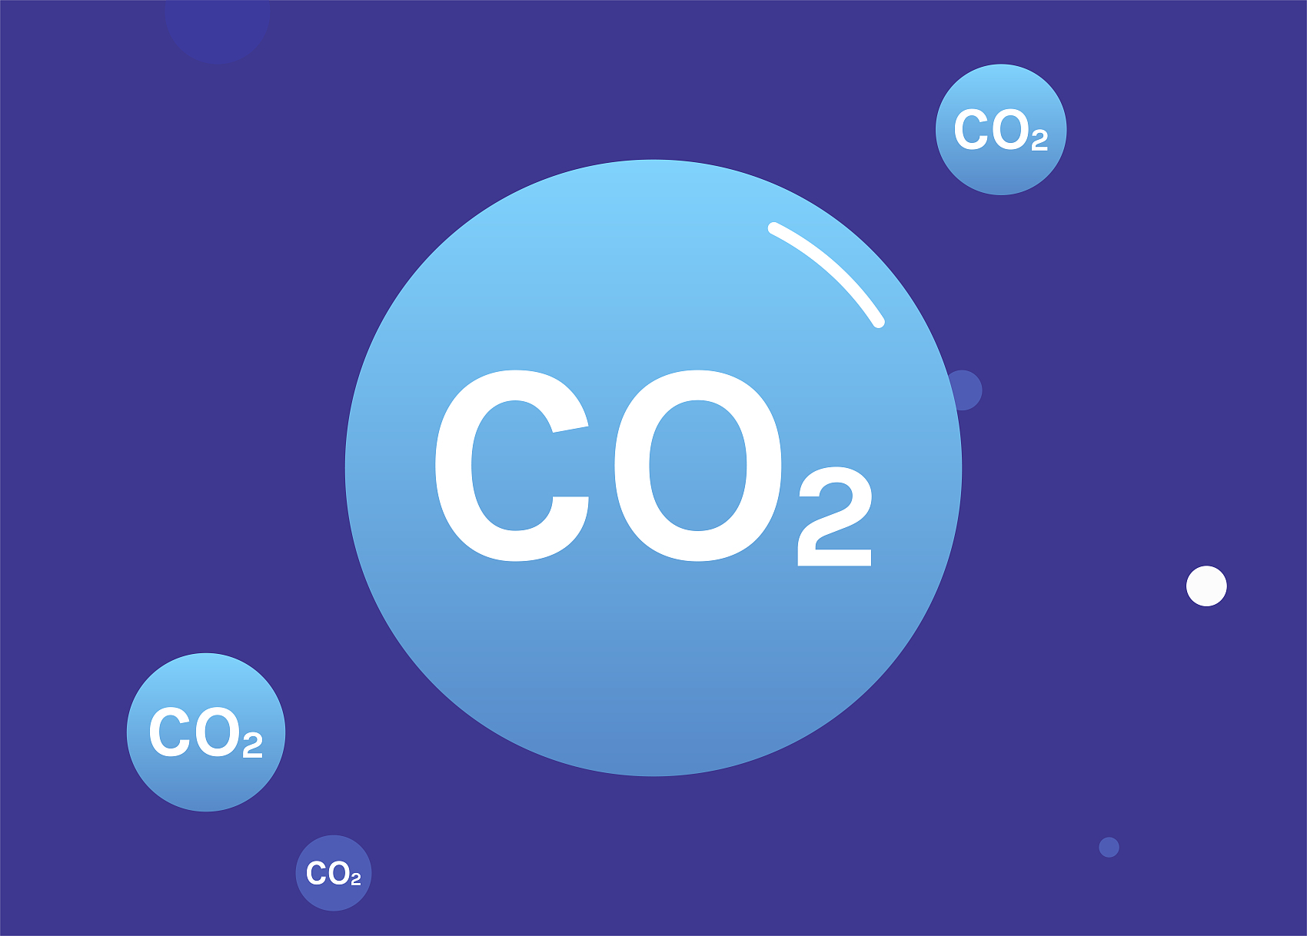
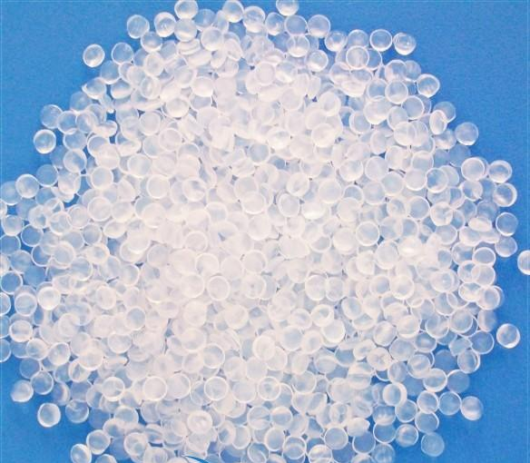
5. Storage
(3) Gas Composition Control
Core Gaseous Components in Storage Environments:
  Oxygen (O₂)
  Carbon dioxide (CO₂)
  Ethylene (C₂H₄)
Concentrations of these gases must be precisely managed to regulate respiration and ripening processes, thereby extending shelf life.
Notes:
3.气体成分调控
贮藏环境中核心气体成分为氧气（O2）、二氧化碳（CO2）和乙烯（C2H4），三者浓度需精准配比，通过干预呼吸作用与成熟进程延长贮藏期。
3.Gas Composition Control
The core gaseous components in storage environments are oxygen (O₂), carbon dioxide (CO₂), and ethylene (C₂H₄). The concentrations of these gases must be precisely managed to regulate respiration and ripening processes, thereby extending shelf life.

Slide 28

5. Storage
(3) Gas Composition Control
Oxygen (O₂)
Role of O₂
  O₂ concentration directly influences respiration intensity.
  Ambient air ≈ 21% O₂.
  Storage environments should maintain 5–10% O₂ → respiration significantly reduced.
Low O₂ risks
  O₂ < 2% → anaerobic respiration → producing ethanol + causing fermentation and spoilage.
Optimal O₂ control
  Maintaining O₂ at 5–8% → suppresses aerobic microbial activity + reduces decay risk + prevents anaerobic-respiration-induced injury.
Notes:
（1）氧气：氧气浓度直接影响呼吸强度，大气中氧气含量约21%，贮藏环境需将氧气浓度控制在5%—10%之间，在此区间内可显著降低呼吸强度。若氧气浓度过低（低于2%），则易引发无氧呼吸，产生乙醇并导致果蔬发酵变质；当氧气浓度控制在5%—8%时，可抑制好氧微生物活性，减少腐烂风险，同时避免无氧呼吸造成的伤害。
(1)Oxygen (O₂)
Oxygen concentration directly influences respiration intensity. Ambient air contains approximately 21% O₂, but in storage environments, O₂ should be maintained at 5–10%. Within this range, respiration is significantly reduced.
•If O₂ falls below 2%, anaerobic respiration occurs, producing ethanol and causing fermentation and spoilage.
•Maintaining O₂ at 5–8% suppresses aerobic microbial activity, reduces decay risk, and prevent anaerobic respiration-induced injury.

Slide 29


5. Storage
(3) Gas Composition Control
Carbon Dioxide (CO₂)
CO₂ Concentration and Biological Effects
  Ambient CO₂ is ~0.03% (300 ppm); moderate increases inhibit respiration.
  >10% causes metabolic disorders and CO₂ injury.
Optimal Gas Ranges by Species
  Apples — CO₂ 1–4%, O₂ 1.5–3%.
  Pears — CO₂ 0–5%, O₂ 1–3%.
  Strawberries — CO₂ 5–15%, O₂ 3–10%.
  Cauliflower — CO₂ 8%, O₂ 2–4%.
General Optimal CO₂ Levels
  Most commodities optimally stored at 1–5% CO₂ → delays ripening and senescence → extends shelf life.
Precise gas control tailored to their physiology.
Notes:
（2）二氧化碳：大气中二氧化碳浓度约为0.03%（300ppm），适度提高二氧化碳浓度可抑制果蔬呼吸作用，但当浓度超过10%时，会导致组织代谢失调，引发二氧化碳中毒。多数果蔬适宜的二氧化碳浓度为1%—5%，在该范围内可延缓成熟衰老，延长贮藏期。不同品类之间存在差异：苹果适宜二氧化碳浓度 1%—4%、氧气浓度 1.5%—3%；梨适宜二氧化碳浓度 0—5%、氧气浓度 1%—3%；草莓适宜二氧化碳浓度 5%—15%、氧气浓度 3%—10%；花菜适宜二氧化碳浓度 8%、氧气浓度 2%—4%，此类特殊品类需进行针对性调控。
(2)Carbon Dioxide (CO₂)
Ambient CO₂ is ~0.03% (300 ppm). Moderate increases in CO₂ can inhibit respiration, but concentrations above 10% may cause metabolic disorders and CO₂ injury.
•Most fruits and vegetables are optimally stored at 1–5% CO₂, which delays ripening and senescence, thereby extending shelf life.
•Optimal gas ranges vary by species:
Apples: CO₂ 1–4%, O₂ 1.5–3%
Pears: CO₂ 0–5%, O₂ 1–3%
Strawberries: CO₂ 5–15%, O₂ 3–10%
Cauliflower: CO₂ 8%, O₂ 2–4%
This category of specialized commodities requires precise gas control tailored to their physiology.

Slide 30
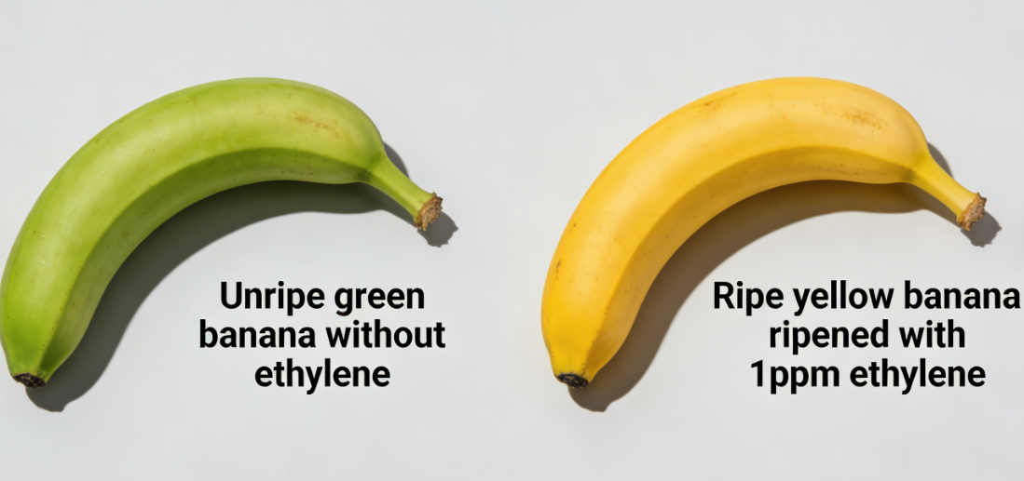
5. Storage
(3) Gas Composition Control
Ethylene (C₂H₄)
Ethylene Effects on Ripening and Senescence
  Ethylene: a gaseous plant hormone that promotes ripening and senescence.
  Its action is autocatalytic: ripen → endogenous ethylene synthesis→ further accelerates ripening (“ethylene burst”).
Ethylene Sensitivity
  Even 1 ppm ethylene can induce noticeable ripening effects.
  Example: green bananas exposed to ethylene→ rapidly degrade chlorophyll and develop yellow pigments.
Notes:
（3）乙烯：13. 乙烯是促进果蔬成熟衰老的气态植物激素，在正常条件下以气态形式存在，其作用具有自催化特性——果实成熟过程中自身合成乙烯，新生成的乙烯进一步加速成熟，形成“乙烯爆发”循环，对成熟衰老进程影响显著。即使浓度低至1ppm，乙烯也能产生明显的催熟效应，例如青香蕉在乙烯作用下可快速降解叶绿素、显现黄色素，实现由绿转黄。
(3)Ethylene (C₂H₄)
Ethylene is a gaseous plant hormone that promotes fruit and vegetable ripening and senescence. Its action is autocatalytic in nature: as fruits ripen, endogenous ethylene synthesis further accelerates ripening, creating an “ethylene burst” that significantly influencethe ripening process. Even at 1 ppm, ethylene can induce noticeable ripening effects—for example, green bananas exposed to ethylene rapidly degrade chlorophyll and develop yellow pigments.

Slide 31
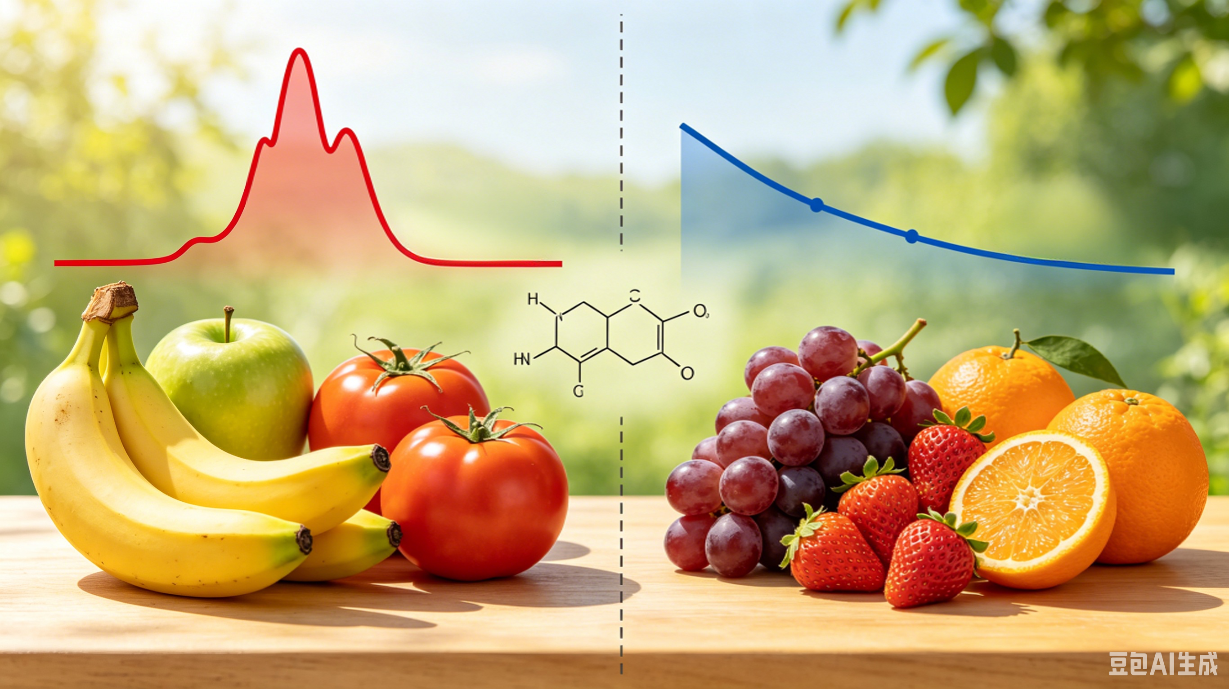
5. Storage
(3) Gas Composition Control
Climacteric
Fruits
Non-Climacteric Fruits
Ethylene (C₂H₄)
Ethylene Production and Respiration Type
  Ethylene production varies widely among species and cultivars and is closely linked to respiration type.
Climacteric Fruits
  Climacteric fruits (bananas, apples, tomatoes, kiwifruit) produce high levels of ethylene.
  Exhibit a respiration peak → ripen rapidly after harvest.
Non-Climacteric Fruits
  Non-climacteric fruits (strawberries, citrus, grapes) produce very low amounts of ethylene.
  Show no postharvest respiration peak and rely on preharvest flavour accumulation.
Notes:
不同品类及同品类不同品种果蔬的乙烯生成量差异显著，其核心与呼吸类型相关：呼吸跃变型果实（如香蕉、苹果、番茄、猕猴桃等）乙烯生成量高，采后会出现呼吸高峰与乙烯爆发，成熟速度快；非跃变型果实（如草莓、柑橘、葡萄等）乙烯生成量极低，采后无明显呼吸高峰，难以自主后熟，风味主要依赖采收前积累。
Ethylene production varies widely among species and cultivars and is closely related to respiration type:
Climacteric fruits (e.g., bananas, apples, tomatoes, kiwifruit) produce high levels of ethylene, exhibit a respiration peak, and ripen rapidly postharvest.
Non-climacteric fruits (e.g., strawberries, citrus, grapes) produce very low amounts of ethylene, show no postharvest respiration peak, and rely on preharvest flavor accumulation.

Slide 32
5. Storage
(3) Gas Composition Control
Ethylene (C₂H₄)
Ethylene Sources and Their Effects
  Endogenous ethylene (synthesized by fruit) and exogenous ethylene (from surrounding fruits or artificially added) accelerate ripening and senescence.
Ethylene Detection Challenges and Storage Management
  Ethylene concentrations are often very low and hard to detect with handheld analysers.
  Storage management should:
Avoid co-storage of climacteric and non-climacteric fruits.
Minimize ethylene accumulation in storage environment.
Notes:
内源乙烯（果实自身合成）与外源乙烯（环境中其他果蔬释放或人工添加）均能加速成熟衰老，且乙烯浓度极低时手持气体分析仪难以检测，因此贮藏中需避免不同呼吸跃变类型果蔬同库存放，同时减少环境中乙烯积累。
Both endogenous ethylene (synthesized by the fruit) and exogenous ethylene (released by surrounding fruits or artificially added) accelerate ripening and senescence.
Because ethylene concentrations can be very low and difficult to detect with handheld gas analyzers, storage management should:
•Avoid co-storage of climacteric and non-climacteric fruits, and
•Minimize ethylene accumulation in the storage environment.

Slide 33
5. Storage
(3) Gas Composition Control
Ethylene (C₂H₄) : Factors Influencing Ethylene Production and Its Control
① Mechanical Damage and Pest/Disease Incidence.
Physiological Changes
  Enhanced respiration.
  Increased susceptibility to pathogen spread.
  Stimulated ethylene synthesis and release.
Impacts of Locally Elevated Ethylene
  Accelerates senescence in nearby undamaged produce.
  Shortens overall storage life.
Production Application
  In most storage scenarios, suppressing ethylene is critical to extend shelf life.
  In specific cases (e.g., green tomatoes turning red, green bananas ripening), ethylene can be deliberately applied to accelerate ripening for market readiness.
Notes:
乙烯生成与作用的影响因素及调控方式如下：
机械损伤与病虫害：带机械损伤、染病虫害的果蔬，不仅呼吸作用旺盛、易传播病害，还会被刺激合成释放更多乙烯，加速周边成熟度较低的完好果蔬衰老，缩短整体贮藏期。生产中对乙烯的调控需分场景：多数贮藏场景需抑制乙烯以延长保鲜期；青番茄转红、青香蕉催熟等场景，则可利用乙烯加速成熟，实现商品化适配。
Factors Influencing Ethylene Production and Its Control
(1)Mechanical Damage and Pest/Disease Incidence
Fruits and vegetables with mechanical injuries or pest/disease infestations exhibit:
•Enhanced respiration,
•Increased susceptibility to pathogen spread, and
•Stimulated ethylene synthesis and release.
This locally elevated ethylene accelerates senescence in nearby undamaged produce, thereby shortening overall storage life.
Production Application:
•In most storage scenarios, ethylene suppression is critical to extend shelf life.
•In specific cases, such as green tomatoes turning red or green bananas ripening, ethylene can be deliberately applied to accelerate ripening for market readiness.

Slide 34
5. Storage
(3) Gas Composition Control
Ethylene (C₂H₄) : Factors Influencing Ethylene Production and Its Control
① Mechanical Damage and Pest/Disease Incidence.
Ethylene Inhibitors
  Most widely used and effective ethylene inhibitor: 1-methylcyclopropene (1-MCP).
  Advantages: low cost, broad applicability.
  Mechanism: 1-MCP binds to ethylene receptors in plant cells → blocks ethylene action → delays ripening and senescence.
  Example:
Untreated bananas gradually turn yellow then blacken.
1-MCP-treated bananas maintain a golden yellow colour, preventing browning, blackening, and decay.
Notes:
① 目前应用最广泛、效果最显著的乙烯抑制剂为1-甲基环丙烯（1-MCP），其成本低廉、适用性强，可有效阻断乙烯与果蔬细胞中的乙烯受体结合，延缓成熟衰老——同等贮藏条件下，未处理香蕉会正常变黄变黑，经1-MCP处理的香蕉可维持金黄状态，避免出现褐变、发黑腐烂。
Ethylene Inhibitors:
•The most widely used and effective inhibitor is 1-methylcyclopropene (1-MCP).
•Advantages: low cost, broad applicability.
•Mechanism: 1-MCP binds to ethylene receptors in plant cells, blocking ethylene action and delaying ripening and senescence.
•Example: Under identical storage conditions, untreated bananas gradually turn yellow then black, whereas 1-MCP-treated bananas maintain a golden yellow color, preventing browning, blackening, and decay.

Slide 35
5. Storage
(3) Gas Composition Control
Ethylene (C₂H₄) : Factors Influencing Ethylene Production and Its Control
② Temperature: Temperature regulates ethylene production by affecting biochemical reaction rates in fruit and vegetable tissues.
High Temperature Inhibition
  >35°C, key biochemical conversions in ethylene synthesis pathway hindered → suppresses ethylene production.
  Example: Tomatoes at such temperatures do not exhibit typical ethylene production peak.
  Heat treatments at 35–38°C suppress ethylene synthesis and postharvest ripening in apples, tomatoes, apricots, etc.
Low Temperature Inhibition
  Ethylene synthesis requires enzyme-mediated reactions.
  Low temperatures reduce enzyme activity → slow ethylene production.
  Optimal production at 20–25°C; minimal production at 0°C.
  As temperature rises from low to moderate, ethylene synthesis accelerates.
Notes:
2.温度：温度通过影响果蔬体内的生物化学反应速度，来调节乙烯的生成：一是高温抑制，多数果实在35℃以上环境中，乙烯合成过程中的关键物质转化受阻，乙烯生成被抑制，例如番茄在该温度下不会出现乙烯生成高峰，35-38℃热处理可抑制苹果、番茄、杏等果蔬的乙烯生成与后熟衰老；二是低温抑制，乙烯合成是一系列需要酶参与的化学反应，低温会降低酶的活性，20-25℃（常温）时乙烯合成速度最快，0℃时生成量最小，温度升高则合成加速 。
(2)Temperature
Temperature regulates ethylene production by affecting the rate of biochemical reactions in fruit and vegetable tissues:
•High Temperature Inhibition
▪At temperatures above 35°C, key biochemical conversions in the ethylene synthesis pathway are hindered, thereby suppressing ethylene production.
▪Example: Tomatoes at such temperatures do not exhibit a typical ethylene production peak.
▪Heat treatments at 35–38°C can suppress ethylene synthesis and postharvest ripening in apples, tomatoes, apricots, and similar produce.
•Low Temperature Inhibition
▪Ethylene synthesis requires enzyme-mediated chemical reactions. Low temperatures reduce enzyme activity, slowing ethylene production.
▪Optimal production occurs at 20–25°C (room temperature); minimal production occurs at 0°C.
▪As temperature rises from low to moderate, synthesis accelerates.

Slide 36
5. Storage
(3) Gas Composition Control
Ethylene (C₂H₄) : Factors Influencing Ethylene Production and Its Control
② Temperature: Implication for Postharvest Preservation
Low-temperature storage: most critical and widely applied method for maintaining fruit and vegetable quality.
Benefits of Low-Temperature Storage
  Reducing the respiration rate.
  Minimizing water loss.
  Suppressing ethylene synthesis and release.
Practical Applications
  Cold chain logistics during transportation.
  Consumer-level refrigerated storage.
By controlling temperature, respiration, and ethylene, postharvest shelf life and quality can be effectively maintained.
Notes:
② 因此，低温贮藏是果蔬保鲜最核心、最常用的手段，可同步降低呼吸作用、减少水分蒸发、抑制乙烯合成释放，管控好这三大维度即可有效维持果蔬品质。运输中的冷链物流、消费者购买后的低温冷藏，均是基于这一原理的实操应用，通过稳定温度与气体环境，延长货架期。
Implication for Postharvest Preservation:
•Low-temperature storage is the most critical and widely applied method for maintaining fruit and vegetable quality.
•Benefits include:
Reducing the respiration rate,
Minimizing water loss,
Suppressing ethylene synthesis and release.
•Practical applications include:
Cold chain logistics during transportation,
Consumer-level refrigerated storage.
By controlling these three factors — temperature, respiration, and ethylene — postharvest shelf life and quality can be effectively maintained.

Slide 37
Summary
Core postharvest preservation and loss-reduction technologies
Two key components
1
2
Understanding Postharvest Quality Dynamics
Standardizing Postharvest Handling Operations
Identify the mechanisms and influencing factors of postharvest quality deterioration.
Develop targeted control strategies based on these mechanisms.
Implement standardized practices across all stages: pre-cooling, grading, packaging, and storage.
Precisely regulate temperature, humidity, and gas composition.
Core goal: Reduce postharvest losses, maintain and improve product quality, and ensure stable storage and marketing conditions.
Notes:
总结
果蔬采后保鲜减损技术核心涵盖两部分：一是明确采后品质变化的机理与影响因素，有针对性地制定控制技术；二是规范采后预冷、分级、包装、贮藏等全环节操作，通过精准调控温度、湿度、气体成分，实现产后减损、品质提升，为贮藏与销售提供保障。
Summary
The core of postharvest preservation and loss-reduction technologies for fruits and vegetables centers on two key components:
1.Understanding Postharvest Quality Dynamics
Identify the mechanisms and influencing factors of postharvest quality deterioration.
Develop targeted control strategies based on these mechanisms.
2.Standardizing Postharvest Handling Operations
Implement standardized practices across all stages: pre-cooling, grading, packaging, and storage.
Precisely regulate temperature, humidity, and gas composition to reduce postharvest losses, maintain and improve product quality, and ensure stable storage and marketing conditions.

