Slide 1
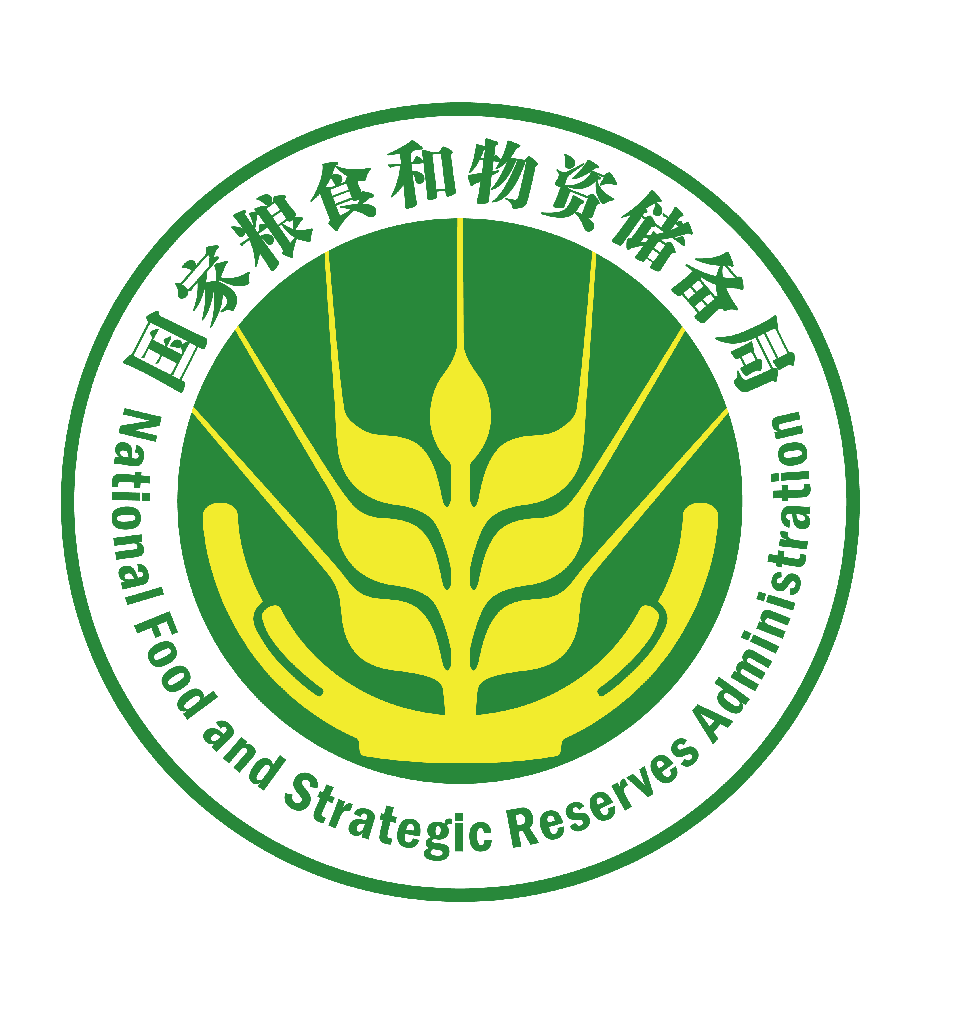

Lecture Four
Reducing Grain Losses and Ensuring Supply during COVID-19

Slide 2
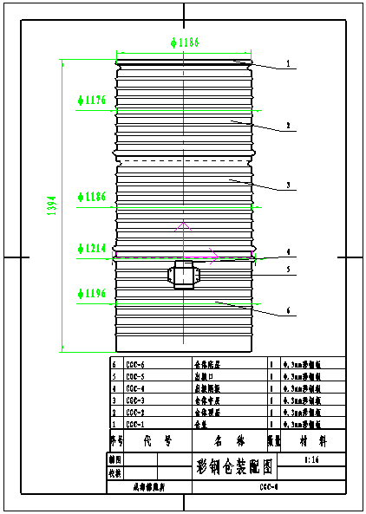
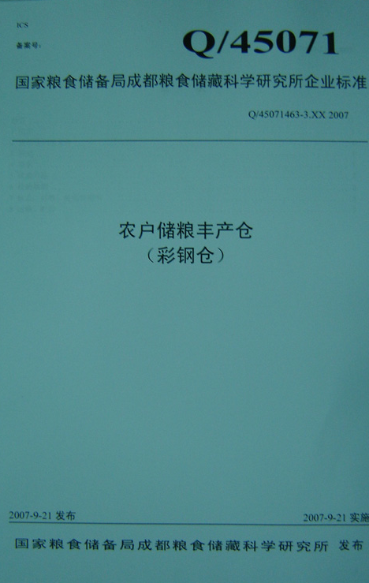
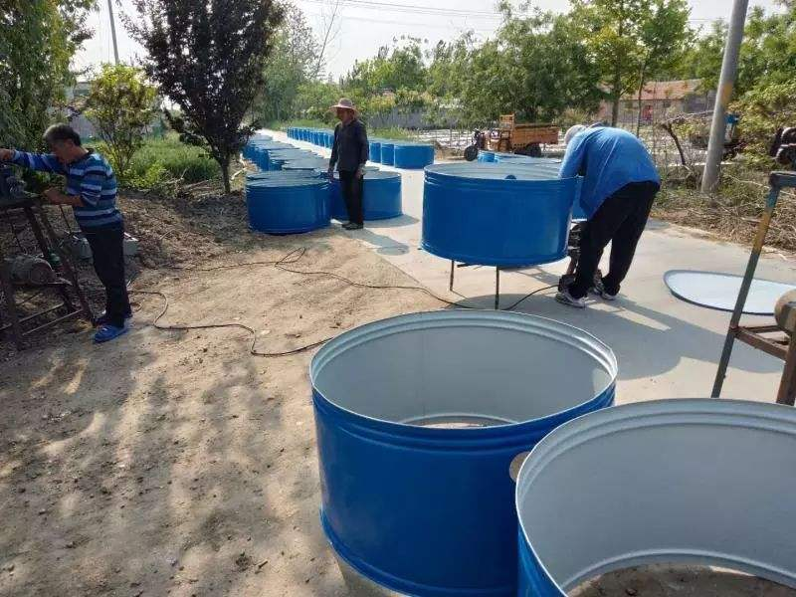
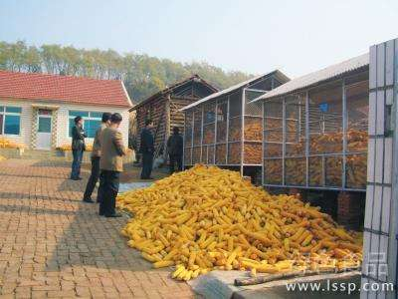
VII. Reducing Grain Losses for Farmers
(I) Realizing technological innovation in grain storage for farmers
1. New equipment and new types of granaries have been developed with a series of standardized designs and the applications have been demonstrated to farmer households

Slide 3
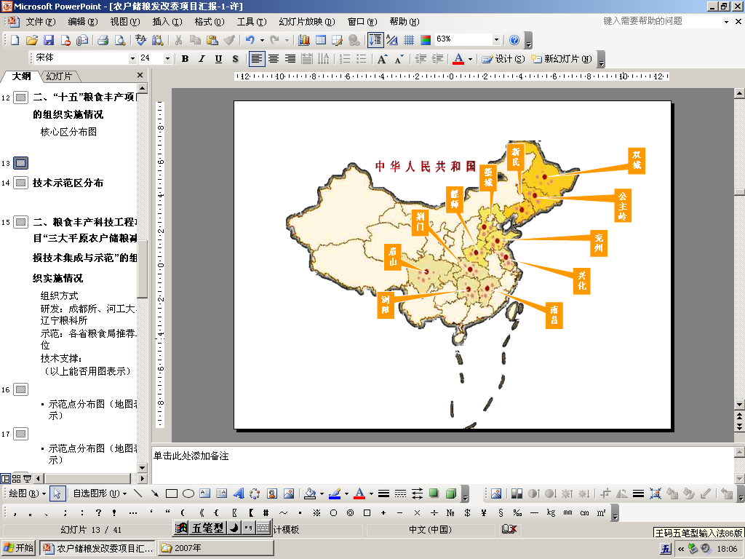
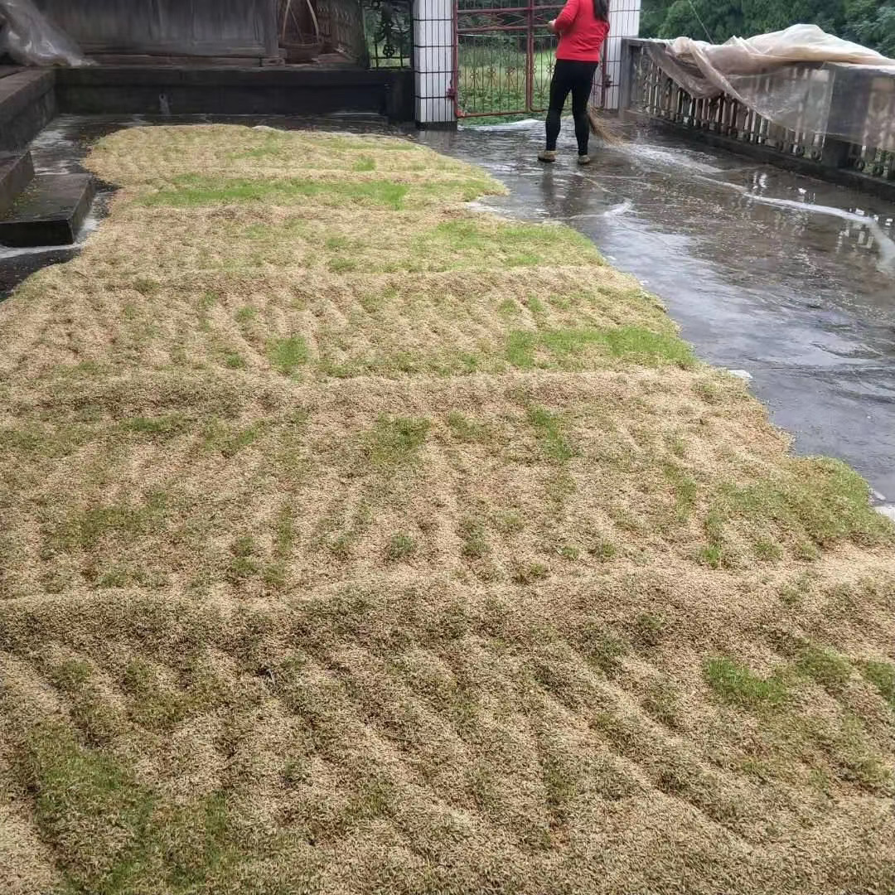
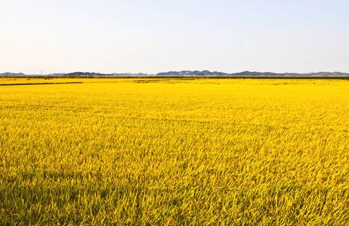
VII. Reducing Grain Losses for Farmers
(I) Realizing technological innovation in grain storage for farmers
2. Five hundred sites have been established to demonstrate scientific ways of grain preservation, and one or two technical solutions have been developed to reduce grain losses for farmers. The Engineering Research Center for Food Preservation under the State Administration of Grain has been established.

Slide 4

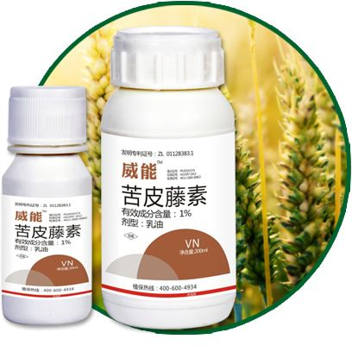
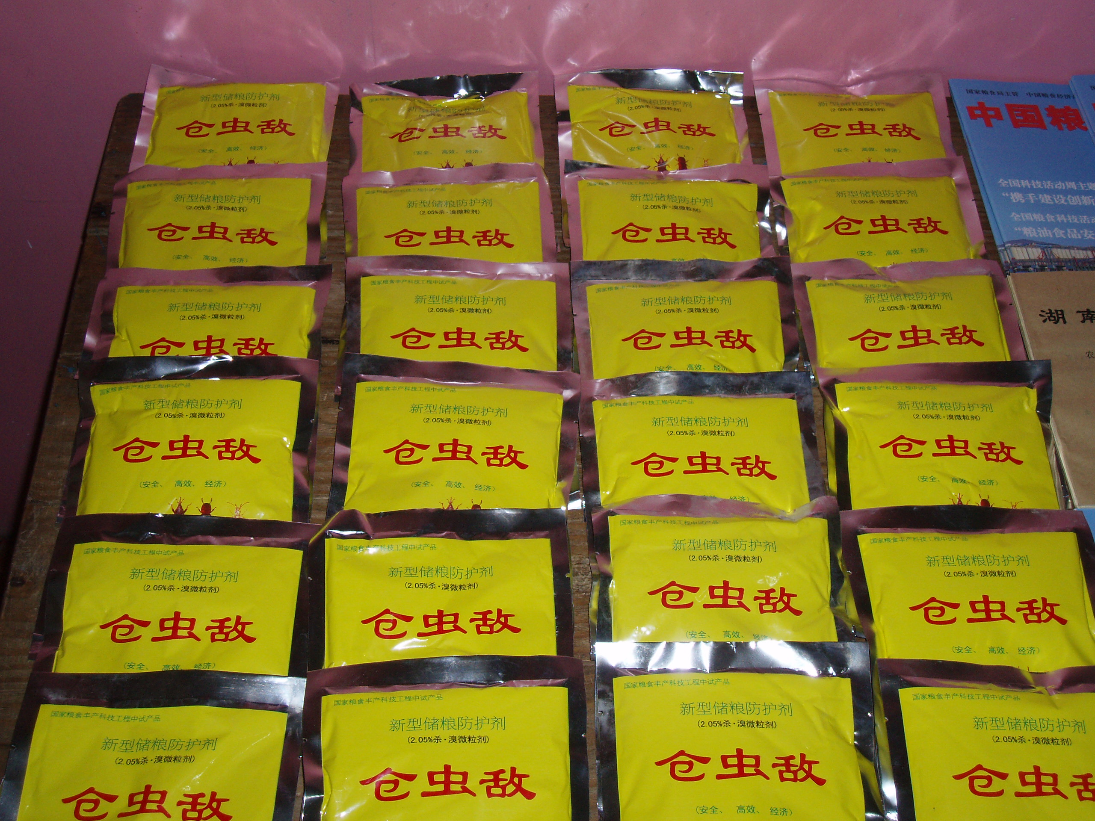
VII. Reducing Grain Losses for Farmers
(I) Realizing technological innovation in grain storage for farmers
3. Botanical farm chemicals have been developed as an effective way to store and protect farmers' grain. The technology of expelling parasite and killing rats has been demonstrated to more than 14,000 farmer households.

Slide 5
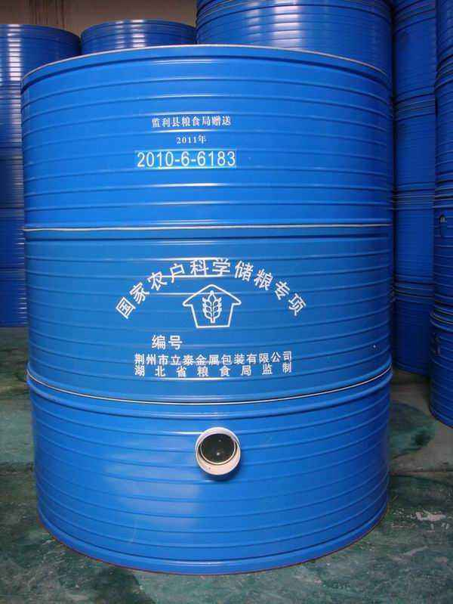
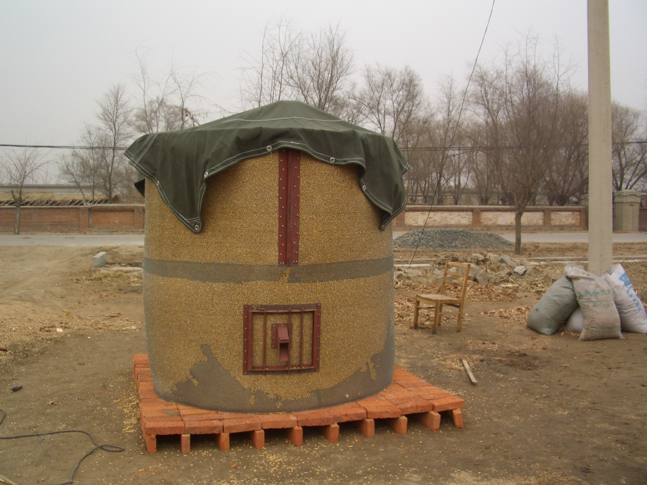
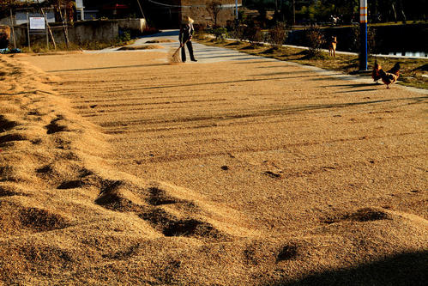
VII. Reducing Grain Losses for Farmers
(I) Realizing technological innovation in grain storage for farmers
4. The technology modes of grain storage for farmers in the three major Chinese plains have been integrated and included into the national standard Technical Guidelines for Grain and Oil Storage for Farmers.
Region | Grain | Integrated grain storage technologies
 | Variety
The Middle-Lower Yangtze | Rice | Rice preservation technology
Plain |  | Rice preservation technology in areas with abundant rainfall
The Northeast Plain | Wheat | Regular wheat preservation technology
 |  | Technology for storing wheat in air-tight spaces.
 |  | Technology for low-oxygen storage of wheat in air-tight spaces.
The Northeast Plain | Corn | Technology for safe storage of corn

Slide 6
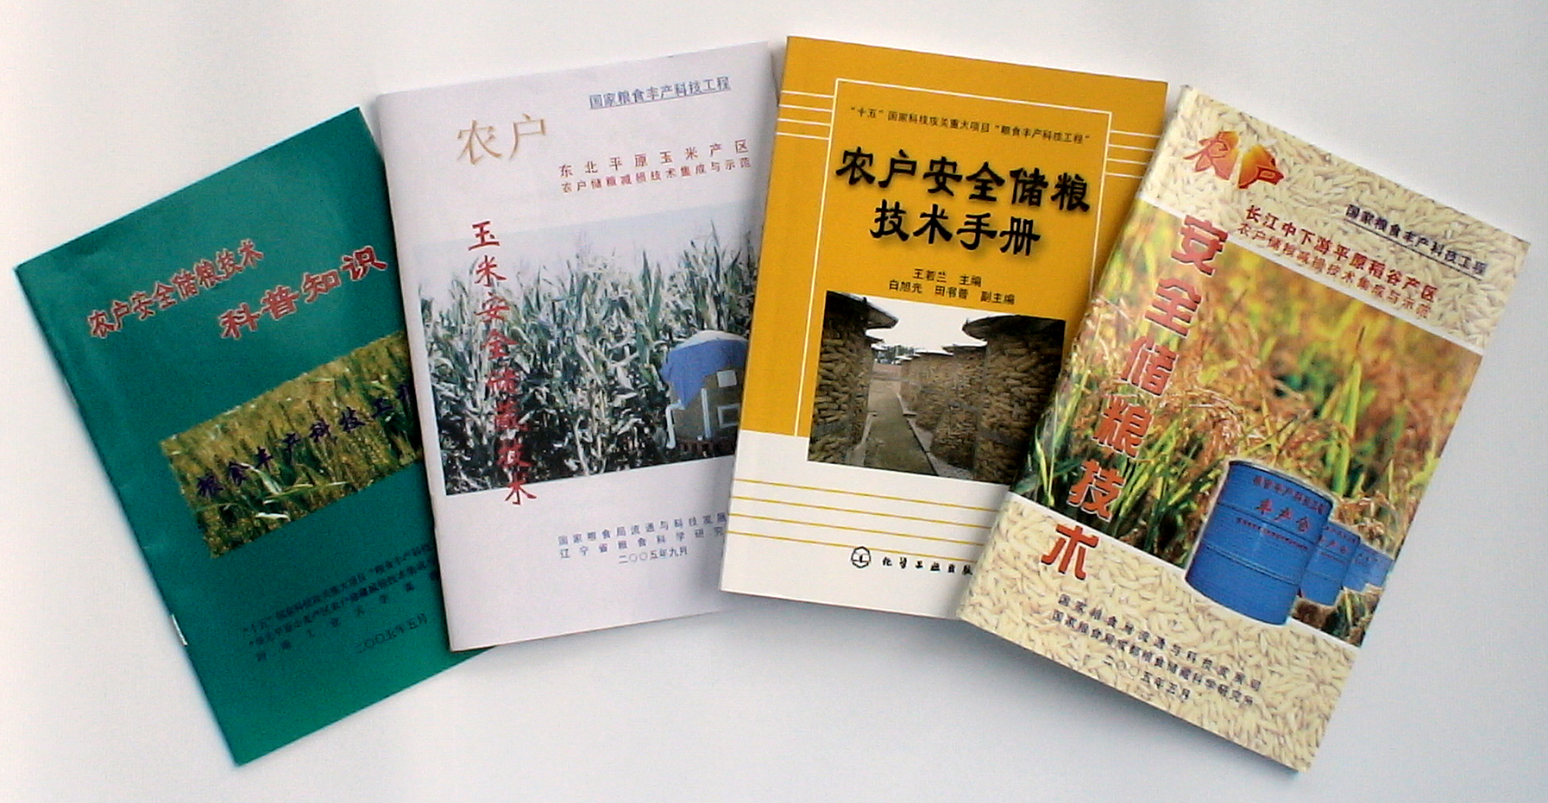
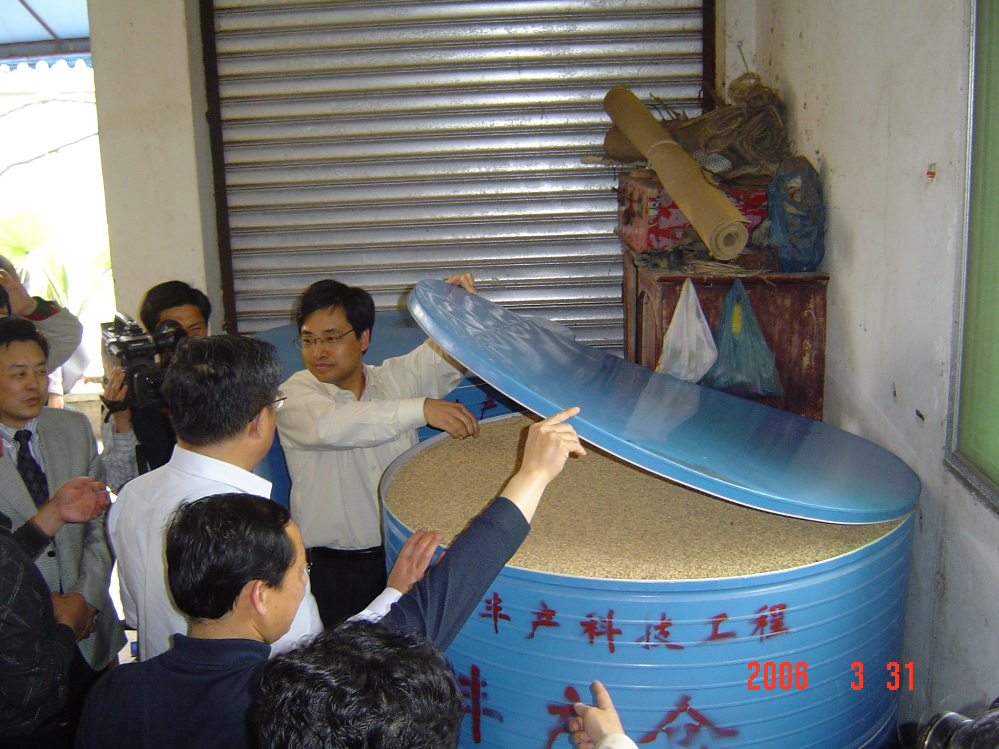
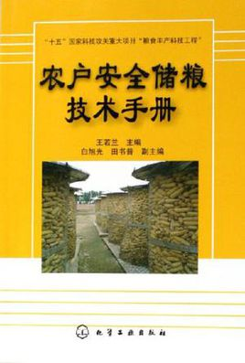
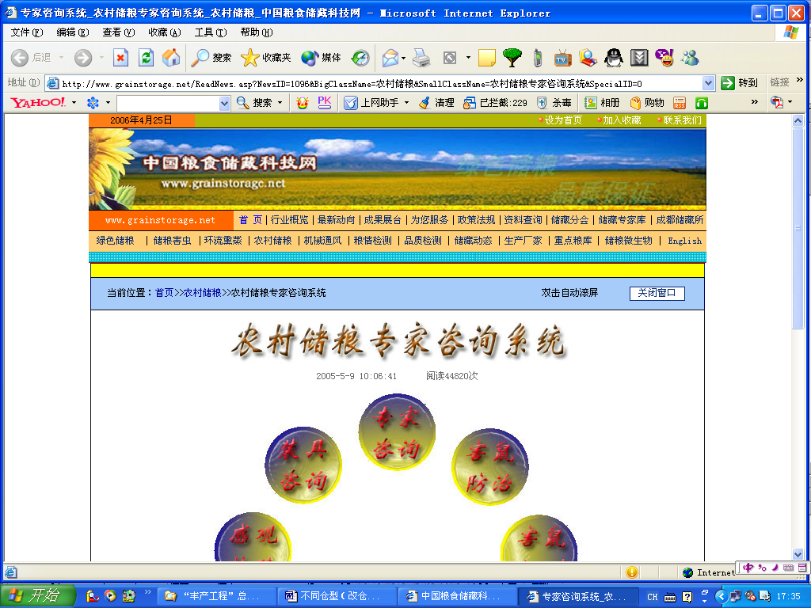
VII. Reducing Grain Losses for Farmers
(I) Realizing technological innovation in grain storage for farmers
5. Farms have been trained to learn how to store grains under demonstration projects and the technologies have been applied to more households.
Expert Consulting System for Grain Storage

Slide 7
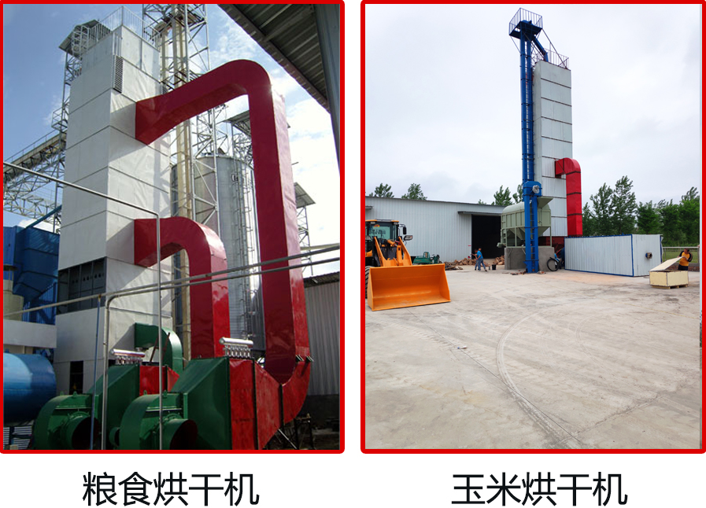
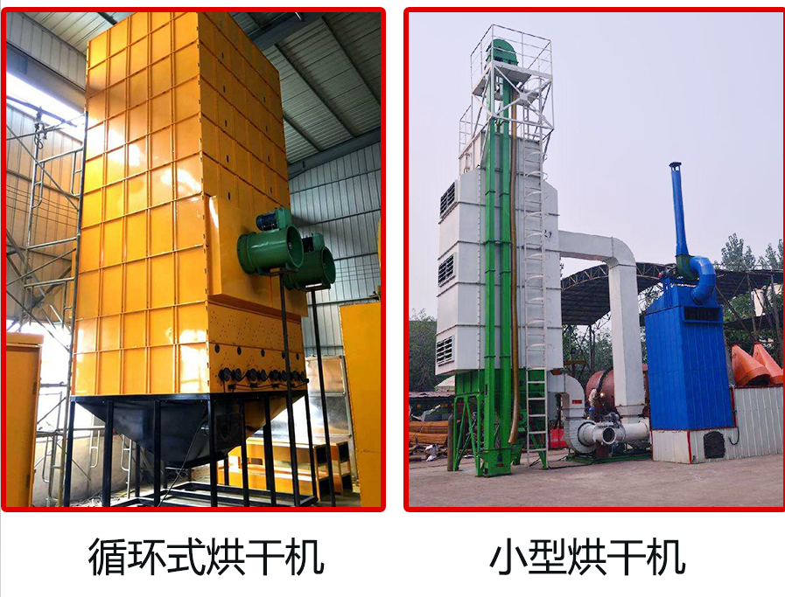
VII. Reducing Grain Losses for Farmers
(I) Realizing technological innovation in grain storage for farmers
6. New technologies and equipment have been developed for grain quality guarantee and drying.

Slide 8
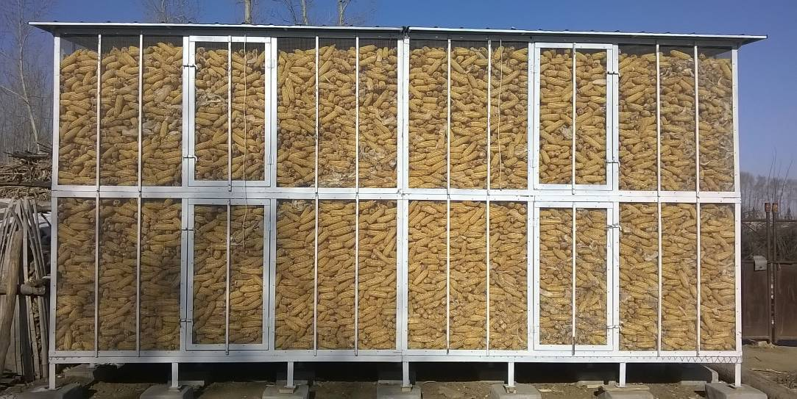
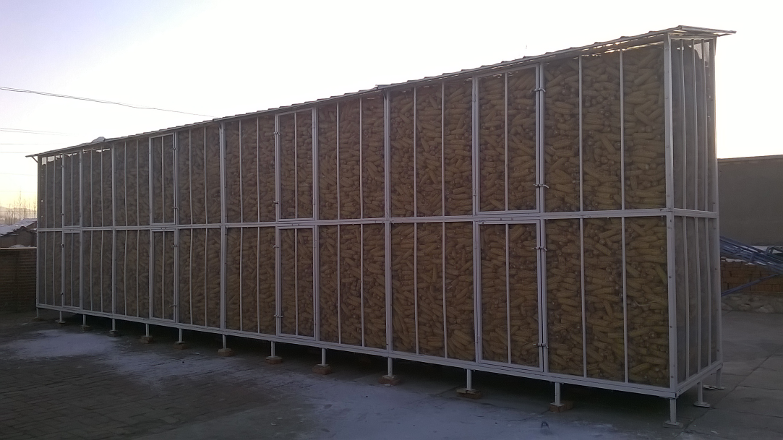
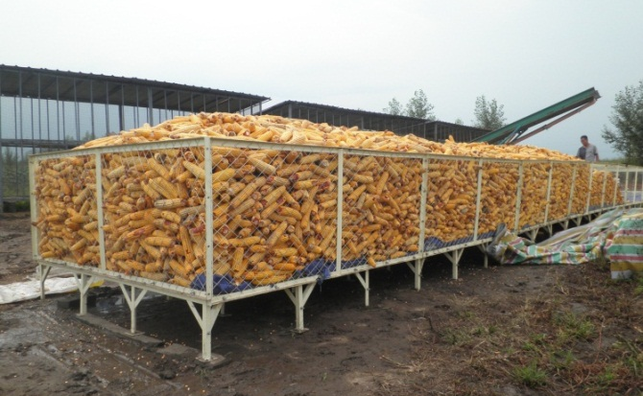
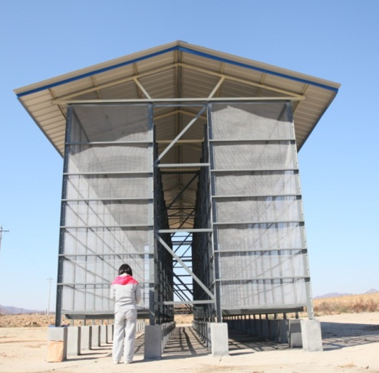
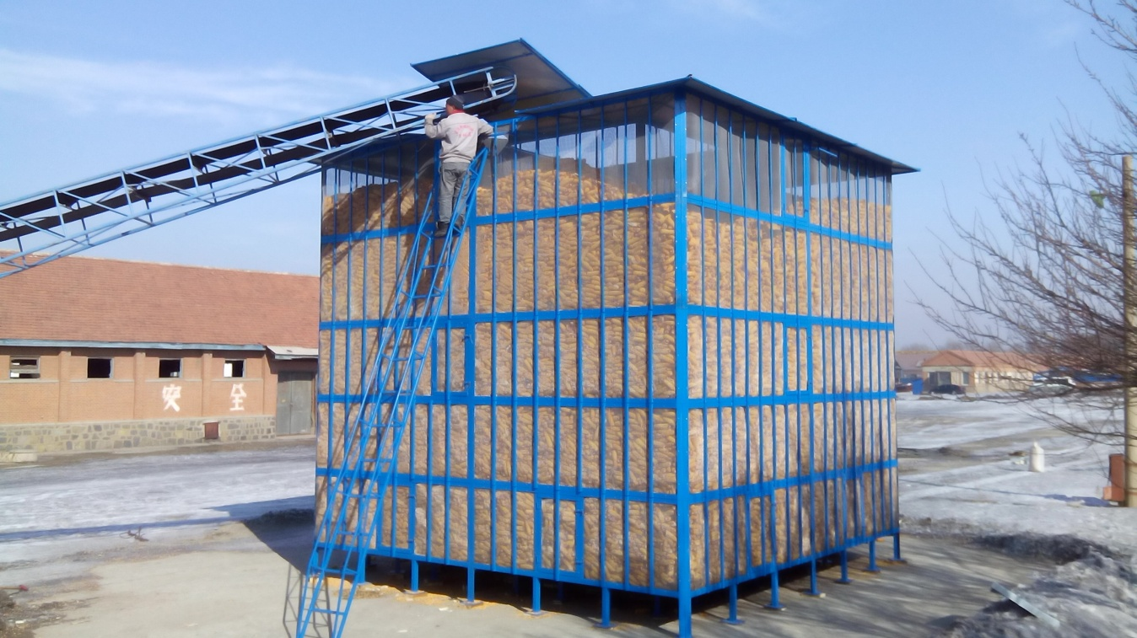
VII. Reducing Grain Losses for Farmers
(I) Realizing technological innovation in grain storage for farmers
7. Three types of granaries with larger capacity, i.e. steel grid collapsible granaries, cellular board collapsible granaries and granaries with round flexible bags, have been developed and their uses have been demonstrated to more farmers.

Slide 9
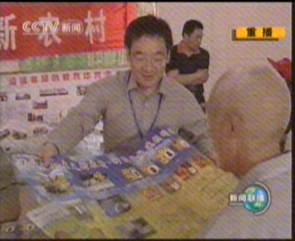
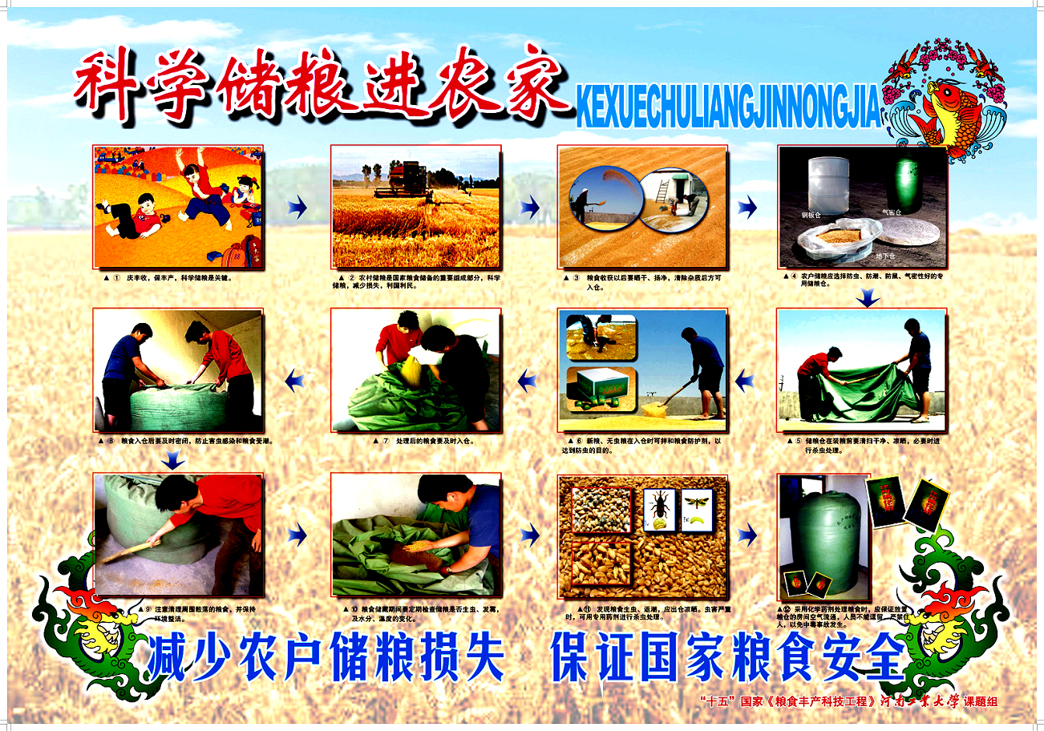
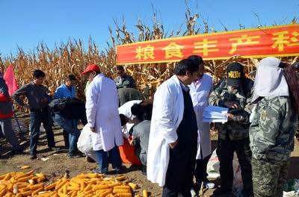
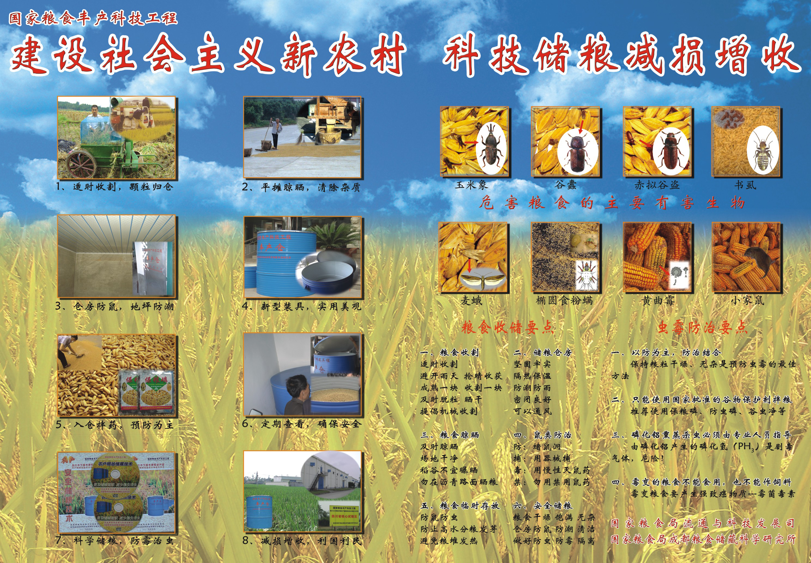
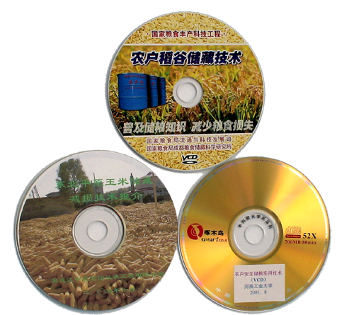
VII. Reducing Grain Losses for Farmers
(II) Spreading grain storage know-how to farmers
Government-owned science platforms are used to spread knowledge on grain preservation. Relevant expertise has been spread through the China Food Newspaper and the Rural Edition of Sichuan Daily.

Slide 10
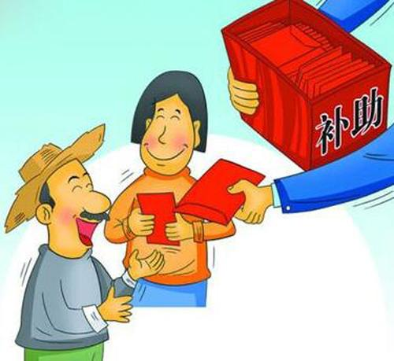
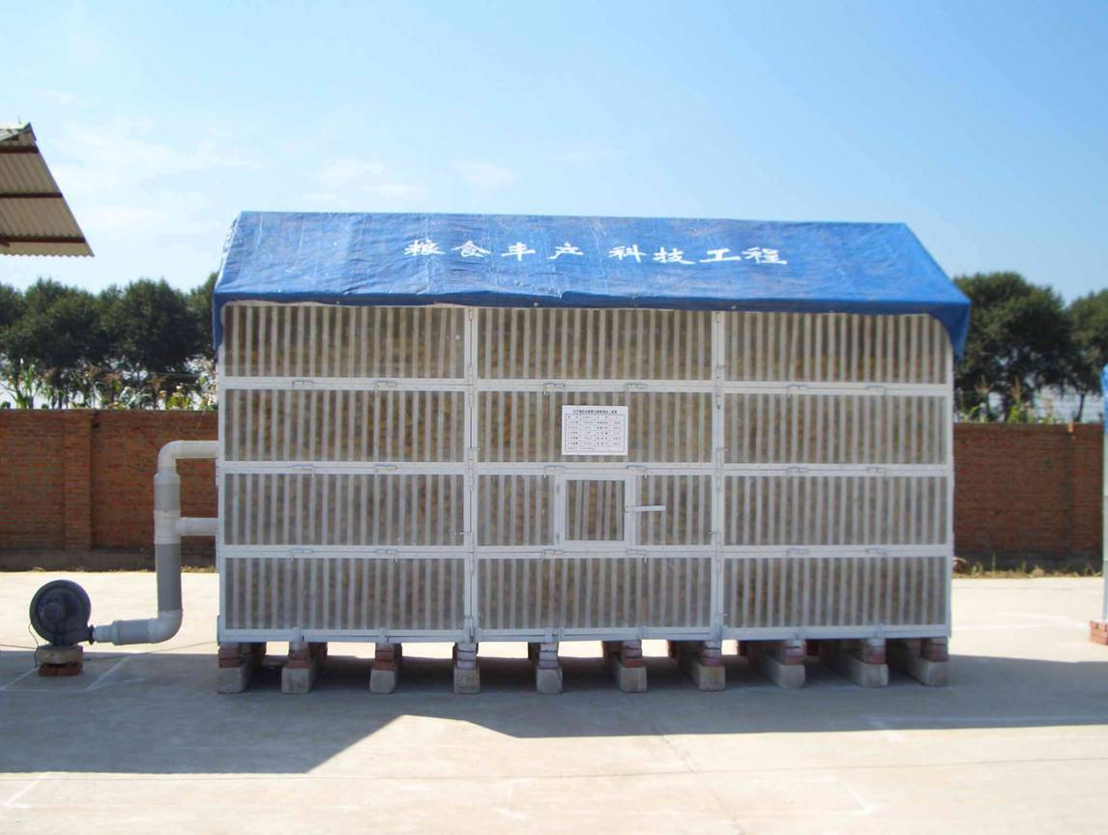
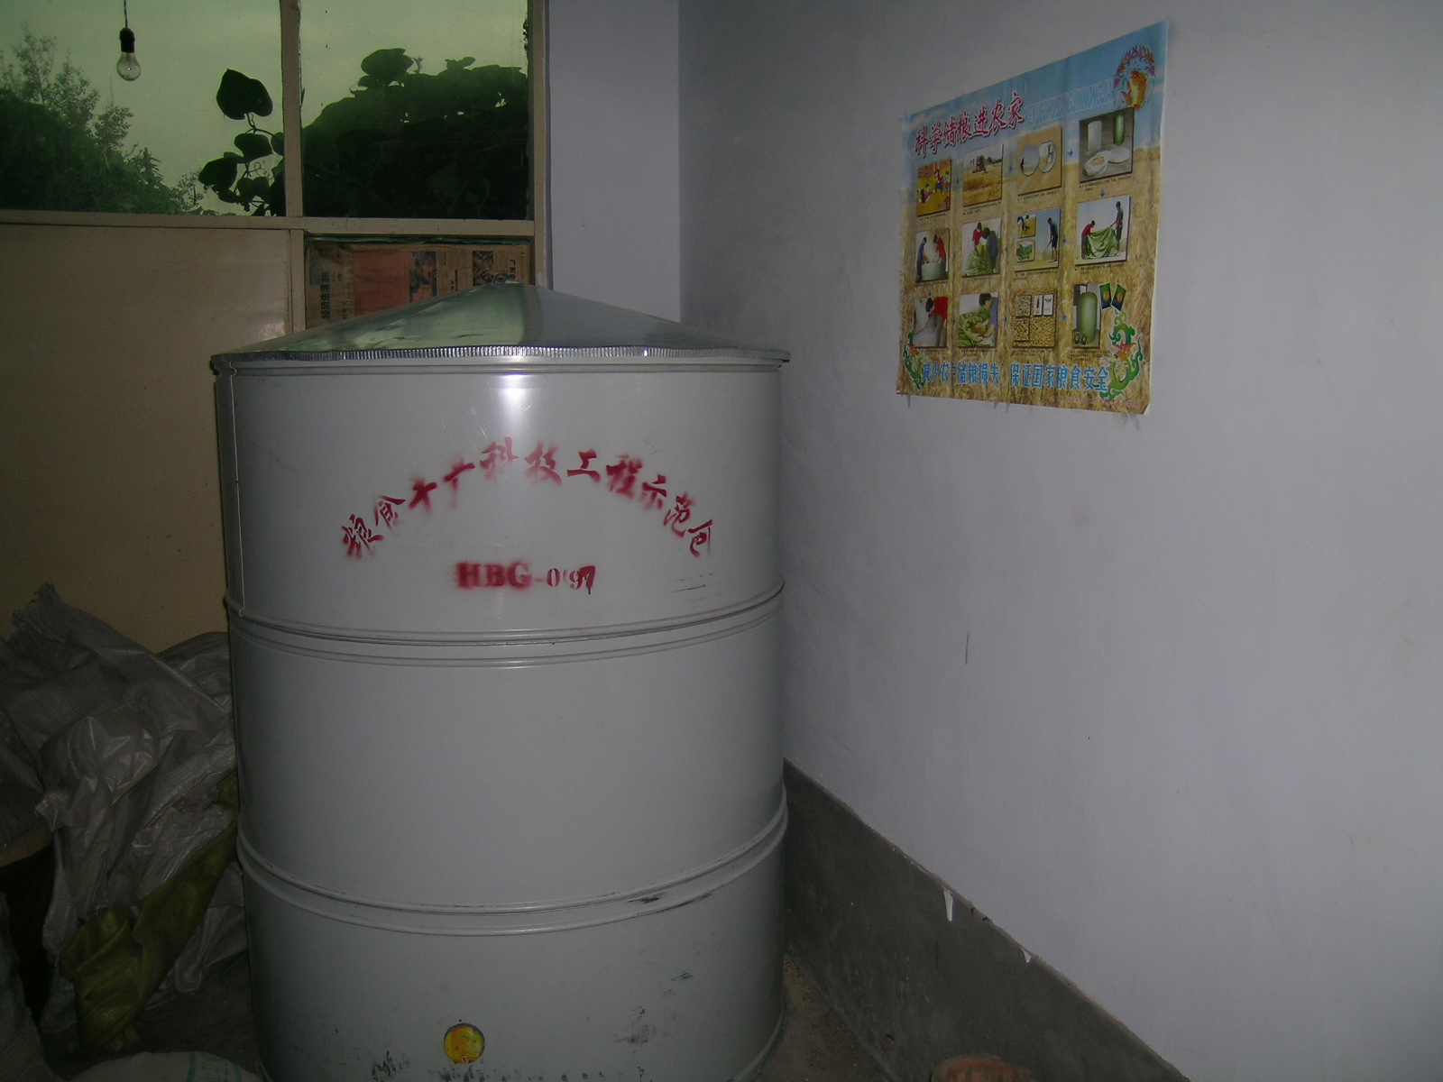
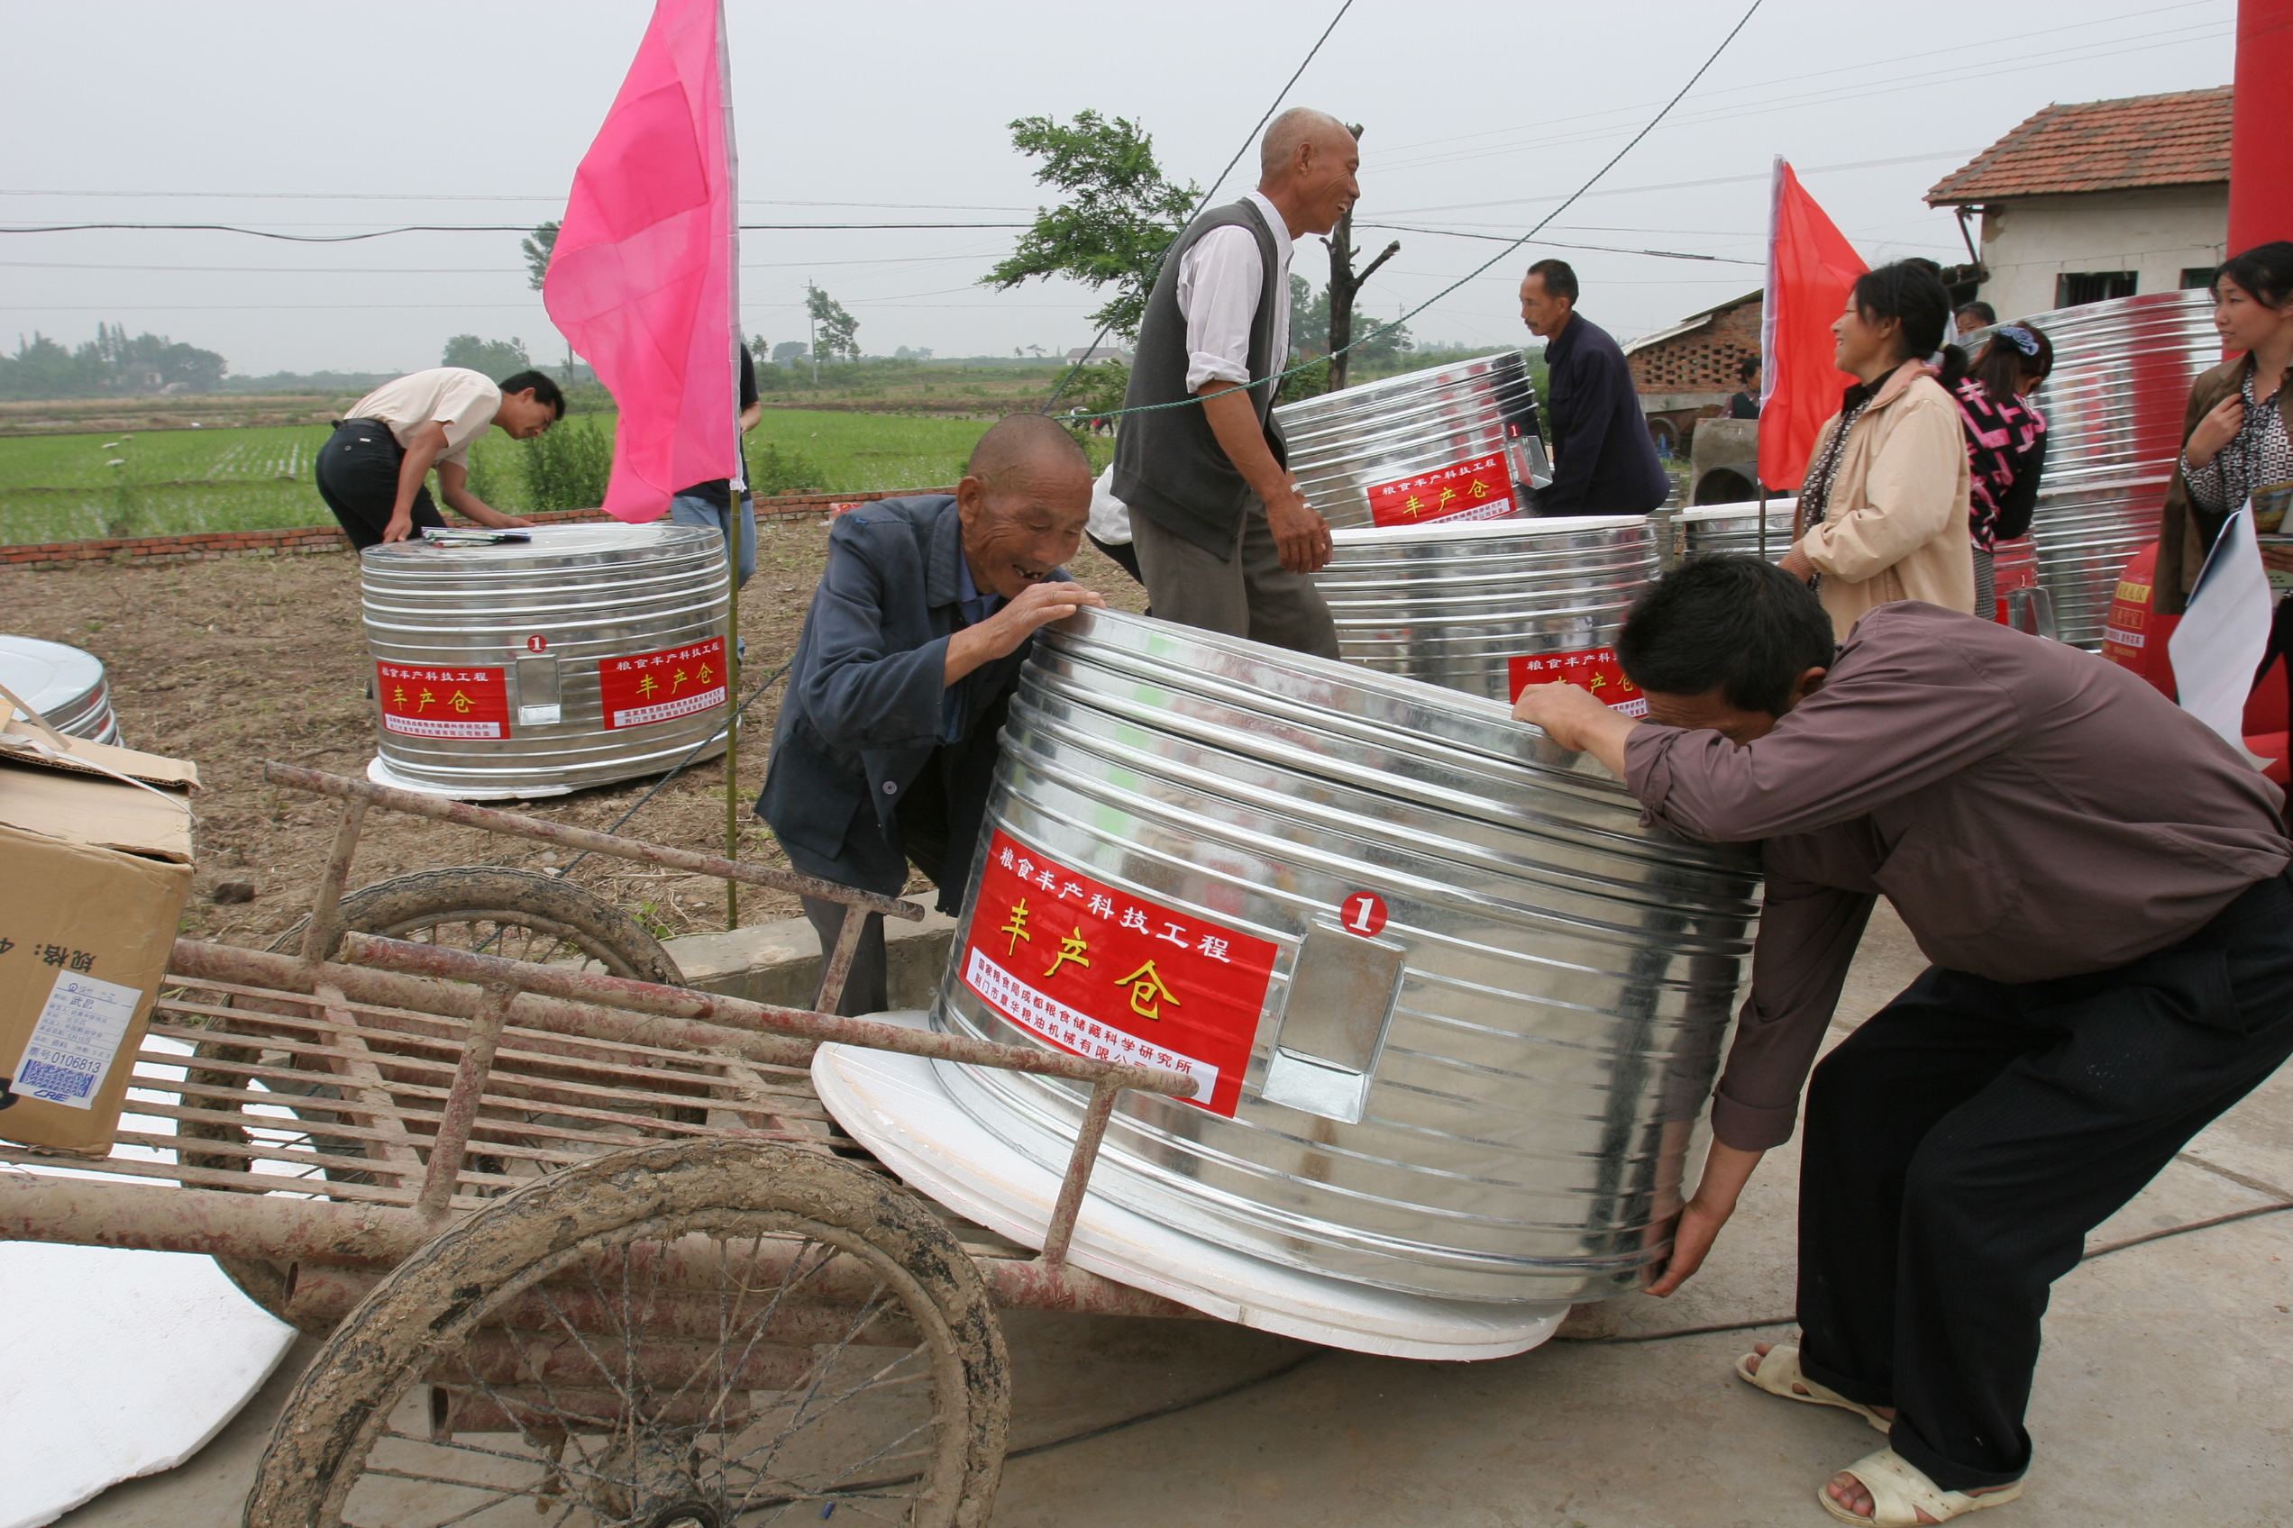
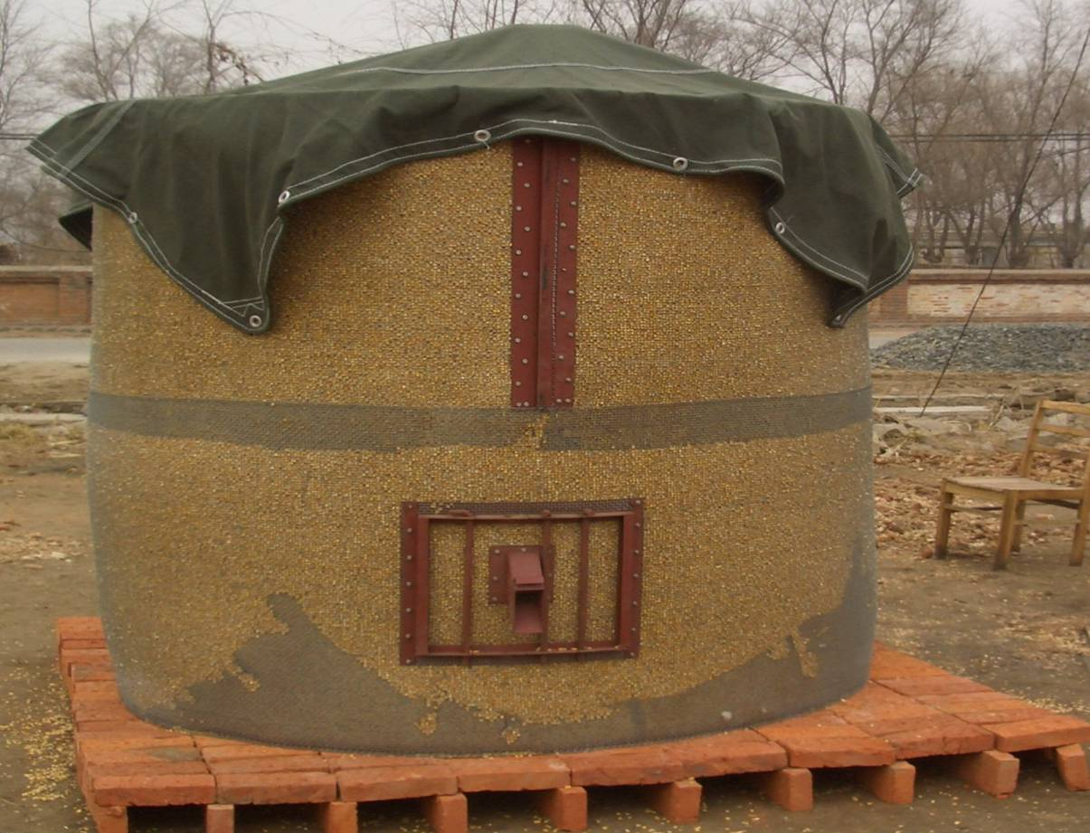
VII. Reducing Grain Losses for Farmers
(III) Building special projects for modern grain storage
1. Phase I – during “the 11th Five-Year Plan”
From 2007 to 2010, nearly 2 million new sets of granaries were provided for Chinese farmers in 25 provinces to store their food.
“Xiaokang (well-off families) granaries”
Square and round granaries

Slide 11
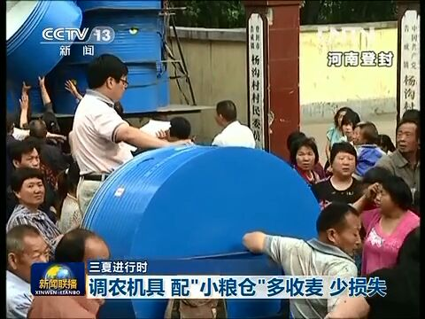
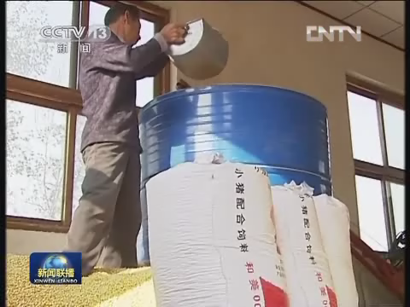
VII. Reducing Grain Losses for Farmers
(III) Building special projects for modern grain storage
1. Phase I – during “the 11th Five-Year Plan”
Great progress has been made with positive effects on the society.

Slide 12
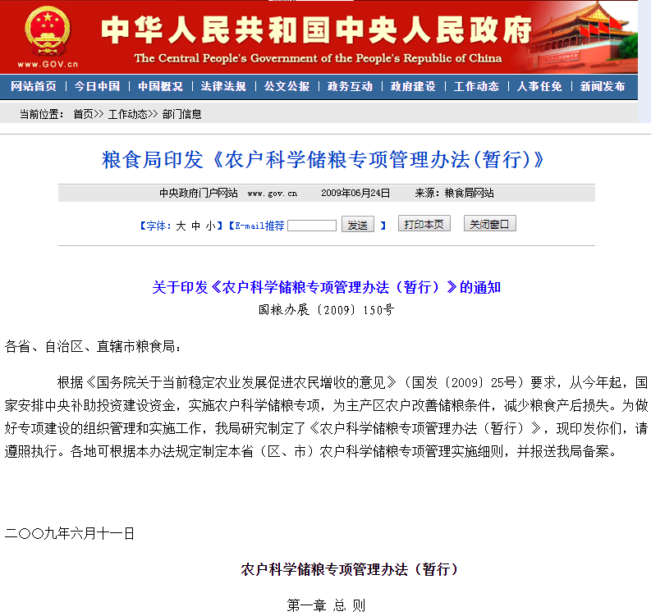
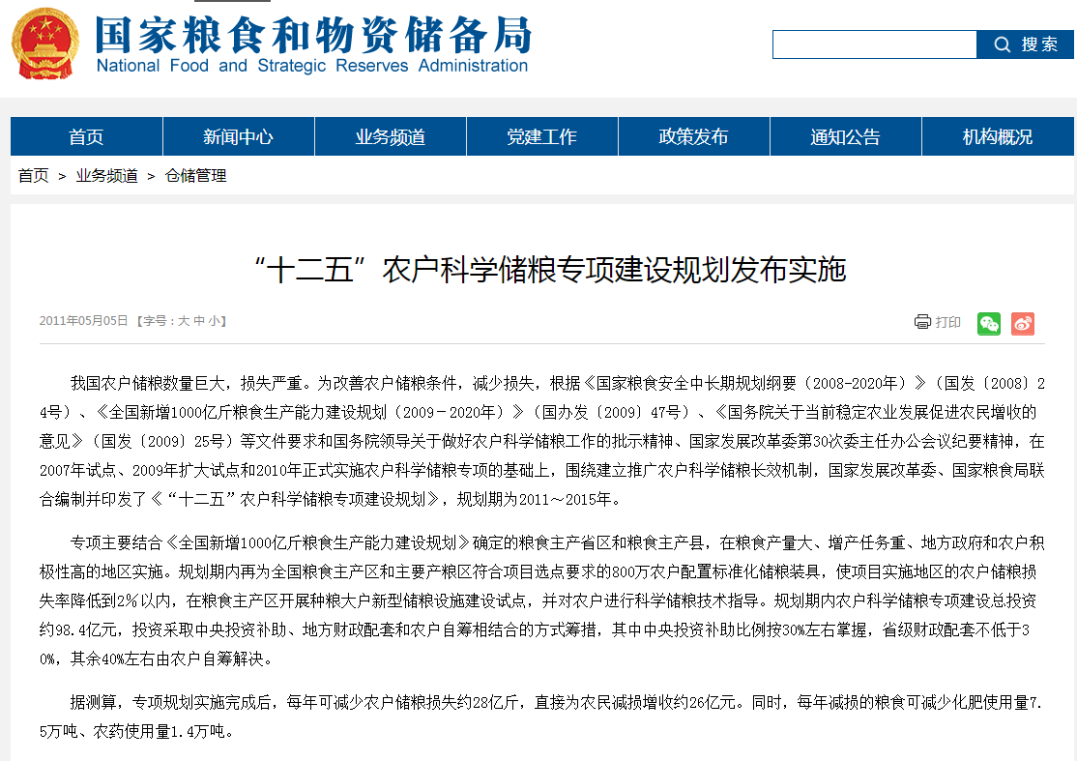
VII. Reducing Grain Losses for Farmers
(III) Building special projects for modern grain storage
2. Phase II – 2011
Totally 6.935 million sets of standardized granaries for grain storage were built in 26 provinces, autonomous regions and municipalities directly under the central government across China except Beijing, Tianjin, Shanghai, Hainan and Jiangsu
Farmers were supplied with standardized granaries to store their food and the grain loss rate was reduced below 3% in the project area. Pilot programs of building new facilities for large-scale grain planters were conducted in major production areas focusing on the construction of a group of steel granaries.
Special Administrative Measures for Modern Grain Storage (Interim) issued by National Food and Strategic Reserves Administration
The 12th Five-Year Plan for Modern Grain Storage Improvement Issued and Implemented

Slide 13
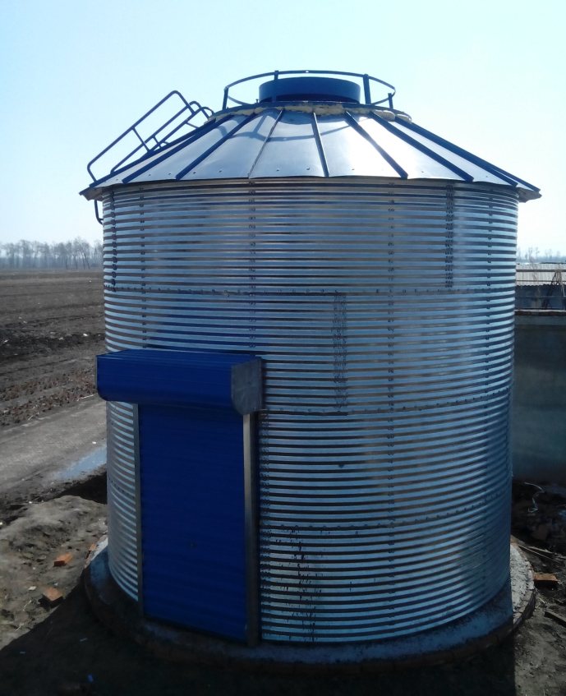
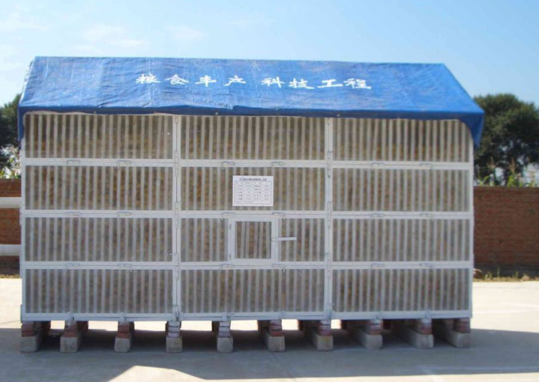
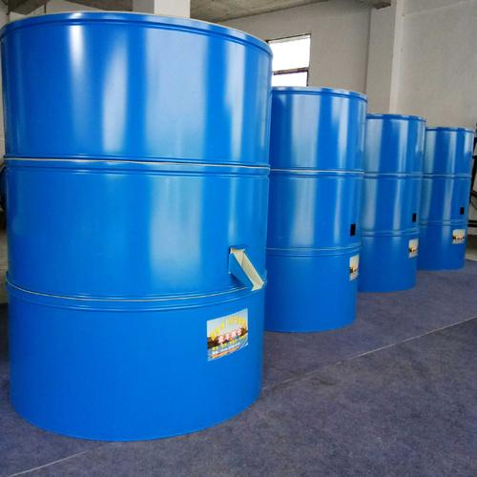
VII. Reducing Grain Losses for Farmers
(III) Building special projects for modern grain storage
2. Phase II – 2011
In particular, South China has seen the popular use of granaries made of color-coated steel sheets to store rice, wheat and highland barley; in northeast China, granaries with steel frame and dry granaries with steel grid are used to store corncobs.

Slide 14
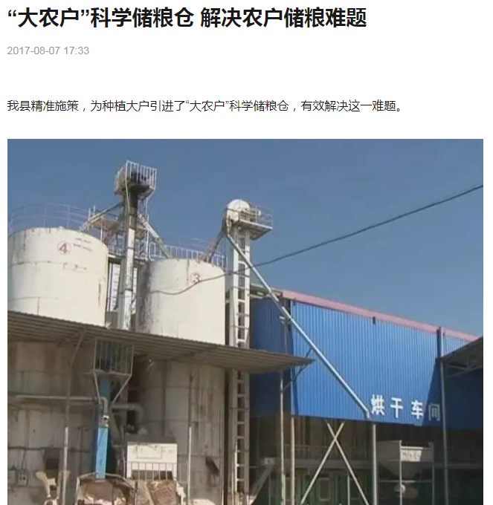
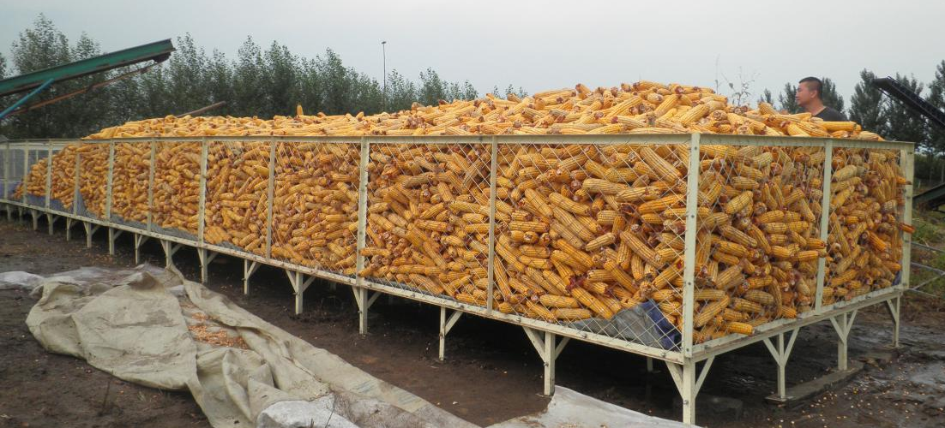
VII. Reducing Grain Losses for Farmers
(III) Building special projects for modern grain storage
2. Phase II – 2011
In northeast China, granaries in a mixed combination were built for large-scale grain planters, each with a storing capacity of 30 square meters. A couple of or dozens of granaries can be used in combination as required.
“Big” Grain Bin Assisting Farmers

Slide 15
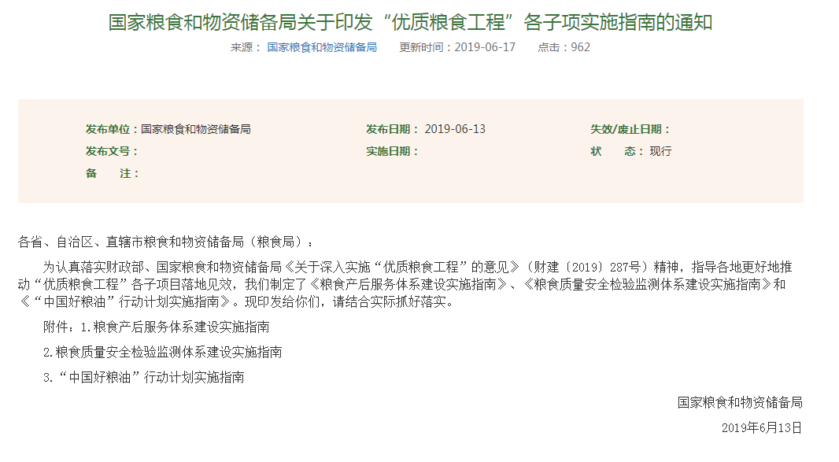
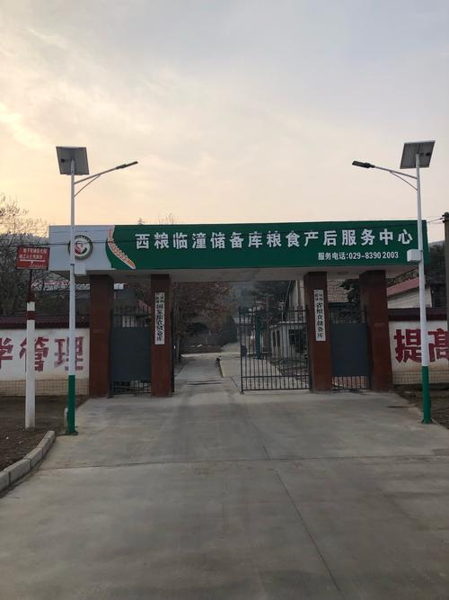
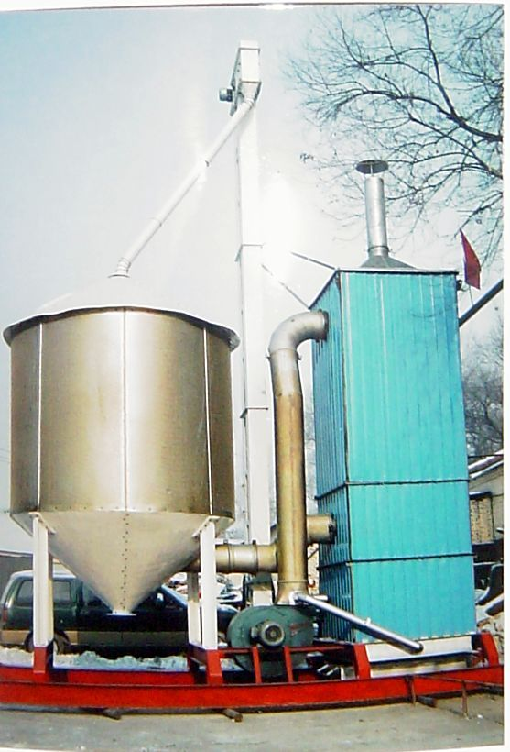
VII. Reducing Grain Losses for Farmers
(III) Building special projects for modern grain storage
3. Phase III – technology to reduce grain losses after the harvest for 2017
Post-harvest grain service system was developed, that is, a post-harvest service center for grain storage, cleaning, drying, production and sales was put into operation on the basis of the reserve bank, farmers' cooperative organizations or related enterprises during the harvest season.
Notice on Printing and Issuing Detailed Implementation Guide for “Quality Grain Project” by National Food and Strategic Reserves Administration

Slide 16
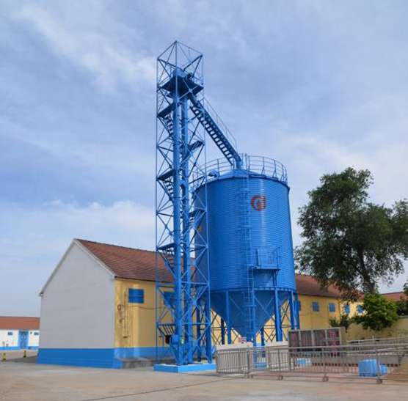
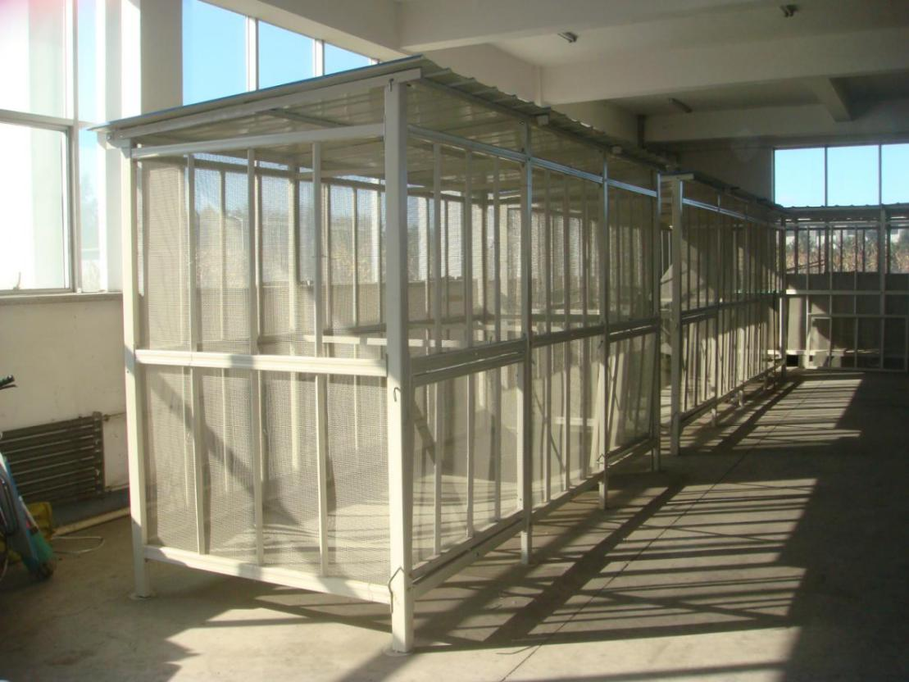
VII. Reducing Grain Losses for Farmers
(III) Building special projects for modern grain storage
3. Phase III – technology to reduce grain losses after the harvest for 2017
Programs for building modern storage facilities have been achieved through the post-harvest grain service centers in 12 provinces, and a total of 576,000 sets of modern storage facilities are planned to be built for farmers within 3 years.

Slide 17
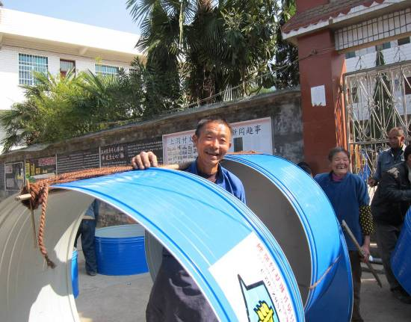
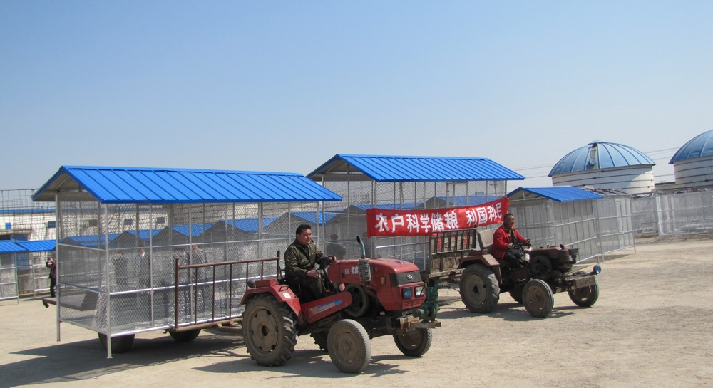
VII. Reducing Grain Losses for Farmers
(III) Building special projects for modern grain storage
4. Achievements in phase III
Nearly 10 million sets of facilities are to be completed across China.
Details | Key Pilot Zone | Technology Demonstration zone | Technology Radial zone | Institutions in Charge
Integration and demonstration of technologies to reduce grain losses in the corn belt in the Northeast Plain | Dalama Village, Xinmin City, Liaoning Province Taojiatun Village, Gongzhuling City, Jilin Province Chaoyang Village, Shuangcheng, Heilongjiang Province | Dalama Village & Xinglongbao Town, Xinmin City, Liaoning Province; Taojiatun Village & Chaoyangpo Village, Gongzhuling City, Jilin Province Chaoyang Village & Lanling Village, Shuangcheng City, Heilongjiang Province | Shenyang City, liaoning province Yushu city & Fuyu County, Jilin province Heilongjiang Province Bayan County & Lanxi County | Liaoning Grain Science Research Institute Heilongjiang Zhongliang Storage Technology Engineering Co. Ltd.

Slide 18






VII. Reducing Grain Losses for Farmers
(III) Building special projects for modern grain storage
4. Achievements in Phase III
In 2013, a 7.0-magnitude earthquake hit Lushan County, Sichuan Province, resulting in collapsed houses, with the exception of farmers' granaries which became a lifeline for the victims.

Slide 19




VII. Reducing Grain Losses for Farmers
(III) Building special projects for modern grain storage
4. Achievements in Phase III
Standardized grain storage facilities have reduced the risk of spillovers on the road and dried corns vulnerable to mildew and made farmers' living environment tidy and clean.

Slide 20







VII. Reducing Grain Losses for Farmers
(IV) Developing a post-harvest service system
The post-harvest service system aims to help farmers increase agricultural incomes and reduce grain losses. Drying and other services help farmers improve their food quality to sell a good price and reduce grain losses to increase incomes.

Slide 21




VII. Reducing Grain Losses for Farmers
(IV) Developing a post-harvest service system
I. With integrated service resources, a full-fledged service chain have been created to improve efficiency and productivity
The Post-harvest Grain Service Center set up at Dashu Town, Quanjiao County, Chuzhou, Anhui Province offers a series of cleaning, drying, storing, production and sales services. Hubei Tianxing Grain and Oil Co., Ltd. specializes in drying rapeseed, wheat, unhulled rice and camellia seeds for farmers according to seasonal needs.

Slide 22


VII. Reducing Grain Losses for Farmers
(IV) Developing a post-harvest service system
II. Achieve "Cheap price and good quality" through cleaning, drying and sorting services. In Anhui Province, the Post-harvest Grain Service Center has been set up by a group of grain processing businesses, creating a service network of "processing firms plus the service center plus cooperatives (large-scale grain planters) plus small-scale farmers"

Slide 23





VII. Reducing Grain Losses for Farmers
(IV) Developing a post-harvest service system
III. Reduce grain losses and waste after harvest by means of timely treatment and proper storage. Shandong Province is reported to reduce grain loss rate by 4 percentage points on average in areas of coverage. Grain has been dried and stored in an orderly and timely manner after harvest in Jiangsu, Anhui, Hubei and other provinces.

Slide 24




VIII. Securing Food Supply during COVID-19
Since the outbreak of COVID-19, Wuhan and other cities have declared a state of emergency in food supply.

Slide 25






VIII. Securing Food Supply during COVID-19
In our combat against COVID-19 in 2020, we have stood the test of food supply in emergency.

Slide 26


VIII. Securing Food Supply during COVID-19
(I) Building a well-managed food emergency plan system
The National Food Emergency Plan. Implement the plan at horizontal and vertical levels
Organizing→pre-warning and monitoring→emergency response→emergency supply→response after the event

Slide 27



VIII. Securing Food Supply during COVID-19
(I) Building a well-managed food emergency plan system
Thirty one provinces, autonomous regions and municipalities directly under the Central Government have formulated provincial-level grain emergency plans. At the county level, 85% of the grain emergency plans have been implemented
Jiangsu Food and Strategic Reserves Administration Ready for Grain and Soil Control during COVID-19
National Food and Strategic Reserves Administration: Emergency Grain Support System Played a Positive Role during COVID-19
Four-level food emergency plan system

Slide 28





VIII. Securing Food Supply during COVID-19
(II) Building an emergency response system
Emergency facilities programs have been covered by investment projects funded by the central government.
Developing Emergency Grain Support System for the Province
Work Summary for Emergency Grain Support System Development by Ruzhou City Food and Strategic Reserves Administration

Slide 29





VIII. Securing Food Supply during COVID-19
(II) Building an emergency response system
It should be ensured that the networks of emergency food supply are well distributed, especially the distribution of processing businesses and delivery centers in response to the emergency. Efforts will be made to improve the market monitoring and early warning system and promote the mechanism for releasing emergency updates.
The Implementation Plan for New Grain Market Monitoring and Early-warning System Issued by Liaoning Province Food and Strategic Reserves Administration

Slide 30



VIII. Securing Food Supply during COVID-19
(III) Providing training with regard to emergency response plans
In 2019, 21 emergency response drills were conducted at the provincial level across China. Below the provincial level, 1,737 drills were carried out.

Slide 31



VIII. Securing Food Supply during COVID-19
(IV) Strengthening the material basis for emergency
Reserves of processed food have been set up for 10 to 15 days' supply in places with volatile prices in China's 36 large and medium-sized cities.
Notice on Establishment of Governor Accountability System for Grain Security: Guarantee a Sustainable Grain and Oil Supply

Slide 32






VIII. Securing Food Supply during COVID-19
(V) Practicing food emergency plan in primary levels
Under the national food supply and security mechanism, local departments in charge of food supply have increased the frequency of monitoring grain markets and encouraged businesses to resume food production and processing in a state of emergency, ensuring normal market supply and stable prices
Cracking down on Price Violations and Guaranteeing a Sustainable Grain and Oil Supply
Guaranteeing and Improving People's Livelihood before Boosting Domestic Demand
Grain and Oil Enterprises in Xinjiang
Ensuring Sustainable Grain and Oil Supply and Stable Price

Slide 33





VIII. Securing Food Supply during COVID-19
(VI) Grain emergency in Wuhan and national response to resume production
During COVID-19, Wuhan City strengthened market analysis and resources arrangement, kept abreast of the grain and oil stocks of enterprises and their daily sales and responded quickly to supermarket demands according to market expectations.
Full Resumption of over 5,000 Chinese Grain Enterprises for Emergency Grain Processing

Slide 34





VIII. Securing Food Supply during COVID-19
(VI) Grain emergency in Wuhan and national response to resume production
Following the outbreak of COVID-19 in Beijing in June, the central government promptly channelled resources from neighboring provinces to ensure the market supply. A coordinated mechanism was established to ensure that grain and oil prices remain stable.
No. [2020]15; Notice on Guaranteeing Grain and Oil Supply during COVID-19 Issued by Guiyang City Food and Strategic Reserves Administration

Slide 35


VIII. Securing Food Supply during COVID-19
Food security is an essential issue for maintaining world peace and development, a pillar for building a community of shared future for mankind and a major factor for sustainable development and common future for all human beings.
We look forward to working together to promote Sino-African cooperation by exploring new fields and blazing new trails in reducing grain losses and to share our experience, expertise, and outcomes in response to the 2030 Agenda for Sustainable Development adopted by the United Nations.

Slide 36





Thank you！
36

