Slide 1
CHINA RESPONGDING TO CLIMATE CHANGE
ZHANG ZHIQIANG
NATIONAL CENTER FOR CLIMATE CHANGE STRATEGY AND INTERNATIONAL COOPERATION
Nov 1st, 2023

Slide 2
CONTENTS
01
BACKGROUND
02
MITIGATION
03
ADAPTAION
.
04
SUPPORTING SYSTEM
05
GLOBAL CLIMATE GOVERNANCE
06
PROGRESS
07
CHALLENGE.
08
POLICY FRAMEWORK

Slide 3
01
Background

Slide 4
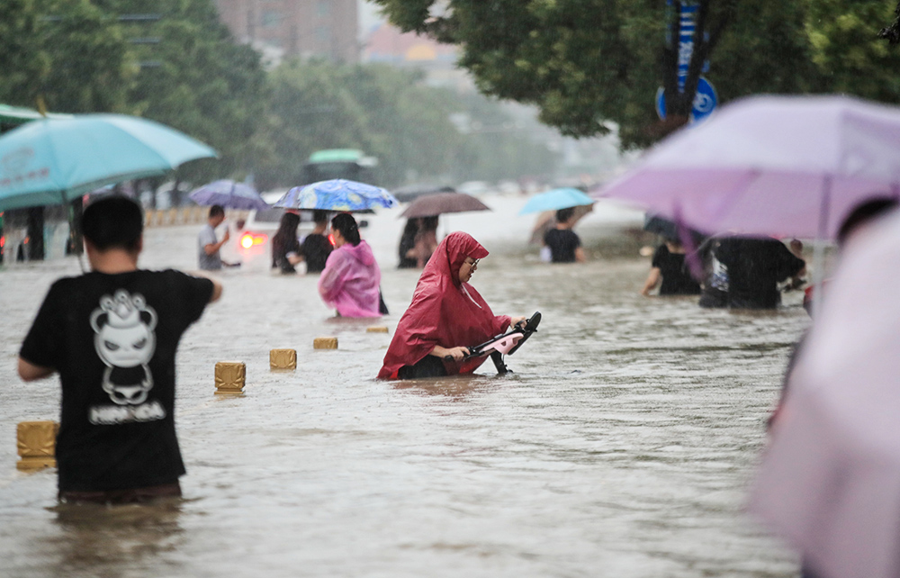
China is vulnerable to climate.
Pollution
Environment
Climate change
Extremely weather

Slide 5
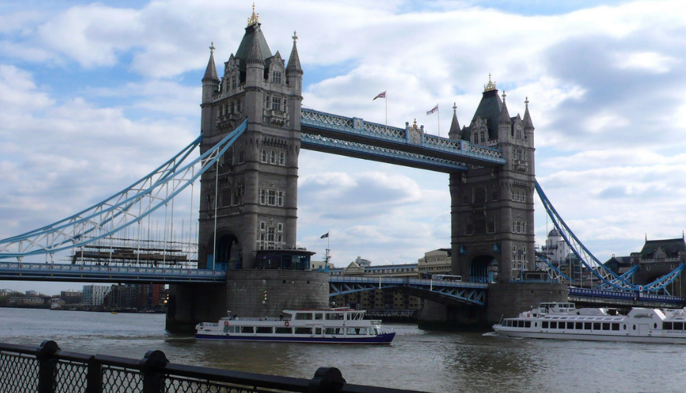
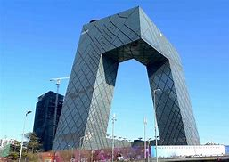
London
Beijing
past
now

Slide 6
Coal consumption in China (10 thousand Tons)

Slide 7
Global GDP and GHG Emission (GDP,100Mdollar;GHG,10,0000Tons)

Slide 9
1. Background
President Xi Jinping stressed that the Paris Agreement is a milestone in the history of global climate governance, represents the main direction of the global green and low-carbon transformation, and shows the minimum action needed to protect our planet.
The Paris Agreement has made it clear that the global temperature rise should be kept below 2° C and trying to kept at 1.5°C, the global emissions should reach peak as soon as possible, the balance between sources and greenhouse gases should be achieved by the second half of this century. We have established a post-2020 global climate governance model that includes "making nationally determined contributions from the bottom to up" and "conducting regular global stocktaking and constantly urging all parties to step up their actions".

Slide 10
1. Background
On September 22, 2020, President Xi announced on the 75th United Nations General Assembly General Debate, "China will enhance national contribution strength, adopt a more powerful policies and measures, achieve carbon dioxide emissions reach peak before 2030, strive to become carbon neutral before 2060, and then repeat in many major international occasion.
On December 12, 2020, President Xi Jinping further announced at the Climate Ambition Summit that "By 2030, China will reduce carbon dioxide emissions per unit of GDP by more than 65% compared with 2005, and non-fossil energy will account for about 25% of its primary energy consumption. The forest stock will increase by 6 billion cubic meters over 2005, and the total capacity of wind and solar power generators will reach more than 1.2 billion kilowatts."
President Xi’s declaration fully demonstrated China's positive response to climate change and the determination to promote the high quality development, embodies China’s best effort according to the national conditions and the ability to inject new political momentum for the global climate governance, received highly praise by international community, which will have a profound impact in economic and social development in China’s green transition for future decades .

Slide 11
1.Background
The carbon reduction is a comprehensive green transformation to promote economic and social development of total gripper, completes the carbon peak, carbon neutral, work as a reversed transmission mechanism to promote the development of high quality and ecological environment protection of the fundamental, unswervingly implement the strategy coping with climate change. To formulate carbon dioxide emissions by 2030 years ago the peak action plan, plan as a whole "difference" goals and tasks to tackle climate change, accelerate the construction and operation of the national carbon emissions trading market, to promote in the industry, energy, finance, investment, finance, price, environmental protection policy, technology and other aspects to form resultant force, to speed up the green low carbon development nurturing and expanding the new kinetic energy, We will translate concrete actions to achieve carbon peak and carbon neutrality into new opportunities to achieve fundamental changes in the pattern and path of development.

Slide 12
02
Mitigation

Slide 13
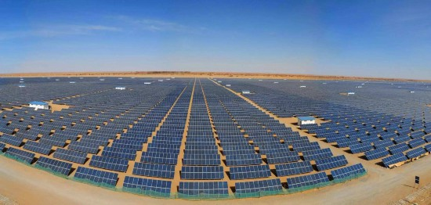
China has taken active measures to adjust its industrial and energy structures to promote energy efficiency, control non-carbon dioxide greenhouse gas emissions, enhance its ecosystems’ carbon sequestration capacity, and conduct pilot demonstrations to co-ordinate pollution reduction and carbon reduction efforts.

Slide 14
2.1 To adjust industrial structure
China is vigorously developing green and low-carbon industries, promoting the construction of industrial clusters such as new energy, new energy vehicles and green environmental protection. It supports the development of green, low-carbon and high-quality industries, establishing a green manufacturing system. Meanwhile, China is strictly controlling the blind development of high-energy consumption, high-emission and low-level (“two highs and one low”) projects, and promoting energy-saving and carbon reduction technology upgrades in high-energy consumer industries.
In 2021, China’s production of new energy vehicles reached 3.677 million units, an increase of 152.5% compared to 2020, while its photovoltaic component production reached 182 gigawatts (GW), ranking first globally for 15 consecutive years.

Slide 15
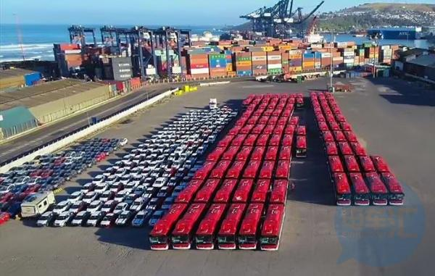
2.2 To optimize its energy structure and improve energy efficiency
China is developing non-fossil energy sources, improving the clean use of fossil energy, promoting the clean and efficient centralized use of coal, implementing dual controls on energy consumption and intensity, promoting quality and efficiency improvements in the industrial sector, accelerating improvements in building energy efficiency, actively building a green, low-carbon comprehensive transportation system, carrying out green, low-carbon public institution actions, and fully enhancing energy-saving management capabilities.
In 2021, China’s non-fossil energy consumption reached 16.6%, with coal consumption accounting for 56.0%. China is accelerating the construction of new energy bases and plans to build 450 million kilowatts of large-scale wind and photovoltaic power bases in desert, Gobi, and barren areas, with 100 million kilowatts of projects already under construction. In 2021, China’s non-fossil energy power generation capacity surpassed that of coal-fired power plants for the first time, with a total renewable energy power generation capacity of 1.063 billion kilowatts, accounting for 44.8% of the total installed power generation capacity, of which hydropower, wind power, and solar power all exceeded 300 million kilowatts. Biomass power generation capacity is 37.98 million kilowatts, and China’s offshore wind power generation capacity has become the world’s largest.

Slide 16
2.3 To control non-carbon dioxide greenhouse gas emissions
China has taken action on major sources such as energy, agriculture and waste, and has actively implemented control measures for non-carbon dioxide greenhouse gas emissions.
China is improving relevant policies, standards and technical specifications for non-carbon dioxide greenhouse gas emission control, and strengthening methane management measures at the local, departmental, industrial, and enterprise levels.
China is promoting the reduction and efficiency increase of chemical fertilizers to reduce nitrous oxide emissions in farmland. In 2020, national chemical fertilizers usage decreased by 12.3% compared to 2016, and soil testing and formula fertilization were conducted in 1.93 billion mu of farmland, an increase of 17.7% compared to 2015.

Slide 17
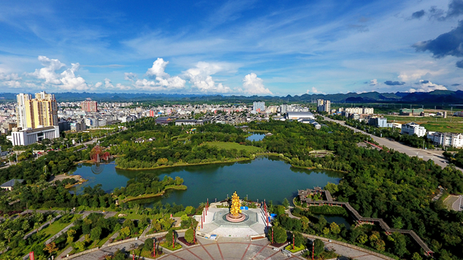
2.4 To enhance the carbon sequestration capacity of ecosystems
China is improving its forest and grassland carbon sinks. In 2021, China completed 34.67 million mu of forest nurturing, restored 14 million mu of degraded forests, and planted 54 million mu of forests. Compared with the previous year, the number of forest fires, the area of damaged forests, and the area of damaged grasslands all decreased by 47%, 50% and 62%, respectively.
China also treated 21.6 million mu of desertified and rocky areas, continued to build nine national desertified land protected areas, and implemented afforestation tasks at the county level for the first time, with the aim of building a natural protected area system centered on national parks.
China has 194 cities designated as national forest cities, and its urban built-up green coverage has reached 42.4%, improving its living environment.
In 2021, the comprehensive vegetation cover of grasslands increased to 50.32%. In 2022, China proposed the action goal of "striving to plant, protect and restore 70 billion trees within 10 years."

Slide 18
2.5 To promote coordinated pollution reduction and carbon reduction efforts
China is carrying out practices to reduce pollution and carbon emissions. During the implementation of the “Three-Year Action Plan to Win the Battle for Blue Sky”, the national emissions of sulfur dioxide, nitrogen oxide, and primary PM2.5 are estimated to have decreased by about 3.67 million tons, 2.1 million tons, and 1.25 million tons, respectively, while cumulative carbon dioxide emissions have been reduced by 510 million tons.
Focusing on areas such as the Beijing-Tianjin-Hebei region and the Fenwei Plain, measures for clean heating in northern areas during winter are being continuously implemented, putting people’s warmth in winter as a top priority. Measures tailored to local conditions are promoting coal combustion control.
By the end of 2021, about 27 million households in the region had completed coal combustion control measures, leading to a reduction in coal consumption of over 60 million tons, and nearly ending the use of loose coal for winter heating in some plain areas.

Slide 19
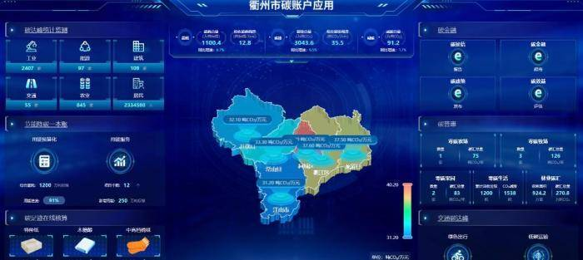
2.6 China has carried out a rich variety of low-carbon pilot demonstration work in the energy, industry, construction, transportation, and financial sectors
Since 2010, China has conducted low-carbon pilots in 6 provinces and 81 cities, covering 31 provinces (autonomous regions and municipalities directly under the central government) and all 5 municipality-level cities, with the carbon intensity of the pilot provinces and cities declining faster than the national average.
Zhejiang Province’s Quzhou City took the lead in exploring digital carbon management, having established carbon accounts for 2.342 million enterprises and individuals, and innovatively developed carbon-account-based financial products.

Slide 20
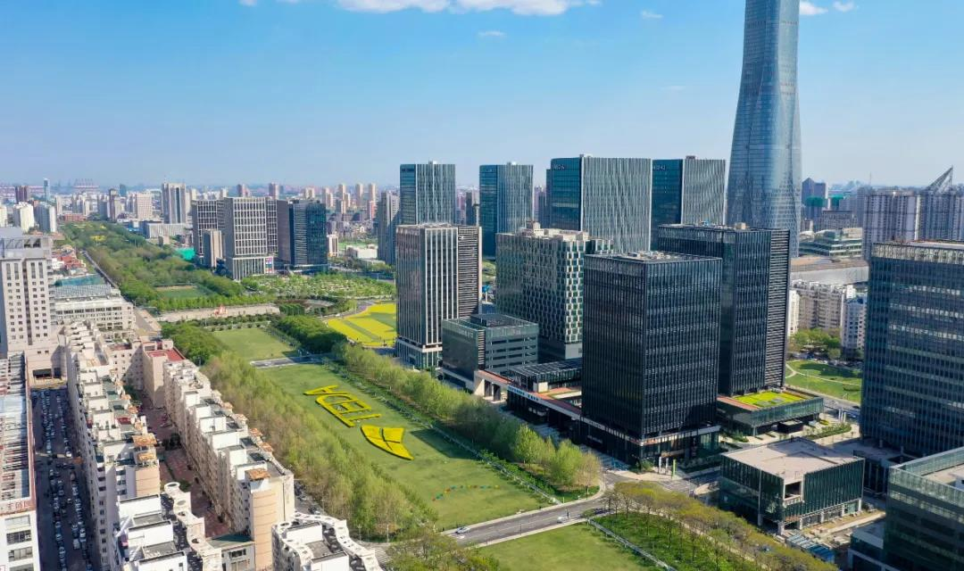
2.7 The pilot construction of low-carbon industrial parks
Implements major strategic plans such as promoting ecological civilization construction, developing main functional areas and new urbanization strategies, building resource-saving and environmentally friendly societies, and actively responding to climate change. The related concepts and requirements are integrated into the entire process of park planning, construction, operation management, and resident life.
Teda Industrial Park in Tianjin raises the quality of green development, optimizes spatial structure, improves urban functions, and constructs a development pattern where living space, production layout and ecological system complement each other.

Slide 21
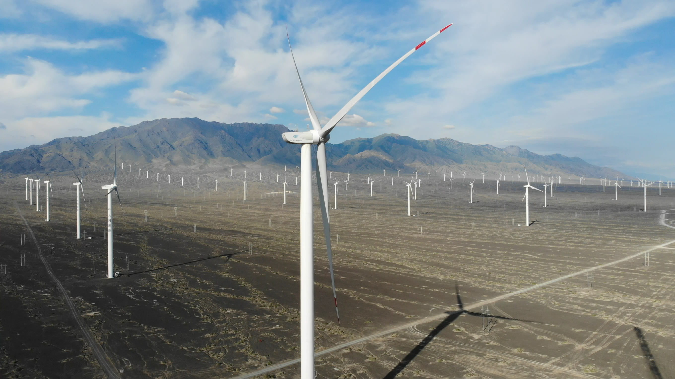
2.8 China is strengthening climate-related investment and financing by launching climate investment and financing pilots
Nine government departments, including the Ministry of Ecology and Environment, jointly issued the “Notice on the Publication of the List of Climate Investment and Financing Pilots” to create a favorable environment for exploring differentiated investment and financing models, organizational forms, service methods and management system innovations.
As of the end of 2021, 85.5 billion yuan of re-lending funds were issued through carbon emission reduction support tools, supporting financial institutions to issue 142.5 billion yuan in loans that meet the requirements in the carbon emission reduction field, driving an annual carbon emission reduction of 28.76 million tons of carbon dioxide equivalent.
In 2022, the Kashgar Branch of the China Development Bank extended a preferential loan of RMB 150 million to the Huadian Fuxin Yecheng New Energy Co., Ltd., receiving RMB 90 million in low-cost central bank fund support. This is the first carbon emission reduction support tool loan in Kashgar, Xinjiang.

Slide 22
03
Adaptation

Slide 23
China has been actively engaged in various climate adaptation work, including the development and implementation of the “National Strategy on Climate Adaptation 2035.” China aims to comprehensively integrate climate adaptation into the overall economic and social development agenda, strengthen climate monitoring and early warning and risk management. Efforts are also being made to enhance the ability of natural ecosystems and economic and social systems to adapt to climate change, improve the climate resilience of key vulnerable areas, and achieve positive results in climate adaptation work.
3.1 China is strengthening climate monitoring and early warning, as well as risk management
Efforts are being made to enhance the assessment of climate change impacts and risks, improve the level of assessment technology and basic capabilities, promote the construction of a climate change data center system and strengthen the assessment of climate change impacts and risks in sensitive areas and key regions. Comprehensive disaster prevention and mitigation capabilities are being strengthened, with a focus on disaster risk management, prevention and resolution of major risks, comprehensive management of natural disasters, and the construction of emergency response mechanisms and disposal capabilities.
As of now, there are 12 forest and grassland fire prevention material reserve depots at the central level, 46 central flood and drought prevention and disaster relief material reserve warehouses and 55 central life-saving and disaster relief material reserve warehouses.

Slide 24
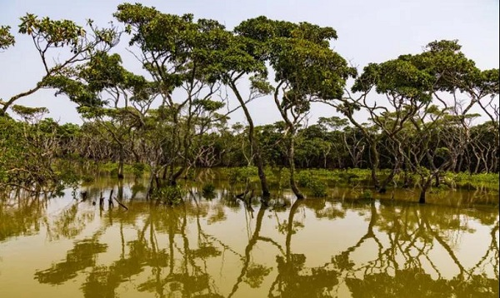
3.2 China is enhancing the ability of natural ecosystems to adapt to climate change
Efforts were being made to coordinate the protection and comprehensive management of rivers, lakes, forests, mountains, farmlands, grasses, sands, and other natural ecosystems, optimize the national ecological security barrier, and deploy and implement 10 integrated protection and restoration projects for rivers, lakes, forests, farmlands, grasslands and sands in 2021. Climate adaptation work on land and sea is being simultaneously promoted, with a focus on improving the ability of natural ecosystems, such as water resources, land, and marine ecosystems, to adapt to climate change.
Support is being provided for coastal cities to implement 31 marine ecological protection and restoration projects targeting blue carbon ecosystems such as mangroves, salt marshes, and seagrass beds, and the “Blue Bay Remediation Action” is being carried out in coastal cities. A total of 1,966 national and provincial water consumption norms have been newly issued and implemented, and the fourth batch of 478 water-saving social construction compliant counties (districts), 262 water-saving universities, and 1,914 water conservancy units have been established. There are 168 public institutions and 15 irrigation districts recognized as water-saving leaders.
Dongzaigang Mangrove Protection Area in Hainan was established in January 1980, and was the first mangrove protection area in China.

Slide 25
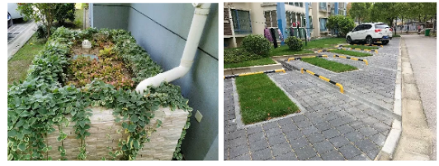
3.3 China is strengthening the adaptive capacity of economic and social systems to climate change
Climate risk prevention is transitioning from natural ecosystems to economic and social systems, with a focus on key areas sensitive to the impacts of climate change and adherence to the integrated principles of mitigation, adaptation, and sustainable development to improve the climate resilience of economic and social systems.
China is promoting 28 climate adaptive cities construction pilot projects, exploring management models that are suitable for local conditions for urban climate adaptation. Building on the experience from the construction of the sponge cities pilot projects in 30 cities, systematic and holistic promotion of sponge city construction demonstrations are being carried out in 45 cities since 2021.
In the Lin-gang Special Area of Shanghai pilot zone, measures such as the renovation of parks, green spaces, waterways and reservoirs are being taken to improve the region’s ability to cope with heavy rain.

Slide 26
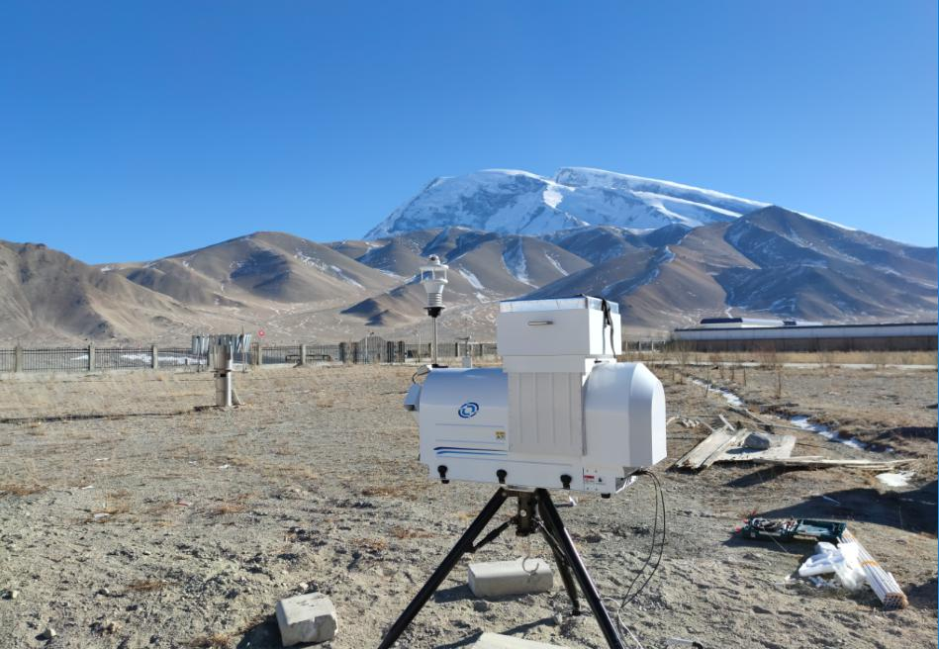
3.4 China is enhancing the climate resilience of key vulnerable areas
Based on regional differences in natural resource distribution, resource and environment carrying capacity, and adaptation to climate change, efforts are being made to strengthen climate resource conditions, climate change impact and risk assessment, scientific and orderly allocation of agricultural, ecological, urban and other functional spaces, and enhance the adaptation capacity of different functional areas such as agricultural production areas, key ecological functional areas, and urban areas to improve national spatial security resilience.
Efforts are being made to conduct regional climate risk assessments, develop demonstration areas, and layout and implement key demonstration projects. The national strategy on climate adaptation is being integrated into the major national regional development strategies including Beijing-Tianjin-Hebei coordinated development, Yangtze River Economic Belt, Guangdong-Hong Kong-Macau Greater Bay Area construction, Yangtze River Delta integration, Yellow River basin ecological protection, and high-quality development to form a regional coordinated adaptation pattern. Adaptation work is being carried out in key areas such as the Qinghai-Tibet Plateau.
In 2017, China launched the second comprehensive scientific expedition and research on the Qinghai-Tibet Plateau.

Slide 27
04
Supporting System

Slide 28
Since 2021, achieving positive results in legislation and standards, economic policies, national carbon emissions trading market (hereinafter referred to as the “national carbon market”) construction, technology innovation support, talent training and capacity building, and green and low-carbon initiatives.
4.1 Legislation is being advanced to promote the development of the national carbon market system
The national carbon market system is being constructed, consisting of departmental regulations, normative documents, technical specifications, and other components. On February 1, 2021, the “Management Measures for Carbon Emission Trading (Trial)” was implemented, establishing a matching system for carbon emission rights registration, trading, settlement, enterprise greenhouse gas emission accounting report verification, and other systems. Efforts are being made to accelerate the revision of the “Interim Measures for Voluntary Greenhouse Gas Emissions Trading” and relevant technical specifications.

Slide 29
4.2 China has implemented economic policies to address climate change
The establishment of a sound green finance standard system, financial subsidies based on fixed electricity prices for renewable energy generation, and a comprehensive system of financial support policies for new energy vehicles. Funds have been arranged for air pollution prevention and control, key ecological protection and restoration, marine ecological protection and restoration, forest and grassland ecological protection and restoration, and other purposes. The government is actively improving its green procurement policies and accelerating electricity pricing mechanism reform.
By the end of 2021, the balance of green loans issued by financial institutions reached RMB 15.9 trillion, a year-on-year growth of 33%, including a loan balance of RMB 4.2 trillion for the clean energy industry, including wind and solar power, a year-on-year growth of 31.7%, and the balance of green bonds issued domestically in China reached RMB 1.1 trillion, a year-on-year growth of 33.2%. In 2021, various entities issued carbon neutral bonds worth RMB 274.3 billion. As of the end of 2021, 222 engineering projects were included in the government’s green procurement pilot program, with an investment of nearly RMB 100 billion and a cumulative purchase of green building materials worth RMB 5.3 billion.

Slide 30
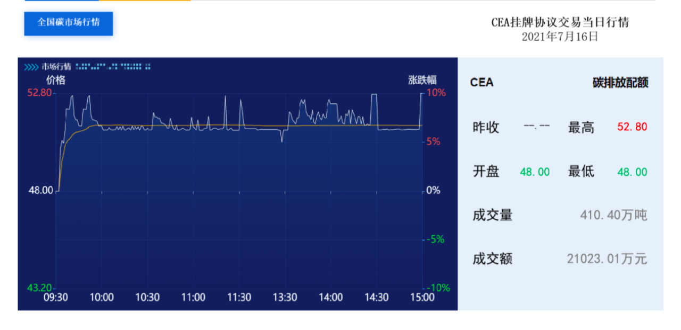
4.3 China is actively and steadily advancing the construction of the national carbon market
The initial system of the national carbon market has been built, which consists of departmental regulations, normative documents, technical specifications, etc. The national carbon market is showing initial effects in incentivizing and constraining emissions, improving enterprise awareness and abilities to reduce emissions, and promoting greenhouse gas emission reductions and green and low-carbon transformation.
China launched the national carbon market on July 16, 2021, which is the largest carbon market globally in terms of its coverage of emissions. During the first compliance period of the national carbon market, which lasted for 114 trading days, the total trading volume of carbon emission quotas reached 179 million tons, with a total trading value of RMB 7.66 billion and a compliance rate of 99.5%.
III. Local pilot carbon markets have been operating smoothly, with Beijing, Tianjin, Shanghai, Chongqing, Guangdong, Hubei, and Shenzhen running pilot carbon markets covering more than 20 industries and almost 3,000 key emitting units. As of July 8, 2022, the cumulative trading volume of quotas in the pilot carbon markets had reached 537 million tons, with a trading value of RMB 13.676 billion.

Slide 31
4.4 China is accelerating the construction of the greenhouse gas statistical accounting and monitoring system
A multi-level carbon emission statistical accounting system covering national, local, industry, enterprise, facility, and product levels has been established, focusing on key industries, cities, and regions. Carbon monitoring and evaluation pilot work has been carried out, and energy-saving and emission-reduction statistical monitoring has been actively implemented.
Pilot monitoring has been conducted in five key industries, including thermal power, steel production, oil and gas exploration, coal mining, and waste treatment, at the industry level. Construction and operation of online energy monitoring systems for key energy-consuming enterprises are being strengthened.
In addition, efforts are being made to strengthen the monitoring and evaluation of marine climate change responses, promote synergies between marine pollution reduction and climate change response, and sustainably reduce the eutrophication level of coastal waters by reducing and controlling the discharge of pollutants such as nitrogen and phosphorus.

Slide 32
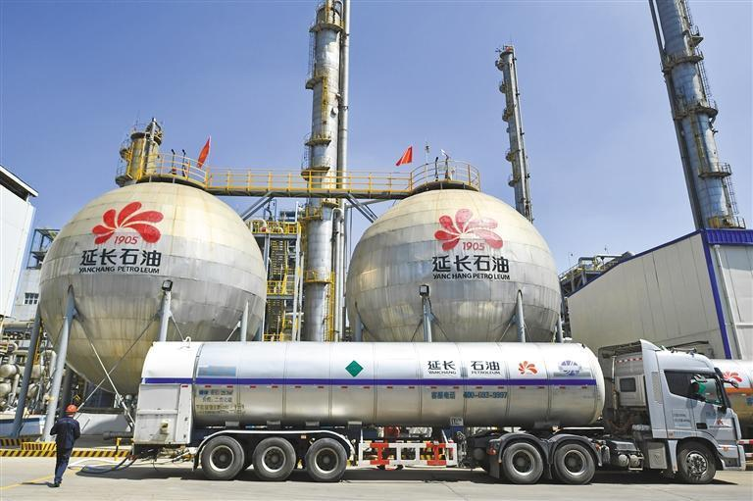
4.5 China is strengthening its support for technological innovation to address climate change
Research and development of critical low-carbon, zero-carbon, and negative-carbon technologies in areas such as energy, industry, construction, and transportation are being promoted. Basic scientific and technological research on climate change is being carried out, and the “14th Five-Year Plan” for technological innovation in the energy sector has been formulated and released.
CCUS technology projects are distributed across 19 provinces in China, covering a diverse range of industries and types of carbon capture and utilization. Thirteen pure capture demonstration projects involving power plants and cement plants have a total carbon capture capacity of 856,500 tons/year, and 11 carbon dioxide geological utilization and sequestration projects have a capacity of 1,821,000 tons/year, of which carbon dioxide utilization to increase oil recovery has a capacity of approximately 1,540,000 tons/year.
The Yulin Coal Chemical Company of Shaanxi Yanchang Petroleum Group has implemented a 300,000-ton/year carbon capture project, with a capture energy consumption of 1.36 GJ/ton and a capture cost of RMB 105/ton. It can reduce carbon dioxide emissions by 300,000 tons per year.

Slide 33
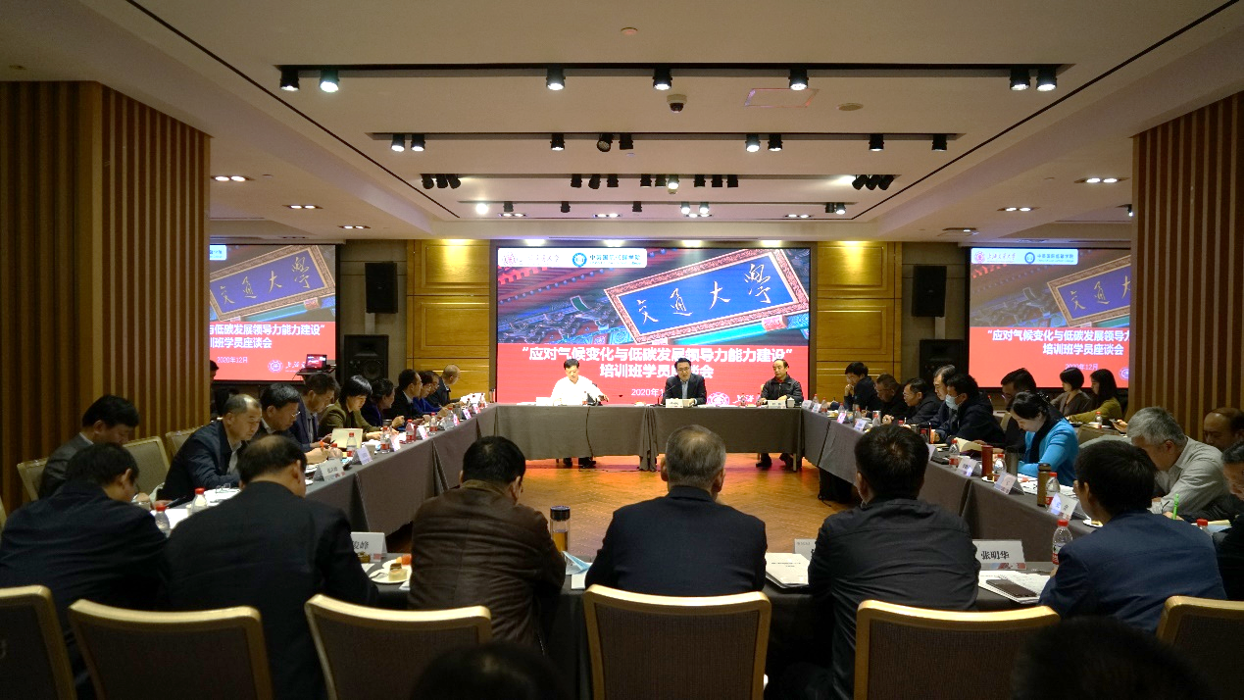
4.6 China is enhancing capacity building to address climate change
Support is being provided for institutions to establish relevant degree-granting programs and for the establishment of new professions, such as “carbon emission administrators” and “carbon management engineers,” which have been added to the national occupational classification system. Training for government officials, enterprises, and professionals at all levels in various fields to address climate change is being strengthened.
Since 2018, training centers, industry associations, and research institutions in related provinces and cities have conducted over 60 national carbon market capacity building training sessions and events. In 2022, two special training sessions on carbon emission data quality management were held, with a total of 17,800 participants, and the training video was viewed over 100,000 times.
In December 2020, the China-UK Low Carbon College of Shanghai Jiao Tong University held a training course on “Leadership Capacity Building for Climate Change and Low-Carbon Development.”

Slide 34
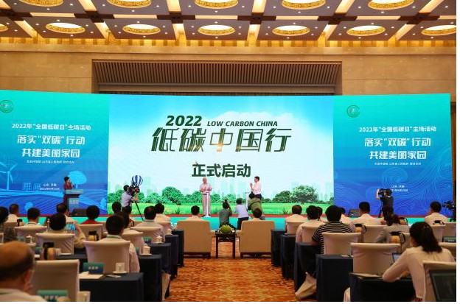
4.7 China is carrying out a nationwide green and low-carbon action
Long-term campaigns such as the “National Energy Saving Publicity Week,” “National Low-carbon Day,” and “June 5th Environment Day” have been organized, with a focus on practical themes, education, forums, popular science, and other activities. The whole society has been mobilized to participate, and companies, including central enterprises in the oil, electricity, transportation, construction, and communication industries, have taken active actions and issued green and low-carbon initiatives.
Local governments in Guangdong, Shenzhen, Chengdu, and other cities have introduced carbon-inclusive management measures. On October 22, 2021, Chongqing launched the “Carbon Benefit Platform,” which integrates carbon compliance, carbon neutrality, and carbon inclusiveness. The Southern Power Grid Shenzhen Power Supply Bureau, Shenzhen Ecological Environment Bureau, and Shenzhen Emissions Trading Exchange jointly launched the first domestic low-carbon electricity application for residents, called the “Carbon Benefit” app.
The 10th “National Low-carbon Day” was held in Jinan, Shandong Province on June 15, 2022.

Slide 35
05
Global Climate Governance

Slide 36
5. China actively participates in global climate governance.
The country attaches great importance to international cooperation on climate change, firmly upholds multilateralism, and steadfastly supports the multilateral process to address climate change. China plays a constructive role in international climate change negotiations, engages in dialogue and exchanges, and promotes practical cooperation with various parties. It also actively advances South-South climate change cooperation and green Belt and Road construction, and puts forward a global development initiative to promote the establishment of a fair, reasonable, cooperative and win-win global climate governance system.

Slide 37
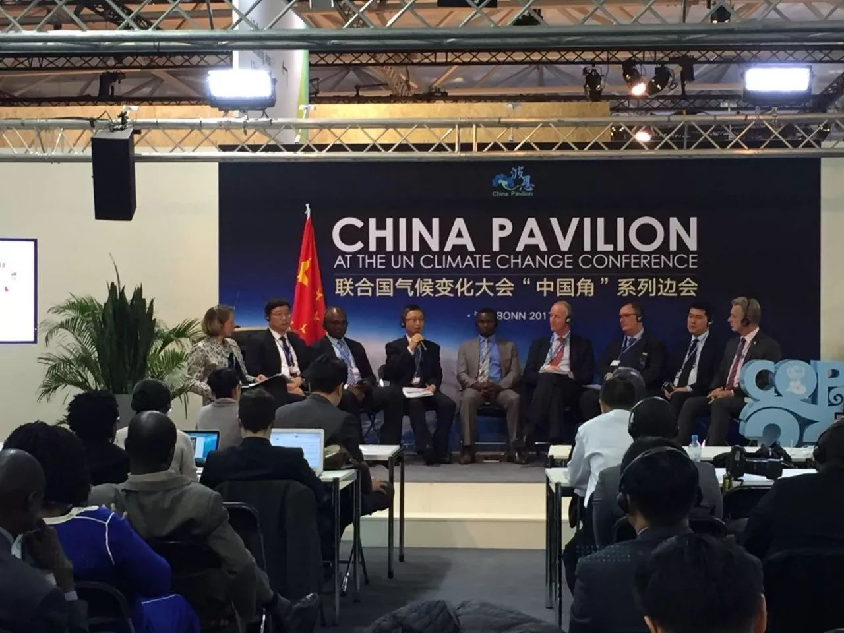
5.1 China deepens high-level exchanges on climate change
In 2021, President Xi Jinping delivered important speeches on many occasions in the international community, promoting significant progress in global climate governance. China has also promoted high-level dialogue and exchanges, and converged political consensus.
In November, President Xi Jinping delivered a written speech to the Leaders Summit of the 26th Conference of the Parties (COP26) to the United Nations Framework Convention on Climate Change, proposing three main points of maintaining multilateral consensus, focusing on pragmatic action, and accelerating green transformation, injecting strong political momentum into the positive outcome of COP26. Chinese and foreign institutions actively participate in the related activities of the United Nations Climate Change Conference in China.

Slide 38
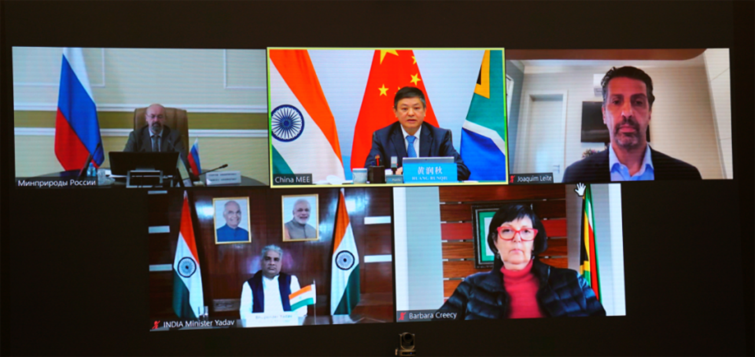
5.2 China is promoting multilateral and bilateral climate change negotiations
The country participates fully and extensively in the main channels of international negotiations such as the Convention and its Paris Agreement, actively engages in negotiations through channels outside the Convention, and collaboratively promotes the multilateral process for climate change.
China attends COP and participates comprehensively in the negotiations on various issues, contributing Chinese wisdom to achieve a comprehensive package of balanced outcomes at the Conference. It also participates actively in negotiations on key issues at meetings of subsidiary bodies of the Convention, monthly consultations on COP presidency-related negotiation issues, coordination meetings of the “Like-Minded Developing Countries” group, and negotiations on climate change issues of the Group of 77 and China. China maintains coordination on key issues and plays a positive role. It actively participates in climate change-related dialogues and negotiations through multiple channels, such as the G20, IPCC, IMO, APEC, WTO, and ICAO.
On May 13, 2022, the BRICS High-Level Meeting on Climate Change was held in a virtual video meeting.

Slide 39
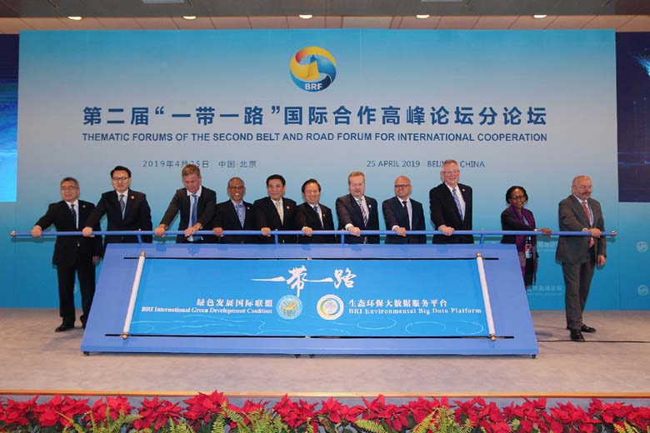
5.3 China is strengthening practical cooperation to address climate change
It deepens the double multilateral cooperation mechanism in the climate field, actively carries out South-South cooperation in low-carbon demonstration area construction, climate change mitigation and adaptation projects, and capacity building, and works together to create practical cooperation for the “Green Silk Road”.
China is promoting the co-construction of nature-based solutions. It conducts the China-UK Dialogue on Climate Change, implements the China-EU Climate Change Flagship Program, works with Germany on the Climate Partnership, Nationally Determined Contributions, Carbon Market, Low Carbon Transportation, and the Comprehensive Action Plan for Low-Carbon and Resilient City and Spatial Planning (China Part) projects, cooperates with Norway on the Carbon Emission Trading System, launches the China-Switzerland Zero Carbon Building Project, and promotes exchanges and cooperation in energy transition, clean energy technology, and industrial green low-carbon development with the EU, Germany, ASEAN, the UK, Finland, Denmark, Japan, South Korea, New Zealand, Singapore, South Africa, Uruguay, and other countries.
III. In April 2019, the Ministry of Ecology and Environment jointly established the Belt and Road Green Development International Alliance with more than 150 partners from over 40 countries.

Slide 40
06
Progress

Slide 41
6.1 Exceeded the 2020 targets for addressing climate change ahead of schedule
China was the first developing country to release the National Climate Change Plan.
14.00%
12.00%
10.00%
8.00%
6.00%
4.00%
2.00%
0.00%
2007
China set the goal of reducing carbon dioxide intensity per unit of GDP by 40-45% from the 2005 level by 2020.
2009
China put forward nationally determined contribution targets such as peaking carbon dioxide emissions around 2030 and striving for an early peak and reducing carbon intensity by 60-65% from 2005 levels and submit them to the United Nations.
2015
2010 2011 2012 2013 2014 2015 2016 2017 2018 2019
Table 1 Reduction rate of carbon intensity from 2010 to 2019
80.0%
_{69.2%} 70.2% _{68.5% 67.4%}
70.0%
65.6% _{63.7% 62.0%}
60.4% _{59.2% 57.7%}
By the end of 2021, China‘s carbon dioxide emissions per unit of GDP had dropped by 50.3% , compared with 2015 and 2005, and non-fossil energy accounted for 16.6 percent of energy consumption. It has achieved a sustained and substantial reduction in carbon intensity and continuous optimization of energy structure, reversed the situation of rapid growth of carbon dioxide emissions, and laid a good foundation for the implementation of carbon peak goal and carbon-neutral vision.
60.0%
2021
50.0%
40.0%
30.0%
煤炭
20.0%
_{17.4% 16.8% 17.0% 17.1% 17.4%} 18.3% 18.5% 18.8% 18.7% 18.9%
油品
9… _{8.4%} 9.7%
_{10.2% 11.3% 12.1%} 13.3% 13.8%14.3%^{15.3%}
天然气
10.0%
0.0%
4.0% 4.6% 4.8%_{5.3% 5.7% 5.9% 6.2% 7.0%} 7.8% 8.1%
非化石能源
2010 2011 2012 2013 2014 2015 2016 2017 2018 2019
Table 2 Structure of energy consumption from 2010 to 2019

Slide 42
6.2 Obvious results have been achieved in key areas and industries
For many years, China has ranked first in the world in renewable energy investment, installation capacity, power generation and technology patents. The development of green and low-carbon industries such as new energy vehicles is at the forefront of the world, and China has become a leader in the development of non-fossil energy sources in the world.
In 2018, China's forest area and forest stock reached 3.31 billion acres and 17.56 billion cubic meters, an increase of 41.1 million hectares and 4.5 billion cubic meters over 2005, making China the world's largest growth country in forest resources over the same period.

Slide 43
6.3 Local low-carbon development models are initially emerging
Both the 12th Five-Year Plan and the 13th Five-Year Plan have incorporated carbon intensity reduction as a binding target, which has been broken down and implemented at the local level
Three batches of low-carbon pilot projects have been carried out in 87 provinces and cities and 28 climate-resilient cities. Positive progress has also been made in low-carbon cities (towns), low-carbon industrial parks, low-carbon communities, and near-zero carbon emission demonstration projects, forming a comprehensive and multi-level low-carbon pilot system.
All 31 provinces (autonomous regions and municipalities directly under the central government) have released their implementation plans or plans for controlling greenhouse gas emissions during the 13th Five-Year Plan period.

Slide 44
6.4 The construction of the national carbon market is advancing steadily
2011
Carbon emission trading pilot was carried out in seven provinces and cities: Beijing, Tianjin, Shanghai, Chongqing, Hubei, Guangdong and Shenzhen, covering nearly 3,000 key emitters.
Guidelines for reporting carbon emissions in 24 industries and 13 national standards for carbon emissions accounting have been released.
Continuously organize and carry out the formulation of historical carbon emission reporting, verification and monitoring plans of key emitters.
Steady progress has been made in building a unified national carbon market system, infrastructure and capacity.
By the end of 2020, China had issued the Measures for the Administration of National Carbon Emission Trading (Trial), marking the start of the first implementation period of the national carbon market and entering a new stage of development.
2017
In December, the <National Carbon Emission Trading Market Construction Plan (Power Generation Industry)> was officially released.

Slide 45
6.5 Significantly enhanced influence and guidance in global climate governance
With the personal participation and direct promotion of President Xi Jinping, China has made historic contribution <Paris Agreement>.President Xi Jinping personally presented China's instrument of ratification of the Paris Agreement to the then UN Secretary General Ban Ki-moon, which promoted the<Paris Agreement> rapid into force.
Participated in the launch of the Global Adaptation Committee and promoted the establishment of the China office of the Global Adaptation Centre.
Organize the preparation of the <Achievements and New Goals and Measures for the Implementation of China’s Nationally Determined Contributions> and <China's Long-term Development Strategy for Low Greenhouse Gas Emission in the Middle of the Century>, which will be submitted to the Secretariat of the United Nations Framework Convention on Climate Change for approval in accordance with relevant procedures.
China take part in organizing all departments and institutions to participate in UN international negotiations on climate change, and work for the establishment of a global climate governance system that is fair, reasonable and win-win through cooperation.
Cooperation and exchanges with other countries in the field of climate change have deepened.
Participated and host the BASIC Ministerial Meeting on Climate Change and the Coordination Meeting on Climate Change Negotiations among Developing Countries with Similar Positions.

Slide 46
Training about 2,000 officials and technicians in the field of climate change for more than 120 developing countries
It has effectively helped African countries, small island countries and the least developed countries to enhance their capacity to cope with climate change, which has been widely praised
A total of 49 training sessions on South-South cooperation on climate change have been held in China
A total of 1.2 billion yuan has been allocated for South-South cooperation on climate change
Since 2012, China has signed 38 memorandums of understanding on cooperation with 35 developing countries

Slide 47
07
Challenge

Slide 48
2035 Vision Target: Steady and Decrease after Carbon Emissions Peak
Finishing Carbon Peak and Carbon Neutrality
The Fifth Plenary Session of the 19th Central Committee of the Communist Party of China included the long-term goal of "stabilizing while reducing carbon emissions after reaching a peak" in 2035, and required "formulating an action plan for reaching a peak of carbon emissions by 2030". 2020 central economic work conference will reach the peak carbon, carbon neutral work next year as one of the eight key tasks, requirements "to carbon emissions by 2030 years ago the peak action" "speed up the construction of the national carbon emissions trading market", fully embodies the party central committee and the State Council to deal with climate change unprecedented attaches great importance to the work, China's efforts to address climate change have entered a new stage of development.

Slide 49
Carbon Peak and Carbon Neutrality Work Leading Group
1+N Policy framework
1：working guidance for carbon dioxide peaking and carbon neutrality in full and faithful implement of the new development before 2030
Action plan for carbon dioxide peaking before 2030
N: Steel
Chemical
Cement
Aviation
……
indicator | goal | year
energy consumption per unit of GDP | reduce 13.5% compare to 2020 | 2025
 | decrease significantly | 2030
CO2 emission per unit of GDP | decrease of 18% compare to 2020 | 2025
 | decrease of 65% compare to 2005 | 2030
proportion of non-fossil fuel consumption | about 20% | 2025
 | about 25% | 2030
 | about 80% | 2060
energy efficiency | increase significantly | 2030
 | achieved international advanced standard | 2060
carbon sink | The forest coverage has reached 24.1%. | 2025
 | The forest coverage has reached 25%. | 2030

Slide 50
7.1 The role of climate change in the overall strategy of China's modernization drive has been significantly improved
The goal of reaching the carbon peak and the vision of carbon neutrality are important strategic arrangements for China government to take climate change as the overall consideration of both domestic and international situations, push for high-quality development and gain the diplomatic initiative from a strategic and long-term perspective.
It is not only a solemn commitment to the international community, but also the goal and direction of China's comprehensive green transformation in economic and social development.
Addressing climate change plays a pivotal role in the strategic deployment of a new development stage, a new development philosophy and a new development pattern.

Slide 51
7.2 The role of climate change in promoting high-quality economic development has been significantly enhanced
China has embarked on a new journey to fully build a modern socialist country and is in a critical period of marching toward the second centenary goal. We must unswervingly transform the development model.
The more action on climate change, fully tap the new economic system innovation and development of new technologies, new forms and, in various fields to leather brings huge potential to reduce emissions, increase the whole society's awareness of low carbon development, and is reversed transmission mechanism, to promote the development of high quality is the fundamental of ecological environment protection, is to promote economic and social development of comprehensive green transformation of gripper.

Slide 52
7.3 The role of climate change in the country's diplomacy is more prominent
The world today is undergoing profound changes unseen in a century. The international political situation and pattern have undergone profound changes since the COVID-19 epidemic. Combined with the impact of the Biden administration, the status of climate change in the global and major country diplomacy agenda is rising rapidly.
BY 2020
Economies that account for 65 percent of global greenhouse gas emissions and 75 percent of global economic output have made carbon-neutral commitments, and a new growth path featuring low-carbon development has become the main direction of the global transition.
Addressing climate change is an important area for China to participate in global governance, conduct diplomacy, and enhance its international influence and voice. It is also an important platform for China to uphold multilateralism and promote the building of a community with a shared future for mankind.

Slide 53
08
Policy Framework

Slide 54
8.1 Action Plan for Peak CO2 Emissions by 2030
By area
Make clear the target, roadmap, action plan and supporting measures for local and key industries to reach the peak.
Support will be given to places where conditions permit to take the lead in reaching the peak.
Support the development of key nationally determined contributions projects.
Translate the realization of national goals into concrete actions by local governments, departments and industries.
Strengthen oversight and assessment, and incorporate the work of the peak campaign into central environmental supervision.
During the 14th Five-Year Plan period and the 15th Five-Year Plan period, we will continue to promote the green transformation of economic and social societies through the important work of achieving peak.
Work with relevant departments to clarify the task, establish a working mechanism, improve the safeguard measures
By discipline
Energy Varieties
Other tasks

Slide 55
8.2 objective & goal
To put forward strong binding targets for carbon intensity reduction in line with the goal of achieving carbon peak and the vision of carbon neutrality, and formulate local decomposition, implementation, supervision and assessment plans. To push the relevant departments to put forward high quality, relevant goals and measures.
Formulate a special plan for addressing climate change during the 14th Five-Year Plan period, and gradually promote the establishment of a total carbon dioxide emission control system, so as to shift from intensity control to total control.
Take the lead in carrying out a carbon-neutral strategy study before 2060, and further define the major areas, technologies, industries, policies and institutional arrangements for China to achieve carbon neutrality.

Slide 56
8.3 National Carbon Emission Trading Market
Better leverage the role of the carbon market in controlling greenhouse gas emissions, promoting innovation in green and low-carbon technologies, and guiding climate investment and financing.
Accelerate the adoption of the Interim Regulations on the Administration of Carbon Emission Trading, and improve supporting systems for accounting reports, quota allocation registration, and trade settlement.
Push forward the preparation work of starting on-line trading with the power generation industry as the breakthrough point.
Adhere to the positioning of the carbon market as a policy tool for greenhouse gas emission reduction. On the basis of ensuring the stable and effective operation of the carbon market, we should further expand the scope of industries and trading subjects involved in the carbon market during the 14th Five-Year Plan period, and gradually increase the types of trading.

Slide 57
8.4 Adaptation
The National Strategy for Adaptation to Climate Change 2035 has been formulated and implemented, and an overall plan has been drawn up for adaptation to climate change in the coming period.
integrate adaptation to climate change into national economic and social development plans, and integrate it with sustainable development, ecological and environmental protection, poverty eradication, and infrastructure construction.
further strengthen research on climate risk and vulnerability assessment, coordinate and intensify action to adapt to climate change in key areas such as agriculture, forestry, water resources, and infrastructure, as well as in cities, coastal areas, and ecologically fragile areas, deepen pilot and demonstration work on climate adaptation, and comprehensively enhance China's ability to adapt to climate change.

Slide 58
8.5 Pilots
To achieve the peak goal of carbon standard and the vision of carbon neutrality, to build an upgraded version of the low-carbon pilot.
research and promote the construction of near-zero carbon emission demonstration projects and zero-carbon demonstration zones
promote the construction of large-scale, full-chain pilot and demonstration projects for carbon capture, utilization and storage.

Slide 59
8.6 Investment
accelerate the establishment of a climate investment and financing policy system, strengthen environmental and economic policy guidance, strengthen fiscal, tax, financial and other policy support and coordination of various policies.
gradually improve the standard system for climate investment and financing, build a database of key items of nationally determined contributions, formulate standards for climate projects, improve standards for climate information disclosure, and establish standards for climate performance evaluation.
encourage local governments to innovate models and tools, and 44 out local trials of climate investment and financing.

Slide 60
8.7 Non-carbon greenhouse gas emissions
increase the frequency of greenhouse gas emission inventories, get a clear picture of China's non-carbon greenhouse gas emissions and their trends, and strengthen analysis and analysis of emissions situations.
Continue to improve the technical system for monitoring, reporting and evaluating non-carbon dioxide greenhouse gases.
promoted the implementation of methane emission control actions, explored and implemented methane emission control policies with relevant provinces and municipalities, and advanced the construction of methane extraction and utilization demonstration projects in key coal mining areas.
continue to strengthen control over the emission of hydrofluorocarbons, nitrous oxide and sulfur hexafluoride.

Slide 61
8.8 Global climate governance
continue to uphold multilateralism and the principles of common but differentiated responsibilities, equity and respective capabilities, take a constructive part in and advance the multilateral process on climate change, and work for the full, balanced and effective implementation of the Paris Agreement.
continue to contribute "Chinese wisdom" and "Chinese solutions" to the building of a global climate governance system that is fair, equitable and win-win through cooperation.
actively carry out South-South cooperation on climate change and provide support to other developing countries within our capacity.

Slide 62
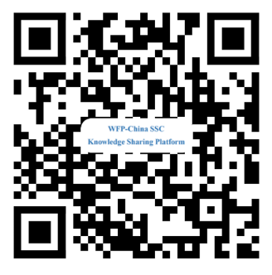
Thank You
Contact Information: zhangzq@ncsc.org.cn
Sharing for Learning

