Slide 1
Food a Fact
of Life
AgroTech+
SUSTAINABLE COLD CHAIN AND
FOOD LOSS REDUCTION
Presented by
Henrietta Mitchell
By
Mr. Elisha Caleb

Slide 2
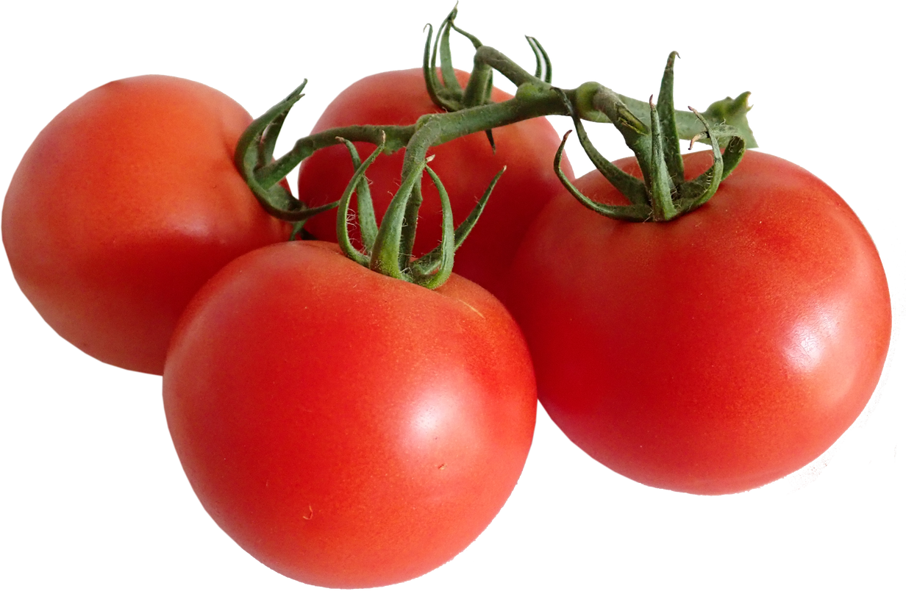
For The Tomatoes, the Clock is ticking.....

Slide 3
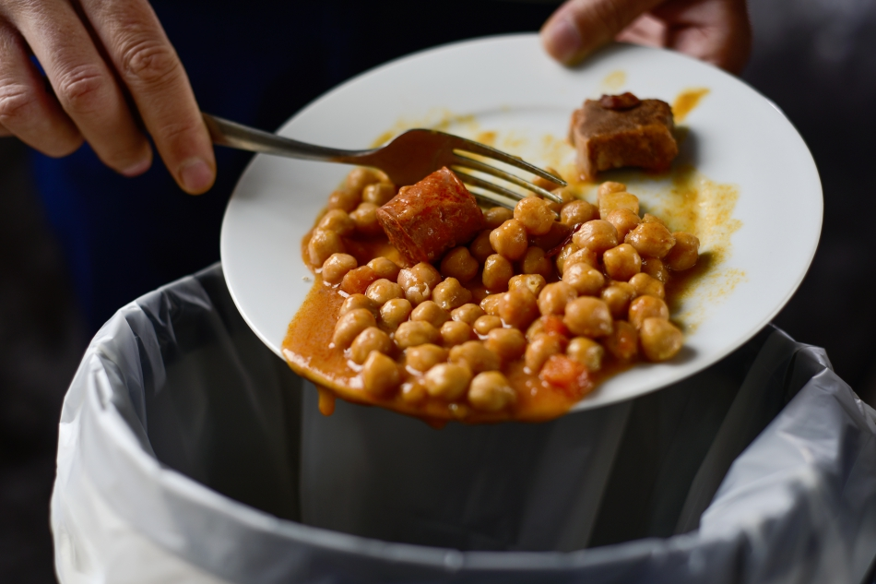
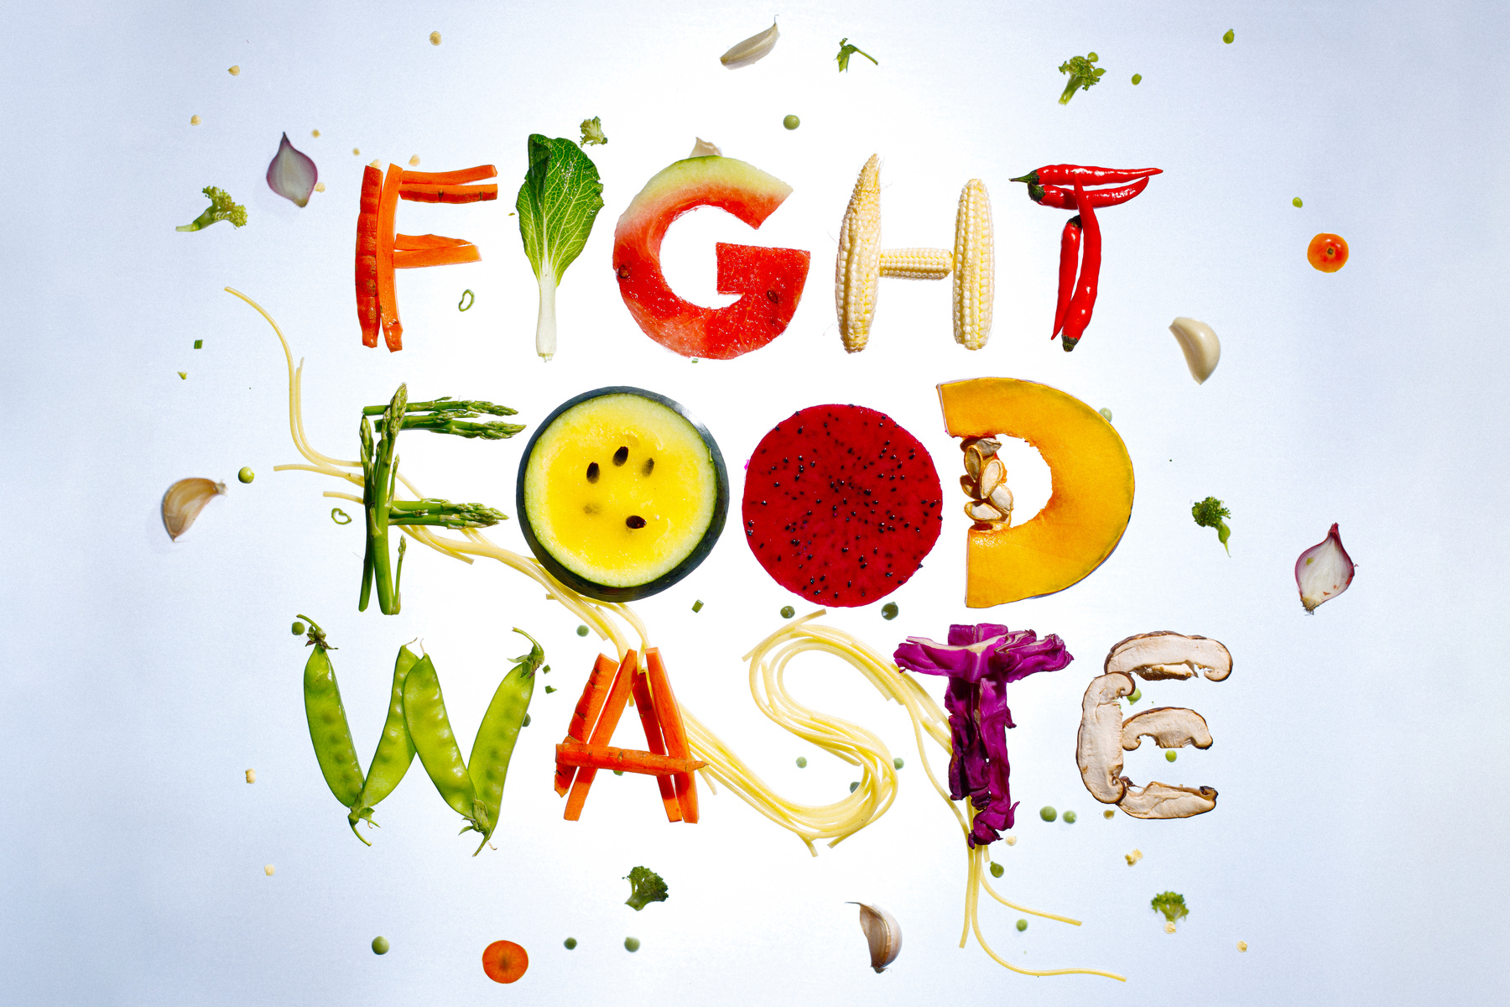
PROBLEM
Food isn’t the only thing that is wasted when it goes uneaten. All of the resources, money and labour that go into making it are also lost.

Slide 5
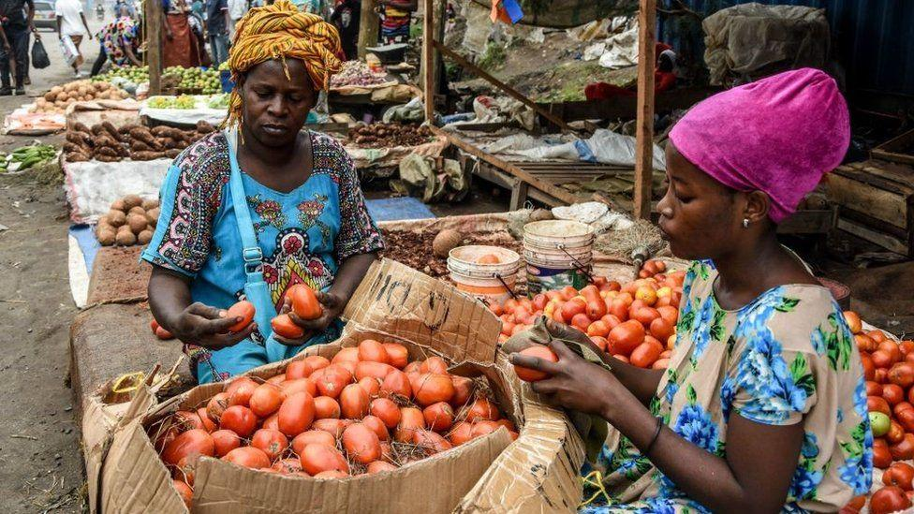
Approximately 828 million people go hungry each year, and3 billion cannot afforda healthy diet.
Food loss post-harvest reduces the income of 470 million smallholder farmers by as much as 15 per cent – with developing countries hit the hardest.
According to FAO"Global Food Losses and Food Waste," 2022, Dalberg analysis report, 50% of food In Africa is spoilt due to lack of cold storage.
This translates to over 606Million tons of food lost
Individually, smallholder Farmers incur an Annual lose of over 25% of their Income.

Slide 6
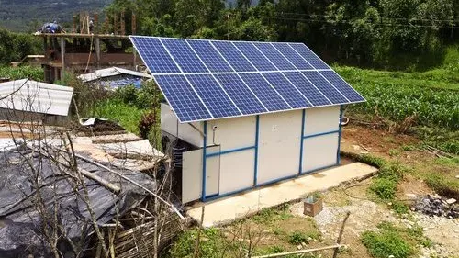
We Provide a Walk-in solar powered cold storage preservation Technology that extends shelf life of perishable produce from the usual 5-days period to 21 days

Slide 7
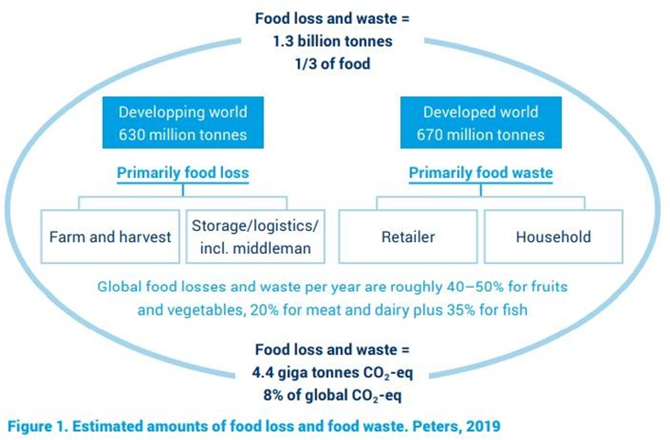
Food
wastage
Food is lost and wasted (food wastage) throughout the supply chain after harvest from producer to final consumption.

Slide 8
What is a cold-chain system?
A cold-chain system:
local, national and international markets while simultaneously helping to build the sustainable and resilient food supply system necessary to feed a growing population;
Affords market connectivity which incentivizes farmers to raise their output because they will earn more from what they produce;
Allows farmers and growers to transition from growing crops of staples to producing higher value, perishable, micronutrient-rich foods, such as fresh fruits and vegetables;
Has the potential to allow higher value to move to rural communities, creating jobs and broader economic growth.

Slide 9
Climate impact of Agrotech+ Fresh Cold systems
Food loss and waste account for up to 10% of greenhouse gas emissions. They use up precious land and water resources for, essentially, nothing. Look, we will never eliminate food waste and loss. But putting a serious dent in them will help us to slow climate change, protect nature and increase food security – at a time when we desperately need these things to happen.
Food loss and waste (FLW) also account for 8-10 percent of global greenhouse gas emissions (GHGs) - contributing to an unstable climate and extreme weather events such as droughts and flooding. These changes negatively impact crop yields, potentially reduce the nutritional quality of crops and cause supply chain disruptions.
Prioritizing the reduction of food loss and waste is therefore critical for the transition to sustainable agrifood systems that improve the efficient use of natural resources, lessen their impact on the planet and ensure food security and nutrition.
Every solar cold room we set up is reducing up to 16.5 tonnes of CO2 emissions each month. This means that with a minimum of two of our preservation units operating, we are able to save over 300 tonnes of CO2 emissions annually in just one community, thereby contributing to achieving a net-zero carbon world.

Slide 10
Our Success is measured by the impact of connecting more farmers to Cold Storages

Slide 11
AgroTech+
founder@agrotekplus.com

