Slide 1
Unlocking the Potential: Transforming Supply Chains to Minimize Post-Harvest Losses
Zhao Xia
Institute of Food and Strategies Reserves, Nanjing University of Finance and Economics
SEMINAR ON POST-HARVEST LOSS MANAGEMENT 粮食减损国际研讨会

Slide 2
content
Post-harvest losses of food in China
Influencing factors of post-harvest losses of food
Loss mitigation potential in food post-harvest system
Loss mitigation strategies in food post-harvest system
河南·开封
2023年9月25日
SEMINAR ON POST-HARVEST LOSS MANAGEMENT 粮食减损国际研讨会

Slide 3
Part 01
Post-harvest losses of food in China
河南·开封
2023年9月25日
SEMINAR ON POST-HARVEST LOSS MANAGEMENT 粮食减损国际研讨会

Slide 4
Part 01 Post-harvest losses of food in China
In China, “food” is commonly translated as “粮食”，which mainly refers to cereals, beans, and tubers. cereals, beans and potatoes.
Quantity perspective of losses
Losses of food: decreased quantities of edible food in various pre-dinner stages of the post-harvest system due to inedibility or diversion to non-food uses
Wastes of food: The discard of edible food or the inedibility at consumption stages.
河南·开封
2023年9月25日
SEMINAR ON POST-HARVEST LOSS MANAGEMENT 粮食减损国际研讨会

Slide 5
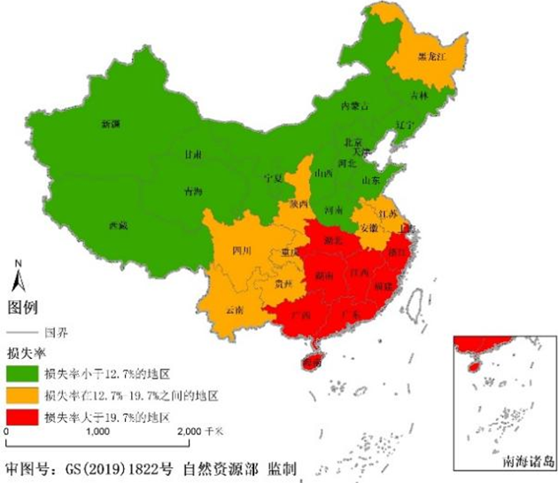
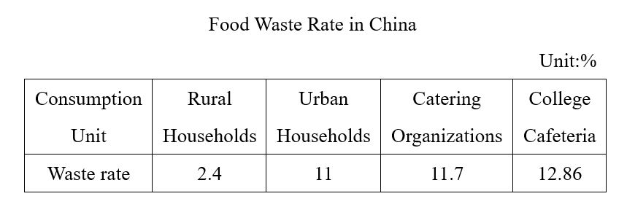
Part 01 Post-harvest losses of food in China
Post-harvest losses of food
Regional differences in rates of post-harvest losses of food
河南·开封
2023年9月25日
SEMINAR ON POST-HARVEST LOSS MANAGEMENT 粮食减损国际研讨会

Slide 6
Part 02
Influencing factors of post-harvest losses of food
河南·开封
2023年9月25日
SEMINAR ON POST-HARVEST LOSS MANAGEMENT 粮食减损国际研讨会

Slide 7
Part 02 Influencing factors of
post-harvest losses of food
Harvesting
Weather
Drying
Farmers: drying temperature, time, weather, thickness, times of turning the material
Crop maturity
Farmers' income
Harvesting method
Field transportation
Grain cleaning operation
Warehouses: ratio of feeding moisture, drying temperature, feeding and discharging methods before and after drying
Processing
Storing
Farmers: storage habits, technology and facilities
Warehouses: entry and exit practices, storage technology, storage ecosystems
Transportation
Packaging and dispersal form
Grain species differ greatly in post-harvest
Method of Transportation
Method of loading and unloading
Craft
Technique
Single link
河南·开封
2023年9月25日
SEMINAR ON POST-HARVEST LOSS MANAGEMENT 粮食减损国际研讨会

Slide 8
Part 02 Influencing Factors of
Post-harvest Losses of Food
Supply chain factors
Food supply chain facility conditions
Food consumer market preferences
Flour Extraction Rate
Rice Milling Yield
Fresh vs Aged food
Food industry standards
National standards
Stricter terminal standards
河南·开封
2023年9月25日
SEMINAR ON POST-HARVEST LOSS MANAGEMENT 粮食减损国际研讨会

Slide 9
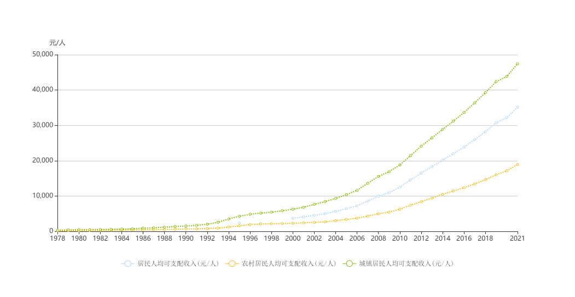
Part 02 Influencing factors of
post-harvest losses of food
Environmental factors
Economic environment
Stable but low grain prices
Higher opportunity costs of production
河南·开封
2023年9月25日
SEMINAR ON POST-HARVEST LOSS MANAGEMENT 粮食减损国际研讨会

Slide 10
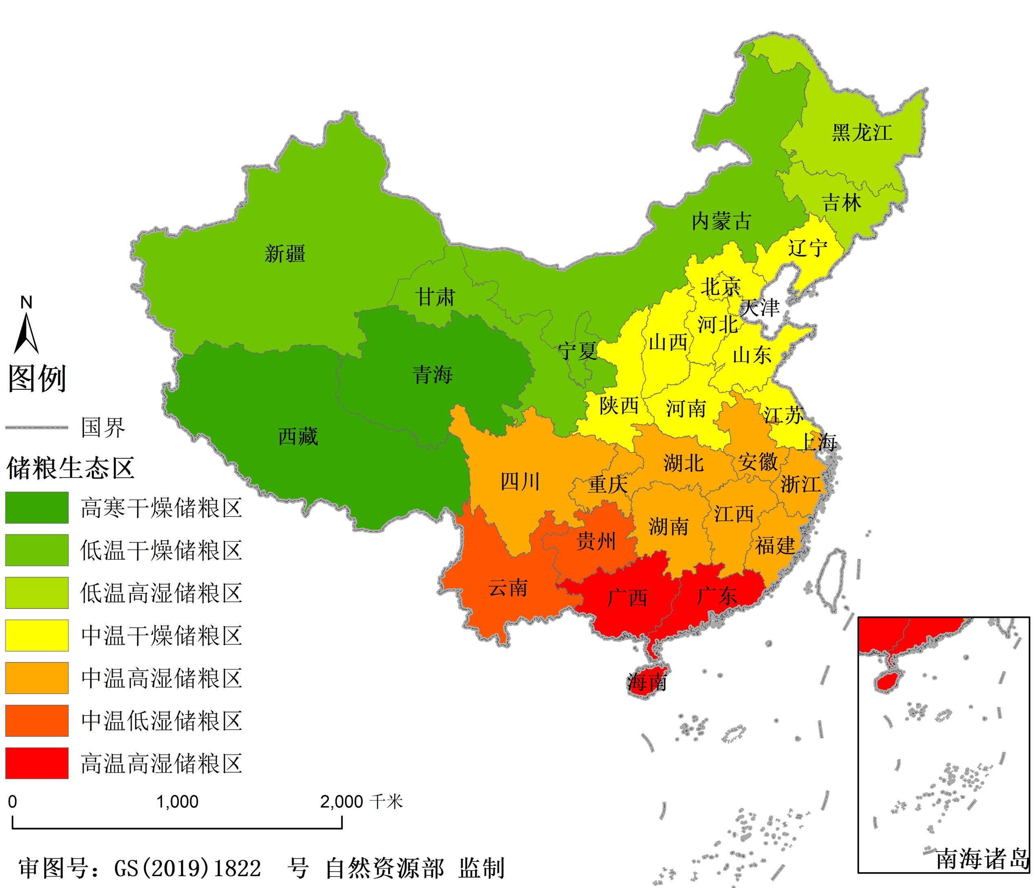
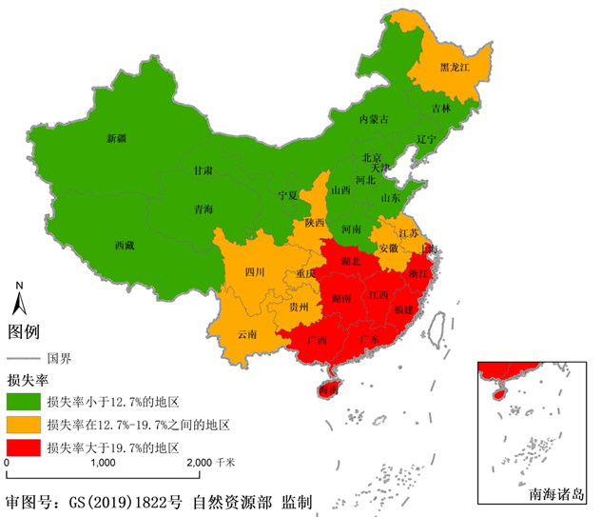
Part 02 Influencing Factors of
Post-harvest Losses of Food
Environmental factors
Natural environment
Climatic conditions and farming systems are complex and variable, and the storage environments in each region are characterized by different geographical features.
Temperature and humidity
High Cold, low temperature, medium temperature, high temperature
Dry, low humidity, high humidity
河南·开封
2023年9月25日
SEMINAR ON POST-HARVEST LOSS MANAGEMENT 粮食减损国际研讨会

Slide 11
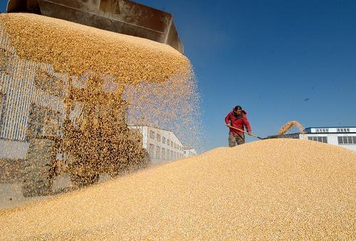
Part 02 Influencing factors of
post-harvest losses of food
Environmental factors
Social environment
Complex international situation and increasing uncertainty of global food security
Three "firsts" in China's food supply and demand situation
Food consumption
Food production
Food importation
On May 11, 2021, the seventh national population census stated that the national population totaled 141,178,000,000 people
Food reserves are the solid foundation for China's food security
Food reserves account for over half of the worldwide total
Food harvesting, security of food storing and fiscal burdens impose enormous pressures and risks of food losses
河南·开封
2023年9月25日
SEMINAR ON POST-HARVEST LOSS MANAGEMENT 粮食减损国际研讨会

Slide 12
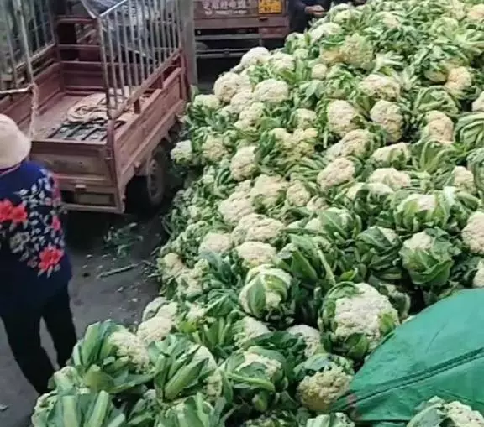
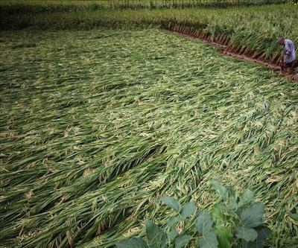
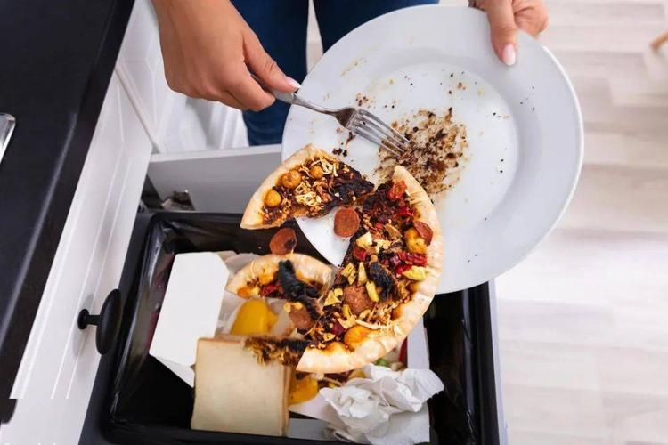
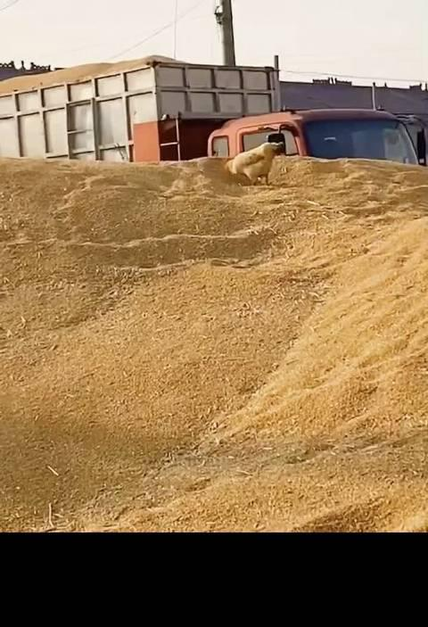
Part 02 Influencing factors of
post-harvest losses of food
Causes of post-harvest losses and wastes of food
Force majeure factors
Subjective factors
Technical factors
Economic factors
Policy factors
Social
factors
Natural
factors
河南·开封
2023年9月25日
SEMINAR ON POST-HARVEST LOSS MANAGEMENT 粮食减损国际研讨会

Slide 13
Part 02 Influencing factors of
post-harvest losses of food
Natural factors
Climatic conditions, geographic locations, natural disasters
Technological factors
Circulation technologies, circulation equipments, circulation processes
Economic factors
Costs, benefits, scarcity of food
Social factors
Labor quality ，work habits
Policy factors
Technical policies, industrial policies, social policies
河南·开封
2023年9月25日
SEMINAR ON POST-HARVEST LOSS MANAGEMENT 粮食减损国际研讨会

Slide 14
Part 03
Loss mitigation potential in food post-harvest system
河南·开封
2023年9月25日
SEMINAR ON POST-HARVEST LOSS MANAGEMENT 粮食减损国际研讨会

Slide 15
Part 03 Loss mitigation potential in
food post-harvest system
Technical space
Difference between current loss ratio and minimum loss ratio
Economic space
Consideration of economic feasibility within the technical space
Policy space
Incentives to change the boundaries of economic feasibility and alter the cost-benefit pattern
Economic space < Technological space
Economic space < Policy space < Technology space
河南·开封
2023年9月25日
SEMINAR ON POST-HARVEST LOSS MANAGEMENT 粮食减损国际研讨会

Slide 16
Part 03 Loss mitigation potential in
food post-harvest system
Feasible areas of loss mitigation
Advances in loss mitigation technology
11.41%
Paradigm shift
Technology promotion
Standardizing operations
Loss mitigation awareness
15.28%
23.61%
0
Loss rate under force majeure conditions
Loss rate under constant level of technology
Urban model
Rural model
Post-harvest loss reduction axis of food
河南·开封
2023年9月25日
SEMINAR ON POST-HARVEST LOSS MANAGEMENT 粮食减损国际研讨会

Slide 17
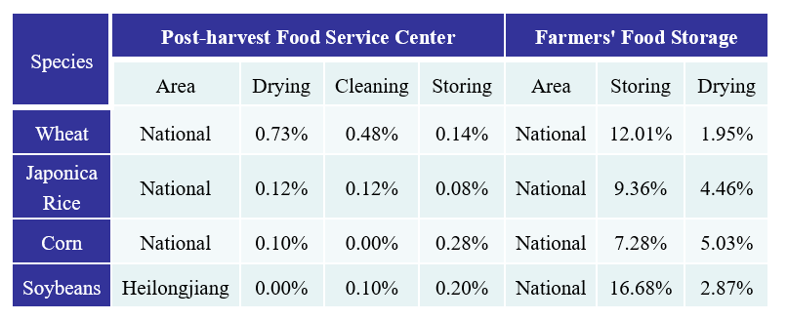
Part 03 Loss mitigation potential in
Food post-harvest system
Presently, China has built more than 4,000 post-harvest service centers for food, realizing complete coverage of the major food-producing counties in the whole nation, reducing food loss and waste and mold loss on average 4% in the areas covered.
河南·开封
2023年9月25日
SEMINAR ON POST-HARVEST LOSS MANAGEMENT 粮食减损国际研讨会

Slide 18
Part 04
Loss mitigation strategies in food post-harvest system
河南·开封
2023年9月25日
SEMINAR ON POST-HARVEST LOSS MANAGEMENT 粮食减损国际研讨会

Slide 19
Part 04 Loss mitigation strategies in
food post-harvest system
Technical factors
Economic factors
Institutional factors
Subjective factors
Force majeure factors ......
Legal governance
Policy governance
Ethical governance
Technical governance
Mitigating losses means of governance
Controllable losses
河南·开封
2023年9月25日
SEMINAR ON POST-HARVEST LOSS MANAGEMENT 粮食减损国际研讨会

Slide 20
Part 04 Loss mitigation strategies in
Food post-harvest system
Loss mitigation targets
Food security, resource depletion, environmental impacts
Stakeholders of loss mitigation
Government, society
Motivators of loss mitigation
Research and development institutions, farmers, manufacturers
Executors of loss mitigation
Farmers, farms, manufacturers
Outputs of loss mitigation
Inputs of loss mitigation
河南·开封
2023年9月25日
SEMINAR ON POST-HARVEST LOSS MANAGEMENT 粮食减损国际研讨会

Slide 21
Thanks for your time!
Xia Zhao
Nanjing University of Finance and Economics
SEMINAR ON POST-HARVEST LOSS MANAGEMENT 粮食减损国际研讨会

