Slide 1


Notes:
Fully Mechanized Rice and Wheat Production with a Focus on Loss Reduction
基于减损的稻麦全程机械化生产技术

Slide 2
Part 01
Mechanization as the Primary Approach for Grain Yield Increase and Loss Reduction
Part 02
Technologies and Measures for Increasing Grain Yield and Reducing Losses Through Mechanization
Part 03
Continuing to Promote the Application of Mechanized Technologies for Uield Increase and Loss Reduction
Notes:
Reducing losses in rice and wheat production is essential for ensuring food security and enhancing agricultural efficiency. This course systematically introduces key mechanized techniques for loss reduction during planting, harvesting, drying and storage. This course is structured into eight modules, each offering in-depth insights into these core techniques.
在农业生产中，减少稻麦生产过程中的损耗对于保障粮食安全和提高农业效益至关重要。本课程聚焦《基于减损的稻麦全程机械化生产技术》，系统讲解稻麦从种植到收获、烘干及储藏等核心环节的机械化减损技术要点，共分八个模块进行深入讲解。

Slide 3

PART.03
Continuing to Promote the Application of Mechanized Technologies for Yield Increase and Loss Reduction
Notes:
III. Continuing to promote the application of mechanized technologies for yield increase and loss reduction
三、持续推进机械化增产减损技术应用

Slide 4
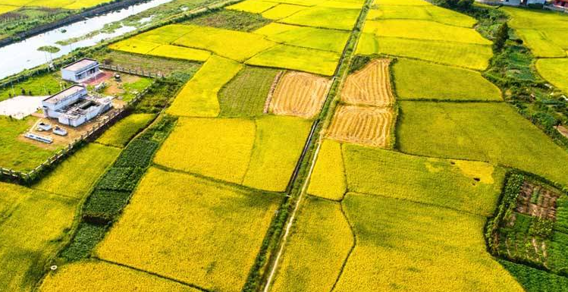
Boosting Yields, Reducing Losses
Institutions
Agricultural Mechanization General Station of the Ministry of Agriculture and Rural Affairs of China.
National agricultural machinery testing and extension agencies.
Specific Measures
Specific Measures
Accelerated supply of yield-increasing and loss-reducing technologies.
Exercised strict quality control over machinery.
Strengthened training and guidance.
Promoted crop-specific, stage-specific, and region-specific solutions.
Notes:
In recent years, the Agricultural Mechanization General Station of the Ministry of Agriculture and Rural Affairs of China,
along with national agricultural machinery testing and extension agencies,
has accelerated the supply of yield-increasing and loss-reducing technologies.
They have exercised strict quality control over machinery,
strengthened training and guidance, and promoted crop-specific, stage-specific, and region-specific solutions. These efforts have achieved remarkable results.
三、持续推进机械化增产减损技术应用
近年来，中国农业农村部农机化总站以及全国农机鉴定推广机构加快增产减损技术的供给，把好机具的质量关，加强培训指导，分作物、分环节、分区域推进粮食作物的减损增产，取得了很好成效。

Slide 5





1. Strengthening the Integration of Machinery and Agronomy
Breed machine-friendly crop varieties
Strengthen the breeding and selection of varieties suitable for mechanized production.
Add mechanization-related indicators in variety approval to reduce losses during mechanized operations.
Match good seeds with suitable machines
Promote seed coating technologies and adoption of commercial seeds.
Pair with precision seeders for strong and even seedling emergence.
Make planting methods more suitable for machines
Solve problems like uncoordinated machinery and cultivation practices.
Improve machine adaptability and compatibility.
Promote full-process mechanization for yield increase and loss reduction
Cover crop variety, cultivation, timing, and field operations.
Speed up integration and application of technologies and equipment.
Develop suitable models for full-process mechanized production.
Notes:
1.Strengthening the integration of machinery and agronomy
This involves four key actions:
O Breed machine-friendly crop varieties – strengthen the breeding and selection of varieties suitable for mechanized production. Add mechanization-related indicators in the variety approval process to reduce losses during mechanized operations.
oMatch good seeds with suitable machines – Promote technologies such as seed coating and improve the adoption of commercial seeds. Pair these with precision seeders to ensure strong and even seedling emergence.
oMake planting methods more suitable for machines – Solve problems like uncoordinated machinery and cultivation practices. Improve machine adaptability and compatibility.
oPromote full-process mechanization for yield increase and loss reduction – From crop variety and cultivation to timing and field operations, speed up the integration and application of technologies and equipment. Develop suitable models for full-process mechanized production.
（一）强化农机和农艺融合。强化农机和农艺融合需从四方面着手。
一是加强宜机化品种的选育，将适宜机械化生产作为品种选育的重要条件，在品种审定环节引入机械化生产特性评价指标，减少机械化作业损失。
二是推进良种和良机配套，推动药剂拌种等技术普及。提高商品种普及率，配套精量播种机，确保机播苗全、苗齐、苗壮。
三是促进栽培方式宜机化，从农机农艺栽培方式不规范、不配套等问题入手，提高机具适应性和通用性。
四是推进全程机械化增产和减损，从品种、栽培、时节等农业生产全过程，加快技术与装备集成应用，探索完善适用的全程机械化生产模式。

Slide 6
2. Accelerating Quality Improvement of Agricultural Machinery Products
01
02
03
Accelerate R&D ( Research and
Experimental Development )
of core technologies
Strengthen product testing and certification
Increase policy support
Increase investment to enhance machinery performance and reliability.
Promote upgrading of agricultural machinery toward intelligence and informatization.
Exclude poor-quality, unreliable, unsuitable machines from the market.
Improve testing capacity.
Accelerate approval and promotion of efficient, low-loss, smart machines.
Provide machinery purchase subsidies + implement policies → scrapping and updating old machines.
Notes:
2.Accelerating quality improvement of agricultural machinery products
oAccelerate R&D of core technologies – Increase investment to improve machinery performance and reliability. Promote the upgrading of agricultural machinery toward intelligence and information.
oStrengthen product testing and certification – Keep poor-quality, unreliable, and unsuitable machines out of the market. Improve testing capacity and accelerate the approval and promotion of efficient, low-loss, and smart machines.
oIncrease policy support – Use machinery purchase subsidies and implement policies for scrapping and updating old machines. （二）加快农机产品质量提升。
一是加快核心技术的研发，加大研发投入，提升机具作业性能和可靠性，推动农业机械向智能化、信息化升级。
二是强化农机试验鉴定管理，严格把关，把不合格、不耐用、不适用的产品挡在门外。同时提升鉴定能力，加快高效低损、智能农机装备的鉴定和推广。
三是加大政策支持力度，发挥农机购置补贴政策导向作用，实施好报废更新补贴政策。

Slide 7
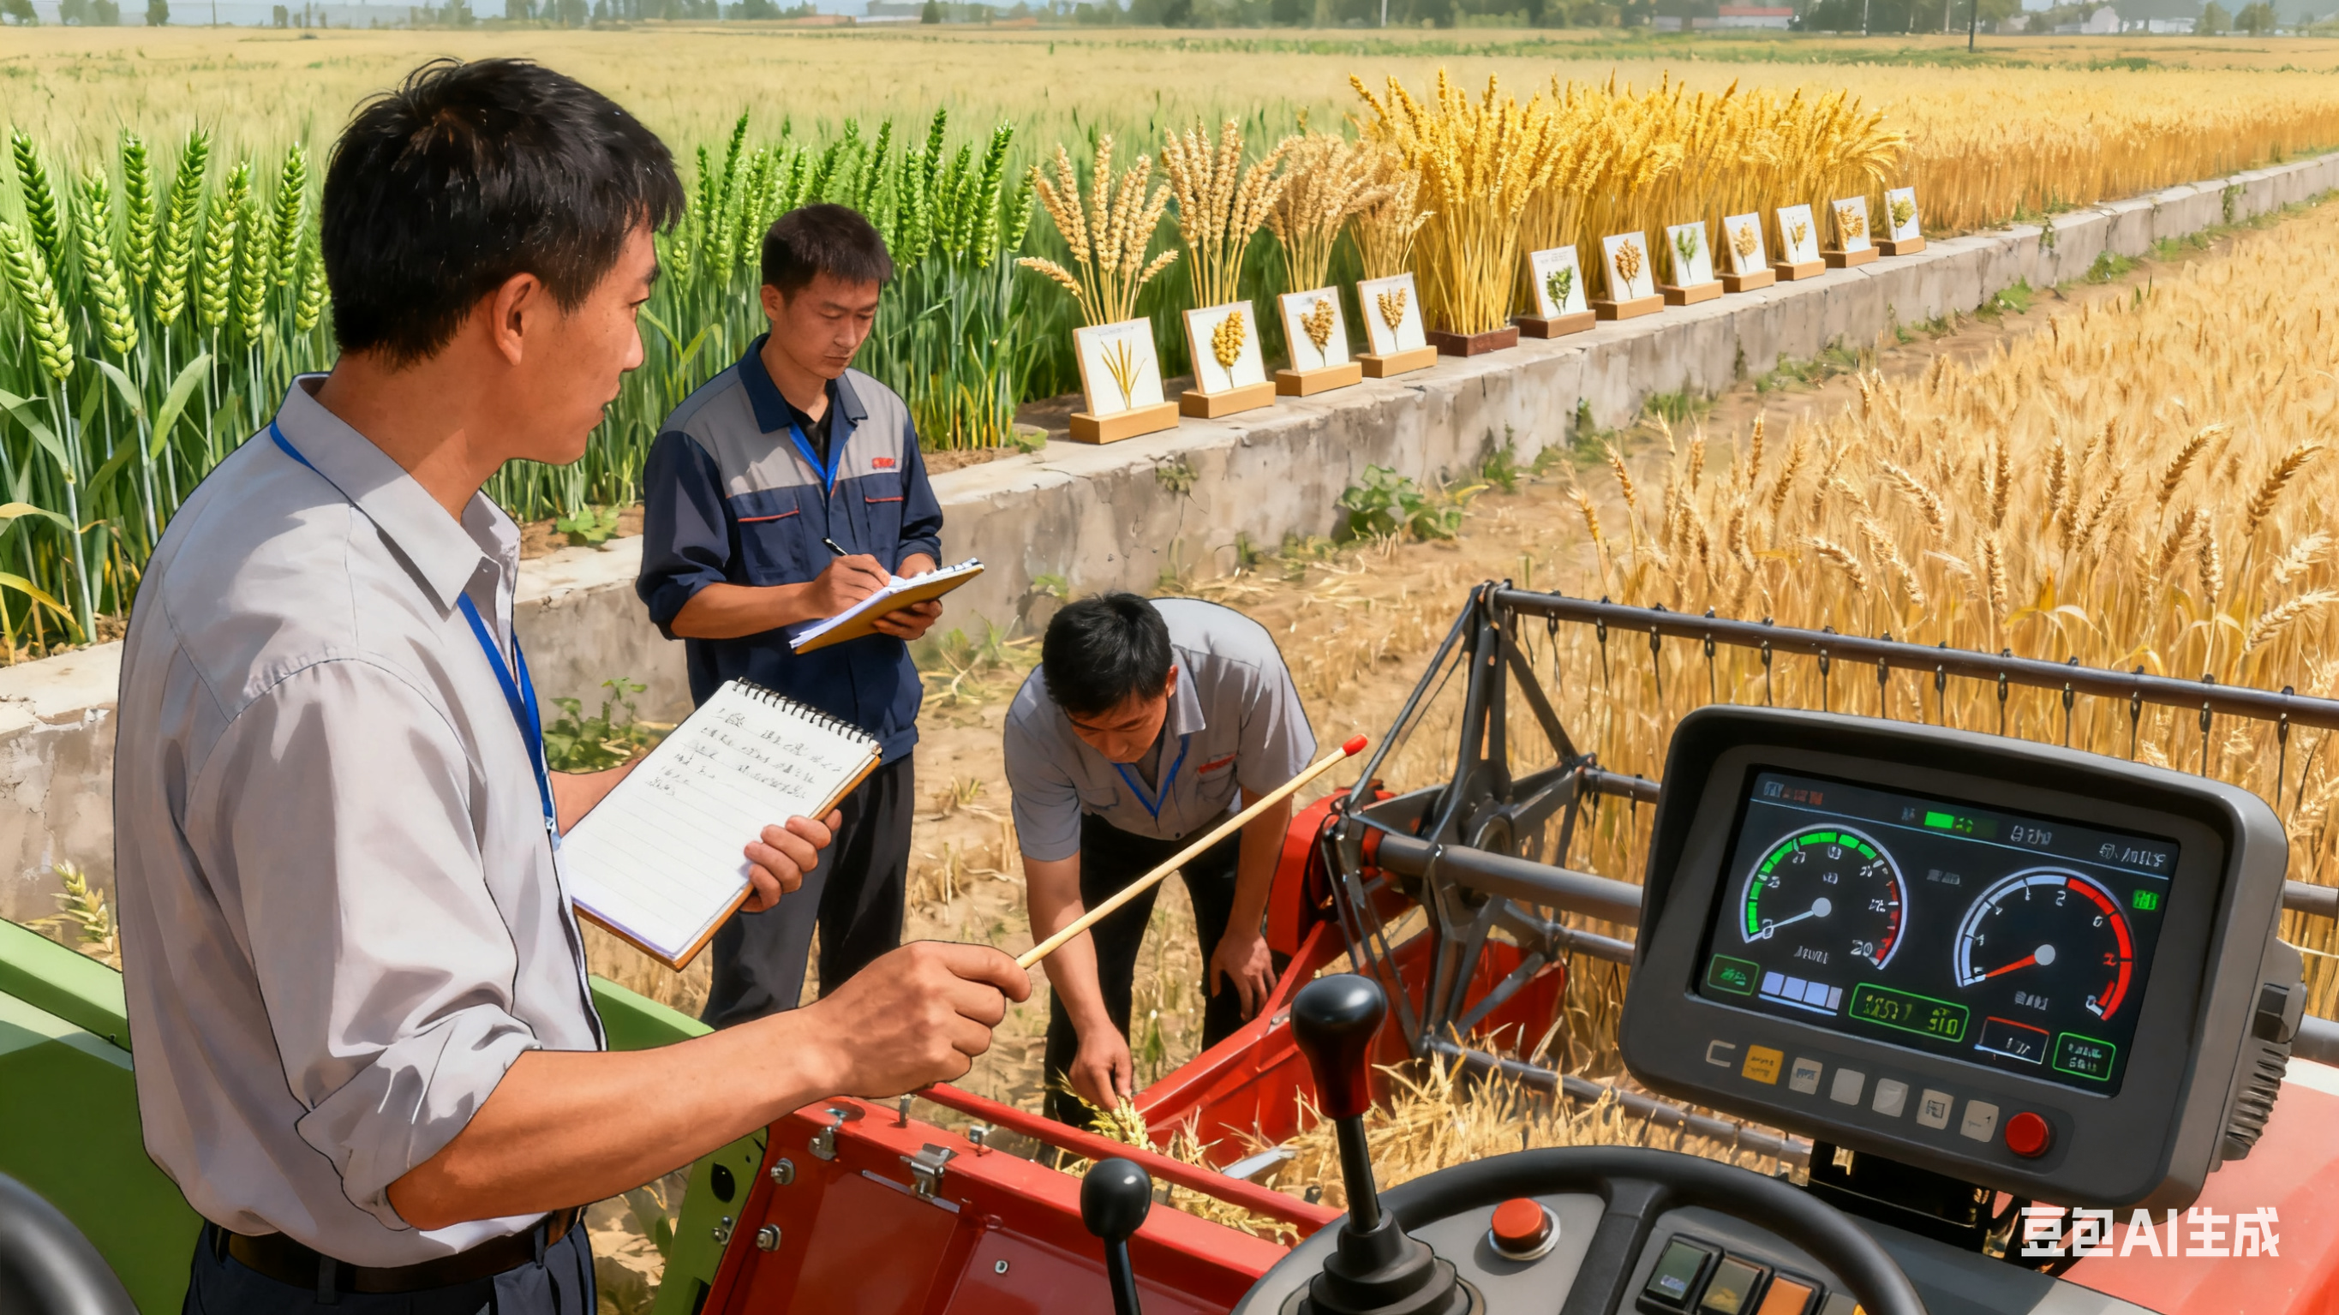
3. Improving Operator Skills
Training Efforts
Increase training intensity and adopt new training methods.
Practical Approach
Provide short, practical, easy-to-learn, results-oriented training sessions.
Targeted Field-Based Training
Tailor training to crop growth stage, machine type, and land conditions.
Field-based, targeted training improves effectiveness and outcomes.
Notes:
3.Improving operator skills
Increase training efforts and adopt new training methods. Provide short, practical, easy-to-learn, and results-oriented training sessions. Targeted, field-based training tailored to crop growth, machine type, and land conditions will be more effective.
（三）提高机手的操作技能。要加大培训力度，创新培训方式，开展短小精悍、容易操作、容易见效的培训。特别是在田间地头结合作物的生长情况、农机具和田块情况，有针对性地开展机手技能培训，效果会更好。

Slide 8
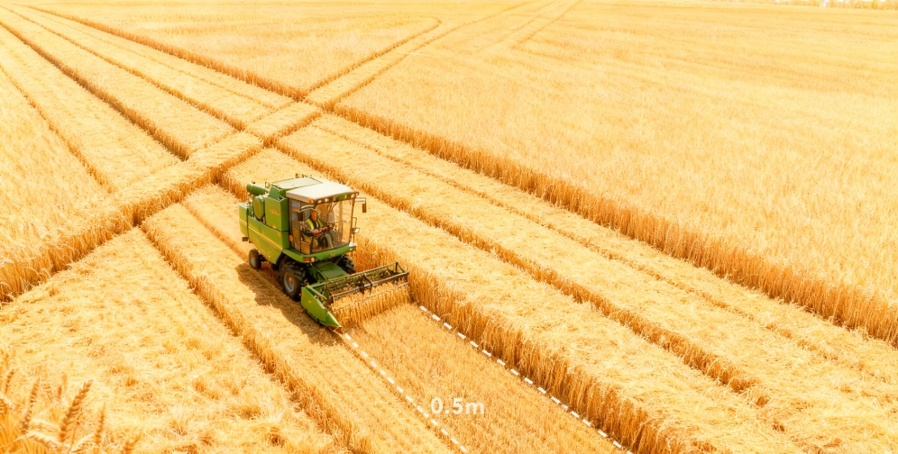
4. Simple Methods to Measure Grain Loss During Harvest
1
Half-Meter Width Method
Example crop: Wheat (1,000-grain weight = 45 g, yield = 6,750 kg/ha, harvester width = 2 m).
Sampling: Create a 0.5 m-long sample area along the harvester’s path.
Threshold
If fallen grains < 300 in the sample area → Loss rate < 2%.
Notes:
4.Simple methods to measure grain loss during harvest
Two main quick methods are now promoted:
oHalf-meter width method: Taking wheat as an example, with wheat that has a 1,000-grain weight of 45 grams, a yield of 6,750 kg per hectare, and a harvester working width of 2 meters,
create a 0.5-meter-long sample area along the machine’s path.
If fallen grains on the ground in that area are under 300, the loss rate is below 2%.
（四）机收籽粒损失简易测定方法。当前主要推广的是两种简易测定方法：半米幅宽法和巴掌法。
半米幅宽法：以小麦千粒重45克，每公顷产量6750公斤，收割机工作幅宽2米为例。取样区为沿着收割机前进方向，长度为0.5米，宽为联合收割机工作幅宽。“半米幅宽法”一个取样区域内落地籽粒应不超过300粒，就能实现损失率在2%以内。

Slide 9

4. Simple Methods to Measure Grain Loss During Harvest
2
Palm Method
Sample area: Adult hand size (~0.02 m²).
Counting grains: If ≤ 6 grains are found in the sample area.
Result: Grain loss rate is below 2%.
Notes:
Palm method: Use the area of an adult hand (about 0.02 m²) as the sample area.
If no more than 6 grains are found, this also indicates that the grain loss is under 2%.
These methods were developed and simplified by experts through formulas. They are easy to understand, remember, and apply.
巴掌法：取样区用成人的手掌（自然状态）划定，面积按0.02平方米计，如果不超过6个籽粒，也可以实现籽粒收获损失在2%以内。
这两个简易的测定方法是通过鉴定机构的专家，经过计算公式，总结提炼而成，非常形象，容易记忆和掌握。

Slide 10

5. Improving Working Conditions for Machinery
Two Main Strategies
Make Land More Suitable for Machinery
Machines have difficulties entering or operating in hilly or scattered small plots.
Give greater priority to machine-friendly land development.
Enhance Emergency Response Capacity
Build a large-scale, standardized, mechanized disaster response system.
Improve technologies for disaster prevention and control.
Stock more emergency-use machines.
Notes:
5.Improving working conditions for machinery
Two main strategies:
oMake land more suitable for machinery – In hilly or scattered small plots where machines have difficulty entering or operating,
give greater priority to machine-friendly land development.
oEnhance emergency response capacity – Build a system for large-scale, standardized, and mechanized disaster response.
Improve technologies for disaster prevention and control,
and stock more emergency-use machines.
（五）改善农机作业条件。
改善农机作业条件需双管齐下。一是加快土地的“宜机化”改造。针对丘陵山区“规模小、分布散、位置偏”地块机械化进地难、种植难、收获难等问题，将农田 “宜机化” 建设放在更加突出位置，解决因地理因素形成的农机作业难的问题。二是提升应急救灾能力，建立完善规模化、标准化农业灾害机械化抢灾救灾机制，完善防灾减灾机械化技术措施，增加应急救灾适用机具储备。

Slide 11
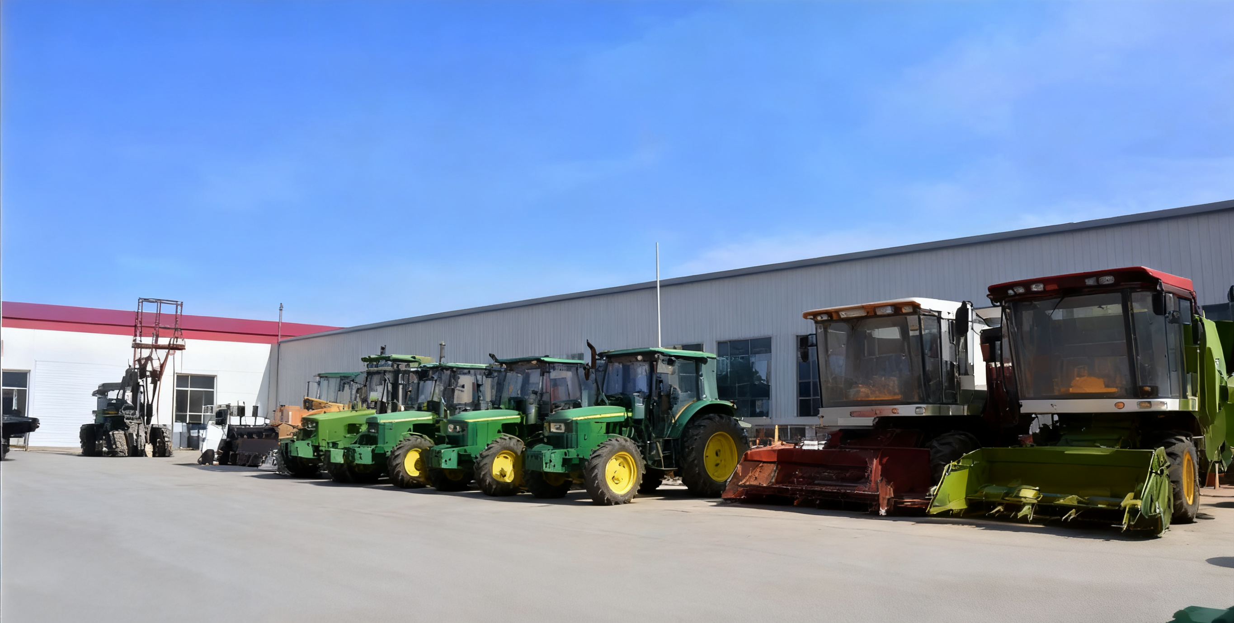
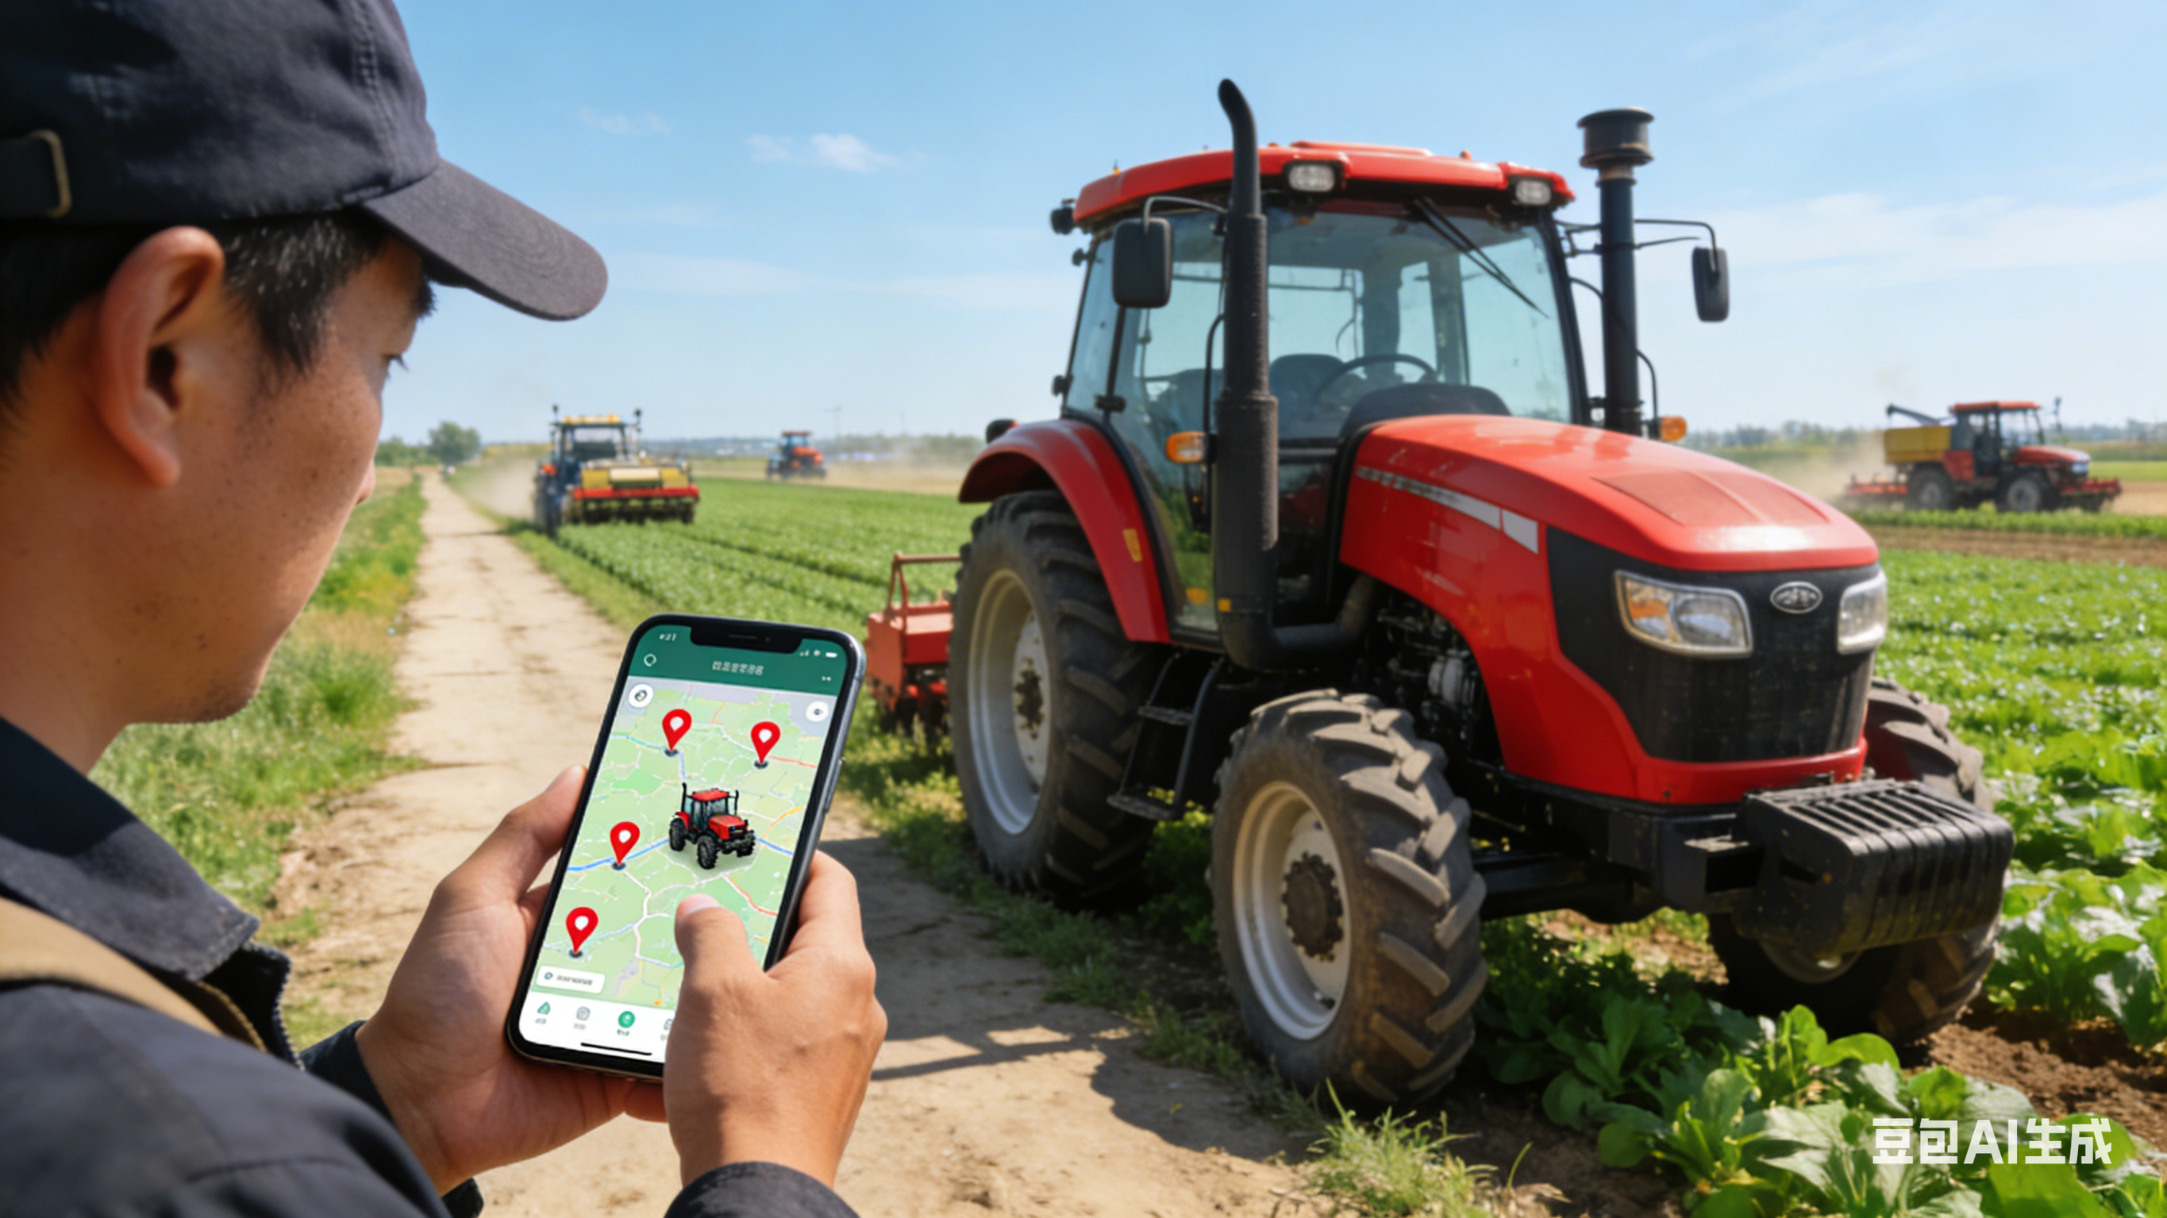

6. Promoting Socialized Services for Agricultural Machinery
Innovate Service Models
“Full-process mechanization + integrated farming services”.
“Internet + agricultural machinery” service platforms.
Innovation in service content.
Focus on Service Innovation & Delivery
Cover the full production chain — before, during, and after production.
Support mechanized yield increase and loss reduction.
Notes:
6.Promoting socialized services for agricultural machinery
Innovate service models, including:
o“Full-process mechanization + integrated farming services”
o“Internet + agricultural machinery” service platforms
oInnovate in service content
Focus on innovation in service content and delivery, covering the full production chain — before, during, and after production — to support mechanized yield increase and loss reduction.
（六）推动农机社会化服务。
农机社会化服务创新包括“全程机械化+综合性全程农事服务”模式，“互联网+”农机服务模式，以及创新服务内容三个方面。推进农机服务的内容和形式创新，应围绕产前、产中、产后全产业链，实现粮食增产减损机械化作业服务。

Slide 12
Key Areas for Promoting Loss-Reduction Harvest Technologies
No.1
No.6
Strengthen integration of machinery and agronomy.
Promote socialized services for agricultural machinery.
Key Areas
No.2
No.5
Improve machinery product quality.
Improve machine operation conditions.
No.3
No.4
Train machine operators.
Apply simple methods to measure grain loss.
Notes:
In a nutshell, we must focus on the following six key areas in order to keep promoting the use of loss-reduction harvest technologies:
oStrengthen integration of machinery and agronomy
oImprove machinery product quality
oTrain machine operators
oApply simple methods to measure grain loss
oImprove machine operation conditions
oPromote socialized services for agricultural machinery
（六）推动农机社会化服务。
总之，持续推进机械收获减损技术的应用，需重点强化农机农艺融合、加快农机产品质量提升、提高机手操作技能、机收籽粒损失简易测定方法、改善农机作业条件、推动农机社会化服务等六个方面的工作。

