Slide 1
Research Progress on Identification and Control Technology of Stored Grain Pests
Prof. WU Yi
Research Field: Stored-grain pests integrated control
Sep 2024

Slide 2
Research progress on identification and control technology
of stored grain pests
01
Stored grain pest identification technology
02
Stored grain pest control technology in China
Demonstration of integrated control technology application of new green grain storage technology
03

Slide 3
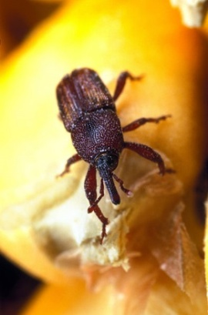
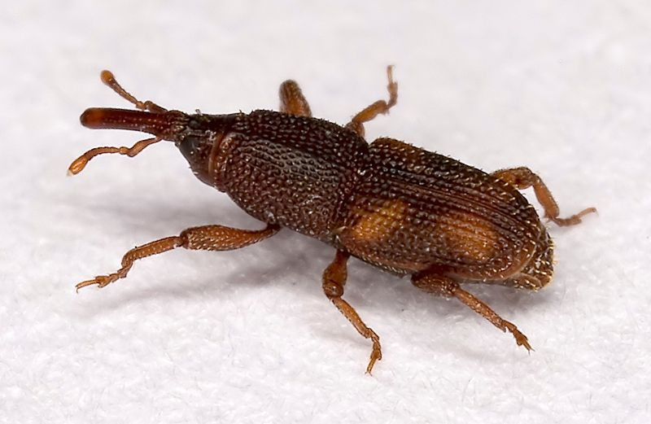
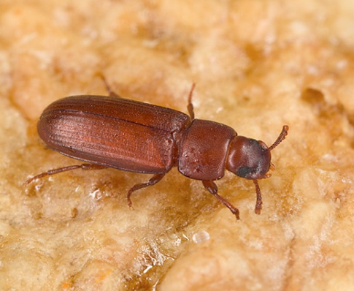
Technology needs of stored grain pest control
Upgrading of storage facilities, technological development, climate environment, and changes in the occurrence and development of stored grain pests, including macro level distribution, growth and development, as well as micro level information changes.
Pests
Issues
Pest control, chemical agent support, low-temperature grain storage pest control; Targeted prevention and control techniques and strategies for pest ecological regions.
Quick and accurate identification - identification of basic databases and systems;
Physical and biological control technologies - protective agents, natural enemy biocontrol.
needs

Slide 4
01
Stored grain pest identification technology

Slide 5
The importance of pest identification
Identification of the basics of control. Regarding the accurate and rapid identification of pests in stored grain, as well as the weak molecular basic data and mechanisms in prevention and control technology.
Issues：
Establish molecular identification and analysis techniques for insects and mites in stored grain, as well as related databases: three major technical systems and related databases, including DNA barcode molecular identification, 3D recognition, and mitochondrial genome.
Contents：
To provide technical and basic data support for the classification, identification, and systematic relationship research of stored grain insects and mites, and to serve the monitoring, identification, and pest control of stored grain insects and mites.
Services：

Slide 6
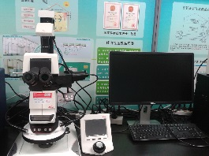
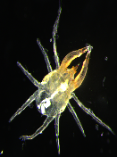
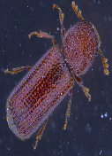
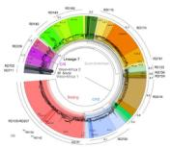
Achievement 1: Grain Pests DNA Barcode Identification System
Formed the "Certificate Specimen - Morphological Identification - Molecular Barcode -3D Digital Specimen" for grain storage insects and mites
Morphological characteristics
morphological identification
PCR amplification and screening of 3 genes: COI, ITS, 18S rDNA, targeting 8 different stored grain pests
DNA barcode gene identification
Barcode Research
At least 5 samples of each stored grain insect should be tested and sequenced bidirectionally to obtain their barcode sequence
DNA barcode sequecing
(1) Standard COI barcode sequence(2) The sequence length is not less than 600bp(3) No missing bases, no terminators(4) The maximum genetic distance within a species is greater than the minimum genetic distance between species.
DNA barcode sequence library：
Based on the sequence of COI gene，established “Grain Pests DNA Barcode Identification System”，including 50 species insects/mites. DNA barcode can effectively identify the main stored grain insects and mites.
Construction of DNA barcode library for insects and mites
Phylogenetic analysis
Evolutionary analysis of haplotype network
Validity analysis of DNA barcode identification

Slide 7
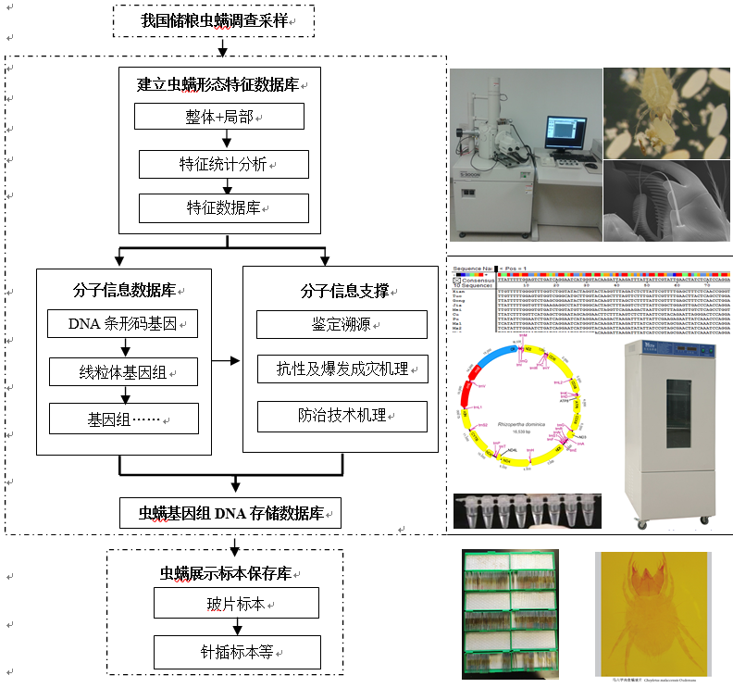
Achievement 1: A identification system for stored grain insects and mites, “specimens—morphological identification—molecular barcode identification“
Three types of information databases:
Form display sample
Molecular Information Database
DNA Genome Database

Slide 8
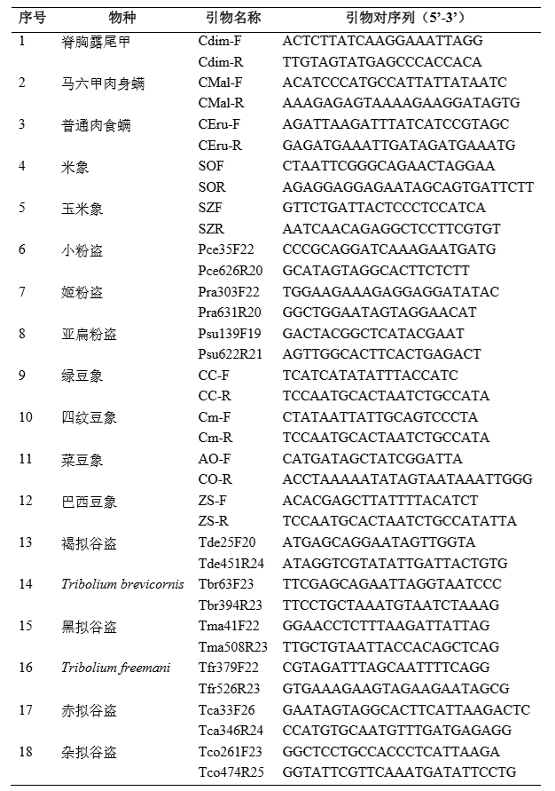
Achievement 1: DNA barcode of stored grain pests-specific primers identification technology for close species
Analyze nucleotide sequence specific sites of 18 species and design specific primers for close species to complete identification within 7 hours without sequencing.
Table Comparison of Morphology and Molecular Identification of Cryptolestes ferrugineus
Morphology Identification | Time（d）
 | Cultivate to adults | Slide production and identification | Total | Average
Eggs | 25 | 5 | 30 | 17
Lava | 1-20 | 5 | 5-25
Adults | 0 | 5 | 5
Molecular Identification | Time（d）
 | DNA extraction | PCR | Sequencing /electrophoresis | Total
DNA barcode | 0.1 | 0.15 | 2.00 | 2.3
specific primers | 0.1 | 0.15 | 0.05 | 0.3

Slide 9
Achievement 2： Three dimensional digital specimen system
for stored grain pests
A three-dimensional digital system for physical specimens of 25 stored grain pests has been established, which has real textures with a resolution of 4K or above, high-definition VR display, and insect specimen display and integration. It can be used for physical specimen replacement, supporting identification, and teaching and training.

Slide 10
Achievement 3: Grain Pests Mitichondrion Identification and Analysis System
Enrich the identification genes of Achievement 1, promote basic research on pest control, and enhance the research capability of rapid and accurate identification, genetic difference analysis, and pest tracing of stored grain pests in China based on mitochondrial.
The main functions include information browsing, information querying, and gene sequence alignment and identification.

Slide 11
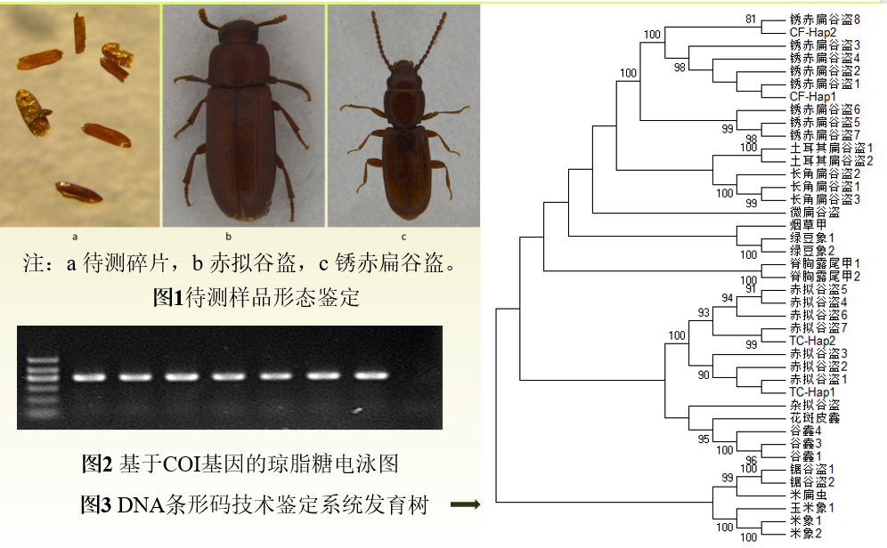
Application situation and social benefits
1. Service for basic application of pests control
2. Molecular identification of stored grain pests-identification of fragments and damaged samples
Complementing traditional morphological identification
Revealing the genetic relationships between species
Research on differences in pest resistance and outbreak patterns.
It is used for the identification of non adult and fragmented insect species, and in the quarantine and identification of food and food imports and exports, to serve the quarantine and identification of insects and mites and ensure food security.
3. Training in China and internation
Five sessions of “Green Ecological Grain Storage New Technology Training and Seminar" in China
Two sessions of the Asia Cooperation Dialogue (ACD) training courses
Warehouse training of Suzhou Food and strategic reserves Administration
4. Establish insustry standards

Slide 12
02
Stored grain pest control technology in China

Slide 13
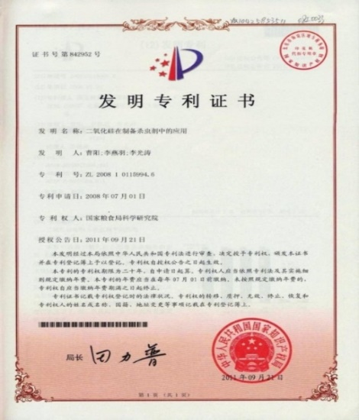
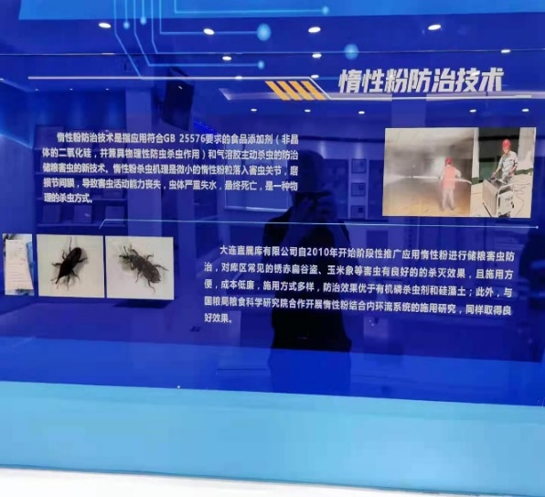
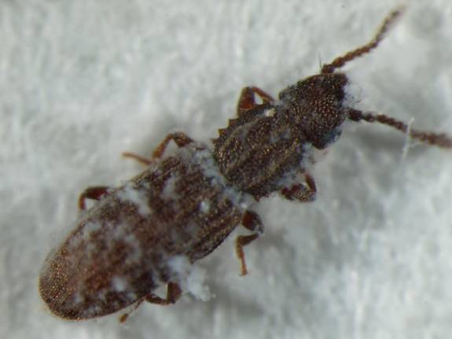
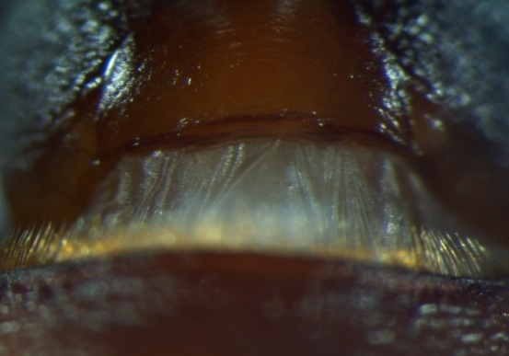
1. Food grade inert powder technology for controlling stored grain pests
Physical protection, independent innovation
Meets food grade requirements and is environmentally friendly
Supporting equipment, mechanization, low cost, wide range of scenarios
Standard, "Regulations on Safe Storage of Grain and Oil", Second prize
Technical Introduction

Slide 14
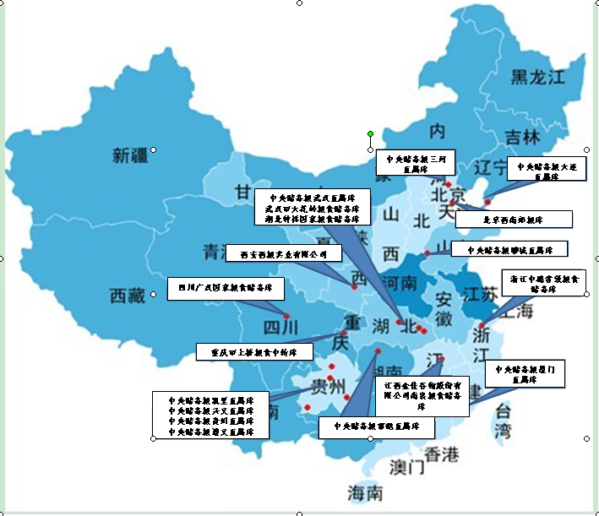
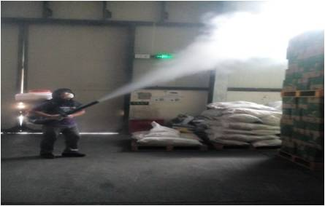
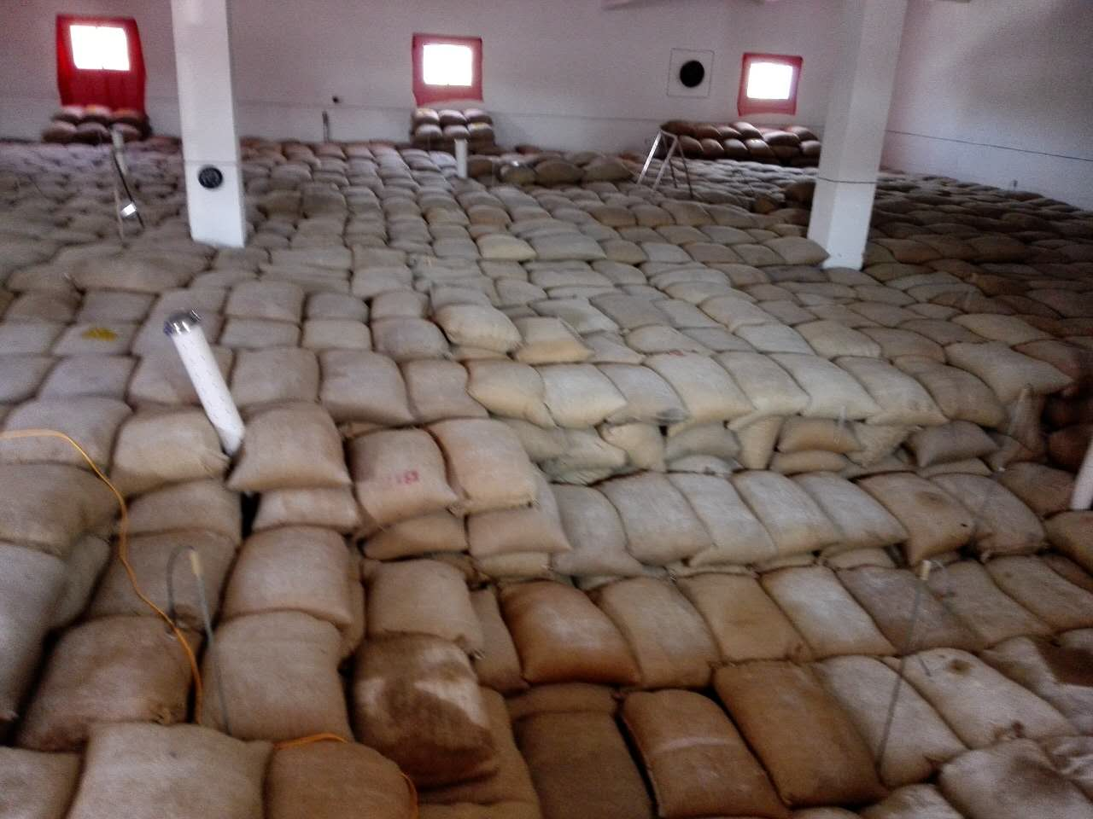
1.Food grade inert powder technology for controlling stored grain pests
More than 130 grain depots in 23 provinces - SINOGRAIN and local grain depots
More than 50 processing enterprises - Yihai and COFCO
More than 500 farmers grain storage application
Application
Empty warehouse insecticide, insecticide line, grain pile surface and local insecticide
After the first fumigation of some grain depots, the entire storage period does not require fumigation to meet the basic requirement of insect free grain.
Effect

Slide 15
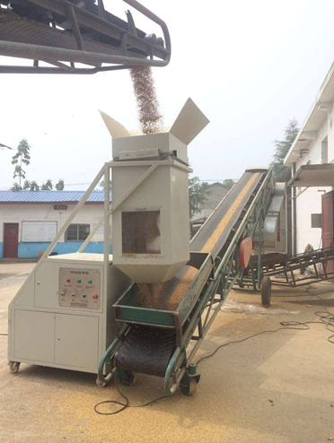
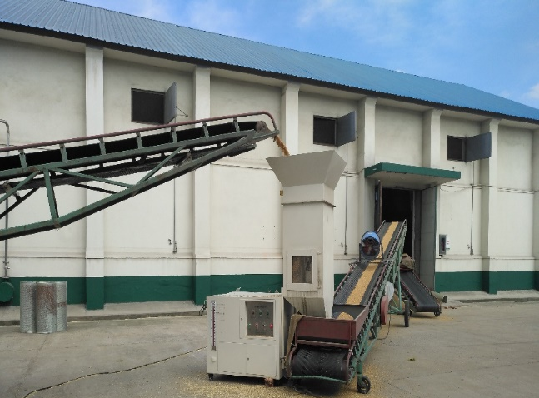
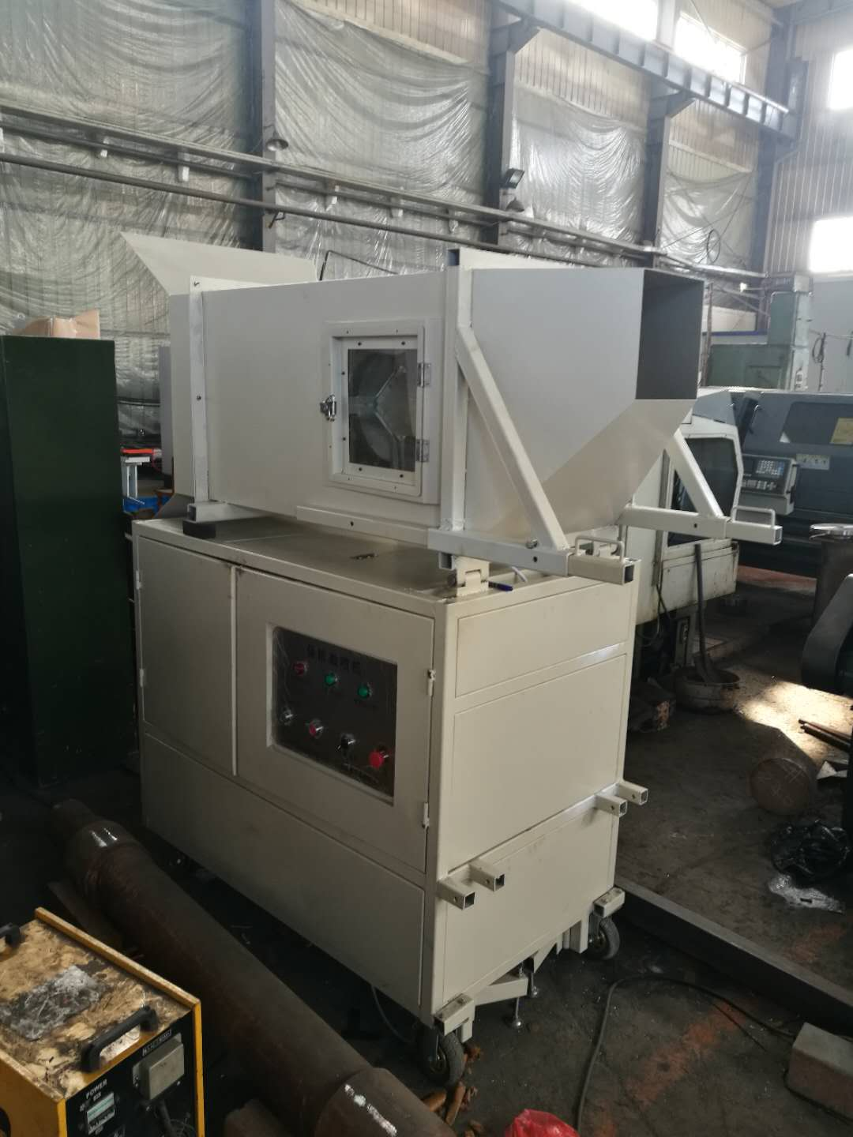
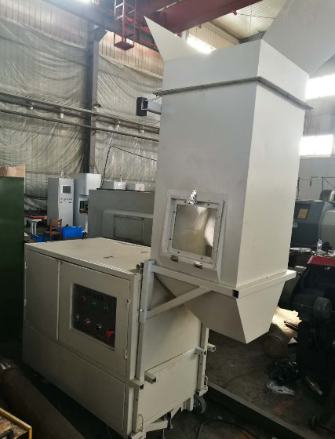
2. Application technology of Spinosad
Scaling up production: breeding high-yield strains and producing 10 tons or more;
Pesticide registration certificate: Obtained the raw material and 0.5% powder;
Technical regulations: industry standards;
Application equipment: Developed automatic application equipment and application robots.
Technical Introduction
防效成本
Second generation equipment (2016)
Third generation equipment (2018)
Automatic spray application by sensing grain flow
Higher automation, stable performance, and large grain flow
First generation equipment (2015)

Slide 16
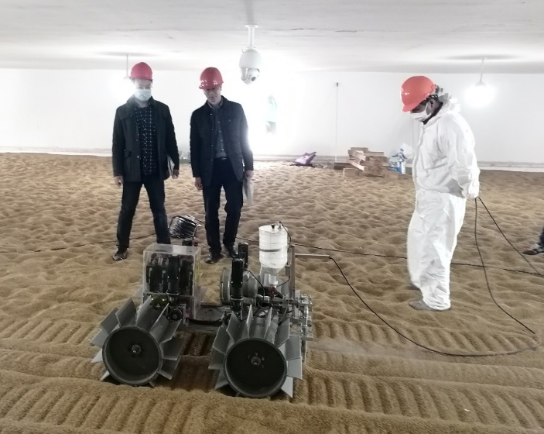
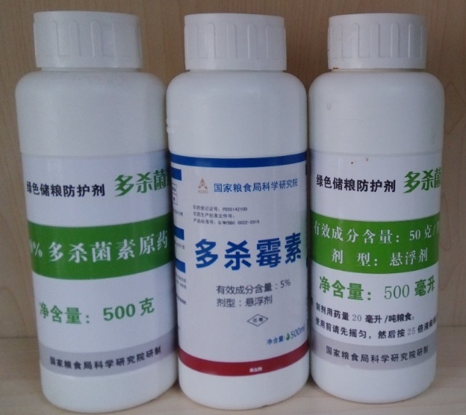
2. Application technology of Spinosad
Application of pesticides on the surface of grain silos based on negative pressure ventilation, using robots for surface application;
When entering the warehouse, mix with the grain;
Ten application grain depots have been established in different grain storage ecological zones.
Application
Empty warehouse insecticide, whole warehouse insecticide, surface and local insecticide of grain piles;
Effective protection time of up to 2 years, with no impact on grain quality;
Dose: 1mg/kg.
Effect

Slide 17
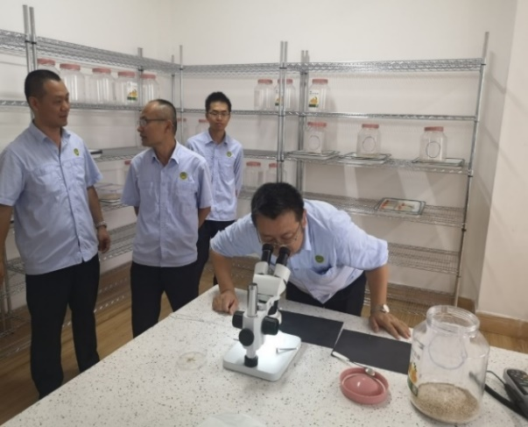
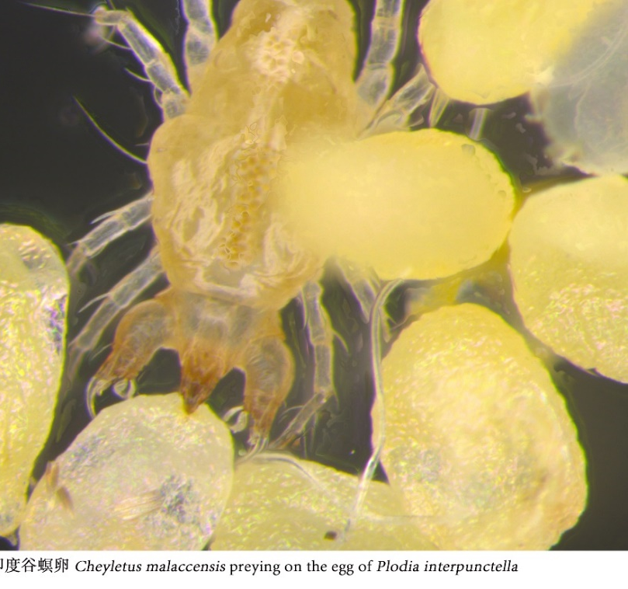
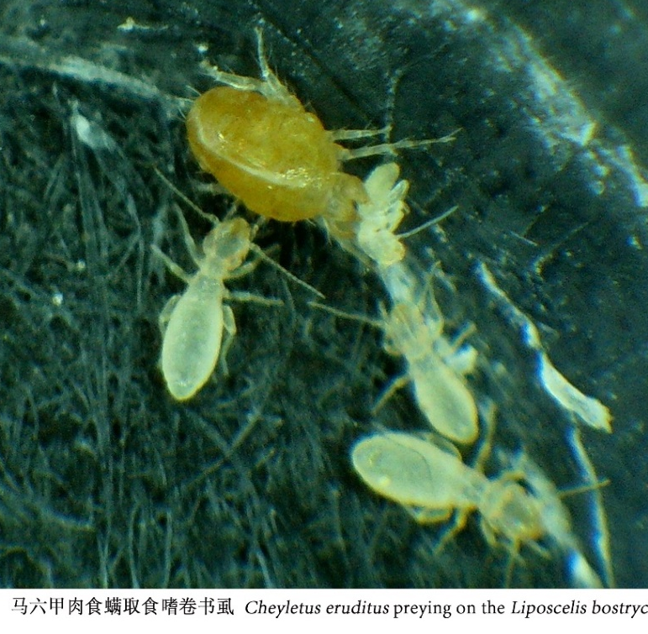
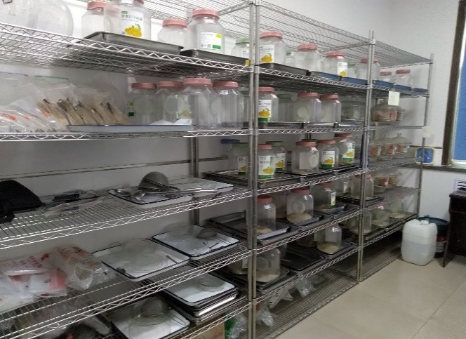
3. Predatory mite technology for controlling stored grain pests
Natural enemy biocontrol: using mites to control mites, using mites to control insects;
Scale production: standardized and large-scale breeding techniques;
Application technology: deployment technology, forming norms, no need for equipment;
Long term mechanism: New green, environmentally friendly and sustainable governance.
Technical Introduction
Predator mite feeding platform

Slide 18
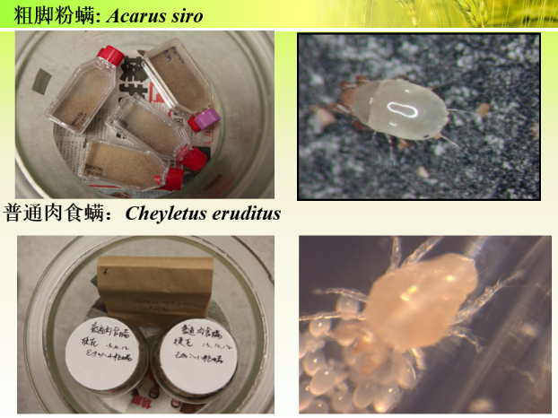
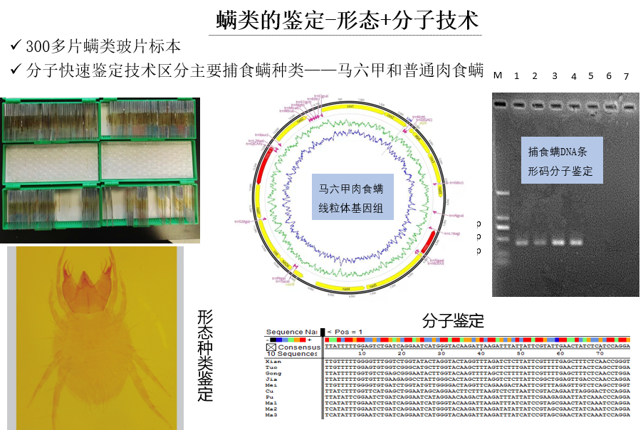
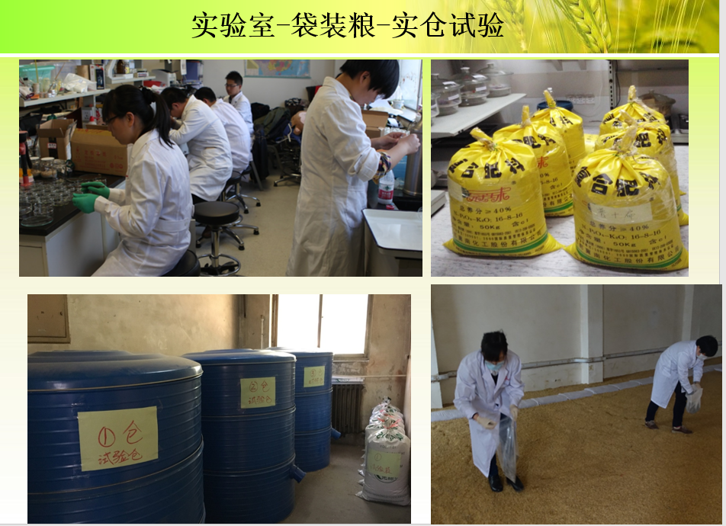
3. Predatory mite technology for controlling stored grain pests
The first large-scale research and application in the grain industry;
Select two advantageous natural enemies of mites suitable for grain depots in China;
For the first time, a predatory mite biocontrol technology system has been established.
Technology innovation
Release at temperatures above 15 ℃, establish a population to reduce the eggs and larvae of pests;
High-temperature and high humidity area is the best. 6 demonstration depots and long-term effects;
2-15 pests per day, ¥4 yuan per 10000 mites.
Effect and cost
Collection and screening
Small and medium scale trial
Predatory ability
Application

Slide 19
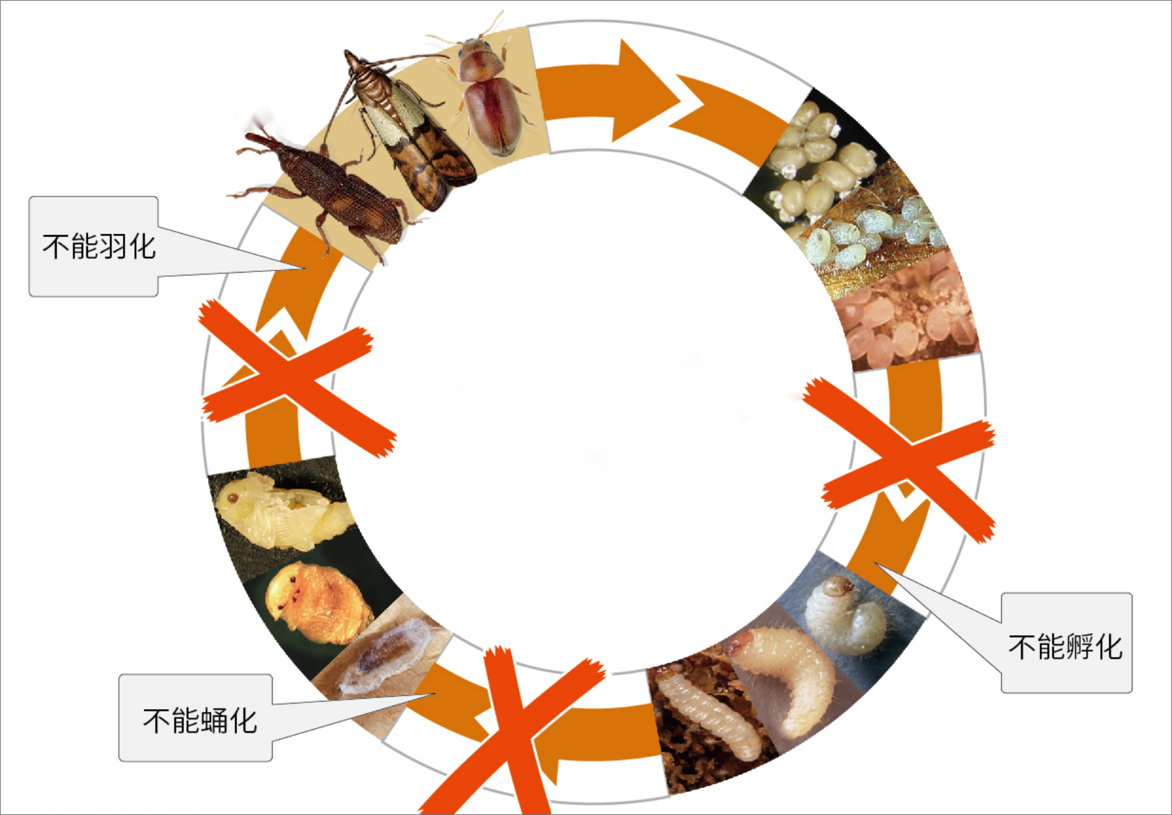
4. S-Methoprene control stored grain pest technology
S-Methoprene： Special Structure, Unique Mechanism, Low Quantity, High Sensitivity, Green and Safe
Chemical structure specificity
Unique mechanism
S-Methoprene mechanism
It does not contain toxic pesticide groups such as halogens, heterocycles, and benzene rings, and only contains carbon, hydrogen, and oxygen elements. It is an unsaturated fatty acid ester (similar to vegetable oil)
Juvenile hormones interfere with the molting process, inhibit the transformation of eggs or larvae into adults, and cause the adults to lose their reproductive ability, thereby controlling the growth of pest populations
High activity, ultra-low dosage
Not easy to develop resistance
Ultra safe and environmentally friendly
The target insects are extremely sensitive, and S-cypermethrin can achieve excellent control effects at ultra-low concentrations ranging from one to three parts per million
Does not affect specific insect sites, but interferes with normal growth and development processes, poses no resistance risk, and has no reported resistance
When exposed to light in the external environment, it decomposes into carbon dioxide and water, with fast degradation and no residue, Harmless to humans and the environment

Slide 20
4. S-Methoprene control stored grain pests technology
No. | Ecological zone | Province | Grain | Test warehouses | Introduction
1 | 7 | Guangdong | Rice | Test 1:Temperature controlled (low temperature) storage+S-Methoprene mixed with whole grain Test 2:Temperature controlled (low temperature) storage+S-Methoprene mixed with surface grain Control: Temperature controlled (low temperature) storage+Conventional pest control methods | Short term testing of insect cages, monitoring of prevention effectiveness, residual and quality determination in test chamber 1, quality determination in control chamber, with an experimental period of 1-2 years.
2 |  | Guangxi | Rice | Test: Conventional storage+S-Methoprene mixed with whole grain Control: Conventional storage+Conventional pest control methods | Short term testing of insect cages, monitoring of prevention effectiveness, with an experimental period of 1-2 years.
3 | 6 | Sichuang | Rice | Test: Temperature controlled (low temperature) storage+S-Methoprene mixed with whole grain Control: Temperature controlled (low temperature) storage+Conventional pest control methods | Same with No.2
4 |  | Yunan | Rice | Same with No.1 | Same with No.2
5 | 5 | Fujian | Rice | Same with No.3 | Same with No.2
6 |  | Jiangsu | Rice | Same with No.1 | Same with No. 1
 |  | Zhejiang | Rice | Same with No.1 | Same with No. 1
7
8 | 4 | Henan | Wheat | Same with No.2 | Same with No.2
9 | 2 | Xinjiang | Wheat | Test 1: Conventional storage+S-Methoprene mixed with whole grain Test 2: Conventional storage+S-Methoprene mixed with surface grain Control: Conventional storage+Conventional pest control methods | Same with No.2

Slide 21
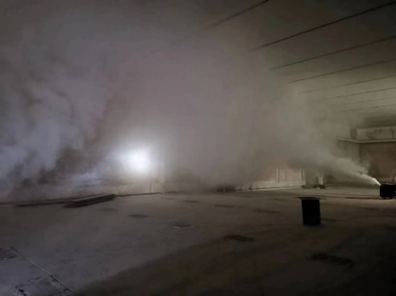
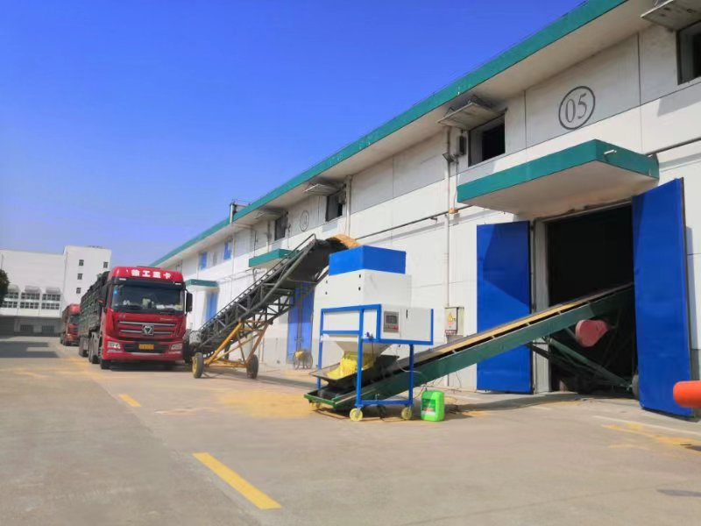
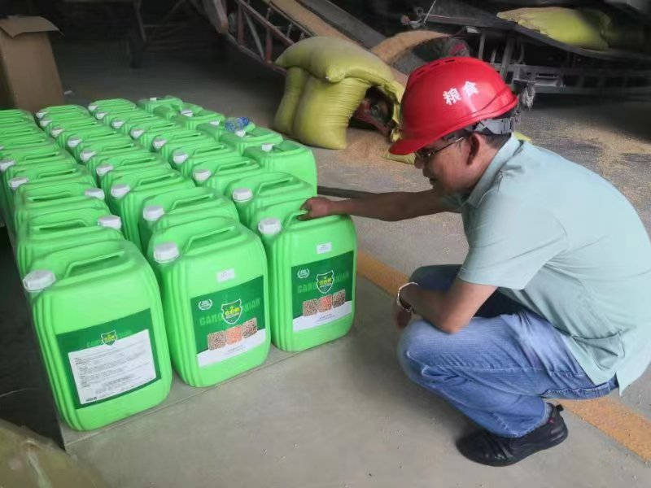
4. S-Methoprene control stored grain pests technology
Effect of pest control in grain storage: S-Methoprene full warehouse application technology can effectively prevent and control common pests in grain warehouses. Surface application can effectively suppress the occurrence of pest populations. During high temperature seasons, local pests may occur and require local or full warehouse treatment.
In terms of maintaining grain quality: S-Methoprene will not cause a deterioration in grain quality.
In terms of economic benefits: some grain depots have seen a ¥ 70 yuan increase in grain prices per ton when grain is released, resulting in an additional profit of over 200,000 yuan for a 3,000ton grain depot.
Empty warehouse handling
Using equipment for whole warehouse storage
S-Methoprene agent

Slide 22
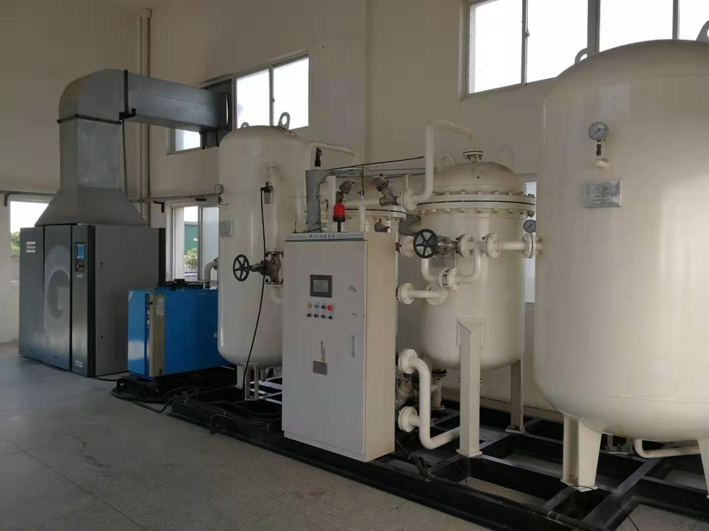
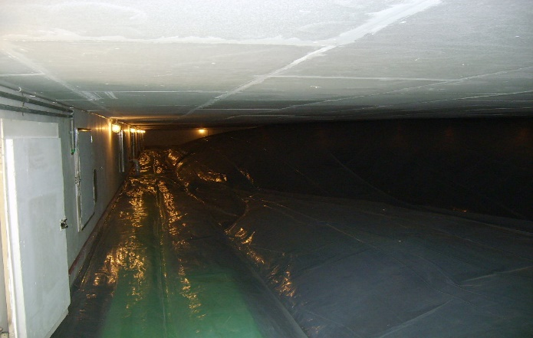
5. Atmospheric adjustment for insect control : N₂
Two types of nitrogen production equipment：At present, there are two mature nitrogen gas controlled grain storage technologies, pressure swing adsorption nitrogen production technology and membrane separation nitrogen production technology, equipment and control systems, which are widely promoted and applied in China.
Three concentrations for controlling：
1. Kill the pests , the concentration is over 98% for more than 30 days；
2. Prevent the pests , the concentration is over 95% for more than 60 days；
3. Atmospheric adjustment grain storage, maintaining a low oxygen state of 90-95% nitrogen concentration for a long time slows down the oxidation of fatty acids
Application scale: The application scale of modified atmosphere grain storage technology in China has reached about 35.9 million tons, with an investment cost of 2.3 yuan/ton of grain.
Pressure Swing Adsorption
Membrane separation
Warehouse covered with film and filled with nitrogen

Slide 23
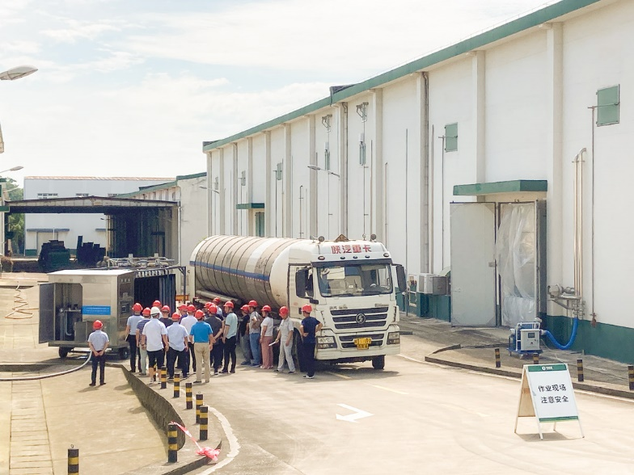
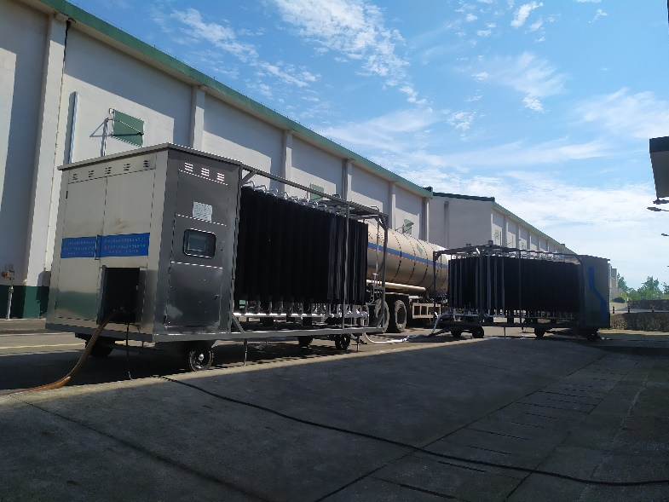
5. Atmospheric adjustment for insect control : CO₂
The concentration of CO₂ for killing the pests
Used to kill various types of pests, the concentration of CO₂ in the sealed grain pile should reach 35% or above and be maintained for more than 15 days.
The mode of CO₂ adjustment
Fill the tank truck, gasification device, intake circulation pipe of the warehouse, and the grain pile inside the warehouse with bottom filling and top filling.

Slide 24
6. Fumigation
There are about a dozen fumigation methods for stored pest insecticides that have been studied globally. Phosphine fumigation is widely used in the storage industry, and sulfuryl fluoride has also been applied in recent years.
Fumigant | Characteristic | Note
Phosphine | Highly toxic and safe for pesticide application
Sulfuryl fluoride | Poisoning, good spreadability, strong permeability, non corrosive
Ozone | Environmentally unfriendly, strong oxidizing agents, and weak penetration power
Hydrogen cyanide | Extremely toxic | Prohibited in China
Ethyl formate | Flammable, explosive, not easy to spread in grain piles, easily adsorbed by grain particles
Chlorine dioxide (dichloroethane, dichloropropene) | Strong oxidants and expensive gas generation devices
Epoxy propane | Flammable, requiring low pressure and oxygen environment | Better fumigation enhancer
Nitric oxide | Unstable, requiring vacuum and ultra-low oxygen environment
Ethane nitrile | Flammable, inconvenient to prepare, easily reduced to cyanide, requiring low oxygen environment

Slide 25
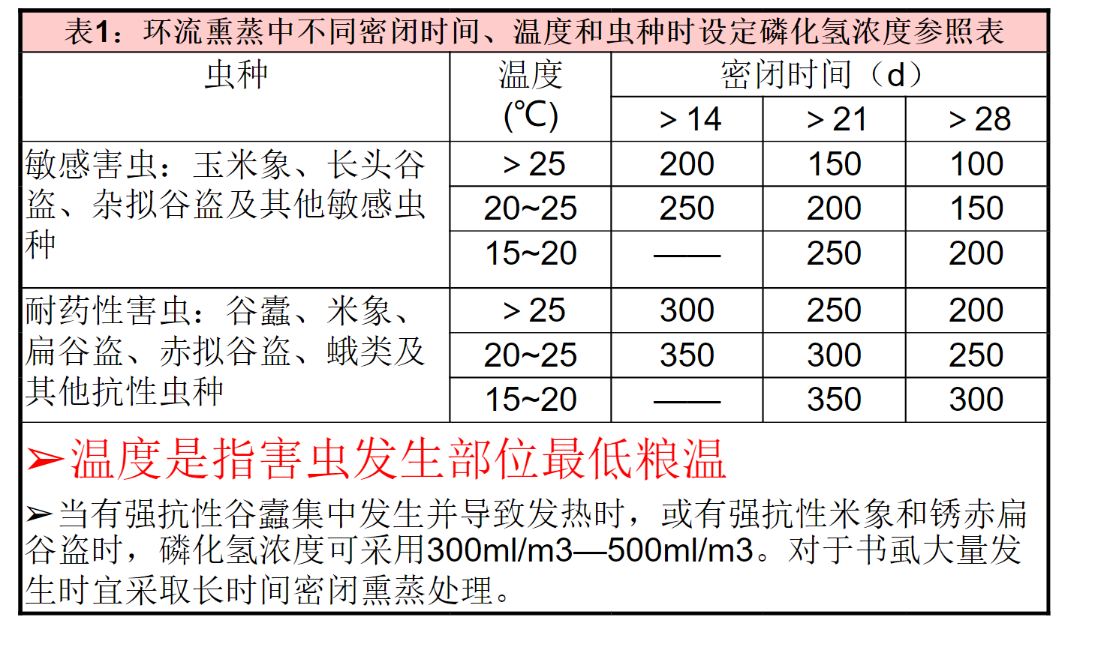
6. Fumigation: Phosphine
Table 1: Reference Table for Setting Phosphine Concentration during Phosphine Fumigation at Different Sealing Times, Temperatures, and Insect Species.
Fumigation equipment: pesticide application device; Circulation device; Detection device.
Main influencing factors of fumigation effect
Sealing time: insect species, warehouse airtightness
Drug concentration: design, calculation, detection, temperature

Slide 26
03
Demonstration of integrated control technology application of new green grain storage technology

Slide 27
Background of Integrated Control Technology Application
（一） Policy
In June 2021, the Ministry of Finance and Academy of National Food and Strategic Reserves Administration jointly issued document Caijian [2021] No. 177 "Opinions on Deepening the Promotion of High Quality Grain Projects", which proposed "six major improvement actions", including the "Green Warehousing Improvement Action";
In July 2021, the Academy of National Food and Strategic Reserves Administration issued a notice to carry out the pilot work of green grain storage standardization. Actively adopt green grain storage standards, strengthen the application, innovative research and development, and standard revision of green grain storage technology, and explore replicable and promotable typical experiences and working models of green grain storage.
（二）Needs
The industry will comprehensively reduce the use of chemical agents, and “integrated control" will become inevitable;
Continuous investment in scientific research has led to multiple breakthroughs in new green storage technologies in the industry, and the development of a batch of new equipment has made it possible to demonstrate green storage technologies.

Slide 28
Multi parameter grain monitoring
“early know”
Optimal Timing
Protective agents: inert powder, Spinosad, S-Methoprene
Green control
low temperature storage technology
Natural Enemy Biological Control: Predator Mite Biological Control Technology
Integrated control technology system
Emergency technology
Emergency response: Reduction fumigation mainly using aluminum phosphide and sulfuryl fluoride
Smart storage
Green storage
Quality and freshness maintaining
Grain conservation and loss reduction
target

Slide 29
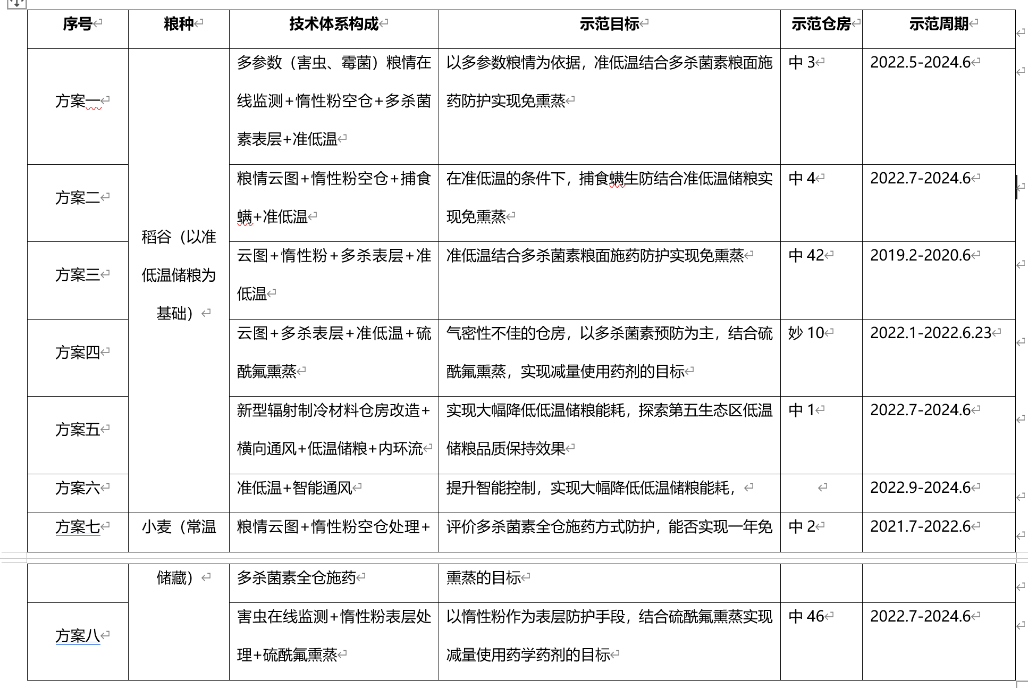
Demonstration plan

Slide 36
Thank You
WU Yi
18811345781 wuyi@ags.ac.cn
Sharing for Learning

