Slide 1
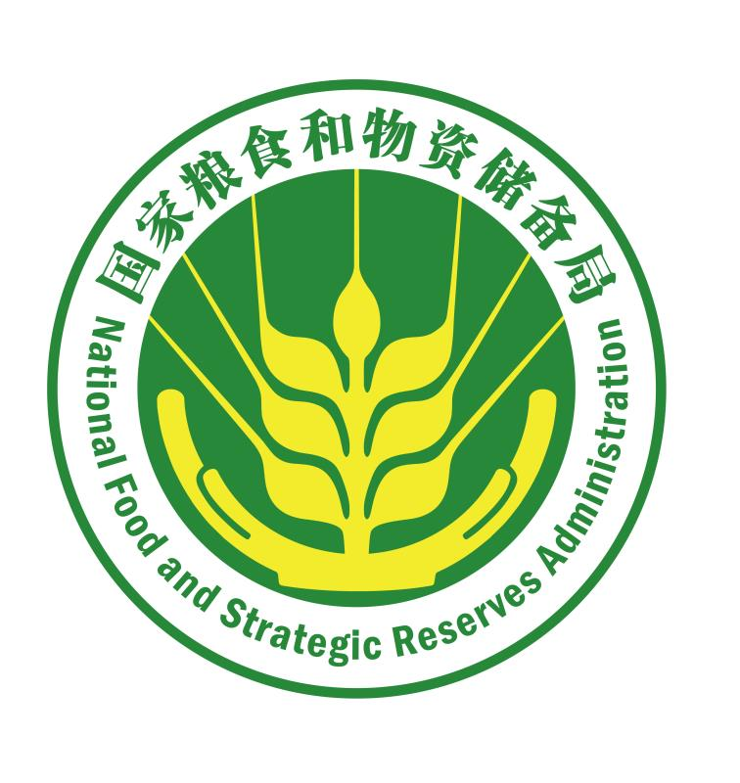
China Experience in Fortified Flour

Slide 2
Experience with Fortified Flour in China
01
The history of flour fortification technology of China
02
Standard- and administrative system-based flour fortification system
Flour fortification and fortification substances common in different countries
03
How to understand flour fortification
04
05
Wheat flour fortification & processing technology
06
Quality safety assurance system

Slide 3
6
Part
Quality Safety Assurance System

Slide 4
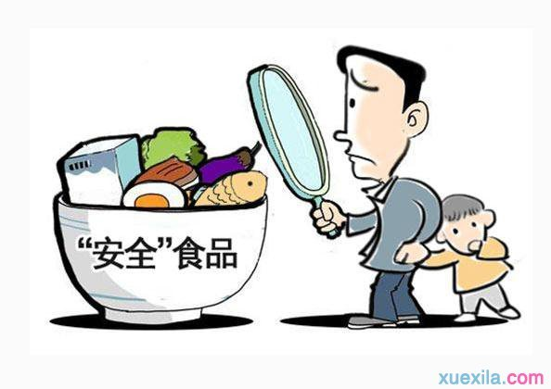
Food safety is the basic condition to guarantee the production of fortified wheat flour. In terms of fortified flour quality control, the quality and sanitary conditions are of great concern. In the meantime, it is necessary to build an interrelated and supporting quality assurance system and food safety assurance system by enterprises, governments and society.
Quality Safety
"Safe" food

Slide 5
In production practice, in addition to strengthening the internal management and enhancing the technology of fortified flour enterprises, it is also attainable for enterprises to maintain the level of food quality and safety management and constantly improve the product quality by being certified and independently supervised through a third party in terms of internal quality management system and safety management system.
Quality Safety
"Safe" foods

Slide 6
6.1
Internal Quality Assurance System and External Supervision
Internal quality assurance system and external supervision of enterprises
Laws and regulations
Management system
Food Safety Law of the People's Republic of China
Quality Management Systems - Requirements (GB/T19001-2016)
Product Quality Law of the People's Republic of China
Food Safety Management Systems - Requirements for Any Organization in the Food Chain (GB/T22000-2006)
Hygienic Standard for the Use of Nutritional Fortification Substances in Foods
Environmental Management Systems - Requirements with Guidance for Use (GB/T14001-2004)
Measures for the Hygienic Administration of Food Additives
Administrative Provisions on the Sanitation Registration and List Entry of Export Food Manufacturing Enterprises
Occupational Health and Safety Management Systems - Requirements (GB/T28001-2011)

Slide 7
6.2
Quality Safety Management Systems
Fortified flour manufacturers, as food manufacturers, must be subject to the management of food hygiene enforcement. Food safety is the priority for any raw-food material manufacturer.
Code for Design of Clean Room (GB50073-2013)
Standards for Drinking Water Quality (GB5749-2006)
Hygienic Specifications of Flour Milling Factory (GB13122-1991)
General Hygienic Regulation for Food Enterprises (GB14881-2013)
General Rules for the Labeling of Prepackaged Food (GB7718-2014)
Standards for Uses of Food Additives (GB2760-2014)

Slide 8
6.2
Quality Safety Management Systems
Food safety is directly related to consumers, and indirectly influences the reputation of enterprises involved in food production, transportation, and food sales, and even the public trust of the food authorities or governments.
Code for Design of Clean Room (GB50073-2013)
Standards for Drinking Water Quality (GB5749-2006)
Hygienic Specifications of Flour Milling Factory (GB13122-1991)
General Hygienic Regulation for Food Enterprises (GB14881-2013)
General Rules for the Labeling of Prepackaged Food (GB7718-2014)
Standards for Uses of Food Additives (GB2760-2014)

Slide 9
6.3
Safety Management and Hazard Analysis
Introduction to key points of fortified flour quality management
(1) Specify the hygienic standards for personnel, plant area, workshops, equipment and facilities, raw materials, processing techniques, management, operation, and storage and transport of finished products in fortified flour mills.
First Strengthening the hygiene education of personnel: comprehensive publicity and education for new staff and senior staff are conducted on Food Safety Law of the People’s Republic of China, hygienic regulations for food manufacturers, quality management objectives, prerequisite programs, etc.

Slide 10
6.3
Safety Management and Hazard Analysis
Introduction to key points of fortified flour quality management
Second Physical examination: establish the health records of staff, and regularly carry out physical examinations.
Third Health requirements: all staff working in the food factories must have the health certificates issued by medical institutions.
Fourth Personal hygiene requirements: personnel involved in food production shall keep good personal hygiene.

Slide 11
6.3
Safety Management and Hazard Analysis
Introduction to key points of fortified flour quality management
(2) Configuration requirements of plants and plant area
First Plants must be built in the areas with convenient traffic and sufficient water resource and away from harmful gases, smoke, dust and other sources of pollution.
Second Plants and facilities must be scientifically organized according to technological processes as well as environmental protection and food hygiene requirements.
Third Ground shall be flat, smooth, clean and dampproof
(3) Plants, equipment, tools, drainage system and other facilities must be kept in good condition, and any defects discovered shall be overhauled in time.

Slide 12
6.3
Safety Management and Hazard Analysis
Introduction to key points of fortified flour quality management
(2) Configuration requirements of plants and plant area
First Plants must be built in the areas with convenient traffic and sufficient water resource and away from harmful gases, smoke, dust and other sources of pollution.
Second Plants and facilities must be scientifically organized according to technological processes as well as environmental protection and food hygiene requirements.
Third Ground shall be flat, smooth, clean and dampproof

Slide 13
6.3
Safety Management and Hazard Analysis
Introduction to key points of fortified flour quality management
(3) Plants, equipment, tools, drainage system and other facilities must be kept in good condition, and any defects discovered shall be overhauled in time.

Slide 14
6.3
Safety Management and Hazard Analysis
Introduction to key points of fortified flour quality management
(4) Raw materials and auxiliary materials
First Raw materials shall be qualified
Second Auxiliary materials shall meet relevant standards

Slide 15
6.3
Safety Management and Hazard Analysis
Introduction to key points of fortified flour quality management
(5) Ensure food processing safety
First Clean unprocessed grains
Second Flour processing workshops must be equipped with dust filters to prevent the dust in workshops from exceeding the standard
Third Use packaging materials that meet the food hygienic standard
Fourth Materials returned to machine and materials to be returned to machine shall be separately stored from finished products or pollution sources, and clear marks shall be made

Slide 16
6.3
Safety Management and Hazard Analysis
Introduction to key points of fortified flour quality management
(6) Finished product storage and transportation safety
First Finished products must be stored in the dedicated warehouses, and bedding materials are required on the ground. The flour stacking shall be 3cm away from walls
Second Other articles irrelevant to finished product storage and transportation must not be stored in the finished products warehouses
Third Vehicles, tools, bedding materials and coverings used for transportation must be cleaned; finished products must not be transported with pollutants in the same vehicle

Slide 17
6.3
Safety Management and Hazard Analysis
Introduction to key points of fortified flour quality management
(7) Inspection and real-time tracking are necessary
First Health and quality inspection agency matching the production capacity shall be equipped; well-trained and qualified inspectors shall be allocated
Second The inspection agency is the laboratory of the food company, with instruments and equipment necessary for test
Third The laboratory shall conduct tests subject to the national inspection measures, and all original inspection records shall be kept for at least 3 years for future reference.

Slide 18
6.3
Safety Management and Hazard Analysis
Hazard points analysis
Hazard points shall be identified to control food safety. Possible food safety risks are analyzed through the hazard analysis of flour in the whole process. The best critical control points are analyzed and identified based on different areas, suppliers and supply channels to give fully play to the HACCP system.

Slide 19
6.3
Safety Management and Hazard Analysis
Hazard point analysis
Wheat acceptance
Wheat blending and weighing
Clean wheat and weighing
Receiving auxiliary materials and additives
Wheat scouring
Milling, bolting and purification
Packaging materials
Screening and stone removal
Micro-adding
Screening and magnetic separation
Selection
Magnetic separation, weighing, insecticide
Warehousing
Dampening and wheat wetting
Packaging
Into dirty wheat bin
Wiping
……

Slide 20
6.3
Safety Management and Hazard Analysis
Management procedure control
Water safety control procedures
Structure, status and cleaning of food contact surfaces
Cross-contamination prevention
Hand cleaning and maintenance of facilities in toilets
Prevent food from being polluted by contaminants
Marking, storage and use of toxic chemicals

Slide 21
6.3
Safety Management and Hazard Analysis
Management procedure control
Health and hygiene control of employees
Prevention and Control of insects and rats
Sanitation control of packaging, storage and transportation
Sanitation control of unprocessed grains
Sanitation control of production and processing
Inspection control procedures

Slide 22
Thank You

