Slide 1
王若兰 Wang Ruolan
河南工业大学 Henan University of Technology

Slide 2
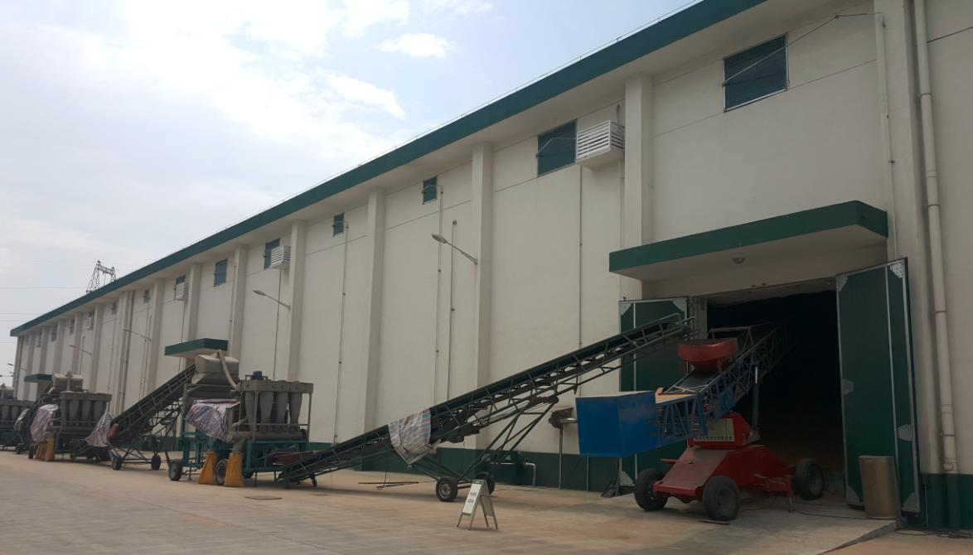
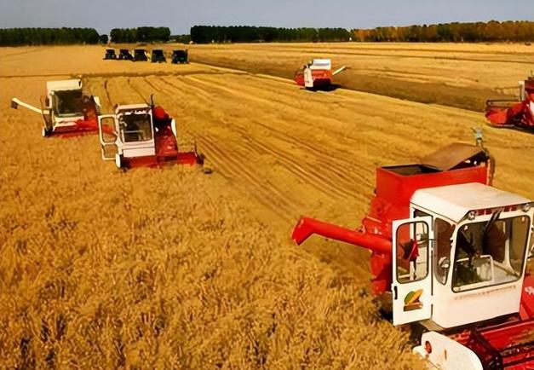
中国粮食流通中
除杂、分级和分选技术及应用
Technologies and Applications of Impurity Removal, Grading, and Sorting in Grain Circulation in China

Slide 3
CONTENTS
一、粮食除杂
02
二、分级储备
01
Grain Impurity Removal
Grain Grading and Storage
三、分选技术
03
Grain Sorting Technologies

Slide 4
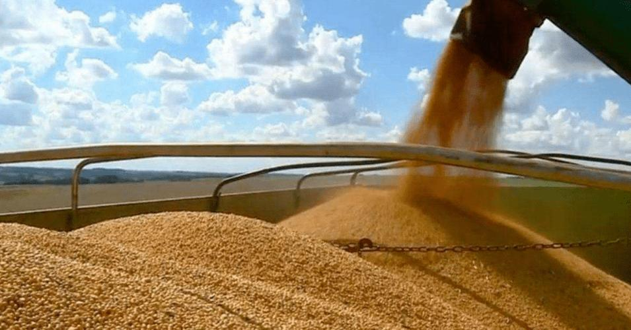
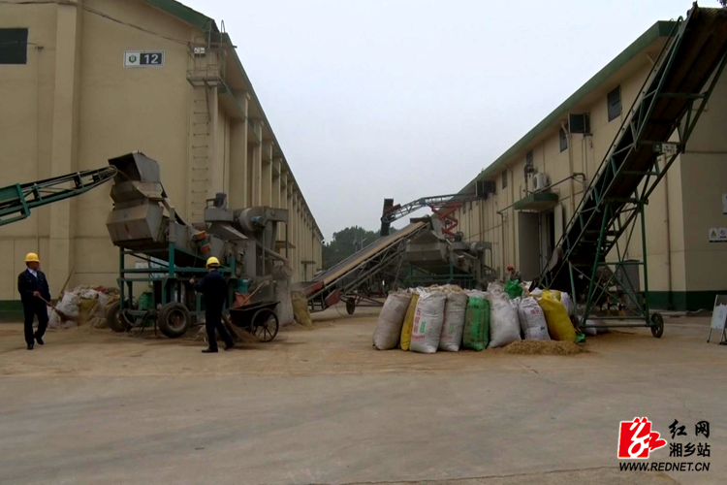
01
一、粮食除杂
Grain Impurity Removal

Slide 5
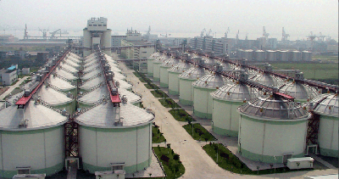
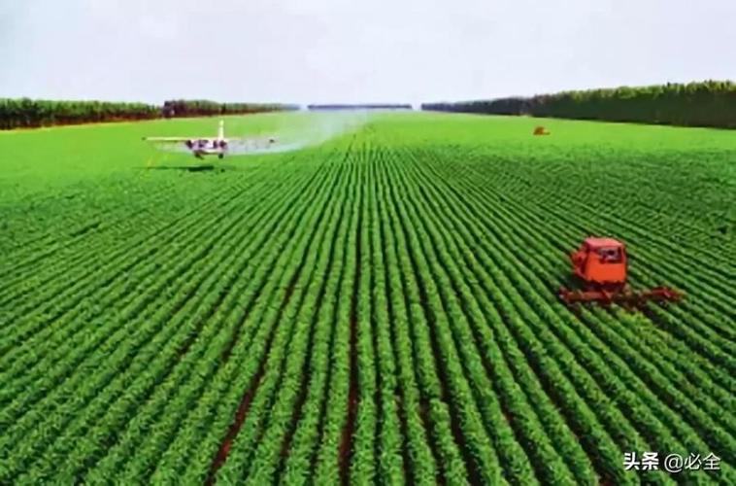
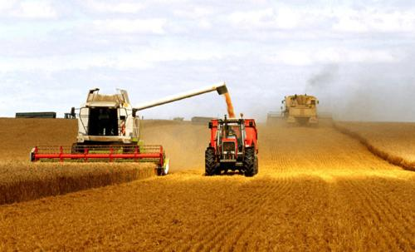
中国是一个粮食生产、粮食储备、粮食消费大国，在长期的粮食产后流通领域，形成了具有中国特色的粮食收购、运输、储藏、加工、销售等环节的技术、装备和工艺，取得了显著的粮食产后减损实效，在国家粮食安全中发挥着重要作用。以下主要介绍关于中国粮食流通中的除杂、分级和分选技术及应用。
China is a major producer, reservist, and consumer of grain. Over the long-term grain post-harvest circulation process, China has developed technologies, equipment, and technical processes with distinctive Chinese characteristics for grain purchasing, transportation, storage, processing, and marketing, which have significantly reduced post-harvest losses and play a crucial role in national food security. The following introduces the technologies and applications of cleaning, grading, and sorting in China's grain circulation.

Slide 6
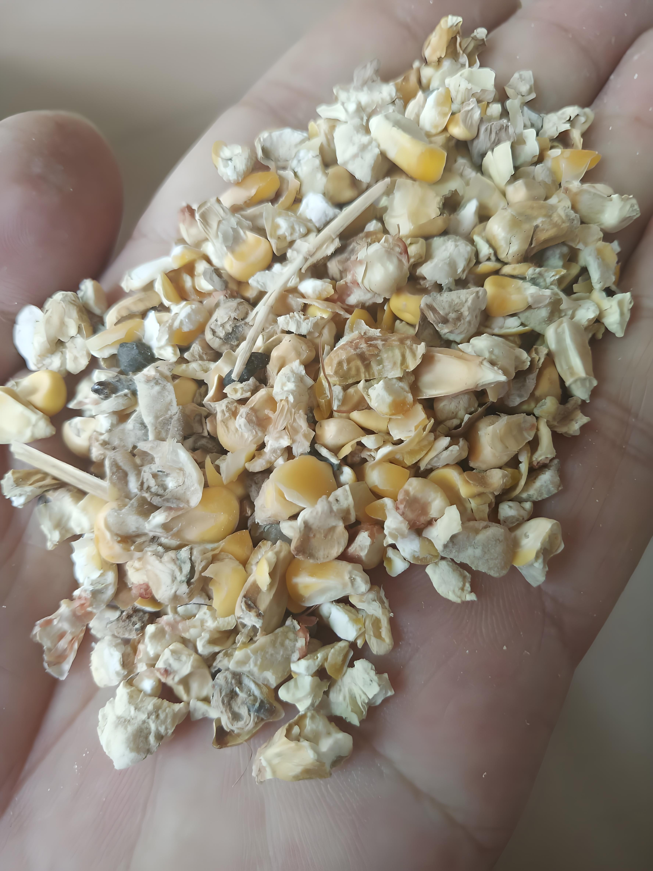
一、粮食除杂 Grain Impurity Removal
粮食中杂质的存在和超标，影响粮食的质量等级和价格以及加工品质、储藏品质、食用品质、卫生品质，而且还会增加粮食流通中的购销、储藏、运输、加工等环节的不安全风险，造成粮食损失。
在中国粮食质量标准、《粮油储藏技术规范 GB T29890 2013》及《粮油安全储存守则》（国家粮食局编制）中各粮种的限定标准均为1%。因此，如何有效地对粮食进行清理，减少粮食的损耗和污染，确保粮食安全，一直是粮食流通及仓储管理中的一个重要课题。
The presence and excess of impurities in grains affect the grain quality grade and price, as well as its processing quality, storage quality, food quality, and sanitary quality, increasing the safety risks at various stages of grain circulation, including purchasing, storage, transportation, processing, and marketing, leading to the grain loss.
The grain quality standards of China, "Grain and Oil Storage Technical Specifications GB/T 29890-2013" and the "Guidelines for Safe Storage of Grain and Oil" (compiled by the National Food and Strategic Reserves Administration), set the impurity limit for each type of grain at 1%. Therefore, cleaning grain effectively to reduce losses and contamination, and ensuring grain safety, have always been the critical topic in grain circulation and storage management.

Slide 7
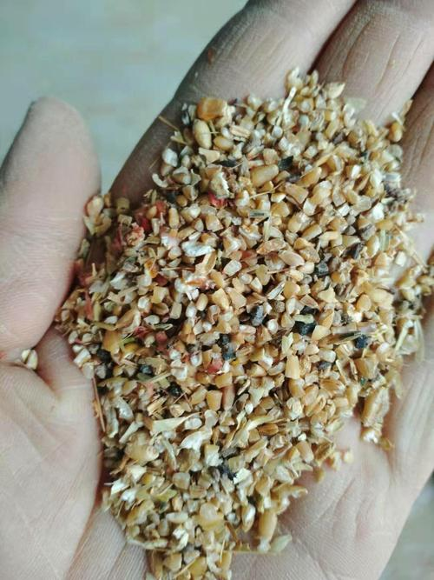
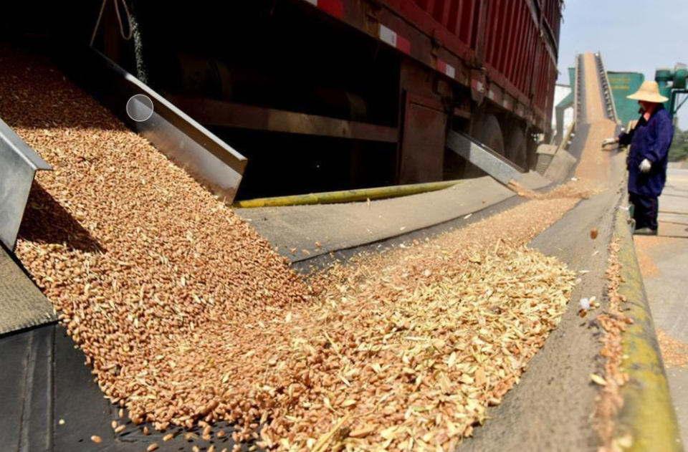
1.杂质的类型
混杂在粮食中无食用价值的物质和质量标准中规定的异种粮粒，以及绝对筛层下的物质称为杂质。根据相关的国家标准规定，杂质一般分为：
1. Types of Impurities
Impurities are materials without edible value mixed in the grain, off-type grain particles specified in quality standards, and materials below the absolute screen layer. According to relevant national standards, impurities are generally classified into:

Slide 8
筛下物：通过规定圆孔直径筛筛层的筛下物质
杂质
无机杂质：泥土、沙石、砖瓦块及其他无机物质
有机杂质：草籽、规定的异种粮粒、无食用价值的粮粒和其他有机物质
Underscreen material: screenings passing through a specified diameter circular mesh screen
Impurities
Inorganic impurities: soil, stones, brick and tile fragments, and other inorganic materials
Organic impurities: weed seeds, specified off-type grains, non-edible grains, and other organic materials
有时也可根据杂质的某些特征和清理作业的特点将其分为：粗杂、大杂、小杂、轻杂、并肩杂及磁性金属杂质等。
Sometimes, impurities can also be classified into categories according to certain characteristics and features of cleaning process: larger impurities,large impurities, small impurities, light impurities, accompanying impurities, magnetic metal impurities, etc.

Slide 9
Impact of Impurities on Grain Storage
2.杂质对储粮的影响
影响粮食商品价值及价格
Affect the commercial value and price of grain
降低粮堆孔隙度，影响湿热散发，为虫霉的发展提供有利条件
Reduce the porosity of grain piles, affecting moisture and heat dissipation, and creating favorable conditions for insects and mold
未熟粒、杂草、破碎粒等吸湿性强，含水量高，易于湿热聚集，降低储粮稳定性
Immature grain particles, weed seeds, and broken grain particles have strong moisture absorption, high water content, and are prone to moisture and heat accumulation, which reduce the stability of stored grain
杂质的影响
粉尘过多污染环境，增加粉尘爆炸风险
Excessive dust contaminates the environment and increases the risk of dust explosions
导致机械设备堵塞、工作面过度磨损等，缩短设备使用寿命，增加事故发生几率
Lead to mechanical equipment blockages, excessive wear on working surfaces, shorten equipment lifespan, and increase the likelihood of accidents
磁性杂质进入人体可伤害胃肠
Magnetic impurities entering the human body can damage the gastrointestinal tract
降低产品纯度，影响粮食的种用价值
Reduce product purity and affect the seed value of the grain

Slide 10
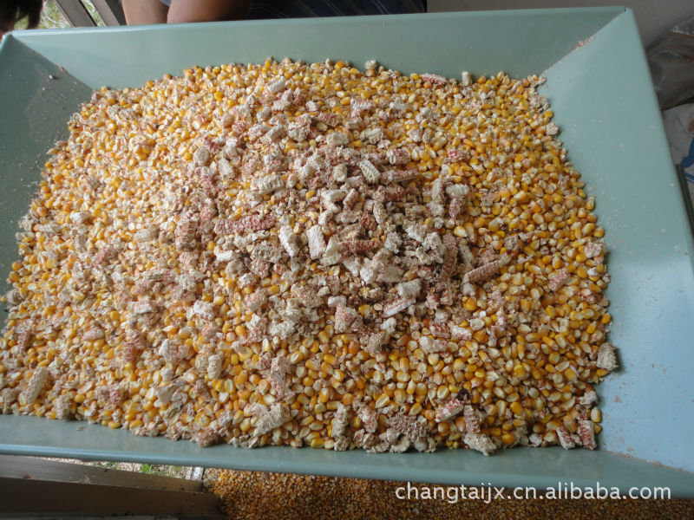
3.清理除杂的意义 The significance of impurity removal
粮食质量达标
提高粮食的商品价值
清理
保证粮食的高品质及安全
降低有害生物发生的风险，减少粮食损失
提高原粮的加工性能及成品粮的品质
Grain quality meets standards
Increase the commercial value of grain
Cleaning
Ensure high quality and safety of the grain
Reduce the risk of harmful organisms and minimize grain loss
Improve the processing performance of raw grain and the quality of finished grain products

Slide 11
4.清理的工艺与设备 Cleaning processes and equipment
在中国粮食杂质的清理主要有风选、筛选、磁选、精选等方式，每种方式的处理量、清理效果各不相同。清理设备又分为初清和细清两大类，初清设备可清除体积较大的粗杂，如：麻绳、土块、茎、叶等杂质，细清设备可清除大杂（比粮粒稍大的杂质，如土块、石子等）、小杂（比粮粒小的杂质，如砂子、土粒等）和轻杂（糠壳、灰尘等）。
（1）粮食收储清理工艺 Grain Storage and Cleaning Processes
在上世纪80年代以前，粮食收购时的清理工艺和设备比较简单，仅仅通过一台初清设备——溜筛除去大杂就能够达到国家标准。
In China, grain impurity removal primarily employs methods with different processing capacities and effectiveness, such as air screening, sieving, magnetic separation, and selection. Cleaning equipment is categorized into two main types: initial cleaning and fine cleaning.
Initial cleaning equipment is designed to remove larger impurities, such as ropes, big soil clumps, stalks, and leaves. Fine cleaning equipment, on the other hand, is used to remove large impurities (slightly larger than grain particles, such as soil clumps and stones), small impurities (smaller than grain particles, such as sand and soil particles), and light impurities (such as husks and dust).
Before the 1980s, the cleaning processes and equipment used during grain purchasing were relatively simple. A single initial cleaning device, such as a gravity screen, was sufficient to remove large impurities and met national standards.

Slide 12
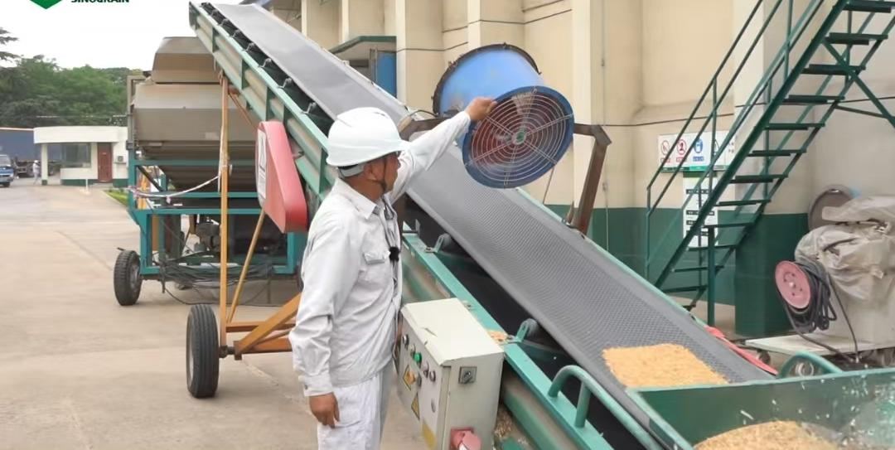
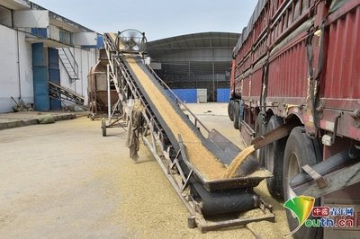
随着中国农业生产规模的变化、粮食收购方式改变、粮食清理设备的发展，收购过程的清理工艺也逐渐完善，初清设备也由滚筒初清筛、网带初清筛取代，提高了清理效果和处理能力。
进入21世纪后，中国粮食的产量和储备粮均有大幅度提高，大豆进口量也逐年增加，粮食的质量随之发生了变化，同时，仓房高大化及国家对储备粮的数量、质量的管理越来越严格，要求越来越高，在粮食收购时逐渐大量应用细清设备——振动筛。形成了不同仓型“两筛两吹”的储备粮收储的典型清理工艺。
With changes in the scale of agricultural production in China, transformation of grain purchasing methods, and development of grain cleaning equipment, the cleaning processes during purchasing have gradually improved. Initial cleaning equipment has been replaced by cylindric precleaner and endless screen precleaner, enhancing the cleaning effectiveness and processing capacity.
Since the beginning of the 21st century, China has seen a significant increase in grain production and reserves, with soybean imports also rising annually. As a result, the quality of grain has changed. At the same time, the height of grain warehousesthe and the government has imposed stricter and more demanding management of the quantity and quality of reserve grain.During grain acquisition, fine cleaning equipment, such as vibrating screens, has been increasingly used. This has led to the development of the typical "two screens and two air blows" cleaning process for different types of granary.

Slide 13
平房仓典型清理工艺流程（移动式）：
Typical Process Flow for Flat Warehouse (Mobile)
小风机
轻杂
小风机
轻杂
皮带输送机
圆筒初清筛
皮带输送机
振动筛
皮带输送机
平房仓
粗杂
大杂、小杂
Small fan
Light impurities
Small fan
Light impurities
Belt conveyor
Cylindric pre-cleaner
Belt conveyor
Vibrating screen
Belt conveyor
Flat Warehouse
Coarse impurities
Large and small impurities

Slide 14
圆筒仓典型工艺流程（固定式）：
Typical Process Flow for Cylindrical Warehouse (Fixed Type)
皮带输送机
磁选器
斗提机
网带初清筛
振动筛
斗提机
仓顶输送机
入仓
金属杂质
粗杂
大杂、小杂
除尘风网
粉尘、轻杂
Belt conveyor
Magnetic separator
Bucket elevator
Endless screen precleaner
Vibrating screen
Bucket elevator
Silo top conveyor
Into Storage
Metallic impurities
Coarse impurities
Large,Small impurities
DustRemoval Air Screen
Dust、Light impurities

Slide 15
近年来，对清理设备进行了一体化改进，研制了多种组合清理技术装备，解决了“两筛两吹”清理工艺中设备数量多、产量低、作业面积大等问题。组合清理技术装备集圆筒筛、振动筛、风选筛和及脉冲（或布袋）除尘器于一体，可实现杂质去除率达95％以上，并可有效降低作业区粉尘污染。
In recent years, the cleaning equipment has undergone integrated improvements. Various combined cleaning technical equipment has been developed, addressing issues such as the large number of devices, low output, and extensive operational area. This combined cleaning technical equipment integrates a cylindrical sieve, vibrating sieve, wind separator, and pulse (or bag) dust collector into one unit. It achieves an impurity removal rate of over 95% and effectively reduces dust pollution in the operational area.
Combined Cleaning Sieve
Bulk Grain Truck
Grain conveyor
Warehouse
Grain conveyor
Clean Grain
Cleaning
Raw Grain

Slide 16
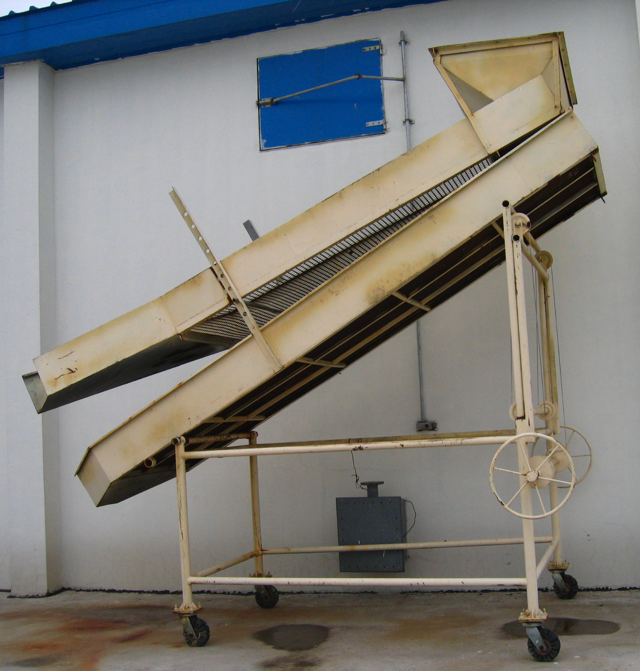
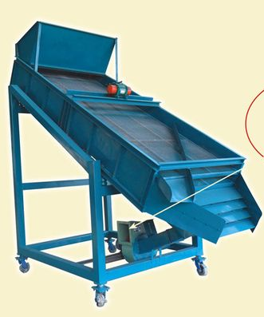
（2）收储清理设备 Collection and Storage Cleaning Equipment
①溜筛 Gravity Sieve
溜筛由筛框和钢丝编织筛组成，结构简单，工作时不用外加动力，但清杂效果欠佳，是我国早期粮食收购时的主要清理设备。
A gravity sieve consists of a sieve frame and a woven wire mesh. It has a simple structure and could operate without external power. However, its effectiveness in removing impurities is relatively limited. It was one of the primary cleaning devices used in the early stages of grain collection in China.

Slide 17
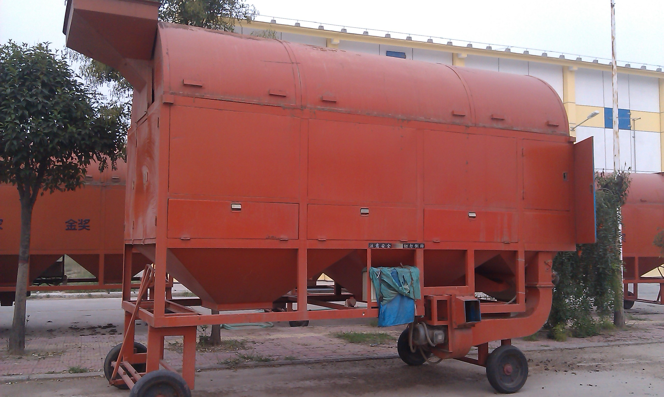
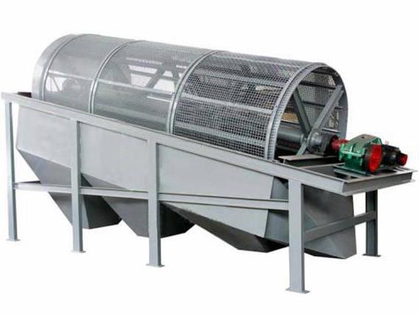
②圆筒初清筛 Cylindric Precleaner
圆筒初清筛是一种常见的初清设备，根据筛分原理除杂。单筒筛仅能除去粗杂，双筒筛配吸风分离器可除去大杂、小杂、轻杂。圆筒式初清筛主要用清理原粮，杂质清除率在80％以下。
The cylindric precleaner is a common type of initial cleaning equipment used in grain processing.The cleaning principle is based on screening. A single-layer cylindric precleaner can only remove coarse impurities, while a two-layer cylindric precleaner be equipped with air separators can remove large, small, and light impurities. The cylindric precleaner is primarily used to clean raw grains, with an impurity removal rate of less than 80%.
Cylindric precleaner
圆筒初清筛

Slide 18
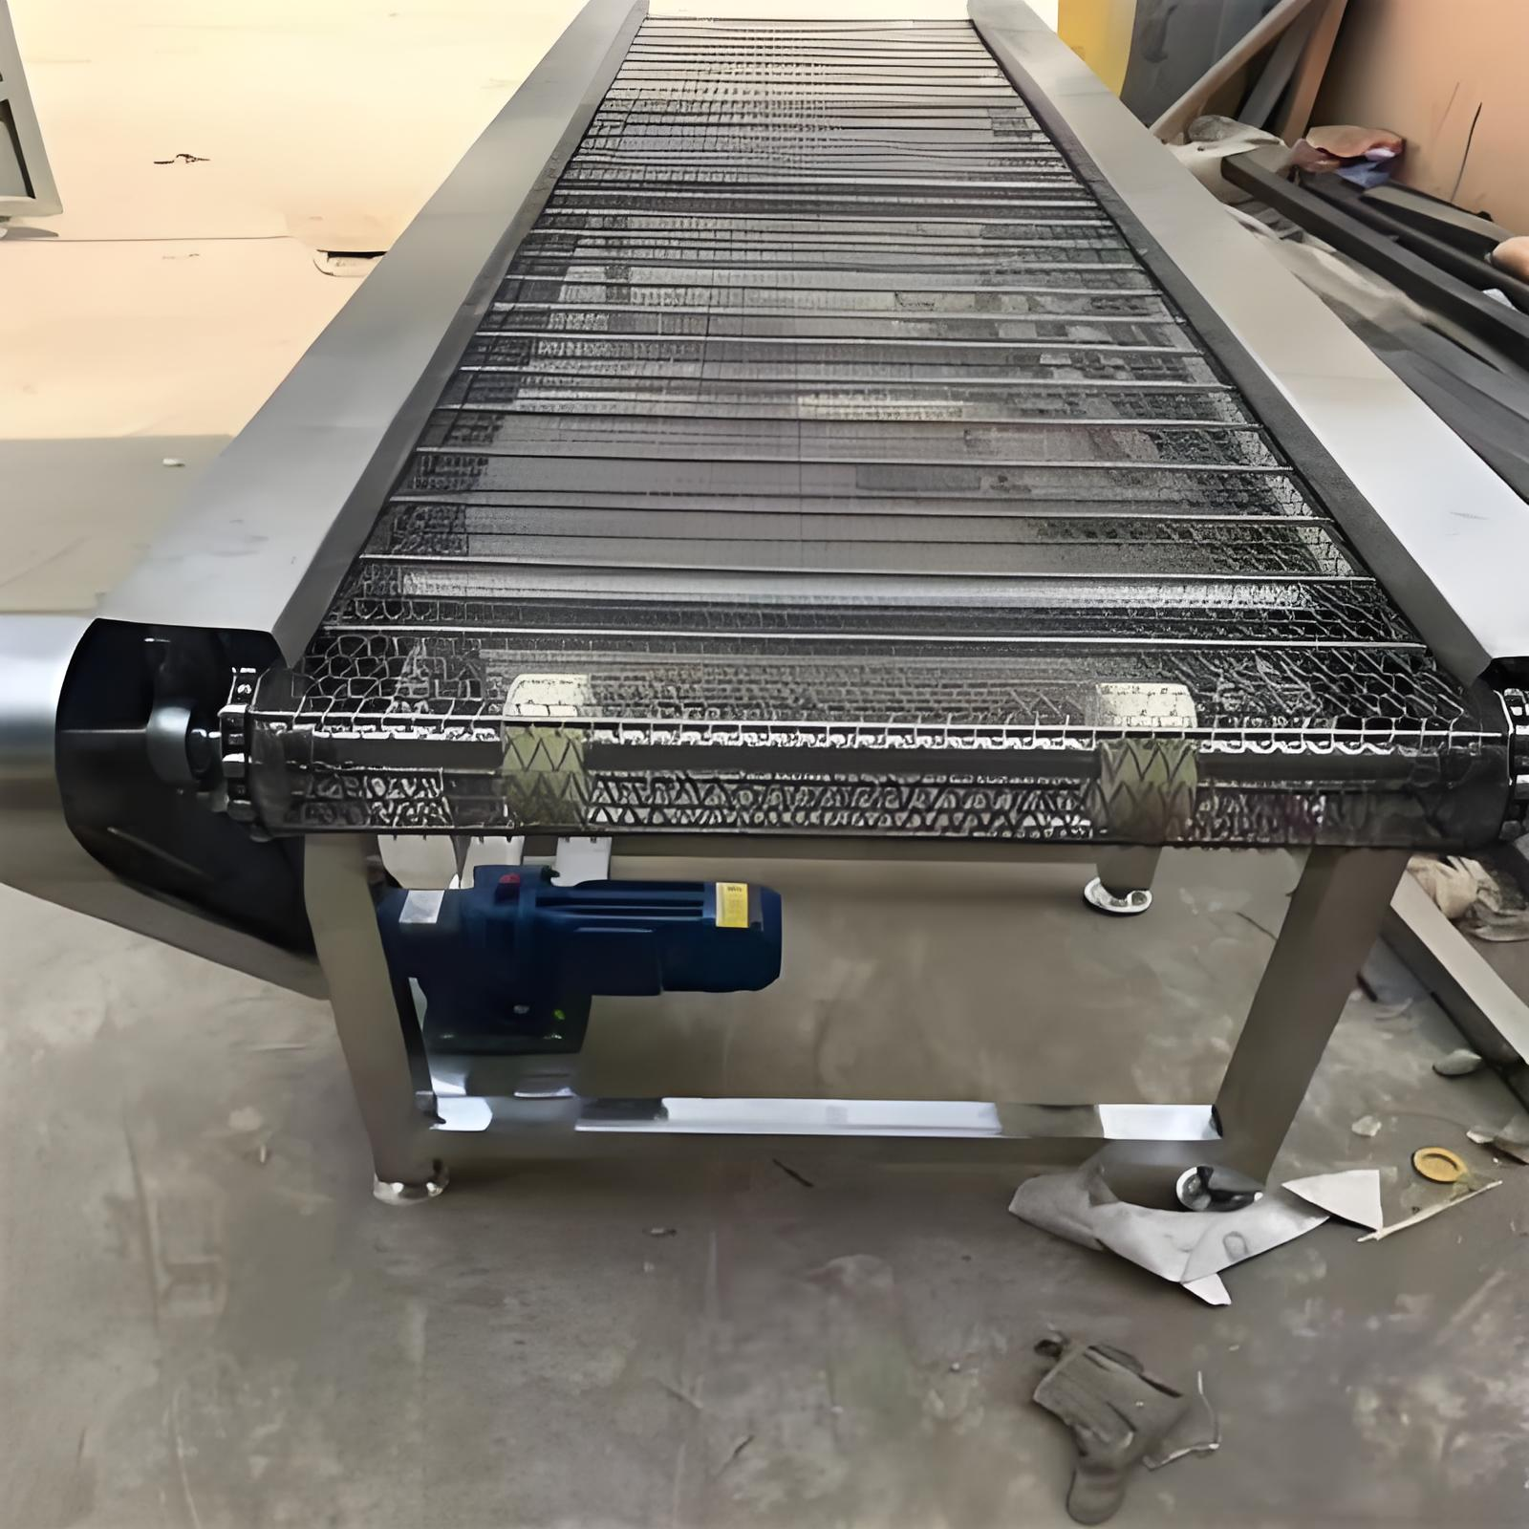
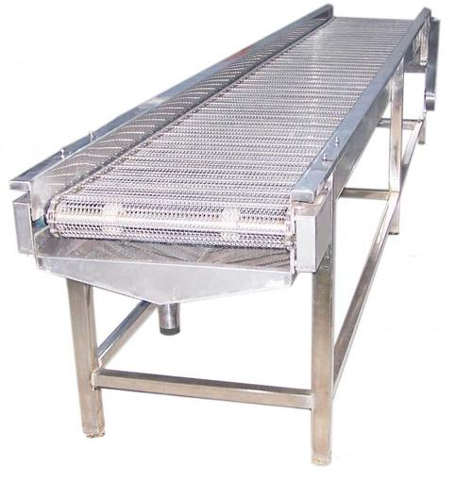
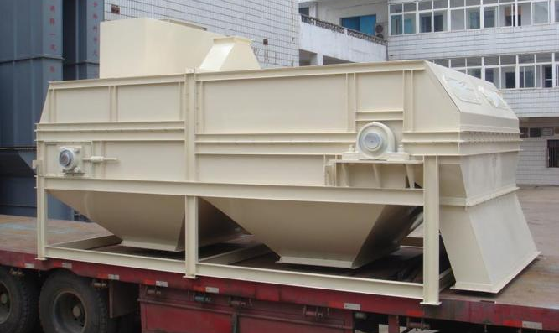
③网带初清筛 Endless screen precleaner
网带式初清筛是以一条筛网带作为筛分清杂的主要构件，常用于圆筒仓（浅圆仓和立筒仓）的入仓初清工序中，清杂原理是筛分，产量大，适用于固定作业线。轻杂、粉尘并入工作塔的除尘风网。
The endless screen precleaner utilizes a screening mesh belt as the main component for separating impurities. It is commonly used in the initial cleaning process of cylindrical silos (both squat and vertical silos). The cleaning principle is based on screening and high production, making it suitable for fixed production lines.The light impurities and dust are integrated into the dust collection system within the working tower.
网带初清筛
Endless screen precleaner

Slide 19
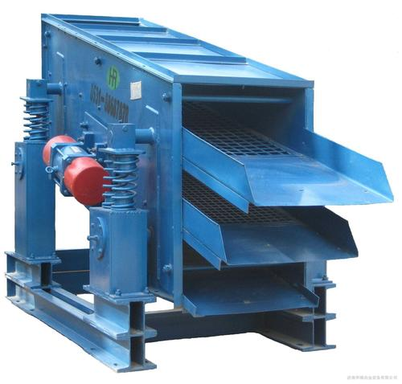
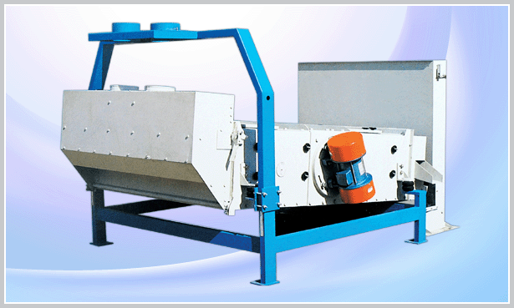
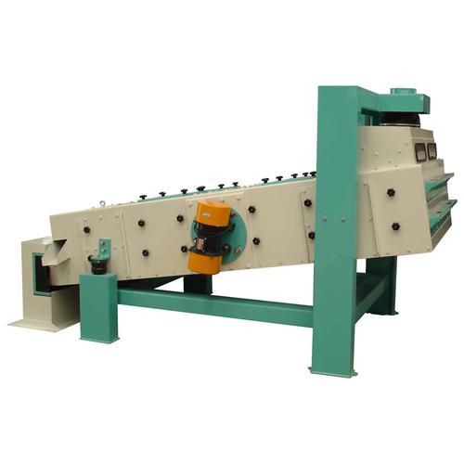
④振动清理筛 Vibrating screen
筛选与振动结合，利用筛选法按物料的粒径进行多层筛面进行分离，可除去大杂和小杂。振动清理筛一般配置有垂直吸风道和除尘系统，可同时除去轻杂，杂质的除去率可达到90％以上。
The combined screening and vibration method utilizes a multi-layer screening surface to separate materials based on particle size. Vibrating screen can remove large and small impurities.The vibrating cleaner screen is typically equipped with vertical air ducts and a dust collection system, which allows for the simultaneous removal of light impurities. The impurity removal rate can reach over 90%.
振动筛
Vibrating screen

Slide 20
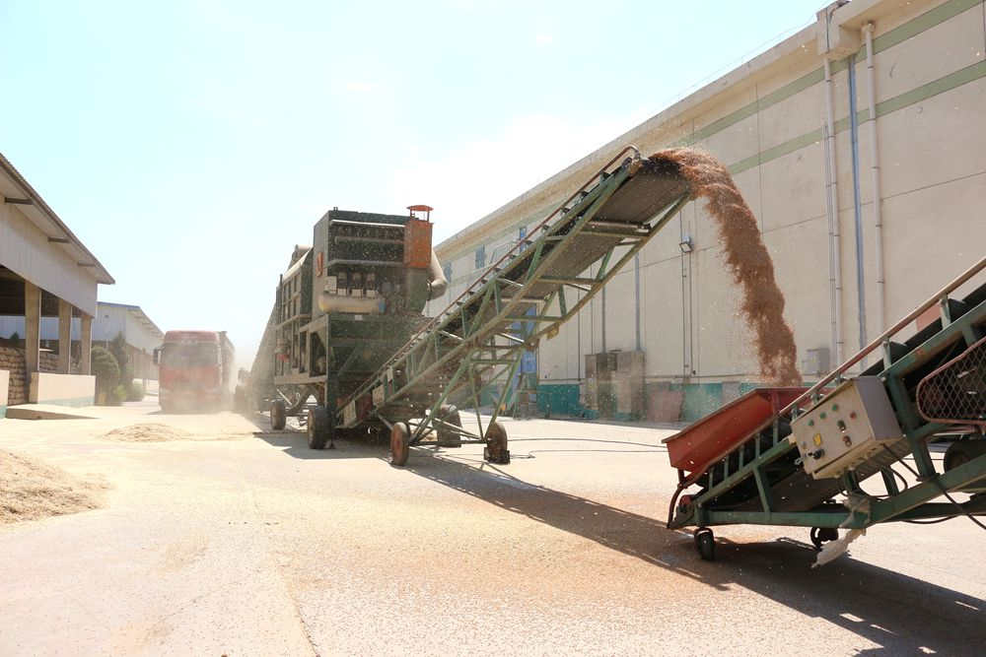
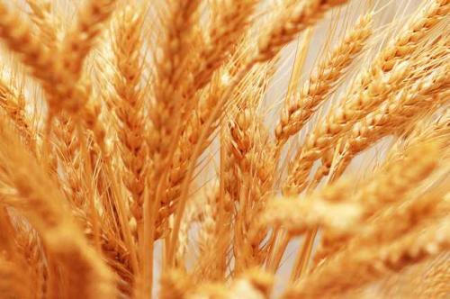
⑤组合清理设备 Combined Cleaning Equipment
组合清理技术装备集多种不同原理、结构和功能的清理设备与一体，可实现减少作业面积、安装布置方便、操作简单、提高产量和除杂率、减少作业区粉尘污染等。
Combined cleaning technology equipment integrates various cleaning devices with different principles, structures, and functions into a single unit. This integration offers several advantages: Reduced operational area, easy installation, simplified operation, increased efficiency, reduced dust pollution, etc.

Slide 21
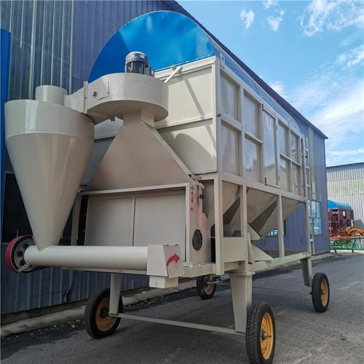
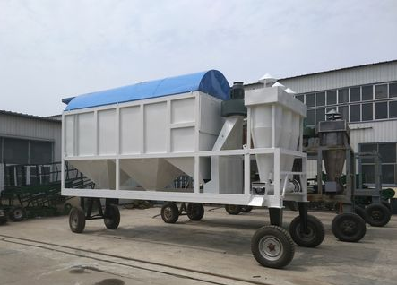
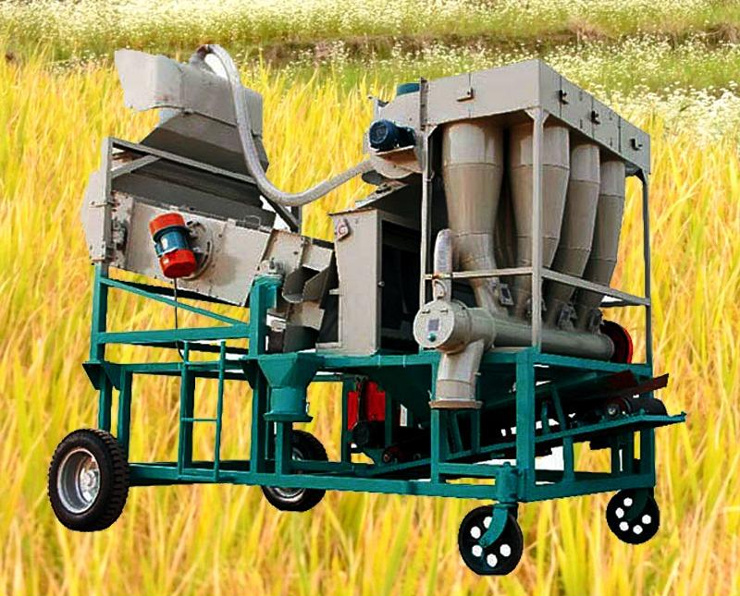
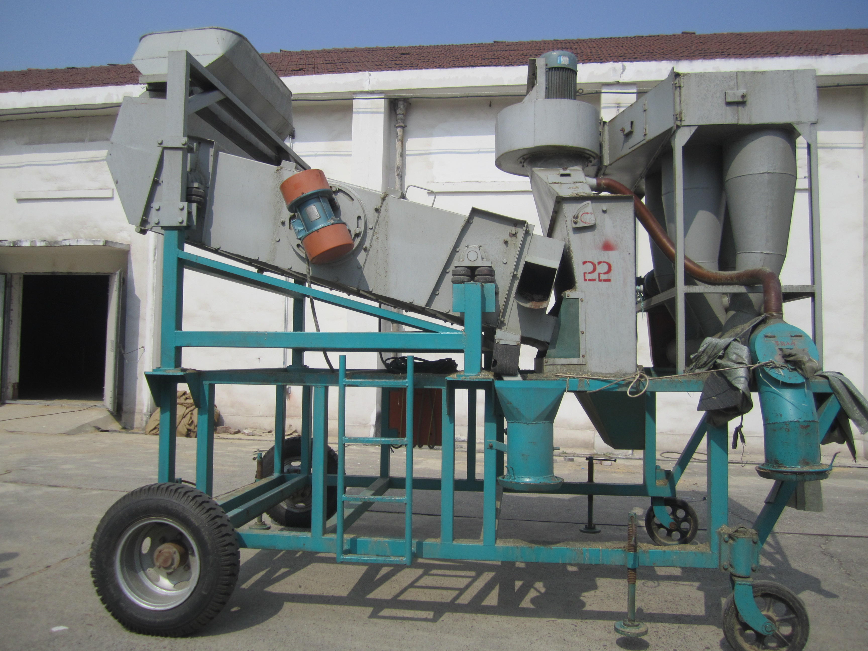
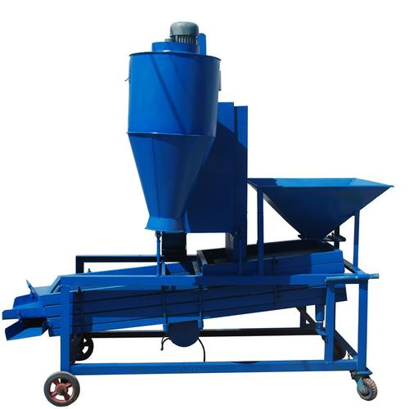
Combined Cylindrical and Air-screen Sieve
圆筒、风选组合筛
振动、风选组合筛
Combined Vibrating and Air-screen Sieve

Slide 22
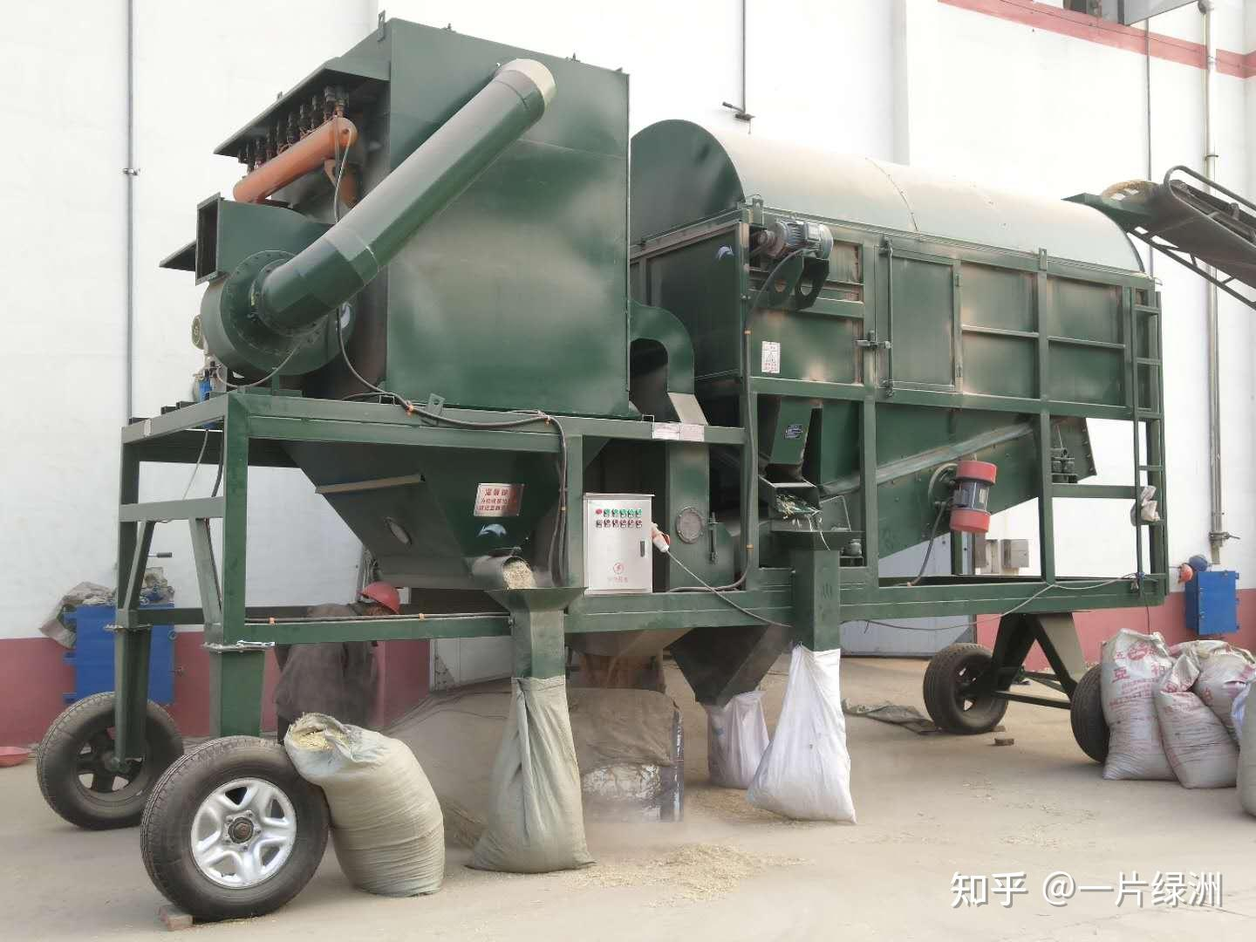
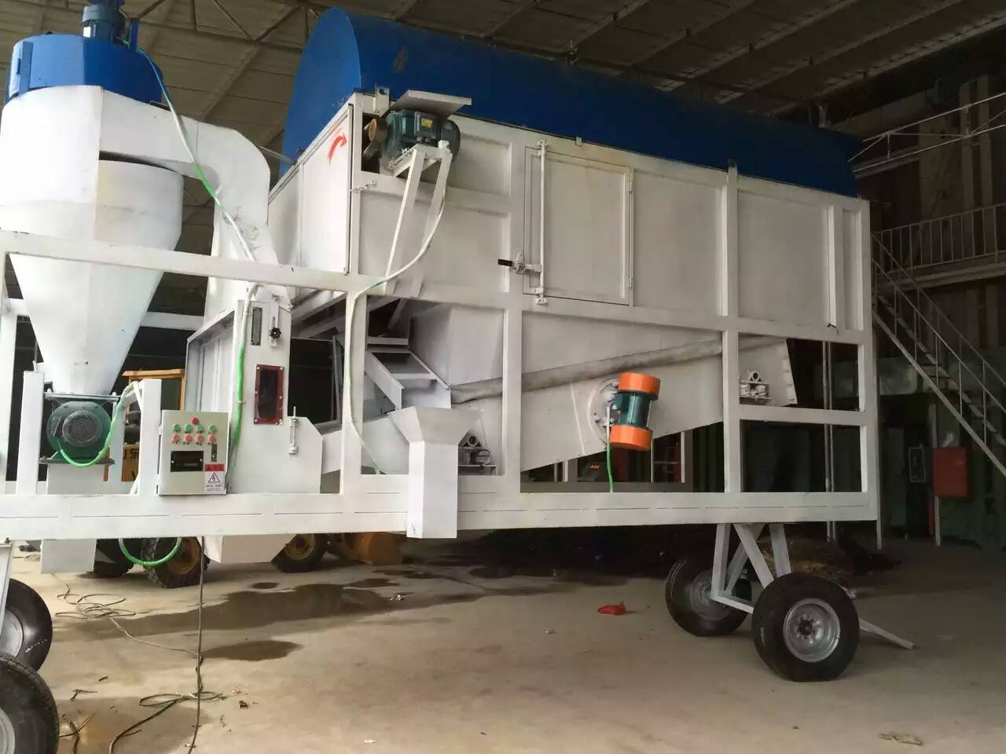
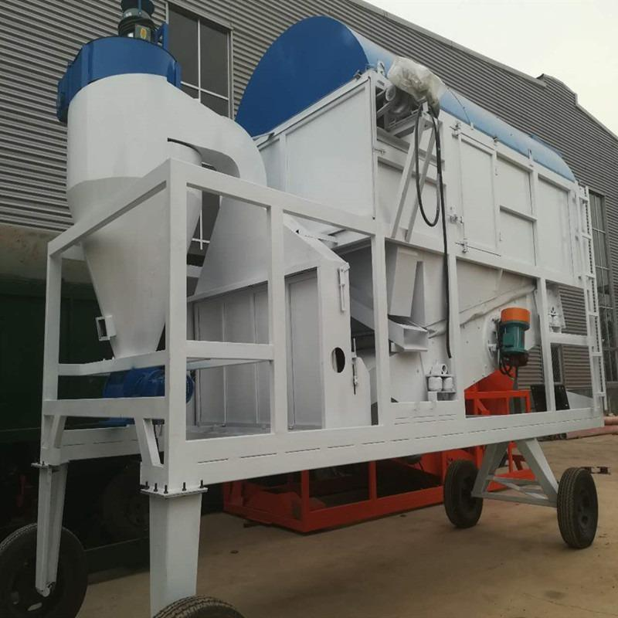
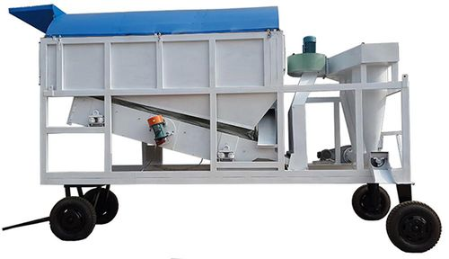
Combined Cylindrical, Vibrating, and Air-Screen Sieve
圆筒、振动、风选组合筛

Slide 23
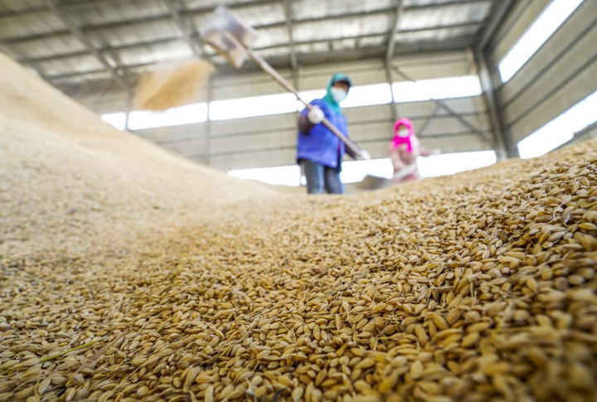
二、分级储备 Grain Grading and Storage
1.分级储备的意义 The Significance of Grain Grading and Storage
储备粮来源复杂、粮食质量及粮情不一，全仓混储，必将为日后的粮食安全、储粮稳定性、保管工作埋下隐患，极有可能在储藏过程中出现虫霉危害、发热结露、干重损失，因此在《粮油储藏技术规范 GB T29890 2013》、《粮油安全储存守则》（国家粮食局编制）等中对粮食入仓时的粮食质量及堆放有严格规定。
The complexity of grain reserves sources, along with variations in grain quality and conditions, poses significant challenges for grain storage. Storing mixed grain in a single warehouse can lead to several potential issues that affect food security, storage stability, and management practices. These issues include: pest and mold infestation; heat generation and condensation; weight loss. To address these concerns, regulations and standards, such as the "Grain and Oil Storage Technical Specifications (GB/T 29890-2013)" and the "Grain and Oil Safety Storage Code" (compiled by the National Food and Strategic Reserves Administration), clearly stipulate grain quality for grains to be stored and grain stacking.

Slide 24
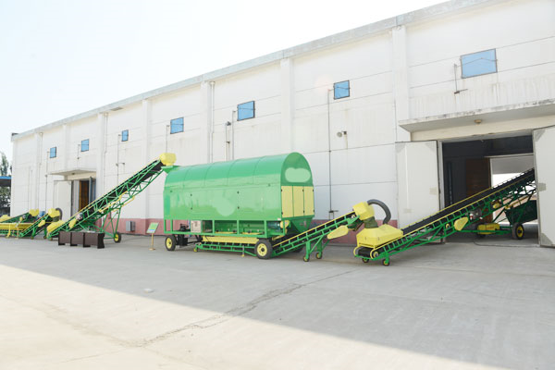
在长期的储粮工作中也总结出了入仓的粮食分类存放更科学、更安全的结论，分类入仓存放的具体要求，在不同的文献和资料中有不同的解释，比较常见的是“五分开”，即种类不同分开、质量不同分开、新粮陈粮分开、干粮湿粮分开、有虫粮与无虫粮分开。
In long-term grain storage, it has been concluded that categorizing and storing grain separately is more scientific and safer. Different literature and standards provide various interpretations of best practices for categorized storage. A common guideline is the "Five Separations," which includes: Separation by type; Separation by quality; Separation by Freshness; Separation by moisture content; Separation by pest presence.

Slide 25
2.五分开与储藏减损 “Five Separations” and Impact on Storage Loss Reduction
（1）种类不同分开 Separation by type
由于粮食的种类不同，对环境条件、储存时间、储藏方法、粮食质量等都有不同的要求。因此，入仓时应分开堆放，达到储藏高效节能，减少损失。不同粮种、不同粮食性质、不同类型、优质品种和普通品种宜分开储藏。
Due to the different types of grain with varying requirements for environmental conditions, storage duration, storage methods, and quality, it is essential to separate them during storage to ensure efficiency, energy conservation, and loss reduction. Grains in different types, properties, varieties, and qualities should be stored separately.
（2）质量不同分开 Separation by quality
同一种类的粮食，质量等级不同宜分开储藏。首先，不同质量等级的同种粮食其价格不一样，混储将会影响企业和国家的经济利益。其次，不同质量等级的粮食储藏稳定性也不同，分开储藏可提高储藏技术应用的针对性，保证储粮安全，且节能减损。最后，分质储存可以为消费者提供不同用途的商品。
The same type of grains at different quality grades should be stored separately. Firstly, the same type of grains with different quality grades have different prices; mixed storage affects economic interests. Secondly, grains at different quality grades have different storage stabilities; separated storage enhances efficiency of storage technology application, safety of stored grain, energy conservation and loss reduction. Thirdly, separated storage by qualities provides consumers with products for various uses.

Slide 26
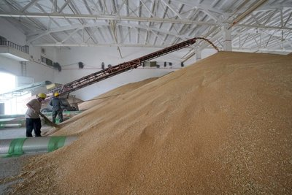
（3）新陈粮分开 Separation by Freshness
新收获的粮食，生命力旺盛，品质和耐藏性好，储藏周期长。而经过一年及以上时间储藏的粮食正好相反。因此，入仓时把新粮与陈粮分开堆放，以利于粮食商品的供应，并确保粮食储藏安全和科学轮换。
Newly harvested grain is characterized by its high vitality, superior quality, better storage resilience, and extended storage life. In contrast, grain stored for one year or more exhibits the opposite characteristics. Therefore, separating the new grain from the old grain when putting it into storage to benefits the supply of grain products and ensures both the safety of grain storage and the scientific rotation of the grain.

Slide 27
（4）干湿粮分开 Separation by moisture content
粮食含水量不同，自身的新陈代谢强度、品质变化速度均不相同，特别是高水分粮极易感染虫霉，造成粮食发热霉变，甚至发芽，损失巨大。因此，入仓时要干湿粮分开堆放，保持同一粮堆各部位的粮食水分基本一致。高水分粮要分开堆放在一个仓内，入仓后要及时处理，以免发生因结露、霉变现象。
Grains with different moisture levels have varying metabolic intensities and rates of quality change. High-moisture grains, in particular, are highly susceptible to insect and mold infestations, which can lead to heating, mold growth, and even sprouting, resulting in significant losses.Therefore, it is important to store dry and wet grains separately upon arrival to maintain consistent moisture levels within each grain pile. However, grains with higher moisture levels should be stored separately and promptly treated after storage to prevent issues such as condensation and mold growth.

Slide 28
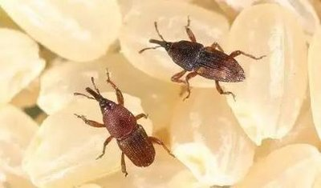
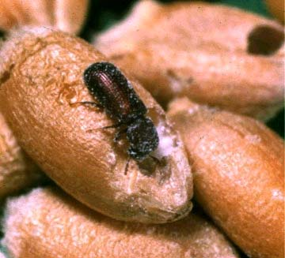
（5）有虫无虫粮分开 Separation by pest presence
入仓时，有虫和无虫的粮食如果混储在一个仓，则会相互感染扩大虫粮数量，增加处理工作量和费用。因此，入库时应将有虫的粮食与无虫的粮食分开储藏，有虫粮及时处理，减少损失。
During storage, if infested and non-infested grains are mixed in the same warehouse, the infestation can spread, increasing the quantity of infested grain and raising the workload and costs for treatment. Therefore, infested grains should be stored separately from non-infested grains, and infested grains should be treated promptly to minimize losses.

Slide 29
三、分选技术 Sorting technology
1.分选的意义 The significance of sorting
分选通常是指颗粒物质在外力作用下，按粒度、形状或密度的差别发生分别富集的现象，表示颗粒大小的均一性。分选技术在粮食清理和加工过程中均有应用，其目的主要是清理杂质、分离各种物理特性差异及病菌感染的颗粒，从而净化和纯化原粮及成品粮，使粮食更纯净、更卫生、更安全。
Sorting typically refers to the phenomenon where particulate matter undergoes separation and enrichment based on differences in size, shape, or density under the influence of external forces, indicating uniformity in particle size.
This sorting technology is applied in the processes of grain cleaning and processing. Its main purposes are to remove impurities, separate particles with different physical characteristics or disease infections, and thus purify and refine raw and finished grains, making them cleaner, more hygienic, and safer.

Slide 30
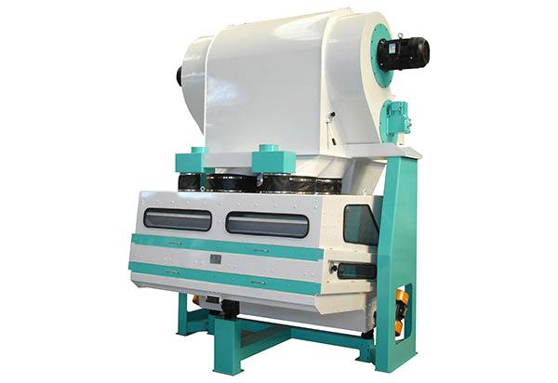
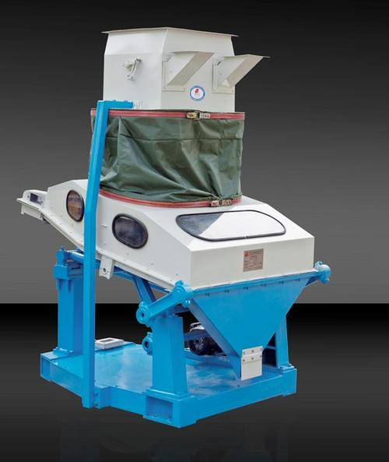
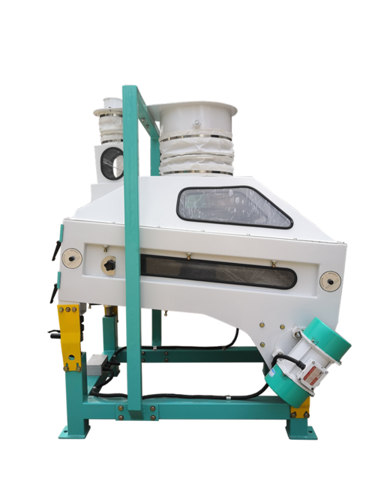
2.分选技术种类及应用 Types and Applications of Sorting Technology
粮食行业的分选技术通常包括清理中的去石、磁选和色选等，多用于粮食加工的前处理工艺中。去石可分为干法和湿法两类。粮食加工厂广泛应用干法去除并肩石，相应设备为比重去石机。
In the grain industry, sorting technologies typically include destoning, magnetic separation, and color sorting, often used in the pretreatment processes of grain processing. Destoning can be classified into dry and wet methods. Grain processing plants widely use the dry method for removing stones with the gravity destoner accordingly.
去石机
Destoner

Slide 31
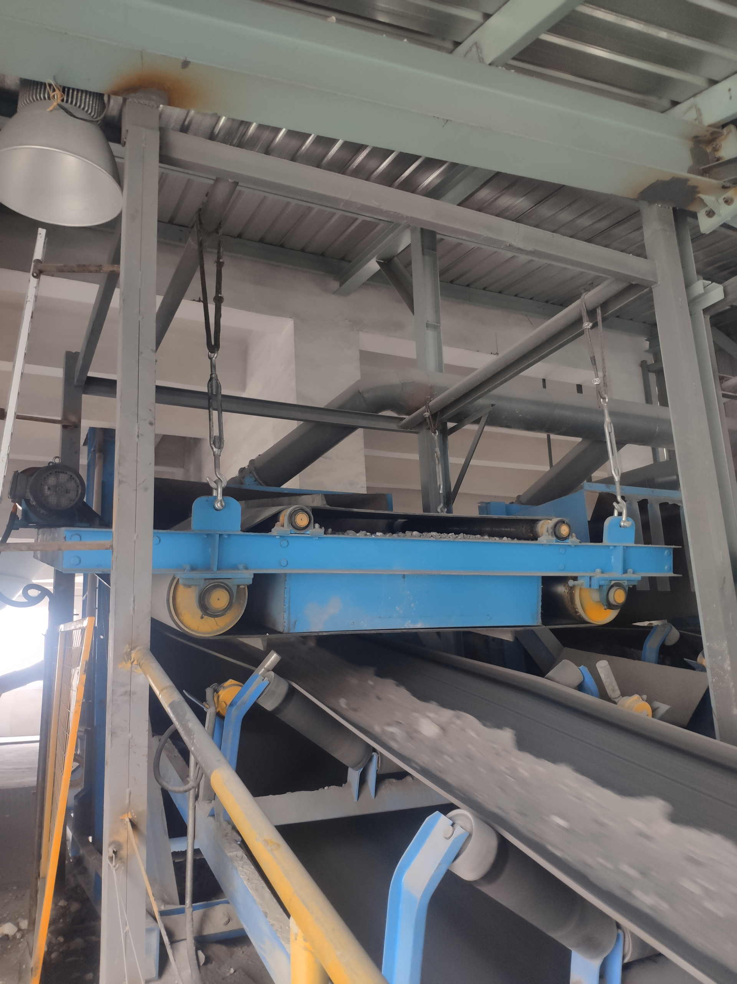
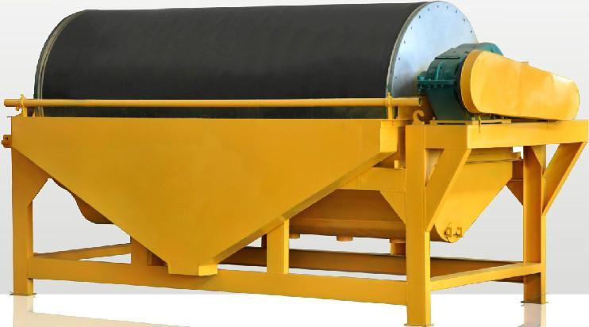
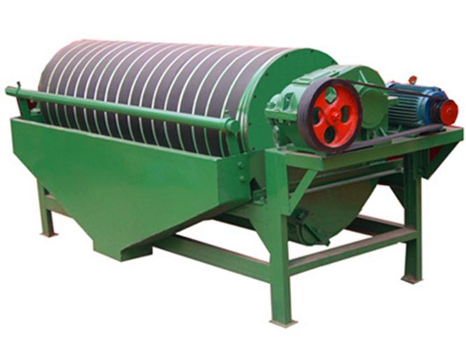
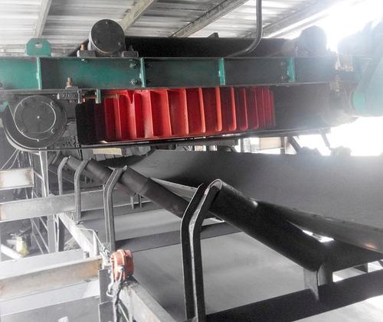
磁选是利用磁力将物料中磁性金属杂质去除的方法。磁选技术主要用于粮食入仓清理作业线中，磁选设备应安装在入仓工艺中的斗式提升机之前，这样既可以清除金属杂质，又可以预防金属杂质在斗式提升机中与金属机壳碰撞，产生火花而引起粉尘爆炸的可能性。粮食加工中磁选设备也是必不可少的。
Magnetic separation is a method that uses magnetic force to remove magnetic metal impurities from materials. Magnetic separation technology is primarily used in the grain cleaning process before storage. Magnetic separation equipment should be installed before the bucket elevator in the storage process, which helps to remove metal impurities and prevents the possibility of metal impurities colliding with the metal casing of the bucket elevator, potentially causing sparks and leading to dust explosions. During grain processing, magnetic separation equipment is essential too.
磁选设备
Magnetic separation equipment

Slide 32
色选是利用光电技术，依据物料之间的色泽差异，从大量散颗粒中将异色颗粒或外来夹杂物识别并分离的单元操作，所使用的设备称为色选机或分选机。在无法用筛选或比重分选设备分离时，色选能进行有效分离。光电分选技术具有无损检测、分选速度快、效率高和重现性好等优点，近年来在粮食分选领域得到了广泛应用。
Color sorting is a unit operation that uses photoelectric technology to identify and separate discolored particles or foreign inclusions from a large quantity of scattered particles based on color differences. The equipment used for this process is called a color sorter or sorting machine. It is effective when screening or gravity separation equipment cannot be used. Photoelectric sorting technology has advantages such as non-destructive testing, fast sorting speed, high efficiency, and good reproducibility, and it has been widely applied in the field of grain sorting in recent years.

Slide 33
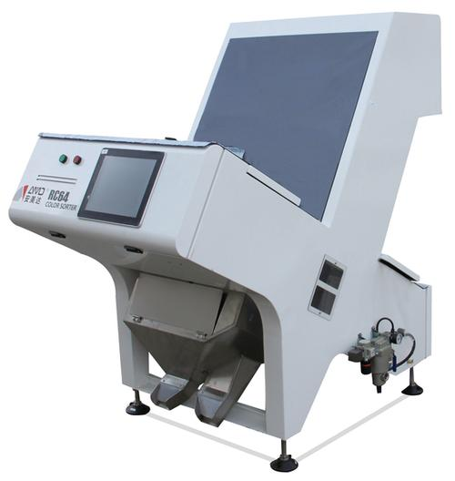
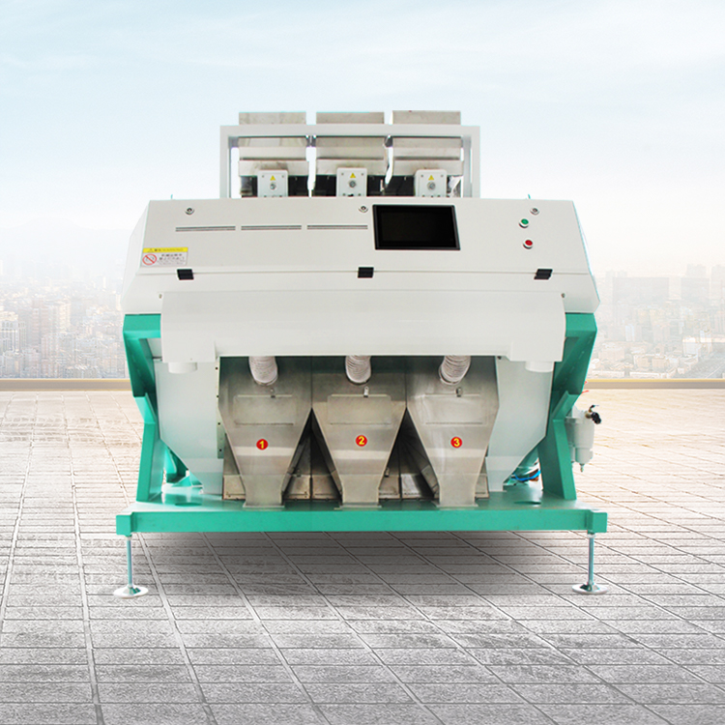
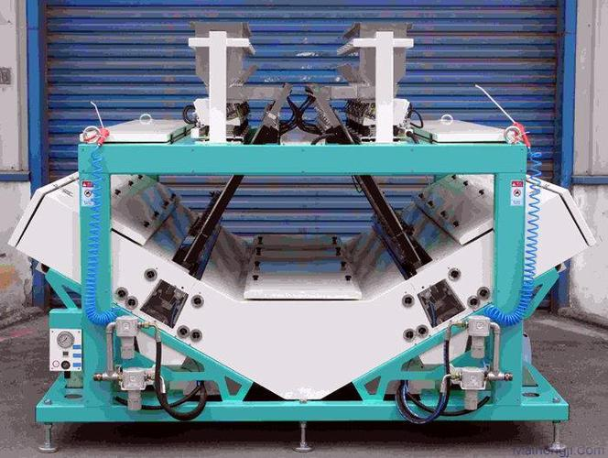
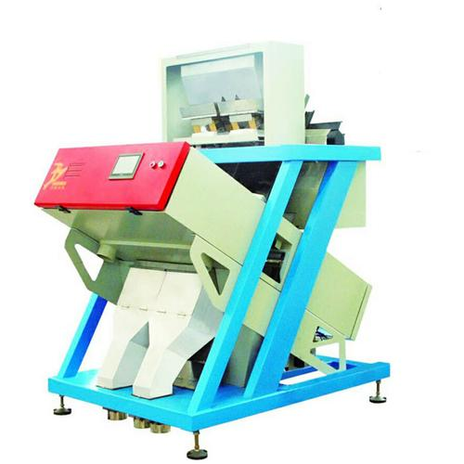
红外色选机
Infrared color sorter
Color sorter
色选机

Slide 34
色选技术最早的应用是在稻谷加工工艺中，主要是分选出大米中颜色明显霉变和黄变的米粒，提高大米纯净度和质量。近年来色选技术也逐渐应用在小麦、玉米、大豆及小杂粮的加工及有效剔除粮食中感染病虫害、霉菌及真菌毒素污染的粮粒，以确保粮食加工品质量和粮食安全卫生。
The earliest application of color sorting technology was in rice processing, where it was used to separate noticeably moldy and discolored rice grains, improving the purity and quality of the rice. In recent years, color sorting technology has also been increasingly applied in the processing of wheat, maize, soybeans, and small grains, effectively removing grains infected with pests, mold, and mycotoxins, thereby ensuring the quality and safety of grain products.

Slide 35
随着在粮食及农产品质量控制中的广泛应用，色选技术及设备的研发也得到了快速发展，目前的设备研发向着双色光或多光谱、应用先进的光电探测器、双面色选、精准自动控制等技术，对清理不同物料杂质更具有针对性及对籽粒内部状况识别，可大幅度提高光电系统的灵敏度，显著提高色选机的选别率和降低带出比。
With the widespread application of color sorting technology in the quality control of grains and agricultural products, the development of sorting technology and equipment has advanced rapidly. Current research and development efforts are focused on technologies such as dual-color or multispectral imaging, the use of advanced photoelectric detectors, double-sided color sorting, and precise automatic control. These advancements make the technology more targeted in removing impurities from different materials and in identifying the internal conditions of grains. They significantly enhance the sensitivity of the photoelectric system, markedly improve the sorting efficiency of color sorters, and reduce the ratio of mis-sorted materials.

Slide 36
Thank You
Sharing for Learning

