Slide 1
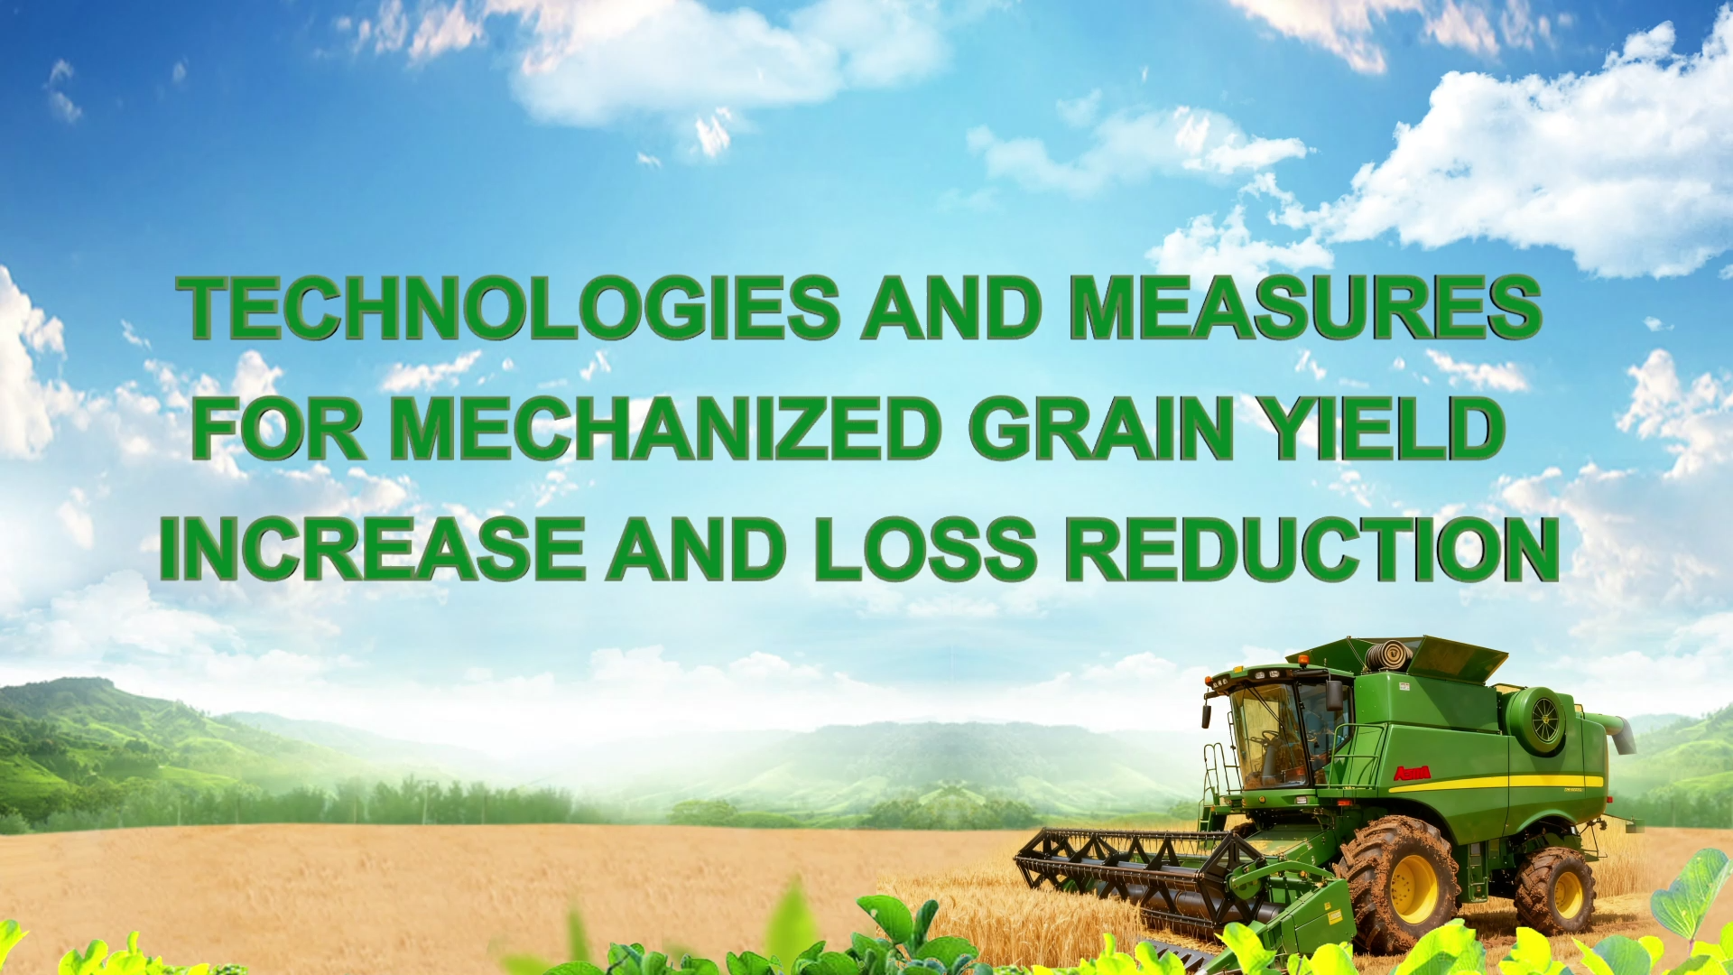

Notes:
Fully Mechanized Rice and Wheat Production with a Focus on Loss Reduction
基于减损的稻麦全程机械化生产技术

Slide 2
Part 01
Mechanization as the Primary Approach for Grain Yield Increase and Loss Reduction
Part 02
Technologies and Measures for Increasing GrainYield and Reducing Losses Through Mechanization
Part 03
Continuing to Promote the Application of Mechanized Technologies for Yield Increase and Loss Reduction
Notes:
Reducing losses in rice and wheat production is essential for ensuring food security and enhancing agricultural efficiency. This course systematically introduces key mechanized techniques for loss reduction during planting, harvesting, drying and storage. This course is structured into eight modules, each offering in-depth insights into these core techniques.
在农业生产中，减少稻麦生产过程中的损耗对于保障粮食安全和提高农业效益至关重要。本课程聚焦《基于减损的稻麦全程机械化生产技术》，系统讲解稻麦从种植到收获、烘干及储藏等核心环节的机械化减损技术要点，共分八个模块进行深入讲解。

Slide 3

PART.02
Technologies and Measures for Increasing Grain Yield and Reducing Losses Through Mechanization
Notes:
Technologies and measures for increasing grain yield and reducing losses through mechanization
二、粮食机械化的增产减损技术与措施

Slide 4
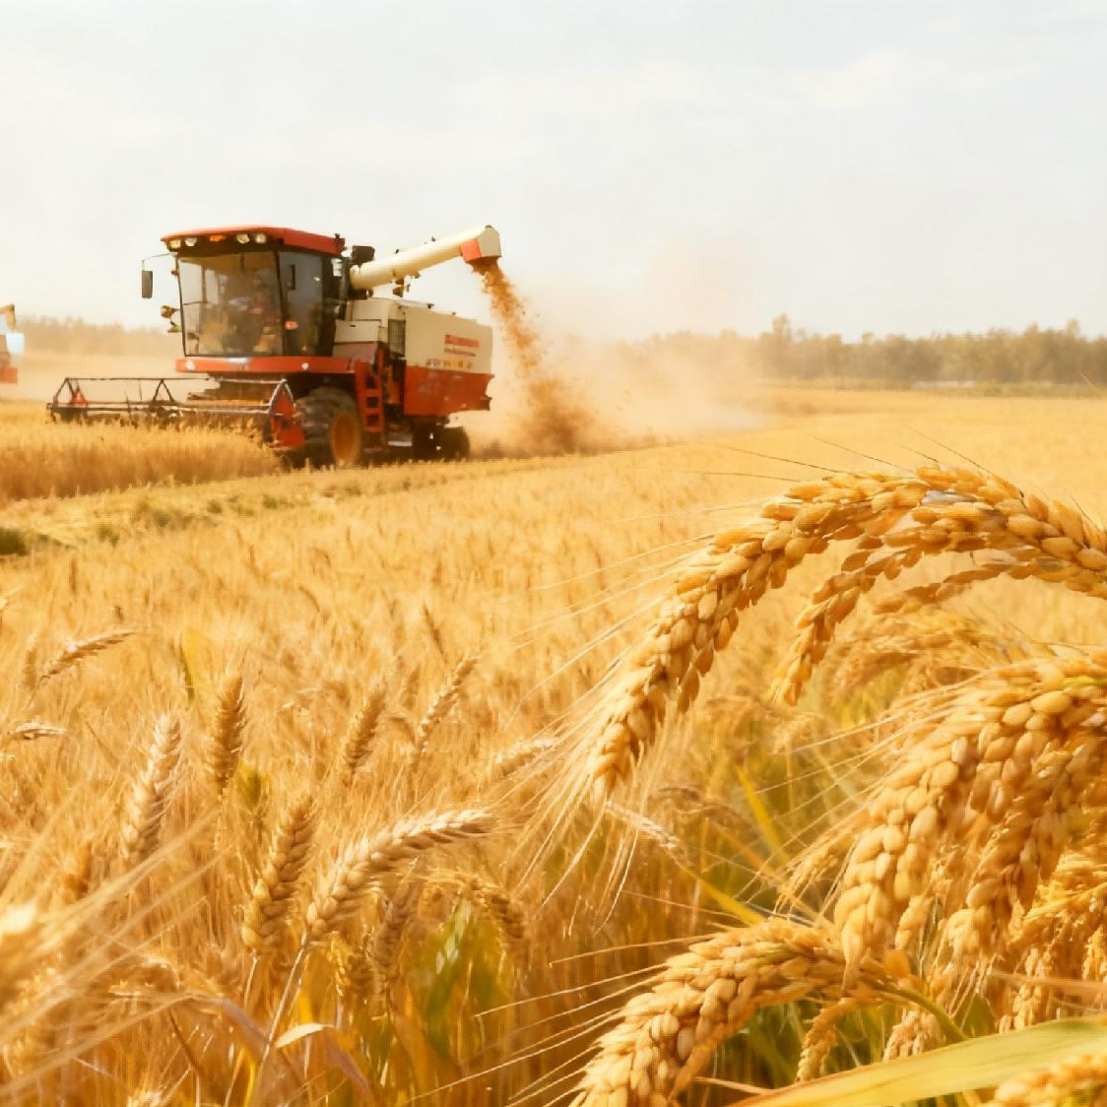
Mechanization Underpinning Stable Grain Output
Grain Harvest Achievements
China has achieved 20 consecutive years of good grain harvests.
For 9 years in a row, the total grain output has stayed above 650 million tons.
Supporting Factor
Agricultural mechanization provides critical support.
Mechanization Level
Overall mechanization rate >75%.
Wheat/Rice/Maize mechanization: 97% / 88% / 91%.
Mechanization serves as a cornerstone for stable grain production and supply.
Foundation for Stabilizing and Increasing Grain Output
Prioritize two key elements: arable land and seeds.
Strengthen the role of agricultural mechanization as a supporting pillar.
Notes:
China has achieved 20 consecutive years of good grain harvests.
For 9 years in a row, the total grain output has stayed above 650 million tons.
This achievement is closely linked to the critical support of agricultural mechanization.
At present, the overall mechanization rate of crop plowing, planting, and harvesting in China has exceeded 75%.
The production of the three major grains — wheat, rice, and maize — has achieved near full mechanization. Their mechanization levels have reached over 97%, 88%, and 91% respectively.
This has become a solid foundation for ensuring stable grain production and supply in China.
中国粮食生产已经实现连续二十年丰收，粮食总产量连续9年稳定在1. 3万亿斤以上。这一成果的取得，离不开农业机械化的重要支撑。目前，中国农作物耕种收综合机械化率已超过75%，小麦、水稻、玉米三大主粮的生产已基本实现机械化，其机械化水平分别超过97%、88%、91%，成为中国粮食稳产保供的重要基石。
下面这部分解说词放在第四页说就可以，在PPT上不用显示相应的文字：
To further stabilize and increase grain output, it is important to prioritize two key elements: arable land and seeds.
At the same time, we must strengthen the role of agricultural mechanization as a supporting pillar.
Next, we will analyze the technologies and effective measures of mechanization for increasing yield and reducing losses in each stage of grain production — planting, field management, harvesting, and drying.
要进一步稳定提高粮食产量，一方面要抓住耕地和种子这两个关键要素，还要抓好农业机械化这个支撑。下面我们从粮食生产的种植、田间管理、收获、烘干各个环节入手，深入分析粮食机械化增产和减损的技术与有效措施。

Slide 5




1. Planting Stage
Core Objectives
Improving sowing quality
Increasing seedling emergence rates
Reducing seed usage
Mechanized Precision Seeding Technology
No-Tillage Planting Technology
Smart Seeding Technology
Mechanized Rice Seedling Raising And Transplanting Technology
Notes:
1.Planting Stage
Improving sowing quality, increasing seedling emergence rates, and reducing seed usage are core objectives of yield-increasing and loss-reducing technologies in grain planting. These goals can be achieved through the following four key technologies:
（一）种植环节。
在粮食种植过程中提高播种的质量，提升出苗质量并减少种子使用量是增产减损技术的核心目标。具体可通过以下四项关键技术实现：

Slide 6
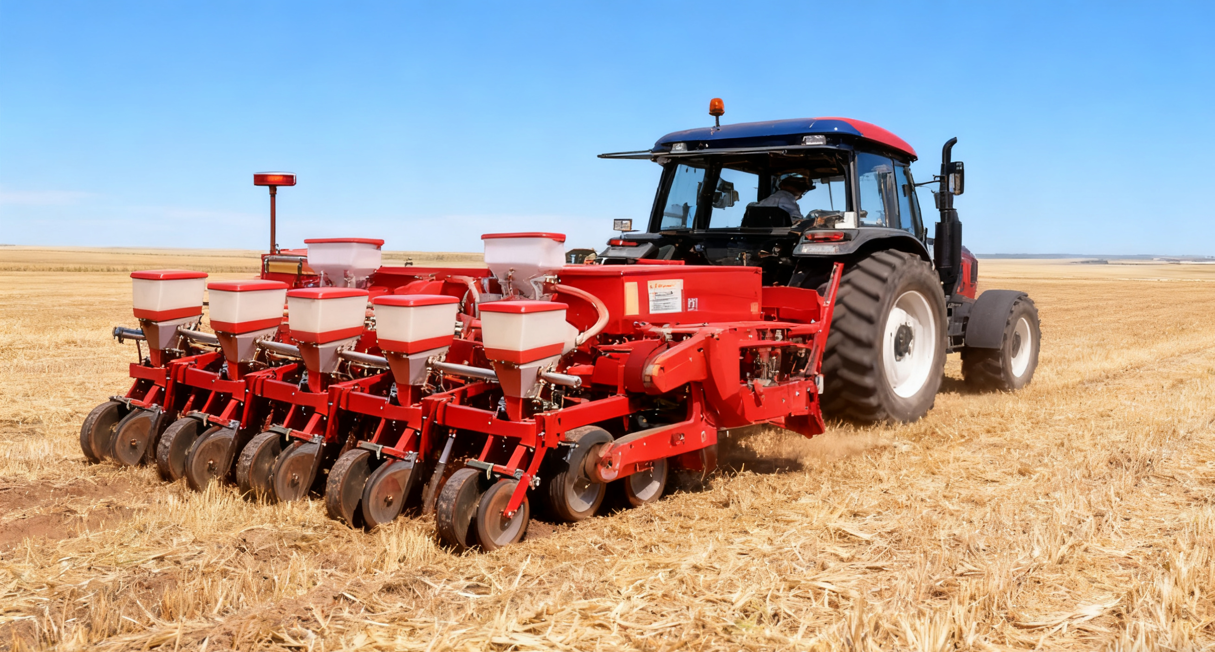
1. Mechanized Precision Seeding Technology
Implementation Method
Using precision maize planters enables precise seeding and fertilizing at the same time.
Technology Advantages
Improve seedling quality.
Ensure accurate seed placement in each hole.
Avoid seedling crowding.
Eliminate the need for manual thinning.
Reduce seed waste.
Notes:
First, mechanized precision seeding technology.
Using precision maize planters enables precise seeding and fertilizing at the same time.
This improves seedling quality,
ensures accurate placement of seeds in each spot,
and avoids overcrowded seedlings caused by traditional planting.
It also eliminates the need for manual thinning and effectively reduces seed waste.
一是机械化精量播种技术。采用玉米精量播种机实现种子和肥料精量同播，提升出苗质量，确保每穴精准播下种子，有效避免传统播种导致的幼苗拥挤问题，从而省去人工间苗环节，有效减少种子浪费。

Slide 7
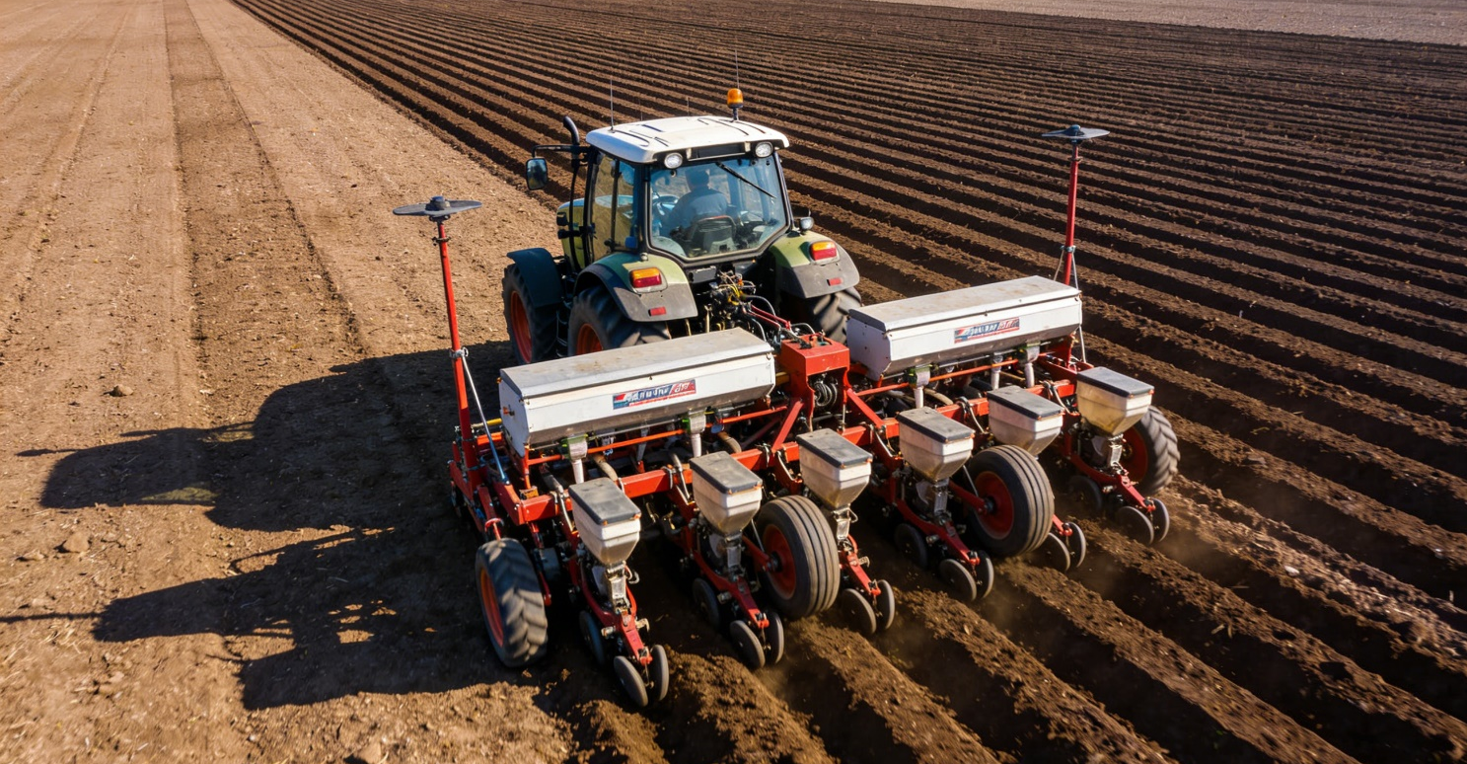
2. No-Tillage Planting Technology
Implementation Method
Utilizes high-performance no-tillage maize planters.
Technology Effects
Achieves uniform and strong seedlings.
Ensures increased grain yields.
Saves seeds.
Contributes to better crop growth.
Notes:
Second, no-tillage planting technology. High-performance no-tillage maize planters help produce uniform and strong seedlings, ensuring increased grain yields. When used properly, no-tillage planting not only saves seeds but also contributes to better crop growth.
二是免耕播种技术。通过采用高性能的玉米免耕播种机可以实现苗齐、苗壮，确保粮食增产。如果免耕播种技术用得好，既可以节省种子，也有利于作物的增产。

Slide 8
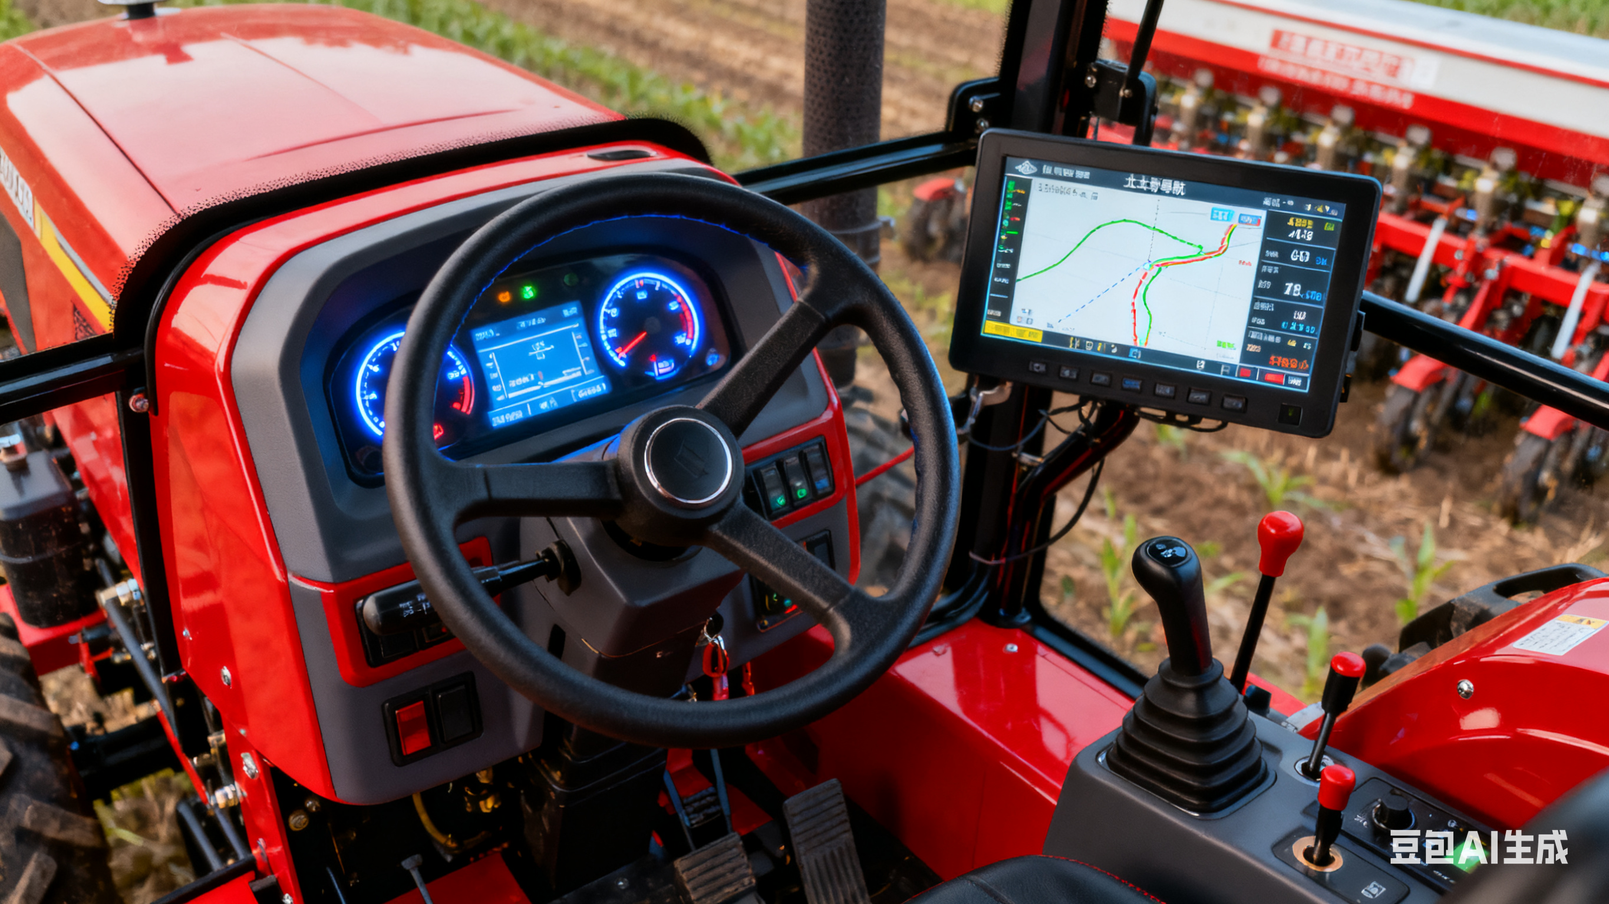
3. Smart Seeding Technology
Key Technologies
Utilize technologies such as Beidou navigation and autonomous driving.
Functions
Solve problems like misaligned planting rows.
Improve land use efficiency.
Notes:
Third, smart seeding technology. Technologies like Beidou navigation and autonomous driving can solve problems such as misaligned planting rows and improve land use efficiency.
三是智能播种技术。采用北斗导航、无人驾驶等技术可以解决传统的播种“不直”等问题，也提高土地的利用率。

Slide 9
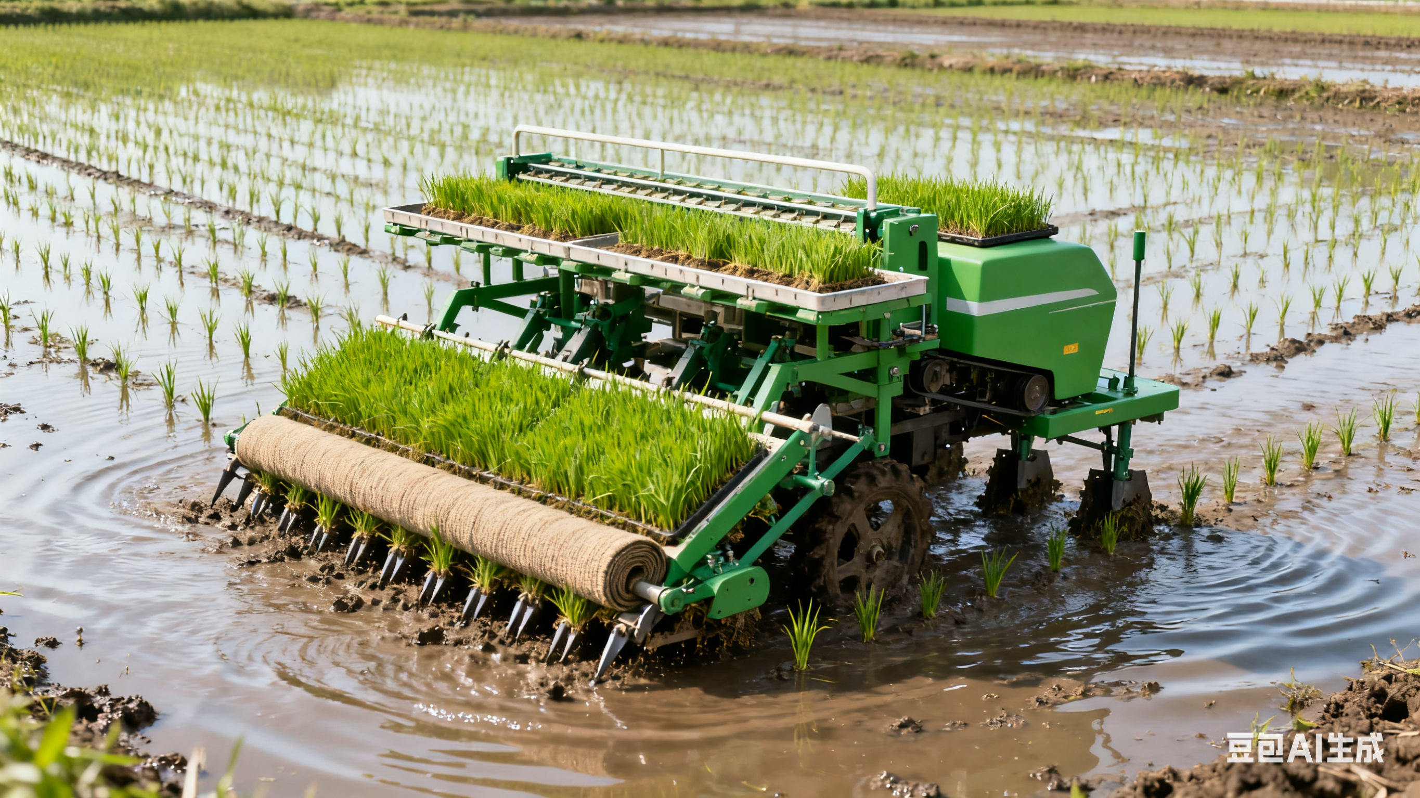
4. Mechanized Rice Seedling Raising and Transplanting Technology
Key Technologies
Large-spot carpet seedling transplanting machines.
Bowl-seedling placement technology.
Mechanized orderly seedling broadcasting.
Main Problems Addressed
Low mechanization levels.
Complicated field management.
Notes:
Fourth, mechanized rice seedling raising and transplanting technology.
This includes technologies such as large-spot carpet seedling transplanting machines,
bowl-seedling placement technology,
and mechanized orderly seedling broadcasting.
These technologies solve the problems in double-season rice production, such as low mechanization levels and complicated field management.
四是机械化育插秧技术，包括水稻大钵体毯状苗育插秧机机械化技术，钵苗摆载技术、机械化有序抛秧技术。这些技术可解决双季稻种植中存在‌的机械化水平不足、田间管理复杂等短板问题。

Slide 10
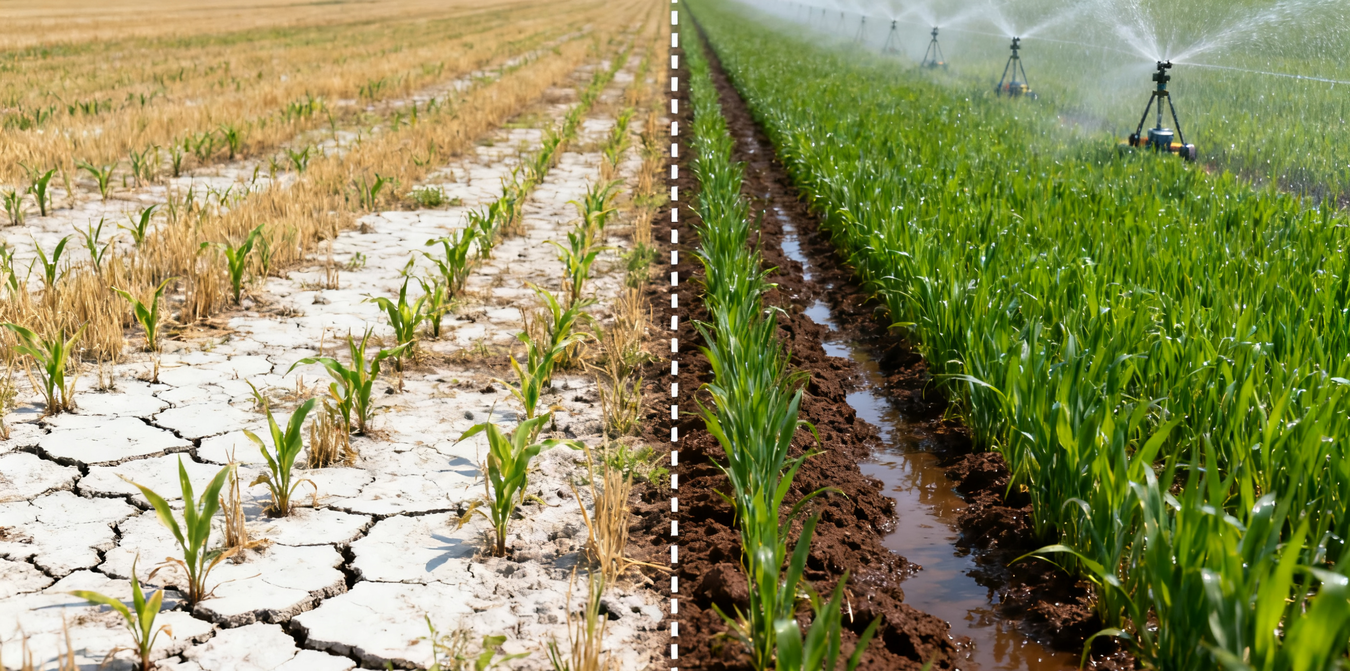
2. Field Management Stage
Challenges
Traditional manual pesticide application lacks precision, causing skipped areas or repeated spraying.
Water shortages in arid and semi-arid areas hinder crop growth and reduce yields.
Mechanized Solutions
Benefits
Mechanized high-efficiency plant protection technologies.
Mechanized high-efficiency irrigation technologies.
Precise pesticide application.
Targeted pest and disease control.
Efficient water-saving irrigation.
Promotion of healthy crop growth.
Notes:
2. Field Management Stage
Traditional manual pesticide application lacks precision and often leads to skipped areas or repeated spraying.
In arid and semi-arid areas, water shortages make it hard for crops to grow and reduce yields.
By applying mechanized high-efficiency plant protection
and mechanized high-efficiency irrigation technologies,
we can achieve precise pesticide application,
targeted pest and disease control,
and efficient water-saving irrigation.
These technologies promote healthy crop growth.
（二）田间管理环节。
传统的人工施药精准性差，存在漏播、重播的问题。干旱和半干旱地区水资源匮乏，不利于作物的生长，也影响了产量。通过应用机械化高效植保和机械化高效喷灌技术，可以实现精准施药，精准防控，高效节水，有利于作物的生长。

Slide 11
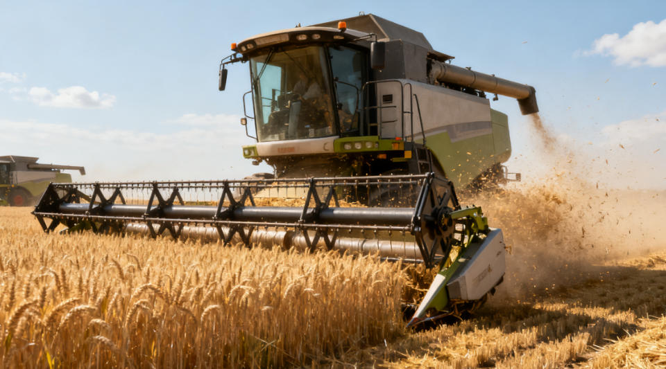
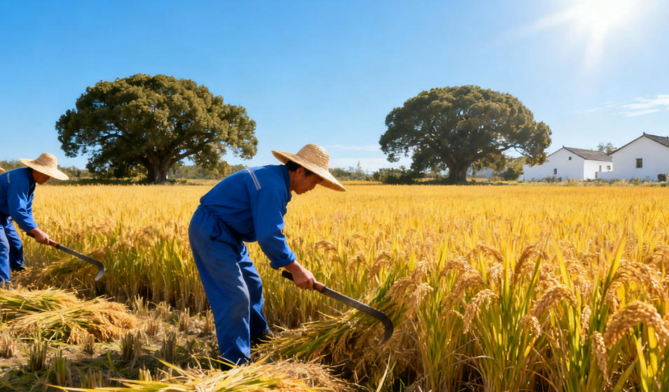
3. Harvesting Stage
Advantages of Mechanized Harvesting
Limitations of Manual Harvesting
Significantly reduces grain losses.
Loss rate can be maintained at 2%–5%, or even lower.
Higher losses at every stage: cutting, bundling, threshing, and transporting.
The loss rate can reach around 10%.
Notes:
3.Harvesting Stage
Using mechanized harvesting can greatly reduce grain losses. With machines, the grain loss rate can be kept around 2% to 5%, or even lower. In contrast, manual harvesting often causes greater losses at every stage — cutting, bundling, threshing, and transporting. The loss rate can reach around 10%.
（三）收获环节。
使用机械化收获，可有效降低粮食损失。机械化收获的粮食谷物损失率可控制在2%到5%左右，甚至更低。而采用人工收获，在收割、打捆、脱粒到运输的每个环节都会有很多损失。损失率在10%左右。

Slide 12
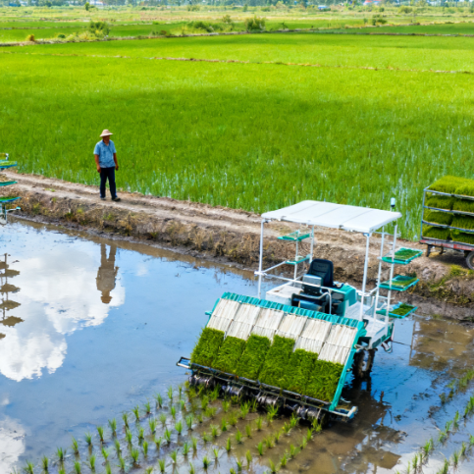
3. Harvesting Stage
Mechanized Measures
Improve the operational performance standards of harvesting machines.
Choose the right time to harvest.
Improve the skills of machine operators.
Use suitable harvesting equipment.
Notes:
To reduce losses during harvesting, four mechanized measures can be used:
oImprove the operational performance standards of harvesting machines
oChoose the right time to harvest
oUse suitable harvesting equipment
oImprove the skills of machine operators
为有效减少粮食收获环节的损失，可以采用以下四个方面的机械化措施：一是提高机具的合格指标，二是确定适时的收获时间，三是选择适宜收获的机械，四是提高机手操作的技能。

Slide 13
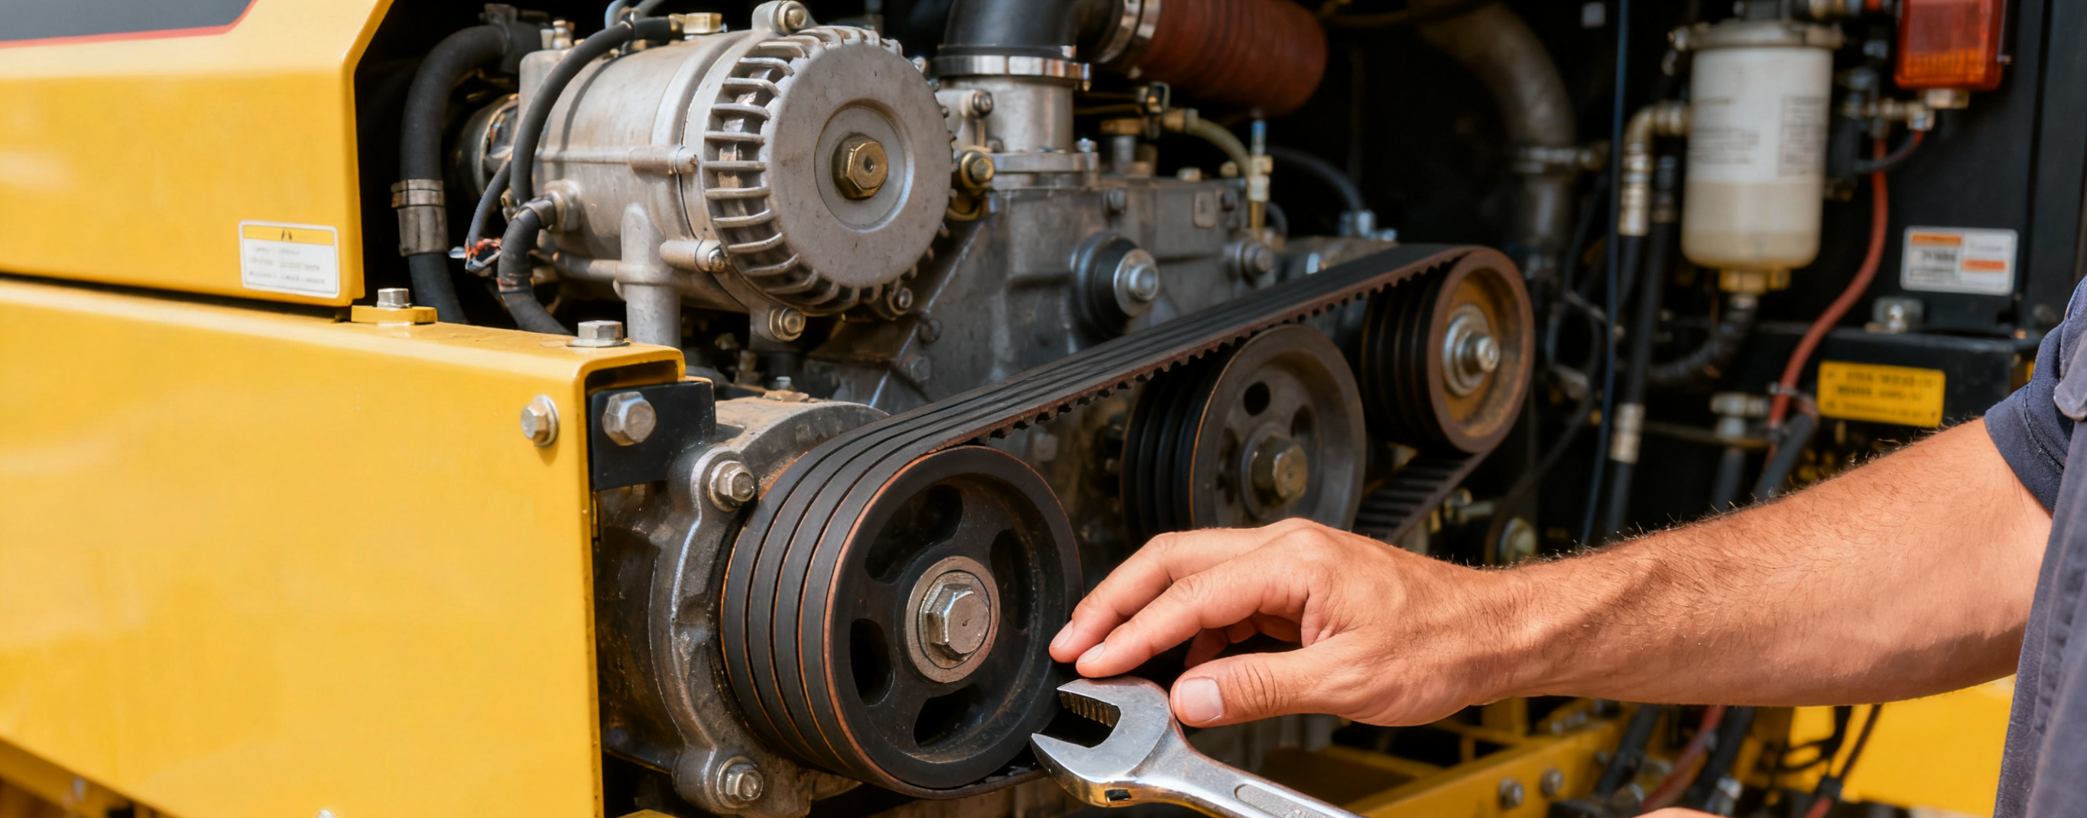
Essential Preparations Before Harvesting
Step 1: Check The Machinery
Overall Requirement
Key Inspection Items
Adjustments Needed
Inspect and maintain the combine harvester according to the user manual.
Fuel tank.
Radiator.
All moving parts.
Lifting system.
Check and adjust the tension of all drive belts.
Notes:
First of all, the following preparations should be made before harvesting:
首先在收获前要做好以下准备工作：
Step 1: Check the machinery:
Before harvesting, follow the user manual to inspect and maintain the combine harvester.
This includes checking the fuel tank, radiator, all moving parts, and the lifting system to ensure they work properly.
Also check and adjust the tension of all drive belts.
第一步检查农机具。在收获前，要依据产品使用说明书对联合收割机进行一次全面检查与保养，包括检查油箱、水箱、各运转部件及升降系统是否工作正常，检查和调整各传动皮带的张紧度。

Slide 14
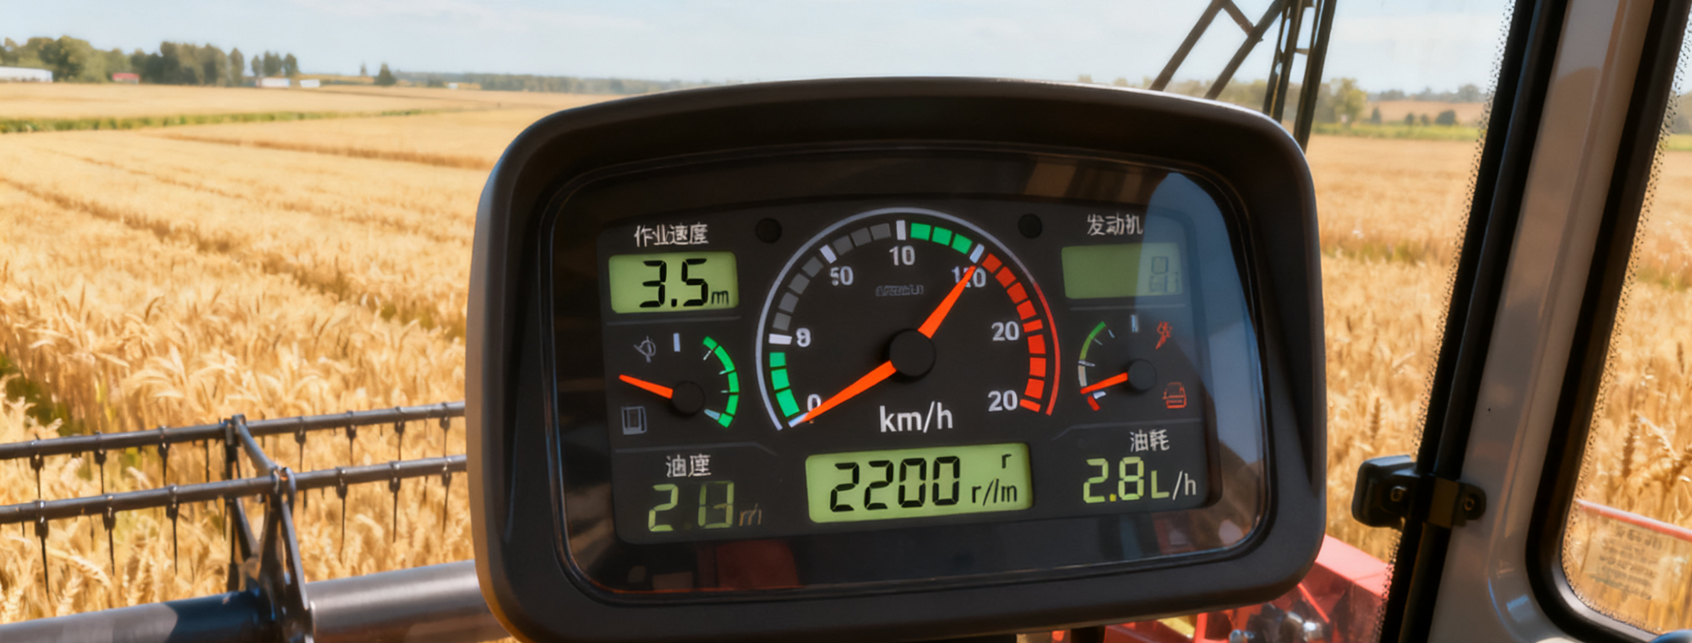
Essential Preparations Before Harvesting
Step 2: Test cutting
Purpose
Key Actions
Follow-Up Checks
Ensure harvesting settings and performance are correct before full operation.
Conduct a test cut of about 30 meters.
Choose a suitable operating speed based on crop and field conditions.
Carefully check the results.
Adjust machine parts and settings as needed.
Notes:
Step 2: Test cutting: Before starting full operation, perform a test cut.
A test run of about 30 meters is recommended. Choose a suitable operating speed based on the crop and field conditions.
Carefully check the results and adjust machine parts and settings as needed.
第二步试割。正式开始作业前要进行试割。试割作业行进长度以30米左右为宜。可根据作物、田块的条件确定适合的作业速度。仔细检测试割效果，并对相应部件位置及参数进行调整。

Slide 15
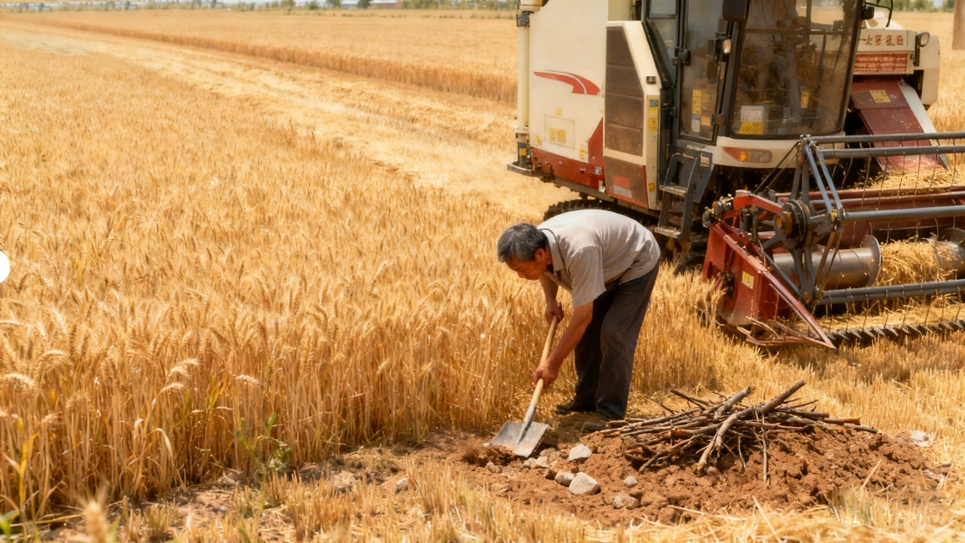
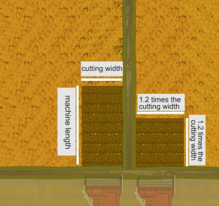
Essential Preparations Before Harvesting
Step 3: Inspect the field
Debris Removal
Clear hard objects such as wooden stakes and stones.
Risk Identification
Check for muddy or unstable ground, and mark any areas that may cause the machine to get stuck, tip over, or fall.
Ridge Adjustment
Inspect the field ridges to ensure they do not obstruct machine entry.
If a ridge is too high, manually create an opening:
· One cutting width × machine length at the right corner.
· A 1.2× cutting width gap at both field ends.
Notes:
Step 3: Inspect the field:
Remove any hard objects, such as wooden stakes and stones,
from the field. Check for muddy or unstable ground, and mark any areas that may cause the machine to get stuck, tip over, or fall.
Check the field ridges. If the ridge is too high, manually cut an open space in the right corner, the size of one cutting width by the length of the machine. Or, at both ends of the field, make a 1.2 times cutting width gap in the ridge to help the harvester enter smoothly.
第三步检查作业的田块。检查去除田里的木桩、石块等硬杂物，了解田块的泥脚情况，对可能造成陷车、倾翻或跌落的地方做出标识。查看田埂情况，如果田埂过高，应用人工在右角割出（割幅）x（机器长度）的空地，或在田块两端的田埂开1.2倍割幅的缺口，便于收割机顺利下田。

Slide 16
Determine the Optimal Harvest Time
Main Types of Harvest Loss
Header loss: Improper cutter bar / reel operation → grain shattering and loss.
Threshing/cleaning loss: Inappropriate drum speed or gap → incomplete grain separation/fan blow-out/sieve blockage.
Loss Patterns at Different Harvest Times
Harvesting Too Early
Kernels remain firmly attached → low header loss.
Kernels are moist and light → higher threshing & cleaning loss.
Harvesting Too Late
Kernels are dry and fall off easily → high header loss.
Threshing & cleaning loss decreases.
Significance
Choosing the best harvest time is crucial for reducing overall harvest losses.
Notes:
Secondly, it is important to determine the optimal harvest time.
In mechanized harvesting, most crop losses come from two sources:
a.Header loss – caused by improper operation of parts like the cutter bar or reel, which can lead to grain shattering and loss.
b.Threshing and cleaning loss – caused by inappropriate drum speed or gap, which can result in incomplete separation of grain from the ear. Grain may also be blown out by the fan or blocked on the sieve surface and not collected.
These two types of losses are inversely related to each other. If harvesting is too early, the kernels remain firmly attached to the ear and header loss is relatively low. But the kernels are still moist and light in weight, so threshing and cleaning losses increase.
If harvesting is too late or the optimal window is missed, the kernels are dry and fall off easily, leading to higher header losses. But threshing and cleaning losses tend to decrease.
Therefore, choosing the best harvest time is critical to reducing overall harvest losses.
其次，要确定适宜的收获期。在机械化收获过程中，作物损失主要来源于两个环节：一是割台损失，即由于收割时割刀、拨禾轮等部件操作不当导致籽粒掉落造成的损失；二是滚筒脱粒与清选环节的损失，即因滚筒转速或间隙不适宜导致籽粒未完全脱离穗头以及籽粒在清选过程中被风扇吹出或筛面堵塞未能收集造成的损失。这两种损失是相互矛盾的。如果收获过早，作物的穗粒不容易掉，割台损失会相对较少。但如果作物重量太轻，或者是还不到蜡熟期，脱粒脱不尽，那么脱粒清选的损失就会增加。反之，如果收获期晚了，或者是错过了最佳的收获期，作物穗粒一碰就掉，则割台的损失就会偏大，同时滚筒和清选的损失相对较少。所以，确定最佳的、适宜的收获期对降低收获损失至关重要。

Slide 17
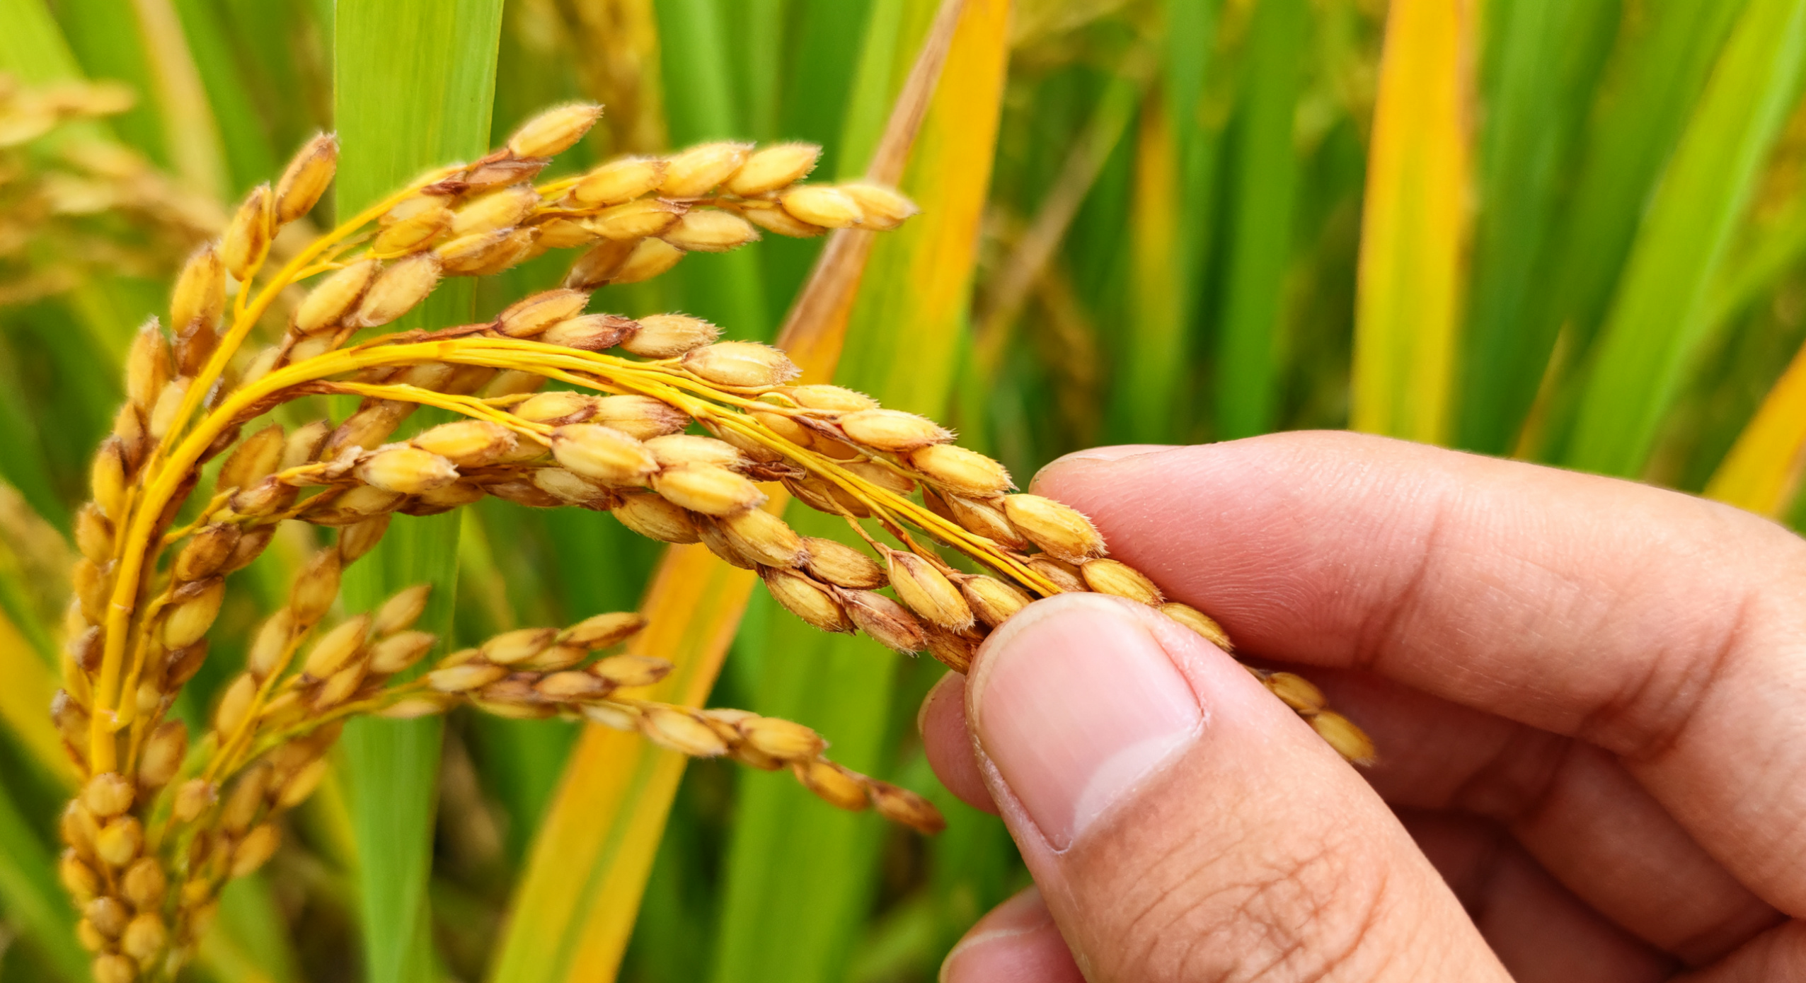
Determine the Optimal Harvest Time
Method 1: Based on Crop Growth Characteristics
Rice
Optimal stage: Late wax-ripening → Early full-ripening.
Moisture content: 15%–28%.
Husk turns yellow; kernels become firm.
Wheat
Stage: Wax-ripening.
Leaves dry and yellow; stems remain flexible.
Kernels yellow, plump, moist; moisture 25%–30%.
Method 2: Based on External Appearance
Rice indicators
Over 90% of kernels have yellow husks.
Rachis & pedicels turn yellow.
Kernels hardened.
The best harvest time should be determined based on actual field conditions.
Notes:
Usually, there are two ways to determine the right time for harvesting:
oBased on crop growth characteristics
For rice, the optimal time is from the late wax-ripening stage to the early full-ripening stage. At this point, the grain moisture content is about 15% to 28%, the husk turns yellow, and the kernels become firm.
For wheat, during the wax-ripening stage, the leaves turn dry and yellow, the stems remain flexible, the kernels become yellow, plump, and moist, with a moisture content of about 25% to 30%.
oBased on external appearance
For rice, when more than 90% of the kernels on the panicle have yellow husks, and the rachis and pedicels have also turned yellow with hardened kernels, the crop is readyfor harvest.
The best harvest time should be determined based on actual field conditions.
判断适宜的收获期通常有两种方法：
一是根据生长的特征来确定。水稻蜡熟末期至完熟初期，籽粒含水量为15%～28%，谷壳变黄、籽粒变硬；小麦蜡熟期叶片干黄，茎秆有弹性，籽粒转黄色，饱满湿润，籽粒含水率为25%～30%。
二是根据外部的形态来确定，水稻穗部90%以上籽粒谷壳及穗轴、枝梗转黄、谷粒变硬时即可进行收获。
要结合实际情况，选择最适宜的收获时间。

Slide 18
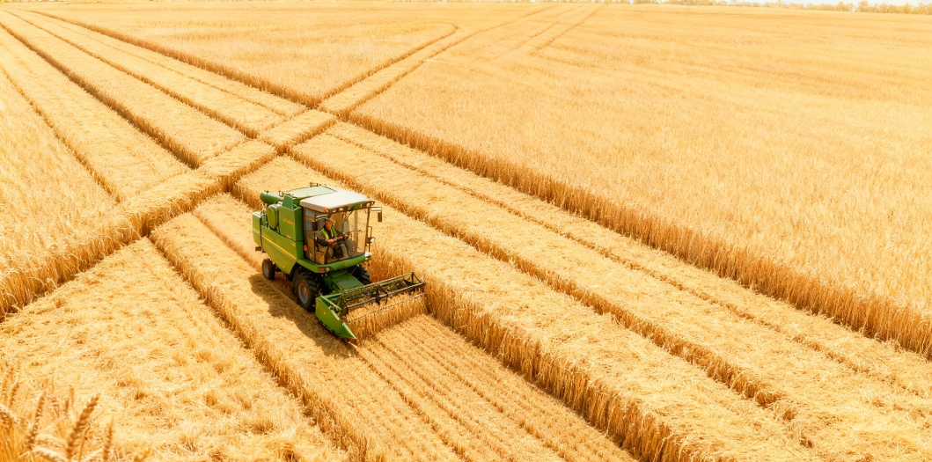
Standardize Harvester Operation
a. Properly Open Harvesting Paths
1. How to Open Entry Paths
Begin from a corner where the harvester can easily enter.
Cut one swath along the field edge, then reverse 5–8 m.
Cut the 2nd and 3rd swaths diagonally, reversing between each pass.
Repeat the method in the crosswise direction to open paths.
In regularly shaped fields, connect small plots to open a three-swath-wide path and then divide the field into sections for harvesting to improve efficiency.
2. Key Operating Practices
Keep the harvester moving in straight lines.
Avoid turning while cutting to prevent crop lodging and missed harvesting.
Notes:
The third measure is to standardize harvester operation. It is important to standardize the operators’ driving practices,. Operators should receive training and follow a consistent set of operating procedures to minimize harvest losses.
a.Properly open harvesting paths
Begin from a corner of the field where the harvester can easily enter.
Cut one swath along the field edge, then reverse 5–8 meters.
Cut the second swath diagonally, reverse again, and cut the third diagonally.
Use the same method in the crosswise direction to open paths.
In regularly shaped fields, connect multiple small plots to open a three-swaths-wide path and then divide the field into sections for harvesting to improve efficiency.
During harvesting, the harvester should move in straight lines.
Avoid turning while cutting, as it can press down crops, cause missed harvesting, and increase losses.
第三要规范驾驶操作。对于机手的操作要进行统一的规范，开展培训，通过规范化作业流程最大限度减少收获损失。
首先要正确地开出割道，从易于收割机下田的一角开始，沿着田埂割出一个割幅，割到头后倒退5～8米，然后斜着割出第二个割幅，割到头后再倒退5～8米，斜着割出第三个割幅；用同样的方法开出横向方向的割道。规划较整齐的田块，可以把几块田连接起来开好割道，割出三行宽的割道后再分区收割，提高收割效率。收割过程中机器保持直线行走，避免边割边转弯，压倒部分谷物造成漏割，增加损失。

Slide 19
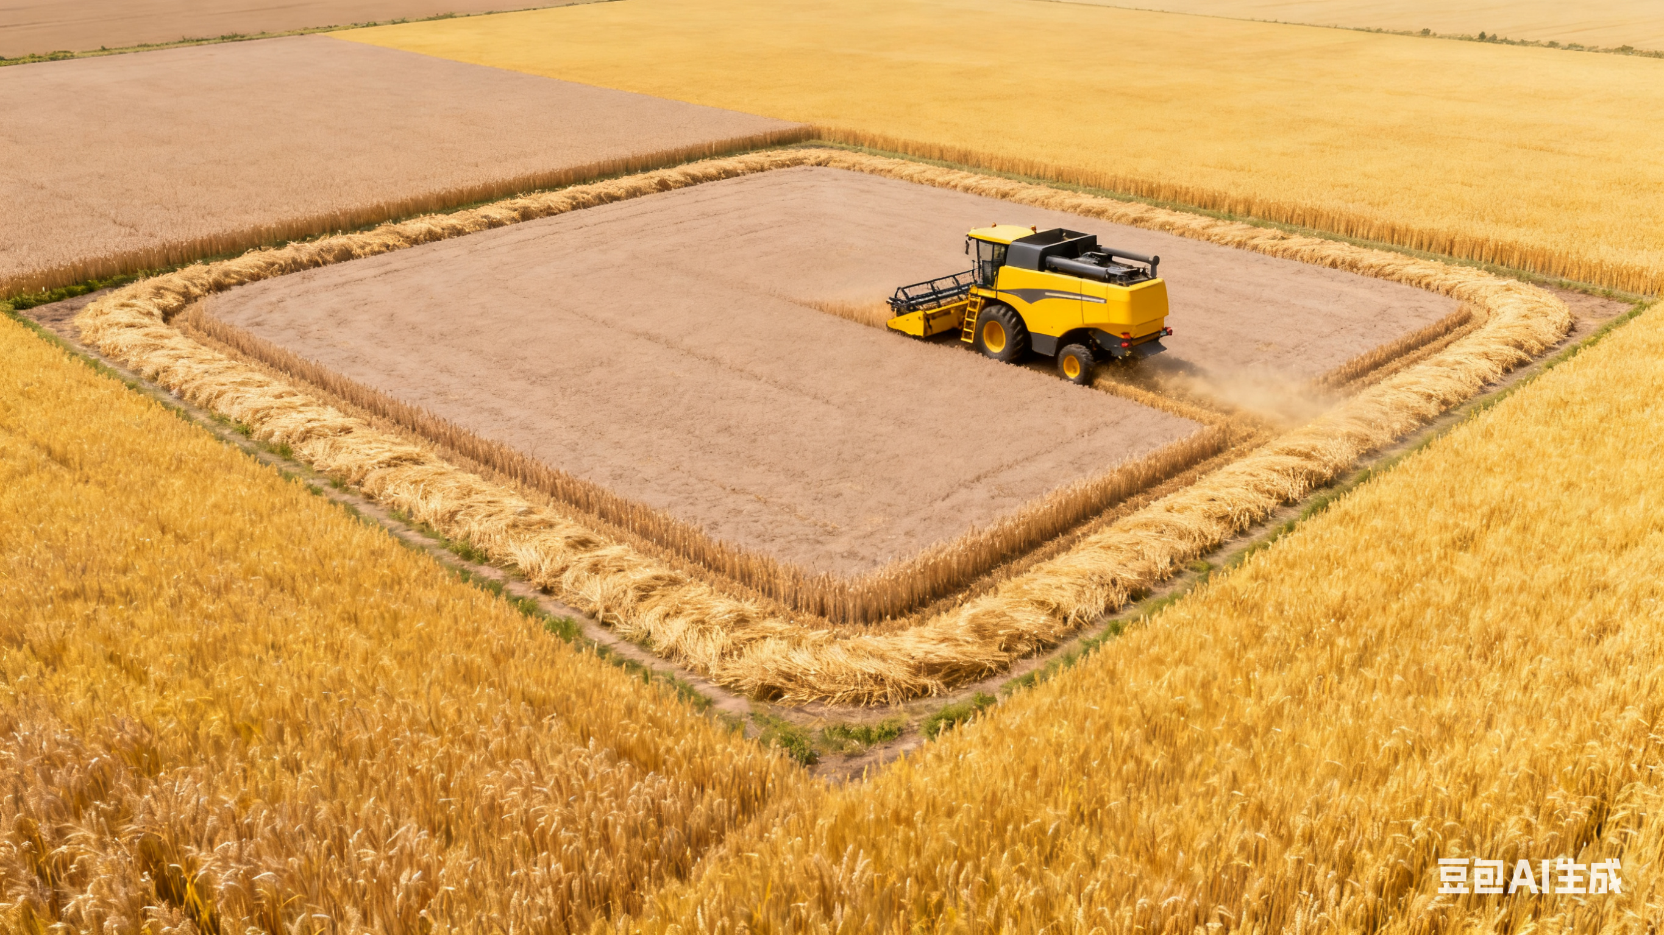
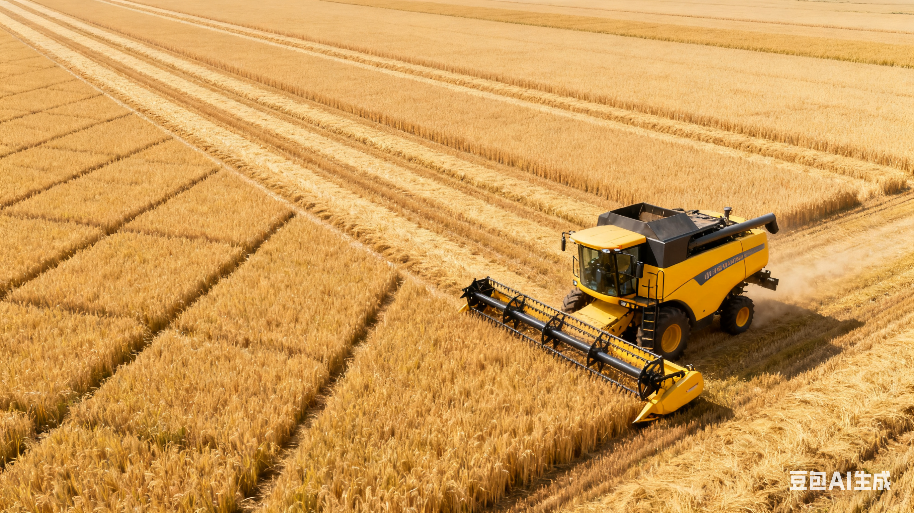
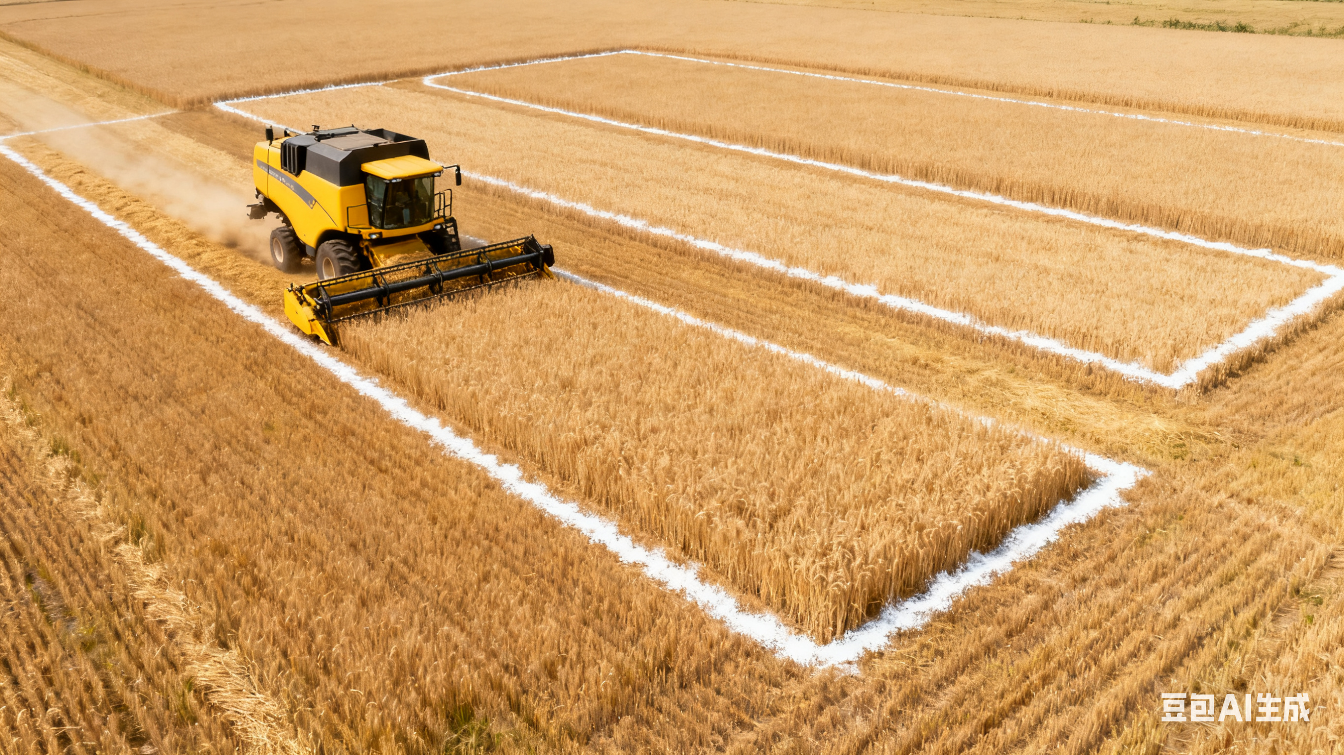
Standardize Harvester Operation
b. Choose the right harvesting route
01
02
03
Four-side harvesting
Diamond-shaped two-way harvesting
Block harvesting
Notes:
b. Choose the right harvesting route
There are three common harvesting methods, and the choice depends on the field’s size and shape:
其次是选择行走路线。最常用的行走路线有三种，分别是四边收割法、菱形双向收割法和分块收割法。选择哪种方法是根据田块的大小和形状特征决定的。

Slide 20
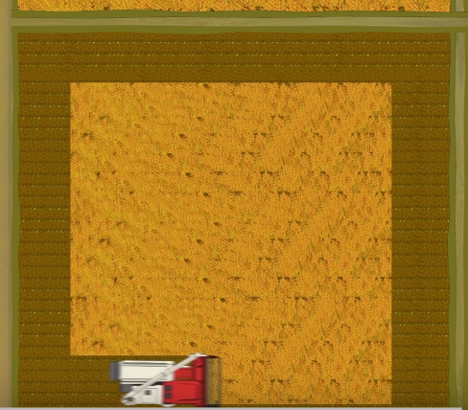
Standardize Harvester Operation
b. Choose the right harvesting route
1.Four-side harvesting
Applicable Scenario
Suitable for fields with similar length and width.
Works best in relatively large area.
Operating Steps
Key Advantages
High efficiency.
Facilitates machine movement in the field.
Reduces unnecessary pulling and collisions.
Minimize harvest losses.
Open harvesting paths first.
Cut one swath to the end of the section.
Move forward 5–8 meters along the path.
Reverse while turning right to position the machine at 90°.
Continue harvesting along the new direction.
Notes:
Four-side harvesting – Suitable for fields with similar length and width and a relatively large area.
After opening paths, cut one swath to the end of the section, then move forward 5–8 meters along the path. Reverse while turning right until the machine is positioned at 90 degrees, and continue harvesting.
This method is efficient, facilitates machine movement in the field, and reduces unnecessary pulling and collisions, thereby minimizing harvest losses.
对于长宽相近且面积较大的田块，适宜采取四边收割法。具体操作方法是，先开出割道，然后收割一个割幅到割区尽头，接着沿割道前进5～8米，边倒车边向右转弯，使机器横过90度后继续收割。这种方法效率高，有利于机械在田间行走和作业，能够减少不必要的拉扯和碰撞，从而将收割损失降到最低。

Slide 21
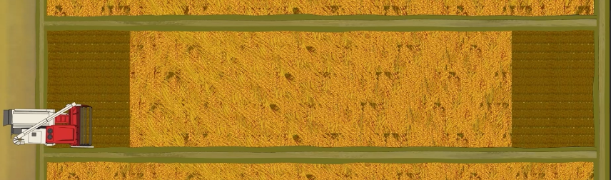
Standardize Harvester Operation
b. Choose the right harvesting route
2.Diamond-shaped two-way harvesting
Application Scenario
Small fields where the length differs significantly from the width.
Operating Steps
Open paths at both ends of the field.
Harvest along the long direction to the end of the section.
Turn left and circle around to the opposite side of the section.
Continue harvesting in the reverse direction.
Notes:
Diamond-shaped two-way harvesting – Suitable for small fields where the length differs significantly from the width.
First open paths at both ends of the field, then harvest along the long directions to the end of the section, turn left and circle around to the opposite side of the section, and continue harvesting.
对于长宽相差比较大且面积较小的田块，可以采取菱形双向收割法。具体做法是，沿着田块两头开出的割道，在长方向上割到割区尽头，然后左转弯绕到割区另一边继续收割。

Slide 22
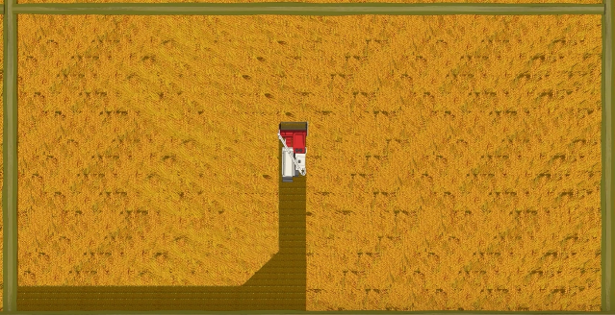
Standardize Harvester Operation
b. Choose the right harvesting route
3.Block harvesting
Applicable Scenario
Large or regularly shaped fields.
Key Features
Facilitates crop harvesting.
Supports smoother scheduling of grain unloading.
Improves overall operational efficiency.
Minimizes harvest losses.
Notes:
Block harvesting – Best for large or regularly shaped fields.
This method facilitates crop harvesting and the scheduling of grain unloading, helps improve operational efficiency and minimizes harvest losses.
对于田块面积比较大或者形状比较规整的田块，采取分块收割法更为合适。这种方法有利于作物的收获和卸粮调整，有助于提高作业效率，同时也能将收获损失降到最低。

Slide 23
Standardize Harvester Operation
c. Maintain proper operating speed
Operating Specifications
Normal Operation
Turning at Field Edges
High-Yield Fields (>9,000 kg/ha)
Fields with Excessive Weeds
Keep the engine running at its rated speed.
Appropriately slow down.
Reduce the speed.
For full-feed combine harvesters, appropriately increase cutting height and reduce cutting width.
Slow down the machine to avoid excessive feeding rates that may lead to higher grain loss and impurity content.
Notes:
c. Maintain proper operating speed
Keep the engine running at rated speed during operation.
Slow down when turning at field edges.
If crop yield exceeds 9,000 kg per hectare, reduce the harvesting speed. For full-feed combine harvesters, appropriately increase the cutting height and reduce the cutting width.
If there are too many weeds in the field, consider slowing down the machine to avoid excessive feeding rates that may lead to higher grain loss and impurity content.
同时要选择适宜的作业速度。作业过程中应保持发动机在额定转速下运转。在地头转弯作业时，应适当降低作业速度。当作物产量超过9000公斤/公顷时，应降低作业速度。全喂入联合收割机还应适当增加割茬高度并减小收割幅宽。若田间杂草太多，应考虑放慢收割机作业速度，防止喂入量过大导致作业损失率和谷物含杂率过高。

Slide 24
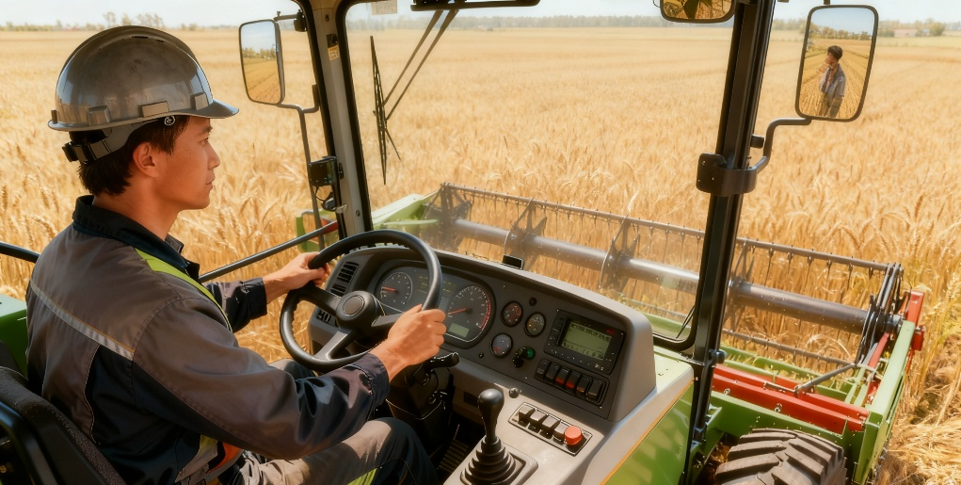
Standardize Harvester Operation
c. Maintain proper operating speed
Operators should
Adjust harvesting speed according to crop growth and yield.
Prevent machine clogging.
Maintain operational efficiency.
Avoid pulling or missed cutting.
⋙ Reduce harvest losses.
Notes:
Operators should adjust harvesting speed according to crop growth and yield to ensure the machine does not become clogged, maintains operational efficiency, and avoids pulling or missed cutting,
thereby reducing harvest losses.
机手要根据作物的长势和产量，选择最适宜的收割速度，确保设备既不发生堵塞，又能保持作业效率，同时避免出现拉扯或者漏割现象，有利于减少收获的损失。

Slide 25
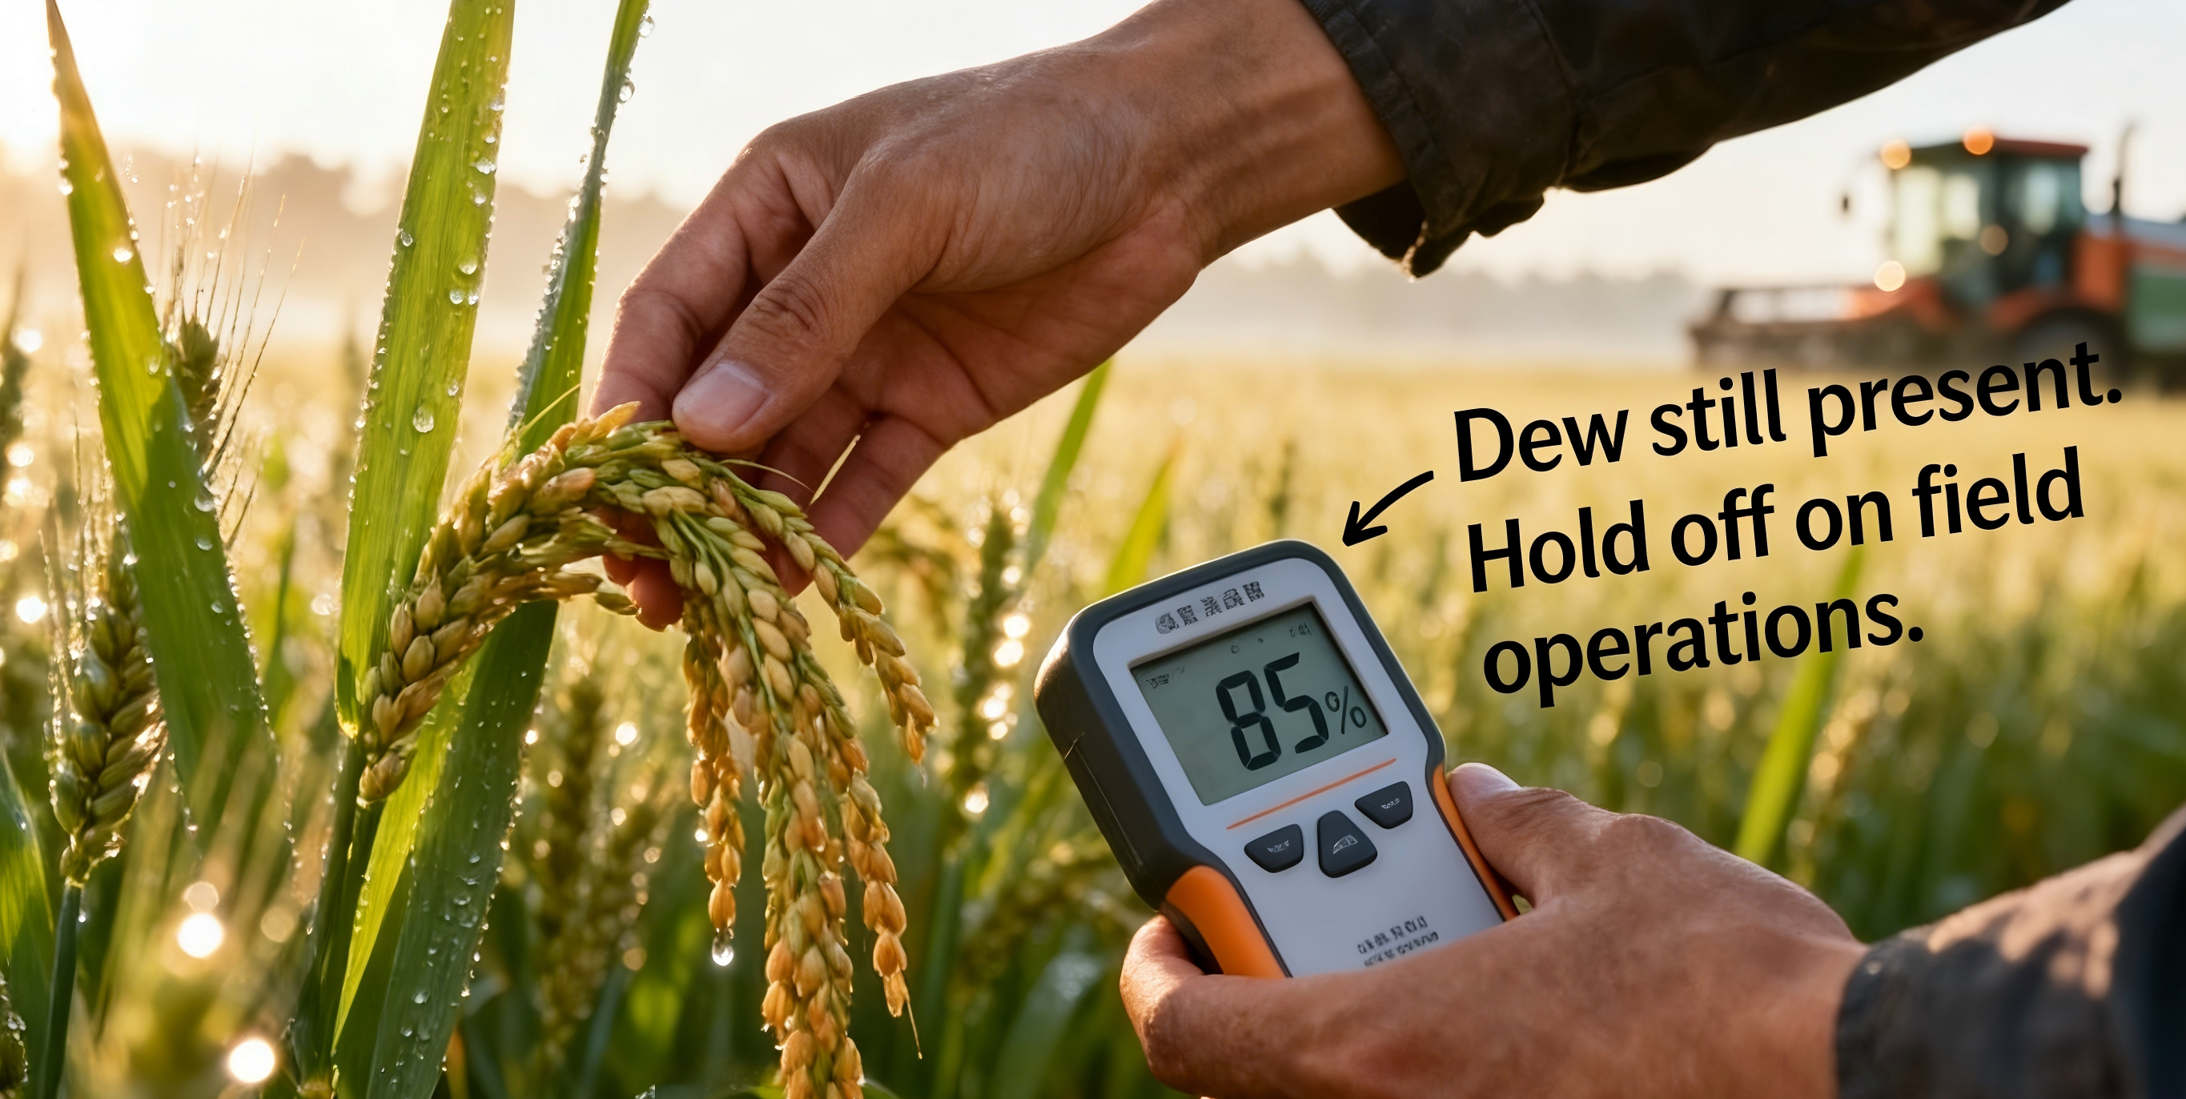
Standardize Harvester Operation
d. Handle special harvesting conditions
1. Harvesting in wet conditions or with wet crops
Checking & Cleaning
Frequently check whether concave sieve and cleaning screen are clogged.
Clean them promptly if needed.
Dew Consideration
When there is dew, wait until it evaporates before starting operations.
Field & Crop Assessment
Before harvesting in wet fields, carefully assess:
Crop conditions (degree of lodging).
Field conditions (degree of muddiness).
Notes:
d. Handle special harvesting conditions
oHarvesting in wet conditions or with wet crops
During urgent harvest seasons, when a significant proportion of crops are wet, frequently check whether the concave sieve and cleaning screen are clogged, and clean them promptly if needed.
When there is dew, wait until it has evaporated before starting operations.
Before harvesting in wet fields, carefully assess the crop conditions (degree of lodging) and the field conditions (degree of muddiness).
第四要注意在特殊情况的收割作业。
一是收割潮湿作物或者在湿田中作业。在季节性抢收时，如遇到潮湿作物较多的情况，应经常检查凹板筛、清选筛是否堵塞，并注意及时清理。有露水时，要等到露水消退后再进行作业。在进行湿田收割前，务必仔细确认作物状态（倒伏角的大小）和田块状态（泥泞程度）。

Slide 26
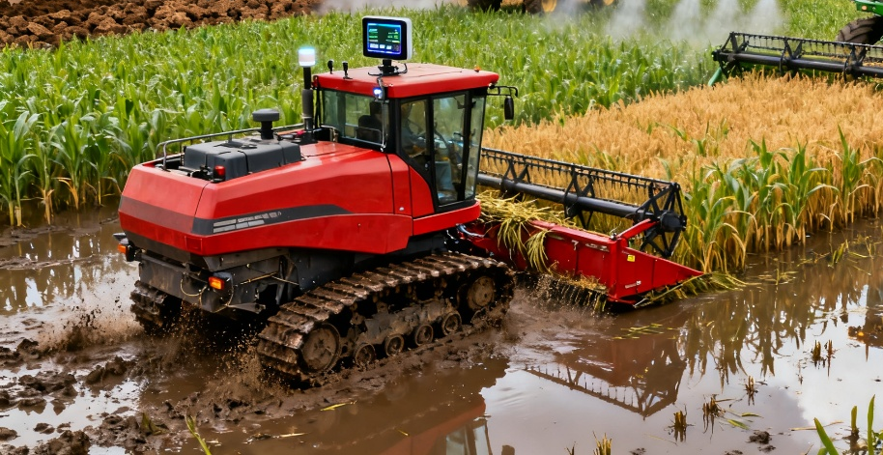
Standardize Harvester Operation
d. Handle special harvesting conditions
1. Harvesting in wet conditions or with wet crops
Harvester Operation in Wet Fields
If harvester slips, sinks, or tilts:
· Reduce speed.
· Avoid sharp turns or turning in place.
· Refrain from sudden forward or reverse movements.
· Promptly empty grain tank to reduce machine weight.
Harvesting Wet or Lodged Crops in Muddy Fields
Cutter header, concave sieve, and vibrating sieve are prone to clogging.
Operate at low speed with reduced feeding volume.
Harvest in small successive passes.
Promptly clear straw debris and mud from cutter blades and feeder housing inlet.
Machine Adaptation
Where conditions allow, replace wheels with semi-tracks to ensure normal harvesting in muddy fields.
Notes:
If the harvester slips, sinks, or tilts during operation, reduce speed, avoid making sharp turns or turning in place, and refrain from sudden forward or reverse movements. Promptly empty the grain tank to reduce the machine’s weight.
When harvesting wet or lodged crops in muddy fields,
the cutter header, concave sieve, and vibrating sieve are prone to clogging. Operate at low speed with reduced feeding volume, harvesting in small successive passes. Promptly clear straw debris and mud from the cutter blades and the feeder housing inlet.
Where conditions allow, replace the wheels with semi-tracks to ensure normal harvesting in muddy fields.
第四要注意在特殊情况的收割作业。
收割过程中如遇到收割机打滑、下沉、倾斜等情况时，应降低作业速度，不急转弯，不在同一位置转弯，避免急进、急退，应及时排除粮仓内的谷粒，以减轻收割机的重量。在较为泥泞的湿田中收割倒伏作物或潮湿作物时，容易造成割台、凹板筛和振动筛的堵塞，因此需低速、少量依次收割，并及时清除割刀和喂入筒入口的秸秆屑及泥土。有条件的地方可以更换半履带，以适应泥泞田块正常收获作业。

Slide 27
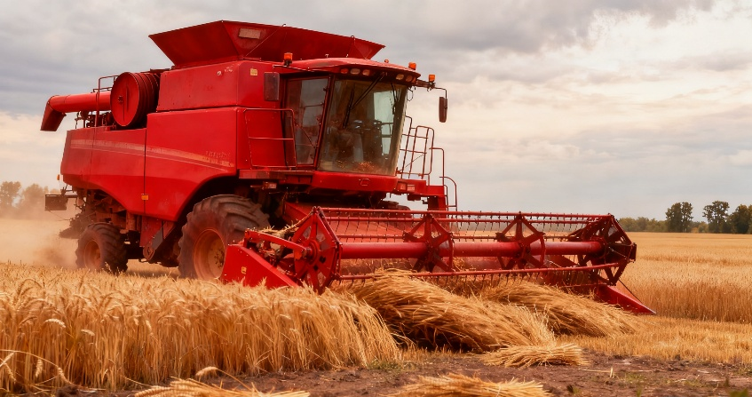
Standardize Harvester Operation
d. Handle special harvesting conditions
2.Harvesting lodged crops
Lodged Crop Harvesting Strategy
Install crop lifters or anti-lodging pickup fingers.
Reduce operating speed to improve harvesting quality.
Harvesting Methods for Different Lodging Angles
Lodging angle < 45°: Harvest as usual.
Lodging angle 45–60°: Move the reel forward and tilt the pickup fingers rearward.
Lodging angle > 60°:
· Use full-feed combine.
· Harvest from the side opposite to lodging direction.
· Ensures grain contacts lifter and header base plate first, reducing losses.
Row-by-Row Harvesting Technique
After each run, return empty to starting point before beginning next row.
Helps minimize grain loss from lodged crops.
Avoid Harvesting in Lodging Direction
Reel or header base plate contacts stems first.
Can pull and shake crops, causing more grain to fall.
Notes:
oHarvesting lodged crops
Install crop lifters or anti-lodging pickup fingers, and appropriately reduce the operating speed to improve harvesting quality.
•If the lodging angle is less than 45°, harvest as usual.
•If the angle is 45–60°, move the reel forward and tilt the pickup fingers rearward.
•If the angle is over 60°, use a full-feed combine to harvest from the side opposite to thelodging direction. This allows the crop lifter and the base plate of the header to contact the grain first, so that the grain falls onto the conveyor before reaching the reel, thereby reducing losses.
After one run, return empty to the starting point to begin the next row. This approach helps minimize grain loss from lodged crops.
If harvesting in the same direction as lodging, the reel or header’s base plate first contacts the stems, which can pull and shake the crop, causing more grain to fall.
二是对倒伏的作物进行收获。可通过安装“扶倒器”和“防倒伏弹齿”装置，并适当降低作业速度来提升收获质量。当倒伏角度小于45度时，收割作业可按常规方式进行； 若倒伏角度处于45-60度时，需将拨禾轮位置前移并调整弹齿角度后倾； 当在倒伏角度大于60度时，应使用全喂入联合收割机进行逆向收割，即收割机从倒伏方向相反一侧进机，使扶禾器和收割机割台的底板最先接触作物籽粒，这样可让作物籽粒在碰到拨禾轮时，能先掉到拖板上，减少籽粒损失。完成单次收割后，收割机需空驶返回起点再开始下一次作业，这样做能够显著降低收获倒伏作物的损失。如果按照顺向来收，拨禾轮或者是收割台的底板先接触到的是作物的茎秆，很容易出现拉扯，导致更多籽粒脱落，造成收获的损失。

Slide 28
Standardize Harvester Operation
d. Handle special harvesting conditions
Applicable crops and conditions
At full maturity, rice panicles, stems, and panicle branches break easily.
3.Harvesting overripe crops
Harvesting Operation Guidelines
Keep stubble height between 10–15 cm.
Prevent the cutter from digging into the soil.
Machine Usage Precautions
Do not use half-feed machines in such cases.
Helps reduce cut-panicle losses and missed-panicle losses.
Notes:
Harvesting overripe crops
When crops like rice are fully mature, their panicles, stems, and panicle branches break easily.
Keep the stubble height between 10–15 cm and prevent the cutter from digging into the soil.
Do not use half-feed machines in such cases, to reduce cut-panicle and missed-panicle losses.
收获过熟作物需要掌握技巧。当水稻等作物完全成熟后，其穗茎和枝梗容易折断，这时应将留茬高度控制在10～15厘米范围内，同时也要防止切割器“入泥吃土”，并且严禁用半喂入机型作业，以减少切穗、漏穗。

Slide 29
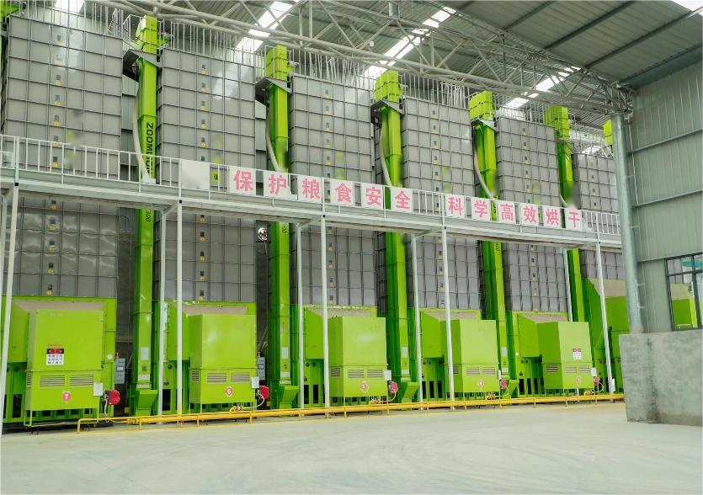
4. Drying Stage
Mechanized drying
High-efficiency, low-loss.
Traditional method
Grain is dried by sun-drying, which is low-cost but weather-dependent.
Advantages of mechanized drying
Improves efficiency and ensures reliable drying even in rainy or cloudy conditions，reducing the risk of mold and loss due to poor drying.
Notes:
4.Drying Stage
High-efficiency, low-loss mechanized drying is an important technology.
Traditionally, grain is dried by sun-drying, which is low-cost but weather-dependent.
Mechanized drying improves efficiency and ensures reliable drying even in rainy or cloudy conditions, reducing the risk of mold and loss due to poor drying.
（四）烘干环节。
机械化烘干高效低损技术是一项重要的技术措施。传统的粮食干燥处理方式是成本较低的自然晾晒方式。而采用机械烘干方式，可以提高烘干效率，并且能在阴雨等不利天气条件下保证作业，减少作物霉变带来的损失。

