Slide 1
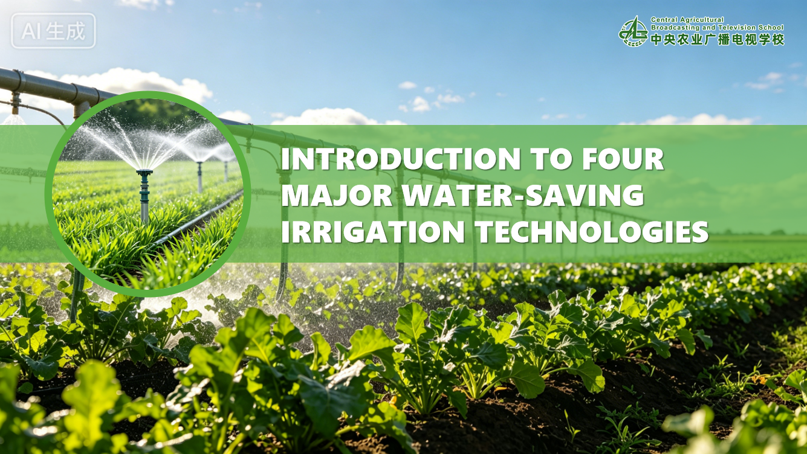

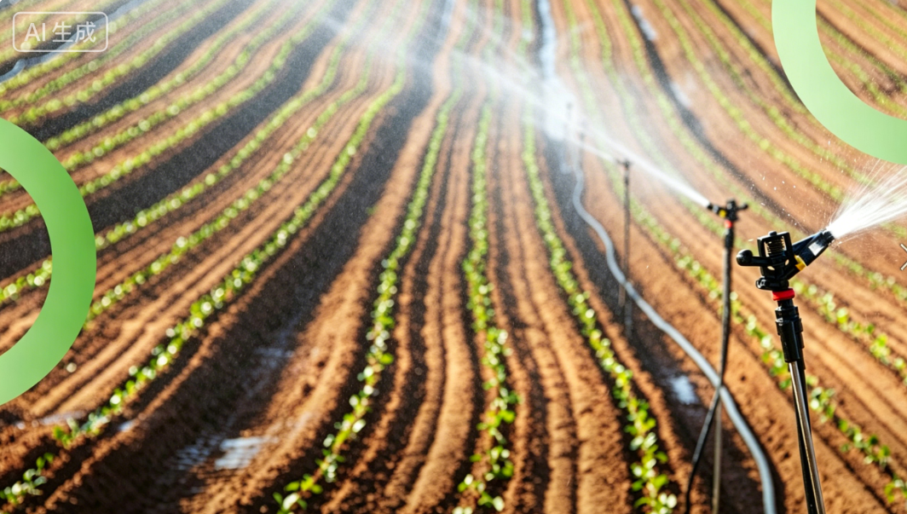
Introduction to Four Major Water-Saving Irrigation Technologies
Notes:
Introduction to Four Major Water-Saving Irrigation Technologies
四大节水灌溉技术介绍

Slide 2

PART.02
Automated Irrigation Technology
Notes:
二、自动化灌溉技术
PART 2 .Automated Irrigation Technology

Slide 3
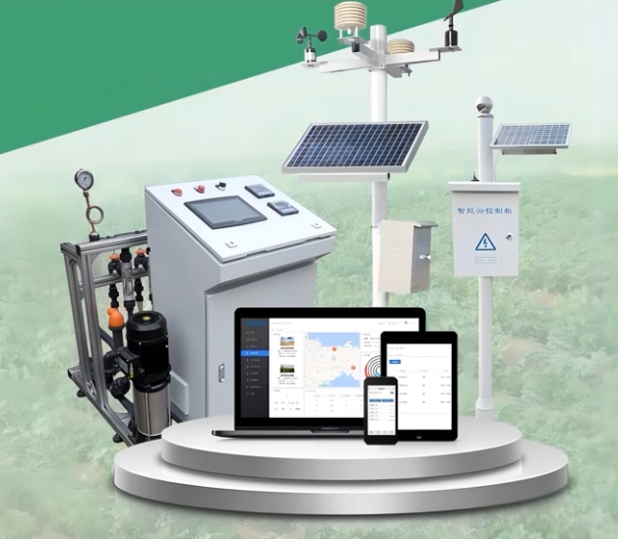
1. System Components
A field automated irrigation solution consisting of:
  Water sources.
  Head control units.
  Measuring instruments.
  Water conveyance and distribution pipe networks.
  Master control computers.
  Field control stations.
  Solenoid valves.
  Control cables.
  Supporting software systems.
Notes:
（一）系统组成
自动化灌溉系统是由水源、首部控制装置、测量仪表、输配水管网、主控计算机、田间控制站、电磁阀、控制电缆及相关的软件系统组成的一套田间自动化灌溉系统。
2.1.System Components
An automated irrigation system is a field-based automated irrigation solution consisting of
water sources,
head control units,
measuring instruments,
water conveyance and distribution pipe networks,
master control computers,
field control stations,
solenoid valves,
control cables and supporting software systems.

Slide 4
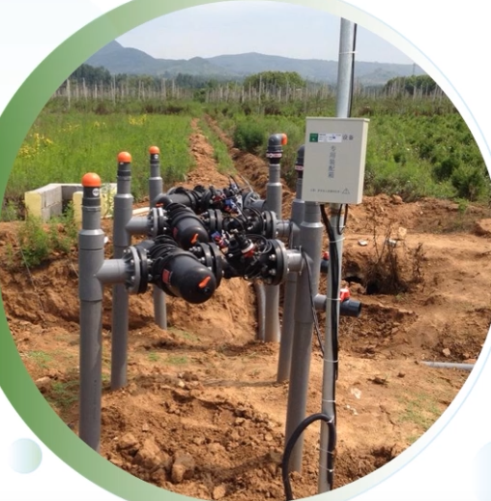
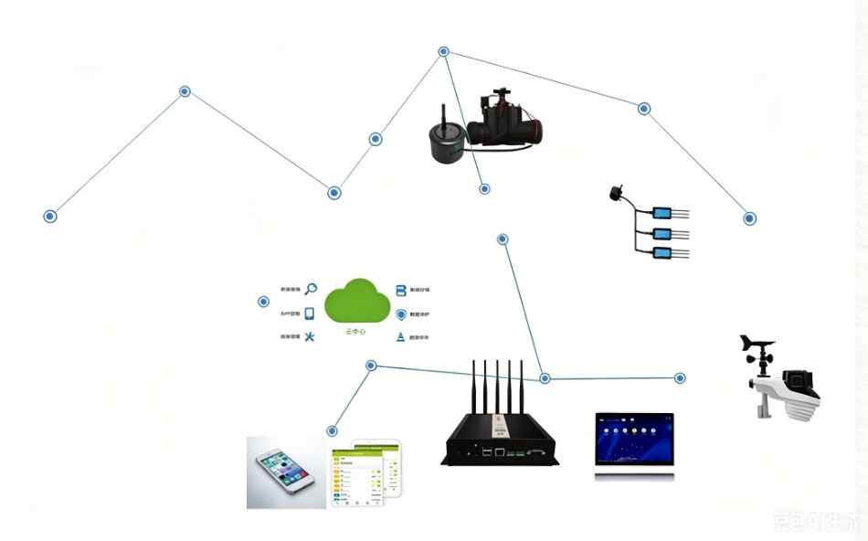
2. Operational Guidelines
Sensors Installation and Control
  Sensors buried and installed across the irrigated area.
  Operators use touch screen connected via control cables to set:
    ➜ control the opening and closing of field solenoid valves.
Irrigation duration.
Water volume.
Pressurization
System
Zone Valve
Irrigation cycles.
Sub-main Pipe
water
meter
Operational Convenience
  Eliminates the need for operators to enter the field.
Main
Pipeline
Wireless
Controller
Emitter
Water Source
Multi-layer Soil
Moisture Sensor
Weather
Monitoring
Mobile Remote
Control
Wireless
Gateway
Local Control
Notes:
（二）操作要点
该系统在灌溉区域埋设安装有传感器，灌水时间、灌水量和灌溉周期等由操作人员利用电缆线通过触摸屏操作，来控制田间给水电磁阀的开启和关闭，操作人员不需要进入田间。
2.2.Operational Guidelines
Sensors are buried and installed across the irrigated area.
Operators use a touch screen connected via control cables to set
irrigation duration,
water volume, and cycles,
thereby controlling the opening and closing of field solenoid valves.
This eliminates the need for operators to enter the field.

Slide 5
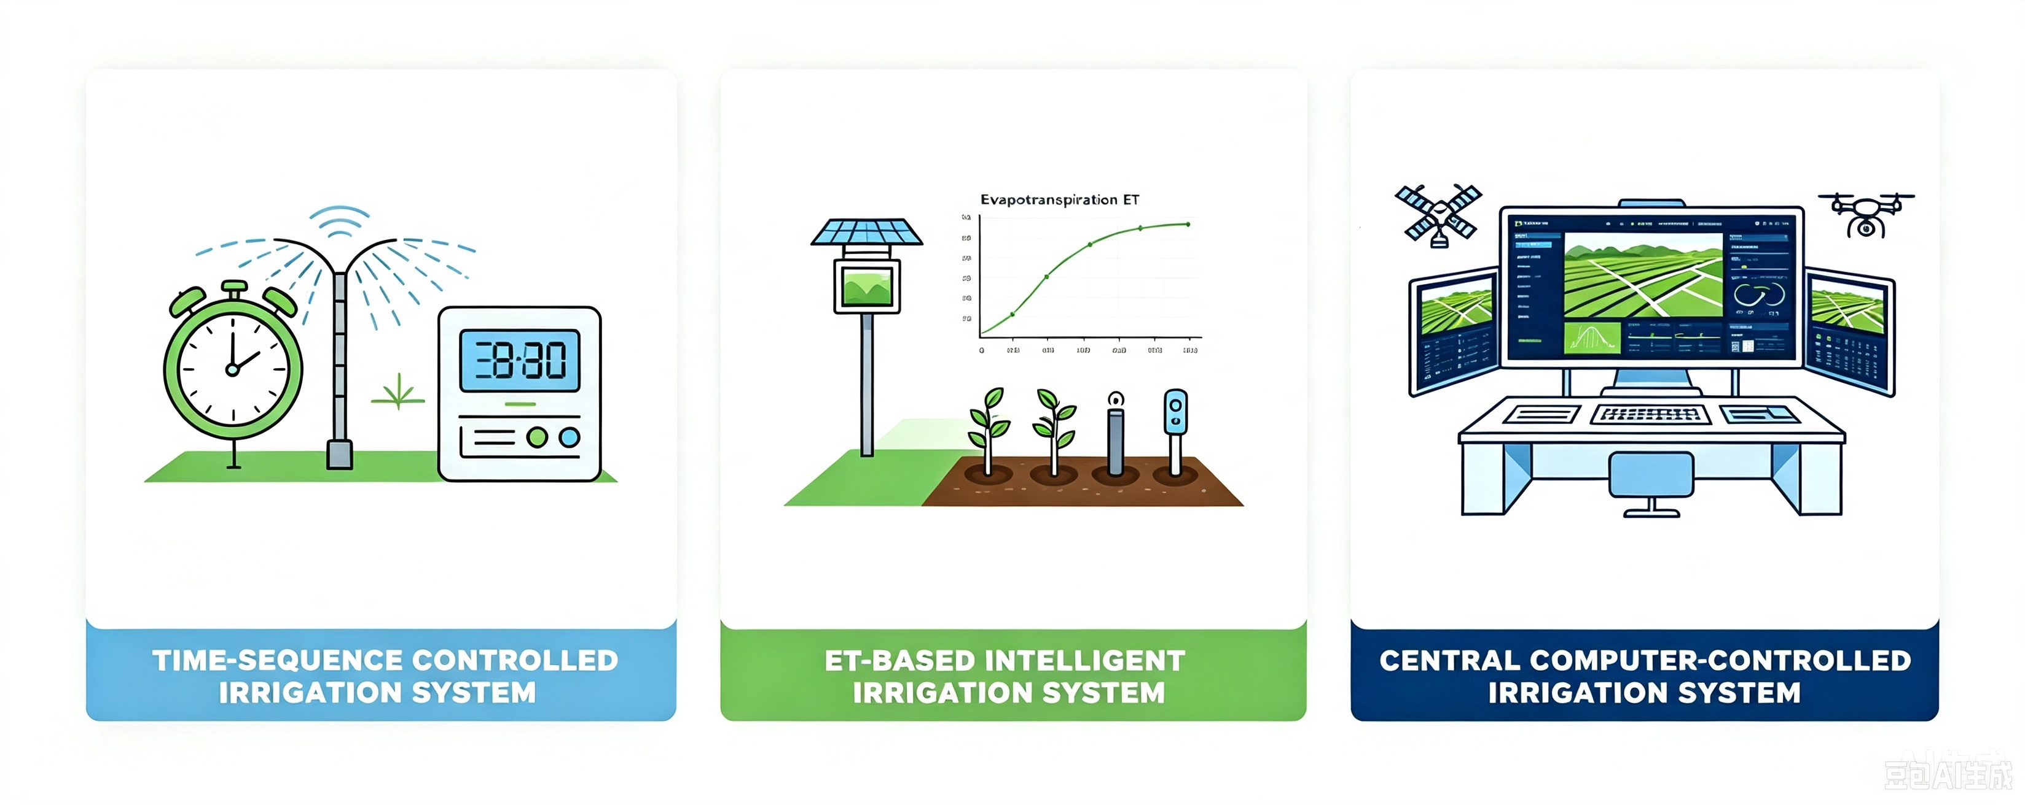
3. Classification of Common Automated Irrigation Systems
Three Main Categories
Notes:
（三）常用自动化灌溉系统分类
目前常用的自动化灌溉系统可分为时序控制灌溉系统、ET智能灌溉系统、中央计算机控制灌溉系统三大类。
2.3.Classification of Common Automated Irrigation Systems
Currently, widely used automated irrigation systems fall into
three main categories:
time-sequence controlled irrigation systems,
ET-based intelligent irrigation systems,
and central computer-controlled irrigation systems.

Slide 6
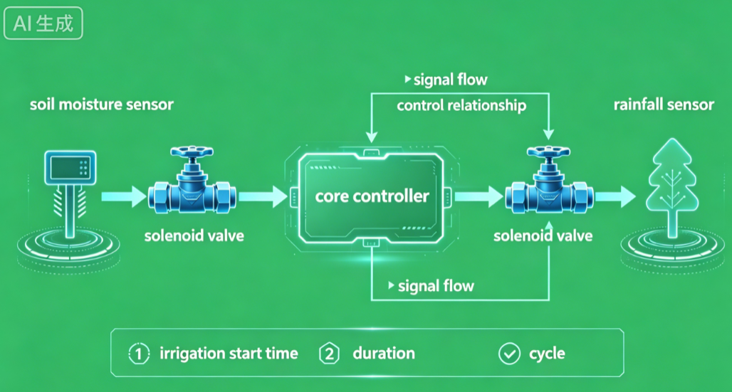
3. Classification of Common Automated Irrigation Systems
(1) Time-sequence controlled irrigation system
Control Parameters
  Irrigation start time.
  Duration.
  Cycles.
  ⇨ achieve fully automated irrigation.
System Components
  Basic Components
  Optional accessories
Controller.
Soil moisture sensors.
Solenoid valves.
Rain sensors.
Frost sensors.
Notes:
1.时序控制灌溉系统。
时序控制灌溉系统将灌水开始时间、灌水延续时间和灌水周期作为控制参量，实现整个系统的自动灌水。基本组成包括控制器和电磁阀，还可选配土壤水分传感器、降雨传感器及霜冻传感器等设备，其中控制器是系统的核心。
2.3.1. Time-sequence controlled irrigation system
This system uses irrigation start time,
duration and cycles as control parameters to
achieve fully automated irrigation.
Its basic components are a controller and solenoid valves,
while soil moisture sensors,
rain sensors and frost sensors
can be installed as optional accessories. The controller serves as the core component.

Slide 7
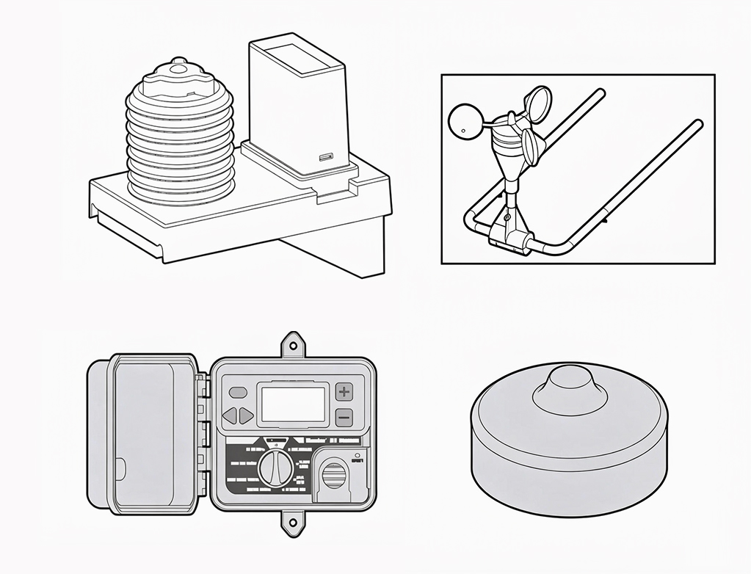
3. Classification of Common Automated Irrigation Systems
(2) ET smart irrigation system
Working Step
Meteorological Data → Digital Signals
  Collects meteorological parameters relevant to plant water demand:
Temperature.
Rainfall.
A: Solenoid Valve Assembly
C: Sprinkler Head Assembly
Wind speed.
Relative humidity.
Solar radiation.
  Automatically converts these parameters into digital signals➜ transmits them unidirectionally to the time-sequence controller.
B: Irrigation Controller
D: Rain/Soil Moisture Sensor
Station Parameters → Automated Precise Irrigation
  Input parameters for each station: slope, crop type, soil type, sprinkler type, etc.
  ⇨ achieves automated precise irrigation based on:
Local weather conditions.
Soil properties.
Crop varieties.
Notes:
2.ET智能灌溉系统。ET智能灌溉系统将与植物需水量相关的气象参量（温度、相对湿度、降雨量、辐射、风速等）通过单向传输的方式，自动将气象信息转化成数字信息传递给时序控制器。使用时，只需将每个站点的信息（坡度、作物种类、土壤类型、喷头种类等）设定完毕，整个系统将根据当地的气象条件、土壤特性和作物类别等，实现自动化精确灌溉。
2.3.2. ET smart irrigation system
This system collects meteorological parameters relevant to plant water demand
(temperature,
relative humidity,
rainfall,
solar radiation,
wind speed, etc.).
It automatically converts these parameters into digital signals and transmits them unidirectionally to the time-sequence controller.
After inputting parameters for each station (slope, crop type, soil type, sprinkler type, etc.),
the system achieves automated precise irrigation based on
local weather conditions,
soil properties,
and crop varieties.

Slide 8
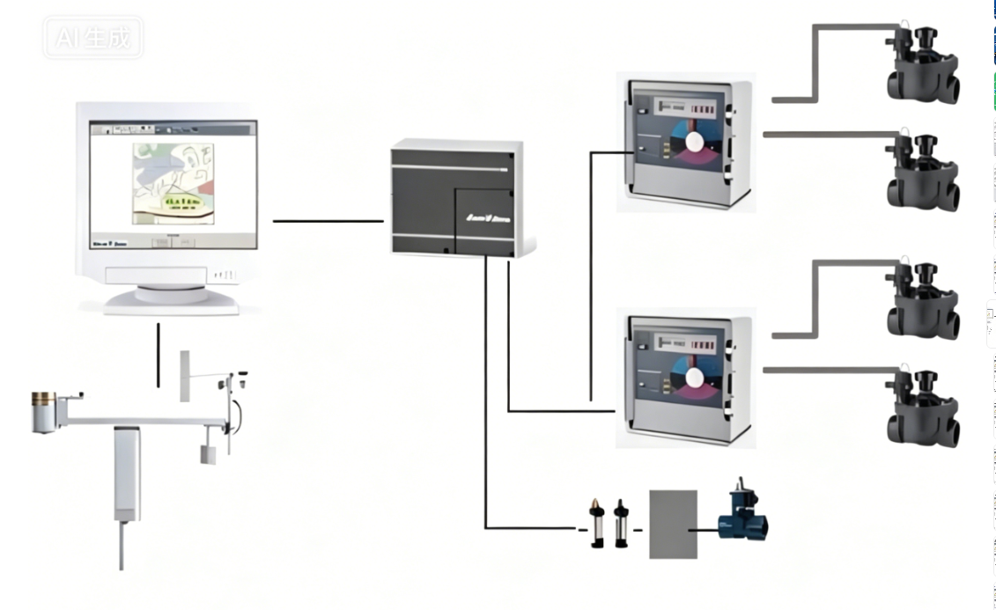
3. Classification of Common Automated Irrigation Systems
(3) Central computer-controlled irrigation system
Working Step
Central computer
Sub-control box
Automatic Weather Station
  A monitoring device automatically collects and transmits meteorological data.
  Feed meteorological parameters related to crop water demand back to central computer:
Switch TWI
Direct
connection (15 meters)
Dual-line or wireless communication
24VAC
Can be expanded to 4 pairs of lines,
28 channels per pair of lines,
24 stations occupying 1 channel
4-wire communication
Temperature.
Solar radiation.
Relative humidity.
Wind speed.
Rainfall.
Weather station
Dual-line communication
Flow sensor
Central Computer
  Autonomously determines the required daily irrigation volume.
  Commands relevant actuators to activate or deactivate designated sub-irrigation systems.
Notes:
3.中央计算机控制灌溉系统。中央计算机控制灌溉系统将与植物需水相关的气象参量（温度、相对湿度、降雨量、辐射、风速等）通过自动电子气象站，即通过能自动收集和传递气象信息的观测装置，反馈到中央计算机，中央计算机会自动决策当天所需灌水量，并通知相关的执行设备开启或关闭某个子灌溉系统。
2.3.3.Central computer-controlled irrigation system
This system relies on an automatic electronic weather station
a monitoring device that automatically collects and transmits meteorological data
to feed meteorological parameters related to crop water demand
(temperature, relative humidity, rainfall, solar radiation and wind speed) back to the central computer.
The central computer
autonomously determines the required daily irrigation volume
and commands relevant actuators to activate or deactivate designated sub-irrigation systems.

Slide 9
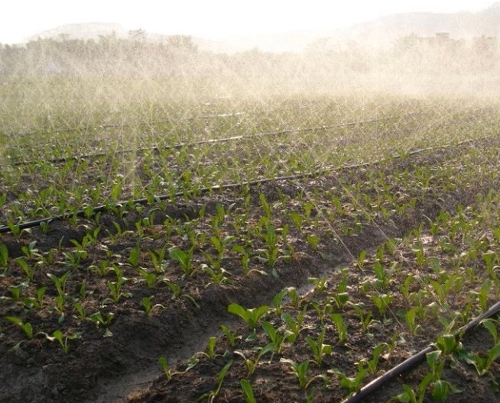
4. Factors Affecting Automated Irrigation and Countermeasures
Factors Affecting Irrigation Uniformity
Variations in emitter operating pressure.
Manufacturing tolerances.
Clogging from debris.
Topographic changes.
Measures for Uniform Water Distribution
  Select emitters with low manufacturing tolerances.
  Fit multi-stage filters at the system head.
  Level fields.
  Install at the head:
Variable-frequency pumps.
Pressure-boosting pumps.
Tank-type constant-pressure water supply units.
  Install on branch lines:
Pressure regulators.
Flow control devices.
Notes:
（四）自动化灌溉影响因素及应对方法
影响灌溉均匀程度的因素很多，如灌水器工作压力变化、灌水器制造偏差、灌水器内部杂质堵塞问题、地形变化等。要想保证自动化灌溉的灌水均匀度，除了选用制造偏差小的灌水器、首部安装多级过滤器以及平整土地以外，还要在灌溉首部运用变频水泵、稳压泵或无塔稳压供水装置，灌溉支管上安装压力调节器和管道流量控制设备，需要从多方面进行综合考虑和操作。
2.4.Factors Affecting Automated Irrigation and Countermeasures
Many factors affect irrigation uniformity,
including variations in emitter operating pressure,
manufacturing tolerances,
clogging from debris,
and topographic changes.
To maintain uniform water distribution in automated irrigation systems, multiple integrated measures are required.
These include selecting emitters with low manufacturing tolerances,
fitting multi-stage filters at the system head
and leveling fields.
Additionally,
variable-frequency pumps,
pressure-boosting pumps,
or tank-type constant-pressure water supply units shall be installed at the head,
along with pressure regulators
and flow control devices on branch lines.

Slide 10
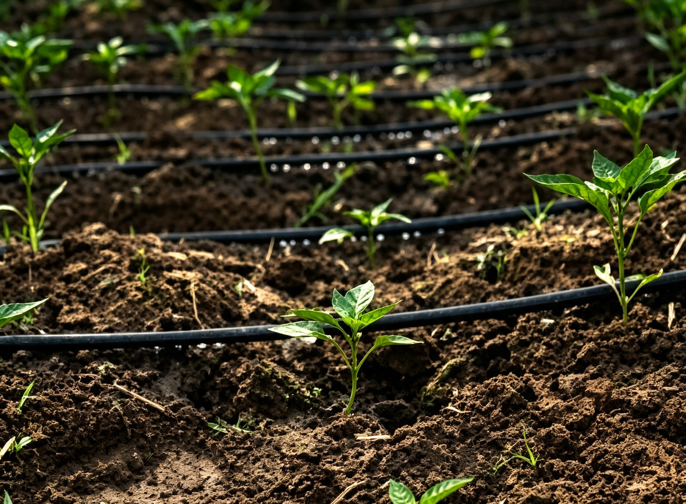
5. Layout of Automated Drip Irrigation Systems
System Layout
  Built around the water source → independent irrigation unit.
  Head unit installed at the water source.
  Main pipelines run through the center of the irrigated area → facilitate water distribution.
  Spacing of branch pipelines → ensure irrigation uniformity within each sub-area and facilitate management.
Head Unit Components
  Water source control assembly.
  Components:
Pipeline Functions
  Main pipelines: deliver pressurized, filtered water to branch lines.
  Branch pipelines: directly connected to drip laterals or emitters. → a key component for uniform field irrigation.
Water pumps.
Fertilization units.
Filters.
Control valves.
Notes:
（五）自动化滴灌系统布置
自动化滴灌系统布置以水源为中心，形成独立的灌溉系统。首部依水源而设，主管道布置在灌区的中间，便于分流；支管布置间距以满足灌水小区的均匀度要求为基础，便于管理。其中，首部是指由水泵、过滤器、施肥装置、控制阀等组成的水源控制单元；主管道负责将加压过滤后的水输送到各支管；支管则直接连接滴灌毛管或滴头，是实现田间均匀灌水的关键。
2.5.Layout of Automated Drip Irrigation Systems
An automated drip irrigation system is
built around the water source as an independent irrigation unit.
The head unit is installed at the water source.
Main pipelines run through the center of the irrigated area to facilitate water distribution.
The spacing of branch pipelines is determined to ensure irrigation uniformity within each sub-area and facilitate management.
In the system, the head unit refers to the
water source control assembly
composed of
water pumps,
filters,
fertilization units
and control valves.
Main pipelines deliver pressurized and filtered water to branch lines.
Branch pipelines are directly connected to drip laterals or emitters,
serving as a key component for uniform field irrigation.

Slide 11
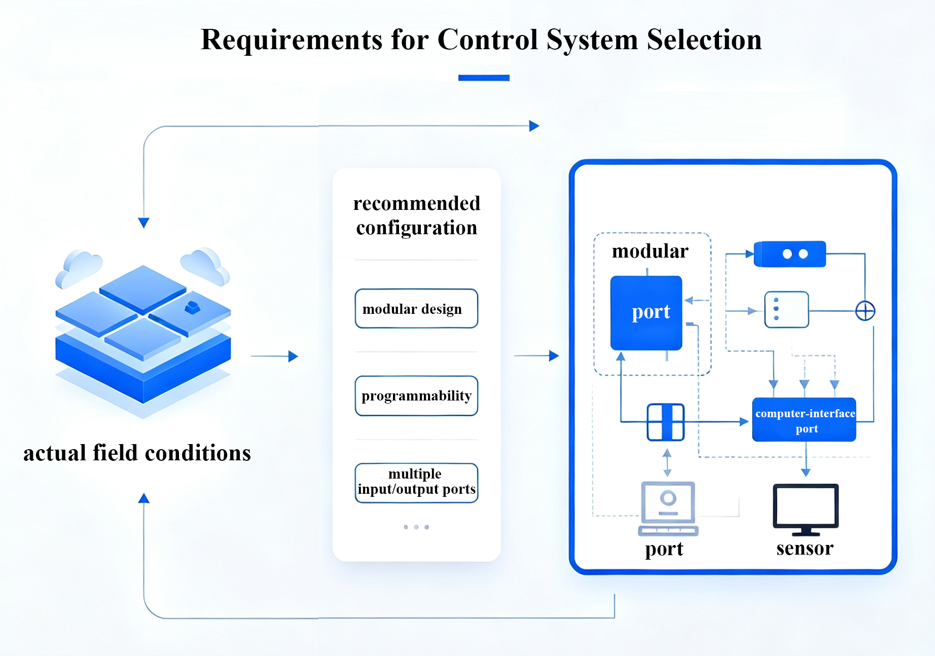
6. Requirements for Control System Selection
Control System Selection
  Selected by comparing technical options based on actual field conditions.
Controller Specifications
  Modular design.
  Programmability.
  Multiple input/output ports → connect to computers and various sensors.
  Full functionality for receiving and executing commands.
AI生成
Notes:
(原配图为原视频中的图)
（六）控制系统的选择要求
控制系统的选择应根据田块实际情况，对不同技术方案进行比较和筛选。建议选用具有模块化设计、可编程等特性的控制器，并配置多个输入输出端口，以便连接计算机和多种传感器。同时，控制器应具备完备的指令接收和执行等功能。
2.6.Requirements for Control System Selection
The control system should be selected by comparing technical options based on actual field conditions.
It is recommended to choose a controller with
modular design
and programmability,
equipped with multiple input/output ports for connection to computers and various sensors.
Additionally, the controller should have full functionality for receiving and executing commands.

Slide 12
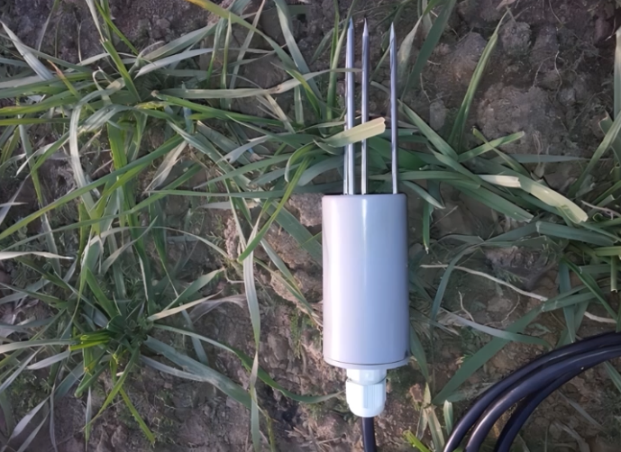
7. Functions and Implementation of Automated Drip Irrigation System Components
(1) Soil moisture sensors (soil humidity sensors)
Components
  Stainless-steel probes.
  Waterproof sensing heads.
Deployment
  Buried for long-term in soil and embankments.
Functions
  Fixed-point monitoring.
  On-site measurement.
  ⇒ soil moisture in surface and deep soil layers.
Notes:
（七）自动化滴灌系统各部分作用及实现
1.土壤水分传感器又称土壤湿度传感器，由不锈钢探针和防水探头构成，可长期埋设于土壤和堤坝内使用，对表层和深层土壤进行墒情的定点监测和在线测量。
2.7.Functions and Implementation of Automated Drip Irrigation System Components
1. Soil moisture sensors, also referred to as soil humidity sensors,
are composed of
stainless-steel probes
and waterproof sensing heads.
They can be buried for long-term in soil and embankments
to conduct fixed-point monitoring
and on-site measurement of
soil moisture in surface and deep soil layers.

Slide 13
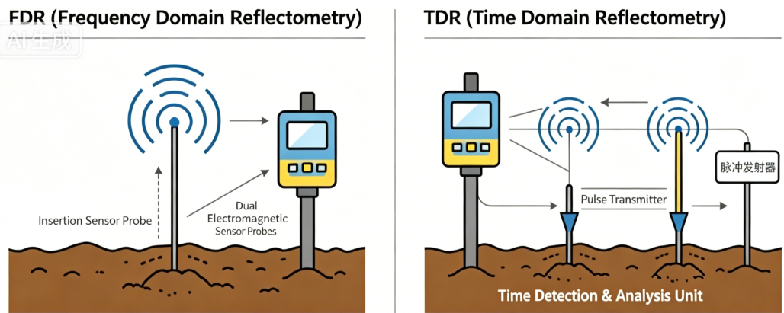
7. Functions and Implementation of Automated Drip Irrigation System Components
(1) Soil moisture sensors (soil humidity sensors)
Common Types of Soil Moisture Sensors
Frequency Domain Reflectometry (FDR)
  Wave Type: Transmits high-frequency electromagnetic waves.
  Measurement Principle: Calculates soil water content by detecting frequency variations during wave propagation in the soil.
  Performance: Excellent stability.
  Application: Well suited for long-term buried installations and continuous monitoring.
Pulse
Transmitter
Time Domain Reflectometry (TDR)
  Wave Type: Transmits short-pulse electromagnetic waves.
  Measurement Principle:
  Performance:
  Cost: Equipment cost is relatively high.
High measurement accuracy.
Measures reflection time.
Strong resistance to salt interference.
Longer propagation time corresponds to higher soil water content.
Notes:
目前常用类型：
频域反射法（FDR）：传感器发射高频电磁波，通过测量波在土壤里传播的频率变化来算含水量。FDR稳定性好，适合长期埋设监测。
时域反射法（TDR）：发射短脉冲电磁波并测量反射时间，水分含量越高传播时间越长。TDR精度很高，抗盐分干扰强，但设备成本相对较高。
Common types of soil moisture sensors:
•Frequency Domain Reflectometry (FDR):
This type of sensor transmits high-frequency electromagnetic waves.
It calculates soil water content by detecting frequency variations during wave propagation in the soil.
Featuring excellent stability,
FDR sensors are well suited for long-term buried installations and continuous monitoring.
•Time Domain Reflectometry (TDR):
It transmits short-pulse electromagnetic waves
and measures their reflection time.
A longer propagation time corresponds to higher soil water content.
TDR delivers high measurement accuracy
and strong resistance to salt interference,
yet the associated equipment comes with relatively high costs.

Slide 14
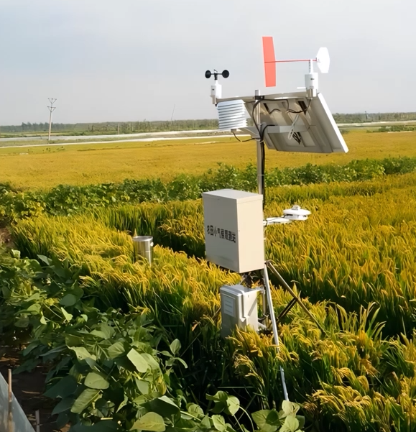
7. Functions and Implementation of Automated Drip Irrigation System Components
(2) Field weather station
System Overview
  An automatic farmland environmental monitoring system integrated with multiple sensors.
Automatic Data Collection
  Wind speed.
  Wind direction.
  Sunshine duration.
  Solar radiation.
  Temperature.
  Precipitation.
Data Transmission, Processing and Purpose
  Data are transmitted as electrical signals to the central computer of the main controller → for analysis, processing, and storage.
  Calculates hourly and daily average crop evapotranspiration.
    Reflects soil water loss.
    Predicts irrigation intervals and water volumes.
    Automatically forecasts and adjusts irrigation schedules.
Notes:
2.田间气候站是一种集成了多种传感器的农田环境自动监测系统，能够自动采集风速、风向、日照、辐射、温度和降水等信息，以电信号的方式传输到中央控制器的中心计算机，由计算机分析、处理并保存，以计算每个时段或日平均的田间耗水蒸腾量，反映土壤水分的损失量，预测灌水周期和灌水量，可以自动预测和调整灌溉计划。
2.7.2.A field weather station is
an automatic farmland environmental monitoring system integrated with multiple sensors.
It automatically collects data on wind speed,
wind direction,
sunshine duration,
solar radiation,
temperature
and precipitation.
These data are transmitted as electrical signals to the central computer of the main controller for analysis,
processing and storage.
The system calculates hourly and daily average crop evapotranspiration
to reflect soil water loss,
predicts irrigation intervals and water volumes,
and automatically forecasts and adjusts irrigation schedules.

Slide 15
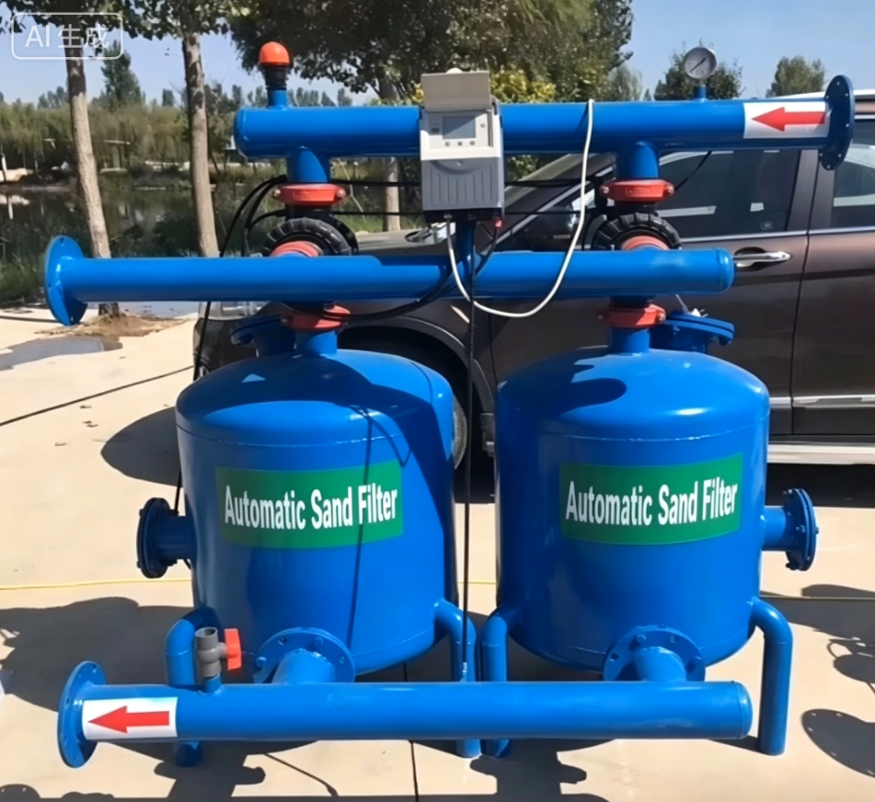
7. Functions and Implementation of Automated Drip Irrigation System Components
(3) Automatic backwash filters
Control Signals
  Time intervals.
  Flow volume.
  Pressure differential.
Functions
  Automatically remove sand and other debris from the water.
  → Ensure stable system operation.
  → Prevent emitter clogging.
Notes:
3.过滤器应选用自动反冲洗过滤器，该过滤器可根据时间间隔、水量、前后压差等控制信号自动运行，以过滤水中的沙粒和其他杂质，确保系统安全和滴头的不堵塞。
2.7.3.Automatic backwash filters are recommended.
Driven by control signals including time intervals,
flow volume, and pressure differential across the filter,
these devices automatically remove sand and other debris from the water
to ensure stable system operation
and prevent emitter clogging.

Slide 16
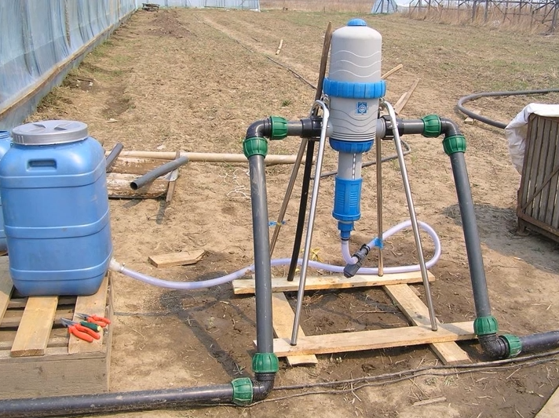
7. Functions and Implementation of Automated Drip Irrigation System Components
(4) Fertilizer injection pumps
Fertigation Method
  Fertilizer injection pumps should be used as fertilization devices.
  Fertilizer is applied along with irrigation water.
Fertigation Basis
  Crop nutrient demand patterns.
  Soil nutrient status.
Purpose
  Meet crop nutrient requirements at different growth stages.
Notes:
4.注肥器应选用注肥泵，根据作物生长发育需肥规律和土壤养分状况进行随水滴肥，以满足作物不同阶段的需肥量。
2.7.4. Fertilizer injection pumps
should be used as fertilization devices.
Fertilizer is applied along with irrigation water
according to crop nutrient demand patterns
and soil nutrient status
to meet crop nutrient requirements at different growth stages.

Slide 17
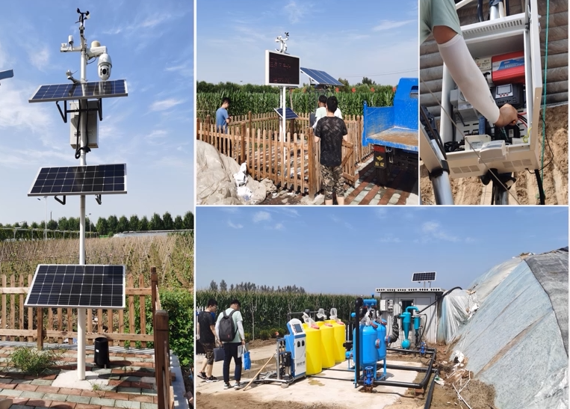
7. Functions and Implementation of Automated Drip Irrigation System Components
(5) Automated drip irrigation control system software
Software-Driven Automatic Operation
  Software can be programmed to enable the central controller.
  → perform fully automatic drip irrigation according to commands.
Data-Based Dynamic Adjustment
  Leverages data from soil moisture sensors and field weather stations.
  Adjusts operational settings based on actual field evapotranspiration.
  ⇒ Optimizes water and fertilizer application rates with greater precision.
Notes:
5.自动化滴灌控制系统软件可通过编程设计，让中心控制器按照指令完成自动化滴灌作业；同时依托土壤水分传感器、气象站采集的数据，结合田间蒸腾耗水的实际情况动态调整程序，让滴灌施肥的用量更加精准合理。
2.7.5. Automated drip irrigation control system software
The software for the automated drip irrigation control
system can be programmed to enable the central controller
to perform fully automatic drip irrigation according to commands.
Meanwhile, leveraging data collected from soil moisture sensors and field weather stations,
the system dynamically adjusts its operational settings based on actual field evapotranspiration,
thereby optimizing water and fertilizer application rates with greater precision.

Slide 18
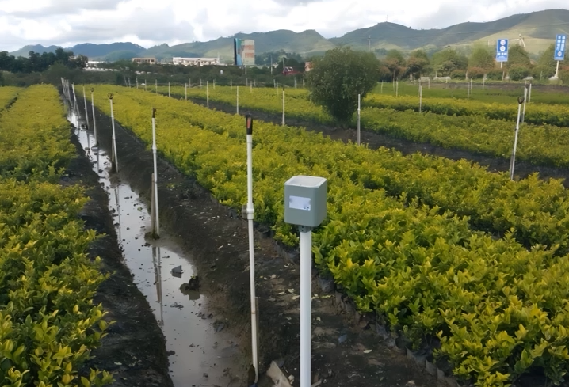
7. Functions and Implementation of Automated Drip Irrigation System Components
(5) Automated drip irrigation control system software
Real-Time Data Transmission
  Soil moisture sensors and field microclimate stations transmit real-time data to the irrigation cloud platform via gateways.
Definition of Rotational Irrigation Groups
  A sub-area divided from the overall irrigation area.
  Each sub-area irrigates independently within a set period.
  Receives water in a preset rotating order.
Automatic Irrigation Control
  When monitored data reach preset thresholds, the cloud platform automatically issues commands.
  → adjust water supply sequence of rotational irrigation groups OR
  → halt irrigation directly.
Advantages of Rotational Irrigation
  Adapts to limited water sources and pipeline conveyance capacity.
  → achieves efficient and uniform irrigation.
Notes:
在灌溉过程中，土壤水分传感器及田间小气候站能够通过网关将数据实时传输到灌溉云平台上。当云平台监测到的数据值达到预期值时，云平台会自动下达指令，调整轮灌组的供水顺序或者直接停止灌溉。轮灌组是指将灌溉区域划分为若干子区域，每个子区域在同一时间段内独立进行灌溉，并按预设顺序轮流供水，以适应有限的水源或输水能力，实现高效、均衡的灌溉高度。
During irrigation, soil moisture sensors and field microclimate stations transmit real-time data to the irrigation cloud platform via gateways.
Once the monitored data reach preset thresholds, the cloud platform automatically issues commands
to adjust the water supply sequence of rotational irrigation groups or
halt irrigation directly.
A rotational irrigation group refers to a sub-area divided from the overall irrigation area.
Each sub-area irrigates independently within a set period
and receives water in a preset rotating order.
This mode adapts to limited water sources and pipeline conveyance capacity
and achieves efficient and uniform irrigation.

