Slide 1
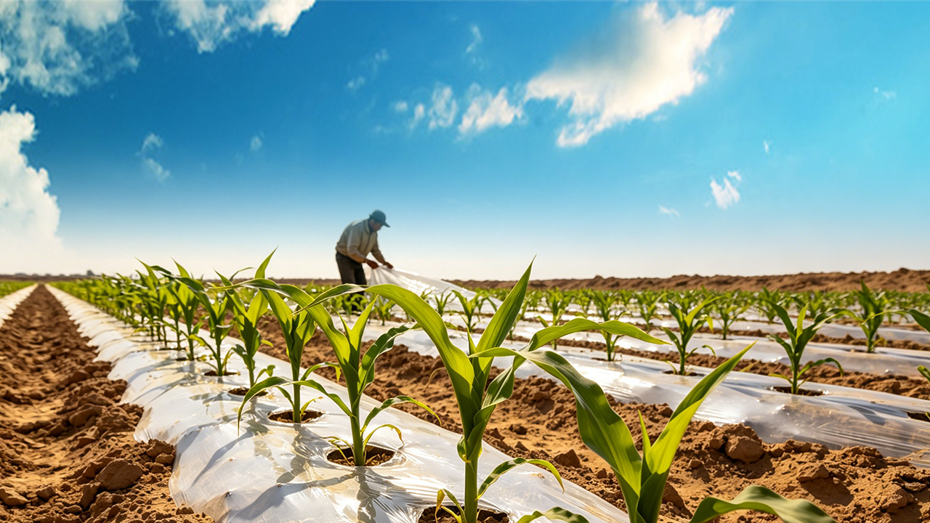
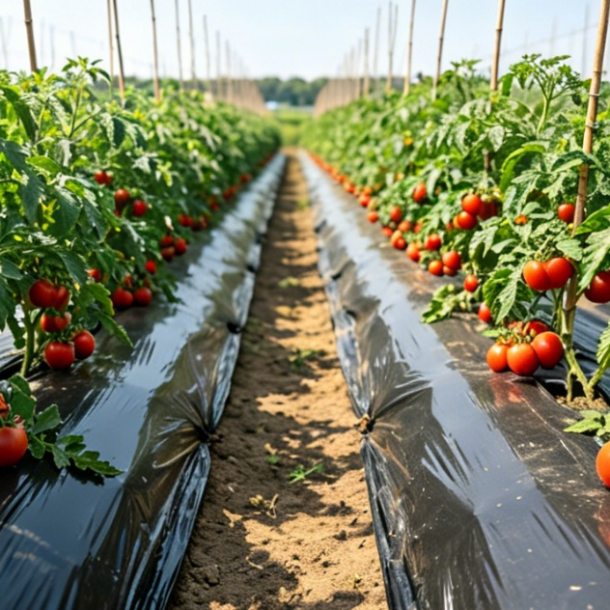
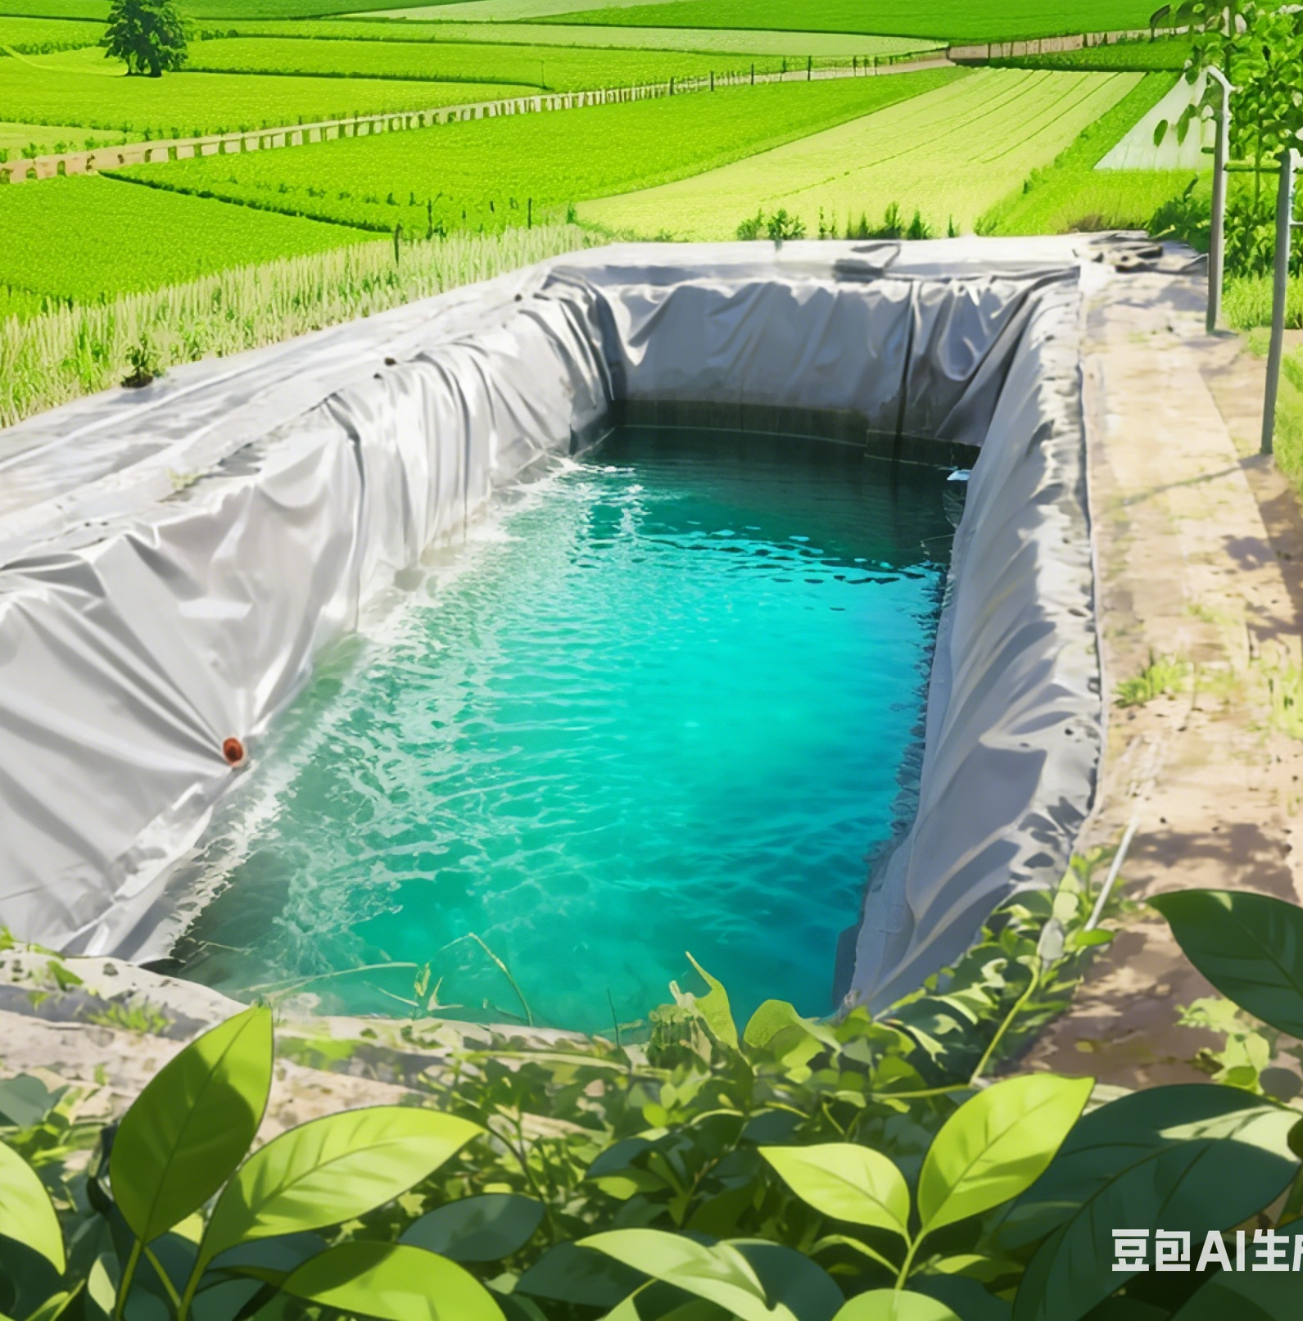
High-efficiency Plastic-Film Mulching Cultivation Techniques for Dryland Farming
Notes:
High-efficiency Plastic-Film Mulching Cultivation Techniques for Dryland Farming
旱作农业地膜覆盖高效栽培技术

Slide 2

PART.03
Ridge Planting and Furrow Irrigation Technology with Partial-Film Mulching for Tomato Cultivation
Notes:
Ridge Planting and Furrow Irrigation Technology with Partial-Film Mulching for Tomato Cultivation
三、番茄半膜覆盖垄作沟灌技术

Slide 3
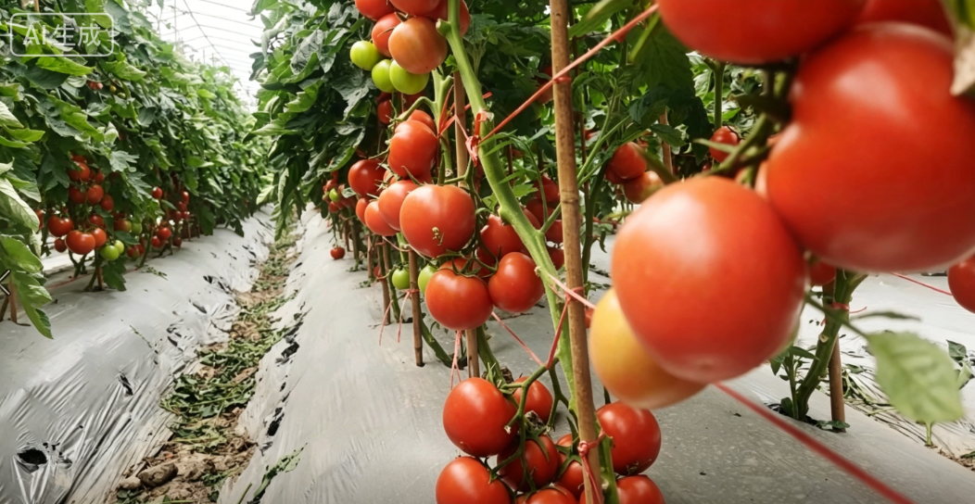
Overview
Ridge-Furrow Cultivation Layout
  Shape field into ridges.
  Partially cover ridge surfaces with plastic film.
  Plant tomatoes on or beside ridges.
Furrow Irrigation Method
  Irrigation water delivered into furrows according to crop’s water requirements.
  ⇨ Ensure efficient use of water resources.
Notes:
番茄半膜覆盖垄作沟灌技术是将土地平面修成垄形，用地膜覆盖垄面，在垄上或垄侧种植番茄。在番茄整个生长期内，根据植株需水规律将灌溉水输送至垄沟内，实现水分的高效利用。
This technology involves shaping the field into ridges,
partially covering the ridge surfaces with plastic film,
and planting tomatoes on or beside the ridges.
Throughout the growth period,
irrigation water is delivered into the furrows according to the crop’s water requirements,
ensuring efficient use of water resources.

Slide 4

1. Land Selection and Preparation
(1) Land Selection
Soil Requirements
  Select loam or sandy loam with:
  Avoid viscous or compacted soils.
Good air permeability
Deep soil layers
Abundant organic matter
Preceding Crop Requirements
  No solanaceous crops (such as potatoes or eggplants) in previous 3 years.
  Legumes, leafy vegetables, alliums or gramineous crops preferred as preceding crops.
Reduce risk of diseases caused by continuous cropping.
Notes:
1、地块选择
要注意选择透气良好、土层深厚、腐殖质充足的壤土或砂壤土，避免选用粘稠、板结的土壤。同时，地块需满足前3年未种植过茄科作物（如马铃薯、茄子等）的要求。前一季以豆类、叶菜类、葱蒜类、禾谷类作物为宜，可减少连作引发的病害风险。
3.1 Land Selection
Select loam or sandy loam with
good air permeability,
deep soil layers,
and abundant organic matter.
Avoid viscous or compacted soils. Meanwhile,
the field must not have grown solanaceous crops (such as potatoes or eggplants) in the previous 3 years.
Legumes, leaf vegetables, alliums or gramineous crops are preferred as preceding crops,
as they help reduce the risk of diseases caused by continuous cropping.

Slide 5
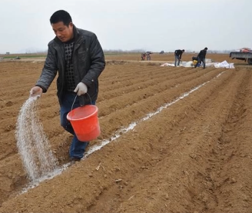
2. Fertilization and Weed Control
Fertilizer Application Rates
  255–375 kg/ha pure nitrogen.
  105–150 kg/ha phosphorus.
  45–75 kg/ha potassium.
  15–22.5 kg/ha zinc sulfate.
  Formula fertilization: used based on soil testing results.
  60,000–75,000 kg/ha High-quality well-decomposed farmyard manure.
Fertilizer Application Methods
  Incorporated into soil during spring ploughing. OR
  Applied in concentrated bands at the bottom of ridges during ridge formation.
Weed Control Timing
  For plots with severe weed infestation.
  Chemical weed control → after ridge formation & before film mulching.
Herbicide Application
  Diluted 750–1050 g of 50% acetochlor EC/ha in 450 kg water.
  Spray evenly to on soil surface to effectively suppress weed emergence.
Notes:
2、施肥与除草
全生育期每公顷施入纯氮255～375kg、磷105～150kg、钾45～75kg、硫酸锌15～22.5kg；或根据测土结果进行配方施肥。同时，每公顷需施入优质腐熟农家肥60,000-75,000 kg。所有肥料可结合春耕翻压施入，或在起垄时集中施于垄底。
对于杂草危害严重的地块，可在起垄后、覆膜前进行化学除草。每公顷用50%乙草胺乳油750～1050g，兑水450kg，均匀喷洒地面，可有效防控杂草滋生。
3.2 Fertilization and Weed Control
In general, 255-375 kg of pure nitrogen,
105-150 kg of phosphorus,
45-75 kg of potassium and
15-22.5 kg of zinc sulfate should be applied per hectare throughout the growth period.
Where applicable, formula fertilization may be used based on soil testing results.
Meanwhile, 60,000-75,000 kg of high-quality well-decomposed farmyard manure should be applied per hectare.
All fertilizers may be
incorporated into the soil during spring ploughing or
applied in concentrated bands at the bottom of the ridges during ridge formation.
For plots with severe weed infestation,
chemical weed control may be carried out after ridge formation and before film mulching.
Dilute 750-1050 g of 50% acetochlor EC per hectare in 450 kg of water
and spray it evenly on the soil surface to effectively suppress weed emergence.

Slide 6
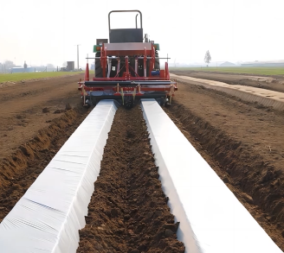
3. Ridge Formation and Film Mulching
Timing of Ridge Formation
  Ridge formation & furrow opening → early to mid-April.
Ridge-formation Dimensions
  Furrow center spacing: 120 cm.
  Ridge surface width: 80 cm.
  Furrow width: 40 cm.
  Ridge height: 15-20 cm.
Post-formation Operations
  Irrigation the field.
  Manually reshape the ridges according to water line.
Film Mulching Requirements
  Plastic mulch width → 120 cm.
  Fits tightly against the ridge surface.
  Stretched flat.
Notes:
3、起垄与覆膜
一般在4月上中旬，按120cm沟心距开沟起垄，垄面宽80cm、沟宽40cm、垄高15～20cm。起垄后灌水，根据水线人工修垄。选用幅宽120cm地膜覆盖，覆膜时地膜要与垄面贴紧拉平。
3.3 Ridge Formation and Film Mulching
Ridge formation and furrow opening are generally carried out in early to mid-April,
with a furrow center spacing of 120 cm.
Each ridge has a surface width of 80 cm,
a furrow width of 40 cm,
and a ridge height of 15-20 cm.
After ridge formation, irrigate the field
and manually reshape the ridges according to the water line.
Use plastic mulch with a width of 120 cm,
ensuring it fits tightly against the ridge surface
and is stretched flat.

Slide 7
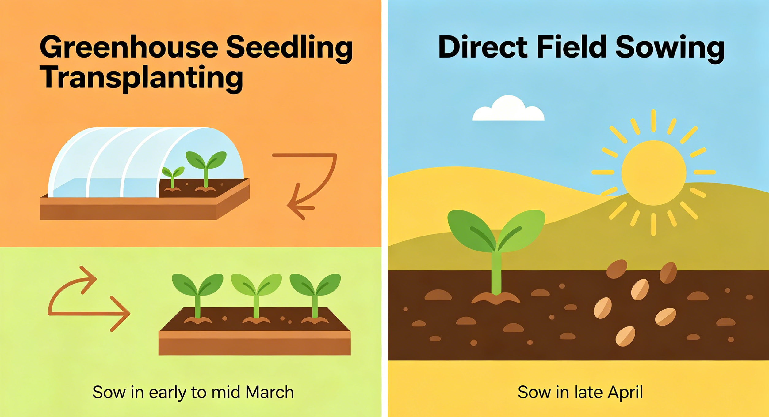
4. Variety Selection and Sowing
Variety Selection
  Select appropriate improved varieties is essential.
  Choose varieties with:
Sowing Time - For seedling raising in greenhouses
  Raising seedlings in insulated seedbeds ⟶ transplanting them to the field when the seedlings reach the appropriate size.
  Sowing in early to mid-March.
Disease resistance
High quality and yield
Good storability and transportability
Good marketability
Meeting processing requirements
Sowing Time - For direct seeding in open fields
  Sowing in late April.
AI生成
Notes:
4、选种与播种
选用合适的良种很重要。选择抗病、优质高产、耐贮藏和运输、商品性好、符合加工要求的品种。采用“阳畦育苗移栽”的，即先在保温苗床里培育幼苗，待幼苗长到合适大小后，再移栽到田间，应于3月上、中旬播种；采用露天田间播种的，则于4月下旬播种。
3.4 Variety Selection and Sowing
Selecting appropriate improved varieties is essential.
Choose varieties with
disease resistance,
high quality and yield,
good storability and transportability,
good marketability
and meeting processing requirements.
For seedling raising in solar greenhouses with subsequent transplanting
(i.e., raising seedlings in insulated seedbeds first and then transplanting them to the field when the seedlings reach the appropriate size), sowing should be carried out in early to mid-March.
For direct seeding in open fields,
sowing is conducted in late April.

Slide 8
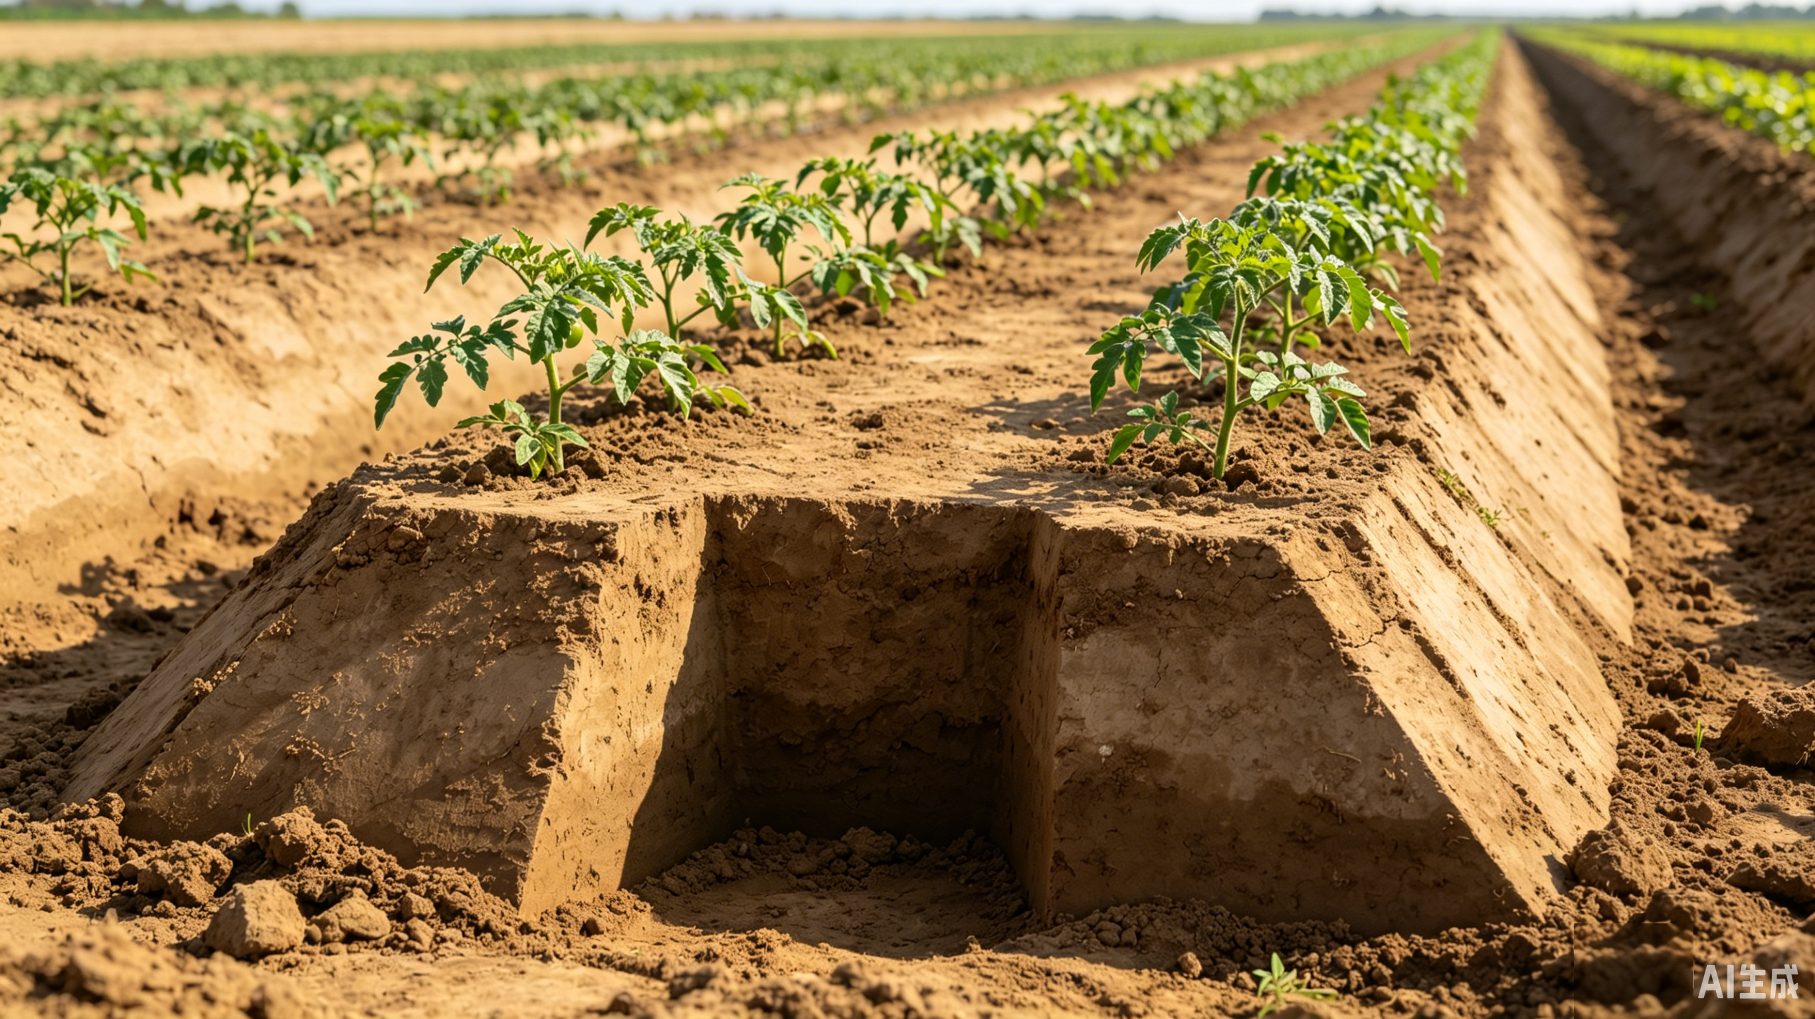
4. Variety Selection and Sowing
Planting Arrangement for Processing Tomatoes
  Planted on sides of ridges.
  Row spacing: 60 cm.
  Plant spacing: 30–35 cm.
  48,000–55,500 surviving seedlings per hectare.
  Seedlings planted >10 cm above ridge bottom on ridge side.
Notes:
加工型番茄采用垄侧种植。行距60cm，株距30～35cm，每公顷确保存活的幼苗约48,000～55,500株。播种或移栽时，种苗应种植在垄侧距离垄底10cm以上。
Processing tomatoes are
planted on the sides of the ridges,
with a row spacing of 60 cm
and a plant spacing of 30-35 cm,
ensuring about 48,000-55,500 surviving seedlings per hectare.
During sowing or transplanting,
the seedlings should be planted more than 10 cm above the ridge bottom on the ridge side.

Slide 9
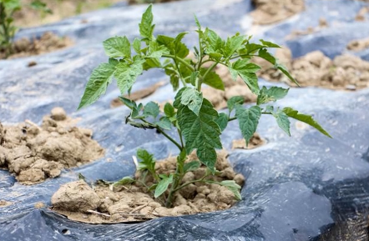
5. Field Management
Rainfall Field Management During Seedling Emergence
  Loosen compacted soil promptly.
  Adjust seedlings breaking through the plastic mulch to prevent damage from film pressure.
Notes:
5、田间管理
番茄在出苗期间如遇雨，应及时疏松板结的土壤，并及时将扎破地膜钻出来的幼苗整理好，防止幼苗被地膜挤压受损。
3.5 Field Management
If rainfall occurs during tomato seedling emergence,
loosen any compacted soil promptly
and adjust seedlings that break through the plastic mulch to prevent damage from film pressure.

Slide 10
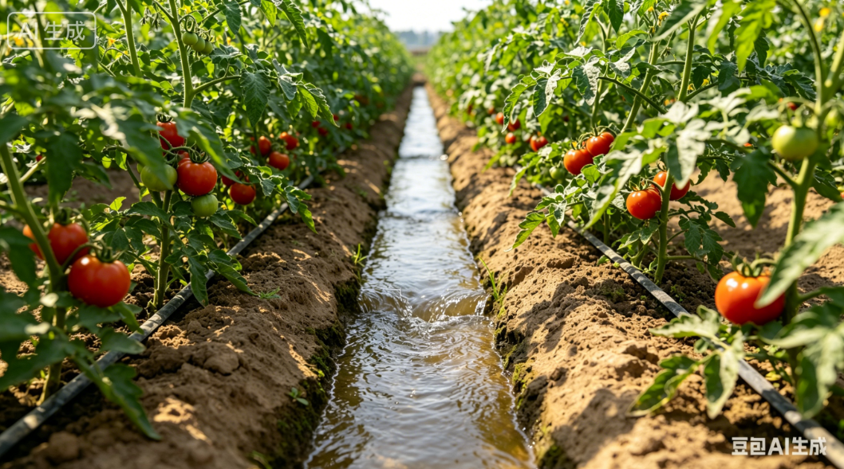
5. Field Management
Irrigation Timing & Frequency
  First irrigation: around April 25.
  Total of 4–5 irrigations during entire growth period.
  4500–6000 m³ water/ha each time.
Irrigation Method & Requirements
  Furrow irrigation used.
  Irrigation water level ≤ two-thirds of furrow depth.
Notes:
一般在4月25日前后浇灌第一次水，整个生育期共浇灌4～5次水，每次灌溉量约为每公顷4,500～6,000m³。采用沟灌方式，灌水水位不得超过沟深的2/3。
The first irrigation is usually carried out around April 25.
A total of 4-5 irrigations is required during the entire growing period,
with 4500-6000 m³ per hectare each time.
Furrow irrigation is used,
and the irrigation water level should not exceed two-thirds of the furrow depth.

Slide 11
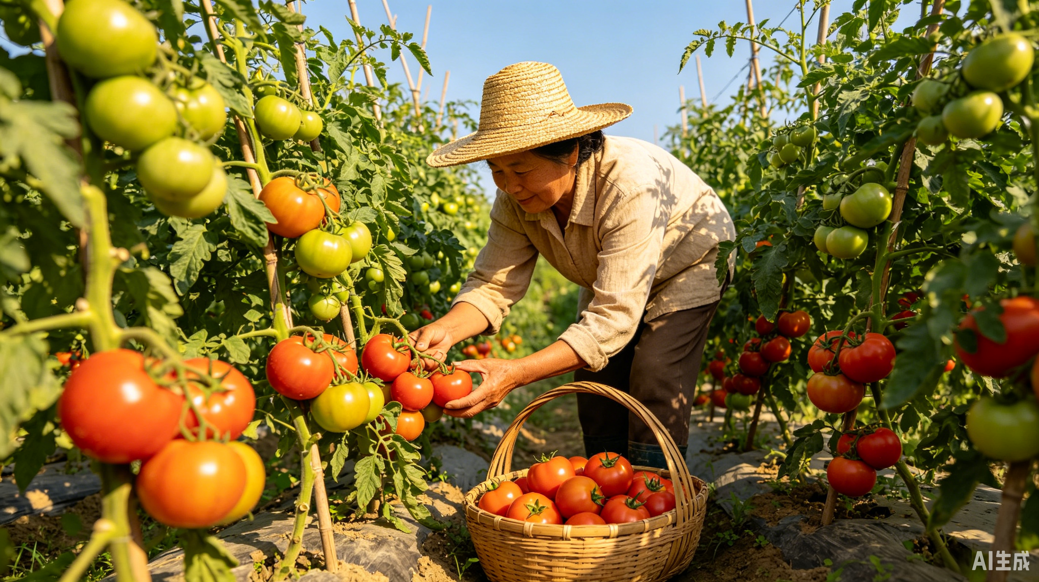
5. Field Management
Harvest Timing
  Harvest in batches in a timely manner when:
fruits fully coloured and soft → reaching the full ripening stage.
Benefits of Timely Harvesting
  Reduces plant load.
  Promotes continued fruit ripening.
  Ensures fruit quality.
  Increases yield benefits per unit area.
Notes:
当果实完全着色、果实变软，即达到完熟期时，分批及时采收，减轻植株负担，促进果实成熟，保证果实品质，提高单位面积产品效益。
Harvest should be conducted in batches in a timely manner when the
fruits are fully colored and soft, i.e. reaching the full ripening stage.
Timely harvesting
reduces plant load,
promotes continued fruit ripening,
ensures fruit quality
and increases yield benefits per unit area.

