Slide 1
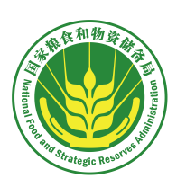
Food Quality and Safety Standards and Regulation in China
Vice President and Secretary- General of Chinese Cereals and Oils Association
Wang Lirong, Senior Engineer
August 2020

Slide 2
Contents
China's Food Security Challenges
I
China’s Food Quality and Safety Standards
II
China’s Regulation of Food Quality and Safety
III

Slide 3
01
China's Food Security Challenges
People's safety
Purpose
Political security
Economic security
Root
Foundation
National security concept
Social security
International security
Guarantee
Support

Slide 4
01
China's Food Security Challenges
As a resource concerning the national economy and people's livelihood, food is a special commodity of strategic significance and public interest with the widest coverage and the highest sensitivity and involving the most stakeholders.
Food security, energy security, and finance security are three major components of economic security, underpinning the national security.
Food
security
Energy security
Finance security

Slide 5
01
China's Food Security Challenges
Security of food concerns the quantity, quality, purchasing and storage, processing, and supply (consumption) of food.
Quantity
Quality
Supply
The grain self-sufficiency rate remains above 95%
The ratio of end-of-season cereal stocks to trend utilisation for the coming marketing year, as the minimum necessary to safeguard world food security, is 17-18 %.
Safe, nutritious and healthy
Affordable and available

Slide 6
01
China's Food Security Challenges
China feeds nearly 20% of the world's population with 9% of the world's farmland and 6% of the world's freshwater.
China has a large population but little arable land. Even worse, the decline in arable land and water resources is irreversible. These have resulted in a long-term tight balance between the food supply and demand in China.

Slide 7
China's Grain Output
Rice: 209.61 million tons
Wheat: 133.59 million tons
Maize: 260.77 million tons
Grain output in China (Unit: 10,000 tons)

Slide 8
Table 1 Output of Different Types of China's Grain Unit: 10,000 tons
Year | Grain
 |  | Cereals |  |  |  | Legumes | Tubers
 |  |  | #Rice | #Wheat | #Maize
2010 | 55911.3 | 51196.7 | 19722.6 | 11614.1 | 19075.2 | 1871.8 | 2842.7
2011 | 58849.3 | 54061.7 | 20288.3 | 11862.5 | 21131.6 | 1863.3 | 2924.3
2012 | 61222.6 | 56659.0 | 20653.2 | 12254.0 | 22955.9 | 1680.6 | 2883.0
2013 | 63048.2 | 58650.4 | 20628.6 | 12371.0 | 24845.3 | 1542.4 | 2855.4
2014 | 63954.8 | 59601.5 | 20960.9 | 12832.1 | 24976.4 | 1564.5 | 2798.8
2015 | 66060.3 | 61818.4 | 21214.2 | 13263.9 | 26499.2 | 1512.5 | 2729.3
2016 | 66043.5 | 61666.5 | 21109.4 | 13327.0 | 26361.3 | 1650.7 | 2726.3
2017 | 66160.7 | 61520.5 | 21267.6 | 13433.4 | 15907.1 | 1841.6 | 2798.6
2018 | 65789.2 | 61003.6 | 21212.9 | 13144.0 | 25717.4 | 1920.3 | 2865.4
2019 | 66384.0 | 61368.0 | 20961.0 | 13359.0 | 26077.0 | 2132.0 | 2883.0

Slide 9
01
China's Food Security Challenges
Challenges to Sufficient Quantity of Food
Population growth and accelerated urbanization
Increase in biomass energy consumption
Freshwater and land resource constraints
Challenges
Natural disasters (earthquake, extreme climate)
Emergencies

Slide 10
01
China's Food Security Challenges
Challenges to Food Quality and Safety
Mycotoxins
Heavy metal pollution
Challenges
Pesticide residue

Slide 11
01
China's Food Security Challenges
Potential risks to food quality and safety
Excessive mycotoxins - causes: abnormal climate, continuous rain during harvest season, etc.
Excessive heavy metals - causes: soil with high background radiation level, environmental pollution, soil acidification, etc.
Excessive pesticide residues - causes: misuse and overuse of pesticides.
Factors including water and soil pollution, abnormal climate, selective breeding, use of fertilizers and pesticides have increased the potential risks to food quality and safety.

Slide 12
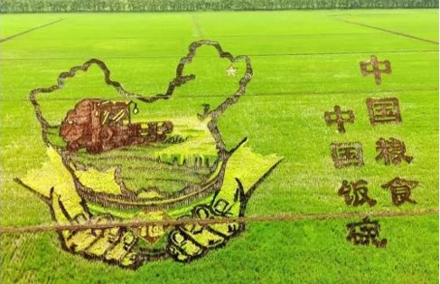
01
China's Food Security Challenges
China's National Food Security Strategy: prioritizing domestic food needs, focusing on domestic situations, securing production capacity, importing moderately, and supporting food security using technologies.
New food security concept: ensuring basic self- sufficiency in cereals and absolute security of the staples.

Slide 13
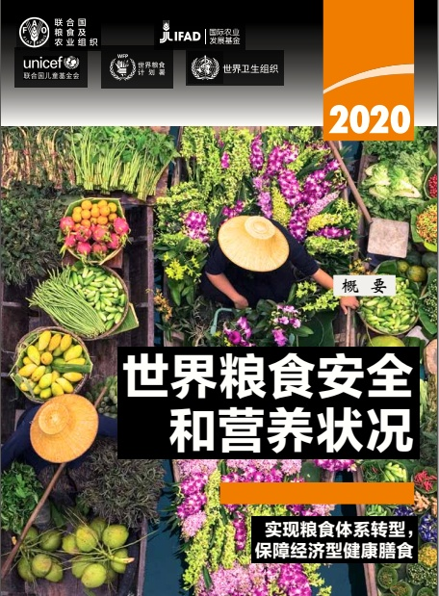
The State of Food Security and Nutrition in the World 2020, jointly prepared by the Food and Agriculture Organization of the United Nations, the International Fund for Agricultural Development, the United Nations Children's Fund, the World Food Programme and the World Health Organization, was published in Rome on July 13, 2020.
In 2019, nearly 690 million people worldwide suffered from hunger, up by 10 million from 2018, and by nearly 60 million in five years.
The COVID-19 outbreak has highlighted the vulnerability of the global food system, which requires joint efforts of relevant stakeholders.
Notes:
The report predicts that on a global scale, due to the economic recession by the COVID-19 outbreak, the number of people suffering from hunger will increase by at least 83 million, or even 132 million in 2020.

Slide 14
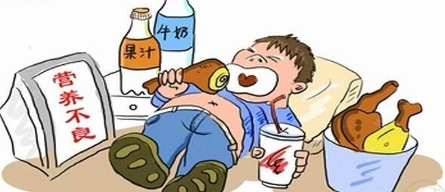
In 2019, nearly 750 million people worldwide faced severe food insecurity, accounting for nearly one-tenth of the world's population.
It is estimated that 2 billion people in the world did not have regular access to safe, nutritious and sufficient food in 2019.
Food insecurity will lead to poorer diet quality and increase the risk of various forms of malnutrition, which is likely to lead to undernutrition, overweight and obesity.
Due to the health and socio-economic impact of COVID-19, the nutritional status of the most vulnerable groups is likely to deteriorate further.

Slide 15
Contents
China's Food Security Challenges
I
China’s Food Quality and Safety Standards
II
China’s Regulation of Food Quality and Safety
III

Slide 16
01
Connotation and Denotation of Food Quality and Safety Standards
Food quality and safety are highly valued in China.
China sticks to the important idea of “paying attention to the quantity and quality of food equally,focusing more on the quality of agricultural products and food safety while ensuring sufficient food supply”, and has made great efforts to build a sound food quality and safety system.
China has been working on ensuring the safety of agricultural products with the most rigorous standards, the strictest regulation, and the most severe punishment and accountability mechanism, in a bid to ensure people's access to safe food.

Slide 17
01
Connotation and Denotation of Food Quality and Safety Standards
Food Quality
Quality of grain under conventional circumstances
Quality of grain in storage
Food Safety

Slide 18
01
Connotation and Denotation of Food Quality and Safety Standards
With a focus on the value and property of grain, these standards are designed to normalize the market order, and increase the product competitiveness.
Most standards deal with the quality of grain under conventional circumstances and in storage, quality of processed grain, and the nutritional quality of grain, etc.
Most of these standards are recommendatory in nature.
Food Quality
Standards
Connotation of Food Quality and Safety Standards
Notes:
Three categories: mycotoxins, heavy metal pollution, pesticide residues.

Slide 19
01
Connotation and Denotation of Food Quality and Safety Standards
Food Quality Standards
According to the Standardization Law of the People's Republic of China, these standards are managed by the Standardization Administration of China in a unified manner, and the relevant administrative department, which is the National Food and Strategic Reserves Administration, will take charge of the standardization work relating to itself and the industry it's involved.
The standard formulation process includes proposing the formulation of a standard, proposal approval, standard drafting, solicitation of opinions, technical review, numbering, and publication.
Notes:
Three categories: mycotoxins, heavy metal pollution, pesticide residues.

Slide 20
Standard formulation and revision organization - National Grain and Oil Standardization Technical Committee(TC/SC)
01
Connotation and Denotation of Food Quality and Safety Standards
TC270: National Grain and Oil Standardization Technical Committee, with 65 members.
TC270/SC1: Sub-Committee on Unprocessed Grains and Their Products, with 40 members.
TC270/SC2: Sub-Committee on Oilseeds, Oils and Fats, with 39 members.
TC270/SC3: Sub-Committee on Grain Storage and Circulation, with 66 members.
TC270/SC4: Sub-Committee on Grain and Oil Processing Machinery, with 37 members.
The National Grain and Oil Standardization Technical Committee is mainly composed of scientific and technological professionals from institutions of higher learning, scientific research institutes, quality inspection agencies, and grain enterprises.
Notes:
The template is from http://docer.wps.cn

Slide 21
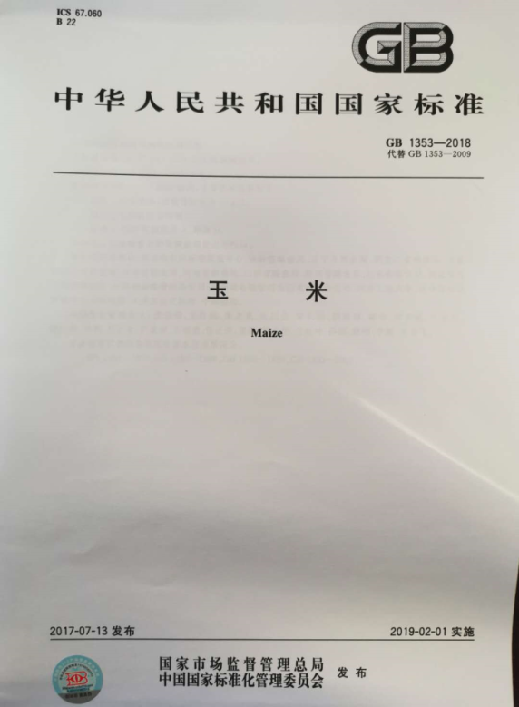
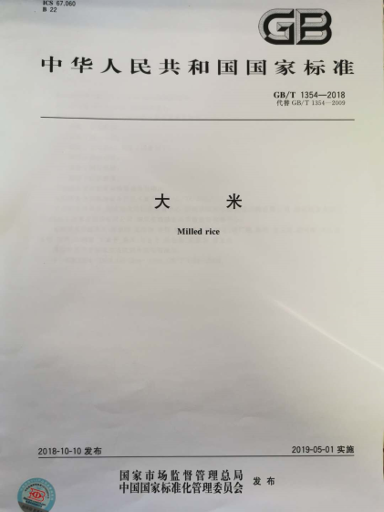
01
Connotation and Denotation of Food Quality and Safety Standards
Food Quality Standards
There are a total of 670 food quality standards under centralized management, including 361 national standards and 309 industry standards, covering aspects including food production, purchasing, storage, processing, transportation and marketing.
Common quality standards:
GB 1350 Paddy GB/T 1354 Milled Rice
GB 1351 Wheat
GB/T 1355 Wheat Flour
GB 1353 Maize
GB 1352 Soybean

Slide 22
Note: The purchase of wheat with moisture content greater than that specified in this table shall be subject to relevant national regulations.
01
Connotation and Denotation of Food Quality and Safety Standards
Wheat quality indicators
Grade | Unit weight (g/l) | Unsound grain (%) | Impurities (%) |  | Moisture | Color, smell
 |  |  | Total quantity | Where: minerals
1 | ≥790 | ≤6.0 | ≤1.0 | ≤0.5 | ≤12.5 | Normal
2 | ≥770 | ≤6.0 | ≤1.0 | ≤0.5 | ≤12.5 | Normal
3 | ≥750 | ≤8.0 | ≤1.0 | ≤0.5 | ≤12.5 | Normal
4 | ≥730 | ≤8.0 | ≤1.0 | ≤0.5 | ≤12.5 | Normal
5 | ≥710 | ≤10.0 | ≤1.0 | ≤0.5 | ≤12.5 | Normal

Slide 23
01
Connotation and Denotation of Food Quality and Safety Standards
Wheat flour quality indicators
Grade | Fineness of Processing | Ash content (%, by dry matter) | Fineness (%) | Gluten content (%, by wet weight) | Sand content (%) | Magnetic metal content (g/kg) | Moisture (%) | Fatty acid value (by wet basis) | Smell, flavor
Grade 1 | Check the colour and bran speck against standard sample | ≤0.70 | All samples pass through the CB36 sieve, and no more than 10.0% remain in the CB42 sieve | ≥26.0 | ≤0.02 | ≤0.003 | 13.5± | ≤80 | Normal
Grade 2 | Check the colour and bran speck against standard sample | ≤0.85 | All samples pass through the CB30 sieve, and no more than 10.0% remain in the CB36 sieve | ≥25.0 | ≤0.02 | ≤0.003 | 13.5±0.5 | ≤80 | Normal
Standard | Check the colour and bran speck against standard sample | ≤1.10 | All samples pass through the CQ20 sieve, and no more than 20.0% remain in the CB30 sieve | ≥24.0 | ≤0.02 | ≤0.003 | 13.5±0.5 | ≤80 | Normal
Average | Check the colour and bran speck against standard sample | ≤1.40 | All samples pass through the CQ20 sieve | ≥22.0 | ≤0.02 | ≤0.003 | 13.5±0.5 | ≤80 | Normal

Slide 24
01
Connotation and Denotation of Food Quality and Safety Standards
These standards are used to protect human health and safety
There are three common categories
Most of them are compulsory
Food Safety
Standards
Extension of Food Quality and Safety Standards
Notes:
Three categories: mycotoxins, heavy metal pollution, pesticide residues.

Slide 25
01
Connotation and Denotation of Food Quality and Safety Standards
Food Safety Standards
According to the Food Safety Law of the Republic of China, these standards are jointly formulated by the National Health Commission, the Ministry of Agriculture and Rural Affairs, and the State Administration for Market Regulation.
The formulation process includes programming, planning, proposal approval, standard drafting, solicitation of opinions, review, approval of the standard, numbering, publication, follow-up evaluation, revision, etc.
Notes:
Three categories: mycotoxins, heavy metal pollution, pesticide residues.

Slide 26
Note: The secretariat is located in China National Center for Food Safety Risk Assessment
01
Connotation and Denotation of Food Quality and Safety Standards
National Food Safety Standards Review Committee
Contaminants
Microorganism
Food additive
Pesticide residue
Veterinary drug residue
Radioactive substance
Food products
Nutritional food and food for special dietary use
Food-related products
Label
Production and operation specifications
Physical and chemical testing methods and specifications
Microbiological testing methods
Toxicological evaluation procedures

Slide 27
01
Connotation and Denotation of Food Quality and Safety Standards
Food Safety
Mycotoxins
Toxic heavy metals
Pesticide residue
Organophosphorus pesticide
Organochlorine pesticides
Other pesticides
Aflatoxin B1
Deoxynivalenol
Zearalenone
Lead, cadmium, mercury, inorganic arsenic
National Food Safety Standard - Maximum Levels of Mycotoxins in Foods
（GB2761-2017）
National Food Safety Standard - Maximum Levels of Contaminants in Foods
（GB2762-2017）
National Food Safety Standard - Maximum Residue Limits for Pesticides in Foods
（GB2763-2019）

Slide 28
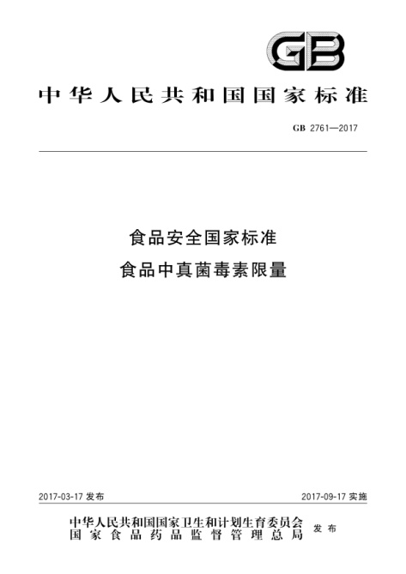
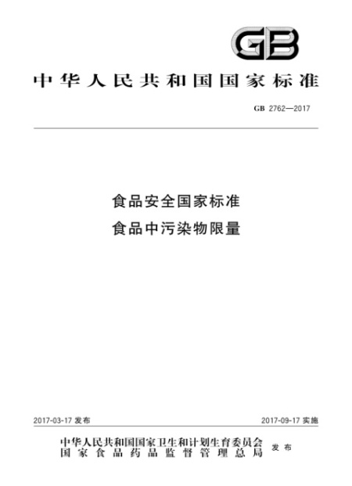
01
Connotation and Denotation of Food Quality and Safety Standards
Food Safety Standards
GB2715: Toxic and harmful fungi and plant seeds
GB2761: Mycotoxins
GB2762: Contaminants
Notes:
Three categories: mycotoxins, heavy metal pollution, pesticide residues.

Slide 29
Note: It can be seen from this table that the limits of toxins and contaminants for wheat and wheat flour are consistent.
01
Connotation and Denotation of Food Quality and Safety Standards
Item |  | Wheat | Wheat flour
Sensory evaluation | Heat-damaged kernel (%) | ≤0.5 | —
 | Moldy kernel (%) | ≤2.0 | —
Mycotoxins | Aflatoxin B1 (ug/kg) | 5.0 | 5.0
 | DON（ug/kg） | 1000 | 1000
 | Ochratoxin A (ug/kg) | 5.0 | 5.0
 | Zearalenone | 60 | 60
Contaminants | Lead (mg/kg) | 0.2 | 0.2
 | Cadmium (mg/kg) | 0.1 | 0.1
 | Mercury (mg/kg) | 0.02 | 0.02
 | Arsenic (mg/kg) | 0.5 | 0.5

Slide 30
National Standardization Management Organizations
02
Food Quality and Safety Standard Management System and Mechanism
Standardization
Administration of China
National Health Commission
Ministry of Agriculture
and Rural Affairs
Ministry of Housing and Urban-Rural Development
Ministry of Ecology
and Environment
National standards
Food Safety Standards
Engineering and construction standards
Environmental protection standards
Standards for pesticides, veterinary drugs, and GMF
National standards are drafted, approved, numbered and issued by the Standardization Administration of China.
The national standards for engineering and construction, food safety, pesticides and veterinary drugs, and environmental protection are drafted and approved by the competent departments of engineering and construction, health, agriculture and environmental protection under the State Council; these national standards are uniformly numbered by the Standardization Administration.

Slide 31
02
Food Quality and Safety Standard Management System and Mechanism
Compulsory Standards
Recommendatory Standards
Compulsory national standards
Recommendatory national standards
Recommendatory industry standards
Recommendatory provincial standards
Association Standards
Enterprise Standards
Current National Standard System

Slide 32
02
Food Quality and Safety Standard Management System and Mechanism
2144 compulsory standards:7%.
370 technical guidance documents: 1%.
Safety, 4.81%.
Healthcare, 2.17%.
Product, 33.02%.
Fundamentals, 18.69%.
Environmental protection, 1.20%.
31408 recommendatory standards: 92%.
Method, 36.08%.
Management, 3.51%.
Current National Standard System

Slide 33
02
Food Quality and Safety Standard Management System and Mechanism
National Food and Strategic Reserve Administration
Quality Standard Management Office, National Food and Strategic Reserve Administration
National Grain and Oil Standardization Technical Committee
Sub-committee on Unprocessed Grains and Their Products
Sub-committee on Oilseeds, Oils and Fats
Sub-Committee on Grain Storage and Circulation
Sub-Committee on Grain and Oil Processing Machinery
Food Standardization Management Organizations

Slide 34
02
Food Quality and Safety Standard Management System and Mechanism
Food Standards under Centralized Management of National Food and Strategic Reserve Administration
Management standards
Terminology
Graphic symbol
Packaging and labeling
Product standards
Unprocessed grain (oil)
Processed grain (oil)
Processed products
Method standards
Testing method
Specifications and procedures
Machinery standards
Processing machinery
Testing instruments
Storage standards
Technical specifications
Monitoring of condition of grain in storage
Basic standards
Information classification
Industry terms
Engineering and construction standards
Current Food Standard System

Slide 35
Current situation of food standards in China
02
Food Quality and Safety Standard Management System and Mechanism
679 standards under centralized management
361 national standards
309 industry standards

Slide 36
T
HANK YOU!

