Slide 1

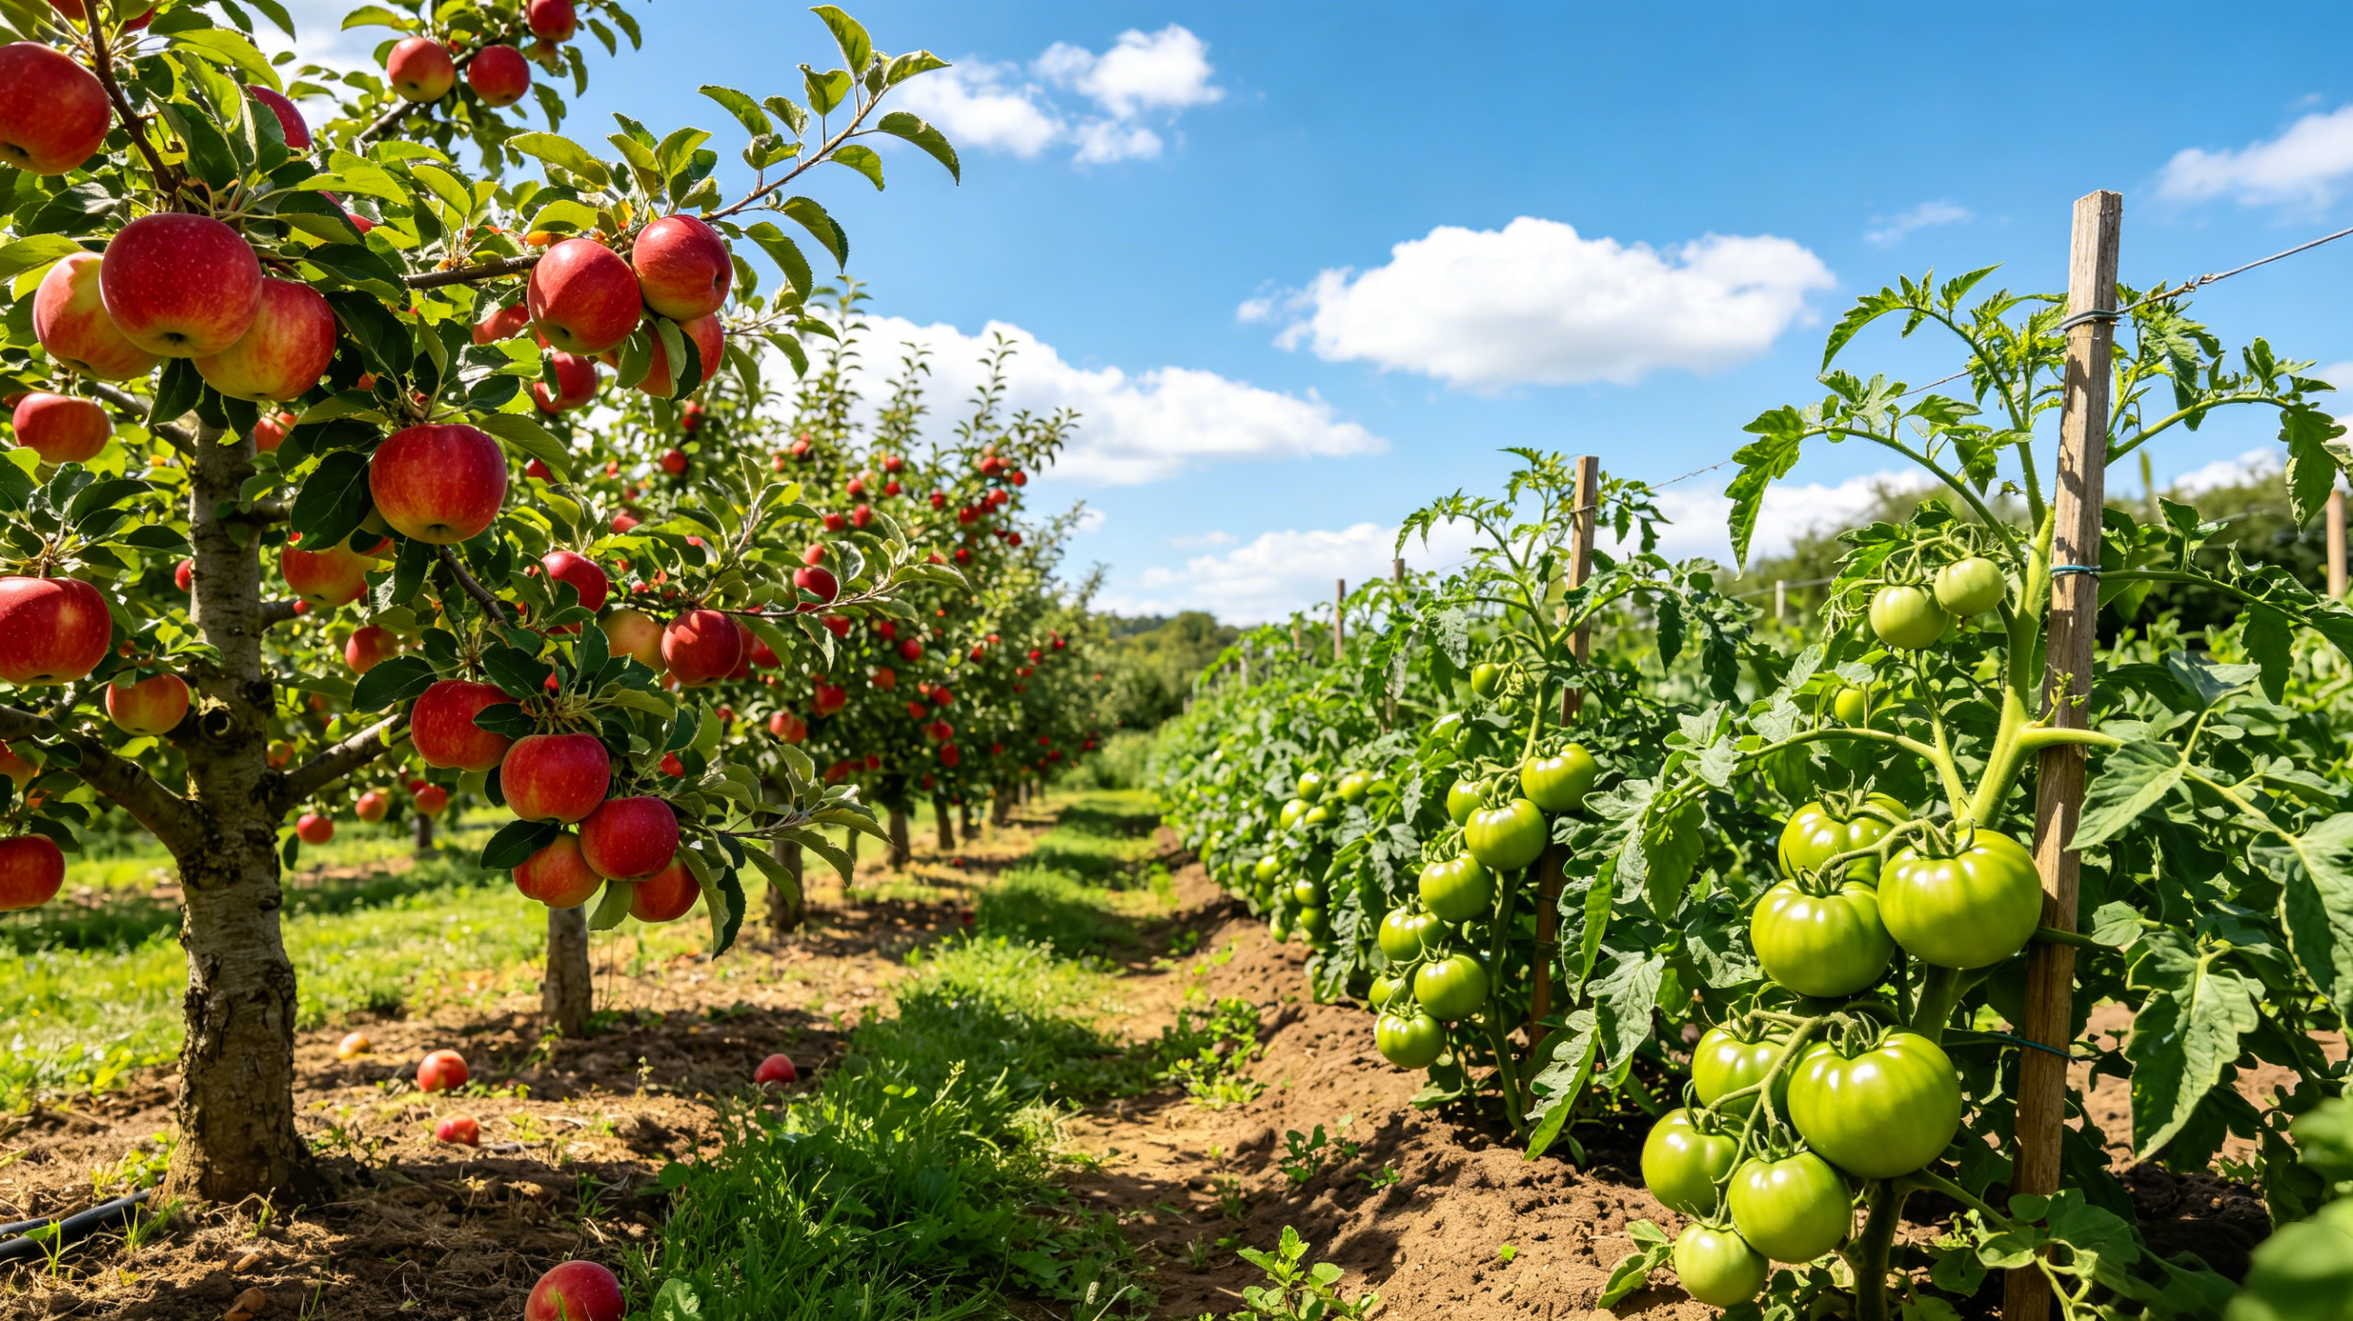



Postharvest Preservation Technologies
For Common Fruits And Vegetables
Notes:
Postharvest Preservation Technologies for Common Fruits and Vegetables
常见果蔬的保鲜技术

Slide 2
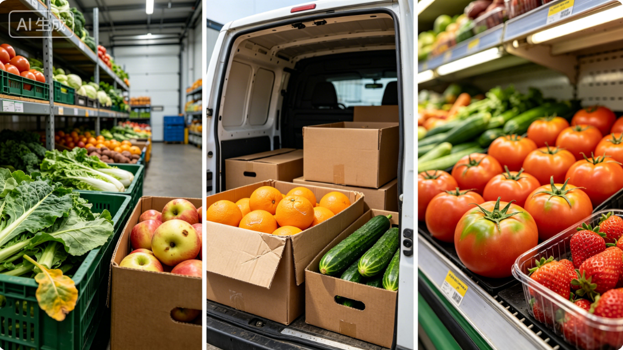
Overview
Postharvest Physiological Characteristics
  After harvest, fruits and vegetables remain living organisms and continue to undergo the following core physiological activities:
Common Postharvest Problems
  During storage, transportation, and marketing, fruits and vegetables are prone to the following problems:
Respiration
Water Loss
Decay
Browning
Transpiration
Senescence
Flavor Deterioration
Ripening
Senescence
Impacts of Postharvest Problems
  The above problems directly lead to:
Reduced quality.
Substantial postharvest losses.
Notes:
果蔬是我们日常生活中不可或缺的农产品，采收后依然是具有生命活动的有机体，会持续进行呼吸、蒸腾、成熟衰老等生理活动。在贮藏、运输和销售过程中，很容易出现失水、腐烂、褐变、老化、风味变差等问题，不仅降低品质，还会造成巨大的产后损耗。
Fruits and vegetables are essential agricultural products in daily life. After harvest, they remain living organisms and continue to undergo physiological activities such as respiration, transpiration, ripening, and senescence. During storage, transportation, and marketing, they are prone to problems such as water loss, decay, browning, senescence, and flavor deterioration. These issues not only reduce quality but also lead to substantial postharvest losses.

Slide 3
Part 01
Preservation Methods for Fruits and Vegetables
Part 02
Preservation Methods for Common Fruits and Vegetables
Notes:
本次课程围绕“常见果蔬的保鲜技术”这一主题，分两大部分展开讲解。
第一部分介绍果蔬的保鲜方式；第二部分重点讲解常见果蔬的保鲜方法。
This course is divided into two main parts: the first introduces general preservation methods, and the second presents practical preservation techniques for specific fruits and vegetables.

Slide 4
PART.01
AI生成
Preservation Methods for Fruits and Vegetables
Notes:
一、果蔬的保鲜方式
Preservation Methods for Fruits and Vegetables

Slide 5
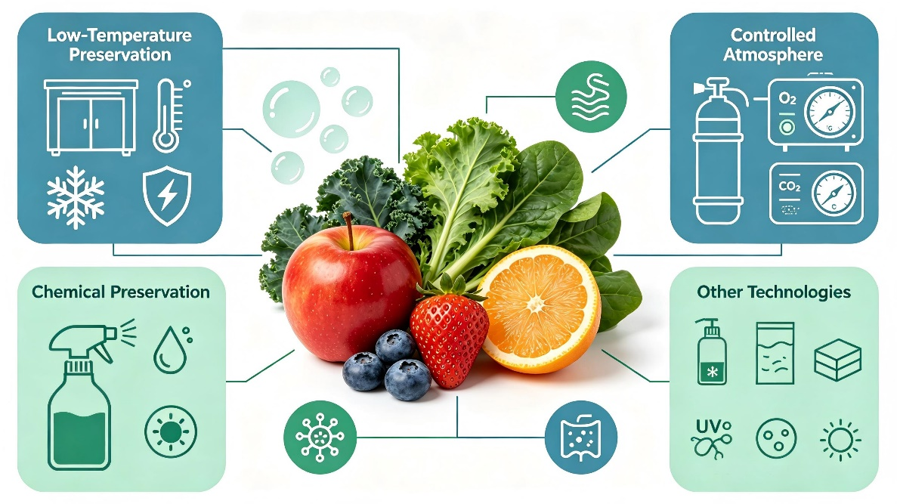
Postharvest Preservation:
Core Objectives and Common Methods
Postharvest State and Core Objectives
  Since fruits and vegetables remain alive after harvest, the core objectives of preservation are threefold:
Reduce Respiration Rate
Minimize Transpiration Loss
Inhibit Pathogen Growth
Common Preservation Methods
  The commonly used preservation methods in practice are as follows:
Low-Temperature Preservation.
Controlled Atmosphere (CA) Preservation.
Chemical Preservation.
Other Preservation Technologies.
Notes:
果蔬采后仍是活的有机体，保鲜的核心目标有三：降低呼吸作用、减少蒸腾失水、抑制致病菌生长。生产实践中常用的保鲜方式包括以下几种。
Since fruits and vegetables remain alive after harvest, the core objectives of preservation are threefold:
(i) reduce respiration rate; (ii) minimize transpiration loss; and (iii) inhibit pathogen growth. The commonly used preservation methods in practice are as follows:
Low-Temperature Preservation.
Controlled Atmosphere (CA) Preservation
Chemical Preservation.
Other Preservation Technologies.

Slide 6
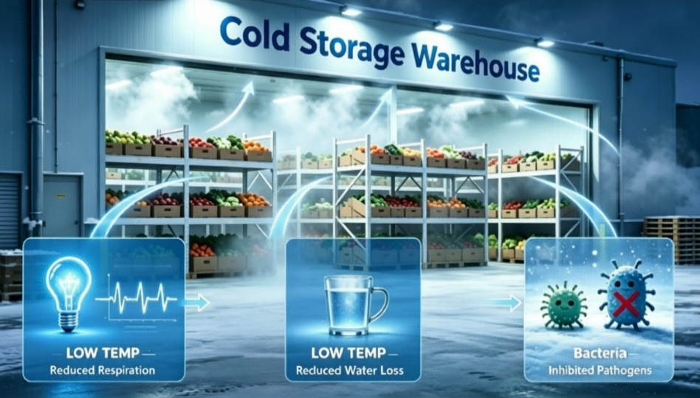
1. Low-Temperature Preservation
Low temperature is the most commonly used preservation method in postharvest practice.
Reduce Respiration Intensity
  As ambient temperature decreases → respiration slows accordingly.
Reduce Water Loss
  Low temperature → helps reduce water loss.
  Higher temperature → faster water evaporation.
  Temperature declines → evaporation rate slows → water loss decreases correspondingly.
AI生成
Effectively Inhibit Growth of Pathogenic Microorganisms
  Most pathogenic bacteria thrive at 20–30°C.
  Their growth significantly inhibited below 10°C.
Notes:
（一）低温保鲜
低温是生产实践中最为常见的一种保鲜方式。
首先，低温可以降低果蔬的呼吸强度。当环境温度降低时，果蔬自身的呼吸作用随之放缓。
同时，低温也有助于减少失水——温度越高，水分蒸发速度越快；
温度降低后，水分蒸发速度减慢，失水也随之减少。
此外，降温还能有效抑制病原菌的生长。大部分致病菌适宜在20～30℃条件下生长，当环境温度降至10℃以下时，病原菌的生长即受到明显抑制。
1.1.Low‑Temperature Preservation
Low temperature is the most commonly used preservation method in postharvest practice.
First, low temperature can reduce the respiration intensity of fruits and vegetables. As the ambient temperature decreases, their respiration slows accordingly. Meanwhile, low temperature also helps reduce water loss: the higher the temperature, the faster the rate of water evaporation. As temperature declines, the evaporation rate slows, and water loss decreases correspondingly. In addition, cooling can effectively inhibit the growth of pathogenic microorganisms. Most pathogenic bacteria thrive at temperatures ranging from 20 to 30°C, and their growth is significantly inhibited when the ambient temperature drops below 10°C.

Slide 7
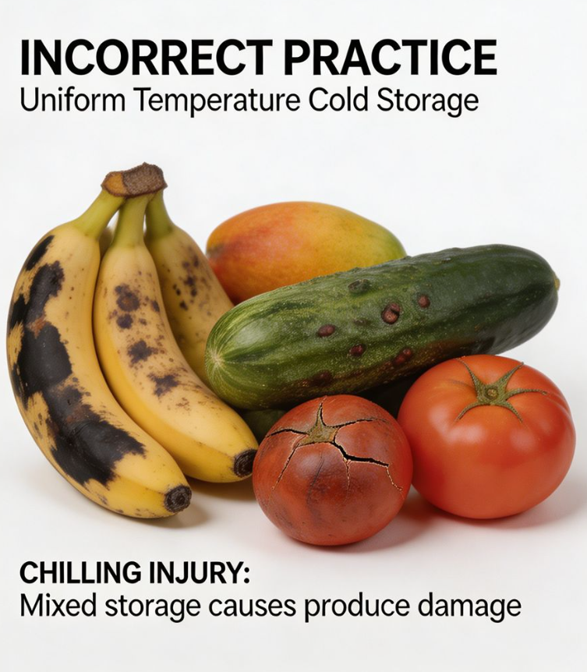
1. Low-Temperature Preservation
Suitable storage temperatures vary across different types of fruits and vegetables.
Avoid Uniform Temperature Settings
  Cold storage facility should not be set a uniform temperature for all produce.
  Uniform settings → chilling injury in cold-sensitive fruits and vegetables.
Select Temperatures Based on Produce Characteristics
  Appropriate temperatures should be selected based on inherent characteristics
  of each fruit or vegetable.
AI生成
Notes:
需要注意的是，不同果蔬适宜的储藏温度并不相同。不可将冷库统一设置一个温度，然后将各种果蔬全部放入保藏，否则不耐低温的果蔬容易发生冻害。应根据果蔬自身的特性选择合适的储藏温度。
It should be noted that suitable storage temperatures vary across different types of fruits and vegetables. A cold storage facility should not be set to a uniform temperature for storing all kinds of produce together; otherwise, chilling injury is likely to occur in cold-sensitive fruits and vegetables. Appropriate storage temperatures should be selected based on the inherent characteristics of each type of fruit and vegetable.

Slide 8
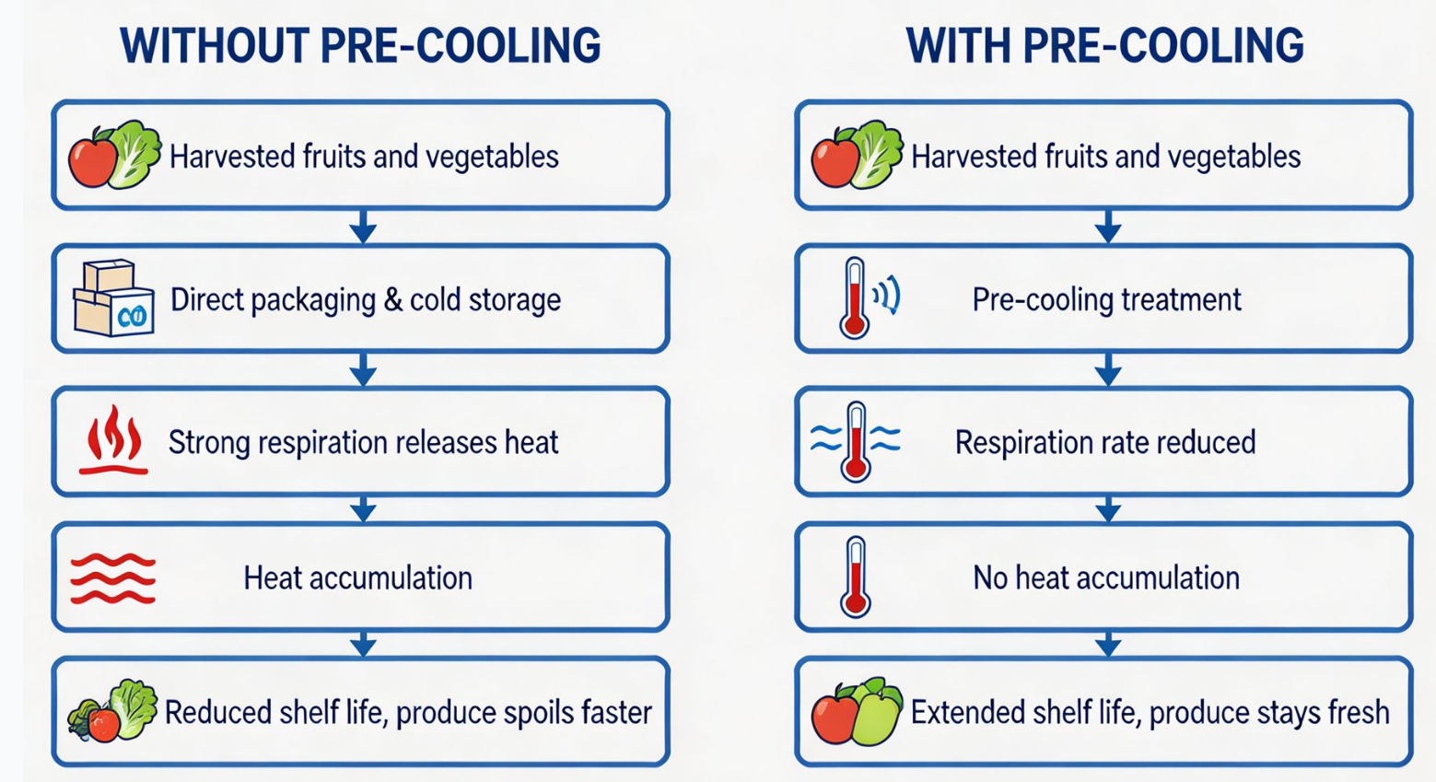
1. Low-Temperature Preservation
Pre-cooling
Pre-cooling is strongly recommended before cold storage.
High Respiration and Metabolic Activity After Harvest
  Immediately after harvest, fruits and vegetables have very high respiration and metabolic activity.
  This activity does not decline spontaneously in a short time.
AI生成
Risks of Skipping Pre-cooling
  Direct packaging and storage without pre-cooling → intense respiratory activity will release and accumulate large amount of heat → making it difficult to effectively reduce metabolic activity → negatively affects shelf life.
Notes:
预冷处理。在有条件的情况下，果蔬入库前应尽可能进行预冷。果蔬在田间采摘后刚离开母体植株，呼吸作用非常旺盛，生命活动强烈，短时间内不会自行下降。若此时不经预冷直接包装入库，果蔬旺盛的呼吸作用会释放并积攒大量热量，难以有效降低其生命活性，从而影响保存期。
Pre-cooling. When conditions permit, pre‑cooling is strongly recommended before cold storage. Immediately after harvest, fruits and vegetables have very high respiration and metabolic activity, which does not decline spontaneously in a short time. If they are directly packaged and stored without pre‑cooling, the intense respiratory activity will release and accumulate a large amount of heat, making it difficult to effectively reduce their metabolic activity and thereby affecting shelf life.

Slide 9
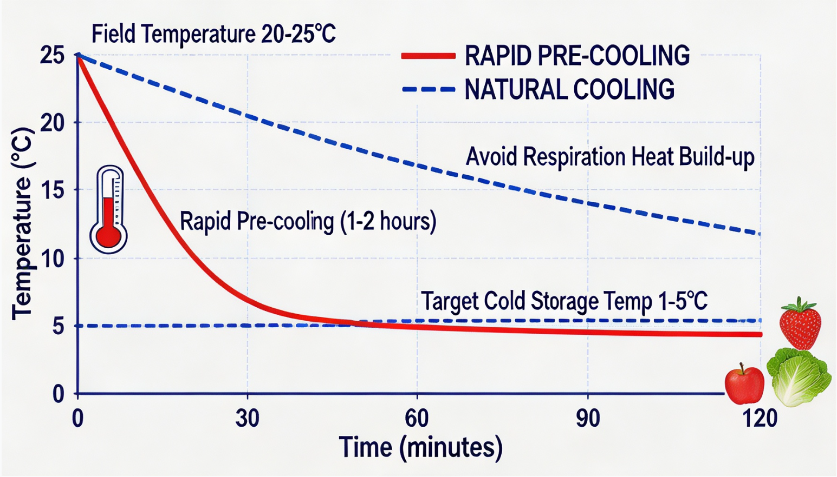
1. Low-Temperature Preservation
Pre-cooling
Rapid Temperature Reduction
  Temperature should be quickly reduced：
    From room temperature (~20°C) or outdoor temperature (~10°C) → to near the cold-storage temperature (4–5°C or 1–2°C).
    Within 1–2 hours or less.
Transfer After Cooling
  Transferred to cold storage to prevent respiration heat compromising the cooling effect.
AI生成
Notes:
因此，尤其是大规模储藏时，应对果蔬进行预冷，在一至两小时甚至更短的时间内，将果蔬温度从室温（二十几摄氏度）或室外温度（十几摄氏度）迅速降至接近冷库温度（4～5℃或1～2℃），再放入冷库保藏，以避免呼吸产热影响冷库保冷效果。
Therefore, especially for large‑scale storage, fruits and vegetables should be pre‑cooled,
and their temperature should be quickly reduced
from room temperature (around 20°C) or outdoor temperature (around 10°C)
to near the cold-storage temperature (4-5°C or 1-2°C)
within one to two hours or even less,
and then transferred to cold storage to prevent respiration heat compromising the cooling effect.

Slide 10
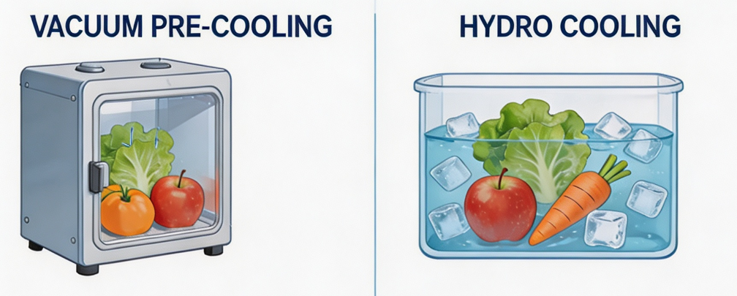
1. Low-Temperature Preservation
Pre-cooling
Vacuum pre-cooling is one of the most widely used pre-cooling methods.
Vacuum Pre-cooling Process
  Fruits and vegetables placed in a vacuum machine.
  Excess surface moisture removed through vacuum extraction → achieve evaporative cooling → allow produce to reach target temperature rapidly before being transferred to cold storage.
AI生成
Alternative Method
  Immersion in cold or ice water may be used → to quickly lower the temperature of fruits and vegetables prior to storage.
Notes:
预冷方式有多种，其中真空预冷是主要的预冷方式之一。将果蔬置于真空机内，通过抽真空除去果蔬一部分多余水分，使其蒸发降温，可迅速达到目标温度，然后送入冷库储藏。若没有条件购买真空预冷机，也可采用冷水或冰水浸泡的方式，使果蔬迅速降温后再入库。
There are several pre‑cooling methods, among which vacuum pre‑cooling is one of the most widely used. Fruits and vegetables are placed in a vacuum machine, where excess surface moisture is removed through vacuum extraction to achieve evaporative cooling, allowing the produce to reach the target temperature rapidly before being transferred to cold storage. If a vacuum precooler is not available, immersion in cold or ice water may also be used to quickly lower the temperature of fruits and vegetables prior to storage.

Slide 11
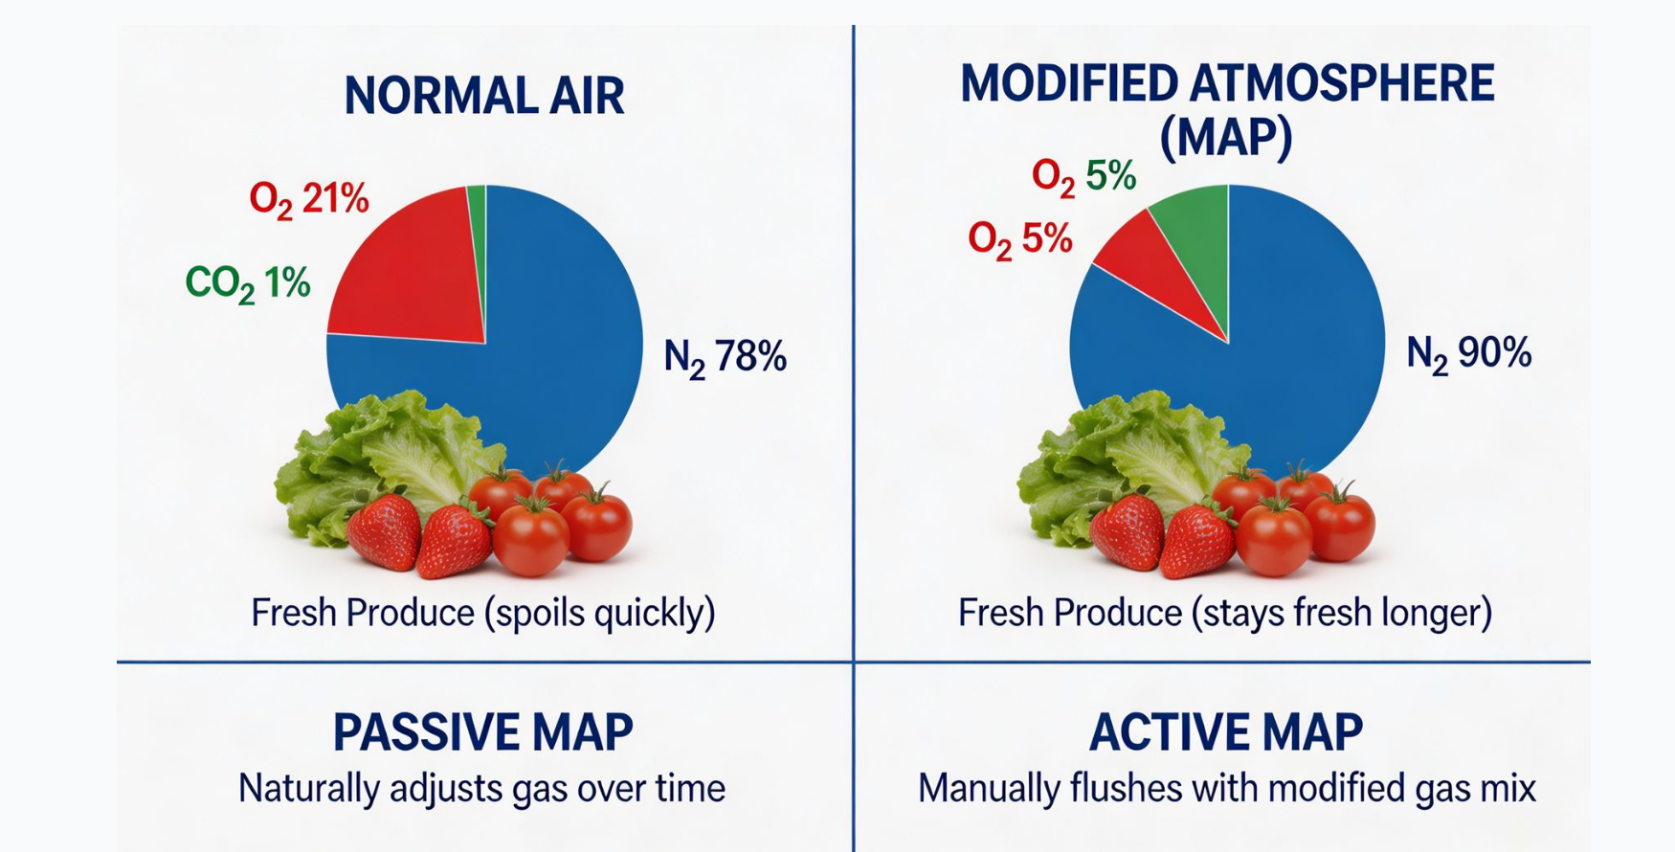
2. Controlled Atmosphere (CA) Preservation
Controlled-atmosphere storage is widely used for certain fruits and vegetables.
Principle: Adjusting Gas Composition
  Prolongs storage life by adjusting the proportions of O₂, CO₂, and N₂ in the storage environment.
AI生成
Normal Air Composition
  In normal air: N₂ ~78%, O₂ ~21%, CO₂ + others ~1%.
CA Preservation: Two Methods
  Modified-atmosphere packaging.
  Artificial controlled-atmosphere packaging.
Notes:
（二）气调保鲜
气调保鲜在一些果蔬储藏中已经比较常见。
气调保鲜通过调整储藏环境中氧气、二氧化碳和氮气的比例来延长保藏时间。在正常空气中，氮气约占78%，氧气约占21%，二氧化碳和其他气体共约占1%。气调保鲜可通过自发性气调包装或人工气调包装两种方式实现。
1.2.Controlled Atmosphere (CA) Preservation
Controlled-atmosphere storage is widely used for certain fruits and vegetables.
It prolongs storage life by adjusting the proportions of oxygen (O₂), carbon dioxide (CO₂), and nitrogen (N₂) in the storage environment.
In normal air, nitrogen accounts
for about 78%, oxygen about 21%, and carbon dioxide and other gases together account for about 1%.
Controlled-atmosphere preservation can be achieved through two methods:
modified-atmosphere packaging or artificial controlled-atmosphere packaging.

Slide 12
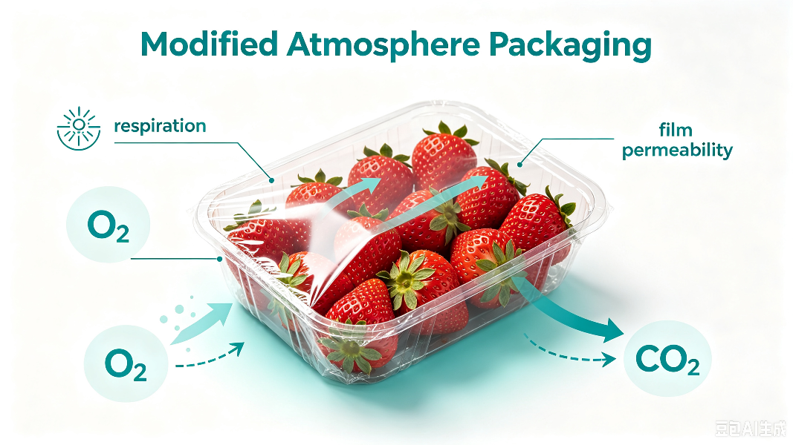
2. Controlled Atmosphere (CA) Preservation
Modified-atmosphere Packaging
Mechanism
  A preservation method that relies on:
  Naturally adjust O₂ and CO₂ levels in a sealed environment.
  ⇒ Inhibits respiration + delays senescence.
    Fruits and vegetables’ own respiration.
    Air permeability of packaging material.
AI生成
Notes:
自发性气调包装是指利用果蔬自身的呼吸作用和包装材料的透气性能，在密封环境中自行调节氧气和二氧化碳含量，从而达到抑制呼吸、延缓衰老的保鲜方法。
Modified-atmosphere packaging refers to a preservation method that relies on the fruits and vegetables' own respiration and the air permeability of the packaging material to naturally adjust oxygen and carbon dioxide levels in a sealed environment, thereby inhibiting respiration and delaying senescence.

Slide 13
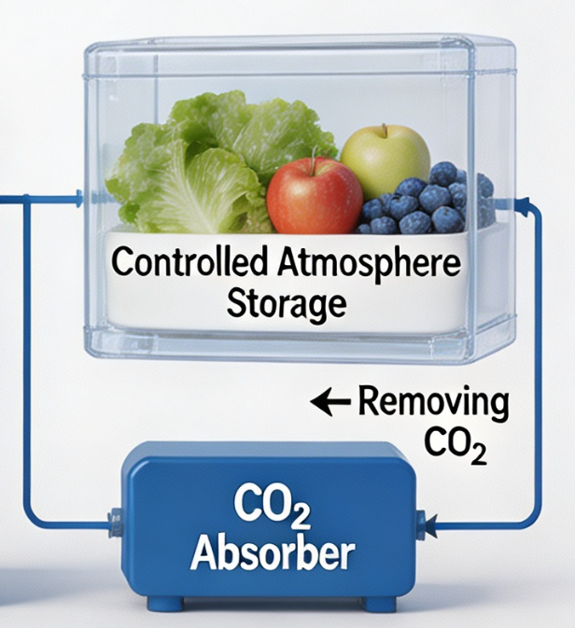
2. Controlled Atmosphere (CA) Preservation
Artificial Controlled-atmosphere Packaging
AI生成
Mechanism:
  Use of mechanical equipment to actively adjust gas composition in packaging or storage space.
  Examples: filling with nitrogen, adsorbing carbon dioxide.
Objective
  Achieve precise and continuous control of O₂, CO₂, and other gas concentrations.
Notes:
人工气调包装是指通过‌机械设备主动调节‌包装或贮藏空间内的气体成分（如充入氮气、吸附二氧化碳等），实现对氧气、二氧化碳等气体浓度的‌精确、连续控制。
Artificial controlled-atmosphere packaging refers to the use of mechanical equipment to actively adjust the gas composition in the packaging or storage space (such as filling with nitrogen or adsorbing carbon dioxide) to achieve precise and continuous control of oxygen, carbon dioxide and other gas concentrations.

Slide 14
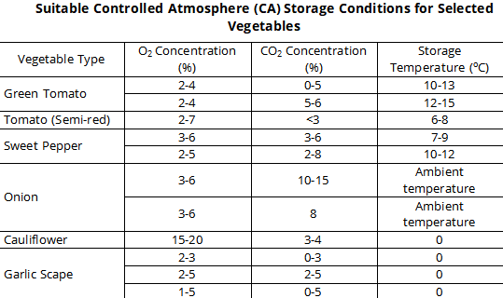
2. Controlled Atmosphere (CA) Preservation
Different vegetables have different requirements for controlled-atmosphere conditions.
Green Tomatoes
  O₂ 2%–4%.
  CO₂ 0%–5% (or 5%–6%).
  Storage temperature 10–13°C (or 12–15°C).
Sweet Peppers
  O₂ 3%–6% (or 2%–5%).
  CO₂ 3%–6% (or 2%–8%).
  Storage temperature 7–9°C (or 10–12°C).
Onions
  O₂ 3%–6%.
  CO₂ 10%–15% (or 8%).
  Storage temperature at ambient temperature.
Cauliflower
  O₂ 15%–20%.
  Only slightly lower than O₂ level of normal air.
Notes:
不同蔬菜对气调配比的要求不同。从下面的表格中可以看到部分蔬菜的适宜气调条件：
绿番茄：氧气浓度2%～4%，二氧化碳浓度0%～5%（或5%～6%），储藏温度10～13℃（或12～15℃）。
甜椒：氧气浓度3%～6%（或2%～5%），二氧化碳浓度3%～6%（或2%～8%），储藏温度7～9℃（或10～12℃）。
洋葱：氧气浓度3%～6%，二氧化碳浓度10%～15%（或8%），储藏温度常温。
花菜：氧气浓度15%～20%，仅比正常空气中氧气比例略微降低。
Different vegetables have different requirements for controlled-atmosphere conditions. From the table below, [From the table on the right]you can see the suitable controlled-atmosphere conditions for several vegetables:
▪Green tomatoes: oxygen concentration 2%–4%; carbon dioxide concentration 0%–5% (or 5%–6%); storage temperature 10-13°C (or 12-15°C).
▪Sweet peppers: oxygen concentration 3%–6% (or 2%–5%); carbon dioxide concentration 3%–6% (or 2%–8%); storage temperature 7–9°C (or 10–12°C).
▪Onions: oxygen concentration 3%–6%; carbon dioxide concentration 10%–15% (or 8%); storage temperature at ambient temperature.
▪Cauliflower: oxygen concentration 15%–20%, which is only slightly lower than the oxygen level in normal air.

Slide 15
2. Controlled Atmosphere (CA) Preservation
Selecting Appropriate CA Conditions
  Appropriate controlled-atmosphere conditions should be selected according to type of fruits and Vegetables stored.
Low-Oxygen CA (Most Common)
  Example: cherries stored with a gas mixture of 7% O₂, 20% CO₂, 73% N₂ → effectively maintains fruit quality.
High-Oxygen CA (Used in Some Cases)
  Example: strawberries stored with O₂concentration increased to ~60%, ~1.2% CO₂, ~38.8% N₂ → maintains good physiological condition.
Used in Conjunction with Low-Temperature Storage
  Integrated regulation of temperature, humidity, and gas composition → fruits and vegetables maintained in optimal dormant state.
Notes:
在实际生产中，应根据储藏果蔬的种类选择合适的气调配比。目前最常用的是低氧气调方式。例如，储藏樱桃可采用氧气7%、二氧化碳20%、氮气73%的气体比例，以较好地维持樱桃品质。在某些情况下也可采用高氧气调方式。比如在草莓储藏中，可将氧气比例提高到60%左右，二氧化碳约1.2%，氮气约38.8%，在此气调条件下，草莓能维持较好的生理品质。
当然，气调保藏要与冷库配合使用，即低温储藏。只有将温度、湿度和气体成分进行综合调控，才能使果蔬保持在最佳休眠状态。
In practical production, the appropriate controlled-atmosphere conditions should be selected according to the type of fruits and vegetables stored. At present, the most commonly used approach is the low-oxygen controlled-atmosphere method. For example, cherries can be stored with a gas mixture of 7% oxygen, 20% carbon dioxide, and 73% nitrogen to effectively maintain fruit quality. In some cases, high-oxygen controlled-atmosphere storage can also be used. For example, in strawberry storage, the oxygen concentration can be increased to around 60%, with about 1.2% carbon dioxide and about 38.8% nitrogen. Under these conditions, strawberries can maintain good physiological condition.
Controlled-atmosphere storage should be used in conjunction with low-temperature storage. Only through integrated regulation of temperature, humidity, and gas composition can fruits and vegetables be maintained in an optimal dormant state.

Slide 16
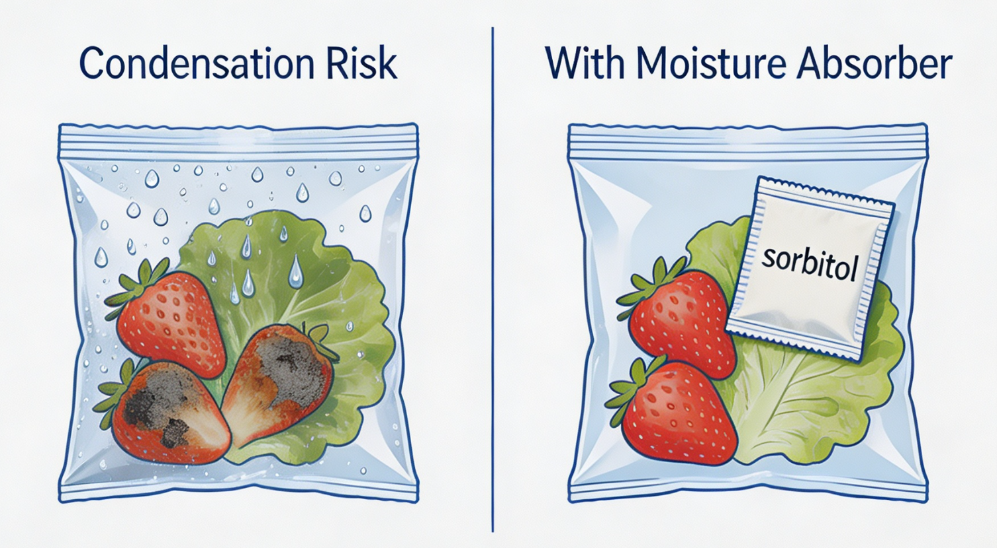
2. Controlled Atmosphere (CA) Preservation
Condensation Issues
Cause of Condensation
  During controlled-atmosphere packaging storage + packaging material has low air permeability.
    ⇒ Water vapor emitted by the fruits and vegetables → condenses into water droplets on the inner surface due to temperature differences.
AI生成
Negative Impact and Mitigation Measure
  Droplets fall onto fruits and vegetables → spoilage or decay.
  Hygroscopic agent (e.g., sorbitol) placed in advance inside CA packaging → reduce condensation.
  Not stored in CA packaging → impact of condensation is less significant.
Notes:
结露问题。在气调包装储藏过程中，如果包装袋透气性较差，果蔬持续向空气中散发的水蒸气接触到包装袋内壁后会因温差凝结成水珠，若滴落在果蔬上易导致腐败变质。为减少结露现象，可在气调包装袋中预先加入吸湿剂（如山梨醇）。如果果蔬储藏中没有采用气调封闭包装，结露带来的影响相对较小。
Condensation Issues. During controlled-atmosphere packaging storage, if the packaging material has low air permeability, the water vapor continuously emitted by the fruits and vegetables can condense into water droplets on the inner surface of the bag due to temperature differences. When the water droplets fall onto the fruits and vegetables, they can easily lead to spoilage or decay. To reduce condensation, a hygroscopic agent (such as sorbitol) can be placed in advance inside the controlled-atmosphere packaging. If the fruits and vegetables are not stored in sealed controlled-atmosphere packaging, the impact of condensation is less significant.

Slide 17
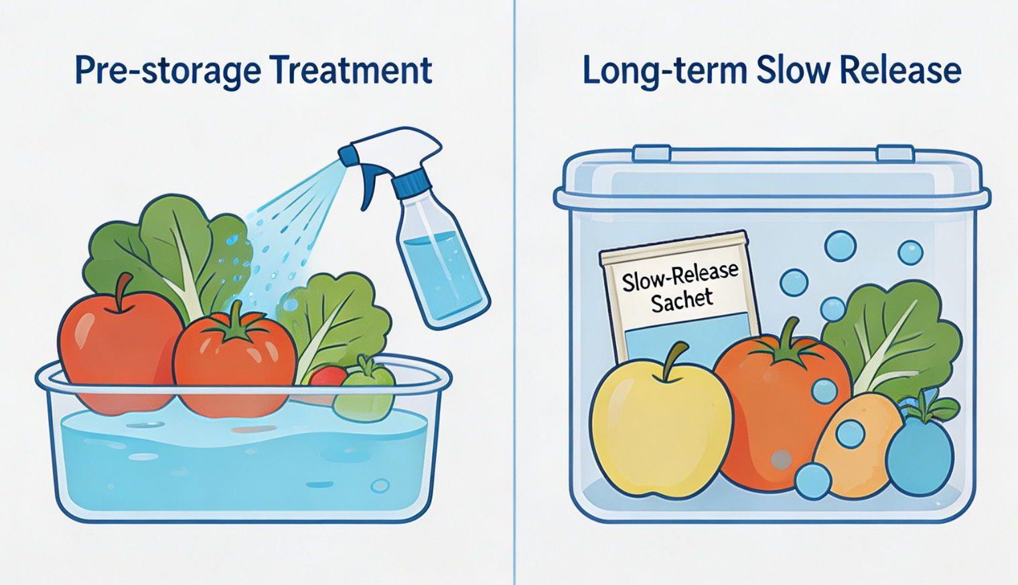
3. Chemical Preservation
AI生成
Two Application Methods
  Applying chemical agents to fruits and vegetables before storage.
  Using long-acting, slow-release agents during storage to maintain continuous efficacy.
Notes:
（三）化学试剂保鲜
化学试剂保鲜是指在果蔬储藏前用化学试剂进行处理，或在储藏过程中使用长效缓释剂使其持续发挥作用。
1.3. Chemical Preservation
Chemical preservation refers to applying chemical agents to fruits and vegetables before storage or using long-acting, slow-release agents during storage to maintain continuous efficacy.

Slide 18
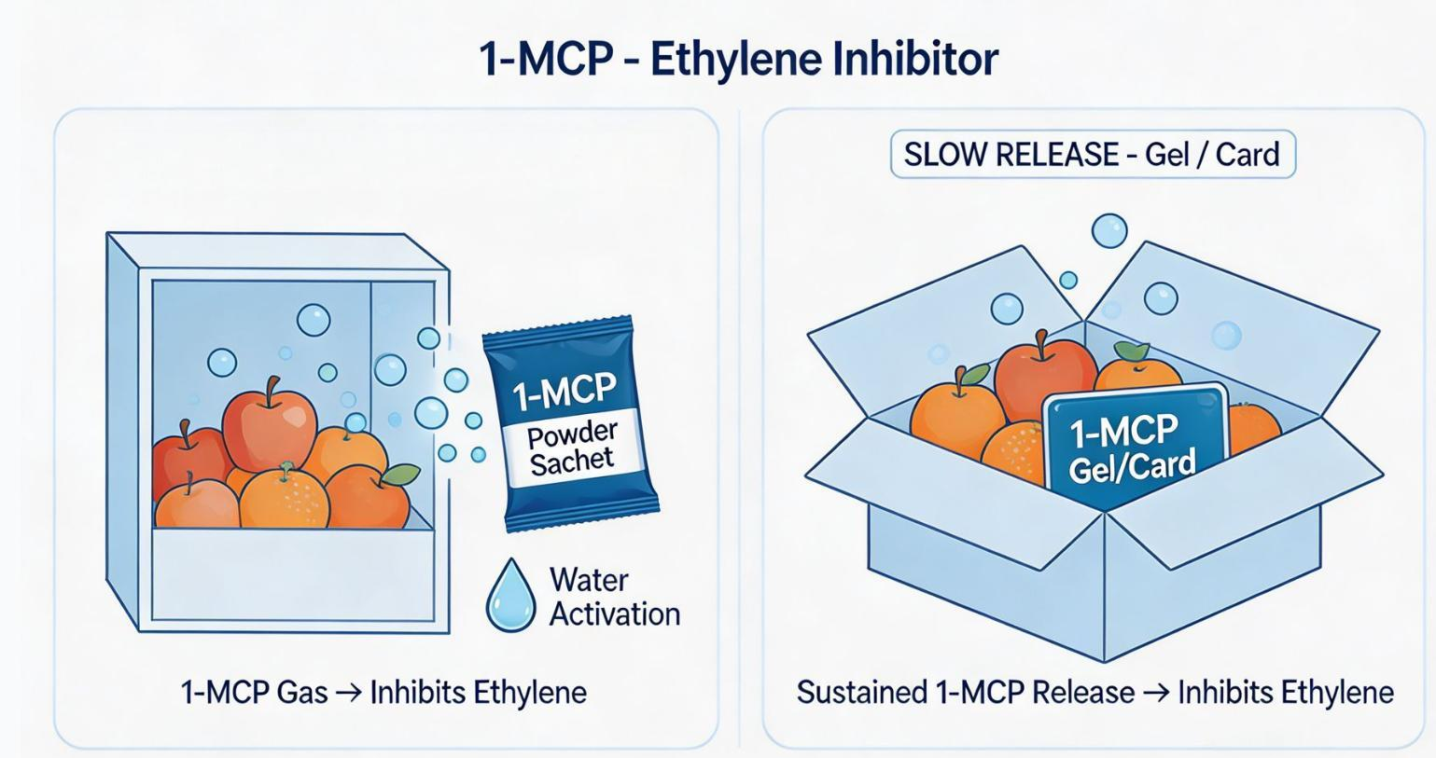
3. Chemical Preservation
(1) 1- Methylcyclopropene (1- MCP)
Properties and Function
  1-MCP is a small-molecule gas.
  Inhibits ethylene action.
  Delays ethylene-induced senescence.
Formulations and Release Mechanism
  Fixed onto powders, tablets, or cards.
  Releases active gas upon contact with water.
  Commercial 1-MCP slow-release formulations available in two forms: gel and powder.
Pre-Storage Fumigation
  Powder-type formulations commonly used.
  Dosage, fumigation time, and water amount determined by storage-space volume + active-ingredient content of the powder.
AI生成
1-MCP releases active gas when exposed to water
Maintaining Continuous Efficacy During Transportation
  Slow-release gels or cards can be used.
  Placed directly into controlled-atmosphere packaging bags.
  Gradually release 1-MCP over time.
Notes:
1.一甲基环丙烯（1-MCP）
1-MCP是一种小分子气体，可抑制乙烯的释放，延缓乙烯促进衰老的作用。1-MCP可固定在粉剂、片剂或卡片上，遇水即释放气体。商品化1-MCP缓释剂有凝胶状和粉末状两种形态。储藏前对果蔬进行熏蒸时，可采用粉剂，根据储藏室空间大小、粉剂含量等确定用量、熏蒸时间和加水量；运输过程中需持续发挥作用时，可选择缓释凝胶或缓释卡片，放入气调包装袋内缓慢释放。
1.3.1. 1‑Methylcyclopropene (1‑MCP)
1MCP (1methylcyclopropene) is a smallmolecule gas
that inhibits ethylene action
and delays ethylene-induced senescence.
It is commonly fixed onto powders, tablets, or cards
and releases the active gas upon contact with water.
Commercial 1MCP slowrelease formulations are available in two forms: gel and powder.
For prestorage fumigation,
powder-type formulations are commonly used.
The required dosage, fumigation time, and amount of water added are determined by the storage-space volume and the active-ingredient content of the powder.
For maintaining continuous efficacy during transportation,
slowrelease gels or cards can be used.
They are placed directly into controlledatmosphere packaging bags,
where they gradually release 1MCP over time.

Slide 19
3. Chemical Preservation
(2) Chlorine Dioxide (ClO₂)
Properties and Functions
  Oxidizing agent: can be made into slow-release products.
  Bactericidal and disinfectant → disinfects surrounding air and fruit/vegetable surfaces.
  Oxidizes ethylene and renders it inactive.
  Key Attributes:
Safety Considerations
  Strong oxidant.
  High concentration or prolonged treatment → colour change due to oxidation.
  Dosage and treatment duration must be carefully controlled.
    Small-molecule gaseous reagent.
    Leaves minimal residues.
Application in Cold Storage
  ClO₂ slow-release gel placed in open containers in corners or along interior walls.
  Gradually releases gas to disinfect air.
  Oxidizes ethylene.
  Helps extend storage period.
    Decomposes rapidly.
    Low toxicity to humans.
Effective Concentration Range
  Effective at low concentrations.
  Achieves microbial control and freshness preservation without requiring high concentrations in the environment.
Notes:
2.二氧化氯（ClO₂）
二氧化氯是一种氧化剂，可制成缓释剂，具有杀菌消毒作用，能对周围空气和果蔬表面进行消毒。二氧化氯气体还能将乙烯氧化使其失效。它是良好的小分子气体化学试剂，残余量小、分解快，对人体危害不大。二氧化氯起作用浓度低，环境中无需高浓度就能杀菌并保鲜。但二氧化氯属强氧化剂，若浓度过高或处理时间过长，可能导致果蔬因氧化而变色，因此使用剂量和时间均需适度。二氧化氯缓释凝胶可敞开放置于冷库角落或四周，让其缓慢释放，对空气进行消毒、氧化乙烯，适当延长储藏期。
1.3.2. Chlorine Dioxide (ClO₂)
Chlorine dioxide is an oxidizing agent that can be made into slow-release products.
It has bactericidal and disinfectant effects and can disinfect the surrounding air and the surfacesof fruits and vegetables.
Chlorine dioxide gas can also oxidize ethylene, rendering it inactive.
It is a that leaves minimal residues,
decomposes rapidly and has low toxicity to humans.
Chlorine dioxide is
effective at low concentrations
and can achsmall-molecule gaseous reagent ieve microbial control and freshness preservation without requiring high concentrations in the environment.
However, chlorine dioxide is a strong oxidant.
If the concentration is too high or the treatment time is too long, it may cause fruits and vegetables to change color due to oxidation.
Therefore, the dosage and treatment duration must be carefully controlled.
Chlorine dioxide slow-release gel can be placed in open containers in the corners or along the interior walls of the cold storage, where it releases
the gas gradually to disinfect the air,
oxidize ethylene,
and help extend the storage period.

Slide 20
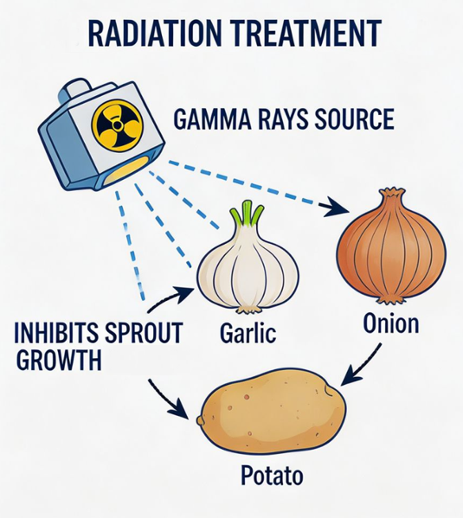
4. Other Preservation Technologies
Irradiation preservation
Application
  Commonly used for storage of onions, garlic, and potatoes.
Sprout-Inhibition Mechanism
  Garlic:
  Potatoes:
    Tends to sprout during storage.
    Exposure to radiation destroys meristematic tissues responsible for sprout initiation → prevents sprouting.
    Treated with irradiation to inhibit sprout development.
AI生成
Safety Requirement
  Radiation dose must be strictly controlled.
  Excessive radiation → adverse effects on fruits and vegetables.
Scale Requirements
  Difficult to achieve at the smallholder level.
  More widely used in industrial-scale storage facilities.
AI生成
Notes:
（四）其他保鲜手段
辐射保鲜。常用于洋葱、大蒜和马铃薯的储藏。大蒜储藏中易发芽，用辐射源照射可直接杀死发芽生长点，抑制发芽；马铃薯同样可通过辐射照射抑制发芽。但辐射剂量需严格控制，过量辐射照射会对果蔬产生不良影响。辐射保鲜在农户层面较难实现，在工业化储藏中应用更为广泛。
1.4. Other Preservation Technologies
1.4.1. Irradiation preservation: It is commonly used for the storage of onions, garlic, and potatoes. Garlic tends to sprout during storage, and exposure to radiation can destroy the meristematic tissues responsible for sprout initiation, thereby preventing sprouting. Potatoes can likewise be treated with irradiation to inhibit sprout development. However, the radiation dose must be strictly controlled, as excessive radiation can have adverse effects on fruits and vegetables. Irradiation preservation is difficult to achieve at the smallholder level and is more widely used in industrial-scale storage facilities.

Slide 21
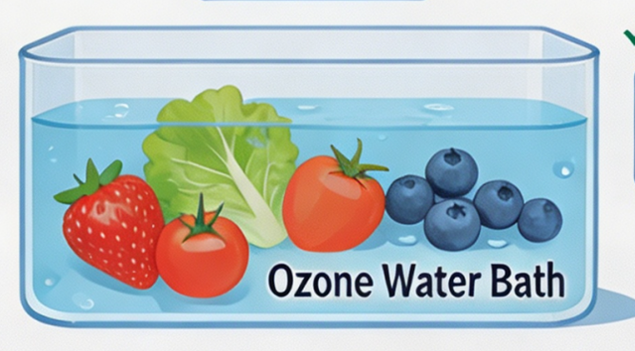
4. Other Preservation Technologies
Ozone preservation
Treatment Method
  Fruits and vegetables are treated by soaking them in ozonated water.
Ozone Effects
  Acts similarly to chlorine dioxide.
  Exhibits strong oxidizing and antimicrobial activity.
  Can delay senescence.
Safety Considerations
  Adverse effects similar to those of chlorine dioxide.
  Appropriate concentrations and treatment durations must be selected.
  Over-treatment may lead to quality deterioration.
AI生成
Notes:
臭氧保鲜。将待保鲜果蔬在臭氧水中浸泡处理。臭氧与二氧化氯原理相似，具有较强的氧化性和杀菌作用，也能延缓衰老。其不良影响也与二氧化氯类似，需选择合适的浓度和处理时间，处理过度反而会降低果蔬品质。
1.4.2. Ozone preservation: Fruits and vegetables are treated by soaking them in ozonated water. Ozone acts similarly to chlorine dioxide, exhibiting strong oxidizing and antimicrobial activity, and can also delay senescence. Its potential adverse effects are also similar to those of chlorine dioxide, so appropriate concentrations and treatment durations must be selected. Over-treatment may lead to quality deterioration.

Slide 22
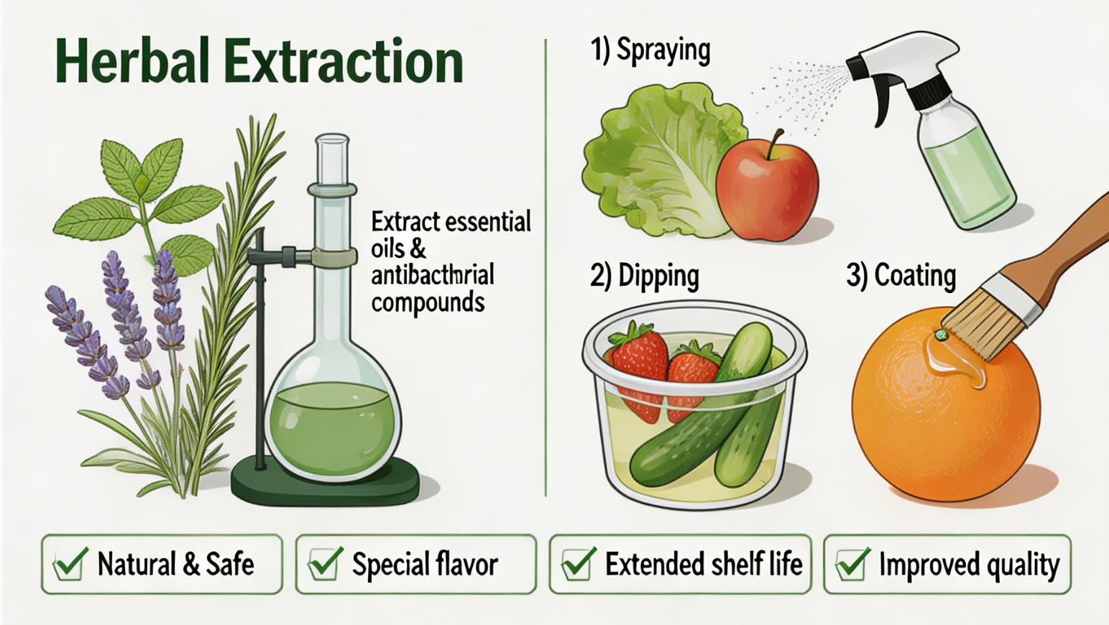
4. Other Preservation Technologies
Biological preservation
Plant-Based Antimicrobial Treatment
  Extracted antimicrobial components from plants (e.g., essential oils from certain medicinal herbs) → applied, sprayed, or used to soak fruits and vegetables.
Effects on Quality and Shelf Life
  Safer.
  Contain some special flavour components → help extend shelf life and improve product quality.
AI生成
Notes:
生物保鲜。提取植物中的抑菌成分（如某些中药材植物的精油），对待保鲜果蔬进行涂抹、喷淋或浸泡。从植物中提取的天然抗菌物质安全性更高，且具有一些特殊的风味成分，能延长保存期、提升产品品质。
1.4.3. Biological preservation: Extracted antimicrobial components from plants (such as essential oils from certain medicinal herbs) can be applied, sprayed, or used to soak fruits and vegetables. These natural antimicrobial substances extracted from plants are safer and contain some special flavor components that help extend shelf life and improve product quality.

Slide 23
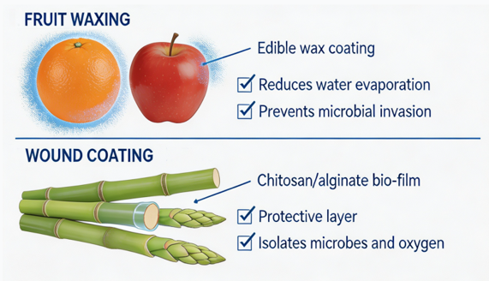
4. Other Preservation Technologies
Coating preservation
Edible Wax Coating for Fruits
  Waxing oranges and apples with edible wax on their surfaces → reduces water evaporation → prevents microbial invasion.
AI生成
Bio-based Coatings for Wounded Produce
  Bamboo shoots and asparagus are prone to decay due to wounds created during harvesting.
  Bio-based coating materials such as chitosan or sodium alginate → applied to cut surfaces to form a protective barrier → limits exposure to microorganisms and oxygen.
Notes:
涂抹保鲜。如对橙子、苹果进行打蜡处理，在其表面涂抹食用蜡，以减少水分蒸发、防止微生物入侵。又如竹笋、芦笋等因切割采收产生伤口、易腐败变质。可在其伤口处涂抹壳聚糖或海藻酸钠等生物保鲜膜，形成保护层，隔绝与外界微生物和氧气的接触。
1.4.4. Coating preservation: It includes practices such as waxing oranges and apples with edible wax on their surfaces to reduce water evaporation and prevent microbial invasion. For produce such as bamboo shoots and asparagus, which are prone to decay due to wounds created during harvesting, bio-based coating materials such as chitosan or sodium alginate can be applied to the cut surfaces to form a protective barrier that limits exposure to microorganisms and oxygen.

