Slide 1
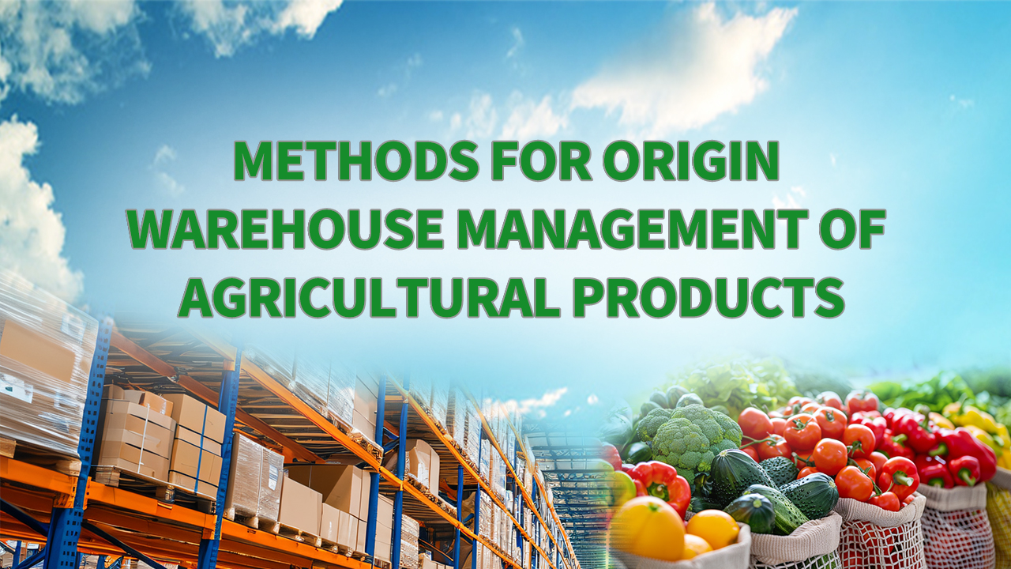
Notes:
Methods for Origin Warehouse Management of Agricultural Products
农产品产地仓储管理方法论

Slide 2

PART.02
Effective Inventory Control
Notes:
Effective Inventory Control

Slide 3
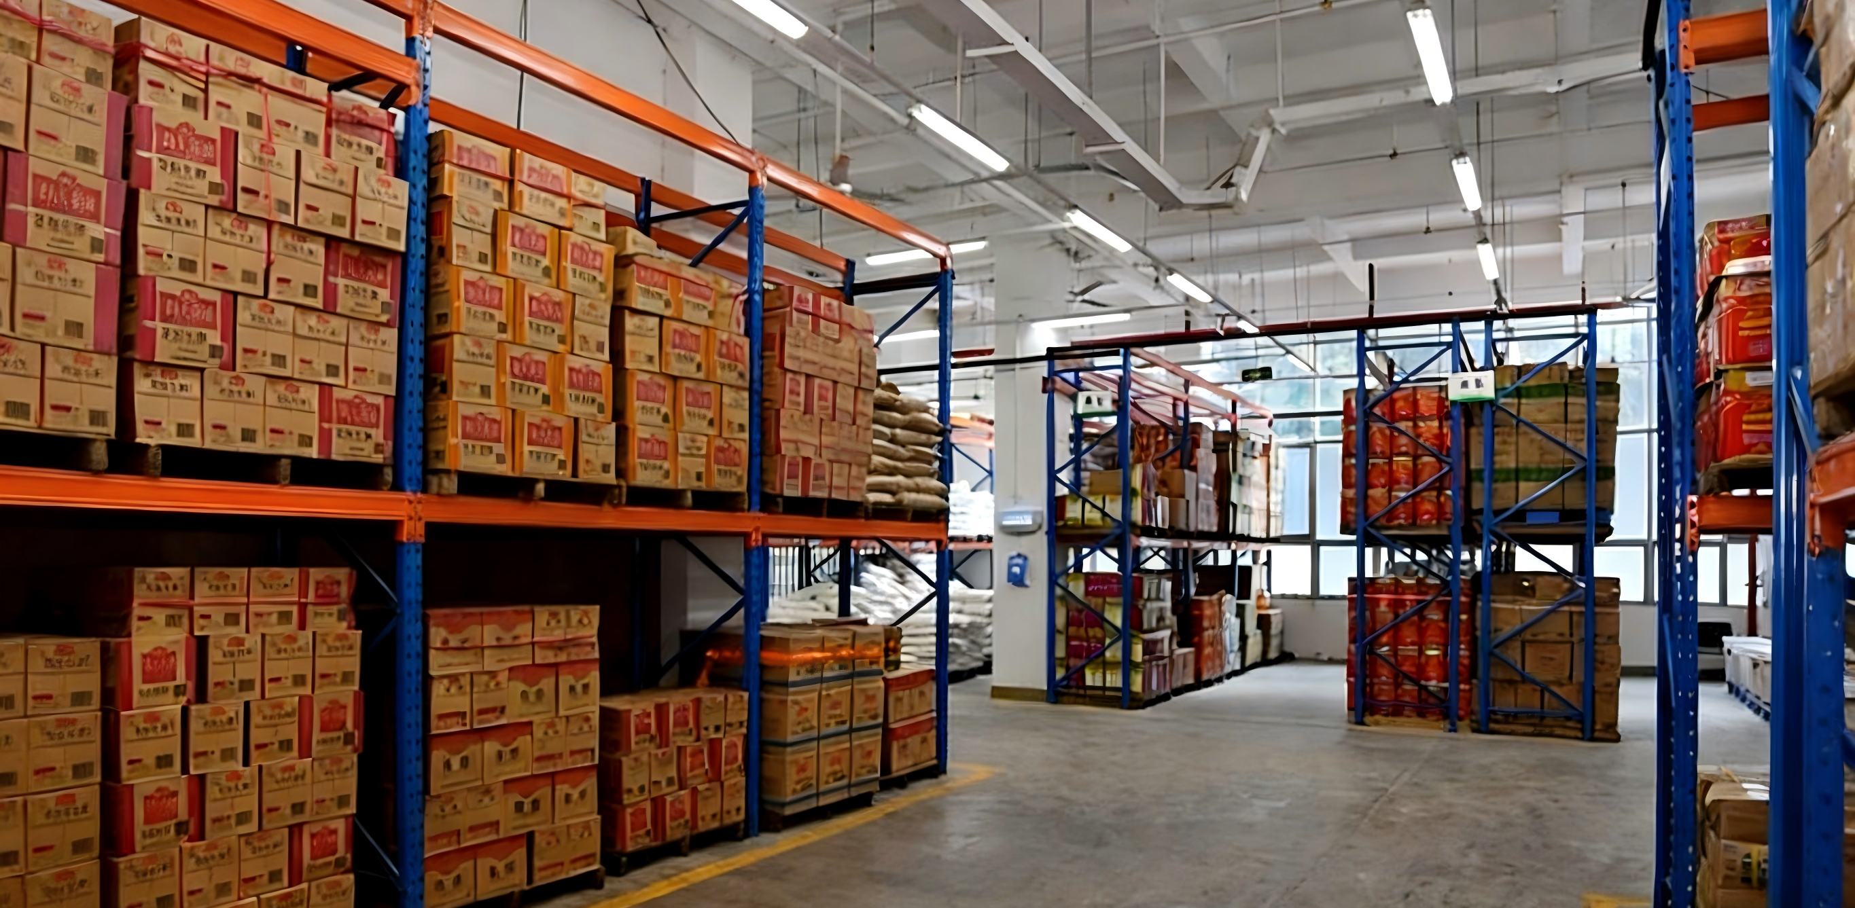
Agricultural Product Inventory Control
Definition
  Manage and regulate the stock quantities of agricultural products.
Control Objective
  Maintain an economically optimal and reasonable level of reserves.
Management Positioning
  A key warehouse management measure to ensure operational efficiency and asset preservation.
Notes:
Agricultural product inventory control refers to the management and regulation of stock quantities to maintain an economically optimal and reasonable level of reserves. It is a key measure within warehouse management that ensures both operational efficiency and asset preservation.
农产品库存控制是对农产品的储存量进行管理和控制，使其储备量保持在经济合理水平上的仓库管理措施。

Slide 4

1. Objectives of Agricultural Product Inventory Control
Objectives
  Reduce inventory of unsellable / slow-moving agricultural products.
  Minimize losses from deterioration, decay, obsolescence resulting from excessive storage.
Operational Benefits
  Accelerate circulation of goods.
  Improve turnover rates.
  Reduce inventory costs.
Asset Protection & Record Integrity
  Regular inspection & verification of stock.
  Prevent theft or loss of tangible assets.
  Ensure recorded inventory value accurately reflects physical stock on hand.
Notes:
1.Objectives of Agr icultural Product Inventory Control
The main objectives of agricultural product inventory control are to:
•Reduce inventory of unsellable or slow-moving agricultural products;
•Minimize losses caused by deterioration, decay, or obsolescence resulting from excessive storage.
Through effective inventory control, the circulation of goods can be accelerated, turnover rates improved, and inventory costs reduced.
In addition, regular inspection and verification of stock help prevent theft or loss of tangible assets, ensuring that the recorded inventory value accurately reflects the physical stock on hand. This supports the overall goal of asset protection and integrity of warehouse records.
（一）农产品库存控制的目的
减少农产品滞销品库存；减少因库存导致的变质、陈腐等损耗。通过对农产品库存的有效控制，加速流通，提高周转率，从而降低库存成本。同时，通过对农产品库存的检查，可有效防止有形资产被窃，保证库存的价值在账簿上有正确的记录，达到财物保护的目的。

Slide 5
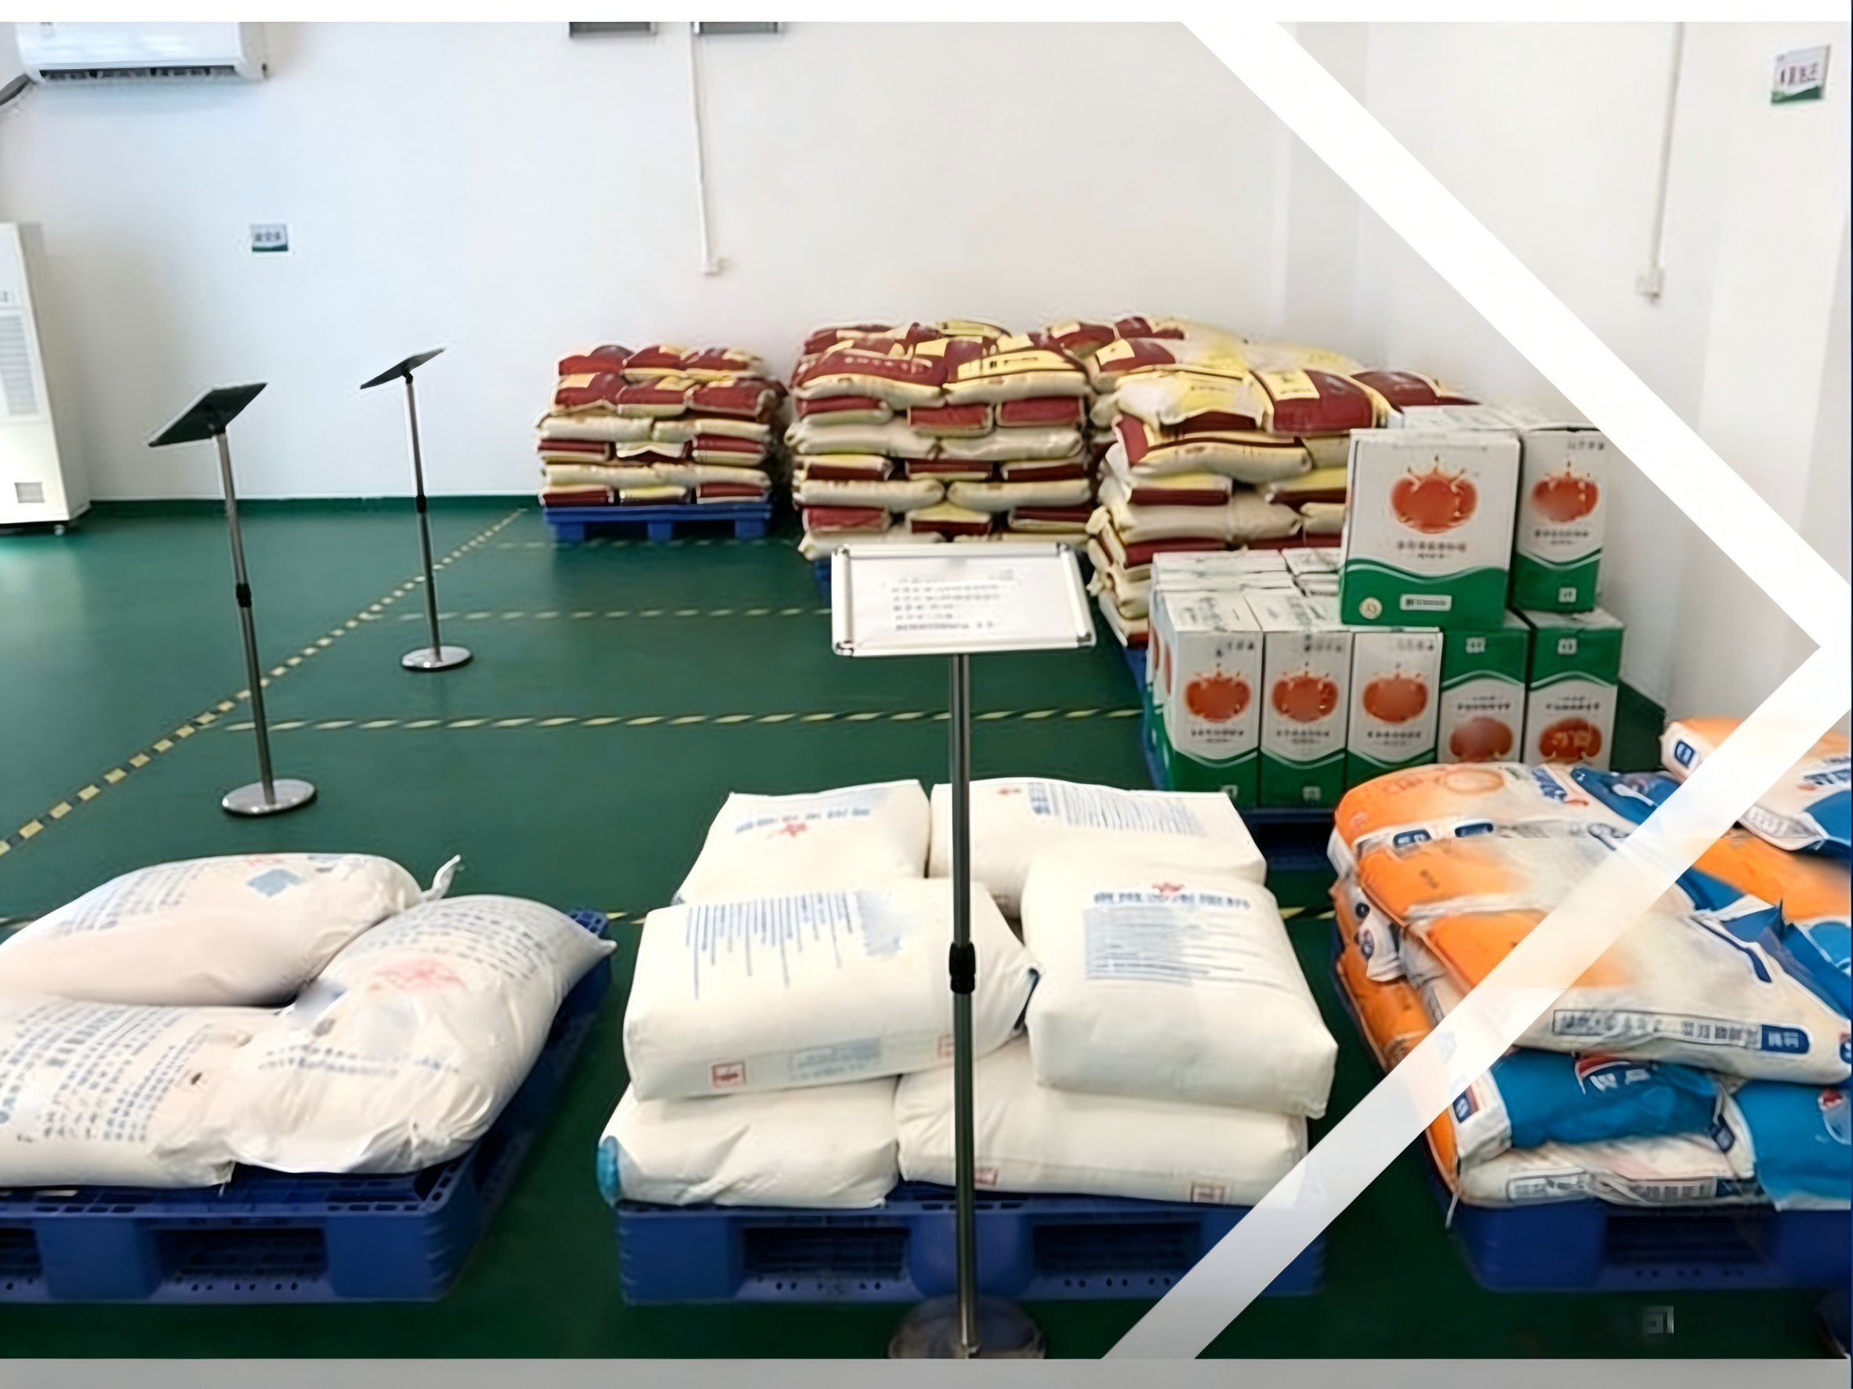
2. Inventory Benchmarks for Agricultural Products
Key to Effective Control
  Determine the appropriate inventory level-the inventory benchmark.
Components of Inventory Benchmark
  Minimum inventory level.
  Maximum inventory level.
Notes:
2.Inventory Benchmarks for Agricultural Products
The unique characteristics of agricultural products determine the complexity of inventory control. The key to effective control lies in determining the appropriate inventory level, also known as the inventory benchmark.
Inventory benchmarks include minimum inventory level and maximum inventory level.
•（二）农产品库存基准
农产品的特殊性决定了农产品库存控制的复杂性，要做好农产品库存控制，重点在于维持多少库存，即库存基准的问题。库存基准包括：最低库存量和最高库存量。

Slide 6
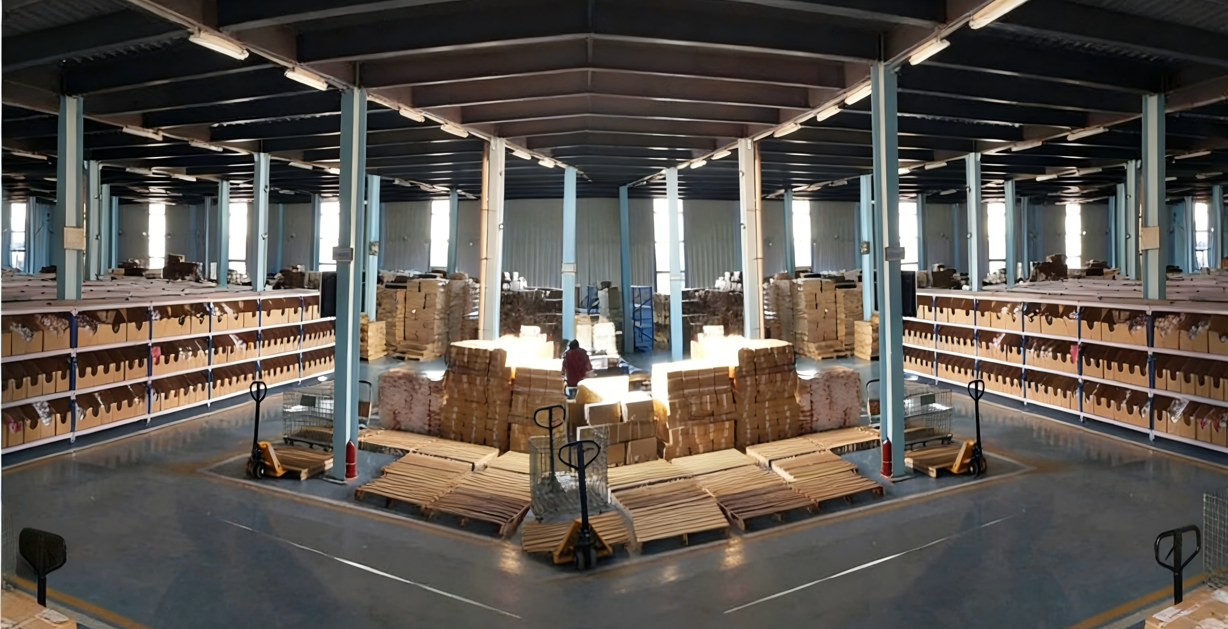
2. Inventory Benchmarks for Agricultural Products
Minimum Inventory Level: Structure & Purpose
Definition
  The lowest permissible quantity of stock required to meet market demand and operational continuity.
Classification
  Ideal Minimum Inventory Level.
  Actual Minimum Inventory Level.
Notes:
The minimum inventory level represents the lowest permissible quantity of stock required to meet market demand and operational continuity. It is further divided into:ideal minimum inventory level and actual minimum inventory level
最低库存量是指在衡量市场的特性和需求后，农产品库存数量应维持的最低界限。最低库存量又分为理想最低库存量及实际最低库存量两种。

Slide 7
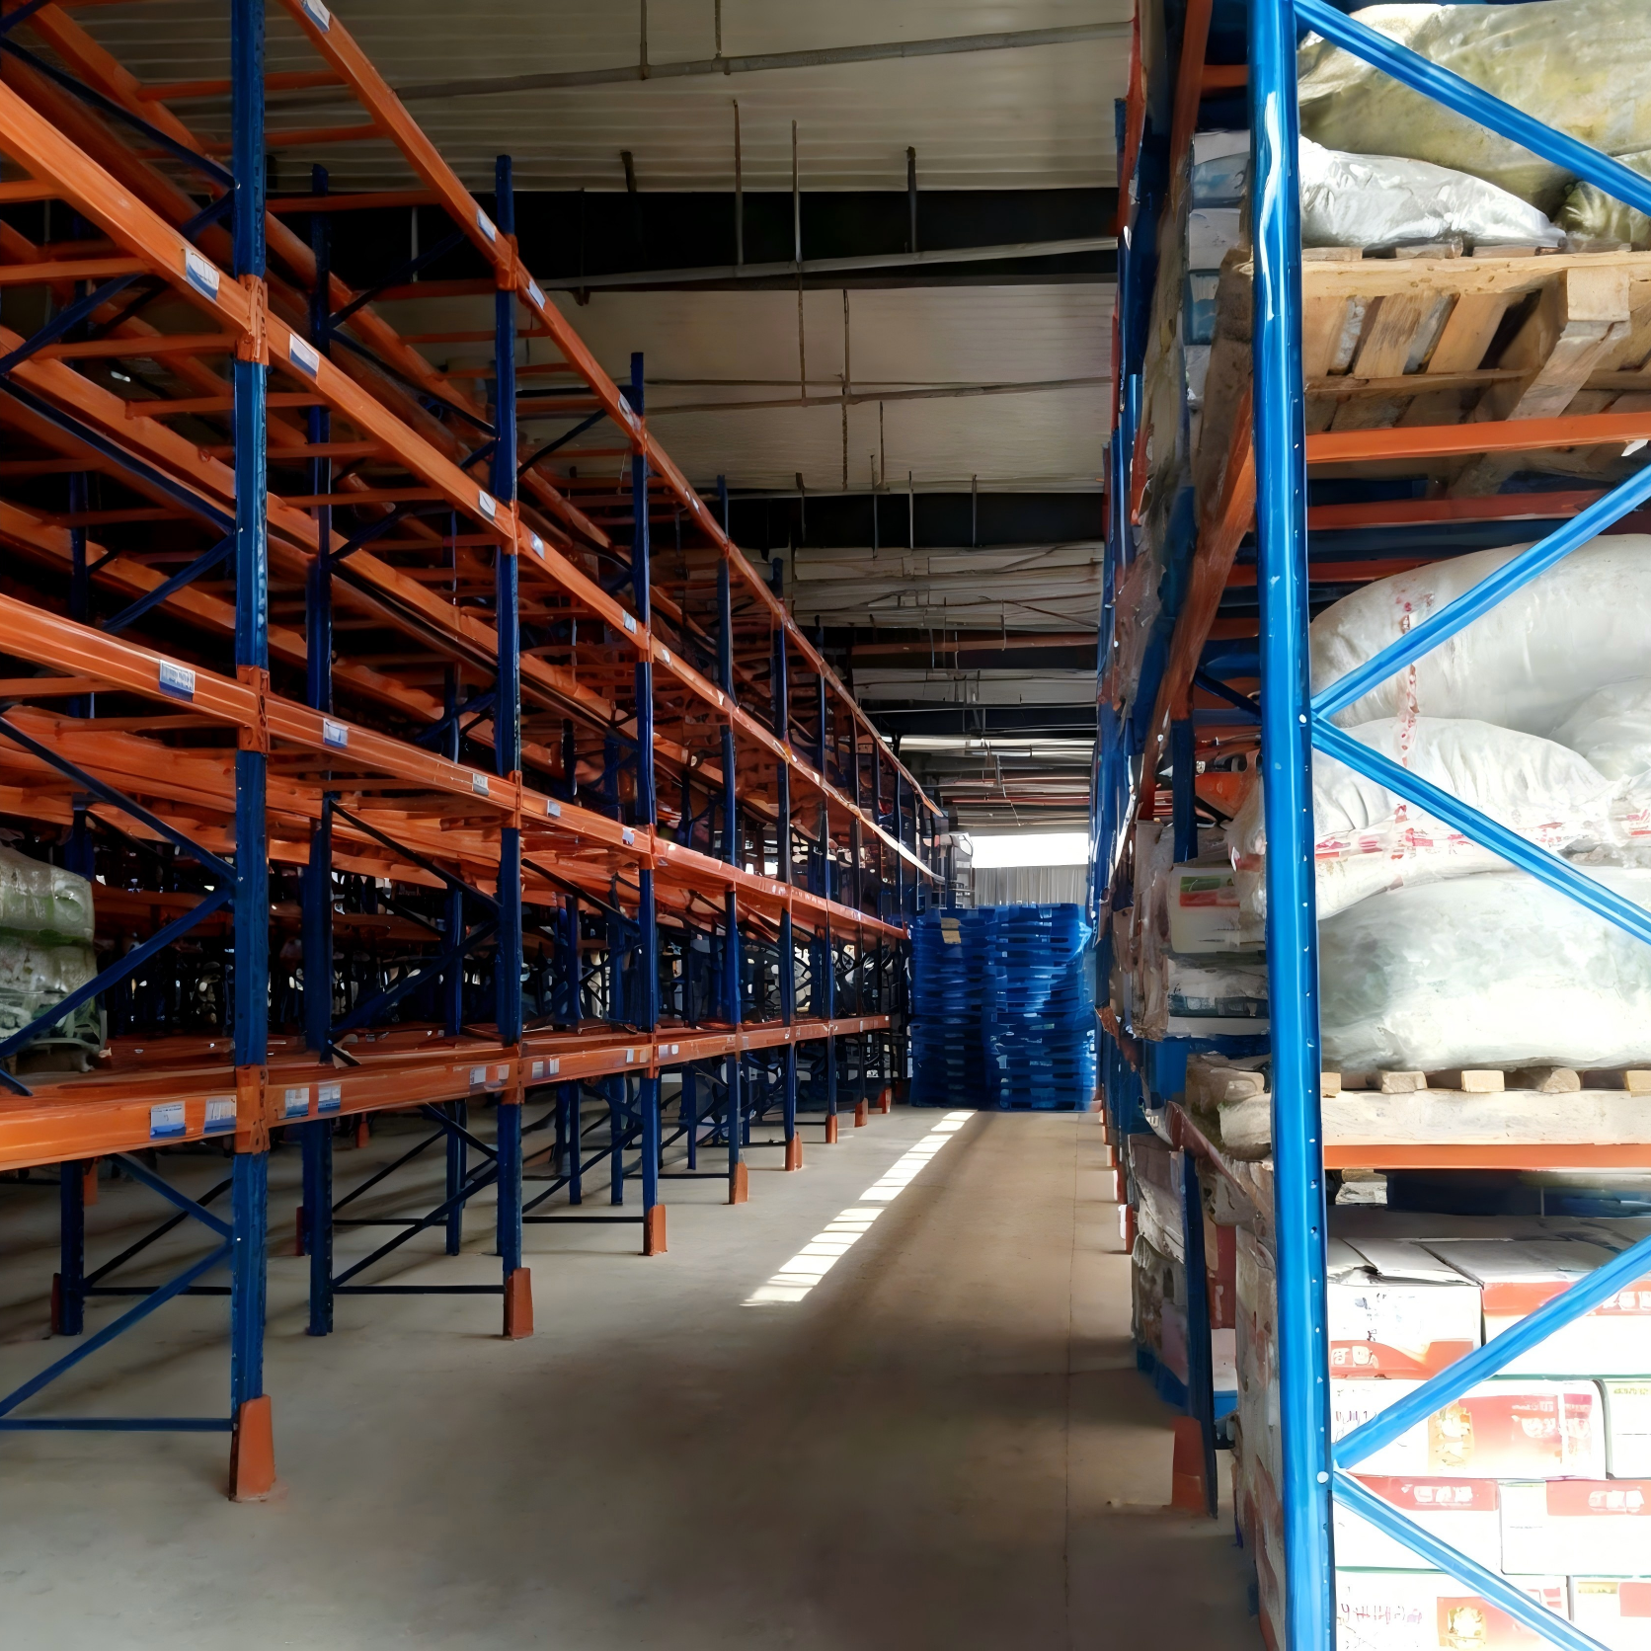
2. Inventory Benchmarks for Agricultural Products
Minimum Inventory Level: Structure & Purpose
Ideal Minimum Inventory Level
  Also called procurement lead-time consumption quantity.
    → Amount required to sustain market demand during replenishment period.
    → Below this threshold ⇒ risks of stockout / production interruptions.
Safety Stock Level
  Added above the ideal minimum → buffer against supply delays.
Actual Minimum Inventory Level
  Ideal minimum level + Safety stock level.
Management Implication
  Maintain inventory between Minimum ↔ Maximum benchmarks → Ensures product availability + cost efficiency.
Notes:
Ideal minimum inventory level, also referred to as the procurement lead-time consumption quantity, which indicates the amount required to sustain market demand during the replenishment period. Falling below this threshold poses risks of stockouts or production interruptions.
To mitigate such risks, most warehouses establish a safety stock level above the ideal minimum to buffer against supply delays.
The actual minimum inventory level is thus the sum of the ideal minimum level and the safety stock level.
Maintaining inventory between the minimum and maximum benchmarks helps ensure both product availability and cost efficiency.
理想最低库存量又称为购置时间使用量，也就是市场的货品需求量，一旦货品库存量低于此界限，会有缺货、停产的危险。为防止供应不及时发生缺货，大多数仓库会在理想最低库存量以外设定“安全库存量”，而实际最低库存量为安全库存量与理想最低库存量的总和。

Slide 8

3. Methods for Determining Actual Inventory Levels
Order-Based Production Inventory Method
Inventory Control Process:
  Achieved through pre-arranged sales or procurement contracts.
  Before planting / during growth → farmers (via cooperatives / e-commerce platforms / distribution centers) identify potential customers → sign purchase orders.
  Confirmed demand → targeted cultivation.
Key Benefits
  Avoid losses caused by blind / speculative planting.
  Reduce spoilage / unsold stock.
Notes:
3.Methods for Determining Actual Inventory Levels
A，Order-Based Production Inventory Method
Under this method, inventory control is achieved through pre-arranged sales or procurement contracts. Before planting or during the growth period, farmers — often through rural cooperatives, e-commerce platforms, or agricultural distribution centers — identify potential customers and sign purchase orders.
This allows targeted cultivation according to confirmed demand,
effectively avoiding losses caused by blind or speculative planting and reducing spoilage or unsold stock.
（三）确定实际库存量方法
订单式生产库存法。具体措施为：在种植之前或生长过程中，通过农村合作社或者电子商务平台、农产品配送中心寻找客户，签订购买订单。这样农民可以根据订单有针对性种植农产品，从而有效避免盲目种植造成的损失，减少卖不出去造成的损耗。

Slide 9
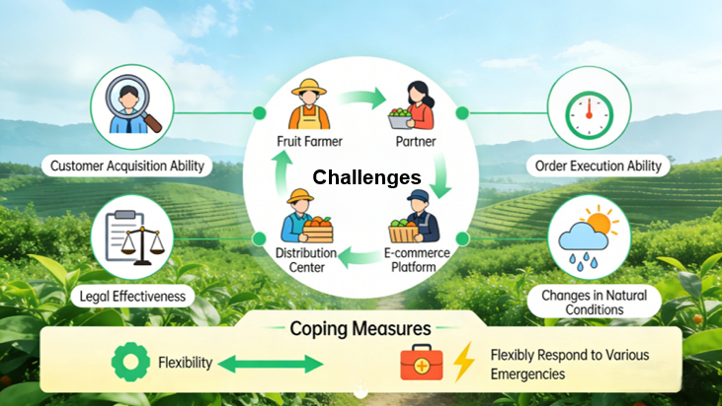
3. Methods for Determining Actual Inventory Levels
Order-Based Production Inventory Method
Implementation Challenges & Requirements
  Coordination needed among multiple stakeholders.
  Uncertainties:
  Requirements:
    Ability to identify & secure customers.
Challenges
    Contract enforceability & reliability.
    Natural / environmental factors affecting production.
    Flexibility + strong contingency management capabilities to handle unforeseen circumstances.
Notes:
However, successful implementation requires coordination among multiple stakeholders and consideration of various uncertainties, including:
•the ability to identify and secure customers;
•the enforceability and reliability of contractual agreements;
•natural or environmental factors that may affect production.
Therefore, this approach demands flexibility and strong contingency management capabilities to handle unforeseen circumstances.
当然这种方式需要多方努力配合，还要考虑各种不确定因素，例如客户的寻找能力，订单的执行能力及法律效力，自然条件的变化等，因此要有足够的灵活性和应对各种突发状况的处理能力。

Slide 10
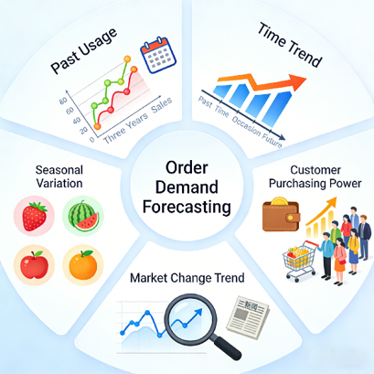
3. Methods for Determining Actual Inventory Levels
Forecasting Method
Forecasting method → determines inventory level based on predicted total demand.
Derived from current order requirements + market indicators.
Reference Indicators
  Historical consumption patterns.
  Time trends.
  Seasonal fluctuations.
  Customer purchasing power.
  Market dynamics.
Notes:
B，Forecasting Method
The forecasting method determines inventory levels based on predicted total demand derived from current order requirements and market indicators. Reference factors typically include:
•historical consumption patterns,
•time trends,
•seasonal fluctuations,
•customer purchasing power, and
•market dynamics.
预测法。指的是根据目前订单需要量来预测总销售量的方法。具体参考指标有：过去的用量、时间趋势、季节变动、客户购买力、市场变化趋势等。

Slide 11

3. Methods for Determining Actual Inventory Levels
Forecasting Method
Decision-Making Process for Agricultural Product Inventory Levels
  Demand forecasts established → make inventory policy decisions → develop inventory management standards → guide real-time control of stock quantities.
  Use monitoring results → revise + optimize inventory decisions → form a continuous feedback and improvement cycle.
Notes:
Once demand forecasts are established, managers make inventory policy decisions accordingly. Based on these decisions, a set of inventory management standards is developed to guide real-time control of stock quantities.
Subsequent monitoring results are then used to revise and optimize the original inventory decisions, forming a continuous feedback and improvement cycle.
由需求预测确定需求状况后，管理者根据需求状况做出存货决策，然后再依存货决策制定一套存货的管理标准，以此标准来对实际库存量情况进行控制管理，最后由控制结果回过头来修正原先的存货决策。

