Slide 1
中国粮食储运管理减损体系
Grain Storage and Transportation Loss Management System in China
孙中叶 教授
Prof. Sun Zhong Ye
Think Tank's Director of the Food Economy Research Center
Henan University of Technology
河南工业大学经济贸易学院院长
河南省特色智库粮食经济研究中心主任
SEMINAR ON POST-HARVEST LOSS MANAGEMENT 粮食减损国际研讨会

Slide 2
contents
Background
global consensus
01
02
imperative for China
Chinese experience
04
03
河南·开封
2023年9月25日
SEMINAR ON POST-HARVEST LOSS MANAGEMENT 粮食减损国际研讨会

Slide 3
01
Background
河南·开封
2023年9月25日
SEMINAR ON POST-HARVEST LOSS MANAGEMENT 粮食减损国际研讨会

Slide 4
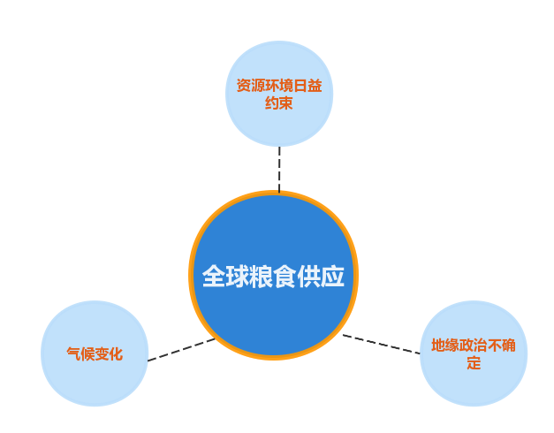
Resource and environmental constraints become tighter
Climate change
Geopolitical uncertainties
保障粮食安全必须坚持开源与节流并重，增产与减损并行。
To ensure food security, we must pay equal attention to increasing food production and decreasing food losses simultaneously.
河南·开封
2023年9月25日
SEMINAR ON POST-HARVEST LOSS MANAGEMENT 粮食减损国际研讨会

Slide 5
02
大力倡导减损理念，凝聚全球广泛共识
We will vigorously advocate the concept of grain loss reduction and
build global consensus
河南·开封
2023年9月25日
SEMINAR ON POST-HARVEST LOSS MANAGEMENT 粮食减损国际研讨会

Slide 6
粮食安全是事关人类生存的根本性问题，减少粮食损耗是保障粮食安全的重要途径，也是解决全球饥饿问题的重要环节。
Food security is a fundamental issue concerning human survival. Reducing food loss is an important way to ensure food security and an important link to solve the global hunger problem.
河南·开封
2023年9月25日
SEMINAR ON POST-HARVEST LOSS MANAGEMENT 粮食减损国际研讨会

Slide 7
据联合国粮农组织统计，每年全球粮食从生产到零售全环节损失占世界粮食产量的14%。这个损失降低1个百分点，就相当于增产2700多万吨粮食，够7000万人吃一年。
According to the Food and Agriculture Organization of the United Nations, the total loss of food from production to retail accounts for 14 percent of the world's food production every year. A reduction of one percentage point in food waste would be equivalent to an increase of more than 27 million tons of grain, which is enough to feed 70 million people for a year.
河南·开封
2023年9月25日
SEMINAR ON POST-HARVEST LOSS MANAGEMENT 粮食减损国际研讨会

Slide 8
2019年全球食品浪费总量为9.31亿吨
Global food waste was 931 million tons in 2019.
2300多万辆载重40吨的卡车,车辆首尾相连可绕赤道9圈左右
Equivalent to more than 23 million trucks with each of them carrying 40 tons of food connected end to end around the equator 9 times or so.
河南·开封
2023年9月25日
SEMINAR ON POST-HARVEST LOSS MANAGEMENT 粮食减损国际研讨会

Slide 9
世界多国主动开展减损治理。
Many countries around the world have taken the initiative to reduce food loss.
美国将减损作为支持都市农业发展的一项主要内容。
The United States has made food loss reduction a major part of the development of urban agriculture.
法国、意大利率先将食品浪费的概念引入国家立法。
France and Italy took the lead in introducing the concept of food waste into national legislation.
巴西将新包装、新技术等与农业研究相结合，最大限度地减少收获后的损失。
Brazil combined new packaging and novel technologies with agricultural research to minimize post-harvest losses.
中国2021年颁布实施反食品浪费法。
China enact《 Anti-Food Waste Law of the People’s Republic of China》
河南·开封
2023年9月25日
SEMINAR ON POST-HARVEST LOSS MANAGEMENT 粮食减损国际研讨会

Slide 10
03
保障14亿人粮食安全，中国节粮减损刻不容缓
it is imperative for China to save food and reduce losses
to ensure food security for its 1.4 billion people.
河南·开封
2023年9月25日
SEMINAR ON POST-HARVEST LOSS MANAGEMENT 粮食减损国际研讨会

Slide 11
中国以全世界7%的土地养育了22%的人口，创造了世界奇迹。
China has created a world miracle by raising 22% of the population with 7% of the world's land.
河南·开封
2023年9月25日
SEMINAR ON POST-HARVEST LOSS MANAGEMENT 粮食减损国际研讨会

Slide 12
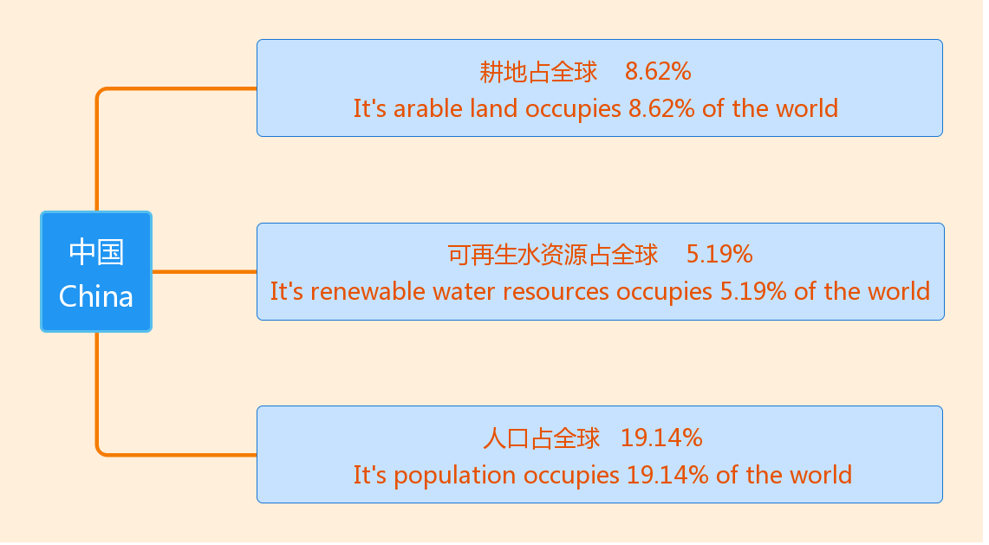
人口众多、资源稀缺的国情决定了节粮减损、保护资源是
中国一项长期重要任务。
Due to the large population and scarce resources, it is a long-term important task for China to save grain, reduce grain loss and protect resources.
河南·开封
2023年9月25日
SEMINAR ON POST-HARVEST LOSS MANAGEMENT 粮食减损国际研讨会

Slide 13
在政策引导、科技支撑和投入保障下，中国粮食生产实现了“十八连丰”，但是粮食进一步增产面临的难度日益增加。
With policy guidance, scientific and technological support and investment guarantee, China's grain production has achieved 18 consecutive years of good harvest, but it is increasingly difficult to further increase grain production.
河南·开封
2023年9月25日
SEMINAR ON POST-HARVEST LOSS MANAGEMENT 粮食减损国际研讨会

Slide 14
粮食单产水平：1990-2020年3个10年的年均增速
Grain yield per unit area: average annual growth rate of three decades from 1990 to 2020
 | 1990-2000年 | 2000-2010年 | 2010-2020年
水稻 rice | 1.40% | 0.37% | 0.70%
小麦 wheat | 2.13% | 2.28% | 1.74%
玉米 corn | 1.85% | 0.94% | 1.42%
日期
Date
品种
variety
河南·开封
2023年9月25日
SEMINAR ON POST-HARVEST LOSS MANAGEMENT 粮食减损国际研讨会

Slide 15
从耕地面积来看，在1996—2020年间中国的耕地面积维持在18.26亿至20.31亿亩。
In terms of the cultivated land area, from 1996 to 2020, the cultivated land area in China maintained from 1.826 billion to 2.031 billion mu (a unit measurement, 1 acre = 6 mu)
未来耕地增加的潜力较小，后备耕地面积有限，中国粮食产量实现持续高位增产的难度加大。
In the future, the issues of lower increasing arable land and limited reserve arable land will make it more difficult for China to achieve a sustained high increase in grain output.
河南·开封
2023年9月25日
SEMINAR ON POST-HARVEST LOSS MANAGEMENT 粮食减损国际研讨会

Slide 16
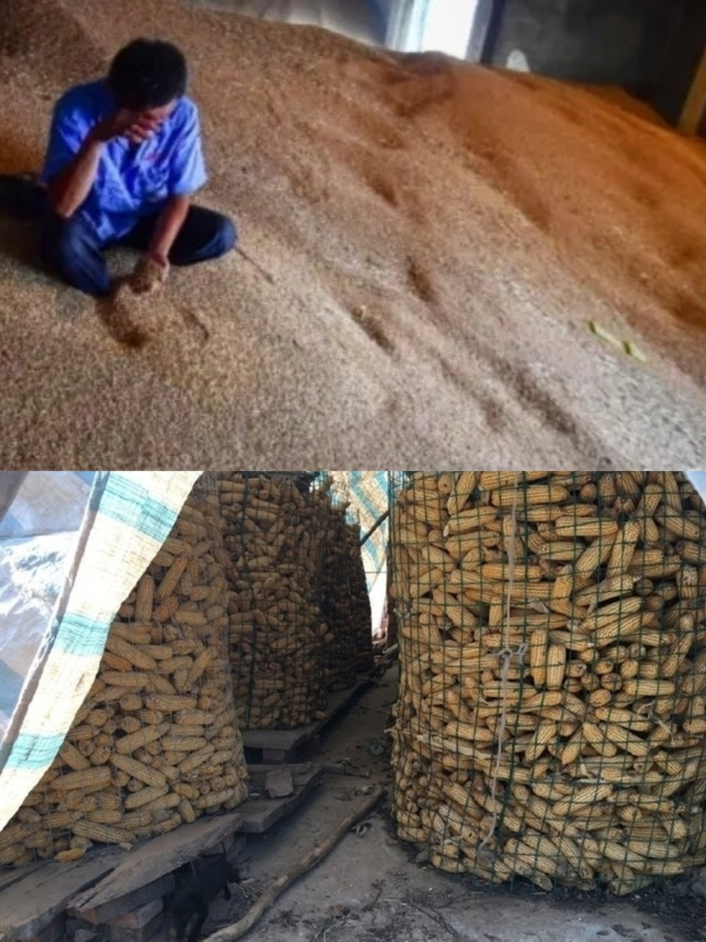
粮食损耗:
Food loss:
农户仓储设施差
Poor storage facilities for farmers’ households
粮食销售和流通效率低下
Inefficient marketing and distribution of grain
......
粮食损耗浪费比较严重
grain loss waste is relatively serious.
河南·开封
2023年9月25日
SEMINAR ON POST-HARVEST LOSS MANAGEMENT 粮食减损国际研讨会

Slide 17
餐饮环节浪费严重
Food waste in catering services is serious.
餐饮企业加工、储藏标准执行不到位
The processing and storage standards of catering services are poorly executed.
剩餐不打包
Leftover food is not to be packed.
日常用餐过量点餐
Ordering too much food in restaurants in daily life.
中国每年因此浪费的食物相当于3000万至5000万人一年的口粮。
The amount of food wasted in catering link every year in China is equivalent to the annual food consumption of 30 million to 50 million people.
河南·开封
2023年9月25日
SEMINAR ON POST-HARVEST LOSS MANAGEMENT 粮食减损国际研讨会

Slide 18
据南京财经大学测算，粮食全产业链至少有6个百分点的减损潜力。
According to Nanjing University of Finance and Economics, the whole grain industry chain has at least 6 percentage points of potential loss reduction.
可以减少损失3963万吨。
It could reduce food loss by 39.63 million tons .
约可以满足全国1/5人口一年的口粮消费。
It can supply the annual grain consumption of about one-fifth of the national population.
河南·开封
2023年9月25日
SEMINAR ON POST-HARVEST LOSS MANAGEMENT 粮食减损国际研讨会

Slide 19
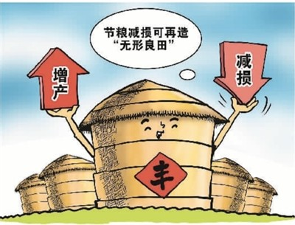
因此，节粮减损意义重大。
Therefore, reducing grain loss is important.
减少粮食损耗相当于增加粮食有效供给的一块“无形良田”，应成为提高粮食安全保障水平的重要着力点。
Reducing grain loss is equivalent to increasing effective food supply by creating a piece of "invisible farmland", which should be emphasized in order to improve the level of food security.
河南·开封
2023年9月25日
SEMINAR ON POST-HARVEST LOSS MANAGEMENT 粮食减损国际研讨会

Slide 20
粮食储运过程损失原因繁杂，需对症下药
The causes of grain storage and transportation losses are complicated and need to be treated accordingly.
粮食收获
Grain harvest.
1
粮食收购
Grain purchase.
2
粮食加工
Grain processing.
5
3
粮食存储
Grain storage.
4
粮食运输
Grain transportation.
河南·开封
2023年9月25日
SEMINAR ON POST-HARVEST LOSS MANAGEMENT 粮食减损国际研讨会

Slide 21
粮食储藏损失
Grain storage loss
粮库和储粮企业，综合损失率已降至1%以内。
The combined loss rate of grain reserves and grain storage enterprises has been reduced to less than 1%.
新型粮食经营主体，储粮损失可降至2%以下。
The loss rate of new-type grain business entities can be reduced to less than 2%.
普通农户，储粮损耗率最高达８%以上。
The loss rate of grain storage for ordinary farmers is as high as 8%.
河南·开封
2023年9月25日
SEMINAR ON POST-HARVEST LOSS MANAGEMENT 粮食减损国际研讨会

Slide 22
粮食运输损失节
Grain transportation loss
包粮运输数量很大，损失率可达5%以上。
The quantity of packaged grain transportion is large, and the loss rate can reach more than 5%.
散粮装卸、运输次数多，每装卸一次约产生1%-3%的损失。
Bulk grain loading, unloading, and transportation are frequent, resulting in approximately 1% -3% loss per loading and unloading.
河南·开封
2023年9月25日
SEMINAR ON POST-HARVEST LOSS MANAGEMENT 粮食减损国际研讨会

Slide 23
04
构建粮食产后减损管理体系，全链条减少粮食产后损失
We will establish management system for reducing post-harvest losses of grains, and reduce post-harvest losses throughout the supply chain.
河南·开封
2023年9月25日
SEMINAR ON POST-HARVEST LOSS MANAGEMENT 粮食减损国际研讨会

Slide 24
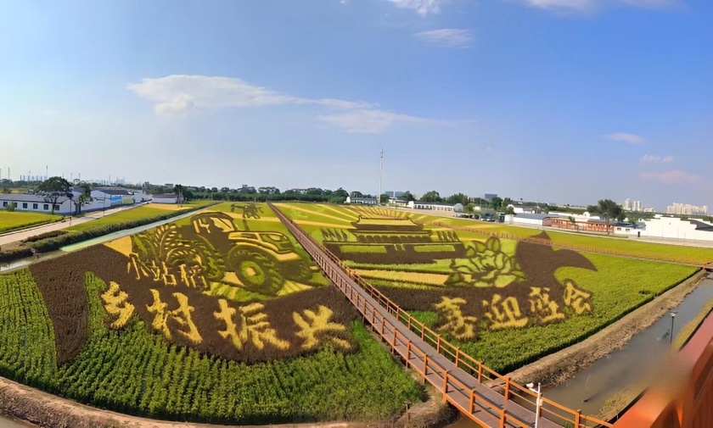
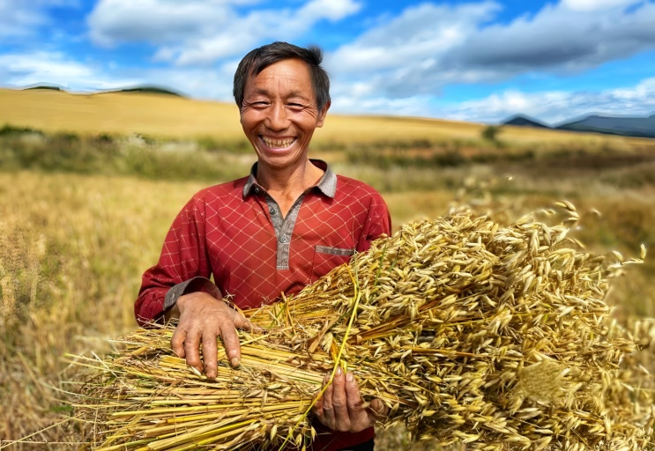
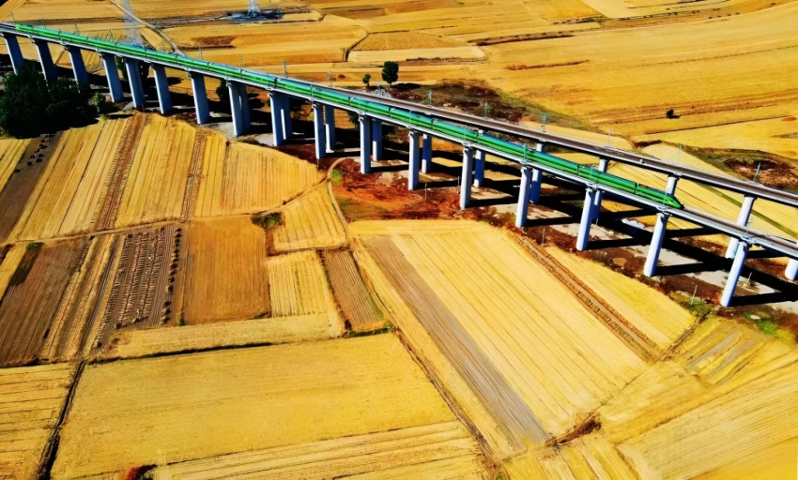
“悠悠万事、吃饭为大”。
Food security is among a country’s most fundamental interests.
多年来中国在粮食产后减损方面不断探索，有效减少粮食产后损失浪费，为维护国家粮食安全、节约资源和减少碳排放作出积极重要贡献。
Over the years, China has explored best practices at the post-harvest stage of grain, efficiently reducing the post-harvest loss. This has made a significant contribution to the field of national grain security, resource-saving, and carbon emissions reduction.
河南·开封
2023年9月25日
SEMINAR ON POST-HARVEST LOSS MANAGEMENT 粮食减损国际研讨会

Slide 25
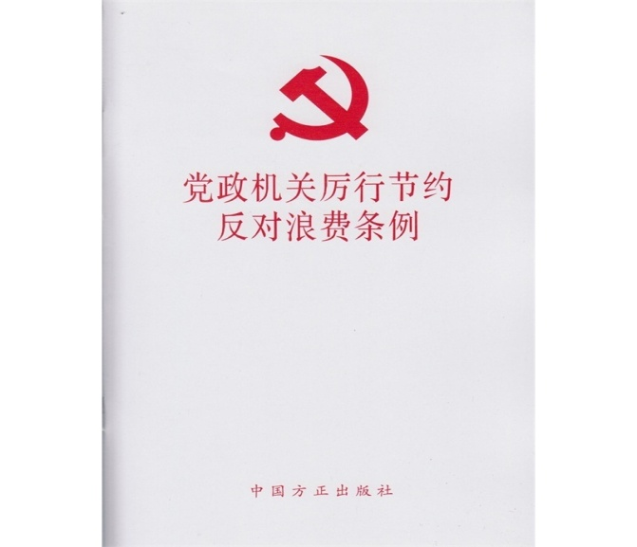
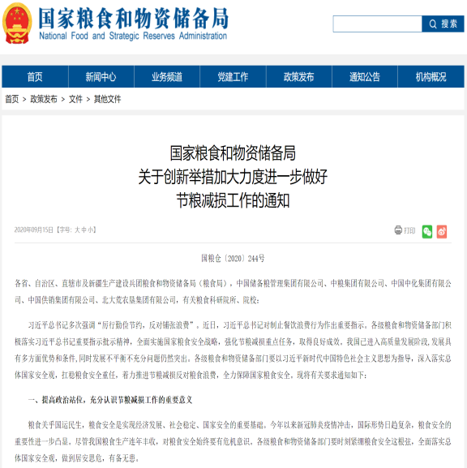
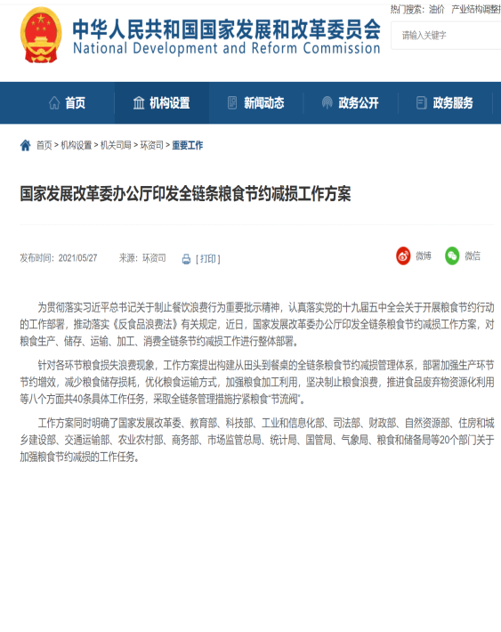
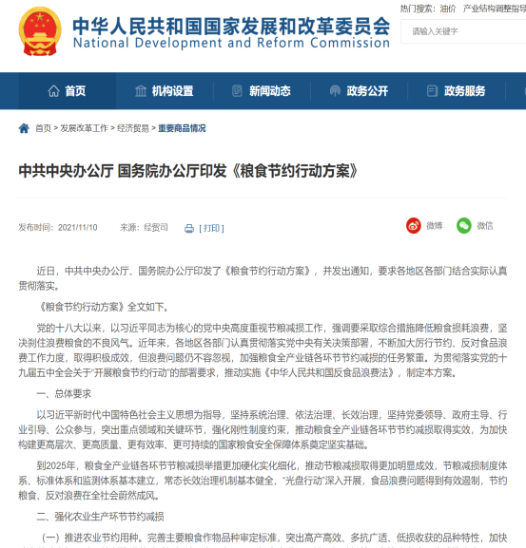
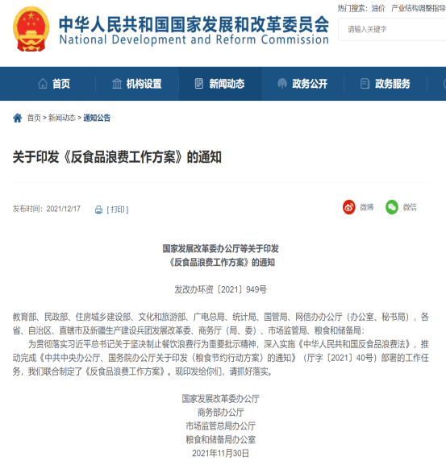
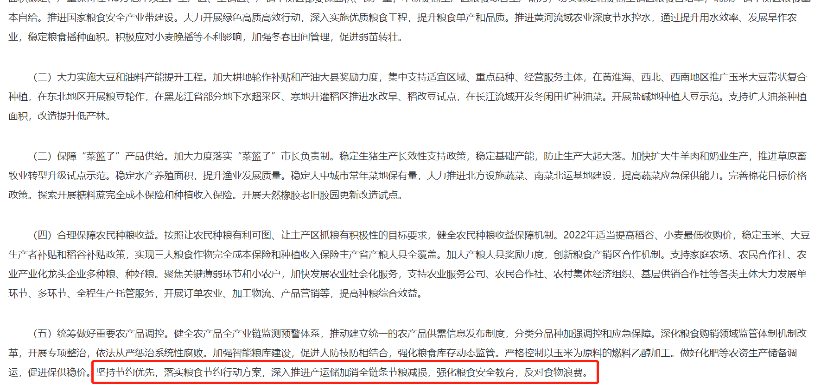
4.1 强化刚性节粮制度约束
Strengthen the constraints on stringent grain conservation system.
2020年9月
2021年4月
2021年5月
2013年11月
2021年10月
2021年12月
2022年
中央一号文件
河南·开封
2023年9月25日
SEMINAR ON POST-HARVEST LOSS MANAGEMENT 粮食减损国际研讨会

Slide 26
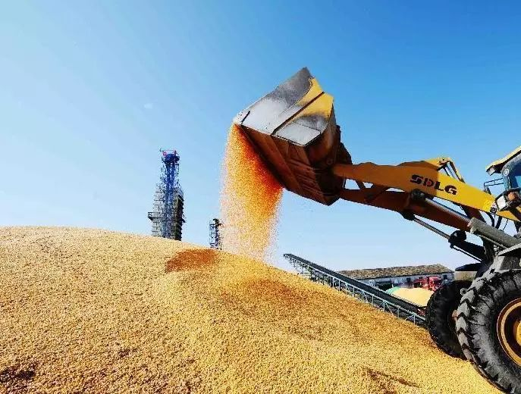
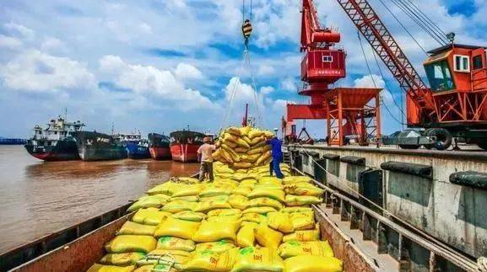
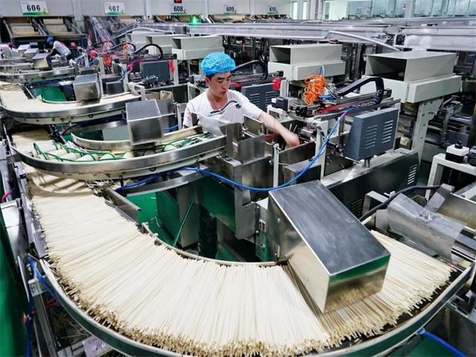
4.2 建立健全粮食产后减损技术支撑体系
Establish and improve the technical support system for post-harvest grain loss reduction.
4.2.1 加强粮食收储环节减损
enhance loss reduction at grain procurement and storage stage.
4.2.2 强化粮食物流环节减损
Strengthen loss reduction at grain logistics stage.
河南·开封
2023年9月25日
SEMINAR ON POST-HARVEST LOSS MANAGEMENT 粮食减损国际研讨会

Slide 27
4.3 坚决遏制餐饮消费环节浪费
Resolutely curb catering consumption waste.
4.3.1重点聚焦餐饮行业，加强食物浪费管控
Focus on the catering industry, strengthen the control of food waste.
4.3.2做好家庭和个人食物浪费减损工作
Focus on reducing household and personal food waste.
河南·开封
2023年9月25日
SEMINAR ON POST-HARVEST LOSS MANAGEMENT 粮食减损国际研讨会

Slide 28
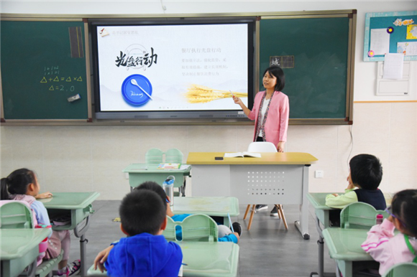
4.4 加强节粮减损宣传教育引导
Enhancee educational guidance on food conservation and loss reduction.
4.4.1 开展节粮减损宣传
Advocacy for food conservation and loss reduction.
4.4.2健全粮食安全教育体系
Improve the education system for food security.
河南·开封
2023年9月25日
SEMINAR ON POST-HARVEST LOSS MANAGEMENT 粮食减损国际研讨会

Slide 29
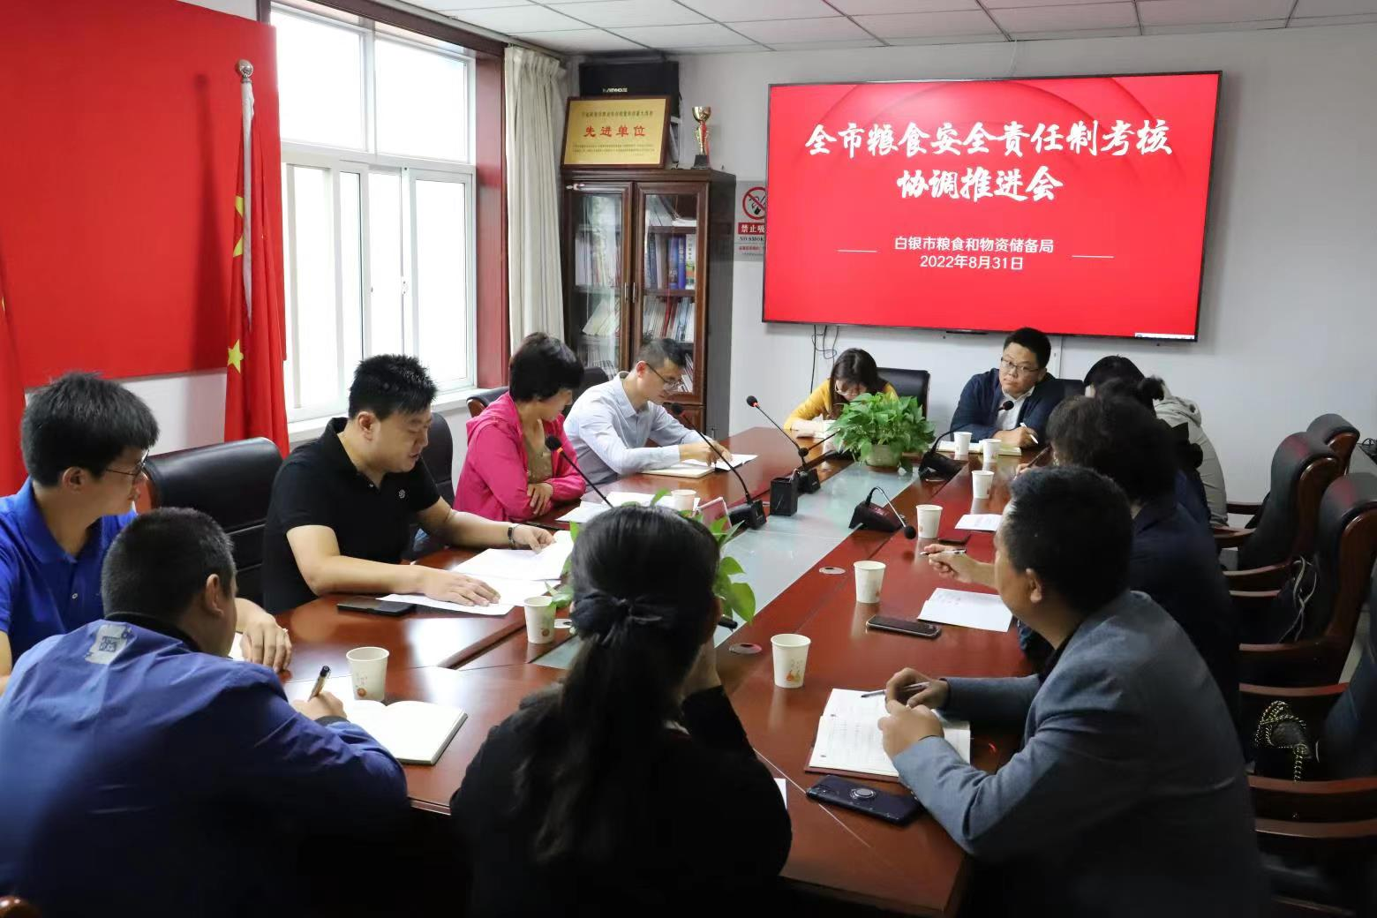
4.5 建立节粮减损的保障运行机制
Establish the policy and operation mechanism of grain saving and loss reduction.
4.5.1 建立节粮减损的统计考核体系
Establish a statistical assessment system for grain loss reduction.
4.5.2 强化标准规则引领
Strengthen the guidance for standard rules.
河南·开封
2023年9月25日
SEMINAR ON POST-HARVEST LOSS MANAGEMENT 粮食减损国际研讨会

Slide 30
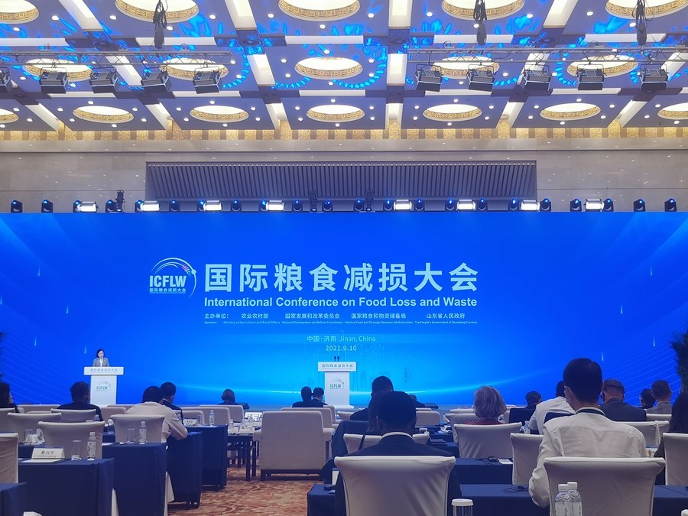
4.6 加强国际节粮减损合作交流
Strengthen international cooperation on food conservation and loss reduction.
积极参与全球粮食安全治理
Participate in global food security governance.
河南·开封
2023年9月25日
SEMINAR ON POST-HARVEST LOSS MANAGEMENT 粮食减损国际研讨会

Slide 31
节粮减损，中国在行动
让我们携手共创粮食安全治理合作新篇章！
Finally, China is taking action to save food and reduce food losses.
Let us work together to create a new chapter of food security governance cooperation!
河南·开封
2023年9月25日
SEMINAR ON POST-HARVEST LOSS MANAGEMENT 粮食减损国际研讨会

Slide 32
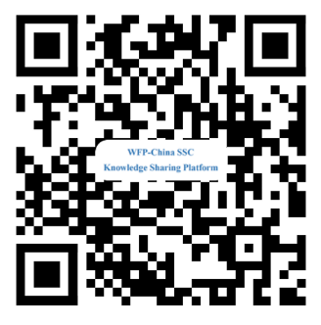
Thank You
Contact: : Prof. Sun Zhong Ye,13838332086@126.com
河南·开封
2023年9月25日
SEMINAR ON POST-HARVEST LOSS MANAGEMENT 粮食减损国际研讨会

