Slide 1




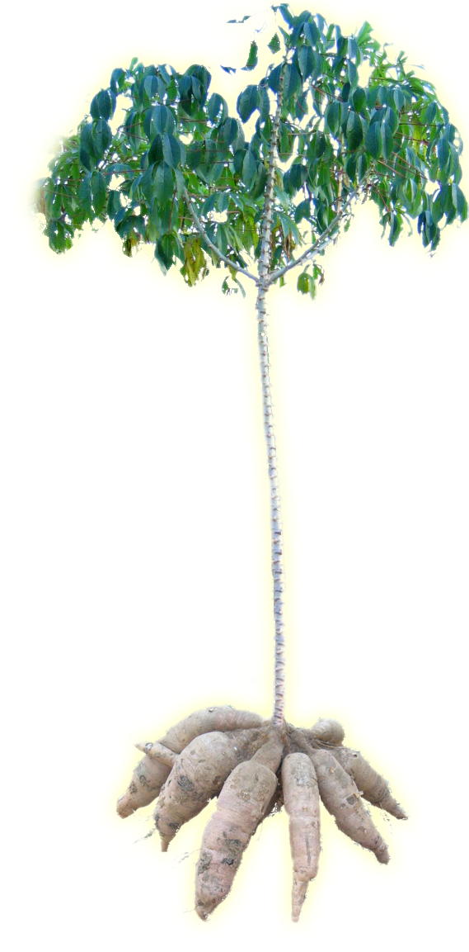

WFP SSTC Field Pilot Project in the Republic of Congo supported by China
Overview of Post-harvest Loss Reduction and
Processing Technology of Cassava in China
Zhenwen ZHANG
Ph.D. Cassava Science, Professor
WFP Centre of Excellence for Rural Transformation
Chinese Academy of Tropical Agricultural Sciences
Sharing for Learning

Slide 2


Expert’s Profile
Prof. Zhenwen ZHANG
Research area: post-harvest physiology and proteomics
Deputy Director of National Cassava Processing Technology R&D Sub-center
Head of Cassava Engineering Department of National Tropical Crops Engineering Technology Research Center
Post Expert of National cassava industry technology system post-harvest treatment and processing
Expert of Hainan Province Science and Technology 110 project
Research and development on plant physiology (photosynthetic physiology and post-harvest physiology) and post-harvest processing and integrated utilization technologies for cassava, an important tropical crop

Slide 3
CONTENTS
General Information
Technologies of Postharvest Loss Reduction
01
02
03
Technologies of Processing
04
Prospects

Slide 4
01
General Information

Slide 5
General Information
Cassava is the sixth largest food crop in the world, the main food for nearly one billion people in the world's hot regions, and important raw material for the starch, alcohol and feed industries in China.
In China, there are four advantageous production areas: "Gui East - Gui South, Gui West - Yunnan South, Guangdong East - Min West Gan East, Qiong West - Guangdong West", among which Guangxi has outstanding advantages.
Planted area of 4.57 million acres, production of 5 million tons （CCARS, 2022)

Slide 6
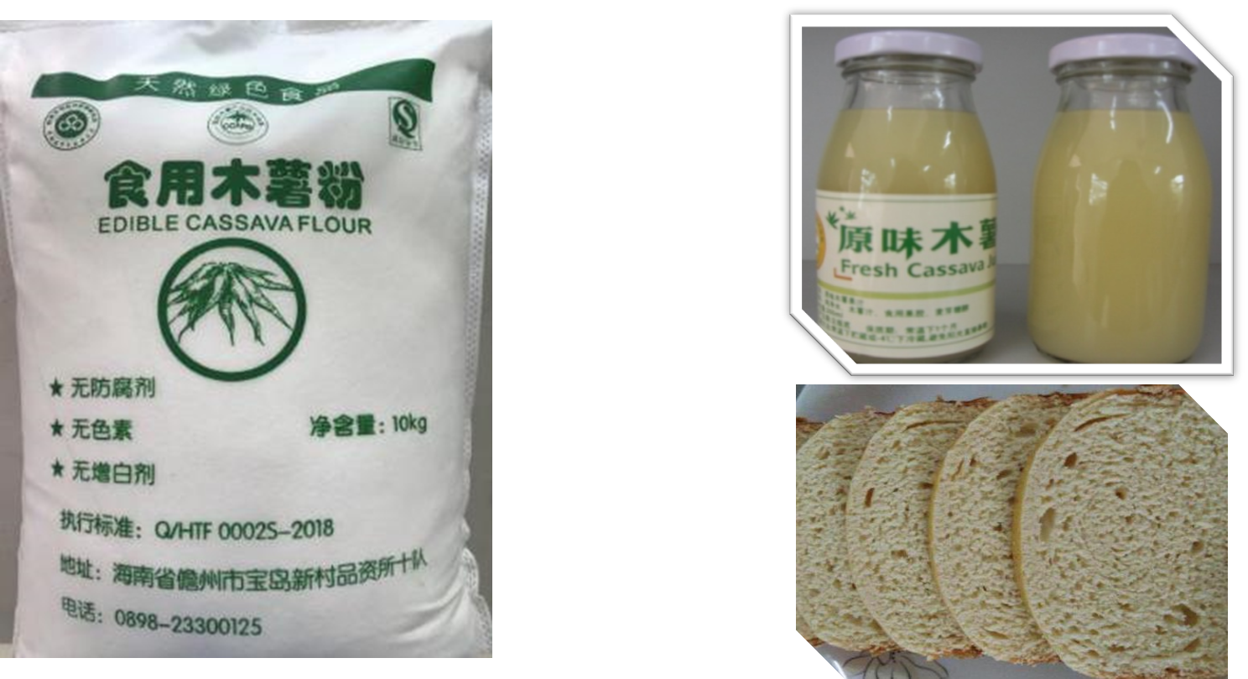
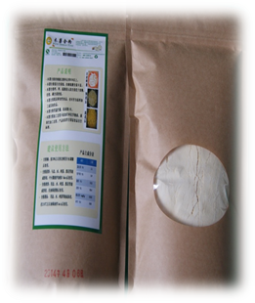
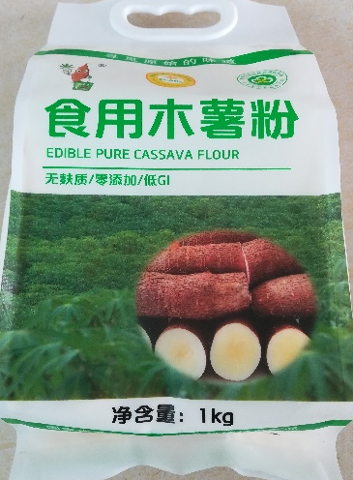
General Information
Leaf: The main vegetable in cassava growing areas in Africa and Southeast Asia, with an annual trade volume of about 400,000 tons, rich in protein, minerals and flavonoids.
Stems: The main propagating material for cassava cultivation, rich in fiber, minerals and tannins; about 250 million tons of cassava stems (about 95%) are unused and wasted every year worldwide.
Fresh / Dried Cassava: Rich in starch, the global annual trade volume of 12 million tons (dried chips), about 80% of the trade is distributed in Thailand, Vietnam and Indonesia in Southeast Asia, China is the main importer and consumer of dried cassava chips and raw starch.

Slide 7
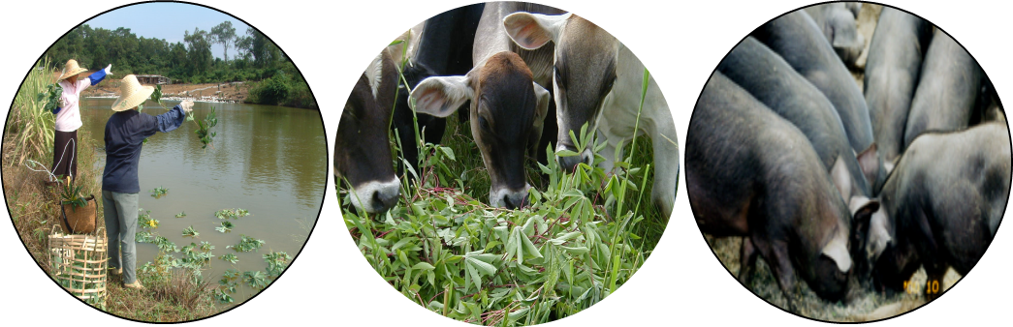
General Information
Cassava leaves
Cassava leaves are important by-products of cassava production, rich in protein (22.0%, DW), comparable to the crude protein content of dry grass (22.5%), but with high biomass and high metabolic energy, they are high-quality raw materials for animal feed. It is reported that cassava grows for about 8 months, and 18.3 tons of fresh stems and leaves can be harvested per hectare, with an annual yield of 40.0 tons/ha/year.
 | Dry matter |  | Crude protein |  | Metabolic energy
 | % | t/ha/year | % | kg/ha/year | thermie /kg/year | thermie /ha/year
Kudzu | 24 | 10.0 | 21.0 | 2,100 | 2.20 | 22,000
Mountain Leeches | 21 | 4.5 | 15.0 | 675 | 1.90 | 8,550
Silver Acacia | 35 | 15.2 | 25.7 | 3,906 | 1.90 | 28,880
Dry grass | 25.8 | 24.0 | 22.5 | 5,400 | 1.47 | 35,280
Young Stem Leaves | 25 | 40.0 | 22.0 | 8,800 | 1.70 | 68,000

Slide 8
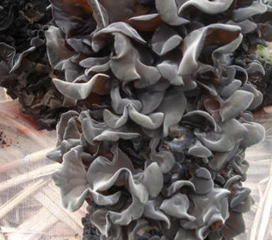
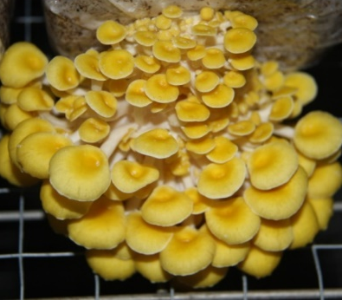
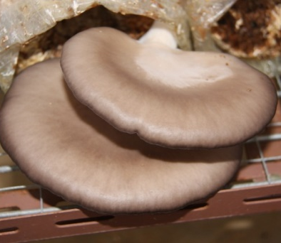
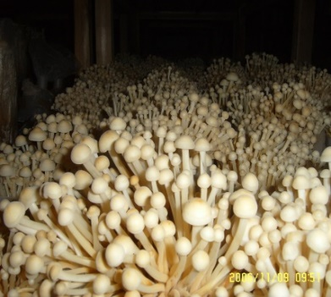
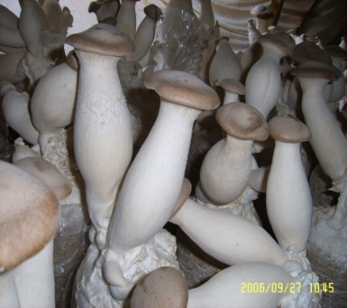
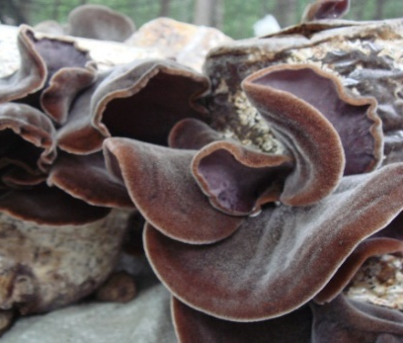
General Information
Cassava Stalks
Cassava stalks contain 4.47% crude protein, 39.32% crude fiber and 19.84% lignin, which is an ideal base material for edible mushroom cultivation. It can be used for black fungus, elm mushroom and golden needle mushroom substitute cultivation.
Base Materials | Crude Protein% | Crude Fat% | Cellulose% | Hemicellulose% | Lignin% | Nitrogen-free Leachate% | Ash%
Mixed Wood Chips | 1.57 | 3.12 | 36.12 | 12.58 | 19.17 | 24.52 | 2.92
Cottonseed Hulls | 5.07 | 1.57 | 32.73 | 21.42 | 15.18 | 18.19 | 5.84
Corn Cobs | 2.05 | 0.78 | 30.26 | 34.13 | 17.19 | 13.46 | 2.13
Corn Stalks | 3.51 | 0.82 | 32.91 | 31.89 | 14.65 | 11.36 | 4.86
Wheat Stalks | 2.63 | 1.16 | 43.6 | 22.21 | 9.32 | 14.81 | 6.27
Sorghum Stalks | 3.42 | 1.73 | 40.11 | 30.15 | 7.68 | 10.79 | 6.12
Cassava Stalks | 4.47 | 0.38 | 39.32 | 11.88 | 19.84 | 21.32 | 2.79
Black Fungus
Elm Mushroom
Flat Mushroom
Enoki Mushroom
Apricot Mushroom
Auricularia Polytricha

Slide 9
General Information
Fresh/Dried Cassava
The starch content of fresh/dried cassava is 60-82% (dry basis), which is an important energy source and food raw material, and its starch yield is about equivalent to the starch yield of 4 acres of single-season rice (rice at 500 kg/acre and 70% dry basis starch). Fat content and protein content of cassava dry with 0.82% and 2.56%, respectively, rich in mineral elements (potassium 1.2%, calcium 0.07%).
The use of edible cassava can be processed into a variety of products such as starch, modified starch, alcohol and food, among which the main ones for industrialized processing are starch, modified starch and alcohol.
Indicators \ Raw Materials | Dried Cassava | Fresh cassava
Starch Content (%) | 75.00 | 25.00
Water Content (%) | 13.73 | 64.70
Ash (%) | 2.46 | 0.63
Fat (%) | 0.82 | 0.25
Protein(%) | 2.56 | 1.07
Coarse cellulose (%) | 3.20 | 1.11
Potassium (%) | 1.20 | Three times the potassium content of bananas
Calcium (%) | 0.07 | Equivalent to red beans

Slide 10
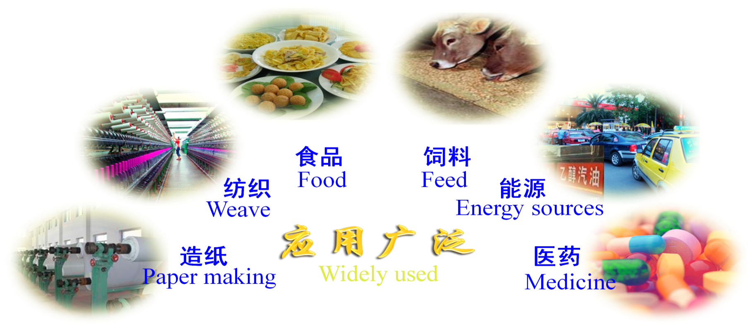
General Information
Application
In China, 90% of cassava tubers are used for alcohol and alcohol processing and 8% for animal feed processing.

Slide 11
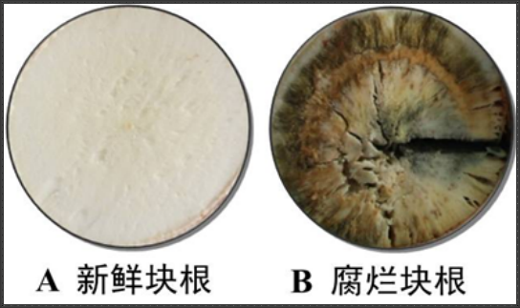
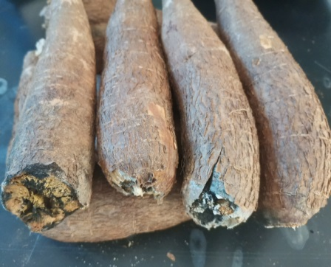
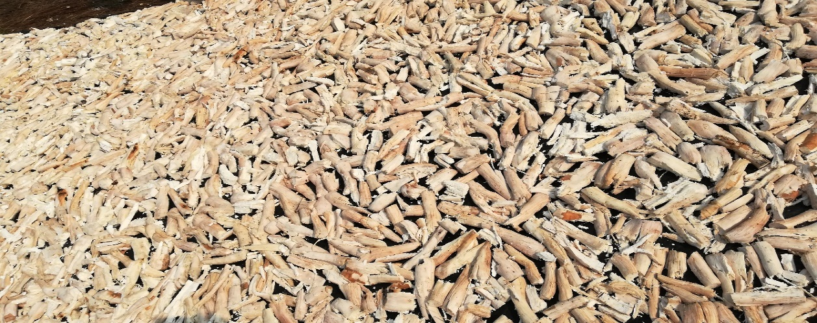
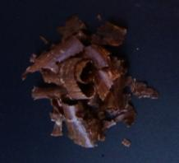
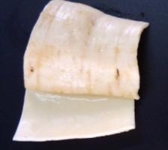
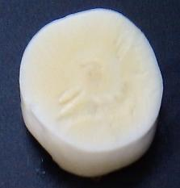
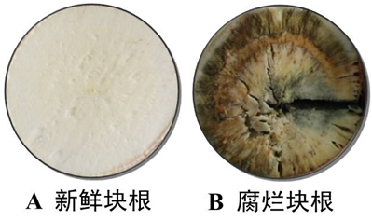
General Information
Main Post-harvest Issues of Fresh Cassavas
(1)Fresh Cassavas are easily rotten after harvesting
(2) Fresh Cassavas are difficult to process and peel
Artificial Peeling Situation
No. | Fresh Cassava Weight (Kg) | Cassava Weight (Kg) | Peeling Speed (Kg/h) | Fresh Cassava Utilization（%）
1 | 9.7007 | 7.4801 | 9.6381 | 77.1089
2 | 9.9172 | 7.4499 | 9.7874 | 75.1210
3 | 9.8010 | 7.1638 | 9.7017 | 73.0925
Average | 9.8063 | 7.3646 | 9.7091 | 75.1075
Outer skin
Phloem
Xylem

Slide 12
02
Technology of Postharvest Loss Reduction

Slide 13
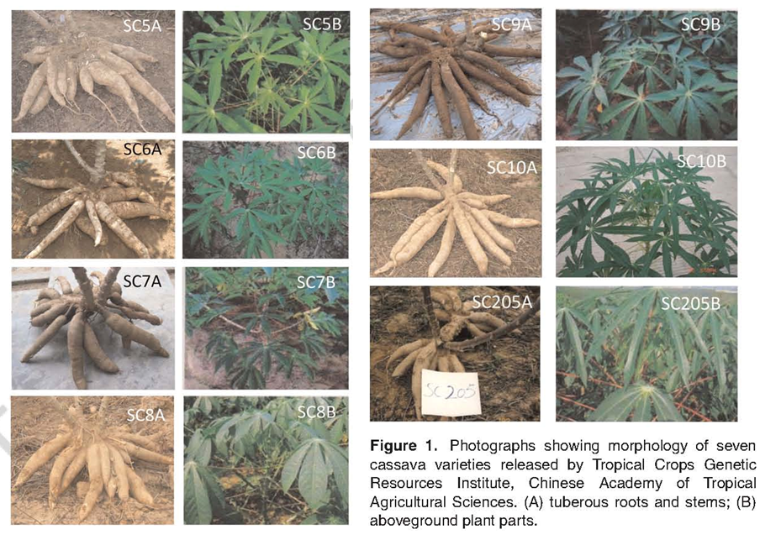
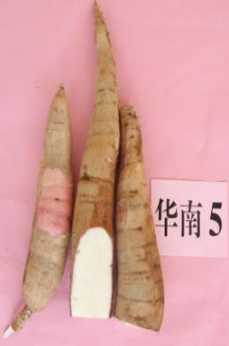
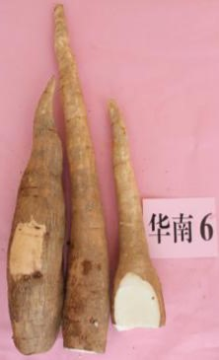
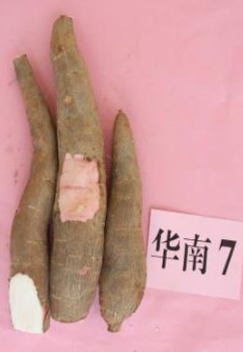
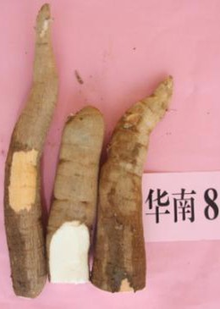
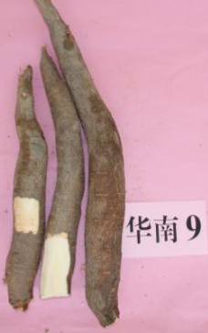
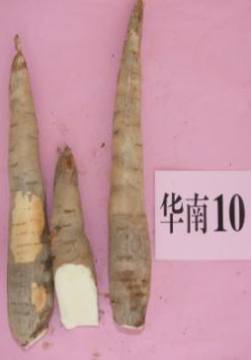
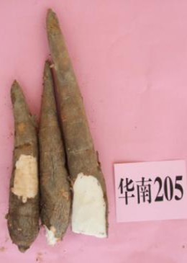
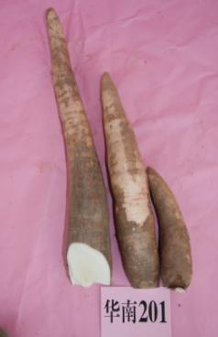
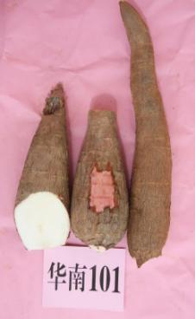
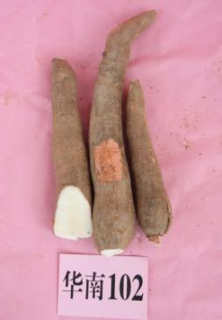
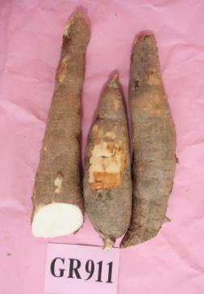
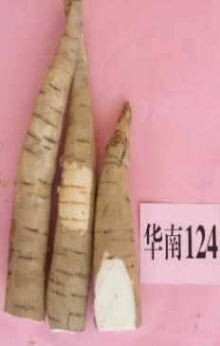
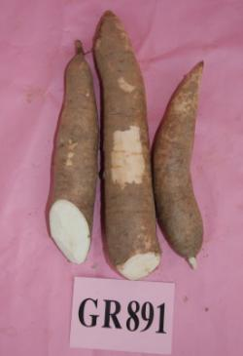
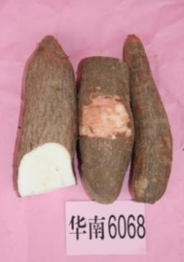
Technology of Postharvest Loss Reduction
Cassava is a typical tuber crop with different varieties, production methods and preservation techniques that are closely related to post-harvest damage reduction. At present, 47 varieties have been selected and promoted in China.

Slide 14
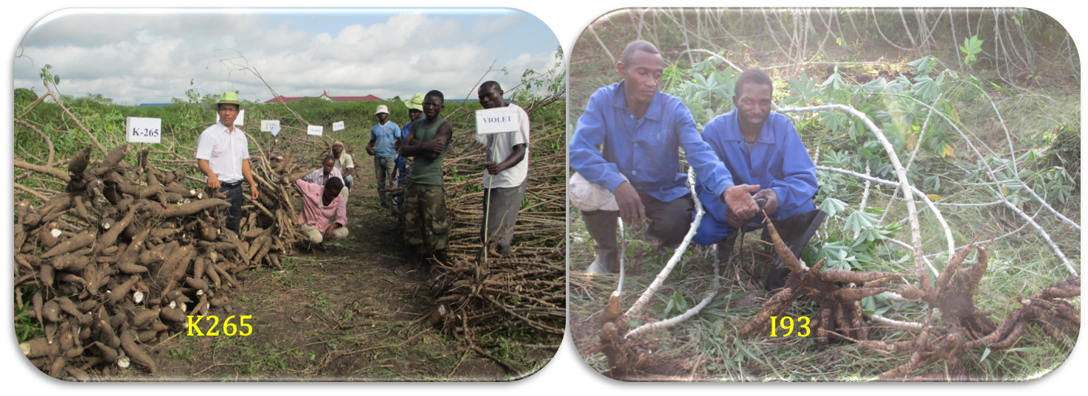
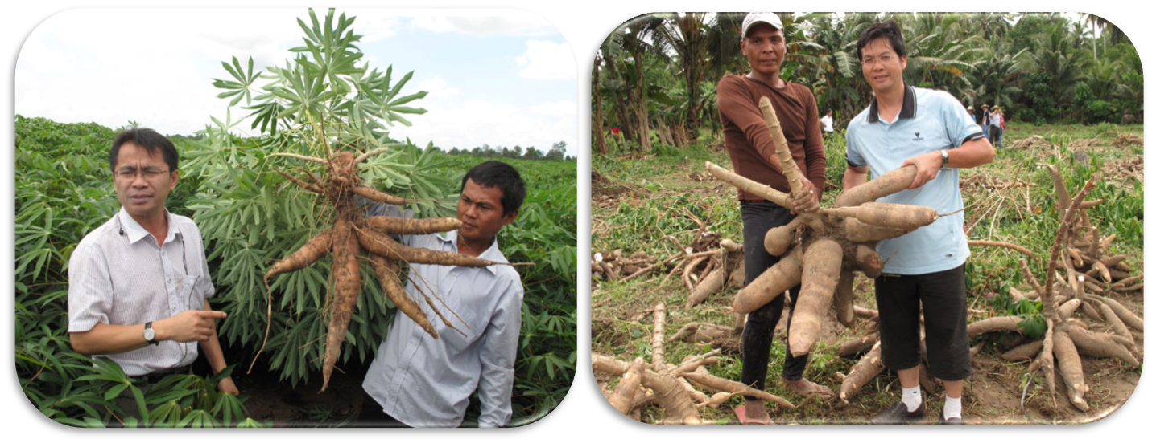
Technology of Postharvest Loss Reduction
South China 5 is applied and promoted in more than 200,000 hectares in Pursat Province and Kratie Province in Cambodia.
The new high-yielding variety of South China 13, suitable for local cultivation, is applied and promoted in PPM Company.
The local cassava industry in the Republic of Congo: 9.0 tons/ha.
The new varieties K265 and I93 yielded 42 tons/ha and 26 ton/ha, respectively, and had some resistance to mosaic disease.

Slide 15
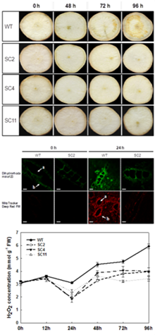
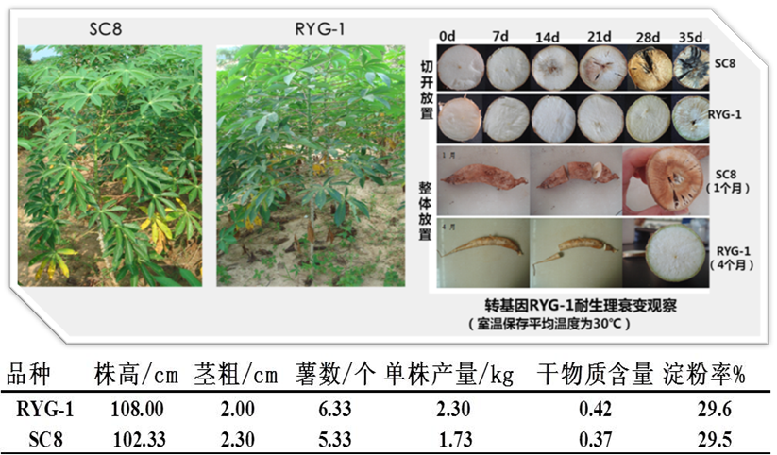
Technology of Postharvest Loss Reduction
Placement after cutting
(1 month)
Whole placement
(4 months)
Observation of physiological decay resistance of transgenic RYG-1 (stored at room temperature at an average temperature of 30°C)
Category | Plant Height/cm | Stem Thickness/cm | Number of Cassava | Yield Per Plant/kg | Dry Matter Content | Starch Rate%
RYG-1 | 108.00 | 2.00 | 6.33 | 2.30 | 0.42 | 29.6
SC8 | 102.33 | 2.30 | 5.33 | 1.73 | 0.37 | 29.5
Using a genetic transformation system, AtGloS2 was transferred into the South China 8 variety, which significantly improved the postharvest physiological rot tolerance of South China 8.

Slide 16
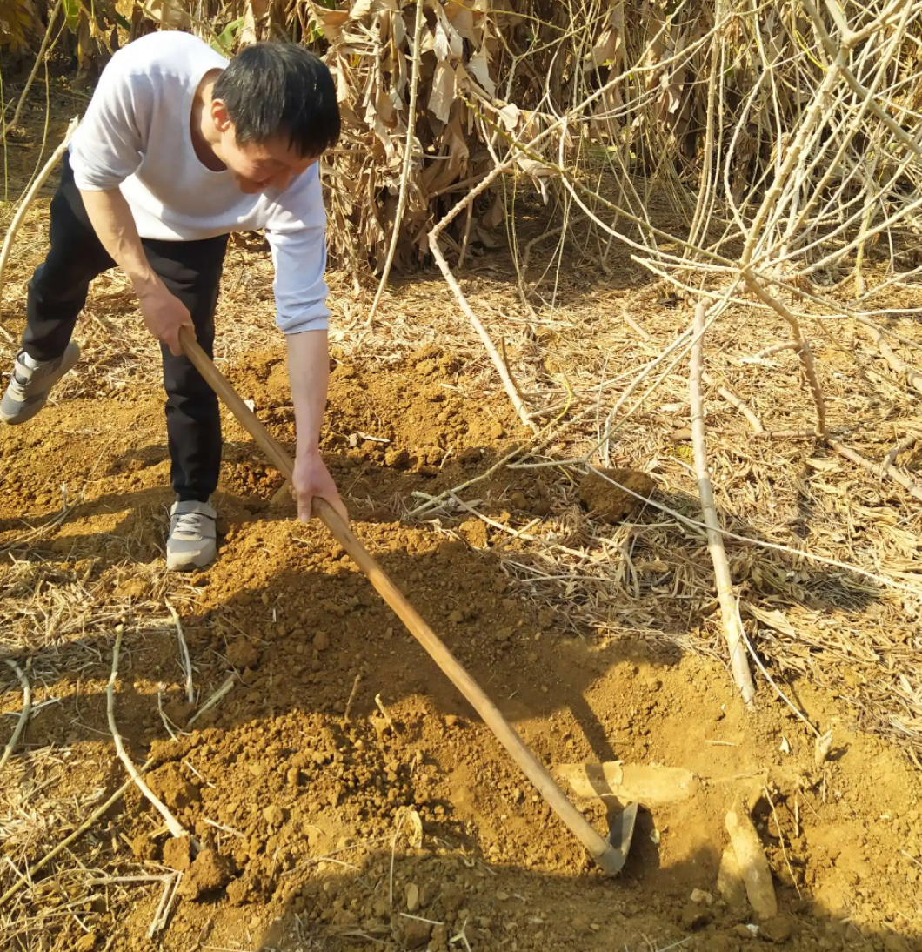
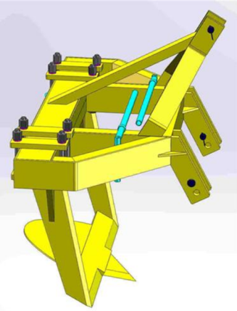
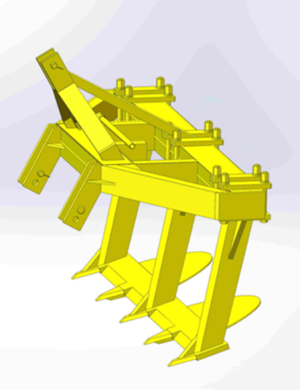
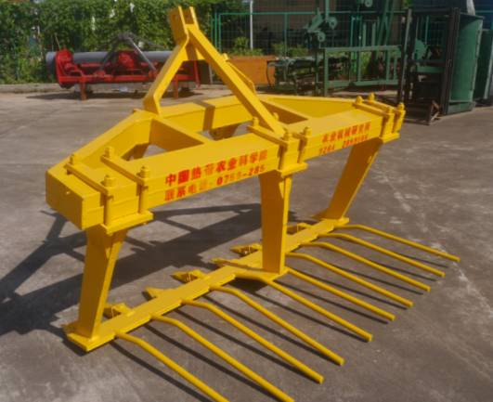
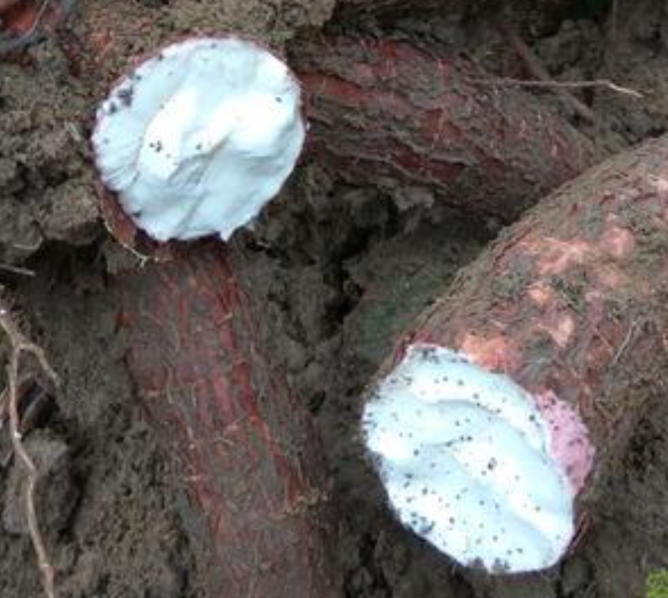
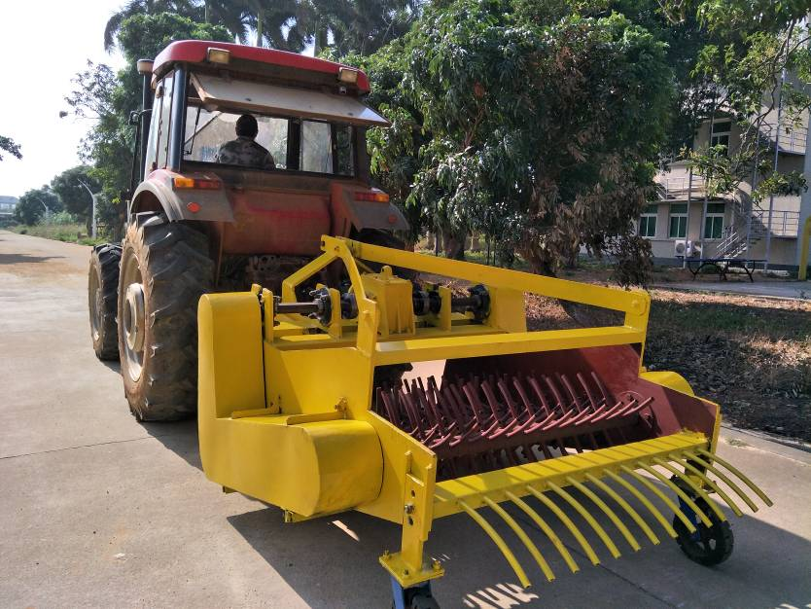
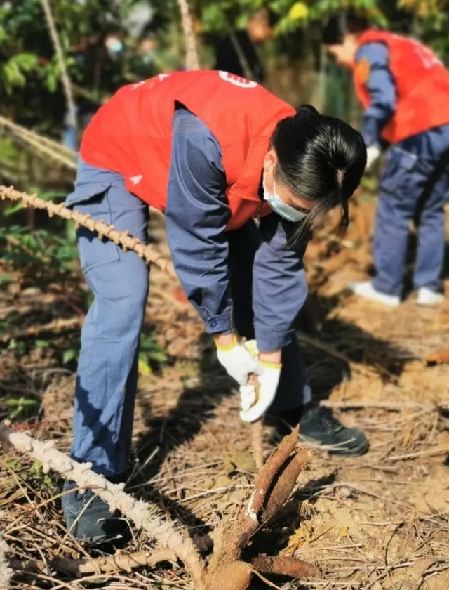
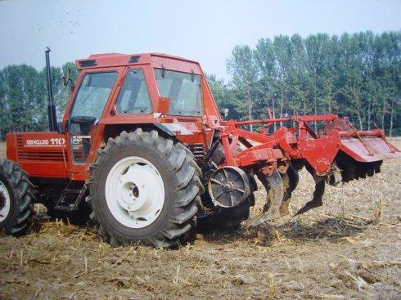
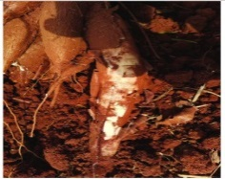
Technology of Postharvest Loss Reduction
30-60%
Digging/Pulling with Hoes
Mechanical Plow
Mechanical Rake

Slide 17
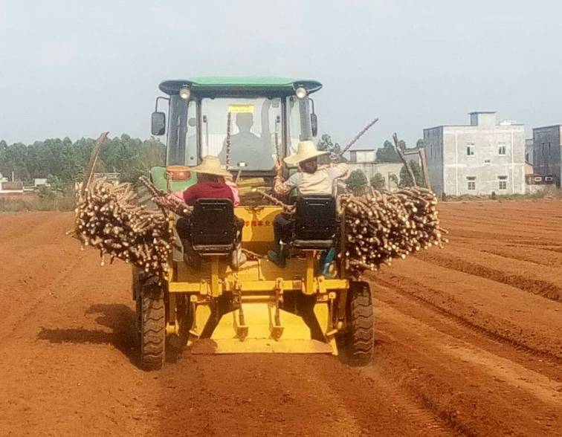
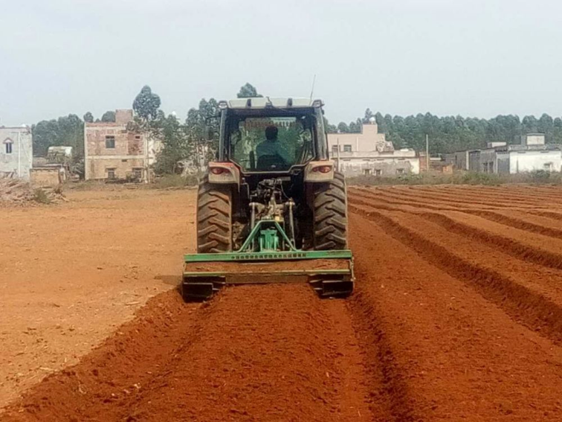
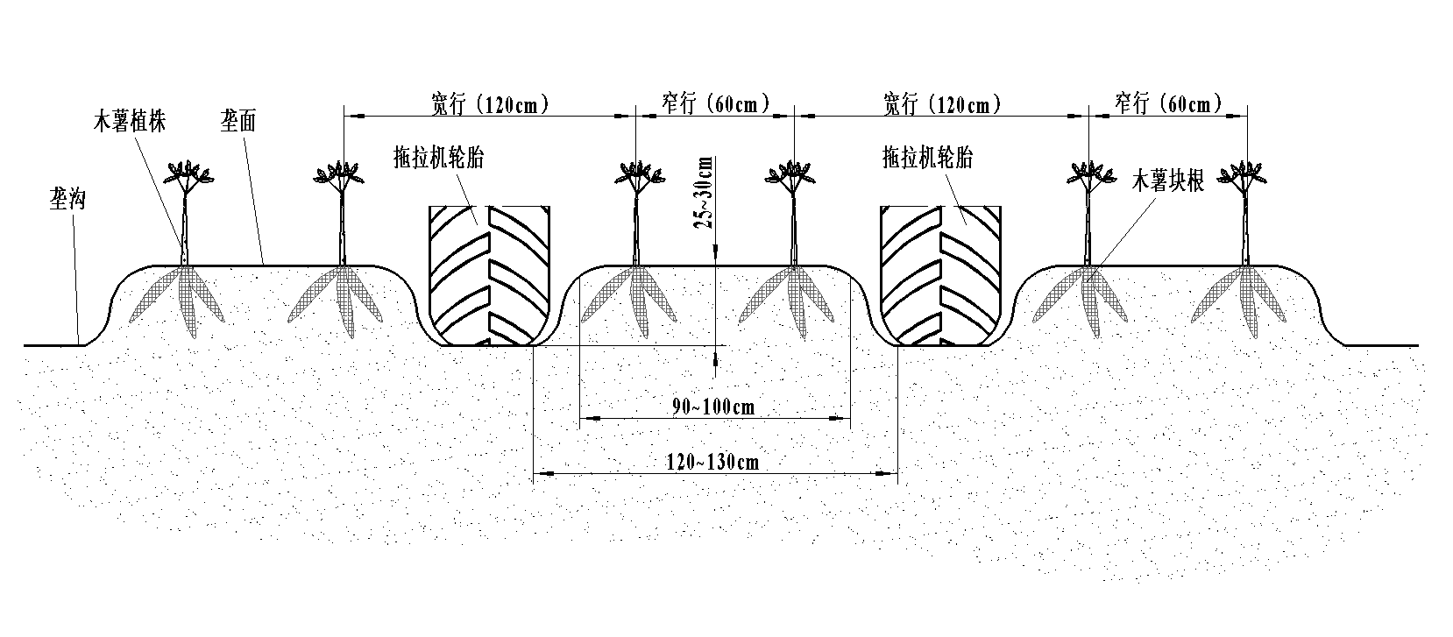


Technologies of Postharvest Loss Reduction
Mechanized Planting Technology
Inter-monopoly width: 120cm for wide rows and 60cm for narrow rows
Monopoly width: 60cm
Plant spacing: 70cm
Suitability: 90hp tractor

Slide 18




Technology of Postharvest Loss Reduction
Mechanized Harvesting Technology
Harrow width: 120cm
Suitability: 90hp tractor

Slide 19
Technology of Postharvest Loss Reduction
(Freshness Preservation Technology)
Postharvest Physiological Deterioration
Post-harvest Physiological Deterioration (PPD) refers to the physiological phenomenon of cassava root tubers appearing inside and outside the central column about 3 days after harvesting, and the black spot will be irreversible changes with storage time and storage environment, closely related to the variety, external conditions.
It is reported that global postharvest losses of fresh cassavas are about 15% of production.
Post-harvest preservation is an important measure to reduce post-harvest losses of fresh cassavas, especially in tropical cassava production areas with high temperatures and high humidity, and preservation technology is particularly important.

Slide 20



Technology of Postharvest Loss Reduction
(Freshness Preservation Technology)
In 2013, researcher Peng Zhang successfully demonstrated that Cu/Zn SOD enzymes are closely related to the scavenging of reactive oxygen species during storage of cassava tubers using a genetic transformation system.
Post-harvest physiological decay
Genomic and proteomic studies have shown that postharvest physiological decay of fresh cassavas is closely related to the imbalance of reactive oxygen species, controlling it at the right level is the key to delaying postharvest decay.
In 2012, Zhang Zhenwen proposed a regulatory network of Ca2+ -CaM complexes to regulate the physiological metabolism of tuberous roots.
In 2017, Yu-Ling Qin proposed the PPI regulatory network.
In 2019, Fei-Fei An proposed a regulatory network consisting of 7 genes in the Golgi apparatus.
In 2003, Professor John Beching, found that the tuber storage process was significantly upregulated with the expression of seven genes associated with reactive oxygen species scavenging.

Slide 21


Technology of Postharvest Loss Reduction
(Freshness Preservation Technology)
Technologies of Postharvest Loss Reduction
（1） Physical preservation technology: Film Coating + Low Temperature Preservation
Fresh cassavas coated with edible fruit wax can be stored at a low temperature of 4°C for about 15 days.

Slide 22






Technology of Postharvest Loss Reduction
(Freshness Preservation Technology)
Technologies of Postharvest Loss Reduction
（1） Physical Preservation Technology: Freezing Point Pre-cooling + Low Temperature Preservation
Cassavas treated with freezing point pre-cooling can be stored and kept fresh at low temperature for about 25 days.

Slide 23

Technology of Postharvest Loss Reduction
Physical Preservation Technology: Reduced Pressure Preservation
By pre-cooling treatment, fresh cassavas start to experience postharvest physiological deterioration only after 30 days of storage at room temperature under 0.03-0.05 MPa. If stored at low temperature, it can be extended for more than 60 days

Slide 24



Technology of Postharvest Loss Reduction
(2) Chemical preservation technology: using 1.5% chitosan + 0.15% citric acid + 0.25% calcium chloride solution for 10min can improve the ROS scavenging ability of fresh potatos, so as to effectively prolong the post-harvest storage period of fresh potato and delay the occurrence of PPD.

Slide 25



Technology of Postharvest Loss Reduction
(Freshness Preservation Technology)
Chemical preservation technology: fresh potatoes can be stored for 20 days after being treated at 98 ℃ with 10 g / lnacl hot water + antioxidant 3% Na2S2O5 solution for 2 minutes to delay the occurrence of PPD

Slide 26
Technology of Postharvest Loss Reduction
Storage comparison
Fruit wax coating / low temperature preservation technology
Advantages: The storage effect is good. There is no browning and no obvious change in hardness within 15 days.
Disadvantages:
The operation is cumbersome, and the labor cost is high;
There are potential food safety hazards;
The injured potato is not suitable, and the selectivity of raw materials is strong.
Freezing point cold preservation
Advantages: easy to operate, easy to industrialized treatment and high benefit; The supply and marketing chain is sound.
Disadvantages:
1. flavor slightly changes,
2. Low temperature storage, high energy consumption;
3. After peeling and low-temperature storage, the root tubers lost water and shrunk, and their appearance was not good.
Low pressure refrigerated preservation
Advantages: Suitable for industrial application; Fresh potato has the best storage effect.
Disadvantages:
1. High standard for storage facilities;
2. After low-pressure storage, the shelf life at room temperature is only 7 days;
3. It is not suitable for low temperature storage after peeling

Slide 27
03
Technology of Processing

Slide 28

Processing Technology
Starch Processing
Cassava is mainly used for starch processing in southern China. The annual output of cassava starch is about 450,000 tons, mainly distributed in Guangxi. At present, China's cassava starch processing technology has strong independent R & D and design capabilities of processes and equipment

Slide 29

Processing Technology
Cassava Modified Starch
Cassava modified starch (CMS) is a kind of starch whose processing characteristics change after physical, chemical or enzyme treatment, including esterified starch, acidic starch, oxidized starch and cross-linked starch.

Slide 30

Processing Technology
Cassava Modified Starch
additive
hot air
hot air
raw starch
mixed
reaction
dehydration
cooling
end product
package
screening

Slide 31







Processing Technology
Alcohol processing
Region | % | Fuel ethanol promotion
Brazil | 20 | 25%
Thailand | 10 | Bangkok
India | 5 | Southern Region
Sweden | 5 | nationwide
Colombia | 10 | 3 major cities
China | 10 | 5 cities
Main raw materials
* sugar cane
* cassava
* sweet potato
* beet
* sweet sorghum
* corn
* ...

Slide 32


Processing Technology
Alcohol processing
Advantages (1) Easy to plant ; (2)Low cost of raw materials ; (3)High conversion rate ; (4)Low cost of waste disposal
China's alcohol production has exceeded 2.6 million tons, twice the actual production in 2011.
China's alcohol production is expected to reach 4.4 million tons by 2025, with huge demand for cassava, sweet potato and corn.
Year | Production capacity (million tons) | ☆Capacity （Million tons）
2007 | 2.80 | 1.32
2008 | 2.80 | 0.86
2009 | 3.10 | 1.00
2010 | 3.15 | 1.25
2011 | 3.20 | 1.30
2017 | 3.50 | 2.60
2025 | 5.00 | 4.40

Slide 33
Processing Technology
Alcohol processing
Traditional craft
Second generation
craft
Three generations
of crafts
Comparison of different alcohol processing processes
Cassava chips
Cassava chips
Cassava chips
 | Time consuming (hours/batch) | Energy consumption (kWh/ton) | Water consumption (cube/ton)
Traditional Craft | 71 | 210 | 60
Second Generation Craft | 55 | 150 | 35
Three generations of crafts | 50 | 120 | 30
Four generations of crafts | ≤48 | ≤80 | ≤20
Crushing
Crushing
Crushing
Desanding
Desanding
Desanding
Amylase
liquefaction
Amylase
liquefaction
Liquefaction
+ saccharification
+ fermentation
synchronization
STARGENTM+ Yeast
Glycosylase
glycation
Glycation+ Fermentation
synchronization
RHIZOZYMETM Yeast
Yeast
fermentation
Filtration /
Distillation
Filtration /
Distillation
Filtration /
Distillation
Increased efficiency of alcohol conversion
Cellulose, etc. as the main raw material
Waste recycling technology
Alcohol
Loss reduction
techniques
Alcohol
Alcohol

Slide 34


Processing Technology
Cassava powder processing
Light simplified dry processing and industrialized wet processing.
Roadmap of cassava powder wet processing
Raw material
Clean/peeling
degretting
segmentation
product
package
screening
crushing
dry
Dry processing Technology of Cassava Powder

Slide 35
04
Prospects

Slide 36



Prospect
The use of biotechnology to breed and apply post-harvest rot varieties can greatly reduce the loss of fresh potatoes due to post-harvest physiological decay in the process of transportation and processing, and is also to meet the needs of the current efficient industrial development, and it is also the general trend of low-carbon industrial development.

Slide 37




Prospect
Diversified use of technology is an extension of cassava value chain
The use of cassava flour, stem and leaf and other by-products to develop a series of high value-added products, e.g. cassava flour food, cassava leaf silkworm farming, cassava stem matrix cultivation of black fungus and cassava leaf protein polypeptide products, etc.

Slide 38


Prospect
International cooperation is the way out for the sustainable development of cassava industry
China has cooperated closely with cassava research institutions in Southeast Asia, South America and Africa, successively built 4 international cooperation bases and more than 40 cooperative units

Slide 39


Prospects
International Cooperation

Slide 40


Thank You
Contact info: scuta96@catas.cn
Chinese Academy of Tropical Agricultural Sciences
The SSTC project is funded by:
Ministry of Agriculture and Rural Affairs
P. R. China
Sharing for Learning

