Slide 1

China’s experience in the development of market opportunities and linkage
Dr. Shen Guiyin
Institute of Agricultural Economics and Development JAAS

Slide 2
Marketization process of Chinese agricultural products
Outlines
II. Main paths for farmers to gain marketing opportunities
III. Policy measures to stabilize the market, and protect producers and consumers
IV. Processing of agricultural products creates marketing opportunities

Slide 3

PART 01
Marketization process of Chinese agricultural products

Slide 4
I. Market-oriented reform of urban food supply system in China
China heavily relies on agriculture. At present, 40% of the total population (560 million people≈170 million rural households) living in rural regions, of which 332.24 million people are engaged in agriculture, forestry, animal husbandry, and fishery. China has a large population but relatively small land areas.
At present, about 80% of China's agricultural production is small-scale household operation. There are multiple scales of land operated, ranging from less than 10 mu to more than 1,000 mu (1 mu≈0.067 ha).
Grains harvested in 2019 achieved 610 million tons in China, accounting for 22.40% of the world's total outputs (2.72 billion tons). The yields of rice, maize, and wheat are 200 million, 260 million, and 134 million tons, respectively. Meat production was 76.49 million tons, with 42.55 million, 6.67 million, 4.88 million, and 22.39 million tons of pork, beef, lamb, and poultry, respectively. The productions of eggs, milk, fruits, and vegetables are 33.09 million, 32.01 million, 266 million, and 720 million tons, respectively.
Most of the agricultural products, except for the small amount of famers self-consumption, circulate to enter the market for Chinese consumers' consumption or exports to foreign markets.
China has gone through a very tortuous road in helping farmers and agricultural products enter the market, and has experienced many changes.
Notes:
统计各所实验基地面积 +表 自建，共建
本部 7450

Slide 5
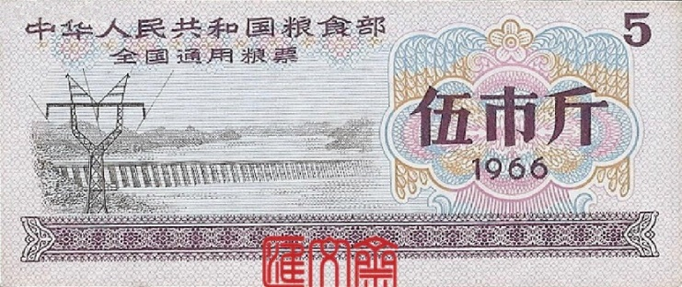
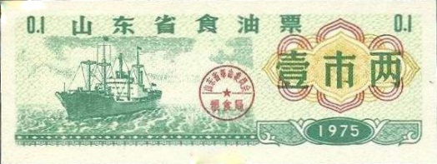
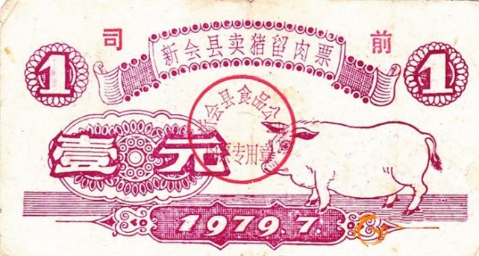
I. Market-oriented reform of urban food supply system in China
i. Traditional marketing system of agricultural products
Before the reform and opening up, China implemented the policy of unified purchase and marketing of agricultural products throughout the country. Private grain merchants were strictly prohibited from grain trading. The government formulated and managed the prices of grain and other agricultural products in a unified way.
Unified/assigned purchase: grain, cotton, and oil are subject to unified purchase; for meat, egg, and other ag-products, the government sets up a purchase quota and purchases from individual farmers according to the proportion (farmers could sell the remaining products freely).
Unified sell: implement unified grain marketing for urban residents and grain deficient farmers through food coupons.
Notes:
统计各所实验基地面积 +表 自建，共建
本部 7450

Slide 6
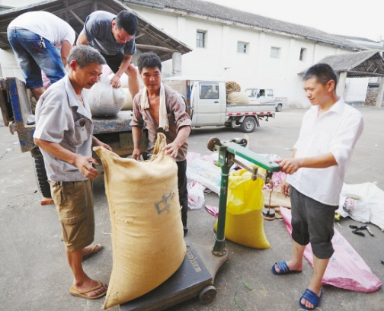
I. Market-oriented reform of urban food supply system in China
Since 1978, China began the process of reform and opening up, and the market-oriented economic reform started in rural areas：
Farmers no longer produced collectively (in the form of production teams or production teams), but acquired a certain amount of land (contracted land, not privately owned) according to the household size.
Specific agricultural products, such as grain, were purchased by the government based on the prescribed price; the rest could be left for self- consumption or sold. However, the base number and varieties were gradually reduced.
With the advancement of rural market-oriented reform, all agricultural products except grain were first allowed to trade in the market. Gradually the grain market was opened up for free trade, with a government-set minimum purchase price. When the market price is lower than the minimum purchase price, the government entrusts grain reserves or state-owned grain enterprises to purchase grain.
Notes:
统计各所实验基地面积 +表 自建，共建
本部 7450

Slide 7
I. Market-oriented reform of urban food supply system in China
ii. Marketization reform process of agricultural products sales
The government liberalized grain prices; grain purchase price switched from contracted price to protective price；the protective purchase price and market price coexisted.
The government liberalized the purchase and marketing of grain in main selling areas; grain price fluctuated based on the market.
Implement the contract purchase for grains and cotton.
1979
1985
1991
1993
1998
2001
2004
Gradually reduces the varieties and quantities of agricultural products for unified/assigned purchase.
The government raised the price of urban grain sales twice to achieve the same price for purchase and sale. After nearly 40 years of unified grain marketing, food coupons were canceled.
“3 policies, 1 reform” for grain circulation system. Key points：purchase farmers' surplus grain at the protective price。
Complete liberalization of the purchase and marketing of grain.Established a unified, open, competitive, and orderly grain marketing system。
Notes:
统计各所实验基地面积 +表 自建，共建
本部 7450

Slide 8
PART 02
Main paths for farmers to gain marketing opportunities

Slide 9
II. Main paths for farmers to gain marketing opportunities
i. Paths of grain entering the market
Market-oriented reform of grain purchase and sales
State grain depot
minumum price
Purchase
Auction
Producer
Consumer
Broker
Grain-processing enterprise
Grain products market
Grain-purchasing enterprise
Notes:
统计各所实验基地面积 +表 自建，共建
本部 7450

Slide 10
II. Main paths for farmers to gain marketing opportunities
ii. Paths of fresh products entering the market
The circulation path for fresh agricultural product from farmland to dining-table
Broker
Field market
Wholesale market in origin of production
Wholesale market in the trading center
Retail market
Producer
Consumer
Farmer-supermarket linkage
Supermarket
Member preorder, field picking, etc
Cooperative
Family farm
Agricultural enterprises
E-commerce platform
Retail store or delivery
Notes:
统计各所实验基地面积 +表 自建，共建
本部 7450

Slide 11

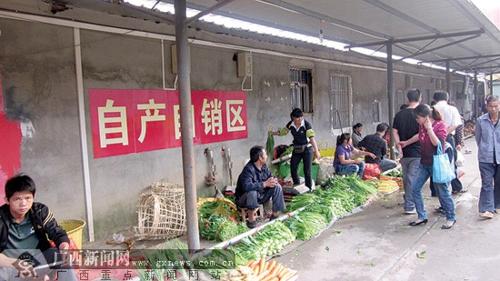
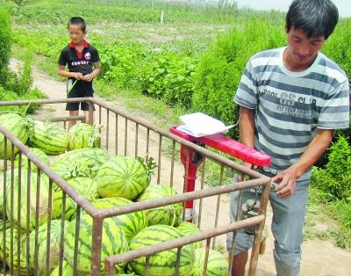
1. Enter the market by themselves or through rural brokers
Markets set up stalls for farmers to sell their home-grown agricultural products.
Farmers sell the self-grown watermelon nearby the fields.
Notes:
统计各所实验基地面积 +表 自建，共建
本部 7450

Slide 12
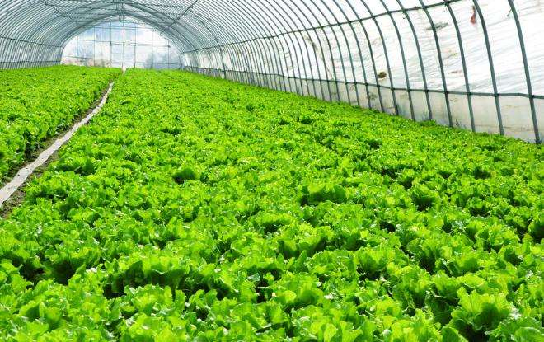
2. Entering the market through cooperatives
Provide socialzed services through '5 Unifications'
Beiqin vegetable professional cooperative
Donghai, Jiangsu
Business value
Cooperative
Dividends
Dividends
Seedling income
Management income
Seedling base
Market
Unified technical mgmt
Reducing production cost
Reducing seedling costs
Reducing marketing cost
Selecting varieties
Increasing price
Dividends
Dividends
Unified planning and preparation, unified seedling breeding and purchase, unified technical management, unified sales, and unified market expansion.
Production base
Dividends
Dividends
Vegetable farmer
Production chain
Notes:
统计各所实验基地面积 +表 自建，共建
本部 7450

Slide 13
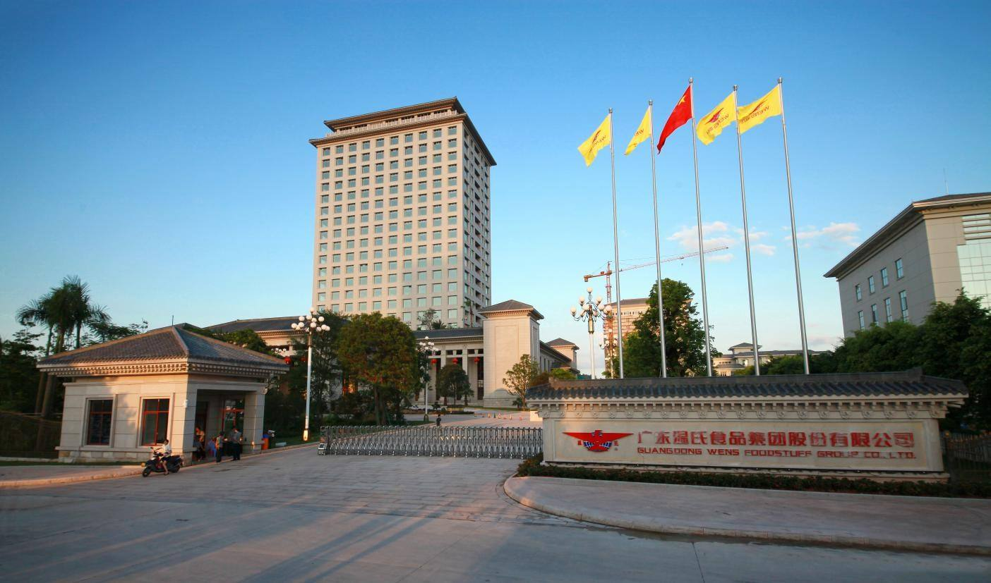
3. Entering the market through agricultural enterprises
Wen's mode
Provide market access for farmers with a 'enterprise+farmer' pattern
On the production side, the enterprise and farmers cooperate through closed entrusted breeding. Farmers provide sites and feed livestock and poultry. The enterprise provides piglets/chicks, feed, epidemic prevention and control, technical services, and buy-back animals for sale.
For profit distribution, after deducting the costs of piglets/chicks, feed, and medicine provided by the company, the remaining part (gross profit) is farmers' earning. The enterprise adopts a price protecting. When the enterprise signs the breeding contract with the farmer, material prices and costs are determined so that farmers' income is decoupled from market price, ensuring farmers' income. In general, farmers can earn reasonable income.
Notes:
统计各所实验基地面积 +表 自建，共建
本部 7450

Slide 14
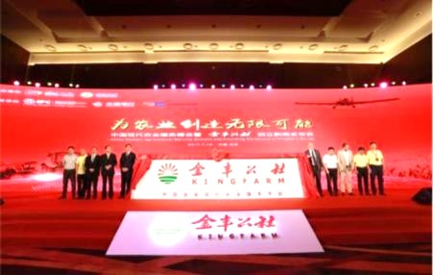
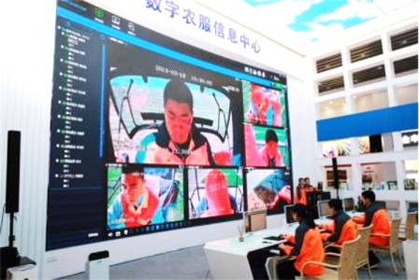
4. Entering the market through agricultural materials enterprises
Jinfeng Commune mode
Integrated service platform for modern agricultural
From fragmented services to one-stop services: breaking up the whole process to a service package for farmers, including land trusteeship, soil remediation, crop nutrition solution, agricultural technology training and guidance, product sales, and agricultural finance, serving 11.25 million mu of land.
From one-way production to production to order: the service agencies joining the Jinfeng commune platform have covered all nodes from planting to harvesting and selling, including e-commerce, supermarkets, agricultural enterprises, etc. Covering 22 cities/counties in 9 provinces; 58 sales channels and 4258 stores have reached cooperation.
From individual economy to sharing economy: “gather resources, build networks, and provide services.” It has gradually become an economic link between urban and rural areas.
Notes:
统计各所实验基地面积 +表 自建，共建
本部 7450

Slide 15
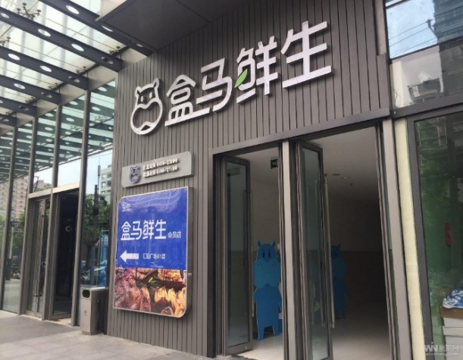
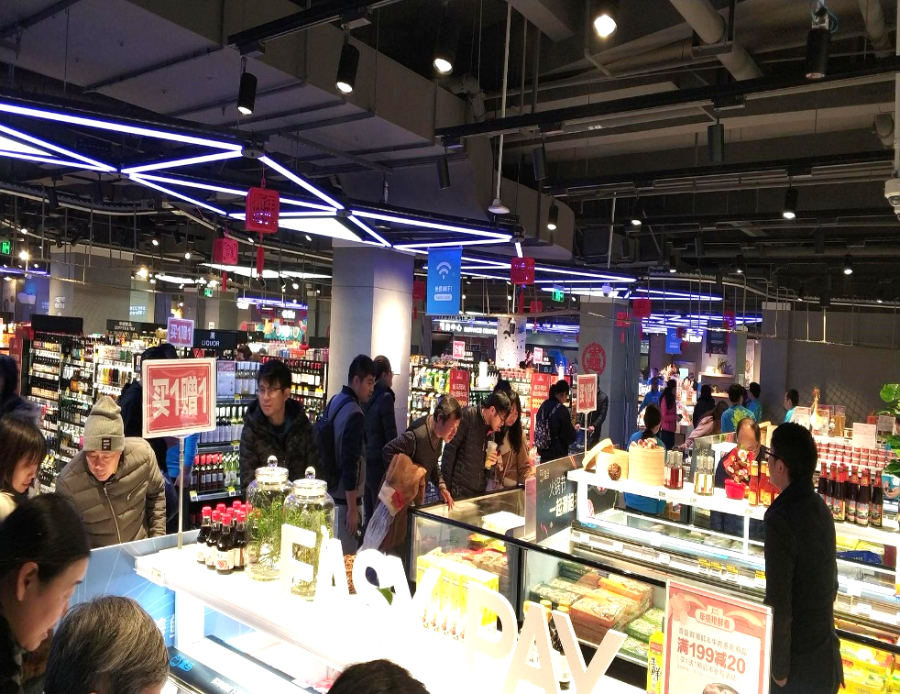
5. Entering the market through E-commerce platform
Development of city region food system
Case：the sales of fresh agricultural products through E-commerce
Fresh HEMA：grocery store、take-out、E-commerce、dine in
HEMA takes "fresh produce e-commerce" and "take-outs" as the entry point. Integrating its online app and offline stores and warehouses, HEMA provides users with a one-stop shopping experience from fresh food to catering service, which meets users' demand for "eating" anytime and anywhere.
Solve the key demand of urban food consumption：
Availability, quality, convenience, safety
Online orders are delivered as soon as within 30 minutes；
Offline stores provide diversified services 24-7.
Notes:
统计各所实验基地面积 +表 自建，共建
本部 7450

Slide 16
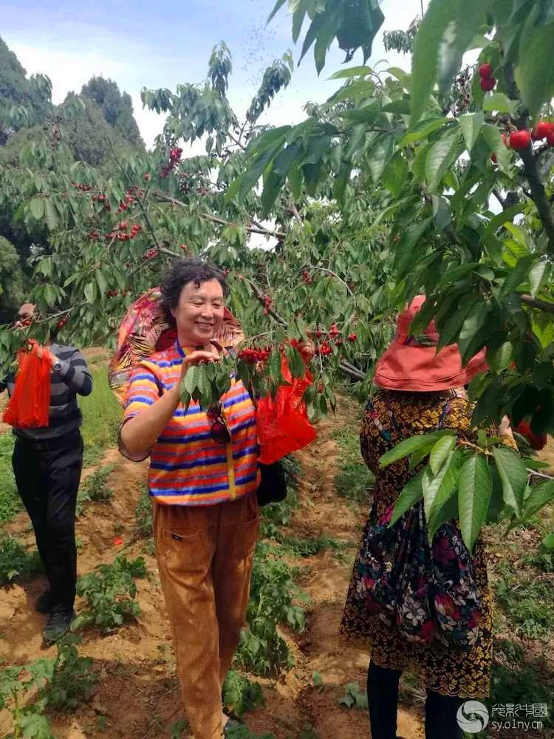
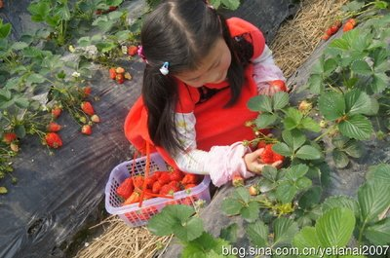
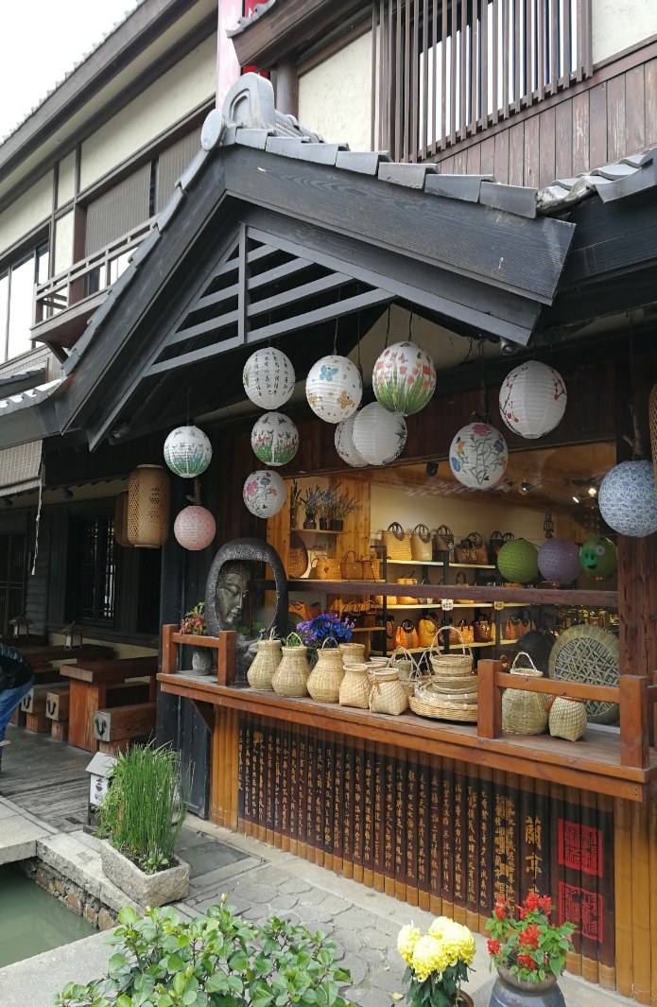
6. Consumers pick the fresh produce on-site or purchase characteristic agricultural products in traveling spots
In some leisure farms and rural tourism sites, consumers could pick some seasonal fruits or vegetables while enjoying the rural scenery. Thus, the sales of conventional and local characteristic agricultural products are promoted.
解决城市食品消费核心需求：
买得到、买得好、买得方便、买得放心
Notes:
统计各所实验基地面积 +表 自建，共建
本部 7450

Slide 17
PART 03
Policy measures to stabilize the market, and protect producers and consumers

Slide 18
III. Policy measures to stabilize the market, and protect producers and consumers
i. Main policies of production, processing and circulation
With the formation of market-oriented production and supply systems, the Chinese government has established a market regulation system for grain and other bulk agricultural products, which integrates measures including the minimum purchase price, national reserves, grain risk fund, import and export tax regulation, etc.
01
02
03
04
Supportive policies for food processing
Supportive policies for food circulation
Producer support policies
Market regulation policies
流通领域支持政策
Notes:
统计各所实验基地面积 +表 自建，共建
本部 7450

Slide 19
III. Policy measures to stabilize the market, and protect producers and consumers
ii. Support policy for urban consumers
Subsidy policy for consumers：Set up the Price-Regulation Fund since 1988. Article 27 of the Price Law stipulates that “the government may establish the reserve system for important commodities, set up a price regulation fund to regulate prices and stabilize the market.” The levy of the price-regulation fund finished in 2016 and started to be arranged by the financial budget. Purposes of the Fund are to 1. provide policy-oriented subsidies (mainly for producers and operators); 2. suppress the abnormal price fluctuations of daily necessities such as grain, oil, and non-staple food (for producers, operators, and consumers); 3. subsidize food prices for low-income residents.
Linkage mechanism between standards of social assistance and security, and price rise（since 2011）：If any of the following conditions are met, the linkage mechanism will be started：
The consumer price index (CPI) increases by 3.5% in a single month, compared with the same period of the previous year. Regions adopting the standard cost of living price index (SCPI) of urban low-income residents can continue to use it and set a reasonable critical value referring to the 3.5% increase of CPI on a year-on-year basis.
Food prices in CPI increases by 6% in a month on a year-on-year basis.
Notes:
统计各所实验基地面积 +表 自建，共建
本部 7450

Slide 20
PART 04
Developing agricultural products processing to create more marketing opportunities

Slide 21
III. Processing of agricultural products creates more marketing opportunities
Developing agricultural product processing is a crucial way to expand farmers' market opportunities. Processing can reduce the size and weight of farm products and facilitate transportation, make perishable agricultural products less likely to rot and ensure the quality and market supply, promote the comprehensive utilization of agricultural products and increase value and farmers' income.
Take maize as an example to illustrate the role of agricultural product processing in providing market opportunities for farmers.
Notes:
统计各所实验基地面积 +表 自建，共建
本部 7450

Slide 22
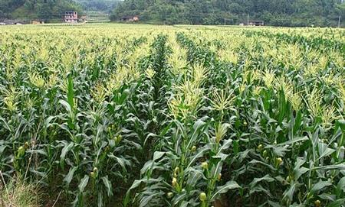
Brief introduction of maize production worldwide
Maize originated from the American continent. Maize was first planted by the Indians more than 7000 years ago; then was introduced into Europe in the 15th century, and gradually spread to the world along the Mediterranean region.
As a C4 plant, maize has the following characteristics compared with C3 plants: weak photorespiration; low CO2 compensation point; photosynthetic point almost reach full sunlight; high optimum temperature for photosynthesis; high photosynthetic rate under strong light conditions. Thus, maize has stronger environmental adaptability than C3 plants.
Maize is one of the three major food crops worldwide, with a wide range of uses such as food, feed, and industrial raw materials. With the growth of production and demand, maize has become the world's largest grain variety, accounting for more than 40% of global grain production.

Slide 23
Corn processing creates more market opportunities for farmers
Corn is nutritious, with 73% starch, 8.5% protein, 4.3% fat, and rich vitamins. It is used as food, feed, and industrial raw material. Therefore, the corn industry chain is the longest among grains。
At present, one-third of the world's population feed on corn.
Suitable as a feed. Corn for feed accounts for more than 60% of global corn production, even more than 70% in some countries.
Corn is a source of edible vegetable oil. The oil extracted from corn germ is rich in unsaturated fatty acids and vitamin E, with high nutritional value.
Corn is also an important industrial raw material. At present, corn used as industrial raw material accounts for about 15% of the total utilization in industrialized countries.
Maize is the cereal crop with the most processing varieties, the longest chain, and the highest added value. There are more than 2000 deep-processing varieties.

Slide 24
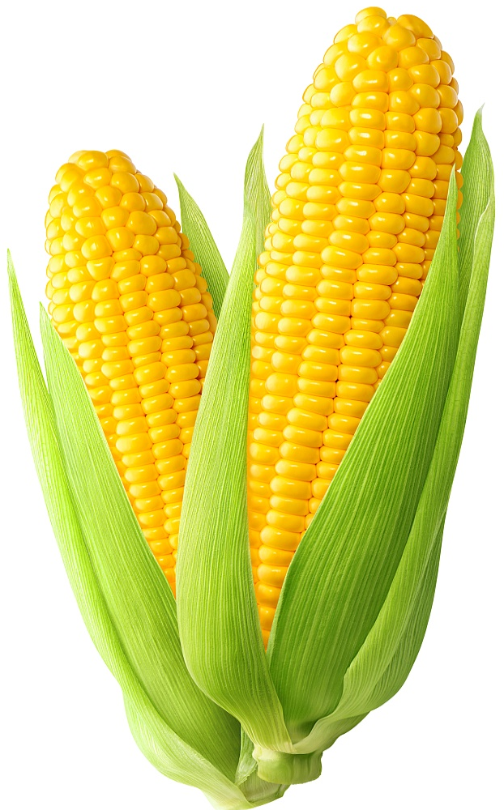
1. Corn as staple food
Fresh corn: hundreds of varieties, including sweet corn, waxy corn, and sweet waxy corn, and so on. The worldwide planting area shows a steady growth trend, as the planting area in China has reached 20 million mu. Processing methods include direct fresh eating, quick freezing and vacuum preservation, canned sweet corn, etc.
Processed corn-products: corn grits, dried corn noodles, high-gluten corn flour, etc.

Slide 25
2. Deep processing of corn
Episperm, endosperm, and germ compose the corn kernel. In the deep processing of corn, the three parts are separated to produce different products.
Starch
Endosperm
Corn kernel
Albumen powder
Episperm
Fiber feed
Animal feed
Corn meal
Germ
Corn oil

Slide 26
2. Deep processing of corn
Starch (including starch sugar): mainly for the edible purpose; accounts for more than 50% of the deep-processing product of corn.
Citric acid: mainly used as a sour agent in beverages, lightly used as a detergent additive.
Lysine (an essential amino acid that cannot be synthesized by the human body): mainly for human consumption.
MSG as a seasoning.
Starch
Ethonal
MSG
Citric
Acid
Lysine
Other

Slide 27
3. Corn Ethonal
Downstream classification of ethanol industry
Producing 1 ton of ethanol costs 3-3.05 tons of corn and 200 US dollars; 0.8-0.85 tons of Distillers Drier Grains with Soluble (DDGS) are produced in the production process, which is an essentail raw material of animal feed.
China is the primary market for the distilled spirit.
Ethyl acetate is an important industrial solvent.
The production and consumption of fuel ethanol have linked the energy market and grain market, thus aggravating the fluctuation of the corn market.
Fuel ethanol
Spirit
Chemical &
pharmaceutical
Other

Slide 28
4. Corn feed
The animal feed industry is the largest component in the downstream industry chain of corn, and 1 kg of corn can be converted to 1.23 feed units.
Compound feed=
Concentrated feed (additives+protein material) +energy feed
The protein material mainly refers to soybean meal (approximately 20%); corn and wheat are the main energy feeds (approximately 70%); feed additives count about 10% (including Amino acids, vitamins, antibiotics, minerals, growth-promoting factors, etc.).
Compound feed
Concentrated feed+
Energy feed
Additive+Protein feed

Slide 29
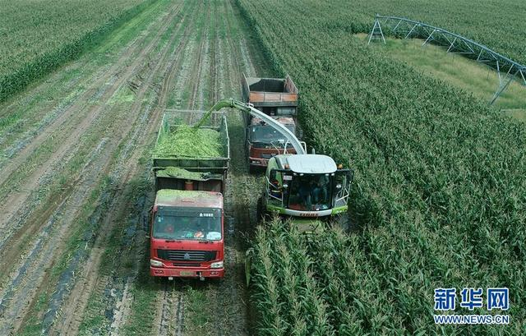
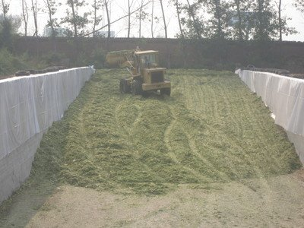
4. Corn feed
There are many types of corn as animal feed：
（1）Silage corn: Harvest all the green plants on the ground in proper time, then chop, process, and silage-ferment to produce silage as herbivorous livestock feed, such as cattle, sheep, etc.
Compared with untreated corn, silage corn has the advantages of high biological yield, good fiber quality, and good green retention; the dry matter and moisture content makes it suitable for closed silage by anaerobic fermentation.

Slide 30
4. Corn feed
There are many types of corn as animal feed：
（2）Energy feed: Corn is rich in energy with good palatability and utilization. The crude protein content of corn is 7-9%, which is the main source of compound feed for chicken and pig. At present, about 60% of global corn production is used for animal feed.
（3）Protein feed: Corn germ meal, corn protein, corn bran, corncob, and DDGS are all by-products of deep processing of corn. DDGS, especially, is a kind of high protein feed with a protein content of 26%.

Slide 31
THANKS

