Slide 1
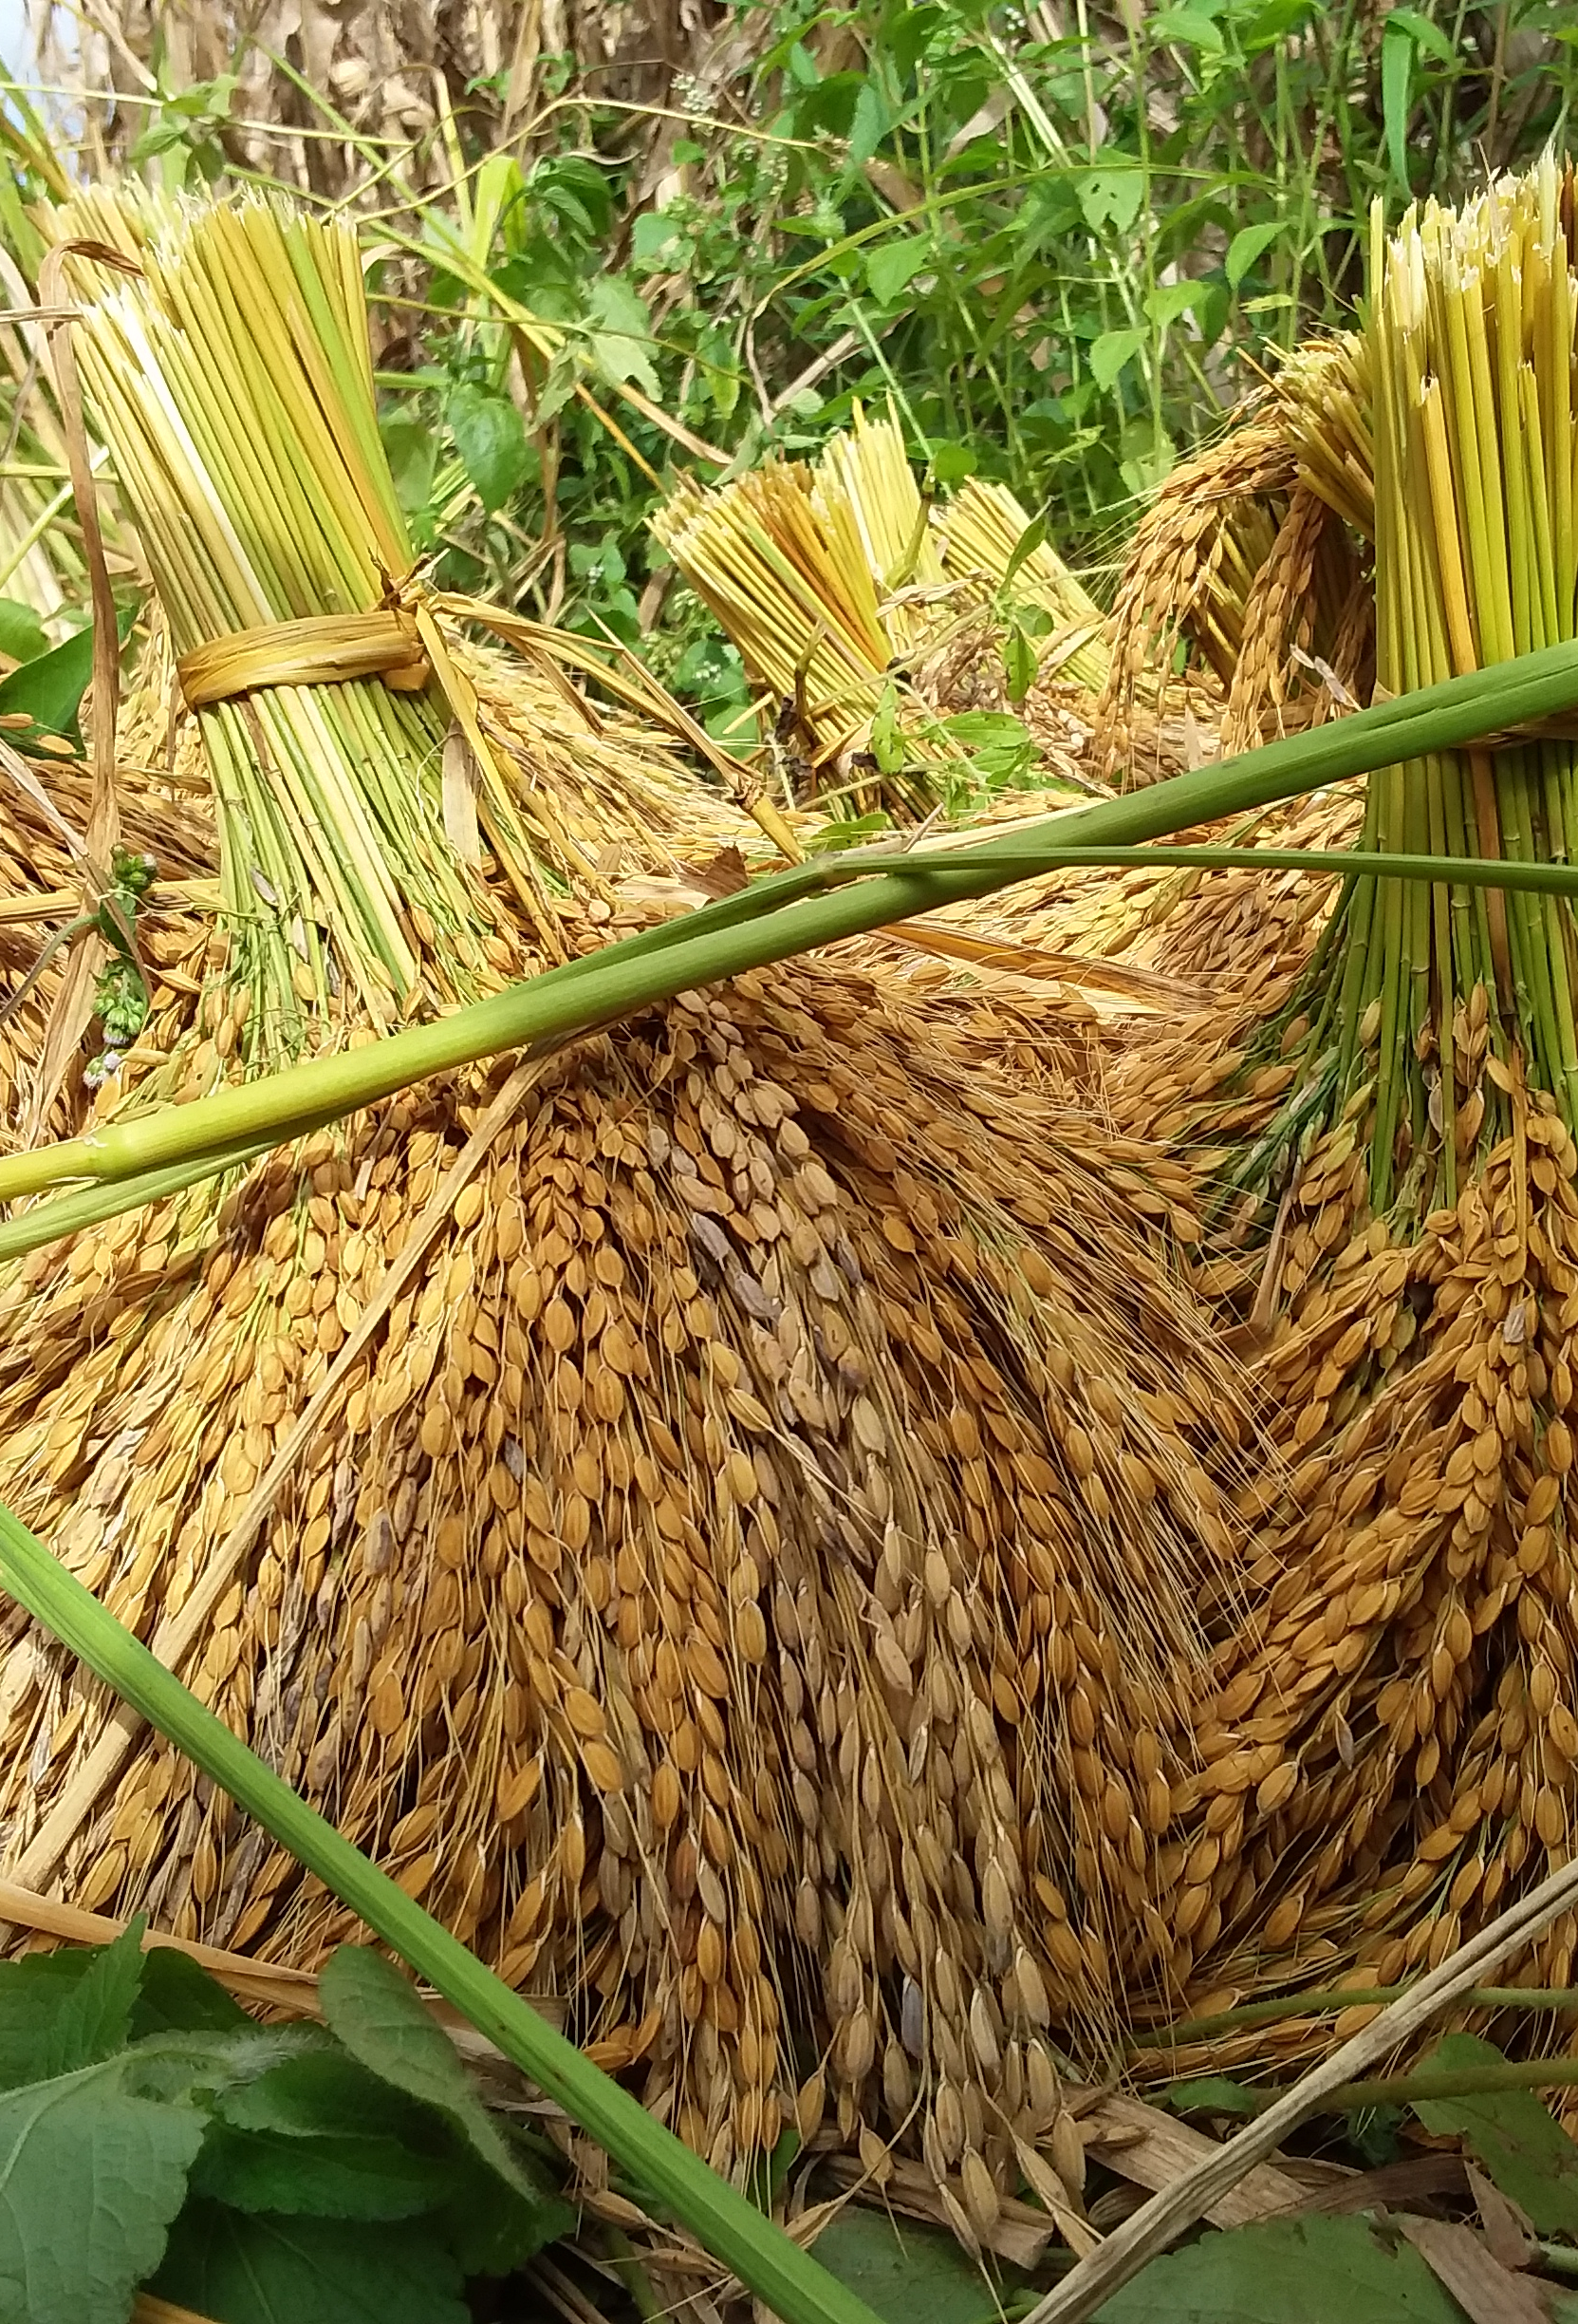
Supporting the rice value chain to increase resilience in Côte d’Ivoire
How the China-Africa rice value chain initiative supports local communities in overcoming challenges and contributes to resilient food systems.
WFP Côte d’Ivoire
Notes:
Eradicate hunger and malnutrition are important goals of the SDG. To do this, it is essential to work on all aspects of food systems, including increase production, promote sustainable business models, invest in production, transformation and distribution technologies and infrastructures, and improve productivity.

Slide 2
AGENDA
1. Context
2. Snapshot of Côte d’Ivoire Rice Value Chain
3. China-Africa Rice Value Chain Initiative
4. Challenges in Rice Value Chain in the North of Côte d’Ivoire
5. Project Timeline (phase1) 2021-2022
6. First Phase Harvesting Point
7. Positive Change
8. Action plan 2nd phase 2023-2024
7. Recommendations

Slide 3
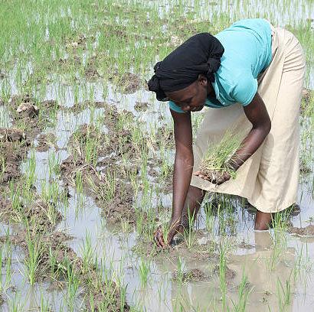
Context
80% of agriculture is composed by small holder farmers
Weak structuring – informal sector
Women represent 90% of agricultural labor forces
155th on the Gender Inequality Index
Notes:
In Côte d'Ivoire, smallholders represent 80% of farmers. Food production is carried out by a very large number of family-type farms that work on limited agricultural areas. For those farmers, it is primarily a self-subsistence activity.
The food sector here has limited yields and is disadvantaged by its informal nature and the weak structuring of farmers organizations. This is mainly due to the lack of cooperative spirit and entrepreneurship, as well as the illiteracy of a large number of actors.
Women represent 90% of the agricultural labor force. Only 8% have property titles, compared to 22% for men. As in many other countries, socio-cultural barriers limit their access to land and participation in decision-making.
Côte d'Ivoire ranks 155th on the gender inequality index. According to the Ministry of Agriculture and Rural Development, if women had the same access as men to agricultural production resources, they could increase the yield of their farms by 20 to 30%.

Slide 4
2. Snapshot of Côte d’Ivoire rice value chain
Rice is the main cereal consumed by almost the entire population of Côte d'Ivoire
National rice production meets less than half of the domestic demand
Country depends on massive imports
YearIm | Domestic production of milled rice | Imported Rice | National consumption | Deficits (Domestic production vs national consumption)
2017 | 854 330 | 1 663 537 | 2 382 788 | -1 528 458
2018 | 879 458 | 1 746 254 | 2 475 624 | -1 596 166
2019 | 904 585 | 1 828 971 | 2 568 460 | -1 663 875
2020 | 929 712 | 1 911 688 | 2 661 296 | -1 731 583
Source ADERIZ
Notes:
Among the main cereals, rice is the food most consumed by the Ivorian population with a growing demand. Despite its strengths in rice production, Côte d'Ivoire is in a situation of massive imports to meet the growing needs of domestic rice consumption. National rice production has been less than half of demand for more than three decades despite the various rice sector development policies.
In this perspective, the Government of Côte d'Ivoire and its technical and financial partners, including WFP, have identified the rice sector as a priority actions to strengthen food system. It is also in this perspective that WFP, through its two centres of Excellences, the CERFAM and the Centre of Excellence of China, have initiated the China-Africa rice Value Chain Initiative.

Slide 5
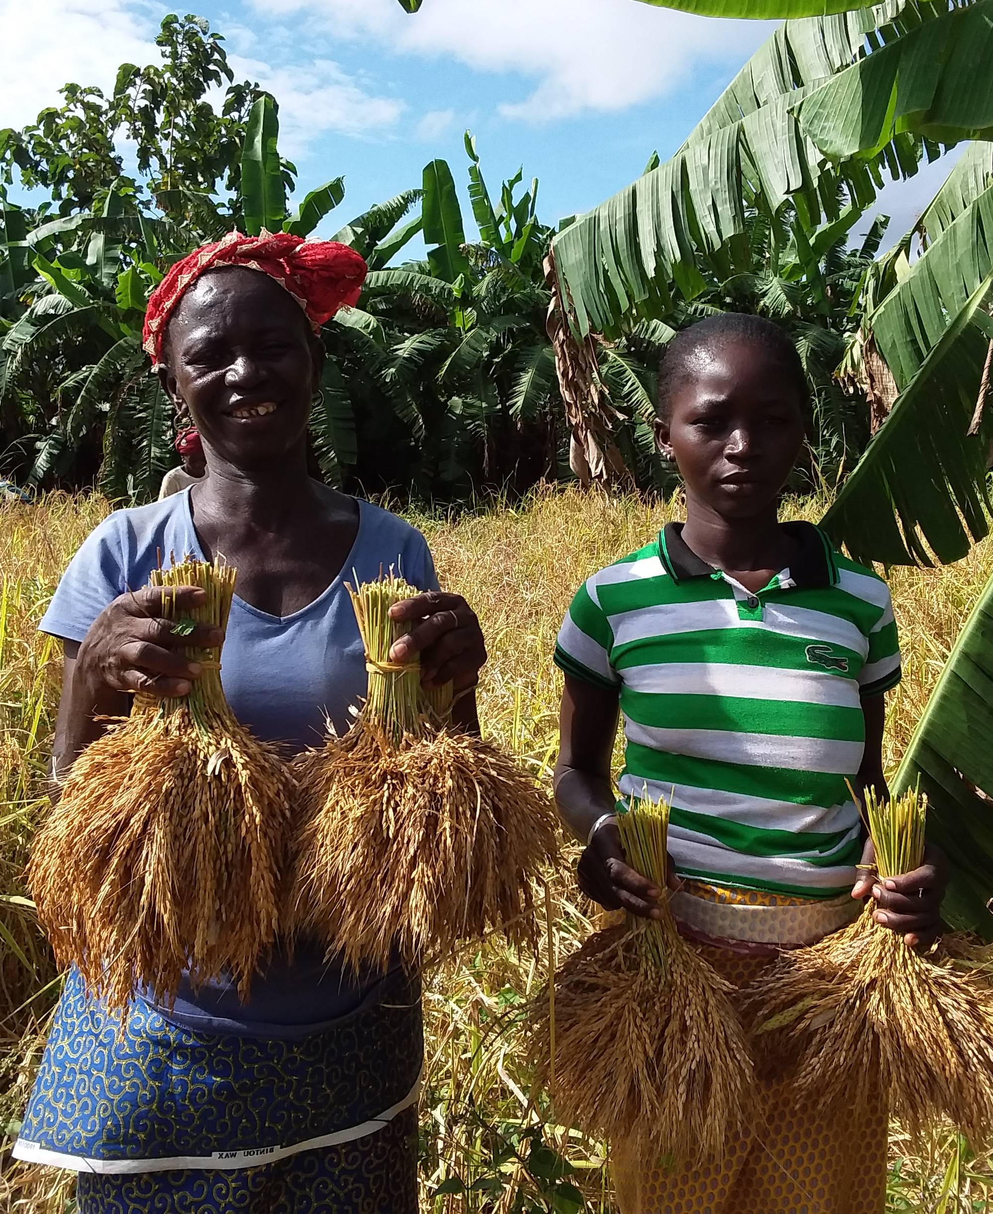
3. China-Africa Rice Value Chain Initiative
Launched in 2021 and funded by UNOSSC
Partners: ADERIZ, AfricaRice, China CoE, CERFAM, CICETE, WFP Côte d’Ivoire
Project objectives: 1) Capacity strengthening for rice local producers, 2) Knowledge and technology exchange between Chinese experts and Ivorian stakeholders, 3) Mechanization of rice production and post-harvest management with machines adapted to local context, 4) Setting up a demonstration sites for other producers in the region
Notes:
The Rice Value Chain project was launched in 2021 and funded by UNOSSC (the United Nation Office for South South Cooperation) . Its objective is to strengthen the capacity of smallholder farmers involved in the rice value chain in Côte d’Ivoire through multi-diversified partnership and to facilitate South-South knowledge-sharing, mutual-learning, as well as technology and expertise transfer in advancing sustainable agriculture and rice value chain development.
Partners:
Aderiz: Agency for rice value chain development
Africa Rice: Research centre
CICETE: China international centre for economic and technical exchanges.
CoE: China Centre of Excellence
CERFAM: Regional Centre of Excellence against Hunger and Malnutrition

Slide 6
4. Challenges in rice value chain in the North of Côte d’Ivoire
Rice production
Rice processing
Distribution
Other challenges
Undevelopped land
Lack of technical itinerary
Deficient upland technique
Mix of different rice variety
Long lean season (from Oct to May)
Insufficiency of raw materials
Difficulty to access to quality inputs
High level of impurity
Existing equipment not
adapted to the context
High soil erosion in some zones
High production cost
Insufficiency of raw materials
Little knowledge of agricultural calendar
Low quality of shelled rice
Limited weather forecast
High level of crack
Non-adaptability of farming land
Poor distribution of rain due to climate change
Lack of quality seeding system
Rice varieties with low yield
Notes:
At the beginning of the project the team conducted a diagnosis of the rice sector. The aim of the diagnosis was to determine the practical modalities for the implementation of activities for the improvement of the rice value chain within groups of women farmers in northern Côte d'Ivoire.
Challenges identified are presented here under various stage of the rice value chain. (explain)
Despite these challenges, strengths were also identified, in particular the potential of available surfaces, the existence of a variety rice seed that has adapted to the conditions on the production side and the existence of a demand or market for the distribution.

Slide 7
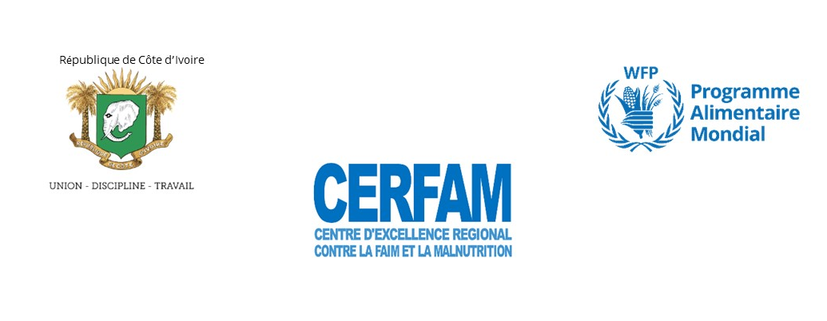
5. Project Timeline (phase1)
2021-2022
Early June
Policy Dialogue on rice value chain with African stakeholders
Mid October
Webinar for exchange between stakeholders/experts in rice value chain
Late November
On-site PHLM training for local stakeholders (Local communities, gov authorities, NGOs)
February 2022
Online training of local stakeholders by Chinese experts
Late April
Visit to a demonstration site established by Chinese experts in CIV
Mid June
Mission to Korhogo for field visit
Mid November
Joint need assessment with AfricaRice and ADERIEZ
Early December
Purchase and installation of harvest and post-harvest equipment
Mid March 2022
Distribution of quality seeds and inputs to target farmer groups

Slide 8
6. FIRST PHASE HARVESTING POINT
N° | Localities | Land caracteristics | Rice seed variety | Planted areas (ha) | Total production (Kg) | Quantities available for their school canteens | Observation
1 | Maranana | Upland rice | Nérica 4 | 5 | 6842 | 823 | Good trend compared to data from the previous campaign, but poor rainfall distribution
 |  | Lowland rice | C26 | 2 | 3106 | 506
2 | Kantara | Upland rice | Nerica 4 | 1 | 1902 | 500 | Good trend compared to data from the previous campaign
 |  | Lowland rice | C 26 | 3 | 11406 | 1500
3 | Pitiangomon | Upland rice | Nerica 4 | 3 | 741 | 0 | Crop damage by animals due to unfenced site
 |  | Lowland rice | C 26 | 5,5 | 4400 | 1500
4 | Nakaha | Lowland rice | C 26 | 2,5 | 2593 | 500 | Good trend compared to data from the previous campaign
 |  | Upland rice | Nerica 4 | 1 | 1504 | 300
TOTAL |  |  |  | 23 | 32494 | 5629

Slide 9
7. POSITIVE CHANGE
Reduction of the hardship of women's work with all the equipment made available to them
Improved rice grain quality (less breakage in rice processing)
Improved knowledge of rice production and post-harvest management
Supplying school canteens with local products

Slide 10
8. Action plan 2nd phase
2023-2024
May - June
Purchase production support equipment, of processing and management of post-harvest losses contract with implementing partner in progress
Late June
Distribution of quality seeds and inputs to target farmer groups
July
Online technical training
by Chinese experts
August
Study and experience-sharing visit to the Guiguidou experimental site with Chinese experts on rice production and post-harvest loss reduction technologies
November
A regional seminar on policies and solutions for rice value chain development to support smallholder market access, production techniques, use of tillers and water led by CERFAM
June Training on the Rice Value Chain in Korhogo by Chinese experts in CIV
June Study visit to China
September
Presentation of the Results at the International Exhibition of Agriculture and Animal Resources of Abidjan (SARA) in Côte d'Ivoire
September
Study visit and experience sharing with AfricaRice on water control and management techniques
December National review workshop
March 2024 Publication of lessons learned (video and brochures)
Notes:
On this slide you can see the main steps of the project:

Slide 11
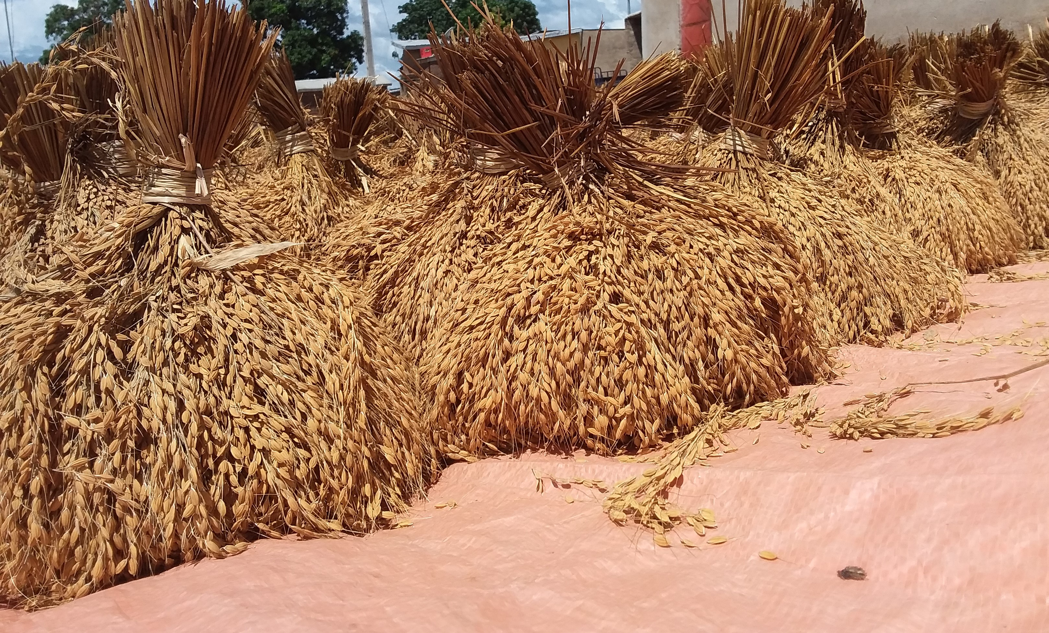
9. Recommendations
Continue similar initiatives aimed at increasing production and modernizing the rice value chain
Continue to develop inclusive value chains
Scaling up the project

Slide 12
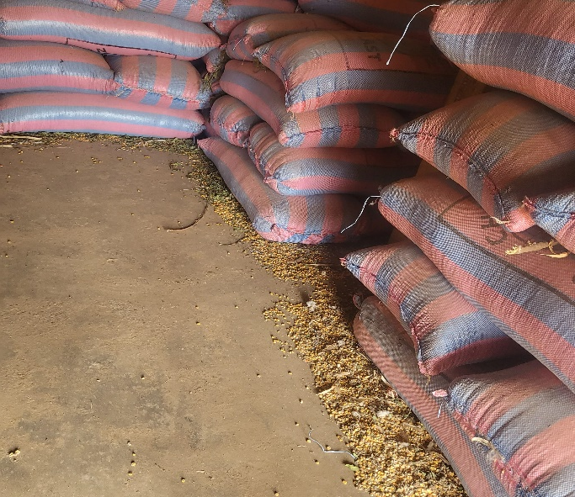
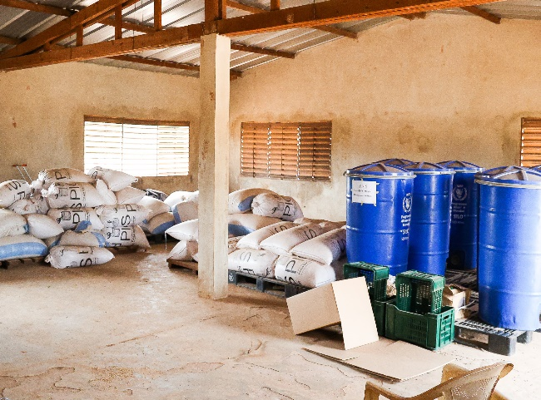
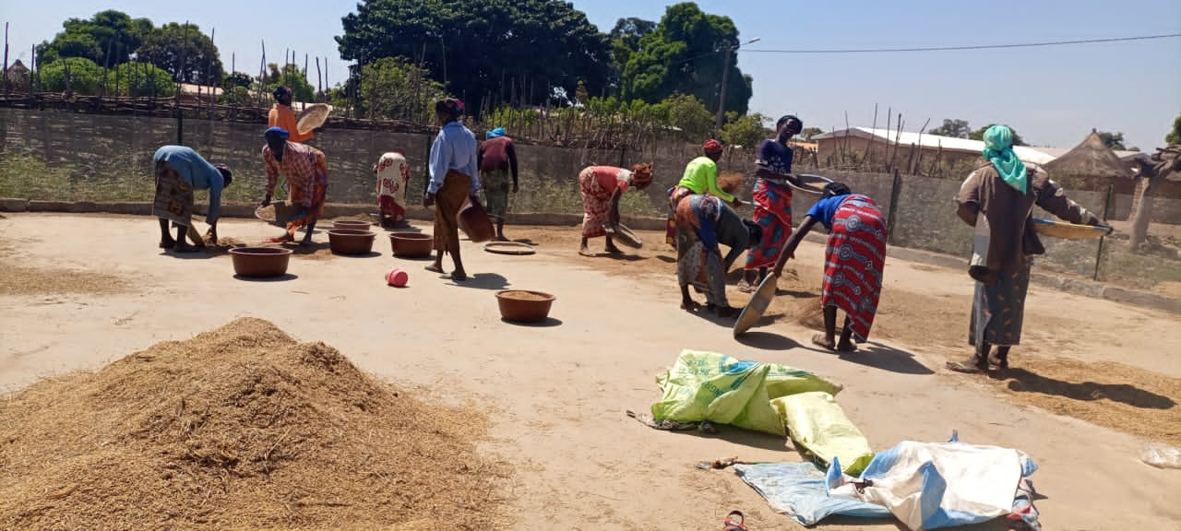
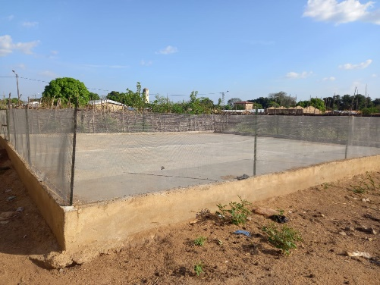
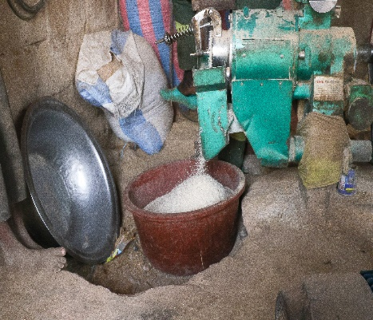
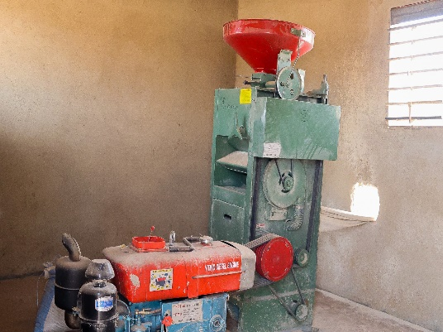
Some field photos
Warehouses of the Nakaha group with some silos
Image of the warehouse in Sissèdougou with products stored on the ground.
Using the Maranama Drying Yard
A sample of drying area with fence Maranama
Milled rice using the Maranama huller
Paddy rice hulling machine of Nakaha

Slide 13
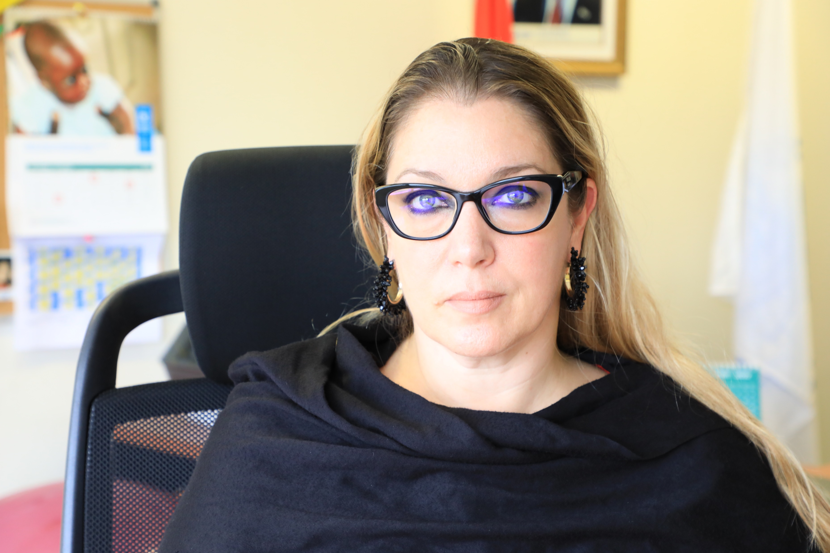
Message of thanks giving from Mrs Olivia HANTZ, Director and Representative of WFP Côte d'Ivoire

Slide 14
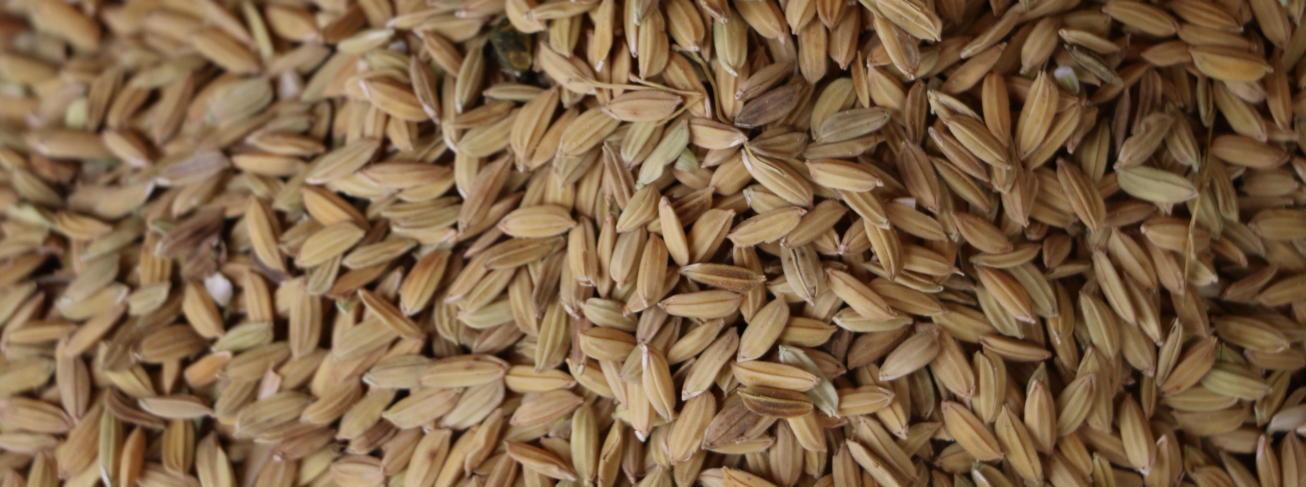
Thank you for your attention

