Slide 1
Post –Harvest Loss Management-Botswana
Name: Godfrey Rantshabeng
Organization: Botswana Agricultural Marketing Board
Position: Head of Supply Chain
SEMINAR ON POST-HARVEST LOSS MANAGEMENT 粮食减损国际研讨会

Slide 2
Content
Introduction-Botswana Agricultural Marketing Board
Overview of Post-Harvest in Botswana
Harvest loss- Storage
Harvest loss-Processing
Opportunities in China
河南·开封
2023年9月25日
SEMINAR ON POST-HARVEST LOSS MANAGEMENT 粮食减损国际研讨会

Slide 3
Botswana Agricultural Marketing Board
Fully owned by the Government of Botswana
Mandated to provide market for locally grown crops
Custodian of the Strategic Grain Reserve of the Country
Facilitate farming (distribution of implements and advisory)
河南·开封
2023年9月25日
SEMINAR ON POST-HARVEST LOSS MANAGEMENT 粮食减损国际研讨会

Slide 4
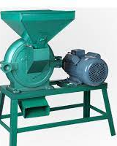
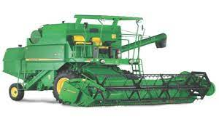
Overview of Post-Harvest in Botswana
Millers
Ploughing
Harvest
Storage
Consumer
河南·开封
2023年9月25日
SEMINAR ON POST-HARVEST LOSS MANAGEMENT 粮食减损国际研讨会

Slide 5
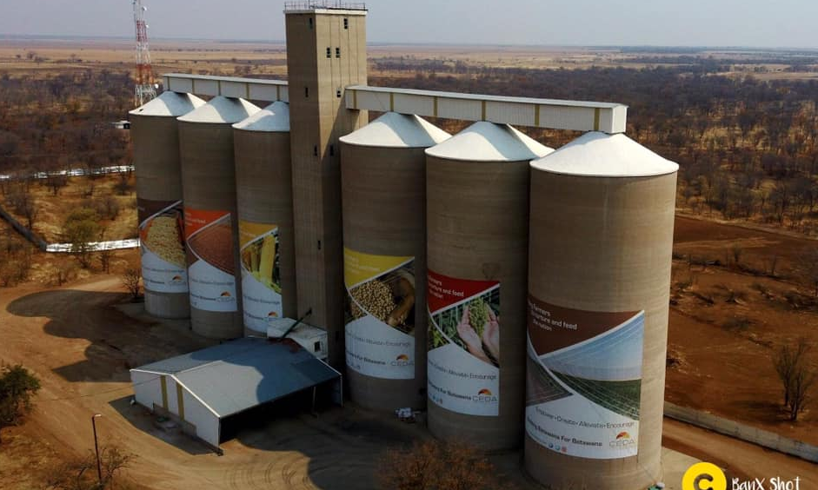
Post Harvest Loss-Storage
5000MT BAMB Grain Storage in Pandamatenga, Botswana
河南·开封
2023年9月25日
SEMINAR ON POST-HARVEST LOSS MANAGEMENT 粮食减损国际研讨会

Slide 6
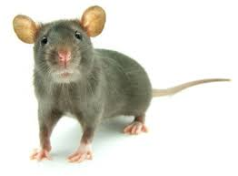
Common Storage Challenges
Pests
Birds
Risk of Salmonella
Weevils/Insects
Molds, damage grain
Rats/Mice/Rodents
Risk of Hantavirus
河南·开封
2023年9月25日
SEMINAR ON POST-HARVEST LOSS MANAGEMENT 粮食减损国际研讨会

Slide 7
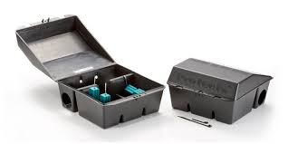
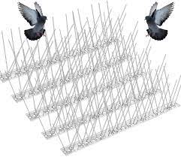
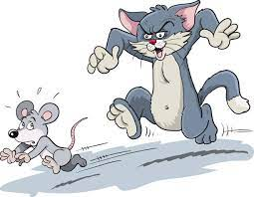
How to protect grain from Pests
Fumigation
Birds Deterrent
Mouse Traps and deterrents
河南·开封
2023年9月25日
SEMINAR ON POST-HARVEST LOSS MANAGEMENT 粮食减损国际研讨会

Slide 8
Pilferage
Unauthorized withdrawal or consumption of grain for personal use
河南·开封
2023年9月25日
SEMINAR ON POST-HARVEST LOSS MANAGEMENT 粮食减损国际研讨会

Slide 9
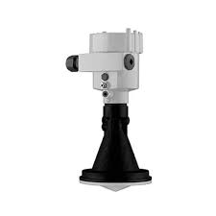
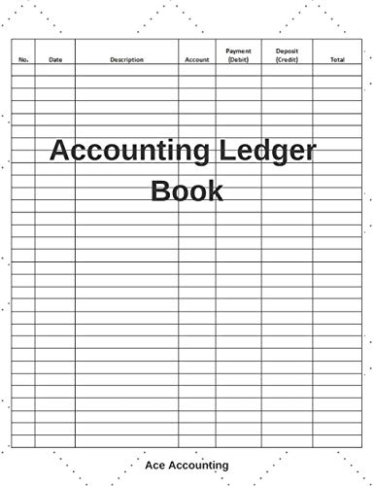
Pilferage Deterrent
3D level Sensors
Personnel monitoring
Accurate Accounting
Regular Stock count
#Automatic Silo Management System-Holistic remote reporting mechanism
河南·开封
2023年9月25日
SEMINAR ON POST-HARVEST LOSS MANAGEMENT 粮食减损国际研讨会

Slide 10
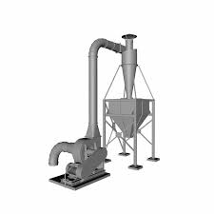
Quality
Dust
Moisture/Water
Aeration
Caking
Molds
Dust extraction-habors weevils
Aeration-Keeps grain cool, prohibits caking, frustrates weevils
Moisture monitoring
河南·开封
2023年9月25日
SEMINAR ON POST-HARVEST LOSS MANAGEMENT 粮食减损国际研讨会

Slide 11
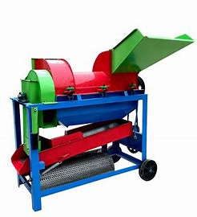
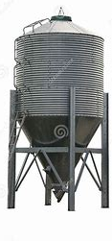
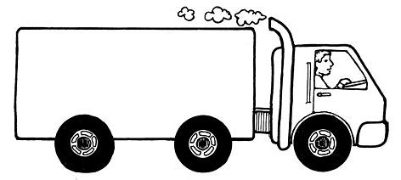
Overview of Post-Harvest Loss -Processing
Milling Process
Points to Note:
Labor intensive
Weighing Human errors
Dehulling human errors
Not efficient
Loss of grain
Loss of time
Loss on bran (25%)
Bran
Storage
Dehulled grain
dehuller
Hammer mill
Logistics
Manual scale and bagging
Consumer
河南·开封
2023年9月25日
SEMINAR ON POST-HARVEST LOSS MANAGEMENT 粮食减损国际研讨会

Slide 12
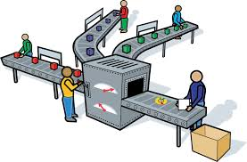
Opportunities in China
Financial Assistance
Mentorship Programmes
Technology
Market opportunities
Local Partnership Productions
河南·开封
2023年9月25日
SEMINAR ON POST-HARVEST LOSS MANAGEMENT 粮食减损国际研讨会

Slide 13
河南·开封
2023年9月25日
SEMINAR ON POST-HARVEST LOSS MANAGEMENT 粮食减损国际研讨会

