Slide 1
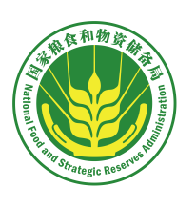
Food Quality and Safety Standards and Regulation in China
Vice President and Secretary-General of Chinese Cereals and Oils Association
Wang Lirong Senior Engineer
August 2020

Slide 2
Contents
China's Food Security Challenges
I
China's Food Quality and Safety Standards
II
China's Regulation of Food Quality and Safety
III

Slide 3
China's Food Quality and Safety Standards
01 Connotation and Denotation of Food Quality and Safety Standards
02 Food Quality and Safety Standards Management System and Mechanism
03 Current Situation and Reform of Food Quality and Safety Standards
04 Participation in International Food Quality and Safety Standardization Efforts

Slide 4
03
Current Situation and Reform of Food Quality and Safety Standards
Food standards are the basis of food production and quality control, which fundamentally ensure food security and safety.
Increase food supply
Increase the diversity of cereals
Ensure food safety
Improve Chinese people's nutritional status
Promote international trade
Notes:
Three categories: mycotoxins, heavy metal pollution, pesticide residue.

Slide 5
The standards cover the whole process of food production and circulation.
03
Current Situation and Reform of Food Quality and Safety Standards
Production
Unprocessed Grain
Imports and exports
Purchase
Oilseeds
Food Standards System
Sales
Storage
Processed Grain and Oil and their Products
Processing

Slide 6
Reform of national standardization efforts
03
Current Situation and Reform of Food Quality and Safety Standards
Old law
New Law
The standards mainly cover the secondary industry.
The standards were expanded to cover the primary, secondary and tertiary industry, and social undertakings (Article 2).
Scope of standards expanded

Slide 7
Reform of national standardization efforts
03
Current Situation and Reform of Food Quality and Safety Standards
Old law
New Law
Association standard was not included in the standard system.
China encourages social organizations such as institutes, associations, chambers of commerce, federations and industrial technological alliances to jointly formulate association standards with relevant market entities to meet market needs and support innovation (Article 18).
Legalization of association standards

Slide 8
Reform of national standardization efforts
03
Current Situation and Reform of Food Quality and Safety Standards
Standards are formulated by government only
Standards are formulated by government and market entities
A
B
Unitary structure
Dual
structure
China's supply system of standards was changed as association standards came along

Slide 9
03
Current Situation and Reform of Food Quality and Safety Standards
Original Standard System
New Standard System
Compulsory standards：national, industrial and local standards.
Recommendatory standards： national,industrial and local standards.
Compulsory standards：national standards.
Recommendatory standards： national, industrial and local standards.
Government-led formulation
Government-led formulation
Formulated by non-government entities independently
Enterprise standards
Association standards
Enterprise standards

Slide 10
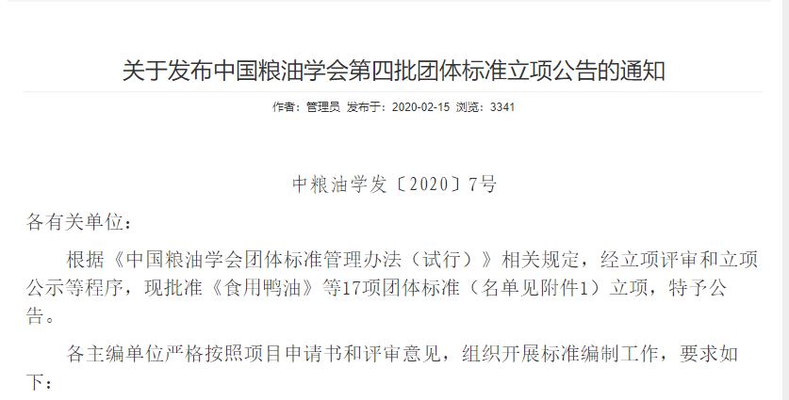
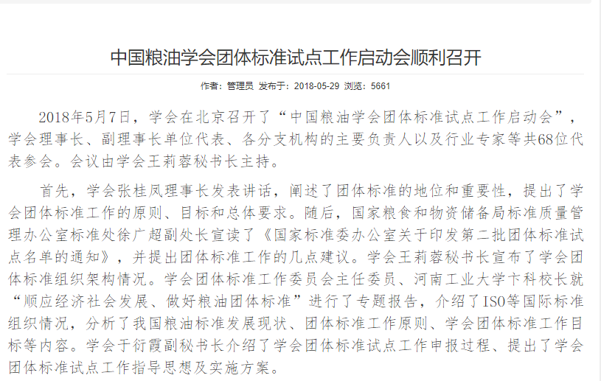
The China Cereals and Oils Association was recommended as one of the second batch of units to pilot the formulation of the market-oriented association standards for grain, which would complement national standards and industrial standards.
03
Current Situation and Reform of Food Quality and Safety Standards
Notice on the Announcement of the Fourth Batch of Approved Proposals for Association Standards Formulation by China Cereals and Oils Association
Chinese Cereals and Oils Association holds kick-off meeting for piloting the formulation of association standards
Increased supply of standards

Slide 11
Highlights of the reform of national standardization efforts
03
Current Situation and Reform of Food Quality and Safety Standards
Emphasizing the
bottom line
by enhancing
compulsory standards
Meeting market needs
by introducing flexible
association standards
A
B
Promoting technological advances
by encouraging stricter
enterprise standards
C
Number of categories of standards formulated mainly by government were reduced from 6 to 4, while that of those formulated by non-government entities independently were increased from 1 to 2.

Slide 12
03
Current Situation and Reform of Food Quality and Safety Standards
Fully implement the system where enterprises must declare their self-formulated product or services standards and put such standards under supervision of authorities concerned
Release enterprise standards rankings
It's receommended to implement the system where enterprises whose self-formulated service or product standards contain industry-leading core indicators are recognized as an “Enterprise Standards Front Runner”.
Explore the establishement of a fast track system for enterprise's self-formulation of standards
Improve the public service platform for enterprise standards information
Unleash the potential of enterprise standards

Slide 13
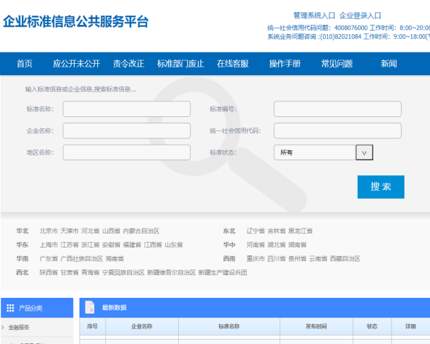
03
Current Situation and Reform of Food Quality and Safety Standards
Time-consuming filing process
More burden for enterprises
Enterprises who formulated standards themselves did not comprehensively assume their primary responsibility for standardization efforts the way they should.
Problems with
the old system
After reform
More than 1.26 million standards for more than 2 million products have been disclosed by more than 270 thousand enterprises.
Streamlined process

Slide 14
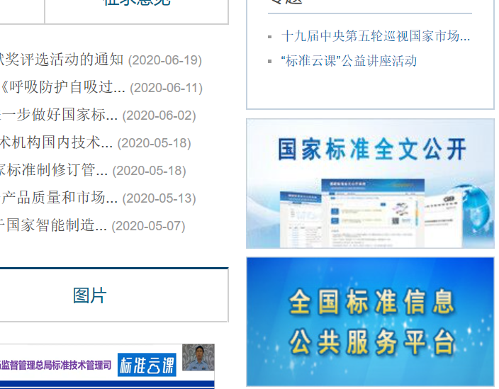
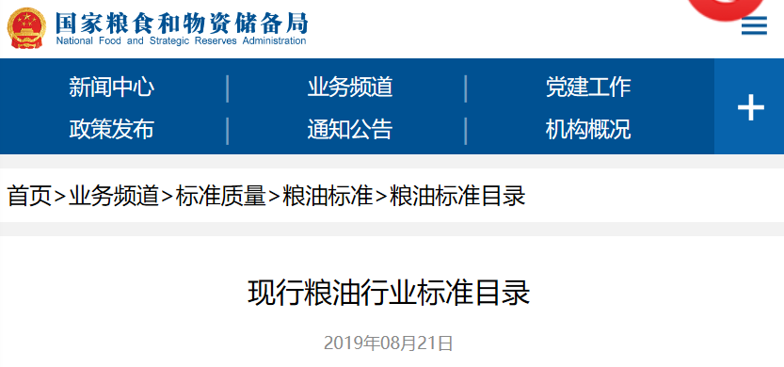
03
Current Situation and Reform of Food Quality and Safety Standards
Full texts of national standards can be accessed at the website of the Standardization Administration of China http://www.sac.gov.cn/
Full texts of industrial grain standards can be accessed at the website of National Food and Strategic Reserves Administration http://www.lswz.gov.cn/
Free access to standards for public good
Public access to national standards
National
Public Service Platform for Standards Information
Home page > Business > Standard & Quality > Grain and Oil Standards > Catalogue of Grain and Oil Standards
Catalogue of Current Grain and Oil Standards

Slide 15
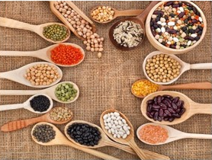
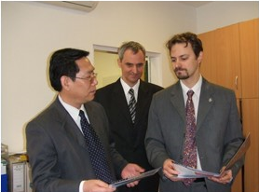
04
Participation in International Food Quality & Safety Standardization Efforts
National Food and Strategic Reserves Administration (NFSRA, formerly the State Administration of Grain(SAG)) has participated in international standardization activities ..
ISO/TC34/SC4
International Standardization Organization / Technical Committee 34 - Food Products / Sub-Committee 4 - Cereals and Pulses
Since December 2006, the NFSRA Standard and Quality Center (formerly the SAG Standard and Quality Center) has served as SC4's secretariat in China, which is the first ISO secretariat in China in the field of agriculture.
Bian Ke, President of Henan University of Technology, was the first chairman of SC4.
A new chapter of international food standardization efforts was unveiled since then.
The job handover in Hungary concerning the work of SC4.

Slide 16
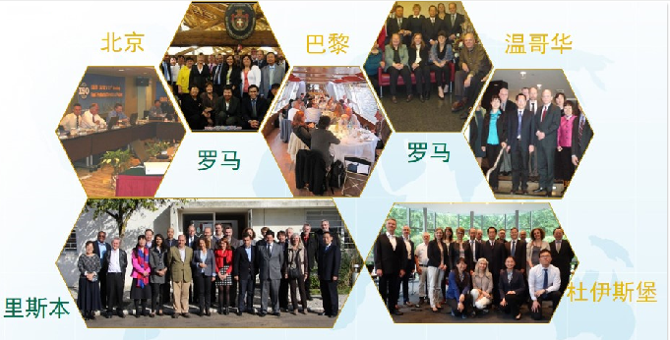
04
Participation in International Food Quality and Safety Standardization Efforts
NFSRA's (formerly SAG) participation in international food quality and safety standardization activities
Beijing
Paris
Vancouver
Rome
Rome
Lisbon
Duisburg
The NFSRA (formerly SAG) hosted 9 successful annual meetings.

Slide 17
04
Participation in International Food Quality and Safety Standardization Efforts
Scope of ISO/TC34/SC4's standardization efforts
Cereals, pulses and their products
Termimology, sampling, product specifications, testing methods, storage, transportation, etc.

Slide 18
04
Participation in International Food Quality and Safety Standardization Efforts
Eliminate technical barriers and promote global fair trade
Improve food quality and safety
Increase the consumption of cereals and pulses
Targets
Improve global nutritional status
Advance food testing technology
Ensure a sustainable food supply
Targets of ISO/TC34/SC4's standardization efforts

Slide 19
04
Participation in International Food Quality and Safety Standardization Efforts
ISO/TC34/SC4's management structure
ISO Technical Management Board
Technical Committee 34 - Food Products
Sub-Committee 4 - Cereals and Pulses
Nomenclature and Vocabulary Working Group
Amylose in Rice Working Group
Colorimetric Analysis Working Group
Maize Working Group
Mycotoxin Working Group
International grain trade organizations
Cross-border grain enterprises
Grain instrument manufacturers
Grain testing labs
Research institutions
Standardization bodies

Slide 20
04
Participation in International Food Quality and Safety Standardization Efforts
ISO/TC34/SC4's standard sytem
62 standards
Basic standards
Product standards
Method standards
Sampling standards
Storage standards
Specifications for durum wheat
Testing of basic quality indicators
Sampling rules
Guides and specifications
Terminology
Wheat specifications
Rice specifications
Testing of safety indicators
Monitoring of condition of grain in storage
Vocabulary
Testing of indicators of features for quality grading purpose

Slide 21
04
Participation in International Food Quality and Safety Standardization Efforts
ISO/TC34/SC4's standard system
2 basic standards
3 product standards
3 standards for pulses
2 standards for maize and sorghum
1 sampling standard
7 standards for rice
29 universal test methods
8 storage standards
48 method standards
21 standards for wheat and Durum wheat

Slide 22
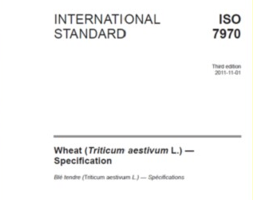
04
Participation in International Food Quality and Safety Standardization Efforts
The NFSRA led the revision of ISO 7970 Wheat (Triticum aestivum L.) -Specification.
ISO 7970 Wheat (Triticum aestivum L.) -Specification
The NFSRA led the revision of ISO 7970 Wheat (Triticum aestivum L.) — Specification, leading to the release of ISO 7970:2011. It's the first agricultural standard whose revision was led by China.

Slide 23
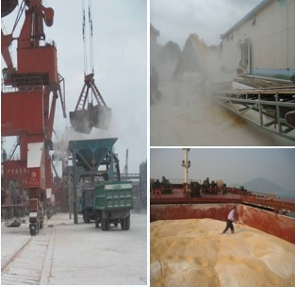
04
Participation in International Food Quality and Safety Standardization Efforts
From 2011 to 2013,China's maize imports surged. However, trade disputes and port safety issues frequently occurred due to high impurity content and other quality problems.
Due to the absence of an internationally accepted maize quality standard, there were no basis for establishing quality indicators in trade contracts.
In 2014, the proposal for formulating ISO 19942:2018 put forward by the then State Administration of Grain was approved by ISO. It was the first time China had led the formulation of an international standard.
ISO 19942:2018 Maize (Zea mays L.) — Specification, formulated under the leadership of the then SAG

Slide 24
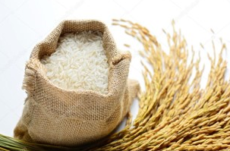
04
Participation in International Food Quality and Safety Standardization Efforts
NFSRA led the revision of ISO 6646: 2000, which resulted in ISO 6646:2011 Rice — Determination of the potential milling yield from paddy and from husked rice, providing a universal method for the determination of the yield of husked rice and of milled head rice.
NFSRA led the revision of ISO 15141-1:1998 and ISO 15141-2:1998, which resulted in ISO 15141:2018 Cereals and cereal products — Determination of ochratoxin A.During the revision, immunoaffinity columns made in China were used in international ring tests. This standard is now in the drafting stage.
Other international standard revisions led by China

Slide 25
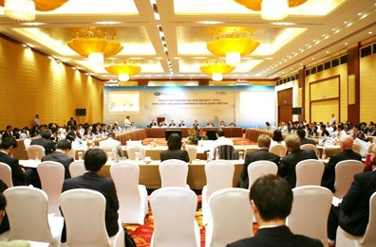
04
Participation in International Food Quality and Safety Standardization Efforts
During APEC China 2014, representatives of the then SAG chaired a series of APEC Policy Partner on Food Security meetings and the then SAG was an organizer of the meetings.
The then SAG came up with proposals such as "step up grain quality management and improve the grain traceability system " and "encourage regional standardization efforts to facilitate grain trade in the Asia-Pacific region", which were improved in meetings held in Ningbo, Qingdao and Beijing later and accepted by various economies. As a result, the Action Plan to Enhance Connectivity of APEC Food Standards and Safety Assurance was formulated, which is a fruit and an initiative included in the 22nd APEC Economic Leaders' Declaration.
Connectivity of APEC Food Standards

Slide 26
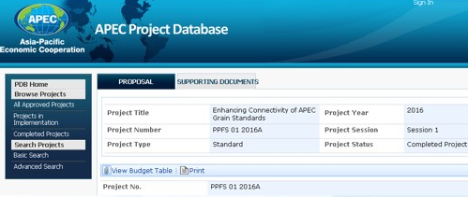
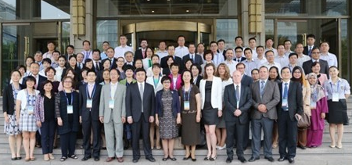
04
Participation in International Food Quality and Safety Standardization Efforts
In July 2016, the APEC Budget and Management Committee approved China's project of "Enhancing Connectivity of APEC Grain Standards".
In August 2016, the 2016 PPFS Seminar on Enhancing Connectivity of APEC Grain Standards was held in Beijing.
Connectivity of APEC Food Standards

Slide 27
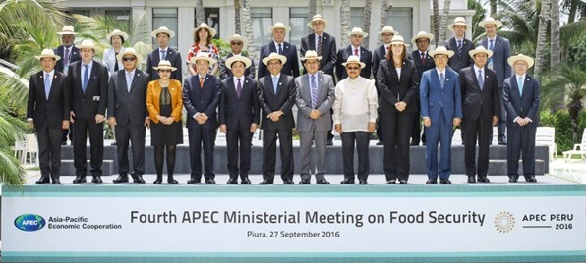
04
Participation in International Food Quality and Safety Standardization Efforts
In September 2016, the Fourth APEC Ministerial Meeting on Food Security was held in Piura, Peru. The food standard initiative put forward in the Beijing Meeting was included as an outcome in Article 25 of the Piura Declaration on Food Security: We value initiatives to enhance food standards connectivity... and will deepen mutual understanding and push forward the cooperation to facilitate food trade and raise regional food security within APEC economies.
Connectivity of APEC Food Standards

Slide 28
T
HANK YOU!

