Slide 1
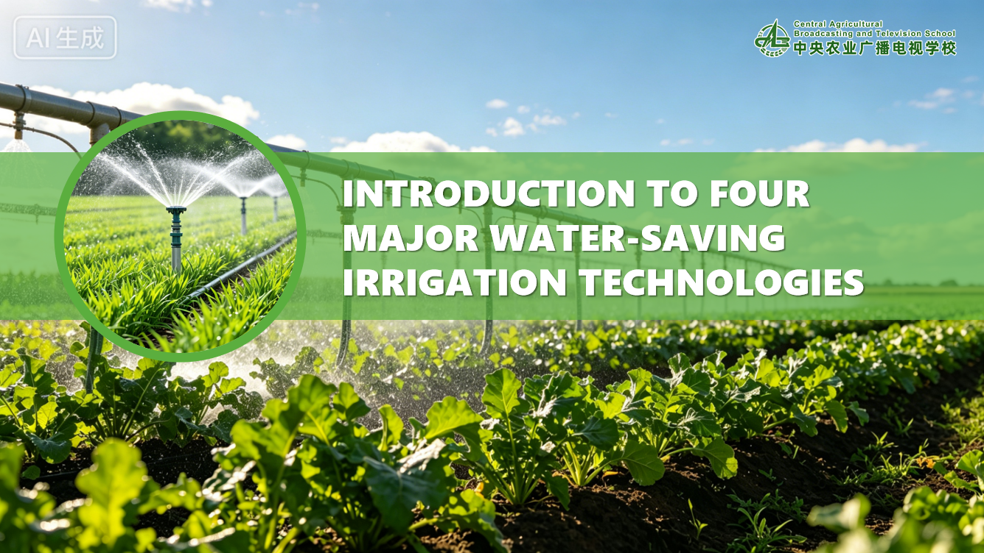

Notes:
四大节水灌溉技术介绍
Introduction to Four Major Water-Saving Irrigation Technologies

Slide 2

PART.04
Tidal Irrigation Technology
Notes:
4.潮汐灌溉技术
PART 4.Tidal Irrigation Technology

Slide 3
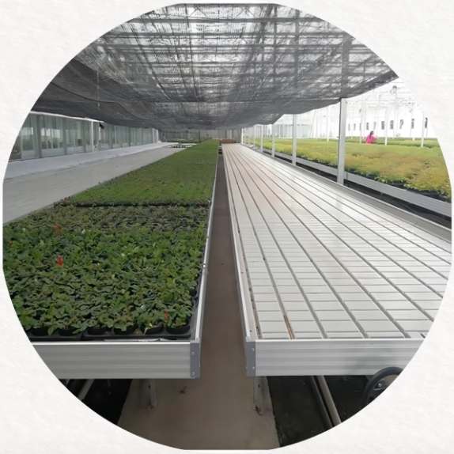
1. What is Tidal Irrigation?
Concept
  A high-efficiency, water-saving irrigation system that artificially simulates the ebb and flow of natural tides.
Core Method
  Uses a bottom-watering irrigation method tailored for nutrient-solution cultivation and container-based seedling production.
Key Outcome
  Effectively improves the utilization efficiency of water and nutrient solutions.
Notes:
（一）什么是潮汐灌溉
潮汐灌溉是基于潮水涨落原理而设计的一种高效节水灌溉系统，是针对盆栽植物的营养液栽培和容器育苗所设计的底部给水灌溉方式，可有效提高水资源和营养液的利用效率。
4.1.What is Tidal Irrigation?
Tidal irrigation is a high-efficiency water-saving irrigation system that artificially simulates the ebb and flow of natural tides.
It uses a bottom-watering irrigation method tailored for nutrient-solution cultivation and container-based seedling production,
effectively improving the utilization efficiency of water and nutrient solutions.

Slide 4
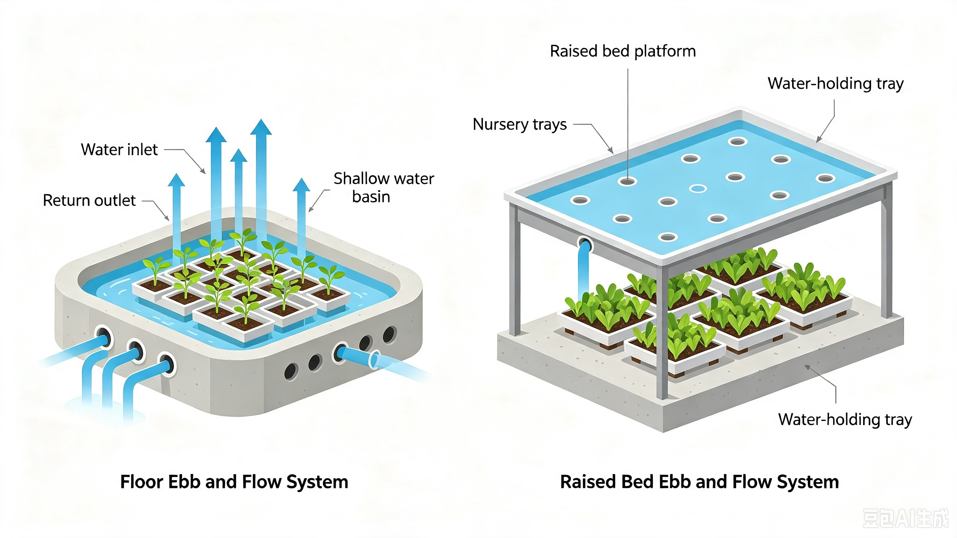
2. Classification of Tidal Irrigation
Two categories
  Ground-based tidal irrigation system.
  Bench-based tidal irrigation system.
Ground-Based Tidal Irrigation System
  A flat water-storage tank similar to a seedling tray is constructed on the ground.
  Multiple water-outlet and return holes are prearranged inside the tank ➜ for water supply and drainage.
Bench-Based Tidal Irrigation System
  Large water-storing seedling trays are installed on seedling benches (elevated cultivation platforms).
  = dedicated units designed to store nutrient solutions and enable tidal irrigation.
  With pre-arranged water-outlet and return holes on the tray surface.
Notes:
（二）潮汐灌溉分类
常见的潮汐灌溉主要分为两类，即地面式和植床式。
1.地面式潮汐灌溉系统：在地表砌筑一个外形扁平如育苗托盘的蓄水池（即苗盘装水池），并在水池中设置若干出水孔和回水孔。
2.植床式潮汐灌溉系统：在苗床（指高出地面的栽培设施平台）上搭建出一层大面积的蓄水苗盘（即架设于苗床上、可蓄留营养液并实现潮汐灌溉的专用托盘），盘面预留出水孔和回水孔。
4.2.Classification of Tidal Irrigation
Common tidal irrigation systems are mainly divided into two categories:
ground-based type type.
and bench-based
4.2.1.Ground-based tidal irrigation system
A flat water-storage tank similar to a seedling tray is constructed on the ground.
Multiple water-outlet and return holes are prearranged inside the tank for water supply and drainage in tidal irrigation.
4.2.2. Bench-based tidal irrigation system
In this bench-based tidal irrigation system,
large water-storing seedling trays are installed on seedling benches (elevated cultivation platforms). These trays are dedicated units designed to store nutrient solutions and enable tidal irrigation,
with pre-arranged water-outlet and return holes on the tray surface.

Slide 5
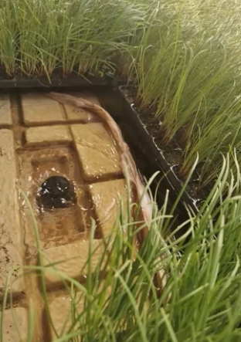
3. Approaches for the Implementation of Tidal Irrigation Technology
Operation Flow of Tidal Irrigation System
Water Filling Phase
  Irrigation water/ prepared nutrient solution overflows from water-outlet holes.
    ➜ Slowly raising the water level inside the seedling bed to an appropriate height.
  Submerge the cultivation bed to a depth of 2–3 cm.
Capillary Absorption Phase
  Timing: retention period of approximately 10–15 minutes.
  Action: nutrient solution is drawn upward through the growing medium via capillary action, wetting the root zone.
  Drainage Phase
  Backwater holes are opened to discharge the nutrient solution back into the nutrient-solution tank.
  Reuse Phase
  The recycled solution can be delivered again when other cultivation beds require irrigation.
Notes:
（三）潮汐灌溉技术实现路径
在应用时，灌溉水或配比好的营养液由出水孔漫出，使整个苗床中的水位缓慢上升并达到合适的液位高度，将栽培床淹没2-3cm的深度。在保持约10-15分钟后，营养液由毛细作用而上升至盆中介质的表面。此时打开回水口，将营养液排出退回营养液池，待另一栽培床需水时，再将营养液送出。
4.3.Approaches for the Implementation of Tidal Irrigation Technology
During operation,
irrigation water or prepared nutrient solution overflows from the water outlet holes, slowly raising the water level inside the seedling bed to an appropriate height
and submerging the cultivation bed to a depth of 2 to 3 centimeters.
During a retention period of approximately 10–15 minutes,
the nutrient solution is drawn upward through the growing medium via capillary action, wetting the root zone.
Afterwards,
the backwater holes are opened to discharge the nutrient solution back into the nutrient solution tank.
The recycled solution can be delivered again when other cultivation beds require irrigation.

Slide 6
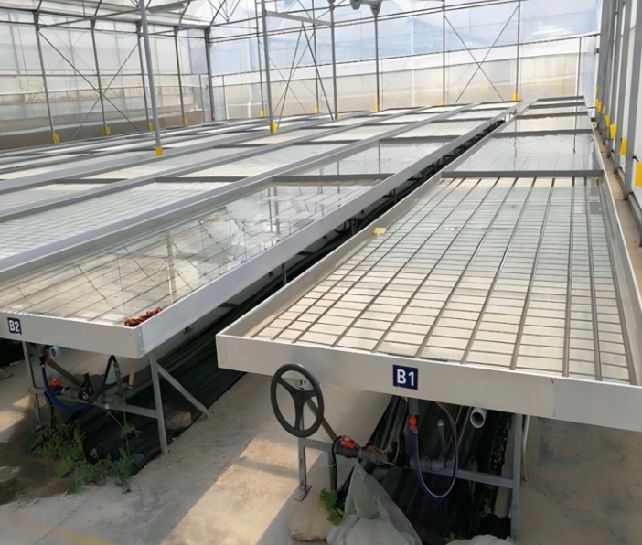
3. Approaches for the Implementation of Tidal Irrigation Technology
Key Features of Tidal Irrigation System
Nutrient Solution Adjustment
  Equipped with devices ➜ to adjust pH and nutrient concentrations of the nutrient solution.
Contamination Control
To prevent excessive contamination of the solution, the system includes:
    Media-filtration units.
    Disinfection units.
Cost Consideration
Bench-based tidal irrigation systems require specially elevated cultivation beds.
The equipment costs are relatively high.
Notes:
潮汐灌溉系统具有调整营养液pH值和各种养分浓度的设备。为避免营养液过度污浊，系统还增加了介质的过滤系统和消毒系统。植床潮汐灌溉系统都须使用架高的特制栽培床，所以相对应的设备费用也较高。
The tidal irrigation system is
equipped with devices to adjust the pH value
and nutrient concentrations of the nutrient solution.
To prevent excessive contamination of the solution,
the system is additionally fitted with media-filtration
and disinfection units.
Since bench-based tidal irrigation systems require specially elevated cultivation beds,
the corresponding equipment costs are relatively high.

Slide 7
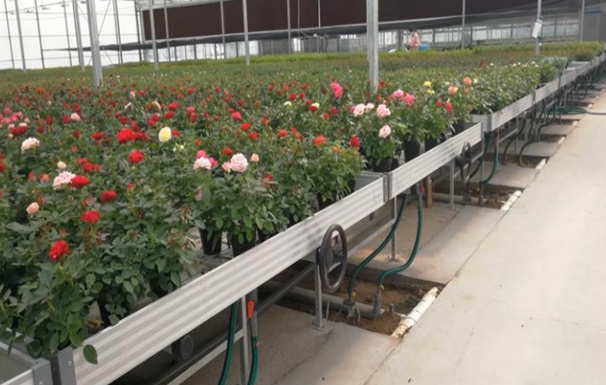
4. Precautions for Tidal Irrigation Application
Nutrient Solution & Sanitation
  Constantly monitor electrical conductivity (EC) and pH of nutrient solution.
  Conduct regular disinfection treatment.
Environmental Conditions
Water temperature needs to be monitored during high-temperature and low-temperature seasons.
Prevent diseases and pests and maintain good ventilation.
Installation Requirements
Follow standardized construction procedures during the installation of tidal irrigation facilities.
Notes:
（四）潮汐灌溉应用注意事项
潮汐灌溉，需要时刻注意电导率和pH值，并注意消毒处理；在高温或低温季节，还要监测水温；还应当注意病虫害防治，加强通风管理；注意潮汐灌溉施工时的标准性。
4.4.Precautions for Tidal Irrigation Application
For tidal irrigation,
operators should constantly monitor the electrical conductivity (EC) value and pH value of the nutrient solution
and conduct regular disinfection treatments.
Water temperature also needs to be monitored during high-temperature and low-temperature seasons.
In addition, it is essential to
prevent diseases and pests and to maintain good ventilation within the facilities.
Standardized construction procedures should also be followed during the installation of tidal irrigation facilities.

