Slide 1
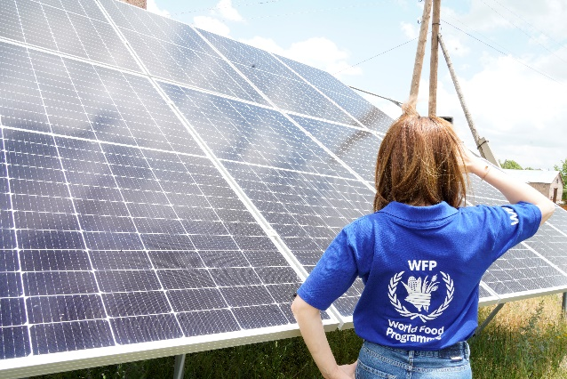
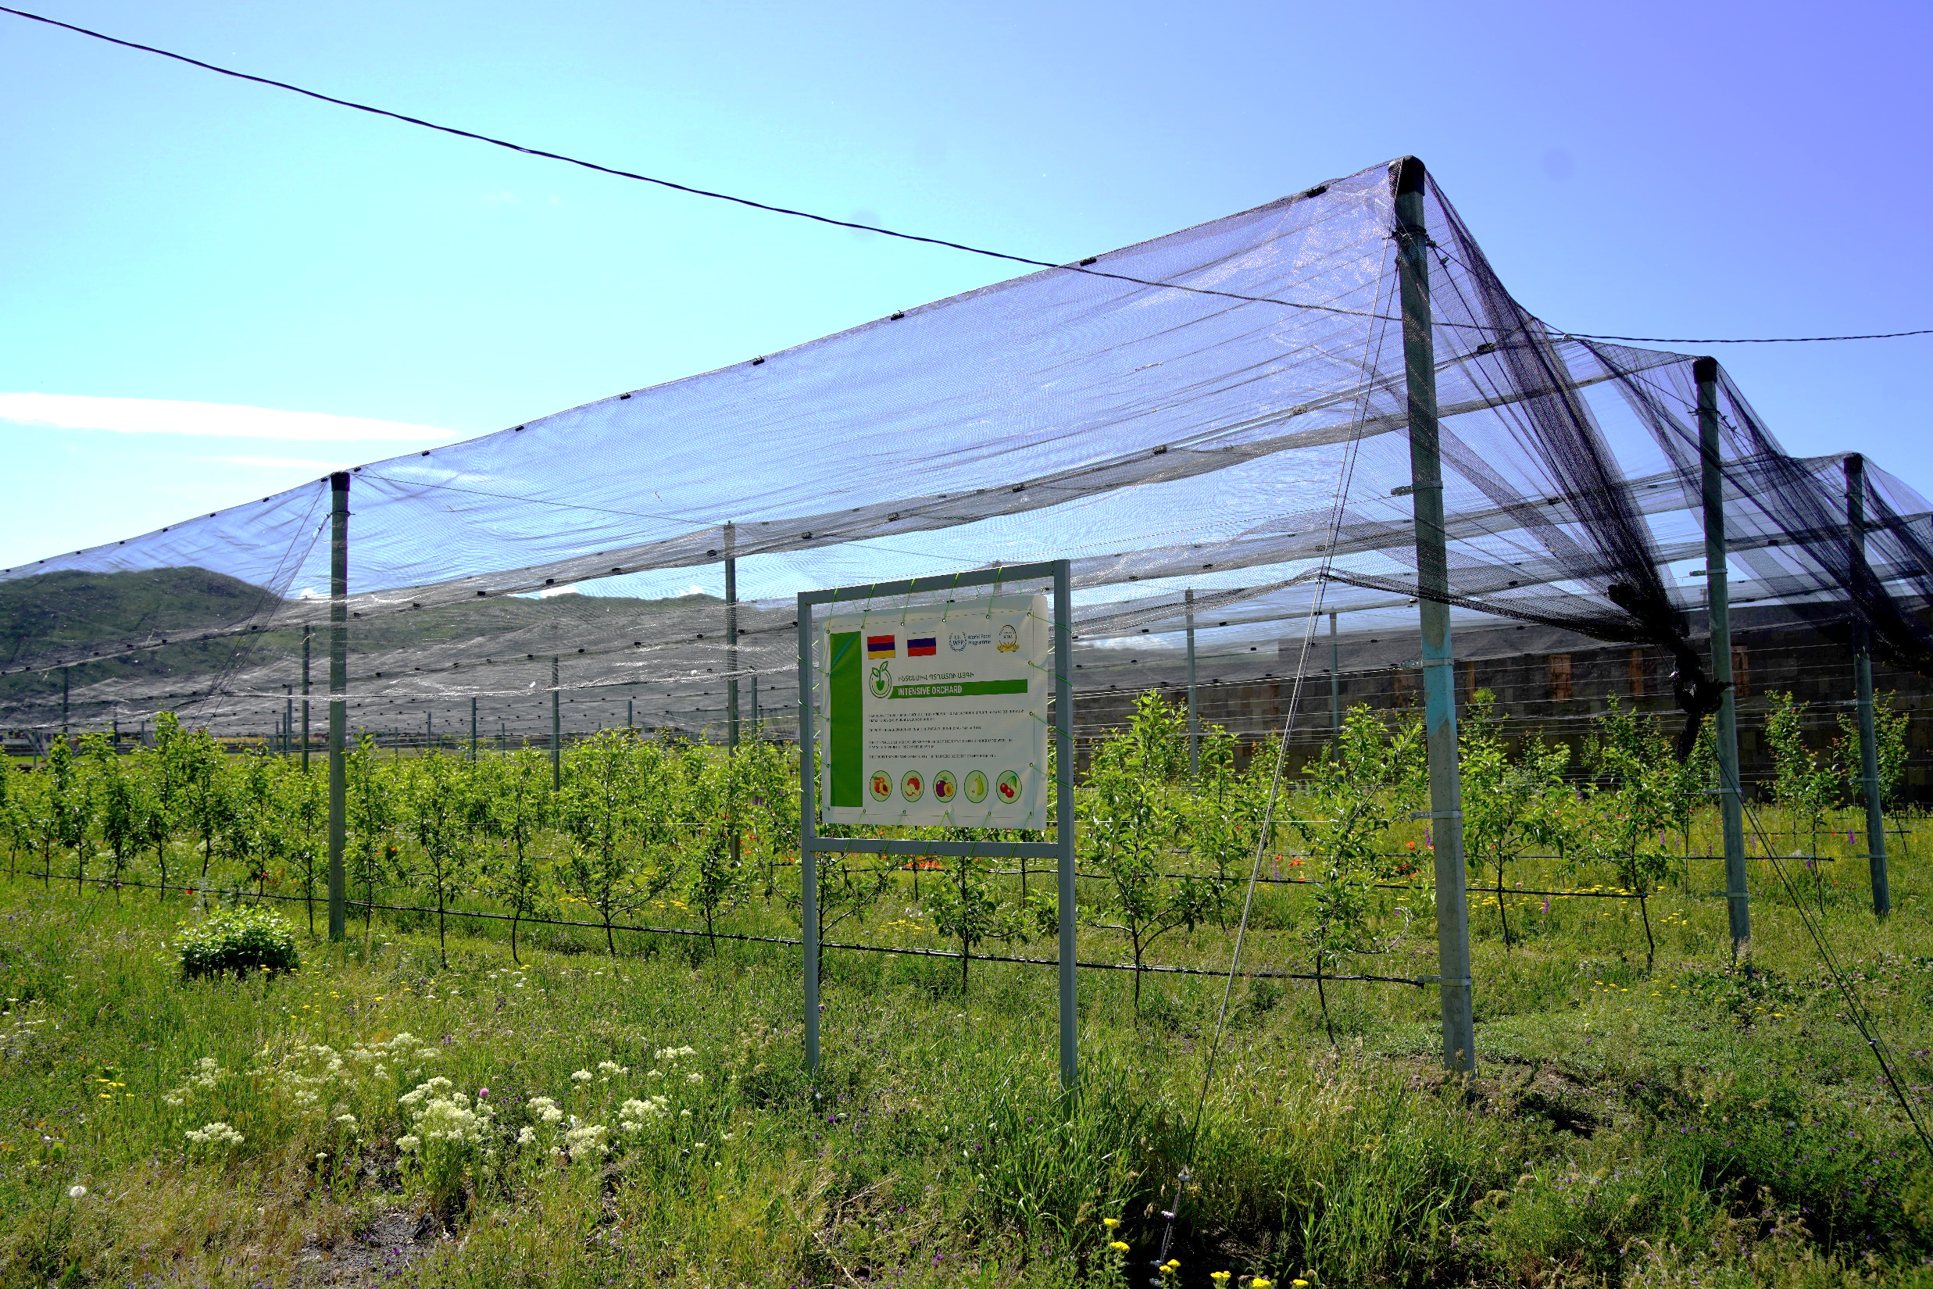
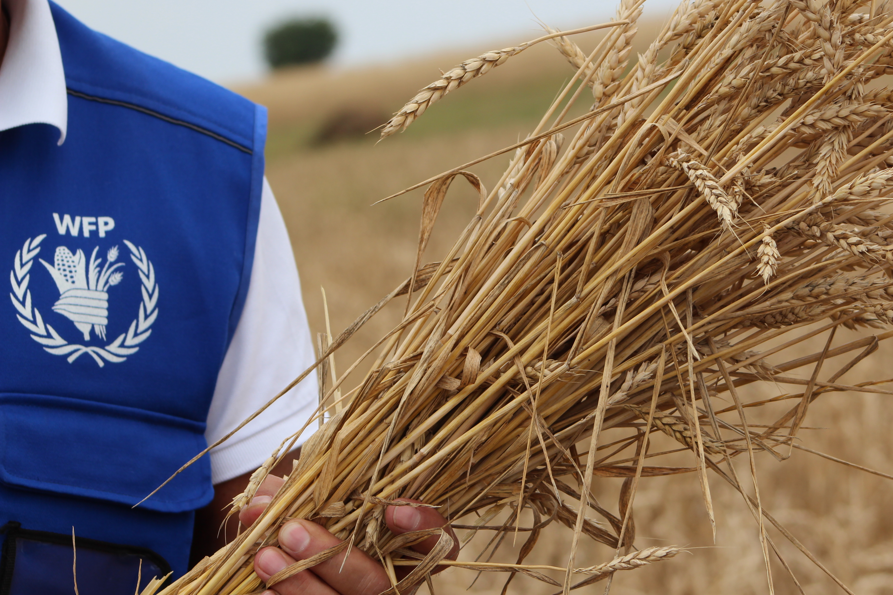
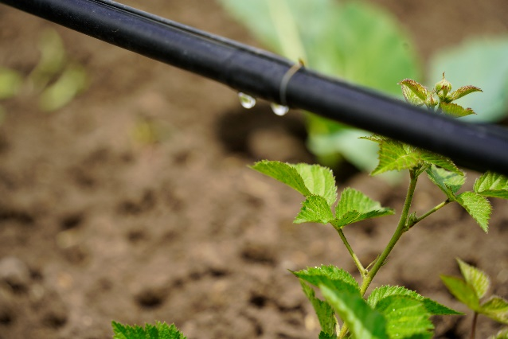
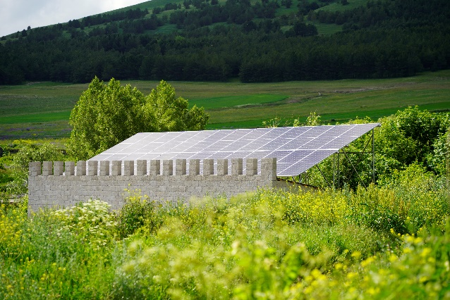
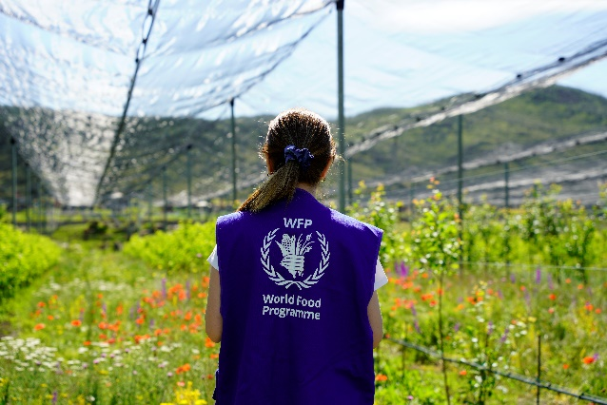
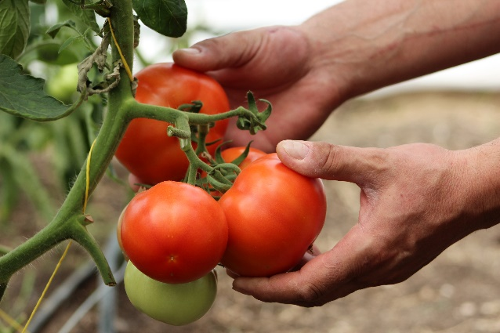
WFP ARMENIA COUNTRY OFFICE Nanna Skau, Country Director
May 2023

Slide 2
ARMENIA’S RISK ENVIRONMENT
Man-made conflicts and natural disasters
Climate change
Broken food systems
Landlocked country
Rise of non-communicable diseases
Lack of employment opportunities

Slide 3
ARMENIA: COUNTRY CONTEXT
HOUSEHOLD
27%
ADULTs
CHILDREN 6-23 months
Poverty Rate
30%
CHILDREN <5
CHILDREN 7-8
Food Insecurity Rate
*MAD: Minimum Acceptable Diet

Slide 4
WFP’S INTEGRATED APPROACH FOR FOOD SECURITY IN ARMENIA
NATIONALISATION
FOOD SYSTEMS
TRANSFORMATIVE
SCHOOL
FEEDING
SOCIAL BEHAVIOUR CHANGE
NUTRITION AND GENDER-SENSITIVE
DRR, MITIGATION AND SHOCK RESPONSIVENESS
CLIMATE-SENSITIVE AND ADAPTIVE
SOCIAL PROTECTION
EVIDENCE BASED AND STRATEGY DEVELOPMENT

Slide 5
SAVING LIVES CHANGING LIVES
Food/cash assistance
Food Value Chains
Shock Responsive Social Protection
Renewable Energy Infrastructure
SAVING LIVES
CHANGING LIVES
Water Resource Management
Food Security Analysis
National Capacity Strengthening

Slide 6
RENEWABLE ENERGY PROMOTION
BY WFP ARMENIA

