Slide 1
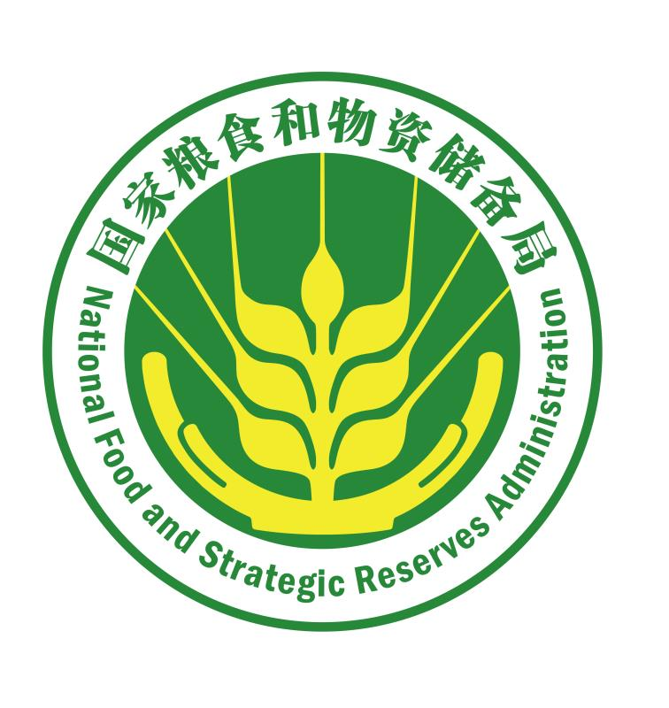
China Experience in Fortified Flour

Slide 2
China Experience in Fortified Flour
01
The history of flour fortification technology in China
02
Standard- and administrative system-based flour fortification system
How to understand flour fortification
Flour fortification and fortification substances common in different countries
03
04
05
Wheat flour fortification & processing technology
06
Quality safety assurance system

Slide 3
1
Part
The History of Flour Fortification Technology in China

Slide 4
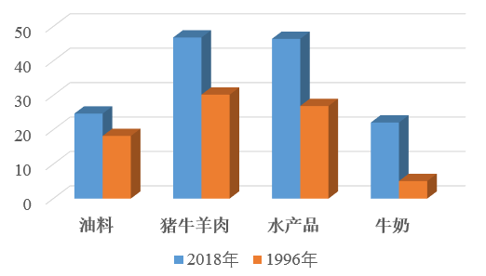
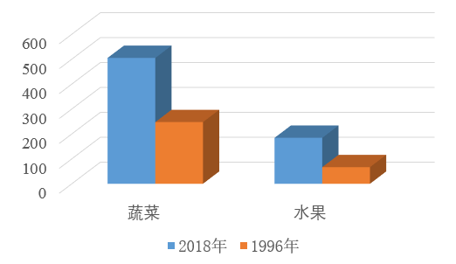
1.1
Food Supply in China
Improved Nutrition for Residents
More choices for meals. The per capita direct consumption of staple grains has decreased, and the consumption of non-grain foods such as meat and fish, ligneous foods, vegetables, and fruits has increased. The Chinese have more choices in what they eat and have a healthier diet.
Per capita shares (kg/person)
Oil
Pork, beef and mutton
Aquatic products
Milk
Vegetables
Fruit
2018
1996
2018
1996
Source: National Bureau of Statistics (NBS)

Slide 5
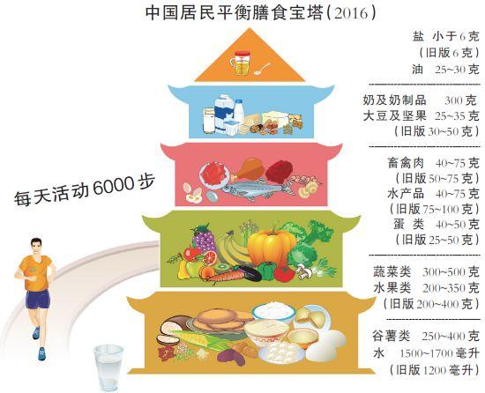
1.1
Food Supply in China
Improved Nutrition Level
Chinese citizens have an adequate supply of dietary energy, with sufficient intake of the three major nutrients – proteins, fat and carbohydrates. The proportion of carbohydrate intake has fallen, and those of fat and quality protein intake have risen.
Food Guide Pagoda for Chinese Citizens (2016)
Average daily intake of a standard person in China
Energy: 2172 kcal,
Protein: 65g,
Fat: 80g,
Carbohydrate: 301g.
Salt: ＜ 6g
(6g in old version)
Oil: 25~30g
Milk and milk products: 300g
Soybean and nuts: 25~35g
(30~50 in old version)
Livestock and poultry meat: 40~75g
(50~75g in old version)
Aquatic products: 40~75g
(75~100g in old version)
Eggs: 40~50g
(25~50g in old version)
Walking exercise: 6000 steps/day
Vegetables: 300~500g
Fruits: 200~350g
(200~400g in old version)
Cereals and potatoes: 250~400g
Water: 1500~1700ml
(1200ml in old version)
Source: National Health Commission

Slide 6
1.1
Food Supply in China
Poor People No Longer Need to Worry about Food
Chinese Government always attaches great importance to eliminating hunger and poverty. Since the 18th National Congress of the CPC, in particular, it has explored a way to successfully develop the rural economy, increase farmers' incomes, and eliminate hunger and poverty; remarkable results have been achieved in targeted poverty alleviation and eradication.
According to China's current poverty standards, as of the end of 2018 there remained 16.6 million people living in poverty in China. This represented a reduction of 82.39 million compared to the number of 98.99 million as of the end of 2012, and the incidence of poverty has fallen from 10.2% to 1.7%. The government has helped 750 million people out of poverty since 1978, when a staggering 770 million people were struggling for the means to live.

Slide 7
1.1
Food Supply in China
Poor People No Longer Need to Worry about Food
According to the World Bank's poverty line of 1.9 US dollars per person per day, China has contributed more than 70 percent of the global poverty reduction effort; China has lifted more people out of poverty than any other country, and is the first country to reach the poverty reduction goal in the UN's Millennium Development Goals.

Slide 8
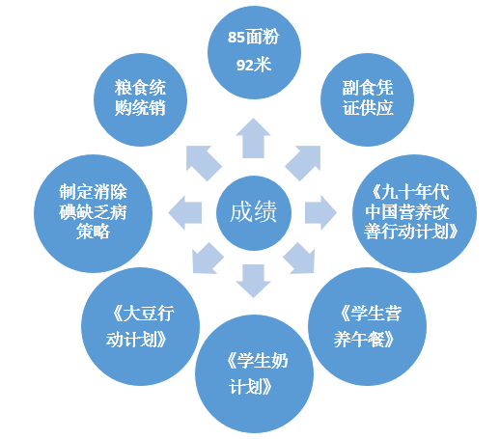
1.1
Food Supply in China
Nutrition for Key Groups in Poverty Has Improved Markedly
In 2018, the per capita disposable income of residents in impoverished rural areas reached 10,371 yuan, an actual increase of 1.7 percentage points higher than that of rural areas in general.
85 flour
92 rice
State monopoly for purchase and marketing of grain
Non-staple food supply with voucher
Develop a strategy to eliminate iodine deficiency disorders
Achievements
China's Action Plan for Nutrition Improvement in 1990s
Soybean Action Programme
Nutritious Lunch for Students
China School Milk Programme

Slide 9
1.1
Food Supply in China
Nutrition for Key Groups in Poverty Has Improved Markedly
This increase in income has enabled poor areas to acquire more food, and the intake of grains among poor groups has grown steadily. The government has carried out extensive nutrition improvement programs in poor areas for young students, infants, children, pregnant women, and the elderly, as a result of which there have been noticeable improvements in their nutrition and health.
85 flour
92 rice
State monopoly for purchase and marketing of grain
Non-staple food supply with voucher
Develop a strategy to eliminate iodine deficiency disorders
Achievement
China's Action Plan for Nutrition Improvement in 1990s
Soybean Action Programme
Nutritious Lunch for Students
China School Milk Programme

Slide 10
1.2
History of Wheat Flour Fortification in China
The regulation on salt iodization was enacted by the State Council in 1994.
The Ministry of Health issued the Measures for the Administration of Health Foods.
Revised National Food Safety Standard – Standards for the Use of Nutritional Fortification Substances in Foods (GB14880-2012) issued by the Ministry of Health
1954
1986
1994
1996
2000
2007
2012
Milk substitute 5410 formula
Eleven nutritional fortification substances can be used in accordance with the Measures and Standards for the Management of Nutritional Fortification Substances issued by the Ministry of Health.
Hygienic Standard for the Use of Nutritional Fortification Substances in Foods (GB 14880-94) issued by the Ministry of Health
Include the scope of application of new nutritional fortification substances, covering 31 nutrients and 87 compound sources in total.
Study on Wheat flour Fortification Technology
The Ministry of Health issued the Fortified Wheat Flour (GB/T 21122-2007).
Thirty seven nutritional fortification substances from 131 compounds can be used to fortify foods. 48 nutritional fortification substances from 127 compounds can be used in special dietary.

Slide 11
1.3
Multi-Cooperation in Nutritional Fortification Promotion
Considering the high-level of flour consumption, the large number of consumers and the public demand on nutrition and health in China, Chinese government agencies have cooperated with the international community to conduct the research and practice on the food nutritional fortification work, in order to explore the effective approach to improve public nutrition in China.
Endorsed by international organizations such as United Nations International Children‘s Emergency Fund (UNICEF) and Asian Development Bank (ADB) and approved by the Chinese Government, the RETA Program has been carried out nationwide to promote, test, pilot and facilitate the public nutrition improvement since 1995.

Slide 12
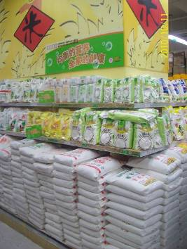
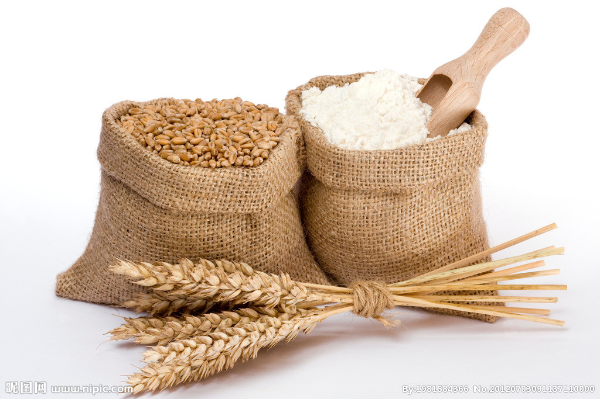
1.3
Multi-Cooperation in Nutritional Fortification Promotion
In 2001 and 2002, with several rounds of discussion and demonstration, authorities determined to use flour (rice, rice flour and other staple food), edible oil, supplementary foods for infants and young children (including food for pregnant women and lactating women) and soy sauce as the carrier for mandatory and instructional food fortification based on the practice of fortifying salt with iodine, and made an overall plan for the fortification methods. In August 2002, Lanzhou (Gansu province) and Chengde (Hebei province) municipal governments started the flour fortification work together with granting subsidies for restoring farmland to forests.

Slide 13
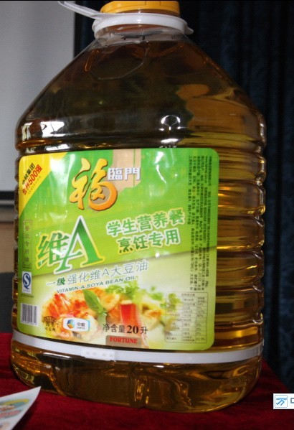
1.3
Multi-Cooperation in Nutritional Fortification Promotion
Currently, fortified food in China involves condiments, cereals and products thereof, milk and products thereof, oils and fats, beverages, etc.

Slide 14
2
Part
Standard- and Administrative System- Based Flour Fortification Management System

Slide 15
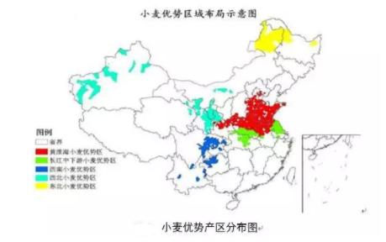
2.1
Government Service System for Fortified Flour
Wheat yield in China accounts for 16%–18% of the world’s production. Most of the wheat produced in China is consumed as staple food domestically, which covers all parts and population of the country.
Most of the wheat is cultivated and consumed in provinces including Henan, Hebei, Shandong, Shanxi, Jiangsu, Anhui, Hubei, Sichuan, etc.
Layout Diagram of Wheat Dominant Areas
Legend
Distribution Diagram of Wheat Dominant Producing Areas

Slide 16
2.1
Government Service System for Fortified Flour
At present, the annual flour demand in China is 80-90 million tons, of which 50 million tons are produced and consumed by the rural households, and only 30-40 million tons of flour flow into the market. During 1997-2006, the sales volume of flour was 107.4 million tons every year, of which about 9 million tons were used as wheat seeds and considered as loss (about 2 million tons). Therefore, the domestic sales volume of flour was 97.4 million tons actually.

Slide 17
2.1
Government Service System for Fortified Flour
Food fortification is the public health policy supported by the Chinese Government. The National Health and Family Planning Commission and State Administration of Grain organized the flour fortification projects to control and prevent micronutrient deficiency and malnutrition in poverty areas.
The Government of Shanxi Province supports flour fortification.
Lanzhou Municipal Government of Gansu Province encourages the promotion of nutritionally fortified food products.
The optimal period to take folic acid is the first three months prior to pregnancy and the first three months after conceiving a child.
The human body cannot make folic acid. It is primarily taken from the folic acid fortified food and vitamins that contain folic acid.
Folic acid
Water-soluble vitamin B

Slide 18
Government Service System for Fortified Flour
2.1
1949
Prosperity, Construction, Production
1954
Patent flour, standard flour, low-standard flour, whole wheat flour
National standard for flour GB 1355—1986
Level I patent flour, level II patent flour, standard flour and plain flour
1986
1988
High gluten wheat flour and low gluten wheat flour were incorporated into GB 8607—1988 and GB 8608—1988.
1993
Standards for bread, cake, noodles, boiled dumplings, fermented biscuit, etc. were approved.
2007
Flour fortification standards were approved.

Slide 19
2.1
Government Service System for Fortified Flour
At present, nutrients approved for use in cereals and products thereof (including flour) include lysine, vitamin A (approved in 2008), vitamin B1, vitamin B2, nicotinic acid, folic acid, calcium, iron, zinc and selenium, which are listed in the Hygienic Standard for the Use of Nutritional Fortification Substances in Foods (GB 14880—2012) to define the variety and usage amount of nutrients in flour.

Slide 20
2.1
Government Service System for Fortified Flour
The nutrition information must be indicated on the label of micronutrient fortified flour, and its identification content and format should be in compliance with the National Food Safety Standard General Standard on Nutrition Labelling of Prepackaged Foods (GB 28050—2011). Chinese Government requests the food manufacturers of mill industry to adopt the quality assurance system, such as GB14881—1994 General Hygienic Regulation for Food Enterprises (GMP), ISO QA System, Food Safety Management System (HACCP, ISO 22000) and other standards.
The establishment of above standards and regulations laid the foundation for the promotion and application of fortified flour and its quality assurance.

Slide 21
2.2
Application Standards for Enterprises and Formula Adjustment
Demonstration
Problem
Solution
Pilot demonstration project in Hebei Province in October 2002
Ingredients: vitamin A, vitamin B1, vitamin B2, folic acid, nicotinic acid, iron, zinc, etc.
Quality problem of raw materials;
Finished flour products were black;
Yellow spots on steamed bun
Firstly, remove vitamin A;
Secondly, calcium is the optional nutrient for enterprises.
Thirdly, in addition to the single variety of "EDTA Iron Sodium”, enrich the iron nutrient formulations by adding optional formulations such as “ferrous sulfate”.

Slide 22
Application Standards for Enterprises and Formula Adjustment
2.2
Formulation
Participating Organizations
Vitamin B1: 3.5mg/kg;
Vitamin B2: 3.5mg/kg;
Nicotinic acid: 35mg/kg;
Folic acid: 1mg/kg;
Iron: 20mg/kg;
Zinc: 25mg/kg;
Calcium: 1000mg/kg
Center for Public Nutrition and Development of China
Chinese Center for Disease Control and Prevention
United Nations International Children's Emergency Fund
Chinese Cereals and Oils Association
China National Food Industry Association
Former Department of Disease Control
Former Beijing Municipal Bureau of Grain
Former Academy of State Administration of Grain

Slide 23
3
Part
How to Understand Flour Fortification

Slide 24
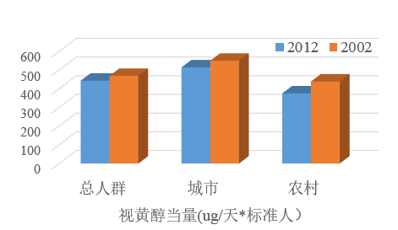
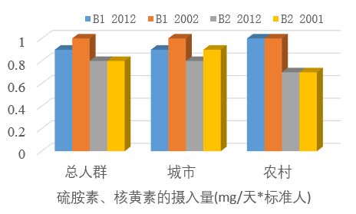
3.1
Food Fortification Program Requests In-Depth Research Basis
For the production of fortified flour, the first task is to make an in-depth and scientific analysis on the nutrition and health status of the people nationwide or in certain areas to obtain the first-hand data and fully understand the relationship between dietary pattern and nutrition deficiency so as to carry out the fortification of nutrients with a purpose – namely to develop the nutrition formulation.
Total population
Urban area
Rural area
Total population
Urban area
Rural area
Retinol equivalent (ug/day*standard person)
Thiamine and riboflavin intake (mg/day*standard person)

Slide 25
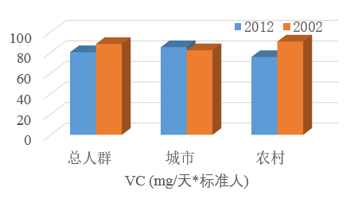
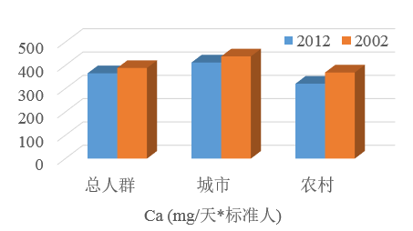
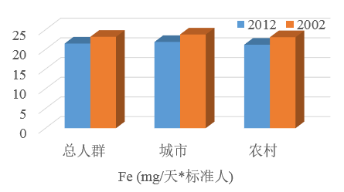
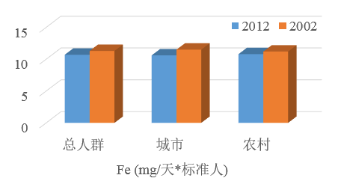
3.1
Food Fortification Program Requests In-Depth Research Basis
Total population
Urban area
Rural area
Total population
Urban area
Rural area
VC (mg/day*standard person)
Ca (mg/day*standard person)
Total population
Urban area
Rural area
Total population
Urban area
Rural area
Fe (mg/day*standard person)
Fe (mg/day*standard person)

Slide 26
3.2
Agreement with the International Community
In 1990, all the member states passed the resolution "Prevention and Control of Iodine Deficiency Disorders" at the World Health Assembly. Subsequently, leaders of the United Nations World Summit for Children signed an Agreement on 'Effective Elimination of Iodine Deficiency and Vitamin A Deficiency, Reduction of Incidence of Iron Deficiency Anaemia in Women to 1/3'.
Salt

Slide 27
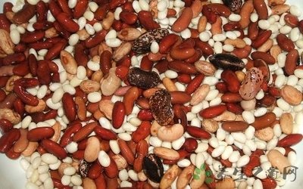
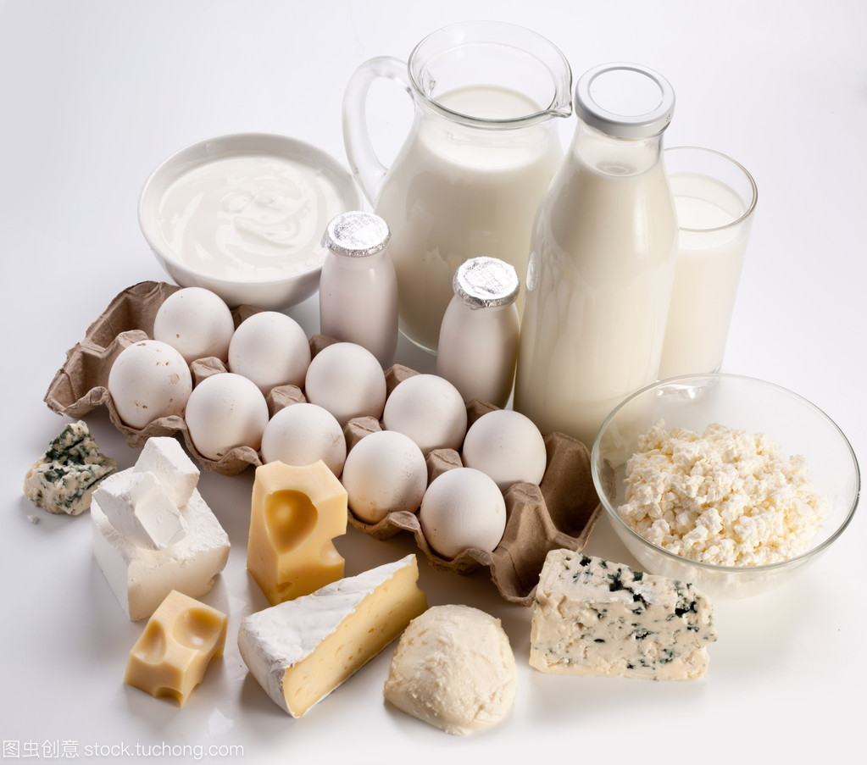
3.2
Agreement with the International Community
These goals were reiterated for many times on the following international forums. The government departments, United Nations agencies, multilateral and bilateral cooperation organizations, academies and research institutions, non-governmental organizations and foundations and other relevant institutions have reached agreement to work together to control micronutrient deficiency.

Slide 28
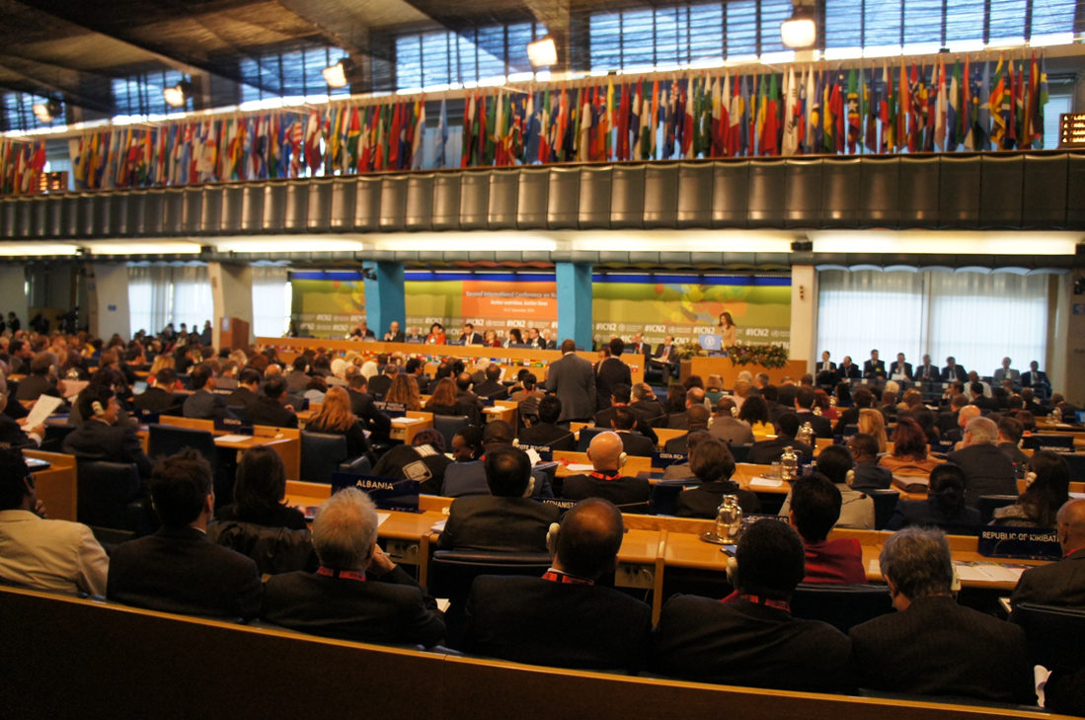
The Second International Conference on Nutrition (November 2014)
19-21 November 2014: Over 2,200 participants from different countries attended this intergovernmental meeting organized by the United Nations, including more than 170 representatives from agricultural, health sectors and other relevant sectors at national and regional levels, and 150 representatives from civil society including trade organizations and business circles, covering all the United Nations member states.

Slide 29
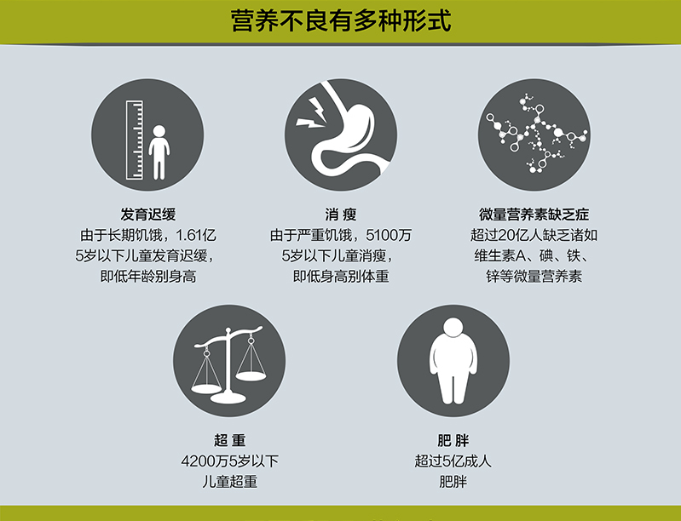
The Second International Conference on Nutrition (November 2014)
Redefinition of Malnutrition:
Malnutrition includes nutrient deficiency, micronutrient deficiency, overweight, obesity, etc.
Diversified forms of malnutrition
Developmental retardation
161 million children under 5 years old suffer from developmental retardation due to chronic hunger, namely low height for age.
Emaciation
51 million children under 5 years old suffer from emaciation due to severe hunger, namely low weight for height.
Micronutrient Deficiency
More than 2 billion people suffer from deficiency of vitamin A, iodine, iron, zinc and other micronutrients.
Overweight
More than 42 million children under 5 years old suffer from overweight.
Obesity
More than 500 million adults suffer from obesity.

Slide 30
The Second International Conference on Nutrition (November 2014)
2 Outcome Documents
Rome Declaration on Nutrition
1. A political document prepared to address current nutrition problems and challenges.
2. Reaffirming "Everyone has the right to have access to safe, sufficient and nutritious food".
3. Urge governments to make commitments to prevent all forms of malnutrition.
From Commitments to Action

Slide 31
The Second International Conference on Nutrition (November 2014)
2 Outcome Documents
From Commitments to Action
Framework for Action
Purpose: Guide the implementation of the commitments of the Declaration.
Provide a set of voluntary policy options and strategies for governments.
The proposals are primarily made towards Heads of State and Government leaders: The action should be conducted at country level, and governments should take the primary responsibility.

Slide 32
3.3
Balanced Nutrition is the Foundation Fortification is the Method
Nutrients in different foods are not exactly the same. Every kind of food provides at least one nutrient substance, and only one kind of natural food cannot provide all the nutrients required by human body.
Timely update, scientific dietary guidance
Food Guide Pagoda for Chinese Citizens (2016)

Slide 33
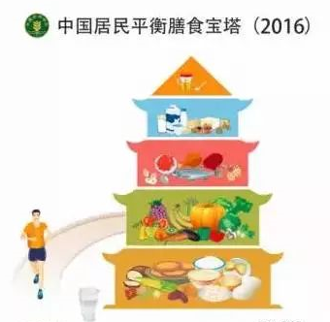
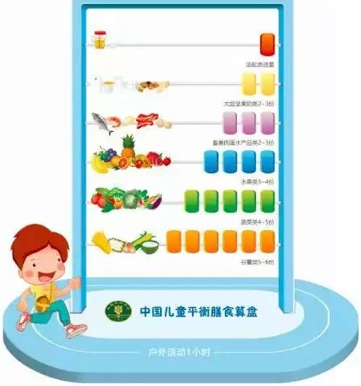
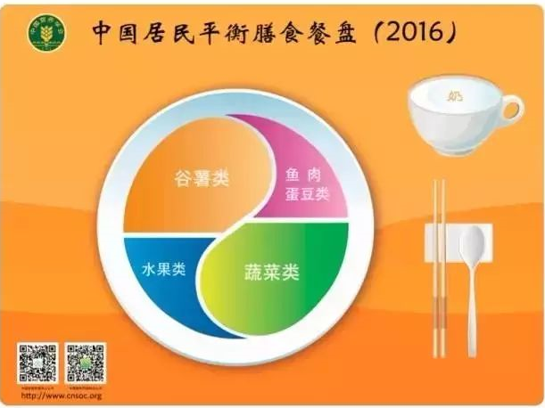
3.3
Balanced Nutrition is the Foundation Fortification is the Method
Maintaining food diversity and guaranteeing the intake of various foods including cereals, foods of animal origin, vegetables and fruits, bean products, milk products, oils, etc. in a scientific proportion to ensure balanced intake of nutrients needed by the body and achieve the aim of taking balanced nutrition and promoting health.
Balanced Diet Pagoda of Chinese Citizens (2016)
Balanced Diet Plate of Chinese Citizens (2016)
Cereals and potatoes
Fish, eggs and beans
Fruits
Vegetables
Balanced Diet Abacus of Chinese Children
Outdoor activity for 1h

Slide 34
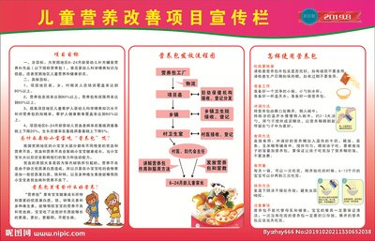
3.3
Balanced Nutrition is the Foundation Fortification is the Method
Special guidelines should be developed for the food fortification work. At present, there are many nutrition guidelines, such as the Dietary Guidelines for Chinese Residents, which is developed for general population and special population (such as infants, young children, preschool children, school-age children, teenagers, pregnant women, breast feeding women and old people) in accordance with the principles of nutriology, the nutrient requirements of different populations and the major deficiencies in the diet. Such guideline will educate the residents to have balanced diet and take balanced nutrients for health promotion.
Bulletin Board of Childhood Nutrition Improvement Program

Slide 35
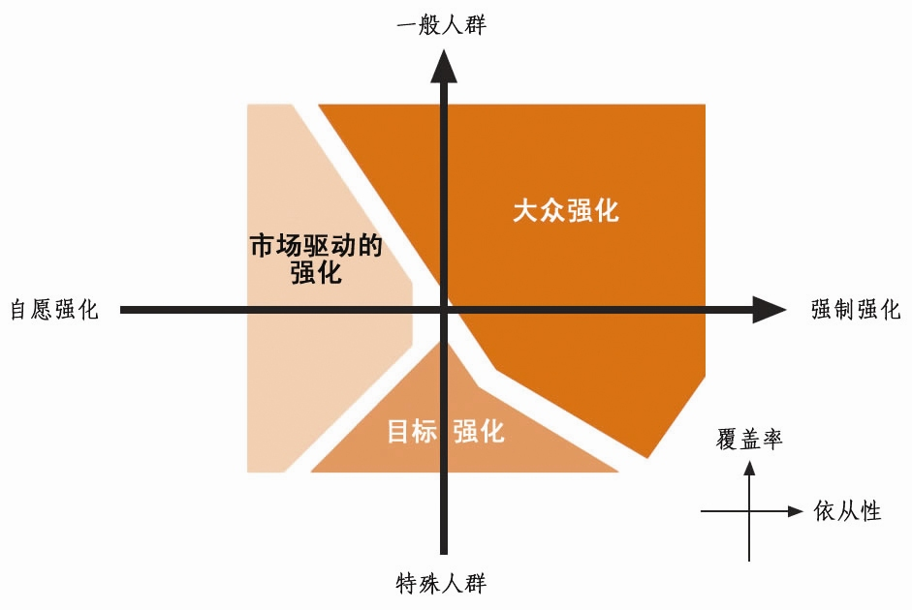
3.3
Balanced Nutrition is the Foundation Fortification is the Method
General population
Necessity and main considerations of food fortification
There are diversified food fortification methods, however, high coverage is the prerequisite for successful food fortification.
There are many forms of food fortification, including fortification of foods widely consumed by the general population (hereinafter referred to as public fortification), fortification of foods for special groups (hereinafter referred to as target fortification), such as supplementary food for infants or rationed foods for migrant population, and also including food enterprises’ voluntary fortification based on the market demands (hereinafter referred to as market-driven fortification).
Public fortification
Market-driven fortification
Voluntary fortification
Mandatory fortification
Target
fortification
Coverage
Obedience
Special populations

Slide 36
3.3
Balanced Nutrition is the Foundation Fortification is the Method
Necessity and main considerations of food fortification
Generally, public fortification is usually mandatory fortification; target fortification may be mandatory or voluntary fortification, primarily depending on the significance of the relevant issues in public health; market-driven fortification is usually voluntary fortification, and shall comply with relevant laws and regulations. “Public fortification” is also known as “common fortification”, and the market-driven fortification is also sometimes known as “industry-driven fortification”, “open-market fortification” or “free market ” food fortification.

Slide 37
3.3
Balanced Nutrition is the Foundation Fortification is the Method
The nature of food carrier and fortified nutrients and the food fortification technology constrain the fortification of many nutrients.
It is difficult for any kind of food to cover all target groups, and therefore, it is imperative to develop more fortification foods. For example, it is difficult for infants to get adequate nutrients from fortified staple food and condiments, and they need fortified foods specially for infants, such as "nutrition package".

Slide 38
3.3
Balanced Nutrition is the Foundation Fortification is the Method
Since the same population suffer from multiple problems of micronutrient deficiency, they need to take multiple fortified foods or multiple micronutrient fortified foods.
The population in extreme poverty tend to consume the food produced by themselves and could hardly afford highly commercialized fortified food.

Slide 39
Thank You!

