Slide 1
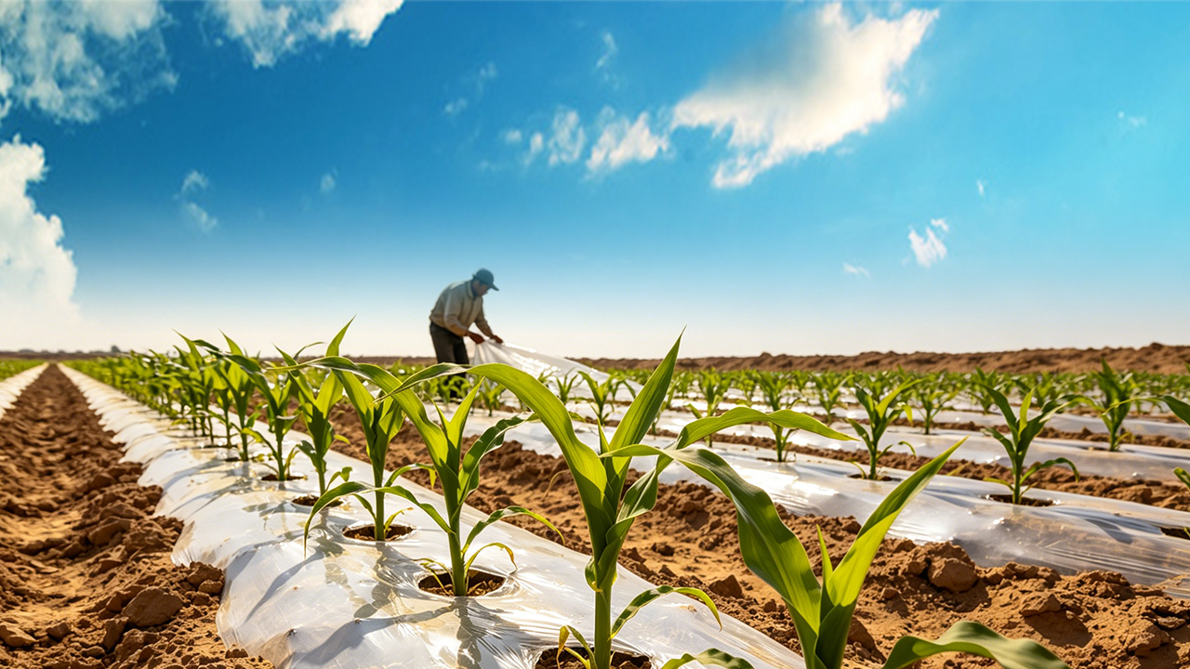
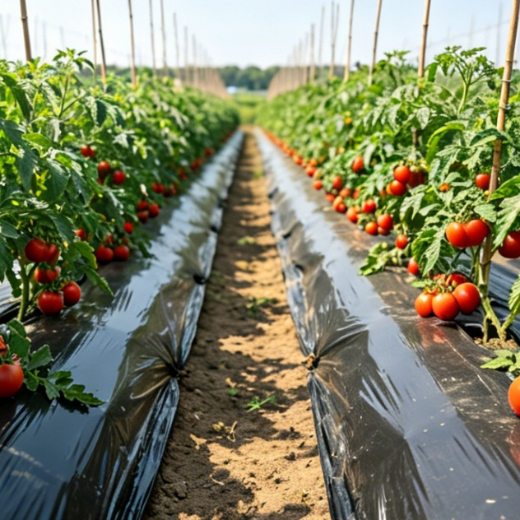
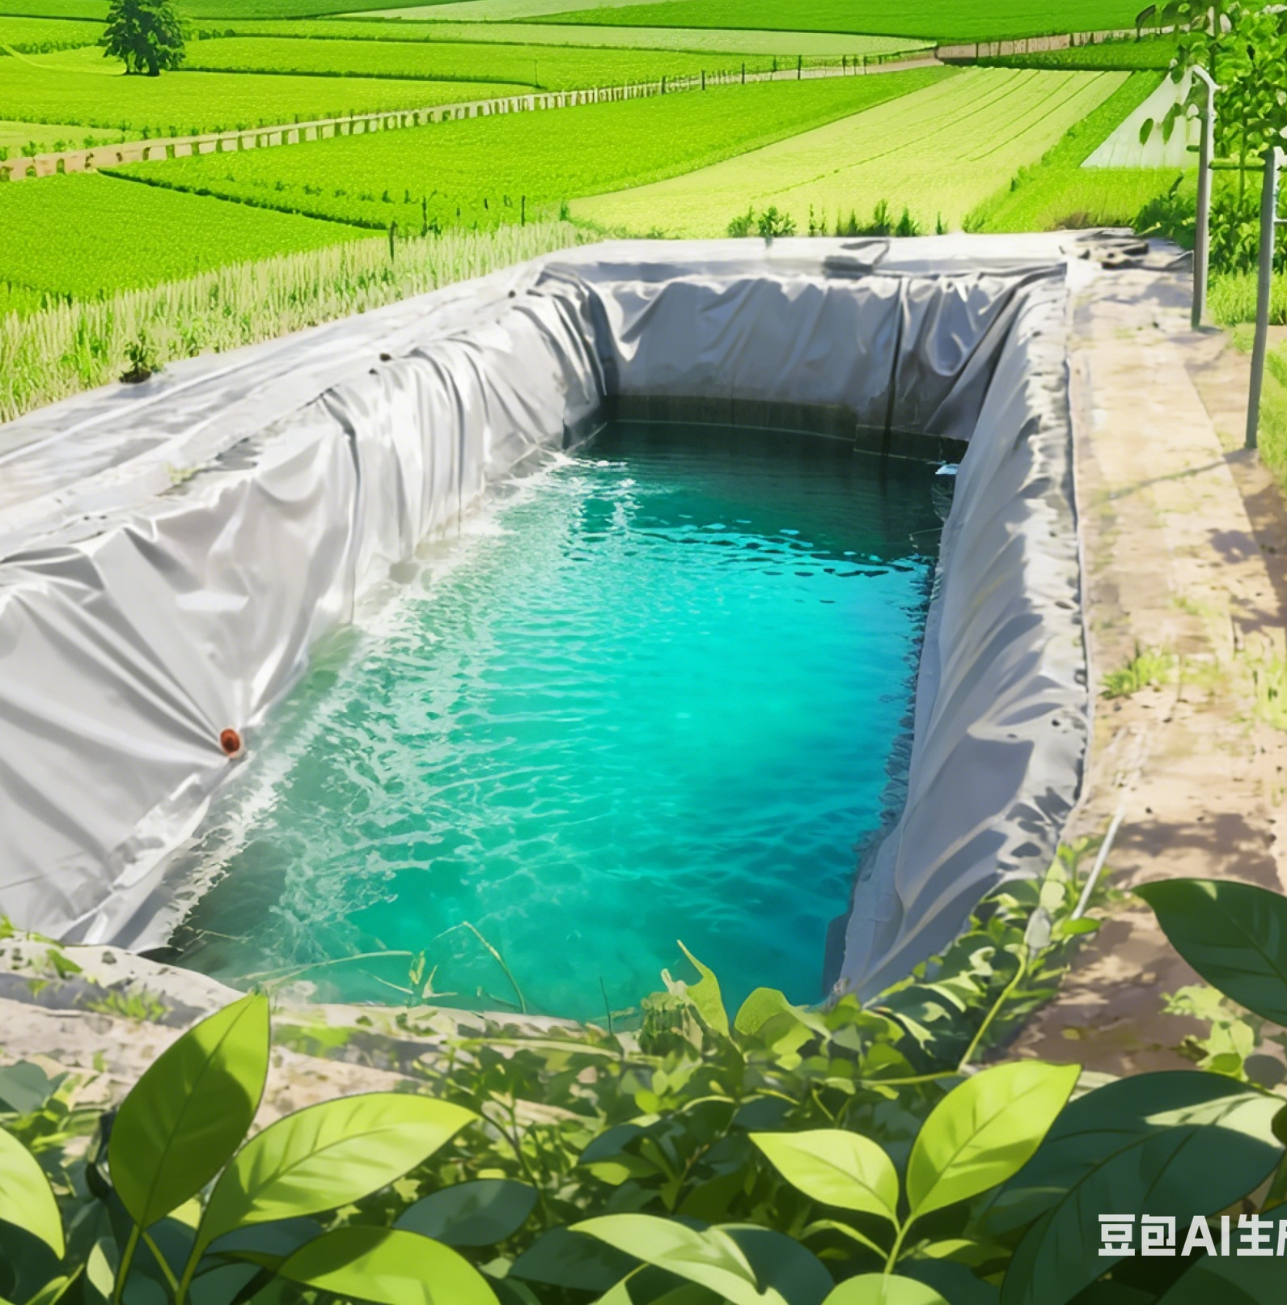

High-efficiency Plastic-Film Mulching Cultivation Techniques for Dryland Farming
Notes:
High-efficiency Plastic-Film Mulching Cultivation Techniques for Dryland Farming
旱作农业地膜覆盖高效栽培技术

Slide 2
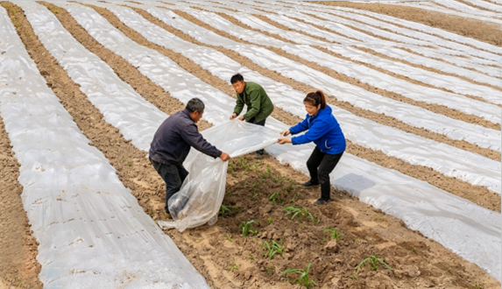
Overview
Key Challenges
  Efficient utilization of limited water resources → to achieve stable and high crop yields in arid and semi-arid farming regions.
Role of plastic film mulching technology
  Key water-saving and yield-enhancing measure for dryland farming.
  Addresses low water-use efficiency in arid areas.
AI生成
Benefits
  Improves soil moisture retention.
  Elevates soil temperature.
  Suppresses weeds.
  Enhances rainfall collection.
Two Main Approaches
  Full-film mulching.
  Partial-film mulching.
Notes:
干旱、半干旱的农业生产区，如何高效利用有限的水资源，实现作物稳产、高产，一直是农业生产的核心挑战。地膜覆盖技术作为旱作农业的核心节水增产手段，凭借其保墒、增温、抑草、集水的多重优势，有效破解了干旱地区水资源利用效率低的痛点。其中，全膜覆盖与半膜覆盖两种方式应用最为广泛。
Efficient utilization of limited water resources to achieve stable and high crop yields in arid and semi-arid farming regions
has long been a core challenge in agricultural production.
As a key water-saving and yield-enhancing measure for dryland farming, plastic-film mulching technology effectively addresses the problem of low water-use efficiency in arid areas.
It improves soil moisture retention, elevates soil temperature, suppresses weeds and enhances rainfall collection.
Full-film mulching and partial-film mulching are two most widely adopted approaches.

Slide 3
Part 01
Full-Film and Partial-Film Mulching Technologies for Maize
Part 02
Full-Film and Partial-Film Mulching Technologies for Dryland Potato
Part 03
Ridge Planting and Furrow Irrigation Technology with Partial-Film Mulching for Tomato Cultivation
Part 04
Partial-Film-Mulched Pepper Cultivation with Ridge Planting and Furrow Irrigation
Notes:
本课程系统梳理了玉米、马铃薯、番茄、辣椒等常见作物的全膜与半膜覆盖核心技术要点，拆解两种覆盖方式的应用逻辑，为种植户提供科学、精准的技术指导，助力实现“旱地变水田”的丰产目标，推动旱作农业高质量发展。
This course systematically outlines the key technical components of
full-film and partial-film mulching for major crops such as maize,
potato, tomato and pepper, and explains the agronomic principles underlying these two mulching approaches.
It provides growers with scientific and precise technical guidance, supports the goal of high yields by "turning dryland into effectively irrigated land” and promotes the high-quality development of dryland farming.

Slide 4
PART.01
Full-Film and Partial-Film Mulching Technologies for Maize
AI生成
Notes:
一、玉米的全膜覆盖与半膜覆盖技术
I.Full-Film and Partial-Film Mulching Technologies for Maize

Slide 5
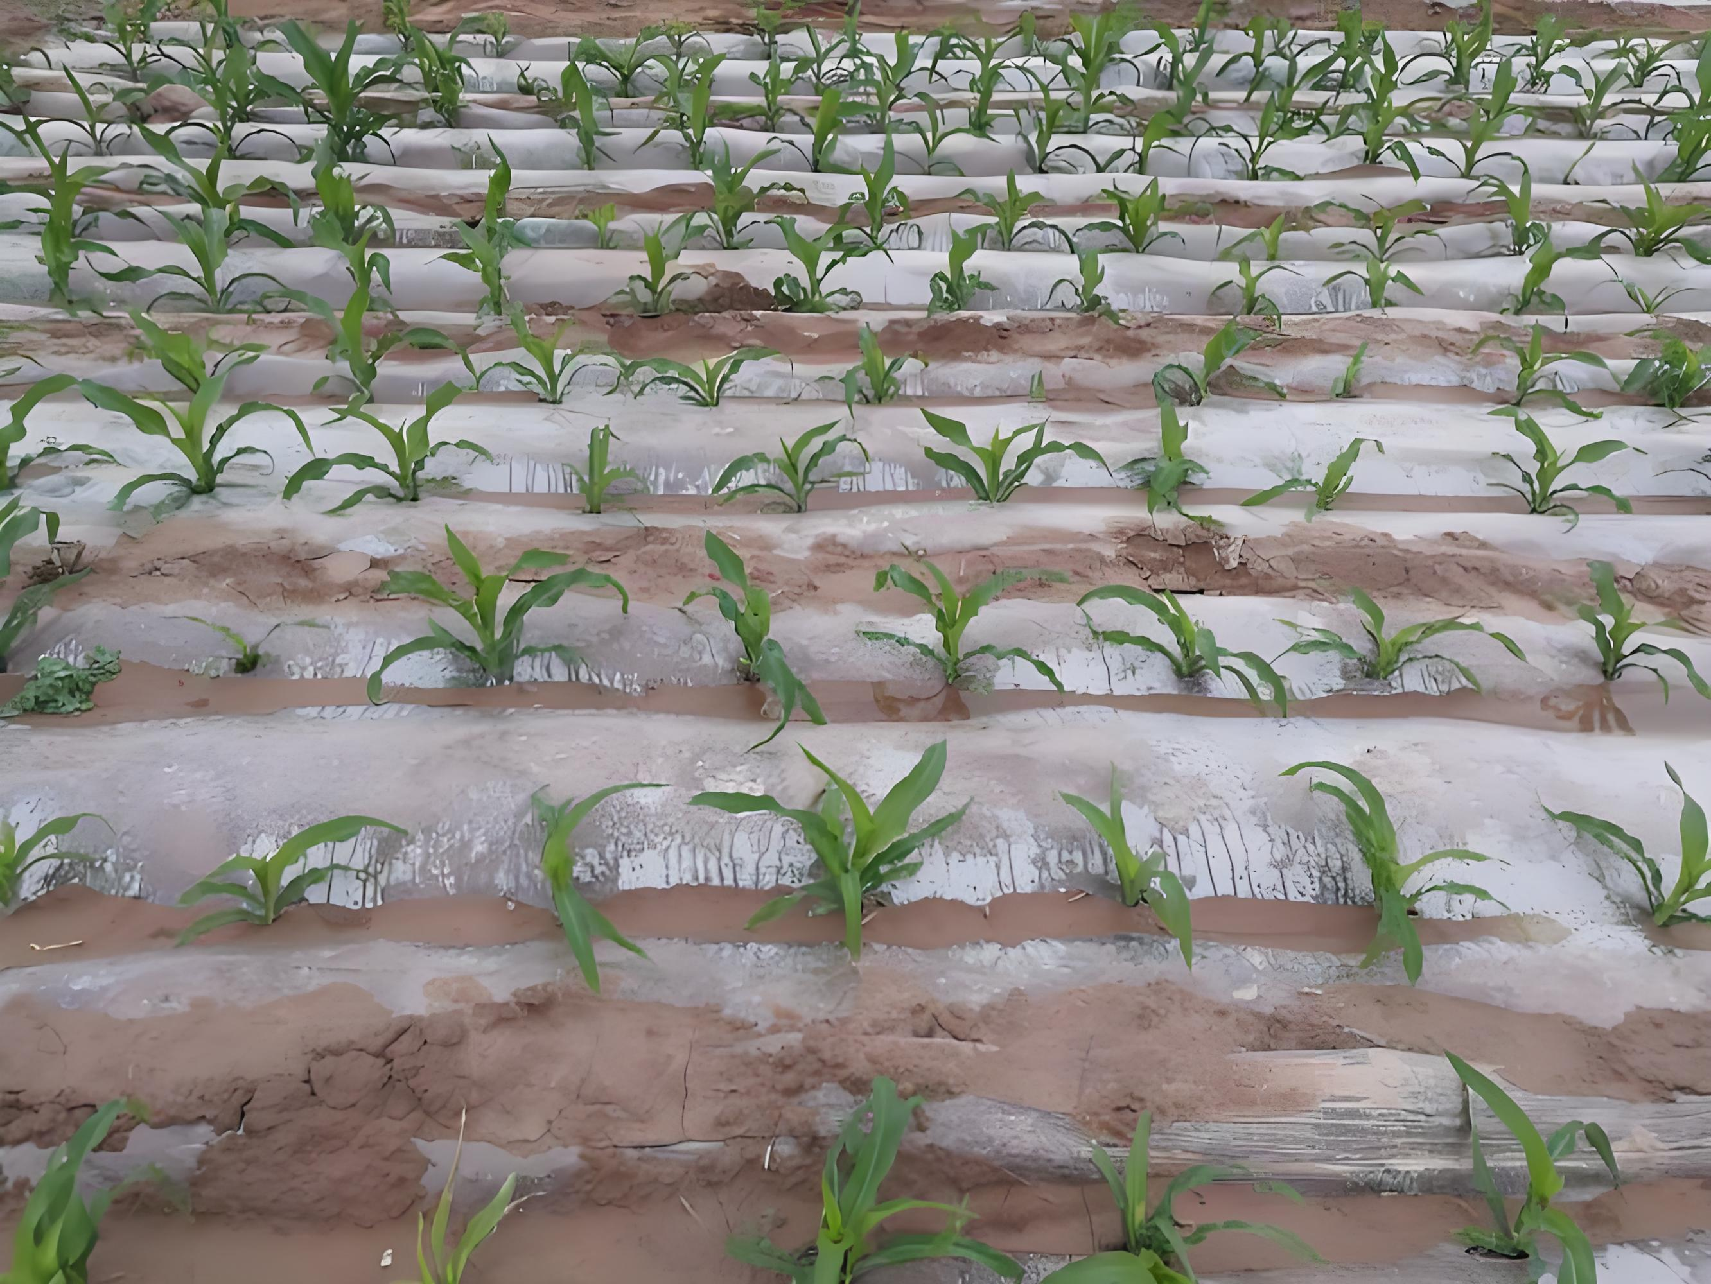
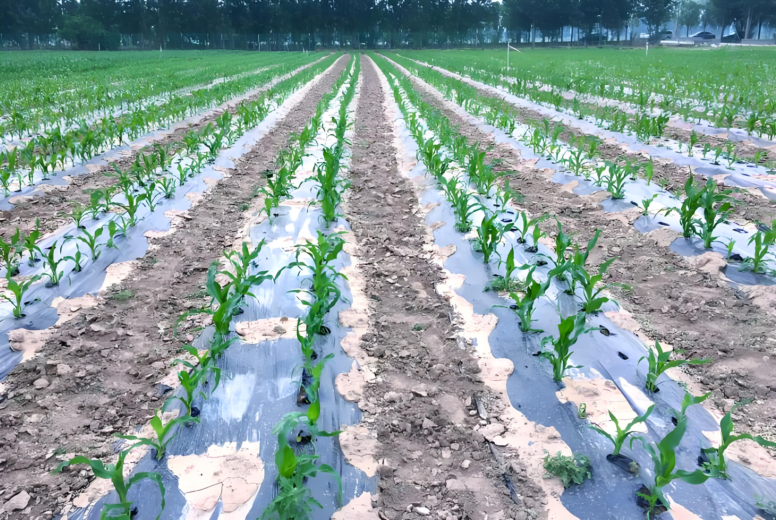
Comparison of Mulching Practices
Two mulching models
  Full-film mulching.
  Partial-film mulching.
  Widely used in dryland maize production.
Key differences
  Mulching methods.
  Resource inputs.
  Applicable areas.
  Yield-enhancing effects.
Shared objectives
  Increase soil temperature.
  Conserve soil moisture.
  Suppress weeds.
  Increase yield.
Full-film mulching
Partial-film mulching
Notes:
玉米的全膜覆盖与半膜覆盖技术是当前旱作农业中广泛应用的两种地膜栽培模式，核心目标均为增温、保墒、抑草和提高产量，但在覆盖方式、资源投入、适用区域及增产效果等方面存在明显差异。
Full-film and partial-film mulching are two widely used practices in dryland maize production.
Both aim to increase soil temperature, conserve soil moisture, suppress weeds, and increase yield.
However, they differ significantly in mulching methods, resource inputs, applicable areas and yield-enhancing effects.

Slide 6
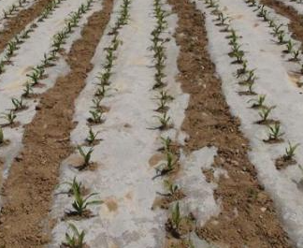
1. Full-Film Mulching Technology for Maize
Full-film mulching is one of the key technologies in dryland farming.
Principle of the Technology
  Construct alternating wide and narrow ridges.
  Fully cover the soil surface with plastic film.
  Sow in the furrows.
Production outcome
  Maximizes use of natural precipitation.
  Effectively mitigates drought impacts.
  Ensures stable and high maize yields
Multiple Functions
  Rainfall harvesting on mulch surface.
  Water accumulation in furrows.
  Reduced evaporation.
  Improved soil temperature and moisture retention.
  Weed suppression.
Notes:
（一）玉米的全膜覆盖技术
全膜覆盖是旱作农业的关键技术之一。玉米全膜覆盖的原理就是在田间起大小双垄，用地膜对地表进行全覆盖，在垄沟中种植，集成膜面集水、垄沟汇集、抑制蒸发、增温保墒、抑制杂草等功能，充分利用自然降水，有效缓解干旱影响，实现高产稳产。
1.Full-Film Mulching Technology for Maize
Full-film mulching is one of the key technologies in dryland farming.
Its principle in maize production is to construct alternating wide and narrow ridges,
fully cover the soil surface with plastic film,
and sow in the furrows.
This technology integrates multiple functions, including rainfall harvesting on the mulch surface, water accumulation in furrows, reduced evaporation, improved soil temperature and moisture retention, and weed suppression.
It maximizes the use of natural precipitation, effectively mitigates drought impacts and ensures stable and high maize yields.

Slide 7
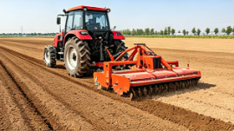
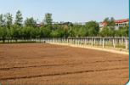
1. Full-Film Mulching Technology for Maize
(1) Land Selection and Field Preparation
Suitable Fields for Full-film Mulching
  Flat terrain.
  Deep soil layers.
  Good soil structure.
  High fertility.
  Strong water-and nutrient-retention capacity.
Post-harvest Soil Preparation
  Deep loosening conducted promptly.
  Immediate soil leveling.
  Fine soil preparation.
  → to enhance water storage and moisture retention.
Soil Surface Condition
  Level and finely tilled.
  Free of large clods and crop residues.
  → create optimal conditions for film mulching and sowing.
AI生成
Notes:
1、选地整地
什么样的地块适合全膜覆盖呢？要选择地势平坦、土层深厚、土壤结构良好、肥力较高、保水保肥能力较强的地块。在前一季作物收获后，需及时开展深松耕作业，耕后立即将土地整平、整细，以此达到整地蓄水保墒的目的。做到土面平整、土壤细绵、无大土块、无根茬，为覆膜、播种创造良好条件。
1.1Land Selection and Field Preparation
Suitable fields for full-film mulching should have flat terrain,
deep soil layers, good soil structure, high fertility and strong water-and nutrient-retention capacity.
After the previous crop is harvested, deep loosening should be conducted promptly, followed by immediate soil leveling and fine soil preparation to enhance water storage and moisture retention.
The soil surface should be level, finely tilled, and free of large clods and crop residues to create optimal conditions for film mulching and sowing.

Slide 8
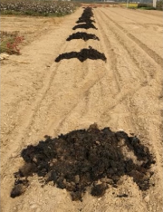
1. Full-Film Mulching Technology for Maize
(2) Fertilization Before Sowing
Organic and Chemical Fertilization
  Apply additional organic fertilizers before sowing.
  Amount and proportion of chemical fertilizers determined based on crop variety, target yield, and soil nutrient status.
Apply Additional Inputs as Needed
  Water-retaining agents.
  Root stimulants.
  Drought- and stress-resistance regulators.
  Medium- and trace-element fertilizers such as zinc.
Recommended Fertilizers under Mulching
  Use long-acting and slow-release fertilizers.
  Use specialized compound fertilizers.
Notes:
2、播前施肥
在播前增施有机肥料。根据作物品种、目标产量、土壤养分等确定化肥用量和比例。科学施用保水剂、生根剂、抗旱抗逆制剂以及锌肥等中微量元素肥料。由于覆膜后很难追肥，所以推荐施用长效、缓释肥料以及相关专用肥。
1.2Fertilization Before Sowing
Apply additional organic fertilizers before sowing.
The amount and proportion of chemical fertilizers should be determined based on crop variety, target yield and soil nutrient status.
Apply water-retaining agents,
root stimulants,
drought-and stress- resistance regulators,
and medium- and trace- element fertilizers such as zinc as needed.
Since topdressing is difficult after mulching,
the use of long-acting and slow-release fertilizers,
as well as specialized compound fertilizers, is recommended.

Slide 9
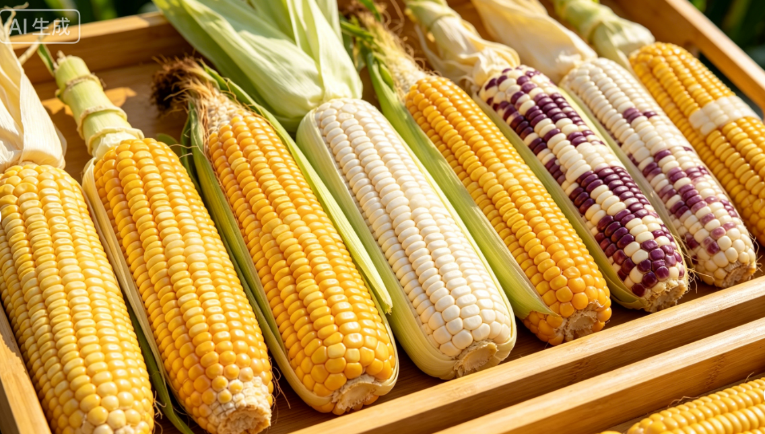
1. Full-Film Mulching Technology for Maize
(3) Variety Selection
Importance
  Selecting an appropriate variety is essential.
Variety Selection for Different Altitudes
  Areas below 1800 m above sea level
    Mid- to late-maturing varieties are recommended.
    Have a spring-sowing growth period of 120–150 days.
    Require accumulated temperature of 2300–2600 °C.
  Areas at an altitude of 1800–2000 m above sea level
    Mid-maturing varieties are suitable.
    Have a spring-sowing growth period of 120–150 days.
    Require accumulated temperature of 2300–2600 °C.
  Areas at an altitude of 2000–2300 m above sea level
    Early- to mid-maturing varieties with a relatively short growth period should be selected → to accommodate the shorter growing season in high-altitude regions.
Selection Basis
  Local precipitation.
  Accumulated temperature.
  Soil fertility.
  Farmland infrastructure conditions.
Notes:
3、品种选择
选择一个合适的品种很重要，可以根据降水、积温、土壤肥力、农田基础设施等情况选择适宜品种。在海拔1800m以下地区宜选用中晚熟品种；在海拔1800-2000m地区宜选用中熟品种；在海拔2000-2300m地区宜选用中早熟品种。
1.3Variety Selection
Selecting an appropriate variety is essential.
Suitable varieties should be chosen based on
local precipitation,
accumulated temperature,
soil fertility, and farmland infrastructure conditions.
For areas below 1800 m above sea level,
mid-to late-maturing varieties are recommended.
These varieties typically have a spring-sowing growth period of 120–150 days
and require an accumulated temperature of 2300–2600 ℃.
For areas at an altitude of 1800–2000 m above sea level,
mid-maturing varieties are suitable.
These varieties typically have a spring-sowing growth period of 120–150 days
and require an accumulated temperature of 2300–2600 ℃.
For areas at an altitude of 2000–2300 m,
early-to mid-maturing varieties with a relatively short growth period should be selected to accommodate the shorter growing season in high-altitude regions.

Slide 10
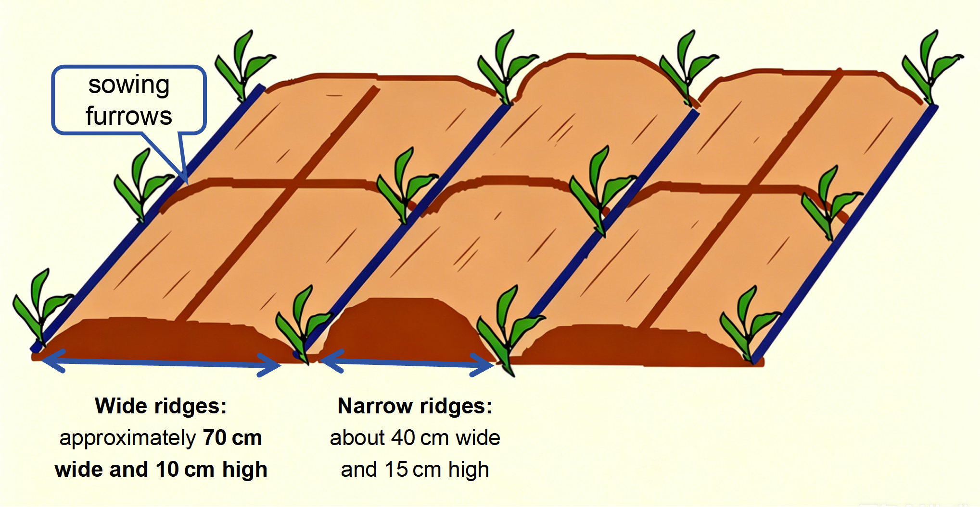
1. Full-Film Mulching Technology for Maize
(4) Ridge Formation and Film Mulching
Ridge Dimensions
  Wide ridges: approximately 70 cm wide and 10 cm high.
  Narrow ridges: about 40 cm wide and 15 cm high.
Ridge Arrangement
  Wide and narrow ridges arranged alternately with sowing furrows in between.
  Each sowing furrow corresponds to one wide and one narrow rainfall-collecting ridge surface.
Ridge Formation Requirements
  Form ridges strictly according to specific dimensions.
  Uniform ridge widths.
  Consistent crest heights.
  Absence of depressions.
AI 生成
Notes:
4、起垄与覆膜技术
起垄时，大垄垄宽约70cm、垄高约10cm；小垄垄宽约40cm、垄高约15cm。大小垄相间，中间为播种沟，每个播种沟对应一大一小两个集雨垄面。按照起垄规格划行起垄，做到垄面宽窄均匀、垄脊高低一致、无凹陷。
1.4 Ridge Formation and Film Mulching
When forming ridges,
wide ridges should be approximately 70 cm wide and 10 cm high,
while narrow ridges should be about 40 cm wide and 15 cm high.
The wide and narrow ridges should be arranged alternately,
with sowing furrows in between.
Each sowing furrow corresponds to one wide and one narrow rainfall-collecting ridge surface.
Ridges should be formed strictly according to the specific dimensions,
ensuring uniform ridge widths,
consistent crest heights,
and the absence of depressions.

Slide 11
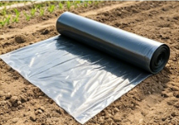
1. Full-Film Mulching Technology for Maize
(4) Ridge Formation and Film Mulching
Film Thickness & Type
  Plastic film thickness > 0.01 mm.
  Black film recommended for fields with heavy weed infestation.
AI生成
Mulching Season
  Mulching in autumn or spring depending on precipitation and soil moisture conditions.
Spring Mulching Timing
  Carried out promptly when soil thaws by day and refreezes at night.
  Apply when topsoil has just thawed.
Autumn Mulching Effects
  Effectively reduce soil moisture evaporation in autumn-winter-spring.
  Enables cross-season water storage.
  Maximizes soil moisture retention.
Spring Mulching Effects
  Effectively reduces spring moisture loss.
  Helps preserve soil moisture for sowing.
Notes:
Plastic film with a thickness greater than 0.01 mm should be used.
Black film is recommended for fields with heavy weed infestation.
Mulching should be carried out in autumn or spring,
depending on precipitation and soil moisture conditions.
Autumn mulching can effectively reduce soil moisture evaporation during autumn, winter and spring,
enable cross-season water storage,
and maximize soil moisture retention.
Spring mulching should be carried out promptly when the soil thaws during the day and refreezes at night,
and when the topsoil has just thawed.
This practice
effectively reduces spring moisture loss and
helps preserve soil moisture for sowing.
地膜应优先选用厚度0.01mm以上的地膜。杂草较多的地块可采用黑色地膜。根据降水和土壤墒情，选择秋季或春季覆膜。在秋季进行覆膜作业，可有效抑制秋、冬、春三季的土壤水分蒸发，实现跨季节蓄水，最大限度地保持土壤墒情；在春季土壤昼消夜冻、表土刚解冻时，抢抓农时及时覆膜，可有效抑制春季水分散失，为播种保墒。

Slide 12
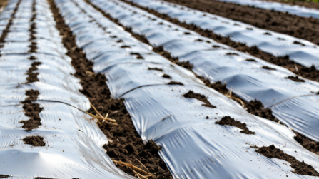
1. Full-Film Mulching Technology for Maize
(4) Ridge Formation and Film Mulching
Mulching Method
  Full soil-surface coverage is required.
  Adjacent plastic film sheets overlapped at crests of wide ridges and compacted with soil.
  Film should be stretched tight and laid flat, closely attached to ridge surfaces and furrows.
Fixing & Water Infiltration
  Secured with transverse soil compaction at interval of about 2 m to prevent wind uplift.
  After mulching, water-infiltration holes about 3 mm diameter made every 50 cm in sowing furrows to facilitate rainfall infiltration.
Maintenance & Protection
  Inspected regularly.
  Any damaged sections promptly covered with soil or repaired.
  Straw may be used to protect film and reduce soil temperature.
AI生成
Notes:
全地面覆盖，相邻两幅地膜在大垄垄脊相接，用土压实。地膜应拉展铺平，与垄面、垄沟贴紧，每隔约2m用土横压，防大风揭膜。覆膜后在播种沟内每隔50cm左右打直径约3mm的渗水孔，便于降水入渗。经常检查地膜，发现破损处及时用土盖严或进行修补，也可用秸秆覆盖, 起到护膜和降温的作用。
Full soil surface coverage is required,
with adjacent plastic film sheets overlapped at the crests of wide ridges and compacted with soil.
The film should be stretched tight and laid flat, closely attached to ridge surfaces and furrows.
It should then be secured with transverse soil compaction at interval of about 2 m to prevent wind uplift.
After mulching, water-infiltration holes about 3 mm in diameter should be made every 50 cm in the sowing furrows to facilitate rainfall infiltration.
The plastic mulch should be
inspected regularly,
and any damaged sections should be promptly covered with soil or repaired.
Straw may also be used to protect the film and reduce soil temperature.

Slide 13
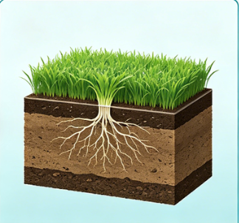

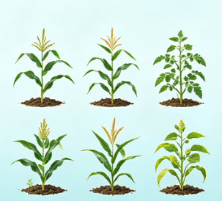
1. Full-Film Mulching Technology for Maize
(5) Planting Density and Sowing Method
Density Determination Basis
  Determined based on soil fertility, precipitation and variety characteristics.
Recommended Density by Annual Precipitation
  In areas with an annual precipitation of 250–350 mm: 45,000–52,500 plants/ha; spacing 35–40 cm.
  In areas with an annual precipitation of 350–450 mm: 52,500–60,000 plants/ha; spacing 30–35 cm.
  In areas with an annual precipitation >450 mm: 60,000–67,500 plants/ha; spacing 27–30 cm.
AI生成
Soil fertility
Precipitation
Variety characteristics
Density Adjustment Conditions
  Density may be increased in fields with high-fertility and good moisture conditions.
Notes:
5、播种密度与方法
播种时，根据土壤肥力、降水条件和品种特性等确定种植密度。在年降水量250-350mm的地区，种植密度以每公顷45,000-52,500株为宜，株距35-40cm；年降水量350-450mm的地区，种植密度以每公顷52,500-60,000株为宜，株距30-35cm；年降水量450mm以上的地区，种植密度以每公顷60,000-67,500株为宜，株距27-30cm。土壤肥力高、墒情好的地块可适当加大种植密度。
1.5 Planting Density and Sowing Method
Planting density should be determined based on soil fertility, precipitation and variety characteristics.
In areas with an annual precipitation of 250-350 mm, the recommended planting density is 45,000-52,500 plants per hectare with a plant spacing of 35-40 cm.
In areas with 350-450 mm of annual precipitation, the recommended planting density is 52,500-60,000 plants per hectare with a plant spacing of 30-35 cm.
In areas with more than 450 mm of annual precipitation,a planting density of 60,000-67,500 plants per hectare with a plant spacing of 27-30 cm is recommended.
Planting density may be increased appropriately in fields with high soil fertility and good moisture conditions.

Slide 14
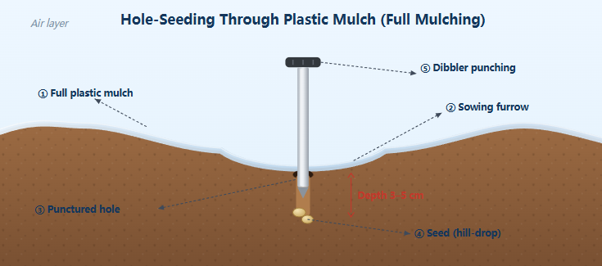
1. Full-Film Mulching Technology for Maize
(5) Planting Density and Sowing Method
Hole Seeding Method
  Hole seeding through film in sowing furrows using a hole-seeding device.
  Follow designated planting density and spacing.
  Sowing depth 3–5 cm.
Post-Sowing Handling
  Sowing holes sealed with soil immediately after sowing.
  Soil too dry during sowing → appropriate irrigation applied before or after sowing.
  Alternatively, sowing may be carried out immediately after rainfall.
AI生成
Notes:
按照种植密度和株距，在播种沟内用点播器破膜穴播，播深3-5cm。播后用土封严播种孔。若播种时土壤过于干旱，则应在播种前后适量补水，或抢在降雨后及时播种。
Hole seeding through the film should be conducted in the sowing furrows using a hole-seeding device,
following the designated planting density and spacing,
with a sowing depth of 3-5 cm.
The sowing holes should be sealed with soil immediately after sowing.
If the soil is too dry during sowing, appropriate irrigation should be applied before or after sowing.
Alternatively, sowing may be carried out immediately after rainfall.

Slide 15
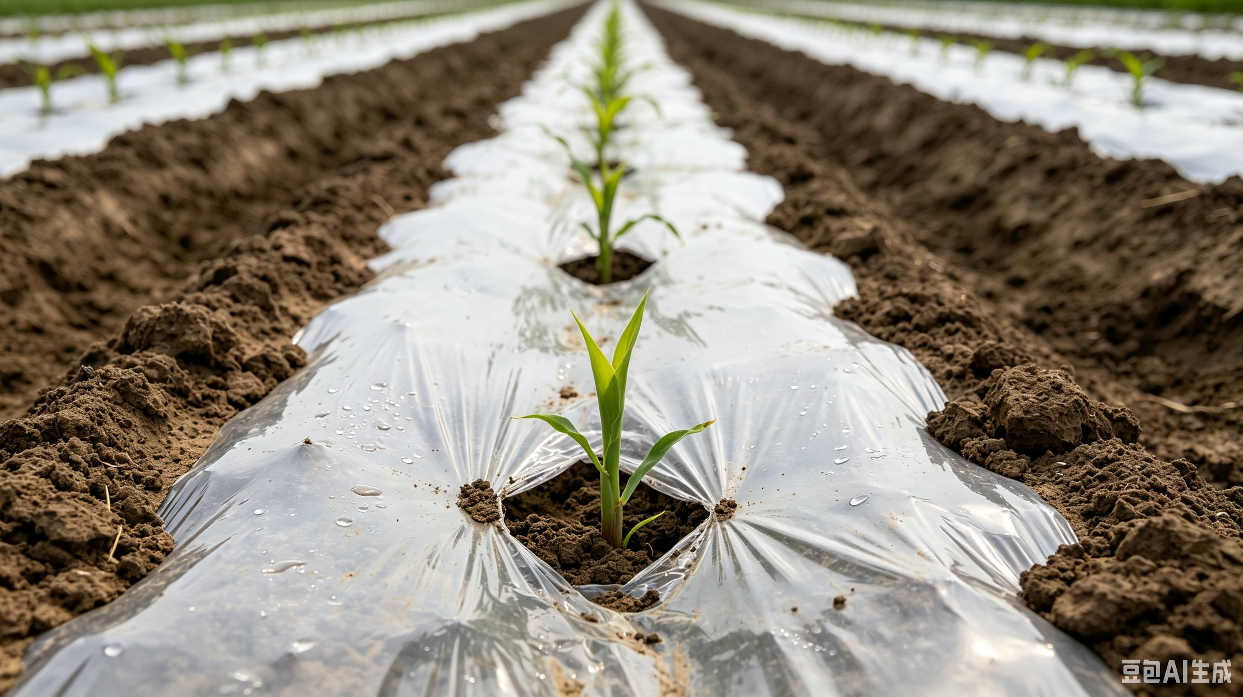
1. Full-Film Mulching Technology for Maize
(6) Field Management
Seedling Emergence Assistance and Replenishment
Seedling Emergence Assistance
  For maize seedlings pressed beneath the plastic film and unable to emerge on their own → manual assistance is required.
  Gently guide seedlings through the film holes and expose them to the external environment.
  Essential practice in film-mulched cultivation to prevent heat injury to seedlings.
Seedling Replenishment
  Fields inspected promptly after seedling emergence.
  Missing plants replenished by sowing pregerminated seeds or transplanting soil-attached seedlings.
Notes:
6、田间管理
（1）放苗与补苗
放苗：指播种后被地膜压住、无法自行钻出的玉米幼苗，需人工小心地将其引出膜孔，使其接触外部环境。这是覆膜栽培中的必要操作，以防膜下高温灼伤幼苗。补苗：出苗后及时检查，对缺苗处进行催芽补种或带土移栽。
1.6Field Management
1.6.1Seedling Emergence Assistance and Replenishment
Seedling emergence assistance:
For maize seedlings pressed beneath the plastic film and unable to emerge on their own,
manual assistance is required to gently guide them through the film holes and expose them to the external environment.
This is an essential practice in film-mulched cultivation to prevent heat injury to seedlings.
Seedling replenishment:
Fields should be inspected promptly after seedling emergence.
Missing plants should be replenished by sowing pregerminated seeds or transplanting soil-attached seedlings.

Slide 16
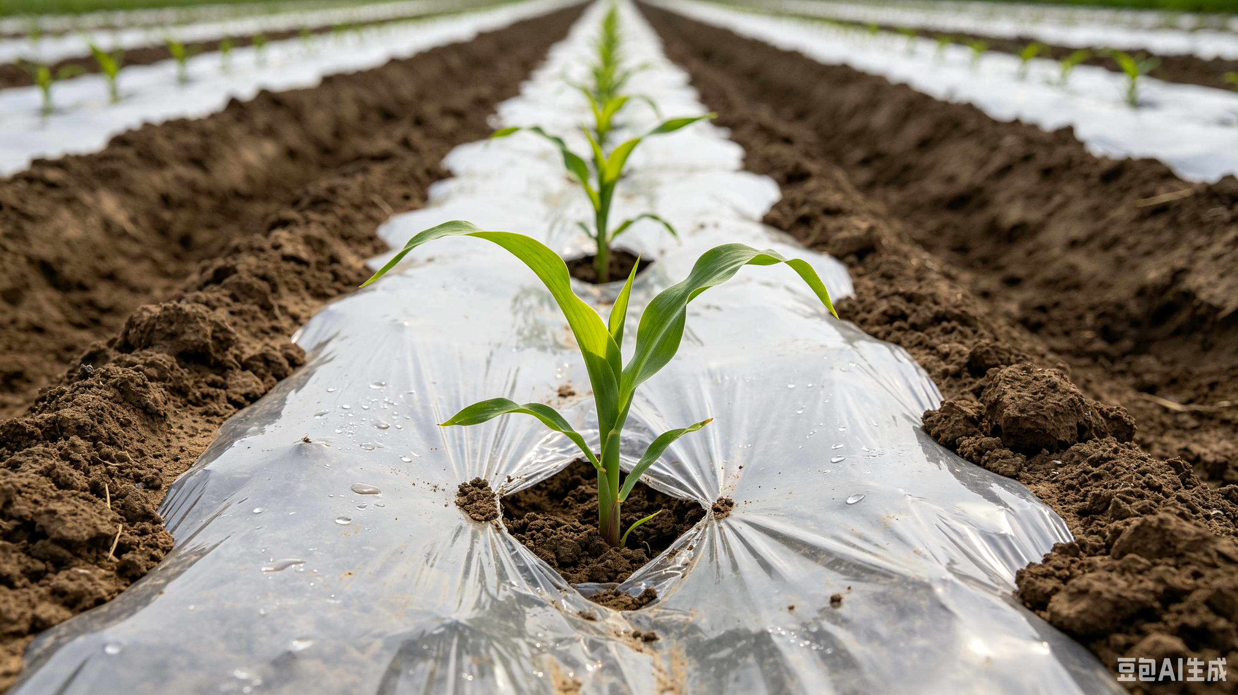
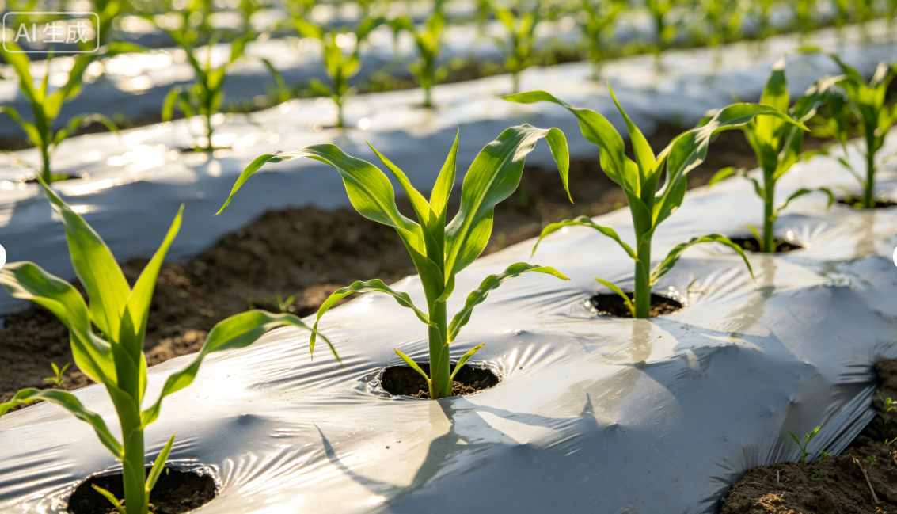
1. Full-Film Mulching Technology for Maize
(6) Field Management
Thinning and Final Singling
Thinning
  Time: when the 3rd true leaf is fully expanded.
  Overcrowded, diseased, weak, off-type seedlings removed to reduce competition.
  Temporarily leave 2 seedlings per hole.
Final Singling
  Time: when seedlings have 4-5 true leaves.
  One vigorous seedling per hole should be retained according to target density.
  Finalize plant spacing and stand establishment with no further adjustments.
Notes:
（2）间苗与定苗
在幼苗第 3 片叶完全展开时，拔除过密、病苗、弱苗、杂苗，减少拥挤，每穴暂留 2 株。
在幼苗长出第 4-5片叶时，按目标密度每穴只留 1 株壮苗，最终确定株距与密度，不再变动。
1.6.2Thinning and Final Singling
When the 3rd true leaf is fully expanded,
overcrowded, diseased, weak and off-type seedlings should be removed to reduce competition,
temporarily leaving 2 seedlings per hole.
When seedlings have 4-5 true leaves,
one vigorous seedling per hole should be retained according to the target density,
finalizing plant spacing and stand establishment with no further adjustments.

Slide 17
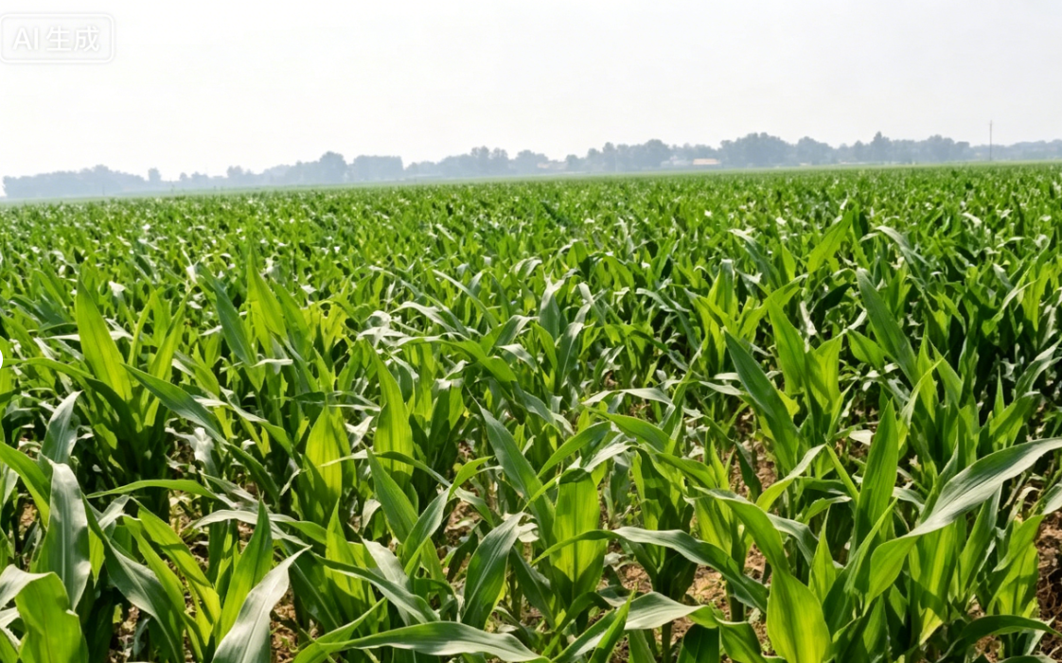
1. Full-Film Mulching Technology for Maize
(6) Field Management
Topdressing Management
Large-Trumpet Stage Characteristics
  Occurs when 10–13 leaves have fully expanded.
  Upper leaves not fully unfolded.
  Lower leaves wrap around newly emerging leaves, forming a trumpet-like shape.
Growth Significance
  Marks critical transition from vegetative → reproductive growth.
  Has decisive influence on final yield.
Topdressing Requirement
  Timely topdressing is essential at this stage.
Notes:
（3）追肥管理
玉米大喇叭口期，一般在植株展开10～13 片叶时出现。此时上部叶片尚未完全展开，下部叶片舒展包裹新叶，整体形似喇叭，是玉米由营养生长转向生殖生长的关键节点，直接决定最终产量高低，此阶段须及时追肥。
1.6.3Topdressing Management
The large trumpet stage of maize generally
occurs when 10-13 leaves have fully expanded.
At this stage, the upper leaves are not yet fully unfolded,
while the lower leaves wrap around the newly emerging leaves, forming a trumpet-like shape.
This stage marks a critical transition from vegetative to reproductive growth
and has a decisive influence on final yield.
Timely topdressing is essential at this stage.

Slide 18
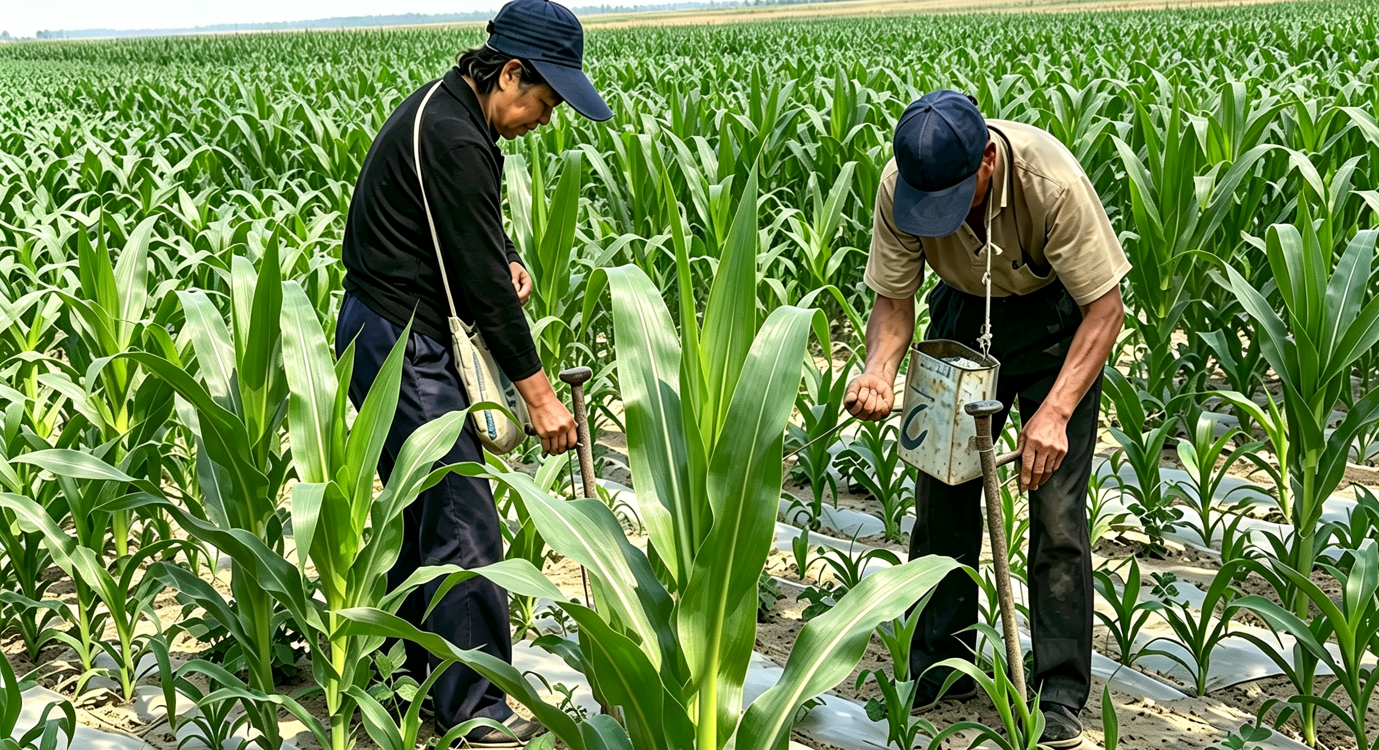
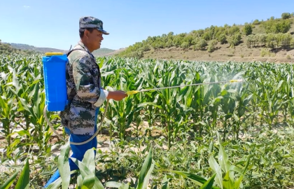
1. Full-Film Mulching Technology for Maize
(6) Field Management
Topdressing Management
Fertilization Methods
  Applied by making holes between two plants with an injector.
  Or by dissolving fertilizer in water and apply as a nutrient solution.
AI生成
AI生成
Deficiency Response
  Yellowing or nutrient-deficiency symptoms appear → timely foliar topdressing should be applied.
Spray-applied Inputs
  Foliar fertilizers.
  Water-soluble fertilizers.
  Drought- and stress-resistance regulators.
  Secondary and micronutrient fertilizers (e.g., zinc)
  → All may be applied by spraying.
Third ear removal
  Third ear should be removed as early as possible→to reduce nutrient competition.
Notes:
可在两株中间用施肥枪等工具打孔施肥，也可将肥料溶解在水中制成肥液注射施肥。或喷施叶面肥、水溶肥、抗旱抗逆制剂以及锌等中微量元素肥。发现植株发黄等缺肥症状时，可采用叶面喷施等方式及时追肥。出现第三穗时尽早掰除，减少养分消耗。
Fertilization may be
applied by making holes between two plants with a fertilizer injector,
or by dissolving fertilizer in water and applying it as a nutrient solution.
Foliar fertilizers,
water-soluble fertilizers,
drought- and stress- resistance regulators,
and secondary and micronutrient fertilizers such as zinc may also be applied by spraying.
If yellowing or other nutrient-deficiency symptoms appear, timely foliar topdressing should be applied.
The third ear should be removed as early as possible when it appears to reduce nutrient competition.

Slide 19
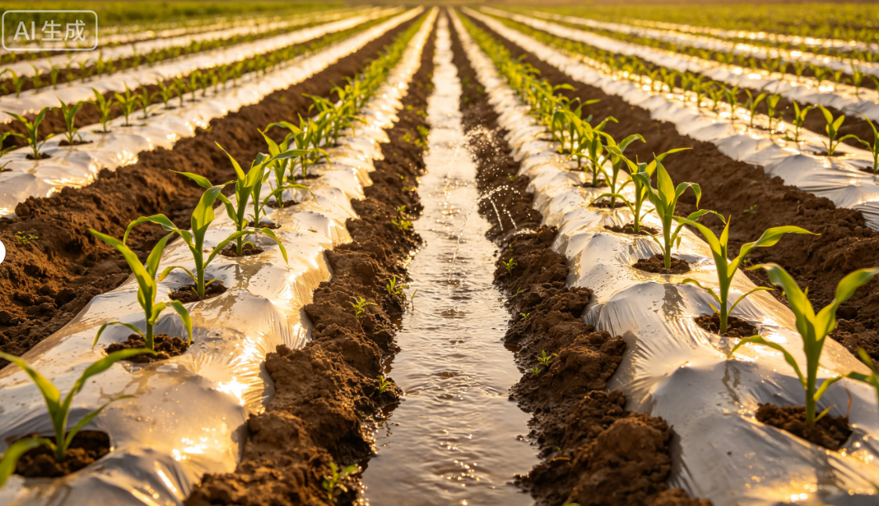
2. Partial-Film Mulching Technology for Maize
Field configuration: ridge planting + furrow irrigation
  Shaping the field into ridges.
  Covering ridge surfaces with plastic film.
  Planting crops on or beside the ridges.
Irrigation method
  Irrigation applied in furrows according to soil moisture-retention dynamics.
AI生成
Notes:
（二）玉米的半膜覆盖技术
半膜覆盖垄作沟灌是将土地平面修成垄形，用地膜覆盖垄面，在垄上或垄侧种植作物，作物生长期按照蓄水规律，将水浇灌在沟内。
2.Partial-Film Mulching Technology for Maize
Partial-film mulching with ridge planting
and furrow irrigation involves shaping the field into ridges,
covering the ridge surfaces with plastic film,
and planting crops on or beside the ridges.
During the crop growth,
irrigation is applied in the furrows according to soil moisture-retention dynamics.

Slide 20
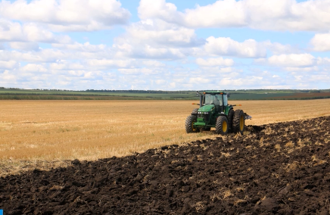
2. Partial-Film Mulching Technology for Maize
(1) Land Selection, Field Preparation and Fertilization
Land Selection
Suitable conditions — For maize grown under a partial-film mulched ridge–furrow irrigation system
  Well-developed soil aggregate structure.
  Strong water-holding capacity.
  Deep topsoil layer.
Preceding crops
  Legumes
  Potatoes
  Wheat
  Vegetables
Notes:
1、选地、整地与施肥
玉米的半膜覆盖垄作沟灌技术，首先要做好地块选择及整地。选择土壤团粒结构好、蓄水能力强、土层较厚的地块。前一季以豆类、马铃薯、小麦、蔬菜等为佳。
2.1 Land Selection, Field Preparation and Fertilization
For maize grown under a partial-film mulched ridge-furrow irrigation system,
proper land selection and field preparation are essential.
Fields should have a
well-developed soil aggregate structure,
strong water-holding capacity,
and a deep topsoil layer.
The best preceding crops include legumes, potatoes, wheat and vegetables.

Slide 21
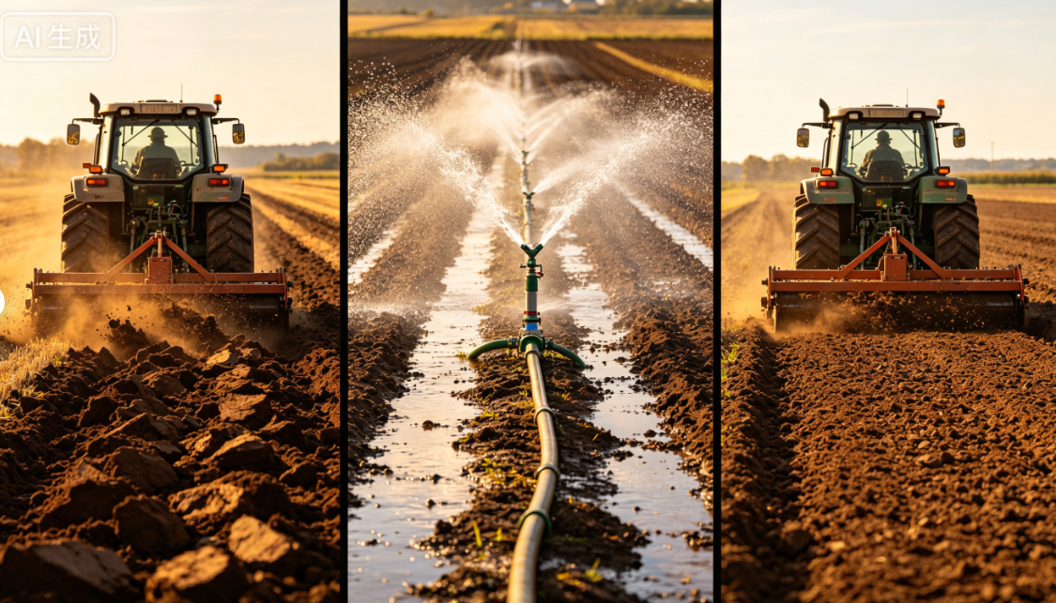
2. Partial-Film Mulching Technology for Maize
(1) Land Selection, Field Preparation and Fertilization
Field Preparation
Deep tillage — Before sowing
  20–25 cm depth.
  Pre-sowing irrigation to ensure adequate base soil moisture.
AI生成
Winter-irrigated Fields Surface Soil Management
  Clod breaking.
  Surface levelling.
  Light compaction.
  Carried out promptly after irrigation.
  → maintain soil moisture and create favourable soil moisture conditions for spring sowing.
Notes:
播种前要深耕土壤20-25cm，并进行播前灌溉，确保土壤底墒充足。对于具备冬季灌溉条件的农田，灌水后应及时开展土壤表土整理作业，包括破碎土块、平整地表并适度压实，以有效保持土壤水分，为春播创造良好墒情。
Before sowing,
the soil should be deeply tilled to a depth of 20-25 cm,
followed by pre-sowing irrigation to ensure adequate base soil moisture.
In fields where winter irrigation is feasible, surface soil management—including
clod breaking, surface leveling and light compaction—should be
carried out promptly after irrigation to effectively
maintain soil moisture and create favorable soil moisture conditions for spring sowing.

Slide 22
2. Partial-Film Mulching Technology for Maize
(1) Land Selection, Field Preparation and Fertilization
Fertilization
Recommended Total Nutrient Application Rates for Maize
  Amounts per hectare over the entire growing period:
Nitrogen Fertilizer Application Methods
  Basal vs. topdressing
Two-thirds applied as basal fertilizer.
One-third applied as topdressing.
  Basal fertilizer placement
Incorporated during spring tillage.
Or band-applied at the bottom of ridges during ridge formation.
390–420 kg of pure nitrogen.
150–225 kg of phosphorus.
90–120 kg of potassium.
22.5–30 kg of zinc sulfate
  Fertilizer rates may be adjusted based on soil testing results.
Important Note
  Rates are based on content of effective nutrient (N, P, K, ZnSO₄), not total weight of fertilizer products.
Farmyard Manure Application
  60,000–75,000 kg of well-decomposed farmyard manure should be applied per hectare.
Notes:
在玉米全生育期内，推荐施肥总量为：每公顷施用纯氮390-420kg、磷 150-225kg、钾 90-120kg、硫酸锌 22.5-30kg。或根据测土结果进行配方施肥。化学肥料中的氮肥的2/3作为基肥施用，剩余1/3作为追肥。基肥可结合春耕施入或在起垄时集中施入垄底。每公顷施优质农家肥60,000-75,000kg。
注：以上施肥量均以有效养分（氮、磷、钾、硫酸锌）含量计算，而非肥料产品本身的总重量。
The total recommended nutrient application rate for maize
over the entire growing period is
390-420 kg of pure nitrogen,
150-225 kg of phosphorus,
90-120 kg of potassium,
and 22.5-30 kg of zinc sulfate per hectare.
Fertilization rates may also be adjusted based on soil testing results.
Two-thirds of the nitrogen fertilizer should be applied as a basal application,
with the remaining one-third applied as topdressing.
Basal fertilizers may be incorporated during spring tillage or band-applied at the bottom of the ridges during ridge formation.
A total of 60,000-75,000 kg of well-decomposed farmyard manure should be applied per hectare.
Note: The above fertilization rates are calculated based on the content of effective nutrients (nitrogen, phosphorus, potassium, and zinc sulfate),
rather than the total weight of the fertilizer products.

Slide 23
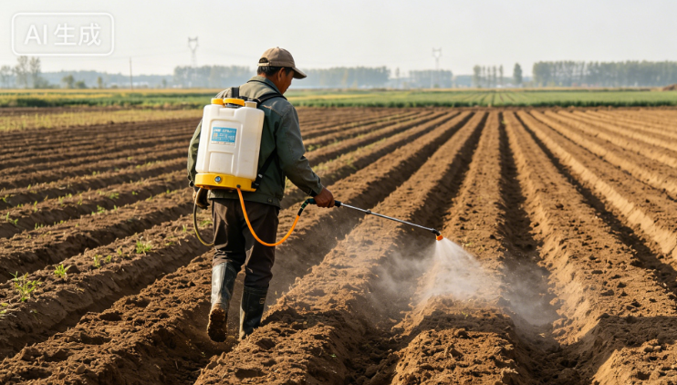
2. Partial-Film Mulching Technology for Maize
(2) Weed Control and Ridge Formation under Partial-Film Mulching
Weed Control
For fields with heavy weed infestation
  Full-field pre-emergence soil-sealing spray with 50% acetochlor emulsifiable concentrate (EC).
  Applied after field preparation and ridge formation.
Recommended Application Rates
  High soil moisture & elevated temperatures:
750–1050 g/ha.
450 kg water dilution for uniform spraying.
Immediate mulching with plastic film.
  Cool regions with short frost-free period & irrigation available:
2250–3000 g/ha.
600–750 kg water dilution for uniform spraying.
Notes:
2、膜下除草与起垄覆膜
对于杂草较多、危害较重的地块，可在整地起垄后，采用50%乙草胺乳油进行全田封闭喷雾处理。推荐用量如下：
土壤湿度大、温度较高的地区：每公顷用50%乙草胺乳油750-1050g，兑水450 kg，均匀喷雾。
气候温凉、无霜期短，可以通过人工灌溉的地区：每公顷用2250-3000g，兑水600-750kg，均匀喷雾。 。
2.2Weed Control and Ridge Formation under Partial-Film Mulching
For fields with heavy weed infestation,
a full-field pre-emergence soil-sealing spray with 50% acetochlor emulsifiable concentrate (EC) may be
applied after field preparation and ridge formation.
The recommended application rates are as follows:
•In regions with high soil moisture and elevated temperatures:
Apply 750–1050 g of 50% acetochlor EC per hectare,
diluted in 450 kg of water for uniform spraying.
Immediately mulch the field with plastic film after application.
•In cool regions with a short frost-free period and irrigation is available:
Apply 2250–3000 g of 50% acetochlor EC per hectare,
diluted in 600–750 kg of water for uniform spraying across the entire field.

Slide 24
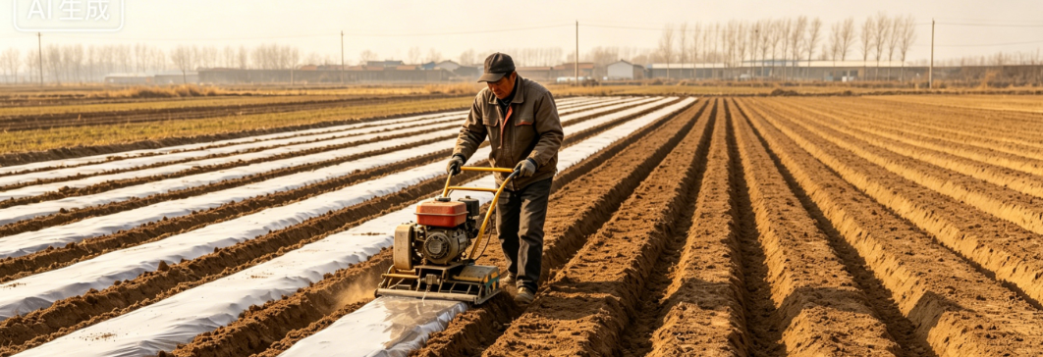
2. Partial-Film Mulching Technology for Maize
(2) Weed Control and Ridge Formation under Partial-Film Mulching
Ridge Formation and Film Mulching
Timing: Early to mid-March once the cultivated layer has thawed.
Ridge & Furrow Dimensions
  Ridge: 60 cm wide & 15 cm high.
  Furrow: 30 cm wide.
Mulching Material
  Plastic film.
  Width: 90–100 cm.
Mulching Requirements
  Pulled tight.
  Laid flat.
  Firmly secured to ridge surface.
Recommended Operation
  Ridge formation and film mulching during early spring—when the soil thaws during the day and refreezes at night.
Benefits
  Maximizes soil moisture retention.
  Suppresses weed emergence.
  Raises soil temperature earlier.
  Creates favourable conditions for maize sowing.
Notes:
一般在3月上中旬，待耕作层解冻后就可以起垄。垄宽60cm、垄高15cm，垄沟宽30cm，选用幅宽90-100cm的地膜。覆膜时应将地膜拉紧、铺正，与垄面紧密贴合。推荐早春土壤昼消夜冻时期进行的起垄和覆膜作业。此时操作可最大程度保持土壤墒情，抑制杂草，并提早提升地温，为玉米播种创造有利条件。
Ridge formation can generally be carried out in early to mid-March once the cultivated layer has thawed.
Ridges should be 60 cm wide and 15 cm high,
with furrows 30 cm wide.
Plastic film with a width of 90-100 cm should be used.
During mulching, the film should be pulled tight, laid flat, and firmly secured to the ridge surface.
Ridge formation and film mulching during early spring—when the soil thaws during the day and refreezes at night—are highly recommended.
This practice
maximizes soil moisture retention,
suppresses weed emergence,
and raises soil temperature earlier.
These effects create favorable conditions for maize sowing.

Slide 25
2. Partial-Film Mulching Technology for Maize
(3) Sowing Technology and Planting Density
Sowing Practices and Planting Layout
Seed Selection
  Drought-resistant.
  High-quality.
  High-yielding.
  → to ensure good emergence and stable yield.
Sowing parameters
  Sowing depth: 3–5 cm.
  Plant spacing: 20–25 cm.
  Planting density: 67,500–82,500 plants/ha.
Sowing time
  In mid to late April when surface soil temperature is > 10°C.
  Sowing too early → result in freezing injury and poor emergence → reducing yield.
Ridge-based planting
  Side-ridge planting: Seeds hill-planted on ridge side, ≥10 cm above ridge bottom.
  On-ridge planting: Seeds hill-planted on ridge crests, with two rows per ridge.
Notes:
3、播种技术与密度
为了保证出苗和产量，应选用抗旱、优质、高产的种子。玉米一般在4月中下旬，土层温度稳定在10℃以上时播种。播种过早容易受冻、出苗受阻，进而影响产量。播种深度3-5cm，株距20-25cm，每公顷种植密度67,500-82,500株。垄侧种植，种子点播在垄侧距离垄底10cm以上；垄上种植，种子点播在垄脊上，每垄种植两行。
2.3Sowing Technology and Planting Density
Drought-resistant,
high-quality and high-yielding maize seeds should be selected
to ensure good emergence and stable yield.
Maize is generally sown in mid to late April, when the surface soil temperature remains steadily above 10℃.
Sowing too early may result in freezing injury and poor emergence, ultimately reducing yield.
The recommended sowing depth is 3-5 cm,
with a plant spacing of 20-25 cm,
and a planting density of 67,500-82,500 plants per hectare.
For side-ridge planting, seeds are hill-planted on the ridge side, at least 10 cm above the ridge bottom.
For on-ridge planting, seeds are hill-planted on the ridge crests, with two rows planted on each ridge.

Slide 26
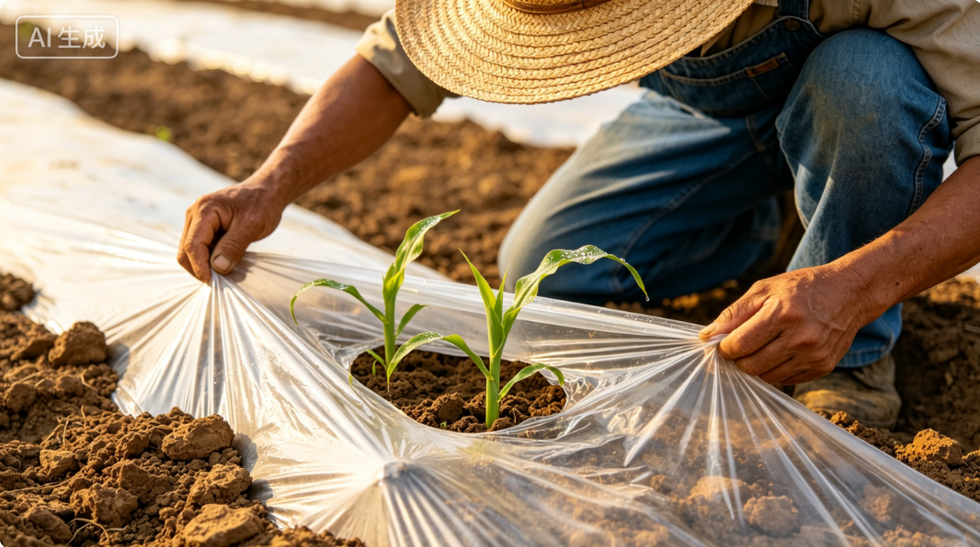
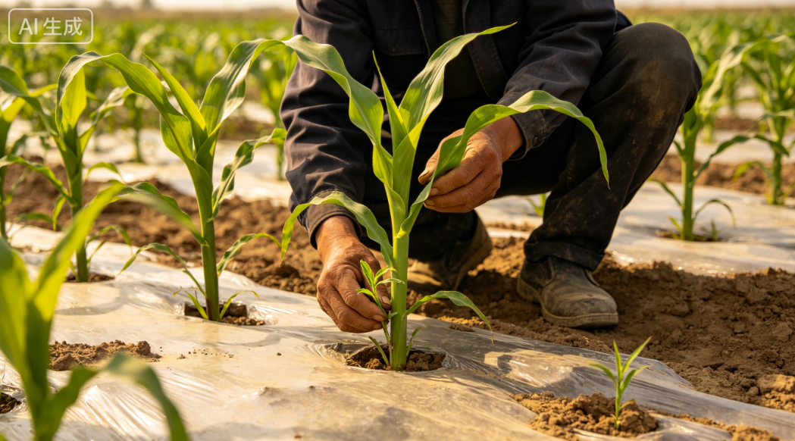
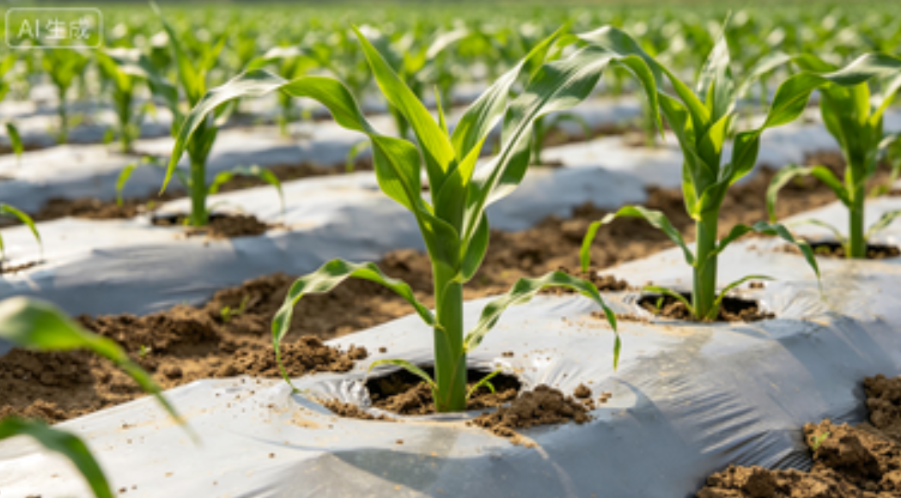
2. Partial-Film Mulching Technology for Maize
(3) Sowing Technology and Planting Density
Early Seedling Management
Emergence timing: Film-mulched maize emerges 10–15 days after sowing.
First-leaf unfolded: Small openings made in mulch to allow seedlings emergence and to prevent heat injury.
3–4 leaf stage: Weak, diseased, and overcrowded seedlings removed to improve field ventilation and light penetration.
4–5 leaf stage: One vigorous seedling retained per hill to ensure optimal plant population structure.
Notes:
覆膜玉米从播种到出苗约需10-15天。在幼苗第一片叶子展开后，应及时在膜上开孔，帮助幼苗伸出膜外，防止高温灼伤；在3-4叶期，拔除弱苗、病苗及过密苗，改善田间通风透光；在4-5叶期，每穴选留1株健壮幼苗，确保合理群体结构。
Film-mulched maize typically emerges 10-15 days after sowing.
Once the first leaf of the seedlings has unfolded, small openings should be made in the mulch to allow seedlings to emerge and to prevent heat injury.
At the 3-4 leaf stage, weak, diseased and overcrowded seedlings should be removed to improve field ventilation and light penetration.
At the 4-5 leaf stage, one vigorous seedling should be retained per hill to ensure an optimal plant population structure.

Slide 27
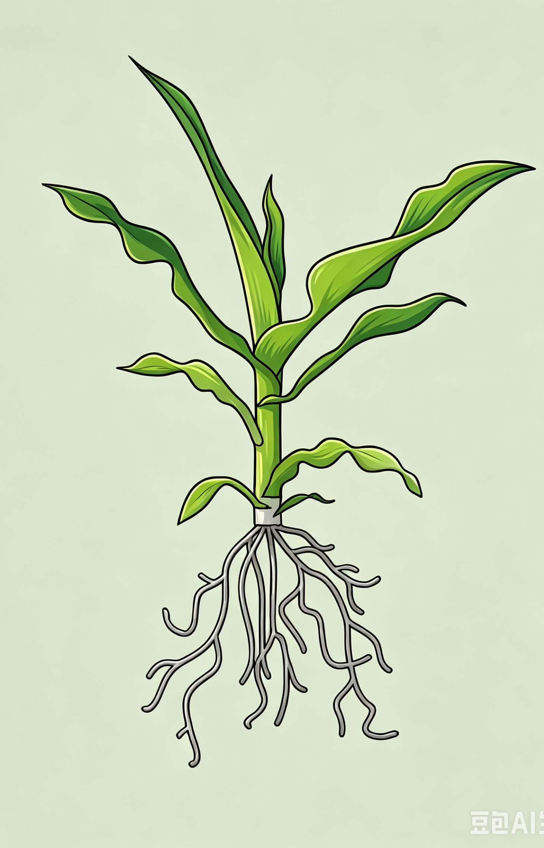
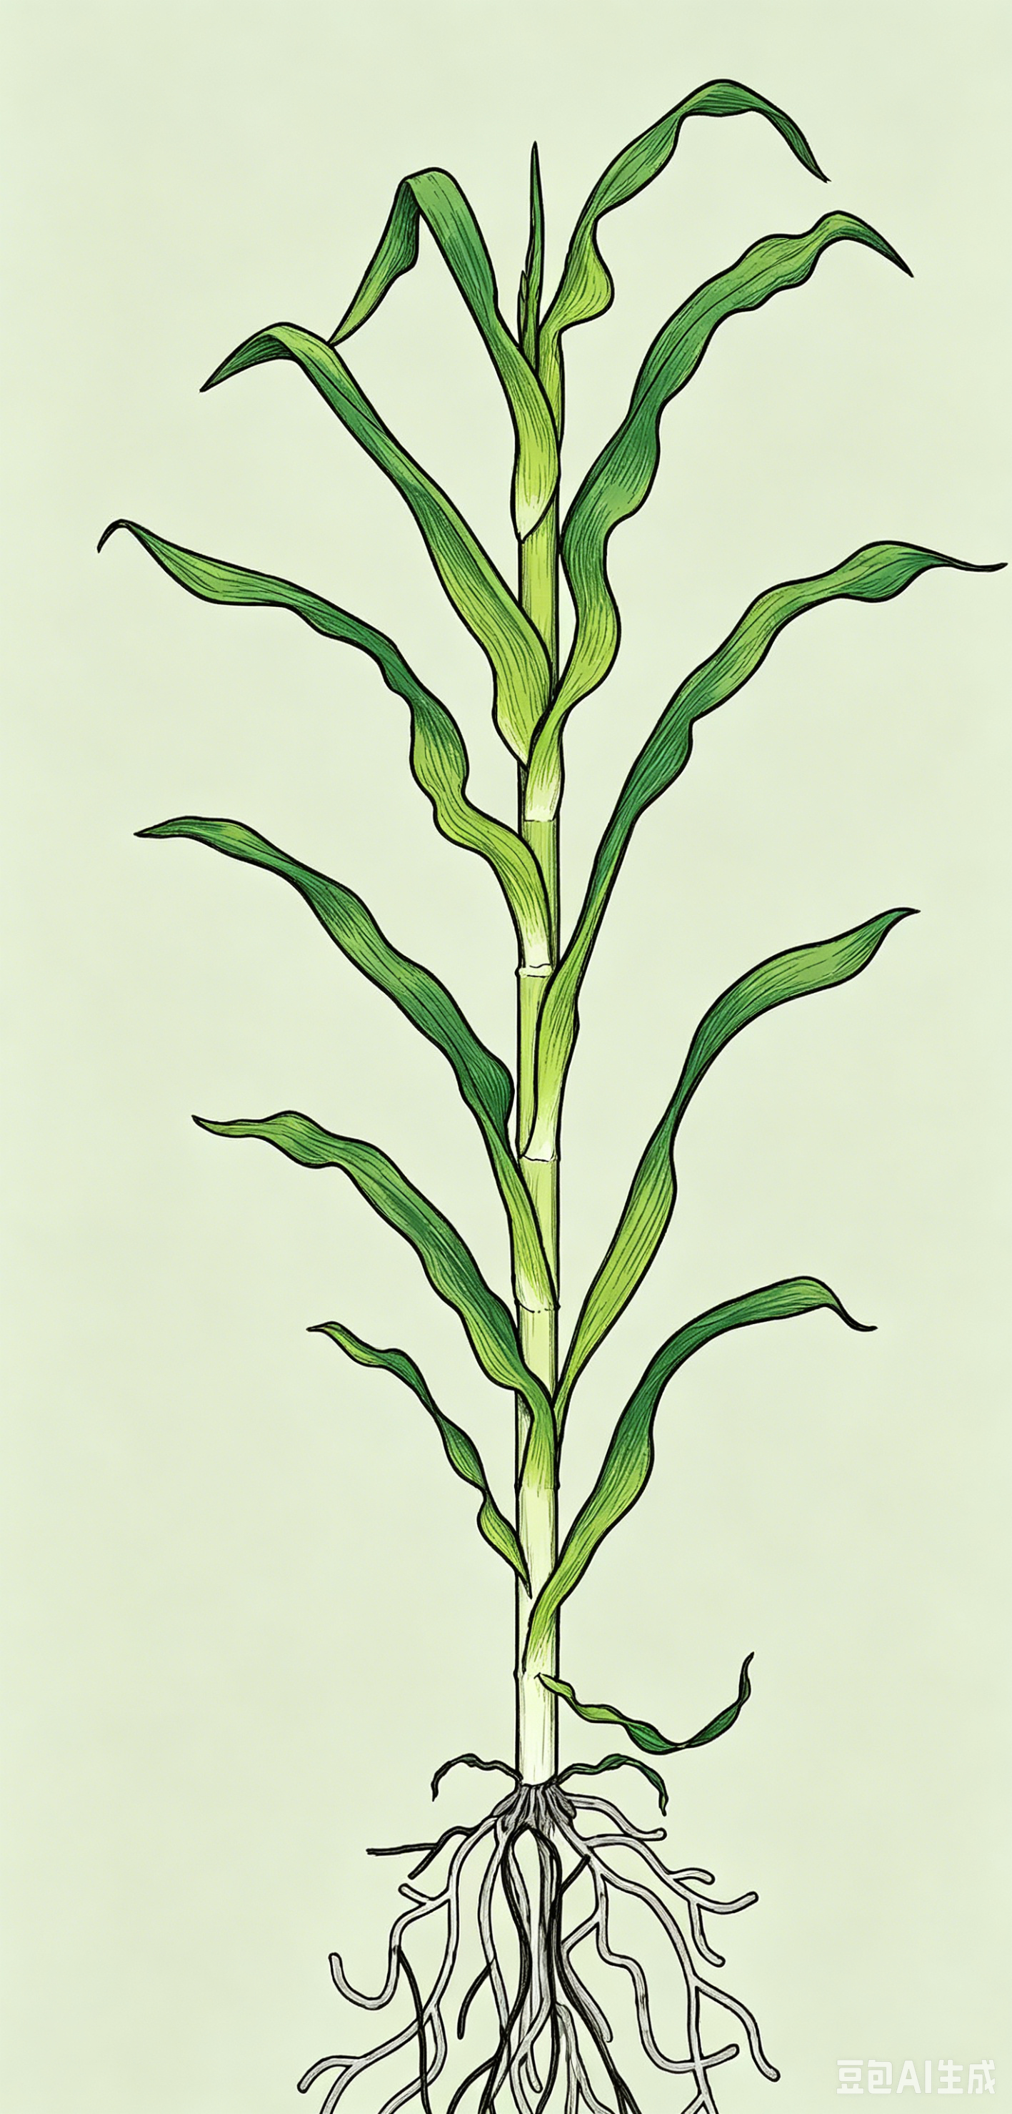
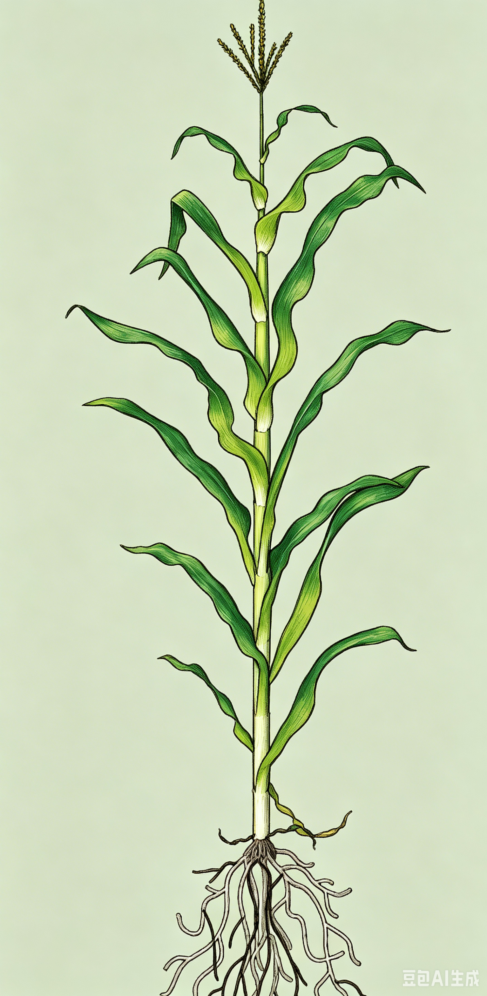
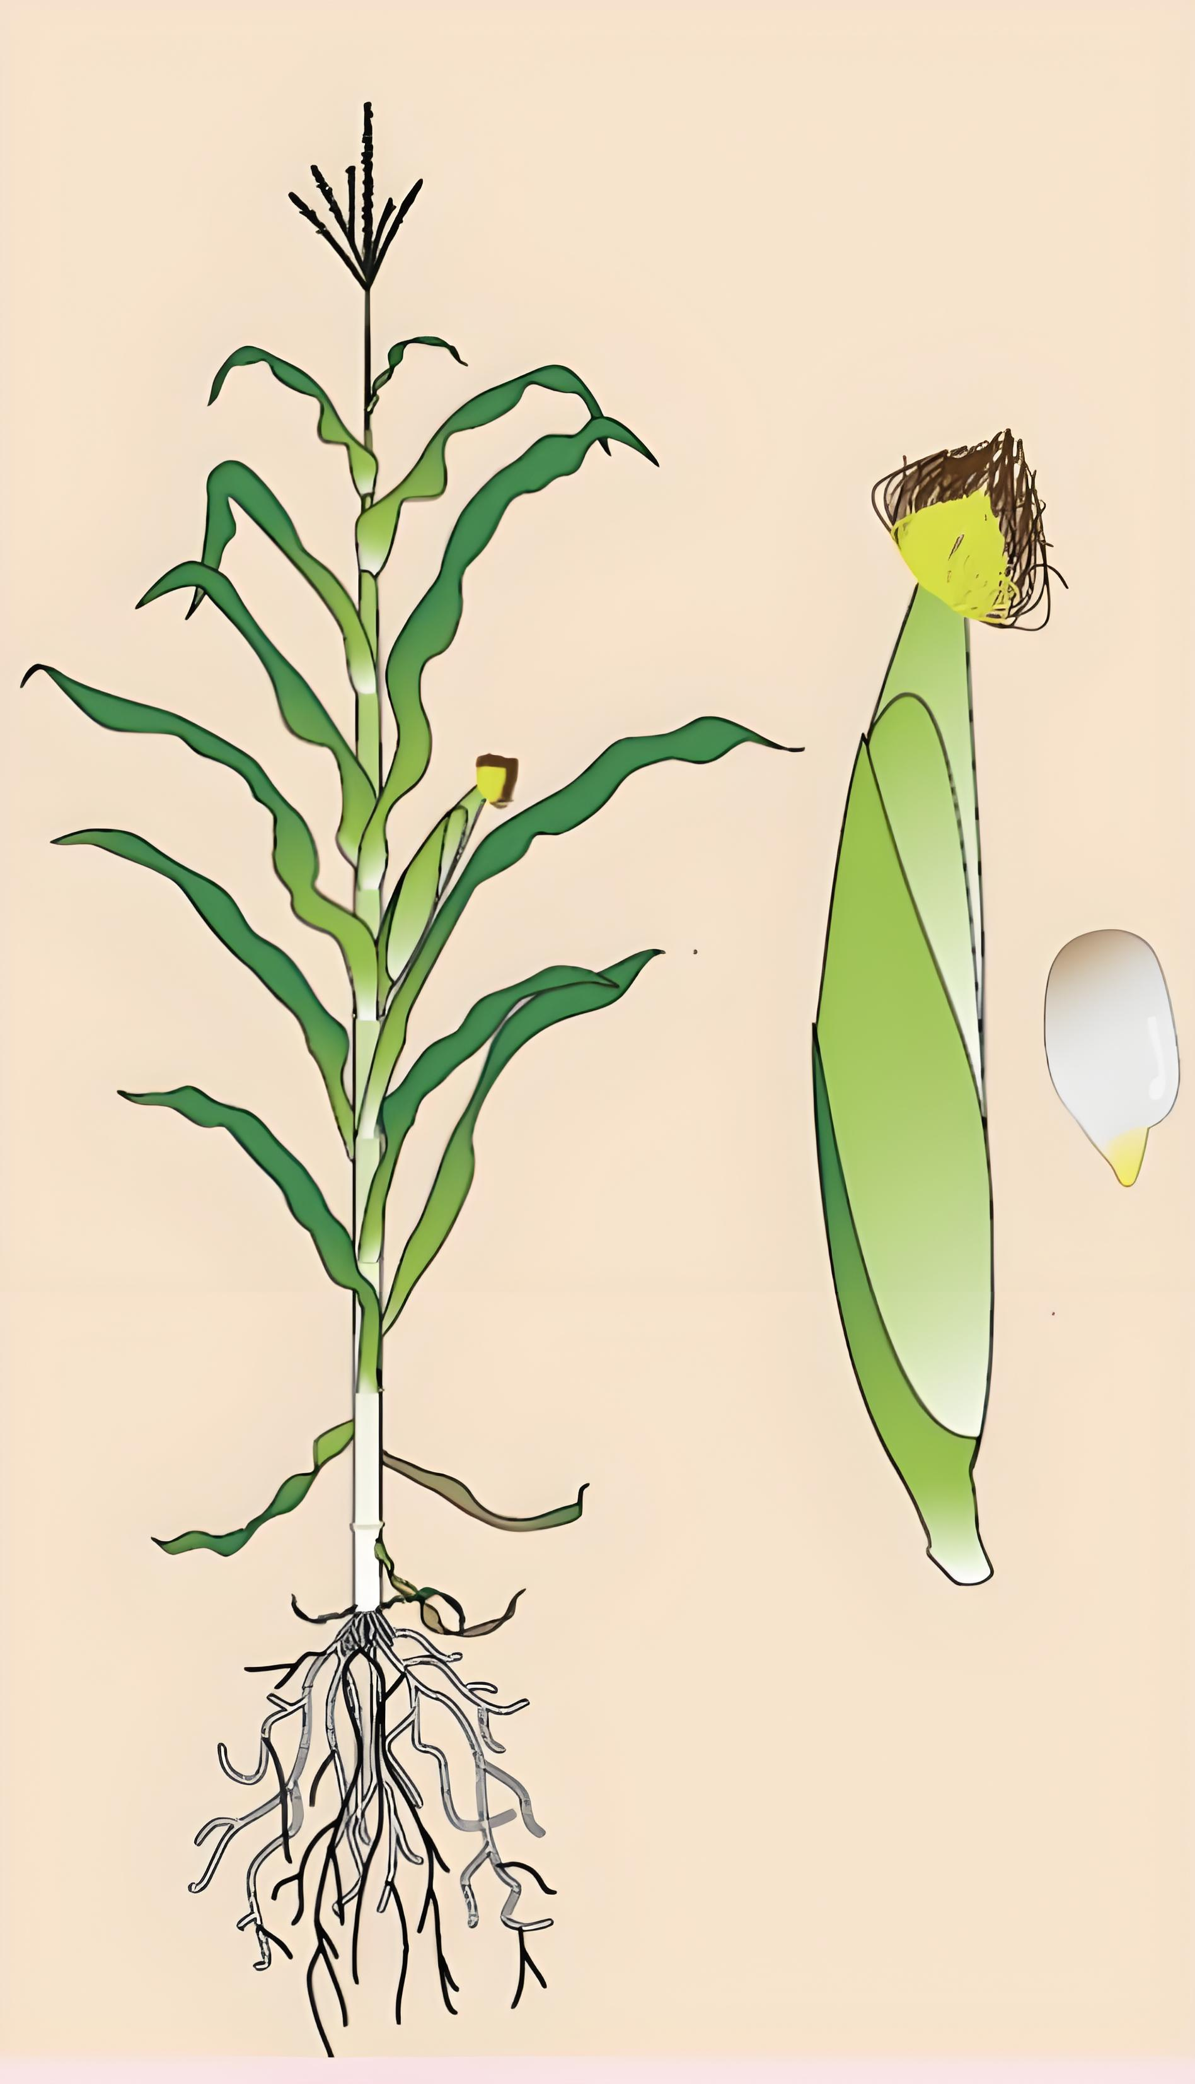
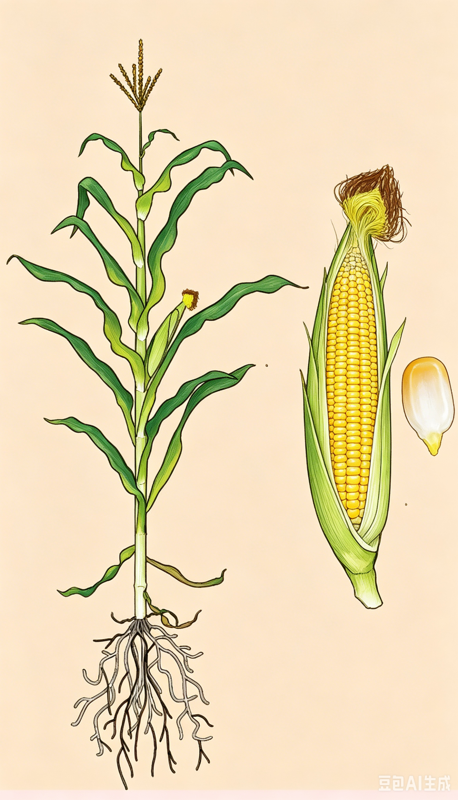
2. Partial-Film Mulching Technology for Maize
(4) Irrigation and Topdressing Management
Irrigation Alignment with Growth Stages
Five Major Phases
  Jointing stage: Rapid stem elongation and transition into rapid growth period.
  Trumpet-shaped stage: Upper leaves form trumpet-like shape; critical period for differentiation and development of male and female inflorescences.
  Tasseling stage: Tassel fully emerges, and the crop enters flowering and pollination period.
  Grain filling stage: Starch deposition increases and kernels progressively enlarge.
  Milk stage: Kernels contain milky endosperm, representing important phase in final yield formation.
Jointing stage
Trumpet-shaped stage
Tasseling stage
Grain filling stage
Milk stage
Notes:
4、灌溉与追肥管理
玉米的灌溉管理需要根据其生长发育的关键节点来进行，主要包括以下五个阶段：
1)拔节期：此时玉米茎秆开始迅速伸长，是植株进入快速生长期的标志。
2)大喇叭口期：此时玉米上部叶片展开呈喇叭状，是雌雄穗分化发育的关键时期。
3)抽雄期：玉米顶端的雄穗开始抽出，植株进入开花授粉阶段。
4)灌浆期：授粉完成后，籽粒开始积累淀粉，逐渐充实饱满。
5)乳熟期：籽粒内呈乳白色浆液状，是产量形成的重要阶段。
2.4 Irrigation and Topdressing Management
Irrigation management of maize should be aligned with its key growth stages.
In practice, this involves five major phases across the crop’s development.
•Jointing stage: Characterized by rapid stem elongation and the transition into rapid growth period.
•Trumpet-shaped stage: The upper leaves form a trumpet-like shape, marking a critical period for the differentiation and development of male and female inflorescences.
•Tasseling stage: The tassel fully emerges, and the crop enters the flowering and pollination period.
•Grain filling stage: Following pollination, starch deposition increases and kernels progressively enlarge.
•Milk stage: Kernels contain milky endosperm, representing an important phase in final yield formation.

Slide 28
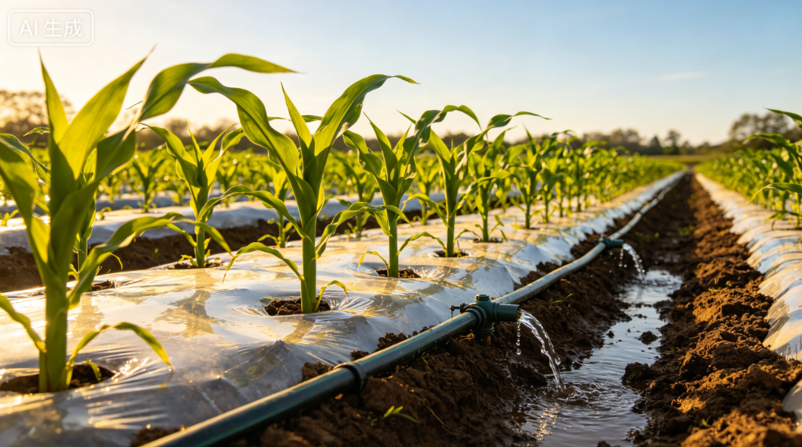
2. Partial-Film Mulching Technology for Maize
(4) Irrigation and Topdressing Management
Key Points of Irrigation Management
Irrigation Timing
  First irrigation at the jointing stage.
  Typically in early to mid-June.
Irrigation Frequency & Volume
  Over the entire growing period, five irrigations are required.
  Each supplying ≈750 m³ water/ha.
Irrigation Depth Requirements
  On-ridge planted maize under furrow irrigation: water depth ≤ two-thirds of furrow depth.
  Side-ridge planting: depth should be sufficient to reach the root zone.
Notes:
灌溉管理要点：
一般在6月上中旬，开始进行第一次灌溉（即拔节期时的灌溉），全生育期共需灌水五次，每次灌溉量约为每公顷750 m3。垄上种植玉米进行沟灌时，水深不得超过沟深的2/3；膜侧栽培时，灌水深度应漫过根部。
Key points of irrigation management:
The first irrigation, applied at the jointing-stage,
is typically carried out in early to mid-June.
Over the entire growing period, five irrigations are required,
each supplying approximately 750 m³ of water per hectare.
For on-ridge planted maize under furrow irrigation,
the irrigation water depth shall not exceed two-thirds of the furrow depth.
For side-ridge planting,
the irrigation depth should be sufficient to reach the root zone.

Slide 29
2. Partial-Film Mulching Technology for Maize
(4) Irrigation and Topdressing Management
Nitrogen Topdressing Management
Nitrogen Application Frequency
  Applied 2–3 times in combination with irrigation throughout the entire growing period of maize.
Topdressing Principles
  Follow light early → heavy mid → supplemental late.
  Light application at the jointing stage.
  Heavy application at the trumpet-shaped stage.
  Supplementary application during grain filling according to plant growth conditions.
Specific Topdressing Schedule
  First topdressing (jointing stage): Apply with first irrigation; 120 kg N/ha.
  Second topdressing (trumpet-shaped stage): Peak nutrient demand; heavy application → 150 kg N/ha.
  Third topdressing (grain filling stage): Supplemental nitrogen applied when nutrient deficiency is observed; ≤45 kg N/ha.
Notes:
玉米全生育期应结合灌水追施氮肥2至3次。追肥应遵循“前轻、中重、后补”的原则（即拔节期轻施、大喇叭口期重施、灌浆期根据长势补施）。
各时期的具体追肥方案如下：
第一次追肥（拔节期）：当玉米进入拔节期，结合灌头水进行。每公顷追施纯氮肥120 kg。
第二次追肥（大喇叭口期）：这是玉米需肥的关键期，应重施。每公顷追施纯氮肥150kg。
第三次追肥（灌浆期）：根据玉米长势，若发现脱肥现象可适当追肥，每公顷追施纯氮肥不超过45kg。
Nitrogen fertilizer should be
applied 2 to 3 times in combination with irrigation throughout the entire growing period of maize.
Topdressing should
follow the principle of "light application in the early stage,
heavy application in the middle stage,
and supplementary application in the later stage," that is,
light application at the jointing stage,
heavy application at the trumpet-shaped stage,
and supplementary application during grain filling according to plant growth conditions.
The specific topdressing schedule is as follows:
•First topdressing (jointing stage): Apply topdressing together with the first irrigation when maize enters the jointing stage. Apply 120 kg of pure nitrogen per hectare.
•Second topdressing (trumpet-shaped stage): This stage represents the peak nutrient-demand period, and a heavy application is required. Apply 150 kg of pure nitrogen per hectare.
•Third topdressing (grain filling stage): Supplemental nitrogen may be applied according to plant growth conditions when nutrient deficiency is observed, with the application rate not exceeding 45 kg of pure nitrogen per hectare.

Slide 30
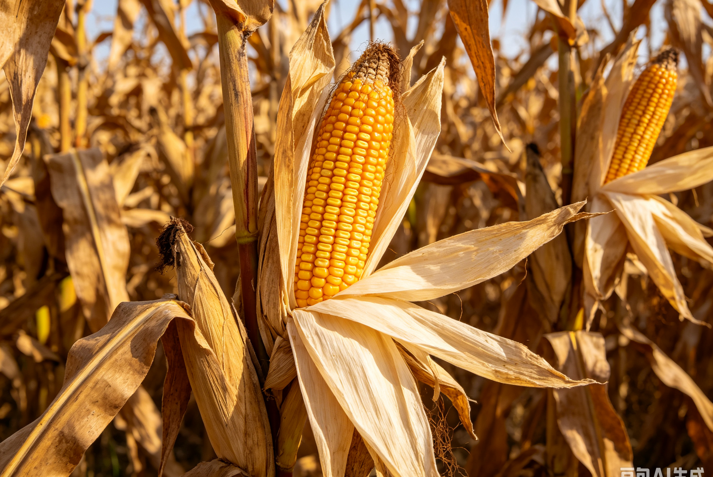
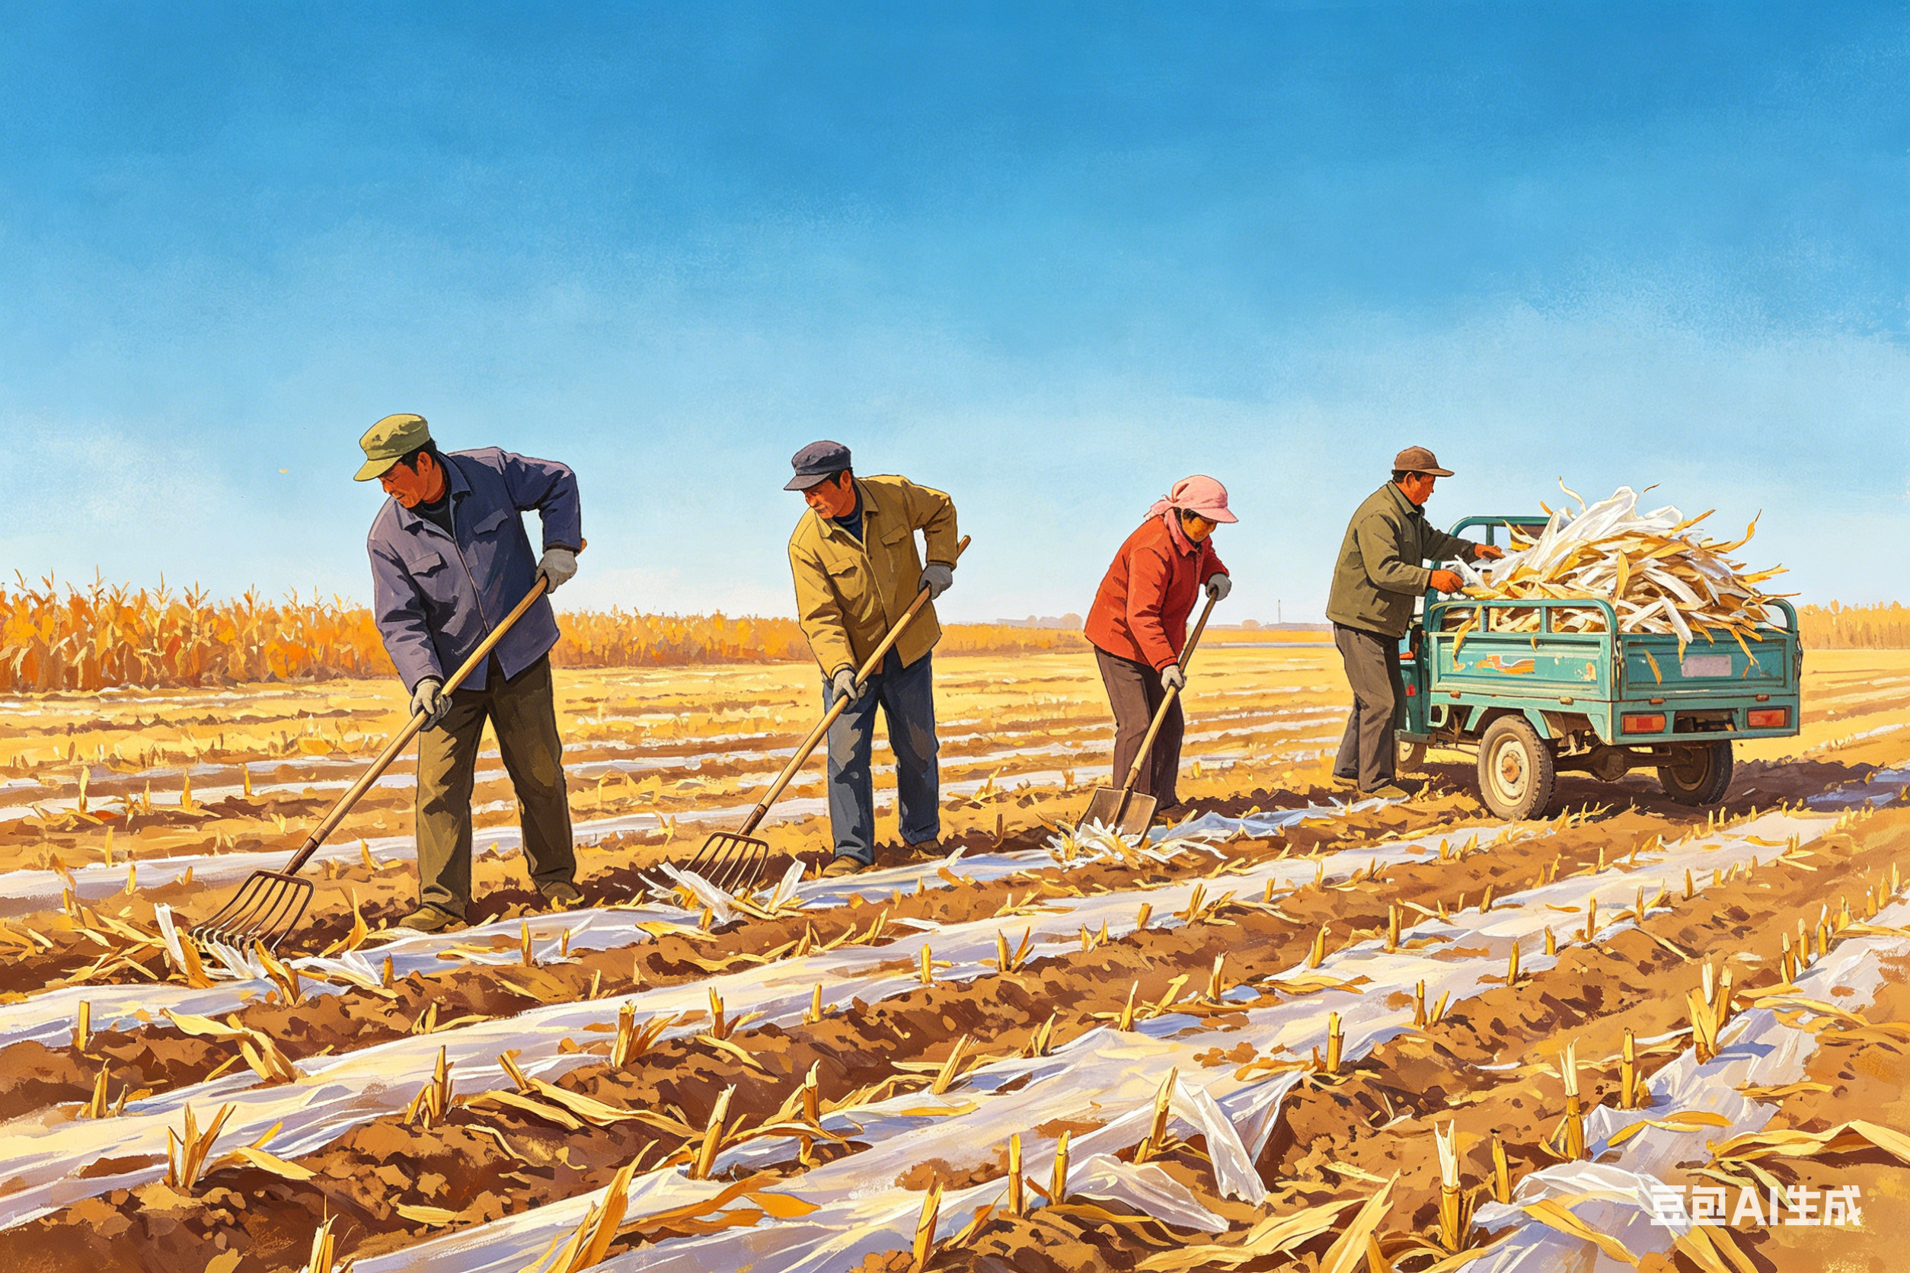
2. Partial-Film Mulching Technology for Maize
(5) Harvesting and Residual Mulch Management
Harvesting and Residual Mulch Management
Harvest Time
  Harvest when maize husks have turned yellow and kernels are hard and glossy.
Post-harvest Handling
  Maize dried and stored without delay to prevent moisture absorption and mold.
Mulch Collection and Reuse
  Residual plastic mulch should be collected manually or mechanically after maize harvest.
  The collected mulch may be reused for up to two consecutive seasons.
Notes:
5、收获与残膜处理
当玉米苞叶变黄、籽粒变硬、有光泽时收获。收获后注意及时晾晒储存，防止受潮霉变。玉米收获后，采用人工或机械回收地膜。在适宜地区可实行一膜两年用。
2.5 Harvesting and Residual Mulch Management
Harvesting should be conducted when the maize husks have turned yellow and the kernels are hard and glossy. After harvest,
the maize should be dried and stored without delay to prevent moisture absorption and mold.
Residual plastic mulch should be collected manually or mechanically after maize harvest.
In areas where conditions allow,
the collected mulch may be reused for up to two consecutive planting seasons.

