Slide 1

粮堆害虫智能监测与预警技术
Introduction to online monitoring and early warning technology of stored grain pests
Academy of National Food and Strategic Reserves Administration
Zhongming Wang
Sep. 2024

Slide 2
CONTENTS
Research background and key scientific issues
Intelligent monitoring technology and equipment for grain pests
01
02
Monitoring and early warning of the distribution of grain piles of main grain storage pests
03

Slide 3
01
Research background and key scientific issues
Notes:
研究背景

Slide 4
（一）Integrated pest control technology system for stored grain
Monitoring
Prevention
Control
Artificial sampling
Attraction and trapping
Online monitoring
Sanitizing
Grain-preservatives
Low temperature
Fumigation
Modified atmosphere
Notes:
储粮害虫综合防治技术体系包括监测、预防和治理3个部分。其中害虫监测的技术手段包括传统的人工扦样、害虫诱捕，以及基于信息化的在线监测。

Slide 5
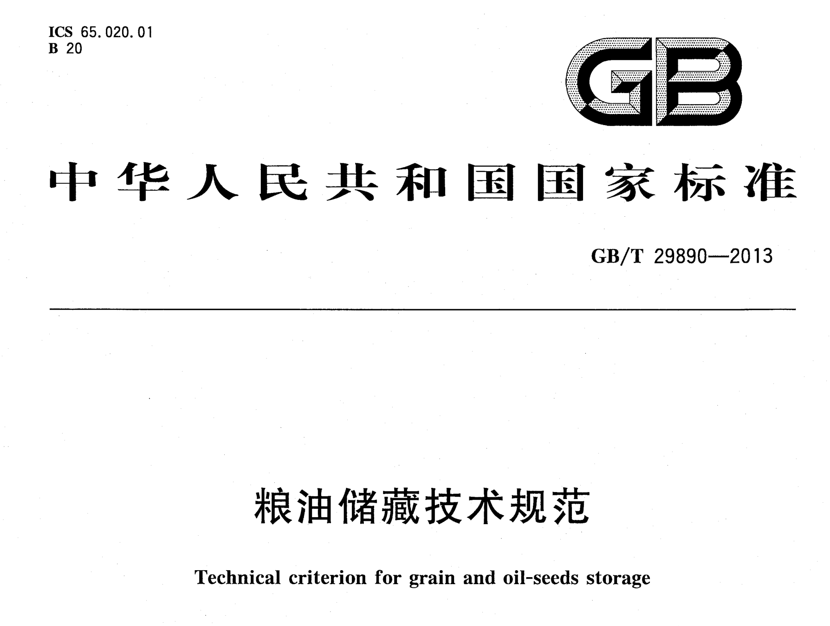
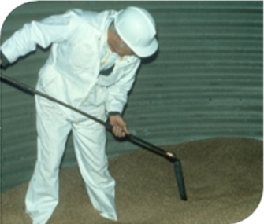
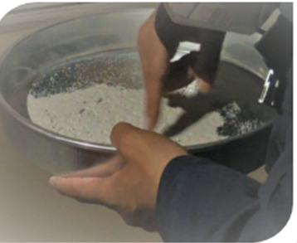
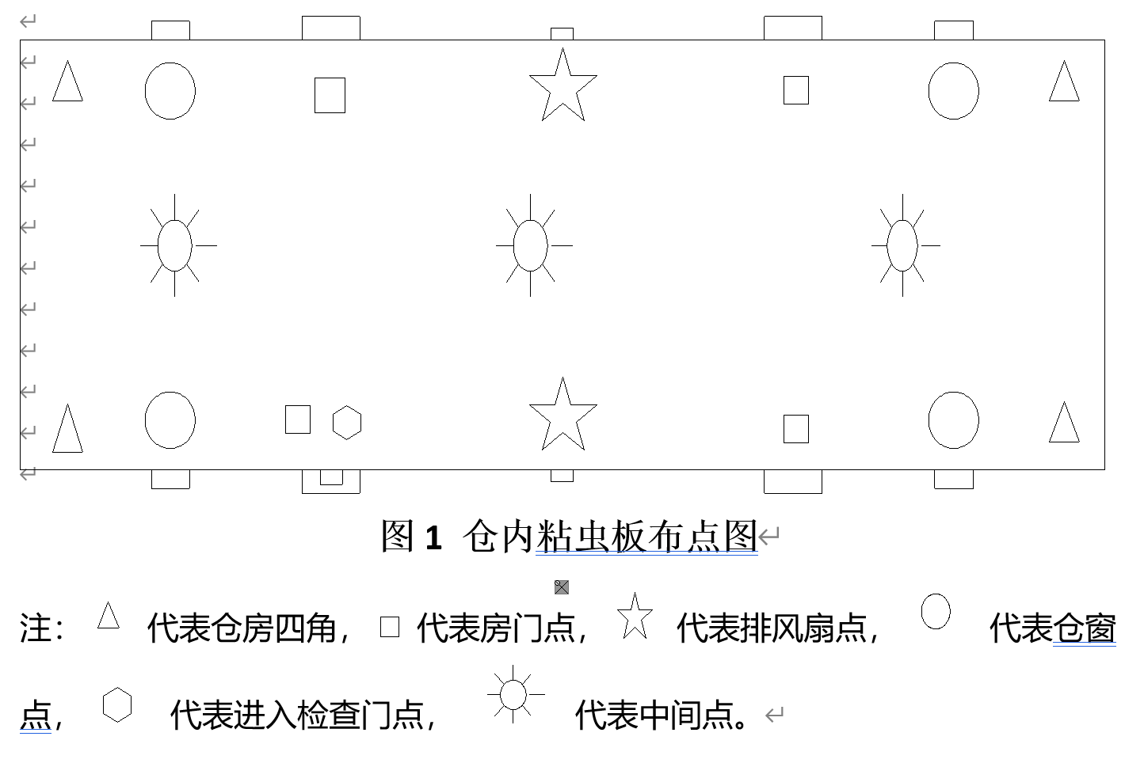
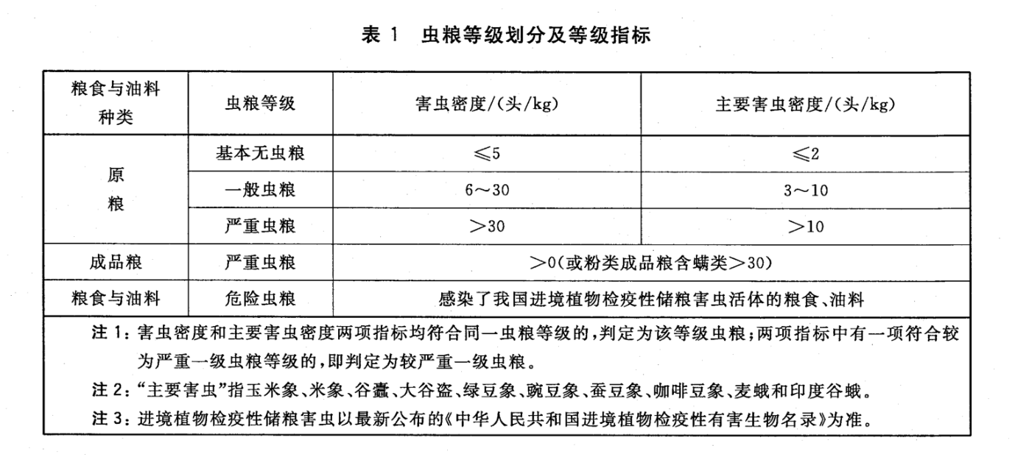
1、Traditional pest monitoring
National standards
Notes:
中国现行的粮油储藏技术规范仍然是以人工扦样筛检作为害虫监测的标准，要求粮库管理员至少每月要对储藏粮堆进行扦样检查，这一传统的手段显得费时费力。

Slide 6
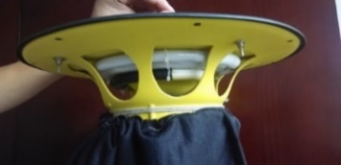

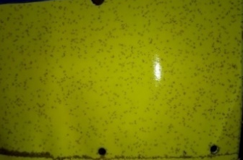

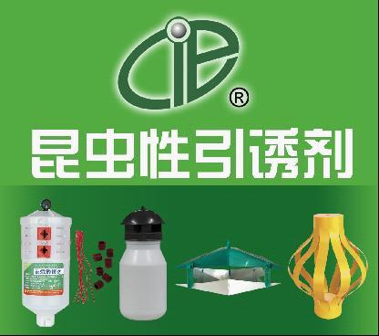
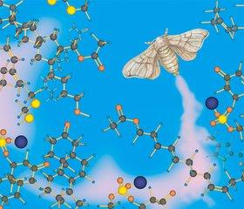
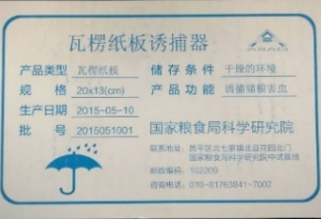
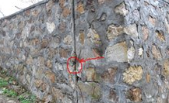
2. Development and application of trapping technology
Physical properties of Insects
phototaxis
Tactile approach
pheromone
Color maculicity
Insect trap lamp
Sticky insect boards
Pheromone trapping
Corrugated cardboard board
Notes:
为了降低劳动强度，很多诱集的技术被逐渐引用于害虫监测。这些诱集的技术主要是利用害虫的生理特性，针对性的研发出诱集产品。包括利用害虫趋光性研发出的诱虫灯，可以应用于善飞行类害虫；利用害虫对颜色的偏好，研发出粘虫板，主要用于爬行类害虫的诱捕；还有利用害虫信息素，以及趋触性的诱捕器等。

Slide 7
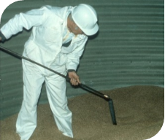
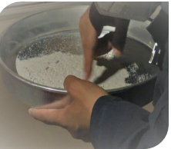
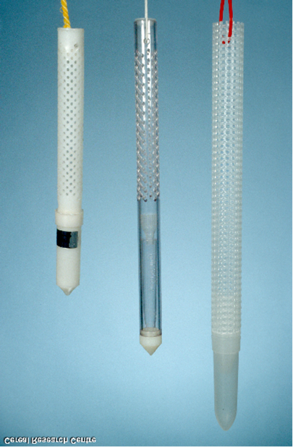
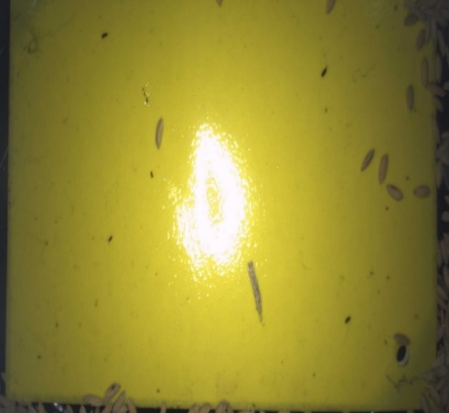
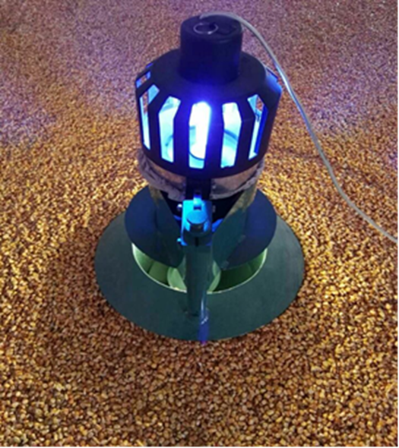
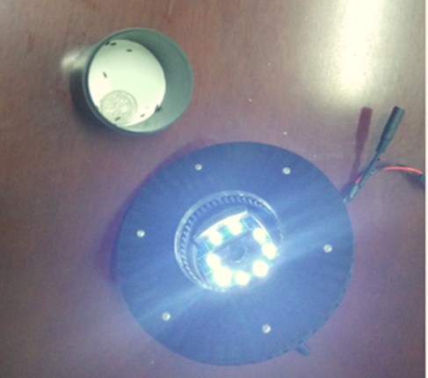
Online, real-time, accurate, intelligent
Notes:
以上介绍的所有基于诱集技术的监测，依然还要依赖于人工，实时性、准确性方面尚有不足。那么基于计算机技术的进步和信息技术的发展，针对害虫监测，我们就迫切的需要一种可以实现在线、实时、准确的智能监测技术和装备。

Slide 8

Part 02
Intelligent monitoring technology and equipment for grain pests
Notes:
粮堆害虫智能监测技术与装备

Slide 9
√
√
equipment
传输
控制
管理
Intelligent management system
数据 支撑
√
√
data set
Identification algorithms
（
相互
支撑
Notes:
害虫在线监测系统是由设备、智能管理系统、数据集和识别算法4个部分组成。下面分别给大家简要介绍一下每个部分的组成和功能。

Slide 10
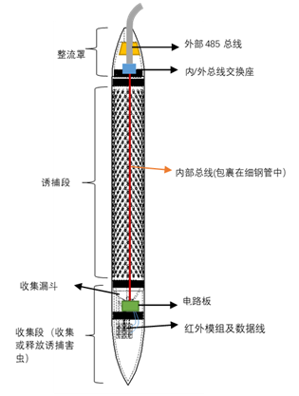
1. equipment——Electron probe trap
Composition structure diagram
The prototype of the device is mainly composed of 5 parts: Trap tube, collection module, infrared detection module, main control board and camera module, centrifugal cleaning module.
The design of the probe tube trap is adopted, and the porous characteristics of the insects are used to attract stored grain pests to crawl into the insect detection equipment to complete the trapping of stored grain pests.
Notes:
第一部分、设备，核心设备就是如图所示的基于探管的诱捕装置。它是由5个部分组成，诱捕管、收集模块、红外检测模块、主控板及摄像头模组、离心清理模块。
采用探管式诱捕器的设计，利用昆虫的趋孔特性，吸引储粮害虫爬入测虫设备，完成对储粮害虫的诱捕。
探管式诱捕器能够有效诱捕蛀蚀性害虫和粉食性害虫

Slide 11
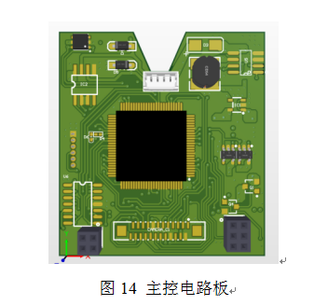
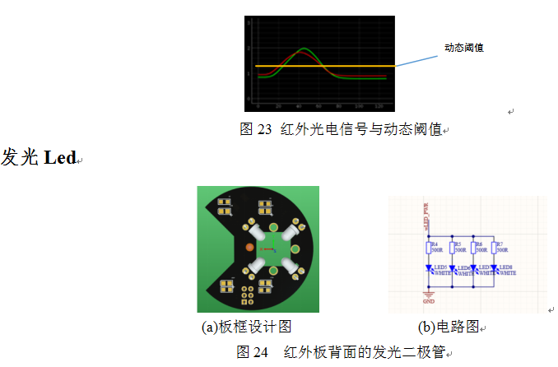
1. Hardware parts
（1）Master circuit board
（2）Infrared panels
Notes:
硬件部分主要包括主控电路板和红外板，红外板包括两对红外光电吃饭图片

Slide 12
2、management software
After receiving the data, the host computer will package and send the data to the server through the network transmission protocol for identification and statistical analysis.
Notes:
设备除了硬件以外，还包括软件部分，上位机管理软件：主要是上位机接收数据后再通过网络传输协议将数据打包发送至服务器进行识别统计分析。

Slide 13
序号 | 害虫种类 | 发生频率
1 | 锈赤扁谷盗 | 13.27%
2 | 玉米象 | 8.42%
3 | 赤拟谷盗 | 7.91%
4 | 米象 | 7.40%
5 | 谷蠹 | 5.61%
6 | 土耳其扁谷盗 | 4.59%
7 | 印度谷螟 | 4.34%
8 | 麦蛾 | 4.08%
9 | 锯谷盗 | 3.57%
10 | 米扁虫 | 3.57%
11 | 长角扁谷盗 | 3.32%
12 | 小蕈甲 | 1.53%
13 | 花斑皮蠹 | 1.28%
14 | 黑菌虫 | 1.02%
15 | 干果露尾甲 | 1.02%
16 | 小斑螟 | 1.02%
17 | 微扁谷盗 | 0.77%
18 | 波纹蕈甲 | 0.77%
19 | 湿薪甲 | 0.77%
20 | 小露尾甲 | 0.77%
(二) data set——
Pest imagery dataset
The construction of image dataset of stored grain pests, 20 main common pests in granaries in China;
Based on image dataset and infrared dot matrix dataset.
Notes:
系统的第二大部分就是数据库：右边这张表是根据中国全国害虫调查的结果，最为常见的20种仓储害虫，我们初步建立了这20种害虫的影像数据库。它包括1套基于图像数据集和1套红外点阵数据集。

Slide 14
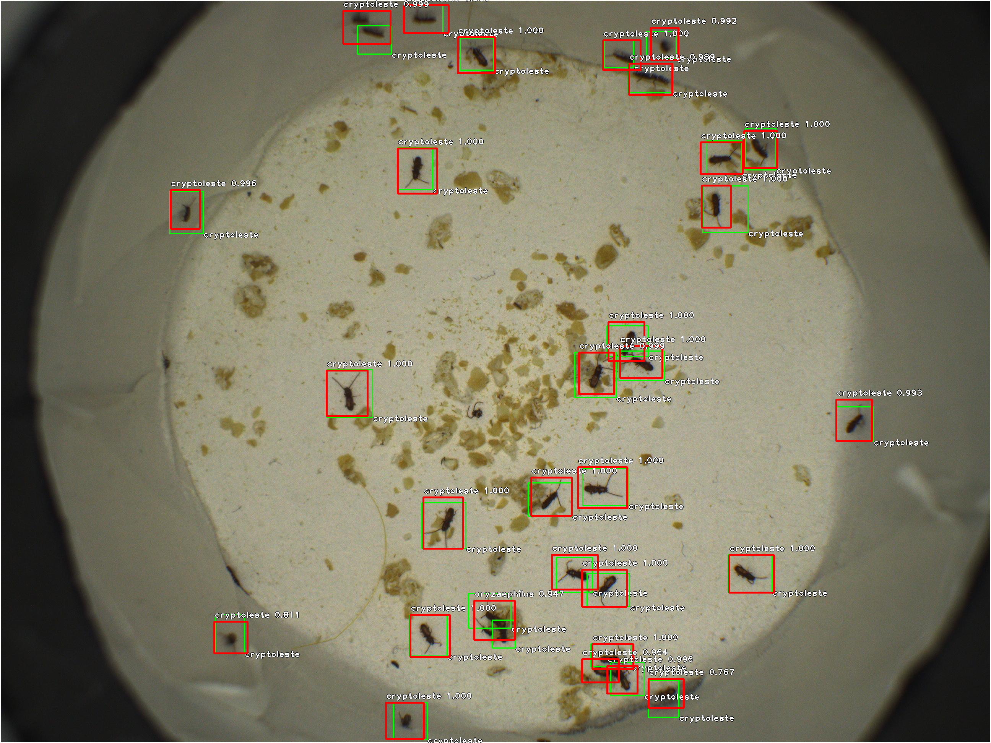
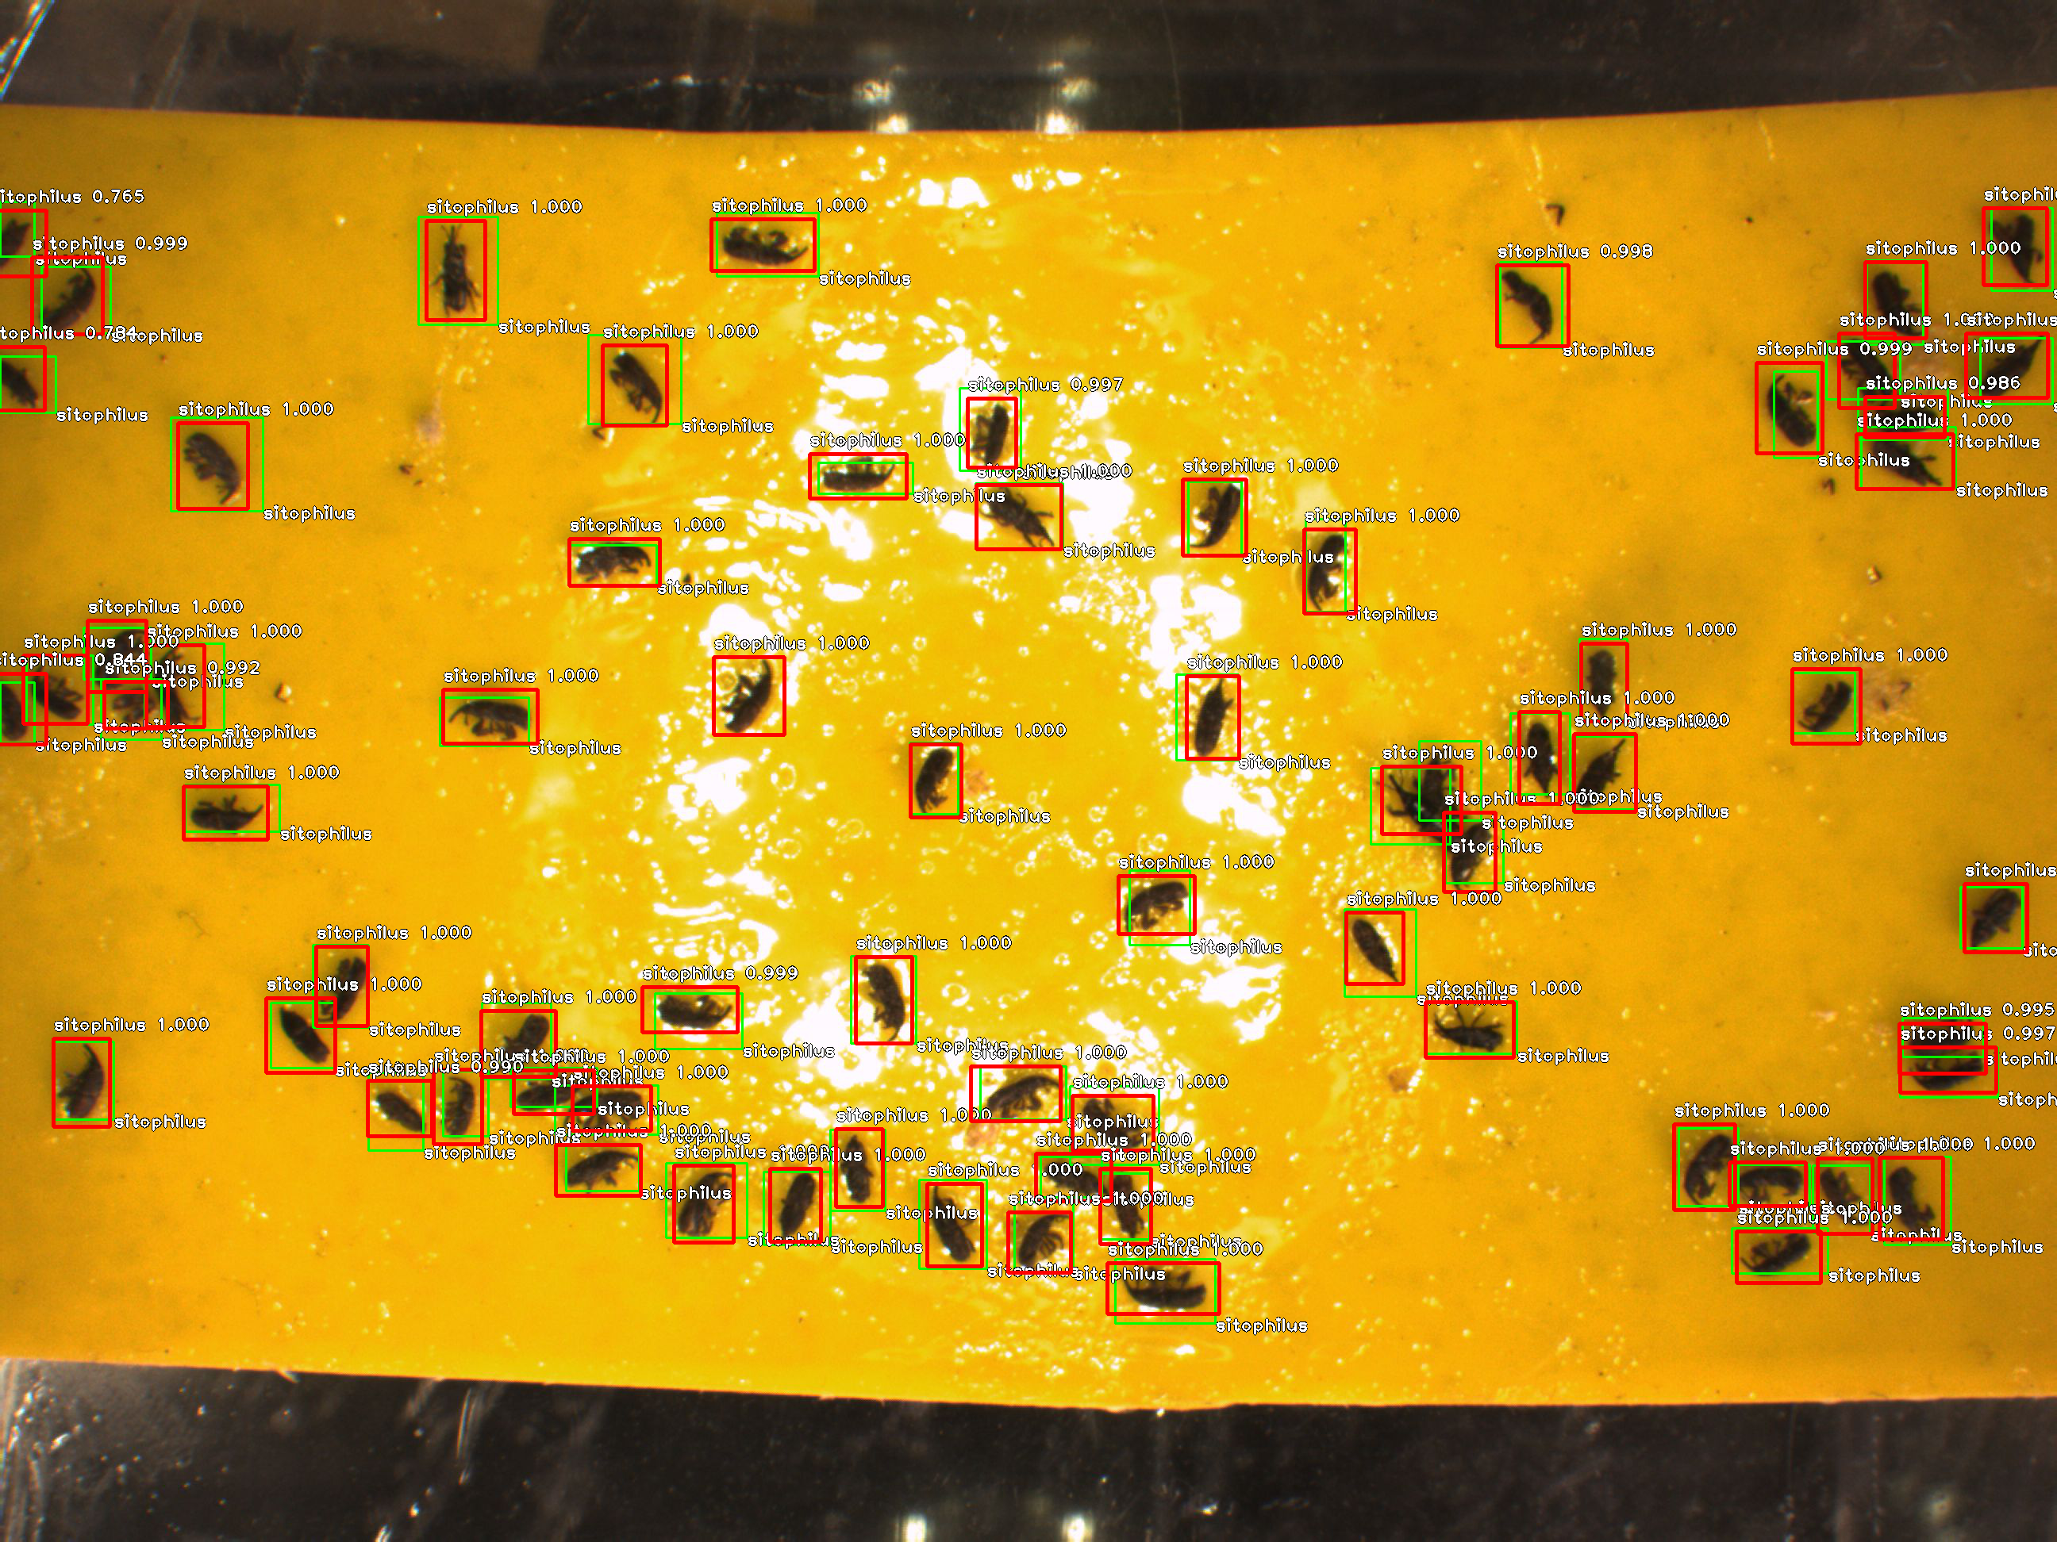
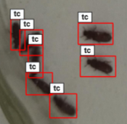
Real image dataset for different cameras and shooting distances (159,000 samples, unit: head)
Transaction of ASABE，Volum 62-74 ， 2019
Notes:
首先介绍基于影像数据集的构建情况：我们建立适配不同相机和拍摄距离的真实图像数据集（15.9万样本，单位：头）

Slide 15
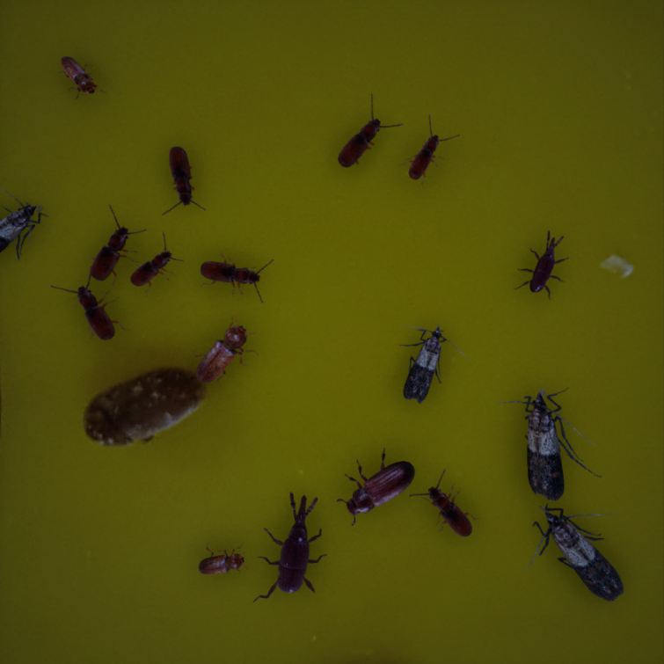
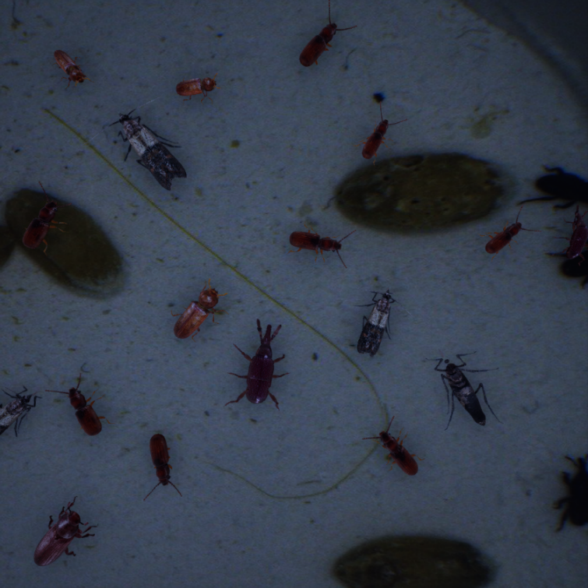
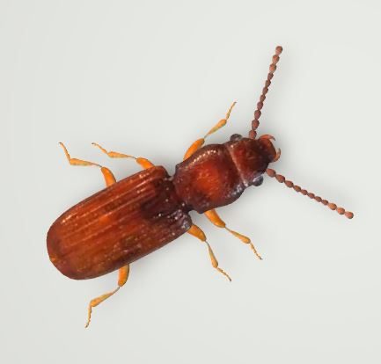
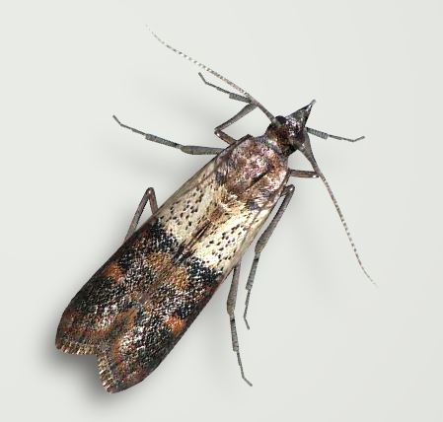
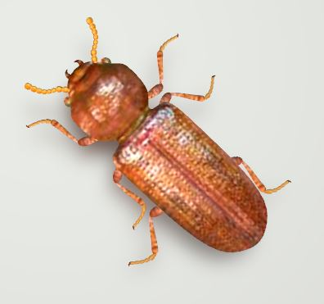
Adapt virtual image datasets to different cameras and shooting distances
锈赤扁谷盗
印度谷螟
谷蠹
Notes:
数据库的建立是一个工作量很大的工作，为了减少工作量，节约时间，我们还专门通过构建害虫虚拟图像，用于影像数据集的建立。

Slide 16
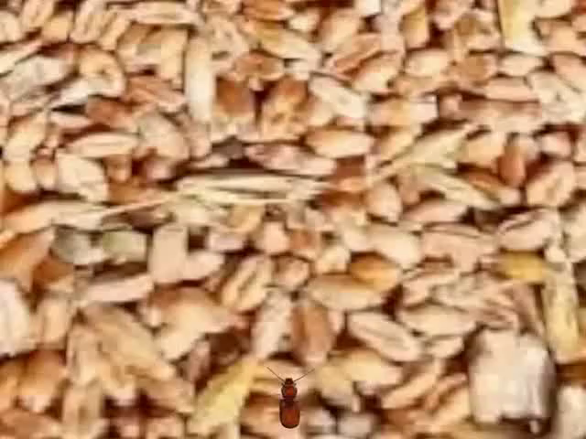
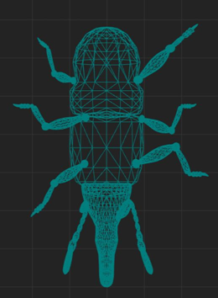
Adapt virtual image datasets to different cameras and shooting distances
Notes:
建立起适配不同相机和拍摄距离的虚拟图像数据集

Slide 17
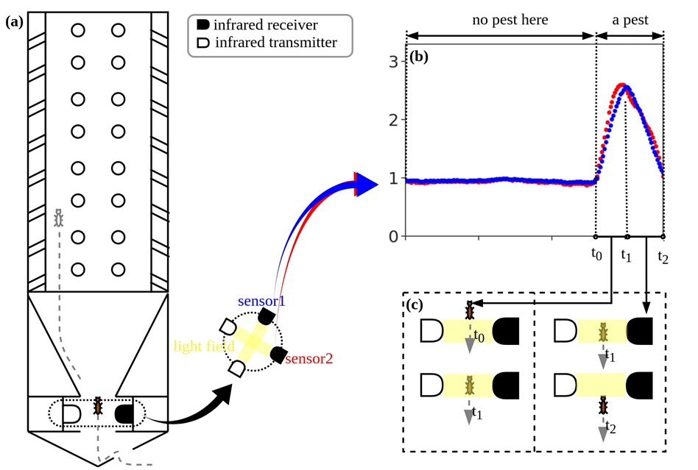
A time-series dataset for infrared light monitoring by an adaptive probe trap
The movement of stored grain pests in the unit
Multi-layered, multi-time series data
Notes:
前面介绍的是害虫影像数据集，除了影像数据集外，我们还建立了一套红外光电的时间序列数据集。通过左图储粮害虫在装置内的运动轨迹,构建右图的多层、多个时间序列数据。

Slide 18
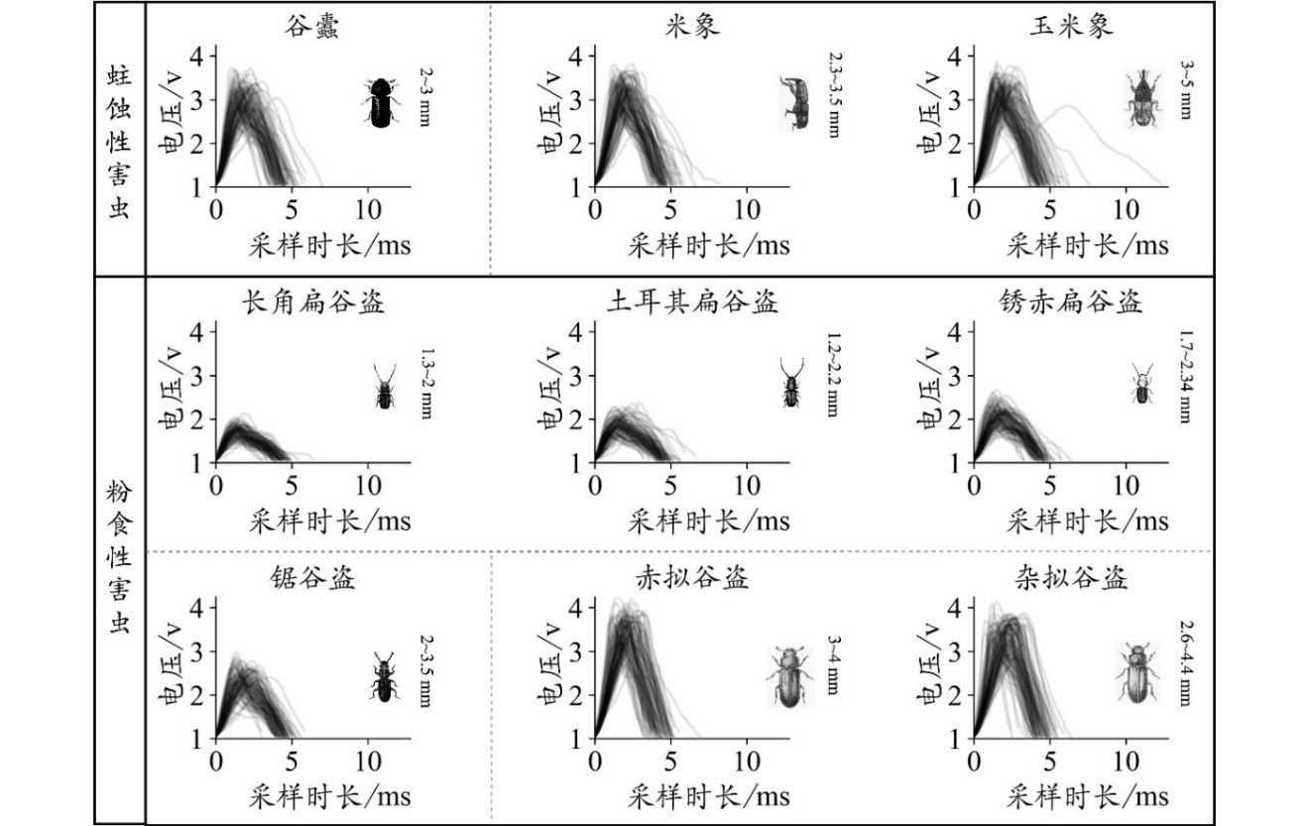
Infrared dot matrix data signal acquisition
Visualized infrared photoelectric time series dataset
Notes:
通过红外点阵数据信号采集，形成可视化的红外光电时间序列数据集

Slide 19
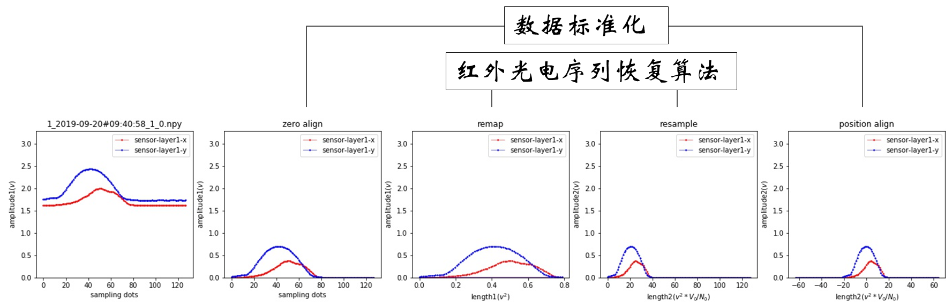
3. Identification algorithms
1）Signal acquisition and identification
Data recovery algorithms
Notes:
系统的第3个部分，识别算法。重点介绍电子探管诱捕器红外光电信号采集和识别

Slide 20
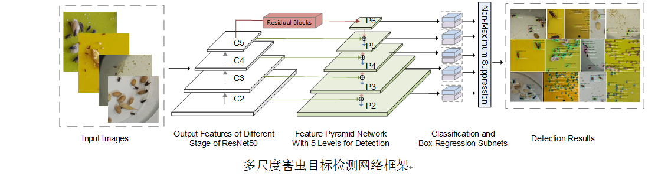
2、Research on pest image recognition algorithm
The ResNet50 network was used for image feature extraction, and the bounding box regression and pest species identification of pests were carried out by fusing the image features of different layers. the accuracy rate was 94.77%.
Notes:
将采集红外光电数据进行标准化处理，再通过数据恢复算法，对害虫进行识别。

Slide 21
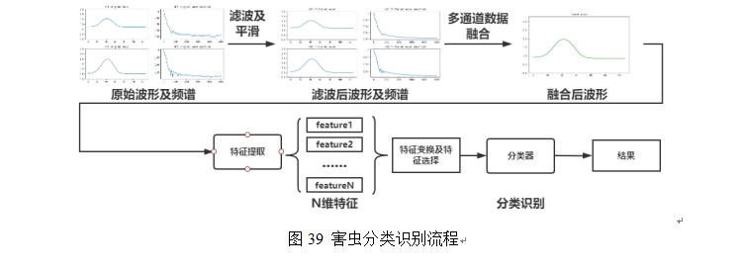

3、Research on insect infrared photoelectric data identification algorithm
an algorithm for the identification of pests in stored grain was proposed, and the steps of pest classification and identification are shown in the figure. The accuracy rate of the final grain pest count is more than 95%, and the identification rate of major categories is more than 90%.
Notes:
害虫红外光电数据识别算法研究：针对害虫红外数据，提出一种储粮害虫识别的算法，通过比较不同算法的效果，结合不同算法的部分实现，以达到一个效果最好的分类模型。最终储粮害虫计数准确率达95%以上，大类识别率达到90%以上。

Slide 22
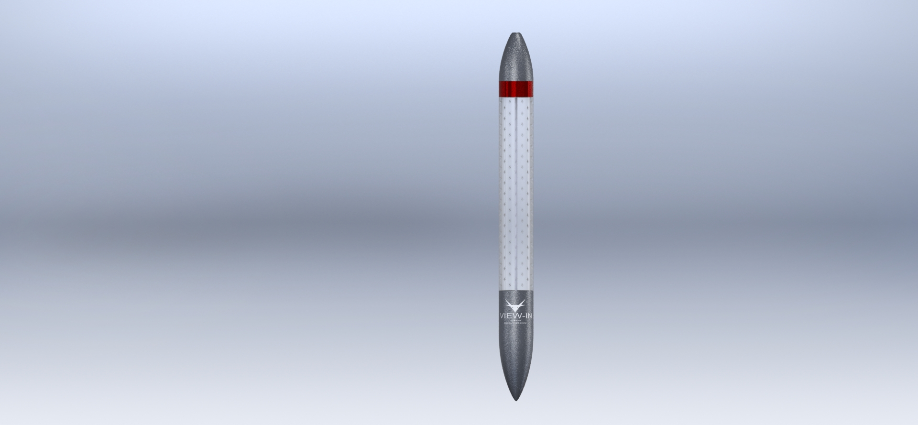
4. Management system
System composition diagram
上位机管理软件
&服务器
485总线
数传终端
System features: flexible modular distribution, real-time monitoring, accurate counting and category identification
Notes:
4. 管理系统，如图所示，系统通过粮堆诱捕器，采集数据，传输至上位机管理软件，对数据进行分析处理，最后完成数据的展示。系统特点表现为模块化布点灵活、实时监测、准确计数和大类识别

Slide 23
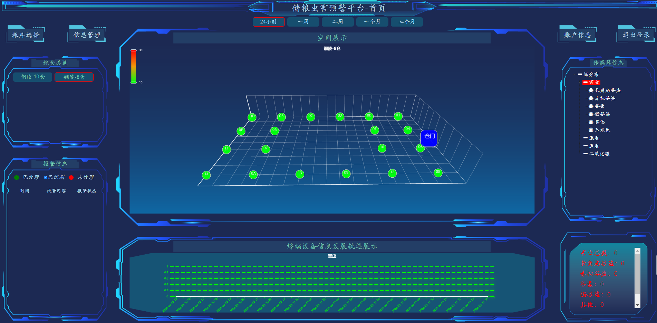
Stored grain pest monitoring platform
Notes:
这是管理系统的展示界面，图中黄色点为粮堆中安装监测点。点击每一个点，可以实时显示过去24小时内害虫种类和数量，实时温度、湿度数据。点击害虫种类，在图的右下角可直接显示害虫的图像。系统还可以根据用户需求，对当前的数据，以及历史数据进行分析和展示。可以呈现趋势图、散点图、拆线图等不同方式。

Slide 24
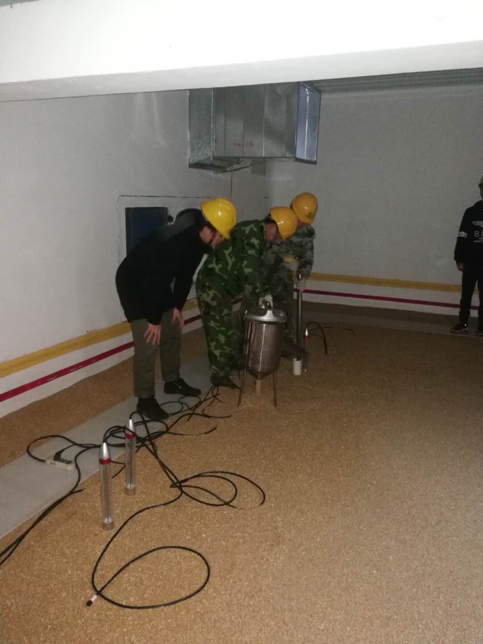
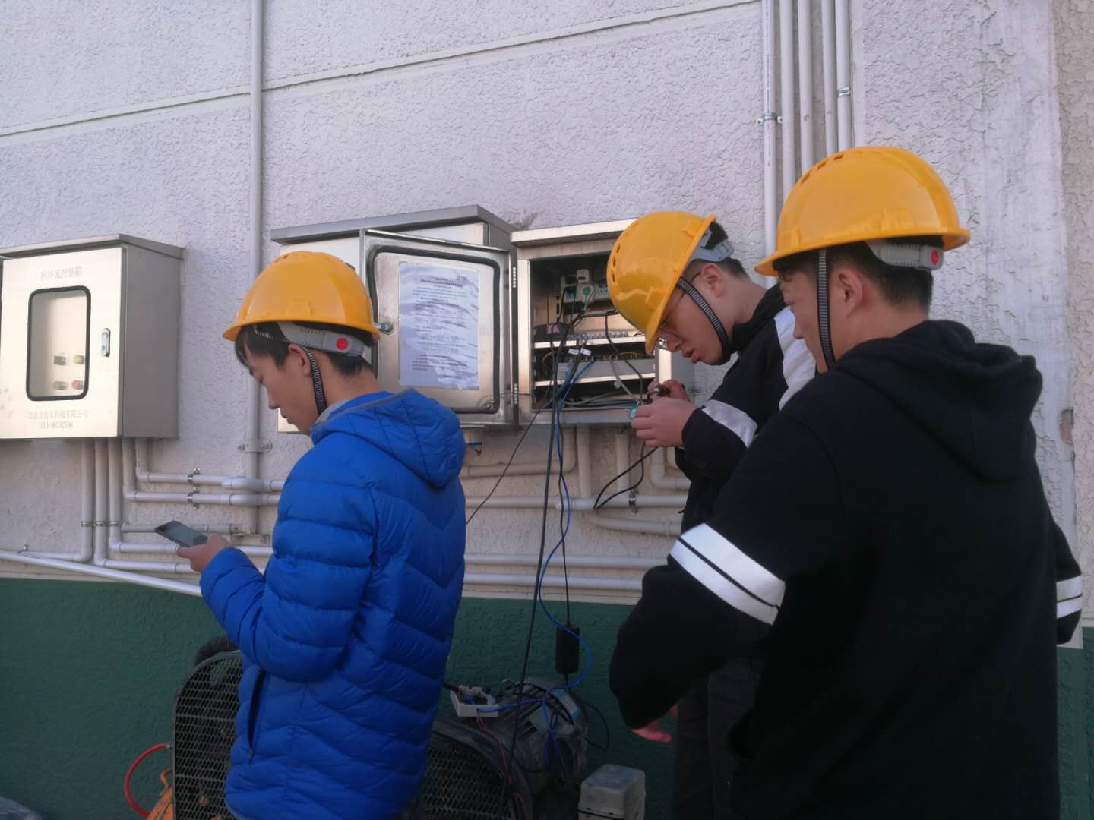
Field application testing现场应用测试
Notes:
这是系统在粮库应用安装的过程情况

Slide 25
03
Monitoring and early warning of the distribution of grain piles of main grain storage pests
Notes:
前面介绍了粮堆害虫在线监测的装备情况。那么这套装备如何应用呢？第3部分，我给大家介绍一下通过这套设备的应用，我们进一步了解粮堆害虫的分布规律，以及建立起来的害虫虫口密度的监测。

Slide 26
1. The pest species for monitor
No | species | Frequency of occurrence | Progress
1 | Cryptolestes ferrugineus | 13.27%
2 | Sitophilus zeamais | 8.42%
3 | Tribolium castaneum | 7.91% | √
4 | Sitophilus oryzae | 7.40% | √
5 | Tribolium castaneum | 5.61%
6 | Cryptolestes pusillus | 4.59% | √
Notes:
我们专门选取了在我国储粮害虫调查结果显示最为常见的6类害虫，进行监测预警分析研究。目前已经完成了赤拟谷盗、米象和长角扁谷盗3种害虫的研究。

Slide 27
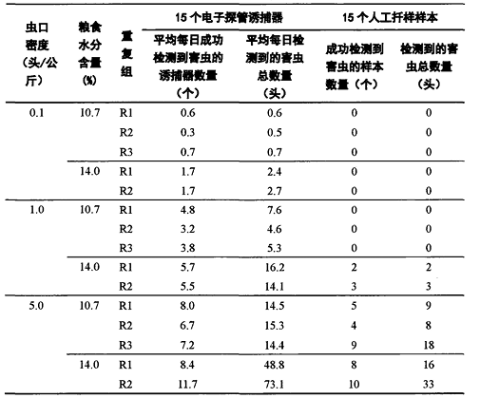
Cryptolestes pusillus Oliver
The statistical results show that:
When the insect population density was 0.1 heads/kg, the screening results of 75 samples were all 0.
When the insect population density was 1.0 heads/kg, 45/75 samples were 0.
At a population density of 5.0 heads/kg, the presence of pests could be detected in most samples.
in the early stage of insect infestation, the electronic probe trap system is more effective than manual sampling.
Comparison of electron probe and manual sampling
Notes:
首先是长角扁谷盗。统计结果显示：
虫口密度为0.1头/kg时，75个扦样样本筛检结果均为0;
虫口密度为1.0头/kg时，45/75个扦样样本筛检结果为0；
虫口密度为5.0头/kg时，大多数样本可以检测到害虫存在。
由此可以看出，在虫口密度小于5.0头/公斤，即虫害发生早期，电子探管诱捕器系统比人工扦样更加有效。

Slide 28
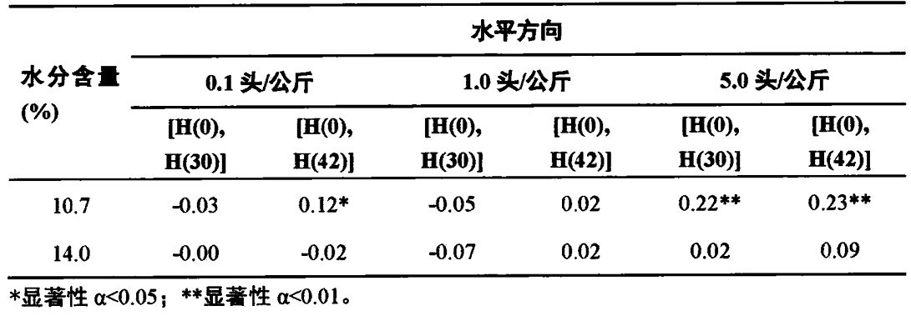
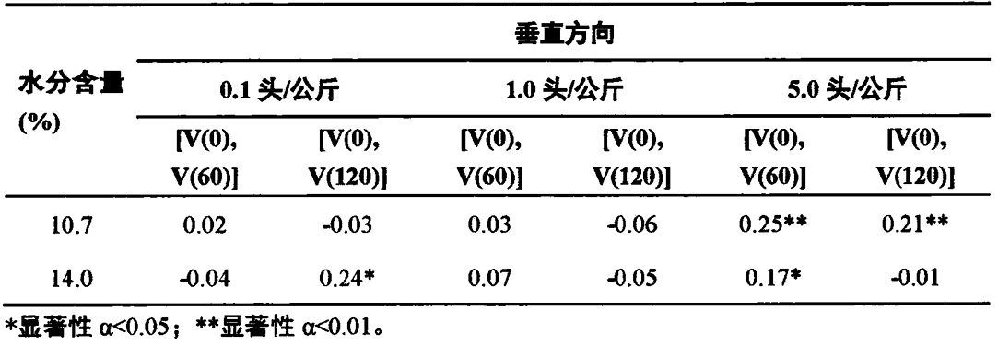
Cryptolestes pusillus Oliver
Changes in the spatial dimension of the trapping data
In the vertical direction, the adult longhorn was more likely to be detected in the middle and top layers, and was more likely to be detected in the upper layer as the water content increased.
The results of the correlation calculation show that the trapping data at different locations are essentially uncorrelated in the horizontal and vertical directions.
1
Notes:
诱捕数据在空间维度上的变化：在垂直方向上，长角扁谷盗成虫更多地在中层和顶层被检测到，随着水分含量的升高，则更容易在上层检测到。在水平方向上，当虫口密度为0.1头/公斤时，长角扁谷盗成虫更偏向半半径的位置，但是当虫口密度升高后，这个趋势便不再明显无法确定了。这可能是由于在较高的虫口密度下，投虫过程中长角扁谷盗成虫的快速扩散运动导致的。由相关性计算结果发现，在水平和垂直方向上，不同位置上的诱捕数据基本上是不相关的。

Slide 29
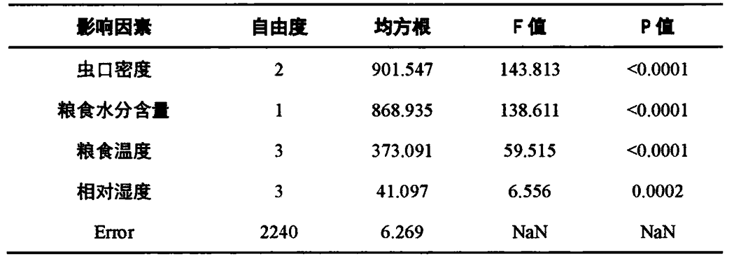
Cryptolestes pusillus Oliver
Correlations between trapping data and temperature and humidity
The results showed that, in addition to the population density of the grain pile, the moisture content of the grain, the temperature and relative humidity of the grain at the trap position had significant effects on the trapping results. The higher the temperature and the greater the relative humidity, the higher the concentration of pests.
Notes:
诱捕数据与温湿度之间的关联性：由分析结果可知，除粮堆虫口密度外，粮食的水分含量和诱捕器位置处的粮食温度和相对湿度对诱捕结果都有显著的影响。温度越高、相对湿度越大的地方，害虫的聚集程度越高。

Slide 30
Cryptolestes pusillus Oliver
Population distribution patterns based on trapping data
虫口密度（头/kg） | 水分含量（%） | 空间分布模式
 |  | Lloyd平均拥挤度 | Taylor幂函数
0.1 | 10.7 | 均匀分布 | 均匀分布
 | 14.0 | 聚集分布 | 聚集分布
1.0 | 10.7 | 聚集分布 | 聚集分布
 | 14.0 | 均匀分布 | 均匀分布
5.0 | 10.7 | 聚集分布 | 聚集分布
 | 14.0 | 聚集分布 | 聚集分布
Most of the time, the adults are clustered.
Notes:
基于诱捕数据的种群分布模式：在绝大多数情况下，长角扁谷盗成虫呈聚集分布状态，基于单个诱捕器采集的数据实现可靠的粮堆害虫发生情况的准确评估面临挑战，可能需要在多个位置部署诱捕器，以提高评估的准确性。

Slide 31
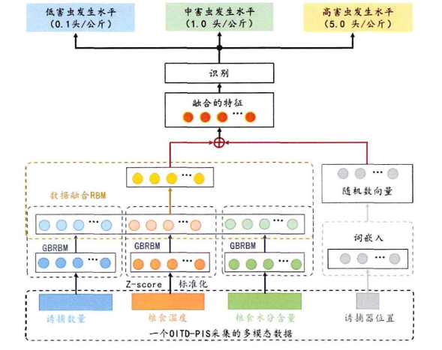
Cryptolestes pusillus Oliver
A model for assessing the occurrence of grain pile pests based on deep belief networks
The fusion characteristics of the four-modal data, including temperature, moisture, trapping amount and location, were sent into the classification layer to obtain the evaluation results of the occurrence of grain pile pests.
DBN_IOE的网络结构
Notes:
基于深度置信网络的粮堆害虫发生情况评估模型:将温度、水分、诱捕量和位置这四种模态数据的融合特征送入分类层，得到粮堆害虫发生情况的评估结果。

Slide 32
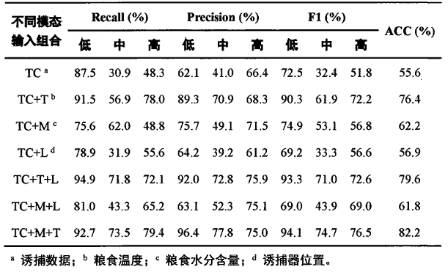
Cryptolestes pusillus Oliver
Experimental analysis of different modes
On the basis of the number of traps and the temperature of the grain, the recognition accuracy was increased to 82.2% and 79.6% when the moisture content of the grain was increased or the location of the trap was used as input, respectively. When these four modal data are used as model inputs at the same time, the recognition accuracy is 84.9%
Notes:
不同模态对比实验分析:由实验结果可知，综合考虑诱捕数量、粮食温度、水分含量和诱捕器位置是准确识别粮堆害虫发生情况等级的关键。在综合诱捕数量和粮食温度的基础上，增加粮食水分含量或诱捕其位置作为输入时，识别准确度分别提高到了82.2％和79.6％。当这四种模态数据同时作为模型输入时，识别准确度为84.9％。

Slide 33
Cryptolestes pusillus Oliver
The results show that the model works best when the kernel function selects RBF.
The K-CV algorithm can better evaluate the generalization ability of the model and reduce the risk of overfitting to a specific dataset, The accuracy of the optimized model has been significantly improved, and the recognition accuracy has been increased to 92.17%.
Regression prediction based on support vector machines
不同类型核函数预测结果精度对比
核函数类型 | R² | MAE | MBE
线性 | 0.4905 | 1.0724 | -0.5697
多项式 | 0.2937 | 1.1372 | 0.6865
RBF | 0.69 | 0.6924 | -0.2159
sigmoid | -4.0681 | 3.2312 | -1.5775
不同模型预测结果精度对比
预测模型 | R² | MAE | MBE
SVR | 0.69 | 0.6924 | -0.2159
优化后SVR | 0.9217 | 0.3629 | 0.0844
Notes:
基于支持向量机回归预测：在其余参数不变的条件下，分别对多项式函数、线性函数、RBF高斯径向基函数以及Sigmoid函数4种常见的核函数进行预测实验，结果显示当核函数选择RBF时，模型效果最好。
K-CV算法能够更好地评估模型的泛化能力，优化后的模型精度得到显著增高，识别准确度分别提高到了92.17%。

Slide 34
Sitophilus oryzae Linne
Comparison of electron probe and manual sampling
虫口密度 (头/kg) |  | 每日检测到害虫样点个数（个） |  | 每日害虫检测数量（头/天）
 | 数值类型 | 电子探管诱捕器系统 | 人工扦样 | 电子探管诱捕器系统 | 人工扦样
0.1 | 平均值±SE | 0.83±0.19 | 0.00±0.00 | 0.87±0.22 | 0.00±0.00
1.0 | 平均值±SE | 4.13±0.56 | 4.00±1.73 | 5.40±1.18 | 10.00±4.62
5.0 | 平均值±SE | 10.57±1.36 | 10.67±1.86 | 40.77±15.94 | 88.67±34.07
Due to the low population density, probe traps are easier to detect pests than manual sampling
Notes:
第2种害虫米象：电子探管与人工扦样的对比:低虫口密度，探管诱捕器比人工扦样法更容易检测到害虫

Slide 35
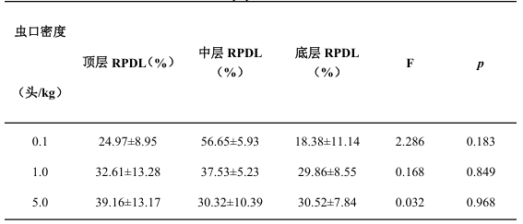
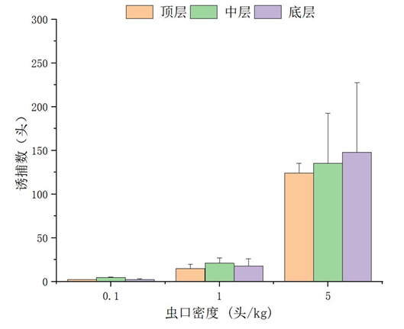
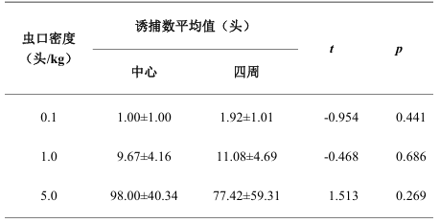
Sitophilus oryzae Linne
Changes in the spatial dimensio the trapping data
When the population density was 0.1 and 1.0 heads/kg, pests were mainly distributed in the middle layer, and when the density increased to 5 heads/kg, the number of bottom layers increased.
Notes:
诱捕数据在空间维度上的变化：虫口密度为0.1头/kg和1.0头/kg时，米象主要分布在中层，当密度上升至5头/kg时，底层的数量增加。

Slide 36
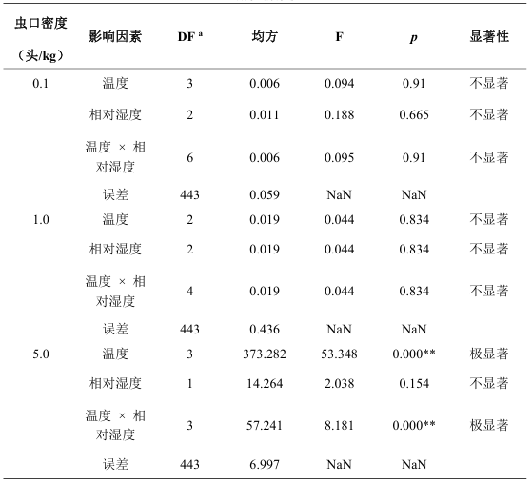
Sitophilus oryzae Linne
Correlations between trapping data and temperature and humidity
When the population density was low, the temperature and relative humidity had no significant effect on the trapping results of rice elephant adults in the grain pile.
When the population density increased to 5.0 individuals/kg, the temperature and the interaction between temperature and relative humidity had a significant effect on the trapping results.
Notes:
诱捕数据与温湿度之间的关联性：当虫口密度较低时，温度和相对湿度对粮堆中米象成虫的诱捕结果影响不显著；
当虫口密度增加至5.0头/kg时，温度以及温度与相对湿度的相互作用都对诱捕结果有极显著影响。

Slide 37
Sitophilus oryzae Linne
Regression prediction based on support vector machines
不同类型核函数预测结果精度对比
核函数类型 | R² | MAE | MBE
线性 | 0.3831 | 1.07 | 0.8228
多项式 | 0.4956 | 0.9834 | -0.5576
RBF | 0.8767 | 0.4555 | -0.2197
sigmoid | -19.5181 | 7.5997 | -1.4554
The error analysis of the four kernel functions showed that the RBF model had the best effect, and the recognition accuracy reached 87.67%. Through the hyperparameter tuning of the K-CV algorithm, the prediction accuracy of the optimized SVR model is improved to 99.18%.
不同模型预测结果精度对比
预测模型 | R² | MAE | MBE
SVR | 0.8767 | 0.4555 | -0.2197
优化后SVR | 0.9918 | 0.1284 | 0.04776
Notes:
基于支持向量机回归预测：4种核函数误差分析显示RBF模型效果最好，识别准确度达到87.67%。
通过K-CV算法超参数调优，优化后SVR模型预测准确度提高到99.18%。

Slide 38
Tribolium castaneum Herbst
Comparison of electron probe and manual skewers
虫口密度 (头/kg) |  | 每日检测到害虫样点个数（个） |  | 每日害虫检测数量（头/天）
 | 数值类型 | 电子探管诱捕器系统 | 人工扦样 | 电子探管诱捕器系统 | 人工扦样
0.1 | 平均值±SE | 3.10±1.39 | 1.00±0.58 | 5.93±2.83 | 1.67±1.20
1.0 | 平均值±SE | 4.33±1.91 | 4.00±0.00 | 15.80±10.64 | 19.67±11.89
3.0 | 平均值±SE | 6.07±2.75 | 7.00±0.58 | 43.93±29.80 | 47.00±28.75
When the population density is low, probe traps are easier to detect pests than manual sampling.
Notes:
电子探管与人工扦样的对比：虫口密度低时，探管诱捕器比人工扦样法更容易检测到害虫。

Slide 39
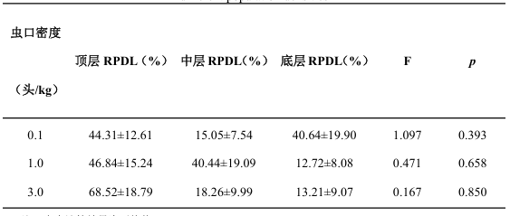


Tribolium castaneum Herbst
Changes in the spatial dimension of the trapping data
The red valley pirates are mainly distributed in the upper layer, and the proportion of the upper layer gradually decreases with the increase of density.
Notes:
诱捕数据在空间维度上的变化：
赤拟谷盗主要分布在上层，随着密度的增加上层的占比逐渐减少。

Slide 40

Tribolium castaneum Herbst
Correlations between trapping data and temperature and humidity
When the population density was 0.1 individuals/kg, the relative humidity and the interaction between temperature and relative humidity had a significant effect on the trapping results. When the population density increased to 3.0 individuals/kg, temperature and humidity had a significant effect on the trapping results.
Notes:
诱捕数据与温湿度之间的关联性：不同虫口密度，温、湿度对诱捕结果影响不同。
当虫口密度为0.1头/kg时，相对湿度以及温度与相对湿度的相互作用对诱捕结果影响极显著；
当虫口密度为1.0头/kg时，粮堆温湿度及其相互作用对诱捕结果的影响均不显著；
当虫口密度增加至3.0头/kg时，温度、湿度对诱捕结果有极显著影响。

Slide 41
Tribolium castaneum Herbst
Regression prediction
The error analysis of the four kernel functions showed that the model had the best effect when the kernel function selected RBF, and the prediction accuracy reached 62.48%. Through the hyperparameter tuning of the K-CV algorithm, the optimized SVR model is significantly improved, and the prediction accuracy is increased to 89.94%.
不同类型核函数预测结果精度对比
核函数类型 | R² | MAE | MBE
线性 | 0.45 | 0.5373 | -0.1022
多项式 | 0.6009 | 0.4611 | -0.0853
RBF | 0.6248 | 0.4389 | -0.0733
sigmoid | -0.5119 | 2.1057 | 0.0266
不同模型预测结果精度对比
预测模型 | R² | MAE | MBE
SVR | 0.6248 | 0.4389 | -0.0733
优化后SVR | 0.8994 | 0.2115 | 0.0037
Notes:
基于支持向量的回归预测：4种核函数误差分析显示当核函数选择RBF时，模型效果最好，预测准确率达到62.48%。
通过K-CV算法超参数调优，优化后SVR模型得到显著增高，预测准确度分别提高到了89.94%。

Slide 42
Main features and application effects:
Features:
Each probe tube is equipped with a sensor, which can realize pest monitoring at any position in the grain pile;
Intelligent identification and counting, with an accuracy rate of more than 90%;
Effect of application:
Compared with manual sampling, pests can be detected 1-2 months earlier.
There are a large number of pests inside the grain pile;
Through the study of the distribution law of pests, the population density of grain pile pests can be deduced through the monitoring data
Notes:
主要特点和应用效果：
产品特点：
每个探管均带传感器，可实现粮堆内任意位置的害虫监测；
智能识别和计数，准确率均在90%以上；
应用效果：
与人工扦样相比，可早1-2个月发现害虫。
粮堆内部有大量害虫；
通过害虫分布规律研究，可以通过监测数据推算出粮堆害虫的虫口密度

Slide 43


Thank You
Sharing for Learning

