Slide 1
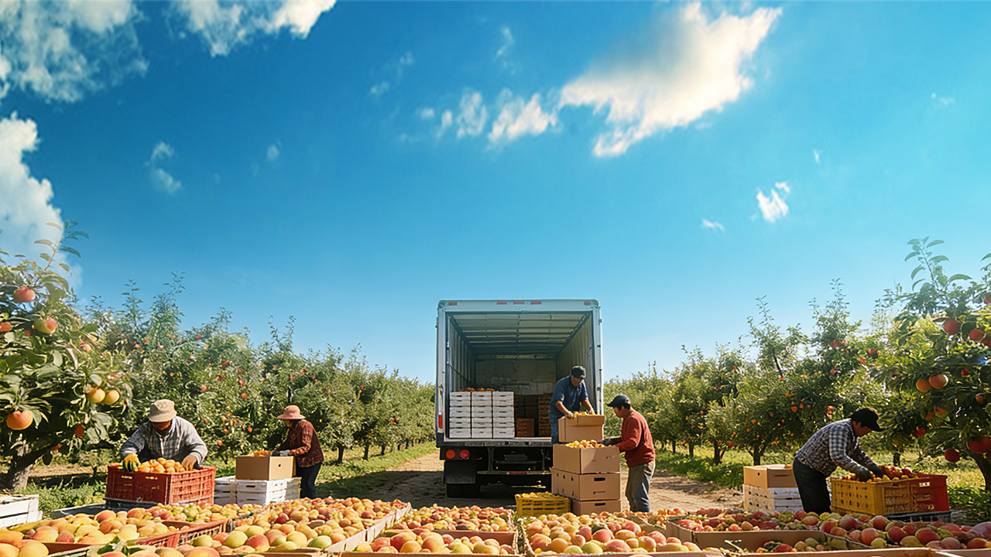

Postharvest Quality Deterioration
and Preservation/Loss Reduction Technologies
in Fruits and Vegetables
Notes:
果蔬采后品质劣变及保鲜减损控制技术
Postharvest Quality Deterioration and Preservation/Loss Reduction Technologies in Fruits and Vegetables

Slide 2

Part 01
Mechanisms of Postharvest Quality Deterioration in Fruits and Vegetables
Part 02
Postharvest Preservation and Loss-reduction Technologies
Notes:
本次课程将围绕果蔬采后品质劣变及保鲜减损控制技术展开。课程包括两大部分：一是果蔬采后品质劣变机制，二是果蔬采后保鲜减损技术。下面先介绍第一部分——果蔬采后品质劣变的机制。
This course focuses on postharvest quality deterioration of fruits and vegetables and the technologies used for preservation and loss reduction. The course consists of two main parts: (1) mechanisms of postharvest quality deterioration in fruits and vegetables, and (2) postharvest preservation and loss-reduction technologies. The first part — mechanisms of postharvest quality deterioration in fruits and vegetables — is introduced below.

Slide 3
PART.01
Mechanisms of Postharvest Quality Deterioration in Fruits and Vegetables
Notes:
一、果蔬采后品质劣变机制
PART.01
Mechanisms of Postharvest Quality Deterioration in Fruits and Vegetables

Slide 4
Structure of Part 01
  Two Sections
Section 1:
Section 2:
Principles underlying quality deterioration in fruits and vegetables
Postharvest technologies for preservation and loss reduction
  Key note:
  Although fresh at harvest, quality control and preservation must be maintained throughout the entire postharvest process, covering the full supply chain from farm-to-table.
Notes:
水果蔬菜采后品质易发生变化，本部分将分两节讲解控制方法。第一节阐述果蔬品质劣变的原理，只有掌握原理才能有效实施控制；
第二节介绍采后减损保鲜技术。需特别说明的是，尽管果蔬采后新鲜度较高，但品质控制与保鲜需贯穿从采收到储藏的全过程，涵盖“从农场到餐桌”的完整供应链环节。
The quality of fruits and vegetables is highly susceptible to change after harvest. This part of the course is presented in two sections to address the related control strategies. The first section elucidates the principles underlying quality deterioration in fruits and vegetables; only by understanding these mechanisms can effective control measures be implemented.
The second section introduces postharvest technologies for preservation and loss reduction. It should be emphasized that although fruits and vegetables are relatively fresh at harvest, quality control and preservation must be maintained throughout the entire postharvest process, from harvest to storage, covering the full supply chain from “farm to table”.

Slide 5
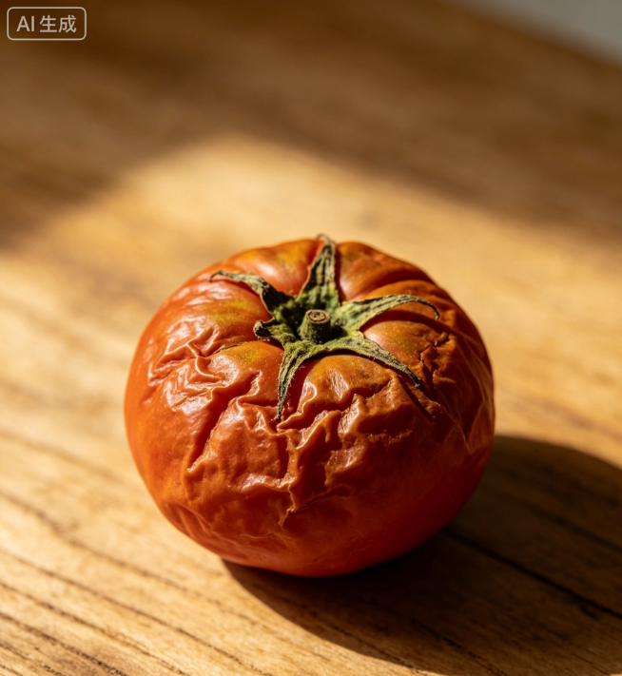
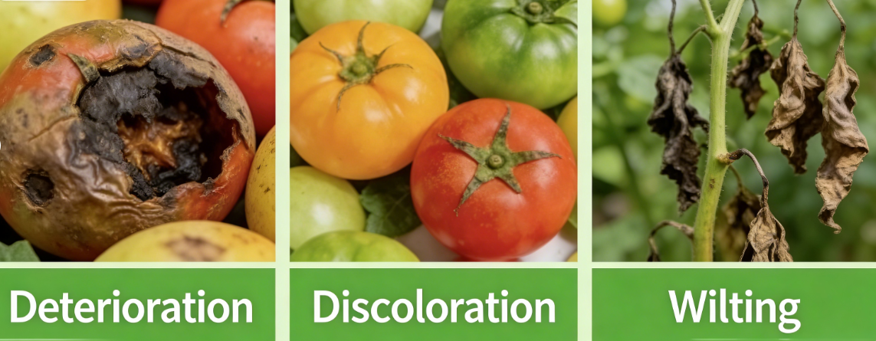
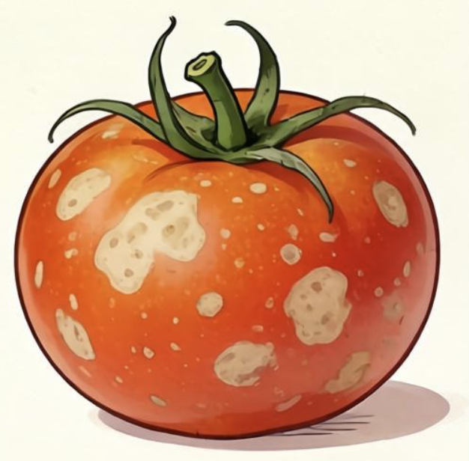
Understanding Postharvest Quality Changes
Purpose
  Identify the manifestations and underlying causes of quality changes after harvest.
  Understand these mechanisms to support targeted strategies and selection of appropriate postharvest handling and storage technologies.
Typical Forms
  Spoilage
  Discoloration
  Wilting
Spoilage
Discoloration
Wilting
Impact
  Declines in sensory quality.
  Losses of nutritional components.
Notes:
做好果蔬储藏保鲜，需先明确其品质变化的表现形式及内在原因。
只有掌握这些规律，才能制定针对性方案，选择科学的采后处理与保藏技术。
果蔬采后品质劣变主要表现为变质、变色、变蔫三类典型现象，直接导致感官品质下降与营养成分流失。
To achieve effective storage and preservation of fruits and vegetables, it is first necessary to identify the manifestations and underlying causes of their quality changes after harvest.
Only by understanding these mechanisms can targeted strategies be developed and appropriate postharvest handling and storage technologies be selected.
Postharvest quality deterioration in fruits and vegetables primarily occurs in three typical forms: spoilage, discoloration, and wilting. These changes directly lead to declines in sensory quality and losses of nutritional components.

Slide 6
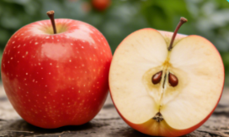
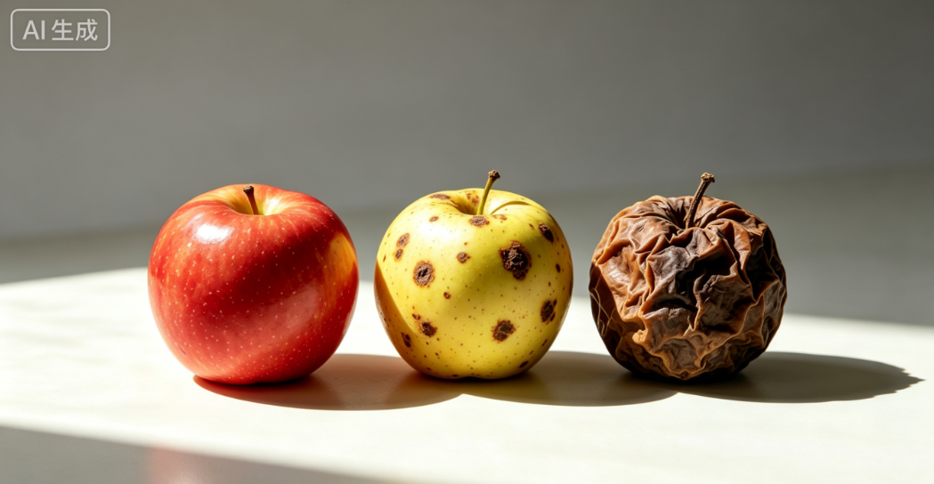
1. Postharvest Spoilage of Fruits and Vegetables
Essence of Spoilage
  Spoilage is a decline in quality caused by the consumption of nutritional components (primarily carbohydrates such as sugars).
Key Driver
  The principal driving force of spoilage is respiration.
Notes:
（一）果蔬采后变质
水果蔬菜采后变质，本质是营养成分（主要是糖类等原料）被消耗导致的质量下降，其主要驱动因素是呼吸作用。
1.Postharvest Spoilage of Fruits and Vegetables
Postharvest spoilage of fruits and vegetables is essentially a decline in quality caused by the consumption of nutritional components (primarily carbohydrates such as sugars). The principal driving force behind this process is respiration.

Slide 7
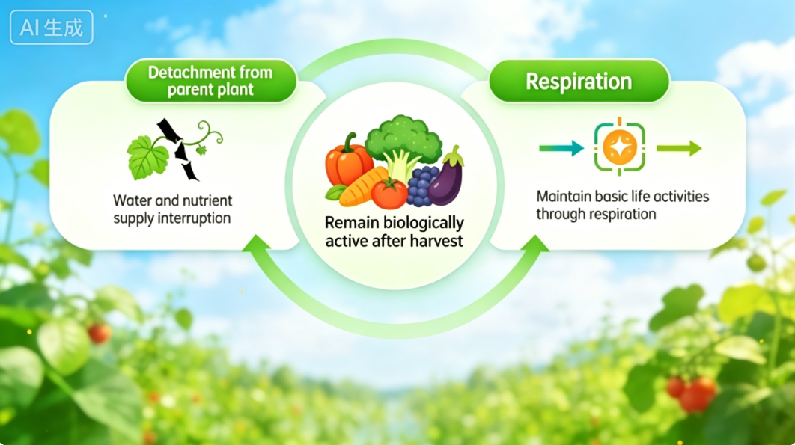
1. Postharvest Spoilage of Fruits and Vegetables
(1) Respiration: the Core Mechanism of Postharvest Spoilage
Fruits and Vegetables: Biologically Active After Harvest.
  Once detached → no longer supplied with water and nutrients → cannot absorb nutrients or synthesize new substances.
  Must still rely on respiration to sustain basic life activities.
Types of Respiration
  Aerobic respiration.
  Anaerobic respiration.
Notes:
1.呼吸作用：采后变质的核心机制
果蔬与一般农产品不同，最大特点是采后仍保持鲜活状态（类似动物）。
虽然脱离了母体的水分和养分供给，无法继续吸收营养或合成新物质，但仍需通过呼吸维持基本生命活动。
果蔬的呼吸作用主要分为有氧呼吸和无氧呼吸两种类型：
(1)Respiration: the Core Mechanism of Postharvest Spoilage
Fruits and vegetables differ from most agricultural products in that they remain biologically active after harvest, similar to animals.
Although they are detached from the parent plant and no longer supplied with water and nutrients, and thus cannot continue to absorb nutrients or synthesize new substances, they must still rely on respiration to sustain basic life activities.
Respiration in fruits and vegetables can be mainly classified into two types: aerobic respiration and anaerobic respiration.

Slide 8
1. Postharvest Spoilage of Fruits and Vegetables
(1) Respiration: the Core Mechanism of Postharvest Spoilage
Aerobic Respiration (Predominant Form)
Process
  In sufficient oxygen → use glucose and organic compounds as substrates → through a series of complex biochemical reactions within cells → organic substances completely oxidized and decomposed → produce CO₂+ H₂O + large amount of energy.
Fog
Heat production
glucose
oxygen
carbon dioxide
water
energy
Energy Release
  Part of released energy dissipates in the form of heat.
    → explains why stacked together often generates internal heat.
  Another portion of energy → support physiological activities.
Water Generation
  Water is generated during respiration.
  Wrapped with plastic film → water droplets/fog condensed on inner surface of plastic film.
Notes:
有氧呼吸（主要呼吸形式）：在有充足氧气参与的情况下，果蔬以葡萄糖等有机物作为原料，经过细胞内一系列复杂的生化反应，将这些有机物彻底氧化分解，最终生成二氧化碳和水，同时释放出大量能量。
这些释放出来的能量，一部分会以热能的形式散失，这就是为什么我们在生活中会发现，堆码在一起的果蔬内部会发热；
还有一部分能量会用于果蔬自身的各种生命活动，并且在呼吸过程中会产生水分，所以当我们用塑料膜将果蔬包裹起来时，过一段时间就会看到塑料膜内层凝结了许多水珠或者出现雾气。
Aerobic respiration (the predominant form of respiration):
In the presence of sufficient oxygen, fruits and vegetables use glucose and other organic compounds as substrates.
Through a series of complex biochemical reactions within cells, these organic substances are completely oxidized and decomposed, ultimately producing carbon dioxide and water while releasing a large amount of energy.
Part of this released energy dissipates in the form of heat, which explains why fruits and vegetables stacked together often generate internal heat. Another portion of the energy is used to support various physiological activities of the produce.
In addition, water is generated during respiration; therefore, when fruits and vegetables
are wrapped with plastic film, water droplets or fog are often observed to condense on the inner surface of the film after a period of time.

Slide 9

1. Postharvest Spoilage of Fruits and Vegetables
(1) Respiration: the Core Mechanism of Postharvest Spoilage
Anaerobic Respiration (Low-Oxygen Conditions)
Condition
  Environments with extremely low oxygen concentrations.
Alcoholic odor
e.g. under airtight packaging conditions (inner plastic liners + corrugated cartons) → may shift to anaerobic respiration.
glucose
ethano
carbon dioxide
energy
Process
  Organic substances (such as glucose) not completely oxidized.
  Produces CO₂ + ethanol + small amount of energy.
Result
  Alcoholic odour detected results from ethanol produced during anaerobic respiration.
Notes:
无氧呼吸（低氧环境下的呼吸形式）：当果蔬所处的环境氧气含量极低时，比如在采用内膜袋加纸箱这种相对密闭的包装条件下，
果蔬就会转而进行无氧呼吸。在无氧呼吸过程中，葡萄糖等有机物不能像有氧呼吸那样彻底氧化分解，而是产生二氧化碳和乙醇，同时只释放出少量能量。
所以，当我们打开这种密闭包装的袋子时，常常能闻到一股酒味，这就是果蔬无氧呼吸产生酒精的缘故。
Anaerobic respiration (respiration under low-oxygen conditions):
When fruits and vegetables are exposed to environments with extremely low oxygen concentrations — for example, under relatively airtight packaging conditions such as inner plastic liners combined with corrugated cartons — they may shift to anaerobic respiration.
During anaerobic respiration, organic substances such as glucose cannot be completely oxidized as in aerobic respiration; instead, carbon dioxide and ethanol are produced, and only a small amount of energy is released.
Consequently, when such sealed packages are opened, a noticeable alcoholic odor is often detected, which results from ethanol produced during anaerobic respiration.

Slide 10
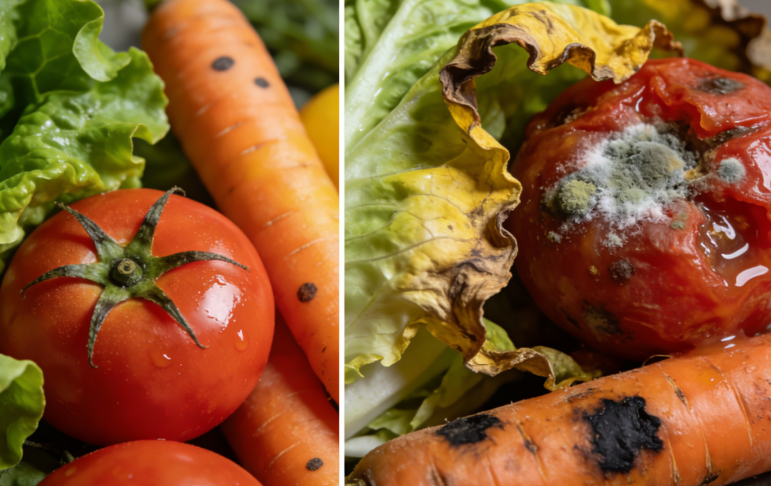
1. Postharvest Spoilage of Fruits and Vegetables
(1) Respiration: the Core Mechanism of Postharvest Spoilage
Anaerobic Respiration (Low-Oxygen Conditions)
Substrates
  Regardless of pathway, substrates consumed during respiration are organic compounds such as glucose.
Consequences
  As respiration continues → internal nutritional reserves progressively depleted → nutrient loss, quality deterioration, and spoilage.
Notes:
无论采用哪种呼吸方式，果蔬在呼吸过程中消耗的原料来源都是葡萄糖等有机物。
随着呼吸作用持续进行，这些内部的营养物质不断被消耗，导致果蔬营养流失、品质劣变，甚至出现变质。
Regardless of the respiration pathway, the substrates consumed during respiration in fruits and vegetables are organic compounds such as glucose.
As respiration continues, these internal nutritional reserves are progressively depleted, leading to nutrient loss, quality deterioration, and eventually spoilage of fruits and vegetables.

Slide 11
1. Postharvest Spoilage of Fruits and Vegetables
(2) Respiration Intensity: A Key Indicator for Evaluating Respiratory Activity
Key question
  How to measure the intensity of respiratory activity.
Core parameter
  Respiration intensity (respiration rate) → to quantity the strength of respiration in fruits and vegetables.
Definition
  Amount of O₂ consumed or CO₂ released per unit time by a unit mass/volume of fruits and vegetables at a given temperature.
Implication
  Higher respiration intensity → faster glucose and other nutrient consumption → accelerated senescence and spoilage → shorter storage and shelf life.
In practical production
  Differences and changes in respiration intensity are highly evident and are mainly reflected in two aspects.
Notes:
2.呼吸强度：衡量呼吸作用的关键指标
既然我们已经了解了果蔬的有氧呼吸和无氧呼吸两种类型，那么该如何衡量呼吸作用的强弱呢？这就需要用到呼吸强度（又称呼吸速率） 这一关键指标。
我们可以用呼吸强度（又称呼吸速率）来衡量果蔬呼吸作用的强弱，它的核心定义是：在一定温度下，单位时间内、单位重量（或体积）的果蔬吸入氧气，或是释放二氧化碳的量。
简单说，呼吸强度越大，果蔬消耗葡萄糖等营养原料的速度就越快，衰老变质也会跟着加速，保鲜贮藏期自然更短。
在实际生产中，呼吸强度的差异和变化很明显，主要体现在两方面：
Now that the aerobic and anaerobic respiration of fruits and vegetables has been described above, the next question is how to measure the intensity of respiratory activity.
This is addressed by the key parameter respiration intensity (also referred to as the respiration rate).
Respiration intensity (respiration rate) is used to quantify the strength of respiration in fruits and vegetables.
It is defined as the amount of oxygen consumed or carbon dioxide released per unit time by a unit mass (or volume) of fruits and vegetables at a given temperature.
In simple terms, the higher the respiration intensity, the faster glucose and other nutritional substrates are consumed, leading to accelerated senescence and spoilage and, consequently, a shorter storage and shelf life.
In practical production, differences and changes in respiration intensity are highly evident and are mainly reflected in two aspects:

Slide 12
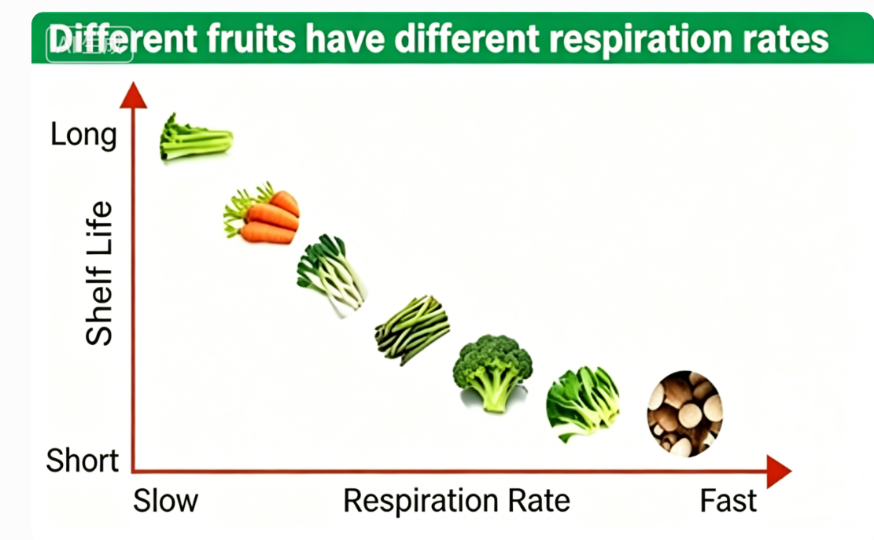
1. Postharvest Spoilage of Fruits and Vegetables
(2) Respiration Intensity: A Key Indicator for Evaluating Respiratory Activity
Large differences in respiration intensity among different fruits and vegetables:
Apples, blueberries, and strawberries inherently differ in their respiration rates.
Storage-tolerant fruits (e.g., apples, pears) have low respiration intensity → longer storage life.
Fruits and vegetables such as strawberries and spinach have high respiration intensity → rapid deterioration at ambient temperature.
Notes:
（1）不同果蔬，呼吸强度差别大：例如苹果、蓝莓、草莓，它们的呼吸速率天生不同。耐储存的苹果、梨，呼吸强度本身偏低，所以能放更久；而草莓、菠菜这类果蔬，呼吸强度天生旺盛，常温下很快就会变质。
Large differences in respiration intensity among different fruits and vegetables:
For example, apples, blueberries, and strawberries inherently differ in their respiration rates.
Storage-tolerant fruits such as apples and pears have relatively low respiration intensity and can therefore be stored for longer periods.
In contrast, fruits and vegetables such as strawberries and spinach have inherently high respiration intensity and deteriorate rapidly at ambient temperature.

Slide 13
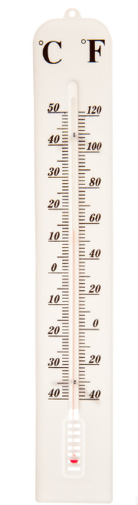
1. Postharvest Spoilage of Fruits and Vegetables
(2) Respiration Intensity: A Key Indicator for Evaluating Respiratory Activity
Temperature is a critical factor affecting respiration intensity:
  Under low temperatures (<5°C) → respiration becomes very weak → nutrient consumption proceeds slowly.
  Temperature rises above 10°C→ respiration intensity increases sharply, like an “accelerator” → nutrients consumed rapidly→ flavour and texture deteriorate quickly→ rate of quality degradation increases significantly.
Notes:
（2）温度是影响呼吸强度的关键：温度对呼吸作用的影响特别显著 —— 在 5℃以下的低温环境中，果蔬的呼吸作用会变得很微弱，营养消耗也慢；可一旦温度升到 10℃以上，呼吸作用会急剧增强，就像按下了 “加速键”。呼吸一加快，果蔬的营养物质消耗得更快，风味、口感会快速变差，品质劣变的速度也会明显提升。
Temperature is a critical factor affecting respiration intensity:
Temperature has a strong influence on respiration.
Under low-temperature conditions below 5°C, respiration in fruits and vegetables becomes very weak, and nutrient consumption proceeds slowly.
However, once the temperature rises above 10°C, respiration intensity increases sharply, as if an “accelerator” has been engaged. As respiration accelerates, nutrients are consumed more rapidly, flavor and texture deteriorate quickly, and the rate of quality degradation increases significantly.

Slide 14
1. Postharvest Spoilage of Fruits and Vegetables
(3) Respiratory Climacteric and Classification of Fruits and Vegetables
Definition
  The respiratory climacteric ➔ a key characteristic of respiration behavior in many fruits.
  It refers to the peak in respiration intensity during fruit growth, development, or postharvest ripening.
Climacteric Produce
Non-climacteric Produce
Two Major Categories of Produce
Notes:
3.呼吸高峰与果蔬类型划分
呼吸高峰是呼吸作用的关键特征，指果实生长发育或后熟阶段出现的呼吸强度峰值。根据呼吸高峰的变化特征，果蔬可划分为呼吸跃变型和呼吸非跃变型两大类。
(3)Respiratory Climacteric and Classification of Fruits and Vegetables
The respiratory climacteric is a key characteristic of respiration, referring to the peak in respiration intensity that occurs during fruit growth, development, or postharvest ripening. Based on the presence and pattern of this climacteric behavior, fruits and vegetables can be classified into two major categories: climacteric and non-climacteric produce.

Slide 15
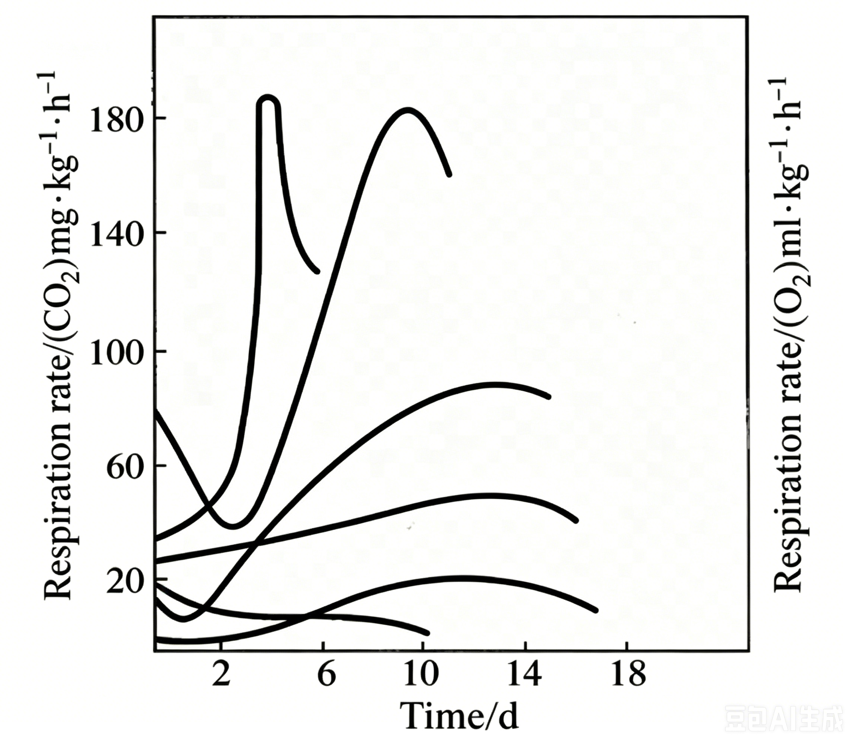
1. Postharvest Spoilage of Fruits and Vegetables
(3) Respiratory Climacteric and Classification of Fruits and Vegetables
Climacteric fruits and vegetables
  Respiration Pattern
During postharvest ripening, respiration intensity in climacteric produce first declines → then rises sharply → form a distinct peak + marked quality changes (e.g., bananas turning yellow, apples becoming mealy).
Artocarpus altilis
Annona cherimola
  Typical Examples
  Postharvest Management Focus
Apples, pears, bananas, plums, etc.
Mangifera indica
Ficus carica
Control ethylene production and action (e.g., inhibition with 1-MCP) to delay the respiratory climacteric and extend shelf life.
Malus domestica
Solanum lycopersicum
Notes:
呼吸跃变型：果蔬采后成熟过程中，呼吸强度先降后升形成高峰，伴随品质剧变（如香蕉转黄、苹果变粉），典型代表包括苹果、梨、香蕉、李子等。
这类果蔬需重点控制乙烯释放（如用1-MCP抑制），延缓呼吸高峰以延长保鲜期。
Climacteric fruits and vegetables:
During postharvest ripening, respiration intensity in climacteric produce first declines and then rises sharply to form a distinct peak, accompanied by marked quality changes (e.g., bananas turning yellow and apples becoming mealy).
Typical examples include apples, pears, bananas, and plums. For these fruits and vegetables,
postharvest management should focus on controlling ethylene production and action (e.g., inhibition with 1-methylcyclopropene, 1-MCP) to delay the respiratory climacteric and extend shelf life.

Slide 16
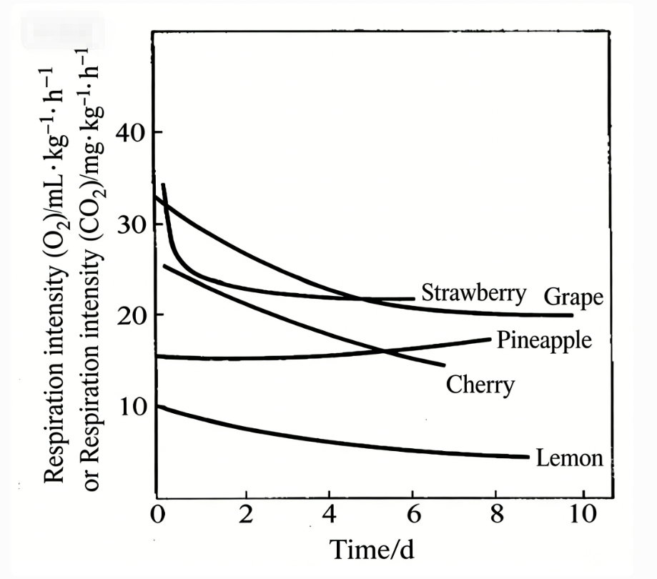
1. Postharvest Spoilage of Fruits and Vegetables
(3) Respiratory Climacteric and Classification of Fruits and Vegetables
Non-Climacteric Fruits and Vegetables
  Respiration Pattern
Non-climacteric produce does not exhibit a respiratory climacteric after harvest.
Instead, respiration intensity decreases gradually and continuously.
Ripening process proceeds in a relatively stable manner (e.g., grape soluble solids content remains essentially unchanged after harvest).
  Typical Examples
  Postharvest Management Focus
Grapes, strawberries, citrus fruits, etc.
Reduce basal respiration intensity (e.g., storage at 0–5°C) to minimize nutrient loss and maintain quality.
Notes:
呼吸非跃变型：采后无呼吸高峰，呼吸强度持续缓慢下降，成熟过程平稳（如葡萄采后糖度基本稳定），典型代表包括葡萄、草莓、柑橘等。这类果蔬需降低基础呼吸强度（如0-5℃低温贮藏），减少营养消耗以维持品质。
Non-climacteric fruits and vegetables:
Non-climacteric produce does not exhibit a respiratory climacteric after harvest;
instead, respiration intensity decreases gradually and continuously,
and the ripening process proceeds in a relatively stable manner (e.g., grape soluble solids content remains essentially unchanged after harvest).
Representative examples include grapes, strawberries, and citrus fruits. For these fruits and vegetables, postharvest management should focus on reducing the basal respiration intensity (e.g., storage at 0–5°C) to minimize nutrient loss and maintain quality.

Slide 17
1. Postharvest Spoilage of Fruits and Vegetables
(3) Respiratory Climacteric and Classification of Fruits and Vegetables
Comparison of Postharvest Management Strategies
Climacteric Produce
Non-Climacteric Produce
Examples: bananas, apples.
Require strict control of ethylene release and action to delay the respiratory peak.
Examples: grapes, strawberries.
Rely primarily on reducing basal respiration through low-temperature storage to slow nutrient depletion and preserve quality.
Notes:
两类果蔬的采后管理策略差异显著：呼吸跃变型（如香蕉、苹果）需重点控制乙烯释放（如用1-MCP抑制），延缓呼吸高峰；呼吸非跃变型（如葡萄、草莓）则需降低基础呼吸强度（如低温贮藏），减少营养消耗。
In summary, postharvest management strategies differ markedly between the two types of produce. Climacteric fruits and vegetables (e.g., bananas and apples) require strict control of ethylene release and action to delay the respiratory peak, whereas non-climacteric fruits and vegetables (e.g., grapes and strawberries) rely primarily on reducing basal respiration through low-temperature storage to slow nutrient depletion and preserve quality.

Slide 18
1. Postharvest Spoilage of Fruits and Vegetables
(4) Benefits and Drawbacks of Respiration
Beneficial Effects of Respiration
  Respiration has dual effects on postharvest quality.
  Reducing respiration intensity is the primary regulatory objective.
Three Aspects of Beneficial Effects
Sustains Basic Life Activities
Enhances Disease Resistance
Promotes Wound Healing
Provides energy required to sustain basic life activities of fruits and vegetables after harvest.
Increases activity of intracellular oxidative systems and the expression of related enzymes → improves the ability of tissues to defend against pathogens and microbial invasion.
After mechanical damage to Chinese yam (Dioscorea spp.), tissues near the wound increase respiration.
  → to synthesize structural substances such as lignin and suberin.
  → to provide energy for biosynthesis.
  ⟹ accelerating formation of wound-healing tissues.
Notes:
4.呼吸作用的利弊
（1）呼吸作用的好处
呼吸作用对果蔬采后品质具有双重影响，但在生产实践中需以降低呼吸强度为主要调控目标。其有益作用主要体现在三个方面：一是提供能量供给，维持果蔬采后的生命活动；二是增强抗病免疫能力，通过提升细胞内氧化系统活性及相关酶的表达，抵御病原菌与微生物侵染；三是促进受伤组织愈合，例如山药在机械损伤后，伤口周边组织会通过增强呼吸作用合成木质素、栓质等结构物质，并提供生物合成所需能量，从而加速愈伤组织形成。
(4)Benefits and Drawbacks of Respiration
•Beneficial Effects of Respiration
Respiration exerts dual effects on the postharvest quality of fruits and vegetables;
however, in practical postharvest management,
reducing respiration intensity is generally the primary regulatory objective.
The beneficial effects of respiration can be summarized in three aspects. First, respiration provides the energy required to sustain basic life activities of fruits and vegetables after harvest.
Second, it enhances resistance to diseases by increasing the activity of intracellular oxidative systems and the expression of related enzymes, thereby improving the ability of tissues to defend against pathogens and microbial invasion.
Third, respiration promotes wound healing in injured tissues. For example, after mechanical damage to Chinese yam (Dioscorea spp.), tissues surrounding the wound increase respiratory activity to synthesize structural substances such as lignin and suberin and to provide the energy required for biosynthesis, thereby accelerating the formation of wound-healing tissues.

Slide 19
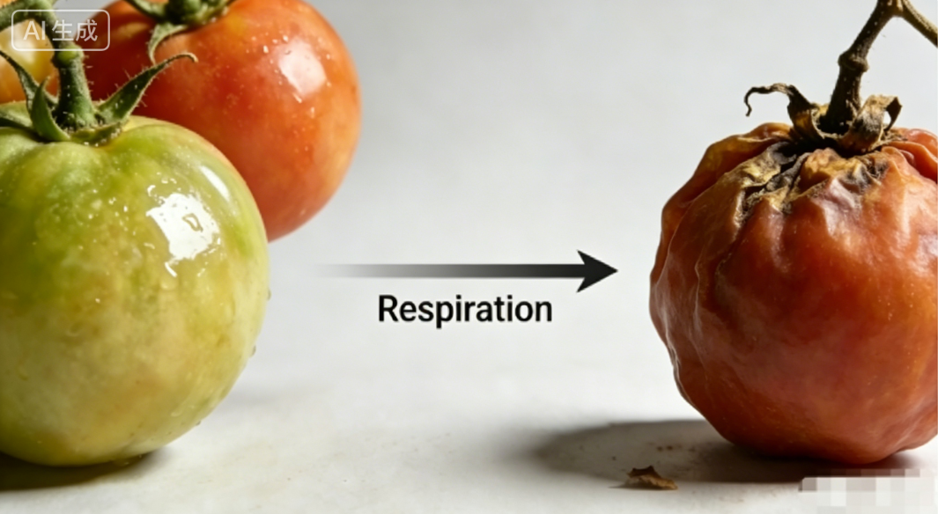
1. Postharvest Spoilage of Fruits and Vegetables
(4) Benefits and Drawbacks of Respiration
Detrimental Effects of Respiration – Three Major Negative Impacts
1）Consumes Substrates → Accelerates Senescence
After harvest, fruits and vegetables detached from the parent plant and cannot acquire water or nutrients.
Rely on respiration to consume internally stored substrates (e.g., glucose).
Lead to nutrient depletion and ultimately loss of biological activity once these substrates are exhausted.
Notes:
（2）呼吸作用的坏处
呼吸作用对果蔬采后品质的负面影响主要体现在三个方面：一是消耗呼吸原料，加速果蔬衰老。果蔬采后脱离母体，无法继续获取水分和养分，只能通过呼吸作用消耗自身储存的葡萄糖等原料，导致营养物质流失，最终因原料耗尽而丧失生命活性。
•Detrimental Effects of Respiration
The negative impacts of respiration on the postharvest quality of fruits and vegetables are also manifested in three major aspects.
First, respiration consumes respiratory substrates and accelerates senescence.
After harvest, fruits and vegetables are detached from the parent plant and can no longer acquire water or nutrients;
they must rely on respiration to consume their internally stored substrates such as glucose,
leading to nutrient depletion and ultimately the loss of biological activity once these substrates are exhausted.

Slide 20
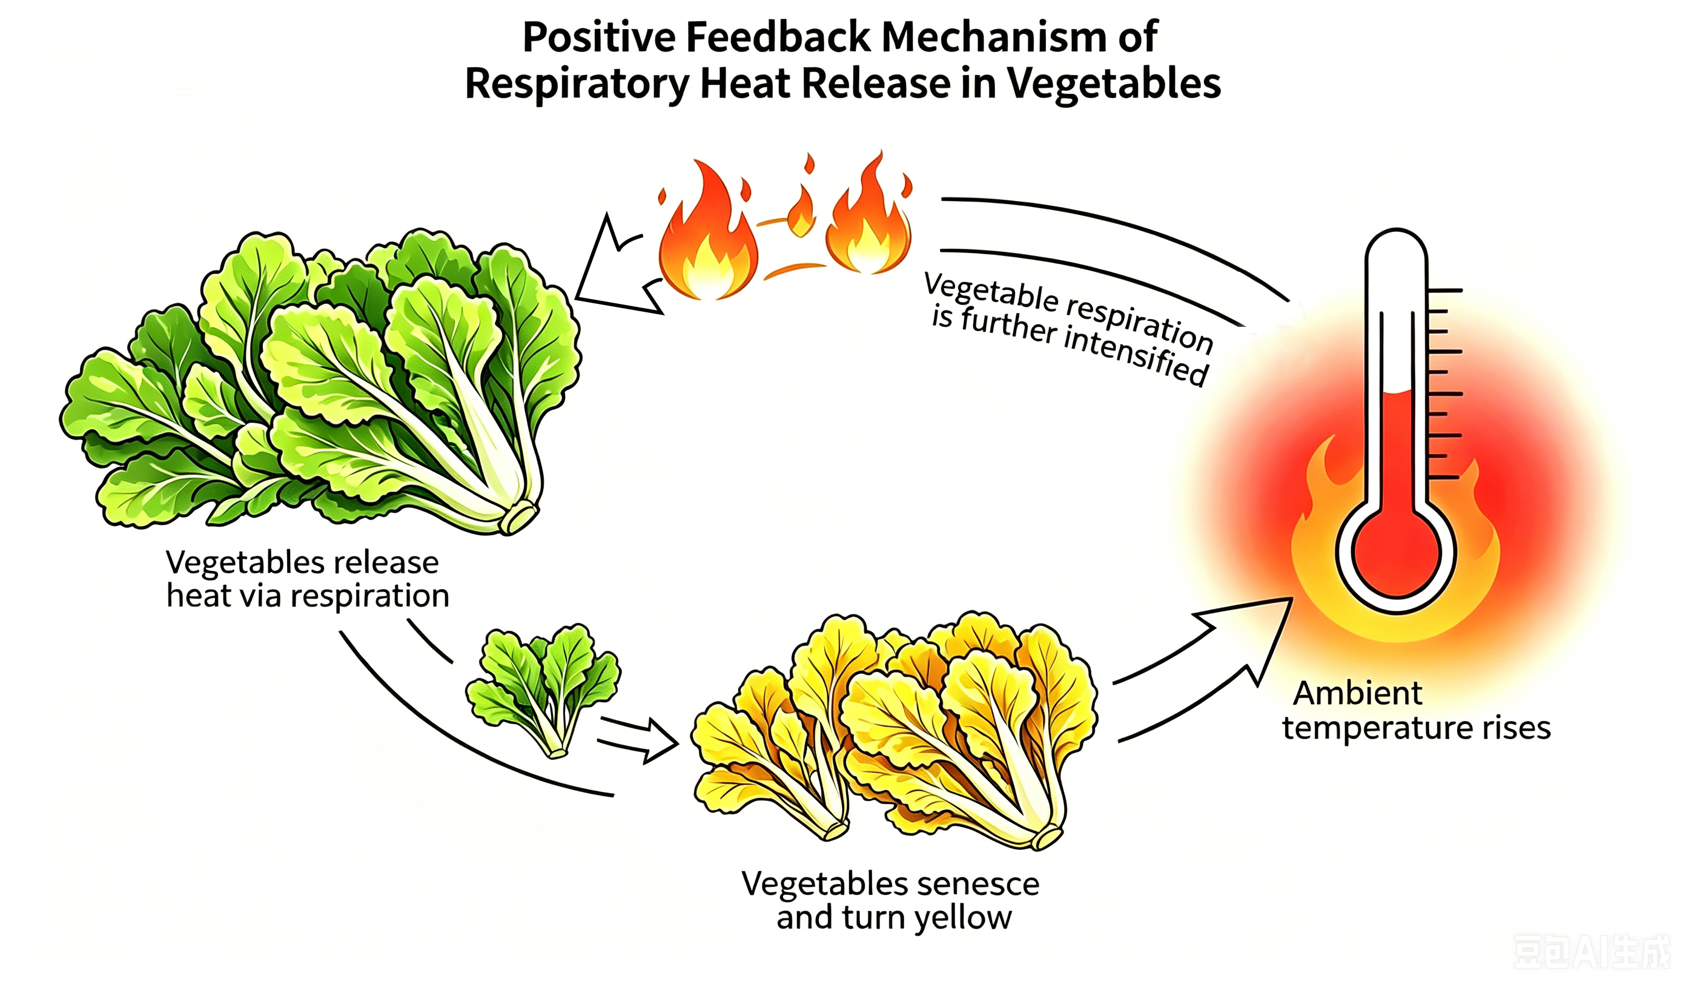
1. Postharvest Spoilage of Fruits and Vegetables
(4) Benefits and Drawbacks of Respiration
Detrimental Effects of Respiration – Three Major Negative Impacts
2）Releases Heat → Forms a Vicious Cycle
Substantial heat generated during respiration raises ambient temperature → further enhances respiration intensity.
This positive feedback mechanism accelerates senescence and yellowing → causing rapid loss of marketability and edibility.
Example: marked increase in internal temperature observed during bulk storage of vegetables.
Notes:
二是释放呼吸热，形成恶性循环。呼吸过程中释放的大量热量会升高环境温度，而温度升高又会进一步增强呼吸强度，这种正反馈机制会加速果蔬衰老变黄，使其快速失去商品价值和食用价值。例如蔬菜堆码贮藏时，内部温度显著升高即为此类现象。
Second, respiration releases heat, forming a vicious cycle.
The substantial amount of heat generated during respiration raises the ambient temperature, which in turn further enhances respiration intensity.
This positive feedback mechanism accelerates senescence and yellowing of fruits and vegetables, causing a rapid loss of marketability and edibility.
A typical example is the marked increase in internal temperature observed during bulk storage of vegetables.

Slide 21
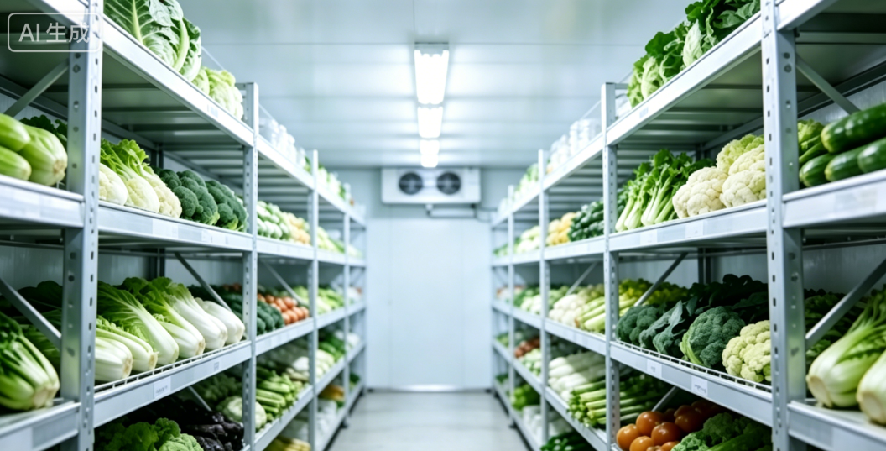
1. Postharvest Spoilage of Fruits and Vegetables
(4) Benefits and Drawbacks of Respiration
Detrimental Effects of Respiration – Three Major Negative Impacts
3）Alters Composition of Atmosphere → Induces Physiological Disorders
In sealed storage environments, respiration consumes O₂ and releases CO₂ → decreased O₂ levels and elevated CO₂ concentrations.
Moderately low O₂ and elevated CO₂ conditions beneficial for preservation.
Excessive CO₂ → cellular injury; insufficient O₂ → anaerobic respiration → ethanol production and subsequent fermentation and spoilage.
  ⟹ Precise regulation of O₂ and CO₂ concentrations during storage and transportation is essential to effectively delay ripening and senescence.
Notes:
三是改变环境气体组成，引发生理问题。在密闭贮藏环境中，果蔬呼吸消耗氧气并释放二氧化碳，导致环境氧气含量降低、二氧化碳浓度升高。虽然适度的低氧高二氧化碳环境有利于保鲜，但二氧化碳过量会造成细胞损伤，氧气不足则会诱发无氧呼吸产生乙醇，导致果实发酵变质。因此，果蔬储运中需精准调控氧气与二氧化碳比例，以有效延缓成熟衰老进程。
Third, respiration alters the composition of the surrounding atmosphere and induces physiological disorders.
In sealed storage environments, respiration by fruits and vegetables consumes oxygen and releases carbon dioxide, resulting in decreased oxygen levels and elevated carbon dioxide concentrations.
While moderately low oxygen and elevated carbon dioxide conditions can be beneficial for preservation,
excessive carbon dioxide may cause cellular injury, and insufficient oxygen can induce anaerobic respiration, leading to ethanol production and subsequent fermentation and spoilage.
Therefore, precise regulation of oxygen and carbon dioxide concentrations during storage and transportation is essential to effectively delay ripening and senescence.

Slide 22
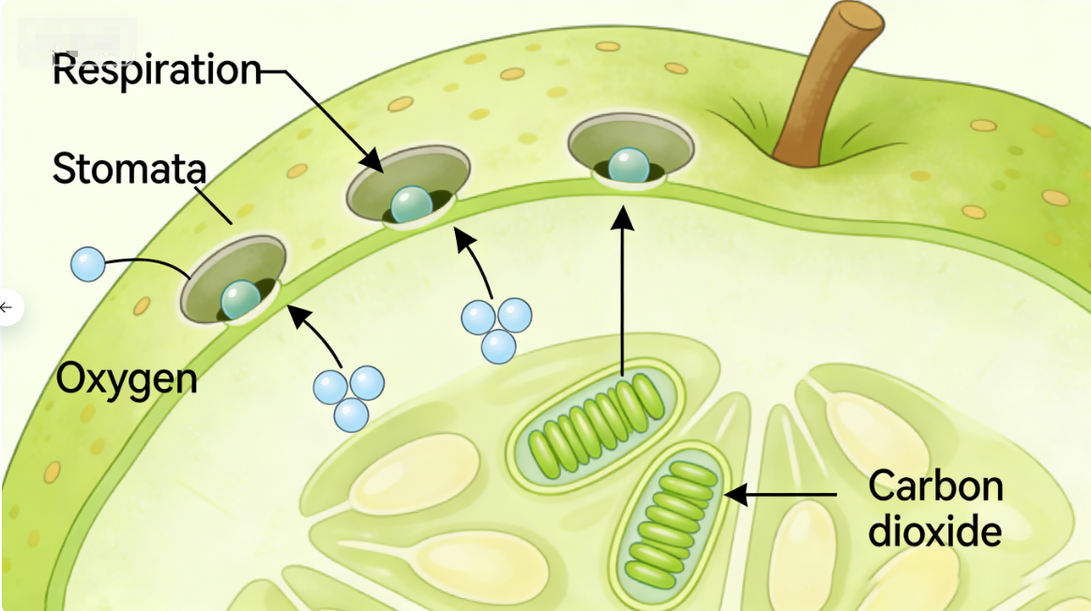
1. Postharvest Spoilage of Fruits and Vegetables
(4) Benefits and Drawbacks of Respiration
Implication — Need to Identify Regulatory Factors
  After understanding dual effects of respiration → necessary to further identify factors that regulate respiration intensity.
  These factors are critical for interpreting quality deterioration.
  They also form an important basis for developing effective postharvest preservation strategies.
Notes:
了解呼吸作用的双重影响后，需进一步明确哪些因素会调控呼吸强度——这些因素既是理解品质劣变的关键，也是制定保鲜策略的重要依据。
After understanding the dual effects of respiration, it becomes necessary to further identify the factors that regulate respiration intensity.
These factors are not only critical for interpreting quality deterioration but also form an important basis for the development of effective postharvest preservation strategies.

Slide 23

1. Postharvest Spoilage of Fruits and Vegetables
(5) Factors Affecting Respiration
Temperature
Temperature Strongly Regulates Respiration
  Temperature is the core factor regulating respiration.
  Within 0–35 °C, respiration intensity increases by 1.0–1.5 times for every 10 °C rise in temperature.
Higher Temperature Shortens Shelf Life
  Increased respiration leads to a proportional shortening of shelf life.
Lowest Safe Temperature Should Be Used
  Respiration intensity is positively correlated with temperature.
  On the premise of avoiding chilling injury or freezing injury, adopt lowest possible storage temperature → to maximize the suppression of respiratory metabolism.
Notes:
5.影响呼吸作用的因素
（1）温度：温度是调控呼吸作用的核心因素。研究表明，在0~35℃范围内，温度每升高10℃，呼吸强度可增强1~1.5倍，导致果蔬货架期成倍缩短。温度与呼吸强度呈正相关，因此在避免冷害或冻害的前提下，应采用尽可能低的贮藏温度，以最大限度抑制呼吸代谢。
(5) Factors Affecting Respiration
Temperature
Temperature is the core factor regulating respiration. Studies have shown that within the range of 0–35°C, respiration intensity increases by approximately 1.0–1.5 times for every 10°C rise in temperature,
resulting in a proportional shortening of the shelf life of fruits and vegetables.
Respiration intensity is positively correlated with temperature; therefore, on the premise of avoiding chilling injury or freezing injury, the lowest possible storage temperature should be adopted to maximize the suppression of respiratory metabolism.

Slide 24
1. Postharvest Spoilage of Fruits and Vegetables
(5) Factors Affecting Respiration
Humidity
Core Effect
  Moderately dry conditions can suppress respiration.
  High humidity promotes respiration →induce decay/mold growth.
Harvesting Conditions
  Prefer harvesting under clear, dry weather → avoid surface moisture from dew or rain.
Storage Requirements
  Maintain appropriate relative humidity.
  Ensure adequate air circulation to prevent surface condensation.
Notes:
（2）湿度：适度干燥可抑制呼吸作用，而高湿环境会促进呼吸并诱发腐烂、霉变。采收宜在晴好天气进行，避免表面带露水或雨水。贮藏时，应维持适宜的湿度，但同时保证空气流通，防止表面结露。
•Humidity
Moderately dry conditions can suppress respiration, whereas high-humidity environments promote respiration and may induce decay and mold growth.
Harvesting should preferably be carried out under clear, dry weather conditions to avoid surface moisture from dew or rain. During storage, an appropriate relative humidity should be maintained
while ensuring adequate air circulation to prevent surface condensation.

Slide 25

1. Postharvest Spoilage of Fruits and Vegetables
(5) Factors Affecting Respiration
Gaseous Environment
Respiration Control
  Respiration can be effectively inhibited by reducing O₂ and increasing CO₂.
Gas Composition Regulation
  Gas composition must be precisely regulated for each specific fruit or vegetable.
Ethylene Management
  Ethylene (ripening-promoting hormone) should be strictly controlled through:
    ⟹ Preventing ethylene accumulation.
Ventilation
Use of ethylene absorbing / ethylene removal agents
Notes:
（3）气体：通过降低氧气浓度和提高二氧化碳浓度可有效抑制呼吸，但需根据果蔬种类精准调控气体配比。此外，乙烯作为典型成熟促进激素，需通过通风或乙烯脱除剂严格控制其积累。
Gaseous Environment
Respiration can be effectively inhibited by reducing oxygen concentration and increasing carbon dioxide concentration;
however, gas composition must be precisely regulated according to the specific type of fruit or vegetable.
In addition, ethylene, a typical ripening-promoting plant hormone, should be strictly controlled through ventilation or the use of ethylene-absorbing or ethylene-removal agents to prevent its accumulation.

Slide 26

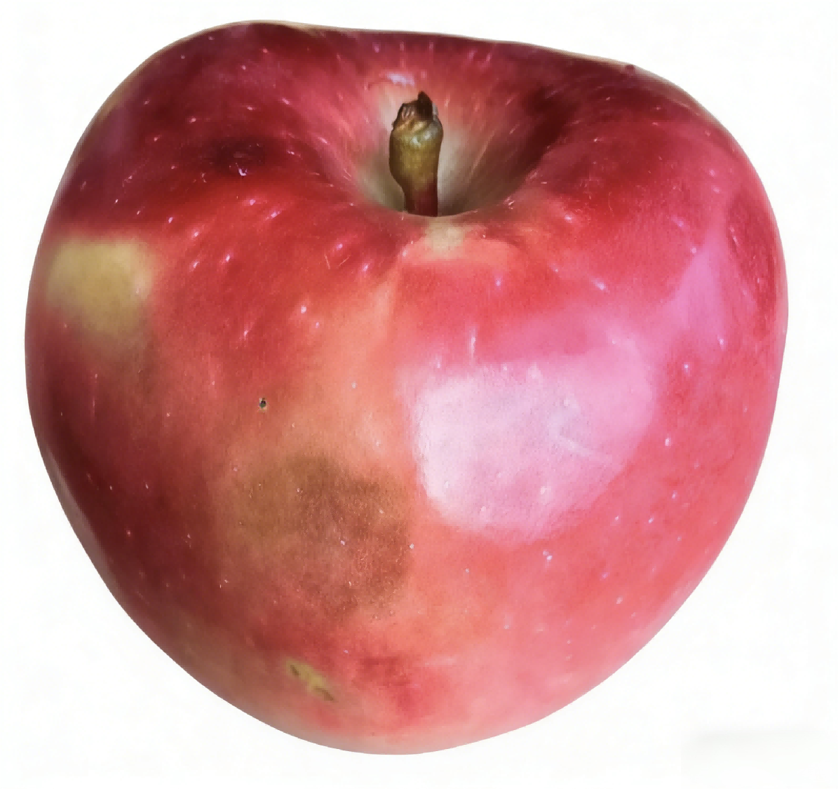
1. Postharvest Spoilage of Fruits and Vegetables
(5) Factors Affecting Respiration
Mechanical Injury
Mechanical Damage
  Mechanical damage has a pronounced effect on respiration.
Respiration Response
  Impacts, compression, or skin injury → respiration intensity increases rapidly.
Consequences
  Shortened storage life.
  Increased susceptibility to pathogen invasion + decay.
Notes:
（4）机械损伤：机械损伤对呼吸作用影响显著，果蔬受碰撞、挤压、破皮等损伤时，呼吸作用迅速增强，导致储藏寿命缩短，还易受病菌侵染腐烂。
•Mechanical Injury
Mechanical damage has a pronounced effect on respiration.
When fruits and vegetables are subjected to impacts, compression, or skin injury, respiration intensity increases rapidly,
leading to a shortened storage life and increased susceptibility to pathogen invasion and decay.

Slide 27

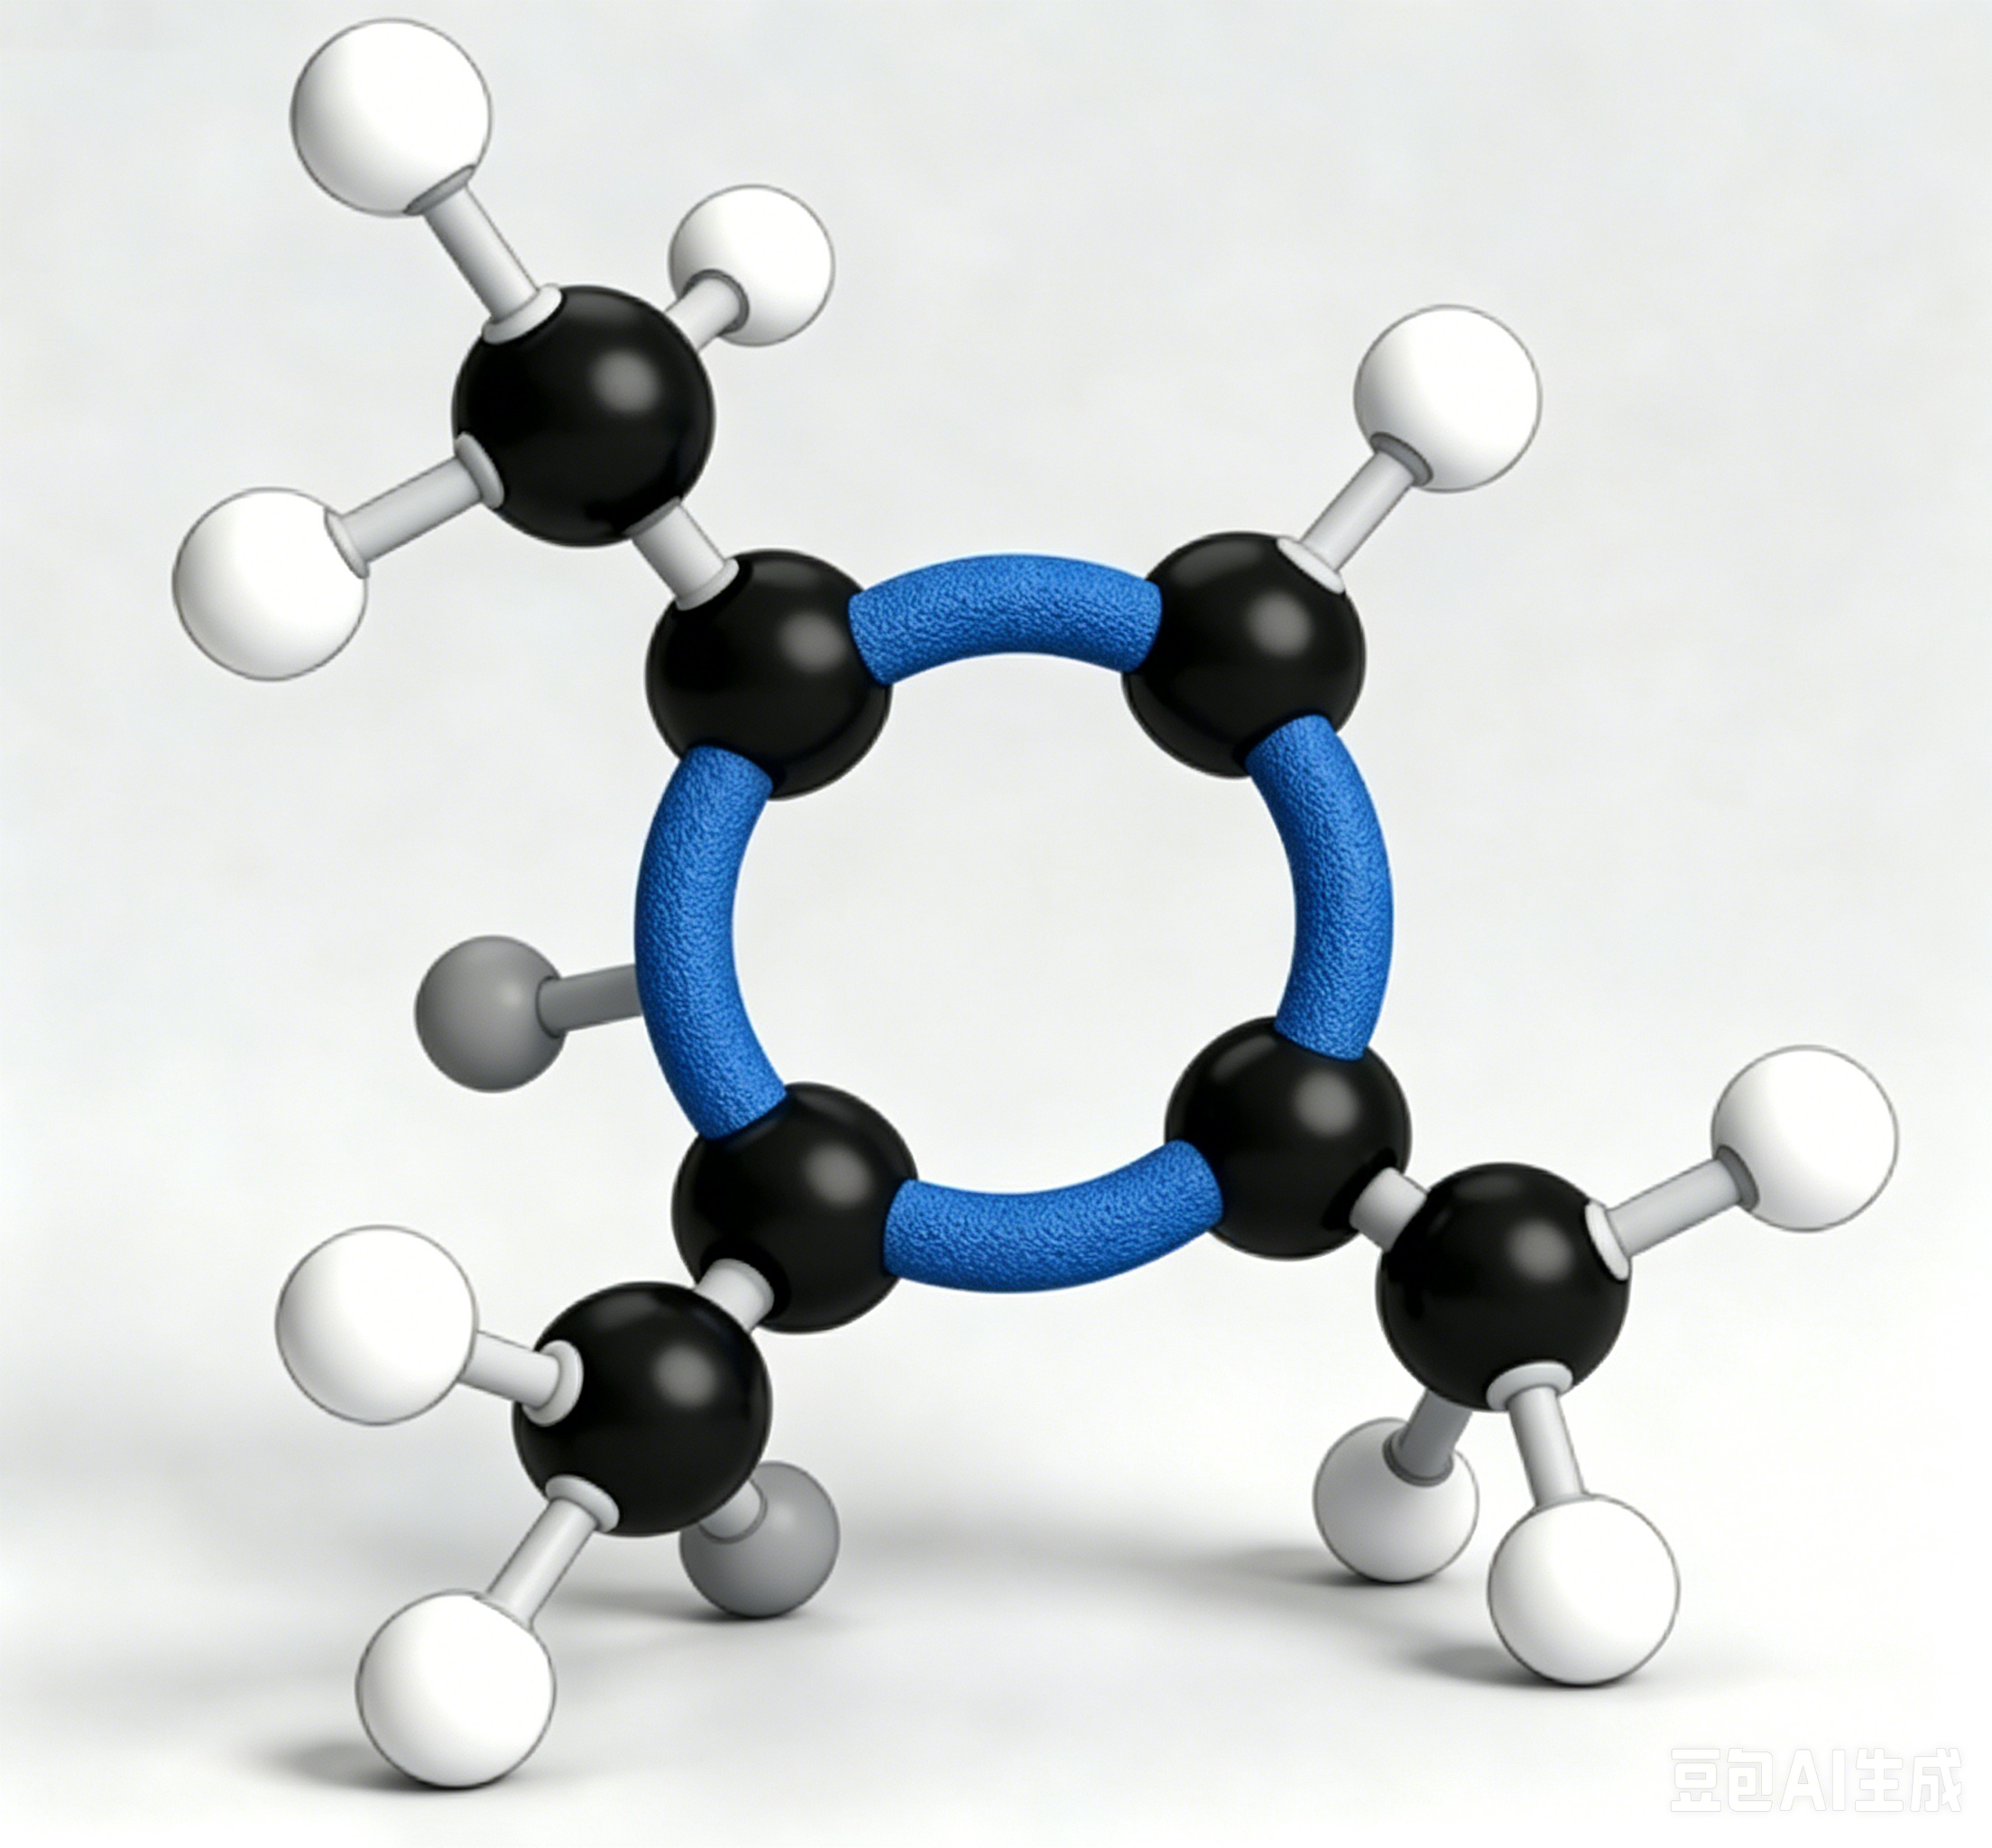
1. Postharvest Spoilage of Fruits and Vegetables
(5) Factors Affecting Respiration
Plant Hormones
Ethylene's Effect
  Ethylene — respiration-promoting hormone that accelerates postharvest ripening & senescence.
(1-MCP)
C₄H₆
Respiration-Inhibiting Hormones
  1-MCP, NAA, abscisic acid, auxins, cytokinins can delay metabolic processes by inhibiting the activity of respiratory enzymes = important regulatory tools in postharvest preservation.
≫ The central role of respiration in the deterioration of nutritional quality in fruits and vegetables
after harvest.
Notes:
（5）植物激素：乙烯是呼吸促进型激素，可加速后熟衰老；而1-甲基环丙烯（1-MCP）、萘乙酸、脱落酸、生长素和激动素等则通过抑制呼吸酶活性延缓代谢进程，是采后保鲜的重要调控手段。上述内容阐明了呼吸作用对果蔬营养品质劣变的核心影响机制。
Plant Hormones
Ethylene is a respiration-promoting hormone that accelerates postharvest ripening and senescence.
In contrast, 1-methylcyclopropene (1-MCP), naphthaleneacetic acid (NAA), abscisic acid, auxins, and cytokinins can delay metabolic processes by inhibiting the activity of respiratory enzymes and are therefore important regulatory tools in postharvest preservation.
The above discussion elucidates the central role of respiration in the deterioration of nutritional quality in fruits and vegetables after harvest.

Slide 28
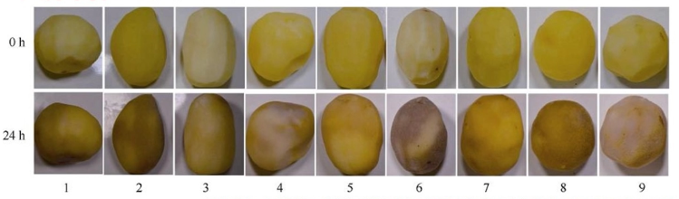
2. Postharvest Discoloration of Fruits and Vegetables
Two Types of Mechanisms
Type 1: Pigment Changes
Includes chlorophyll degradation, pH-induced color variation of anthocyanins, and synthesis/degradation of carotenoids and lycopene.
Type 2: Enzymatic Browning
More prevalent in practice and represents one of the key factors leading to postharvest quality deterioration and loss of commercial value in fruits and vegetables.
Very common in daily life; cut potatoes, apples, or lotus roots exposed to air gradually turn brown or black.
Notes:
果蔬采后品质劣变的第二种典型表现为采后变色。
（二）果蔬采后变色
果蔬在贮藏与加工过程中发生的变色，其机理主要分为两类：一类是色素变化，如叶绿素降解、花青素因pH值改变而显色不同、类胡萝卜素及番茄红素的合成与分解等；另一类则是酶促褐变。后者在生产中更为常见，是导致果蔬采后品质劣变、商品价值下降的关键因素之一。
Another typical manifestation of postharvest quality deterioration is postharvest discoloration.
2.Postharvest Discoloration of Fruits and Vegetables[红色的删除】
Discoloration of fruits and vegetables during storage and processing can be attributed mainly to two types of mechanisms.
One involves changes in pigments, such as chlorophyll degradation, color variation of anthocyanins induced by pH changes, and the synthesis and degradation of carotenoids and lycopene.
The other involves enzymatic browning, which is more prevalent in practice and represents one of the key factors leading to postharvest quality deterioration and loss of commercial value in fruits and vegetables.

Slide 29
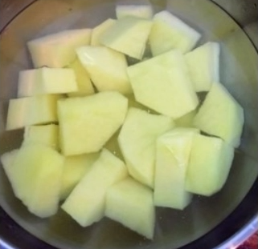
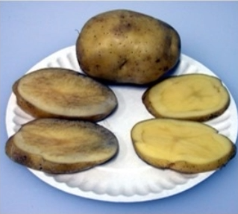
2. Postharvest Discoloration of Fruits and Vegetables
(1) Mechanism of Enzymatic Browning
Phenolic Substrates and Enzymatic Oxidation
  Fruit and vegetable tissues contain flavonoids, phenolic compounds, and other substances → beneficial to human health due to their antioxidant properties and ability to scavenge free radicals.
  During enzymatic browning, phenolic compounds are oxidized to quinones in the presence of oxygen → catalyzed by PPO and POD.
Polymerization and Pigment Formation
  Quinones undergo non-enzymatic polymerization reactions → aggregate on the tissue surface → ultimately form brown/black pigments visible to the naked eye.
Notes:
1.酶促褐变机理
水果和蔬菜的组织中含有黄酮、酚类等物质，这些物质对人体有益，具有清除自由基的抗氧化作用。在果蔬发生酶促褐变时，其中的酚类物质会在氧气、多酚氧化酶（PPO）以及过氧化物酶（POD）的共同作用下，被氧化成醌类物质。随后，醌类物质会通过非酶促的聚合反应，在果蔬组织表面相互聚集，最终形成我们肉眼可见的褐色或黑色物质。
(1)Mechanism of Enzymatic Browning
Fruit and vegetable tissues contain flavonoids, phenolic compounds, and other substances that are beneficial to human health due to their antioxidant properties and ability to scavenge free radicals.
During enzymatic browning, these phenolic compounds are oxidized to quinones in the presence of oxygen and under the catalytic action of polyphenol oxidase (PPO) and peroxidase (POD).
Subsequently, the quinones undergo non-enzymatic polymerization reactions, whick then aggregate on the tissue surface and ultimately form brown or black pigments visible to the naked eye.

Slide 30
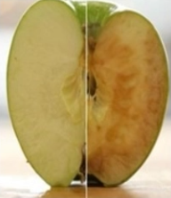
2. Postharvest Discoloration of Fruits and Vegetables
(1) Mechanism of Enzymatic Browning
Enzymatic browning requires three conditions simultaneously.
Condition 1: Substrates
  Phenolic compounds as reaction substrates.
Condition 2: Enzymes
  Oxidative enzymes capable of catalyzing the reaction, mainly PPO and POD.
Condition 3: Oxygen
  Oxygen provides the necessary reaction environment.
Occurrence Logic: Enzymatic browning occurs only when all three conditions are satisfied.
Notes:
酶促褐变的发生需要同时具备三个条件：一是要有作为反应原料的酚类物质；二是要有能够催化反应进行的氧化酶，如多酚氧化酶和过氧化物酶；三是要有作为催化剂的氧气。只有当这三个条件都满足时，酶促褐变才会发生。
The occurrence of enzymatic browning requires the simultaneous presence of three conditions:
phenolic compounds as reaction substrates;
(ii) oxidative enzymes capable of catalyzing the reaction, mainly PPO and POD;
and (iii) oxygen, which provides the necessary reaction environment.
Enzymatic browning occurs only when all three conditions are met.

Slide 31
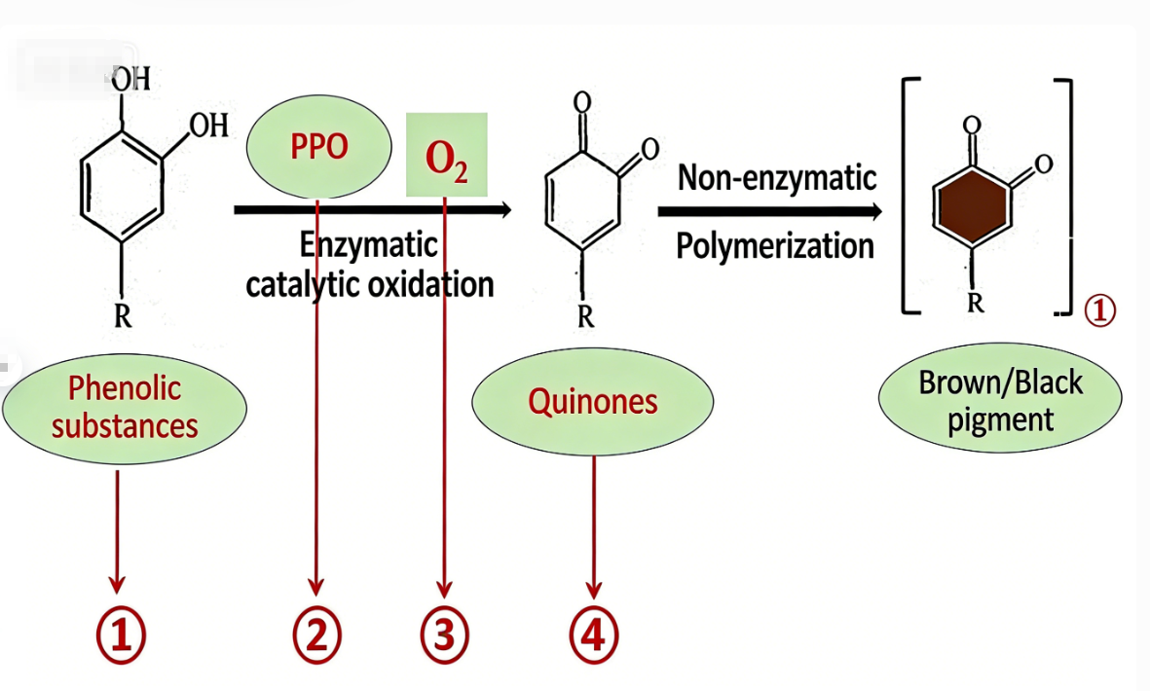
2. Postharvest Discoloration of Fruits and Vegetables
(2) Control of Enzymatic Browning
Key Substances Involved
  Phenolic substrates.
  Oxidative enzymes (PPO and POD).
  Oxygen.
  Quinones (intermediate products).
Example
  Sliced potatoes or lotus roots immersed in water show little color change → oxygen is excluded.
Control Strategies Based on the Four Components
  Target phenolic compounds.
  Inhibit enzyme activity.
  Reduce oxygen availability.
  Reduce quinones back to phenolic compounds.
Notes:
2.酶促褐变的控制
在了解了酶促褐变的成因后，我们该如何对其进行有效控制呢？前面已经讲过，引发酶促褐变涉及四类关键物质：一是作为反应原料的酚类物质；二是不可或缺的氧化酶，即多酚氧化酶（PPO）和过氧化物酶（POD）；三是氧气，它为反应提供了必要的条件；四是醌类物质，它是酶促褐变过程中的中间产物。就像切好的土豆片、莲藕片放在水里颜色不易变化，就是因为隔绝了氧气。如果我们能从控制酚类物质、抑制酶的活性、降低氧气含量、减少醌类物质或将其还原为酚类物质这几个方面入手，就能有效控制酶促褐变。接下来，我们从这四个方面详细介绍控制方法。
(2)Control of Enzymatic Browning
After understanding the causes of enzymatic browning, the next step is to consider effective control strategies.
As discussed above, four key components are involved in enzymatic browning:
(i) phenolic substrates;
(ii) essential oxidative enzymes (PPO and POD);
(iii) oxygen; and (iv) quinones, which are intermediate products of the reaction.
For instance, sliced potatoes or lotus roots immersed in water show little color change because oxygen is excluded.
Therefore, enzymatic browning can be effectively controlled by targeting phenolic compounds, inhibiting enzyme activity, reducing oxygen availability, and reducing quinones back to phenolic compounds. Control measures based on these four aspects are described below.

Slide 32
2. Postharvest Discoloration of Fruits and Vegetables
(2) Control of Enzymatic Browning
Reduction of Phenolic Content:
Strategy: Low-Phenolic Breeding
  Breeding cultivars with low phenolic content is one possible approach to reduce enzymatic browning.
Nutritional Trade-Off
  Phenolic compounds possess strong antioxidant activity and are highly beneficial nutrients.
  Reducing their content /cultivation low-phenol varieties → may conflict with consumer demand (appearance + nutrition).
  Should be applied with caution in practice.
Notes:
（1）降低酚类物质含量。培育低酚类物质品种是一种控制途径，但酚类物质具有清除自由基、抗氧化的作用，是对人体非常有益的营养成分。若降低其含量或培育低含量品种，可能与消费者对高颜值、富营养果蔬的需求相悖。因此，在实际应用中，这种方法需要谨慎权衡利弊。
Reduction of phenolic content
Breeding cultivars with low phenolic content is one possible approach.
However, phenolic compounds possess strong antioxidant activity and are highly beneficial nutrients.
Reducing their content or cultivating low-phenol varieties may conflict with consumer demand for visually appealing and nutritionally rich fruits and vegetables. Therefore,
this approach should be applied with caution in practice.

Slide 33
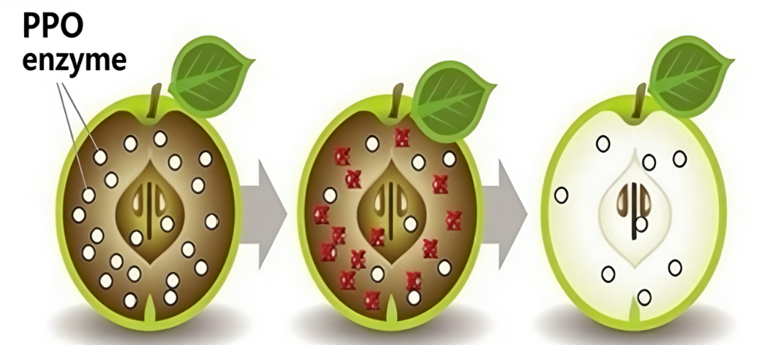
2. Postharvest Discoloration of Fruits and Vegetables
(2) Control of Enzymatic Browning
Inhibition of enzyme activity:
Core Principle: Enzyme Activity Suppression
  Suppressing PPO and POD activity is key to controlling enzymatic browning.
  Both physical and chemical methods can be employed.
Physical Methods
  Three types:
    Temperature control
    Irradiation
    Electromagnetic field treatments
  Low-temperature treatment → can reduce enzyme activity.
  Irradiation → can partially disrupt enzyme structures → inhibits activity.
Notes:
（2）抑制酶的活性。抑制多酚氧化酶（PPO）和过氧化物酶（POD）的活性是控制酶促褐变的关键。我们可以采用物理和化学两种方法来实现。物理方法包括利用温度、辐照、电磁场等手段。例如，适当的低温处理可以降低酶的活性；辐照技术能在一定程度上破坏酶的结构，从而抑制其活性。化学方法则是使用抑制剂，如维生素C、亚硫酸盐等。维生素C具有还原性，能将醌类物质还原为酚类物质，间接抑制酶促褐变；亚硫酸盐能与酶分子中的某些基团结合，使酶失去活性。
•Inhibition of enzyme activity
Suppressing the activity of PPO and POD is the key to controlling enzymatic browning.
Both physical and chemical methods can be employed.
Physical methods include temperature control, irradiation, and electromagnetic field treatments.
For example, appropriate low-temperature treatment can reduce enzyme activity, while irradiation can partially disrupt enzyme structures, thereby inhibiting their activity.
Chemical methods involve the use of inhibitors such as vitamin C (ascorbic acid) and sulfites.
Vitamin C acts as a reducing agent, converting quinones back to phenolic compounds and indirectly inhibiting browning, whereas sulfites can bind to specific functional groups of enzyme molecules, leading to enzyme inactivation.

Slide 34
2. Postharvest Discoloration of Fruits and Vegetables
(2) Control of Enzymatic Browning
Inhibition of enzyme activity:
Chemical Methods (Vitamin C and Sulfites)
  Vitamin C (ascorbic acid)
    Acts as a reducing agent.
    Converts quinones → phenolic compounds, indirectly inhibiting browning.
  Sulfites
        Bind to specific functional groups of enzyme molecules → lead to enzyme inactivation.
Notes:
（2）抑制酶的活性。抑制多酚氧化酶（PPO）和过氧化物酶（POD）的活性是控制酶促褐变的关键。我们可以采用物理和化学两种方法来实现。物理方法包括利用温度、辐照、电磁场等手段。例如，适当的低温处理可以降低酶的活性；辐照技术能在一定程度上破坏酶的结构，从而抑制其活性。化学方法则是使用抑制剂，如维生素C、亚硫酸盐等。维生素C具有还原性，能将醌类物质还原为酚类物质，间接抑制酶促褐变；亚硫酸盐能与酶分子中的某些基团结合，使酶失去活性。
•Inhibition of enzyme activity
Suppressing the activity of PPO and POD is the key to controlling enzymatic browning. Both physical and chemical methods can be employed. Physical methods include temperature control, irradiation, and electromagnetic field treatments. For example, appropriate low-temperature treatment can reduce enzyme activity, while irradiation can partially disrupt enzyme structures, thereby inhibiting their activity.
Chemical methods involve the use of inhibitors such as vitamin C (ascorbic acid) and sulfites.
Vitamin C acts as a reducing agent, converting quinones back to phenolic compounds and indirectly inhibiting browning, whereas sulfites can bind to specific functional groups of enzyme molecules, leading to enzyme inactivation.

Slide 35
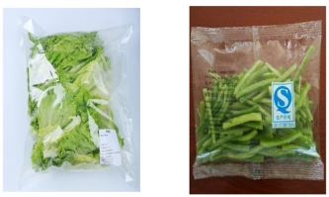
2. Postharvest Discoloration of Fruits and Vegetables
(2) Control of Enzymatic Browning
Control of oxygen concentration:
Physical Method
  Modified Atmosphere Packaging (MAP) is the most commonly used and effective technique.
  Adjusts gas composition within the package and reduces O₂ levels → creates a low-oxygen environment → inhibits enzymatic browning.
Chemical Method
  Include the use of oxygen scavengers.
  Precise control of oxygen concentration is difficult.
Practical Considerations
  Excessively low O₂ may trigger anaerobic respiration in produce.
  Leads to ethanol accumulation → quality and flavour deterioration.
Notes:
（3）控制氧气的含量。控制氧气含量也有物理和化学两种方式。物理方法中，气调包装是最常用且有效的方法。它通过调节包装内气体的成分，降低氧气含量，创造一个低氧环境，从而抑制酶促褐变。化学方法则是使用氧气吸收剂，但这种方法不易精确控制氧气含量。如果氧气含量过低，果蔬可能会进行无氧呼吸，产生酒精等有害物质，影响果蔬的品质和口感。
•Control of oxygen concentration
Oxygen control can also be achieved through physical and chemical means.
Among physical methods, modified atmosphere packaging (MAP) is the most commonly used and effective technique.
By adjusting the gas composition within the package and reducing oxygen levels, a low-oxygen environment is created to inhibit enzymatic browning.
Chemical methods include the use of oxygen scavengers;
however, precise control of oxygen concentration is difficult with this approach.
Excessively low oxygen levels may induce anaerobic respiration in fruits and vegetables, resulting in ethanol production and deterioration of quality and flavor.

Slide 36
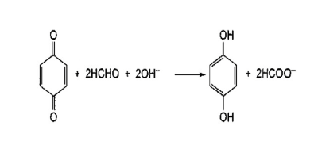
2. Postharvest Discoloration of Fruits and Vegetables
(2) Control of Enzymatic Browning
Reduction of quinone polymers:
Quinone-reducing agents (e.g., ascorbic acid)
  → convert quinones → phenolic compounds.
  → reduce quinone accumulation at the source.
  → alleviate browning.
Quinone-coupling agents (e.g., cysteine)
  → react with benzoquinones.
  → form colourless compounds.
  → prevent further polymerization.
  → significantly reduce discoloration.
Notes:
（4）减少醌类聚合物。减少醌类物质可以从两个方面入手。一是使用醌类还原剂，如抗坏血酸。它能将醌类物质还原成酚类物质，从源头上减少醌类物质的积累，从而减轻酶促褐变。二是使用醌类偶联剂，例如半胱氨酸。它可以与苯醌结合，形成无色的化合物，阻止醌类物质的进一步聚合，使果蔬的变色现象得到明显减轻。
Reduction of quinone polymers
Quinone accumulation can be reduced in two ways.
First, quinone-reducing agents such as ascorbic acid can be used to convert quinones back into phenolic compounds,
thereby reducing quinone accumulation at the source and alleviating browning.
Second, quinone-coupling agents such as cysteine can
react with benzoquinones to form colorless compounds,
preventing further polymerization and significantly reducing discoloration in fruits and vegetables.

Slide 37
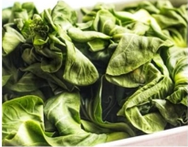
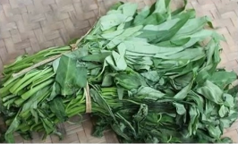
3. Postharvest Wilting of Fruits and Vegetables
(1) Water Loss and Quality Changes
Primary cause
  continuous loss of internal water.
Before Harvest
  Plant root systems absorb water from soil →continuous supply to stems, leaves, fruits → maintains tissue turgor and prevents dehydration.
After Harvest
  Water supply cut off and not replenished→ water continuously lost through epidermis → tissue wilting, loss of crisp texture, reduced storability and disease resistance.
Key point
  Minimizing water loss during storage is critical.
Notes:
（三）果蔬采后变蔫
1.果蔬失水与品质变化
果蔬发蔫，主要是体内水分不断散失造成的。采收之前，果蔬的根系能从土壤里吸收水分，源源不断地补充到茎叶和果实中，维持饱满状态，不会缺水；但采收之后，水源被切断，水分无法再得到补充，体内的水分会持续通过表皮散发到空气中，导致组织萎蔫、失去脆嫩口感，耐储存和抗病的能力也会变差。因此在贮藏过程中，要尽量减少水分流失。
3.Postharvest Wilting of Fruits and Vegetables
(1)Water Loss and Quality Changes
Wilting of fruits and vegetables is primarily caused by continuous loss of internal water.
Before harvest, plant root systems absorb water from the soil and continuously supply it to stems, leaves, and fruits, maintaining tissue turgor and preventing dehydration.
After harvest, the water supply is cut off and cannot be replenished; water is continuously lost to the surrounding air through the epidermis, leading to tissue wilting, loss of crisp texture, and reduced storability and disease resistance.
Therefore, minimizing water loss during storage is critical.

Slide 38
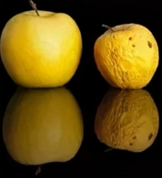
3. Postharvest Wilting of Fruits and Vegetables
(1) Water Loss and Quality Changes
Quality deterioration caused by water loss is mainly reflected in weight loss and loss of freshness.
Weight Loss
  Primarily due to water evaporation.
  Examples:
Loss of Freshness
  Refers to deterioration of external appearance and texture.
  Thresholds for visible symptoms:
    Apples: ~0.5% weight loss during lowtemperature storage is attributed to water loss.
    Most fruits & vegetables: >5% water loss → noticeable skin wrinkling.
    Citrus fruits: ~75% of total weight loss during storage results from water loss.
    Leafy vegetables with large surface areas: >only 2% water loss → obvious wilting.
Notes:
水分散失导致果蔬品质变差，主要体现在失重和失鲜两个方面。
失重主要是由水分蒸发造成。例如，苹果在低温贮藏期间的失重约有0.5%来自水分损失；柑橘贮藏期间，其总失重中约75%可归因于失水。
失鲜指新鲜外观和质地的丧失。通常，多数果蔬（尤其是水果）失水率超过5%，即会出现表皮皱缩；而叶菜类等表面积大的蔬菜，失水率超过2%便会明显萎蔫。
Quality deterioration caused by water loss is mainly reflected in weight loss and loss of freshness.
Weight loss is primarily due to water evaporation.
For example, approximately 0.5% of weight loss in apples during low-temperature storage is attributed to water loss,
while about 75% of total weight loss in citrus fruits during storage results from water loss.
Loss of freshness refers to the deterioration of external appearance and texture.
In most fruits and vegetables (especially fruits), a water loss exceeding 5% leads to noticeable skin wrinkling,
whereas leafy vegetables with large surface areas may exhibit obvious wilting when water loss exceeds only 2%.

Slide 39
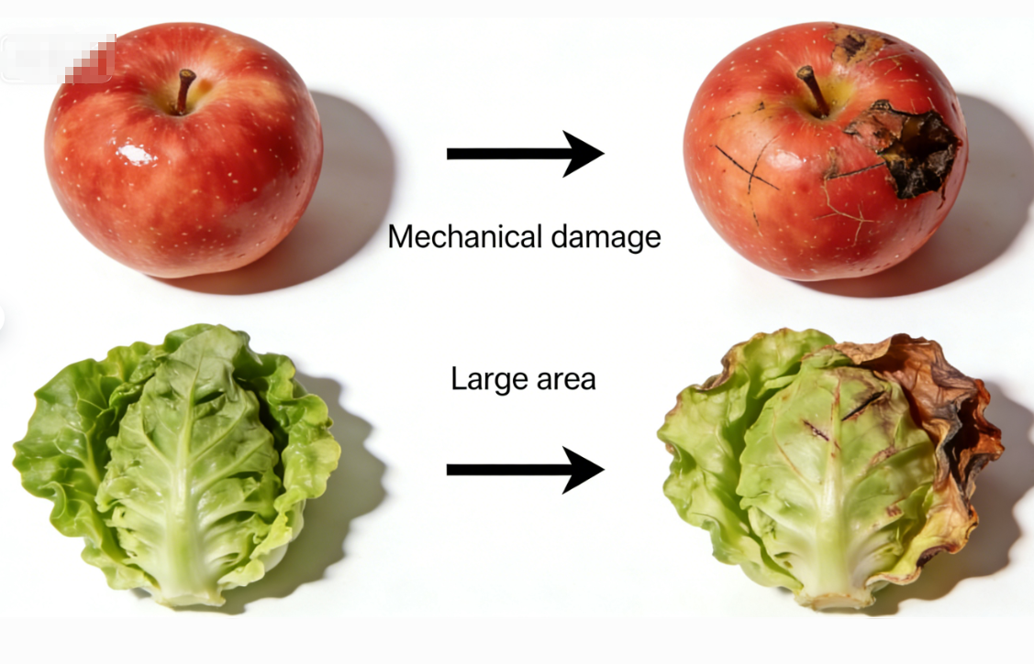
3. Postharvest Wilting of Fruits and Vegetables
(2) Factors Affecting Water Evaporation and Loss
Intrinsic Factors Influencing Water Loss
Factors Influencing Water Loss
  Intrinsic characteristics.
  External environmental conditions.
Intrinsic Characteristics
  Surface area ratio: The larger the surface area per unit mass → the faster the water loss.
  Differences in species and maturity: Variations in cuticle thickness, lenticel density (e.g., pears, Golden Delicious apples), or stomatal number → directly affect water retention capacity.
  Mechanical damage: Wounds disrupt protective tissues and expose internal tissues → significantly accelerating localized water loss.
Notes:
2.影响水分蒸发流失的因素
影响果蔬水分蒸发流失的因素可分为自身特性与外界环境两大类：
自身因素主要包括三个方面：一是表面积比，果蔬单位质量的表面积越大，其水分蒸发越快；二是种类与成熟度差异，不同果蔬的角质层厚度、皮孔（如梨、金冠苹果）或气孔数量存在差异，直接影响其保水能力；三是机械损伤，伤口破坏了保护组织，使内部组织直接暴露，从而显著加速局部水分散失。
Factors Affecting Water Evaporation and Loss
Factors influencing water loss in fruits and vegetables can be divided into intrinsic characteristics and external environmental conditions.
Intrinsic factors mainly include three main aspects:
•surface area ratio — the larger the surface area per unit mass, the faster the water loss;
•differences in species and maturity — variations in cuticle thickness, lenticel density (e.g., pears, Golden Delicious apples), or stomatal number directly affect water retention capacity;
•mechanical damage — wounds disrupt protective tissues and expose internal tissues, significantly accelerating localized water loss.

Slide 40
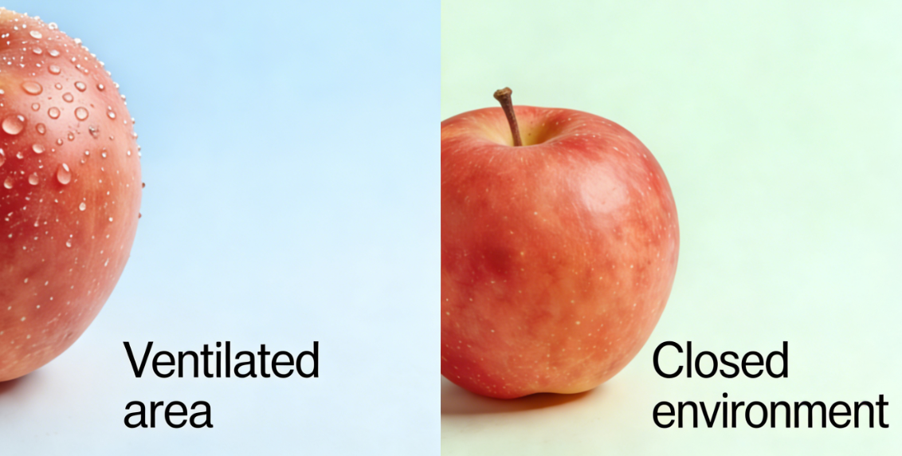
3. Postharvest Wilting of Fruits and Vegetables
(2) Factors Affecting Water Evaporation and Loss
External Environmental Factors
Temperature & Humidity
  Higher temperatures → accelerate water evaporation.
  Higher ambient humidity → suppresses water loss.
Light
  Directly affects stomatal opening and closing.
  A key regulator of transpiration.
  Under light exposure → stomata generally open for gas exchange, but water loss simultaneously intensified.
Air Velocity
  Faster air movement removes the moist boundary layer on the produce surface more rapidly → exacerbating water loss.
Notes:
外界环境因素主要有：一是温度与湿度，温度升高会加速水分蒸发，而较高的环境湿度能有效抑制水分散失；二是光照，光照直接影响气孔开闭，是调控水分蒸发的关键因素。在光照下，气孔通常打开以进行气体交换，但同时加剧了水分流失；三是空气流速，空气流动越快，会更快地带走果蔬表面的湿润空气层，从而加剧水分蒸发流失。
External environmental factors include:temperature and humidity —
higher temperatures accelerate water evaporation,
whereas higher ambient humidity effectively suppresses water loss;
•light — light directly affects stomatal opening and closing
and is a key regulator of transpiration;
under light exposure, stomata generally open for gas exchange, but water loss is simultaneously intensified;
•air velocity — faster air movement removes the moist boundary layer on the produce surface more rapidly, thereby exacerbating water loss.

Slide 41
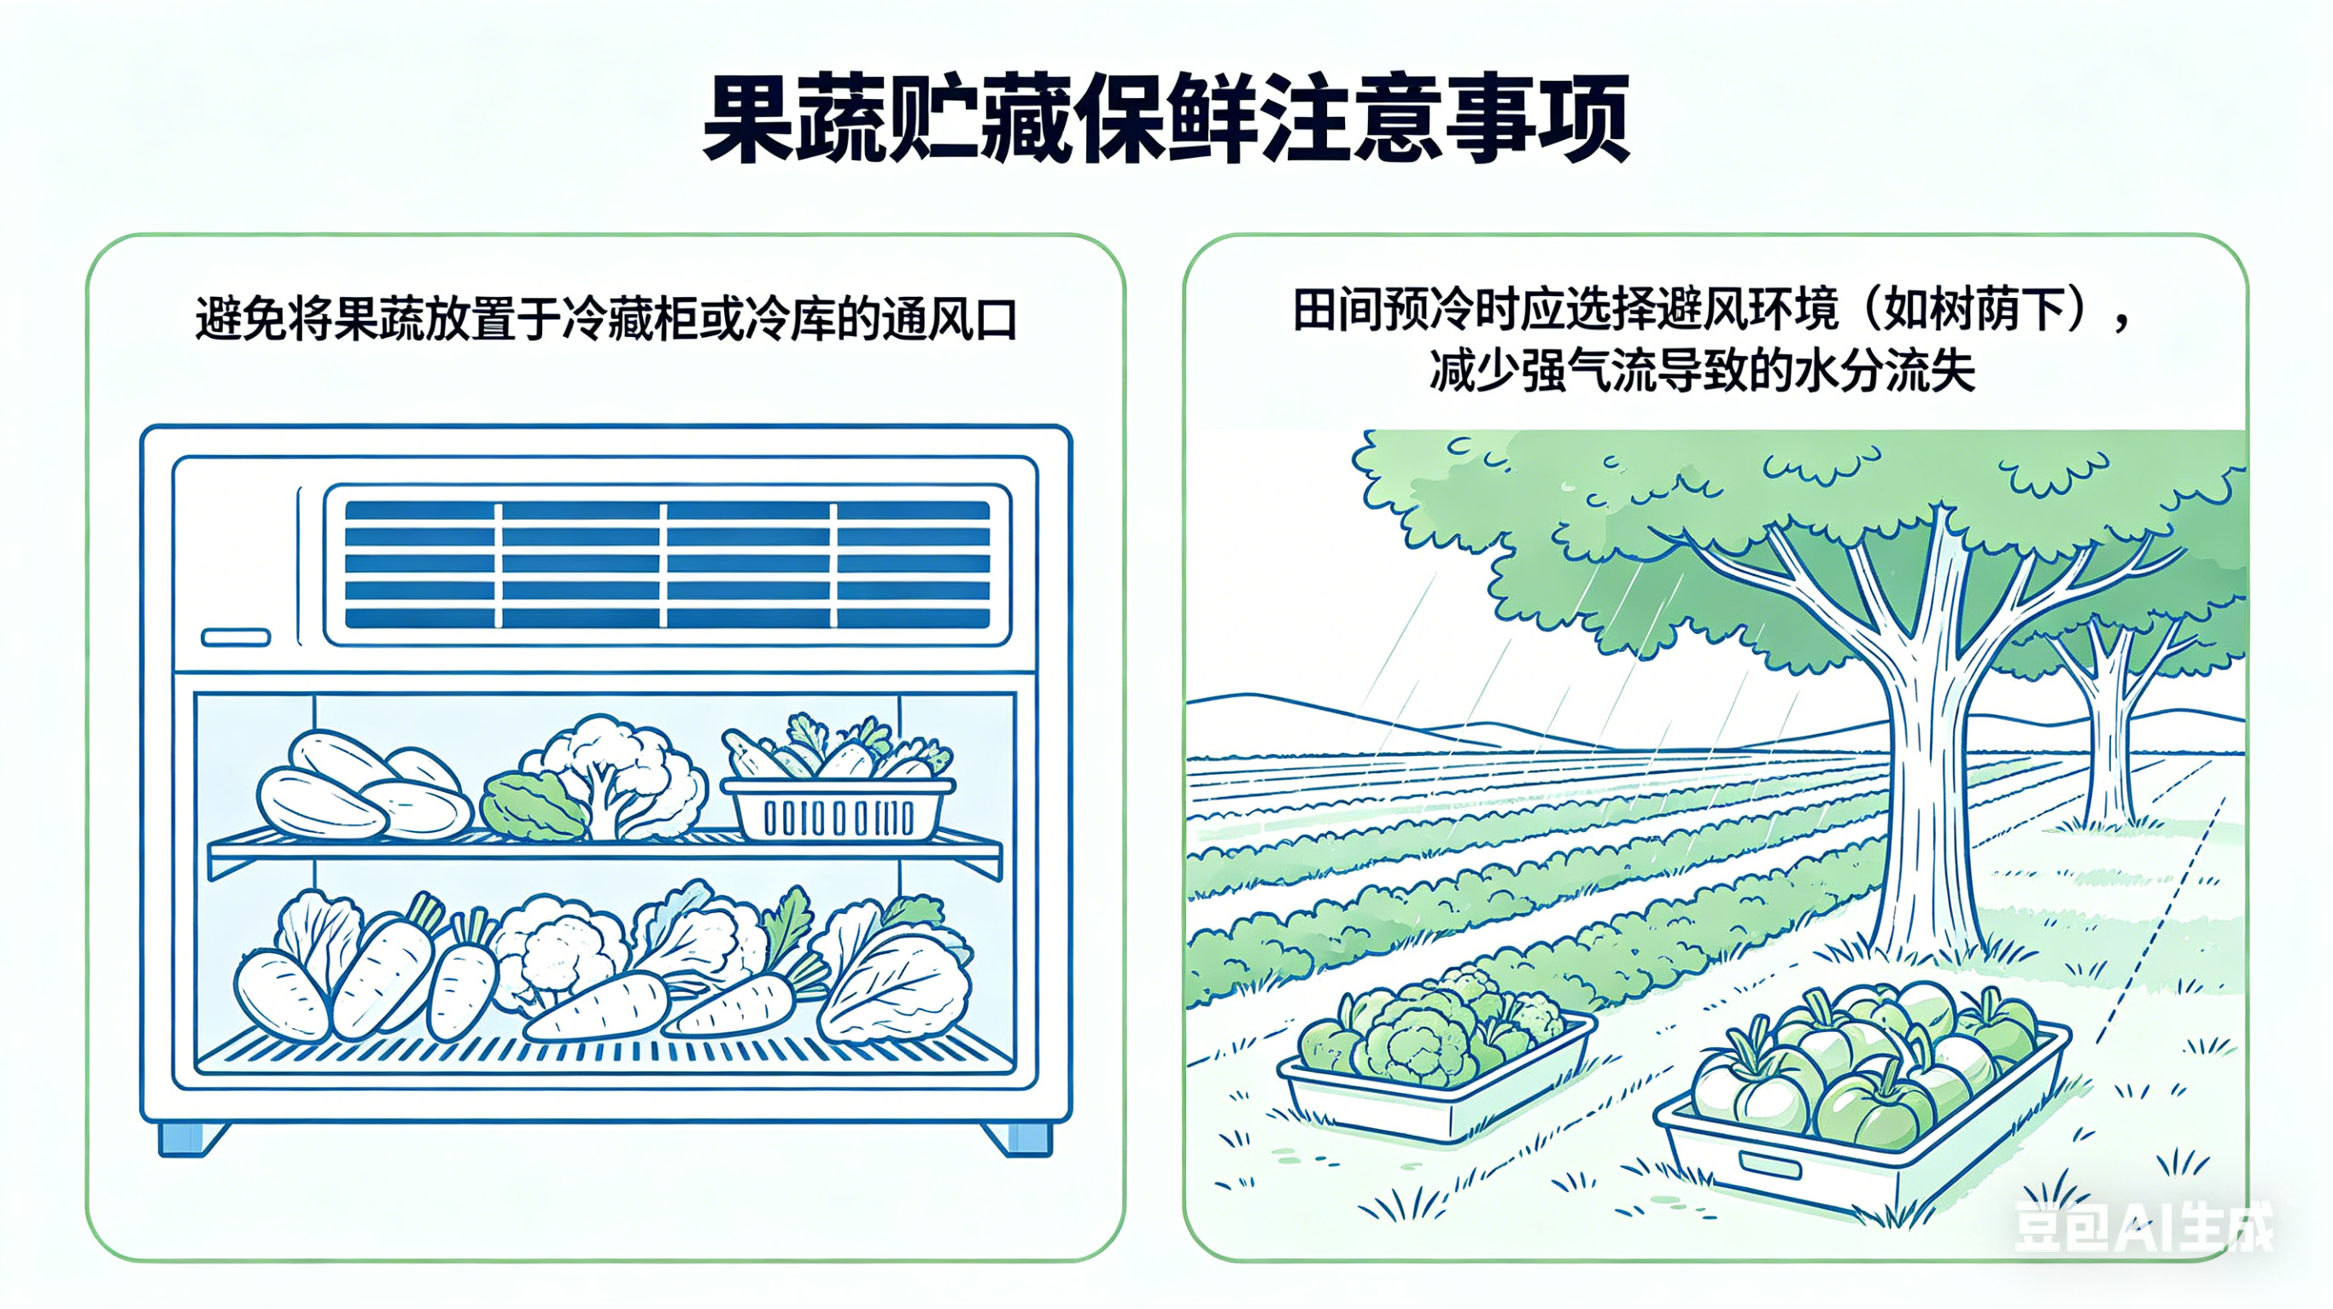
3. Postharvest Wilting of Fruits and Vegetables
(2) Factors Affecting Water Evaporation and Loss
Storage Recommendations
  Avoid placing fruits and vegetables near air outlets in refrigerated cabinets or cold storage facilities.
  During field pre-cooling, sheltered and wind-protected environments (e.g., shaded areas) should be selected to reduce water loss caused by strong airflow.
Notes:
基于上述机制，贮藏保鲜实践中需注意：避免将果蔬放置于冷藏柜或冷库的通风口；田间预冷时应选择避风环境（如树荫下），减少强气流导致的水分流失。
Based on these mechanisms, storage practices should avoid placing fruits and vegetables near air outlets in refrigerated cabinets or cold storage facilities.
During field pre-cooling, sheltered and wind-protected environments (e.g., shaded areas) should be selected to reduce water loss caused by strong airflow.

Slide 42
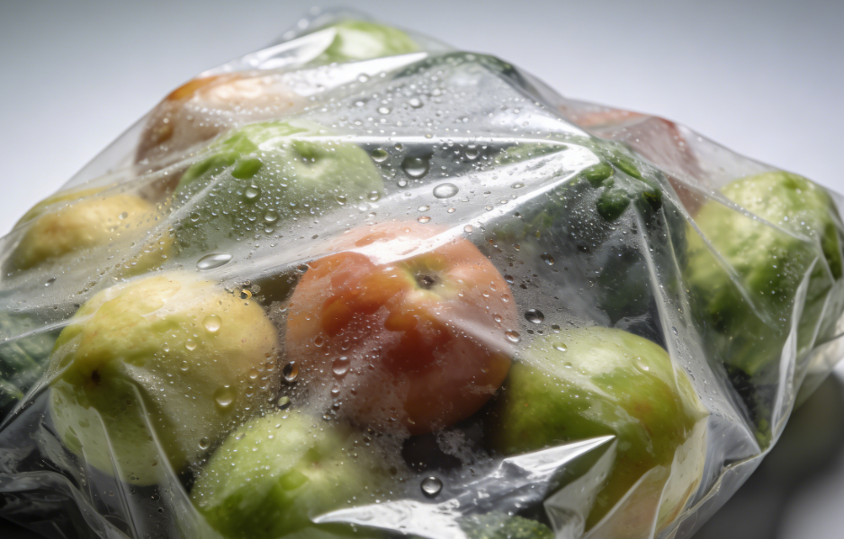
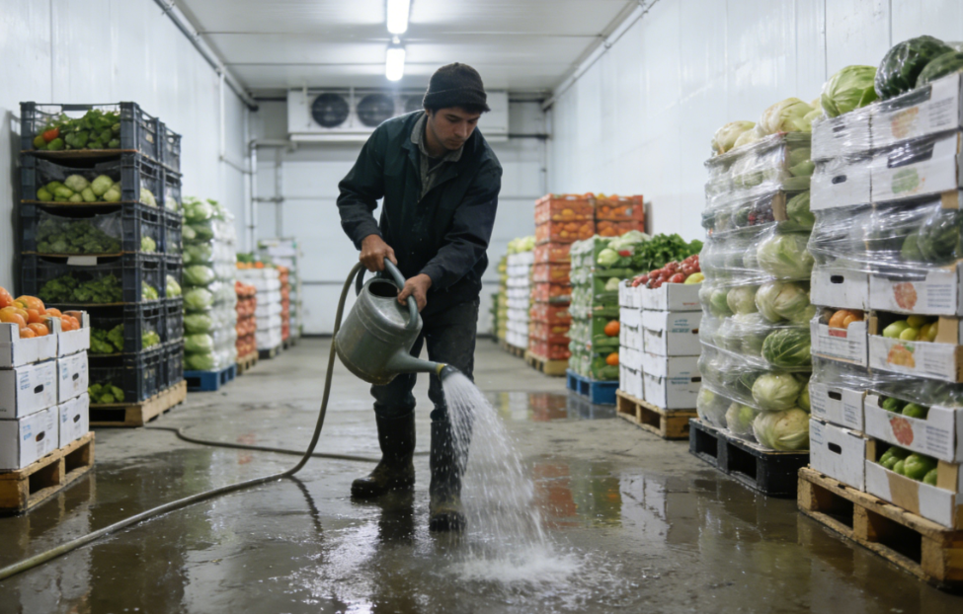
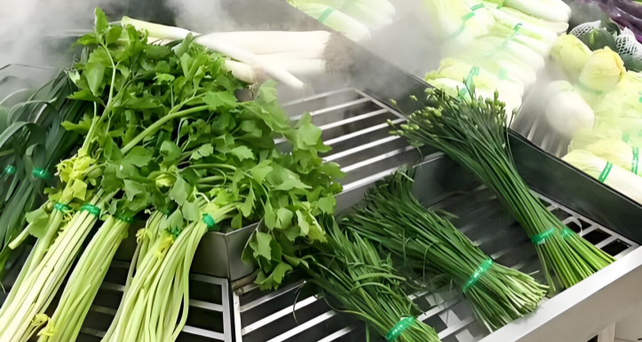
3. Postharvest Wilting of Fruits and Vegetables
(3) Technical Measures for Controlling Water Loss
Requires combined application of four major technical measures:
First, increasing ambient humidity, which can be achieved by:
  Packaging with plastic films or waterproof yet breathable materials
  → creates a high-humidity “microenvironment”.
  Regulating air humidity in storage spaces through:
  → Sprinkling water on the floor.
  → Hanging wet curtains.
  → Using humidifiers.
  Applying low-temperature pre-cooling before packaging
  → Avoids condensation and decay caused by temperature differences between warm packaging materials and cold storage environments.
Notes:
3.控制水分蒸发流失的技术措施
控制果蔬水分蒸发流失需综合采用四大技术措施，具体实施方式如下：
一是提高环境湿度，可通过三种方式实现：①采用塑料膜或防水透气材料包装，构建高湿“微环境”；②在储藏空间通过地面洒水、悬挂湿帘或加湿器调控空气湿度；③包装前进行低温预冷处理，避免高温包装材料在低温贮藏时因温差导致结露腐烂。
(3)Technical Measures for Controlling Water Loss
Control of water evaporation and loss in fruits and vegetables requires the combined application of four major technical measures:
First, increasing ambient humidity, which can be achieved by:
•packaging with plastic films or waterproof yet breathable materials to create a high-humidity “microenvironment”;
•regulating air humidity in storage spaces through sprinkling water on the floor, hanging wet curtains, or humidifiers;
•applying low-temperature pre-cooling before packaging to avoid condensation and decay caused by temperature differences between warm packaging materials and cold storage environments.

Slide 43

3. Postharvest Wilting of Fruits and Vegetables
(3) Technical Measures for Controlling Water Loss
Second: Optimizing storage temperature
  Low temperatures reduce metabolic rates and transpiration intensity → decreasing water loss.
  Minimize temperature fluctuations to avoid condensation.
Third: Proper control of air velocity
  Ensure uniform temperature and humidity within the storage environment.
  Minimize unnecessary air movement.
  Avoid direct exposure of produce to strong airflow outlets.
Fourth: Physical barrier techniques
  Apply waxing, edible coatings, or skin-tight packaging as postharvest treatments → to form a protective surface layer that directly reduces water loss.
Notes:
二是优化贮藏温度，低温可同时降低代谢速率与蒸腾强度，减少水分损耗；需特别注意控制温度波动，避免频繁温变引发结露现象。
Second, optimizing storage temperature. Low temperatures simultaneously reduce metabolic rates and transpiration intensity, thereby decreasing water loss.
Special attention should be paid to minimizing temperature fluctuations to avoid condensation.
Third, proper control of air velocity. While ensuring uniform temperature and humidity within the storage environment, unnecessary air movement should be minimized,
and direct exposure of produce to strong airflow outlets should be avoided.
49
Fourth, physical barrier techniques, such as waxing, edible coatings, or skin-tight packaging, can be applied as postharvest treatments to form a protective layer on the surface of fruits and vegetables, directly reducing water loss.

