Slide 1

Building An Agricultural Insurance System:
China's Experience
Fujin Yi
China Academy of Rural Development
Zhejiang University
July 9th, 2026

Slide 2
CONTENTS
01
Why Agricultural Insurance Matters
02
China’s Experience
03
Conclusion

Slide 3
01
Why Agricultural Insurance (AI) Matters

Slide 4
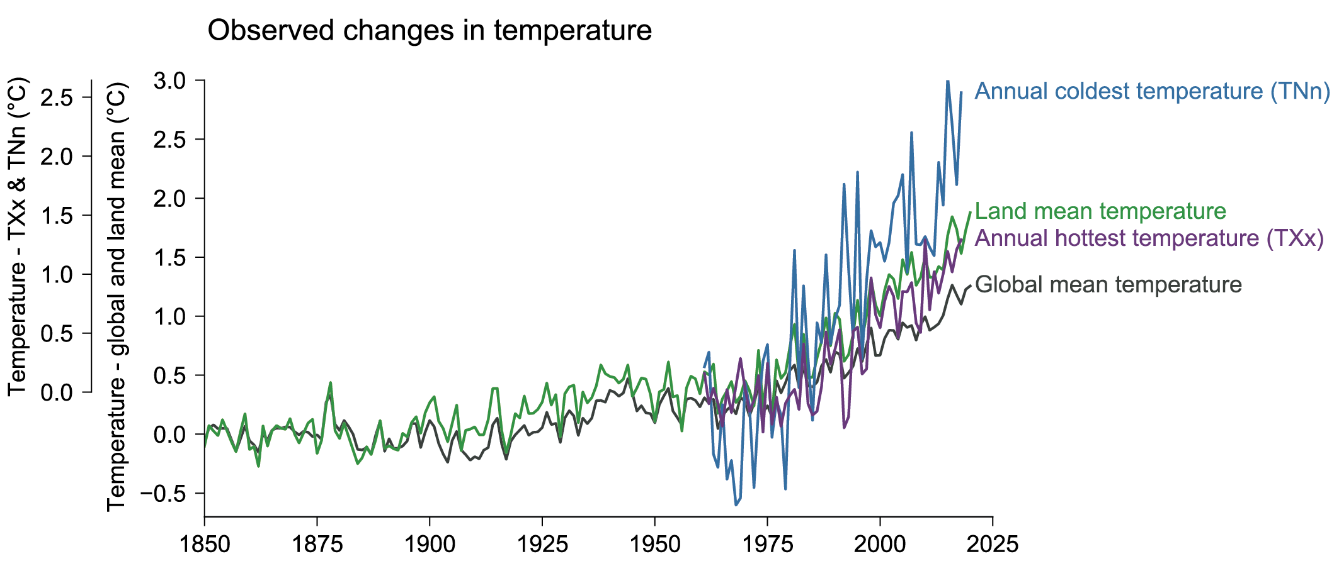
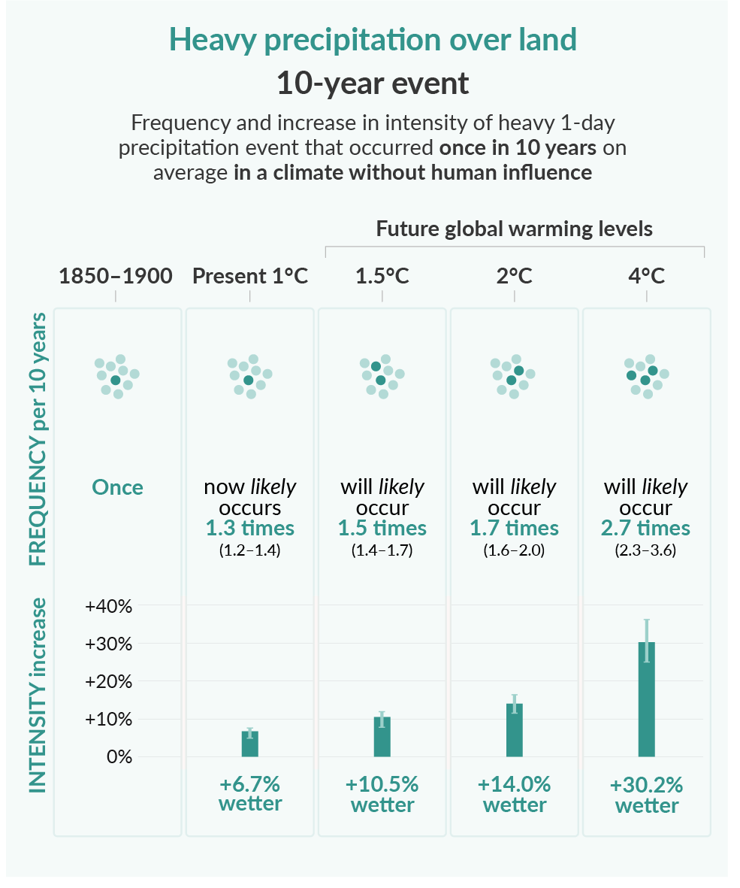
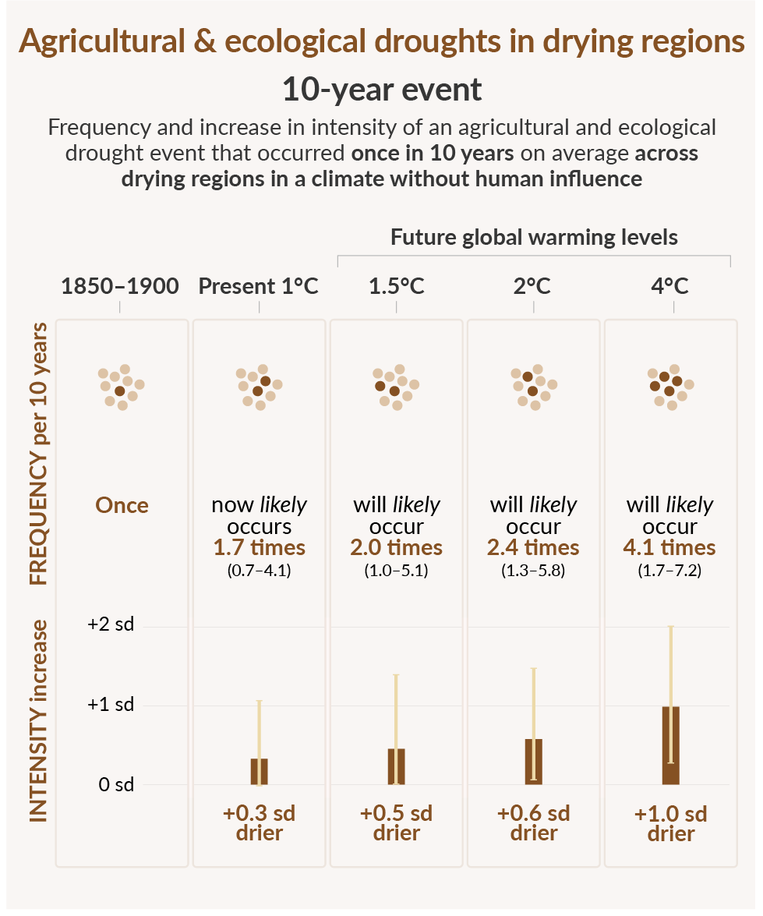
  1.1 Global Challenge
            Climate change
              Rising average temperature
              More severe temperature extremes
Source: IPCC AR6 WG1
Figure 1. Observed weather anomalies

Slide 5
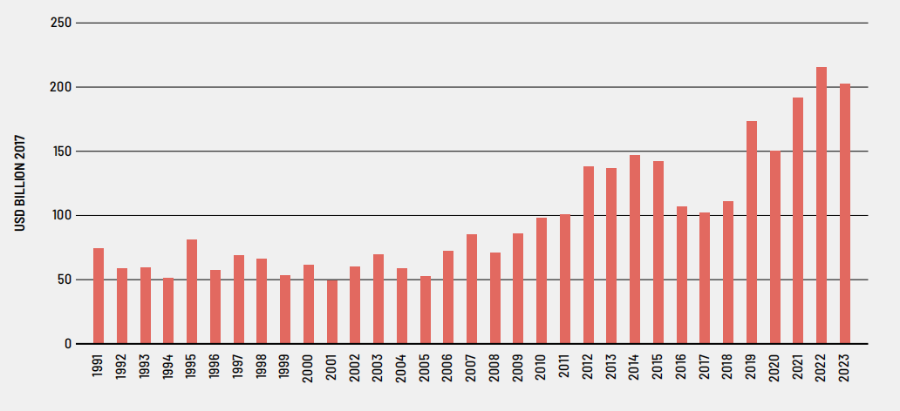
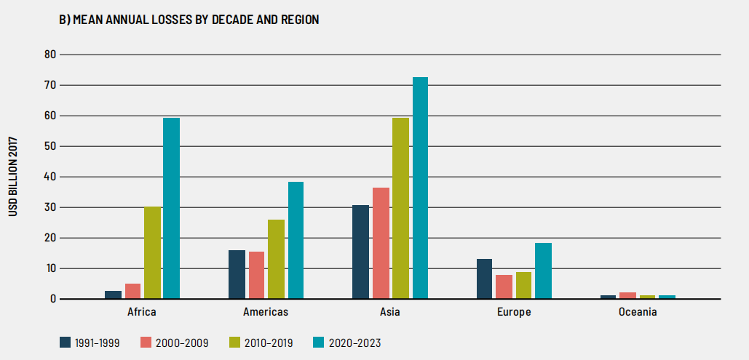
  1.1 Global Challenge
              Increasing agricultural losses
              Worsening regional disparities
Figure 2 Total estimated agricultural production losses
Figure 3 Mean annual losses by decade and region
Source: FAO. The Impact of Disasters on Agriculture and Food Security 2025. Figure 7, p.31.

Slide 6
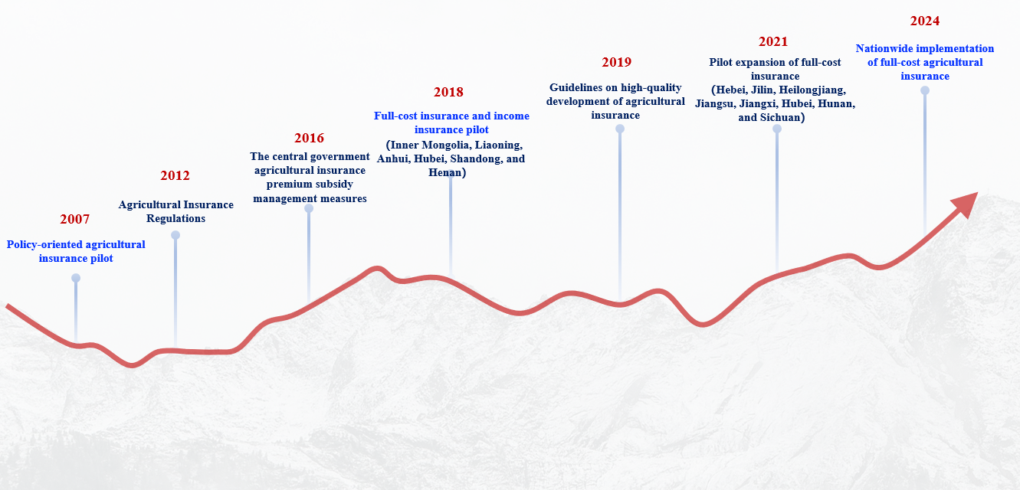
  1.2 China Agricultural Insurance Market

Slide 7
  1.2 China Agricultural Insurance Market
            China has built the world's largest agricultural insurance system in last two decades
Global share of agricultural insurance market in 2025

Slide 8
            Agricultural insurance products
            Types of risk coverage
              Production costs: Main body
              Income
              Price
              Index
Product | Coverage | Subsidized
Grain crops | Rice, Wheat, Corn | Yes
Other crops | Cotton, Potato, Soybean, Sugarcane, Rubber | Partial
Livestock | Breeding sows, Fattening pigs, Cows | Yes
Forest | Forests | Partial
Other products | Apple, Oranges, Flowers, Fishery | Minor

Slide 9
02
China’s Experience

Slide 10
  2.1 Lesson 1: Government as a market builder
            Commercialization Phase: No government support
              1930: Plow ox insurance in Sichuan province
              1952: Discontinue agricultural insurance
              1982: Restore agricultural insurance
              1992: Highest agricultural insurance premiums USD 100 million
              2002: Phase-out of agricultural insurance
            Public-Private Partnership (PPP) Phase: With government support
              2004: Central government decided to support the development of agricultural insurance
              2007: Central government implemented premium subsidies
              2018: Improve the level of coverage to the total cost of production
              ……

Slide 11
  2.1 Lesson 1: Government as a market builder
              Excessively high transaction costs
                Farmers with farm sizes of 3 hectares or less account for 98% of the total
                Land fragmentation
                Output heterogeneity
                Limited understanding of the insurance rule
                Lack of trust in insurance companies

Slide 12






  2.1 Lesson 1: Government as a market builder
Government Support
            Market formation
              High transaction costs
              Systemic risks
              Information asymmetry
            Strategies
              Demand
                Lower farmers’ cost
              Supply
                Lower insurers’ cost
Financial Support
Institutional Support
Premium subsidy
Management expense subsidy
Administrative coordination
Local implementation
Agricultural technicians
Data support
Lower farmers’ cost
Lower insurers’ costs
Agricultural Insurance Market

Slide 13
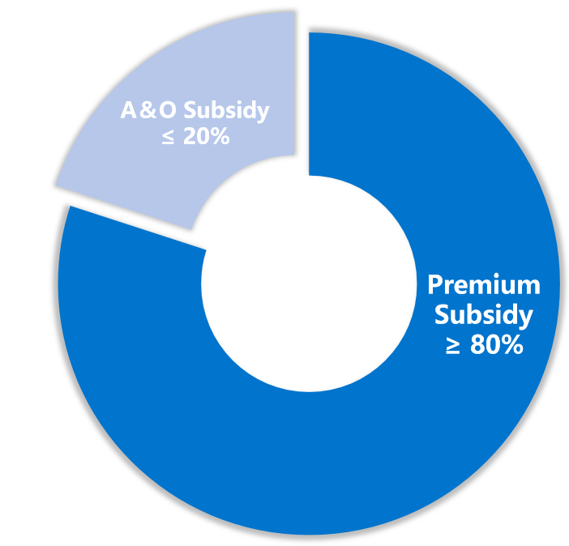
  2.2 Lesson 2: Premium Subsidy
            Around 80% premium is subsidized
            Joint Subsidies from the Four Levels of Government
              20% of administration and organization (A&O) subsidy + 80% of premium subsidy
Central
（30%-50%）
Provincial
（≥ 25%）
Prefectural
（provinces set their own ratio）
County
（provinces set their own ratio）
Agricultural Insurance Premiums and Fiscal Subsidies

Slide 14
  2.3 Lesson 3: Institutional Support
            U.S. model
              Agents
              Associations
Manage
RMA
FCIC
Supervise
Operate
AIPs
Agent
Local Insurance Company
Credit Company
Financial Institution...
Association
Service Associations
Company Associations
Professional Associations
Adjuster
Staff: Loss Adjuster
Independent Loss Adjuster
Public Loss Adjuster
Promote
Train
Service
Train
Claims
Certify
Certify
Educate
Insured Farmers
Market entities
Institutional Framework and Local Implementation of U.S. Agricultural Insurance
Notes: RMA refers to Risk Management Agency. AIPs is the Approved Insurance Providers. FCIC is the Federal Crop Insurance Corporation.
Government entities

Slide 15
  2.3 Lesson 3: Institutional Support
            China’s model
              Bidding and Monopolistic Operations
              Publicity
              Organizing smallholder farms
              Damage assessment
              Claims oversight
              Share meteorological information
Central
Provincial
Municipal
County
Township
Subsidize
Subsidize
Bid
Policy Support
Insurers
Administrative Support
Village leaders
Underwrite
Underwrite
Technology
Experts
Claims settlement
Claims settlement
Technology Experts
Insured Farmers
Large-Farm Holders
Smallholders
Market entities
Institutional Framework and Local Implementation of Agricultural Insurance in China.
Government entities

Slide 16
  2.3 Lesson 3: Institutional Support
            China’s model
              Over 23 million farm households
              Over 480,000 villages
              Over 40,000 insurance coordinator (village leaders)
              Average 15 agricultural insurance specialists in every county
              Challenges
                1.1 billion plots
                22,000 plots for every insurance specialist
                Difficulty in accurately processing claims

Slide 17
  2.3 Lesson 3: Institutional Support
Front-end Operations |  |  |  | Government Coordination |  |  | Operational Independence |  | Market Specialization
 |  |  | Design | Government | Insurers |  | Insurers |  | Company Or Service Providers
 |  | High Transaction Costs | Underwriting | Government | Insurers |  | Insurers |  | Agents
Back-end Operations |  |  | Loss Assessment & Claims Settlement | Government | Insurers |  | Insurers |  | Agents
 |  |  | Indemnity | Insurers |  |  | Insurers |  | Company
 |  |  | Low Degree of Marketization High Degree of Marketization
Insurer Costs (Including Commissions Paid to Service Providers) Government Costs Cost Savings from Market-Based Specialization | Insurer Costs (Including Commissions Paid to Service Providers) Government Costs Cost Savings from Market-Based Specialization
            Market formation
Figure 2. Agricultural Insurance Costs and Their Allocation.
Notes: Indemnity costs refer to claim payments made by insurers. Negotiation, litigation, and other dispute-resolution expenses over claim amounts are included in loss adjustment and claims settlement costs. Government-provided social security card or “All-in-One Card” accounts facilitate indemnity payments but are not shown because they were not created specifically for agricultural insurance.

Slide 18
            Insurance market reform
Demand Growth
Cost Reduction
US
FCIC established to implement the FCIP with private agents
FCIC amended to introduce premium subsidies
1938
1980
1982
2007
China
Commercial Agricultural Insurance Pilots
Agricultural insurance pilots launched with government support and subsidies.
Cost Reduction
Demand Growth
Figure 1. Stages of Cost Reduction and Demand Growth in Agricultural Insurance Reform in China and the US
Notes: FCIC refers to the Federal Crop Insurance Corporation. FCIP is the Federal Crop Insurance Program. FCIA is the Federal Crop Insurance Act.

Slide 19
03
Conclusions

Slide 20
            A persistent goal
              Every year, the No. 1 Document promotes the development of agricultural insurance
            The government needs to be a driver of the market, not just a provider of subsidies
              A large number of smallholder farmers need to be organized
            Select the most important agricultural products for subsidies
              Government funds are always limited, and food is the most important thing
            Mobilize the enthusiasm of governments at all levels
              Those with money contribute money; those with manpower contribute manpower
            Regional yield insurance or index insurance can be used even they are not accurate
              Data from developing countries is unlikely to be complete

Slide 21
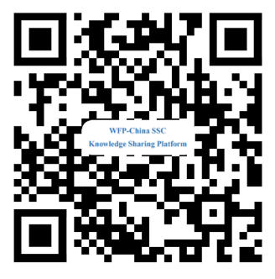
Thank You
yifujin@zju.edu.cn
Sharing for Learning

Slide 22
  4.1 Challenge 1: Government creates AI market
            The puzzle of the stable loss ratio

Slide 23
  4.2 Challenge 2: Government creates AI market
            Overcrowded agricultural insurance market

