Slide 1
Key Technology for Value-added Utilization of Feed Raw Material from Grain
粮食谷物饲料原料增值利用关键技术
Dr. Weiwei Wang
Academy of National Food and Strategic Reserves Administration
王薇薇 研究员
国家粮食和物资储备局科学研究院

Slide 2
CONTENTS
Global food security situation
全球粮食安全态势
Development and utilization of feed resources from grain
谷物饲料资源的开发与利用
01
02
The significance and future development of the new biotechnologies 饲料资源开发的意义与未来前景
03

Slide 3
01
Global food security situation

Slide 4
Global Food Security Situation
The global food production experienced a slight increase overall, while regional shortages became more pronounced
Main Threats
Significant Supply Gaps and Uneven Food Distribution
Climate change
Resource constraints
Geopolitical conflicts
Supply chain issues
The number of food insecure people is rising, especially in developing countries and conflict-affected regions.
Global hunger levels have remained high for three consecutive years, with 713 million to 757 million people facing food shortages in 2023, an increase of approximately 152 million since 2019.
The adult obesity rate has steadily increased from 12.1% in 2012 to 15.8% in 2022.
The coexistence of malnutrition with overweight and obesity is sharply rising across all age groups globally.
Food production capacity is facing challenges, particularly in Africa, South Asia, and the Middle East.
Global food prices have fluctuated significantly, having sharply risen since 2021, and remain above historical averages, mainly impacting low-income countries, especially those with import-dependent economies.
The global total grain production in 2023 was approximately 2.83 billion tons, with an increase of about 1.2% (according to FAO and IGC data).
Sharing for Learning

Slide 5
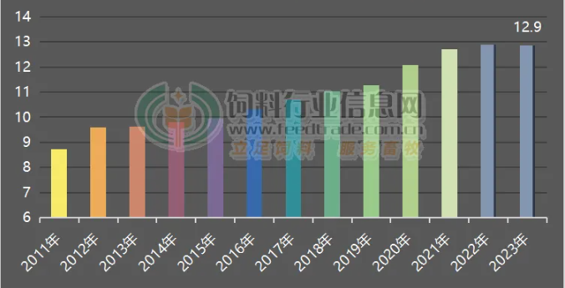
Global Feed Grain Production Trends
Global Feed Production from 2011 to 2023
(100 Million Tons)
In 2023, global feed production reached 1.29 billion tons, a year-on-year decrease of 0.2%.
The largest production regions are Asia-Pacific, North America, and Europe.
Asia-Pacific has the highest production and the largest growth.
Europe experienced the most significant decline due to the spread of diseases such as African swine fever and avian influenza.
Corn consumption is approximately 550 million tons, with nearly 50% used for feed; soybean meal consumption is about 280 million tons, equivalent to roughly 358 million tons of soybeans, with over 85% used for feed.
Top Ten Feed-Producing Countries in the World in 2023
Country | Production (Million Tons)
China | 262.71
United States | 238.09
Brazil | 83.32
India | 52.83
Mexico | 40.42
Russia | 35046
Spain | 27.53
Vietnam | 24.15
Japan | 23.94
Turkey | 23.37
In 2023, the top ten feed-producing countries globally produced 811.8 million tons of feed, accounting for 63% of the world total.
Nearly half of the global feed production is concentrated in China, the United States, Brazil, and India.
Region | 2023 Production (100 Million Tons) | 2023 Production (100 Million Tons) | Increase (10,000 Tons) | Growth Rate (%)
Asia-Pacific | 4.75 | 4.69 | 6540 | 1.40
North America | 2.59 | 2.62 | -2800 | -1.07
Europe | 2.53 | 2.63 | -10070 | -3.82
Latin America | 2.01 | 1.98 | 2457 | 1.24
Africa | 0.51 | 0.5 | 980 | 1.94
Middle East | 0.36 | 0.36 | -120 | -0.32
Oceania | 0.11 | 0.1 | 390 | 3.71
Total | 12.86 | 12.88 | -2623 | -0.20

Slide 6
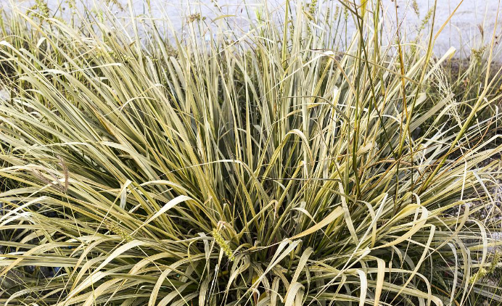
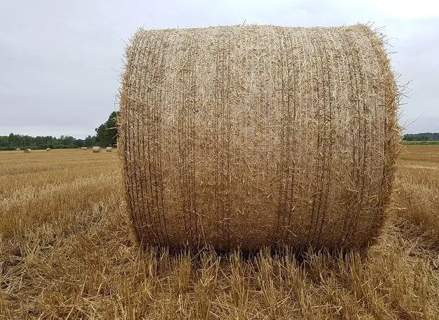
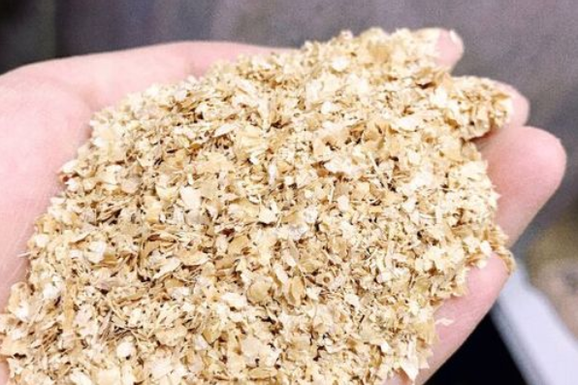
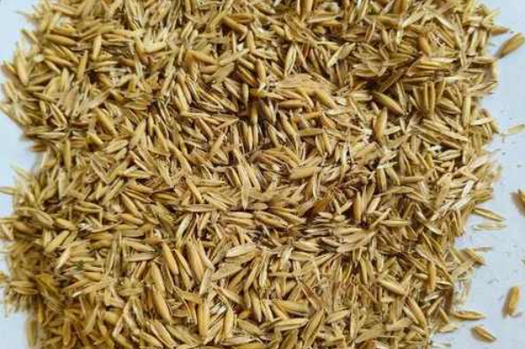
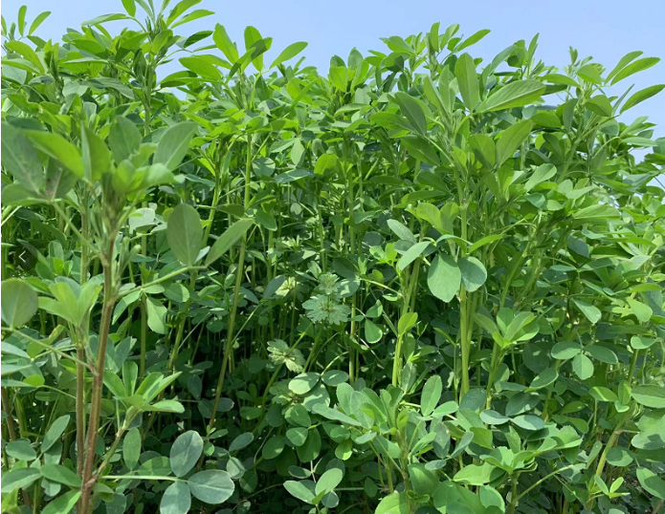
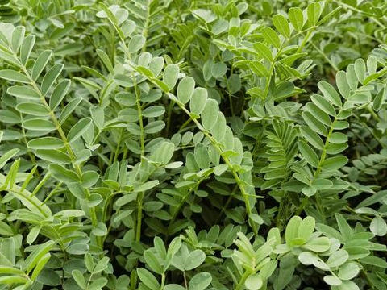
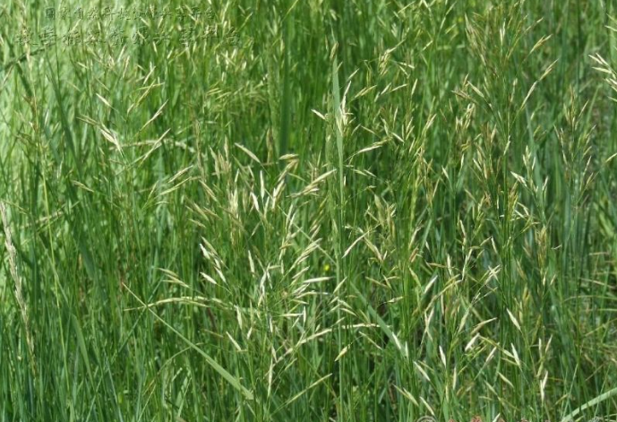
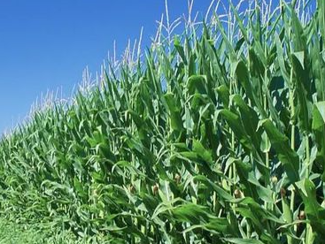
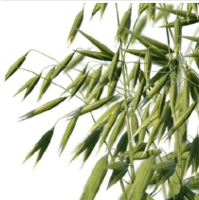
Classification of Feed Raw Materials
Roughage: Crude fiber ≥ 18%, such as forage, hay, straw, and bran
Hay
Straw
Wheat bran
Oat hull
Green forage: Refers to feed made from the fresh stems and leaves of plants. Moisture content ≥ 60%, crude fiber content around 20%, with a higher content of certain vitamins and crude protein in the dry matter. It includes forage, young stems and leaves of crops, and tender branches of trees, such as alfalfa, red clover, millet, green corn, and oats.
Alfalfa
Sainfoin
Awnless brome
Green corn
Oat
Sharing for Learning

Slide 7
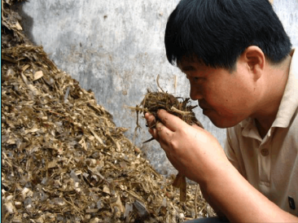
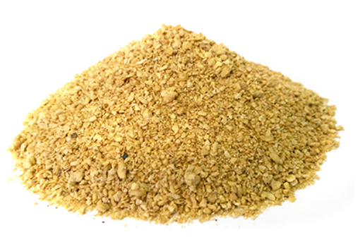
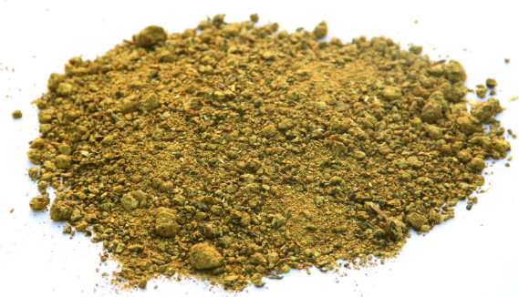
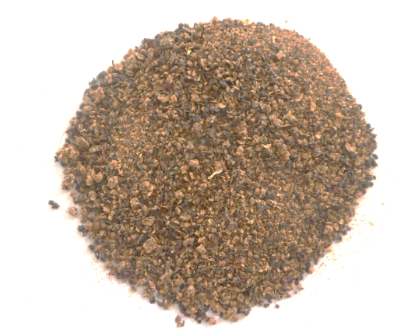
Classification of Feed Raw Materials
Silage: A type of roughage obtained by chopping green forage with a moisture content of 65% to 75% and fermenting it under anaerobic conditions using lactic acid bacteria, which suppress the growth of various contaminants. It has a sour and fragrant smell, is soft and juicy, palatable, nutritious, and suitable for long-term storage, mainly used for ruminant animals.
The process of making silage: Harvesting → Chopping → Adding additives (2-3% sugar, 0.3-0.4% of 85% formic acid, amylase, cellulase, ammoniated compounds, etc.) → Bagging for storage → Sealing in a pit for more than 40 days.
Energy Feed: Crude fiber < 18%, crude protein < 20%, and digestible energy ≥ 10.46 MJ/kg. Common examples include corn, wheat, rice, sorghum, fats, wheat bran, and by-products of grain processing.
Protein Feed: Crude protein ≥ 20%, crude fiber < 18%, commonly includes:
Plant-based Protein Sources: Soybean meal, cottonseed meal, rapeseed meal, and other by-products of oilseed processing
Animal-based Protein Sources: Fish meal, meat and bone meal, silkworm pupae, etc.
Single-cell Protein Feed: Yeast powder, methanol protein, spirulina, etc.
Non-protein Nitrogen Feed: Urea, ammonium salts, etc.

Slide 8
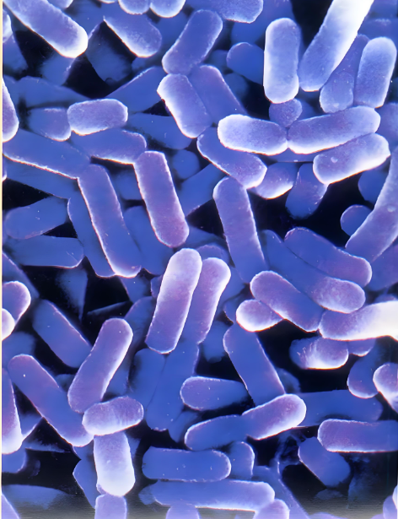
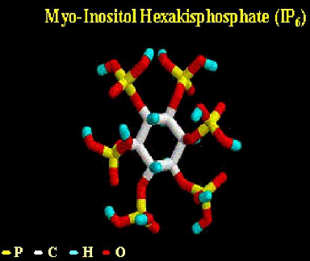
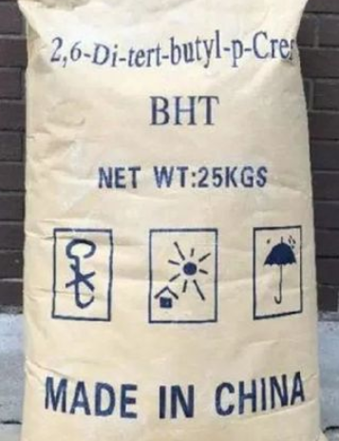
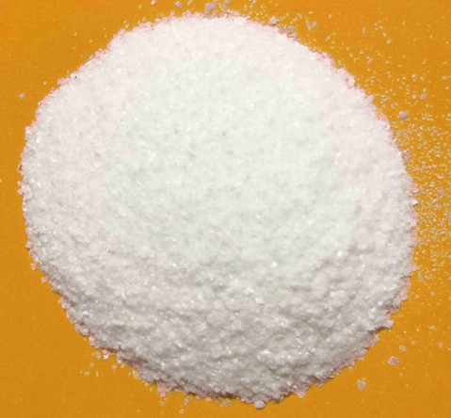
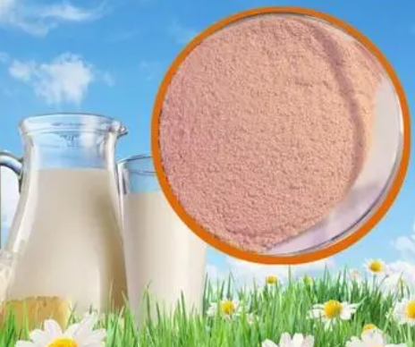
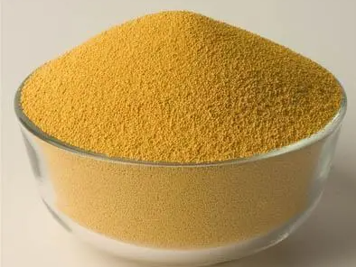
Classification of Feed Raw Materials
Mineral Feed: Provides trace or macro mineral elements necessary for animal growth, such as dicalcium phosphate, limestone powder, copper sulfate, ferrous sulfate, zinc oxide, and salt.
Vitamin Feed: A class of low molecular organic substances required for animal growth, usually divided into fat-soluble vitamins and water-soluble vitamins.
Fat-soluble: Includes vitamins A, D, E, and K.
Water-soluble: Includes B vitamins and vitamin C.
Feed Additives: Nutritional or non-nutritional substances added in small or trace amounts to feed to ensure or improve feed quality, promote animal growth and reproduction, and ensure animal health. Common examples include probiotics, enzyme preparations, antifungal agents, antioxidants, flavoring agents, and traditional Chinese herbs.
Lactobacillus
Phytase
Calcium propionate
BHT
Odorant with milk flavor
Chinese herbal medicine

Slide 9
Problems with Grain Processing By-products
Processing by-products.
“”
Abundant resources, low utilization efficiency, and even unusable
1. High content of endogenous anti-nutritional factors
2. Low average crude protein, amino acid utilization, and metabolizable energy
3. Large quality variation
By-products of grain and oil processing and utilizable waste resources
Grains unsuitable for human consumption
Grain processing by-products.
Wheat bran, broken rice, rice bran, and mixed bran
1. High crude fiber content and low energy value
2. Prone to contamination by harmful substances like mycotoxins
3. Some products have high moisture content, making storage, transportation, and processing difficult, with high drying costs
By-products of deep processing of grains and other crops

Slide 10
02
Development and utilization of feed resources from grain

Slide 11
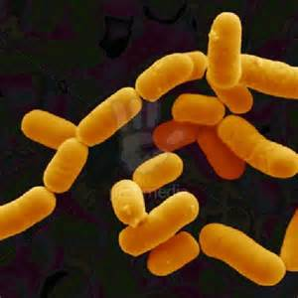
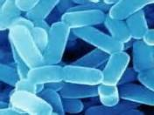
Fermentation Enzymatic Hydrolysis Technology: A New Technological Revolution in the Feed Industry
Biological Feed: Refers to a general term for feed products developed using biotechnological techniques such as fermentation engineering, enzymatic engineering, protein engineering, and genetic engineering, utilizing feed raw materials and additives permitted by national regulations. This includes fermented feed, enzymatic feed, synergistic fermented feed with microbes and enzymes, and biological feed additives.
Preparation Process of Fermented Enzymatic Feed: Select appropriate raw materials → Crush and mix → Adjust moisture content (30-60%) → Add microbial fermentation agents or enzyme preparations: strain activation (using glucose, sucrose, molasses, etc.; sugar concentration in the sugar solution should be 1% to 2%; activation temperature should be 30-40°C; activation time should be 2-12 hours) → Control fermentation conditions: suitable temperature (generally 25-40°C), humidity (generally maintained at 50-65%), and pH value → Monitor the fermentation process (regular checks and adjustments are necessary to ensure feed quality and safety); fermentation time is generally 5-7 days → Perform drying and other post-treatments → Store (in a cool, dry, and ventilated place) → Feed directly to animals or use as feed ingredients to formulate complete feed
Single material
Pretreatment
Mixture
Fermentation
Post-processing
Mixed
materials
Activated strains
Drying,
Grinding, etc.
Notes:
菌种活化就是将发酵菌剂投入温糖水中复苏的过程, 使用的糖类包括葡萄糖、 蔗糖、 糖蜜等, 糖水中含糖量为1%~2%、 活化温度在30~40 ℃ 、 活化时间在2~12 h 为宜。

Slide 12
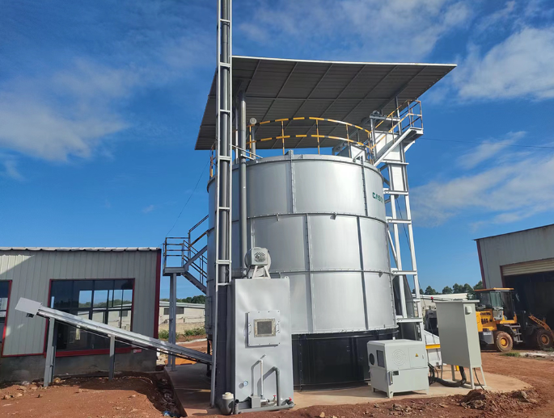
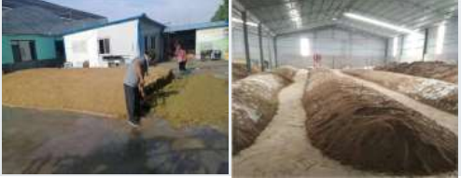
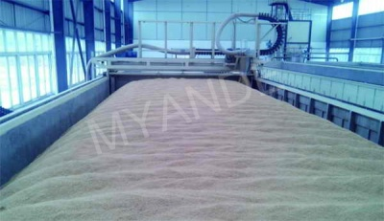
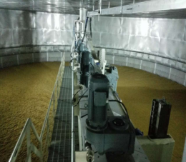
Fermentation Enzymatic Technology
Production Process of Fermented Feed
1、Aerobic Fermentation: The process of fermentation using aerobic probiotics under oxygen conditions. Common aerobic microorganisms include Bacillus species, yeast, and Aspergillus. Aerobic fermentation requires continuous introduction of fresh air and constant stirring during the fermentation process to meet the respiratory needs of the microorganisms.
Traditional Piled Open Fermentation
Rectangular Tank Fermentation Bed
Rectangular Tank Fermentation Bed
Closed Vertical Aerobic Fermentation Tank
Advantages | Disadvantages
Fast fermentation speed, allowing for the full utilization of inorganic nitrogen sources to synthesize microbial protein. | Significant equipment investment; for shallow fermentation, a large area is required.
Fast fermentation speed, allowing for the full utilization of inorganic nitrogen sources to synthesize microbial protein. | High technical requirements, making it prone to contamination by foreign microorganisms.
Capable of producing high-value-added products, such as liquid enzyme preparations, antibiotics, vitamins, and more. | High energy loss in the materials.

Slide 13
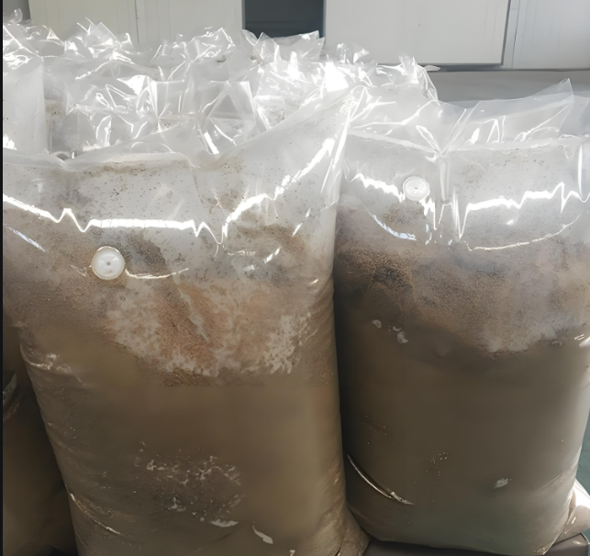
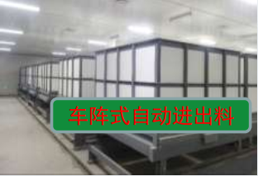
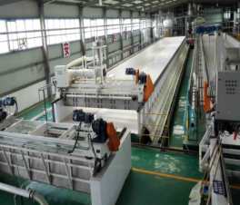
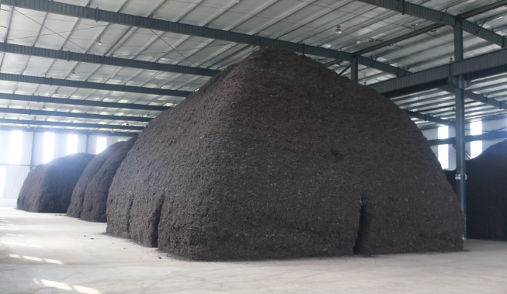
Fermentation Enzymatic Technology
Production Process of Fermented Feed
2. Anaerobic Fermentation: After preparing the raw materials with the appropriate moisture and nutrients, inoculate with anaerobic bacteria and place them in a sealed container or sealed environment. After a period of fermentation, a nutritious, palatable, and highly digestible microecological feed is produced, containing a large number of probiotics and their metabolic products that promote health and growth.
Automatic feed in and out
Piled Fermentation
One-Way Exhaust Valve Fermented Feed Bag
Vehicle-Style Fermenter
Automated Rectangular Fermentation System
Advantages | Disadvantages
Simple operation, easy to master; equipment occupies a small area, allowing for deep fermentation | The bacterial proliferation is lower than that of aerobic fermentation.
Material loss does not exceed 5%, and usable energy may increase. | The decomposition strength of the materials is insufficient, but this can be addressed by using exogenous compound enzyme preparations.
As long as it is well sealed, the shelf life is long.
Fermentation produces organic acids (such as lactic acid) and rich lactobacillin.

Slide 14
Fermentation Enzymatic Technology
Production Process of Fermented Feed**
3. Facultative Fermentation:** A fermentation process completed by the joint action of aerobic bacteria, anaerobic bacteria, and facultative anaerobic bacteria. Different types of microorganisms grow and function in varying oxygen concentration environments, possessing both aerobic respiration and anaerobic fermentation capabilities.
Maximize control of aerobic contaminating bacteria proliferation, quickly transition into the anaerobic fermentation phase, minimize fermentation losses, and produce as many metabolic products, such as organic acids, as possible.

Slide 15
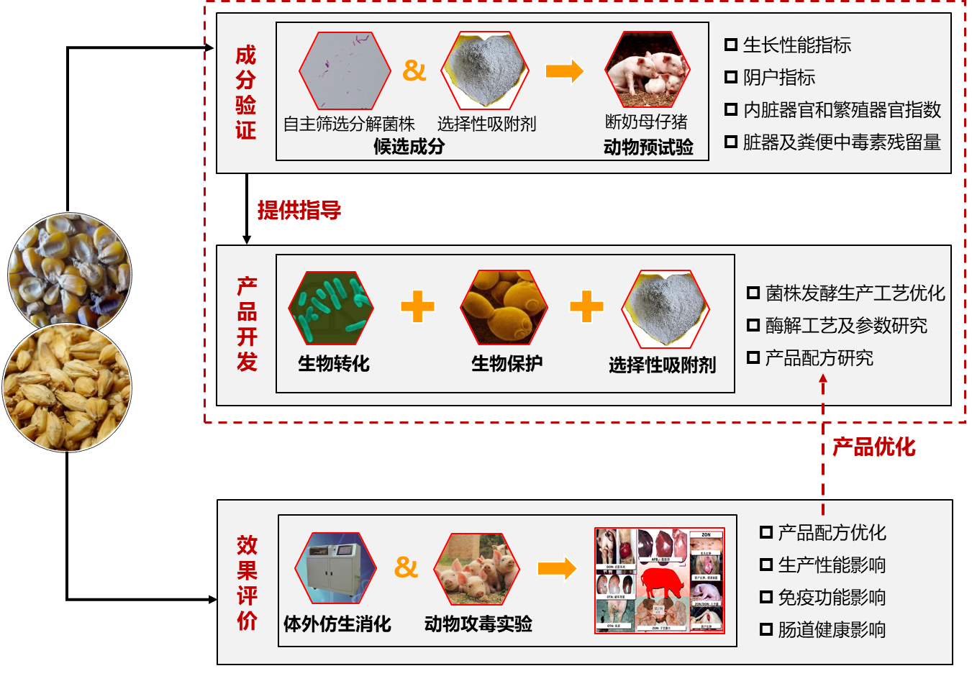
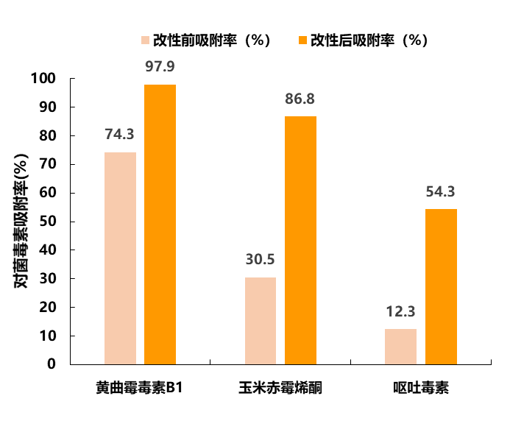
15
Technologies for the Development and Utilization of By-Products from Grain Processing
Technologies for the removal of mycotoxins from grain and its by-products
Based on the "Microorganism + Enzyme + Adsorbent" synergistic reduction technology, a mycotoxin detoxifying agent product has been developed, achieving removal rates of over 80% for vomitoxin and deoxynivalenol.
Growth performance
Reproductive performance
Organ development
Toxin residue
Pre-modification
Post-modification
Component verification
Degrading bacteria
Selective adsorbent
Animal experiment
adsorption rate (%)
Fermentation technology
Enzymolysis technology
Formulating
product development
Biotransfo-rmation
Biological conservation
Selective adsorbent
Optimization
AFB1
ZEN
DON
Growth performance
Immune function
Intestinal health
Changes in Mycotoxin Adsorption Rates Before and After Physical Modification
Evaluation
Biomimetic digestion
Animal feeding
Mycotoxin Degrading Enzymes and Degrading Microorganisms

Slide 16
1. Development and Application of Fermented Wheat Bran
Current Status of Wheat Bran Resources
Nutritional Value of Wheat Bran
*China Feed Composition and Nutritional Value Table (2019, 30th Edition)
Project | DM | CP | CF | NFE | Ca | A-P | Starch | ASH
Wheat | 88 | 13.4 | 1.9 | 69.1 | 0.11 | 0.13 | 54.6 | 1.9
Wheat bran | 87 | 13~15 | 13~16 | 53~56 | 0.17 | 0.28 | 19~22 | 4~5
Current Status of Wheat in China:
Most Widely Grown: Cultivation Area and Distribution Highest Production: Total Yield and Yield per Unit
Taking the domestic wheat situation in 2020 as an example:
Annual Production: 134 million tons
Grain Proportion: ≈ 20%
Feed Usage: ≈ 15 million tons
Wheat Bran Proportion: ≈ 15-20%
Wheat Bran Production: ≈ 30 million tons
Nutritional Characteristics of Wheat Bran
Disadvantages
Advantages
“Five Low”
Bound phenolic acids > Free phenolic acids
Low SDF/IDF
Low crude protein (CP) and poor quality
Low cellulaseLow energy
Phenolic acidsFlavonoidsLignans
Phenolic compounds
Dietary fiber (TDF)
Polysaccharides/Non-starch polysaccharides (NSP)
Bioactive substances
SDF（0.9-4.1%）
IDF
“Two High”
High ANF (Anti-Nutritional Factors, such as crude fiber and phytic phosphorus)
High levels of mycotoxins
Arabinoxylan (46%)
β-1,3-1,4-Glucan (6%)
Probiotic Effects
Development/Utilization Limitations
*Data from the National Grain and Oil Information Center
Notes:
以现有的小麦现状特点，玉米豆粕为参考值，具有较大的利用优势，但也是人畜争粮的解决途径之一，利用非常规饲料。

Slide 17
Wheat Bran Fermentation Process
Determinative Factors of Fermentation Effects
Fermentation effects
Project | Effect
Palatability
Crude protein | 20~23%
Crude fiber | 5~6%
Phytic acid | 20~40%
Phenolic compounds | 30~40%
Dietary fiber | 86.94%
Probiotics | 10⁸CFU/g
Strain characteristics
Number of strains
Solid-State Fermentation
Liquid Fermentation
Combination synergistic effect
Microbial Fermentation Technology
Anaerobic
Aerobic
Faculative
Single strain
Mixed strains
Enzymes from microorganisms
Fermentation process parameters
Lactic acid bacteria, Bacillus, yeast, fungi
Wheat bran (30 articles)
Fermented wheat bran (35 articles)
*Research data sourced from CNKI and NCBI (2020-2021).
Notes:
麦麸经固态发酵后营养成分、生物活性物质和抗营养因子等含量不同程度的将提高/降低。

Slide 18
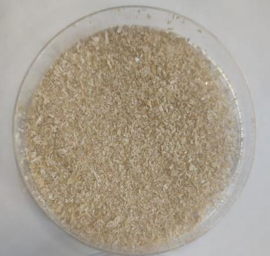
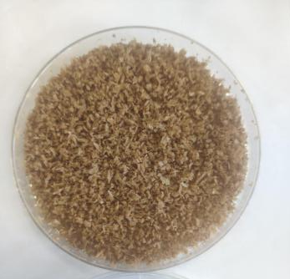
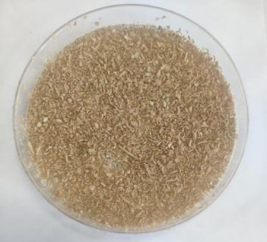
Sensory evaluation of fermented wheat bran
Wheat bran
Fermented wheat bran（no drying）
Fermented wheat bran（drying）
Items | Morphologies, texture | Color | Flavor
Wheat bran | Clastic with white powder attached to the surface | light brown | Flavor of bran
Wet fermented wheat bran | Fluffy and soft | brown | strong sour scent
Dried fermented wheat bran | Curly and hard | hopscotch | Light sour scent

Slide 19
Application of fermented wheat bran to broilers and laying hens
Items | Wheat bran | Fermented wheat bran
Dry matter | 90.03 | 94.45
Crude protein | 14.94 ± 0.06ª | 18.02 ± 1.23^{b}
Acid soluble protein | 1.48 ± 0.01ª | 5.08 ± 1.84^{b}
Crude fiber | 16.01 ± 0.01^{b} | 14.65 ± 0.68ª
Total energy (MJ/kg) | 8.15 ± 0.01ª | 8.89 ± 0.41^{b}
Mannan | 0.23 ± 0.01ª | 0.49 ± 0.13^{b}
Total polyphenol (mg/g) | 3.27 ± 0.01ª | 10.07 ± 2.57^{b}
Rough polysaccharide(mg/g) | 9.02 ± 0.10 | 16.24 ± 12.24
Aflatoxin B1 (μg/kg) | 0.22 ± 0.01^{b} | 0.13 ± 0.02ª
Zearalenone (μg/kg) | 6.36 ± 0.49^{b} | 1.26 ± 0.25ª
Deoxynivalenol (μg/kg) | 924.20 ± 20.99 | 889.18 ± 15.73
The content of crude protein and many active substances increased,crude fiber and cytotoxins decreased
10% additive amount
7% additive amount
performance and immune performance improved
Supress the immune stress, wet format was better than dry format
Wang Yu, Li Aike, Wang Yongwei, et al, 2022, 《 Food Agricultural and Immunology 》
An jishan, Li Aike, Wang Yongwei, et al, 2022, 《 Animals 》

Slide 20
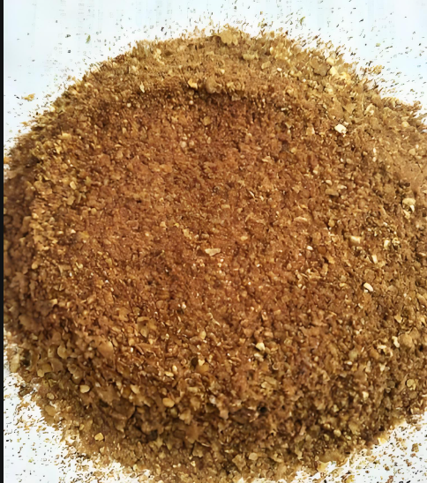
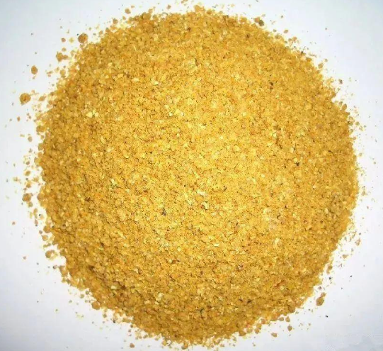
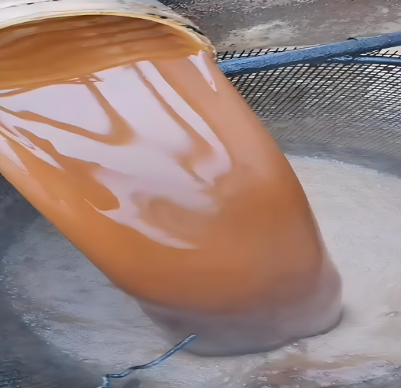
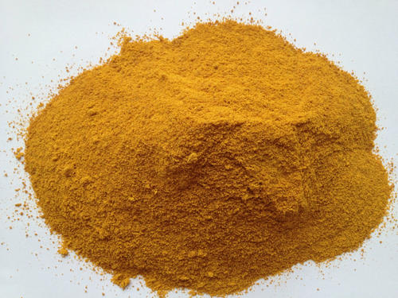
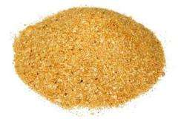
2. Development and application of by-products of fermented corn processing
Main corn deep-processing by-products
Corn germ meal: a by-product of corn oil extraction from corn and is rich in protein and fat.
Corn gluten meal: Protein extracted from corn can be used in the production of food and feed.
Corn DDGS: a by-product of corn fermentation and is rich in protein and vitamins.
Corn bran: the skin of corn separated by soaking and crushing.
Corn steep liquor：To make corn starch, corn kernels must be soaked with sulfite first, and the soaking liquid is concentrated to make a yellowish brown liquid, called corn pulp
Problems
Sulfite ion residue: pungent taste, reduce the palatability.
Ingredients that are difficult to digest and use residue, which reduces feed utilization.
batch Quality is unstable.
Mycotoxin residue.
Corn germ meal
Corn gluten meal
Corn DDGS
Corn bran
Corn steep liquor

Slide 21
Indexes of fermented corn processing by-product （DM based）
Items | Pre-fermentation | Post-fermentation | P-value
Crude protein（%） | 20.08±0.95 | 21.82±0.12 | 0.120
Acid soluble protein（%） | 3.18±0.02ª | 1.48±0.16^{b} | 0.004
Aflatoxin B1（µg/kg） | 2.47±0.42^{b} | 0.86±0.21ª | 0.008
Zearalenone（µg/kg） | 150.07±6.78 | 137.13±27.02 | 0.547
Deoxynivalenol（µg/kg） | 1369.60±85.92 | 1160.33±122.78 | 0.119
Fumonisin（µg/kg） | 3158.68±105.77^{b} | 1968.42±144.48ª | 0.001
Ether Extract （%） | 6.51±0.10ª | 4.35±0.24^{b} | 0.001
Crude fiber（%） | 12.10±0.02 | 12.03±0.86 | 0.957
Crude ash（%） | 5.29±0.15 | 5.40±0.02 | 0.381
Calsium（%） | 0.04±0.01 | 0.03±0.00 | 1.000
Total phosphate（%） | 0.44±0.01^{b} | 0.50±0.02ª | 0.015
The contents of mycotoxins in corn by-products were significantly reduced by fermentation, and the contents of p-aflatoxin B1 and fumonitoxin were the most significantly decreased

Slide 22
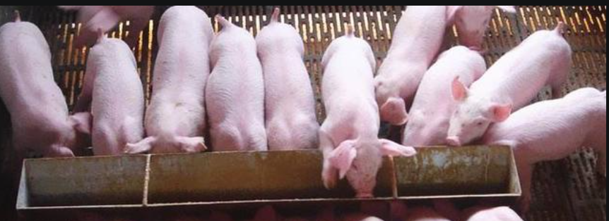
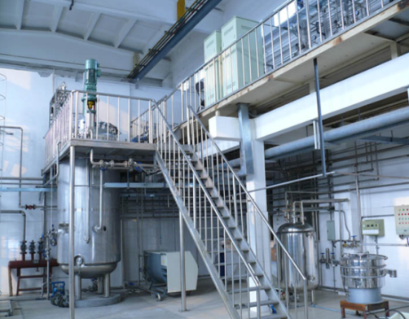
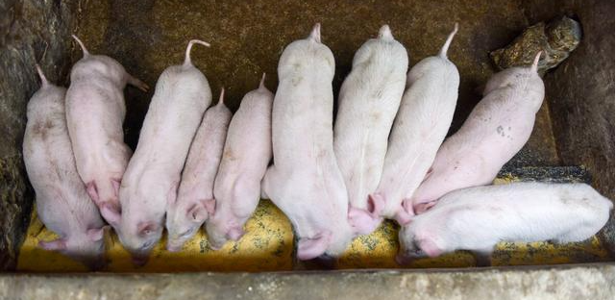
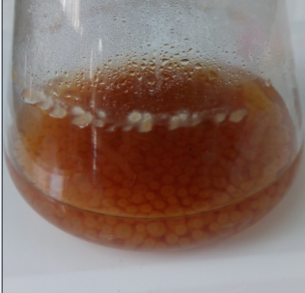
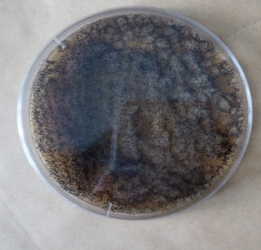
3. Fermented wheat starch processing wastewater
Wheat starch processing wastewater (Pentosan Syrup): a high concentration organic wastewater rich in pentosan produced in the process of wheat starch production. Its main dry matter components include starch, pentosan, protein and so on
The content of 2.02 mg/mL functional xylo-oligosaccharide was converted from 1.6% indigestible pentosan in wheat starch processing byproduct amylpolysyrups
The effects of the product on growth in piglets
Fed with fermented pentosane syrup
Liquid fermenter
Fed with basal diet
Aspergillus niger

Slide 23
Conclusions：The effects of fermented feeds
Probiotics can inhibit intestinal spoilage and reduce the production of harmful gases.
Remove or reduce anti-nutrient factors and mycotoxins
Fermented feeds
Improve the nutritional value of feed
Maintain the balance of intestinal microbiota
Improve animal performance
Improve the animal feeding environment
Safe, efficient and environmentally friendly
Natural fermented flavor, good palatability, can stimulate appetite; Beneficial bacteria produce a variety of enzymes that promote digestion and absorption.
Probiotics can adhere to intestinal wall cells to act as a barrier

Slide 24
03
The significance and future development of the new biotechnologies

Slide 25
General technical route
New resources
New technologies
New integration
New equipment
Bacteria
Grain and oil processing by-products
Rapid detection of anti-nutrient factors and exogenous toxins
Multiple fermented feed raw material technologies and parameters
New drying equipment
New continuous intelligent fermentation equipment
Large fermentation feed equipment production line
Key technology of industrial development and utilization of fermented meal feed
Key technology of industrial development and utilization of fermented grain processing by-products
Integrated innovation
A wider range of industrial promotion and application

Slide 26
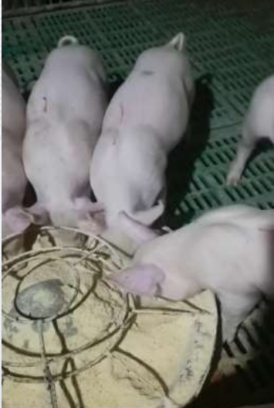
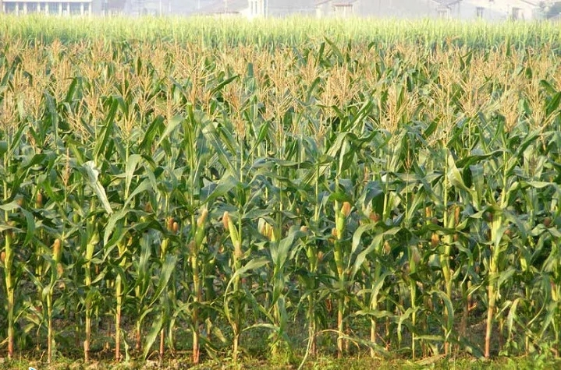
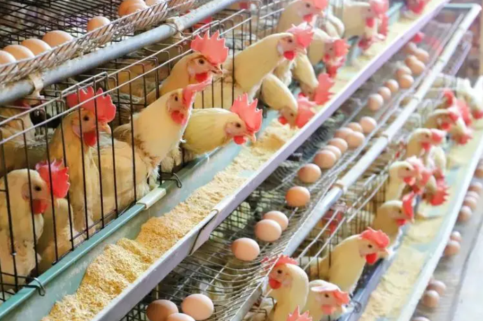
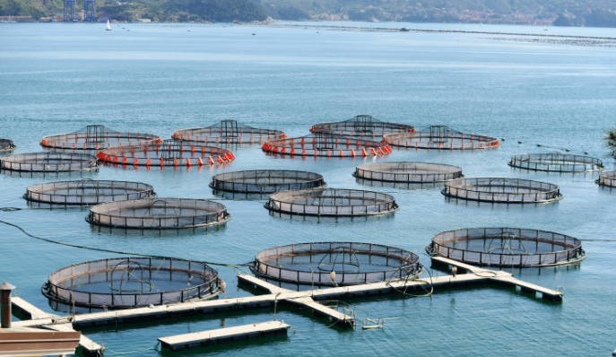
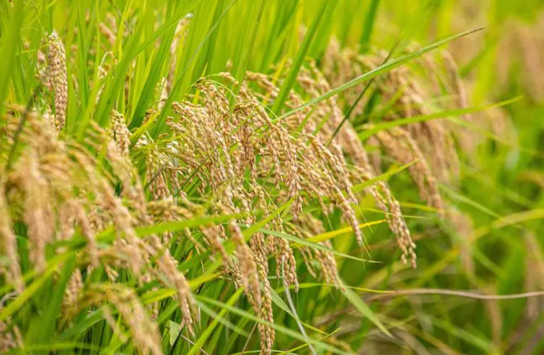
Social and ecological benefits
contribute to grain conservation and loss reduction
The fermented grain promoted the development of anti-resistant feed, significantly reduced the residues of toxic and harmful substances in aquaculture products, improved the flavor of livestock products, and reduced fecal odor
Replace high cost raw materials and feed additives, reduce feed costs

Slide 27
Policies for Corn and Soybean Meal Substitution Globally
Food and Agriculture Organization of the United Nations（FAO）
“Global Feed Security: The Role of Alternative Feed Ingredients” Encouraging the use of diverse feed ingredients to reduce dependence on corn and soybean meal, especially in situations of resource scarcity or significant price fluctuations. Recommended alternatives include other grains, legume by-products, and novel feed sources such as insect protein and algae.
International Feed Industry Federation（IFA）
“Guidelines for Sustainable Feed Industry” (2021) , "Feed Sustainability Initiative" (2022) They provide recommendations for the use of alternative feed ingredients, including reducing dependence on corn and soybean meal through technological innovations and research. Specific measures to promote the substitutions of feed components are proposed, emphasizing the use of environmentally friendly raw materials. These guidelines include nutritional value assessments of alternative feeds, environmental impact analyses, and economic benefits.
People's Republic of China (PRC)
"Opinions on Promoting High-Quality Development of Animal Husbandry" (2020), "Work Plan for Reducing and Substituting Corn and Soybean Meal in Feed" (2021), and "Three-Year Action Plan for Reducing and Substituting Soybean Meal in Feed" (2023) China's strategic thinking and practices in addressing feed resource shortages and promoting sustainable agricultural development aim to improve feed utilization efficiency and ensure food security. The consensus emphasizes enhancing efficiency while reducing usage and exploring alternative sources.

Slide 28
Thank You
Sharing for Learning

