Slide 1
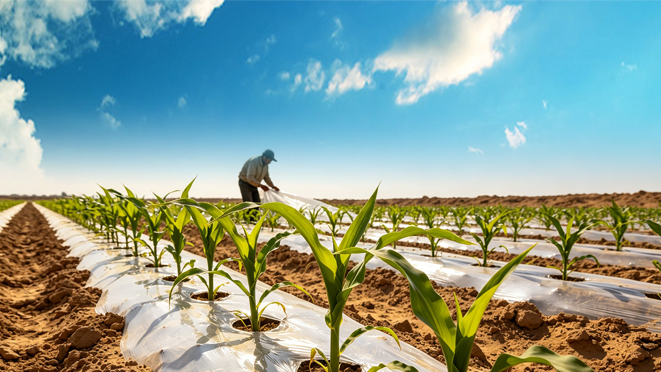
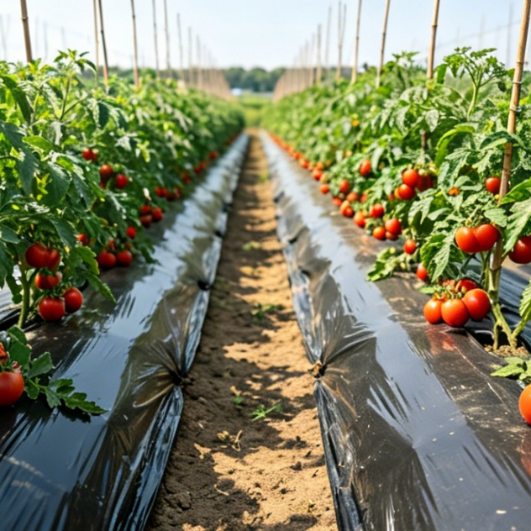
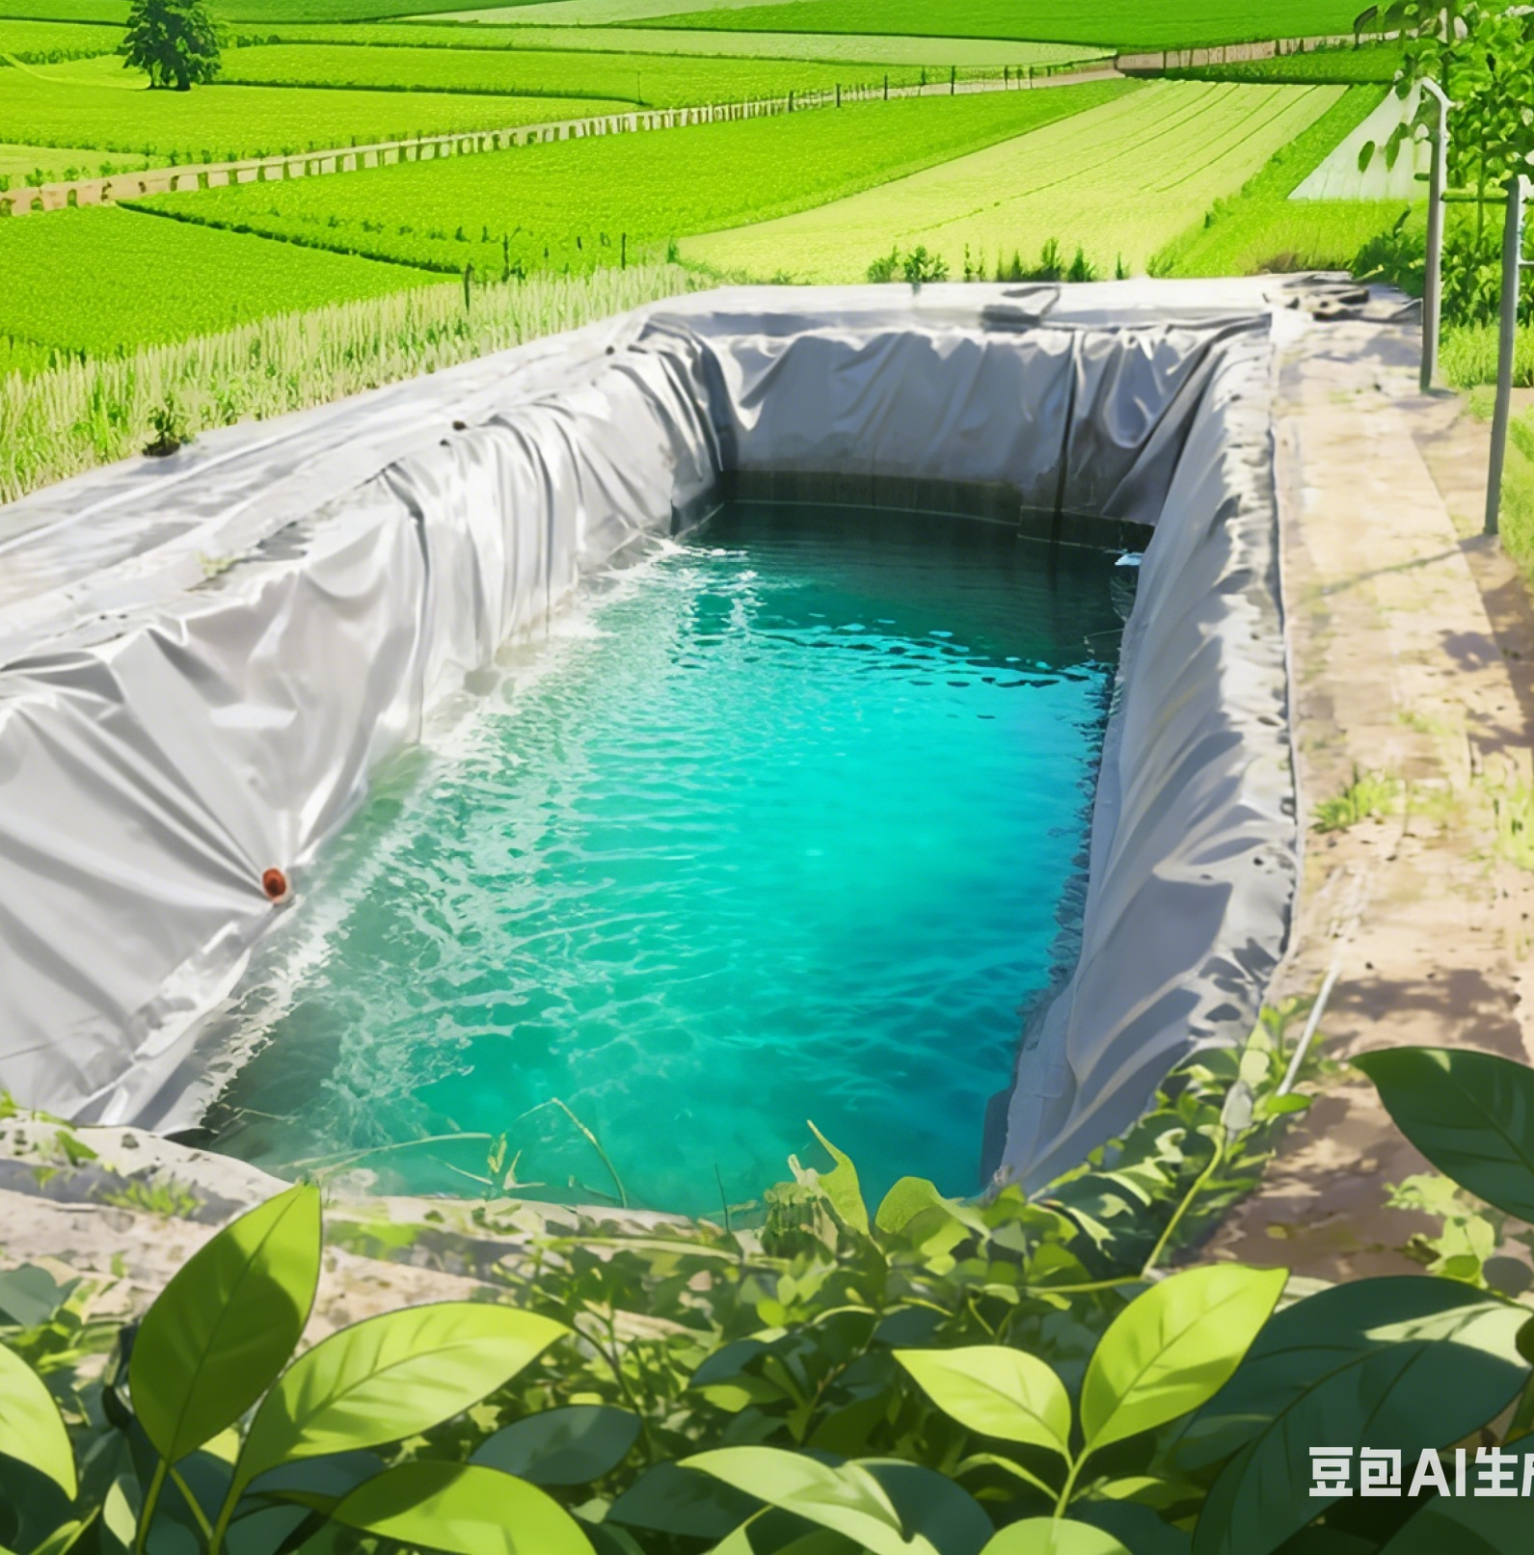
High-efficiency Plastic-Film Mulching Cultivation Techniques for Dryland Farming
Notes:
High-efficiency Plastic-Film Mulching Cultivation Techniques for Dryland Farming
旱作农业地膜覆盖高效栽培技术

Slide 2

PART.02
Full-Film and Partial-Film Mulching Technologies for Dryland Potato
Notes:
Full-Film and Partial-Film Mulching Technologies for Dryland Potato
二、旱作马铃薯全膜覆盖与半膜覆盖技术

Slide 3
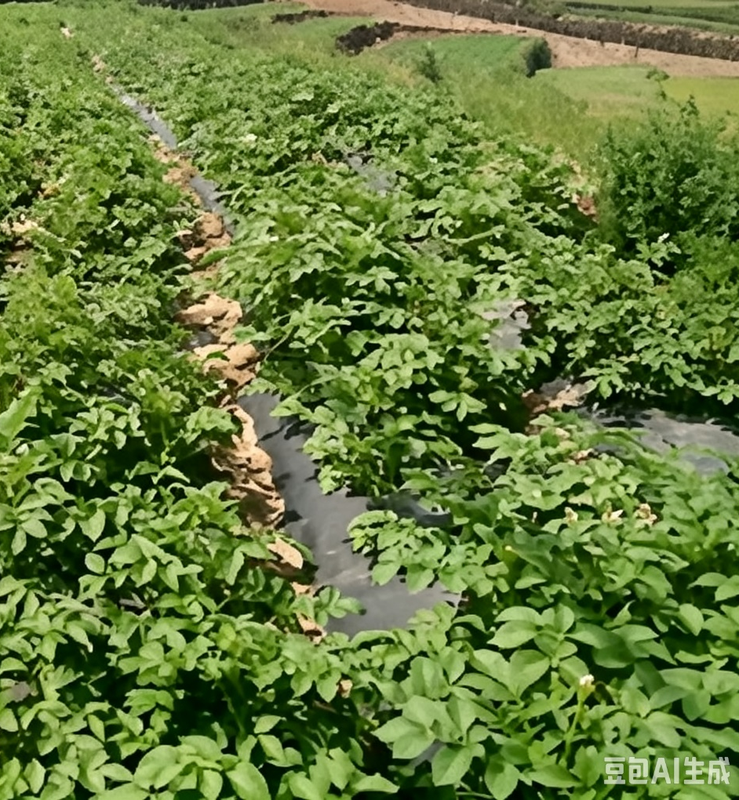
Overview
Full-film and Partial-film Mulching Systems for Dryland Potato
  Two core drought-resistant cultivation systems.
  Developed in in arid and semi-arid regions.
  ➜ Mitigate frequent spring drought.
  ➜ Improve precipitation-use efficiency.
Full-film Mulching Advantages
  Outperforms partial-film mulching in yield and drought-resistance.
  → Especially under severe water-limitation conditions.
Partial-film Mulching Advantages
  Cost control.
  Ecological sustainability.
Notes:
旱作马铃薯全膜覆盖与半膜覆盖技术是干旱、半干旱地区为应对春旱频发、降水利用率低而发展出的两种核心抗旱栽培模式。从增产效果和抗旱能力来看，‌全膜覆盖技术整体优于半膜覆盖‌，尤其在严重缺水区域表现突出；但在成本控制与生态可持续性方面，半膜覆盖具有一定优势。
Full-film and partial-film mulching technologies for dryland potato are
two core drought-resistant cultivation systems
developed in arid and semi-arid regions
to mitigate frequent spring drought
and improve precipitation-use efficiency.
With respect to yield performance and drought resistance,
full-film mulching generally outperforms partial-film mulching,
especially under severe water-limitation conditions.
However, partial-film mulching offers advantages in cost control and ecological sustainability.

Slide 4
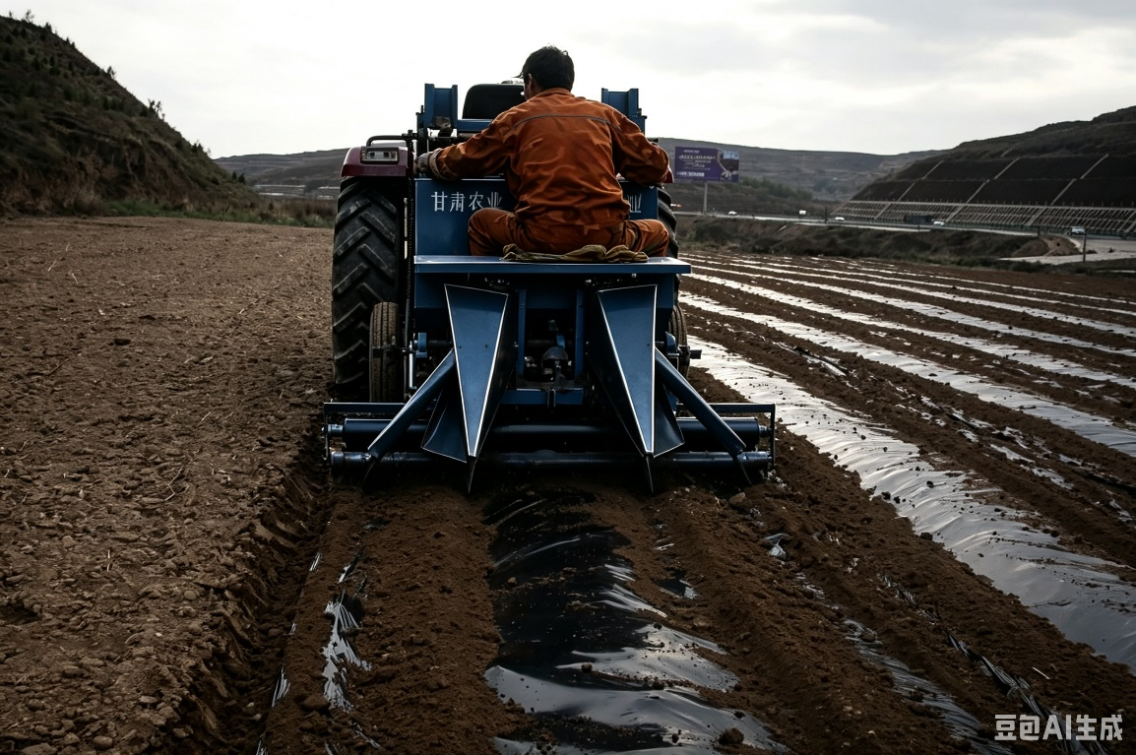
1. Full-Film Mulching for Dryland Potato
A key technology for potato production in the dryland farming areas in northern China.
Mulching Structure
  Construct alternating wide and narrow ridges.
  Fully cover the soil surface with plastic film.
Planting Method
  Conduct ridge-top planting.
Notes:
（一）旱作马铃薯全膜覆盖
全膜覆盖是中国北方旱作区马铃薯生产的重要技术之一，其原理是在田间起大小双垄，使用地膜对地表进行全覆盖，并在垄上完成播种作业。
2.1Full-Film Mulching for Dryland Potato
Full-film mulching is a key technology for potato production in the dryland farming areas of northern China.
The technique
consists of constructing alternating wide and narrow ridges,
fully covering the soil surface with plastic film,
and conducting ridge-top planting.

Slide 5
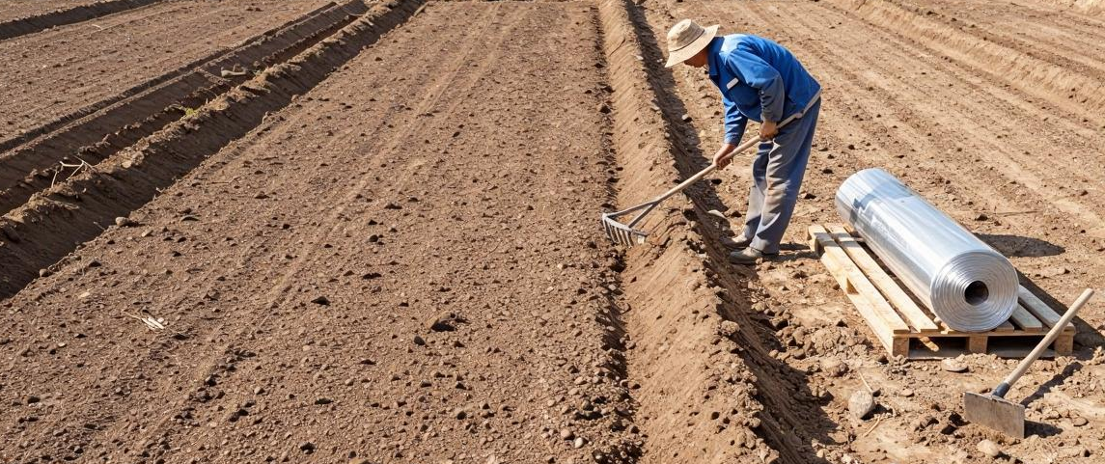
1. Full-Film Mulching for Dryland Potato
(1) Land Selection and Preparation
Land Selection
  Flat surface.
  Deep soil layers.
  Loose soil texture.
  Good soil structure.
  High fertility.
  Strong water and nutrient retention capacity.
Preceding Crops
  Preferred: wheat or legumes.
  Acceptable: maize and flax.
  Avoid: continuous cropping with solanaceous crops.
Notes:
1、选地与整地
在采用全膜覆盖技术时，应选择田面平整、土层深厚、土质疏松，土壤结构良好、肥力较高且保水保肥能力强的地块。前一季最好为小麦或豆类，玉米和胡麻次之，不宜与茄科作物连作。
2.1.1Land Selection and Preparation
For full-film mulching,
fields should be selected that have a
flat surface,
deep soil layers,
loose soil texture,
good soil structure,
high fertility,
and strong water- and nutrient- retention capacity.
The preferred preceding crops are wheat or legumes,
followed by maize and flax.
Continuous cropping with solanaceous crops should be avoided.

Slide 6
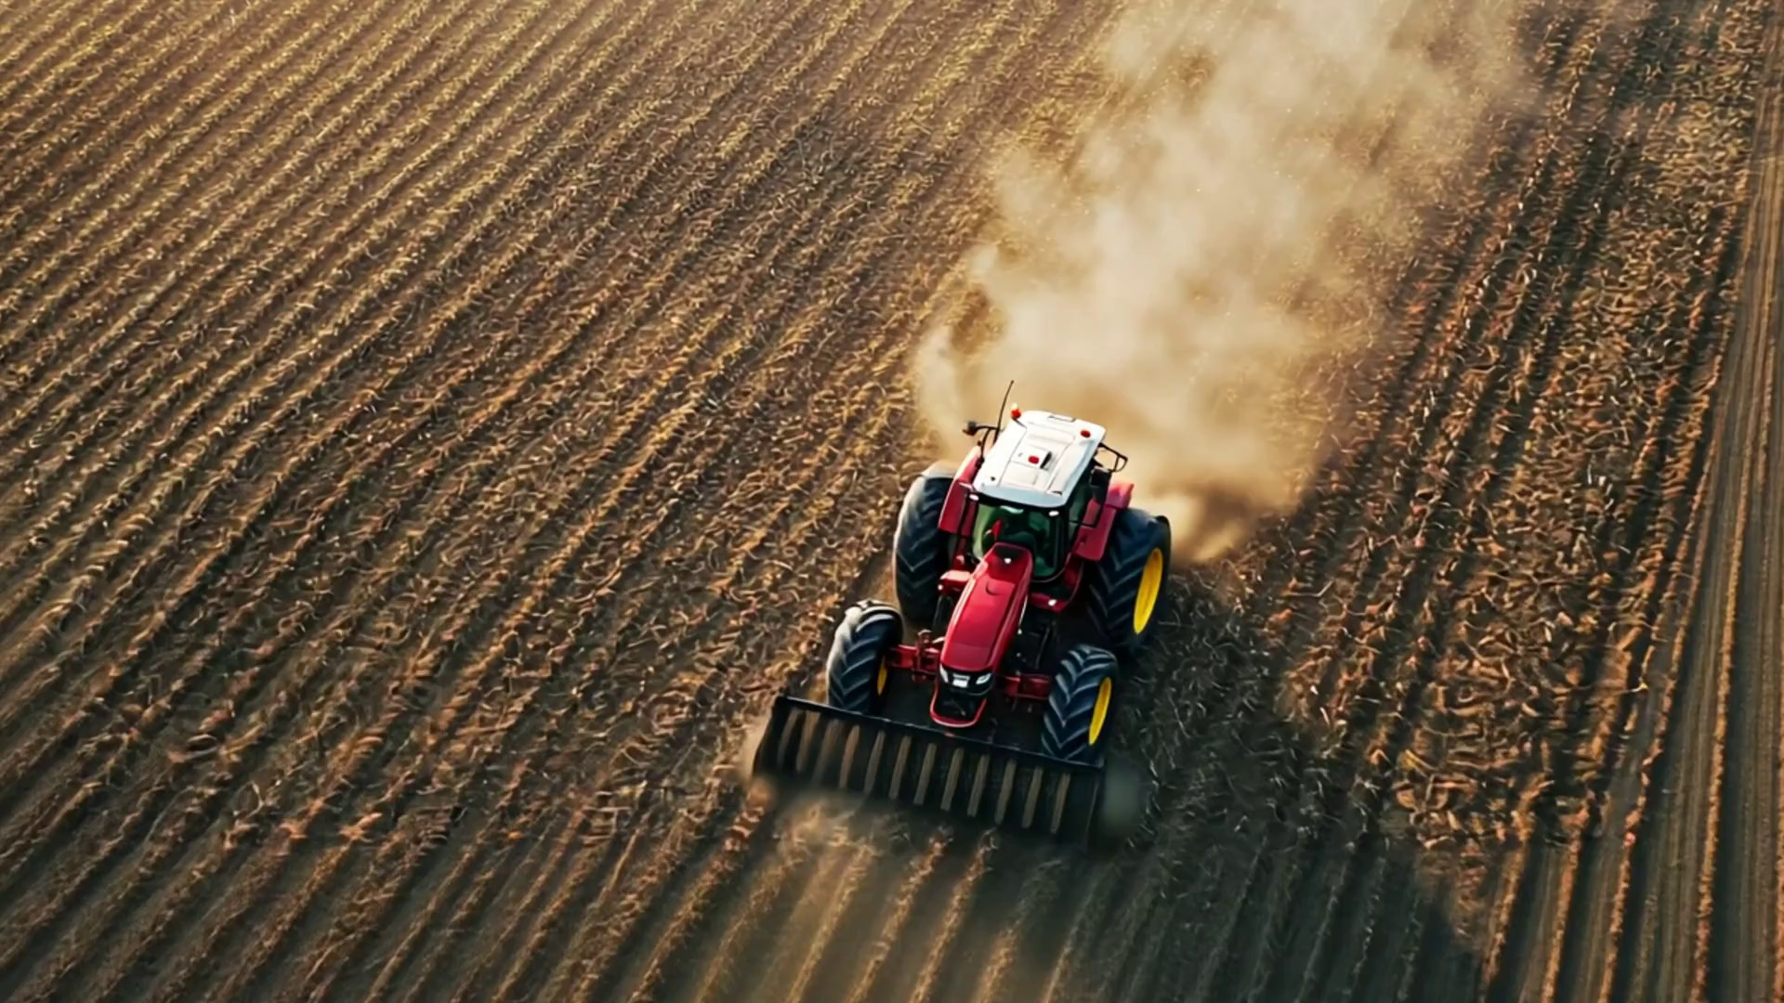
1. Full-Film Mulching for Dryland Potato
(1) Land Selection and Preparation
Soil Preparation Steps
  After previous crop harvest: ploughing, deep loosening, and rotary tillage.
  Followed by: soil crushing and levelling to ensure a flat, fine soil surface free of large clods and residues.
  Helps conserve soil moisture and establishes a solid foundation for subsequent film mulching and sowing.
Straw Incorporation
  Straw can be crushed and incorporated into the soil during field preparation.
Notes:
在前一季作物收获后，应进行翻耕、深松、旋耕等整地作业，以及耕后碎土平整，确保土壤表面平整细碎，无大土块和作物残茬。这样既能保住土壤里的水分，又能为后续的覆膜和播种打好基础。有条件的地区，可结合整地进行秸秆粉碎还田。
After the previous crop is harvested, soil preparation should include ploughing, deep loosening, and rotary tillage.
This should be followed by soil crushing and leveling to ensure a flat, fine soil surface free of large clods and crop residues.
This practice helps conserve soil moisture and establishes a solid foundation for subsequent film mulching and sowing.
Where conditions permit,
straw can be crushed and incorporated into the soil during field preparation.

Slide 7
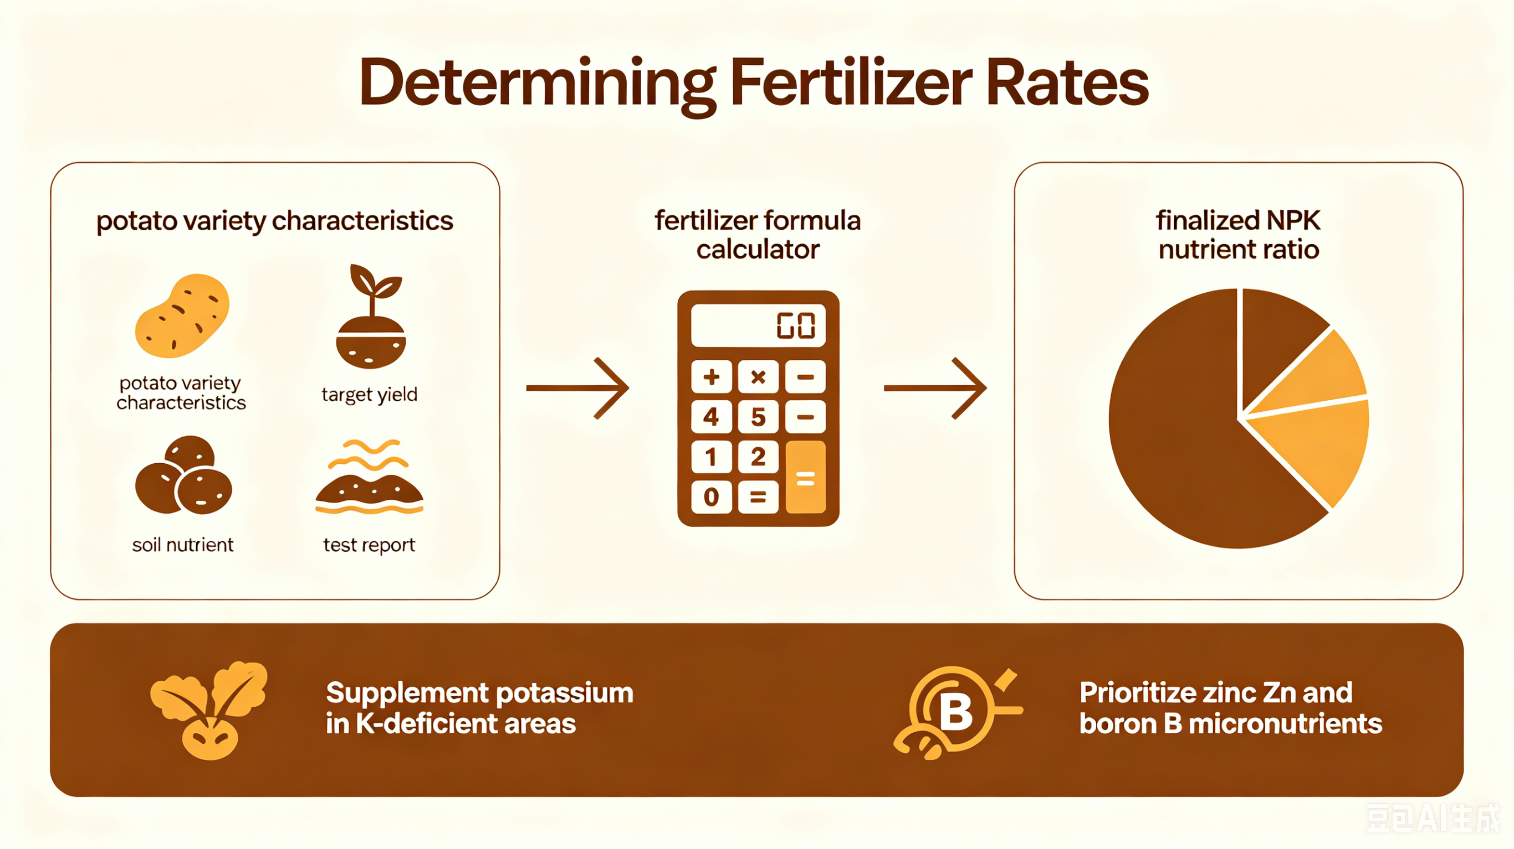
1. Full-Film Mulching for Dryland Potato
(2) Fertilizer Preparation
Fertilizer Determination
  Fertilizer application rates and nutrient ratios determined by potato variety characteristics, target yield, and soil’s nutrient status.
  Potassium supplementation essential in potassium-deficient areas.
  Emphasize application of medium and micronutrient fertilizers such as zinc and boron.
Conditioners and Fertilizer Types
  Apply water-retaining agents and drought- and stress-resistance conditioners appropriately.
  Recommend using long-acting fertilizers, slow-release fertilizers, and specialized compound fertilizers.
Base Fertilizer Application
  Base fertilizer applied during field preparation and ridge formation.
Notes:
2、肥料准备
根据马铃薯的品种特性、目标产量以及土壤养分等，确定肥料用量和养分比例。缺钾地区应注意补充钾，同时注重锌、硼等中微量元素肥料的施用，科学施用保水剂、抗旱抗逆制剂。推荐施用长效肥、缓释肥及相关专用肥。底肥应在整地起垄时施用。
2.1.2 Fertilizer Preparation
Fertilizer application rates and nutrient ratios should be determined according to potato variety characteristics, target yield, and soil’s nutrient status.
Potassium supplementation is essential in potassium-deficient areas.
In addition, the application of medium and micronutrient fertilizers such as zinc and boron should be emphasized.
Water-retaining agents and drought- and stress- resistance conditioners should be applied in a scientifically appropriate manner.
The use of long-acting fertilizers, slow-release fertilizers, and specialized compound fertilizers is recommended.
Base fertilizer should be applied during field preparation and ridge formation.

Slide 8
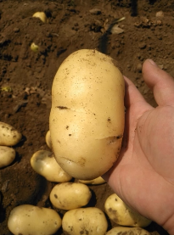
1. Full-Film Mulching for Dryland Potato
(3) Variety Selection
By Local Conditions
  Choose suitable varieties according to precipitation, accumulated temperature, soil fertility, and production requirements.
By Intended Use
  Select varieties for table use, fresh marketing, starch processing, or frying processing based on intended use.
By Maturity Period
  Choose varieties with different maturity periods (early, early-mid, mid, mid-late, or late) according to local climatic conditions.
≫ Opt for virus-free seed potatoes.
Notes:
3、品种选择
根据降水、积温、土壤肥力、生产需要等情况，选择适宜品种。根据用途有针对性选择菜用型、鲜食型、淀粉加工型或油炸加工型品种，并结合当地气候条件，选择早熟、中早熟、中熟、中晚熟或晚熟等不同生育期的品种。宜选用脱毒种薯。
2.1.3 Variety Selection
Varieties should be selected according to local precipitation,
accumulated temperature, soil fertility, and production requirements.
Varieties for table use, fresh marketing,
starch processing or frying processing may be selected based on the intended use.
Varieties with different maturity periods—early-maturing,
early-mid-maturing, mid-maturing,
mid-late- maturing or late-maturing— should be selected according to local climatic conditions.
Virus-free seed potatoes are preferred.

Slide 9
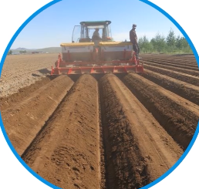
1. Full-Film Mulching for Dryland Potato
(4) Ridge Formation and Film Mulching
Ridge Formation under Full-film Mulching
Ridge Dimensions & Arrangement
  Wide ridges: 60–70 cm wide, about 10 cm high.
  Narrow ridges: 40–50 cm wide, about 15 cm high.
  Wide and narrow ridges arranged alternately.
  Sowing belts reserved on ridge tops.
Ridge Formation Requirements
  According to specified dimensions.
  Uniform ridge width.
  Consistent crest height.
  No surface depressions.
Operational Requirements
  On gentle slopes, ridges and furrows should be constructed along contour lines.
  Integrated mechanical operations combining ridge formation, fertilization, sowing, and film mulching are recommended.
Notes:
4、起垄与覆膜
全膜覆盖起垄，大垄垄宽60-70cm、垄高约10cm，小垄垄宽40-50cm、垄高约15cm，大垄与小垄交替排列，在垄上预留出播种带。按照起垄规格划行起垄，做到垄面宽窄均匀、垄脊高低一致、无凹陷。在缓坡地，应沿等高线开沟起垄；有条件的地区，推荐采取机械起垄、施肥、播种、覆膜一体化作业。
2.1.4 Ridge Formation and Film Mulching
For ridge formation under full-film mulching,
wide ridges should be 60-70 cm wide and about 10 cm high,
whereas narrow ridges should be 40–50 cm wide and about 15 cm high.
Wide and narrow ridges are arranged alternately,
with sowing belts reserved on the ridge tops.
Ridges should be formed according to the specified dimensions,
ensuring uniform ridge width,
consistent crest height,
and no surface depressions.
On gentle slopes, ridges and furrows should be constructed along the contour lines.
Where conditions permit,
integrated mechanical operations combining ridge formation, fertilization, sowing, and film mulching are recommended.

Slide 10
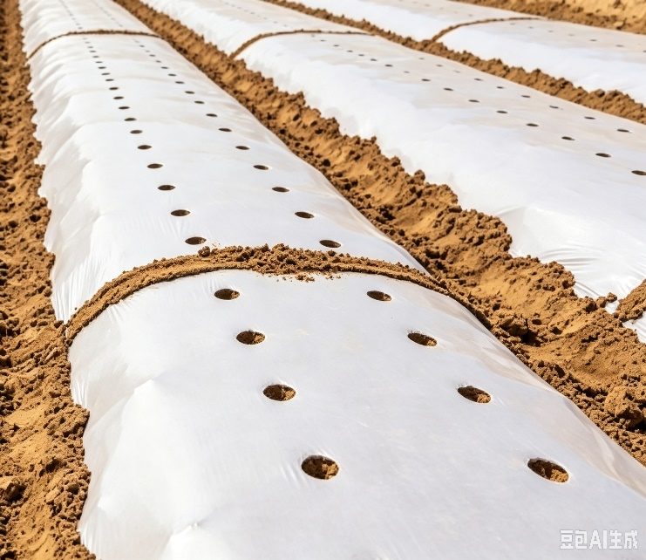
1. Full-Film Mulching for Dryland Potato
(4) Ridge Formation and Film Mulching
Full-surface Mulching with Plastic Film
  Adjacent film sheets joined at crests of wide-ridge and compacted with soil.
  Film stretched tight, laid flat → to ensure close adherence to ridge surfaces and furrows.
Wind-proof Compaction
  Transversely compacted with soil at intervals of ~2 m to prevent wind damage.
Water-infiltration Holes After Mulching
  Small water-infiltration holes ~3 mm in diameter, at intervals of ~50 cm within reversed sowing belts → to facilitate rainfall infiltration.
Mulch Inspection & Repair
  Inspect regularly.
  Any damaged sections promptly sealed with fine soil or protected with straw mulch.
Notes:
全地面覆盖地膜，相邻两幅地膜在大垄垄脊相接，用土压实。地膜应拉展铺平，与垄面、垄沟贴紧，每隔约 2m用土横压，防止大风把地膜掀开。覆膜后，在预留的播种带内每隔 50 cm左右，打直径约 3 mm的渗水小孔，方便雨水渗入土壤。要经常检查地膜，一旦发现破损，要及时用土盖严，也可以用秸秆覆盖保护地膜。
Full-surface mulching with plastic film is required,
with adjacent film sheets joined at the crests of wide ridges and compacted with soil.
The film should be stretched tight and laid flat to ensure close adherence to the ridge surfaces and furrows.
It should be transversely compacted with soil at intervals of about 2 m to prevent wind damage.
After mulching,
small water-infiltration holes approximately 3 mm in diameter should be made at intervals of about 50 cm within the reserved sowing belts to facilitate rainfall infiltration.
The film should be inspected regularly,
and any damaged sections should be promptly sealed with fine soil or protected with straw mulch.

Slide 11


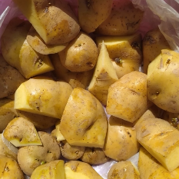


1. Full-Film Mulching for Dryland Potato
(5) Seed Potato Treatment
Initial Handling of Seed Potato
  Taken out of cellar ~15 days before sowing.
  Diseased, insect-infested, rotten tubers discarded.
  Selected seed potatoes sun-dried.
Seed Potato Pre-sprouting
  Begin 7 days before sowing.
  Seed potatoes piled and covered with plastic film to raise temperature + promote sprout development.
  Sprouts reach ~1 cm in length → tubers ready for cutting.
Seed Potato Cutting
  Cutting tools disinfected with potassium permanganate before use.
  Seed potatoes cut into pieces weighing 25–50 g, each with 1–2 bud eyes.
Treatment of Cut Pieces
  Treated with plant ash or seed-coating agent by dressing or soaking.
  Air-dried in a cool place before sowing.
Notes:
5、种薯处理
播种前15天左右将种薯出窖，剔除病薯、虫薯、烂薯后进行晒种，播种前7天开始催芽，将种薯集中堆放，用农膜覆盖提高温度促其发芽。芽长1cm左右准备切块播种，切薯前用高锰酸钾消毒刀具，将种薯切成25-50g大小的薯块，每个薯块带1
2.1.5 Seed Potato Treatment
Seed potatoes should be taken out of the cellar about 15 days before sowing.
Diseased, insect-infested and rotten tubers should be discarded.
The selected seed potatoes should then be sun-dried.
Pre-sprouting should
begin 7 days before sowing.
The seed potatoes should be piled together and covered with plastic film to raise the temperature and promote sprout development.
When the sprouts reach about 1 cm in length, the tubers can be prepared for cutting.
Cutting tools should be disinfected with potassium permanganate before use.
Seed potatoes should then be cut into pieces weighing 25-50 g, each with 1-2 bud eyes.
The cut pieces should be treated with plant ash or a seed-coating agent by dressing or soaking,
and then air-dried in a cool place before sowing.

Slide 12
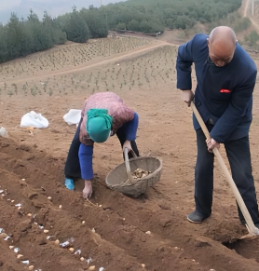
1. Full-Film Mulching for Dryland Potato
(6) Sowing
Sowing Conditions and Timing
  Begin when soil temperature at 5–10 cm depth remains consistently >10 °C.
  Typical window: late April-early May.
  Adjust timing according to local climate, soil moisture and varieties.
Planting Density
  Recommended density: 45,000–67,500 plants/ha.
  Higher density conditions:
High soil fertility
Adequate soil moisture
Or when using early-maturing or dwarf varieties
Notes:
6、播种
当5-10cm土层温度稳定在 10℃以上时即可播种，通常在4月下旬至5月上旬，也可根据当地气候条件、土壤墒情状况和马铃薯品种等因素适当调整。一般情况下，每公顷种植密度为45000株至67500株。土壤肥力高、墒情状况好的地块，或选择生育期短、植株矮小品种的地块，可适当加大种植密度。
2.1.6 Sowing
Sowing should begin when the soil temperature at the 5-10 cm depth remains consistently above 10 ℃,
typically from late April to early May.
The timing should be adjusted according to local climatic conditions, soil moisture status and potato varieties.
Generally, the recommended planting density is 45,000 to 67,500 plants per hectare.
A higher planting density can be adopted in fields with
high soil fertility
and adequate soil moisture conditions,
or when using early-maturing and dwarf varieties.

Slide 13
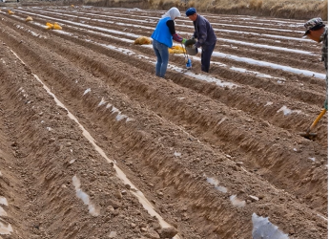
1. Full-Film Mulching for Dryland Potato
(6) Sowing
Sowing Method
  Hole sowing through mulch film according to designated density and spacing.
  Specialized puncher used to make holes at the predetermined plant spacing (10–15 cm depth, 4–5 cm diameter).
  Seed potatoes placed with bud eyes facing upward.
  Sowing holes sealed immediately after placement.
Mechanization
  Use of integrated machine for ridge forming, fertilization, sowing, and film mulching recommended.
Soil Moisture Requirement
  If relative water content of plough-layer soil <60% → irrigation applied before sowing.
Notes:
按照种植密度和株距将种薯破膜穴播，用特制的打孔器按预定株距打孔，孔深10-15cm、直径4-5cm。播种时芽眼向上，播后及时将播种孔封闭。有条件的地区，推荐采用起垄施肥播种覆膜一体机播种，若耕层土壤相对含水量低于60%，应先进行补水再播种。
Seed potatoes should be sown by
hole sowing through the mulch film according to the designated planting density and spacing.
A specialized puncher should be used to make holes at the predetermined plant spacing, with a hole depth of 10-15 cm and a diameter of 4-5 cm.
Seed potatoes should be placed with the bud eyes facing upward,
and the sowing holes should be sealed immediately after placement.
Where conditions permit,
the use of an integrated machine for ridge forming, fertilization, sowing, and film mulching is recommended.
If the relative water content of the plough-layer soil is below 60%, irrigation should be applied before sowing.

Slide 14
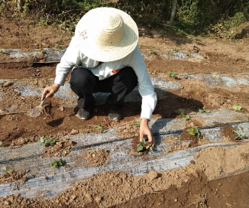
1. Full-Film Mulching for Dryland Potato
(7) Field Management
Two Key Management Tasks at Seedling Stage
Seedling Inspection and Emergence Assistance
  When first break through the soil but fail to emerge through the reserved sowing holes:
Manually guide seedlings through mulch film.
Holes resealed with soil.
  After seedling emergence:
Missing seedlings and gaps should be promptly replenished.
Mulch Film Inspection and Protection
  From seedling emergence to budding stage:
  Keep mulch film intact.
  Any damaged sections promptly sealed with fine soil → to prevent wind lifting and maintain mulching effectiveness.
Notes:
7、田间管理
在幼苗生长阶段（苗期），要做好两件事：一是查苗、助苗出膜。幼苗刚破土时，如果没有从预留的播种孔长出来，要及时帮助幼苗露出地膜，并重新用土把播种孔封好，出苗后发现缺苗断垄时应及时补苗；二是检查地膜、保护地膜。马铃薯出苗到长出花苞的阶段，要保持地膜完好，及时用细土封严破损处，防止大风揭膜。
2.1.7 Field Management
During the seedling stage,
two key management tasks should be carried out:
•Seedling inspection and emergence assistance.
When seedlings first break through the soil but fail to emerge through the reserved sowing holes,
they should be manually guided through the mulch film,
and the holes should be resealed with soil. After seedling emergence,
missing seedlings and gaps in the row should be promptly replenished.
•Mulch film inspection and protection.
From potato seedling emergence to the budding stage,
the mulch film must be kept intact.
Any damaged sections should be promptly sealed with fine soil to prevent wind lifting and maintain mulching effectiveness.

Slide 15
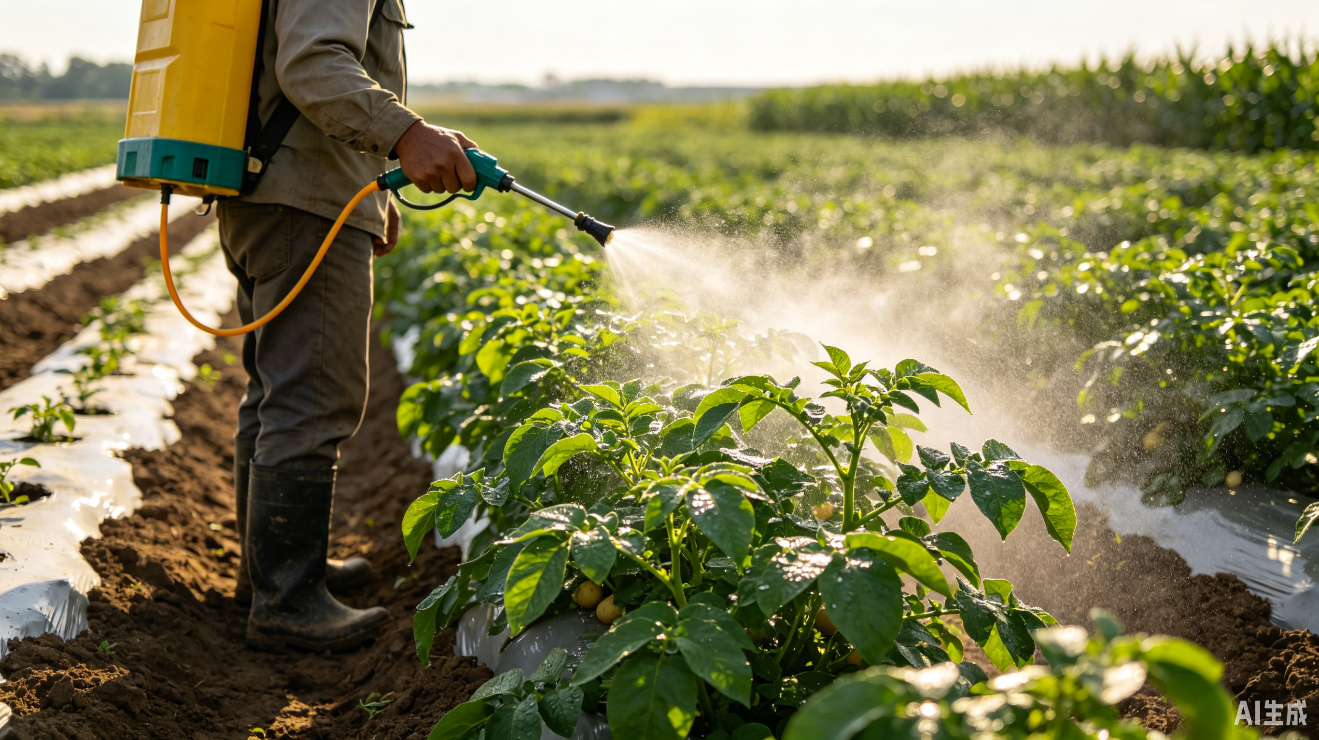
1. Full-Film Mulching for Dryland Potato
(7) Field Management
Topdressing at Budding Stage
  Topdressing applied according to plant growth.
  Drill holes through mulch film for fertilizer application.
  Or apply foliar spray.
Mulch Removal & Hilling
  Timing: underground tubers begin rapid enlargement.
  Mulch film removed in a timely manner.
  Conduct manual or mechanical hilling.
  Promote tuber expansion.
Pest & Disease Management
  Prevent and control of early blight, late blight, bacterial ring rot.
  Control pests such as grubs, mole crickets, and aphids.
  Use of biological control technologies is encouraged.
Notes:
当马铃薯长出花苞后，根据植株长势进行追肥，采取在地膜上打孔施肥或叶面喷施，当马铃薯地下块茎开始快速长大时，适时揭开地膜，并进行人工或机械培土，以利块茎膨大。还要做好早疫病、晚疫病、环腐病及蛴螬、蝼蛄、蚜虫等病虫害防治，鼓励应用生物防治技术。
After the plants enter the budding stage,
topdressing should be applied according to plant growth,
either by drilling holes through the mulch film for fertilizer application or by foliar spraying.
When underground tubers begin rapid enlargement,
the mulch film should be removed in a timely manner,
followed by manual or mechanical hilling to promote tuber expansion.
Effective
prevention and control of early blight, late blight, bacterial ring rot,
and pests such as grubs, mole crickets, and aphids should be implemented,
and the use of biological control technologies is encouraged.

Slide 16
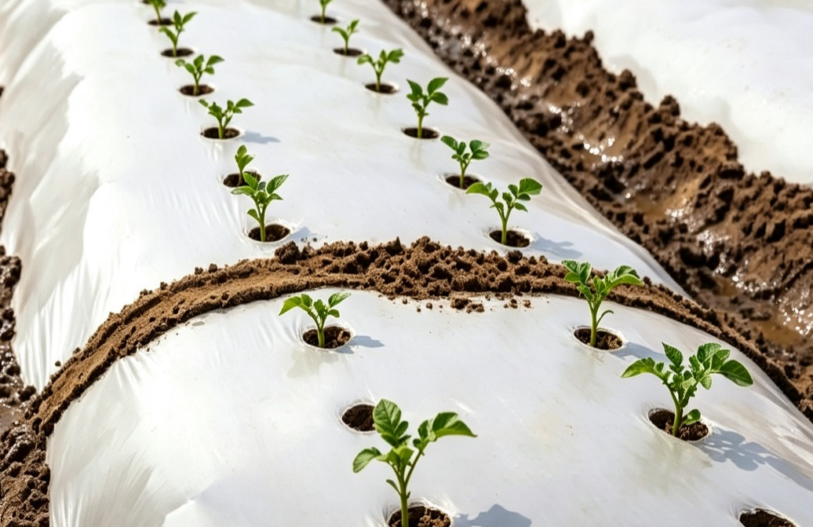
2. Partial-Film Mulching Technology for Dryland Potato
Ridge-Furrow Cultivation with Furrow Irrigation
  Shape field into alternating ridges and furrows.
  Cover ridge surfaces with mulch film.
  Plant potatoes on or beside ridges.
Irrigation Method
  Irrigation water delivered into furrows according to crop’s water demand during growth.
  Water supplied to plants through lateral seepage.
  Improves water resource use efficiency.
AI生成
Notes:
（二）旱作马铃薯半膜覆盖技术
半膜覆盖垄作沟灌是将土地平面修成垄沟交替形状，用地膜覆盖垄面，在垄上或垄侧种植马铃薯，按照作物生长需水规律,将灌溉水输送至垄沟内，通过侧渗供应植株生长，从而提高水资源利用效率。
2.2 Partial-Film Mulching Technology for Dryland Potato
Ridge-furrow cultivation with furrow irrigation
under partial-film mulching involves
shaping the field into alternating ridges and furrows,
covering the ridge surfaces with mulch film,
and planting potatoes on or beside the ridges.
Irrigation water is delivered into the furrows according to the crop’s water demand during growth,
and is supplied to the plants through lateral seepage,
thereby improving water resource use efficiency.

Slide 17
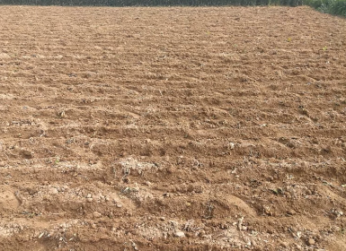
2. Partial-Film Mulching Technology for Dryland Potato
(1) Land Selection
Purpose
  For the application of the water-saving ridge–furrow irrigation technology under partial-film mulching for potatoes.
Land Selection Criteria
  Deep plough layer.
  Loose soil.
  Medium to high fertility.
  Convenient irrigation and drainage.
  Previous crop: non-solanaceous.
  Adequate sunlight.
Notes:
1、地块选择
在应用马铃薯半膜覆盖垄作沟灌节水技术时，要选择耕层深厚、土壤疏松、肥力中等以上、灌排方便、前一季为非茄科作物光照充足的地块。
2.2.1 Land Selection
For the application of the water-saving ridge-furrow irrigation technology under partial-film mulching for potatoes,
fields should have a
deep plough layer,
loose soil,
medium to high fertility,
and convenient irrigation and drainage.
The previous crop should be non-solanaceous,
and the field should receive adequate sunlight.

Slide 18
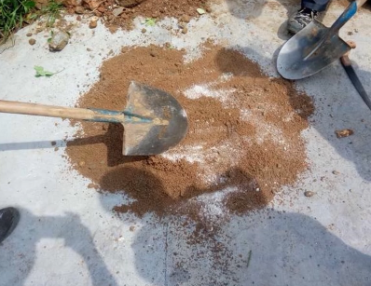
2. Partial-Film Mulching Technology for Dryland Potato
(2) Soil Preparation and Pretreatment
Base Irrigation & Deep Tillage
  Before sowing: sufficient base irrigation should be applied.
  Followed by deep tillage to depth of 20–25 cm to ensure loose soil and fine soil crumbs.
In Fields with Severe Underground Pest Treatment
  7.5 kg of 40% isofenphos-methyl EC/ha mixed with 225 kg fine sand to prepare toxic soil.
  Apply toxic soil evenly during soil preparation and ridge forming.
Notes:
2、整地与预处理
播种前要浇足底水，进行深翻20-25cm，做到土壤疏松、土块细碎。
地下害虫危害严重的地块，在整地、起垄时，每公顷使用40%甲基异柳磷乳油7.5kg，与225kg细沙土混合制成毒土，均匀撒施；
2.2.2 Soil Preparation and Pretreatment
Before sowing, sufficient base irrigation should be applied,
followed by deep tillage to a depth of 20–25 cm to ensure loose soil and fine soil crumbs.
In fields with severe underground pest infestation,
7.5 kg of 40% isofenphos-methyl EC per hectare should be mixed with 225 kg of fine sand to prepare toxic soil,
which is then evenly applied during soil preparation and ridge forming.

Slide 19
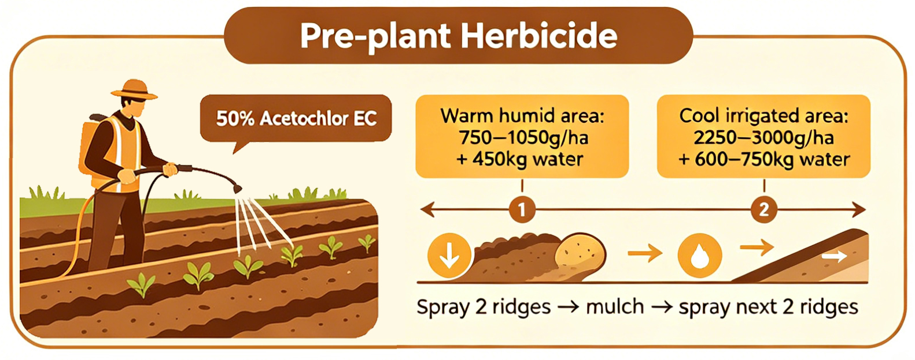
2. Partial-Film Mulching Technology for Dryland Potato
(2) Soil Preparation and Pretreatment
In Fields with Heavy Weed Infestation:
  Entire soil surface sprayed with 50% acetochlor EC after soil preparation and ridge forming.
Herbicide Dosage for Different Conditions
  In areas with high soil moisture & elevated temperature: 750–1050 g of 50% acetochlor EC per hectare → diluted in 450 kg of water.
  In cooler irrigated regions: 2250–3000 g of 50% acetochlor EC per hectare → diluted in 600–750 kg water.
Method to Improve Herbicide Effectiveness
  Two ridges sprayed first + immediately cover with mulch film.
  Followed by spraying next two ridges in sequence.
Notes:
杂草危害严重的地块，整地起垄后，用50%乙草胺乳油全地面喷雾，土壤湿度大、温度较高的地区，每公顷用50%乙草胺乳油750–1050g，兑水450kg，气候冷凉的灌溉区，每公顷用50%乙草胺乳油2250–3000g兑水600–750kg进行防治。为提高药效，一般采用先喷两垄、覆盖地膜后再喷两垄的方式，依次进行。
In fields with heavy weed infestation,
the entire soil surface should be sprayed with 50% acetochlor EC after soil preparation and ridge forming.
In areas with high soil moisture and elevated temperatures, 750-1050 g of 50% acetochlor EC per hectare should be diluted in 450 kg of water.
In cooler irrigated regions, 2250–3000 g of 50% acetochlor EC per hectare should be diluted in 600-750 kg of water for weed control.
To improve the effectiveness of herbicide application,
two ridges are typically sprayed first and immediately covered with mulch film,
followed by spraying the next two ridges in sequence.

Slide 20
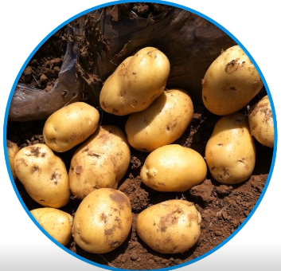
2. Partial-Film Mulching Technology for Dryland Potato
(3) Seed Potato Treatment
Seed Drying
  Spread seed potatoes evenly on a soil surface for 2-3 days before sowing.
  Avoid direct exposure to sunlight on cement ground.
Seed Selection During Drying
  Diseased, rotten, or mechanically damaged tubers removed.
Reduce the risk of missing seedlings.
Ensure uniform emergence.
Lay foundation for high yield.
Notes:
3、种薯处理
播种之前先晒种，将种薯平摊在土质场上晒种2-3天，注意避免在水泥地上暴晒。晒种期间剔除病烂、伤薯，以降低田间缺苗率，保证全苗，为丰产奠定基础。
2.2.3 Seed Potato Treatment
Before sowing,
seed potatoes should be dried by spreading them evenly on a soil surface for 2-3 days,
avoiding direct exposure to sunlight on cement ground.
During seed drying,
diseased, rotten, or mechanically damaged tubers should be removed
to reduce the risk of missing seedlings in the field,
ensure uniform emergence,
and lay the foundation for high yield.

Slide 21
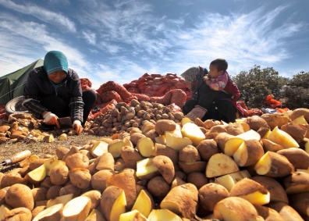
2. Partial-Film Mulching Technology for Dryland Potato
(3) Seed Potato Treatment
Seed Selection for Cutting
  Virus-free and disease-free seed potatoes should be selected.
Cutting Requirements
  Each tuber cut into pieces weighing 30–50 g.
  Each piece retains 2–3 bud eyes.
  Cutting tools disinfected with 75% alcohol or 40% formaldehyde.
Post-Cut Treatment
  Tuber pieces dressed in plant ash.
  Pile for one day before sowing.
Alternative Treatment
  Tuber pieces soaked in “Handibao” at a ratio of 30 ml to 50 kg of water for 10 min.
  Removed, drained, and kept ready for sowing.
Notes:
选择脱毒无病种薯进行切块，每块种薯大小在30-50克、保留2-3个芽眼，并用75%酒精或40%甲醛进行切刀消毒，切块后，用草木灰拌种，堆放1天后播种，或用“旱地宝‌”按每30毫升兑50kg水浸种10分钟，捞出后沥干水分待播种。
Virus-free and disease-free seed potatoes should be selected for cutting.
Each tuber should be cut into pieces weighing 30-50 g,
each retaining 2-3 bud eyes.
Cutting tools should be disinfected with 75% alcohol or 40% formaldehyde.
After cutting,
the tuber pieces should be dressed in plant ash
and piled for one day before sowing.
Alternatively,
they may be soaked with "Handibao" at a ratio of 30 ml to 50 kg of water for 10 minutes,
then removed, drained, and kept ready for sowing.

Slide 22
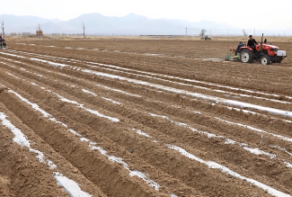
2. Partial-Film Mulching Technology for Dryland Potato
(4) Ridge Formation and Film Mulching
Timing for Ridge Forming
  Early to mid-March once cultivated soil layer thawed.
Ridge Dimensions
  Ridge surface: 60 cm wide.
  Ridge height: 30 cm.
  Inter-ridge spacing: 40 cm.
  Total with of ridge group (two ridges +inter-ridge furrow): 120 cm.
Plastic Film Specifications
  Thickness: 0.01 mm.
  Width: 90 cm.
  Application rate: ~60 kg/ha.
Mulching Method
  Film stretched tight and laid flat.
  Film covered tightly.
  Edges compacted with soil to ensure sealing.
Uniformity Requirements
  Ridge and furrow width should be uniform.
  Ridge crest heights should be consistent.
Notes:
4、起垄与覆膜
一般在3月上中旬，土壤耕作层解冻后就可以起垄，垄面宽60cm、垄高30cm，垄间距40cm，每组垄（含两个垄和中间的垄沟）的总宽度120cm，垄和垄沟宽窄要均匀、垄脊高低要一致。选用厚度0.01mm、宽90cm的地膜，每公顷用量约60kg左右。覆膜要求地膜要拉紧绷直、平整舒展、覆盖严密、并用土压实边缘。
2.2.4 Ridge Formation and Film Mulching
Ridge forming can generally be carried out in
early to mid-March once the cultivated soil layer has thawed.
Each ridge surface should be 60 cm wide
and 30 cm high,
with a 40 cm spacing between ridges.
The total width of each ridge group, including two ridges and the inter-ridge furrow, is 120 cm.
Ridge and furrow width should be uniform,
and ridge crest heights should be consistent.
Plastic film with a thickness of 0.01 mm
and a width of 90 cm should be used,
with an application rate of about 60 kg per hectare.
During mulching,
the film must be stretched tight, laid flat,
covered tightly,
and the edges compacted with soil to ensure secure sealing.

Slide 23
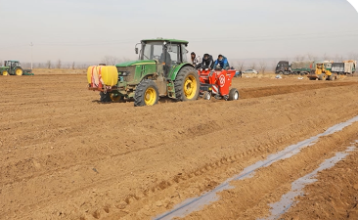
2. Partial-Film Mulching Technology for Dryland Potato
(5) Sowing
Sowing Density
  Varies among different varieties.
Spacing
  Row spacing: 20–30 cm.
  Plant spacing: 17–25 cm.
Planting Arrangement
  Two rows are planted on each ridge.
  Number of surviving seedlings per hectare maintained at 82,500–97,500 plants.
Sowing Depth
  About ~15 cm.
Notes:
5、播种
马铃薯不同品种播种密度不同，一般以行距20-30cm、株距17-25cm为宜。每垄种两行。每公顷应确保存活的幼苗数量在82,500-97,500株。播种深度约为15cm。
2.2.5 Sowing
Sowing density
varies among different potato varieties,
but a row spacing of 20-30 cm
and a plant spacing of 17-25 cm are generally appropriate.
Two rows are planted on each ridge.
The number of surviving seedlings per hectare should be maintained at 82,500-97,500 plants.
The sowing depth is about 15 cm.

Slide 24
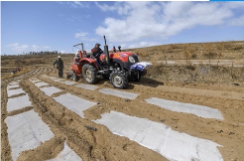
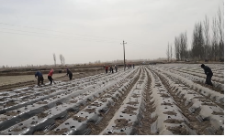
2. Partial-Film Mulching Technology for Dryland Potato
(6) Field Management
First Soil Covering
  Timing: About 15–18 days after potato sowing, i.e., about one week before seedling emergence.
  Conditions: Seedlings ~2 cm below film surface
  Method: 1–2 cm layer of soil covered on plastic film manually or mechanically.
  Purpose: Prevents seedling scalding caused by excessively high film surface temperature.
Second Soil Covering
  Timing: potato seedlings reach ~20 cm in height.
  Method: Conduct second soil covering.
  Purpose: Prevents tuber from becoming exposure and turning green due to light exposure.
Seedlings emerge naturally without need for manual assistance.
Notes:
2.2.6Field Management
About 15-18 days after potato sowing, i.e., about one week before seedling emergence,
when the seedlings are about 2 cm below the film surface,
1-2 cm layer of soil should be covered on the plastic film manually or mechanically.
This prevents seedling scalding caused by excessively high film surface temperature.
After soil covering,
seedlings can emerge naturally without the need for manual assistance.
When
potato seedlings reach about 20 cm in height,
a secondary soil covering should be conducted to
prevent tubers from becoming exposed and turning green due to light exposure.
6、田间管理
在马铃薯播种后约15-18天，即出苗前一周左右，幼苗距膜面约2cm时，在地膜上人工或机械覆土1-2cm，避免地膜表面温度过高而烫苗。覆土后幼苗可以自然顶出，无需人工掏苗。在马铃薯苗高20cm左右时进行二次覆土，可防止薯块露出后因见光变绿。

Slide 25
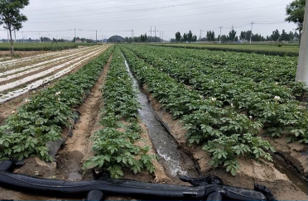
2. Partial-Film Mulching Technology for Dryland Potato
(6) Field Management
Irrigation Periods: During the vigorous growth stage, flowering stage, and rapid tuber enlargement stage of potatoes.
Number of Irrigations: 5-6 times.
Water Volume per Irrigation
  Approximately 450-600 m³ per hectare each time.
Irrigation Requirement
  The irrigation water level must not exceed the ridge tops.
Notes:
在马铃薯生长旺盛期、开花期以及块茎快速长大期，需要进行 5-6 次灌溉。每次灌溉每公顷用水量约为 450-600 m³。灌水时水位不要漫过垄顶。
During the vigorous growth stage, flowering stage and rapid tuber enlargement stage of potatoes,
5-6 irrigations are required,
with 450-600 m³ of water per hectare applied each time.
The irrigation water level must not exceed the ridge tops.

Slide 26
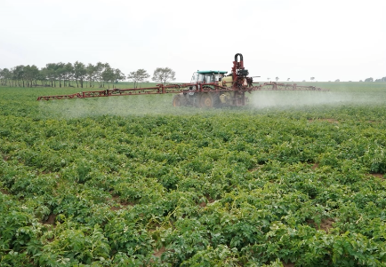
2. Partial-Film Mulching Technology for Dryland Potato
(6) Field Management
Field Cleaning
  Soil loosening and weeding simultaneously with irrigation.
  Diseased plants removed promptly.
Integrated Pest and Disease Management
  Mancozeb → to prevent early blight.
  Beta-cypermethrin → to control underground pests.
  Kocide → to prevent ring rot and blackleg.
  Methomyl → to control aphids.
  Bingduqing → to mitigate virus damage.
  Curzate and metalaxyl-mancozeb → used alternately to control late blight.
Notes:
灌水时应同时进行松土与除草。发现病株要及时拔除，使用杜邦锰杀生预防早疫病；使用高效氯氰菊酯喷雾防治地下害虫；使用可杀得预防环腐病、黑胫病；使用杜邦万灵防治蚜虫；使用病毒清缓解病毒危害；使用杜邦克客和甲霜灵锰锌交替防治晚疫病。
Soil loosening and weeding should be carried out simultaneously with irrigation.
Diseased plants should be removed promptly.
Mancozeb may be used to prevent early blight;
beta-cypermethrin may be sprayed to control underground pests;
Kocide may be used to prevent ring rot and blackleg;
Methomyl may be used to control aphids;
Bingduqing may be applied to mitigate virus damage;
and Curzate and metalaxyl-mancozeb should be used alternately to control late blight.

Slide 27
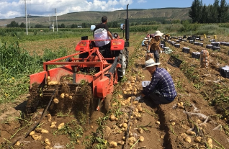
2. Partial-Film Mulching Technology for Dryland Potato
(7) Harvest
Harvest Promptly When:
  Aboveground stems and leaves turn yellow.
  Leaves begin to fall off.
  Stems wither.
  Underground tubers have ceased growth and can be easily separated from vines.
  → yield reached its peak.
For Late-Maturing Varieties not Fully Matured
  Measures: chemical seedling killing, vine rolling, or vine cutting should be applied before onset of frost → to promote earlier maturation.
These measures help to ensure timely harvest and prevent frost-related losses.
Notes:
7、收获
当地上的茎叶由绿变黄、叶片脱落、茎枯萎，地下块茎停止生长，并易与薯秧分离，产量达到最高峰时及时进行收获。对还未成熟的晚熟品种，在霜冻来临之前应采取药剂杀秧、轧秧、割秧等方法提前催熟，及早收获，以避免因霜冻而造成损失。、
2.2.7Harvest
Harvesting should be carried out promptly when the
aboveground stems and leaves turn from green to yellow,
leaves begin to fall off,
stems wither.
At this stage, underground tubers have ceased growth and can be easily separated from the vines,
indicating that yield has reached its peak.
For late-maturing varieties that have not yet fully matured,
measures such as chemical seedling killing, vine rolling,
or vine cutting should be applied before the onset of frost to promote earlier maturation.
These measures help to ensure timely harvest and prevent frost-related losses.

