Slide 1


Lecture one:
Production and Utilization of Agri. Jiaosu
Yuegao HU Ph.D
China Agricultural University
Beijing,9/3，2023

Slide 2
Part I:
General type of organic fertilizer in traditional agriculture period in China

Slide 3
The General type
Livestock manure
Human excrement
Waste retting fertilizer
Crop straw retting
Legume crops turn and press green manure
Grass charcoal fertilizer
......

Slide 4
It is known that:
Human food comes from soil, and soil food comes from fertilizer. Fertilizer is the food for human food.
In dynamic terms, humans provide fertilizer for the soil, and the soil produces food for humans. The two are harmonious and symbiotic.

Slide 5

Reflects the fundamental food is:
Human - soil cycle symbionts
Human
Fertilizer
Food
Soil
Note: Some elements of the picture are from the Internet. Thank you to the author!

Slide 6
1.1 Human-soil relationships in agricultural period in history

Slide 7
The traditional agriculture period :
Human
Fertilizer
Food
Soil
Crop
Development status: general sustainable developpment
(Note: Drawing based on research by Anni Zhu)

Slide 8
The period of traditional agriculture:
The relationship between man and soil
Human
Herbicide
Insecticide
Food
Fertilizer
Chemical fertilizer
Soil
Crop
Reduction of organic matter
Fewer animals and plants
Reduction of microorganism
Trace element reduction
？
？
State of development: unsustainable development.
(Note: Drawing based on research by Anni Zhu)

Slide 9
Agricultural problems in industrialization development
Agricultural industrialization
Focus on major commodity crops and livestocks
Chemical instead of biological
Implement scale, standardization, specialization and commercialization
Capital as the core
Agricultural resources are increasingly concentrated in the hands of a few
Treat soil in a similar way to "killing the goose that lays the golden egg"
It kidnaps the economy and everyday life
Multinational monopoly

Slide 10
Chemical fertilizer and organic fertilizer difference
Chemical fertilizer | Organic fertilizer
Fertilizer with single elemental properties | Comprehensive fertilizer effect
A non-renewable resource, natural gas | Circulation, sustainable development
Soil acidification, heavy metal element pollution | Beneficial to soil
Food quality deteriorates | Stability of food quality
Originated in modern times, more than 100 years ago | From tradition, thousands of years old
Modern agriculture is not sustainable | Sustainable organic agriculture

Slide 11
Future in Agriculture:
The relationship between human and soil
Human
Organic
fertilizer
Food
Biological fertilizer
Biological fertilizer
Soil
Crop
Development status:sustainable development.
(Note: Drawing based on research by Anni Zhu)

Slide 12
Development trend in agriculture system
Reduction of organic matter
Fewer animals and plants
Reduction of microorganism
Trace element reduction
Organic fertilizer
Biological fertilizer
Mineral fertilizer
Existing
problem
Basic countermeasure

Slide 13
Fertilizer types for organic farming
Organic fertilizer
Biological fertilizer
Mineral fertilizer(Marine sediments
, sedimentary rocks weathering minerals)
Agricultural Jiaosu: It is an active biological fertilizer technology in organic agriculture, which has been made rapidly progress in recent years.
The other fertilizer: is steady developping.
Development trend

Slide 14
Part II
The production of agricultural Jiaosu

Slide 15
1. Definition of Jiaosu fertilizer
Jiaosu is the biological products produced by fermentation.
Garbage Jiaosu, environmental protection Jiaosu, agricultural Jiaosu
Washing Jiaosu
Food Jiaosu
Medical Jiaosu
Special Jiaosu
Agricultural Jiaosu are biological products produced by fermentation and used in agricultural production. Most of them are liquid.

Slide 16
2. Origin of Jiaosu production in China
Fermentation of wine: 4,000 years ago, Xia Dynasty
Fermentation of vinegar: 3000years ago, Zhou Dynasty
Fermentation of sauce: 2000years ago, Han Dynasty
The origins of Jiaosu can be traced back to food brewing techniques.

Slide 17
3. Initiation of modern Jiaosu
Garbage Jiaosu (environmental protection Jiaosu) : Around 1960’s, the Chinese Thai-born Le Sukun obtained the application Jiaosu, and then promoted the application. In the 1980s, FAO awarded the "Food Safety Special Project". The technology was introduced to China by Wen Xiuzhi in 2013.

Slide 18
Initiation of modern Jiaosu
Industrial production of edible Jiaosu: from Japan, at the end of the 19th century, once spread to Taiwan, China, and then to the mainland;
Cultivation Jiaosu: Zhao Hangui in Korea developed around 1980, and introduced to China after 2000;
Relevant technology has also spread to Europe, America and the other part in the world.

Slide 19
General trend of human application of fermentation technology
From food to drug fermentation technology applications
Application of agricultural Jioasu technology

Slide 20
4. Production and utilization of agricultural Jiaosu
4.1 Preparing Materials
（1）Brown sugar (or black sugar, molasses, brown granulated sugar, other sugar)
（2）Peels, tail vegetables, fallen fruit, rotten fruit ready to be thrown away
（3）Tap water
（4）Plastic bucket that can be sealed (stainless steel bucket, water tank)

Slide 21
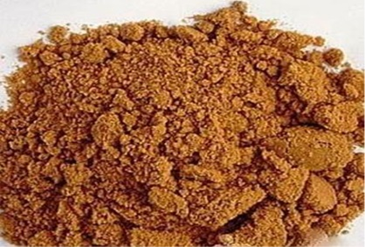
Making Jiaosu：
---红糖：brown sugar

Slide 22
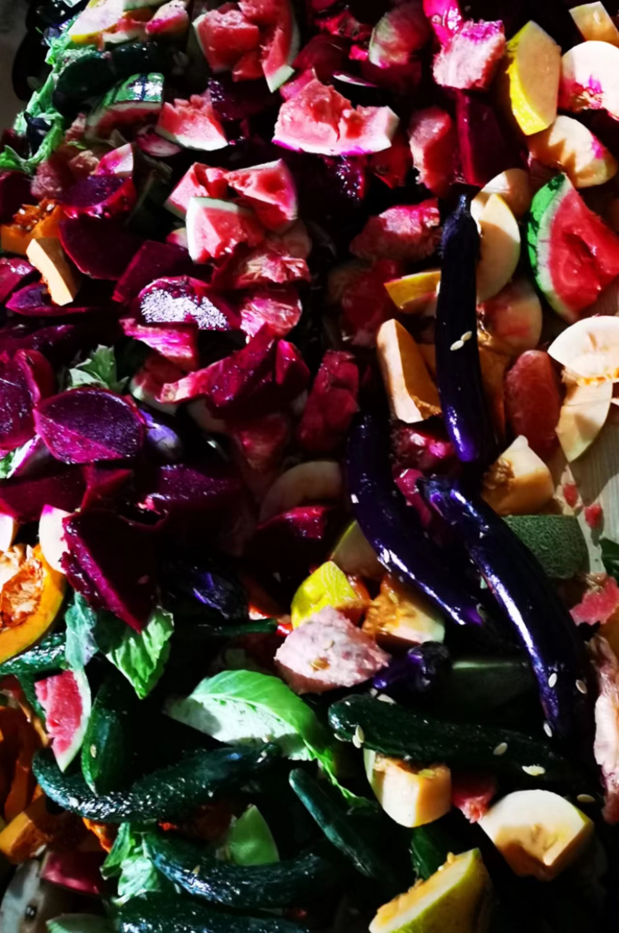
Fruit and vegetable Raw materials
(Fujian Wangde)

Slide 23
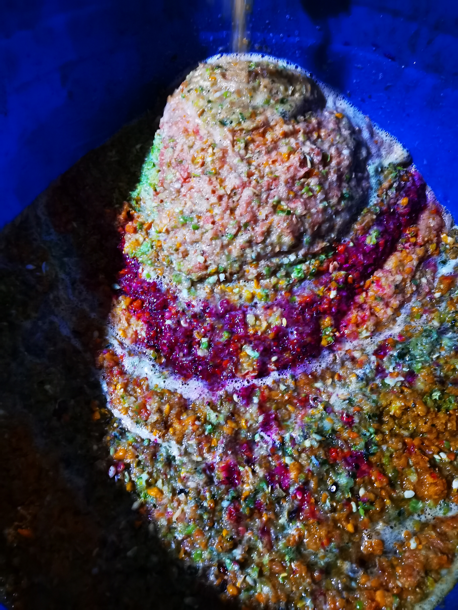
Material crushing (Fujian Wangde)

Slide 24
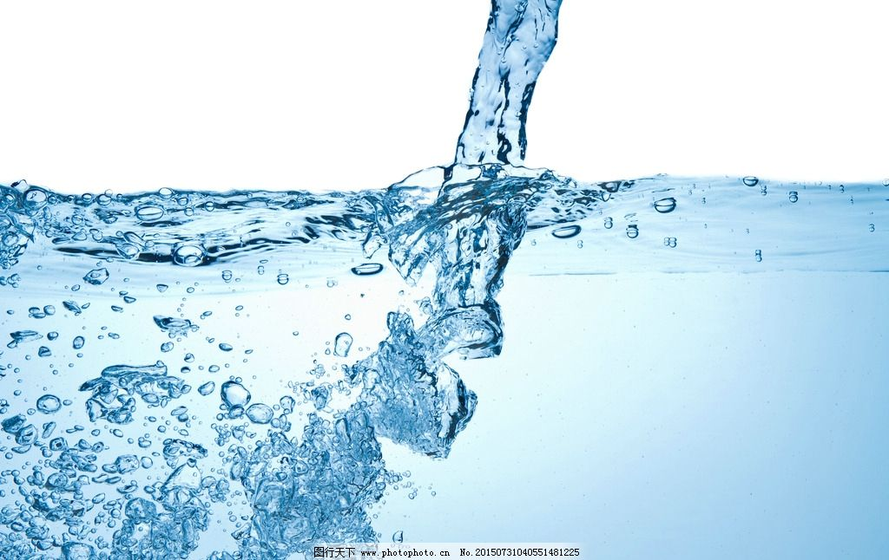
Making Jiaosu：
---干净水：clean water

Slide 25
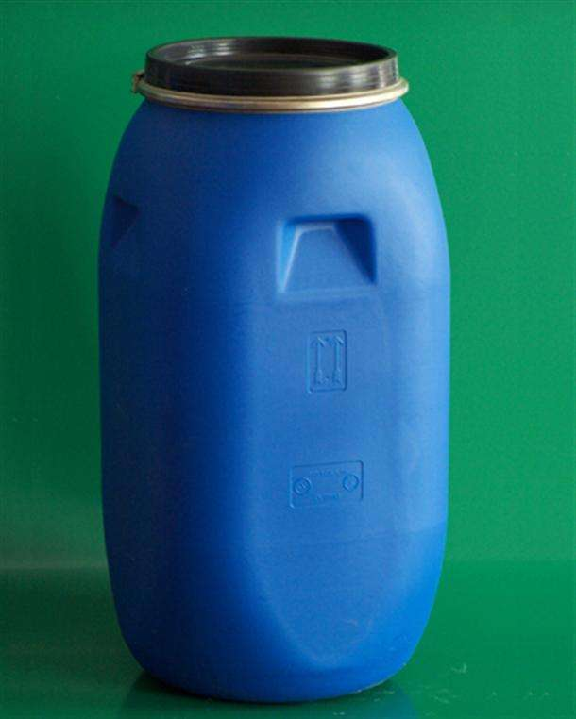
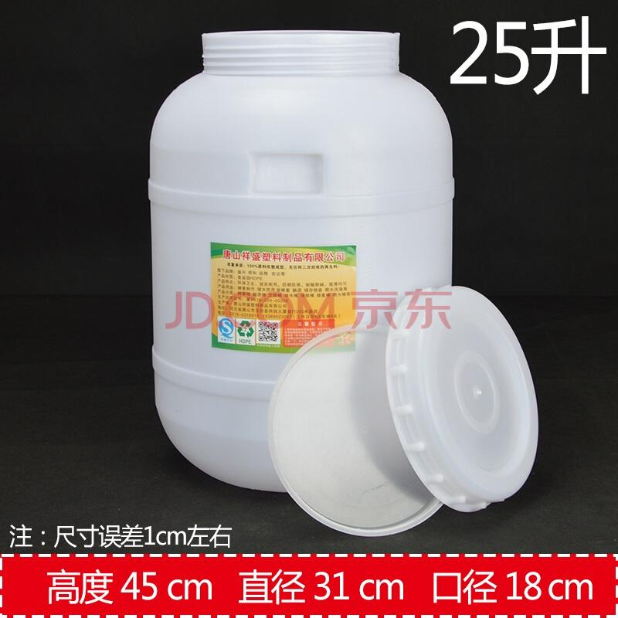
Making Jiaosu：
---能够密封的塑料桶：sealed container

Slide 26
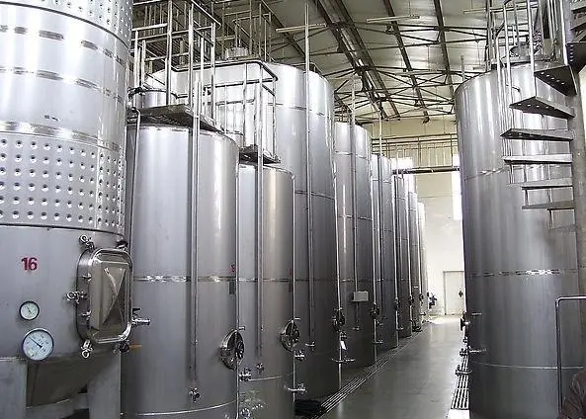
Enzyme fermenter

Slide 27
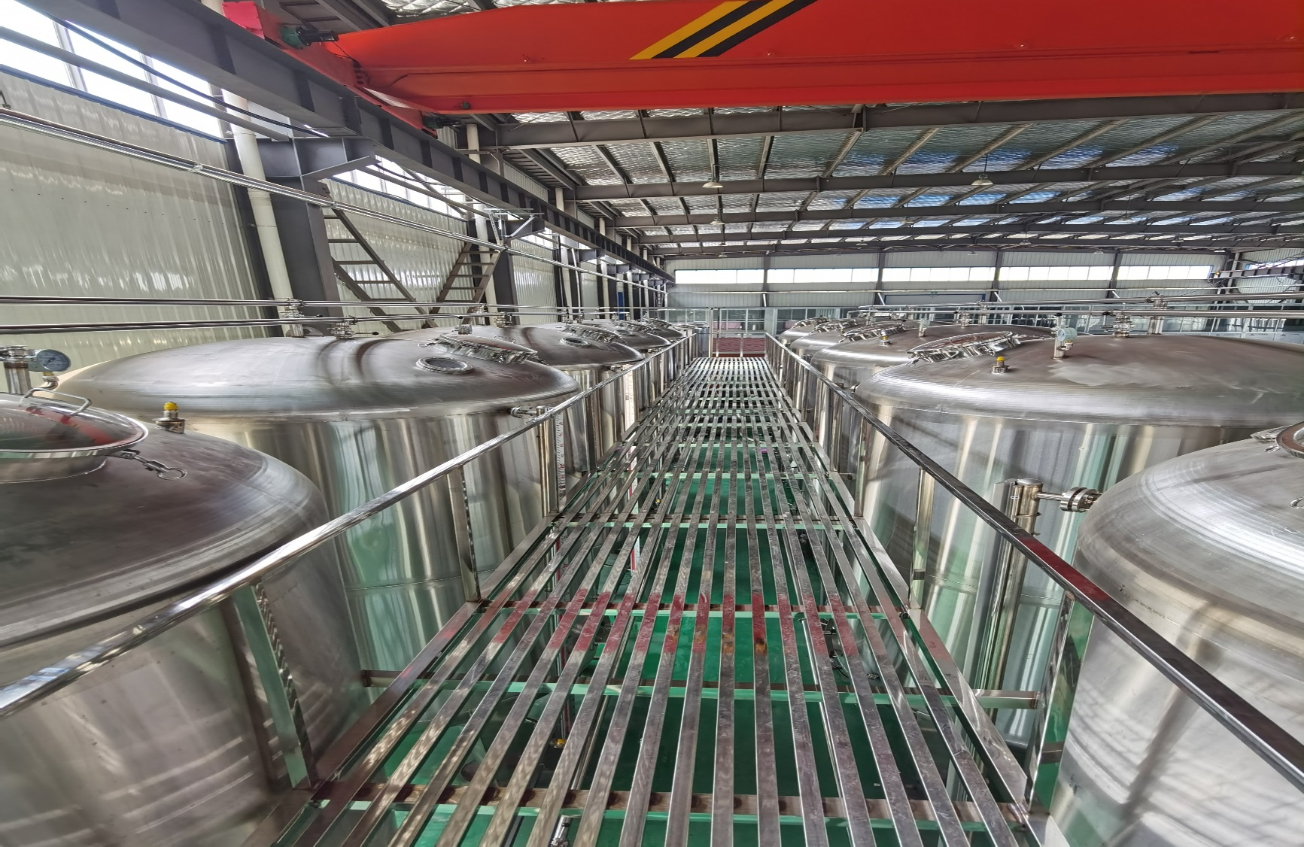
Shandong Pingyin fermentation plant fermenter (Fengguo Li)

Slide 28
4.2 Production Method
The general method of Jiaosu production proposed by Sukun Le :
Brown sugar: Peel: Clean water =1:3:10
Safety, stability, everyone can succeed (Xiuzhi Wen, 2016).

Slide 29
4.3 steps of actual production of agricultural Jiaosu:
(1) Fill the plastic container with 60 % clean water. In the case of empty 5L cans of 3L water, the container shall have a tight lid for sealing.

Slide 30
The steps in the actual production of agricultural Jiaosu:
(2) One-tenth of the amount of water is the amount of brown or yellow sugar required. One liter of water is equal to one kilogram of weight. Add 300 grams of brown or yellow sugar to 3L of water (molasses can also be used for agricultural jiaosu). Pour the sugar into the water and stir gently to dissolve (use a stick to stir).

Slide 31
The steps in the actual production of agricultural Jiaosu:
(3) Three-tenths of water is the amount of food waste for fresh vegetables and fruits. For example, 900g of fruit and/or vegetable waste should go with 3L of water. Chop up the fruit and vegetable ingredients, put them into the sugar water and stir well. Soak vegetable and fruit materials in water. (Note that: the filling material should be minced or crushed, length is about 3-5cm.)

Slide 32
The steps in the actual production of agricultural Jiaosu:
(4) Tighten the sealing lid of the plastic can and indicate the date of production on the label of the tank. Keep in a cool, ventilated place. Leave about 20% space in the container to prevent the contents from spilling out while the Jiaosu ferments.

Slide 33
The steps in the actual production of agricultural Jiaosu:
(5) During the first month of production, the tank will produce gas, pay attention to loosen the lid of the tank once a day, and then close it immediately. Small mouth bottle because of good sealing, air is very important; Wide mouth container tightness is slightly poor, such as no gas, can not be deflated; Steel vessels with exhaust valves do not need to vent air.

Slide 34
The steps in the actual production of agricultural Jiaosu:
(6) After a month, generally no expanding gas is produced (the plastic container no longer bulges). Then seal, continue to sit until three months expired, ready to use. It can also be kept for a long time and enabled at any time.

Slide 35
4.4 Other conditions of agricultural jiaosu:
(1) Plastic bucket is the preferred agricultural fermentation container. Due to the fermentation process produced gas, such as glass bottles, may burst. Plastic drums in fermentation will also expand, timely exhaust, will not burst the barrel. In addition, plastic buckets are easy to carry to other place.

Slide 36
Other conditions of agricultural jiaosu:
(2) Kitchen waste includes fruit skins, vegetable roots and leaves, roots, stems, leaves, flowers, fruits, grain products, animal organs, etc. The materials used are all kinds of local discarded fresh biological materials. Note that although the material is discarded, it should not rot.
(3) The water shall be clean and pollution-free water, which may be well water, tap water, rainwater, water from rivers and lakes.
(4) Finally, adding one thousandth of the jiaosu strain stock solution will be better for fermentation.

Slide 37
Other conditions of agricultural fermentation:
(5) It should be noted that full canning should be done at one time, and the time of canning should not exceed 24h.
(6) After adding materials and water, leave 15%~20% space in the container. During the first month of fermentation, there is a gas spill, and if you overfill, the liquid will spill out.

Slide 38
Other conditions of agricultural fermentation:
(7) The fermentation container materials, water and yeast stock solution are all added, and the lid is sealed. Make sure it is sealed. Large buckets should be wrapped with plastic cloth and then tightened to prevent air intake. Air leakage, intake will become smelly.
(8) Pay attention to put the bucket in a cool ventilated place away from light.

Slide 39
Other conditions of agricultural fermentation:
(9) Fermentation environment temperature should be maintained at 20-35℃. If the temperature is low in winter, when the temperature is below 15℃ in the beginning of a month, the timing begins when the temperature rises to 15℃-20℃. When the ambient temperature is below 12℃, the microbial flora is in a dormant state.

Slide 40
Other conditions of agricultural fermentation:
(10) Pay attention to make detailed canning records throughout the whole process for inspection and retention.

Slide 41
4.5 Criteria for successful fermentation of agricultural jiaosu
More than 3 months;
The color is brown and yellow liquid, or dark or light, related to the sugar content of the material. When Sugar in more, the color is dark, less sugar will gets light color;
The smell is sour;
And the pH is below 4.

Slide 42
4.6 Principle of the fermentation on Jiaosu
Chenyang Zhao et al. (2019) pointed out that Leuconostoc, Acetobacter and Lactobacillus form the dominant bacterial genus in natural fermentation of enzymes. Yeast (Hanseniaspora) and Kazachstania were dominant genera. The above bacteria groups are common bacteria and yeast in food fermentation.

Slide 43
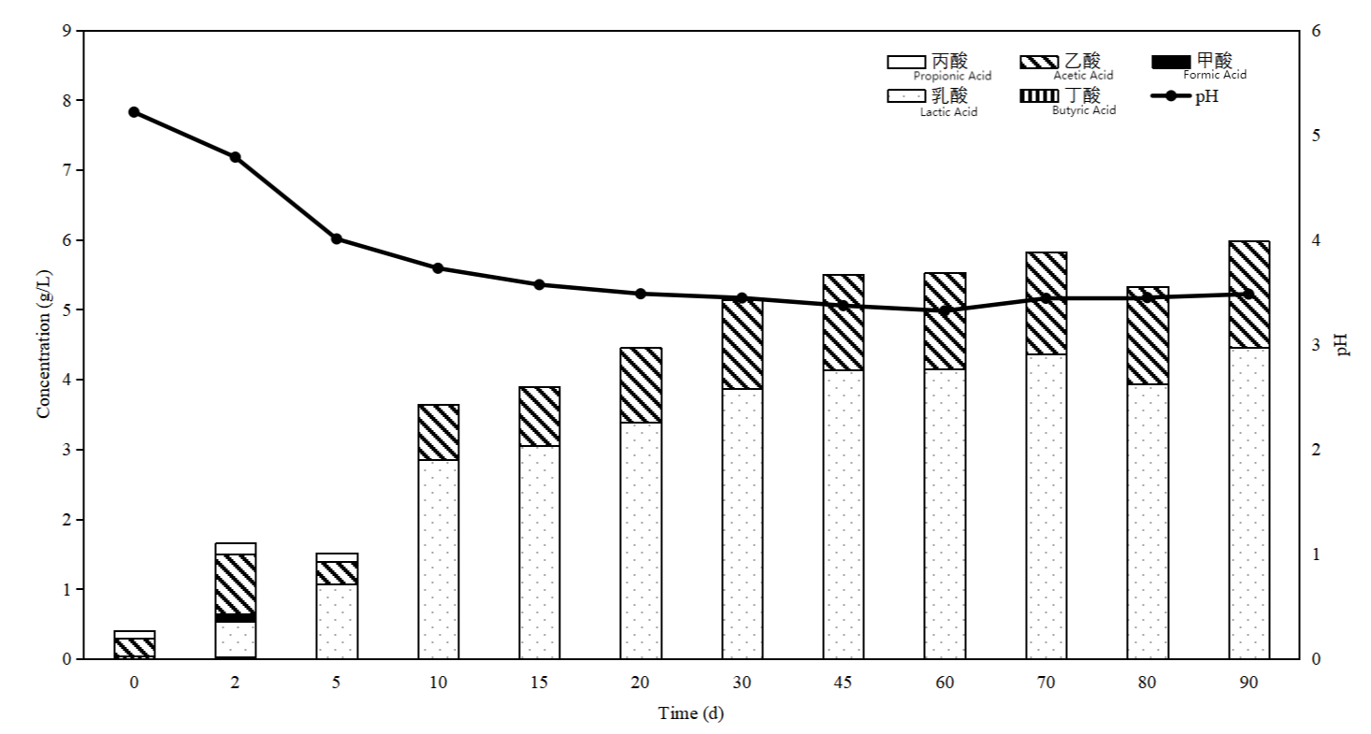
Dynamic changes of pH and VFAs during agricultural fermentation (Xiaofen Wang, 2021)
pH: decreased significantly in the first 10 days of fermentation, stabilized below 4 after 20 days, and was 3.48 after 90 days.
Organic acids: Organic acids continue to accumulate in fermentation, mainly lactic acid and acetic acid. At 90 d, their contents are 4.46 and 1.52 g/L, respectively.

Slide 44
Dynamic changes of sugars during the fermentation of agricultural jiaosu
(Xiaofen Wang, 2021)
The first 2 days: sucrose concentration decreased, glucose and fructose increased, sucrose hydrolyzed to glucose and fructose;
2-5 days: All three sugars decreased. Is the growth and metabolism of microorganisms using sugars as substrate;
After 5 days: sucrose and glucose stabilized, fructose decreased slightly, and microbial metabolism decreased.

Slide 45
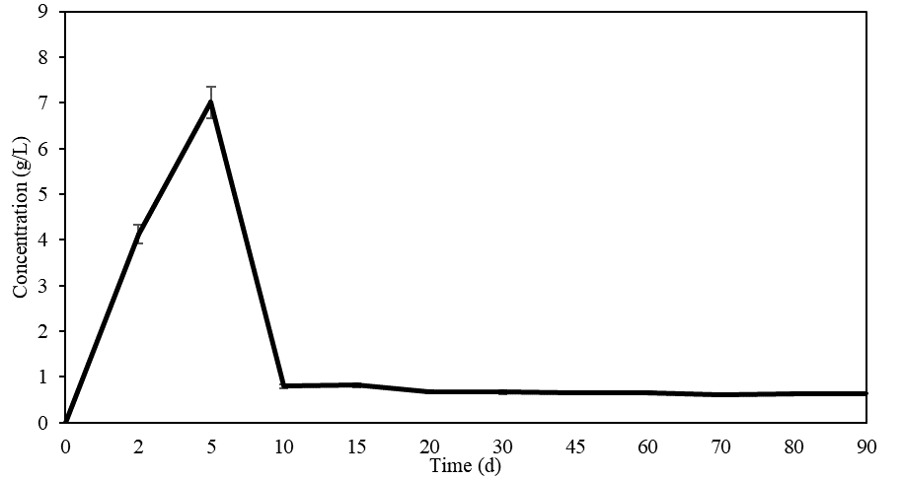
Dynamic changes of ethanol during agricultural fermentation (Xiaofen Wang, 2021)
Ethanol concentration: concentration change concentrated in the first 10 days, the 5th day increased to 7.01 g/L, then decreased and stabilized at 0.80 g/L. This means that alcohol is formed in the system and then converted.

Slide 46
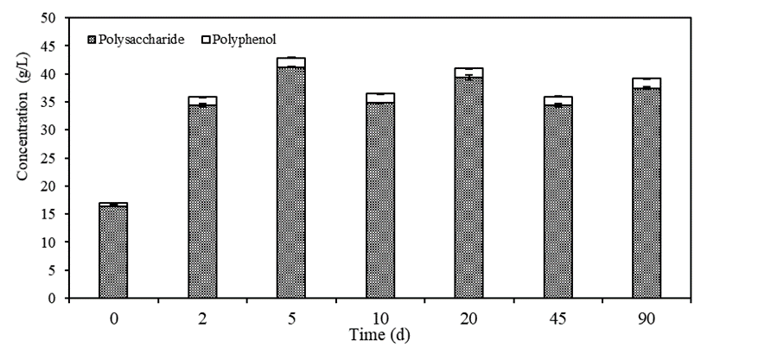
Dynamic changes of polyphenols and polysaccharides during agricultural fermentation
(Xiaofen Wang, 2021)
Polysaccharide content increased from 16.45 to 34.42 g/L 2 days before fermentation and remained stable after fermentation, which had positive effects on improving soil aggregate structure, antibacterial and disease prevention.
Polyphenols: At a stable level (< 2 g/L) during the whole fermentation process, they have certain bactericidal effect.

Slide 47
Contents of Minerals and Amino Acids in agricultural jiaosu (Xiaofen Wang, 2021)
Index
Numerical Value
Index
Numerical Value
In addition to potassium, calcium, magnesium, phosphorus and other major elements, the minerals of agricultural enzymes contain iron, zinc, copper, manganese and other trace elements;
All 18 amino acids were detected, among which proline, aspartic acid, alanine and glutamic acid were the main ones.

Slide 48
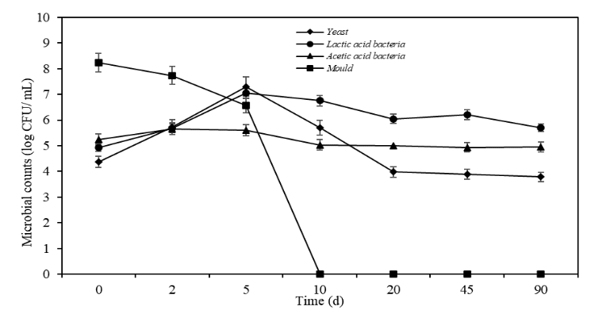
Changes in the effective viable count of Lactic acid bacteria, acetic acid bacteria, yeast and mold during the fermentation of agricultural jiaosu (Xiaofen Wang, 2021)
The lactic acid bacteria and yeast reached the peak value on day 5 (7.04 log CFU/mL), and the mold gradually decreased.
From 5 to 90 days, mold growth was continuously inhibited, completely disappeared on the 10th day, and the fermentation system was basically stable on the 20th day.
At 90 days, there was no mold in the agricultural enzyme, which was a mixture of lactic acid bacteria, acetic acid bacteria and yeast, lactic acid bacteria > Acetic acid bacteria > Yeast.

Slide 49
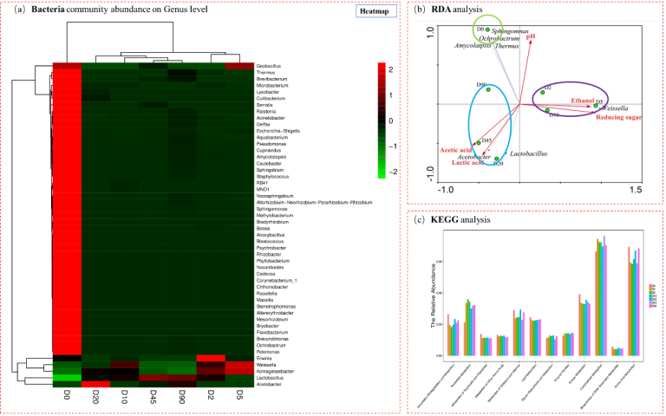
Part2
Dynamic Changes of bacterial diversity during agricultural jiaosu fermentation (Xiaofen Wang, 2021)
Bacterial diversity decreased, with Lactobacillus and Acetobacter as the dominant bacterial group, and Weissella was briefly present.

Slide 50
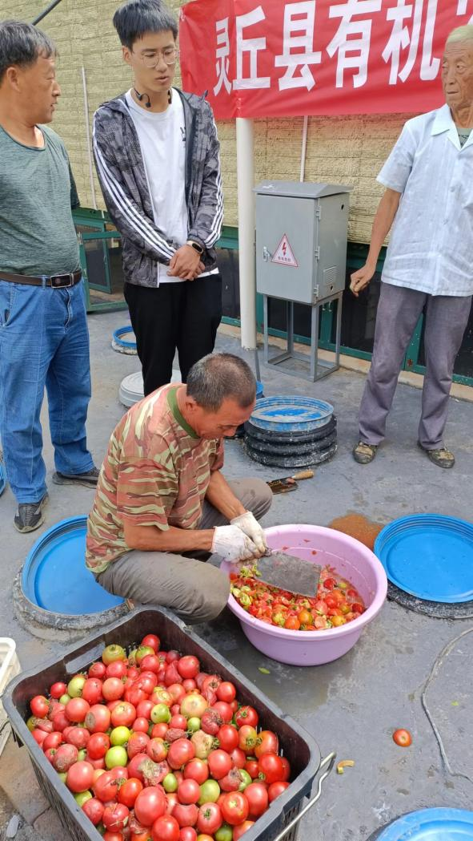
Raw Materials for making agricultural enzymes (Lingqiu, 2022)

Slide 51
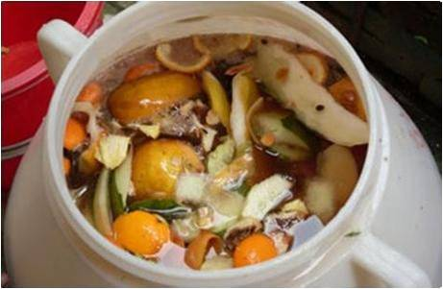
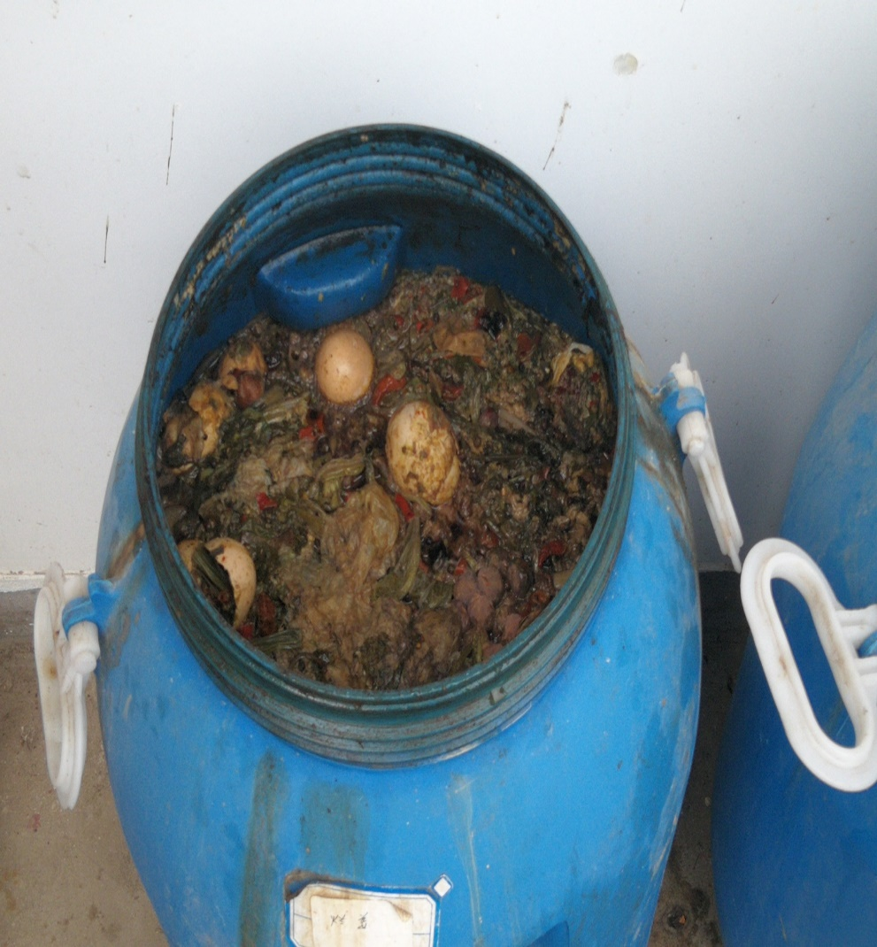
The fermentation procedure

Slide 52
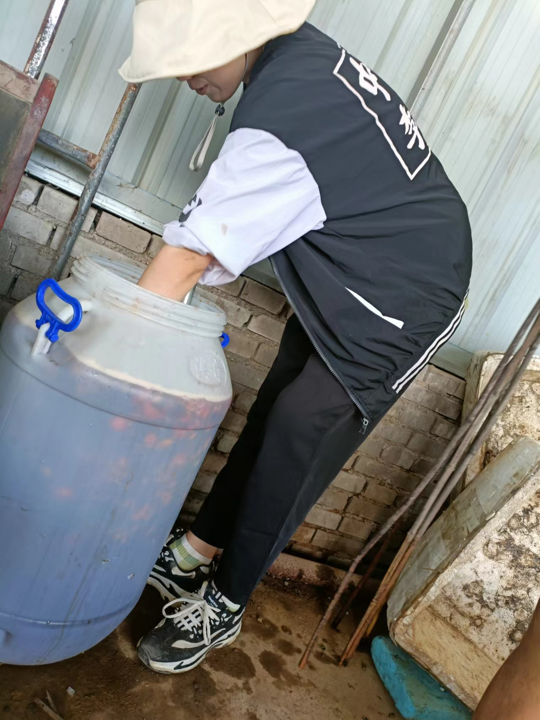
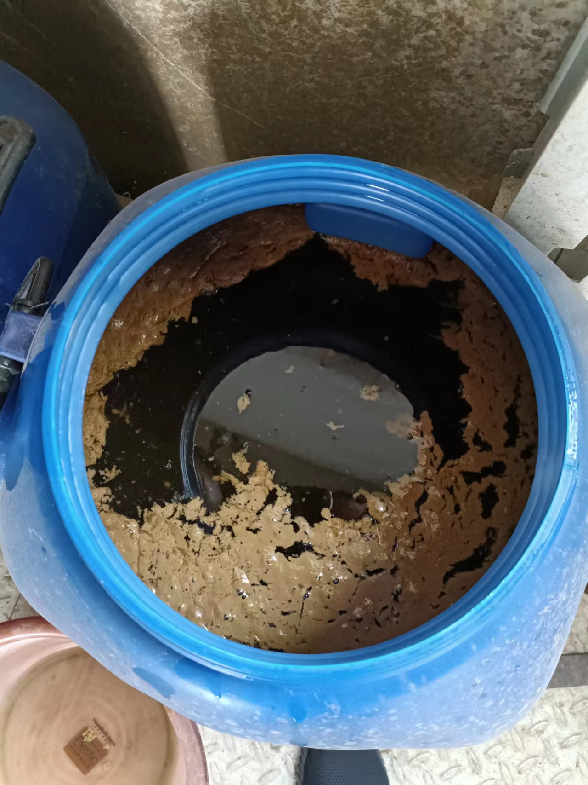
The fermentation liquid is stirred during fermentation

Slide 53
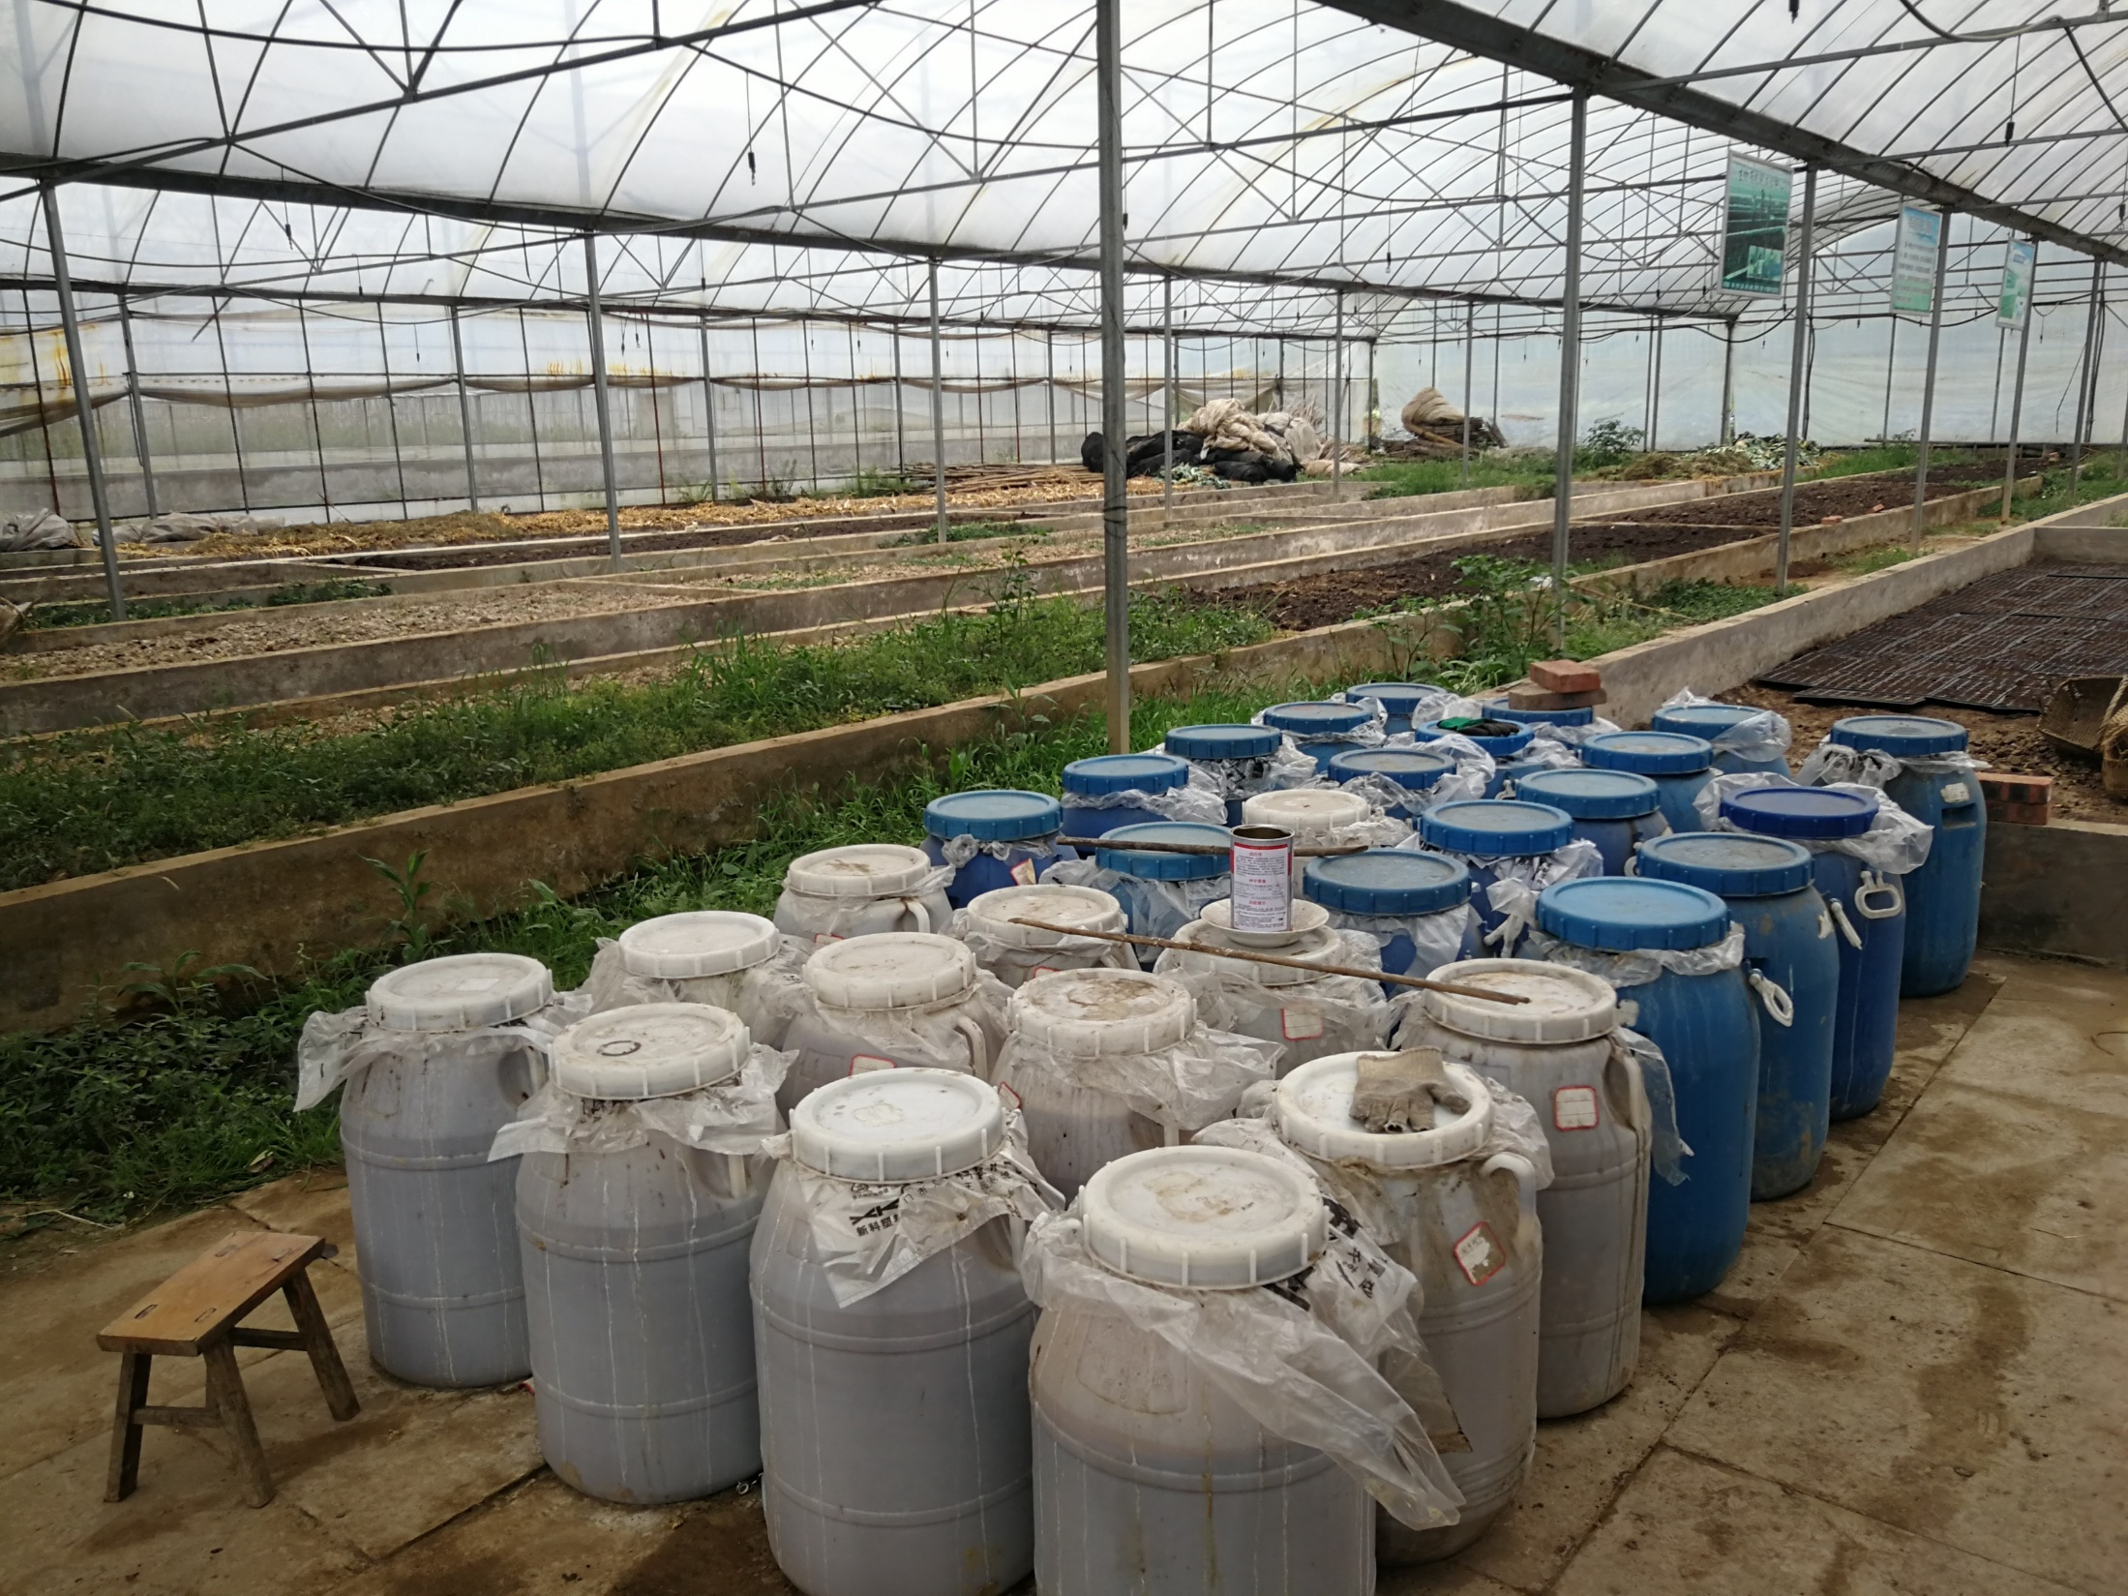

Slide 54
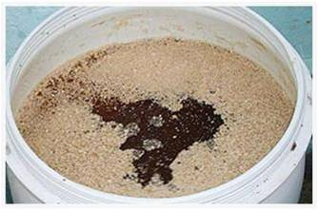
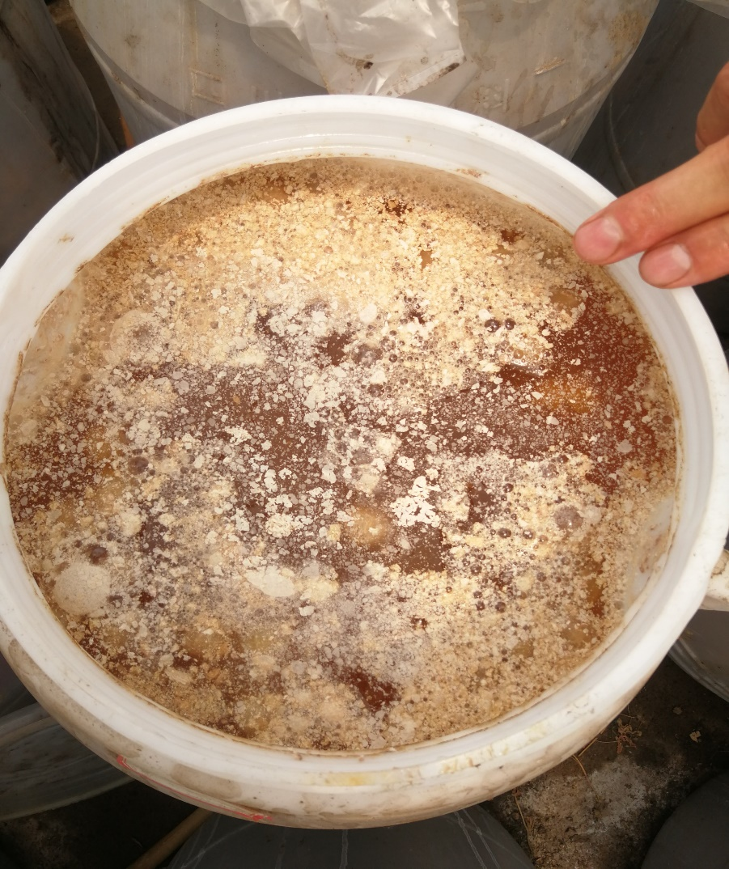
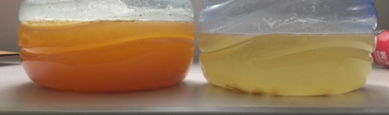
The fermentation procedure

Slide 55
4.7 Advantages of home-made jiaosu
(1) Materials and appliances are readily available
Wherever there is activity, there is plant waste, waste plastic buckets, clay POTS, vats are easy to find, brown sugar consumption is low, and the combined cost looks low.
Almost every family has resources.

Slide 56
Advantages of home-made jiaosu
(2) Simple operation
After filling cans, water and sugar, fruit and vegetable materials can be filled once or repeatedly. Remember the sealing time (remember the sealing time, and can be used three months later).
Operating under family conditions, lift a finger, should be sooner rather than later, do not increase too much work.

Slide 57
Advantages of home-made jiaosu
(3) Security
Production process safety, product safety, production and use assured and reliable. Suitable for all ages.

Slide 58
Advantages of home-made jiaosu
(4) Healthy and friendly
Healthy production process, healthy use of products, participants and users of physical and mental pleasure, is a good partner of family and society.

Slide 59
Advantages of home-made jiaosu
(5) Convenient for everyone in the community to participate in the production
Unknowingly, it can attract residents to participate in garbage classification, reduction, and resource reuse work, killing multiple birds with one stone.

Slide 60
4.8 Types of agricultural jiaosu
Because of different raw materials, the function of agricultural enzymes is different, divided into a variety of types.
(1) germ jiaosu
Choose materials with high sugar content, as rich and varied as possible, preferably including vegetables, fruits, agricultural products, Chinese medicinal materials scraps, etc.

Slide 61
Types of agricultural enzymes
(2) soil improvement jiaosu
Select raw materials containing nitrogen, phosphorus, potassium, iron, calcium, magnesium and other elements required by the soil. Such as algae, vegetables, bean residue and so on.
(3) Leaf spraying jiaosu
Choose nutrient-rich materials such as pig blood, tofu, animal offal, fish by-products, kelp, almonds, etc.

Slide 62
Types of agricultural enzymes
(4) Biological control jiaosu
Choose plants with special smells, special ingredients (including alkaloids, antibiotics and tannins), insect repellent and disease control materials, such as: medicinal materials, pitcher plants, lavender, nocturnes, and many coats, very thick waxy layer, cuticle and small stomata.

Slide 63
Table 1: Reference table of material resources of biological control agent bacteria tank
Category | Name and component | Service conditions
Plant and animal sources | Toosedarin(Extracts of azedarach,Neem,etc) | Insecticide
 | Natural pyrethrins(Extract of Pyrethrum plant) | Insecticide
 | Matrine and oxymatrine(Sophora flavescens and other extracts) | Insecticide
 | Rotenone(Such as hair fish vine) | Insecticide
 | Tea saponin(Tea seeds and other extracts) | Insecticide
 | Saponins(Extracts such as saponin) | Insecticide、Bactericide
 | Cnidium lactone(Snowparsley extract) | Insecticide、Bactericide
 | Extract of Coptis coptis, Phellodendron, etc | Bactericide
 | Emodin monomethyl ether(Rhubarb, knotweed and other extracts) | Bactericide
 | Vegetable oil(Such as peppermint oil, pine oil, coriander oil) | Insecticides,acaricides, fungicides,germinationinhibitors
 | Oligosaccharide(Chitin) | Fungicide, plant growth regulator
 | Natural attractant and nematicide(Such as marigold, peacock grass, mustard oil) | Nematicide
 | Natural vinegar(Such as vinegar, wood vinegar, bamboo vinegar) | Bactericide
 | Mushroom proteoglycan | Bactericide
 | Hydrolyzed protein | Attractants, only under conditions approved for use and in combination with the appropriate products in this Appendix
 | Milk | Bactericide
 | Beewax | Used for grafting and pruning

Slide 64
5. Additives-free fermentation method

Slide 65
5.1 General Introduction
When I was in Tanzania in 2018, I was faced with the difficulty of solving the problem of brown sugar or molasses in fermenting jiaosu. At that time, I learned that Kai Hu of China Agricultural University used dates instead of sugar for fermentation in Xinjiang. However , the specific method is unknown. Now I know that the problem of substituting brown sugar can be solved by additives-free fermentation method.

Slide 66
5.2 additives-free fermentation method（1）
It has s to use high-sugar fruit. You can collect your own peels, leftover fruit, such as apples, bananas, pineapples, or other similar high-sugar fruits.
Farmer can also collect pineapple peels from markets, from fruit stores, farm markets, supermarkets, and restaurants.
In spring and summer, there are much fruits, are easy to be collected.

Slide 67
Additives-free fermentation method（2）
Find a resealable plastic bucket with a capacity of 50Kg. For example, put 5kg to 10kg of pineapple peel in the bucket in the first day, it should be broken (with a stick for this amount fruit peel, or broken mechanically for a large amount). Then on the second day continusly loading stabbed...... Until the 50kg bucket is full. Be careful to keep the material under the poked surface of fruit liquid.

Slide 68
Additives-free fermentation method（3）
When filling, keep in mind that the fruit peel at the bottom of the barrel has fermented to a certain extent by 7-10 days. Be careful to collect and fill the bucket within 10 days and then seal it directly with the lid. Such a perfect tub of additives-free jiaosu is almost completed.
Normally, it takes about three months for the jiaosu to ferment without adding water.

Slide 69
5.3 Additives-free jiaosu replaced sugar for fermentation ratio (Guang Chen,2023)
Item | Amount of material addedd | Additives-free jiaosu | The amount of water | Proportional relationship among the three parts
Normal fruit | 20 | 20 | 60 | 1:1:3
Low sugar tail dishes,etc | 20 | 30 | 50 | 1:1.5:2.5
Fish viscera（Saltwater fish） | 20 | 30 | 50 | 1:1.5:2.5
Animal offal | 20 | 30 | 50 | 1:1.5:2.5
Urinary jiaosu | 70 | 30 | -- | 7:3

Slide 70
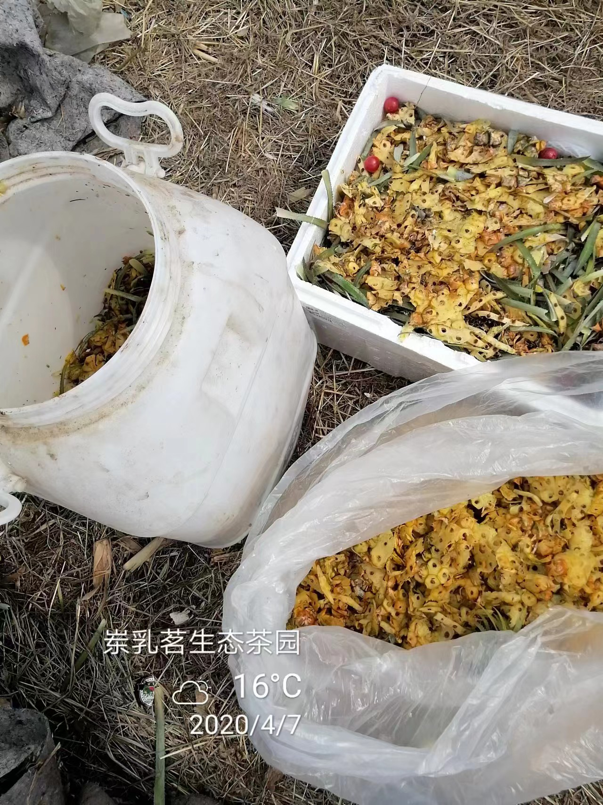
5.4 Instance Photos
Raw material for additives-free fermentation (Guang Chen )

Slide 71
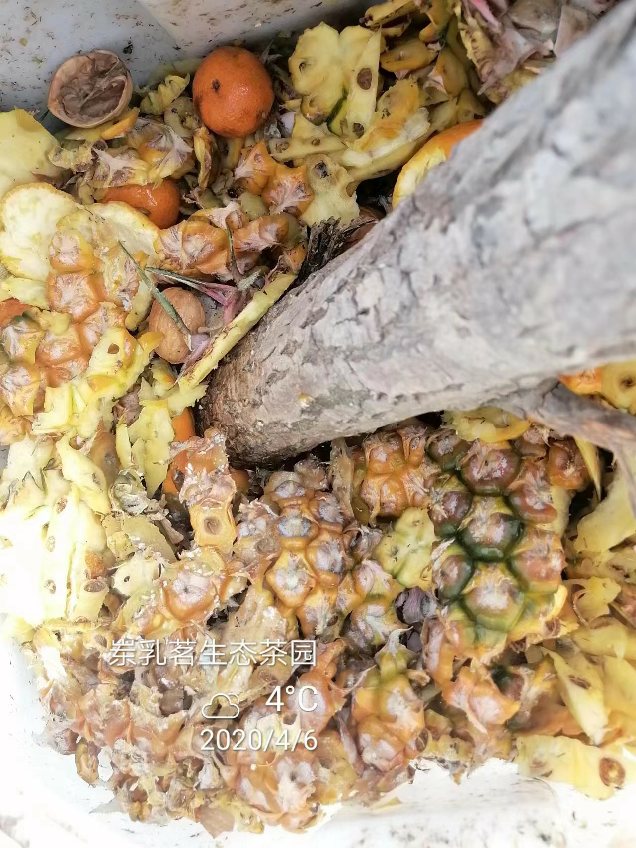
Smash the fruits peel with a stick
(Guang Chen )

Slide 72
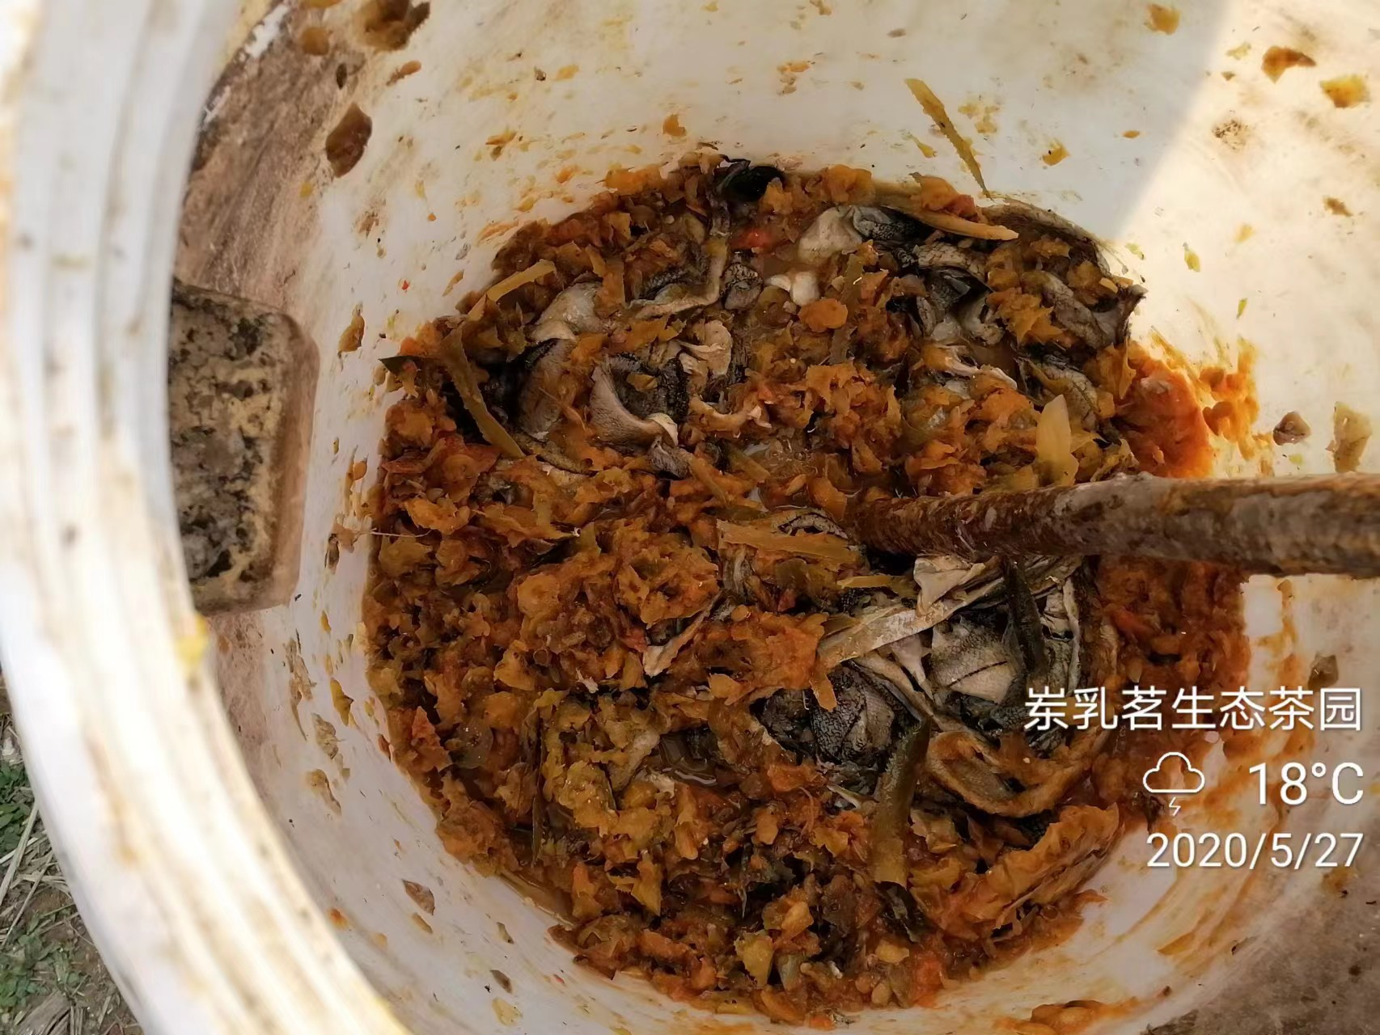
The ingredients are a little messy
(Guang Chen )

Slide 73
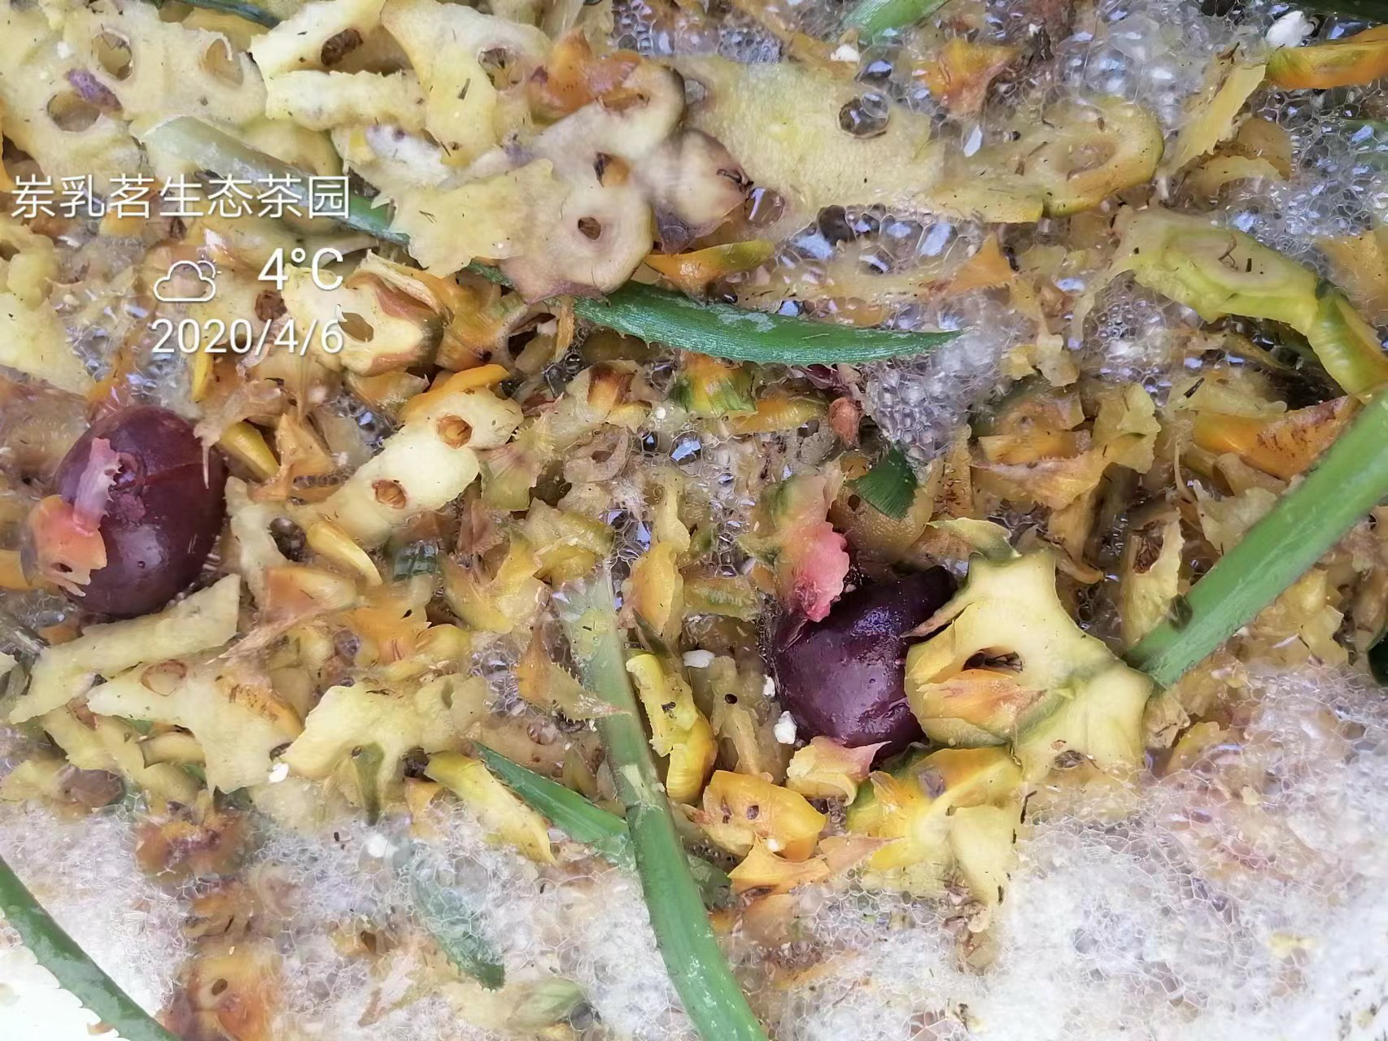
Before sealing condition, pay attention to loose sealing

Slide 74
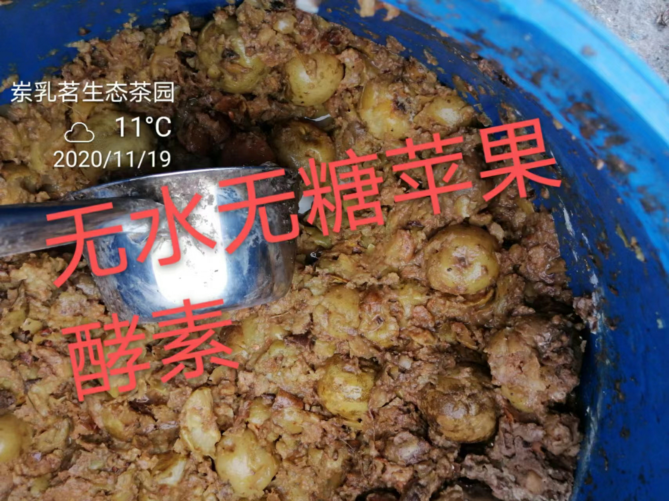
Additives-free fermentation apple, Guang Chen,2020
Anhydrous and glucose-free enzyme of apple

Slide 75
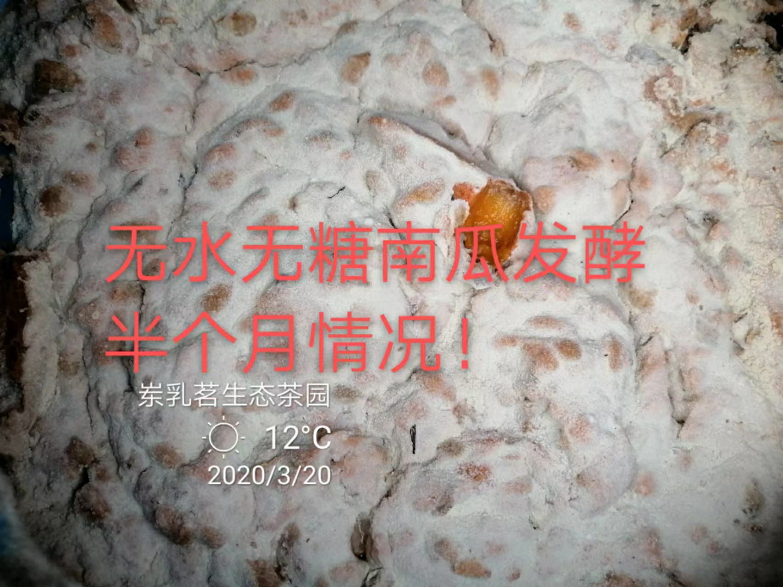
The state of pumpkin by the way of additives-free fermentation at 15 days

Slide 76
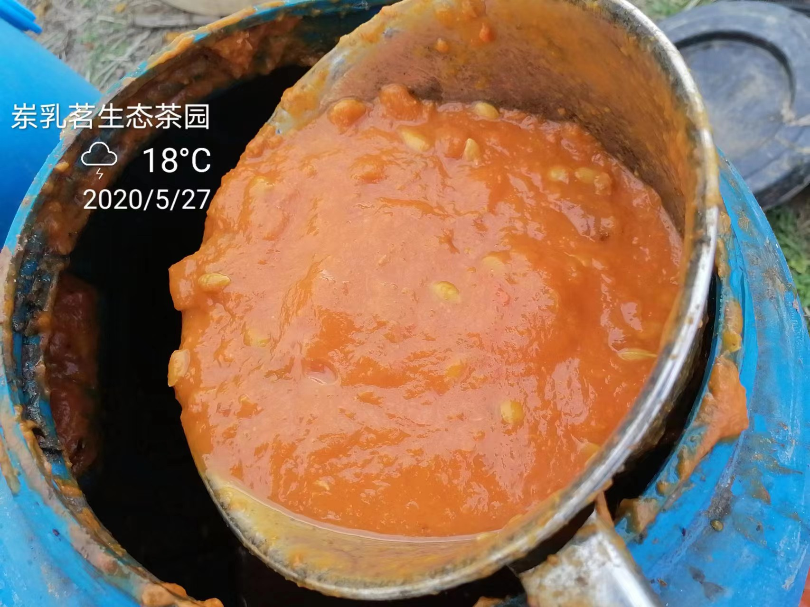
The pure pumpkin jiaosu that had completed the fermentation

Slide 77
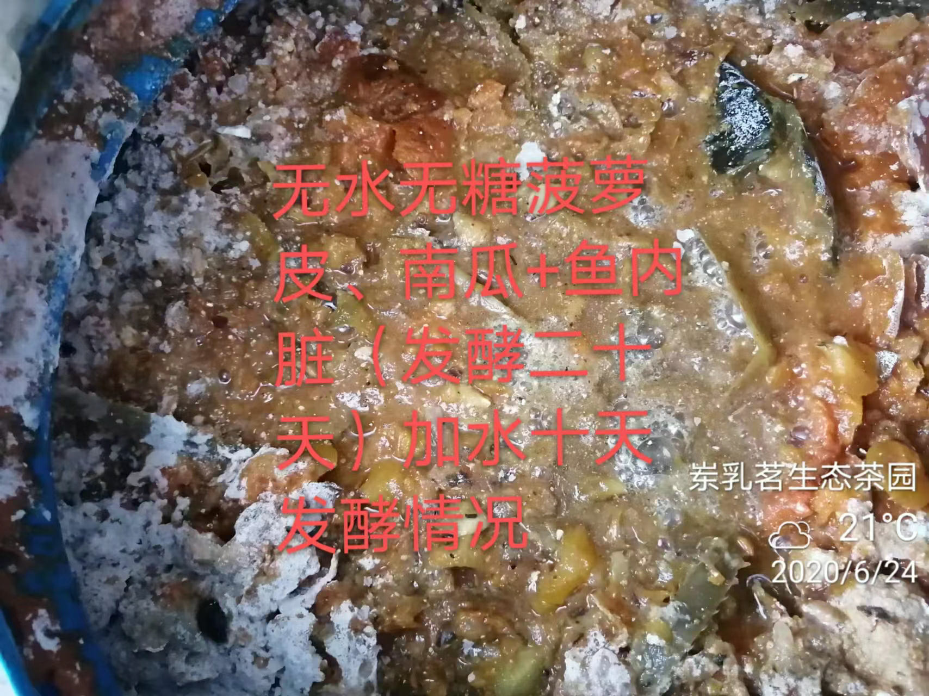
Additives-free fermentation pineapple jiaosu plus pumpkin jiaosu instead of sugar for making fish jiaosu (20 days later)

Slide 78
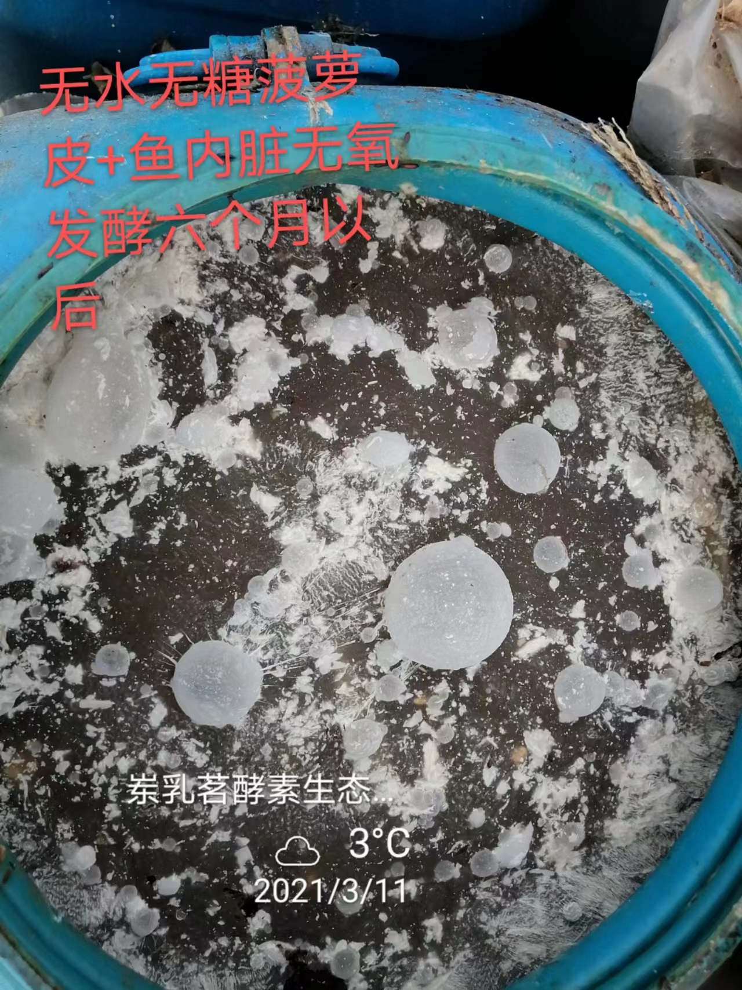
Additives-free fermentation pineapple jiaosu plus pumpkin jiaosu instead of sugar for making fish jiaosu (180 days later)

Slide 79
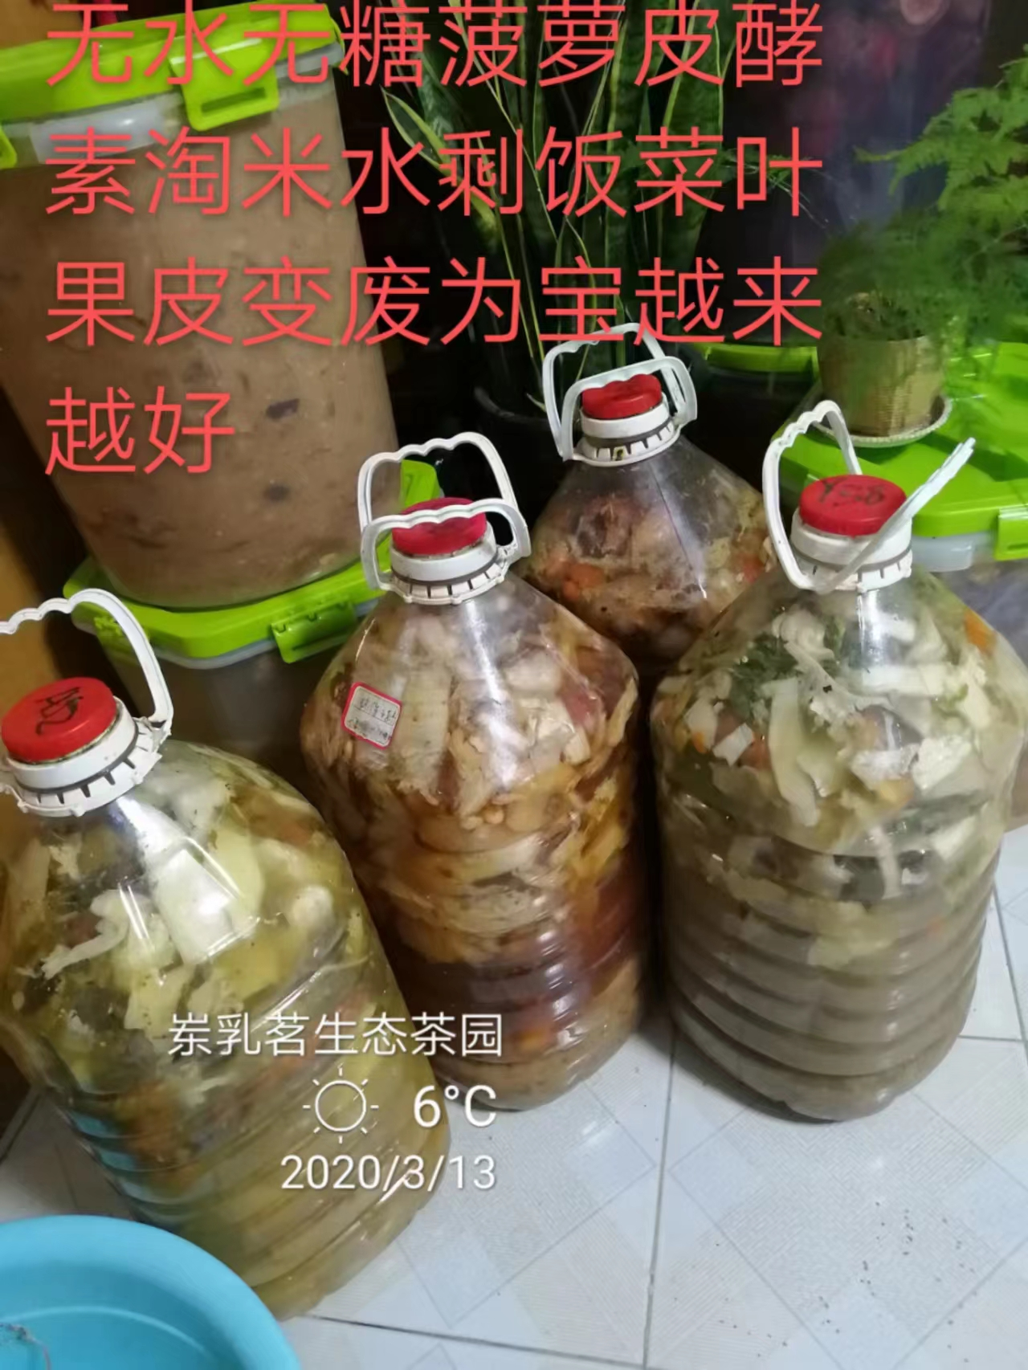
Additives-free fermentation jiaosu plus Food waste fruit sparse material

Slide 80
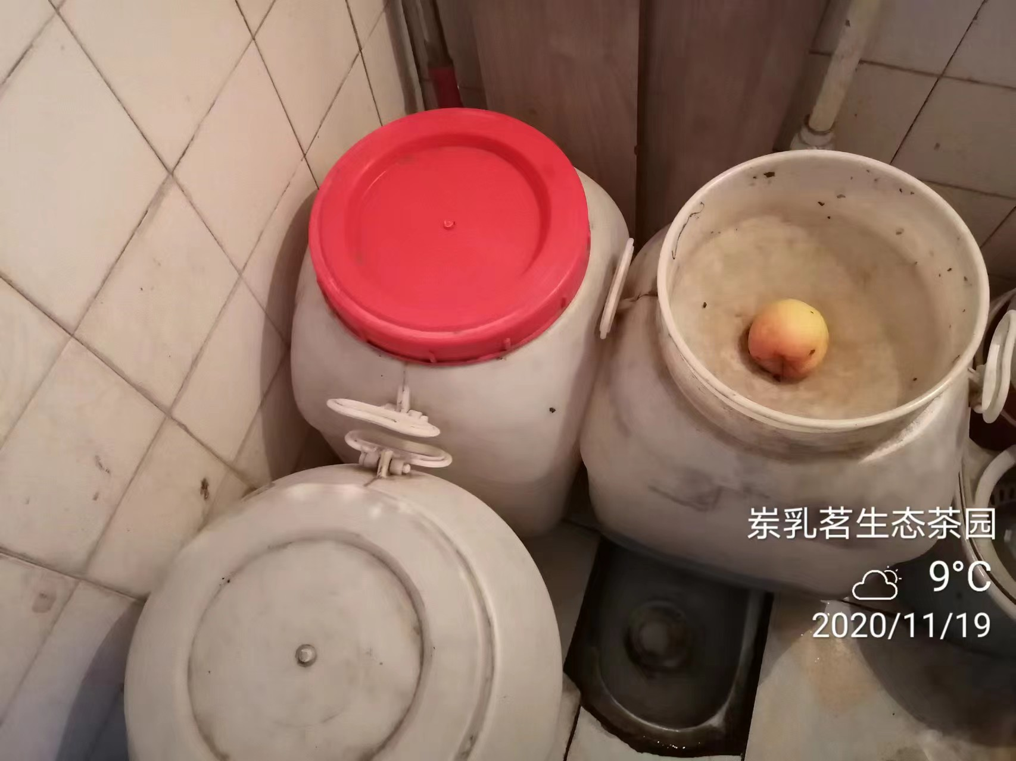
Additives-free fermentation made for urinary jiaosu

Slide 81
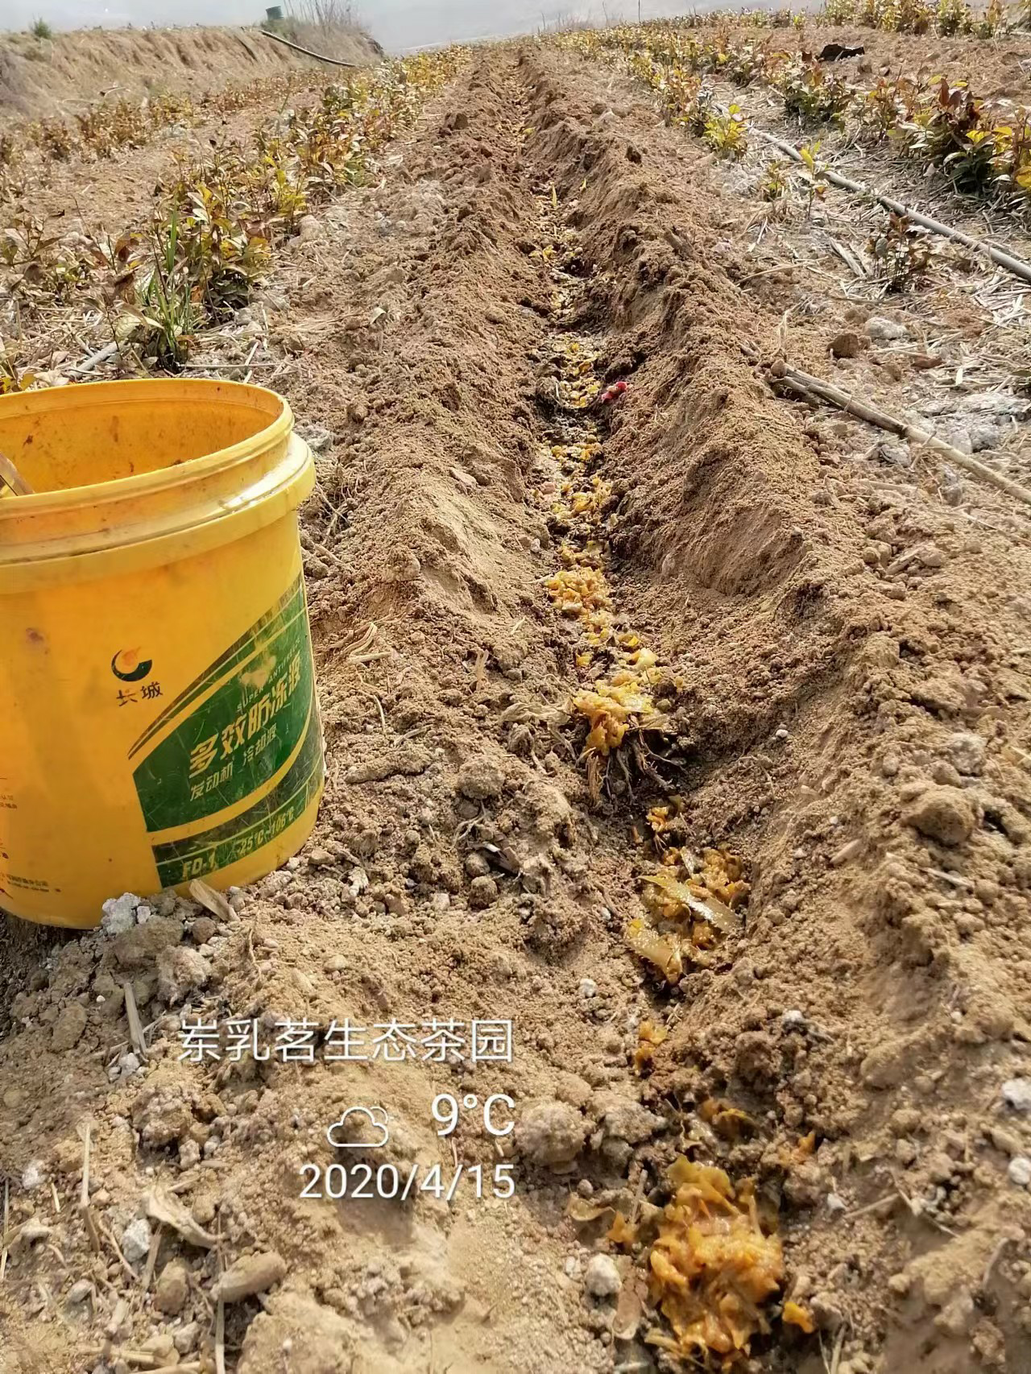
After extracting the liquid, Additives-free fermentation jiaosu’s residue was applied in the field to improve Additives-free fermentation the soil

