Slide 1


Research on the Moderate Processing Technology Model of Rice
Dr. Xiaoliang Duan
Institute of Quality and Nutrition, Academy of National Food and Strategic Reserves Administration

Slide 2
CONTENTS
Key Factors Affecting Rice Quality
The Impact of Excessive Rice Processing
01
02
Rice Processing Precision Inspection Method
Rice Moderate Processing Technology Model
03
04
Notes:
1.影响大米品质的主要因素;2.大米过度加工影响 ;3.大米加工精度检测方法;4.大米适度加工技术模型.

Slide 3
01
Key Factors Affecting Rice Quality

Slide 4
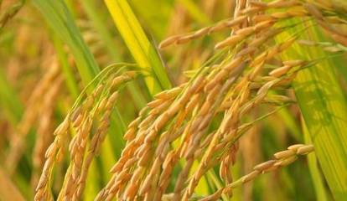
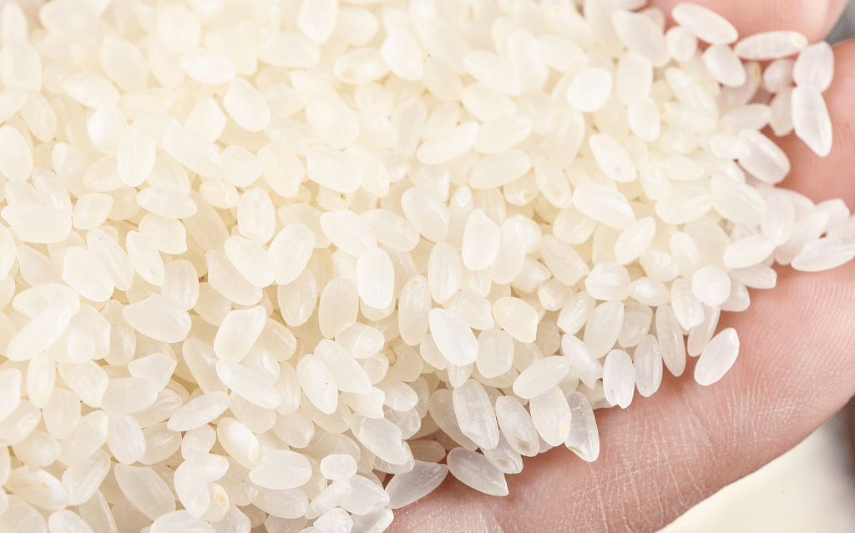
Optimal Cultivation Regions
High-Quality Cultivation Techniques (Water and Fertilizer Management)
Optimal Harvesting Period
Appropriate Drying Methods
Proper Storage (Quasi-Low Temperature)
Moderate Processing
Determine Production Based on Sales Volume
Good Rice Varieties
High-Quality Rice Products
Notes:
优势种植区域
优质栽培技术（水肥管理）
适时收获
保质烘干
保质储存（准低温）
适度加工
以销定产

Slide 5
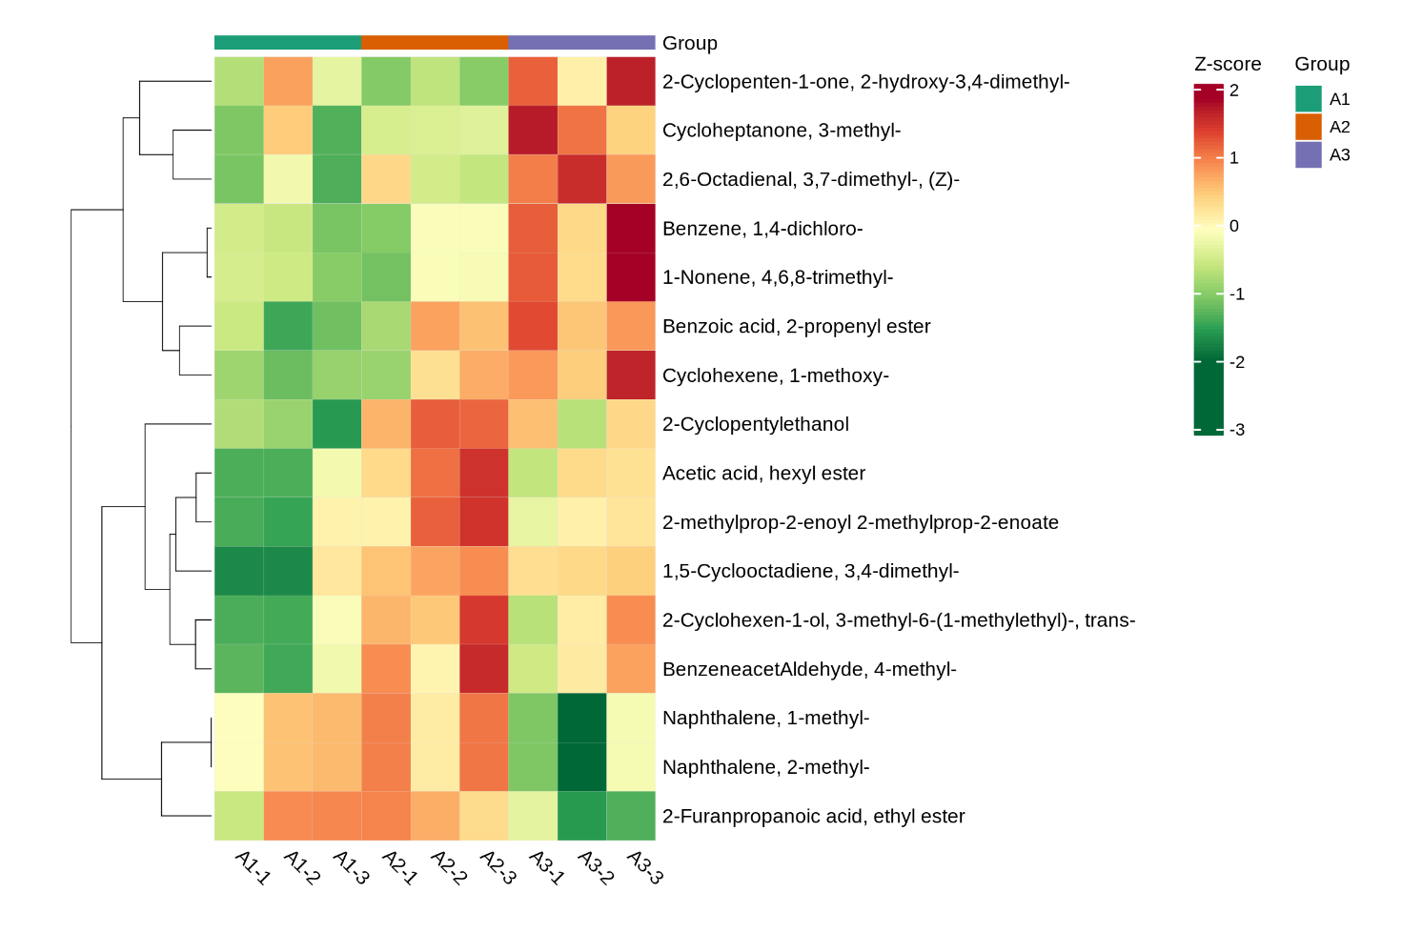
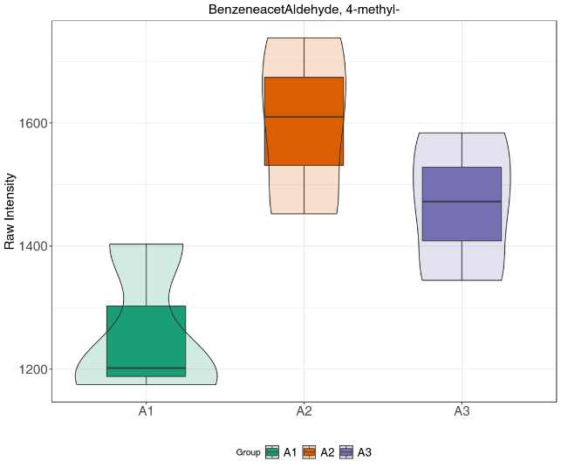
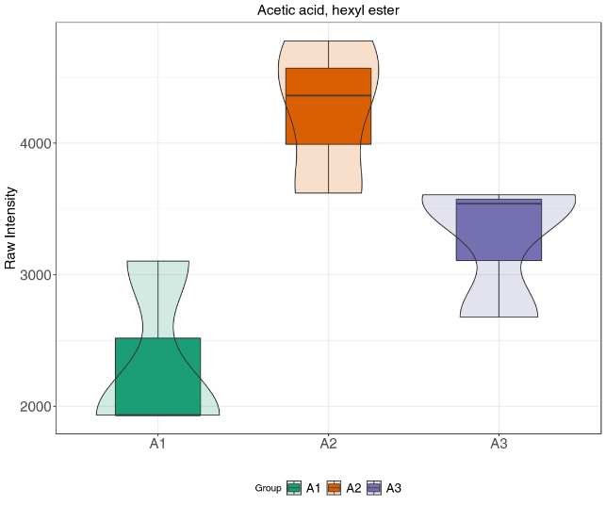
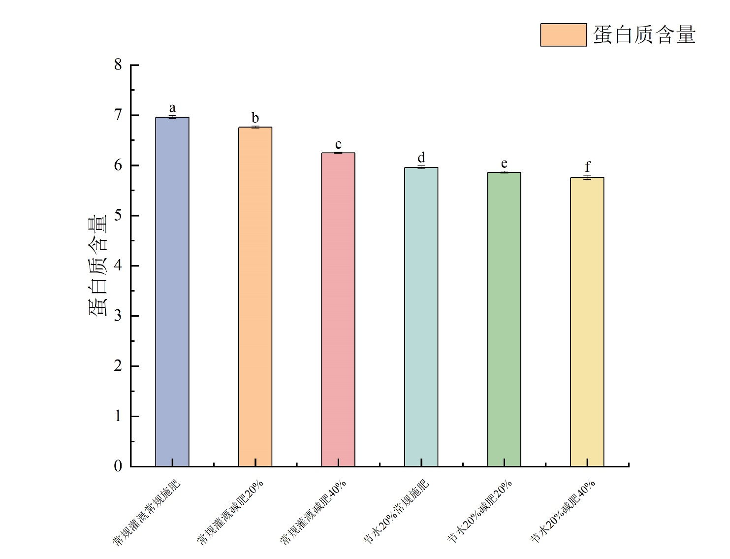
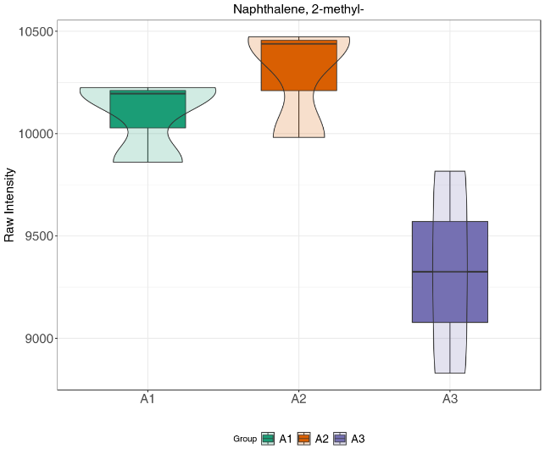
The Impact of Nitrogen Fertilizer on Rice Quality
4-甲基-苯乙醛
乙酸己酯
2-甲基-萘
Under the condition of reduced nitrogen fertilizer use, the taste value of rice is improved, which also benefits the flavor of the cooked rice.
This is beneficial for reducing the management of rice production and enhancing environmental and output benefits.
Notes:
在正常灌溉条件下，随着氮肥减量，稻米的食味评分提高。其中减肥20%评分最高。
特征代谢物在常规灌溉减肥20%的条件下含量最高。
减氮肥条件下，食味值提高，同时也有利于米饭风味。这对于降低水稻生产管理，提高环境和产出效益是有利的。

Slide 6
The Impact of Storage on Rice Quality
In japonica rice, 171 significantly different lipid species were identified, and 14 metabolic pathways of lipid species were elucidated; in indica rice, only 5 significantly different lipid species were identified, mainly involved in glycerophospholipid metabolism.
Mechanism of Lipid Changes During Rice Storage
Notes:
粳稻与籼稻的非淀粉脂和淀粉脂代谢通路不尽相同，淀粉-溶血磷脂复合物含量的降低可能是稻谷食味品质下降的重要调控途径之一。
脂质组学：粳稻中鉴定出171种显著差异的脂类物质，解析了14条脂类物质的代谢通路；籼稻中仅鉴定出5种差异显著的脂类物质，主要参与甘油磷脂代谢

Slide 7
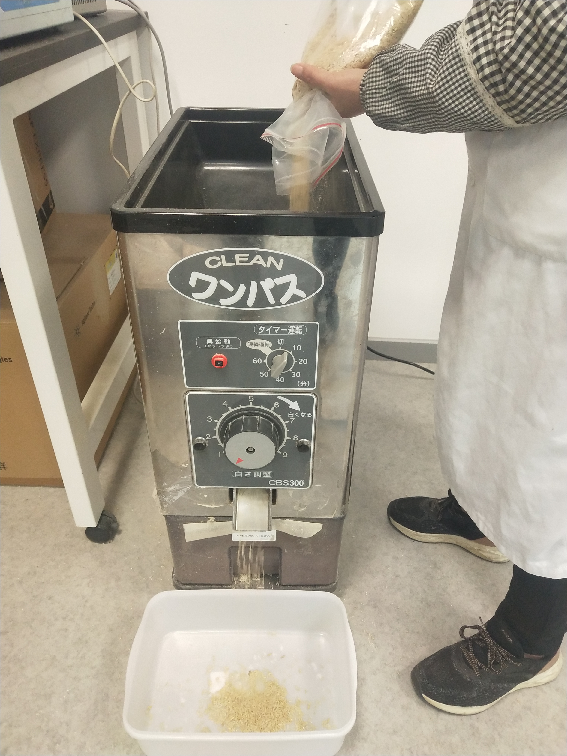
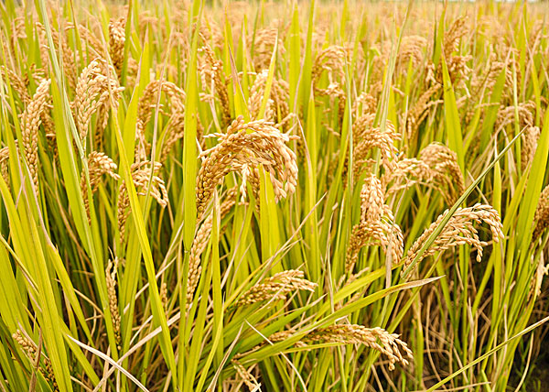
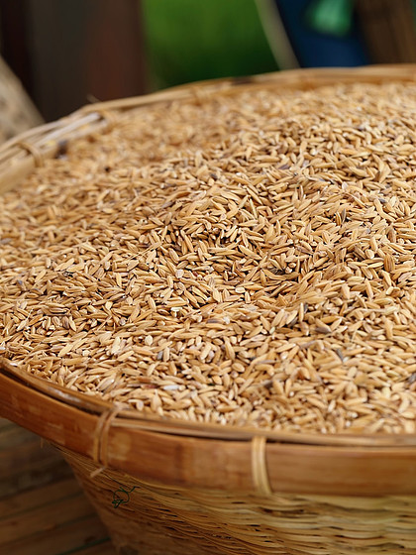
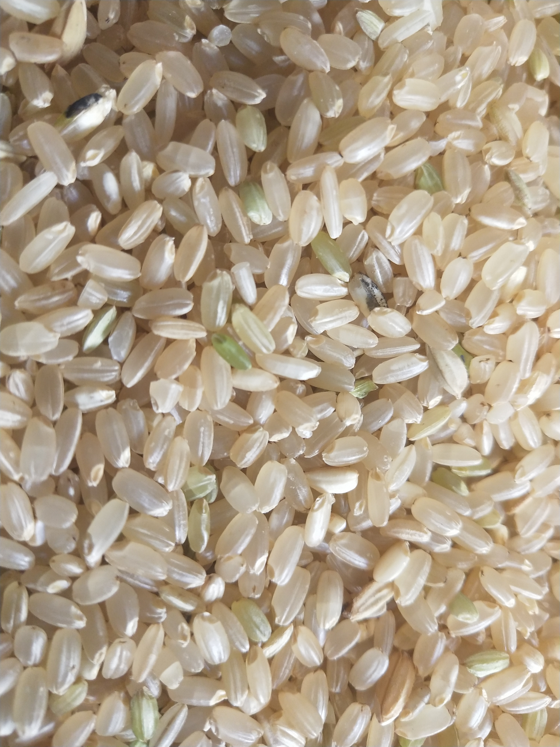
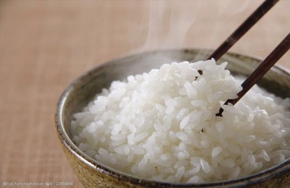
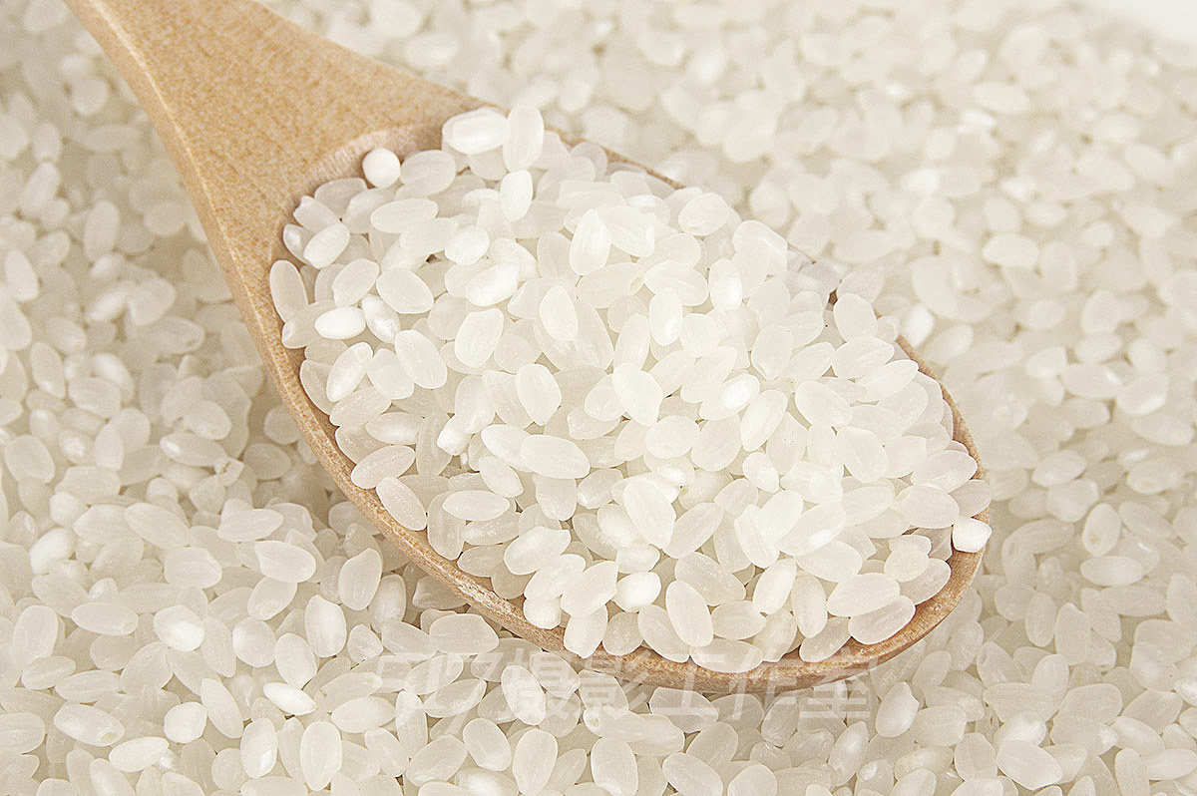
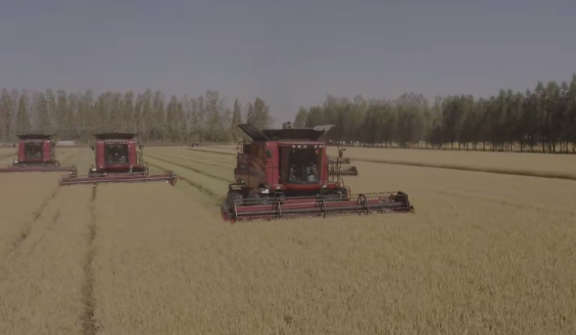
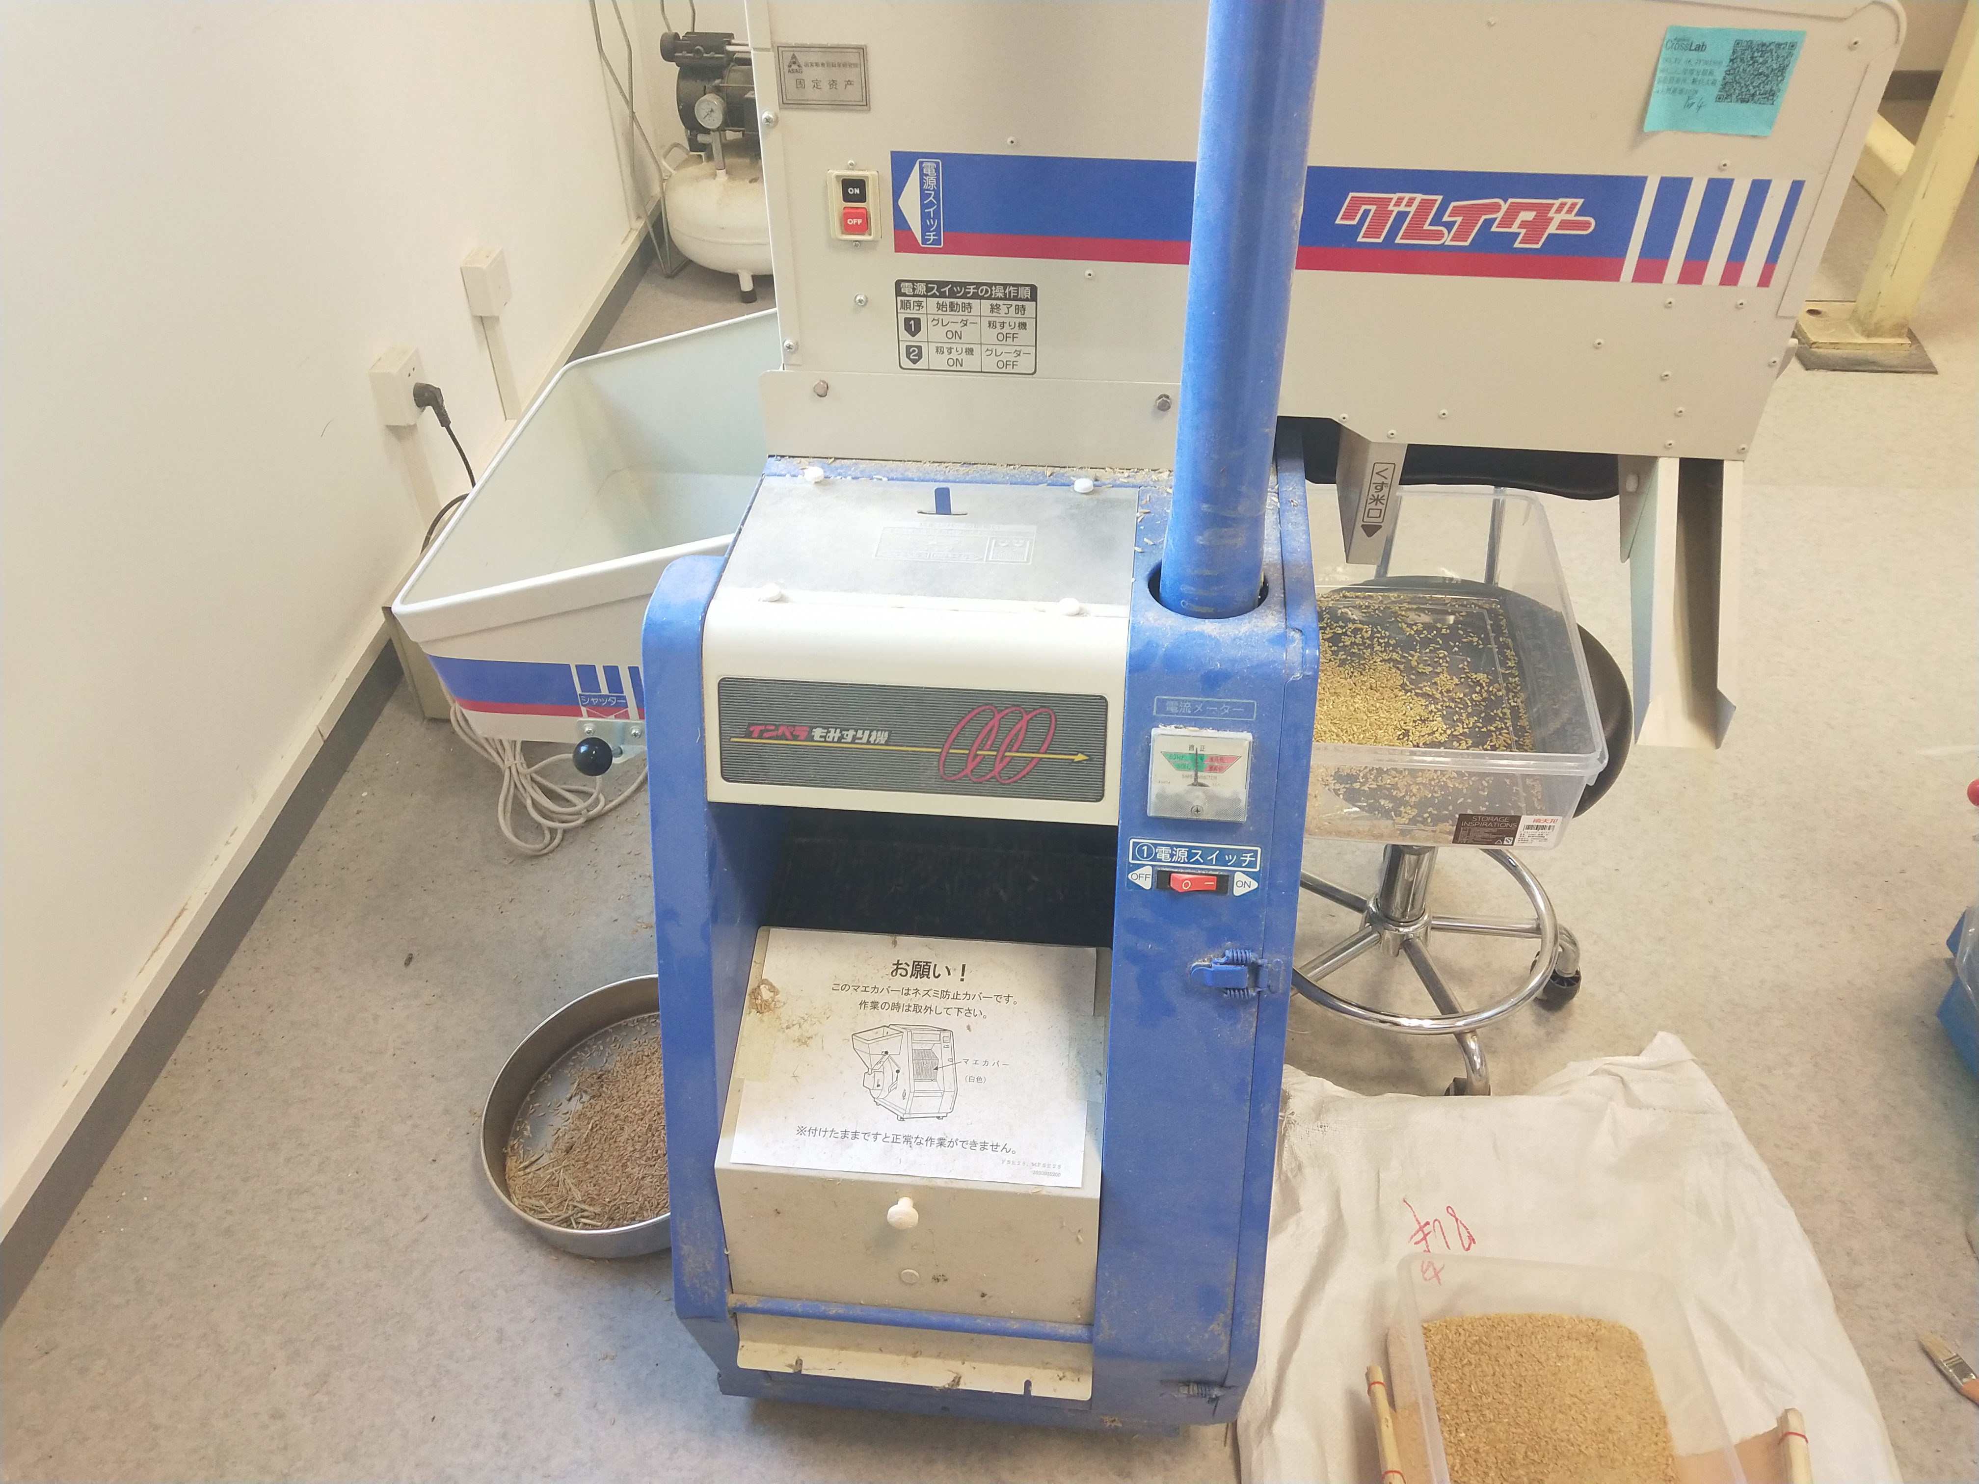
Rice Milling Diagram
Notes:
大米从农田到餐桌大概包括收割、砻谷、碾米这些步骤，过度加工是导致质量损失浪费的最主要成因。

Slide 8
02
The Impact of Excessive Rice Processing

Slide 9
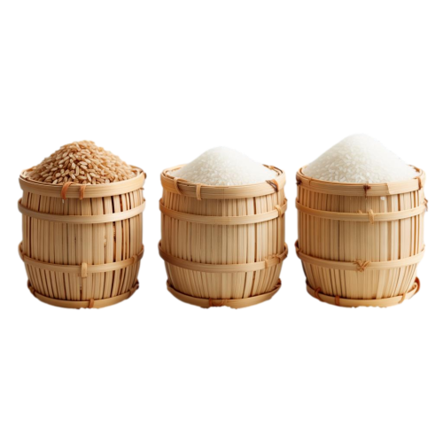

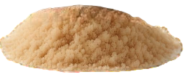
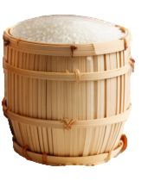
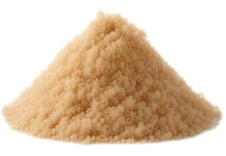
Decreased milling yield, leading to resource waste.
Moderate Processing
Excessive Processing
Notes:
有研究表明稻谷加工过程中，清理和砻谷环节导致的损失浪费很少，均不足千分之一，过度加工是导致质量损失浪费的最主要成因，其中过度加工使得碎米率增加而出米率降低，从而导致口粮大米的损失，且损失量随着碾米道数和抛光道数的增加而明显增大。
有研究表明适度加工可以节约电耗近30%，按照我国年产稻谷2亿吨计算，相较于过度加工，适度加工年间可多产白米1000万吨，相当于2350万亩水田的产量。

Slide 10
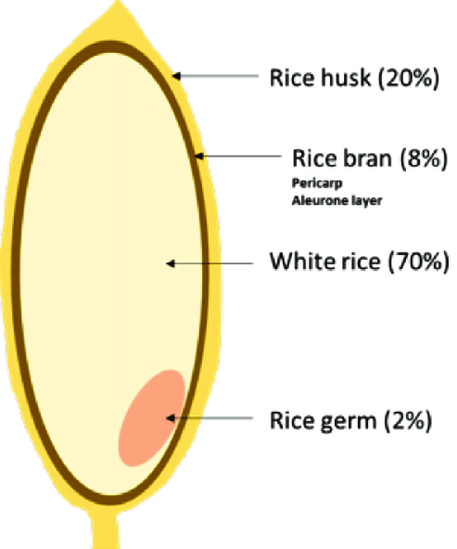
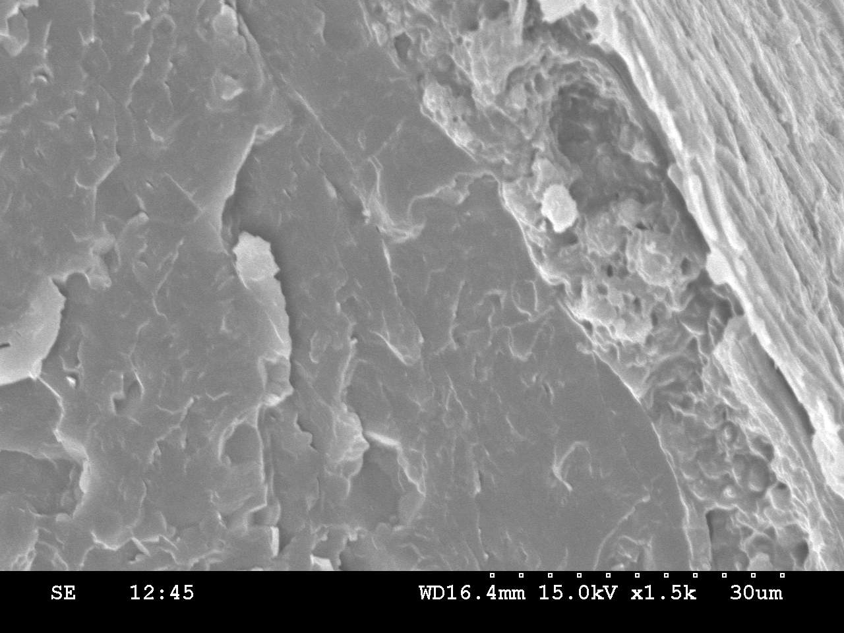
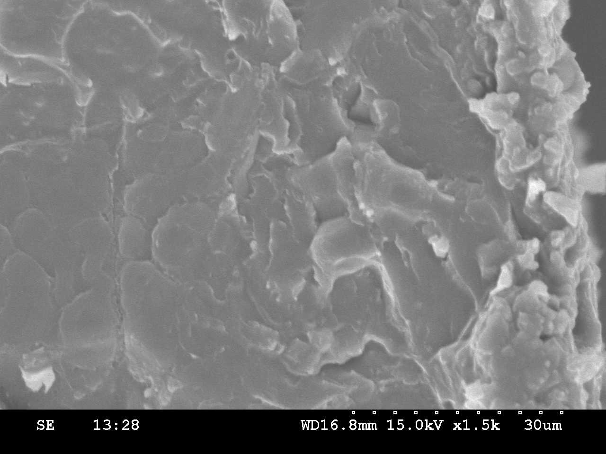
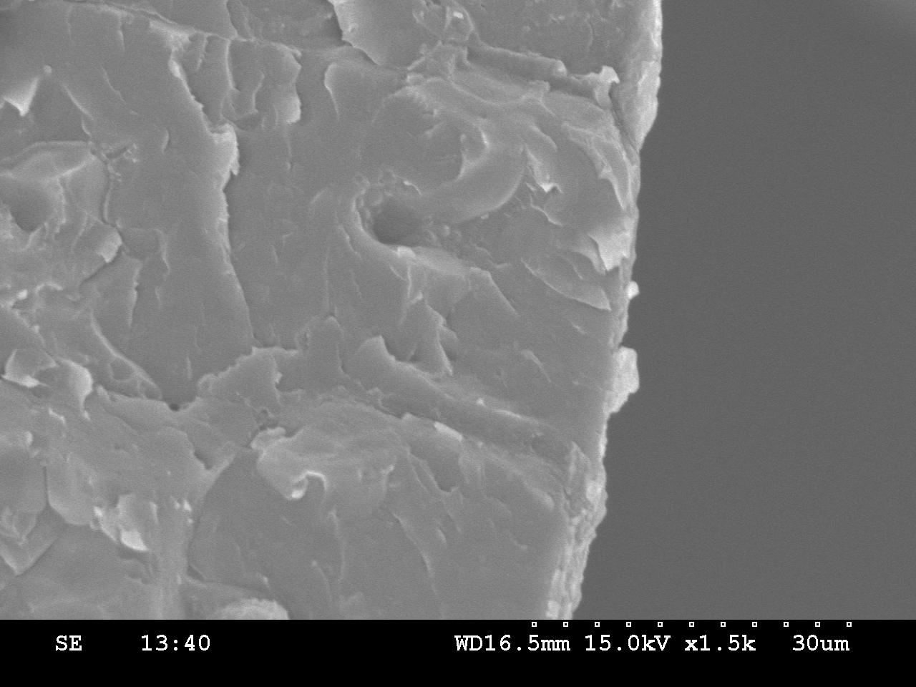
Loss of nutrients in rice.
Brown rice
Moderate Processing
Excessive Processing
Scanning Electron Microscope (SEM) image of rice
The lost nutrients include:
dietary fiber,
trace elements：Ca, Fe, Zn, etc.
vitamins：VB1, VE, etc.
Notes:
大米中以VB1为代表的维生素以及以Mg、Fe等为代表的部分矿物质元素主要是分布在糊粉层等糠层中，适度加工能保留籽粒的部分糊粉层，而过度加工大米几乎没有糊粉层。

Slide 11
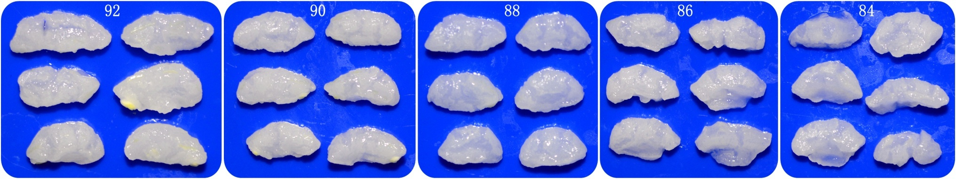
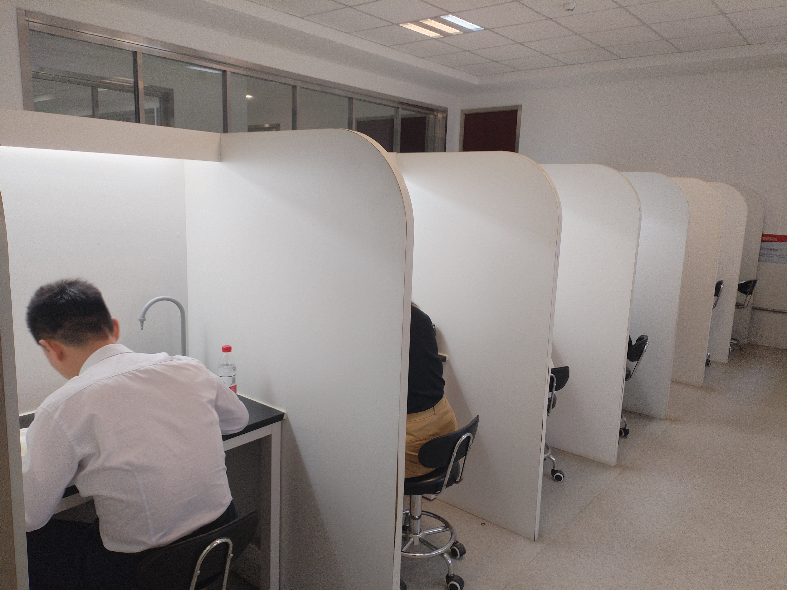
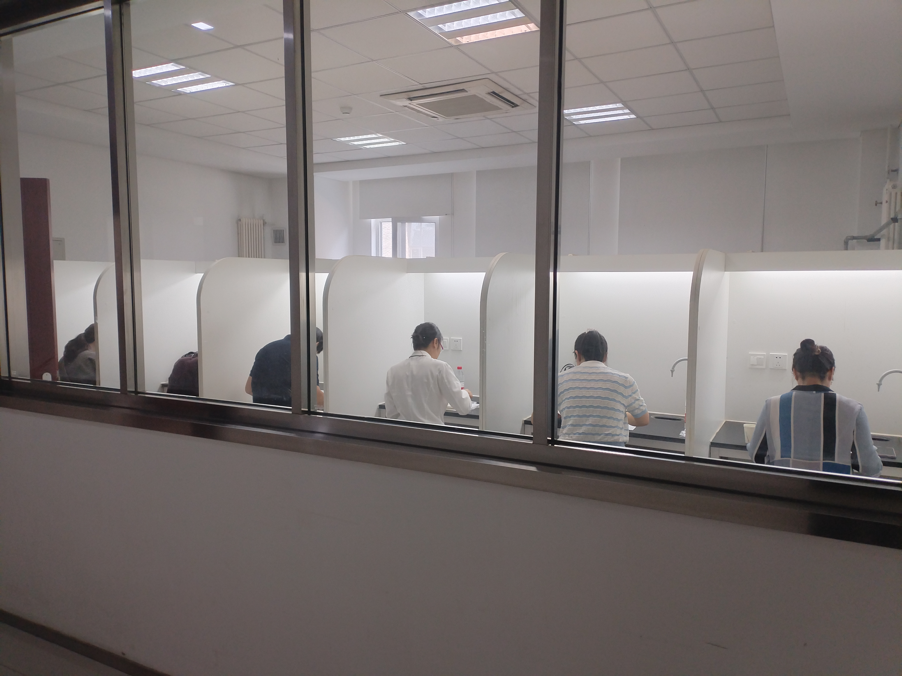
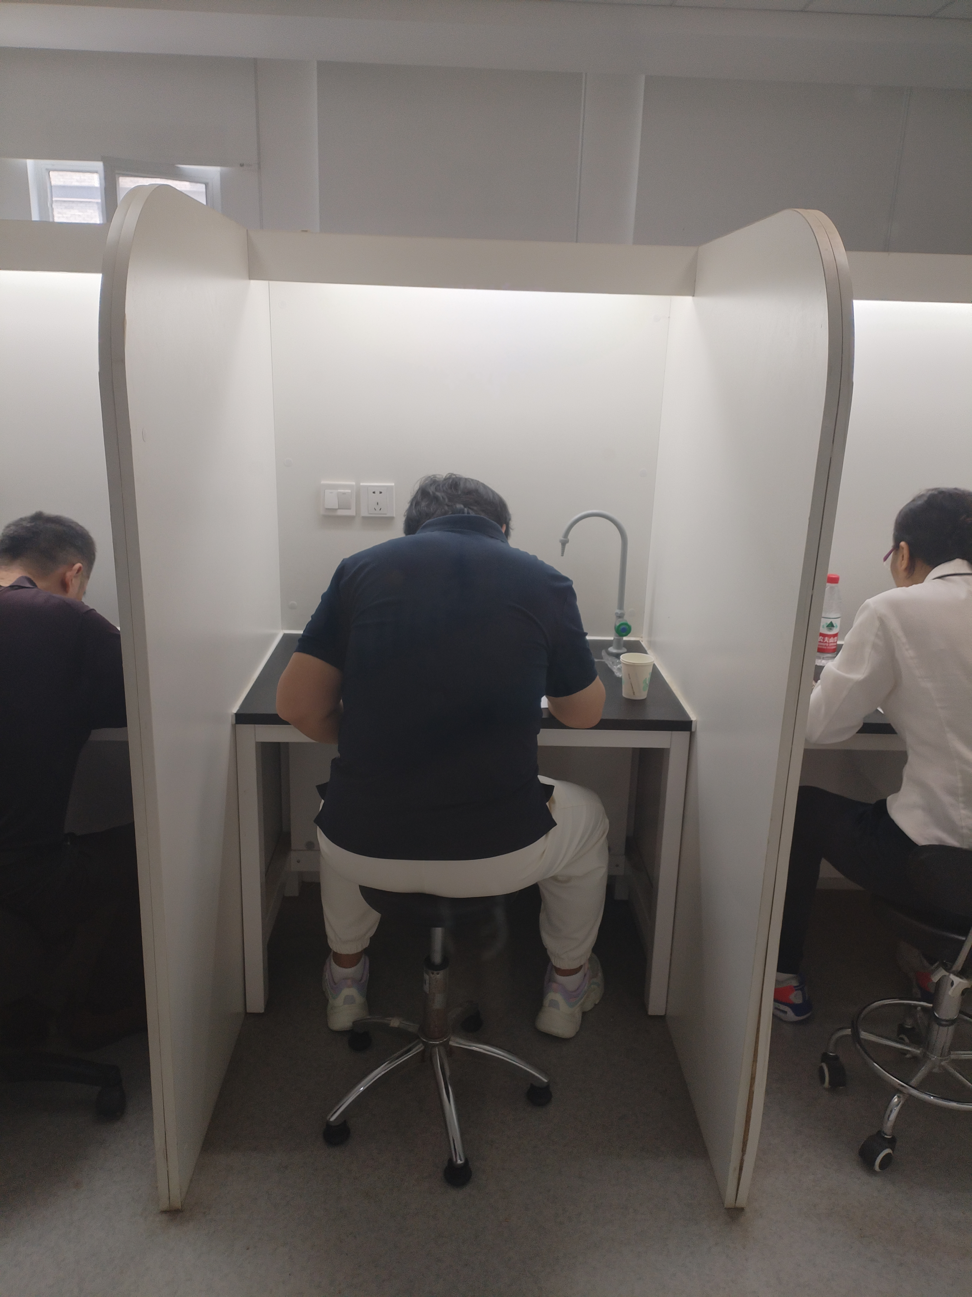
Reduce the taste value of rice.
Excessive processing of rice tends to absorb water and expand easily during cooking, leading to the cracking of rice grains and affecting the texture;
Excessive processing of rice significantly reduces the flavor of the rice, impacting the taste.
Notes:
过度加工的大米在煮饭过程中容易吸水膨胀，导致米饭裂开，影响口感；过度加工大米会显著降低大米风味，影响口感。
过度加工会显著减少大米的风味物质，从而影响大米口感。

Slide 12
03
Rice Processing Precision Inspection Method

Slide 13

Milling Yield Test Method
Milling yield reduction rate (%) = [1 - (polished rice weight / brown rice weight)] × 100
or
White rice yields(%) = polished rice weight / brown rice weight × 100
Notes:
碾减率；糙出白率。

Slide 14
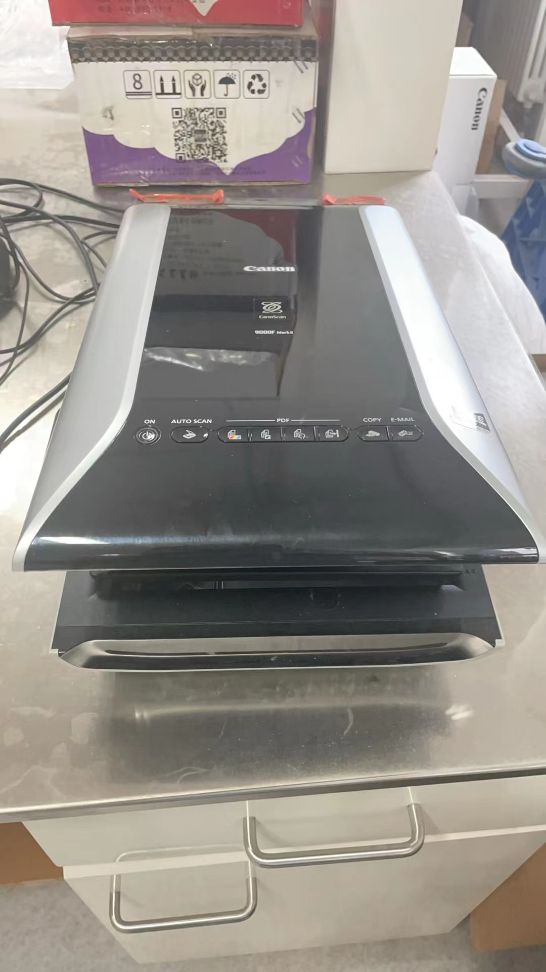

GB/T 5502-2018
Inspection of grain and oils-Determination of milling degree of rice
Comparative Observation Method
Comparing the stained rice sample with the stained standard sample for rice milling precision.
Instrument-Assisted Detection Method
The stained rice samples and the stained rice processing precision standard samples are compared by image analysis methods for determination.
Instrumental Detection Method
Detecting the degree of skin retention in stained rice samples using image capture and image analysis methods.
~30,000 RMB
Notes:
对比观测法:利用染色后的大米试样与染色后的大米加工精度标准样品对照比较,通过观测判定试样的加工精度与标准样品加工程度的相符程度。
仪器辅助检测法:染色后的大米试样与染色后的大米加工精度标准样品通过图像分析方法进行测定比较,根据米粒表面残留皮层和胚的程度,人工判定大米的加工精度。
仪器检测法:利用图像采集和图像分析法检测经过染色的大米试样的留皮度,仪器自动判定大米的加工精度。

Slide 15
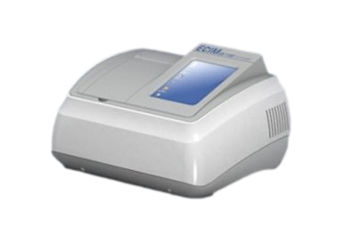
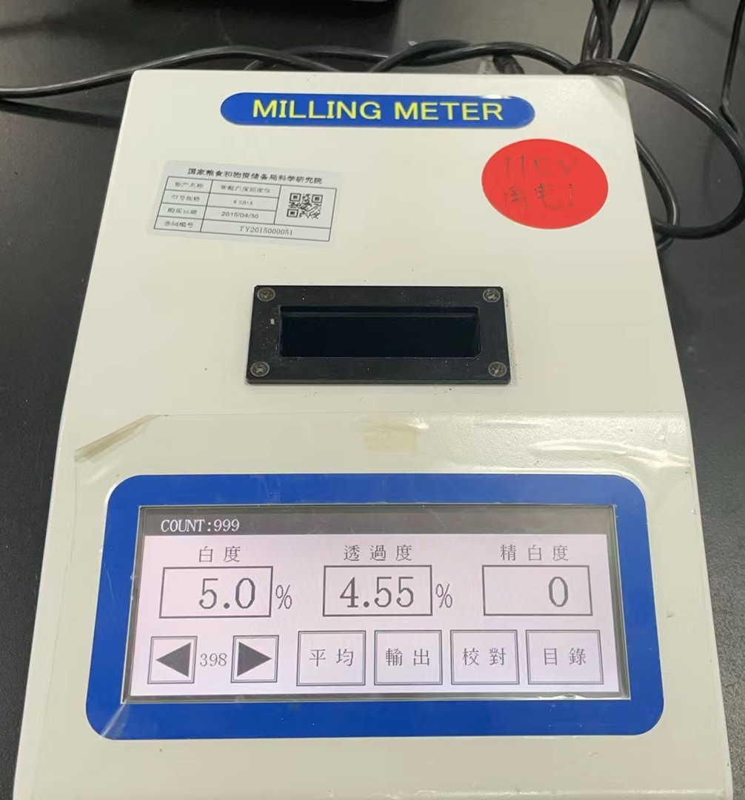
Whiteness Determination Method
Reflecting the rice processing precision by measuring the whiteness of rice.
Near-Infrared Spectroscopy(NIR)
Judging the processing precision of rice by detecting the changes in surface fat content.
~80,000 RMB
Methods Based on Imaging Technology and Machine Learning
Notes:
白度测定法：通过测量白度来反映稻米的加工品质，进而判断其加工精度.
近红外光谱法：通过检测稻米表面脂肪含量的变化来判断其加工精度。
利用高分辨率相机等成像设备采集大米的图片数据，然后对采集到的图片进行预处理（如灰度化、去噪等），再通过图像处理技术分辨糠层和胚乳，最终利用机器学习算法判别大米的加工精度.

Slide 16
04
Rice Moderate Processing Technology Model

Slide 17

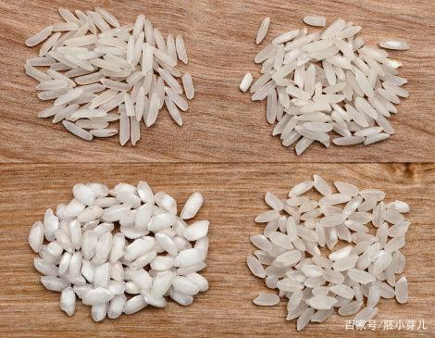
The purpose of moderate rice processing is to maintain good taste while preserving more nutrients. But what kind of rice is considered moderately processed rice?
Notes:
适度加工大米的目的是让大米既保持较好的食味值，又能保留更多的营养。但是什么样的大米才叫适度加工大米呢？ 针对我们国家稻谷种类的多样性，我们选取代表性粳稻样品进行研究。

Slide 18
The white rice yields of japonica rice samples with different processing precisions
Sample | White rice yields/% | Sample | White rice yields/% | Sample | White rice yields/% | Sample | White rice yields/% | Sample | White rice yields/%
longdao-0 | 100.0 | longjing-0 | 100.0 | yanfeng-0 | 100.0 | yujing-0 | 100.0 | nanjing-0 | 100.0
longdao-1 | 97.3 | longjing-1 | 96.3 | yanfeng-1 | 95.7 | yujing-1 | 94.8 | nanjing-1 | 96.8
longdao-2 | 93.1 | longjing-2 | 94.1 | yanfeng-2 | 92.5 | yujing-2 | 92.1 | nanjing-2 | 94.4
longdao-3 | 92.2 | longjing-3 | 92.9 | yanfeng-3 | 91.4 | yujing-3 | 91.3 | nanjing-3 | 92.5
longdao-4 | 91.0 | longjing-4 | 91.3 | yanfeng-4 | 90.1 | yujing-4 | 89.7 | nanjing-4 | 91.6
longdao-5 | 90.4 | longjing-5 | 90.5 | yanfeng-5 | 89.3 | yujing-5 | 88.0 | nanjing-5 | 91.1
longdao-6 | 89.2 | longjing-6 | 89.4 | yanfeng-6 | 88.3 | yujing-6 | 86.8 | nanjing-6 | 90.1
longdao-7 | 88.0 | longjing-7 | 87.7 | yanfeng-7 | 87.9 | yujing-7 | 85.9 | nanjing-7 | 89.2
longdao-8 | 86.3 | longjing-8 | 86.5 | yanfeng-8 | 86.7 | yujing-8 | 85.2 | nanjing-8 | 88.2
longdao-9 | 84.1 | longjing-9 | 84.5 | yanfeng-9 | 84.6 | yujing-9 | 83.9 | nanjing-9 | 86.4
longdao-10 | 83.7 |  |  |  |  |  |  | nanjing-10 | 85.5
longdao-11 | 82.8
Select five representative varieties of japonica rice with different grain types for milling to different extents to explore the impact of milling degree on the physicochemical quality, nutritional components, and taste quality of rice, in order to determine the appropriate range for rice processing.
Notes:
选取5种不同粒型的粳稻代表性品种进行不同程度的碾磨，探究碾磨程度对大米理化品质、营养成分及食味品质的影响，以确定合适的糙出白率范围，使得大米既好吃又保留更多的营养，这个糙出白率范围定义为大米适度加工范围。

Slide 19
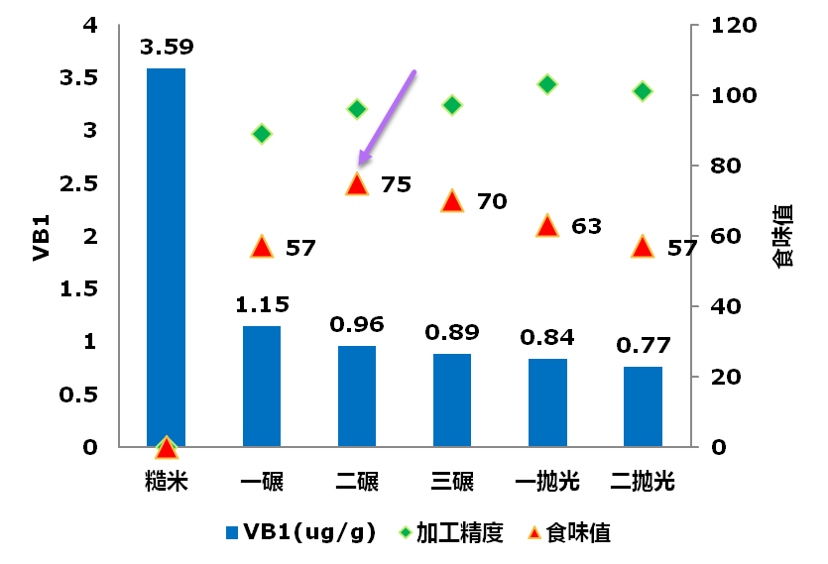
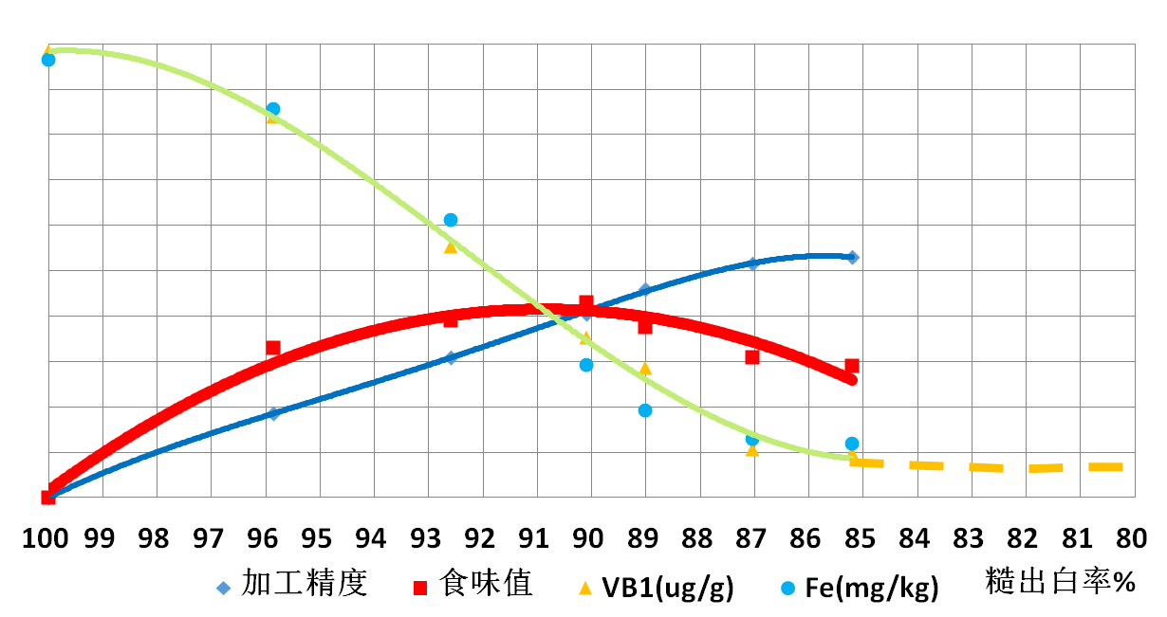
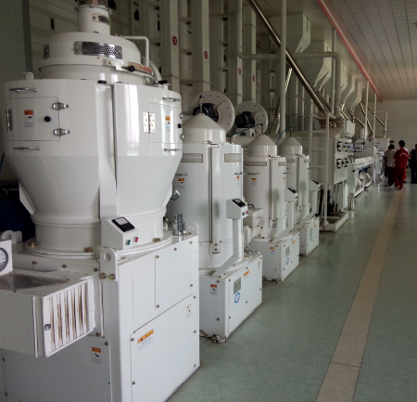
Moderate Processing
Notes:
适度加工范围为88%-92%。

Slide 20

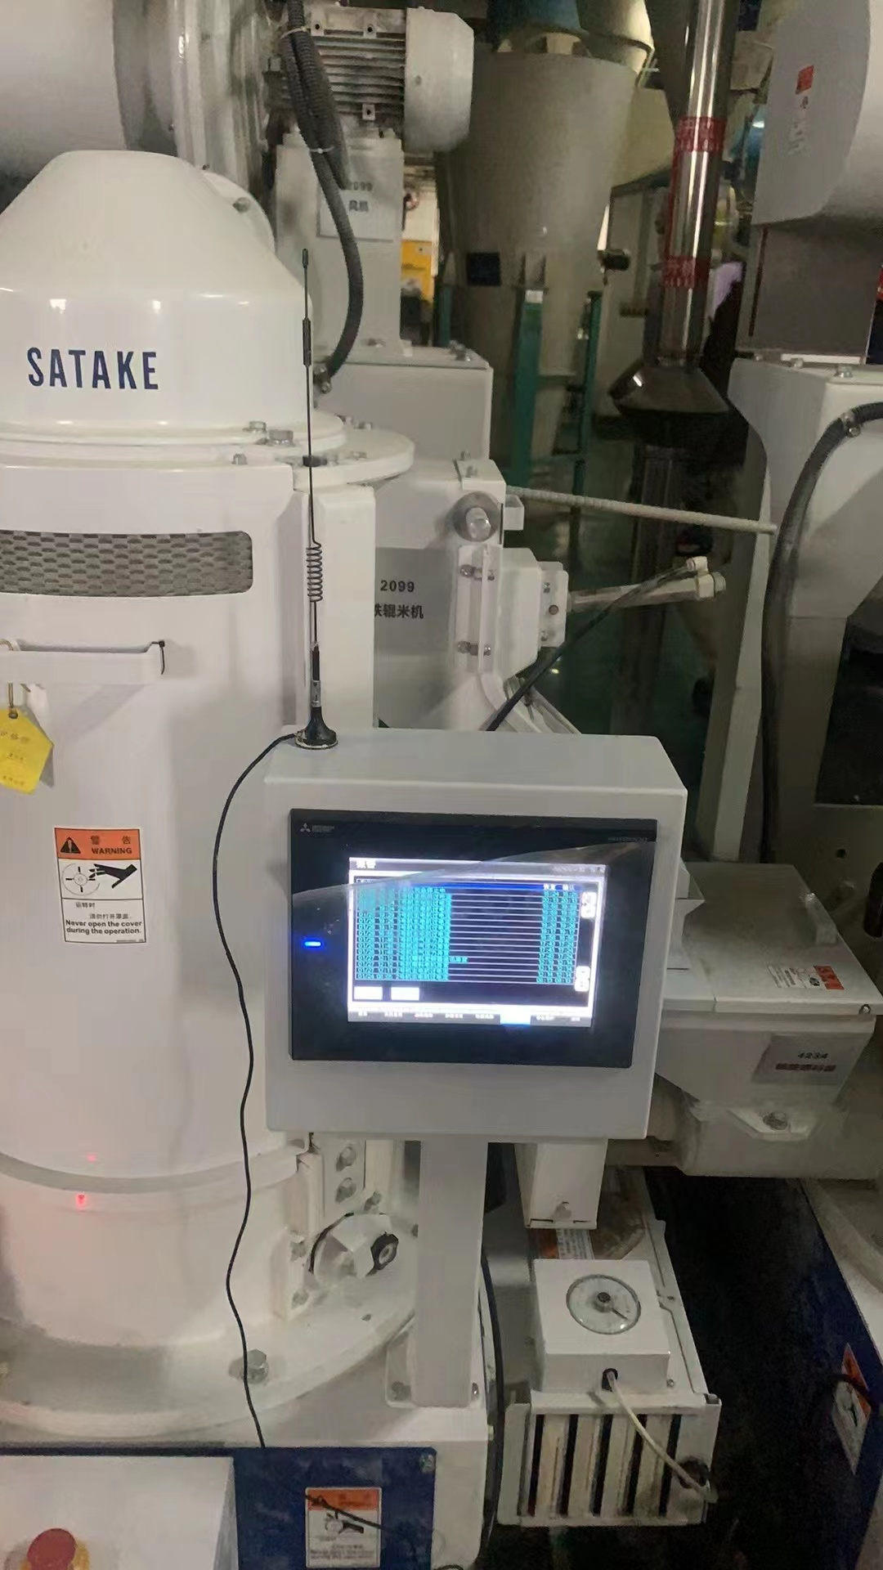
How to achieve moderate processing automatic control on the rice processing production line?
~200,000 RMB
Whiteness Determination Method
Notes:
怎样在大米加工生产线实现适度加工的自动控制？ 白度值的检测方法较为成熟，并且操作比较简单，适合应用于大米生产线，因此建立白度增加值和糙出白率的线性模型。

Slide 21
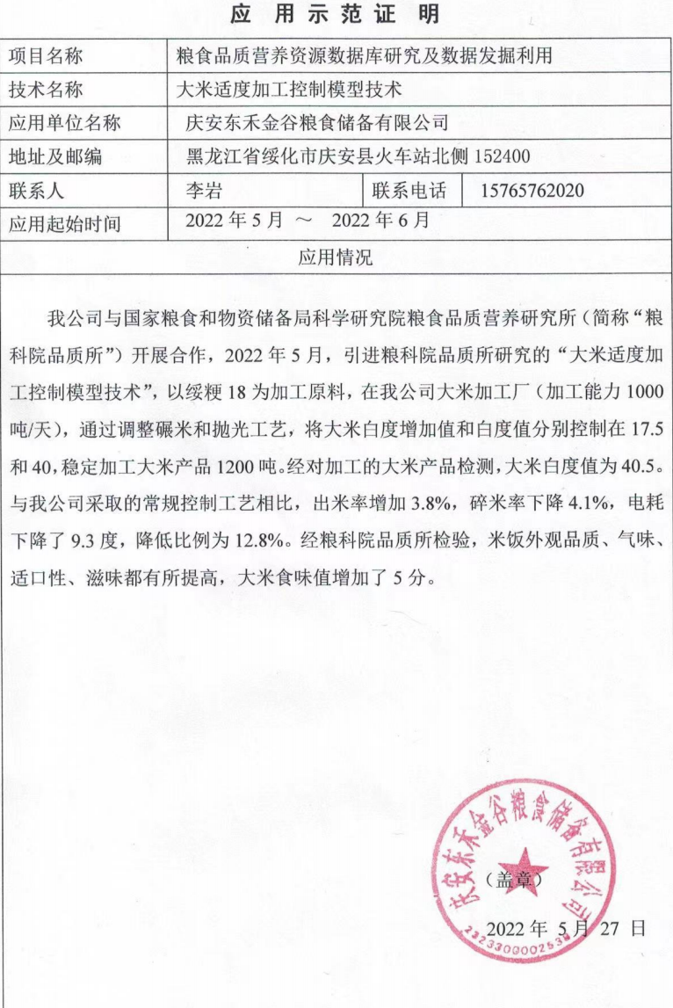
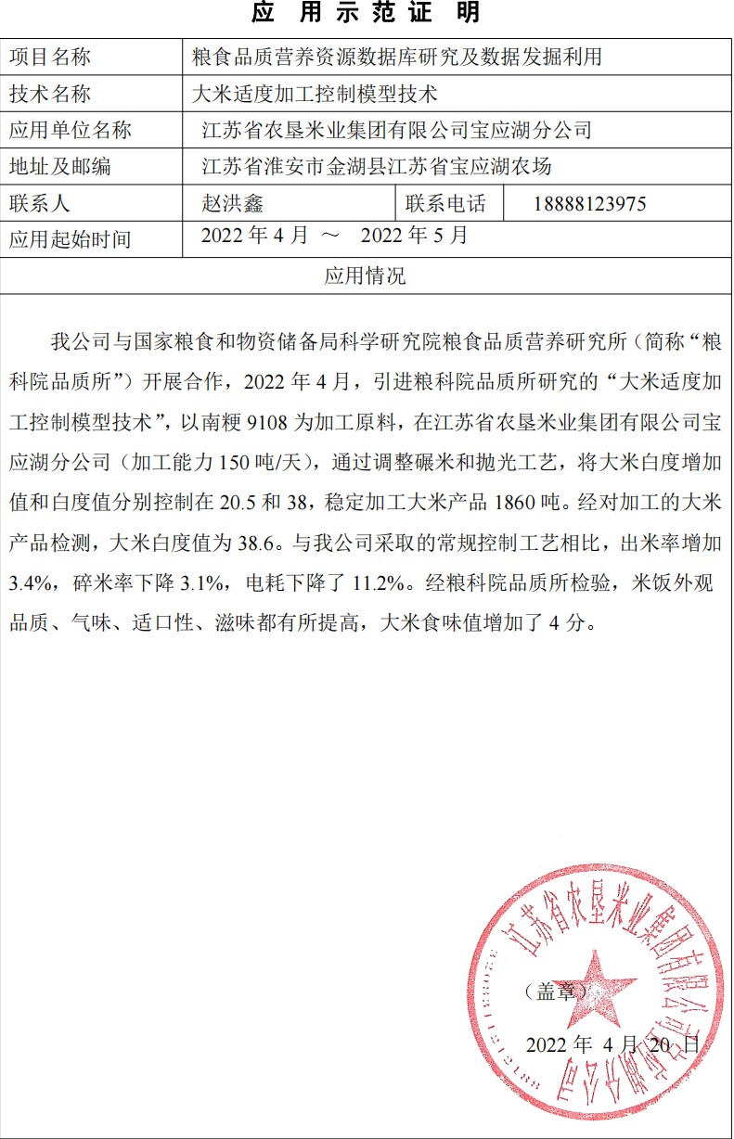
The moderate processing technology model has been applied and demonstrated in two companies, achieving good results.
It can improve the taste value of rice by more than 5 points, reduce energy consumption by more than 10%, and increase the milling yield by more than 3.0%.
Notes:
研究了适度加工关键控制指标，构建适度加工模型套，申请发明专利1件，该技术在2家企业进行了应用示范，取得了较好的效果，食味提高5分以上，降耗10%以上，出米提升3.0%以上；
庆安东禾金谷粮食储备有限公司以绥粳18为加工原料，设置白度增加值和白度值分别控制在17.5和40.
大米产品白度值为40.5
出米率增加3.8%，碎米减少4.1%；
电耗下降了9.3度，降低比例为12.8%
江苏省农垦米业集团有限公司宝应湖分共公司以南粳9108为加工原料，大米白度增加值和白度值分别控制在20.5和38
大米产品白度值为38.6；
出米率增加3.4%，碎米减少3.1%；
电耗下降了8度，降低比例为11.2%

Slide 22
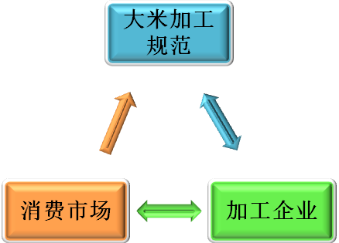
How to achieve moderate processing of rice?
Rice Processing Specification
Transform consumption concepts and advocate for nutritious and healthy consumption.
Improve the relevant standards for moderate rice processing to correctly guide enterprises.
Emphasize the collaboration between scientific research and enterprises.
Consumer Market
Processing Enterprise
Notes:
1、转变消费观念，提倡营养健康消费。为此需加大大米营养价值的宣传与讲解，有效利用电视、报纸等广告媒体，为企业施行适度加工提供市场需求；
2、从我国大米加工企业的特点出发，选定适合我国大米适度加工规范具有可操作性的考核指标。比如白度管理、出米率管理、吨米耗能管理；
3、重视大米加工过程中其营养指标、食味品质的变化规律的研究，结合大米白度的变化、出米率的变化及吨米能耗等指标，研究攻克不同精度大米与主要理化指标、营养品质和食用品质，以及能耗的关系等技术难题，确定大米适度加工的优化工艺条件，制定大米适度加工技术规范；
4、要重视科研与企业的合作，选择2-3个典型具有代表性的加工企业，建立合作关系，为大米适度加工的研究提供保障支持，以确保大米适度加工规范的可施行性。

Slide 23

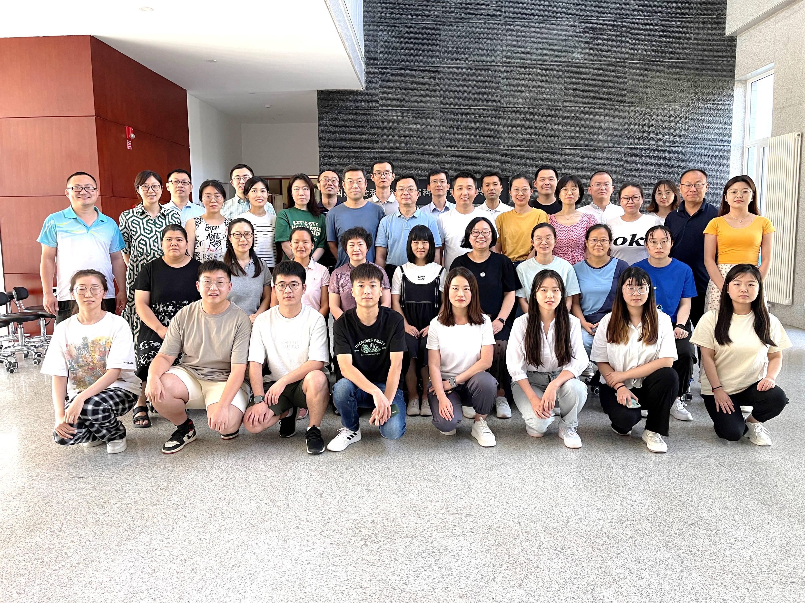
Thank You
Email：pzyys@ags.ac.cn
Phone: 010-56452651
Better Quality Better Life
Sharing for Learning

