Slide 1
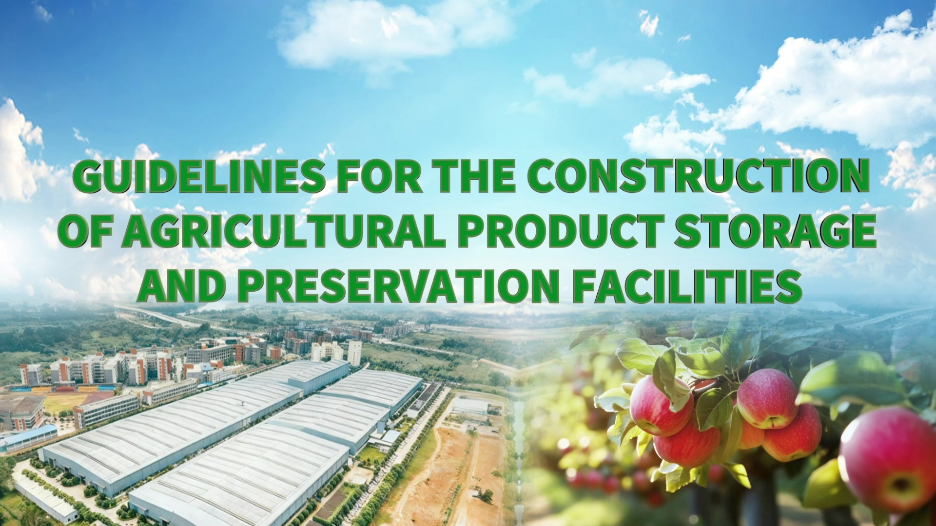

Notes:
Guidelines for the Construction of Agricultural Product Storage and Preservation Facilities
农产品仓储保鲜设施建设指南

Slide 2
Part 01
Nature, Classification and Characteristics of Cold Storage for Agricultural Products
Part 02
How to Select Sites for Agricultural Product Warehouses
Part 03
How to Build Large-scale Agricultural Product Warehouse
Notes:
This course focuses on three modules: the nature, classification and characteristics of cold storage for agricultural products; key conditions for warehouse site selection; and layout strategies for large-scale storage.
本课程将围绕农产品冷库的性质、分类及特点、仓库选址的关键条件、规模化仓储的布局策略三大模块展开。

Slide 3

PART.02
How to Select Sites for Agricultural Product Warehouses
Notes:
PART.02 How to Select Sites for Agricultural Product Warehouses
二、农产品仓库如何选址？

Slide 4
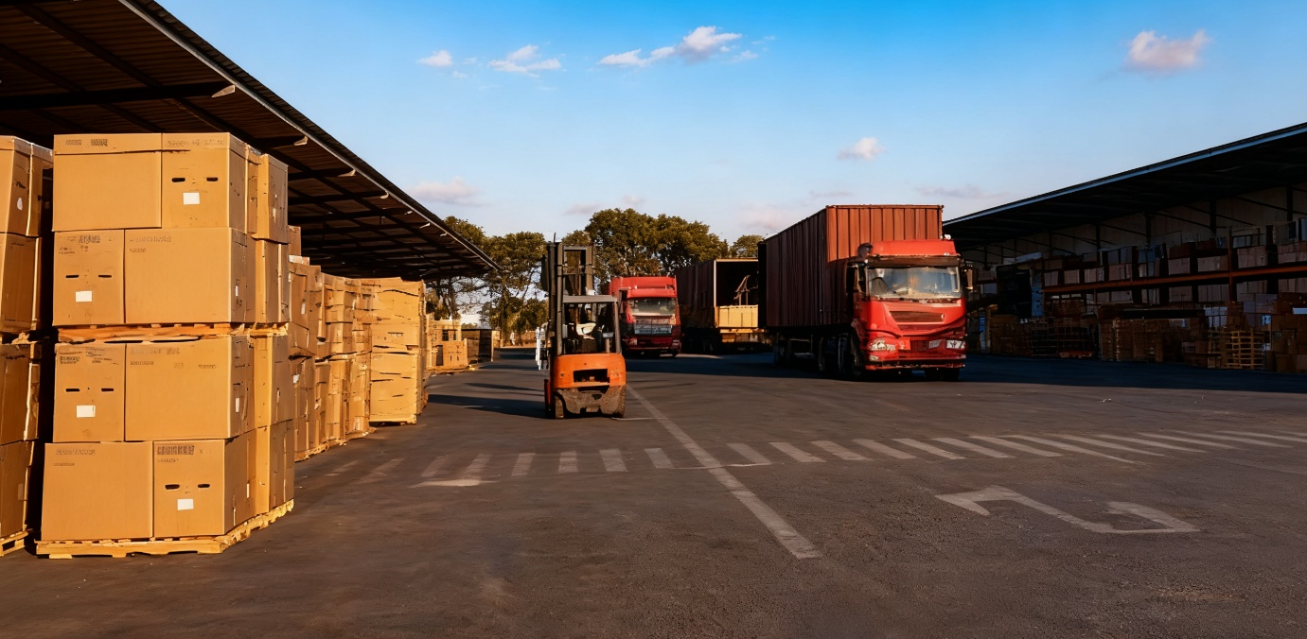
Three Main Conditions
Transportation
Purchase and distribution
Environmental sanitation
Notes:
As essential infrastructure for storing large volumes of agricultural products and as key nodes in product circulation, warehouse site selection should consider three main conditions:
transportation, purchase and distribution, and environmental sanitation.
农产品仓库作为存放大量农产品的基础设施和农产品流通中的重要环节，其选址一般要考虑交通运输、购销集散和环境卫生三个条件。

Slide 5
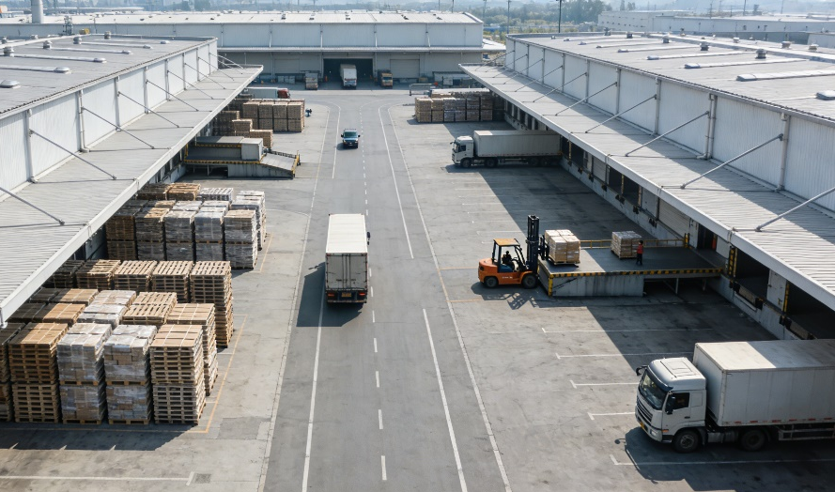
1. Transportation Conditions
Core Principle
Construction and distribution of warehouses must align with transportation conditions.
Key Requirement for Specific Warehouses
Warehouses with high throughput and transfer functions should be located near major transportation routes and towns.
Core Objective
Facilitate product movement and accelerate circulation.
Notes:
1.Transportation Conditions
The construction and distribution of agricultural product warehouses must align with transportation conditions.
Warehouses with high throughput and transfer functions should be located near major transportation routes and towns to facilitate product movement and accelerate circulation.
（一）交通运输条件
农产品仓库的建设与分布，要与交通运输条件相适应，尤其是那些吞吐量大，属于中转性质的农产品仓库，要建在靠近交通沿线的城镇，便于农产品运输，加速流通。

Slide 6
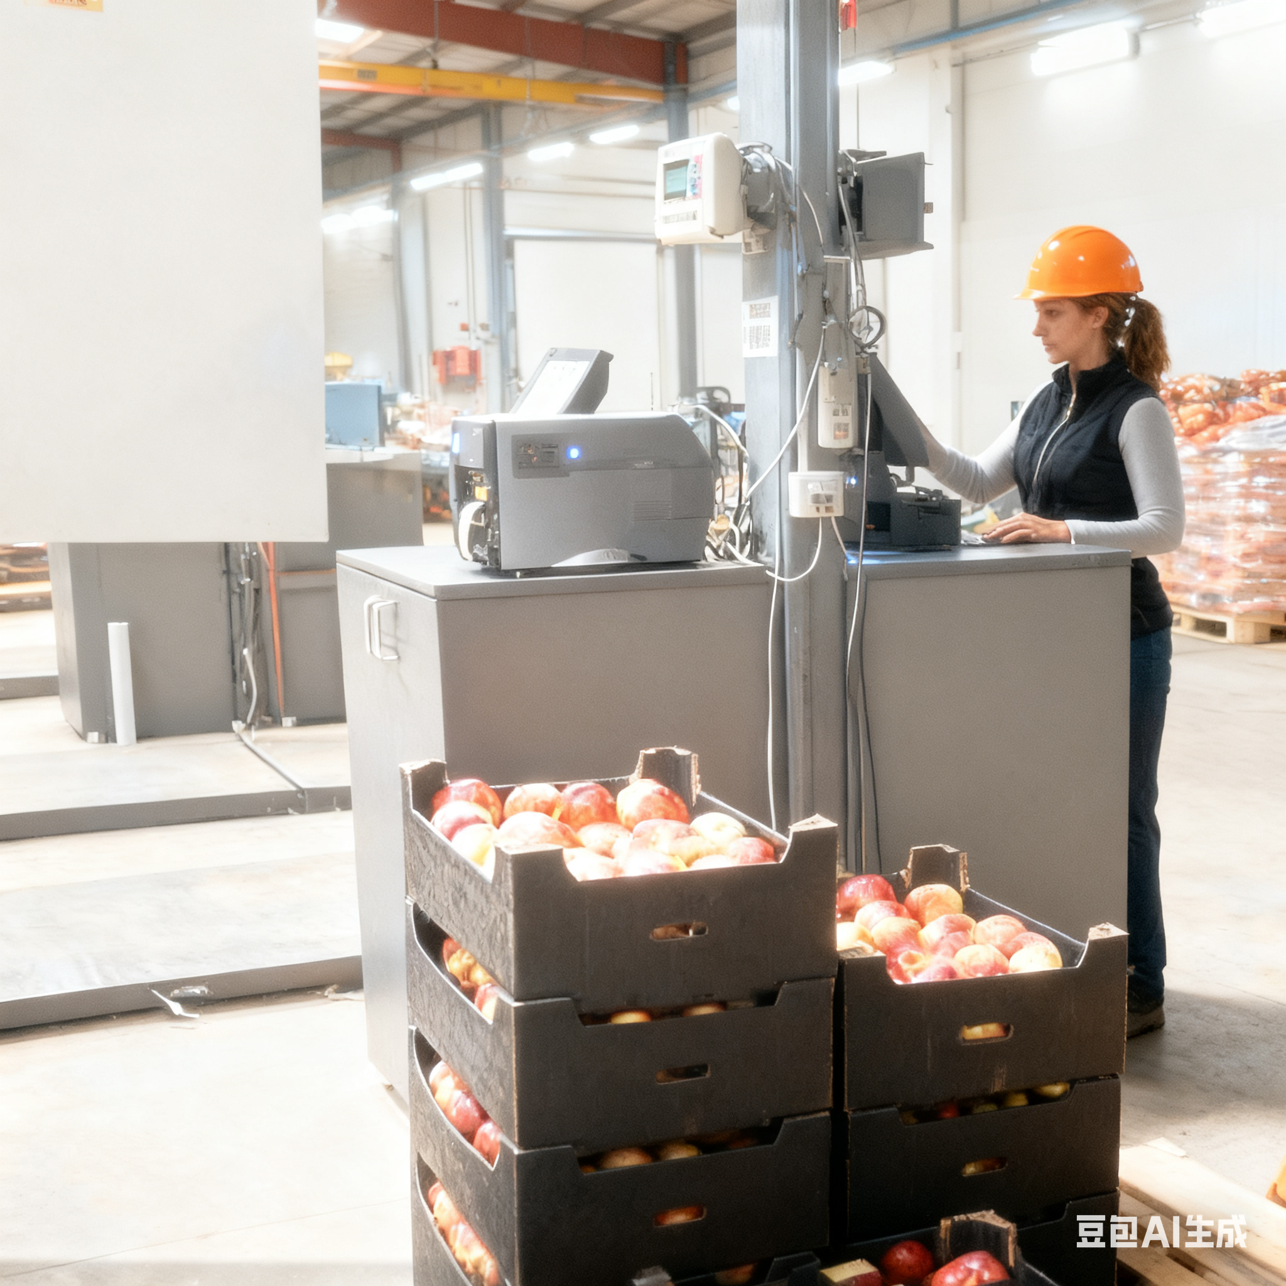
2. Purchase and Distribution Conditions
Core Principle
Balance product collection and market distribution.
Follow production and sales patterns.
Key Requirement for Specific Warehouses
For large-volume, long term storage.
Especially unprocessed or primary processed raw products (e.g., grain).
Build close to production areas or product-concentrated areas.
Notes:
2.Purchase and Distribution Conditions
Warehouse locations must balance product collection and market distribution. Site selection should follow production and sales patterns.
In general, warehouses storing large volumes for long periods, especially unprocessed or primary processed raw products such as grain, should be built close to production areas or in areas where products are concentrated.
（二）购销集散条件
农产品仓库地址的选择，要兼顾农产品收购集中与销售扩散两个方面，即要按照农产品的产销特点建设仓库。
一般而言，储存数量大，储备时间长，属于未加工和初加工的原料型农产品仓库，如原粮仓库，应接近产地，或建在农产品集中区。

Slide 7
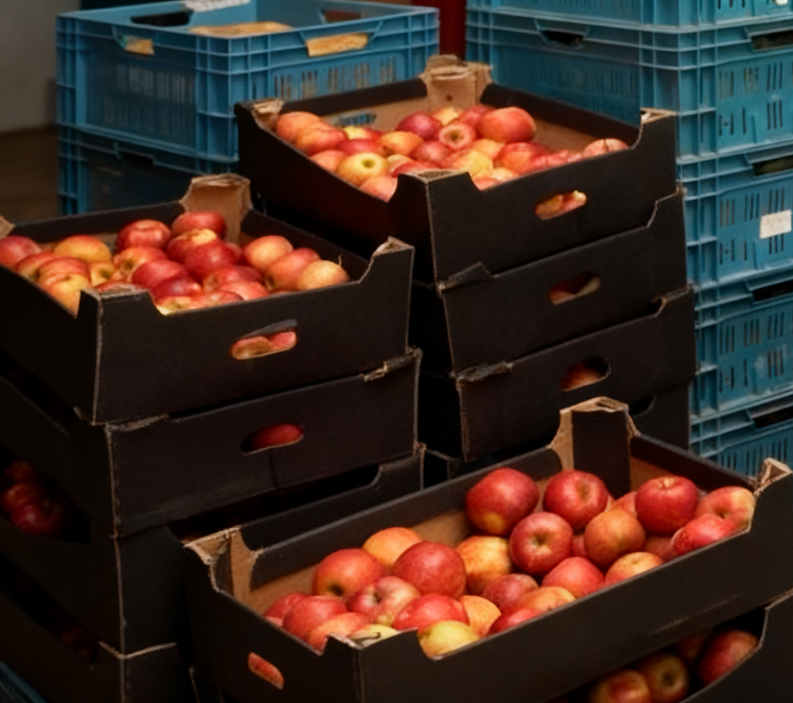
3. Environmental Sanitation Conditions
Core Principle
Agricultural product warehouses require good environmental conditions for storage.
Site Conditions
Located on solid, dry, level ground.
Free from flood, fire hazards, and pollution sources.
Special Requirement for Production-Area Warehouses
Near cultivation zones.
Away from poultry and livestock farms.
Prevent contamination and product loss.
Notes:
3.Environmental Sanitation Conditions
Agricultural product storage requires good environmental conditions.
Warehouses should be located on solid, dry, level ground, free from flood or fire hazards, and away from pollution sources.
For production-area warehouses, proximity to cultivation zones is necessary, but they must remain distant from poultry and livestock farms to prevent contamination or product loss.
（三）环境卫生条件
农产品储存需要有良好的环境条件，仓库应建在地基坚实、干燥平坦、无水火之患、无污染之危、清洁卫生的地方。
产地的农产品仓库，应与农产品种植地邻近，远离家禽、家畜等饲养场所，避免禽畜进入农产品仓库吃食或污染农产品。

