Slide 1
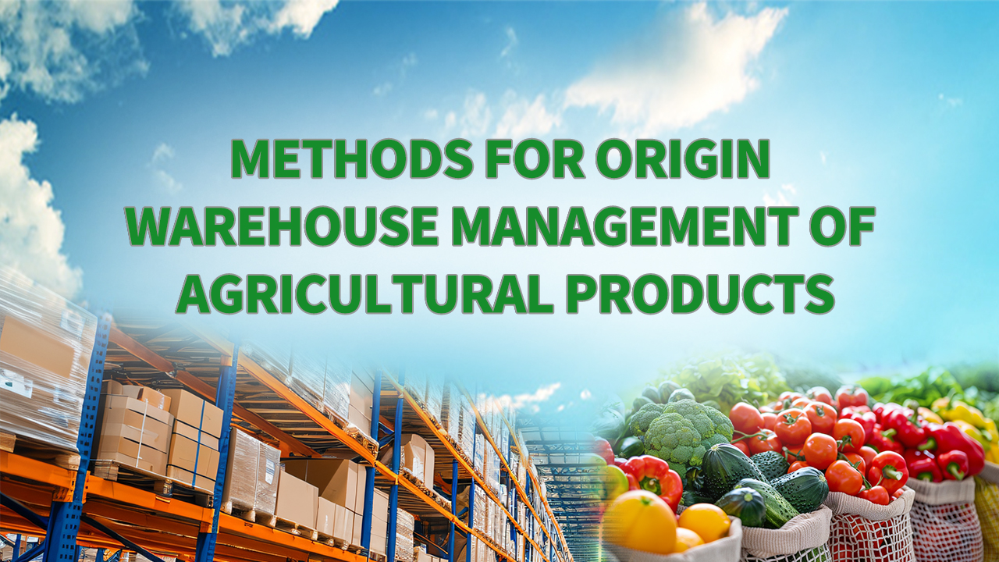
Notes:
Methods for Origin Warehouse Management of Agricultural Products
农产品产地仓储管理方法论

Slide 2

Part 01
An Overview of the Full Workflow of Agricultural Product Warehouse Operations
Part 02
Inventory Control for Agricultural Products
Part 03
Food Safety and Sanitation Management for Origin Warehouses
Part 04
Safety Management Measures for Origin Warehouses of Agricultural Products
Notes:
This course focuses on management methodologies for origin warehouses of agricultural products, and the content is organized into four main sections:
1.An overview of the full workflow of agricultural product warehouse operations;
2.Inventory control for agricultural products;
3.Food safety and hygiene management in origin warehouses;
3.Food Safety and Sanitation Management for Origin Warehouses
4.Safety management measures for origin warehouses of agricultural products.
本课程聚焦于农产品产地仓储管理方法，内容主要围绕以下四个部分展开：第一部分是对农产品仓储作业全流程的介绍；第二部分聚焦于农产品库存控制；第三部分主要讲解产地仓食品安全与卫生管理；第四部分介绍农产品产地仓储的安全管理措施。

Slide 3
PART.01
Overview of Agricultural Product Warehouse Operations
Notes:
I.Overview of Agricultural Product Warehouse Operations
一、农产品仓储作业全流程概述

Slide 4
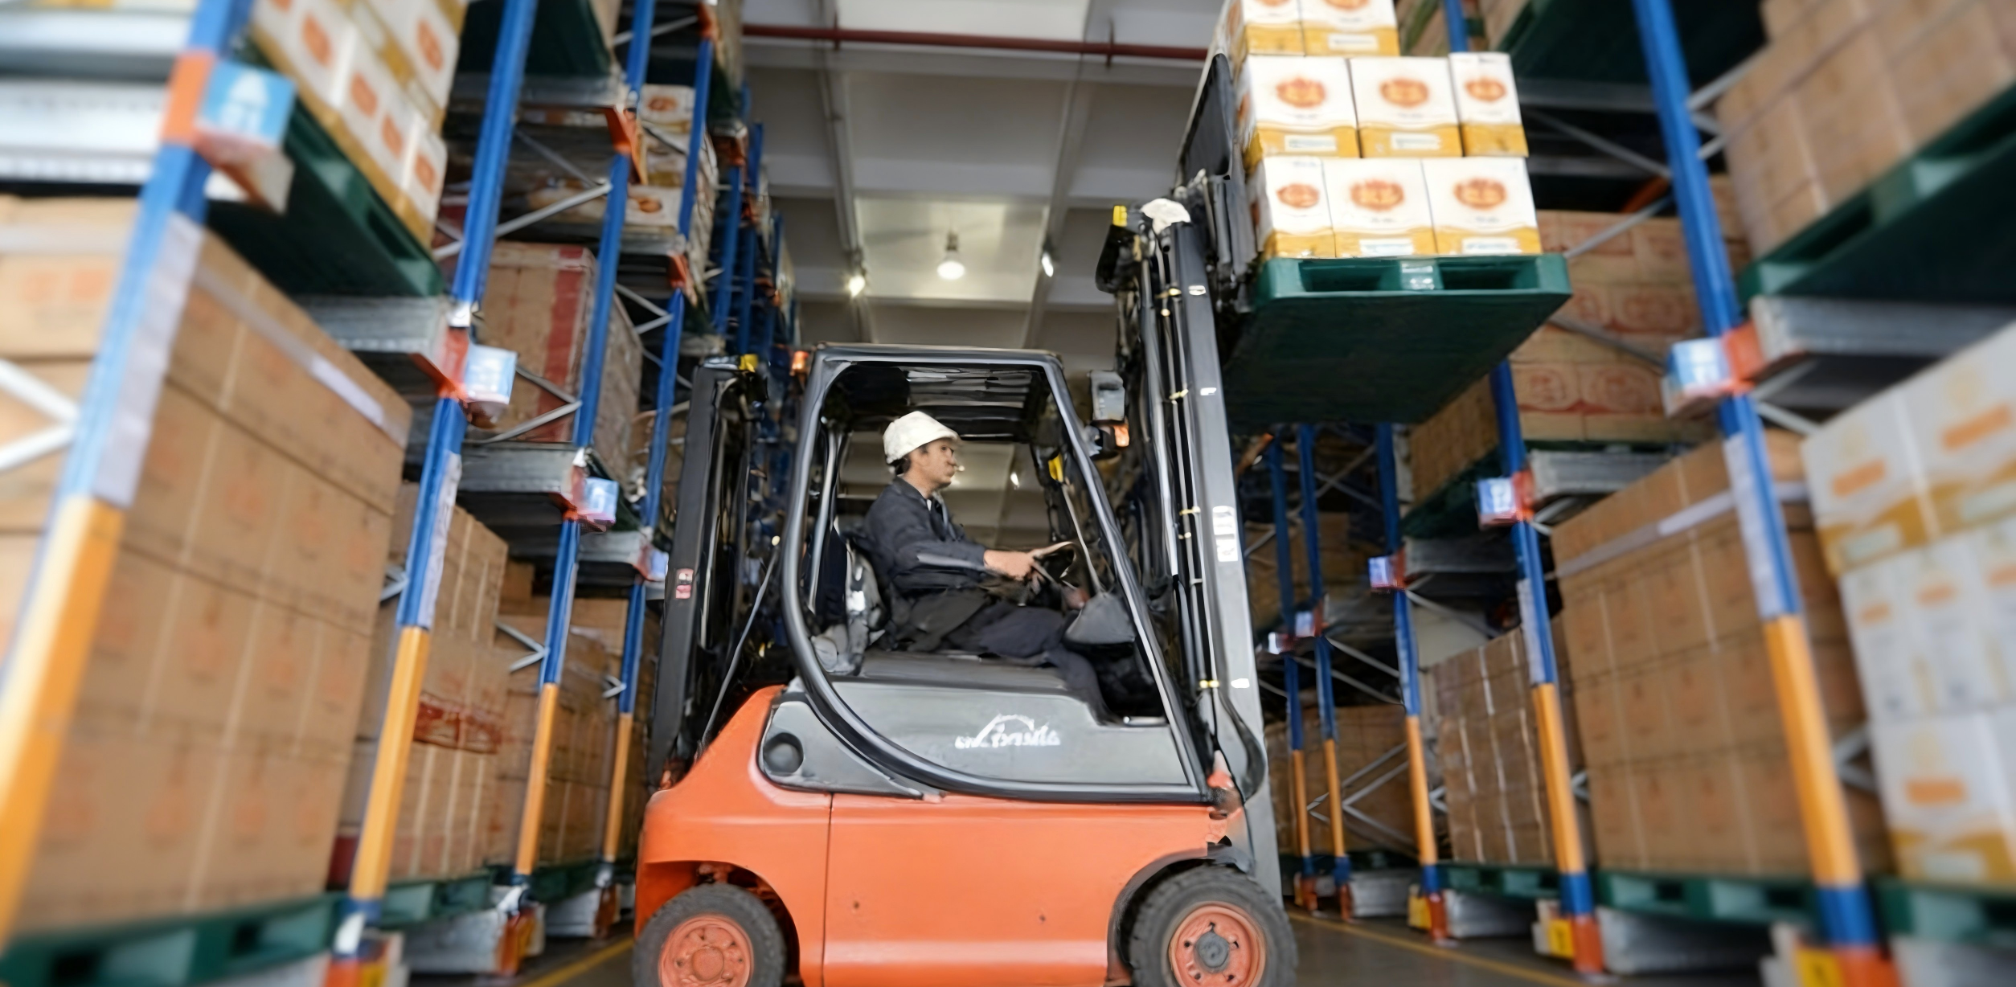
Warehouse Operations Overview
Definition of Warehouse Operations
  The full workflow centered on storage and preservation.
  From receiving goods → to dispatching them in good condition according to operational needs.
Core Stages of Warehouse Operations
Inbound
Storage
Outbound
Importance of Pre-inbound Preparation
  Affects the efficiency of the inbound process.
  Affects the safety of subsequent storage.
Notes:
Warehouse operations refer to the full workflow centered on the storage and preservation of goods—
from the receipt of goods into the warehouse to dispatching those goods in good condition according to operational needs.
The warehouse operation process consists of three main stages: inbound, storage, and outbound.
The quality of pre-inbound preparation directly affects the efficiency of the inbound process and the safety of subsequent storage.
仓储作业是指以存储、保管活动为中心，从仓库接收货物入库开始到按需要把货物全部完好地发送出去的全过程。仓储作业过程主要由入库、保管和出库三个阶段组成，入库前准备工作的好坏直接关系到入库时的工作效率和入库后的安全储藏。

Slide 5
1. Eight Key Preparatory Steps Before Inbound Operations
Familiarizing with inbound agricultural products.
Assessing warehouse conditions.
Proper warehouse layout planning.
Preparation of storage areas.
Preparation of covering and padding materials, and operational tools.
Establishing loading and unloading procedures.
Preparation for inspection and acceptance.
Preparation of documentation.
Notes:
1.Key Pre-inbound Steps
The preparatory work for receiving agricultural products can be summarized in eight steps:
入库前关键步骤

Slide 6
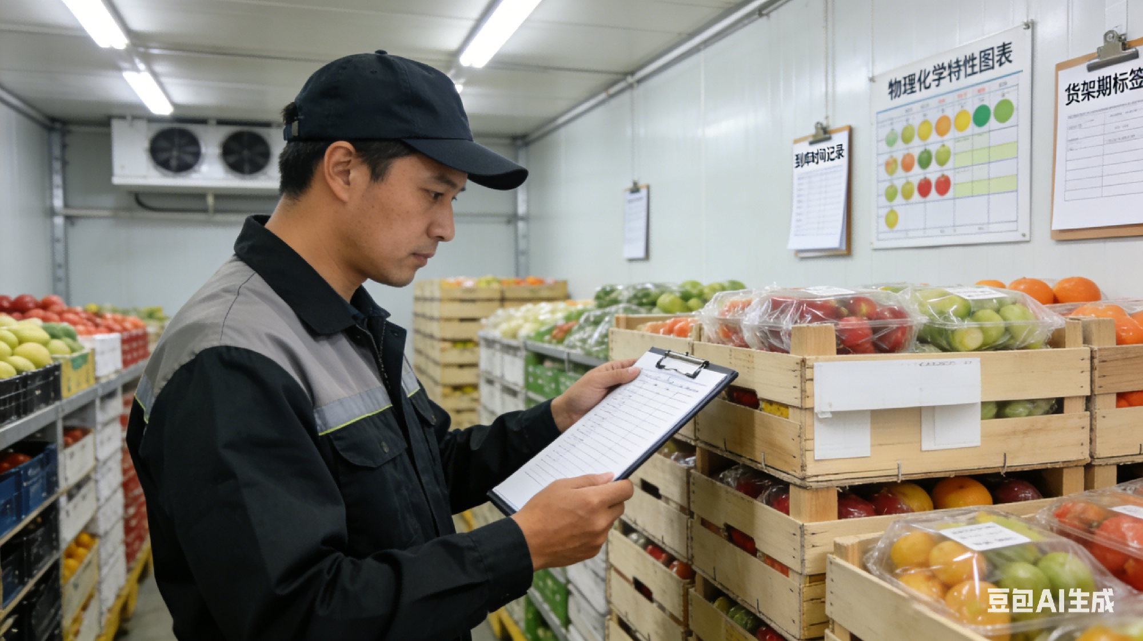
1. Eight Key Preparatory Steps Before Inbound Operations
(1) Familiarizing with inbound agricultural products
Review Incoming Product Documentation
  Carefully review relevant documents for incoming agricultural products.
Understand Product Information
  Varieties.
  Specifications.
  Quantities.
  Packaging conditions.
  Unit size.
  Exact arrival time.
  Expected storage duration.
  Physicochemical characteristics.
  Storage requirements.
Conduct Warehouse Planning and Preparation
  Plan appropriate warehouse layout.
  Conduct operational preparation.
Notes:
1.Familiarizing with inbound agricultural products.
Warehouse management personnel should 17carefully review the relevant documentation for the incoming agricultural products
and understand their varieties, specifications, quantities, packaging conditions, unit size, exact arrival time, expected storage duration, physicochemical characteristics, and storage requirements.
Based on this information, appropriate warehouse layout planning and operational preparation should be conducted.
1.要熟悉入库农产品。
仓库业务管理人员应认真查阅入库农产品的资料，掌握入库农产品的品种、规格、数量、包装状态、单件体积、到库确切时间、货物存期、货物的物理化学特性、保管要求等，根据这些信息做好库场安排和准备。

Slide 7

1. Eight Key Preparatory Steps Before Inbound Operations
(2) Assessing warehouse conditions
Understand Warehouse Status
  Warehouse capacity.
  Equipment availability.
  Personnel status during inbound and storage periods.
Conduct Warehouse Preparations
  Cleaning, consolidation, and maintenance of the warehouse and storage areas.
Notes:
2.Assessing warehouse conditions.
Staff should have a clear understanding of the warehouse capacity, equipment availability, and personnel status during the inbound and storage periods.
Preparations should include cleaning, consolidation, and maintenance of the warehouse and storage areas.
2.要掌握仓库库场情况，
了解农产品入库期间、保管期间仓库的库容、设备和人员变动，
准备好仓房、器材，做好仓房、货场的清理，归并、整修等工作。

Slide 8
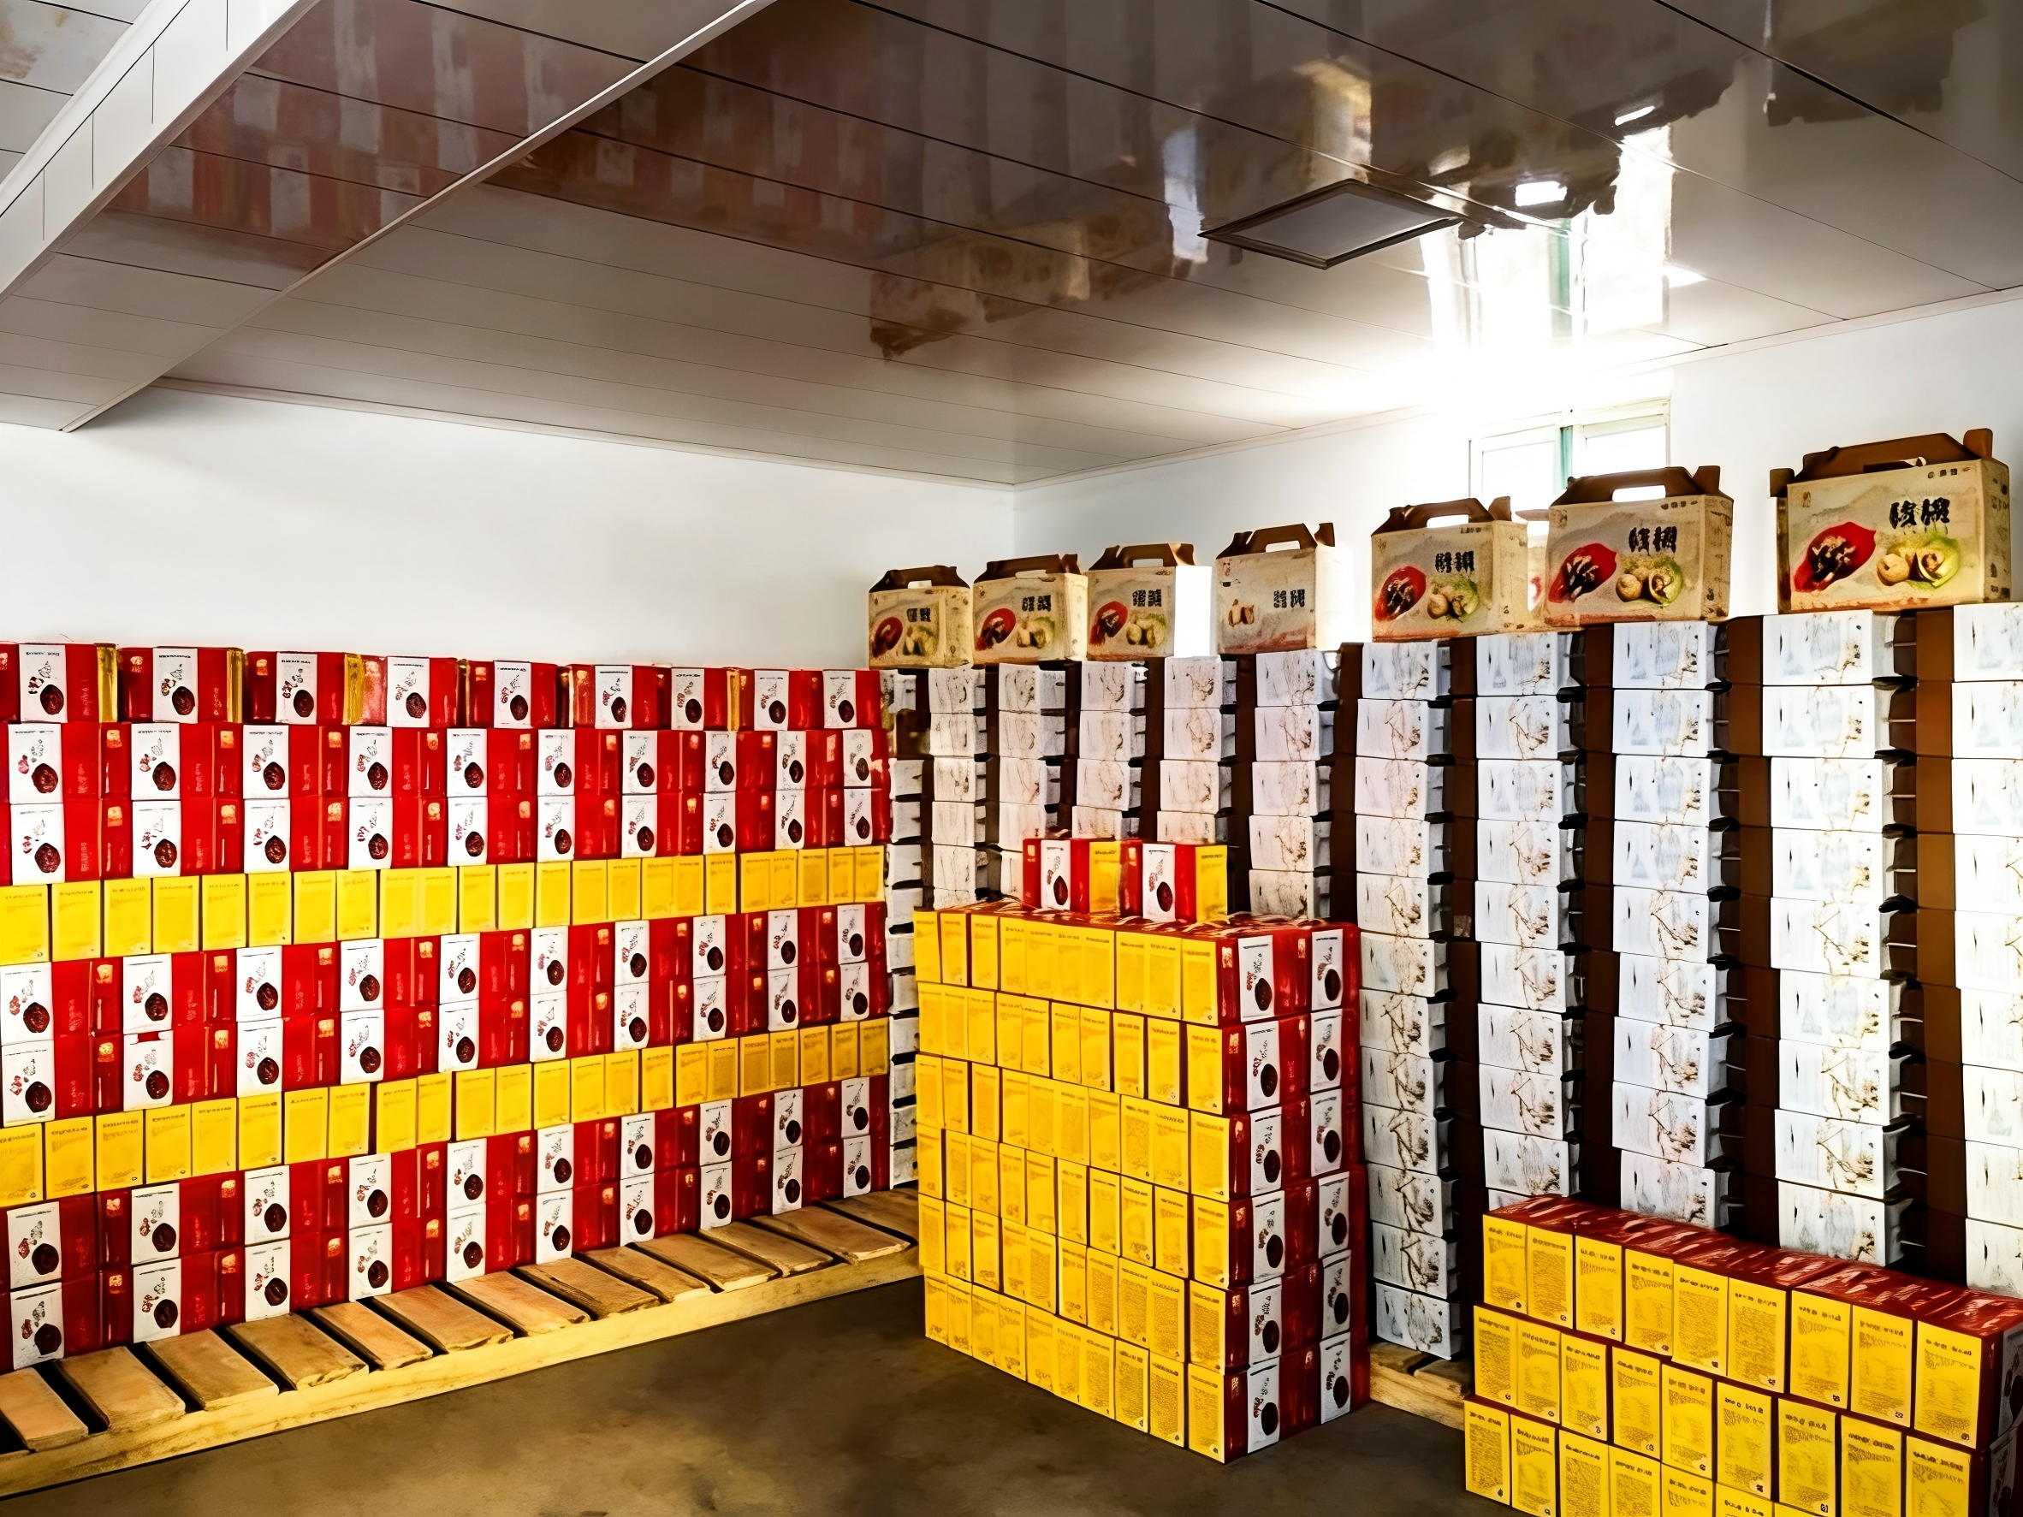
1. Eight Key Preparatory Steps Before Inbound Operations
(3) Proper warehouse layout planning
Systematic Location Planning
  The location of agricultural products within the warehouse should be planned systematically to avoid unnecessary secondary handling.
Storage Area Organization Criteria
  Product categories.
  Quality grades.
  Moisture conditions.
  Presence or absence of pests.
  Subsequent distribution or processing plans.
Notes:
3.Proper warehouse layout planning.
The location of agricultural products within the warehouse should be planned systematically to avoid unnecessary secondary handling.
Storage areas should be organized according to product categories, quality grades, moisture conditions, and the presence or absence of pests,
while also taking into account subsequent distribution or processing plans.
3.要合理安排库内农产品的位置，避免库内二次搬运，同时应按照农产品的种类、好次、干潮、有虫无虫等分仓储存，按调运、加工等计划安排仓房或货场。

Slide 9
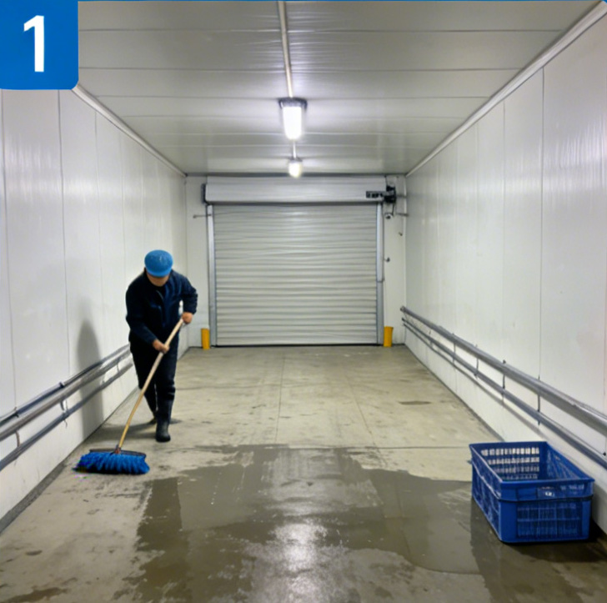
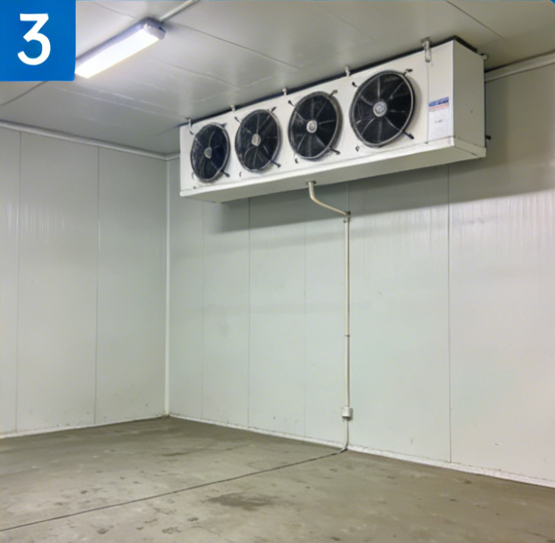
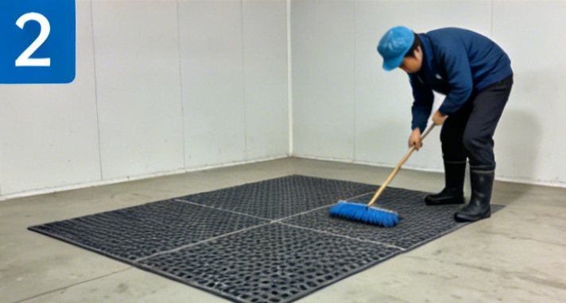
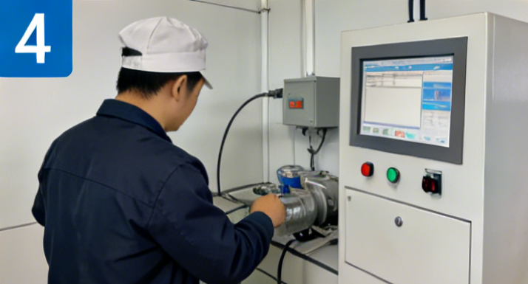
1. Eight Key Preparatory Steps Before Inbound Operations
(4) Preparation of Storage Areas
Cleaning, Clearing, and Sanitation
  Thoroughly clean the designated storage areas.
  Remove any residues.
  Clear drainage pipes or channels.
  Conduct disinfection and pest control when necessary.
Cleaning and Sanitation
Equipment Inspection
Protective Measures and Equipment Maintenance
  Lay protective ground coverings.
  Inspect lighting and ventilation equipment.
  Report and repair damaged equipment or facilities promptly.
Disinfection and Pest Control
Fault Handling
Notes:
4.Preparation of storage areas.
Warehouse staff must thoroughly clean the designated storage areas, remove any residues, clear drainage pipes or channels, and when necessary, conduct disinfection and pest control. They should also lay protective ground coverings and inspect lighting and ventilation equipment. Any damaged equipment or facilities should be reported and repaired promptly.
4.要准备货位，仓管员要及时进行货位准备，彻底清洁货位，清除残留物，清理排水管道或排水沟，必要时安排消毒除虫、铺地，检查照明、通风设备，发现损坏要及时通知修理。

Slide 10
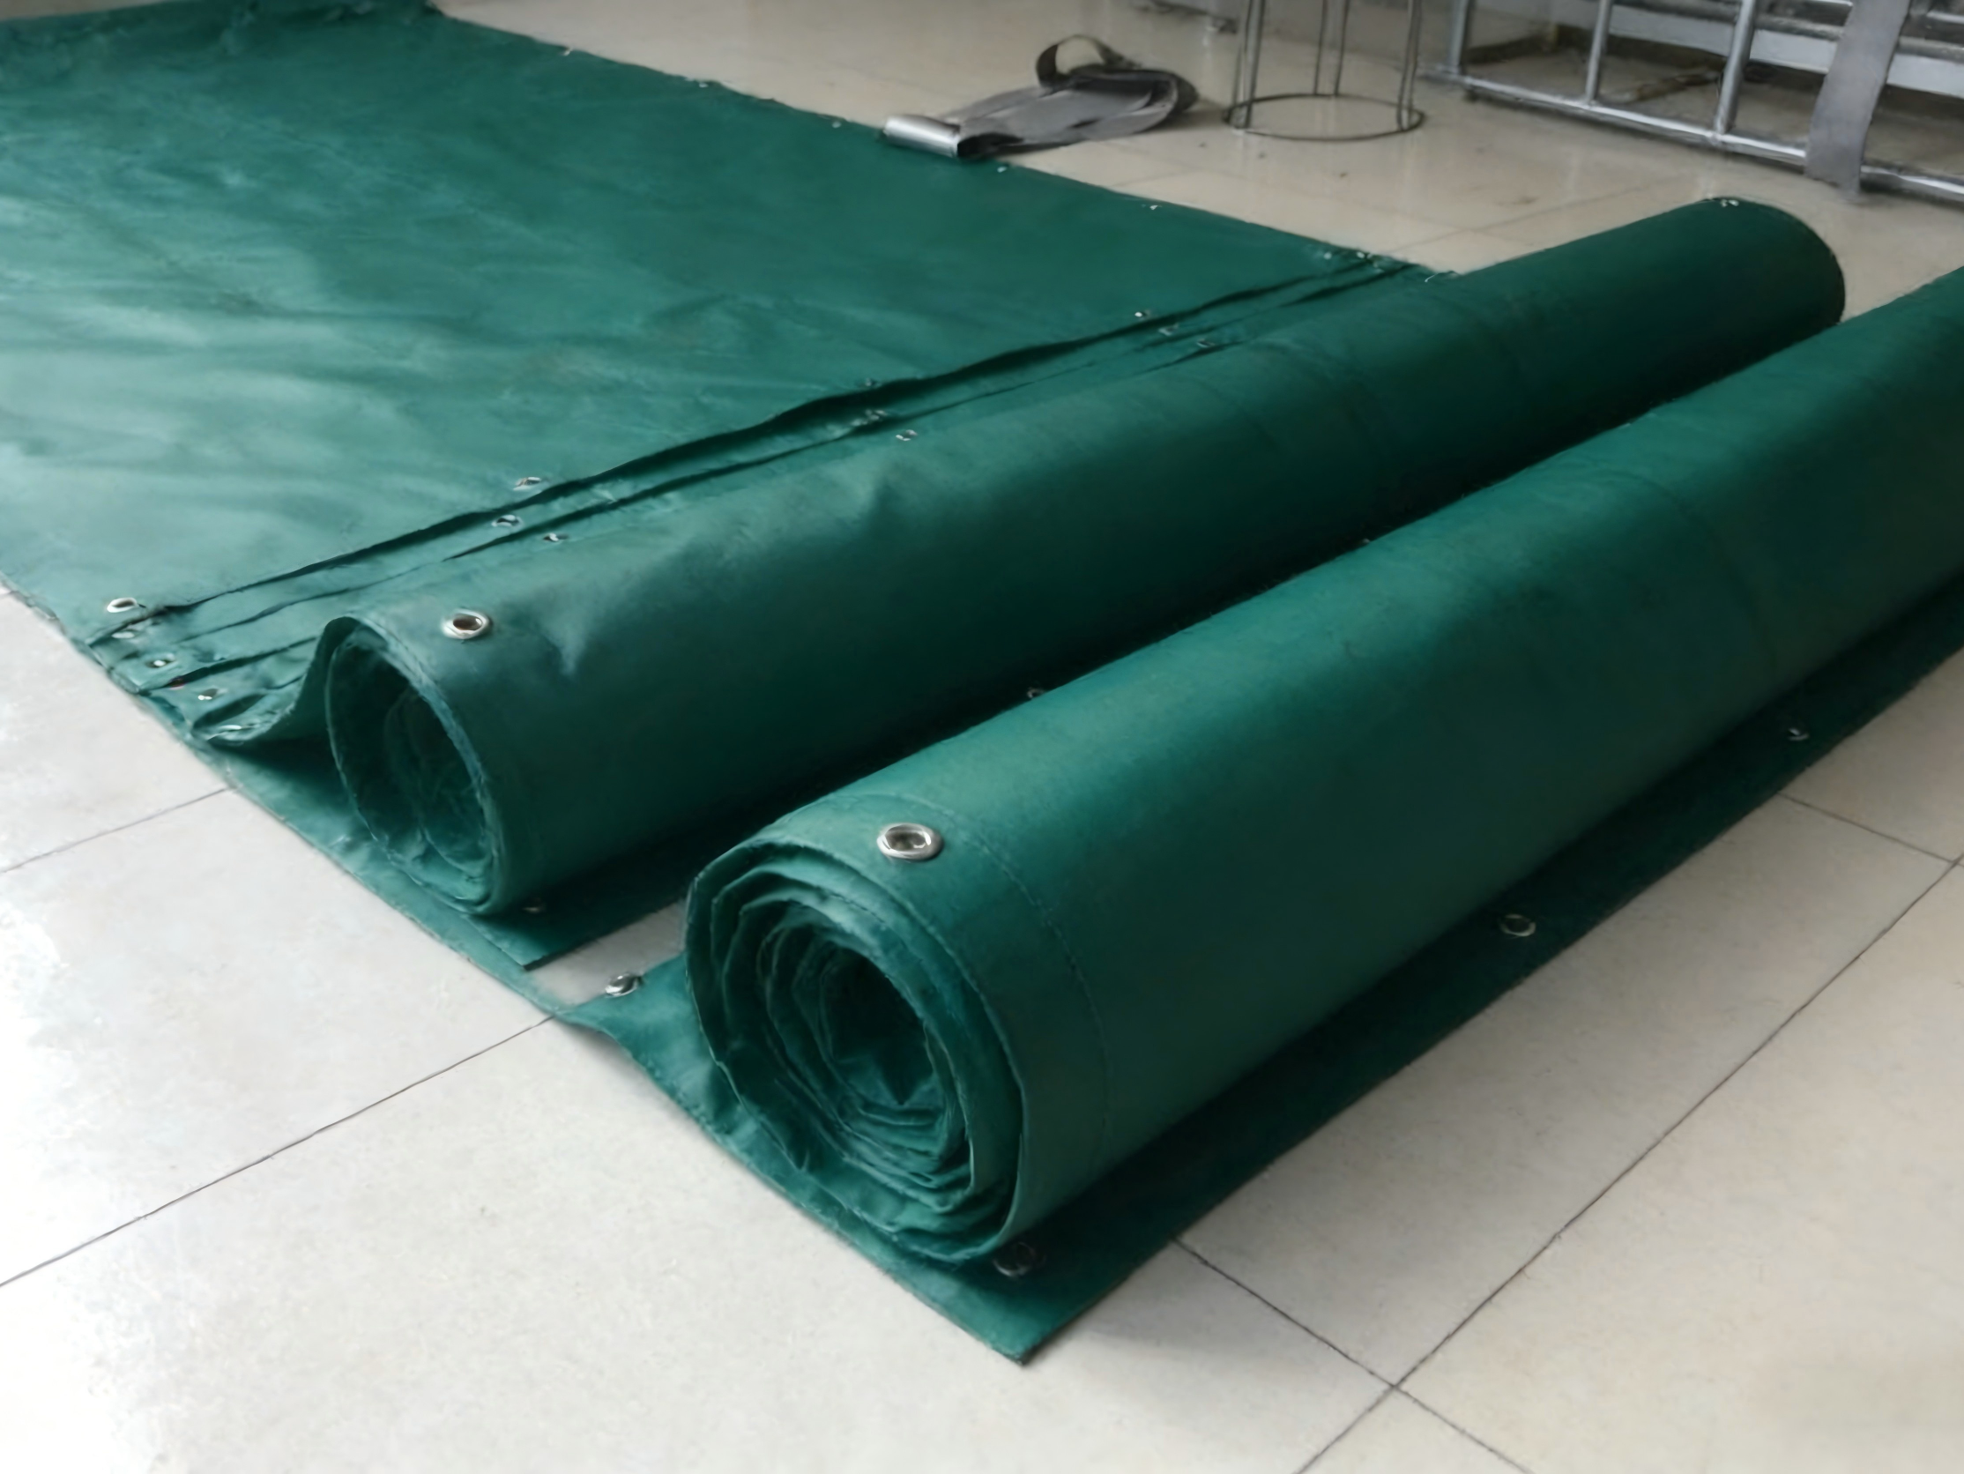
1. Eight Key Preparatory Steps Before Inbound Operations
(5) Preparation of materials and tools
Prepare Materials and Tools
  Based on the designated plan, prepare the required covering and padding materials and operational tools in advance.
Organize Setup Work
  Organize the placement or setup work before the agricultural products arrive.
Notes:
5.Preparation of covering and padding materials, and operational tools.
Based on the designated covering and padding plan,
the required materials should be prepared in advance, and the placement or setup work should be organized before the agricultural products arrive.
Preparation of materials and tools
Based on the designated plan, the required covering and padding materials and operational tools should be prepared in advance, and the placement or setup work should be organized before the agricultural products arrive.
5.要准备苫垫材料、作业用具。
在农产品入库前，根据所确定的苫垫方案准备相应的材料，并组织苫垫铺设作业。

Slide 11

1. Eight Key Preparatory Steps Before Inbound Operations
(6) Preparation for inspection and acceptance
Determine Inspection Methods
  Product characteristics and warehouse management regulations → determine the appropriate inspection methods.
Prepare Necessary Tools
  Prepare all necessary tools for counting, weighing, sampling, measuring, testing, opening and repacking, and portable lighting.
Notes:
6.Preparation for inspection and acceptance.
Based on product characteristics and warehouse management regulations,
warehouse tally clerks should determine the appropriate inspection methods and
prepare all necessary tools for counting, weighing, sampling, measuring, testing, opening and repacking, and portable lighting.
6.要做好验收准备。仓库理货人员根据货物情况和仓储管理制度，确定验收方法，准备验收所需要的点数、称量、测试、开箱、装箱、丈量、移动照明等工具。

Slide 12
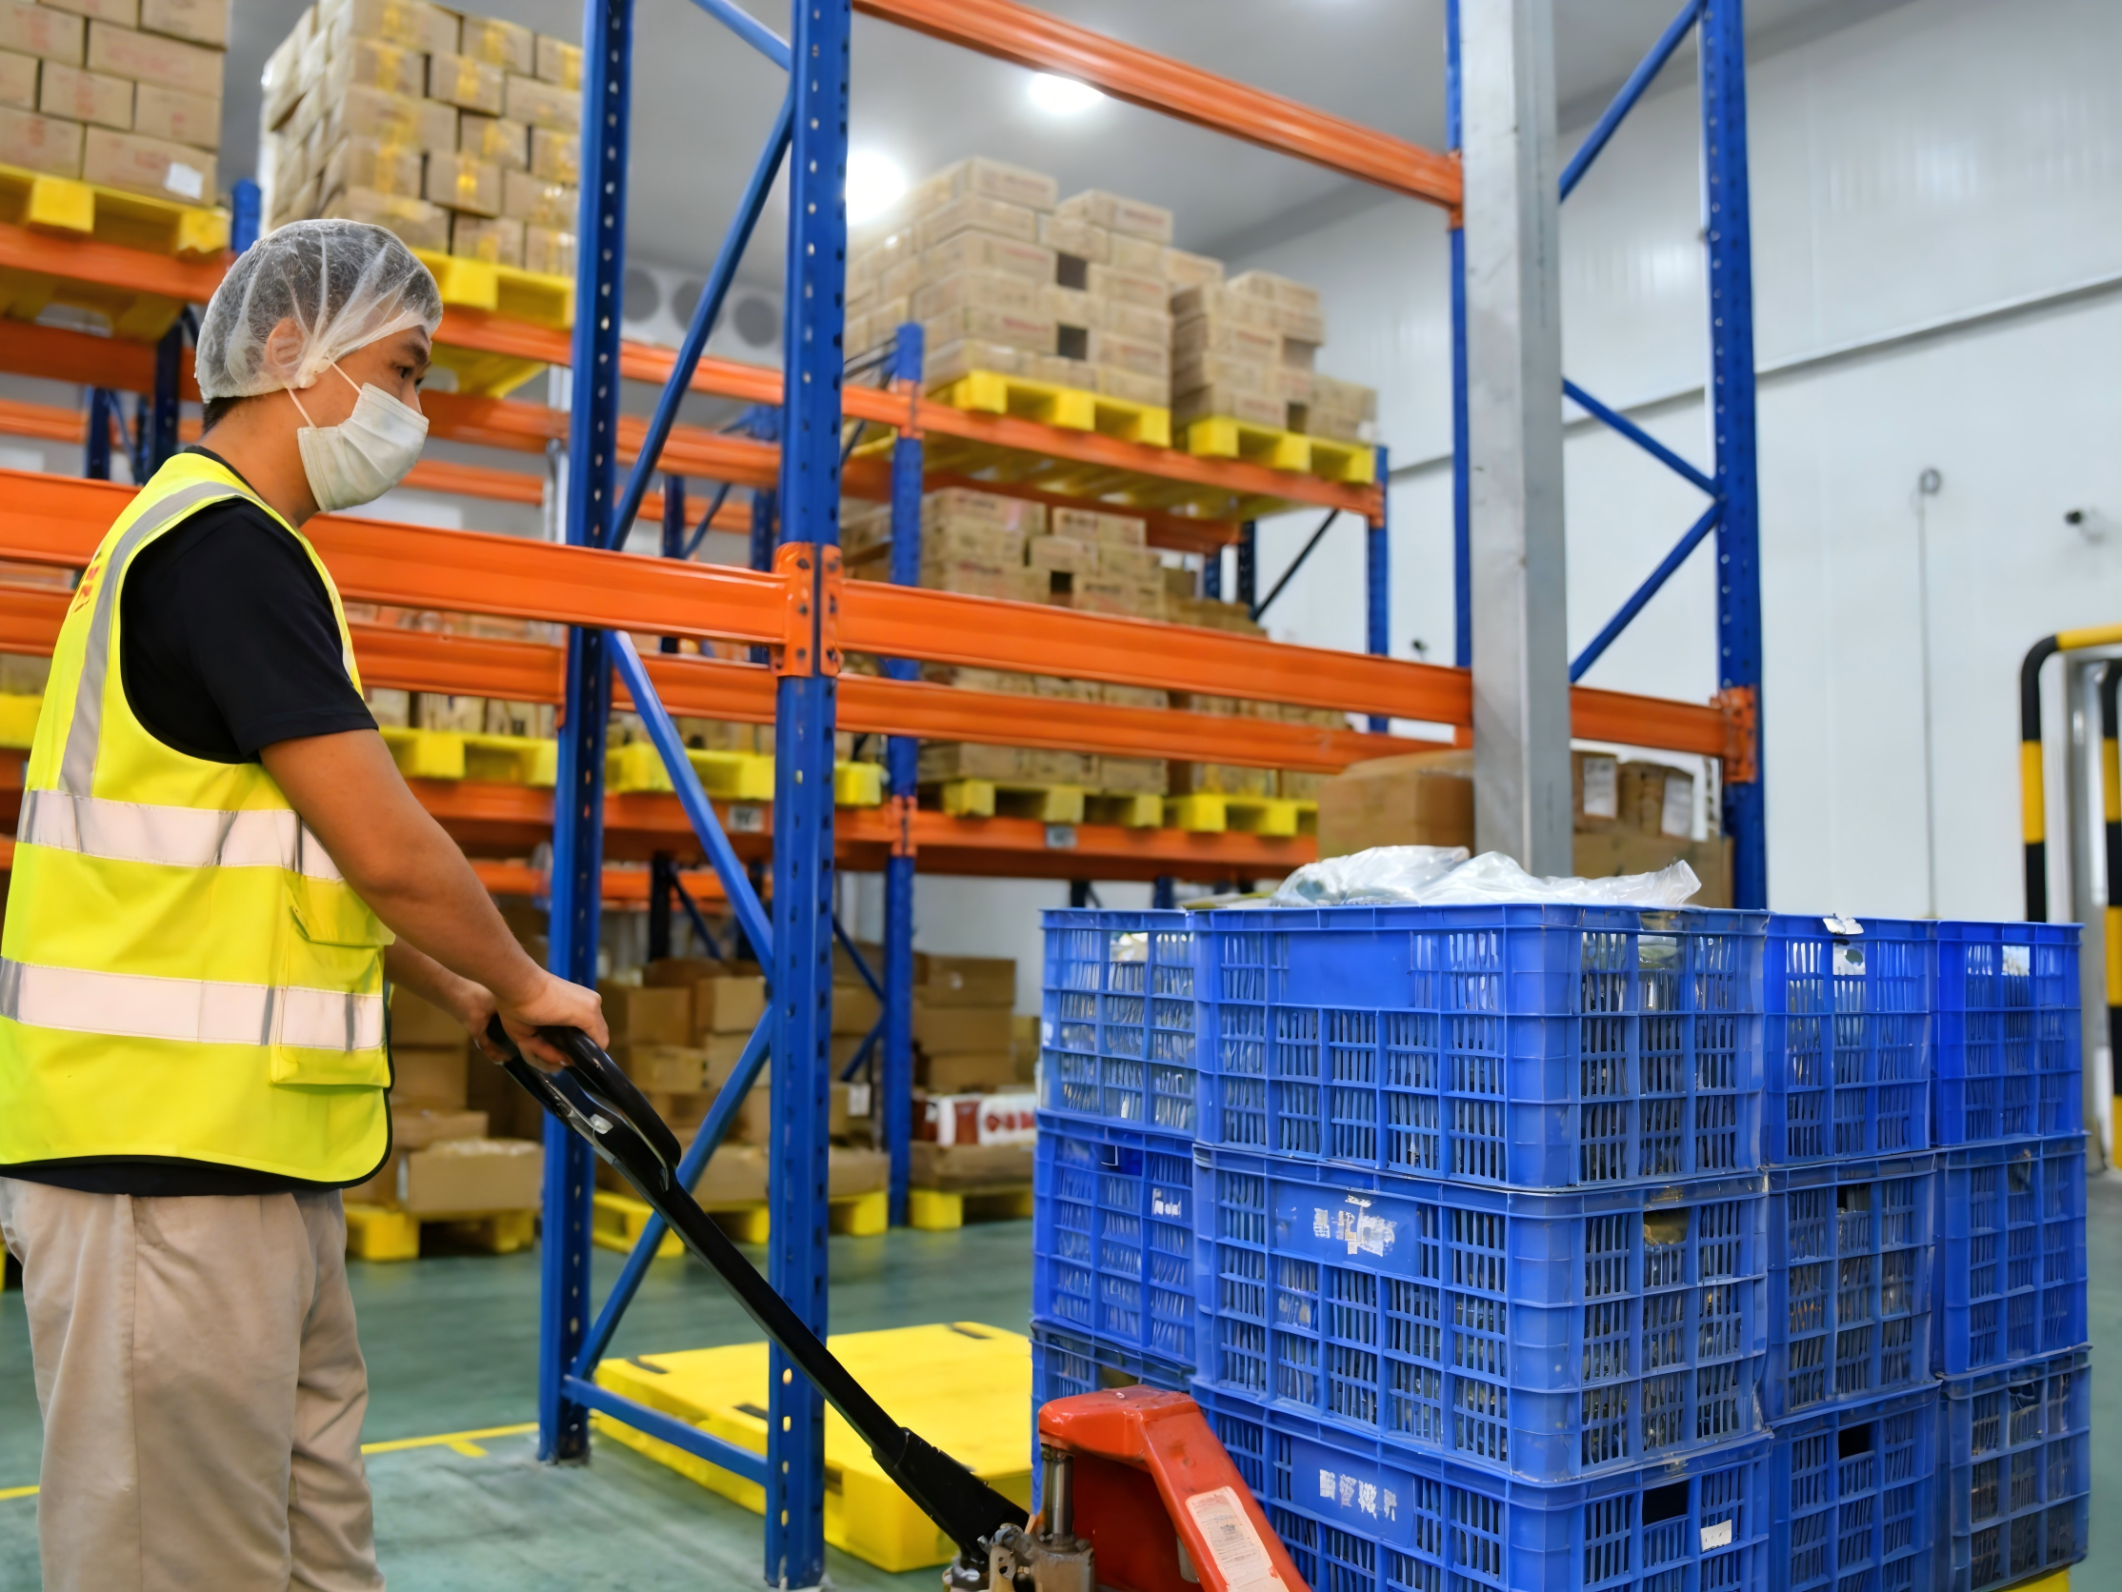
1. Eight Key Preparatory Steps Before Inbound Operations
(7) Establishing loading and unloading procedures
Identify Key Factors
  Consider product type, storage location, equipment conditions, and workforce.
Develop Operational Procedures
  Develop scientifically designed and efficient loading and unloading procedures to ensure operational safety and efficiency.
Notes:
7.Establishing loading and unloading procedures.
Based on product type, storage location, equipment conditions,
and workforce, scientifically designed and efficient loading and unloading procedures should be developed to ensure operational safety and efficiency.
7.要设定装卸搬运工艺。根据货物、货位、设备条件、人员等情况，合理科学地制定卸车搬运工艺、保证作业效率。

Slide 13

1. Eight Key Preparatory Steps Before Inbound Operations
(8) Preparation of documentation
Prepare Required Records
  Prepare all required forms, documents, and ledgers needed for inbound operations.
Adjust Preparatory Work
  As warehouse and product types differ, adjust the specific preparatory work according to actual conditions and warehouse management policies.
Notes:
8.Preparation of documentation.
Warehouse managers should prepare all required forms, documents, and ledgers needed for inbound operations.
As warehouse and product types differ,
the specific preparatory work should be adjusted according to actual conditions and warehouse management policies.
8.要准备文件单证。仓管员对货物入库所需要的各种报表、单证、账簿要准备好，以备使用。在实际操作中，不同仓库、不同货物的业务性质不同，入库准备工作也有所区别，需要根据具体情况和仓储管理制度做好充分准备。

Slide 14
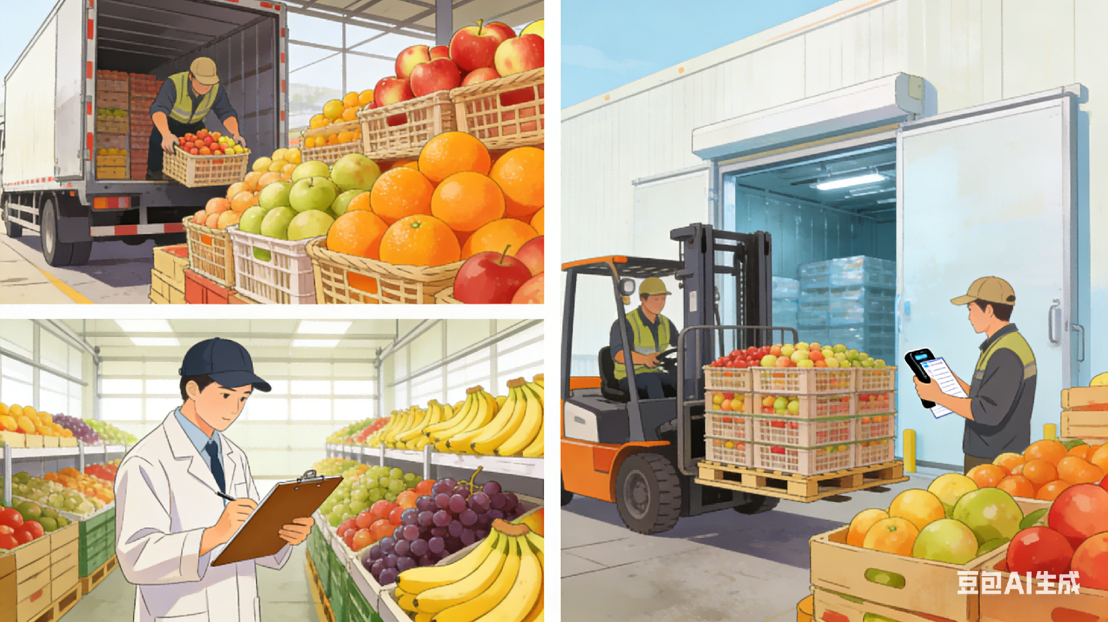
2. Inbound Warehouse Operations for Agricultural Products
Overall Process
  Preparatory work completed → proceed to inbound operation.
Three Stages
  Transportation and receiving.
  Inspection and acceptance.
  Inbound handover.
Notes:
2.Inbound Warehouse Operations for Agricultural Products
After completing the preparatory work, the next step is the actual inbound operation, which generally includes three stages: transportation and receiving, inspection and acceptance, and inbound handover.
（二）农产品仓储入库作业
做好农产品入库前的主要准备工作后，下一步是农产品的入库作业。
入库作业一般由接运、验收和入库交接三个环节构成。

Slide 15
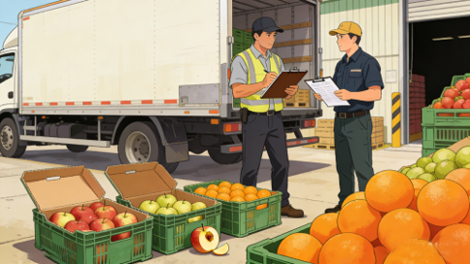
2. Inbound Warehouse Operations for Agricultural Products
Transportation and receiving
First stage of inbound operations.
Requirements:
  Proper documentation.
  Clear accountability.
Purpose:
  Prevent damaged goods—caused by transportation or pre-transport handling—from being brought into the warehouse.
Notes:
A.Transportation and receiving.
This is the first stage of inbound operations. Proper documentation and clear accountability are required to prevent bringing damaged goods –caused by transportation or pre-transport handling- from being brought into the warehouse.
1.农产品接运是农产品入库的第一道作业环节，要求手续清楚，责任分明，避免将一些在运输过程中或运输前已经损坏的农产品带入仓库。

Slide 16

2. Inbound Warehouse Operations for Agricultural Products
Inspection and acceptance
Purpose
  Before formal storage → inspect products according to prescribed procedures → verify quantity and quality.
Quantity Inspection
  Count individual units for piece goods.
  Weighing or theoretical conversion for weight-based goods.
Quality Inspection
  Physical, chemical, and biological analyses.
  Evaluate specifications, composition, and technical standards.
  Sensory methods (when applicable): sight, sound, touch, smell, taste.
Notes:
B.Inspection and acceptance.
Before formal storage, products must be inspected according to prescribed procedures to verify both quantity and quality.
2. 入库验收是指农产品在正式进入仓库前，严格按照一定的程序和手续，对所接运的物品进行必要的检查，包括农产品的数量和外观质量。
Quantity inspection involves counting individual units for piece goods and weighing or theoretical conversion for weight-based goods.
数量验收指的是计件商品要清点全部件数，计算方法通常是采用轧点计算，计重商品的重量采用过磅，或理论换算的方法求得。
Quality inspection may involve physical, chemical, and biological analyses using instruments and equipment to evaluate specifications, composition, and technical standards. In some cases, sensory methods (sight, sound, touch, smell, taste) are used for assessment.
质量验收可利用各种试剂，仪器和机器设备，对商品的规格、成分、技术标准等进行物理、化学和生物的性能分析，也可以直接用视觉、听觉、触觉、嗅觉和味觉等感官检验来检验商品质量。

Slide 17
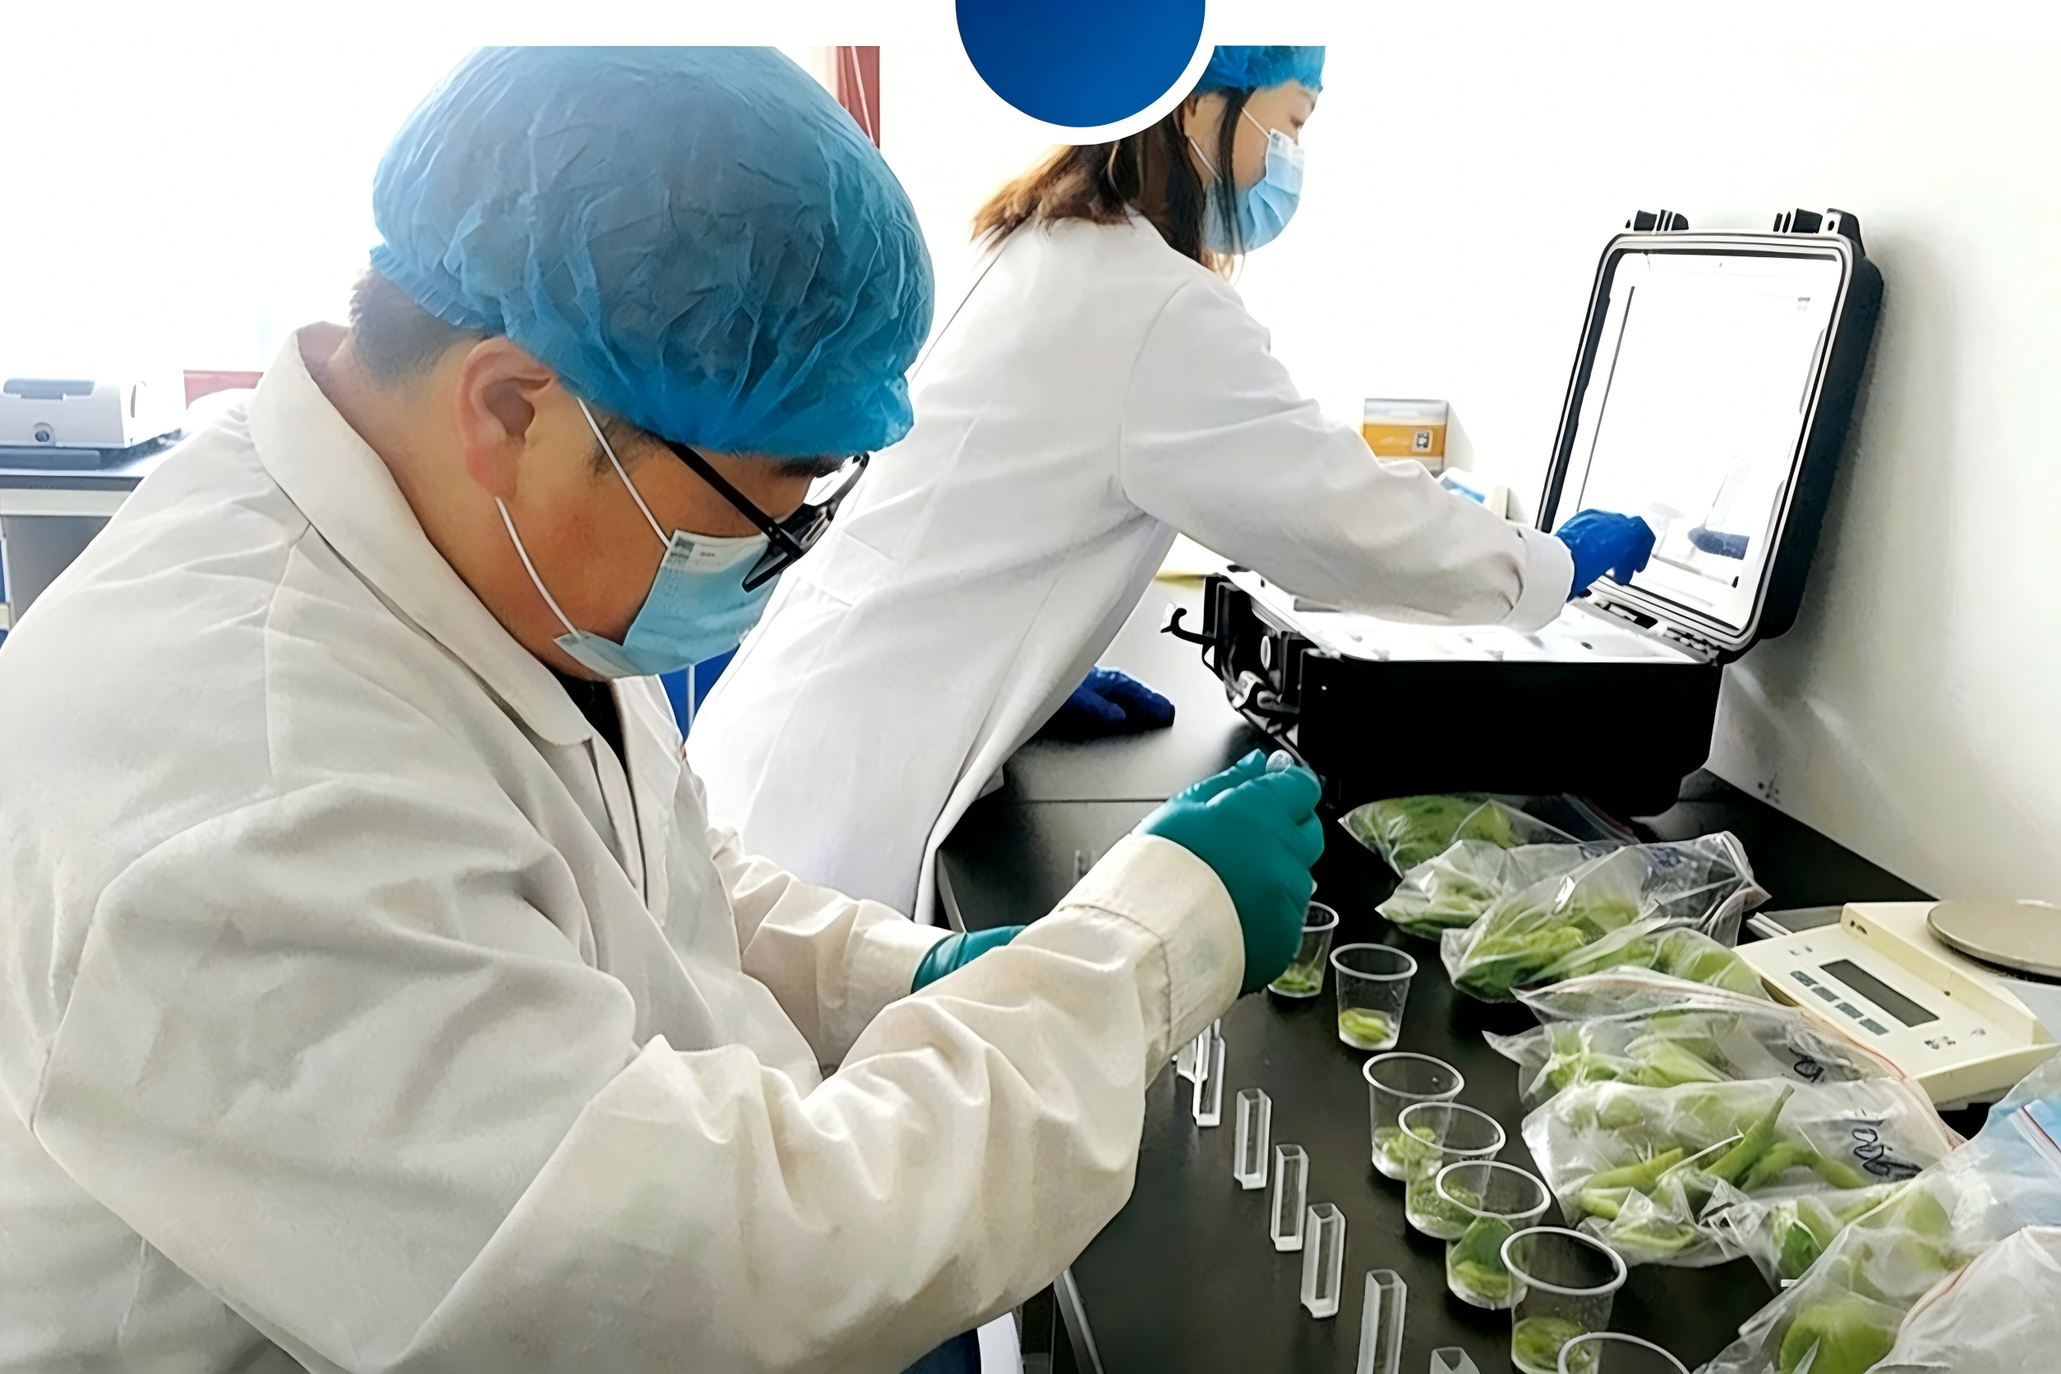
2. Inbound Warehouse Operations for Agricultural Products
Inspection and acceptance
Sampling Inspection
  Used to improve efficiency.
  Sampling ratio should be determined based on:
    Product characteristics
    Transport conditions
    Product value
    Climate
    Production technology
    Packaging
    Supplier credibility
Notes:
To improve efficiency, sampling inspection can be employed. The sampling ratio should be determined based on product characteristics, value, production technology, supplier credibility, transport conditions, climate, and packaging.
为节约人力，提高商品入库速度，有时也可采用抽样检验，验收比例可参考农产品的性质、特点、价值、生产技术条件，供货单位的信誉、运输条件、气候条件和包装情况合理制定。

Slide 18
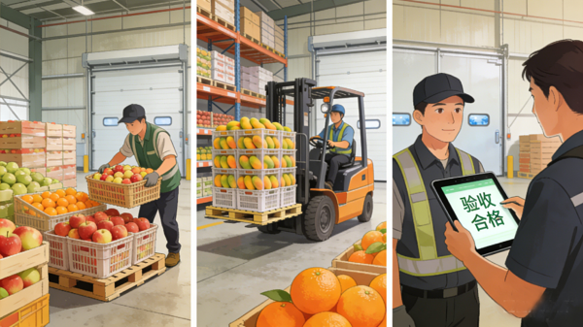
2. Inbound Warehouse Operations for Agricultural Products
Inbound handover
Key Process:
  → Agricultural products pass quantity and quality inspection.
  → Management staff arrange unloading and warehousing.
  → Complete the handover procedures.
Notes:
C.Inbound handover.
After the agricultural products pass quantity and quality inspection, the management staff arrange unloading and warehousing while completing the handover procedures, there by successfully concluding the inbound handover process.
3. 入库交接。农产品经过数量和质量的检验合格后，由管理人员安排卸货、入库，同时办理交接手续，即圆满完成入库交接工作。

Slide 19
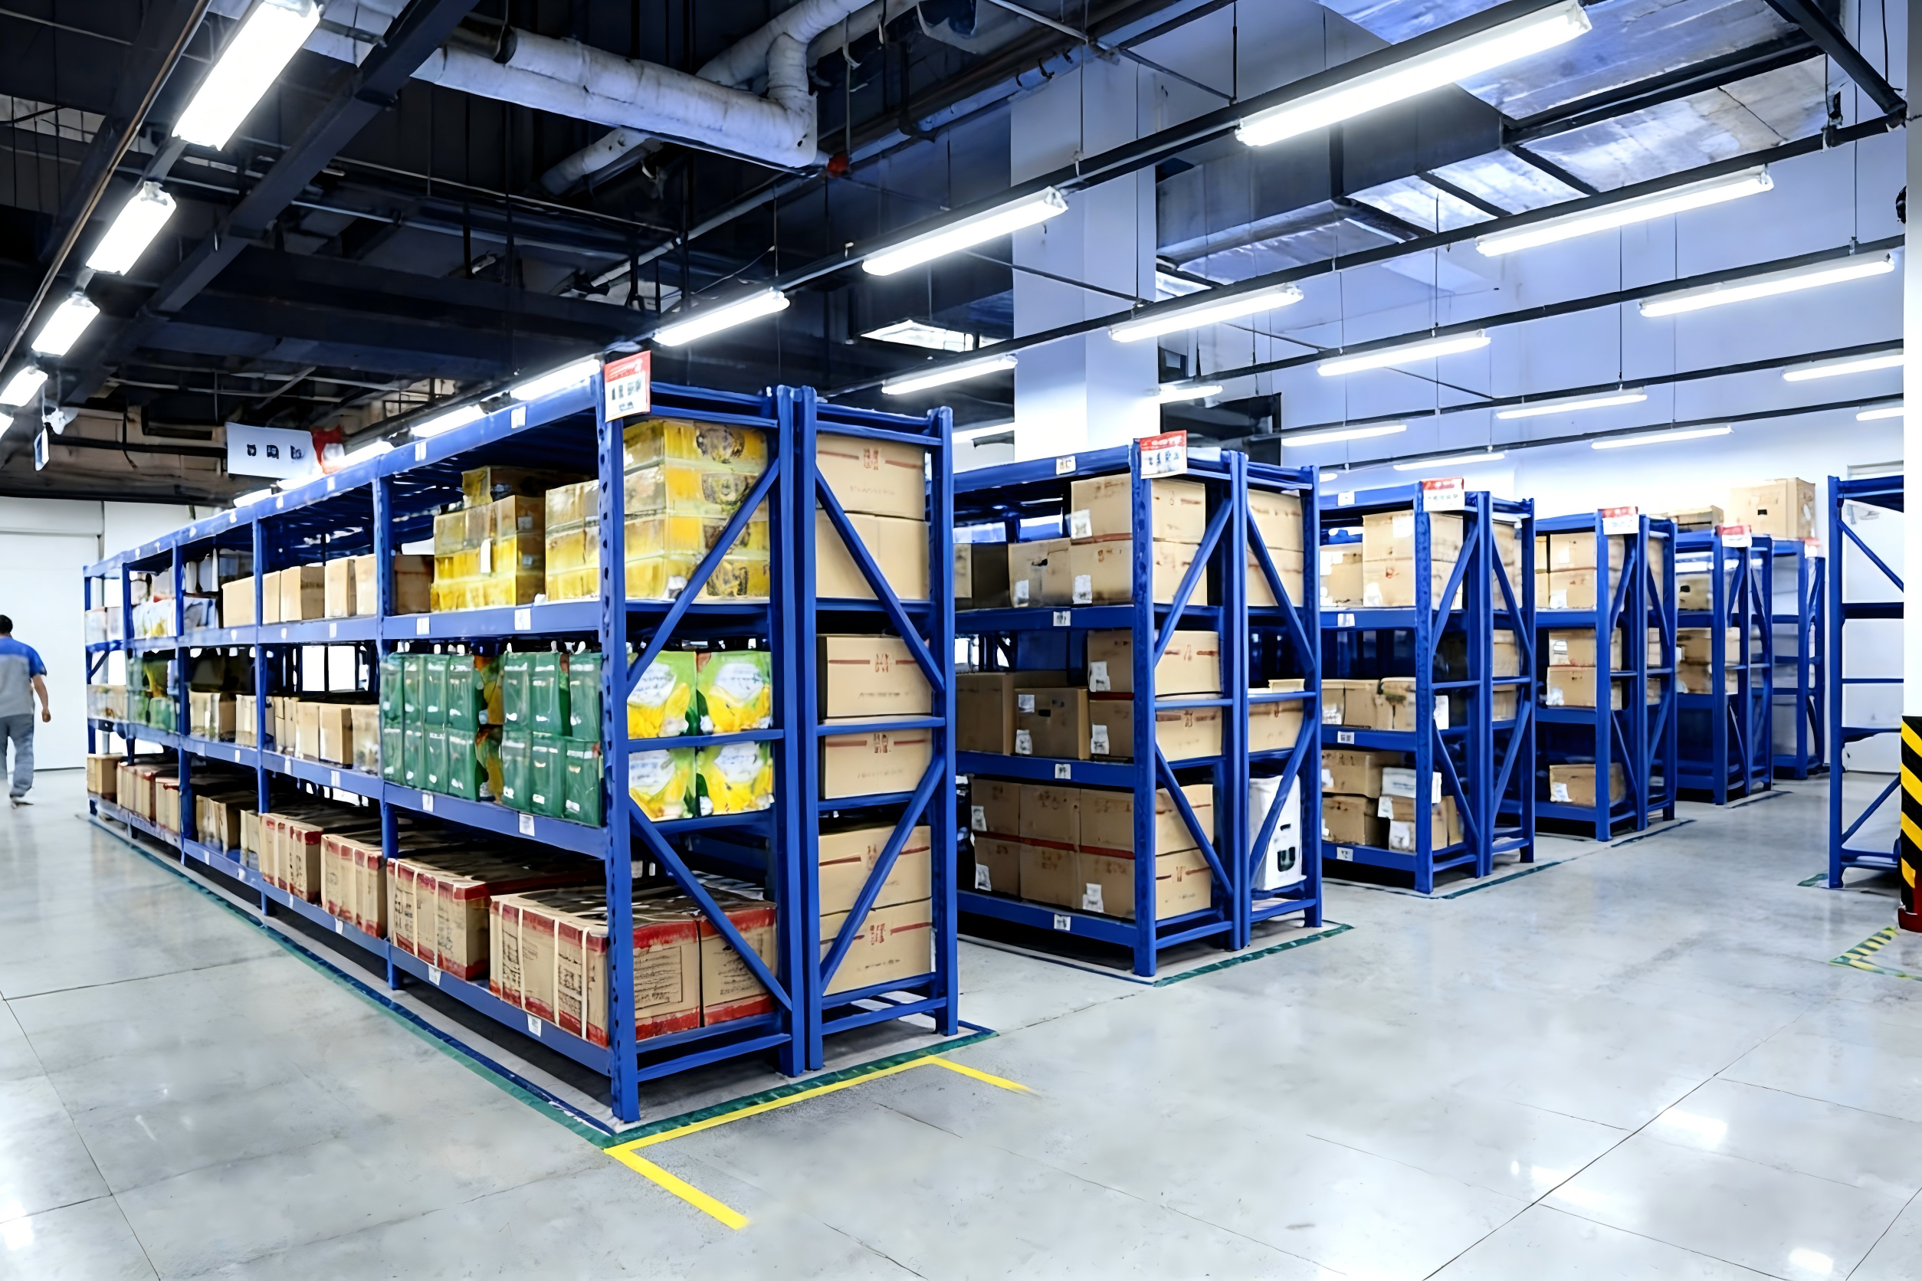
3. In-Storage Management of Agricultural Products
Definition
  In-storage management: all activities involved in the custody and control of product quantity and quality during storage.
Core Activates
  Tallying
  Stacking
  Maintenance
  Preservation
Notes:
3.In-Storage Management of Agricultural Products
In-storage management refers to all activities involved in the custody and control of product quantity and quality during storage. This includes tallying, stacking, maintenance, and preservation.
（三）农产品在库保管工作。
在库保管是对农产品进行存储及对其数量、质量进行控制的活动，主要包括对农产品的理货、堆存、养护、保管等业务。

Slide 20
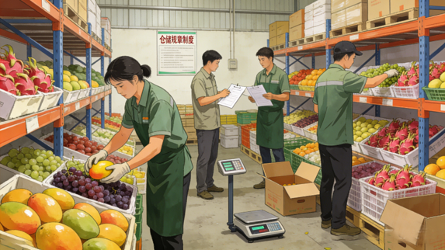
3. In-Storage Management of Agricultural Products
Tallying
Verify quantities.
Check external quality.
Sort and classify products.
Follow inbound documents, transport records, and warehouse contracts.
Notes:
Tallying involves verifying quantities, checking external quality, sorting and classifying products according to inbound documents, transport records, and warehouse contracts.
理货是指农产品仓库在接收入库农产品时，根据入库单、运输单据、仓储合同和仓储规章制度，对农产品进行数量清点，检查外表质量，分类分拣，数量验收等交接工作。

Slide 21
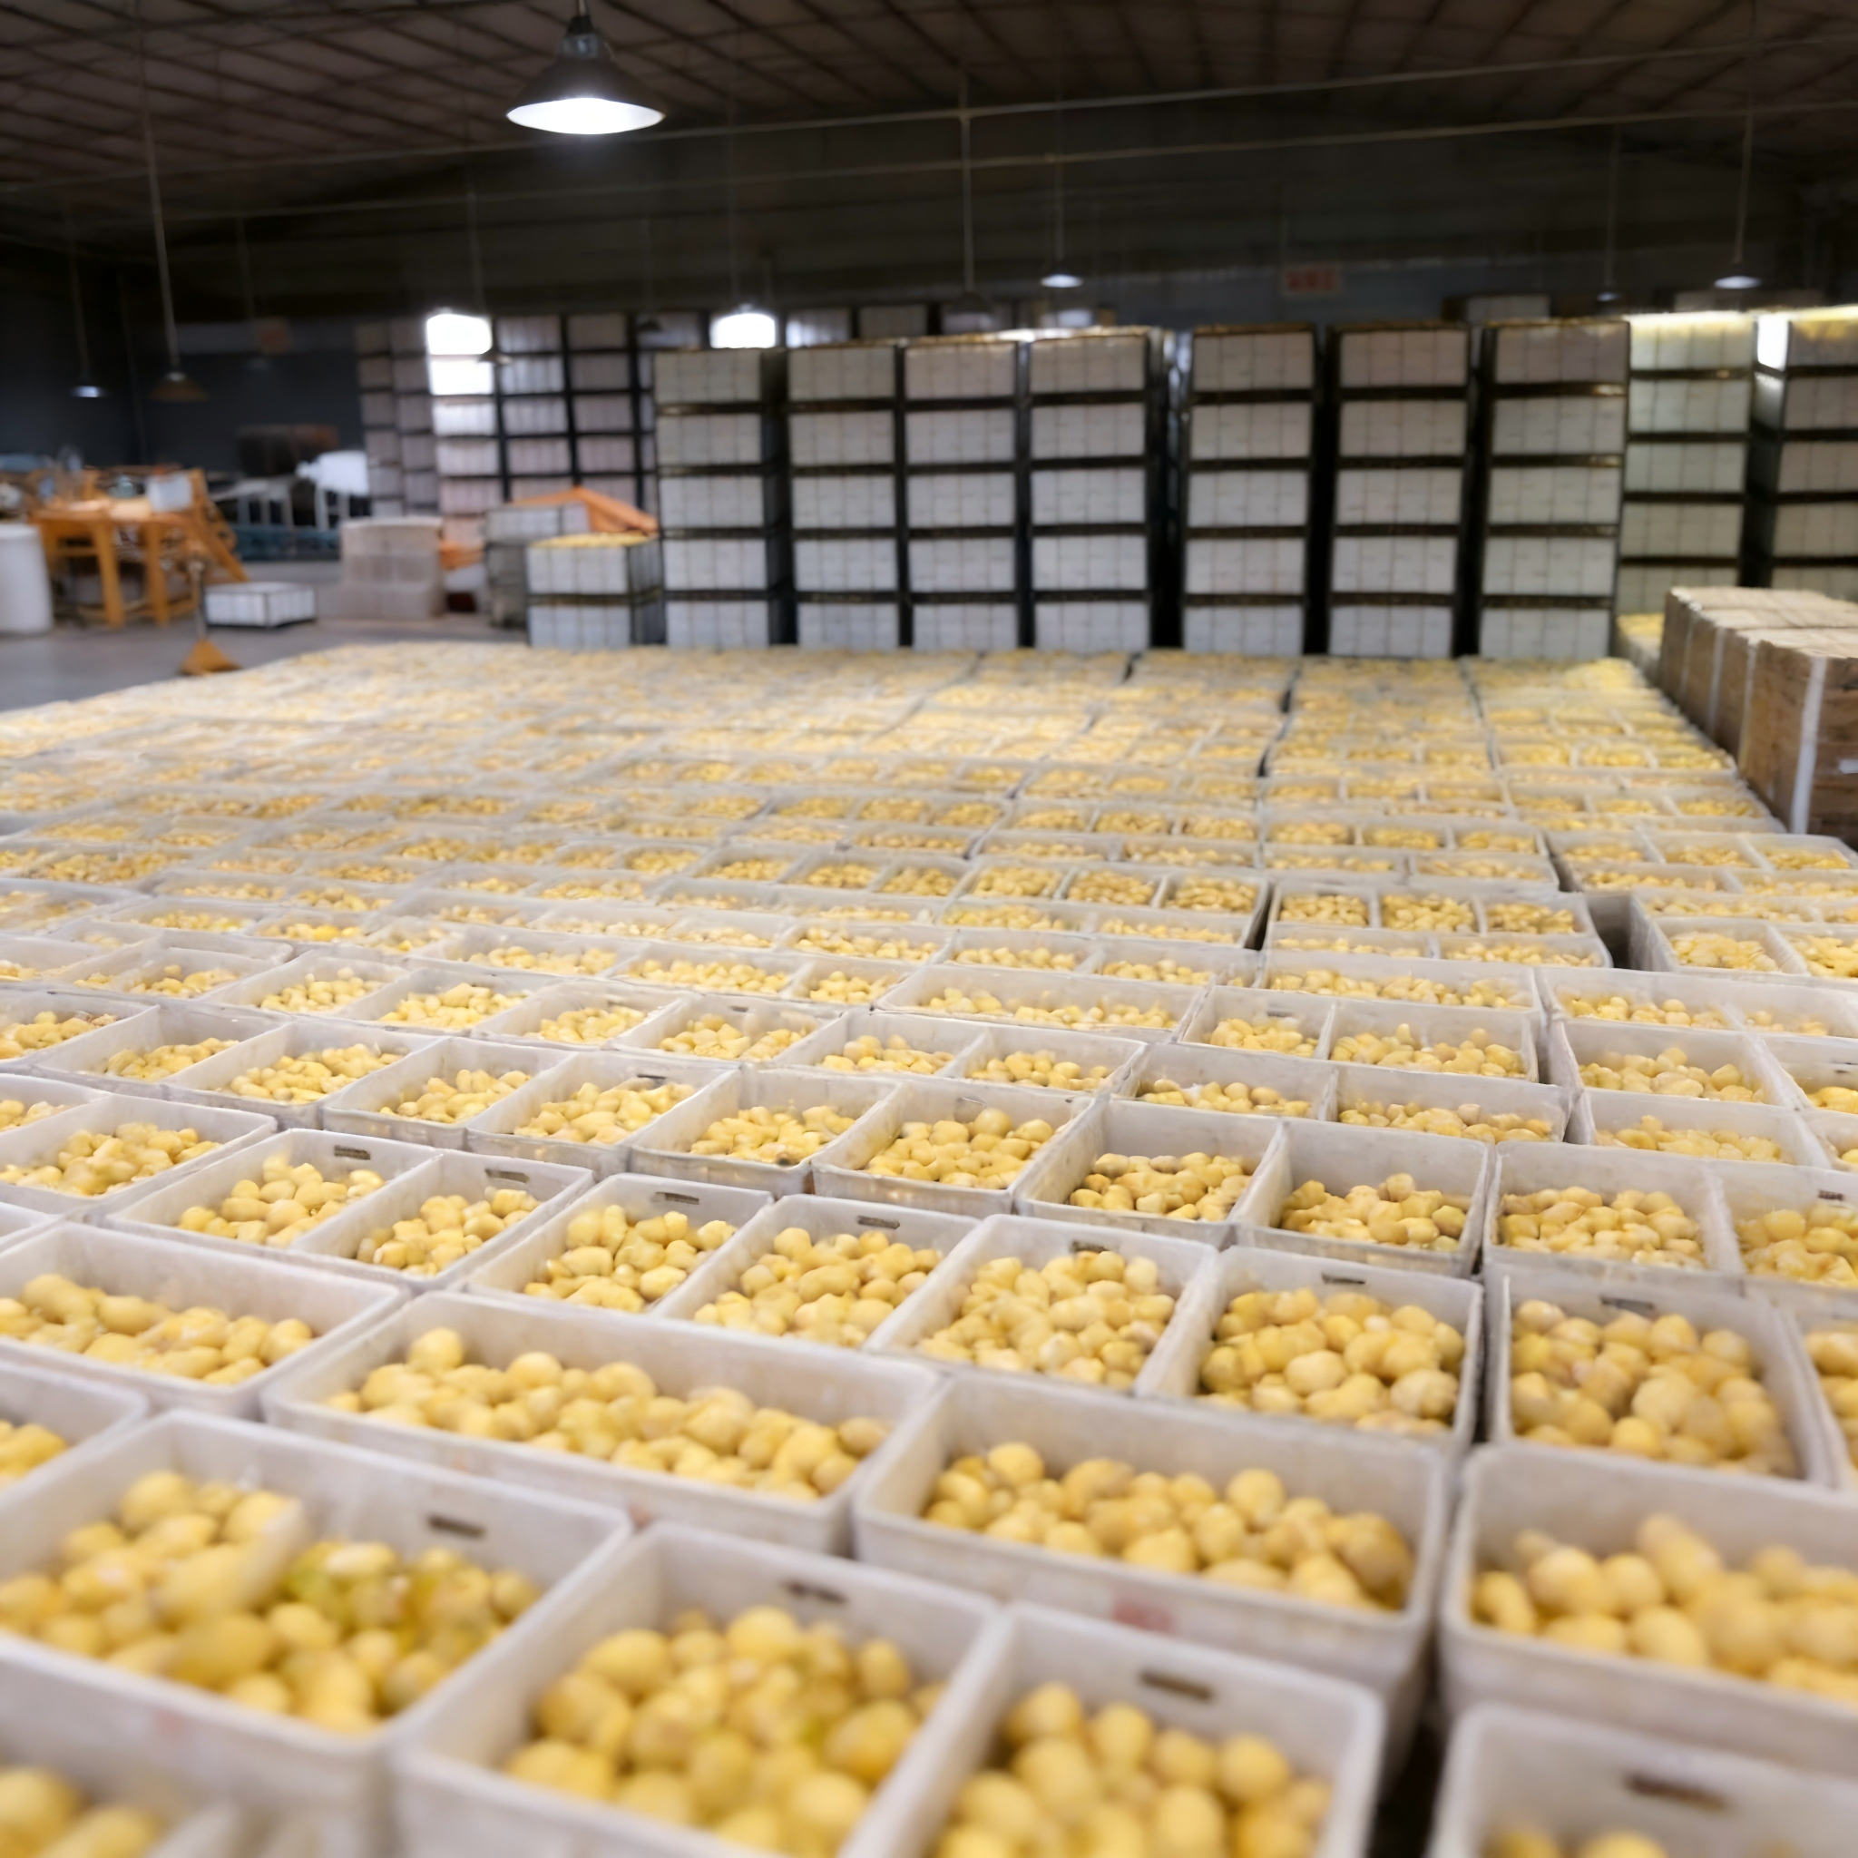
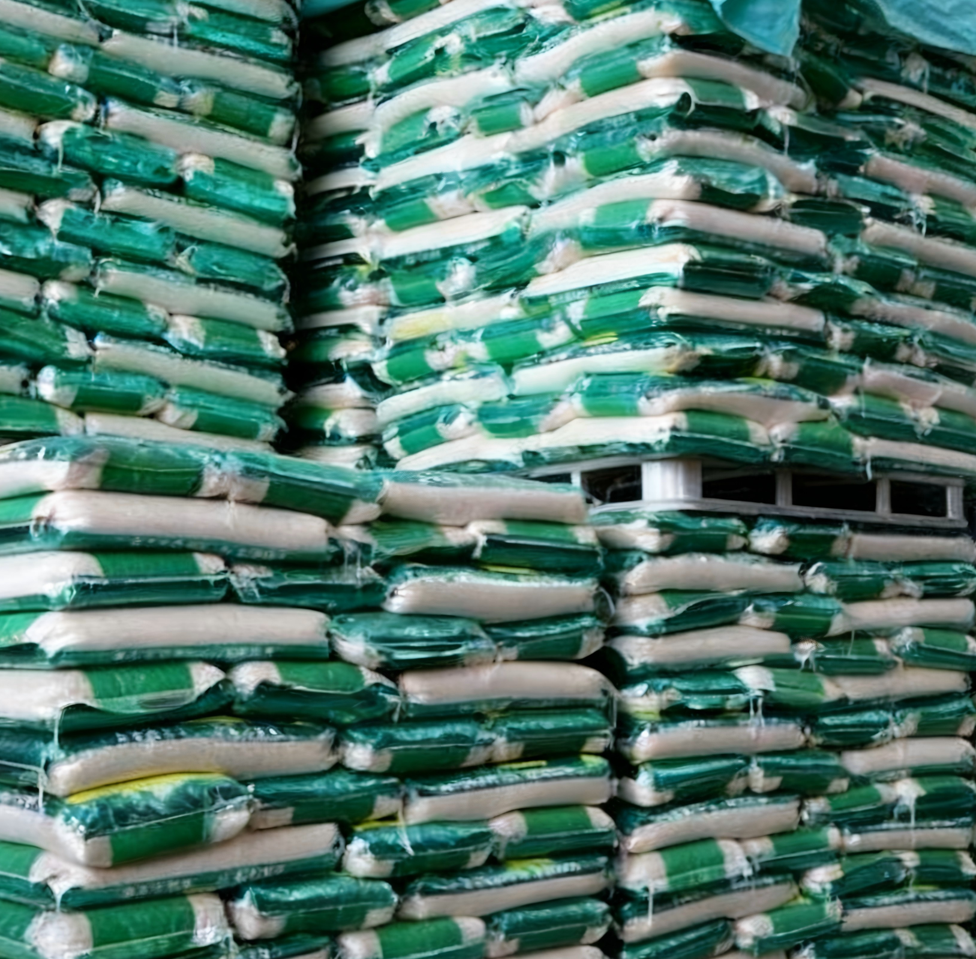
3. In-Storage Management of Agricultural Products
Stacking
Influencing Factors
  Arrange products according to their nature, quantity, packaging, and seasonal requirements.
  Ensure stacks are in a stable and orderly manner.
Ventilation Requirements
  Leave adequate ventilation space between stacks to allow air circulation and prevent heat and moisture accumulation.
Common Stacking Methods
  "井"-type/cross-stacking.
  "非"-type.
  Semi-"非"-type.
Notes:
Stacking refers to arranging products according to their nature, quantity, packaging, and seasonal requirements in a stable and orderly manner. Adequate ventilation space must be left between stacks to allow air circulation and prevent heat and moisture accumulation. Common stacking methods include “井”-type (cross-stacking), “非”-type, and semi- “非”-type arrangements.
商品堆码是指根据商品的性质、数量，及其包装、质量、形状，以及仓库条件，按季节变化的要求采取适宜的形式、方法，将商品堆放稳固、整齐。为了保证农产品质量的完好，农产品堆码时要留有足够的空隙，以便于通风、散热和散湿。常见的堆码方式有“井”字形、“非”字形，半“非”字形等。

Slide 22
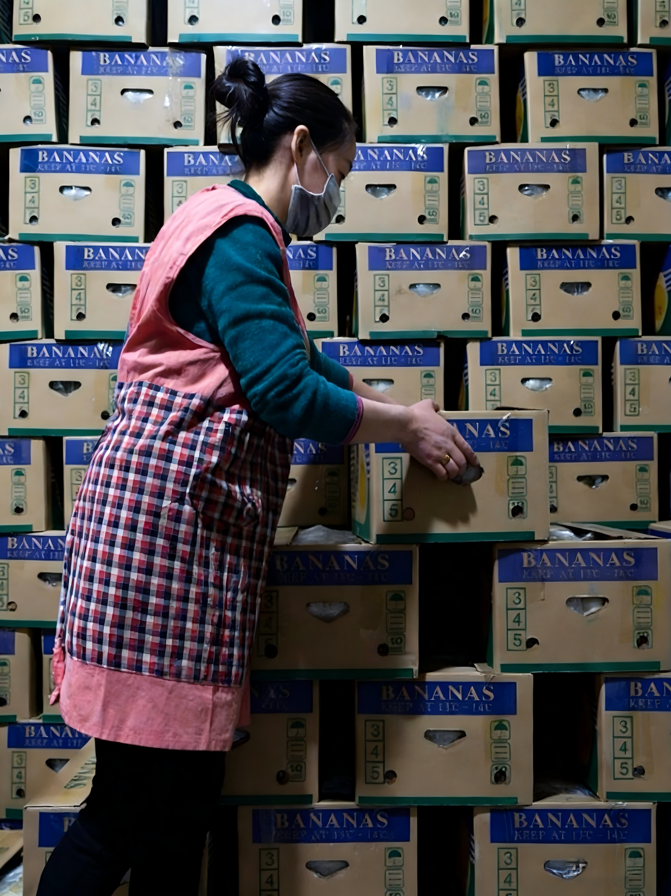
3. In-Storage Management of Agricultural Products
Preservation of agricultural products
Products should face passageways → facilitate access.
Heavier items placed at the bottom, lighter ones on upper shelves.
Stack vertically where possible → facilitate efficient use of space.
Perishable or fragile goods should follow the first-in, first-out (FIFO) principle to ensure timely turnover.
Space & Accessibility
Weight & Fragility Management
Notes:
Preservation of agricultural products:
To facilitate access and efficient use of space, products should face passageways and be stacked vertically where possible. Heavier items should be placed at the bottom, lighter ones on upper shelves.
Perishable or fragile goods should follow the first-in, first-out (FIFO) principle to ensure timely turnover
农产品的保管。
农产品仓储保管的原则有：为使农产品出入库方便，容易在仓库内移动，应将农产品面向通道保管，为有效利用库内容积，应尽量向高处码放，安排放置场所时，质量大的农产品放在下面，质量小的农产品放在货架上方。

Slide 23
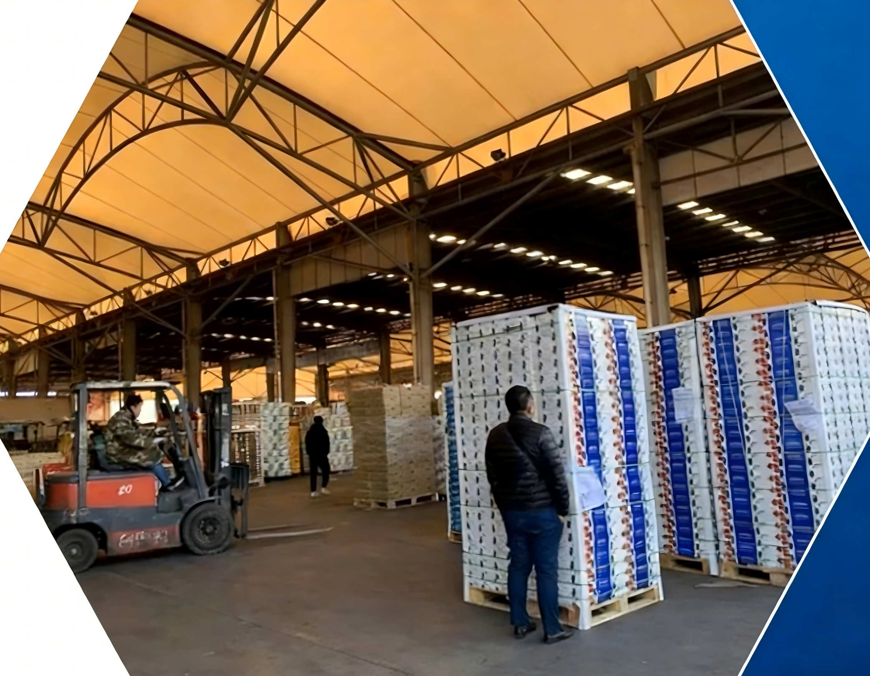
3. In-Storage Management of Agricultural Products
Location Strategy
High-frequency items stored near entrances/exits.
Low-turnover items placed deeper inside.
Seasonal goods positioned according to their active periods.
Similar / identical products stored together to improve efficiency.
Notes:
High-frequency items should be stored near entrances and exits; low-turnover items can be placed deeper inside. Seasonal goods should be positioned according to their active periods. Similar or identical products should be stored together to improve efficiency.
对于易变质、易破损、易腐败的农产品，应尽可能地按先入先出的原则加快周转。
出货和进货频率高的农产品，应放在靠近出入口，易于作业的地方；流动性差的农产品放在距离出入口稍远的地方；季节性强的农产品，则依其季节特性来选定放置的场所。为提高作业效率和保管效率，同一农产品或类似农产品应放在同一地方保管。

Slide 24
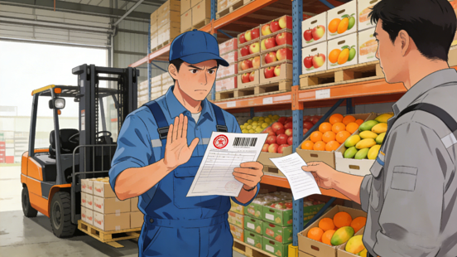
4. Outbound Operations for Agricultural Products
Requirements for Outbound Operations
  Conducted strictly in accordance with established procedures.
  Delivery documents
  → valid + properly authorized.
  → Informal or handwritten notes are not accepted.
  Items Shipped First:
    Shorter shelf life.
    Simpler packaging.
    Higher risk of spoilage.
Notes:
4.Outbound Operations for Agricultural Products
Outbound operations must be conducted strictly in accordance with established procedures.
Delivery documents must be valid and properly authorized; informal or handwritten notes are not accepted.
Under the condition that product usability is preserved, the FIFO principle should be followed: items with shorter shelf life, simpler packaging, or higher risk of spoilage should be shipped first.
（四）农产品出库
农产品出库作业管理的要求有：
农产品出库必须按照规定程序进行。农产品提货单据必须符合要求；非正式凭证或白条一律不得发料出库；

Slide 25
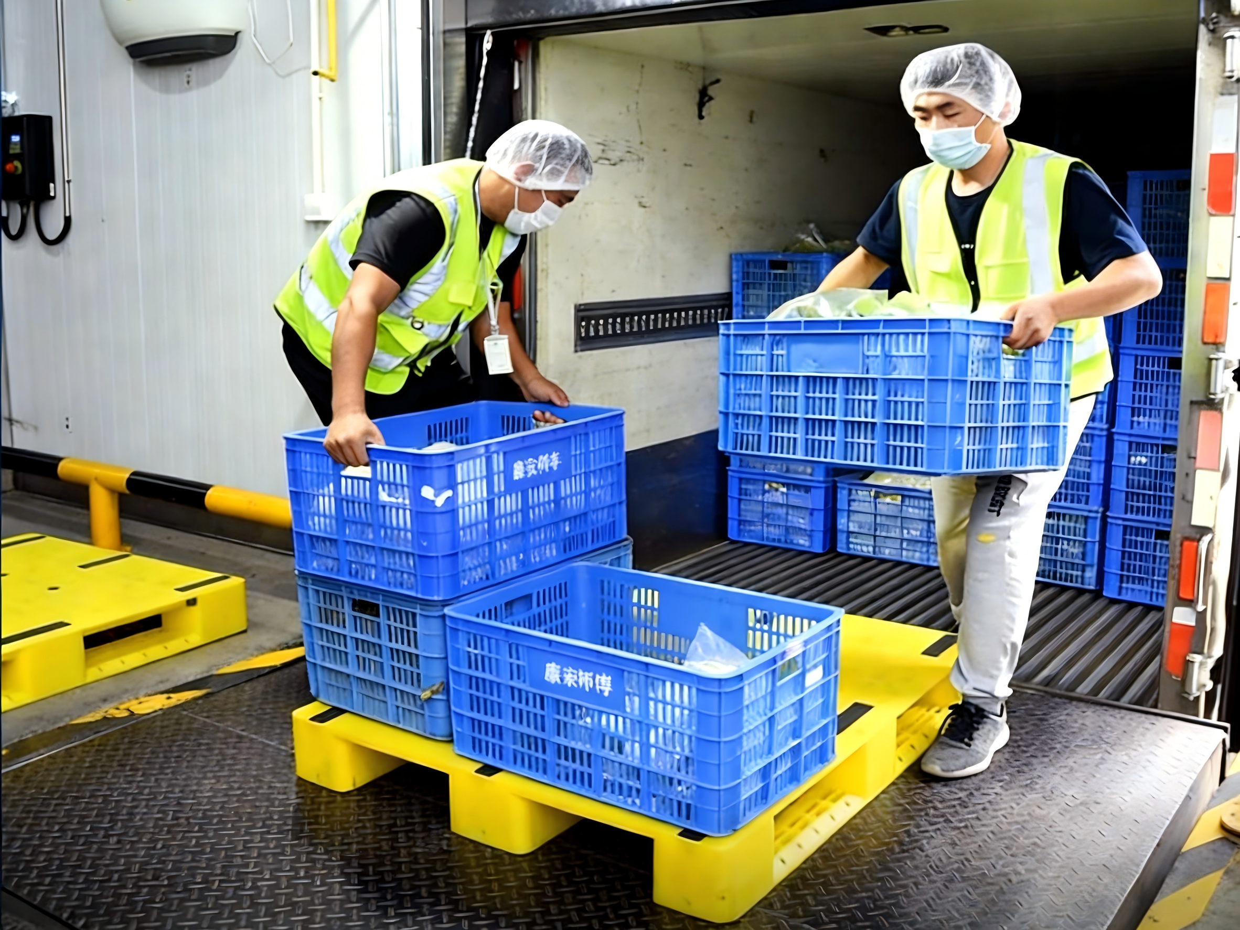
4. Outbound Operations for Agricultural Products
Preparations Before Outbound Operations
  Breaking bulk
  Repackaging
  Duplicating documents
  Organizing handling personnel
  Preparing tools and equipment
Notes:
Before outbound operations, necessary preparations such as breaking bulk, repackaging, duplicating documents, organizing handling personnel, and preparing tools and equipment must be completed.
出库前要做好发放准备，如“化整为零”，备好包装、复印材料，组织搬运人力，准备好设备工具等等。

Slide 26
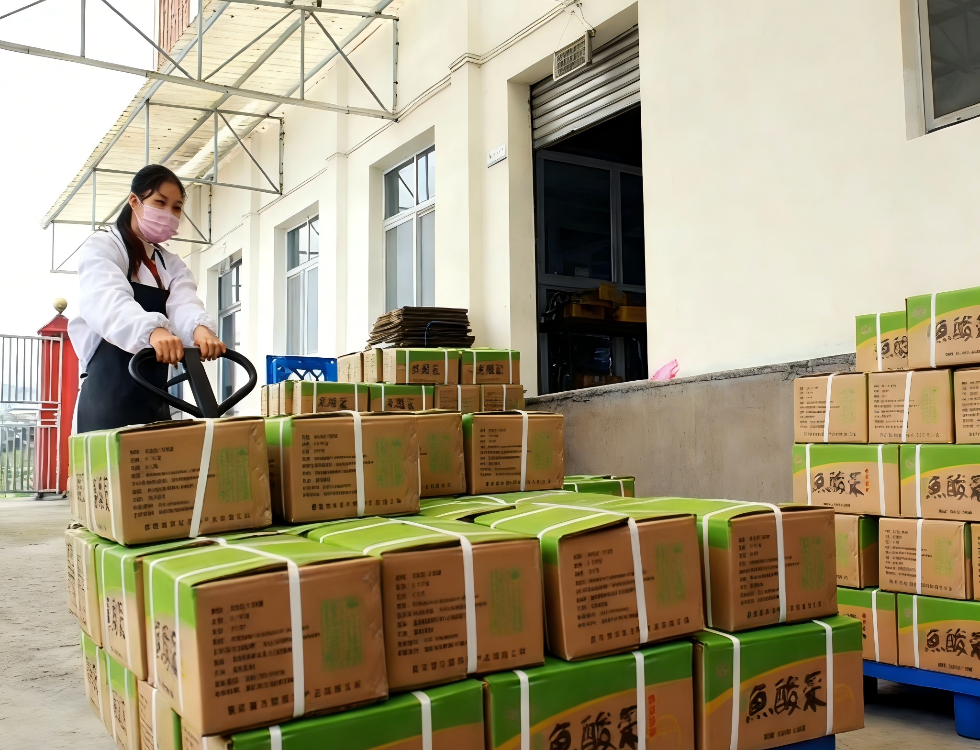
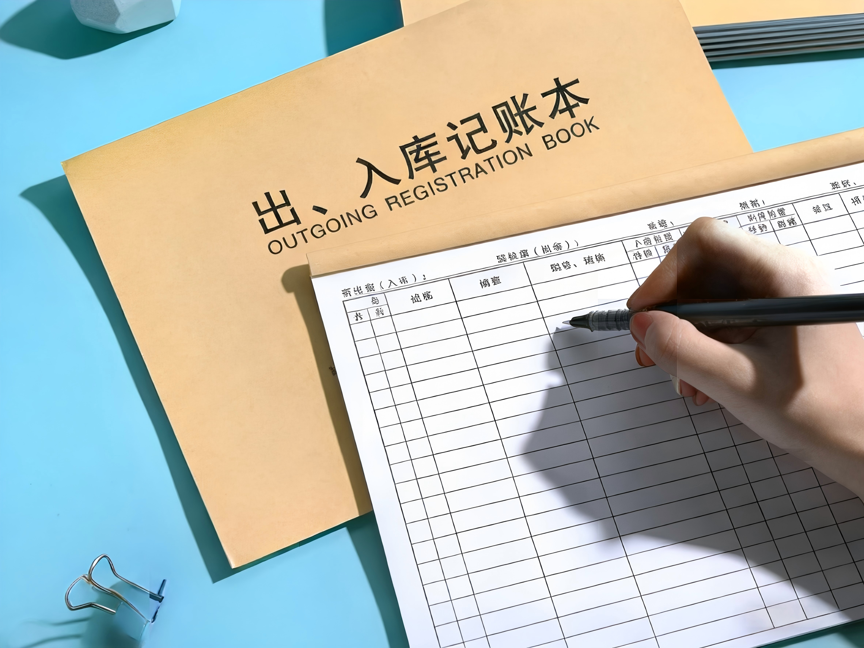
4. Outbound Operations for Agricultural Products
Requirements During Outbound Handling
  Ensure operational safety.
  Monitor storage life of products.
  Prohibit distribution of spoiled, expired, or degraded goods.
Update Warehouse Records
  Records immediately updated in warehouse ledgers after dispatch.
File Delivery DocumentsU
  Delivery documents filed properly for reference.
Notes:
During outbound handling, operational safety must be ensured. Warehouse staff must monitor the storage life of products and prohibit the distribution of spoiled, expired, or degraded goods.
After dispatch, records must be updated immediately in warehouse ledgers, and delivery documents filed properly for reference.
出库时要保证安全操作。仓库作业人员必须经常注意农产品的安全保管期限，对已变质、已过期失效，已失去原食用价值的农产品，不允许分发出库。

