Slide 1
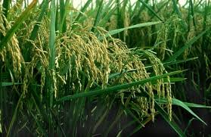
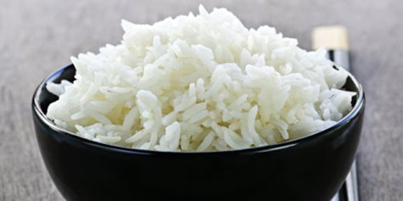
Rice value chain in Côte d'Ivoire: Key challenges
REPUBLIQUE DE COTE D’IVOIRE
Union – Discipline – Travail
MINISTERE DE L’AGRICULTURE ET DU DEVELOPPEMENT RURAL
Presented by : Mr ABOUBAKARY TRAORE, RICE DEVELOPMENT SUPPORT MANAGER, From the National Agency for Rice in Côte d'Ivoire
June 2023

Slide 2
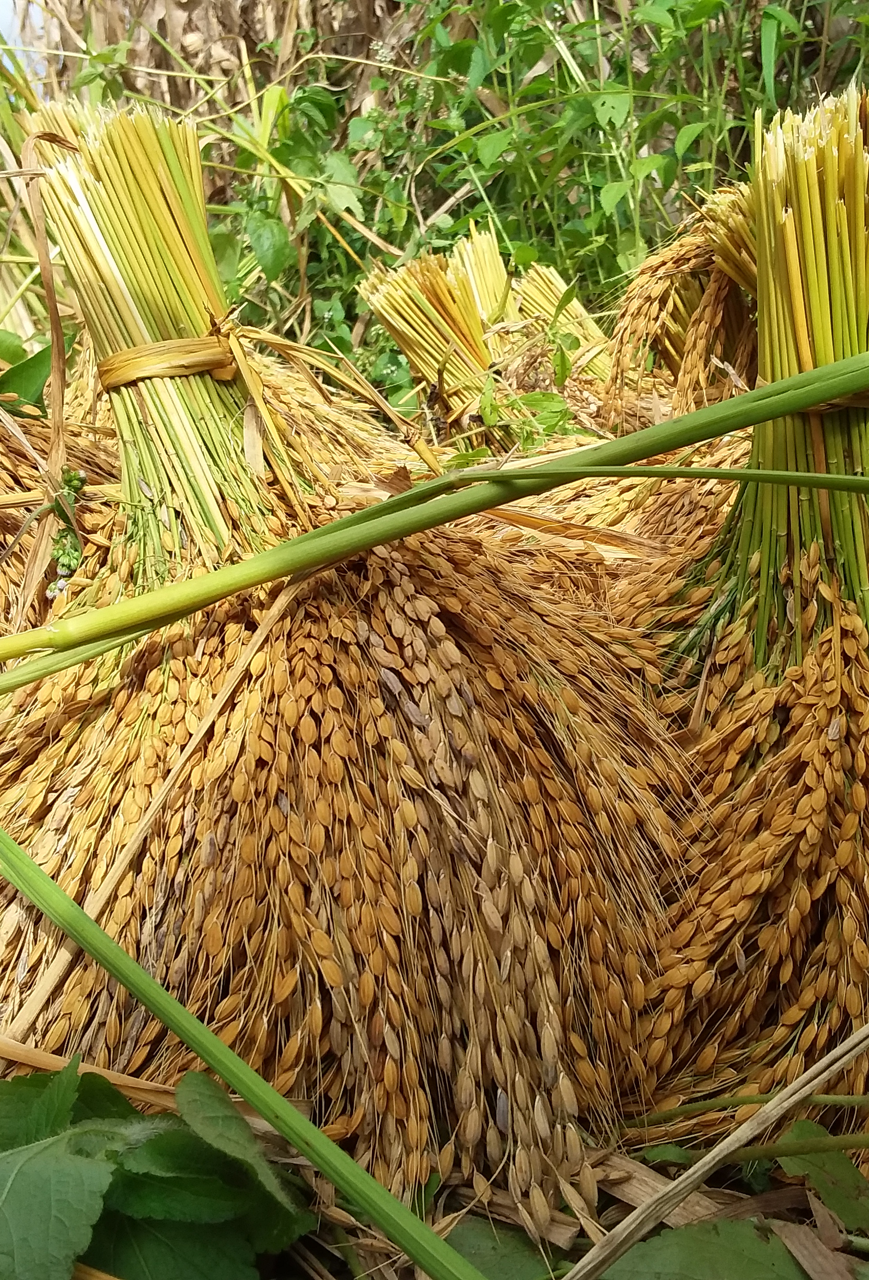
AGENDA
Key figures for rice Value Chain in Côte d'Ivoire
National Rice Development Strategy
Main challenges of the rice value chain in Côte d'Ivoire
Perspectives

Slide 3
Key figures in Rice Value Chain in CIV
2,024,000 tons of rice consumed in 2022, i.e. 72 kg per capita per year
1107,000 tons of rice produced in 2022, i.e. 55% of requirements covered by local production
1,563,000 tons of rice worth $1 billion by 2022

Slide 4
The National Development Strategy for the Rice Sector
VISION: A competitive and sustainable rice industry capable of meeting national needs and generating surpluses.
MAIN OBJECTIVE: Ensure 100% coverage of consumption needs by national production of good quality milled rice and guarantee the necessary safety stocks.
SPECIFIC OBJECTIVES:
Increase the area under water-controlled rice cultivation ;
Increase the productivity of rice farms;
Improve the value-added of rice
Strengthen monitoring, financing and governance of the sector.

Slide 5
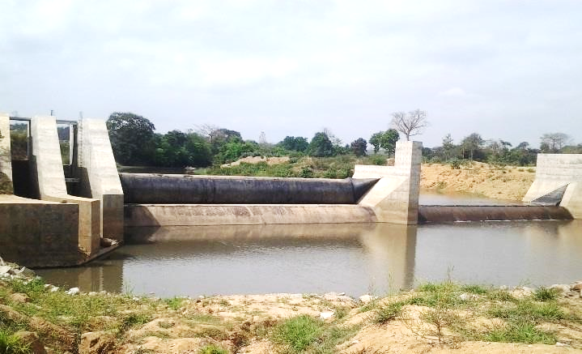
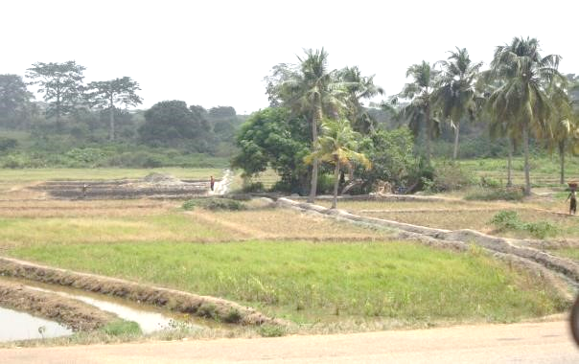
The main challenges facing the rice value chain in Côte d'Ivoire
Production
Harvesting and post-harvest management
Processing and
Marketing

Slide 6
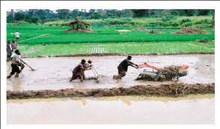
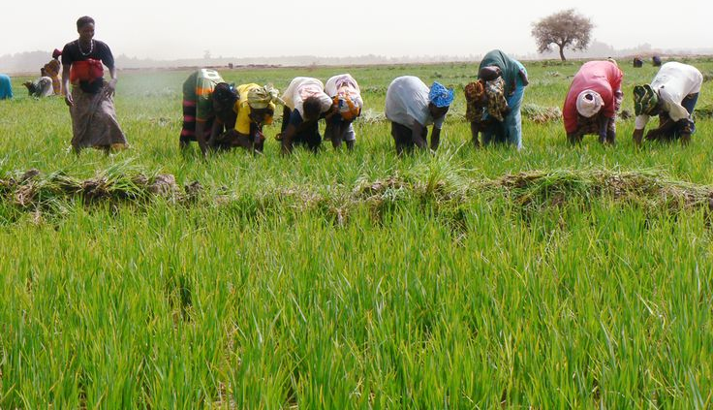
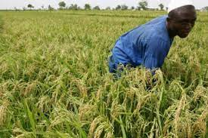
Production
Current Situation
land development and water management for production
Facilitate farmers' access to improved seeds and inputs
Improve the level of land use with appropriate technical itineraries
Facilitate farmers' access to mechanized services
Reduce the impact of high climate variability through water management
Challenges
Quality seed coverage rate
2 %
Rice farms mechanization rate
5 %
Percentage of irrigated land
5 %
Smallholder farmers engaged in rice production
80 %

Slide 7
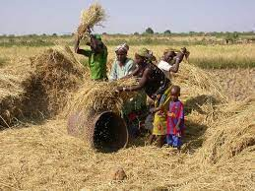
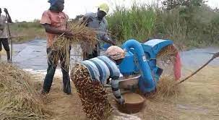
Harvesting and post-harvest management
Current Situation
Mechanization of harvesting operations
Mechanization of drying, threshing and winnowing operations to reduce post-harvest losses.
Set up paddy storage and preservation facilities
Improved bagging for paddy collection and storage
Challenges
Manual harvesting
98 %
Post-harvest Losses
40 %
Traditional threshing and winnowing
90 %

Slide 8
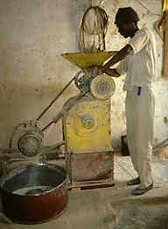
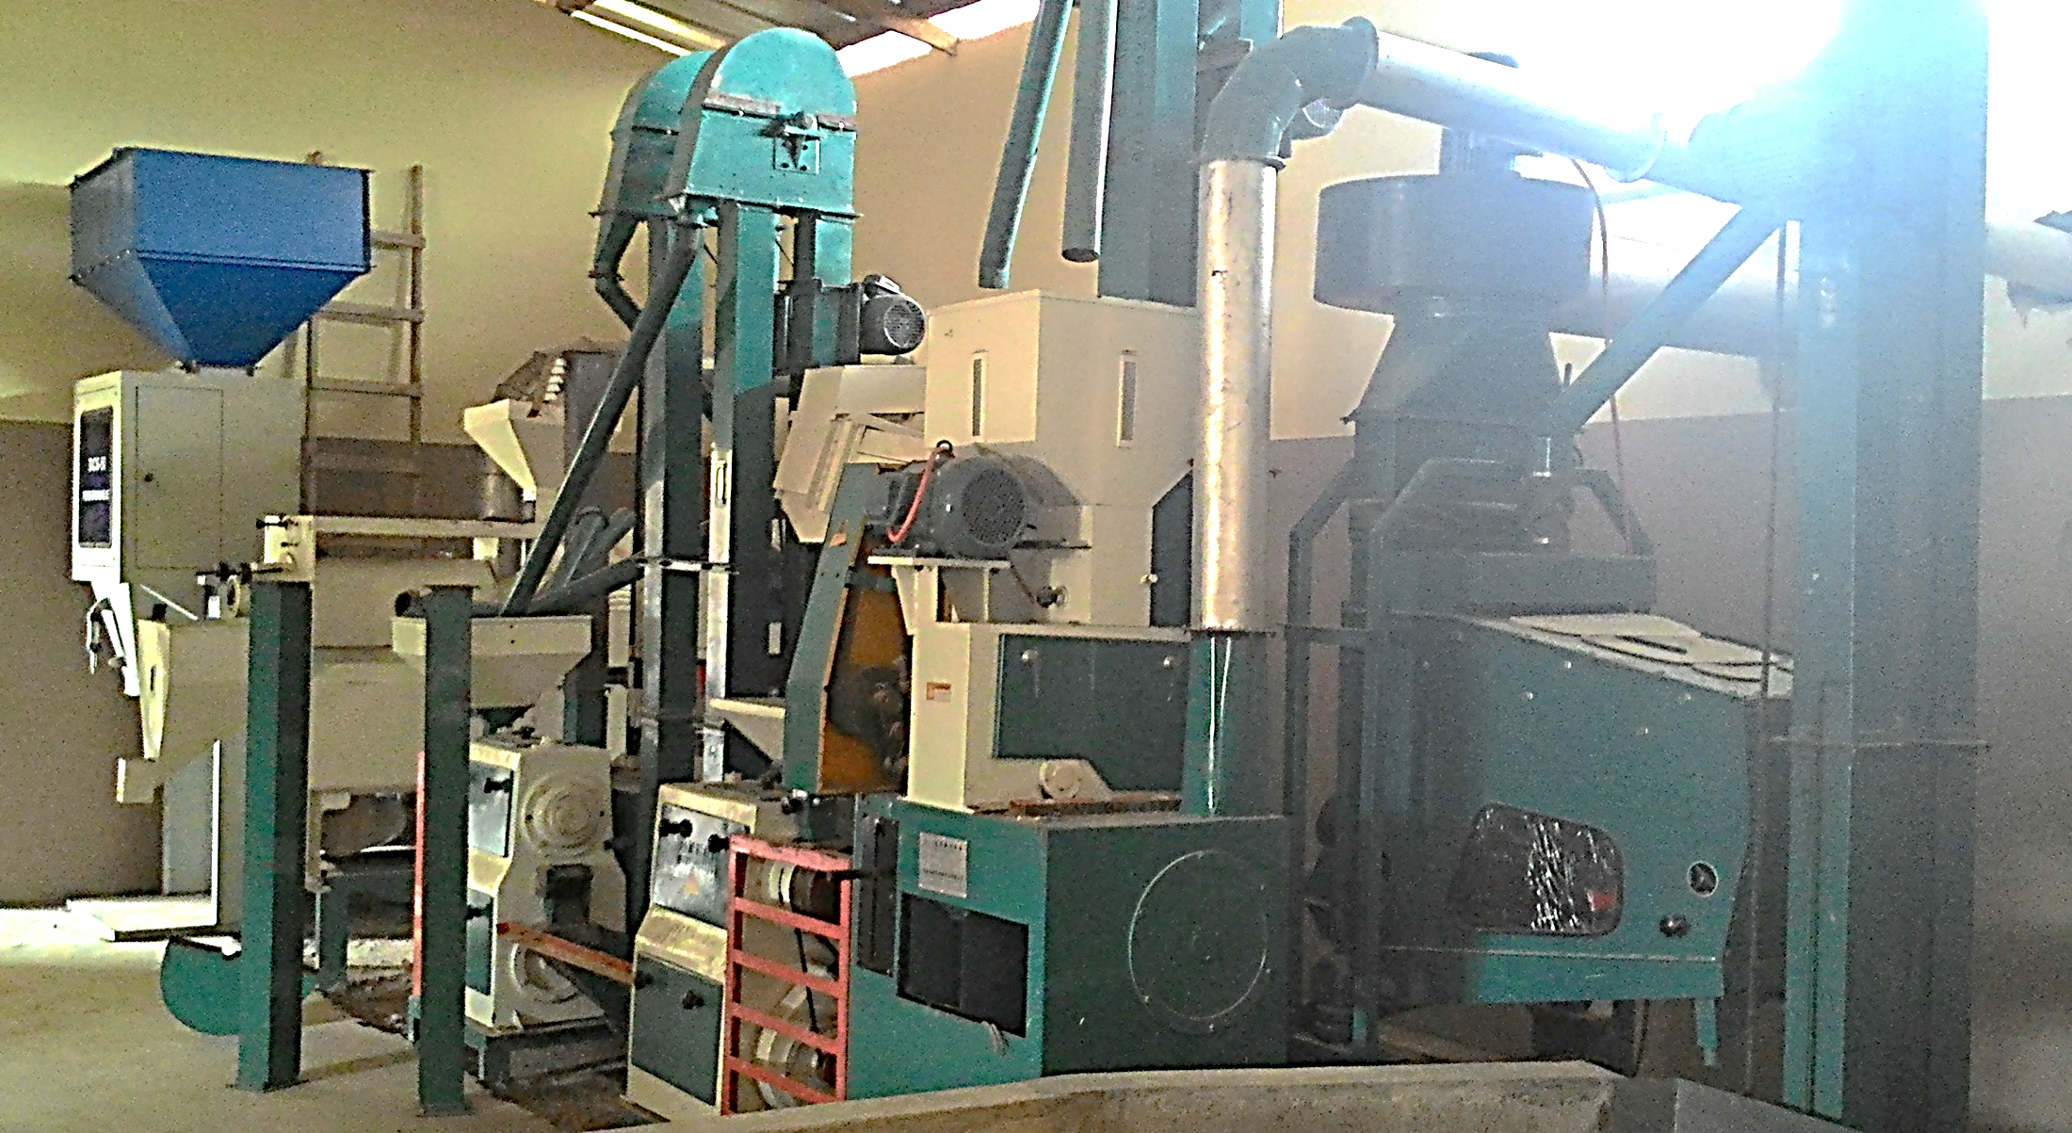
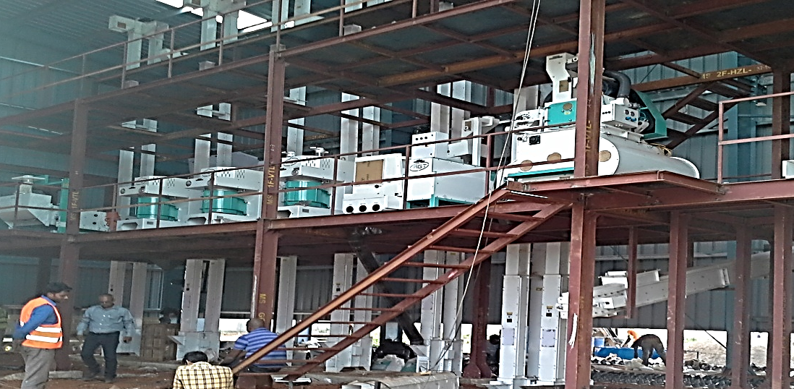
Processing
Current Situation
Modernization of the industrial fabric,
Set up of silos and other storage and conservation facilities
Upgrading of rice husk, straw, flour, fine broken grains and bran
Challenges
Small-scale and informal processing
95 %
Limited storage and preservation facilities
1
%
Low value-added of by-products
10 %

Slide 9
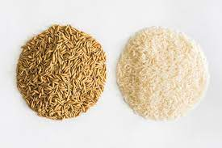
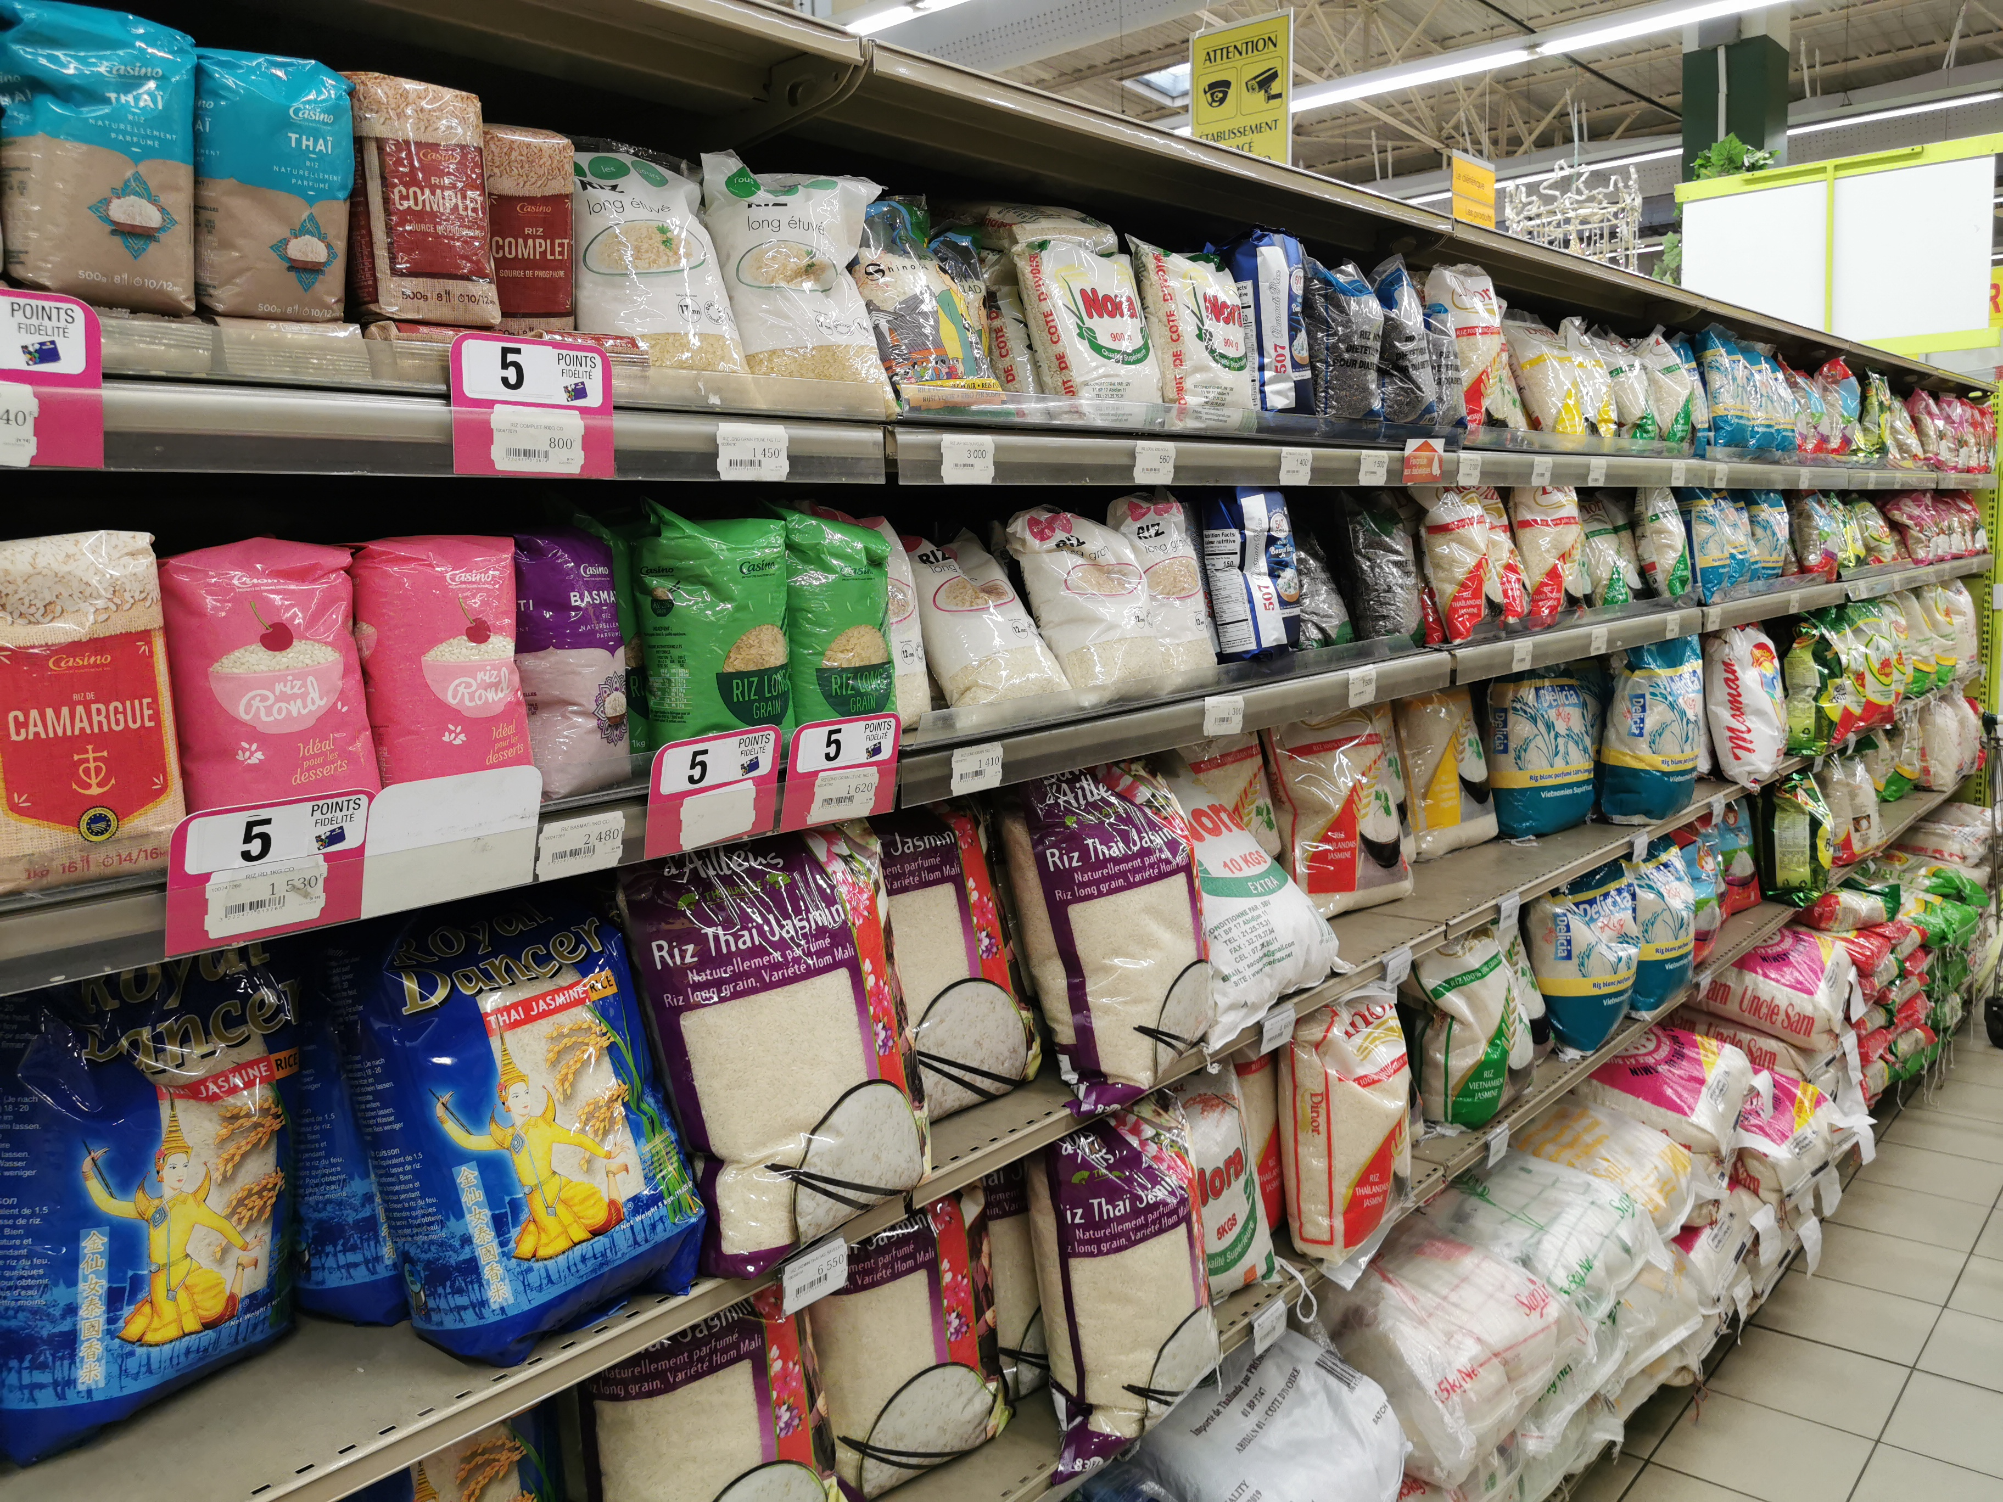
Access to market
Current Situation
Increase paddy production and collection through a financing scheme
Set up a mechanism to regulate quality and distribution
Enhance the value of rice husk, straw, flour, fine broken grains and bran
Challenges
Rate of availability of local rice
55 %
Rice homogeneity and purity rates
60 %
Informal distribution channels
80 %
Unstable prices and quality
95 %

Slide 10
PERSPECTIVES
Strengthening Sino-Ivorian cooperation: Capitalizing on and disseminating the best practices of the Chinese Agricultural Technical Assistance Mission (MATAC) on the Guiguidou rice-growing perimeter.
Capitalize on the experiences and achievements of rice value chain development projects: Support and knowledge sharing within the framework of the rice development project in northern Côte d'Ivoire.
Strengthen South-South and Triangular Cooperation, including public-private partnerships
Develop market access mechanisms:
Strengthen land and water management mechanisms

Slide 11
MERCI

