Slide 1
How to arrange a poultry vaccination plan
Beijing huaduyukou poultry Co., Ltd
Xiuying Huang Ph.D
Nov,2021
Notes:
Today's topic is vaccination plan，How to arrange a poultry vaccination plan.

Slide 2
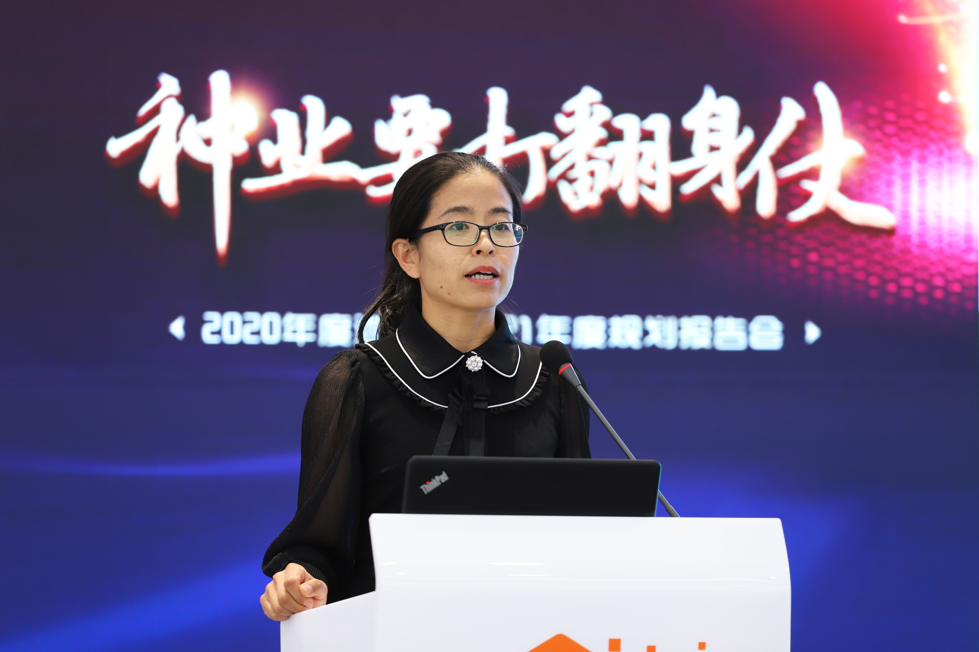
Xiuying Huang
Ph.D. in Preventive Veterinary Medicine.
Secretary General of the Poultry Disease Branch of the Veterinary Association.
Production Director of Breeding Company,responsible for production management.including breeder,hatching, feed and disease prevention and control.

Slide 3

Directory
Thoughts on disease prevention and control
01
02
Key points of the vaccination plan
03
How to arrange a vaccination plan

Slide 4
01 Thoughts on disease prevention and control

Slide 5
Principles of prevention and control
the occurrence of disease is not often caused by a single factor In the clinical.
Principles of prevention and control of poultry diseases.
Breeding is over prevention.
Prevention is over treatment.
Combination of breeding and prevention.
Comprehensive prevention and control.
Notes:
First we should realize
Because the occurrence of disease is often not caused by a single factor,It is often said that diseases are caused by feeding.
necessary

Slide 6
Classification of disease
Vertically transmitted diseases
Immune controlled disease
Environmental conditioned diseases
  Source purification
  Build immunity
  Environmental improvement
Avian leukemia
Chicken salmonellosis
Chicken Mycoplasmosis
AI,IB,ND,IBD,MD,IC,ILT,EDS,AE,POX,etc.
Respiratory diseases
Digestive tract disease
Reproductive tract disease
Notes:
Classification of diseases according to disease control ideas，Diseases can be divided into
Each disease has a different focus on prevention and control。
The control program for vertically transmitted diseases

Slide 7

Three factors of disease occurrence
Necessary conditions for disease transmission，all three are indispensable
Source of infection
Route of transmission
Susceptible animals
Disease occurrence
Notes:
疾病防控

Slide 8



Things we can control
Find the easiest things we can control
1
2
3
Pathogens spread with sales all over the country, it is impossible to strictly cut off the source of infection, only to slow down the occurrence of diseases.
Turn susceptible animals into unsusceptible animals through prevention and control measures.
The source of infection cannot be eliminated Only by corporation.
Source of infection
≡
Route of transmission
≡
Susceptible animals
Notes:
through prevention and control measures.

Slide 9
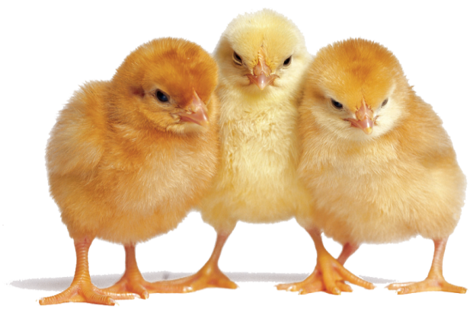
What are unsusceptible animals ?
By combining artificially created conditions with the self-immunity of the chickens,Establish a protective barrier for susceptible animals-uniform and effective antibodies to resist disease infections, making them "not susceptible animals".
Uniform effective antibody
Human
Vaccinationg
Susceptible animals
Less susceptible animals
Notes:
This requires humans to vaccinate

Slide 10

The core of disease prevention
The core of disease prevention and control is to make chickens produce uniform and effective antibodies.
Uniform and effective antibodies :
Effective : Strain matching, high protection value
Uniform : The antibodies value are within 4 titers
Notes:
understand

Slide 11
How to produce antibodies?
Four aspects to create chicken uniform effective antibody
40%
30%
Vaccination is the core to produce
Environment is the basis for ensure
均匀有效抗体
Monitoring is a means of testing
Medicine is the guarantee to maitain
20%
10%
Notes:
There are four aspects to create
40% Vaccination is the core of chicken to produce uniform and effective antibodies.
30% Environment is the basis for chickens to ensure uniform and effective antibodies.
20% Monitoring is a means of testing uniform effective antibodies in chickens.
10% Medicine is the guarantee for chickens to maintain uniform and effective antibodies.

Slide 12

Vaccination is the core
Uniform and effective antibodies
Vaccination
Human
Susceptible animals
Less susceptible animals
Notes:
Vaccination is the core of creating uniform effective antibody,

Slide 13
A vaccination plan
Vaccination plan: According to the epidemic situation of infectious diseases and the characteristics of vaccines in certain areas or farms, the type, sequence, frequency, route and interval of vaccination for specific animal groups are defined.

Slide 14
02 Factors considered in vaccination programs

Slide 15
Main factors
Disease
Virulent strair
Vaccine
Age、timing
Method
Site
Dosage
Notes:
So next We will explain the main factors one by one，then we will know how to arrange a vaccination plan.

Slide 16
03 How to arrange vaccination plan

Slide 17
Which diseases need to be vaccinated ？
第一
Part 01

Slide 18

According to disease prevention and control methods
Disease classification
Improved management to control environmental conditions
Purifies vertically transmitted diseases
Vaccination controls immune-controlled diseasesd
Avian leukemia
Chicken salmonellosis
Chicken Mycoplasmosis
AI、IB、ND、IBD、MD、IC、ILT、EDS、AE、POX......
Respiratory diseases
Digestive tract disease
Reproductive tract disease
Notes:
We have just mentioned that The control program for Immune Controlled Disease is build immunity by vaccination.
Do these diseases all need to be vaccinated?
Or are there other diseases that need to be vaccinated？

Slide 19

Need to consider regional epidemics
Non-regional
H5，H9，ND，MD、IBD ，IB，EDS
Vaccination controls immune-controlled diseasesd
Regional
IC，AE，ILT，CIA、Fad
Notes:
Non-regional disease all need to be vaccinated.
Regional disease need to consider the epidemic situation around your farm。

Slide 20
Need to consider the farm’s biosafety situation
the risk level of epidemic .(Red, orange, yellow, green)
the farm’s biosafety situation.(All in all out, No disinfection isolation)
Risk level of epidemic | Farm’s biosafety situation
Risk level | All in all out（whole farm） | All in all out （one house） | No disinfection isolation
Red（<50km） | Yes | Yes | Yes
Orange(50-100km) | No | Yes | Yes
Yellow(100-300km) | No | No | Yes
Green(>300km) | No | No | No
Notes:
Also we should consider the level of biosafety.
Look at this chart present situation
The level of biosafety is green means there is no epidemic in the country or 500 kilometers away，No matter what kind of situation your farm is，No need to be vaccinated。
But,The level of biosafety is red means disease epidemic within 50 kilometers,No matter what kind of situation your farm is,need to be vaccinated.
The level of biosafety is orange means epidemic diseases are prevalent within 50-100 kilometers,In this case,if your whole farm is ali in all out,and disinfection and isolation are well,No need to be vaccinated.if only one house all in all out or there is no disinfection and isolation,need to be vaccinated

Slide 21
Which strain needs to be vaccinated？
第二
Part 02

Slide 22
Consider existing strains
Name | Dominant strain
ND | VII | Lasota | Clone30 | VH
MD | CVI988 | 814 | HVT
H5 | Re-11 | Re-12
H7 | H7N9 Re-3
IB | LDT3 | H120 | MA5 | QXL87 | M41
IC | B | A | C
Notes:
Look at this chart
These existing strains most need to be vaccinated.

Slide 23
Consider epidemic strains
Some diseases have different strains in different periods,We need to inoculate epidemic strains in time.
H5、H7
IC
MD
IBD
H5:Re-11 Re-12
H7N9:Re-3
The new strain is about to be updated
A,B,C strain
A+B?
A+C?
A+B+C?
Replace the strain in high incidence areas.
The general site was inoculated with 1-day-old genetic engineering vaccine
Multiple sites require live or inactivated vaccine .
Notes:
Some diseases have different strains in different periods，We need to inoculate epidemic strains in time。

Slide 24
Which manufacturer and what vaccine？
第三
Part 03

Slide 25
Selection of vaccines
Strains
Access directory
Test report
Vaccines containing epidemic strains
Vaccines allowed by the company
The vaccine has been tested
Notes:
We should choose

Slide 26
Access directory
Each farm should establish its own Veterinary vaccines access catalogue.
Only those with good verification effect and stable quality can be entered into the catalog and used.
Strictly control the use of veterinary drugs and vaccines.
Notes:
I suggest

Slide 27
Vaccine quality testing
Strengthening the monitoring of veterinary drugs and vaccines.
Includ exogenous virus,composition and content,safety,stability,effectiveness
If there is no laboratory, at least choose a reputable manufacturer.

Slide 28
Age and timing of vaccination？
第四
Part 04

Slide 29
Follow three rules
Regularity of disease occurrence
Body physiology
Rule of antibody ebb and flow

Slide 30
Body physiology
The developmental characteristics of chicken are different at different growth stages.
Muscle, tendon
Sexual maturity
0-21
days
42-70
days
77
days
161
days
210
days
Immune system, cardiovascular system, feathers, skeleton
Fallopian tubes/ovaries begin to develop
Mature body
① From 0 to 21 days, the immune system develops gradually.
② Underdeveloped, unable to produce a good immune response.
③ Excessive vaccinations damage immune organs.
④ Live vaccines activate the immune system, creating immune memory.
⑤ Early inoculation can effectively occupy the space and avoid the invasion of wild poison.
Notes:
The growth and development of chickens at different physiological stages are different
rapid growth

Slide 31
Regularity of disease occurrence
AI
IB
ND
1.It happens easily in autumn and winter.
2.Peak chicken flocks are prone to occur.
3.Poor constitution is apt to occur.
4.Low antibodies are prone to occur.
1.Winter and spring chicks are easy to occur.
2.Occurred at 1 to 3W and also at 60 to 98 days of age.
3.Immune-controlled diseases greatly affected by changes in environmental conditions.
1.Occur all year round.
2.Chickens of all ages were susceptible.
3.There is only one serotype.

Slide 32
Rule of antibody ebb and flow
Maternal antibody stage
Start immunization
Antibody protection
Antibody maintenance
AI
less-sensitive period
Sensitive period
less-sensitive period
Start up
Strengthen and maintain
ND
Susceptibility throughout the whole process, mucosal antibody + humoral antibody
Early vac+ Start up
Strengthen and maintain
IB
Reproductive IB
Respiratory type + reproductive type IB: mucosal antibody + humoral antibody
Early vac + Start up+ Complementation
Strengthen and maintain
Notes:
There are four four periods of antibody growth and decline，Maternal antibody stage，Start immunization，Antibody protection，Antibody maintenance。
Has a serious impact on production performance

Slide 33
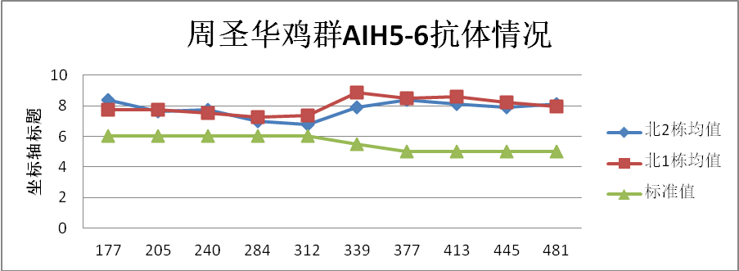
Age of vaccination
Determination of replenishment interval based on Antibody maintenance
The better the antibody is maintained, the longer the vaccination interval is
Notes:
Determination of replenishment interval based on antibody digestion

Slide 34
Age of vaccination
Based on five difference
Different generations
Different ages
Chickens boost immunization for maternal antibodies
Small age→ short vaccination interval
Large age→ long vaccination interval
Different seasons
Different species
Less vaccination in summer and more vaccination in autumn and winter
POX jingfen no.1 is sensitive
Different poultry farm
Different Antibody level
Different biosafety, different immune intervals
The better the antibody is maintained, the longer the vaccination interval is

Slide 35
Which inoculation method to use？
第五
Part 05

Slide 36
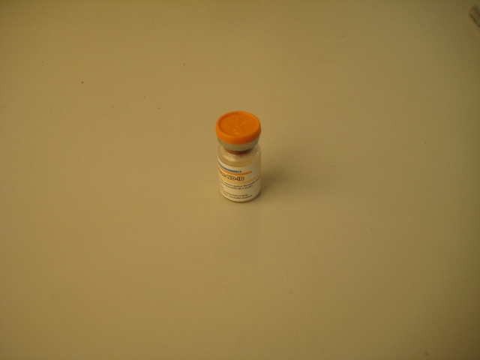
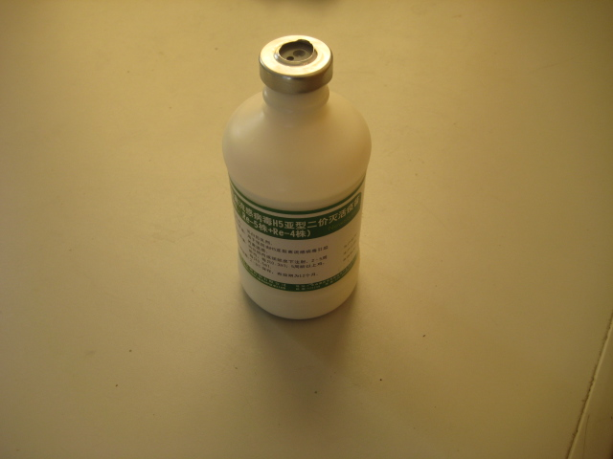
Routes for vaccination
免疫方法
Vaccine types + Characteristics→ Routes of vaccination
滴
鼻 点
眼
饮水/滴口
活苗
(Nose-dripping)
(Drinking water)
(Live vaccine)
气 雾
刺 种
免疫方法
（Vaccination methods）
(Aerosol vaccination)
(Wing-web)
颈部皮下
胸部皮下
Live vaccines and inactivated vaccines use different methods
(Subcutaneous neck)
(Subcutaneous chest)
油苗
腿部皮下
胸部肌肉
(Inactivated vaccine)
(Subcutaneous leg)
(Intramuscular chest)
腿部肌肉
Injectable
vaccination
(Intramuscular leg)
Notes:
Each method has its own operating standards and considerations

Slide 37
Common vaccination methods
Different diseases and different vaccines are administered in different ways
methods | Vaccines of disease
Nose dropping and eye dropping | IB | ND | ILT | MG
Aerosol vaccination | IB | ND
Drinking water | IBD
Daub the anus | ILT（Great stress response）
wing-web | POX | AE
Subcutaneous injection （neck, chest） | IB | ND | AI | IBD | MD | IC | EDS
intramuscular injection （Chest muscles, leg muscles） | IB | ND | EDS
Notes:
Different diseases and different vaccines are administered in different ways。
Here are some vaccination methods for the main diseases
Severe stress

Slide 38
How to determine the inoculation site？
第六
Part 06

Slide 39
Vaccination site
胸部皮下
颈部皮下
翅根皮下
胸部肌肉
翅根肌肉
腿部肌肉
(Subcutaneous chest)
(Subcutaneous wing root)
(Wing root muscle)
(Subcutaneous neck)
(Chest muscles)
(Leg muscles)
抗体上升与维持、鸡群应激
（The rise and maintenance of antibody、hens stress）
39

Slide 40
Vaccination site
Selection principles of vaccination sites
Non-repetitive
Easy to absorb
Vaccine species
+
Virus target organs
Easy to operate
Notes:
Standard dose vaccination is generally used,
Don't let other factors affect vaccine potency

Slide 41
What dose is appropriate？
第六
Part 06

Slide 42

Standard dose
Vaccine antigen content
Vaccine storage
vaccination operation
02
04
01
03
05
Vaccine transport
Vaccine dilution
Don't let other factors affect vaccine potency
Notes:
Don't let other factors affect vaccine potency

Slide 43
Summary
时机准确
(Accurate timing)
准确率100%
剂量准确
(Accurate dose)
Perfect results
(Accurate site)
部位准确
(Accuracy rate)
数量准确
(Accurate quantity)
免疫率100%
程序准确
(Accurate procedure)
(Vaccination rate)
有效率100%
毒株准确
(Accurate strain )
(Effective rate)
方法准确
(Accurate method)
Notes:
So how to ensure the effect of vaccination?You have to make sure” 7 accurate”,

Slide 44

感 谢 聆 听！
Notes:
OK，That's all for today,thank you.see you!

