Slide 1

Agricultural Disaster Mitigation and
Climate-Resilient Agriculture Development
in the Context of Climate Change
ZHENG Dawei
China Agricultural University
25 June 2026

Slide 2
CONTENTS
The Impact of Climate Change on Agriculture
New Characteristics of Agricultural Disasters Caused by Climate Change
01
02
Responses to Agricultural Disasters under Climate Change
Agricultural Disaster Reduction Coordination Mechanism of the Chinese Government
03
04

Slide 3
01
The Impact of Climate Change on Agriculture

Slide 4
Climate change represents the greatest environmental challenge facing humanity, directly threatening sustainable development and human living conditions.
Agriculture is highly sensitive to climate change and natural disasters because
reliance on living organisms: high vulnerability
primarily outdoor production conditions: high exposure
The impact of climate change on agriculture
In the short term： both advantages and disadvantages:
  high latitudes & cold seasons benefit more;
  low latitudes & hot seasons suffer more.
In the long term： negative factors are rapidly increasing, posing a serious threat to food security and farmers' livelihoods.
Beneficial and adverse effects can be mutually converted under certain conditions.

Slide 5
Positive Impacts
Improve photosunthesis and crop water use efficiency
Facilitate the expansion of crop planting boundaries & multipe-crop index increase
Lead to an overall reduction in freeze and cold injuries
Improve water resources in some regions
Increase the proportion of the reproductive growth phase
Lead to decrease in disasters of some severe convection
Positive Impacts of Climate Change on Global Agriculture

Slide 6
Negative Impacts of Climate Change on Global Agriculture
Climate Change
Extreme Events & Cascading Effects
Resource and environmental changes
Pest/disease and natural enemy shifts
Shifts in agricultural market demand
Impacts on agribusiness and related services
Damage to biota and facilities
Impacts on yield potential, quality, and distribution
Damage to crops and livestock
Impacts on scale, yield, and prices
Impacts on farming conditions and post-harvest support
Yield, quality, profit, and sustainability in the agricultural system

Slide 7
02
New Characteristics of Agricultural Disasters Caused by Climate Change

Slide 8
2.1 Climate change-related agricultural disasters
Meteorological disasters: drought, flood, waterlogging; cold damage, heat injury, snow disaster, hailstorm; gale, tropical cyclone, hot-dry wind, persistent rainy weather, shading damage, scorching damage; sandstorm; animal hot stress, animal cold stress, and fish suffocation
Marine disasters: storm surges, sea ice, rogue wave, tsunami, and red tides
Geological disasters: soil erosion, land subsidence, ground collapse, rockfalls, landslides, and debris flows
Biological disasters: plant diseases, insect pests, weed pests, and rodent pests; animal epidemics, animal parasitic diseases, and fish diseases
Environmental disasters: forest and grassland fires, water pollution, and acid rain

Slide 9
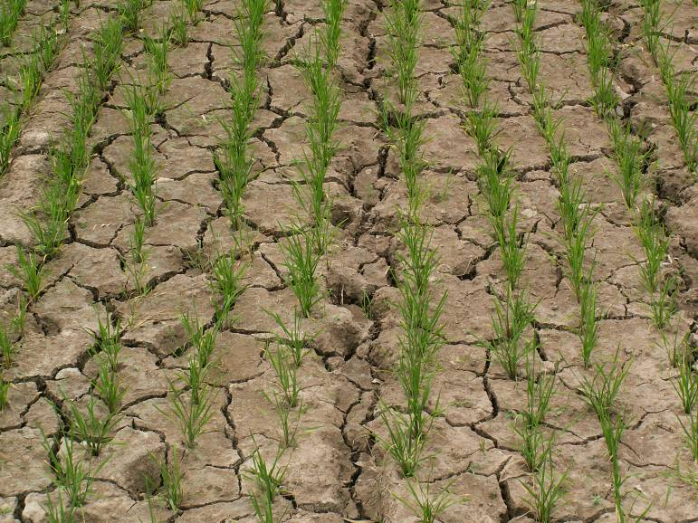
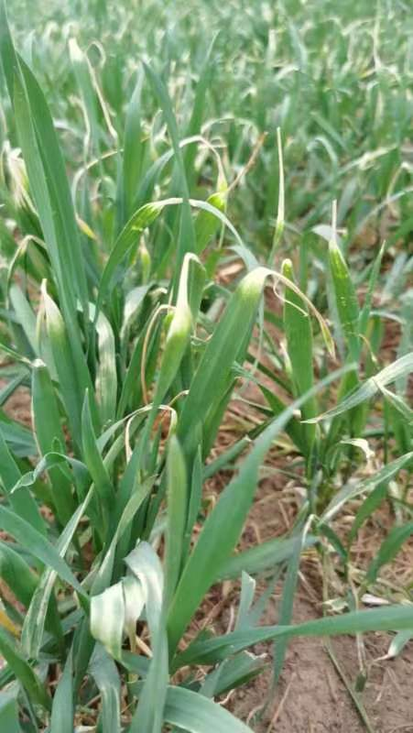
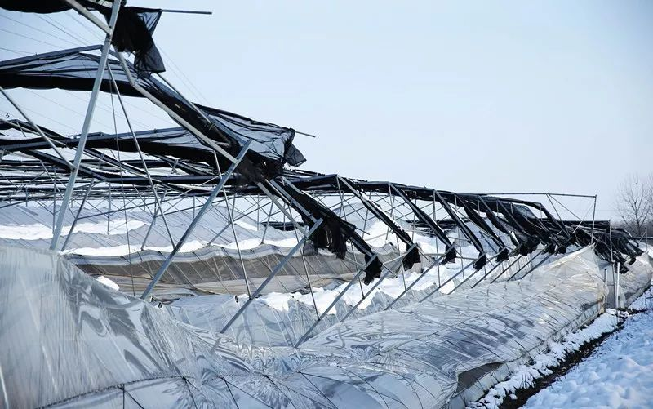
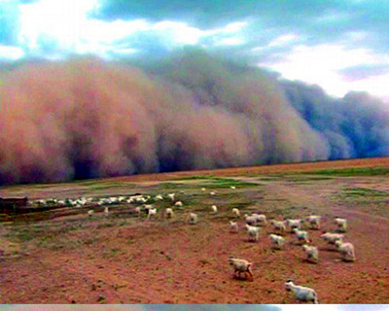
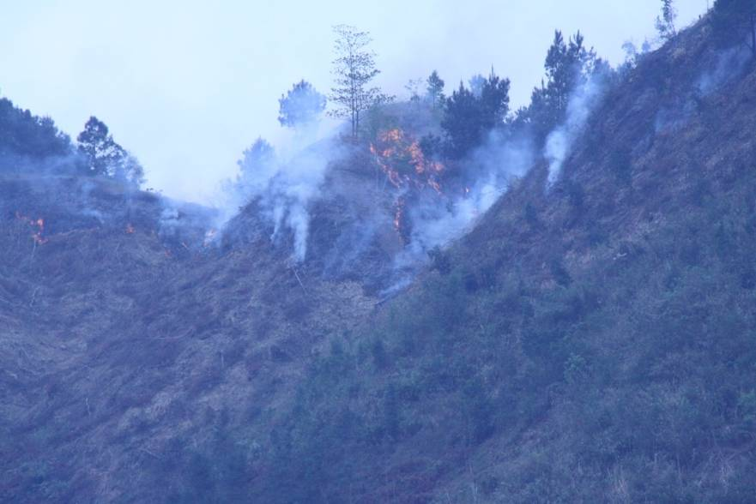
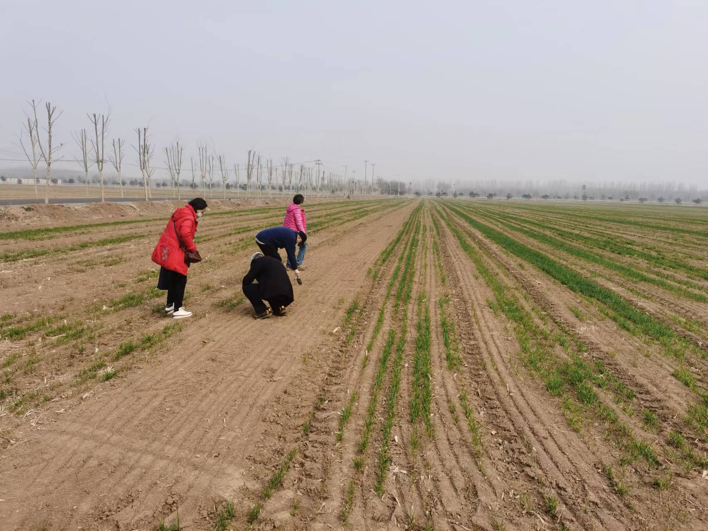
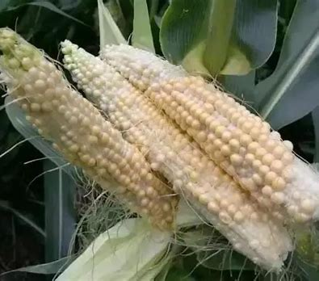

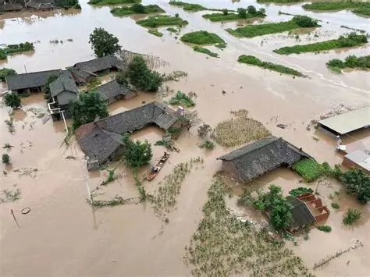
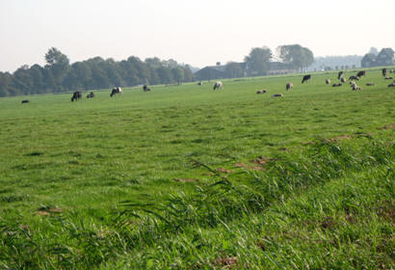
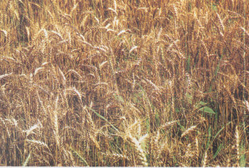

spring frost
greenhouse collapsed by snowstorm
rice drought
sand-dust storm
forest fire
freezing damage of wonter wheat
heat injury
typhoon
wind & rain waterlogging
hail stone
hot-dry wind
flood

Slide 10
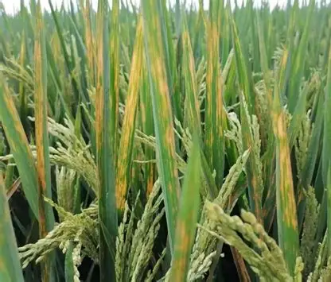
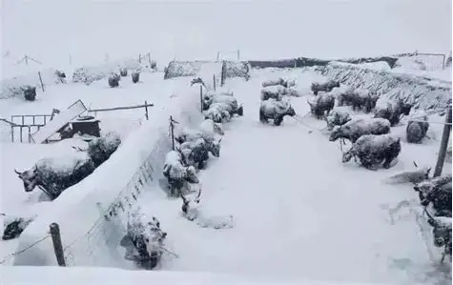
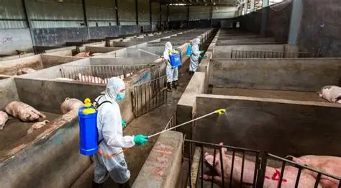
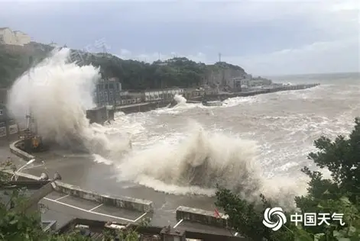
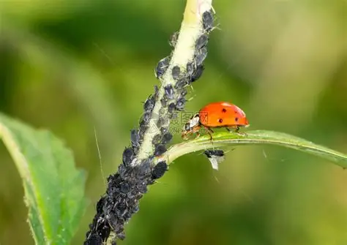
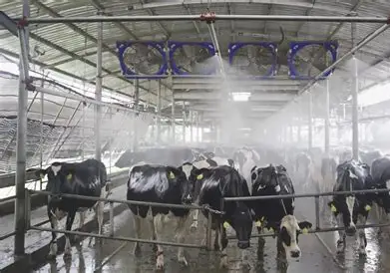
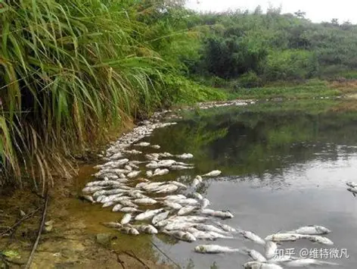
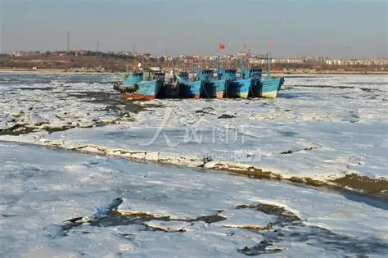
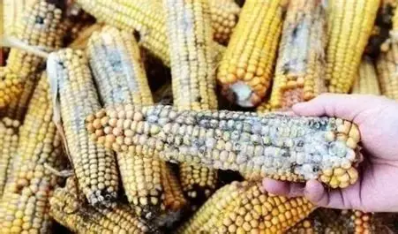
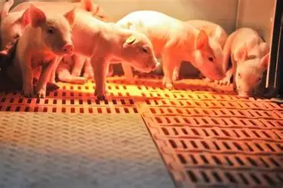
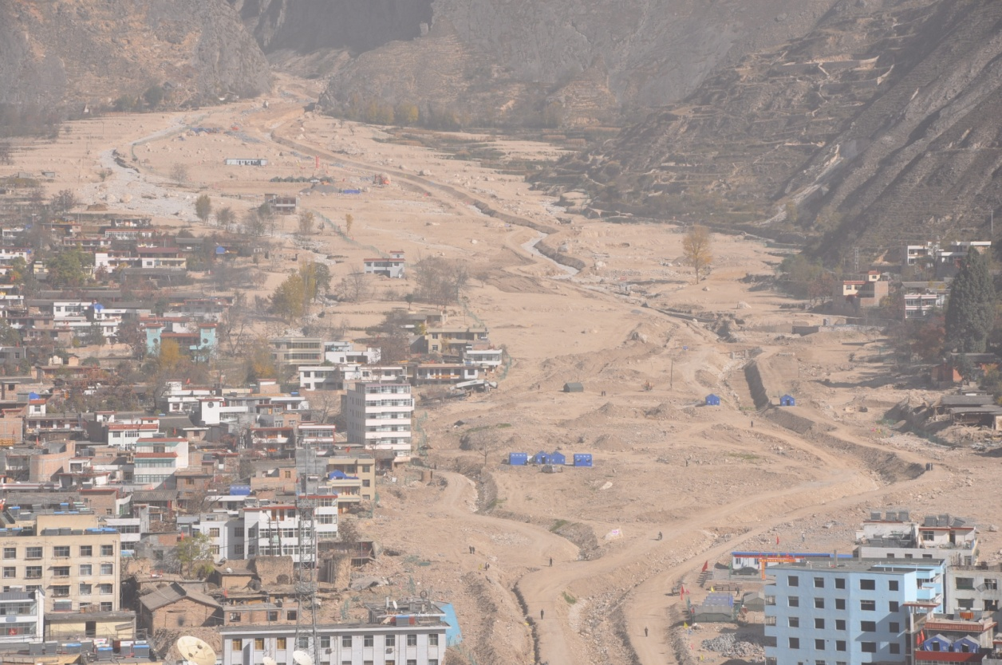
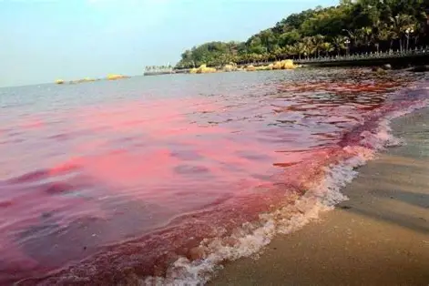
rice disease
swine house
epidemic prevention
tide storm
snow disaster
pest and
its enemy
fish suffocation
sea ice
rinse and cool down
moldiness
mud-rock flow
red tide
Infrared incubator
Notes:
Rinse and cool down

Slide 11
2.2 New characteristics of major agricultural disasters
Temperature Exceedance of crops
Climate Variability causes more extreme events
Evapotranspiration increase leads to Flash Droughts & wild fires
Exponentially increased water vapor leads to more heavy rains and less light rains
Snow Cover Instability leads to plant cold damage
Abrupt temperature transitions & drought-flood shifts leads to water and soil run-off
Sea level rise causes storm surge and seawater intrusion
Increased surface water vapor leads to tropical cyclone intensification
Ocean warming, acidification & deoxygenation leads to less fish catch
Pest overwintering, poleward expansion & more generations
Elevated plant C/N ratio leads to pest food intake increase
Habit disruption & food chain alterations leads to pest enemy extinct

Slide 12
03
Responses to Agricultural Disasters under Climate Change

Slide 13
3.1 A Three-Tier Agricultural Disaster Mitigation
Pre-disaster Prevention
  Monitoring, forecasting & early warning
  Prevention engineering, preparedness & contingency planning, training & drills
  Institutional improvement
During-disaster Resistance
  Temporary reinforcement of hazard-bearing bodies
  Emergency resource allocation & microclimate regulation
  Weather modification
Post-disaster Relief & Review
  Impact assessment, crop recovery management & replanting based on remaining accumulated temperature
  Relief supplies, work-relief programs & disaster insurance
  Lessons learned, hazard elimination, plan revision & mechanism improvement
Climate Imperative: Adaptive adjustments to traditional mitigation measures are essential under climate change.

Slide 14
3.2 Technical Approaches for Agricultural System Adaptation
Information of climate and ecosystem change
Changing the environment of growth & reproduction
Agricultural System
Global climate change
Regional ecological change
Information of bioresponse
Production Objects:
Agricultural Biota
Gene-Individual-Population
Response of productive system
Improving self adaptation ability
Ecological construction Regulate microclimate
Adjust industrial layout Adjust planting, harvesting and breeding periods
Industrialization
Agricultural infrastructure Agricultural technology development
Structural adjustment & Biological pest control
Variety breeding
Resistant cultivation & feeding
Agricultural Climate Change Response Management System
Reducing GH gases emission and increasing their sinks
Decision-making consultation
Technical solution
Information processing
Information flow
Ways of adaptation
Mitigation measures

Slide 15
Agricultural Disaster Mitigation Technologies for Climate Adaptation
Breeding: gene mutation is the basic way for organisms to adapt to environ-mental changes, and genetic modification is the most basic and cost-effective strategy. Breeding objectives should be dynamically adjusted in response to climate change—appropriately relaxing cold-tolerance requirements while enhancing heat, drought, waterlogging, and disease resistance.
Hardening / Acclimation: techniques such as seedling stress conditioning and seed sun-drying are employed to induce the expression of stress-resistance genes.
Adjusting Sowing, Transplanting, and Harvesting Dates: optimizing the crop calendar to fully utilize accumulated temperature and effectively evade meteorological disasters.
Optimizing of Cropping Systems (Rotation, Intercropping, and Relay Cropping): leveraging the complementary and synergistic relationships among different crops.

Slide 16
Agricultural Disaster Mitigation Technologies for Climate Adaptation
Microclimate Modification and Improvement: implementing protected cultivation, summer shading and cooling, shelterbelts, water-saving irrigation, rainwater harvesting, soil fertilization, and soil-water conservation.
Adjustment of Spatial Planting Layout: concentrating production in climate-favourable advantageous zones, appropriately expanding northward and to higher altitudes, and moderately increasing the multiple cropping index in transitional thermal zones.
Adaptive Cultivation Techniques: timely adjustments based on meteorological conditions and crop growth stages.
Infrastructure Development: upgrading production conditions through farmland capital construction, irrigation, transportation, and storage facilities.

Slide 17
Agricultural Disaster Mitigation Technologies for Climate Adaptation
Livestock Farming (Agricultural Areas):
Ventilation, shading, and temperature control in barns
Shifting to dry manure removal in water-scarce regions
Strengthening quarantine and disease prevention
Adjusting feed crop zones
Adopting smart factory-based environmental control
Pastoral Farming (Grasslands):
Using stress-resistant grass species and establish artificial grasslands
Implementing rotational grazing and seasonal grazing bans
Harvesting and ensiling forage in summer/fall for winter/spring supplementation; adding watering points
Improving breeds for higher feed conversion efficiency, heat tolerance, and disease resistance
Cultivating feed crops and utilize crop residues; improving feeding techniques to shorten the rearing cycle and increase marketability
Strengthening quarantine and epidemic prevention

Slide 18
Agricultural Disaster Mitigation Technologies for Climate Adaptation
Aquaculture:
Adjusting structural layout and species selection
Protecting the aquatic environment
Ensuring aeration to prevent pond suffocation (fish kills)
Eliminating harmful organisms
Disaster Prevention & Mitigation Measures:
Improving the accuracy and precision of disaster forecasting
Developing monitoring, early warning, and emergency response systems
Enhancing disaster preparedness, including contingency plan formulation and drills
Promoting disaster insurance

Slide 19
3.3 Building a Climate-Resilient Agriculture System
Climate-Resilient Agriculture: In the context of escalating climate change, it aims to sustainably utilize natural resources to boost long-term agricultural productivity and farmers’ incomes. It focuses on enhancing the resilience of highly exposed and vulnerable agricultural systems, reducing climate-related disaster risks and losses, and ensuring a rapid recovery capacity.
Key Strategy
Optimize Industrial and Crop Variety Distribution Layout by new climatic zoning
Upgrade Farmland and Water Conservancy Infrastructure
Develop intelligent disaster-reduction technologies and equipment
Enhance Monitoring & Establish Region-specific Adaptive Tech Frameworks
Scenarios and Risk Projection & Reserve Corresponding Technologies
Improve Policy Systems and Socialized Services, weather index insurance
Strengthen International Cooperation especially South-South Cooperation

Slide 20
04
Agricultural Disaster Reduction Coordination Mechanism of the Chinese Government

Slide 21



4.1 Inter-Agency Coordination
In March 2025, the Ministry of Agriculture and Rural Affairs (MARA), Ministry of Water Resources, Ministry of Emergency Management, and China Meteorological Administration (CMA) jointly issued the Guiding Opinions on Strengthening the Capacity Building for Agricultural Disaster Prevention, Mitigation, and Relief.
Core Objective: To enhance China’s capacity to respond to natural disasters in the agricultural sector
Enhanced Coordination Mechanism: The policy emphasizes establishing a seamless collaborative framework among departments of agriculture, water resources, emergency management, meteorology, marine management, and maritime law enforcement
Synergy & Impact: By jointly analysing disaster risks, sharing information, and coordinating actions, these departments will forge a synergy to more effectively safeguard agricultural production and farmers’ livelihoods.

Slide 22
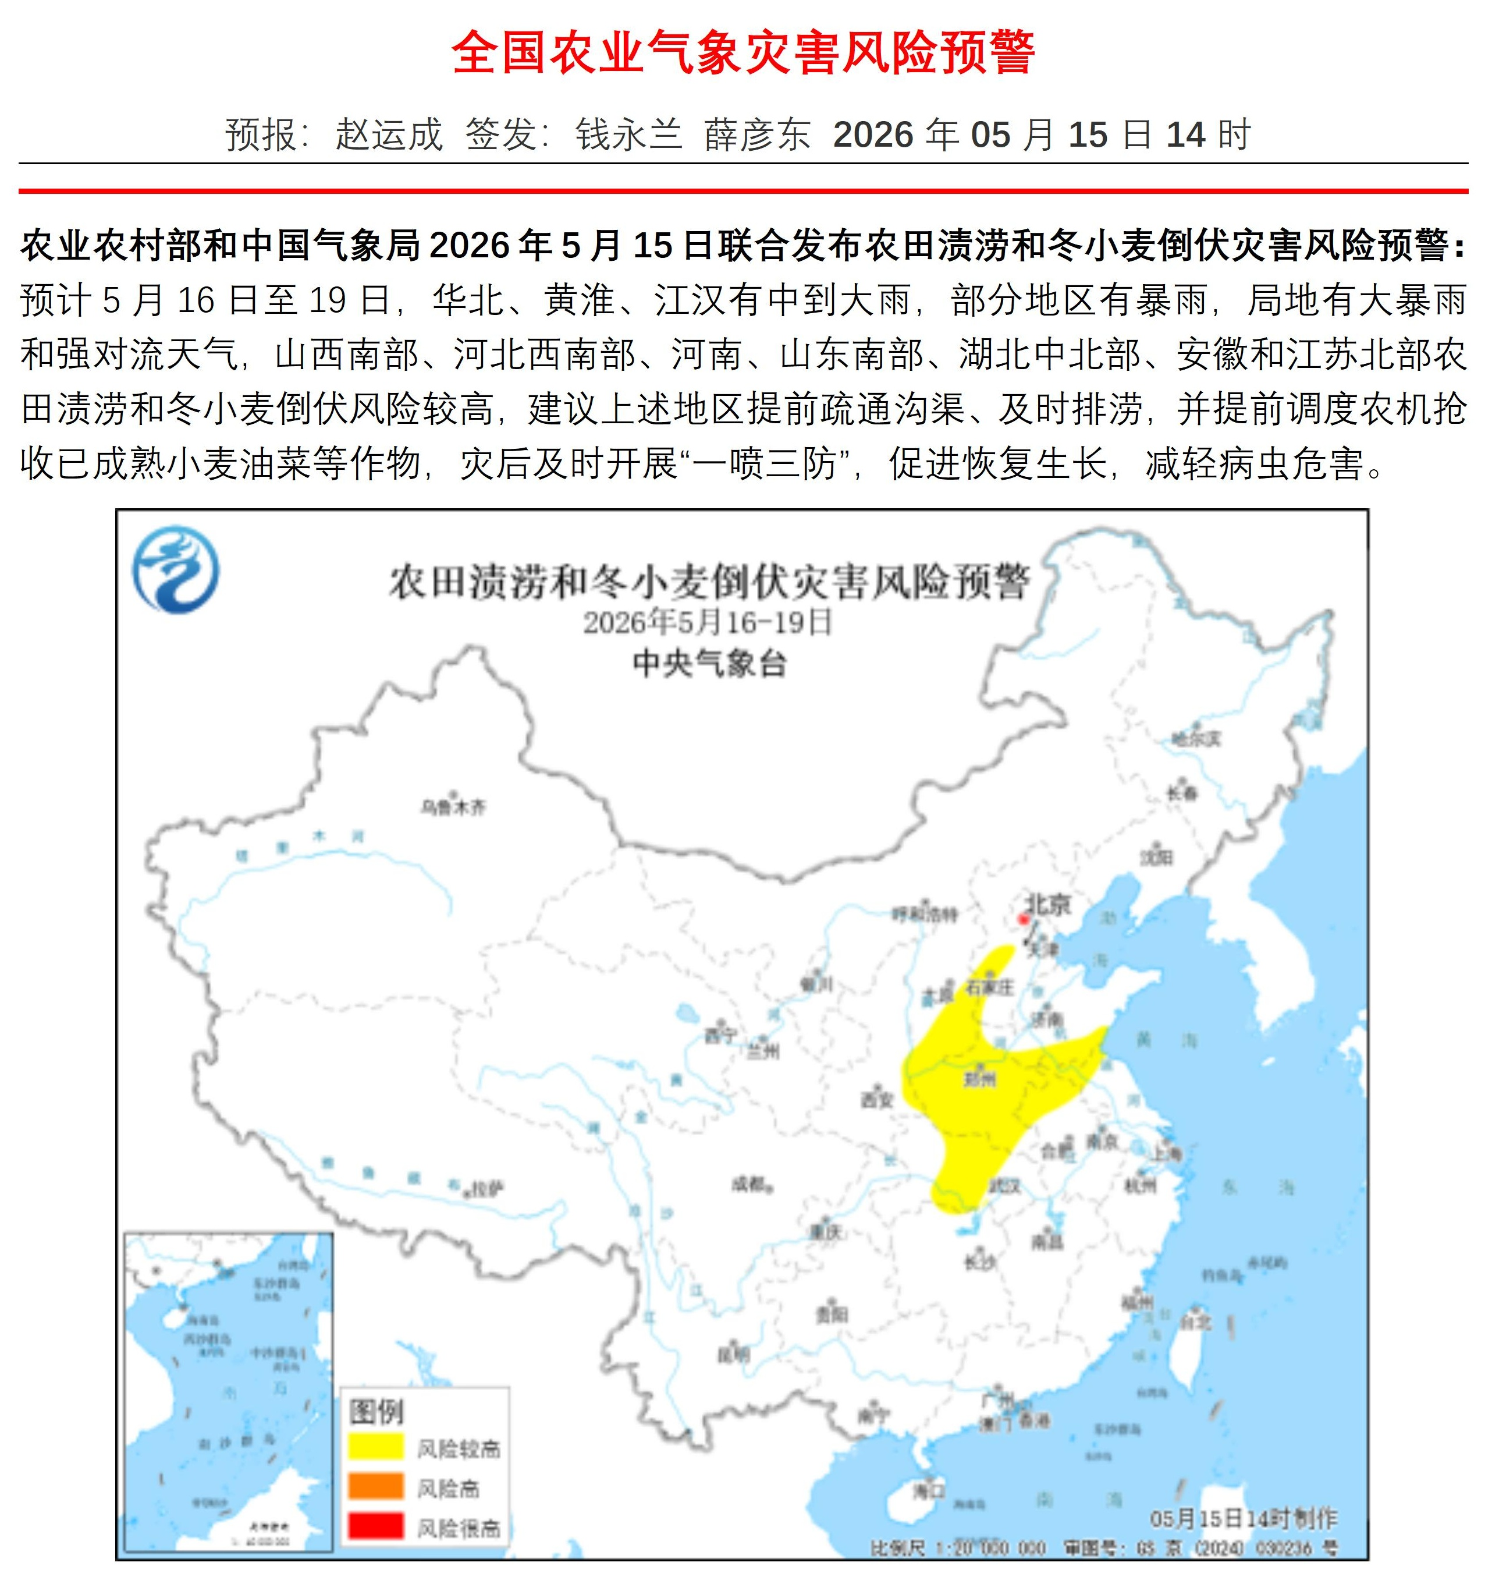



4.2 Vertical and Cross-Regional Coordination
In October 2025, the Ministry of Agriculture and Rural Affairs (MARA) released the Emergency Response Plan for Major Agricultural Natural Disasters.
Central-Local Roles: It emphasizes that during disasters, local governments take the lead in organizing and directing response efforts, while national agricultural authorities provide coordination and technical support.
Synergy & Protection: Through this approach, central and local governments forge a synergy to more effectively safeguard agricultural production and farmers’ livelihoods.
Dedicated Command System: Agricultural departments at all levels have established dedicated disaster response command organs to ensure unified coordination, information sharing, joint disaster analysis, and operational guidance across regions.
MARA-CMA Joint Early Warnings

Slide 23
4.3 Case Study: Coordinated Emergency Harvest in Xiangyang City (2026)
The Crisis
The Coordinated Response
The Outcome
Timeline: Mid-May 2026. Heavy rain hit Xiangyang, Hubei Province during the maturation of 360,000 hectares of wheat and 53,000 hectares of rapeseed.
The Challenge: A forecasted downpour on May 23 threatened crop lodging, sprouting, and rotting if not harvested within 3 days. A typical harvest takes 7-10 days; local machinery was insufficient.
National Machinery Deployment: MARA urgently coordinated 4,200 combine harvesters for cross-regional support. Operators worked 20 hours/day, completing 90% of the harvest within the critical 3-day window.
The 24/7 Drying Operations: Major drying plants operated at full capacity. Mobile dryers were deployed to remote areas to assist scattered smallholder farmers.
Logistics & Green Channels: The government and society collaborated closely. Expressways opened “green channels” for priority machinery passage, offering free weather updates, operational guidance, and repair services.
Comprehensive Field Support:
  Idle buildings were repurposed for free operator accommodation.
  Power companies provided mobile emergency lights and drone illumination for night operations.
  Food delivery and machinery refuelling & repair services were brought directly to the fields, with on-site dispute resolution.
By the end of June, all 360,000 hectares of wheat and 53,000 hectares of rapeseed were successfully harvested, securing the grain in the barns.

Slide 24
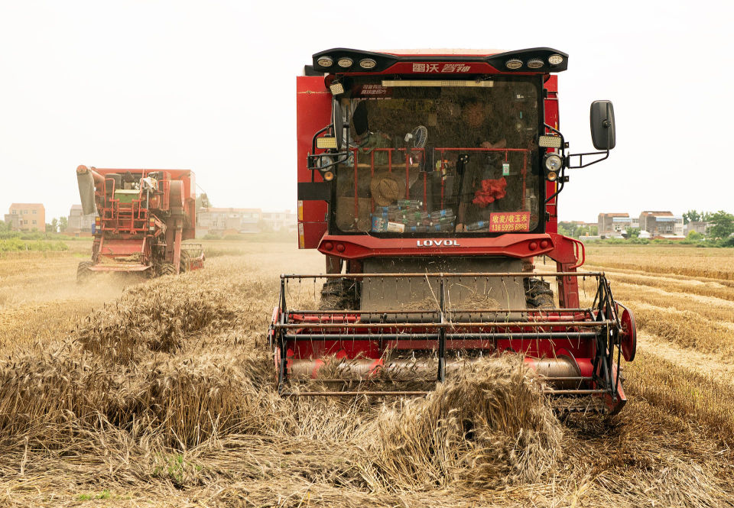
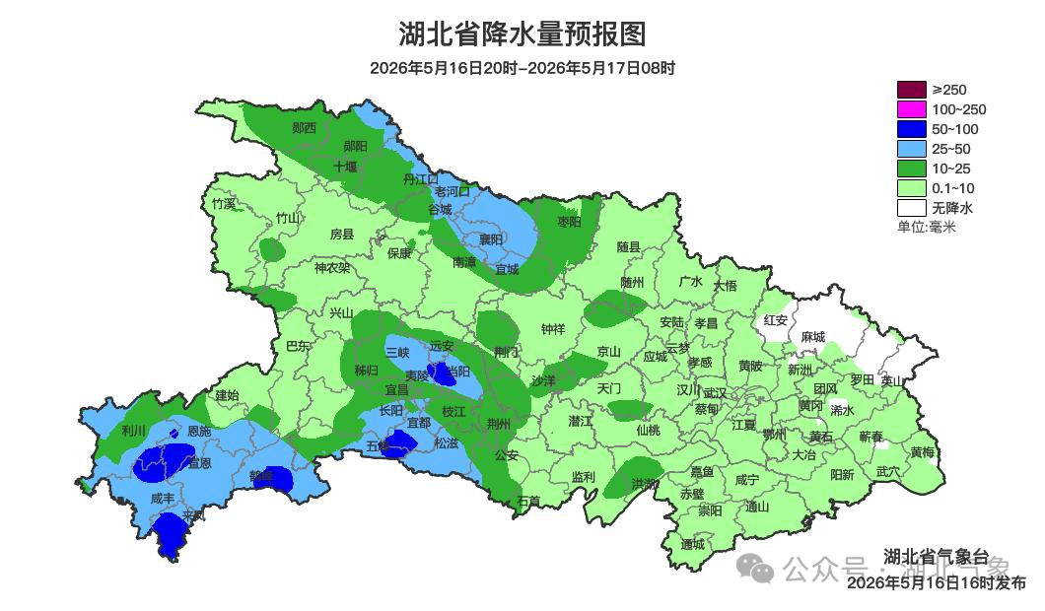
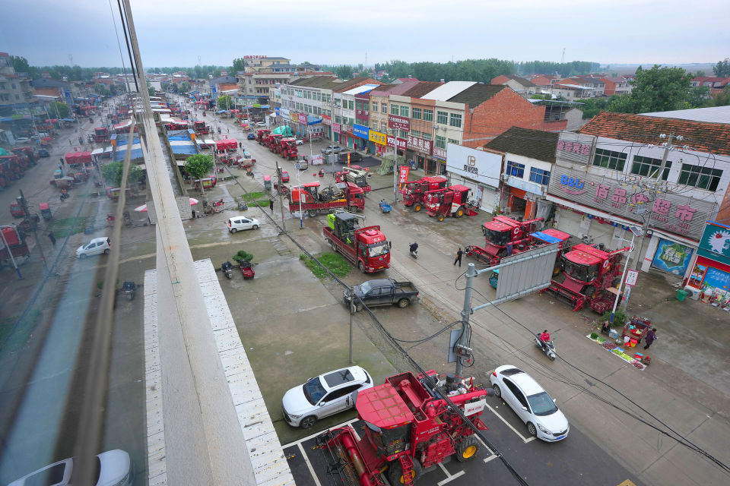
Emergency Harvesters Rush to Xiangyang City
Hubei Province Precipitation Forecast
Xiangyang City
Precipitation(mm)
Hubei Meteorological Observatory

Slide 25

Thank You
Sharing for Learning

